Slide 1
EDK2 – TDVF Design Overview (V0.8)
May 30, 2021
Min Xu, Jiewen Yao (Intel)

Slide 2
Agenda
Overview
SEC Phase
DXE Phase
Library

Slide 3
Overview

Slide 4
Background
Trust Domain Extensions (TDX) is an Intel technology that extends Virtual Machines Extensions (VMX) and Multi-Key Total Memory Encryption (MKTME) with a new kind of virtual machine guest called Trust Domain (TD). A TD runs in a CPU mode which protects the confidentiality of its memory contents and its CPU state from any other software, including the hosting Virtual Machine Monitor (VMM), unless explicitly shared by the TD itself.
Trusted Domain Virtual Firmware (TDVF) is the edk2 based firmware that will be used to boot the guest VM. Its pkg file is OvmfPkgX64.dsc

Slide 5
Reference
[TDX] Intel Trust Domain Extensions
https://software.intel.com/content/www/us/en/develop/articles/intel-trust-domain-extensions.html
[TDVF] Intel TDX Virtual Firmware Design Guide
https://software.intel.com/content/dam/develop/external/us/en/documents/tdx-virtual-firmware-design-guide-rev-1.pdf
[GHCI] Guest-Hypervisor-Communication Interface
https://software.intel.com/content/dam/develop/external/us/en/documents/intel-tdx-guest-hypervisor-communication-interface.pdf
[TDVF-UEFI] Virtual Firmware for Intel Trust Domain Extensions
https://uefi.org/sites/default/files/resources/Virtual%20Firmware%20for%20Intel%20Trust%20Domain%20Extensions%20-%20UEFI_12.15.2020.pdf
[TDVF-code] TDVF EDKII Code
https://github.com/tianocore/edk2-staging/tree/TDVF

Slide 6
Goal
Reach consensus on the TDVF design to upstream.
One binary for OVMF.
https://edk2.groups.io/g/devel/topic/81969494#74319

Slide 7
One binary requirement
One binary run on:
Normal OVMF
AMD-SEV/SNP
Intel-TDX
PROs
A single binary makes a common attestation interface possible where customer might be running different kinds of VMs.
A single binary makes the guest firmware deployment and management easier and more efficiency.
CONs
Some hacks may be imported to impact the quality/maintainability of the upstream code
It makes the architecture more complicated

Slide 8
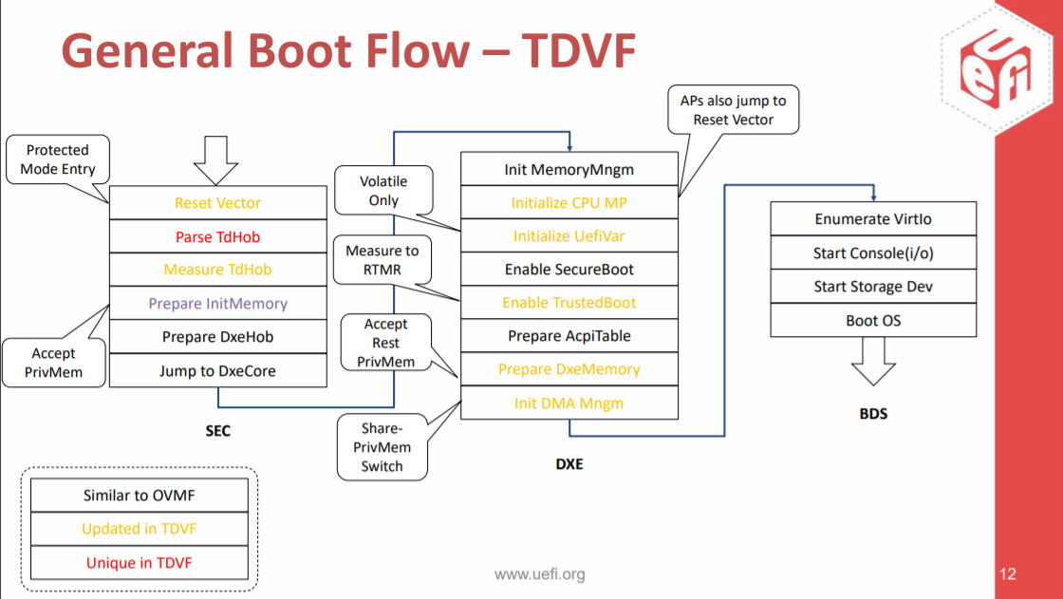
Source: https://uefi.org/sites/default/files/resources/Virtual%20Firmware%20for%20Intel%20Trust%20Domain%20Extensions%20-%20UEFI_12.15.2020.pdf

Slide 9
TDVF Flow
Standard EDK2 flow (Non-Td guest) is SEC -> PEI -> DXE -> BDS
For Td guest flow is SEC -> DXE -> BDS
There is no PEI phase and so there are additional work required in SEC (as early DXE to handle this).
This additional work is done by TdxStartupLib (See slides 25 for more details)

Slide 10
Key impact to firmware
All CPUs ‘reset’ to running on 32-bit protected mode with flat descriptor (paging disabled).
CPUs are left running in long mode after exiting firmware
Memory resources require ‘accepting’ before using
Memory is not sharable by default outside of the VM
Not required to initialize platform
I/O, MMIO, MSR accesses are different
#VE handler needed
TCG measurement and event log framework w/o TPM

Slide 11
TDVF Image (1)
Figures in Slides 14/15
OVMF X64 image
OvmfPkgX64.fdf
VarStore/FVMAIN_COMPACT/SECFV
2 work area added in MEMFD (new)
TdMailBox (1 page)
PcdTdMailboxBase/ PcdTdMailboxSize
TdHob (1 page)
PcdTdHobBase/ PcdTdHobSize
Layout consists of:
CFV – Configuration Firmware Volume (VarStore.fdf.inc)
Secure Boot Keys
Other variables as needed
Initial Mailbox used for serializing CPUs (TdMailBox)
HOB Memory – used by VMM for its HOB data (TdHob)
Temporary Stack and Heap (PcdOvmfSecPeiTempRamBase/PcdOvmfSecPeiTempRamSize)
BFV – Sec Code and compressed DXE FV (FVMAIN_COMPACT + SECFV)

Slide 12
TDVF Image (2)
Mailbox is initialized at build so no race conditions with BSP and APs
Mailbox, Stack/Heap must be in loaded into r/w memory
Page table should support both 4-level and 5-level page table
Problem statement:
Standard OvmfPkg supports 4-level page table. It consumes 6 pages (defined in MEMFD – 0x800000)
Td guest supports both 4-level and 5-level page table. (48 bit GPAW and 52 bit GPAW)
In Td guest BSP and APs share the same ResetVector entry point and may build the page table multi-times.
Option 1: static built-in page table.
TDVF page table is statically built in ResetVector.(See Page 13)
PROs:
Perf is good because it is built statically.
Easy to implement and there is no BSP & Aps conflict.
CONs:
Size: there are 7 more pages in ResetVector
Not compatible with the standard OvmfPkg page table.
Option 2: dynamic built (Standard Ovmf). ← Preferred.
Need to expand the page table in MEMFD from 0x6000 to 0x7000. (to support both 4-level and 5-level )
Add the page table memory region in tdx Metadata so that VMM can pre-init the memory region.
Conflict by BSP and APs should be considered. (The page table should be built-in only once)
PROs:
Size is small and compatible with the current OVMF
CONs:
More complicated than option 1.

Slide 13
TDVF Image (3)
A ‘metadata’ structure is included in the image(ResetVector) with information about the image for VMM use.
Offset to the metadata is at a GUIDed structure in ResetVectorVtf0.asm
Open: How will the QEMU find the metadata location?
Option1: Offset is fixed, so that the QEMU can find it. ⬅ Preferred
Open : Where is the fixed offset?
4G-0x10[0x10] is copied by CPU reset vector (Intel/AMD x86 *Arch defined*)
4G-0x20[0x10] is OVMF AP reset vector (used in OVMF implementation)
4G-0x30[0x50]: is AMD SEV (used in AMD *implementation* and QEMU. Its length is 0x50 Bytes (including the padding))
4G-0x80[0x20]: is Intel TDX (used in Intel *implementation* and QEMU. Its length is 0x20 Bytes (including the padding)) ⬅ preferred
PROs:
Implementation in QEMU is easier to find the metadata.
CONs:
AMD SEV is submitting patches in the same area so that the offset cannot be fixed until the patch is accepted.
Option2: Offset is dynamic, and can be found by an indicator (such as 8 bytes signature, 16 bytes GUID), so that the QEMU can find it.
PROs:
The offset doesn’t depend on the patch in the same area(ResetVector).
CONs:
Implementation in QEMU is more complicated than option 1.

Slide 14
Image Layout

Slide 16
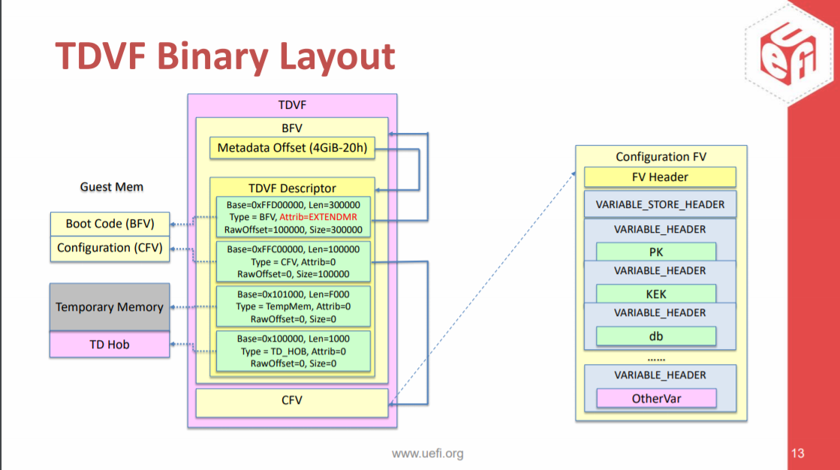
Image Layout
Source: https://uefi.org/sites/default/files/resources/Virtual%20Firmware%20for%20Intel%20Trust%20Domain%20Extensions%20-%20UEFI_12.15.2020.pdf
Note: Metadata Offset in BFV is not decided yet. It may be updated. see Slides 13

Slide 17
SEC Phase

Slide 18
SEC Phase
ResetVector – OvmfPkg/ResetVector
https://github.com/tianocore/edk2-staging/tree/TDVF/OvmfPkg/ResetVector
SecEntry – OvmfPkg/Sec/X64
https://github.com/tianocore/edk2-staging/tree/TDVF/OvmfPkg/Sec
Core – OvmfPkg/Sec/SecMain.c
https://github.com/tianocore/edk2-staging/blob/TDVF/OvmfPkg/Sec/SecMain.c
TdxStartupLib – OvmfPkg/Library/TdxStartupLib (New)
https://github.com/tianocore/edk2-staging/tree/TDVF/OvmfPkg/Library/TdxStartupLib
Startup – TdxStartupLib.c
Hob – Hob.c
Mp Support – Mp.c
Pre-Dxe Tcg – Tcg.c
Dxe Loading – DxeLoad.c
VmTdExitLib (new)
https://github.com/tianocore/edk2-staging/tree/TDVF/OvmfPkg/Library/VmTdExitLib
#VE handler - VmTdExitVeHandler.c

Slide 19
SEC - ResetVector
ResetVector flow is in next slides.
Initial State of CPUs is unique. Register state has information for firmware, including input HOB list with system resources (memory and i/o)
All CPUs (BSP and APs) start executing at ‘resetvector’ in 32-bit protected mode with flat descriptors (paging disabled).
ResetVector will:
Determine 32-bit protected mode or 16-bit real mode and decide to jump to EarlyPmEntry or EarlyBspInitReal16.
ReloadFlat32
Initialize TDX_WORK_AREA which save TD flags and Infos
Search Boot Firmware Volume and locate SEC entry point
Transition to Long Mode (BSP builds page table, APs just set their CR3 with the page table built by BSP)
Jump to SEC entry point

Slide 20
ResetVector flow

Slide 21
SEC EntryPoint – OvmfPkg/Sec/X64
SEC EntryPoint flow is in next slides.
Determines if BSP or AP
If BSP, initializes the temporary stack and jumps to Core
if APs, spin in a modified mailbox loop using initial mailbox structure
Wait for command, see if command is for me, execute command
Supports 2 commands:
WakeUp – documented in SAS, SEC-Core issues this command to move APs to final OS spinloop and mailbox in reserved memory
AcceptPages – firmware command. To spread of performance impact of accepting pages in SEC Core on the BSP, the BSP will parse memory resources and assign each AP the task of accepting a subset of pages. This command may be called several times until all memory resources are processed.

Slide 22
SEC
EntryPoint Flow

Slide 23
SEC Core – OvmfPkg/Sec/SecMain.c
SEC Core and TdxStartup flow is in next slides.
Determines if Td guest or Non-Td guest
If Td guest
TdxInitialize:
A simplified SecCoreStartupWithStack without ProcessLibraryConstructorList
Why: ProcessLibraryConstructorList cannot be called until page accepted.
In LzmaDecompressLibConstructor memory in 0x1000000 (PcdGuidedExtractHandlerTableAddress) will be accessed. It is not allowed in Td guest until the memory (at 0x1000000) is accepted.
OPEN: Do we have to use Compression?
TdxStartup
Do Tdx specific tasks (refer to TdxStartupLib)
Why: Wrapping the Tdx specific code in TdxStartupLib makes code of SecMain.c clean and readable.
If Non-Td guest, follow the legacy code flow

Slide 25
TdxStartupLib - OvmfPkg/Library/TdxStartupLib
There is no PEI phase and so there are additional responsibilities required in SEC to handle this as Early DXE does. This is done by TdxStartupLib.
Processes VMM HobList (in the area of TdHob)
Accept pages
Transfer the VMM HobList to the final hoblist for DXE
Calls TdvfPlatform Initialization Library (TdvfPlatformLib)
Sets PMBA, IO Space Enable, Acpi Control Registers
Sets ICH Pci Root Complex Bar
Reads PM Sleep States from QemuFwCfg
Sets up AP Relocation Memory (EfiACPIMemoryNVS) and Relocates APs
Builds Hobs for FV, CPU, etc
Measure & Extend external inputs, such as CFV/VMM HobList/External QemuCfg items
Loads and executes DXE

Slide 26
TdxStartupLib - Hob.c
ProcessHobList() – parses VMM HobList (in the area of TdHob)
For each, low memory resource, must accept each page before use
BSP, uses a mailbox broadcast with the AcceptPages mailbox command
Parameters are physical-start, physical-end, and accept-size
Accept-size is number of continuous pages an AP accepts
An AP starting address is physical-start + (cpu-id * accept-size)
An Ap, accepts X number of pages based on accept-size
An AP, increments starting address by (num-cpus * accept-size)
An AP, repeats until at physical-end
SEC uses the largest low memory resource range and constructs a new HobList there for SEC memory poll.
MdePkg/Library/SecMemoryAllocationLib provides the early memory allocator.

Slide 27
TdxStartupLib/Hob.c
TransferHobList() – creates new HobList in system memory
For each system resource in VMM HobList
Add to new HobList
If low system memory, mark Hob attribute with EFI_RESOURCE_ATTRIBUTE_ENCRYPTED
LogHobList() – TDVF needs to ‘measure&extend’ VMM HobList
Measure the VMM HobList and extend to TDX RTMR register.
A Guid HOB is created with the above Hash value and an Event log will be created in DXE phase.

Slide 28
TdxStartupLib - Mp.c
MP Support Routines
General flow is CPU serialization is:
MpSerializeStart() – wait for all reported (TDINFO) cpus to arrive
APs: increment and wait for mailbox->num-of-cpus-arriving == num-of-cpus
BSP: wait for mailbox->num-of-cpus-arriving == num-of-cpus -1
Sets mailbox->num-of-cpus-exiting = num-of-cpus
Increments num-of-cpus-arriving
MpSerializeEnd() – wait for all reported (TDINFO) cpus to finish
APs: decrement and wait for mailbox->num-of-cpus-exiting == 0
BSP: wait for mailbox->num-of-cpus-exiting == 1
Sets mailbox->num-of-cpus-arriving = 0, and clears mailbox->command
Decrements num-of-cpus-exiting
MpAcceptMemoryResourceRange
To spread of performance impact of accepting pages in SEC Core on the BSP, the BSP will parse memory resources and assign each AP the task of accepting a subset of pages. This command may be called several times until all memory resources are processed.

Slide 29
TdxStartupLib - Tcg.c
Td measurement in SEC Phase (Td measurement in DXE Phase is in Slide 42)
TDVF doesn’t require or support a TPM, instead it supports TDX RTMR registers
Every external input should be measured and extended to TDX RTMR registers.
For example, the VMM HobList, CFV, QemuFwCfg items, etc.
GUID Hob entry (gTcgEvent2EntryHobGuid) is created with hash value and passed to DXE. The hob contains:
TCG_PCR_EVENT
Measurement (SHA-384)
In DXE phase TdTcg2Dxe module parses HobList for these events and create event logs.
Lib (new)
HashLib|OvmfPkg/Library/HashLibBaseCryptoRouterTdx (for both SEC and DXE)
SecCryptLib|CryptoPkg/Library/BaseCryptLib/SecCryptLib.inf (for SEC)
SHA-384

Slide 30
TdxStartupLib - DxeLoad.c
DXE Loading in SEC phase
Minics code in PEI that would locate, load, and jump to DXE
MemoryAllocationLib|MdePkg/Library/SecMemoryAllocationLib/SecMemoryAllocationLib.inf
Allocate memory in PHIT->EfiFreeMemoryTop
Create a Memory Allocation HOB
PrePiLib|OvmfPkg/Library/PrePiLibTdx/PrePiLibTdx.inf
FwVol.c : Ffs APIs
PrePiLib.c : load DXE core

Slide 31
Exception
Module
CpuExceptionLib
VmgExitLib
(AMD SEV #VC)
VmTdExitLib
(Intel TDX #VE)

Slide 32
VmTdExitLib – VmTdExitVeHandler.c
TDVF provides the default #VE exception handler
#VE handler also convert below forbidden instruction to the TDCALL[TDG.VP.VMCALL]<INSTRUCTION.XX>
CPUID => TDCALL [TDG.VP.VMCALL] <INSTRUCTION.CPUID>
IO => TDCALL [TDG.VP.VMCALL] <INSTRUCTION.IO>
RDMSR => TDCALL [TDG.VP.VMCALL] <INSTRUCTION.RDMSR>
WRMSR => TDCALL [TDG.VP.VMCALL] <INSTRUCTION.WRMSR>
#VE handler is registered in early SEC and DXE phases
See next slides for the #VE handler flow.

Slide 33
VmTdExitLib – #VE handler flow

Slide 34
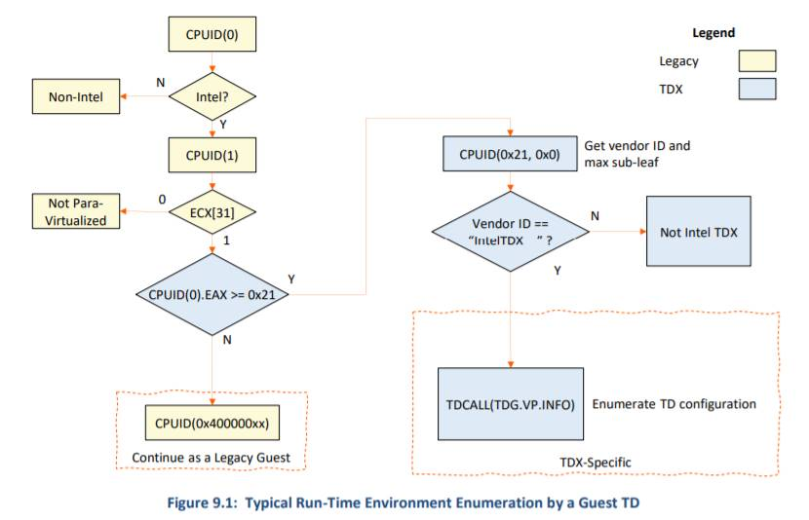
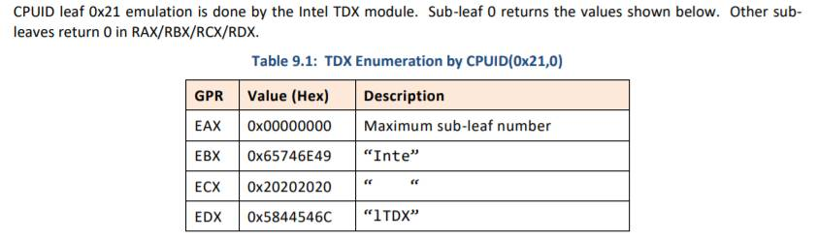
CPUID (0x21,0)
New CPUID is imported to detect Td guest
Leaf – 0x21
Sub leaf – 0x0
https://software.intel.com/content/dam/develop/external/us/en/documents/tdx-module-1eas-v0.85.039.pdf chapter 9.

Slide 35
DXE Phase

Slide 36
DXE Phase
DXE Core
TdxDxe
IoMmuDxe
MemEncryptTdxLib
TdTcg2Dxe
HashLibBaseCryptoRouterTdx
DxeTpmMeasurementLib
Td measurement and Measure boot
Some DXE Drivers not allowed to load/start in Td guest
Network stack
RNG
etc.
Other DXE Phase drivers
IncompatiblePciDeviceSupportDxe
AcpiPlatformDxe
LocalApicTimerDxe
EmuVariableFvbRuntimeDxe

Slide 37
DXE Core
FwVolRead.c – SMM is not supported in Td guest
Handle the Tdx private memory
Most memory in a trusted domain is private to the VM. Its contents are encrypted with keys unique to the VM.
Guest OS looks at the memory mapped generated by the firmware to make decisions about which resources are private or shared.
EDK2 introduce a memory attribute called EFI_MEMORY_CPU_CRYPTO and we identify the private memory regions with this attribute.
We introduce a new HOB resource attribute (EFI_RESOURCE_ATTRIBUTE_ENCRYPTED) which is set to describe memory resources in SEC phase
Extend DXE Core’s conversion table to convert new resource attribute (EFI_RESOURCE_ATTRIBUTE_ENCRYPTED) into the existing EFI_MEMORY_CPU_CRYPTO memory attribute
See next slides for detailed implementation

Slide 38
Details
MdePkg/Include/Pi/PiHob.h
+//^M
+// Physical memory encrypted attribute. This^M
+// memory uses platform encrpytion capabilities for^M
+// protection. If this bit is clear, the memory does^M
+// not use platform encryption protection^M
+//^M
+#define EFI_RESOURCE_ATTRIBUTE_ENCRYPTED 0x04000000^M
MdeModulePkg/Core/Dxe/Gcd/Gcd.c
Extend mAttributeConversionTable
+ { EFI_RESOURCE_ATTRIBUTE_ENCRYPTED, EFI_MEMORY_CPU_CRYPTO,

Slide 39
TdxDxe
OvmfPkg/TdxDxe
Dispatched early in DXE due to being listed in APRIORI.
Set PcdCpuMaxLogicalProcessorNumber by the number reported in TDINFO
Set PcdOvmfHostBridgePciDevId based on the GuidHOB (gUefiOvmfPkgTdxPlatformGuid ) so that we can make use of some ovmf modules that depend on it.
Initializes PcdPciMmio32, PcdPciMmio64 and PcdPciIo
Sets PcdTdRelocatedMailboxBase to address where SEC relocated APs, needed for ACPI table

Slide 40
IoMmu
OvmfPkg/IoMmuDxe (IOMMU design is in slides 42)
Handles IOMMU protocol for PCI and others.
A converged version of OvmfPkg’s IoMmuDxe with AMD SEV
AmdSevIoMmu.c -> IoMmu.c
AmdSevIoMmu.h -> IoMmu.h
Distinguish TDX and SEV in IoMmuDxeEntryPoint in Run-time
IOMmuMap() calls MemEncryptTdxClearPageEncMask or MemEncryptSevClearPageEncMask
IoMmuUnmapWorker() calls MemEncryptTdxSetPageEncMask or MemEncryptSevSetPageEncMask
OvmfPkg/Library/BaseMemEncryptTdxLib (new)
Provides the MemEncryptTdxClearPageEncMask/ MemEncryptTdxSetPageEncMask for Tdx guest

Slide 41
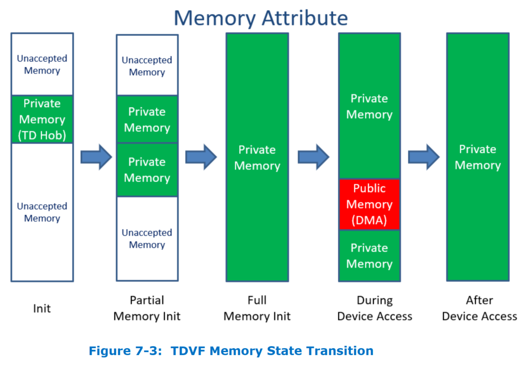
Private & Shared Transition

Slide 42
IOMMU design
Virtio Block / Scsi / FS
Virtio GPU
Virtio Net
Virtio Rng
VIRTIO
Virtio10 Driver
PCI Device Driver
Other Device Driver
PCI_IO
PCI Bus Driver
PCI_ROOT_BRIDGE_IO
PCI Host Bridge
IOMMU_PROTOCOL
AllocatePages / FreePages
Map / Unmap
SetAttribute
IOMMU Driver
(AMD SEV/Intel TDX)
MemEncryptSevLib
MemEncryptTdxLib

Slide 43
DXE Phase – TdTcg2Dxe
OvmfPkg/Tcg/Tcg2Dxe (new)
Removes dependencies on Tpm
Generates new event log (and ACPI Table) that is based on Tpm2 event log
Allocate system memory to hold the TCG2 Event Log (EfiACPIMemoryNVS)
Put the address to TDEL ACPI Table (lama)
Parses all gTcgEvent2EntryHobGuid Hob entries added in SEC phase, and create event log
Install EFI_TD_PROTOCOL (gEfiTdProtocolGuid)
re-use the EFI_TCG2_PROTOCOL definition(see more details in next slide)
Notes:
Note:
In current TDVF the Protocol name is TD_TCG2_PROTOCOL (gTdTcg2ProtocolGuid)
Should be renamed to EFI_TD_PROTOCOL (gEfiTdProtocolGuid)

Slide 44
EFI_TD_PROTOCOL
EFI_TD_PROTOCOL (gEfiTdProtocolGuid) re-use the EFI_TCG2_PROTOCOL definition
HashLogExtendEvent is the major API in EFI_TCG2_PROTOCOL which does below tasks:
Do Hash (sha-384)
Extend to Tdx RTMR registers
Create event log
Libraries
HashLib|OvmfPkg/Library/HashLibBaseCryptoRouterTdx (new)
Implement the HashAndExtend which will be called in above HashLogExtendEvent
TdxLib|MdePkg/Library/TdxLib (new)
TdExtendRtmr (in TdxLib/Rtmr.c) will be called by above HashAndExtend
It does the actual extending to RTMR
Notes:
Note:
In current TDVF the Protocol name is TD_TCG2_PROTOCOL (gTdTcg2ProtocolGuid)
Should be renamed to EFI_TD_PROTOCOL (gEfiTdProtocolGuid)

Slide 45
Measured Boot Design
Any Module
TpmMeasurementLib
TpmMeasurmentLib
EFI_TD_PROTOCOL
EFI_TCG_SERVICE
EFI_TCG2_PROTOCOL
TcgDxe
Tcg2Dxe
TdMeasurementDxe
TPM12
TPM2
RTMR

Slide 46
Td Measurement
Note:
Td Measurement in SEC phase, refer to slides 29
Problem statement
Tdx guest doesn’t support TPM, instead it supports RTMRs which can be treated as the TPM PCRs.
UEFI Measurement call TpmMeasureAndLogData (in TpmMeasurementLib) to measure/extend to TPM PCRs, then to create event log.
PCR index is used in UEFI measure boot, not RTMR index
Option 1: <- Preferred
SecurityPkg/Library/DxeTpmMeasurementLib
Install EFI_TD_PROTOCOL which exports the same interfaces as EFI_TCG2_PROTOCOL, such as HashLogExendEvent, GetEventLog, etc
Update TpmMeasurementLib to support Tdx measurement (detect Td or Non-Td in runtime and then locate EFI_TD_PROTOCOL or EFI_TCG2_PROTOCOL to HashLogExtendEvent, because EFI_TD_PROTOCOL shares the same definition as EFI_TCG2_PROTOCOL)
Map PCR index to RTMR index. See [TDVF] Chap 8 Td Measurement
PROs:
Current measurement code needn’t be changed.
CONs:
Name of TpmMeasurementLib refers to Tpm, not Tdx. It is confused.
Name of Some APIs in EFI_TCG2_PROTOCOL are confused, such as GetActivePcrBanks, etc
Option 2:
Create TdxMeasurementLib to support Tdx measurement, SecurityPkg/Library/DxeTdxMeasurementLib
Install EFI_TD_PROTOCOL which exports tdx specific interfaces, such as HashLogExtendEvent, GetEventLog, etc
PROs:
It is semantically more reasonable
Some TPM specific APIs in EFI_TCG2_PROTOCOL can be removed.
CONs:
Need to update all the measurement code which call TpmMeasureAndLogData.
Notes:
Note:
In current TDVF the Protocol name is TD_TCG2_PROTOCOL (gTdTcg2ProtocolGuid)
Should be renamed to EFI_TD_PROTOCOL (gEfiTdProtocolGuid)

Slide 47
Measure Boot
Problem statement
Tdx guest doesn’t support TPM, instead it supports RTMRs which can be treated as the TPM PCRs.
DxeTpm2MeasureBootHandler (SecurityPkg/Library/DxeTpm2MeasureBootLib) is registered as the Security2Handler in edk2. This handler will then be called in UEFI measure boot.
But this handler doesn’t support Tdx RTMR registers.
Option 1: <- Preferred
SecurityPkg/Library/DxeTpm2MeasureBootLib
Install EFI_TD_PROTOCOL which exports the same interfaces as EFI_TCG2_PROTOCOL, such as HashLogExendEvent, GetEventLog, etc (It is done in TdTcg2Dxe)
Update DxeTpm2MeasureBootHandler to support Tdx measurement (detect Td or Non-Td in runtime and then locate EFI_TCG2_PROTOCOL)
Map PCR index to RTMR index. See [TDVF] Chap 8 Td Measurement
PROs:
Current measure boot code needn’t be changed.
CONs:
Name of DxeTpm2MeasureBootLib refers to Tpm2, not Tdx. It is confused.
Name of Some APIs in EFI_TCG2_PROTOCOL are confused, such as GetActivePcrBanks, etc
Option 2:
Create DxeTdxMeasureBootLib to support measure boot in Td guest, SecurityPkg/Library/DxeTdxMeasureBootLib
Register DxeTdxMeasureBootHandler in edk2 (in Td guest) when then will be called in measure boot.
DxeTpm2MeasureBootHanlder is registered in Non-Td guest.
PROs:
It is semantically more reasonable
Some TPM specific APIs in EFI_TCG2_PROTOCOL can be removed.
CONs:
Need to update all the measure boot code which call DxeTpm2MeasureBootHandler.
Almost 90% code are duplicated between DxeTpm2MeasureBootLib and DxeTdxMeasureBootLib
Notes:
Note:
In current TDVF the Protocol name is TD_TCG2_PROTOCOL (gTdTcg2ProtocolGuid)
Should be renamed to EFI_TD_PROTOCOL (gEfiTdProtocolGuid)

Slide 48
DXE Phase – Other Modules
IncompatiblePciDeviceSupportDxe
Registers Protocol that allows us to disable Pci Option Rom support for all devices
Legacy 16bit Option Rom and 32-bit UEFI OROM must be rejected. ([TDVF] 9.5)
PI Spec 1.7a Table 20. ACPI 2.0 & 3.0 QWORD Address Space Descriptor Usage. Type-specific flags (when Address Translation Offset == 6) can be set to 0 to skip device option ROM (do not probe option ROM BAR).
OvmfPkg/AcpiPlatformDxe
Support for MADT/ACPI addition to report Td Mailbox entry ([TDVF] 6)
EmuVariableFvbRuntimeDxe
Copy configuration variables into configuration volume.

Slide 49
Libraries

Slide 50
Library
TdxLib (new)
BaseMemEntryptLibTdxLib (new)
BaseIoLibIntrinsicTdx (new)
CpuException related libraries (new)
Td measurement and Measure boot related libraries (new)
QEMU related lib

Slide 51
TdxLib
MdePkg/Library/TdxLib (both SEC/DXE) (new)
Wrap the functions which perform the related Tdx operation.
TdCall : To cause a VM exit to the Intel TDX module
TdVmCall : A leaf function 0 for TDCALL
TdVmCallCpuid : Enable the TD guest to request VMM to emulate CPUID
TdAcceptPages : To accept pending private pages
TdExtendRtmr : To extend one of the RTMR registers
[GHCI] Chap 2/3

Slide 52
BaseMemEncryptLib
OvmfPkg/Library/BaseMemEncryptTdxLib (new)
Handles setting or clearing S-bit for address range.
Called by IOMMU Protocol
For TDX, it must:
Set or Clear S-Bit in page table
Inform host with TDVMCALL_MAPGPA
TdAcceptPages if converting shared memory back to private

Slide 53
BaseIoLibInstrinsicTdx
MdePkg/Library/BaseIoLibIntrinsic (new)
Base IoLib which supports both Td guest and Non-Td guest (including AMD SEV)
Why: We need dump debug message to serial port in exception lib. Otherwise, we will have recursive exception.
Detect Td-guest or Non-Td in runtime by CPUID (0x21,0)
https://software.intel.com/content/dam/develop/external/us/en/documents/tdx-module-1eas-v0.85.039.pdf, chapter 9.
For Td-guest:
Para-Virtualized I/O module is used. It replaces IO/MMIO access with TDVMCALL to invoke VMM provided IO/MMIO emulation functions.
For Non-Td guest
Follow the legacy code flow
Open: What is a proper name?
Option 1: BaseIoLibIntrinsicConfidential <- Preferred
PROs:
It is a neutral name which covers both Td and Non-Td (including Normal OVMF, SEV)
It will replace the BaseIoLibIntrinsicSev.inf (Which is currently used as the base IoLib in OVMF).
CONs:
Option 2: BaseIoLibIntrinsicTdx
PROs:
CONs:
The name doesn’t reflect that this lib covers both Td and Non-Td (including TDX/SEV)

Slide 54
CpuException related libraries
SecPeiCpuExceptionHandlerLib
Register #VE early in SEC
PeiDxeCpuExceptionHandlerLib
Register #VE early in DXE
VmTdExitLib (see slides 32) (new)
OvmfPkg/Library/VmTdExitLib
Handle the #VE exception

Slide 55
Td measurement & Measure boot libs
HashLibBaseCryptoRouterTdx (new)
HashLib for Tdx
Calculate the SHA-384 and extend to TDX RTMR registers
SecCryptLib (new)
Support SHA-384 in SEC phase
SecCryptLib|CryptoPkg/Library/BaseCryptLib/SecCryptLib.inf
DxeTpmMeasurementLib
Update the SecurityPkg/Library/DxeTpmMeasurementLib/DxeTpmMeasurementLib.c to support Tdx measurement (measure and extend to TDX RTMR registers)
DxeTpm2MeasureBootLib
Update the SecurityPkg/Library/DxeTpm2MeasureBootLib/DxeTpm2MeasureBootLib.c to support measure boot in Td guest

Slide 56
QEMU related lib
QemuFwCfgDxeLib – update to support both Tdx and SEV
OvmfPkg/Library/QemuFwCfgLib
Add MemEncryTdxLib in Library class
TdvfPlatformLibQemuSec (new)
OvmfPkg/Library/TdvfPlatformLibQemu
Called by TdxStartupLib to support for SEC Platform Initialization in Td-guest
Sets PMBA, IO Space Enable, Acpi Control Registers
Sets ICH Pci Root Complex Bar
Reads PM Sleep States from QemuFwCfg

Slide 57
MpInitLib
MpInitLib
UefiCpuPkg/Library/MpInitLib
Support for both Td-guest and Non-Td guest. Detect Td or Non-Td in run-time
For Td-guest
No AP executes in DXE
No logic to init AP, wakeup AP, or relocate AP for BIOS exit

