Slide 1
EDK2 – TDVF Design Overview (V0.95)
Jun 23, 2021
Min Xu, Jiewen Yao (Intel)

Slide 2
Agenda
Overview
SEC/PEI Phase
DXE Phase
Library

Slide 3
Overview

Slide 4
Background
Trust Domain Extensions (TDX) is an Intel technology that extends Virtual Machines Extensions (VMX) and Multi-Key Total Memory Encryption (MKTME) with a new kind of virtual machine guest called Trust Domain (TD). A TD runs in a CPU mode which protects the confidentiality of its memory contents and its CPU state from any other software, including the hosting Virtual Machine Monitor (VMM), unless explicitly shared by the TD itself.
Trusted Domain Virtual Firmware (TDVF) is the edk2 based firmware that will be used to boot the guest VM.

Slide 5
Reference
[TDX] Intel Trust Domain Extensions
https://software.intel.com/content/www/us/en/develop/articles/intel-trust-domain-extensions.html
[TDVF] Intel TDX Virtual Firmware Design Guide
https://software.intel.com/content/dam/develop/external/us/en/documents/tdx-virtual-firmware-design-guide-rev-1.pdf
[GHCI] Guest-Hypervisor-Communication Interface
https://software.intel.com/content/dam/develop/external/us/en/documents/intel-tdx-guest-hypervisor-communication-interface.pdf
[TDVF-UEFI] Virtual Firmware for Intel Trust Domain Extensions
https://uefi.org/sites/default/files/resources/Virtual%20Firmware%20for%20Intel%20Trust%20Domain%20Extensions%20-%20UEFI_12.15.2020.pdf
[TDVF-code] TDVF EDKII Code
https://github.com/tianocore/edk2-staging/tree/TDVF

Slide 6
Goal
Reach consensus on the TDVF design to upstream.
2 Configuration for TDVF to upstream (See next 2 slides)
Strategy/Principle of design/implementation of 2 Configs
Config-A:
Compatible with the existing OvmfPkgX64.dsc and be very careful/cautious to import changes
Don’t be over-complicated for the sake of TDX, even considering only the "basic" TDVF feature set existing OvmfPkgX64.dsc
Config-B:
Implement the full set of Tdx features

Slide 7
Config-A
Config-A: ← existing OvmfPkgX64.dsc/OvmfPkgX64.fdf
Merge the *basic* TDVF feature to existing OvmfPkgX64.dsc (Align with existing SEV)
Threat model: VMM is NOT out of TCB. (We don’t make things worse.)
The OvmfX64Pkg.dsc includes SEV/TDX/normal OVMF basic boot capability. The final one binary can run on SEV/TDX/normal OVMF.
No changes to existing OvmfPkgX64 image layout
No need to add additional security features if they do not exist today.
QEMU based vTpm Trusted boot is disabled by default.
RTMR based Trusted boot is disabled.
RTMR based vTpm is disabled
No need to remove features if they exist today
PEI is *NOT* skipped (follow the standard EDK2 flow SEC -> PEI -> DXE -> BDS)
RTMR is *NOT* supported.

Slide 8
Config-B
Config-B: ← new IntelTdx.dsc/IntelTdx.fdf
Add a standalone IntelTdx.dsc/IntelTdx.fdf to a TDX specific directory for a *full* feature TDVF. (Align with existing SEV)
Threat model: VMM is out of TCB. (We need necessary change to prevent attack from VMM)
IntelTdx.dsc includes TDX/normal OVMF basic boot capability. The final one binary can run on TDX/normal OVMF.
It might eventually merge with AmdSev.dsc, but NOT at this point of time. And we don’t know when it will happen. We need sync with AMD in the community, after both of us think the solutions are mature to merge.
Need to add necessary security feature as mandatory requirement, such as RTMR Based Trusted Boot support.
QEMU based vTpm Trusted boot is disabled
RTMR based Trusted boot is enabled.
RTMR based vTpm is disabled now. Maybe enabled in the future.
Need to remove unnecessary attack surfaces, such as network stack.

Slide 9
TDVF Flow (Config-A)
Option 1: ← Preferred
For Non-Td flow is SEC -> PEI -> DXE -> BDX
For Td guest flow is SEC -> DXE -> BDS
There is no PEI phase and so there are additional work required in SEC (as early DXE to handle this).
This additional work is done by TdxStartupLib
Pros:
Consistent with the flow to Config-B. TdxStartupLib can be reused in Config-A.
Cons:
Break the standard EDK2 flow and jump over PEI
Option 2: ← Preferred
Standard EDK2 flow (Td & Non-Td guest) SEC -> PEI -> DXE -> BDS (See slide 11)
Accept Memory in SEC
Relocate TdMailbox, Prepare DXE hobs, Initialize Tdx platform in PEI
Pros:
Consistent to the standard EDK2 flow
Tcg2Pei is supported
Cons:
In-consistent to the flow in Config-B
Tcg2Pei is not supported

Slide 10
TDVF Flow (Config-B)
For Non-Td Standard EDK2 flow : SEC -> PEI -> DXE -> BDS
For Td guest flow : SEC -> DXE -> BDS
There is no PEI phase and so there are additional work required in SEC (as early DXE to handle this).
This additional work is done by TdxStartupLib

Slide 11
Config-B
Config-A
(Option 2)
DXE
BDS
ResetVector
PEI Core
Init MemoryMngm
Enumerate VirtIo
ParseTdHob
Tdx Platform Init
Initialize CPU MP
Start Console (I/O)
Accept Memory
Prepare DXE Hob
Initialize UefiVar
Start Storage Dev
Jump to PEI Core
Relocate TdMailbox
Enable SecureBoot
Boot OS
Tcg2Pei
Enable TrustedBoot
Jump to Dxe Core
Prepare AcpiTable
SEC
Prepare DxeMemory
PEI
Init DMA Mngm
ResetVector
Init MemoryMngm
Enumerate VirtIo
ParseTdHob
Initialize CPU MP
Start Console (I/O)
Accept Memory
Initialize UefiVar
Start Storage Dev
Tdx Platform Init
Enable SecureBoot
Boot OS
Prepare DXE Hob
Enable TrustedBoot
Relocate TdMailbox
Prepare AcpiTable
Similar in OVMF
Tdx Measurement
Prepare DxeMemory
Updated in TDVF
Jump to DXE Core
Init DMA Mngm
Unique in TDVF

Slide 12
Config-A: Implementation in SEC/PEI
The functions in Config-A can be divided into 2 subsets: (detailed information is in slides 14 - 15)
Accept Memory (SEC)
Accept Memory
Called in Sec/SecMain.c
Initialize Tdx platform , build Dxe Hob and relocate td mailbox (PEI)
Tdx Platform Init
Tdx Build DxeHob
Relocate mailbox
They’re wrapped in OvmfPkg/PlatformPei/IntelTdx.c and called in InitializePlatform@OvmfPkg/PlatformPei (PEI phase)

Slide 13
Config-A : Accept Memory
Functions are listed below:
Parse TdHob
Accept Memory
Memory must be accepted before ProcessLibraryConstructorList is called. Because In LzmaDecompressLibConstructor memory in 0x1000000 will be accessed. It is not allowed in Tdx until the memory (at 0x1000000) is accepted.
Called in Sec/SecMain.c
Option-1: (source code) ← Preferred
Put TDX specific code in IntelTdx.c and call the API in Sec/SecMain.c
Put SEV specific code in AmdSev.c and call the API in Sec/SecMain.c
Pros:
Make SecMain.c clean and clear
Cons:
Option-2: (new lib)
Wrap the above functions into a lib (TdxSecLib)
Call the functions exported by the lib in Sec/SecMain.c
Pros:
Cons:
Over-design

Slide 14
Config-A : OvmfPkg/PlatformPei
Tdx specific functions are listed below:
Initialize Tdx Platform
Build Dxe Hob
Relocate Mailbox
Implemenation
Add IntelTdx.c in OvmfPkg/PlatformPei which implements the above functions
Update OvmfPkg/PlatformPei/Platform.c to do the TDX specific tasks

Slide 15
Config-B: Implementation in SEC
For Config-B a Tdx specific SecMain.c is created under OvmfPkg / IntelTdx / Sec / SecMain.c
Don’t import extra complexity into OvmfPkg/Sec/SecMain.c
The functions can be divided into 3 subsets:
Initialization of Tdx
Accept Memory
Tdx Platform Init
Tdx Build DxeHob
Relocate mailbox
Jump to Dxe Core
Jump to Dxe Core
Tdx Measurement
MeasureTdHob
MeasureFvImage
MeasureQemuCfgSystemItem

Slide 16
Key impact to firmware
All CPUs ‘reset’ to running on 32-bit protected mode with flat descriptor (paging disabled).
CPUs are left running in long mode after exiting firmware
Memory resources require ‘accepting’ before using
Memory is not sharable by default outside of the VM
Not required to initialize platform
I/O, MMIO, MSR accesses are different
#VE handler needed
TCG measurement and event log framework w/o TPM
Config-A: by default no trusted boot, no secure boot
Config-B: trusted boot, secure boot

Slide 17
TDVF Image (Config-A)
Note: There is *NO* layout update in Config-A
OvmfPkgX64.fdf/ OvmfPkgX64.fdf
2 TDX work area in MEMFD (new) ← reuse SEV work area in MFMFD
TdMailBox (1 page) ← PcdOvmfSecGhcbBase
TdHob (1 page) ← PcdSevEsWorkAreaBase
Page table
4-level page table (OvmfPkg/ResetVector/Ia32/PageTables64.asm)
Layout consists of:
No layout update

Slide 18
TDVF Image (Config-B)
Note: There is layout update in Config-B
Intel/IntelTdx.dsc/.fdf
VarStore/FVMAIN_COMPACT/SECFV
2 TDX work area in MEMFD (new) ← same as Config-A
Page table
Tdx support both 4-level and 5-level paging, based on the GPAW (48bit or 52bit)
Layout consists of:
CFV – Configuration Firmware Volume (VarStore.fdf.inc)
Secure Boot Keys
Other variables as needed
BFV – Sec Code and compressed DXE FV (FVMAIN_COMPACT + SECFV)
SMM_FV – All Smm drivers are put in a separated FV so that it can be excluded easily if it is not to be loaded in Tdx
NETWORK_FV – All Network drivers are put in a separated FV so that it can be excluded easily if it is not to be loaded in Tdx
... … (other FV which may be excluded in Tdx)

Slide 19
Image Layout (Config-A)

Slide 20
Image Layout (Config-B)

Slide 21
TDVF Image (2)
Mailbox is initialized at build so no race conditions with BSP and APs
Mailbox, Stack/Heap must be in loaded into r/w memory
A ‘metadata’ structure is included in the image(ResetVector) with information about the image for VMM use. (see figure in next slide)
Offset to the metadata is put in a GUID-ed structure
Tdx-Metadata-GUID-ed structure is chained in the GUID-ed chain from a fixed GPA (0xffffffd0)
QEMU search from the GPA (0xffffffd0) and find the Tdx-Metadata-GUID-ed structure by its GUID.
Definition of Tdx-Metadata-GUID-ed struct
Option A: an offset points to the actual TdxMetadata ← Preferred
TdxMetata is in a separate file which is flexible
Option B: put TdxMetadata in the GUID-ed struct

Slide 22
Tdx-Metadata-GUID-ed Struct in the GUID-ed Chain

Slide 24
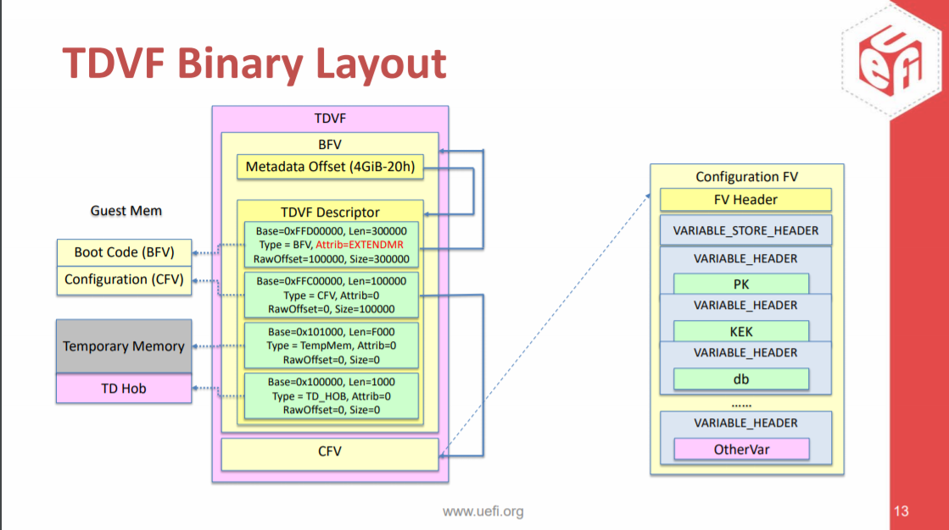
Image Layout (Config-B)
Source: https://uefi.org/sites/default/files/resources/Virtual%20Firmware%20for%20Intel%20Trust%20Domain%20Extensions%20-%20UEFI_12.15.2020.pdf
Note: Metadata Offset in BFV is not decided yet. It may be updated. see Slides 13

Slide 25
SEC/PEI Phase

Slide 26
SEC Phase (Config-A & Config-B)
ResetVector – OvmfPkg/ResetVector
https://github.com/tianocore/edk2-staging/tree/TDVF/OvmfPkg/ResetVector
SecEntry – OvmfPkg/Sec/X64
https://github.com/tianocore/edk2-staging/tree/TDVF/OvmfPkg/Sec
Sec Core – SecMain.c
Config-A: OvmfPkg/Sec/SecMain.c
Config-B: OvmfPkg/IntelTdx/Sec/SecMain.c (new)
VmTdExitLib (new)
https://github.com/tianocore/edk2-staging/tree/TDVF/OvmfPkg/Library/VmTdExitLib
#VE handler - VmTdExitVeHandler.c

Slide 27
SEC - ResetVector
Initial State of CPUs is unique. Register state has information for firmware, including input HOB list with system resources (memory and i/o)
All CPUs (BSP and APs) start executing at ‘resetvector’ in 32-bit protected mode with flat descriptors (paging disabled).
ResetVector will:
Determine 32-bit protected mode or 16-bit real mode and decide to jump to EarlyPmEntry or EarlyBspInitReal16.
ReloadFlat32
Initialize TDX_WORK_AREA which save TD flags and Infos
Search Boot Firmware Volume and locate SEC entry point
Transition to Long Mode (BSP builds page table, APs just set their CR3 with the page table built by BSP)
Jump to SEC entry point

Slide 28
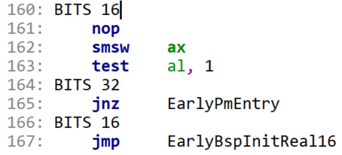
Entry point for Tdx (32bit Protected mode)
Problem statement
All CPUs (BSP and APs) start executing at ‘resetvector’ in 32-bit protected mode.
ResetVector entry point at 0xfffffff0 is 16-bit real mode
How to handle real-mode and protected-mode:
Use BITS 16/32. See code excerpt →
Another way is that different mode goes to different entry point
TDX Module should be updated. It is not feasible.

Slide 29
ResetVector flow

Slide 30
SEC EntryPoint – OvmfPkg/Sec/X64
SEC EntryPoint flow is in next slides.
Determines if BSP or AP
If BSP, initializes the temporary stack and jumps to Core
if APs, spin in a modified mailbox loop using initial mailbox structure
Wait for command, see if command is for me, execute command
Supports 2 commands:
WakeUp – documented in SAS, SEC-Core issues this command to move APs to final OS spinloop and mailbox in reserved memory
AcceptPages – firmware command. To spread of performance impact of accepting pages in SEC Core on the BSP, the BSP will parse memory resources and assign each AP the task of accepting a subset of pages. This command may be called several times until all memory resources are processed.

Slide 31
SEC
EntryPoint Flow

Slide 32
SEC Core –SecMain.c
The flow of Config-A is in slide 33
The flow of Config-B is in slide 34

Slide 33
Config-A (OvmfPkg/Sec/SecMain.c)
Existing
Updated
TDX added
From SecEntry
PEI Start
Check Tdx Supported
Initialize the dispatch of the PEI Foundation
OvmfPkg/PlatformPei
Tdx?
Relocate TdMailbox
Prepare DXE Hobs
Init Tdx Platform
TdxInialize
Invoke PEIMs
Legacy OVMF flow
Parse Td Hob
Prepare state to hand off to DXE IPL PPI
Accept Memory
DXE IPL PEIM
Load/Start Dxe
Prepare state to hand off to DXE IPL PPI
SecStartupPhase2
DXE Core

Slide 34
Config-B
(OvmfPkg/IntelTdx/Sec/SecMain.c)

Slide 35
Overview of tasks in SEC/PEI
Processes VMM HobList (in the area of TdHob) to accept memory
Accept Memory
Transfer the VMM HobList to the final hoblist for DXE
Do Tdx Platform Initialization
Sets PMBA, IO Space Enable, Acpi Control Registers
Sets ICH Pci Root Complex Bar
Reads PM Sleep States from QemuFwCfg
Sets up AP Relocation Memory (EfiACPIMemoryNVS) and Relocates APs
Builds Hobs for FV, CPU, etc
Measure & Extend external inputs, such as CFV/VMM HobList/External QemuCfg items
This feature is feasible in Config-B.
In Config-A No additional security feature is to be added. (In standard OVMF external inputs are not measured)
Loads and executes DXE core

Slide 36
Process VMM Hoblist and Accept Memory
Process VMM HobList (in the area of TdHob)
For each, low memory resource, must accept each page before use
BSP, uses a mailbox broadcast with the AcceptPages mailbox command
Parameters are physical-start, physical-end, and accept-size
Accept-size is number of continuous pages an AP accepts
An AP starting address is physical-start + (cpu-id * accept-size)
An Ap, accepts X number of pages based on accept-size
An AP, increments starting address by (num-cpus * accept-size)
An AP, repeats until at physical-end
Config-A
PEI will construct the new HobLib at SecCoreData->PeiTemporaryRamBase (0x810000 - 0x81ffff)
Config-B
SEC uses the largest low memory resource range and constructs a new HobList there for SEC memory pool.
MdePkg/Library/SecMemoryAllocationLib provides the early memory allocator.

Slide 37
TransferHobList & LogHobList
TransferHobList() – creates new HobList in system memory
For each system resource in VMM HobList
Add to new HobList
If low system memory, mark Hob attribute with EFI_RESOURCE_ATTRIBUTE_ENCRYPTED
LogHobList() – TDVF needs to ‘measure&extend’ VMM HobList
Measure the VMM HobList and extend to TDX RTMR register.
A Guid HOB is created with the above Hash value and an Event log will be created in DXE phase.

Slide 38
MP Support Routines in SEC/PEI
MP Support Routines
General flow is CPU serialization is:
MpSerializeStart() – wait for all reported (TDINFO) cpus to arrive
APs: increment and wait for mailbox->num-of-cpus-arriving == num-of-cpus
BSP: wait for mailbox->num-of-cpus-arriving == num-of-cpus -1
Sets mailbox->num-of-cpus-exiting = num-of-cpus
Increments num-of-cpus-arriving
MpSerializeEnd() – wait for all reported (TDINFO) cpus to finish
APs: decrement and wait for mailbox->num-of-cpus-exiting == 0
BSP: wait for mailbox->num-of-cpus-exiting == 1
Sets mailbox->num-of-cpus-arriving = 0, and clears mailbox->command
Decrements num-of-cpus-exiting
MpAcceptMemoryResourceRange
To spread of performance impact of accepting pages in SEC Core on the BSP, the BSP will parse memory resources and assign each AP the task of accepting a subset of pages. This command may be called several times until all memory resources are processed.

Slide 39
Tdx Measurement in SEC
Tdx measurement in SEC Phase
This feature in Config-A is not feasible because external input is not measured in standard Ovmf
This feature in Config-B is feasible
In Config-B:
TDVF doesn’t require or support a TPM, instead it supports TDX RTMR registers
Every external input should be measured and extended to TDX RTMR registers.
For example, the VMM HobList, CFV, QemuFwCfg items, etc.
GUID Hob entry (gTcgEvent2EntryHobGuid) is created with hash value and passed to DXE. The hob contains:
TCG_PCR_EVENT
Measurement (SHA-384)
In DXE phase TdTcg2Dxe module parses HobList for these events and create event logs.
Lib (new)
SecTpmMeasurementLibTdx is an instance of TpmMeasurementLib
It exports below API:
TpmMeasureAndLogData
HashLib|OvmfPkg/Library/HashLibBaseCryptoRouterTdx (for both SEC and DXE)
SecCryptLib|CryptoPkg/Library/BaseCryptLib/SecCryptLib.inf (for SEC)
SHA-384

Slide 40
Load and Execute Dxe Core
DXE Loading in SEC phase (Config-B)
Mimics code in PEI that would locate, load, and jump to DXE
MemoryAllocationLib|MdePkg/Library/SecMemoryAllocationLib/SecMemoryAllocationLib.inf
Allocate memory in PHIT->EfiFreeMemoryTop
Create a Memory Allocation HOB
PrePiLib|OvmfPkg/Library/PrePiLibTdx/PrePiLibTdx.inf
FwVol.c : Ffs APIs, Get Fv image from FV type file, then add FV & FV2 Hob
PrePiLib.c : load DXE core

Slide 41
Exception
Module
CpuExceptionLib
VmgExitLib
(AMD SEV #VC)
VmTdExitLib
(Intel TDX #VE)

Slide 42
VmTdExitLib – VmTdExitVeHandler.c
TDVF provides the default #VE exception handler
#VE handler also convert below forbidden instruction to the TDCALL[TDG.VP.VMCALL]<INSTRUCTION.XX>
CPUID => TDCALL [TDG.VP.VMCALL] <INSTRUCTION.CPUID>
IO => TDCALL [TDG.VP.VMCALL] <INSTRUCTION.IO>
RDMSR => TDCALL [TDG.VP.VMCALL] <INSTRUCTION.RDMSR>
WRMSR => TDCALL [TDG.VP.VMCALL] <INSTRUCTION.WRMSR>
#VE handler is registered in early SEC and DXE phases
See next slides for the #VE handler flow.

Slide 43
VmTdExitLib – #VE handler flow

Slide 44
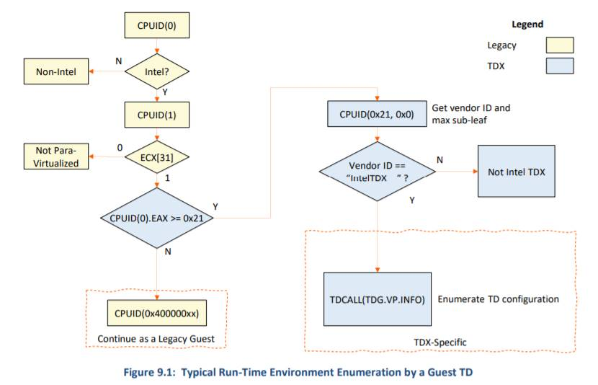
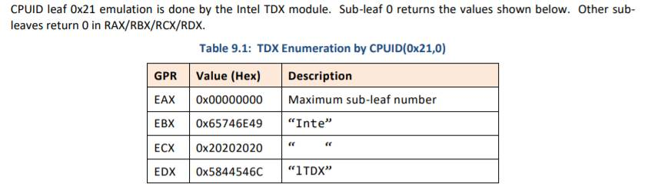
CPUID (0x21,0)
New CPUID is imported to detect Td guest
Leaf – 0x21
Sub leaf – 0x0
https://software.intel.com/content/dam/develop/external/us/en/documents/tdx-module-1eas-v0.85.039.pdf chapter 9.

Slide 45
DXE Phase

Slide 46
DXE Phase
DXE Core
TdxDxe
IoMmuDxe
MemEncryptTdxLib
TdTcg2Dxe (Config-B)
HashLibBaseCryptoRouterTdx (SecurityPkg)
DxeTpmMeasurementLib (SecurityPkg)
Td measurement and Measure boot (Config-B)
Some DXE Drivers not allowed to load/start in Td guest (Config-B)
Network stack
RNG
etc.
Other DXE Phase drivers
IncompatiblePciDeviceSupportDxe
LocalApicTimerDxe
EmuVariableFvbRuntimeDxe (Config-B)

Slide 47
DXE Core
FwVolRead.c – SMM is not supported in Td guest
Handle the Tdx private memory
Most memory in a trusted domain is private to the VM. Its contents are encrypted with keys unique to the VM.
Guest OS looks at the memory mapped generated by the firmware to make decisions about which resources are private or shared.
EDK2 introduce a memory attribute called EFI_MEMORY_CPU_CRYPTO and we identify the private memory regions with this attribute.
We introduce a new HOB resource attribute (EFI_RESOURCE_ATTRIBUTE_ENCRYPTED) which is set to describe memory resources in SEC phase
Extend DXE Core’s conversion table to convert new resource attribute (EFI_RESOURCE_ATTRIBUTE_ENCRYPTED) into the existing EFI_MEMORY_CPU_CRYPTO memory attribute
See next slides for detailed implementation

Slide 48
Details
MdePkg/Include/Pi/PiHob.h
+//^M
+// Physical memory encrypted attribute. This^M
+// memory uses platform encrpytion capabilities for^M
+// protection. If this bit is clear, the memory does^M
+// not use platform encryption protection^M
+//^M
+#define EFI_RESOURCE_ATTRIBUTE_ENCRYPTED 0x04000000^M
MdeModulePkg/Core/Dxe/Gcd/Gcd.c
Extend mAttributeConversionTable
+ { EFI_RESOURCE_ATTRIBUTE_ENCRYPTED, EFI_MEMORY_CPU_CRYPTO,

Slide 49
TdxDxe
OvmfPkg/TdxDxe
Dispatched early in DXE.
Set PcdCpuMaxLogicalProcessorNumber by the number reported in TDINFO
Set PcdOvmfHostBridgePciDevId based on the GuidHOB (gUefiOvmfPkgTdxPlatformGuid ) so that we can make use of some ovmf modules that depend on it.
Initializes PcdPciMmio32, PcdPciMmio64 and PcdPciIo
Sets PcdTdRelocatedMailboxBase to address where SEC relocated APs, needed for ACPI table
Register call back for the Protocol of gEfiAcpiTableProtocolGuid (it is to install MADT table with MPWK structure which records the TdMailbox information).

Slide 50
IoMmu
OvmfPkg/IoMmuDxe
Handles IOMMU protocol for PCI and others.
A converged version of OvmfPkg’s IoMmuDxe with AMD SEV and Intel TDX
Distinguish TDX and SEV in IoMmuDxeEntryPoint in Run-time and call the corresponding decryption/encryption primitives.
Note: The generic logic is not touched, only to customize the page decryption / encryption primitives in the driver
OvmfPkg/Library/BaseMemEncryptTdxLib (new)
Provides the MemEncryptTdxClearPageEncMask/ MemEncryptTdxSetPageEncMask for Tdx

Slide 51
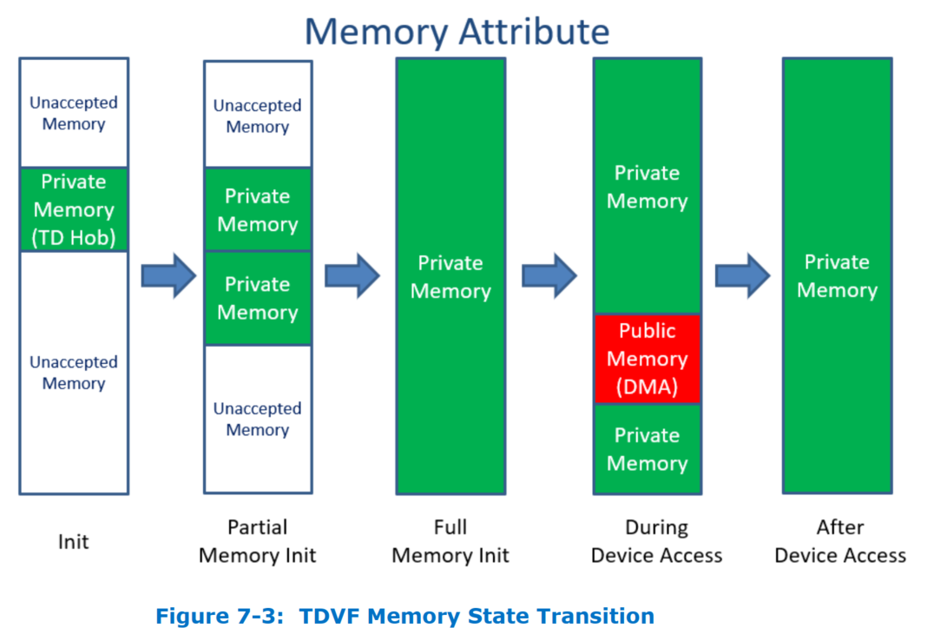
Private & Shared Transition

Slide 52
IOMMU design
Virtio Block / Scsi / FS
Virtio GPU
Virtio Net
Virtio Rng
VIRTIO
Virtio10 Driver
PCI Device Driver
Other Device Driver
PCI_IO
PCI Bus Driver
PCI_ROOT_BRIDGE_IO
PCI Host Bridge
IOMMU_PROTOCOL
AllocatePages / FreePages
Map / Unmap
SetAttribute
IOMMU Driver
(AMD SEV/Intel TDX)
Unchanged
Updated
MemEncryptSevLib
MemEncryptTdxLib
Newly added

Slide 53
DXE Phase – TdTcg2Dxe (Config-B)
OvmfPkg/Tdx/TdTcg2Dxe (new)
Removes dependencies on Tpm
Generates new event log (and ACPI Table) that is based on Tpm2 event log
Allocate system memory to hold the TCG2 Event Log (EfiACPIMemoryNVS)
Put the address to TDEL ACPI Table (lama)
Parses all gTcgEvent2EntryHobGuid Hob entries added in SEC phase, and create event log
Install EFI_TD_PROTOCOL (gEfiTdProtocolGuid)
re-use the EFI_TCG2_PROTOCOL definition(see more details in next slide)
Notes:
Note:
In current TDVF the Protocol name is TD_TCG2_PROTOCOL (gTdTcg2ProtocolGuid)
Should be renamed to EFI_TD_PROTOCOL (gEfiTdProtocolGuid)

Slide 54
EFI_TD_PROTOCOL (Config-B)
EFI_TD_PROTOCOL (gEfiTdProtocolGuid) re-use the EFI_TCG2_PROTOCOL definition
HashLogExtendEvent is the major API in EFI_TCG2_PROTOCOL which does below tasks:
Do Hash (sha-384)
Extend to Tdx RTMR registers
Create event log
Libraries
HashLib|OvmfPkg/Library/HashLibBaseCryptoRouterTdx (new)
Implement the HashAndExtend which will be called in above HashLogExtendEvent
TdxLib|MdePkg/Library/TdxLib (new)
TdExtendRtmr (in TdxLib/Rtmr.c) will be called by above HashAndExtend
It does the actual extending to RTMR
Notes:
Note:
In current TDVF the Protocol name is TD_TCG2_PROTOCOL (gTdTcg2ProtocolGuid)
Should be renamed to EFI_TD_PROTOCOL (gEfiTdProtocolGuid)

Slide 55
DxeTpm2MeasurementLib Design
Any Module
TpmMeasurementLib
DxeTpmMeasurmentLib
EFI_TD_PROTOCOL
EFI_TCG_SERVICE
EFI_TCG2_PROTOCOL
TcgDxe
Tcg2Dxe
TdTcg2Dxe
TPM12
TPM2
RTMR
Unchanged
Updated
Newly added

Slide 56
DxeTpm2MeasureBootLib Design
LoadImage
RegisterSecurity2Handler(DxeTpm2MeasureBootHandler)
DxeTpm2MeasureBootHandler
EFI_TD_PROTOCOL
EFI_TCG_SERVICE
EFI_TCG2_PROTOCOL
TcgDxe
Tcg2Dxe
TdTcg2Dxe
TPM12
TPM2
RTMR
Unchanged
Updated
Newly added

Slide 57
IncompatiblePciDeviceSupportDxe
IncompatiblePciDeviceSupportDxe
Registers Protocol that allows us to disable Pci Option Rom support for all devices
Legacy 16bit Option Rom and 32-bit UEFI OROM must be rejected. ([TDVF] 9.5)
PI Spec 1.7a Table 20. ACPI 2.0 & 3.0 QWORD Address Space Descriptor Usage. Type-specific flags (when Address Translation Offset == 6) can be set to 0 to skip device option ROM (do not probe option ROM BAR).

Slide 58
EmuVariableFvbRuntimeDxe (Config-B)
pflash is not part of the *board* in TDX setup
This is a limitation from the Qemu (the tdx-qemu) side. TDVF is copied into RAM. Generic loader is the one for it.
In this case (pflash is not found), QemuFlashFvbServicesRuntimeDxe/ FvbServiceRuntimeDxe.inf will return EFI_WRITE_PROTECTED in its FvbInitialize().
EmuVariableFvbRuntimeDxe will then perform its in-RAM flash emulation.
In the traditional EmuVariableFvRuntimeDxe, the FV contents will be initialized.
TDVF has its own requirement, that the SB keys in CFV need to be copied into the FV contents. That’s what EmuVariableFvRuntimeDxe is updated in TDVF project.

Slide 59
Libraries

Slide 60
Library
TdxLib (new)
ProbeTdGuest (new)
BaseMemEntryptLibTdxLib (new)
BaseIoLibIntrinsicTdx (new)
CpuException related libraries (new)
Td measurement and Measure boot related libraries (new)
QEMU related lib

Slide 61
TdxLib
MdePkg/Library/TdxLib (both SEC/DXE) (new)
Wrap the functions which perform the related Tdx operation.
TdCall : To cause a VM exit to the Intel TDX module
TdVmCall : A leaf function 0 for TDCALL
TdVmCallCpuid : Enable the TD guest to request VMM to emulate CPUID
TdAcceptPages : To accept pending private pages
TdExtendRtmr : To extend one of the RTMR registers
[GHCI] Chap 2/3

Slide 62
ProbeTdGuest()
The capability of probe Td / Non-Td in run-time is needed
Option A: ← Preferred
Implement in BaseLib
Option B:
Implement in TdxProbeLib (new)
How to do the probe?
Probe the Td guest using CPUID (0x21, 0).
This API supports all Architectures (X64, IA32, ARM, etc) but only do the actual Td Probe in X64. It always return FALSE in other architecture. It is because that Td guest only works in X64.

Slide 63
BaseMemEncryptLib
OvmfPkg/Library/BaseMemEncryptTdxLib (new)
Handles setting or clearing S-bit for address range.
Called by IOMMU Protocol
For TDX, it must:
Set or Clear S-Bit in page table
Inform host with TDVMCALL_MAPGPA
TdAcceptPages if converting shared memory back to private

Slide 64
BaseIoLibInstrinsic
MdePkg/Library/BaseIoLibIntrinsic
Why: We need dump debug message to serial port in exception lib. Otherwise, we will have recursive exception.
Detect Td-guest or Non-Td in runtime by CPUID (0x21,0)
https://software.intel.com/content/dam/develop/external/us/en/documents/tdx-module-1eas-v0.85.039.pdf, chapter 9.
For Td-guest:
Para-Virtualized I/O module is used. It replaces IO/MMIO access with TDVMCALL to invoke VMM provided IO/MMIO emulation functions.
For Non-Td guest
Follow the legacy code flow

Slide 65
BaseIoLibInstrinsic
Problem statement
IoLib is a basic lib which is used by a number of Pkgs. Must be VERY careful to make any changes so that below libs are not broken.
There are 3 inf in current IoLib
BaseIoLibIntrinsic.inf – IA32 X64 EBC ARM AARCH64 RISCV64 (un-touched)
BaseIoLibIntrinsicArmVirt.inf - ARM AARCH64 (un-touched)
BaseIoLibIntrinsicSev.inf – IA32 X64
BaseIoLibIntrinsicSev.inf is updated to to support both Td and Non-Td IO in IA32/X64. Name may be updated like below:
Option 1: BaseIoLibIntrinsicSevTdx.inf
Option 2: BaseIoLibIntrinsicTee.inf (Tee: Trusted Executed Environment)
Files are added
IoLibInternalTdx.c
The actual IO APIs in Td guest
IsTdGuest(wrap the API in ProbeTd.nasm) to check whether it is Td or Non-Td guest
X64/ProbeTd.nasm
Probe Td guest using CPUID(0x21,0) in run-time
IoLibInternalTdxNull.c
The null APIs in Non-Td guest
IsTdGuest() always return FALSE
IoLibTee.c/IoLibGccTee.c/IoLibMscTee.c

Slide 66
IA32
IoLibInternalTdxNull.c
IsTdGuest() always return FALSE
Null TD IO APIs
X64
IoLibInternalTdx.c
Probe Td guest in run-time
TD IO APIs

Slide 67
CpuException related libraries
SecPeiCpuExceptionHandlerLib
Register #VE early in SEC
PeiDxeCpuExceptionHandlerLib
Register #VE early in DXE
VmTdExitLib (see slides 32) (new)
OvmfPkg/Library/VmTdExitLib
Handle the #VE exception

Slide 68
Td measurement & Measure boot libs (Config-B)
SecurityPkg/Library/HashLibBaseCryptoRouterTdx (new)
HashLib for Tdx (In OvmfPkg)
Calculate the SHA-384 and extend to TDX RTMR registers
SecCryptLib (new)
Support SHA-384 in SEC phase
SecCryptLib|CryptoPkg/Library/BaseCryptLib/SecCryptLib.inf
DxeTpmMeasurementLib
Update the SecurityPkg/Library/DxeTpmMeasurementLib/DxeTpmMeasurementLib.c to support Tdx measurement (measure and extend to TDX RTMR registers)
DxeTpm2MeasureBootLib
Update the SecurityPkg/Library/DxeTpm2MeasureBootLib/DxeTpm2MeasureBootLib.c to support measure boot in Td guest
Notes:
Open: tdx measurement code in SecurityPkg or OvmfPkg

Slide 69
QEMU related lib
QemuFwCfgDxeLib – update to support both Tdx and SEV
OvmfPkg/Library/QemuFwCfgLib
Add MemEncryTdxLib in Library class
TdvfPlatformLibQemuSec (new)
OvmfPkg/Library/TdvfPlatformLibQemu
Called by TdxStartupLib to support for SEC Platform Initialization in Td-guest
Sets PMBA, IO Space Enable, Acpi Control Registers
Sets ICH Pci Root Complex Bar
Reads PM Sleep States from QemuFwCfg

Slide 70
MpInitLib
MpInitLib
UefiCpuPkg/Library/MpInitLib
Support for both Td-guest and Non-Td guest. Detect Td or Non-Td in run-time
For Td-guest
No AP executes in DXE
No logic to init AP, wakeup AP, or relocate AP for BIOS exit

