Slide 1
Logic Gates
CS 202, Spring 2007
Epp, setions 1.4 and 1.5
Aaron Bloomfield

Slide 2
Review of Boolean algebra
Just like Boolean logic
Variables can only be 1 or 0
  Instead of true / false

Slide 3
Review of Boolean algebra
Not is a horizontal bar above the number
  0 = 1
  1 = 0
Or is a plus
  0+0 = 0
  0+1 = 1
  1+0 = 1
  1+1 = 1
And is multiplication
  0*0 = 0
  0*1 = 0
  1*0 = 0
  1*1 = 1
_
_

Slide 4
Review of Boolean algebra
_ _ _
Example: translate (x+y+z)(xyz) to a Boolean logic expression
  (x∨y∨z)∧(¬x∧¬y∧¬z)
We can define a Boolean function:
  F(x,y) = (x∨y)∧(¬x∧¬y)
And then write a “truth table” for it:
x | y | F(x,y)
1 | 1 | 0
1 | 0 | 0
0 | 1 | 0
0 | 0 | 0

Slide 5
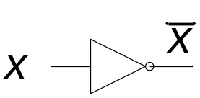
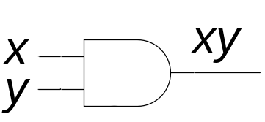
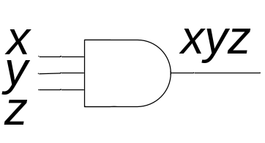
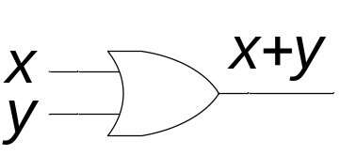
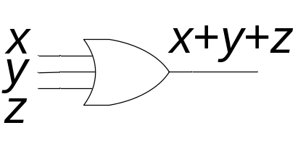
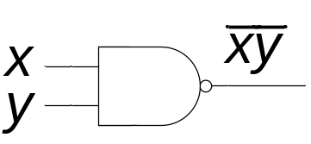
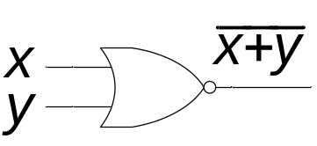
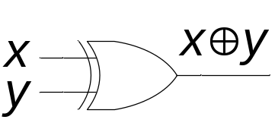
Basic logic gates
Not
And
Or
Nand
Nor
Xor

Slide 6
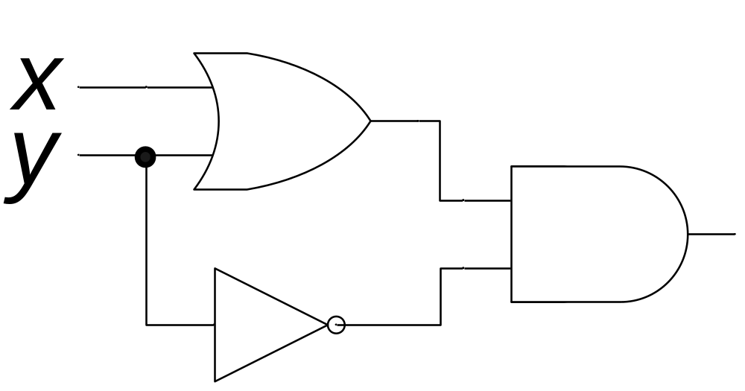
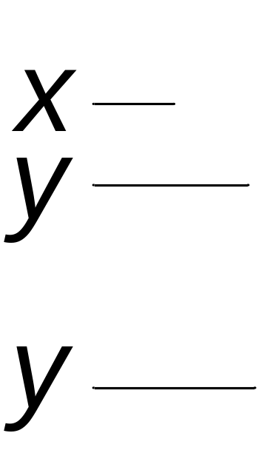
Converting between circuits and equations
Find the output of the following circuit
Answer: (x+y)y
  Or (x∨y)∧¬y
x+y
(x+y)y
y
__

Slide 7
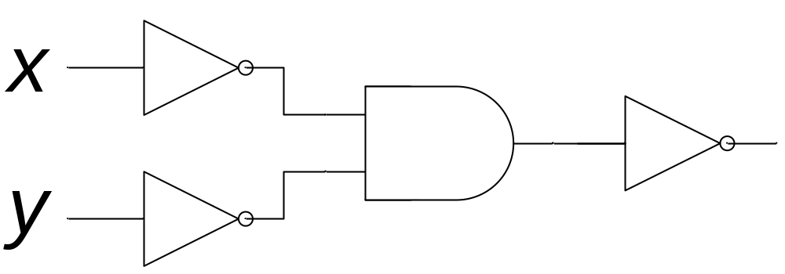
Converting between circuits and equations
Find the output of the following circuit
Answer: xy
  Or ¬(¬x∧¬y) ≡ x∨y
x
x
y
x
y
y
___
_ _

Slide 8
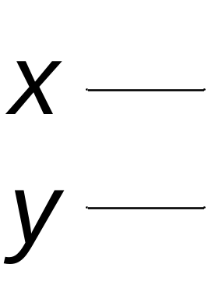
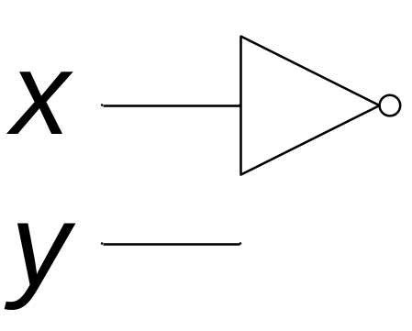
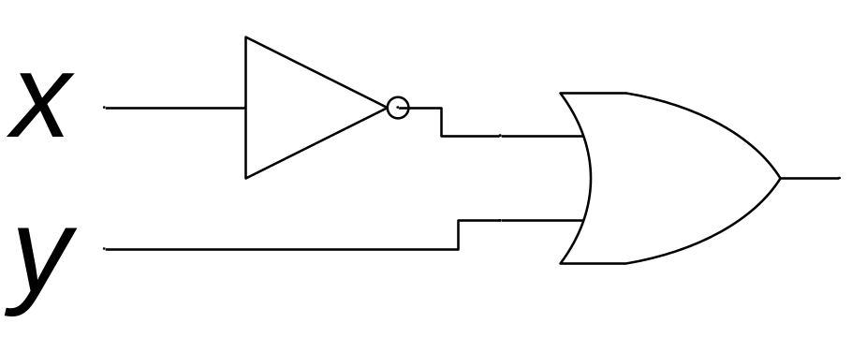
Converting between circuits and equations
Write the circuits for the following Boolean algebraic expressions
x+y
__
x
x+y

Slide 9
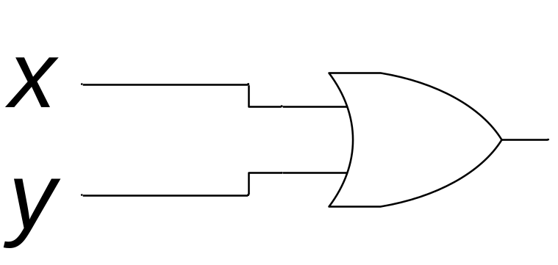
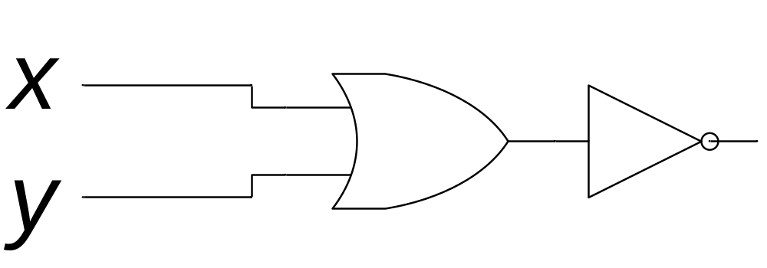
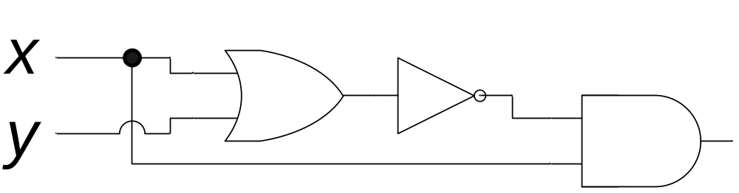
Converting between circuits and equations
Write the circuits for the following Boolean algebraic expressions
(x+y)x
_______
x+y
x+y
(x+y)x

Slide 10
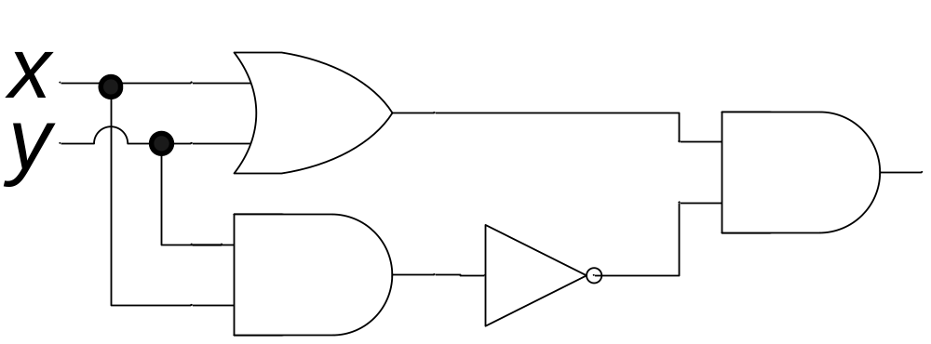
Writing xor using and/or/not
p ⊕ q ≡ (p ∨ q) ∧ ¬(p ∧ q)
x ⊕ y ≡ (x + y)(xy)
x | y | x⊕y
1 | 1 | 0
1 | 0 | 1
0 | 1 | 1
0 | 0 | 0
____
x+y
(x+y)(xy)
xy
xy

Slide 11
Converting decimal numbers to binary
53 = 32 + 16 + 4 + 1
  = 2⁵ + 2⁴ + 2² + 2⁰
  = 1*2⁵ + 1*2⁴ + 0*2³ + 1*2² + 0*2¹ + 1*2⁰
  = 110101 in binary
  = 00110101 as a full byte in binary
211= 128 + 64 + 16 + 2 + 1
  = 2⁷ + 2⁶ + 2⁴ + 2¹ + 2⁰
  = 1*2⁷ + 1*2⁶ + 0*2⁵ + 1*2⁴ + 0*2³ + 0*2² +
  1*2¹ + 1*2⁰
  = 11010011 in binary

Slide 12
Converting binary numbers to decimal
What is 10011010 in decimal?
  10011010 = 1*2⁷ + 0*2⁶ + 0*2⁵ + 1*2⁴ + 1*2³ +
  0*2² + 1*2¹ + 0*2⁰
  = 2⁷ + 2⁴ + 2³ + 2¹
  = 128 + 16 + 8 + 2
  = 154
What is 00101001 in decimal?
  00101001 = 0*2⁷ + 0*2⁶ + 1*2⁵ + 0*2⁴ + 1*2³ +
  0*2² + 0*2¹ + 1*2⁰
  = 2⁵ + 2³ + 2⁰
  = 32 + 8 + 1
  = 41

Slide 13
A note on binary numbers
In this slide set we are only dealing with non-negative numbers
The book (section 1.5) talks about two’s-complement binary numbers
  Positive (and zero) two’s-complement binary numbers is what was presented here
  We won’t be getting into negative two’s-complmeent numbers

Slide 14
End of lecture on 24 January 2007

Slide 15
How to add binary numbers
Consider adding two 1-bit binary numbers x and y
  0+0 = 0
  0+1 = 1
  1+0 = 1
  1+1 = 10
Carry is x AND y
Sum is x XOR y
The circuit to compute this is called a half-adder
x | y | Carry | Sum
0 | 0 | 0 | 0
0 | 1 | 0 | 1
1 | 0 | 0 | 1
1 | 1 | 1 | 0

Slide 16
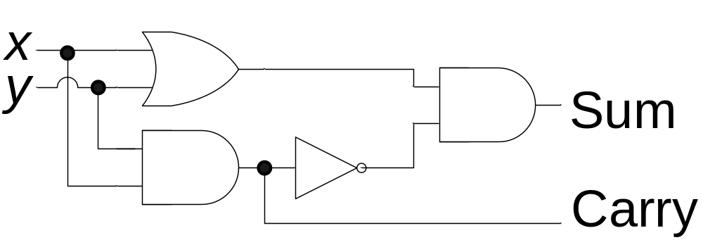
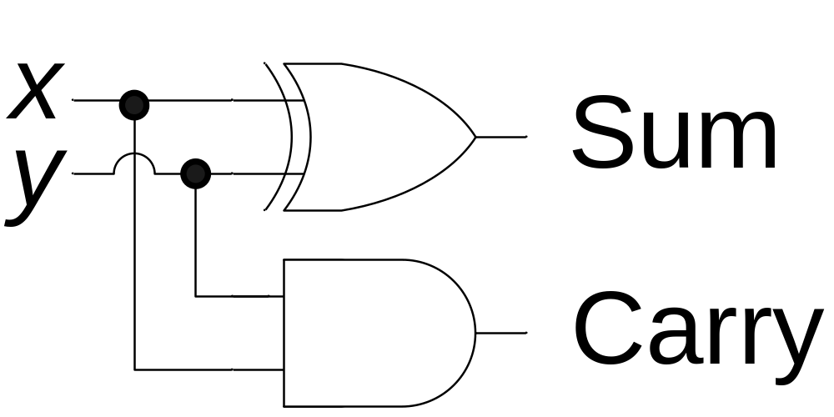
The half-adder
x | y | Carry | Sum
0 | 0 | 0 | 0
0 | 1 | 0 | 1
1 | 0 | 0 | 1
1 | 1 | 1 | 0
Sum = x XOR y
Carry = x AND y

Slide 17
Using half adders
We can then use a half-adder to compute the sum of two Boolean numbers
1
0
0
1 1 0 0
+ 1 1 1 0
?
0
1
0

Slide 18
How to fix this
We need to create an adder that can take a carry bit as an additional input
  Inputs: x, y, carry in
  Outputs: sum, carry out
This is called a full adder
  Will add x and y with a half-adder
  Will add the sum of that to the
  carry in
What about the carry out?
  It’s 1 if either (or both):
  x+y = 10
  x+y = 01 and carry in = 1
x | y | c | carry | sum
1 | 1 | 1 | 1 | 1
1 | 1 | 0 | 1 | 0
1 | 0 | 1 | 1 | 0
1 | 0 | 0 | 0 | 1
0 | 1 | 1 | 1 | 0
0 | 1 | 0 | 0 | 1
0 | 0 | 1 | 0 | 1
0 | 0 | 0 | 0 | 0

Slide 19
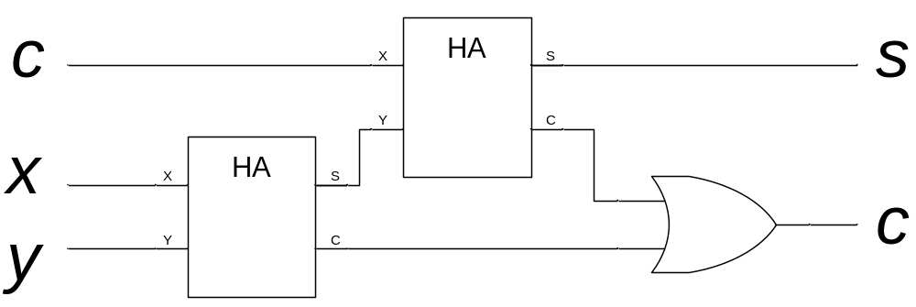
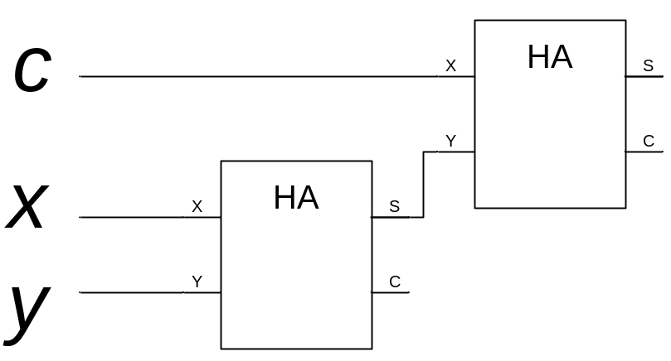
The full adder
x | y | c | s₁ | c₁ | carry | sum
1 | 1 | 1 | 0 | 1 | 1 | 1
1 | 1 | 0 | 0 | 1 | 1 | 0
1 | 0 | 1 | 1 | 0 | 1 | 0
1 | 0 | 0 | 1 | 0 | 0 | 1
0 | 1 | 1 | 1 | 0 | 1 | 0
0 | 1 | 0 | 1 | 0 | 0 | 1
0 | 0 | 1 | 0 | 0 | 0 | 1
0 | 0 | 0 | 0 | 0 | 0 | 0
The “HA” boxes are
half-adders
s₁
c₁

Slide 20
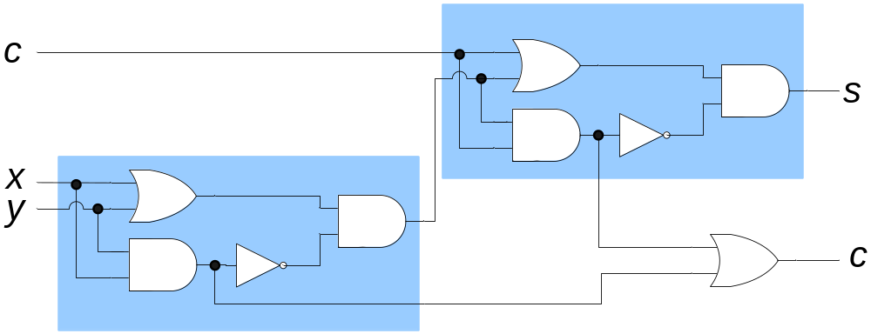
The full adder
The full circuitry of the full adder

Slide 21
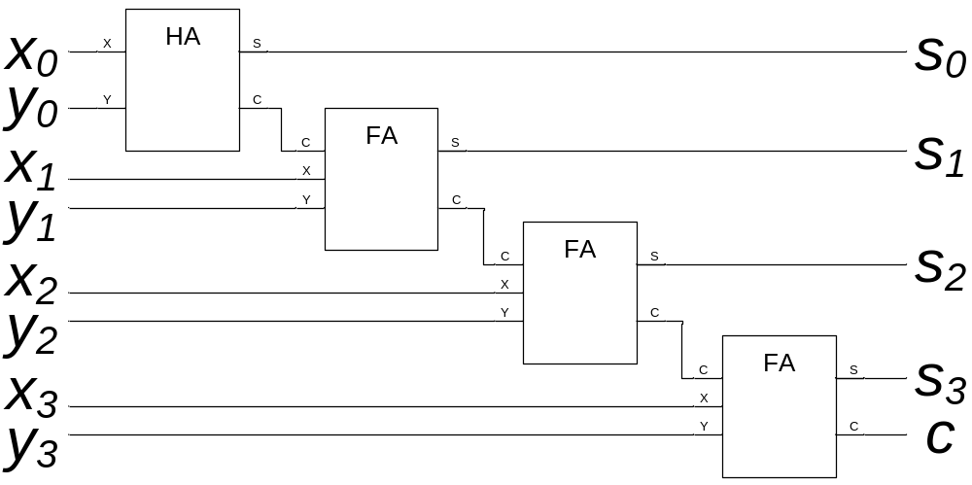
Adding bigger binary numbers
Just chain full adders together
. . .

Slide 22
Adding bigger binary numbers
A half adder has 4 logic gates
A full adder has two half adders plus a OR gate
  Total of 9 logic gates
To add n bit binary numbers, you need 1 HA and n-1 FAs
To add 32 bit binary numbers, you need 1 HA and 31 FAs
  Total of 4+9*31 = 283 logic gates
To add 64 bit binary numbers, you need 1 HA and 63 FAs
  Total of 4+9*63 = 571 logic gates

Slide 23
More about logic gates
To implement a logic gate in hardware, you use a transistor
Transistors are all enclosed in an “IC”, or integrated circuit
The current Intel Pentium IV processors have 55 million transistors!

Slide 24
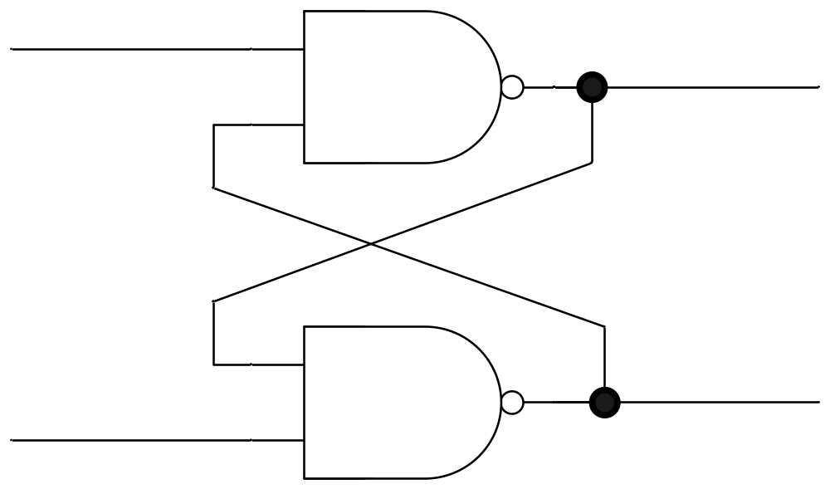
Flip-flops
Consider the following circuit:
What does it do?

Slide 25
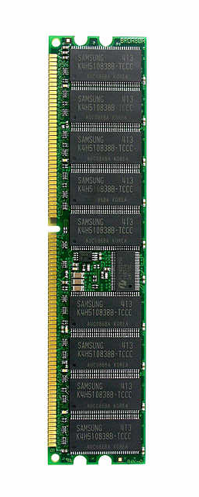
Memory
A flip-flop holds a single bit of memory
  The bit “flip-flops” between the two NAND gates
In reality, flip-flops are a bit more complicated
  Have 5 (or so) logic gates (transistors) per flip-flop
Consider a 1 Gb memory chip
  1 Gb = 8,589,934,592 bits of memory
  That’s about 43 million transistors!
In reality, those transistors are split into 9 ICs of about 5 million transistors each

Slide 26
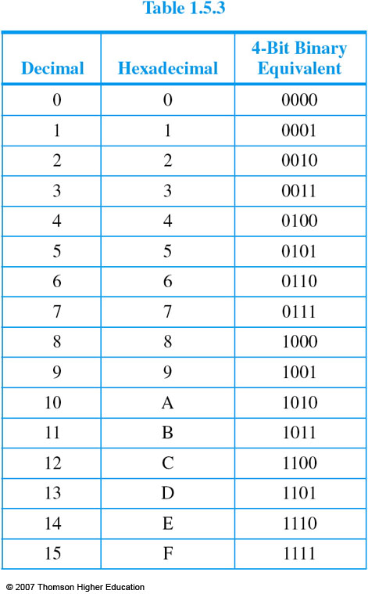
Hexadecimal
A numerical range from 0-15
  Where A is 10, B is 11, … and F is 15
Often written with a ‘0x’ prefix
So 0x10 is 10 hex, or 16
  0x100 is 100 hex, or 256
Binary numbers easily translate:

Slide 27
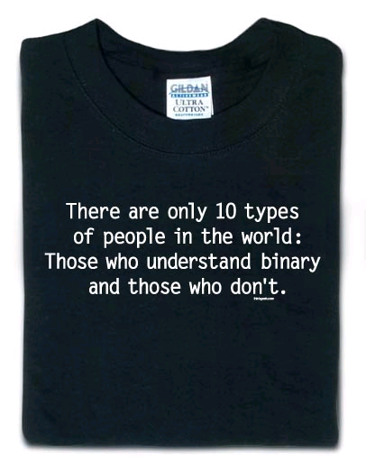
From ThinkGeek (http://www.thinkgeek.com)

Slide 28
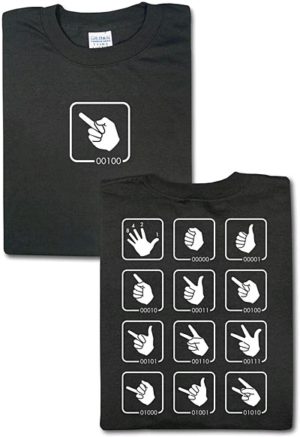
Also from ThinkGeek (http://www.thinkgeek.com)

Slide 29
DEADBEEF
Many IBM machines would fill allocated (but uninitialized) memory with the hexa-decimal pattern 0xDEADBEEF
  Decimal -21524111
  See http://www.jargon.net/jargonfile/d/DEADBEEF.html
Makes it easier to spot in a debugger

Slide 30
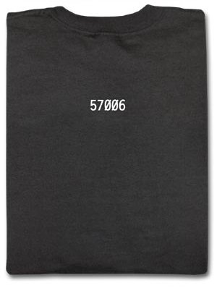
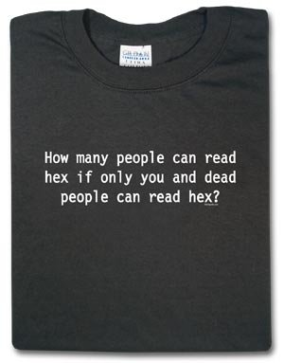
Also also from ThinkGeek (http://www.thinkgeek.com)
0xDEAD = 57005
Now add one to that...

