Slide 1
PsychRNN Worklog
Date: Aug. 11th

Slide 2

Basic model
figsize=(8, 6)
figsize=(8, 6)
$x_{t+1}=$ $\left(1−α\right)∗x_{t}+α∗\left(W^{rec}∗relu\left(x_{t}\right)+W^{rec}∗u_{t}+b_{rec}\right)+\sqrt{2∗α∗N_{rec}^{2}}+N(0,1)$
$y_{t+1}= \left(W^{out}∗relu\left(x_{t+1}\right)+b_{out}\right)$

Slide 3
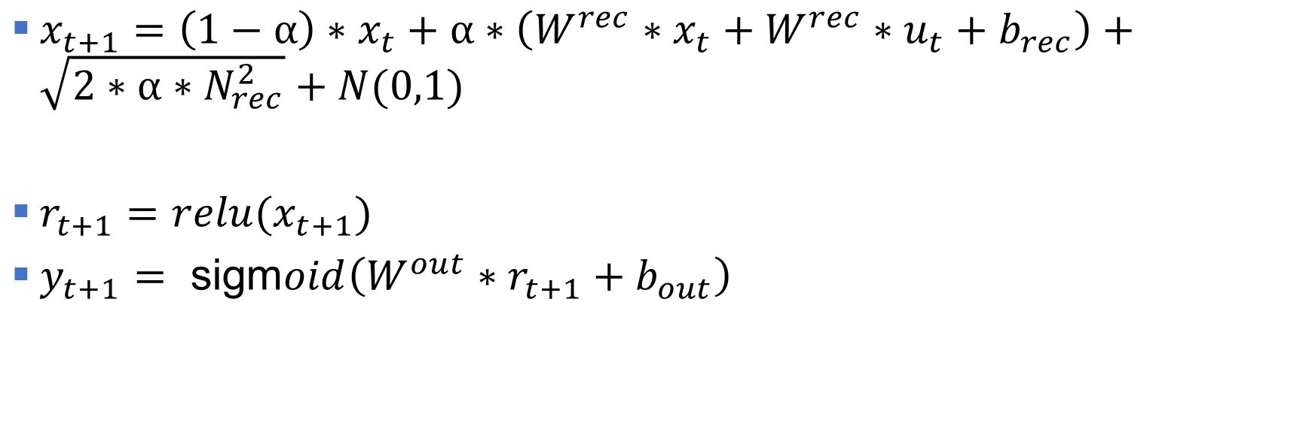
Gain/basic2 model
figsize=(8, 6)
figsize=(8, 6)
$x_{t+1}=$ $\left(1−α\right)∗x_{t}+α∗\left(W^{rec}∗x_{t}+W^{rec}∗u_{t}+b_{rec}\right)+\sqrt{2∗α∗N_{rec}^{2}}+N(0,1)$
$r_{t+1}=relu(x_{t+1})$
$y_{t+1}= \text{sigm}oid\left(W^{out}∗r_{t+1}+b_{out}\right)$

Slide 4
Gain2/basic model
figsize=(8, 6)
figsize=(8, 6)
Didn’t have a look in detail

Slide 5
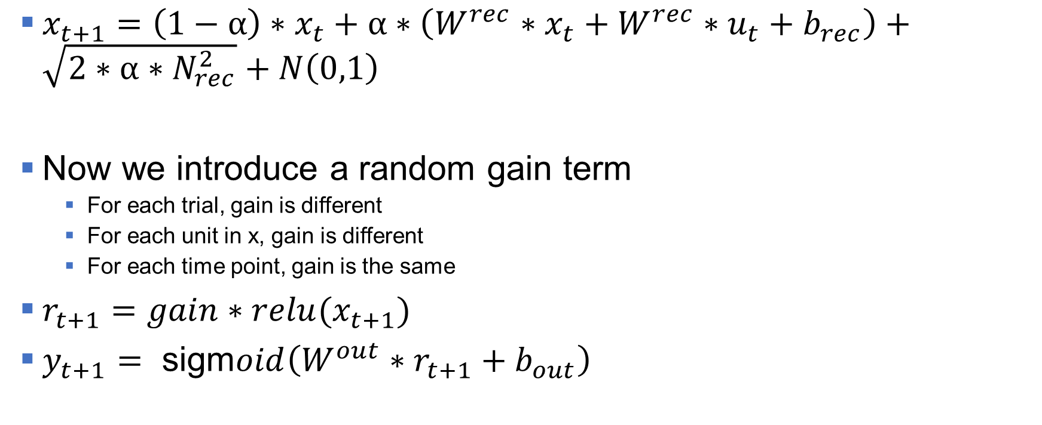
Gain2/basic2 model
figsize=(8, 6)
figsize=(8, 6)
$x_{t+1}=$ $\left(1−α\right)∗x_{t}+α∗\left(W^{rec}∗x_{t}+W^{rec}∗u_{t}+b_{rec}\right)+\sqrt{2∗α∗N_{rec}^{2}}+N\left(0,1\right)$
Now we introduce a random gain term
For each trial, gain is different
For each unit in x, gain is different
For each time point, gain is the same
$r_{t+1}=gain∗relu(x_{t+1})$
$y_{t+1}= \text{sigm}oid\left(W^{out}∗r_{t+1}+b_{out}\right)$

Slide 6
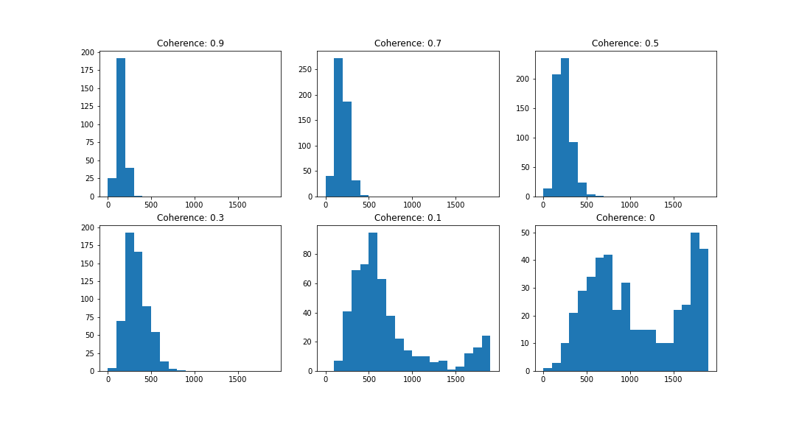
RT Results: gain equals to 1
figsize=(8, 6)
figsize=(8, 6)

Slide 7
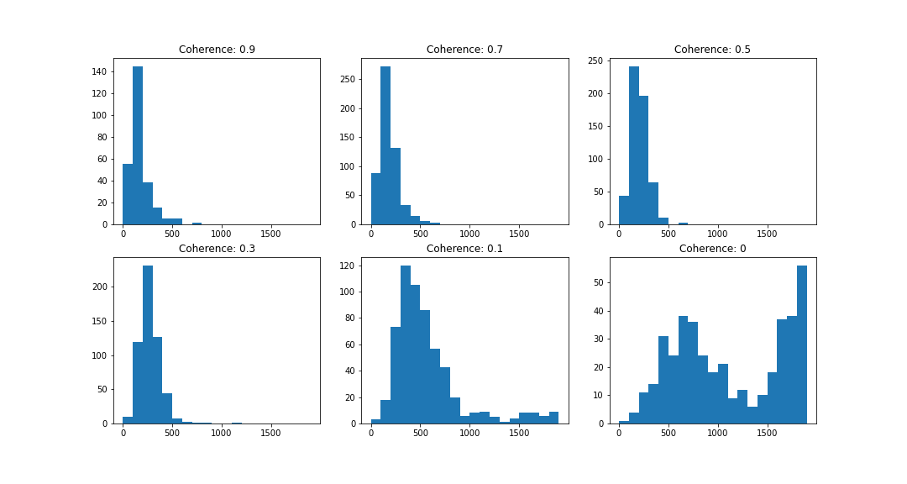
RT Results: gain (1-2 uniform distribution)
figsize=(8, 6)
figsize=(8, 6)

Slide 8
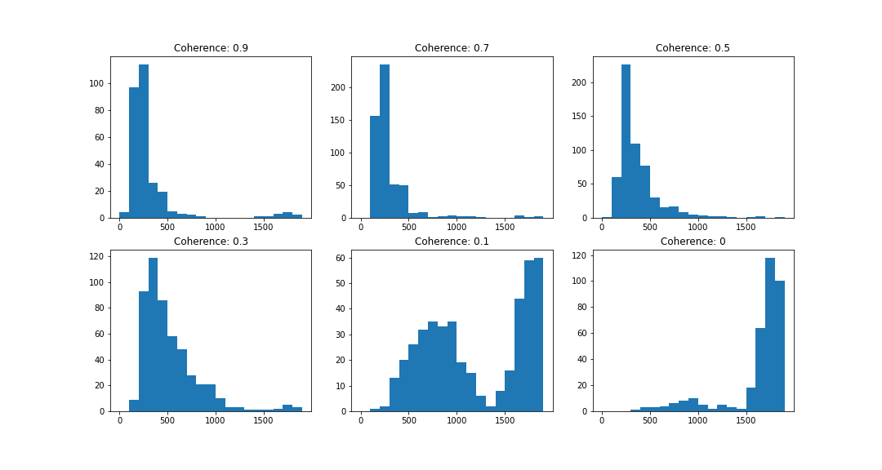
RT Results: gain (0-1 uniform distribution)
figsize=(8, 6)
figsize=(8, 6)

Slide 9
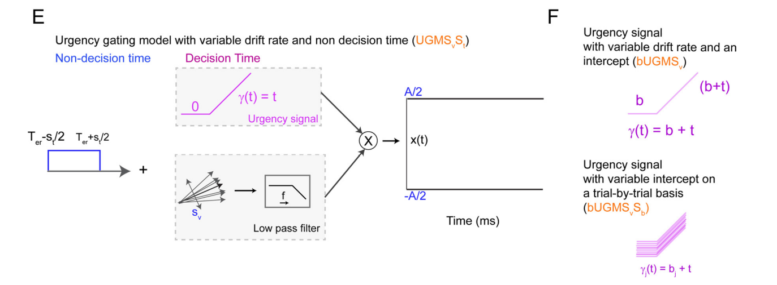
Urgency Gating model
figsize=(8, 6)
figsize=(8, 6)

Slide 10
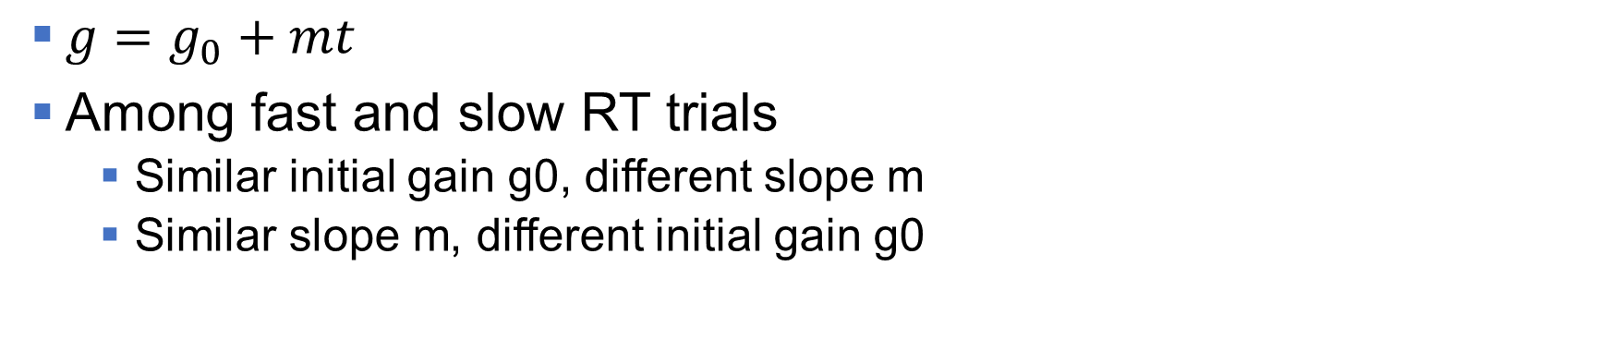
Some Previous Results
figsize=(8, 6)
figsize=(8, 6)
$g=g_{0}+mt$
Among fast and slow RT trials
Similar initial gain g0, different slope m
Similar slope m, different initial gain g0

Slide 11
Potential New Way to Apply Gain
figsize=(8, 6)
figsize=(8, 6)
y1
y3
y2
y4
r1
r3
r2
r4
x1
x3
x2
x4
u1
u3
u2
u4
g1
g3
g2
g4

Slide 12
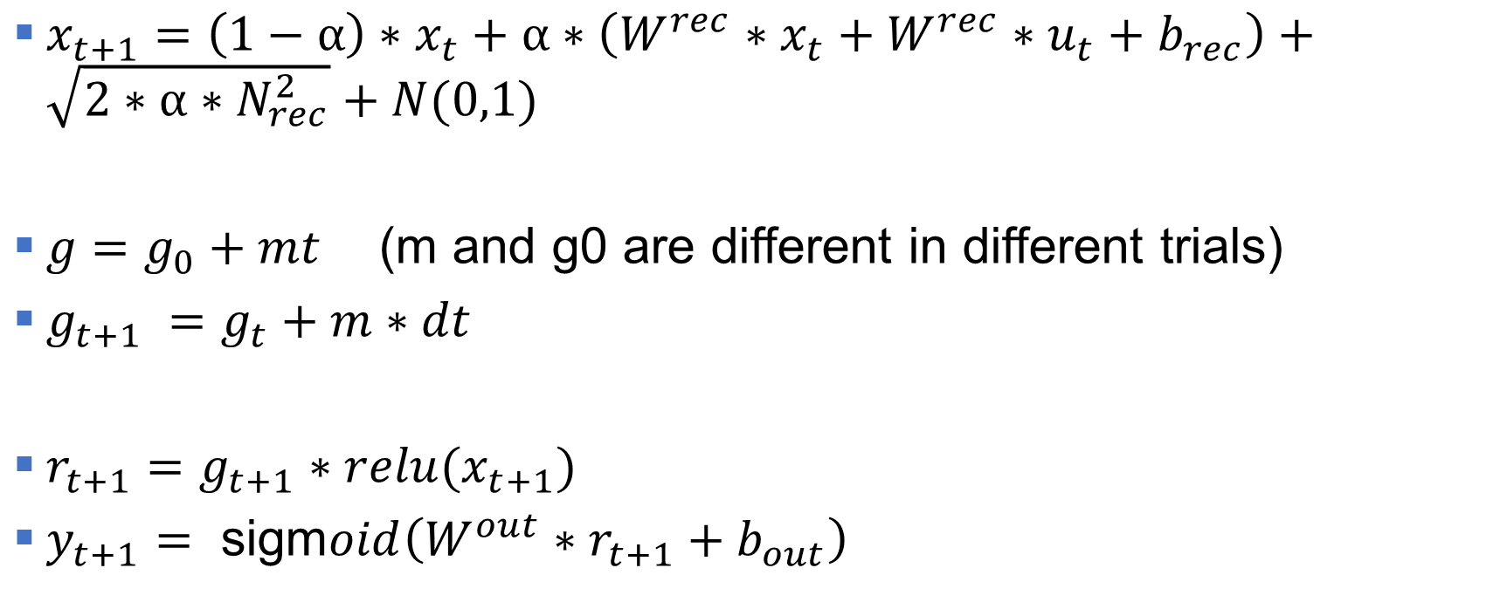
Potential New Way to Apply Gain
figsize=(8, 6)
figsize=(8, 6)
$x_{t+1}=$ $\left(1−α\right)∗x_{t}+α∗\left(W^{rec}∗x_{t}+W^{rec}∗u_{t}+b_{rec}\right)+\sqrt{2∗α∗N_{rec}^{2}}+N(0,1)$
$g=g_{0}+mt$ (m and g0 are different in different trials)
$g_{t+1} =g_{t}+m∗dt$
$r_{t+1}=g_{t+1}∗relu(x_{t+1})$
$y_{t+1}= \text{sigm}oid\left(W^{out}∗r_{t+1}+b_{out}\right)$

