Slide 1
PsychRNN Worklog
Date: Aug. 11th

Slide 2

Basic model
figsize=(8, 6)
figsize=(8, 6)
$x_{t+1}=$ $\left(1−α\right)∗x_{t}+α∗\left(W^{rec}∗relu\left(x_{t}\right)+W^{rec}∗u_{t}+b_{rec}\right)+\sqrt{2∗α∗N_{rec}^{2}}+N(0,1)$
$y_{t+1}= \left(W^{out}∗relu\left(x_{t+1}\right)+b_{out}\right)$

Slide 3
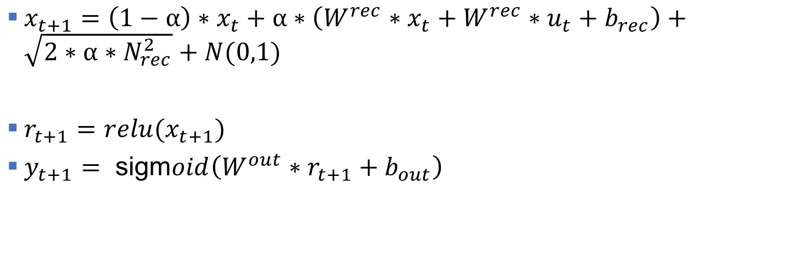
Gain/basic2 model
figsize=(8, 6)
figsize=(8, 6)
$x_{t+1}=$ $\left(1−α\right)∗x_{t}+α∗\left(W^{rec}∗x_{t}+W^{rec}∗u_{t}+b_{rec}\right)+\sqrt{2∗α∗N_{rec}^{2}}+N(0,1)$
$r_{t+1}=relu(x_{t+1})$
$y_{t+1}= \text{sigm}oid\left(W^{out}∗r_{t+1}+b_{out}\right)$

Slide 4
Gain2/basic model
figsize=(8, 6)
figsize=(8, 6)
Didn’t have a look in detail

Slide 5
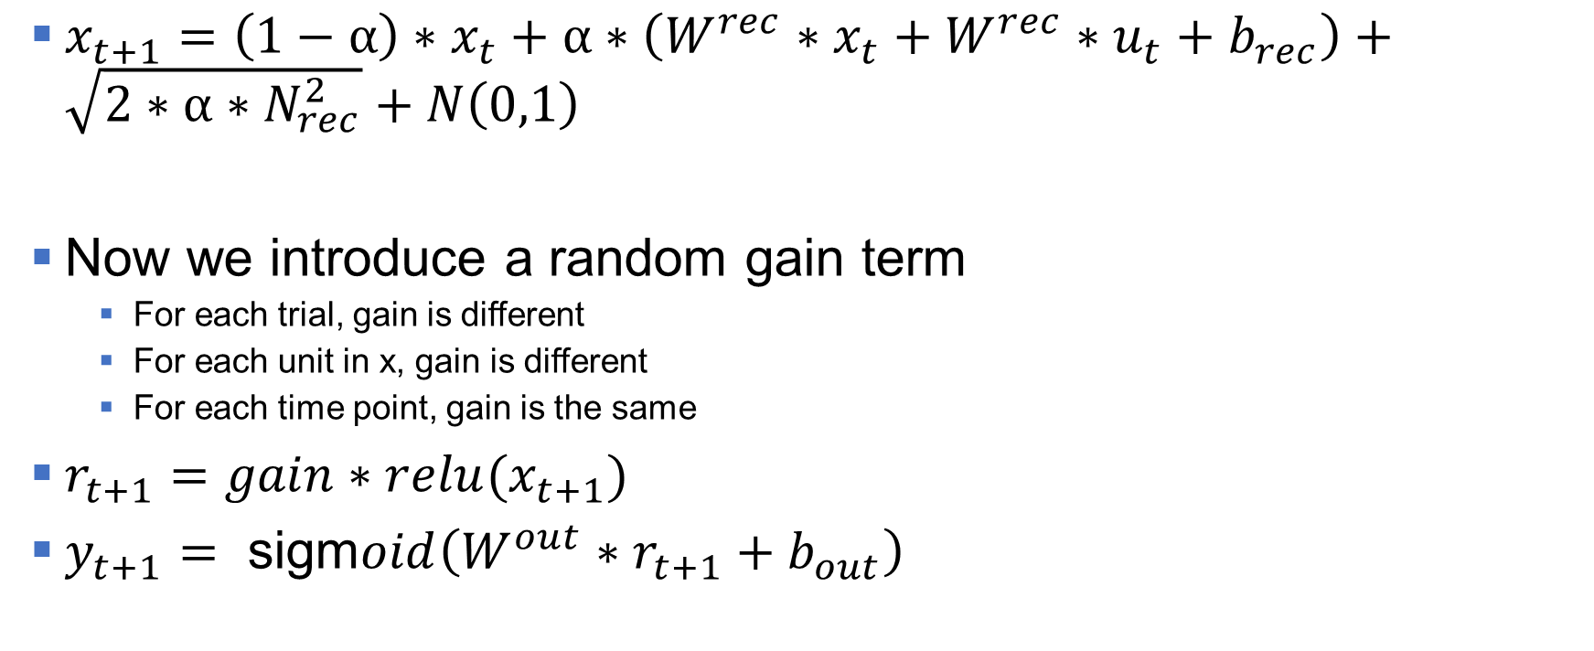
Gain2/basic2 model
figsize=(8, 6)
figsize=(8, 6)
$x_{t+1}=$ $\left(1−α\right)∗x_{t}+α∗\left(W^{rec}∗x_{t}+W^{rec}∗u_{t}+b_{rec}\right)+\sqrt{2∗α∗N_{rec}^{2}}+N\left(0,1\right)$
Now we introduce a random gain term
For each trial, gain is different
For each unit in x, gain is different
For each time point, gain is the same
$r_{t+1}=gain∗relu(x_{t+1})$
$y_{t+1}= \text{sigm}oid\left(W^{out}∗r_{t+1}+b_{out}\right)$

Slide 6
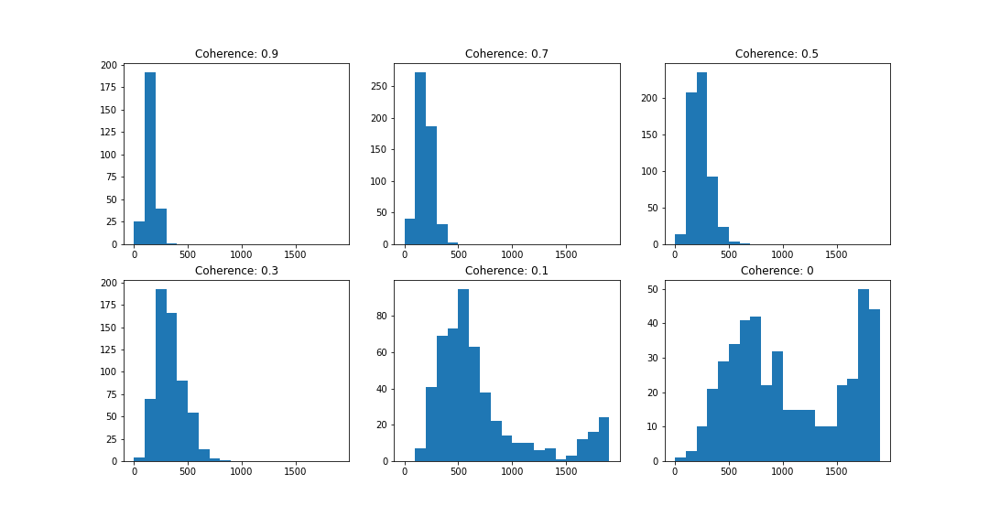
RT Results: gain equals to 1
figsize=(8, 6)
figsize=(8, 6)

Slide 7
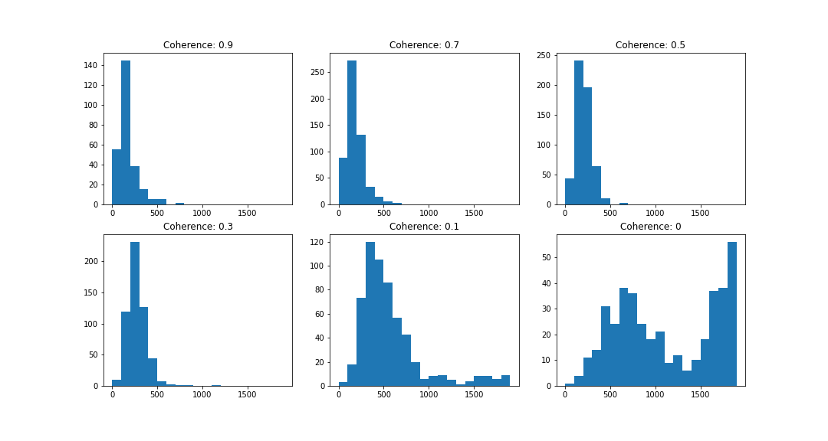
RT Results: gain (1-2 uniform distribution)
figsize=(8, 6)
figsize=(8, 6)

Slide 8
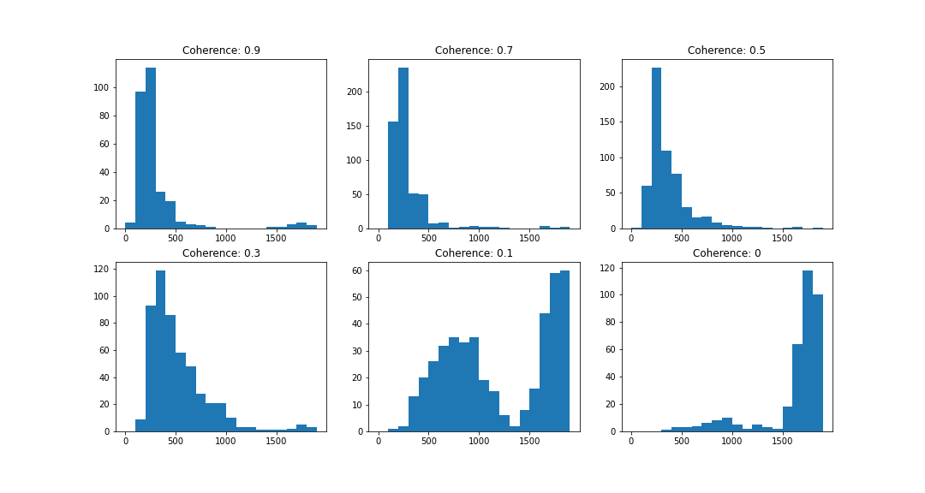
RT Results: gain (0-1 uniform distribution)
figsize=(8, 6)
figsize=(8, 6)

Slide 9
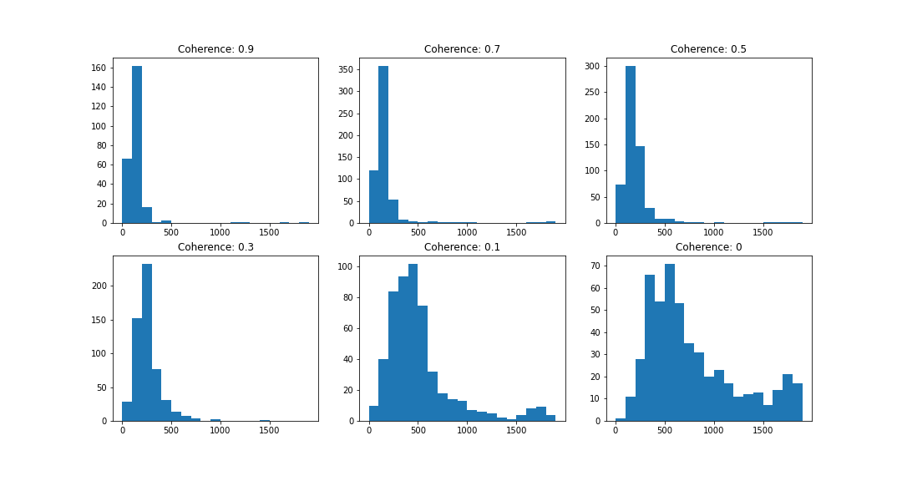
Train with gain = 1; test on gain = [1, 2]

Slide 10
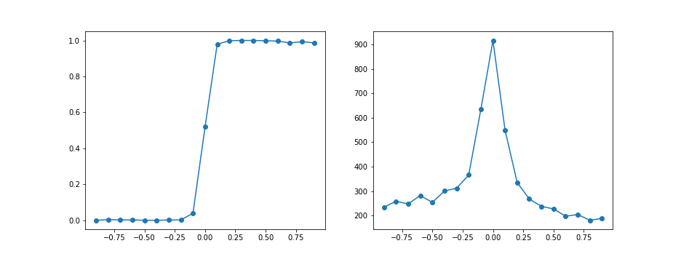
Psychrometric curve

Slide 11
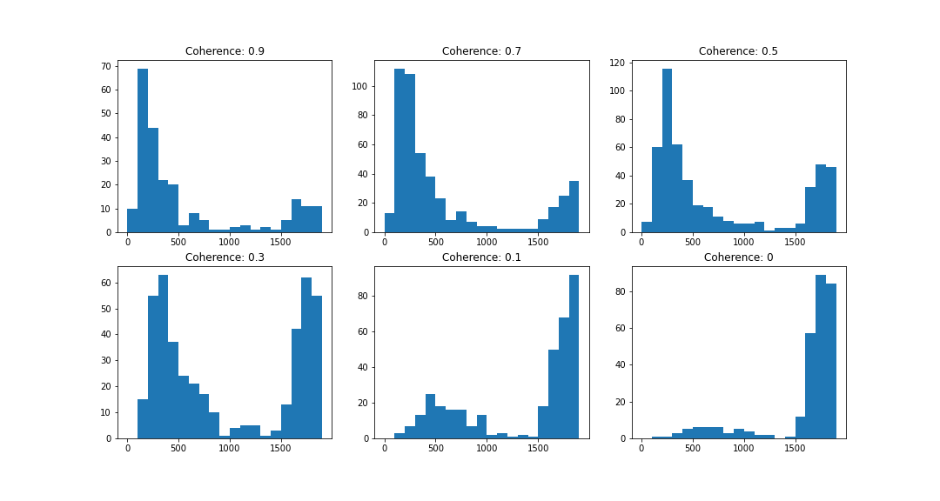
Train with gain = 1; test on gain = [0, 1]

Slide 12
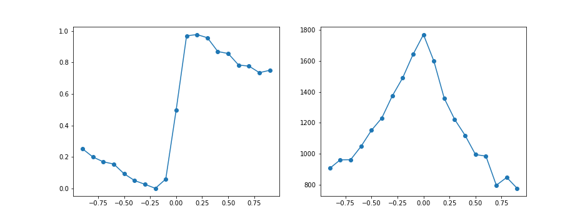
Psychrometric curve

Slide 13
Conclusion & confusions
As the gain increases, the trained weights have small values
When test trials have different gains
Lower gain: longer RT
Higher gain: shorter RT
In a, the 0.1 coherence has the highest accuracy
In b, the higher gain should amplify the noise and might decrease accuracy, but it doesn’t

Slide 14
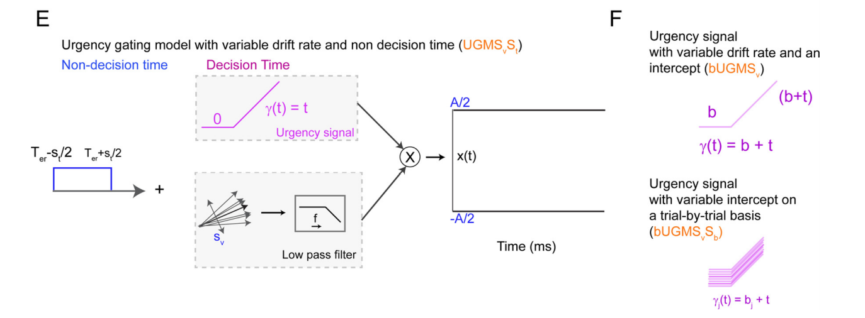
Urgency Gating model
figsize=(8, 6)
figsize=(8, 6)

Slide 15
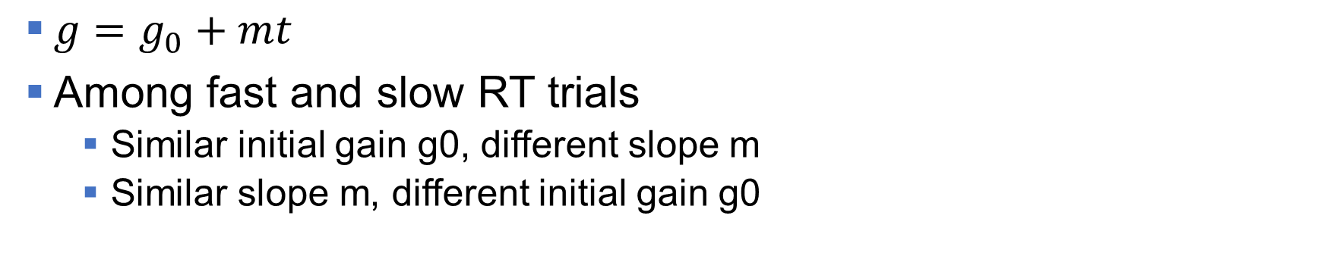
Some Previous Results
figsize=(8, 6)
figsize=(8, 6)
$g=g_{0}+mt$
Among fast and slow RT trials
Similar initial gain g0, different slope m
Similar slope m, different initial gain g0

Slide 16
Potential New Way to Apply Gain
figsize=(8, 6)
figsize=(8, 6)
y1
y3
y2
y4
r1
r3
r2
r4
x1
x3
x2
x4
u1
u3
u2
u4
g1
g3
g2
g4

Slide 17
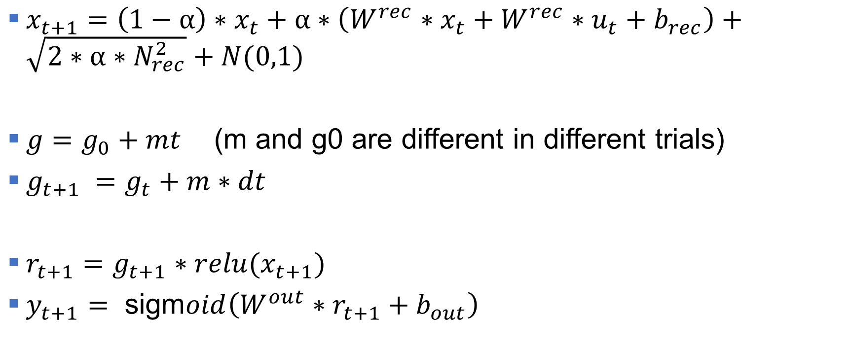
Potential New Way to Apply Gain
figsize=(8, 6)
figsize=(8, 6)
$x_{t+1}=$ $\left(1−α\right)∗x_{t}+α∗\left(W^{rec}∗x_{t}+W^{rec}∗u_{t}+b_{rec}\right)+\sqrt{2∗α∗N_{rec}^{2}}+N(0,1)$
$g=g_{0}+mt$ (m and g0 are different in different trials)
$g_{t+1} =g_{t}+m∗dt$
$r_{t+1}=g_{t+1}∗relu(x_{t+1})$
$y_{t+1}= \text{sigm}oid\left(W^{out}∗r_{t+1}+b_{out}\right)$

