Slide 1
PsychRNN Worklog
Date: Aug. 11th

Slide 2

Basic model
figsize=(8, 6)
figsize=(8, 6)
$x_{t+1}=$ $\left(1−α\right)∗x_{t}+α∗\left(W^{rec}∗relu\left(x_{t}\right)+W^{in}∗u_{t}+b_{rec}\right)+\sqrt{2∗α∗N_{rec}^{2}}∗N(0,1)$
$y_{t+1}= \left(W^{out}∗relu\left(x_{t+1}\right)+b_{out}\right)$

Slide 3
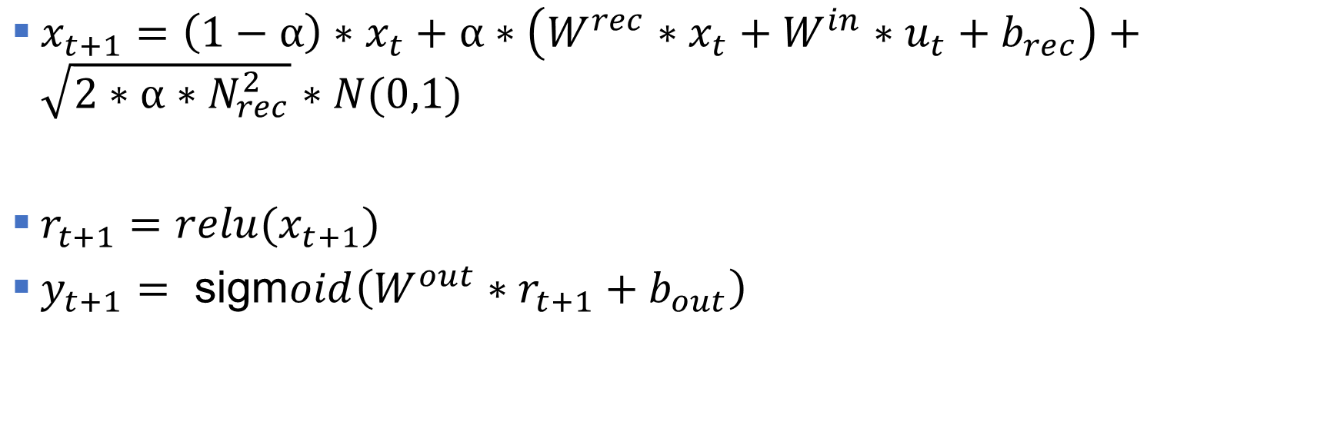
Gain/basic2 model
figsize=(8, 6)
figsize=(8, 6)
$x_{t+1}=$ $\left(1−α\right)∗x_{t}+α∗\left(W^{rec}∗x_{t}+W^{in}∗u_{t}+b_{rec}\right)+\sqrt{2∗α∗N_{rec}^{2}}∗N(0,1)$
$r_{t+1}=relu(x_{t+1})$
$y_{t+1}= \text{sigm}oid\left(W^{out}∗r_{t+1}+b_{out}\right)$

Slide 4
Gain2/basic model
figsize=(8, 6)
figsize=(8, 6)
Didn’t have a look in detail

Slide 5
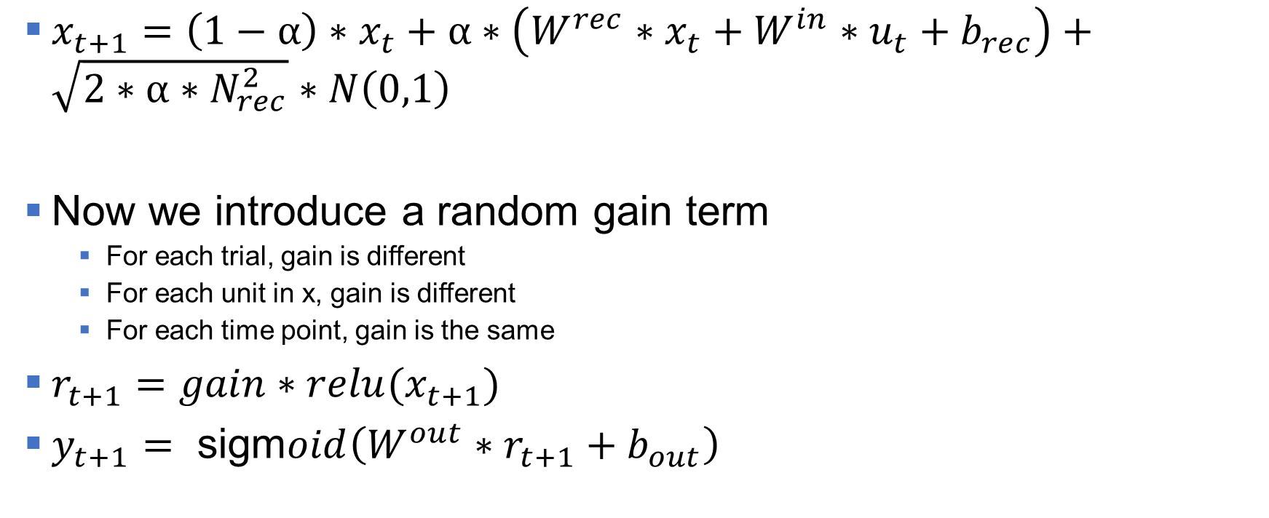
Week1: Gain2/basic2 model
figsize=(8, 6)
figsize=(8, 6)
$x_{t+1}=$ $\left(1−α\right)∗x_{t}+α∗\left(W^{rec}∗x_{t}+W^{in}∗u_{t}+b_{rec}\right)+\sqrt{2∗α∗N_{rec}^{2}}∗N\left(0,1\right)$
Now we introduce a random gain term
For each trial, gain is different
For each unit in x, gain is different
For each time point, gain is the same
$r_{t+1}=gain∗relu(x_{t+1})$
$y_{t+1}= \text{sigm}oid\left(W^{out}∗r_{t+1}+b_{out}\right)$

Slide 6
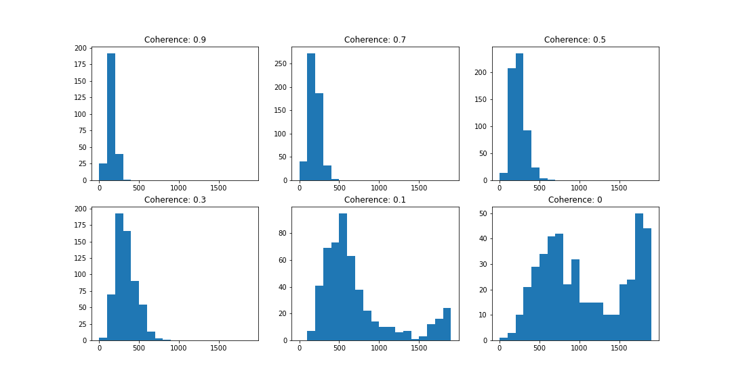
RT Results: gain equals to 1
figsize=(8, 6)
figsize=(8, 6)

Slide 7
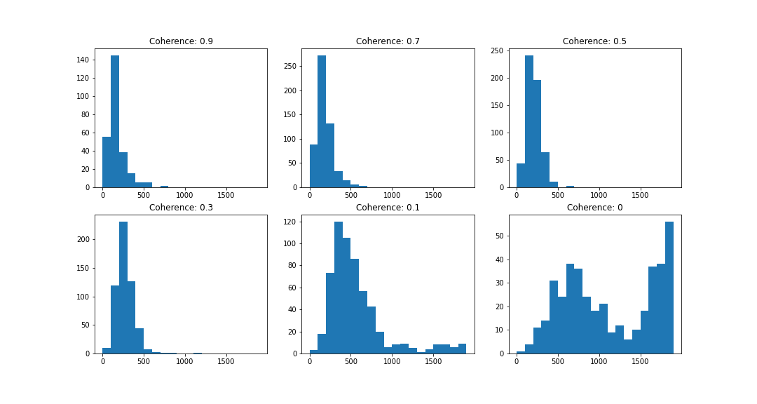
RT Results: gain (1-2 uniform distribution)
figsize=(8, 6)
figsize=(8, 6)

Slide 8
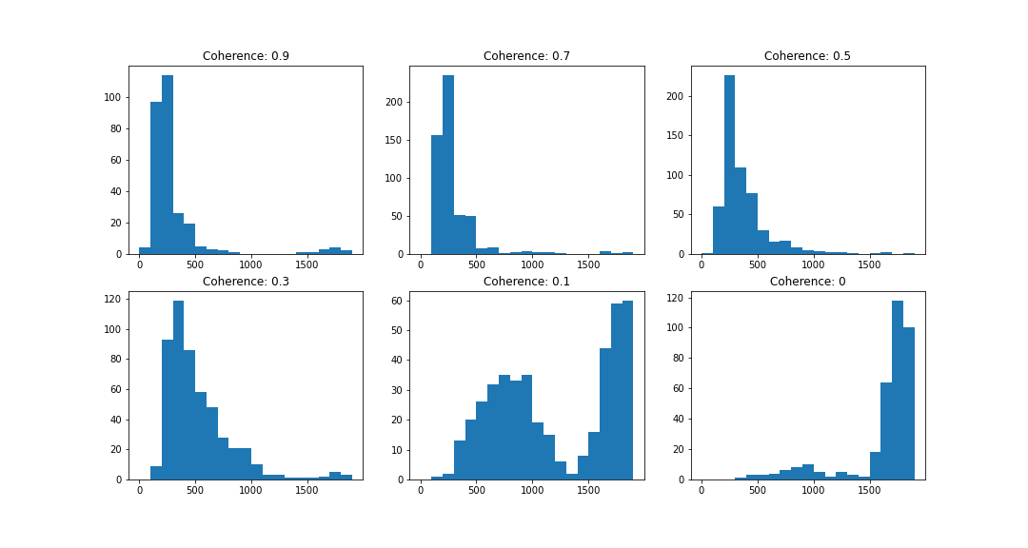
RT Results: gain (0-1 uniform distribution)
figsize=(8, 6)
figsize=(8, 6)

Slide 9
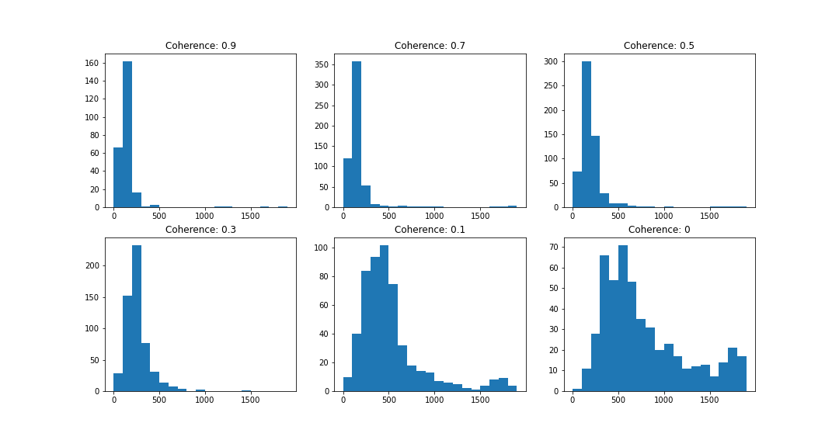
Train with gain = 1; test on gain = [1, 2]

Slide 10
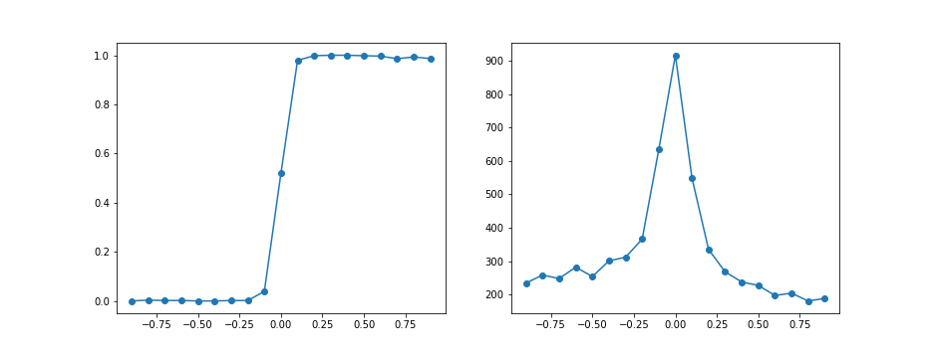
Psychrometric curve

Slide 11
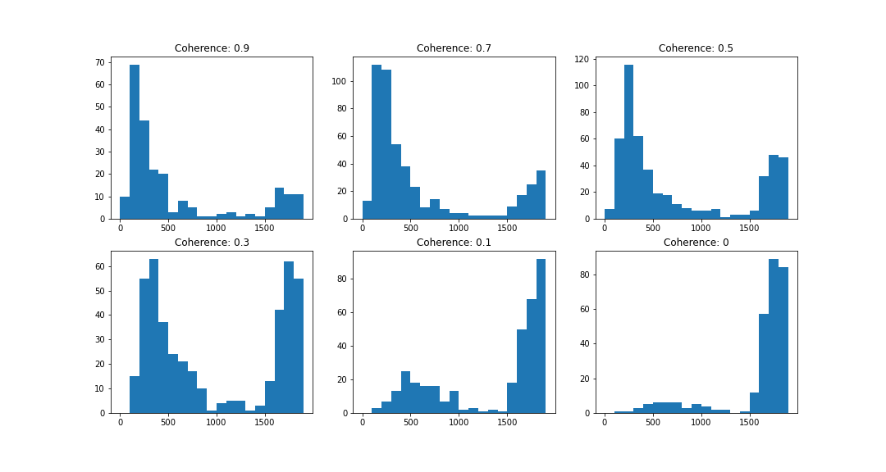
Train with gain = 1; test on gain = [0, 1]

Slide 12
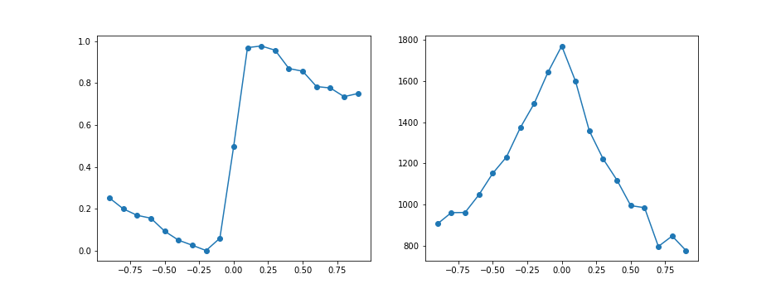
Psychrometric curve

Slide 13
Summary & Confusions
As the gain increases, the trained weights have small values
When test trials have different gains
Lower gain: longer RT
Higher gain: shorter RT
In a, the 0.1 coherence has the highest accuracy
In b, the higher gain should amplify the noise and might decrease accuracy, but it doesn’t

Slide 14
Week 2: Applied Recurrent Noise
Recurrent Noise: [0.5, 1, 1.5, 2, 2.2, 2.4, 2.6, 2.8, 3]
For each recurrent noise, 10 models are trained
For each trained model, decision threshold is 0.7
Test models with decision threshold of 0.6 and 0.8

Slide 15
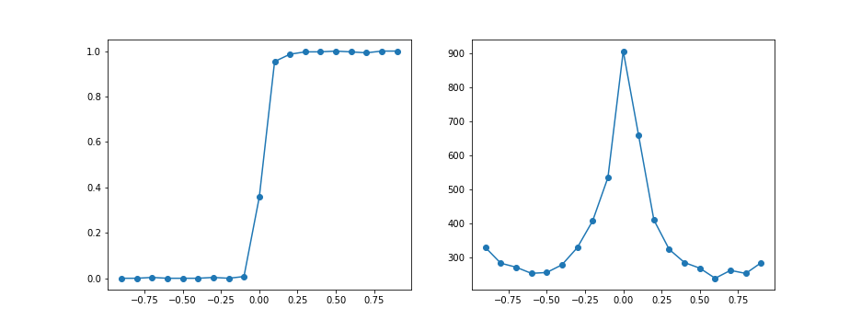
Trained rec_noise0.5; threshold 0.7; round 4

Slide 16
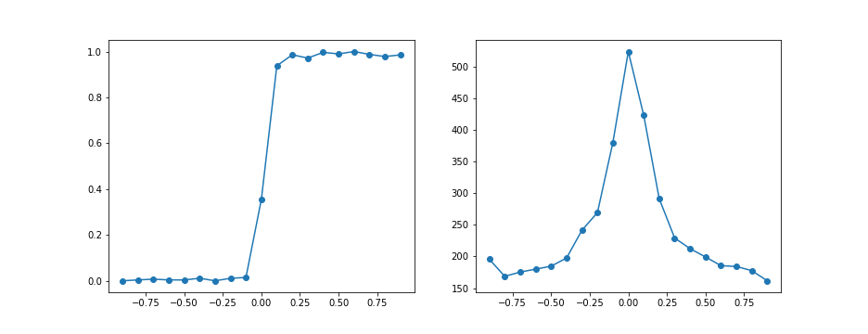
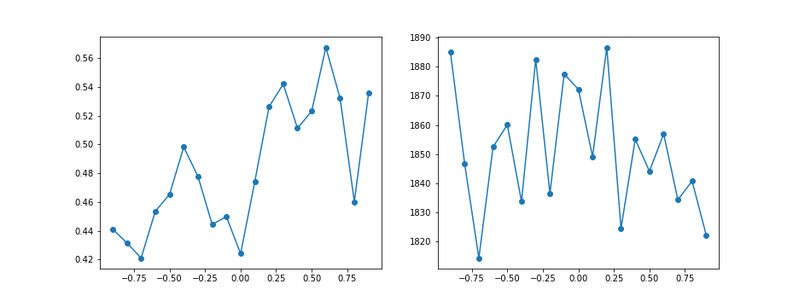
Trained rec_noise0.5; threshold 0.6 VS 0.8; round 4
Threshold: 0.6
Threshold: 0.8

Slide 17
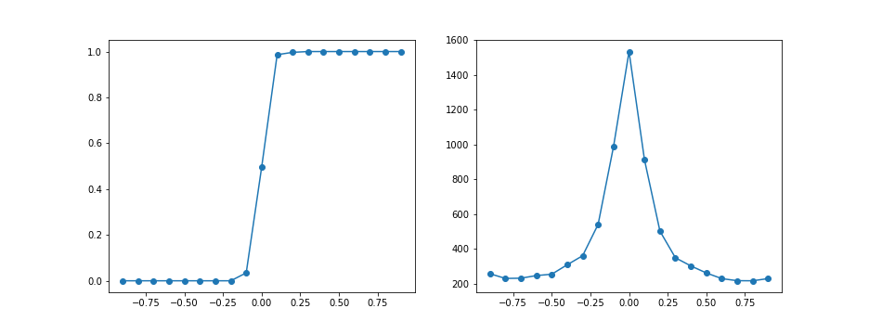
Trained rec_noise 0.5; threshold 0.7; round 5

Slide 18
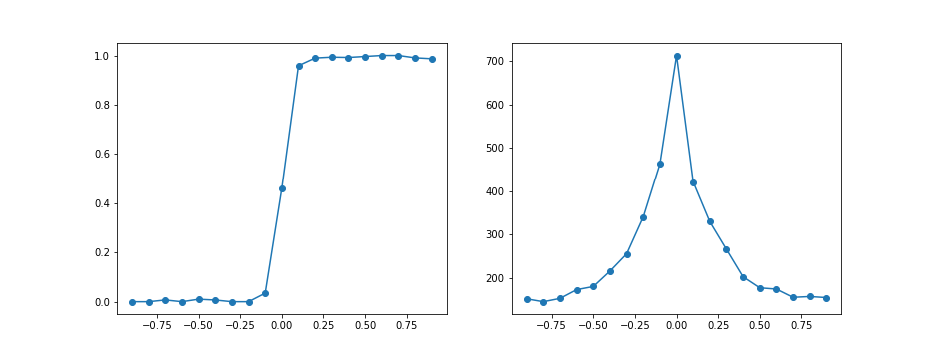
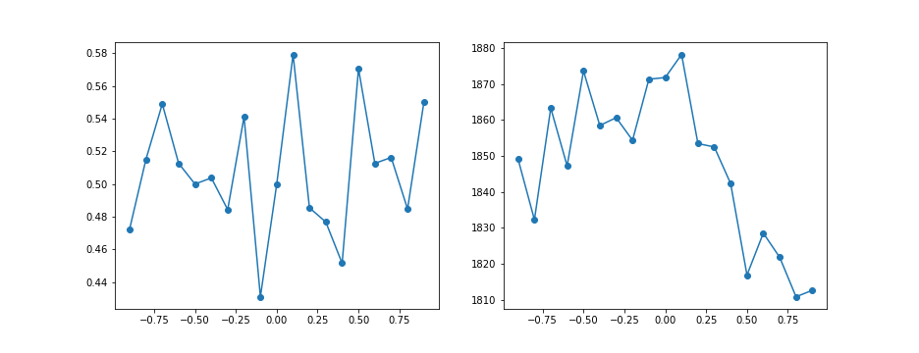
Trained rec_noise0.5; threshold 0.6 VS 0.8; round 5
Threshold: 0.6
Threshold: 0.8

Slide 19
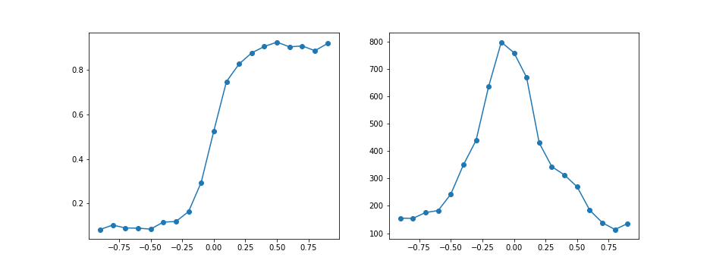
Trained rec_noise 2.2; threshold 0.7; round 0

Slide 20
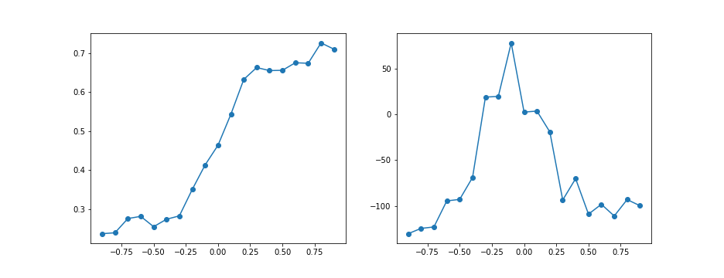
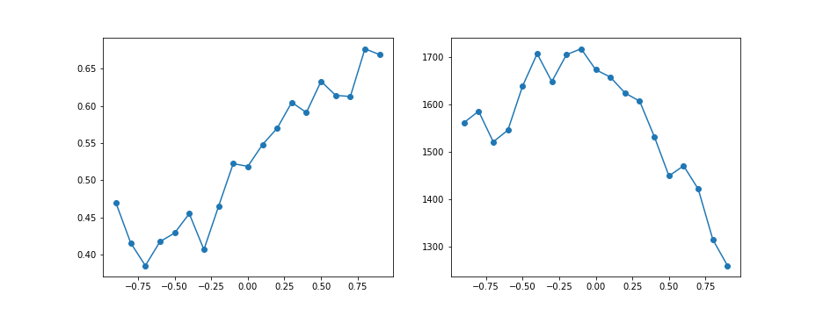
Trained rec_noise2.2; threshold 0.6 VS 0.8; round 0
Threshold: 0.6
Threshold: 0.8

Slide 21
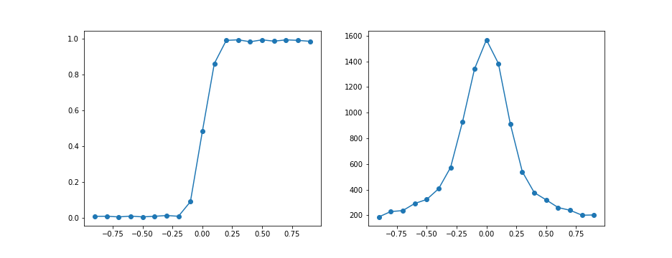
Trained rec_noise 2.2; threshold 0.7; round 1

Slide 22
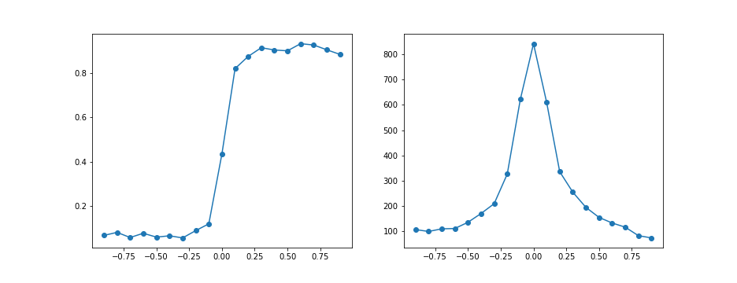
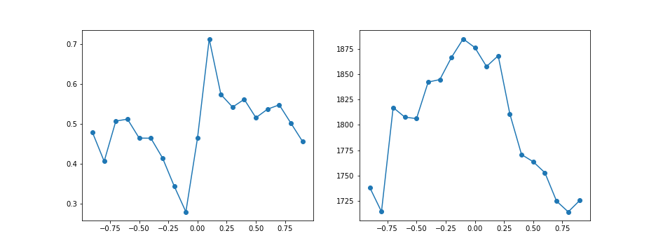
Trained rec_noise2.2; threshold 0.6 VS 0.8; round 1
Threshold: 0.6
Threshold: 0.8

Slide 23
Summary
For low rec_noise, increase the threshold will cause almost all trials out of task time; decrease the threshold doesn’t have a significant effect
For high rec_noise, slow decision models have similar performance as low rec_noises
For fast decision model, changes in threshold slightly decrease the performance
Increase threshold: decision fluctuation induced by the noise will make correct choices reach the threshold
Decrease threshold: decision fluctuation induced by the noise will make wrong choices reach the threshold
When rec_noise is high enough, there is no longer fast model trained

Slide 24
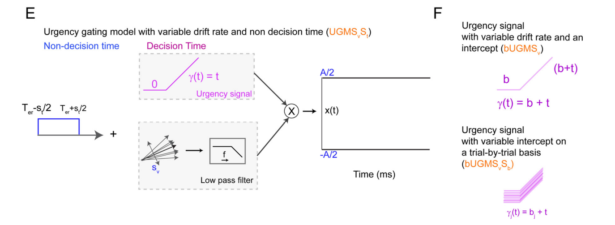
Urgency Gating model
figsize=(8, 6)
figsize=(8, 6)

Slide 25
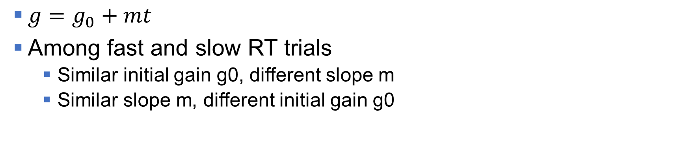
Some Previous Results
figsize=(8, 6)
figsize=(8, 6)
$g=g_{0}+mt$
Among fast and slow RT trials
Similar initial gain g0, different slope m
Similar slope m, different initial gain g0

Slide 26
Potential New Way to Apply Gain
figsize=(8, 6)
figsize=(8, 6)
y1
y3
y2
y4
r1
r3
r2
r4
x1
x3
x2
x4
u1
u3
u2
u4
g1
g3
g2
g4

Slide 27
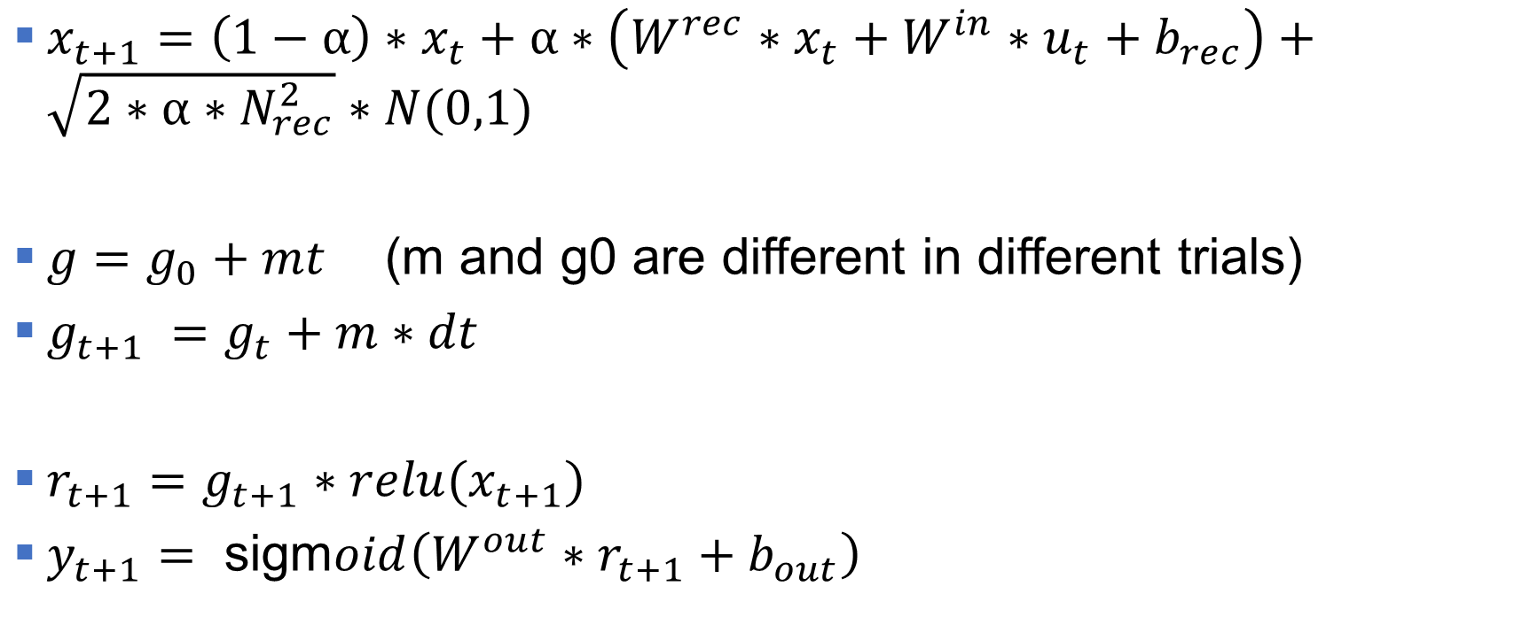
Potential New Way to Apply Gain
figsize=(8, 6)
figsize=(8, 6)
$x_{t+1}=$ $\left(1−α\right)∗x_{t}+α∗\left(W^{rec}∗x_{t}+W^{in}∗u_{t}+b_{rec}\right)+\sqrt{2∗α∗N_{rec}^{2}}∗N(0,1)$
$g=g_{0}+mt$ (m and g0 are different in different trials)
$g_{t+1} =g_{t}+m∗dt$
$r_{t+1}=g_{t+1}∗relu(x_{t+1})$
$y_{t+1}= \text{sigm}oid\left(W^{out}∗r_{t+1}+b_{out}\right)$

