Slide 1

EDLD 652 - Presentation
The Journey of a graphic

Slide 2
The Dashboard

Slide 3
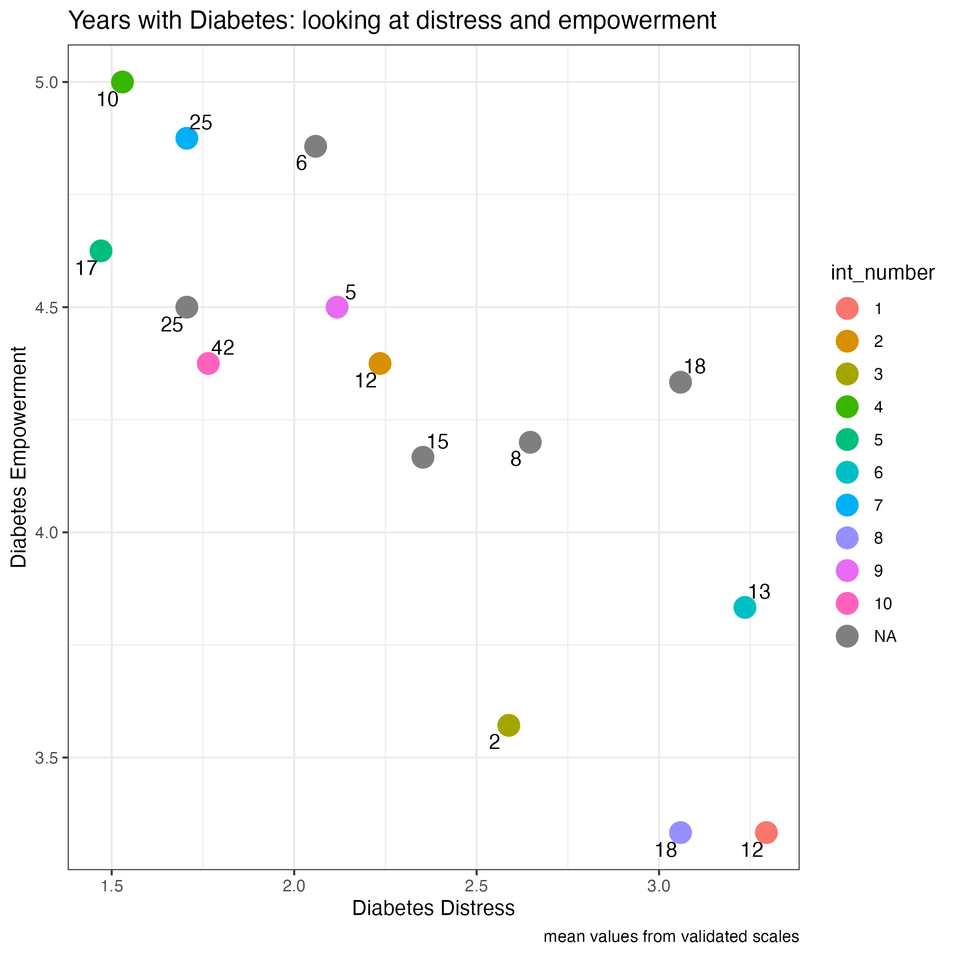

Slide 4

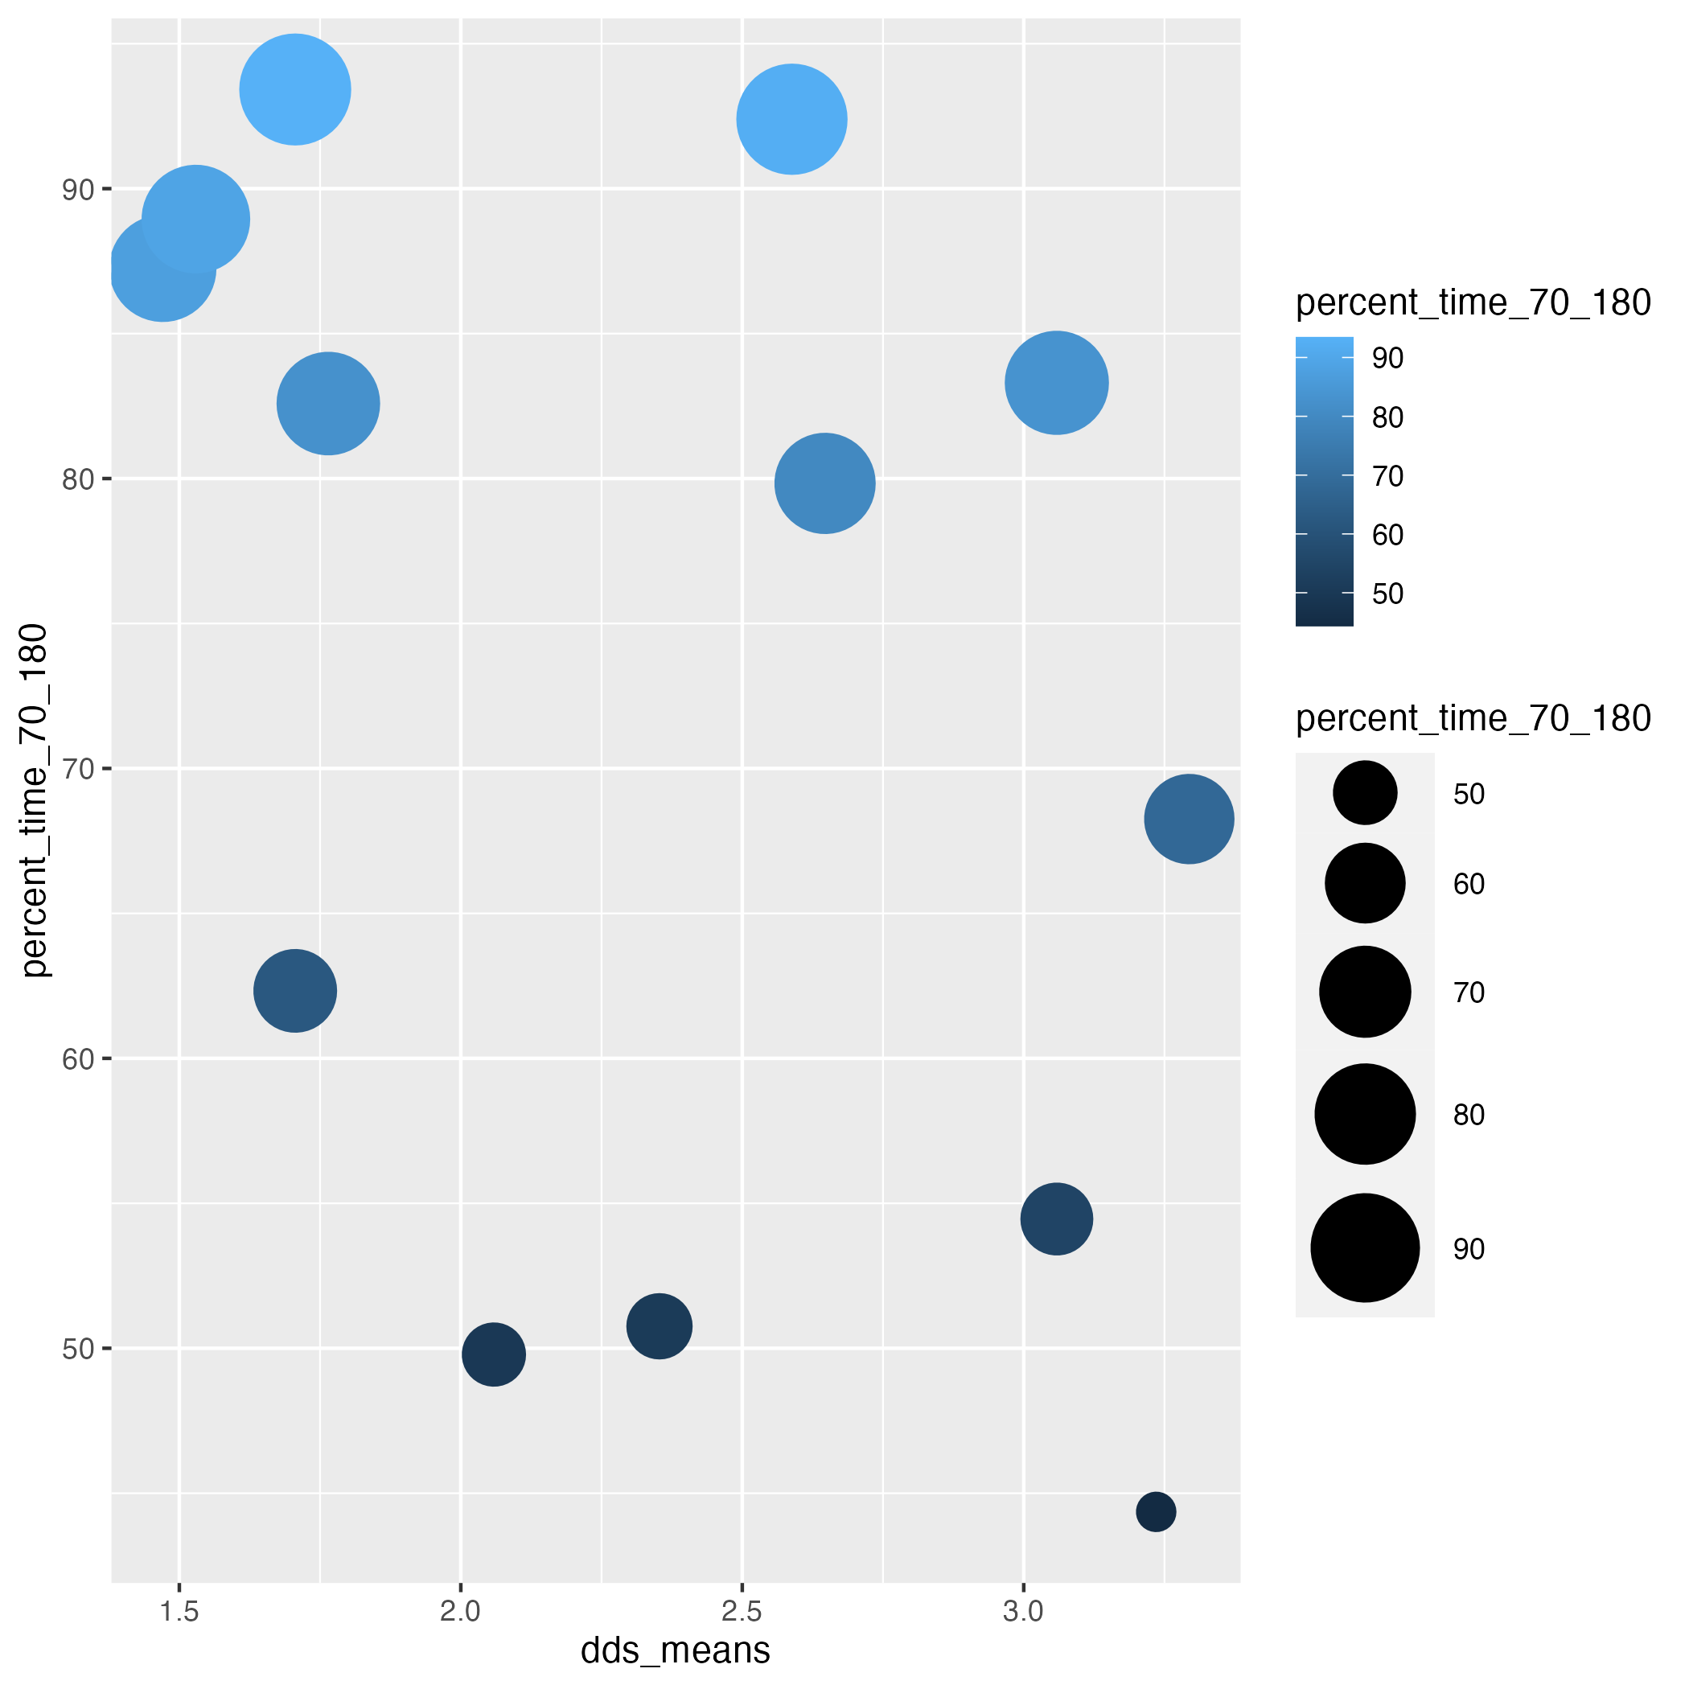

Slide 5
