Slide 1
Potential causal connections
?
Control components
?
Target component

Slide 2
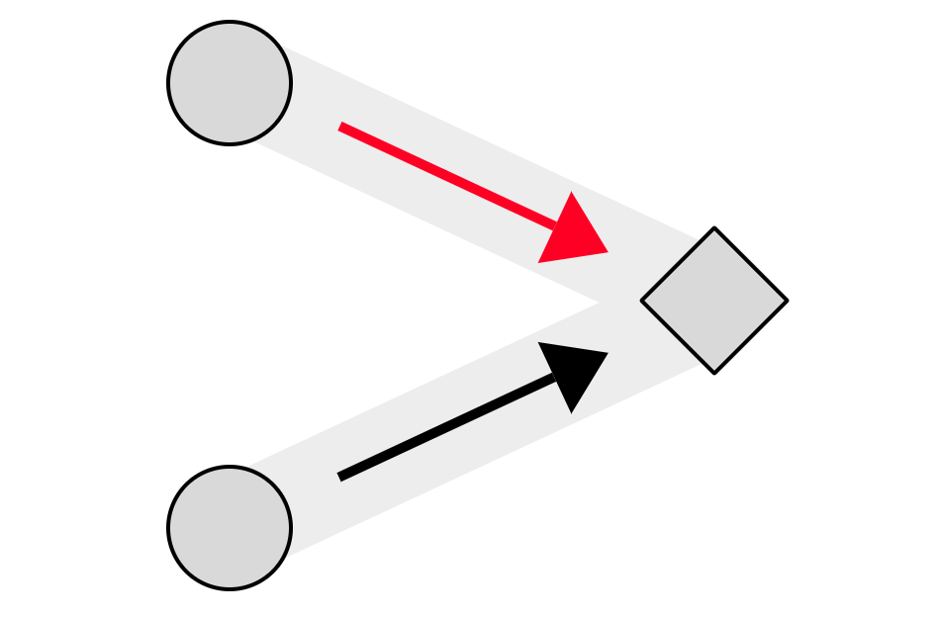

Click once:
Generate connection
Click twice:
Preventative connection
Click three times/No click:
Non-causal connection

