Slide 1
Introduction to ADAMS/View
ME 751

Slide 2
VIRTUAL PROTOTYPING PROCESS
Build
Test
Review
Improve
Build a model of your design using:
Bodies
Forces
Contacts
Joints
Motion generators

Slide 3
VIRTUAL PROTOTYPING PROCESS
Build
Test
Review
Improve
Test your design using:
Measures
Simulations
Animations
Plots
Validate your model by:
Importing test data
Superimposing test data

Slide 4
VIRTUAL PROTOTYPING PROCESS
Build
Test
Review
Improve
Review your model by adding:
Friction
Forcing functions
Flexible parts
Control systems
Iterate your design through variations using:
Parametrics
Design Variables

Slide 5
VIRTUAL PROTOTYPING PROCESS
Build
Test
Review
Improve
Improve your design using:
DOEs
Optimization
Automate your design process using:
Custom menus
Macros
Custom dialog boxes

Slide 6
Creating some parts
Link
Box
Sphere
Extrusion
Importing a geometry from CAD
In ADAMS/View, use File→Import
Change the filetype to CAD standard
e.g. Parasolid (*.x_t, *.x_b), IGES, STEP
Properly defined solids will have their inertia properties imported
Sheet/surfaces need to have their inertia defined

Slide 7
Constraints
Definition of a constraint
Restricts relative movement between parts.
Represents idealized connections.
Removes rotational and/or translational DOF from a system.
Joints
Revolute
Translational
Fixed
etc., e.g. Joint Primitives, Hooke, etc.

Slide 8
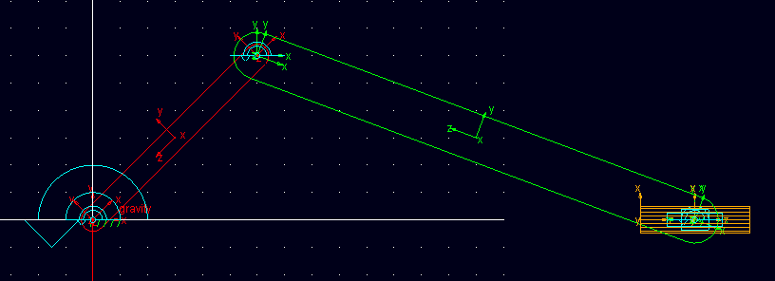
Slider Crank Example

Slide 9
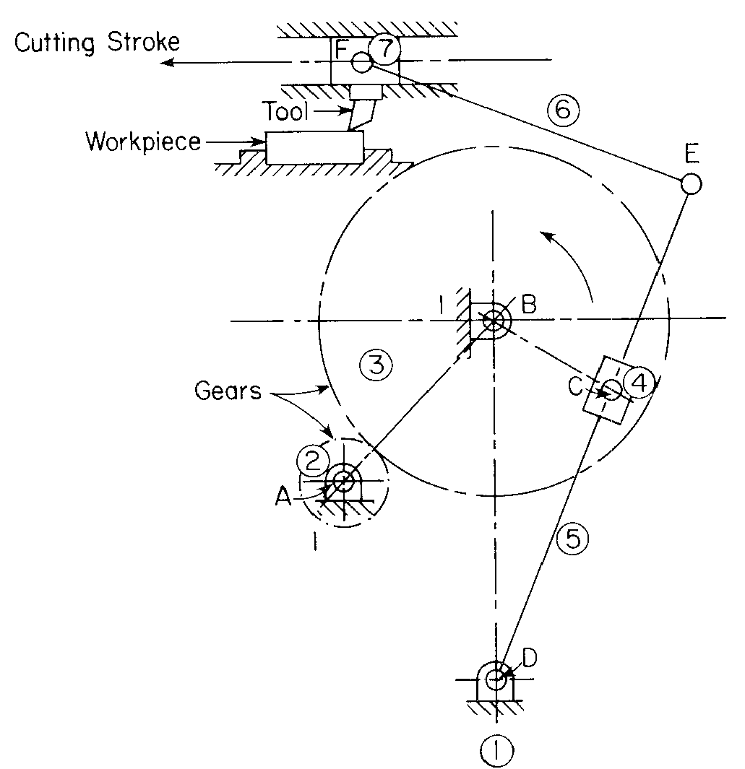
Reference layout for a quick return Mechanism

Slide 10
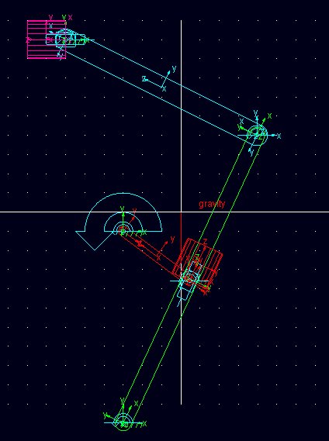
Snapshot of ADAMS Model

Slide 11
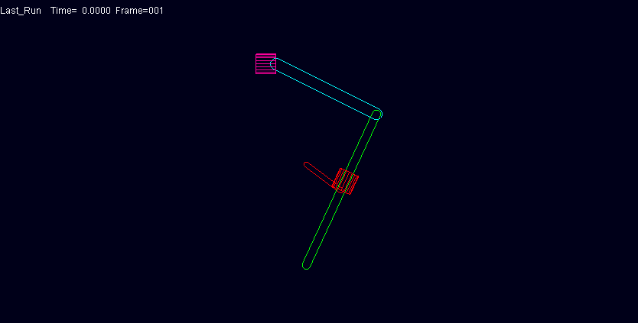

Slide 12
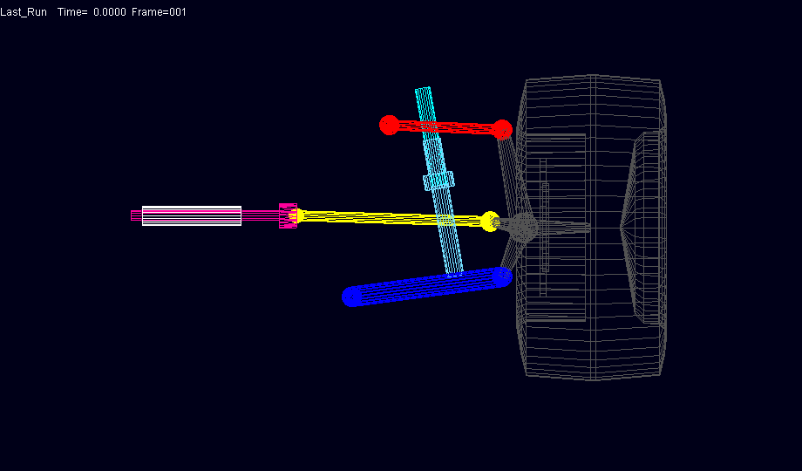
Suspension System

Slide 13
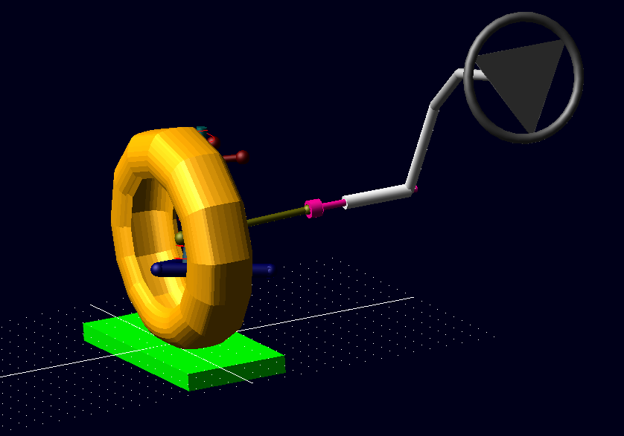
Flexible Tire with Suspension
Here is a snapshot of suspension system with a flexible tire attached to it
The flexible tire model was imported in ADAMS using a MNF file created using ABAQUS

Slide 14
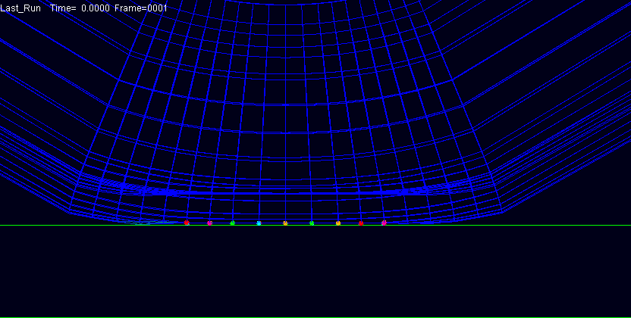
Tire deformation

Slide 15
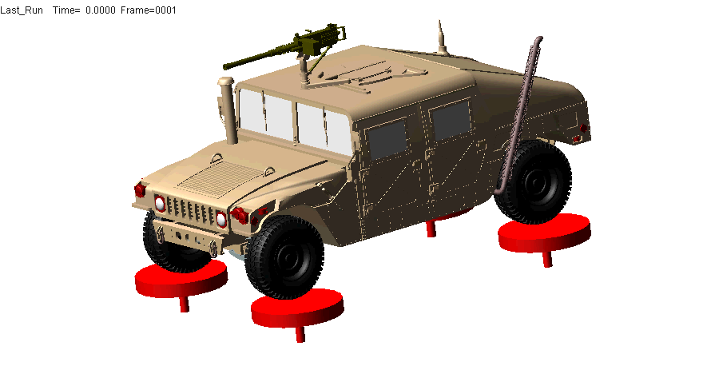
Full Vehicle Model

Slide 16
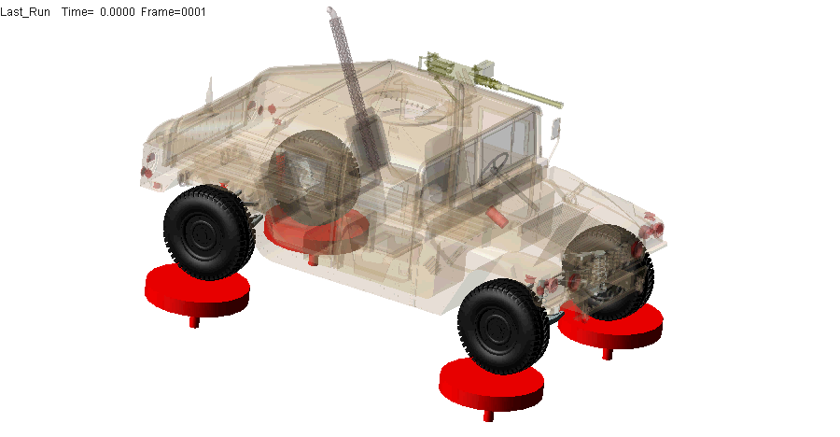
Full Vehicle Model

Slide 17
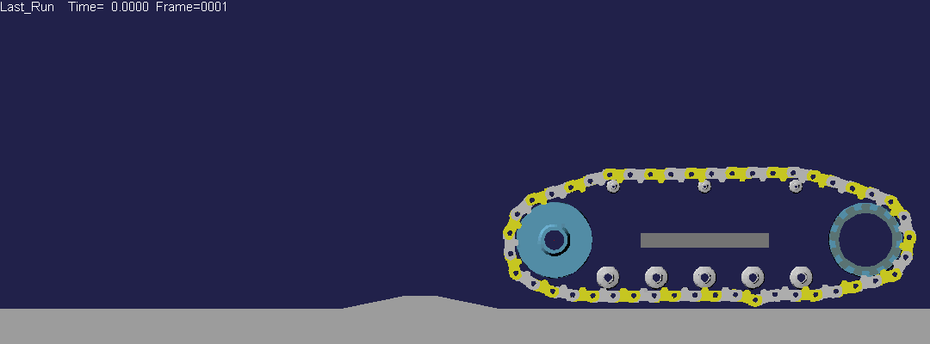
Track Model Snapshot
Track shoes & Rolling elements interact through frictional contacts
Video available on SBEL lab website

Slide 18
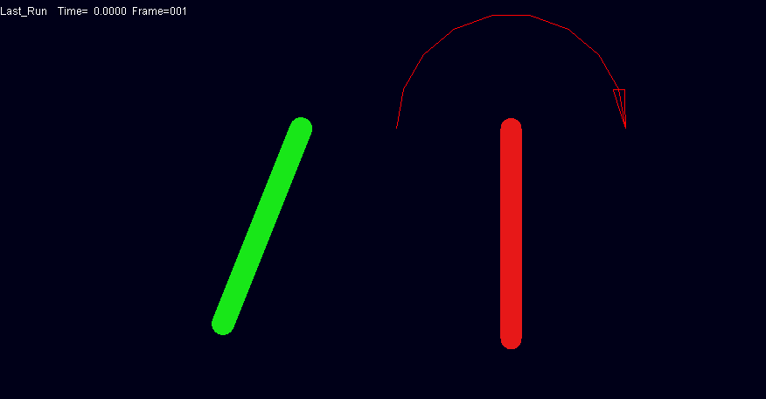
Controls in ADAMS/View

Slide 19
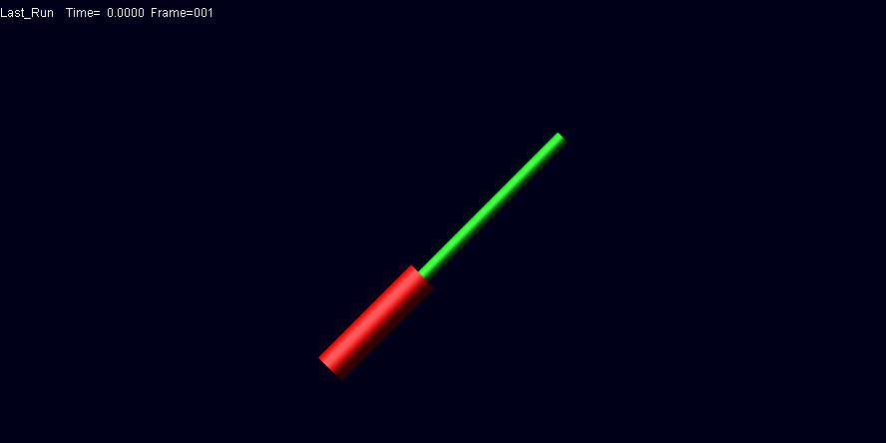
Controls

Slide 20
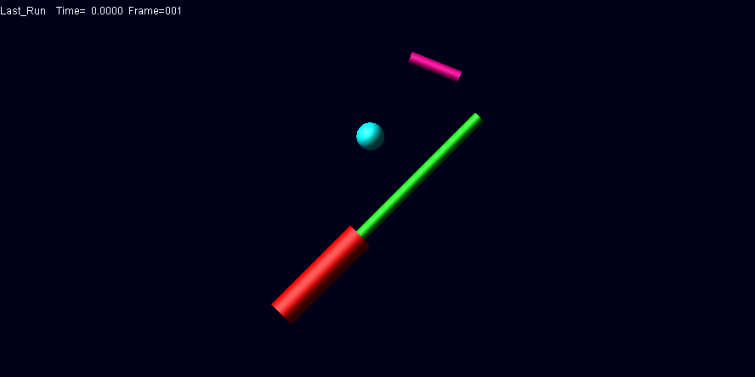
Controls

Slide 21
Controls example using ADAMS/SIMULINK Interface
Electric Mining shovel shown in class
Multi-body model in ADAMS
Motor characteristics and controls in Simulink
H in
HOIST
H out
Position
x,y,z
ADAMS
MODEL
S in
SWING
S out
C in
CROWD
C out

Slide 22
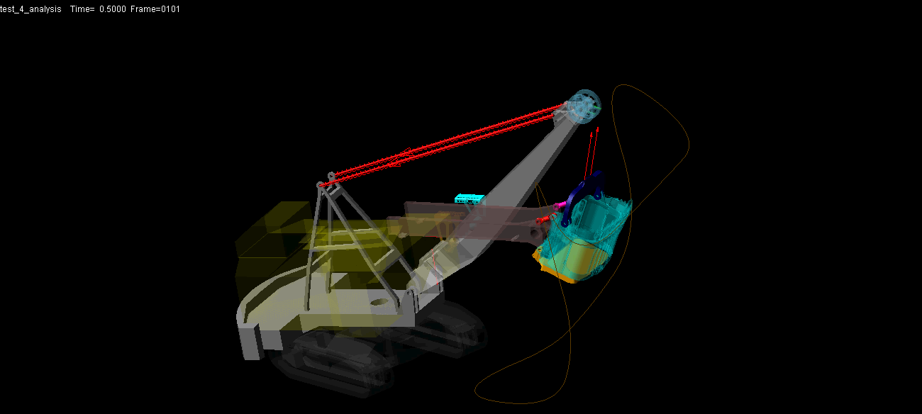
Snapshot of ADAMS/View multibody dynamic model

Slide 23
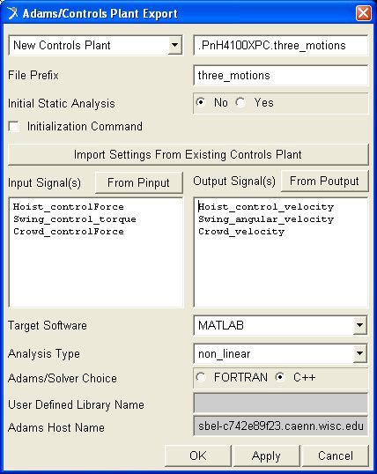
ADAMS/Controls
Plug-In creates the ADAMS PLANT (*.m,*.cmd,*.adm)
Used to export ADAMS/View model into Simulink
State Variables as Inputs and Outputs between ADAMS & Simulink simulators

Slide 24
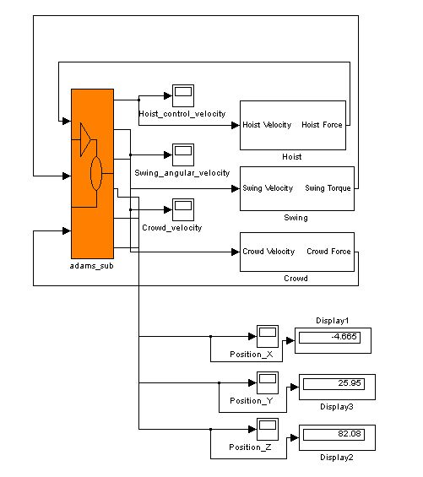
SIMULINK Model
Adams_sub = Adams Model
Motor characteristics included in Lookup Tables
Three different motors
Hoist
Swing
Crowd

Slide 25
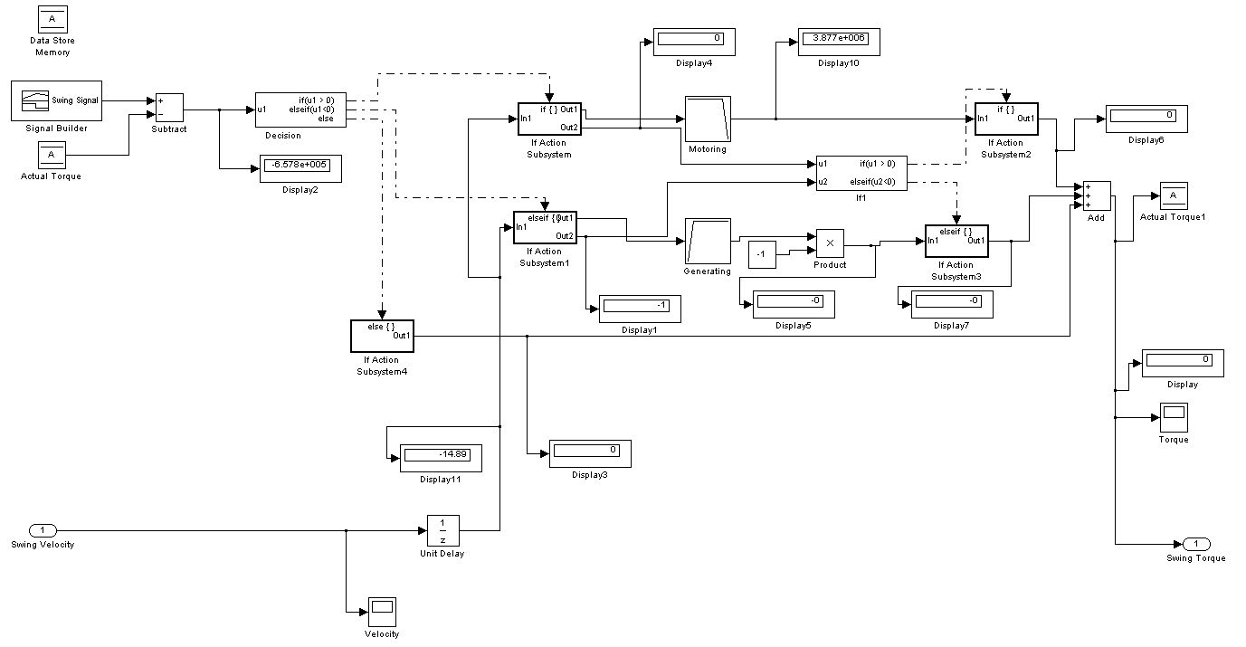
SIMULINK Model
Swing Motion torque controlled

Slide 26
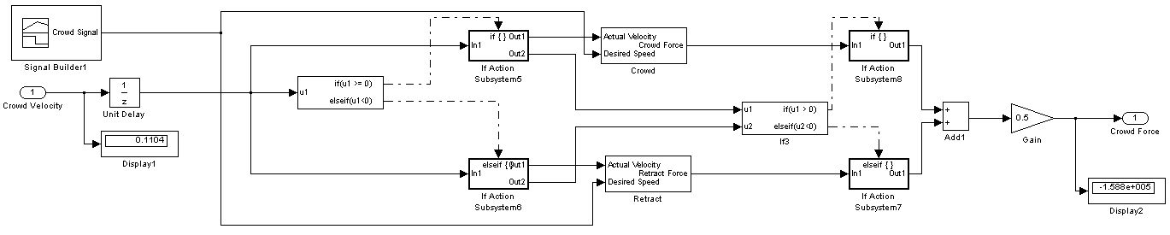
SIMULINK Model
Crowd Motion velocity controlled

Slide 27
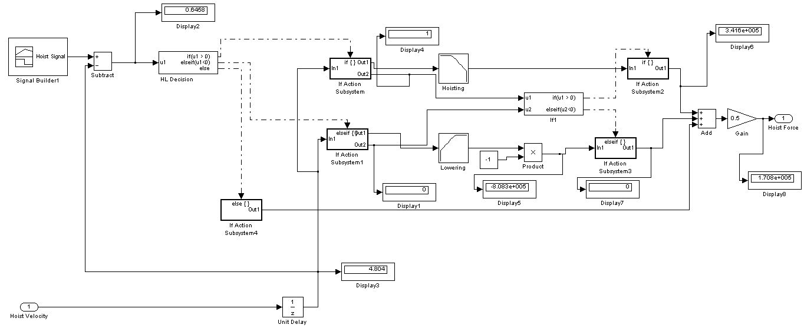
SIMULINK Model
Hoist Motion velocity controlled

Slide 28
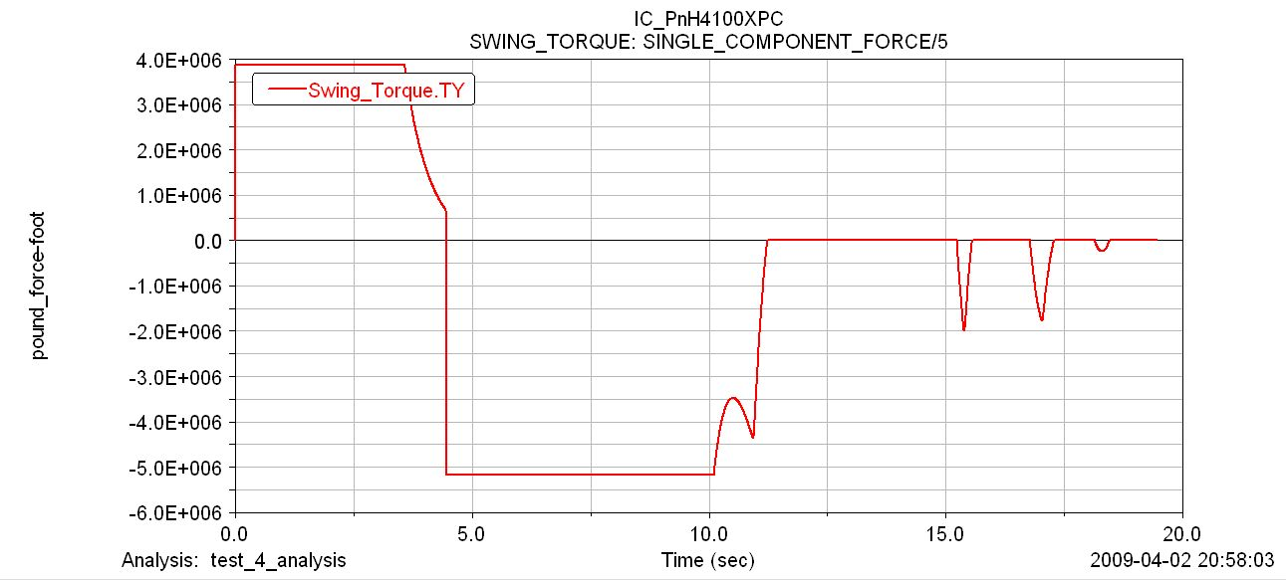
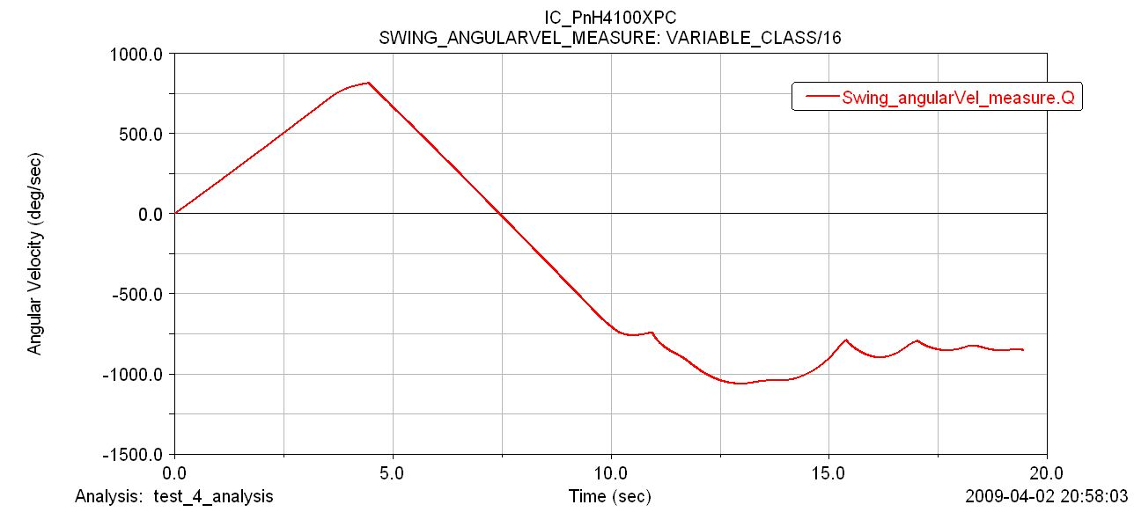
Results
Simulation results easily imported and analyzed using ADAMS/PostProcessor
.GRA Files → Animations
.RES Files → Plots
Example Plots of Swing Torque and Velocity

Slide 29
Interested in specific models or animations?
Contact Makarand or Justin in the lab
Makarand – datar @ wisc.edu
Justin – jcmadsen @ wisc.edu

