Slide 1
ME751
Advanced Computational Multibody Dynamics
Introduction
January 19, 2010
© Dan Negrut, 2010
ME751, UW-Madison
Dan Negrut
University of Wisconsin, Madison

Slide 2
Before we get started…
Today:
  Discuss Syllabus
  Other schedule related issues
  Discuss class structure
  Review
    Basic Matrix Algebra
    Lagrange Multiplier Theorem

Slide 3
Instructor: Dan Negrut
  Polytechnic Institute of Bucharest, Romania
    B.S. – Aerospace Engineering (1992)
  The University of Iowa
    Ph.D. – Mechanical Engineering (1998)
  MSC.Software
    Product Development Engineer 1998-2004
  The University of Michigan
    Adjunct Assistant Professor, Dept. of Mathematics (2004)
  Division of Mathematics and Computer Science, Argonne National Laboratory
    Visiting Scientist (2005, 2006)
  The University of Wisconsin-Madison, Joined in Nov. 2005
    Research: Computer Aided Engineering (tech lead, Simulation-Based Engineering Lab)
    Focus: Computational Dynamics (http://sbel.wisc.edu/)

Slide 4
Good to know…
Time 9:30 – 10:45 AM [ Tu, Th ]
Room 2106
Office 2035ME
Phone 608 890-0914
E-Mail negrut@engr.wisc.edu
Course Webpage:
  https://learnuw.wisc.edu – solution to HW problems and grades
  http://sbel.wisc.edu/Courses/ME751/2010/index.htm - for slides, audio files, examples covered in class, etc.
Grader: Naresh Khude (khude@wisc.edu)
Office Hours:
  Monday 3 – 4 PM
  Wednesday 3 – 4 PM
  Friday 3 – 4 PM
  Stop by any other time in the afternoon, I’ll try to help if I’m in

Slide 5
Text
Edward J. Haug: Computer Aided Kinematics and Dynamics of Mechanical Systems: Basic Methods (1989)
  Book is out of print
  Author provided PDF copy of the book, available free of charge at Learn@UW
  The material in the book will be supplemented with notes
  Available at Wendt Library (on reserve)
  We’ll cover Chapters 9 and 11

Slide 6
Other Sources of Information Used
Dynamics of Multibody Systems, by Ahmed A. Shabana, 3rd ed., 2007
Computer Methods for Ordinary Differential Equations and Differential-Algebraic Equations, by U. Ascher and L. Petzold, SIAM, 1998
Solving Ordinary Differential Equations I: Nonstiff Problems, by E. Hairer, S. Norsett, G. Wanner, 1993
Solving Ordinary Differential Equations II: Stiff and differential-algebraic Problems (Second Revised Edition) by E. Hairer and G. Wanner, 2002
Numerical Methods in Multibody Dynamics, E. E. Soellner and C. Fuhrer, 2002 (out of print)
CUDA Programming Guide, Version 2.3, NVIDIA Corporation, July 2009

Slide 7
History of Class
This class started back in the day by Professor John Uicker
Class used to be called “Matrix Methods in the Design and Analysis of Mechanisms”
Changed title to “Advanced Computational Multibody Dynamics”
  Not official, need to follow up on some bureaucratic aspects
Emphasis on the use of the computer to predict the dynamics (time evolution) of system of mutually interacting rigid bodies
  Key words: predict, time evolution, rigid bodies, mutually interacting

Slide 8
Course Related Information
Offering class for the first times, rough edges super likely to show up
Trying to alleviate this: I plan to upload the lectures + sound
Why bother?
  PPT notes + lack of book means you might find yourself in a situation where things don’t add up.
  Good if you miss class
  Allows me to review my teaching and hopefully improve

Slide 9
Course Related Information [Cntd.]
Handouts will be printed out and provided before most of the lectures
The class has a website: http://sbel.wisc.edu/Courses/ME751/2010/index.htm
PPT lecture slides will be made available online at lab website
Homework solutions will be posted at Learn@UW
Grades will be maintained online at Learn@UW
Syllabus will be updated as we go and will contain info about
  Topics covered
  Homework assignments and due dates
  Midterm exam date
Syllabus available at the course website

Slide 10
Grading
Homework 40%
Midterm Exam 20%
Final Project 40%
100%
NOTE:
Score related questions (homeworks/exams) must be raised prior to next class after the homeworks/exam is returned.

Slide 11
Homework
Shooting for weekly homeworks
  Assigned at the end of each class
  Typically due one week later, unless stated otherwise
  No late homework accepted
  I anticipate to have about 11 or 12 homeworks

Slide 12
Exams & Final Project
One midterm exams, on 04/22
  Exam will be in the evening, starting at 7:15 pm
No final exam
Final Project
  You have to select a topic by 03/11
  Final project is individual
  I will provide an overview of topics selected by you on 03/18
  You are encouraged to select a topic that ties into your research
  In general, anything is ok as long as it is related to one of the following
    Rigid body dynamics
    Numerical integration methods for dynamic systems (not necessarily mechanic)
    High performance computing

Slide 13
Final Project, Example Topics
Investigation of animating rotation with Quaternion curves
Practical implications of the parameterization of rotations using the exponential map
Parallel collision detection on the GPU
Comparison of penalty and DVI approaches for frictional contact in rigid body dynamics
Extension of the functionality of any open source dynamics engine (ChronoEngine, IMP, etc.)
On the use of iterative methods in multibody dynamics
Rigid-Deformable body co-simulation for applications in biomechanics
Methods of uncertainty quantification in multibody dynamics
Advanced modeling in open source dynamics engine with validation in ADAMS
Investigation of a ADAMS-MATLAB co-simulation approach for mechatronics applications
Development of a computer game using an open source physics engine

Slide 14
Final Project, Evaluation
Each student will have a one hour presentation of his/her final project
  40 minute PPT presentation reports on your contributions/innovations/achievements
  20 minutes set aside for Q&A
Each students should schedule after consultation with the instructor the Final Project presentation during the last week of class or finals’ week
Your presentation will be videotaped and posted at Learn@UW for the rest of the students to review if interested
Any student can participate in any final project presentation of interest
To allow you to focus on the final project no HW will be assigned and no new material covered in the last two weeks of class

Slide 15
Last Two Weeks of Class
Trying to bring in colleagues from industry
Tentative schedule, last two weeks:
  April 27 – Dr. Andrei Schaffer, of MSC.Software
  April 29 – Dr. Jonathan Cohen, of NVIDIA Research
  May 4 – Field Trip (John Deere and NADS) – not confirmed yet
  May 6 – Richard Tonge, of NVIDIA PhysX

Slide 16
Scores and Grades
Score Grade
94-100 A
87-93 AB
80-86 B
73-79 BC
66-72 C
55-65 D
Grading will not be done on a curve
Final score will be rounded to the nearest integer prior to having a letter assigned
  86.59 becomes AB
  86.47 becomes B

Slide 17
Class Goals
Given a general mechanical system, understand how to generate in a systematic and general fashion the equations that govern the time evolution of the mechanical system
  These equations are called the equations of motion (EOM)
Have a basic understanding of the techniques (called numerical methods) used to solve the EOM
  We’ll rely on MATLAB to implement/illustrate some of the numerical methods used to solve EOM
Focus on rigid bodies connected through joints and mutually interacting through contact and friction

Slide 18
Why/How do bodies move?
Why?
  The configuration of a mechanism changes in time based on forces and motions applied to its components
    Forces
      Internal (reaction forces)
      External, or applied forces (gravity, compliant forces, etc.)
    Motions
      Somebody prescribes the motion of a component of the mechanical system
How?
  They move in a way that obeys Newton’s second law
    Caveat: there are additional conditions (constraints) that need to be satisfies by the time evolution of these bodies, and these constraints come from the joints that connect the bodies (to be covered in detail later…)

Slide 19
30,000 Feet Perspective…
MECHANICAL SYSTEM
=
BODIES + JOINTS + FORCES
THE SYSTEM CHANGES ITS CONFIGURATION IN TIME
WE WANT TO BE ABLE TO
PREDICT & CHANGE/CONTROL HOW SYSTEM EVOLVES

Slide 20
Applications of Multibody Dynamics
Mechanical Engineering
Biomechanics
Rheology
Computer Gaming
Movie Industry

Slide 21
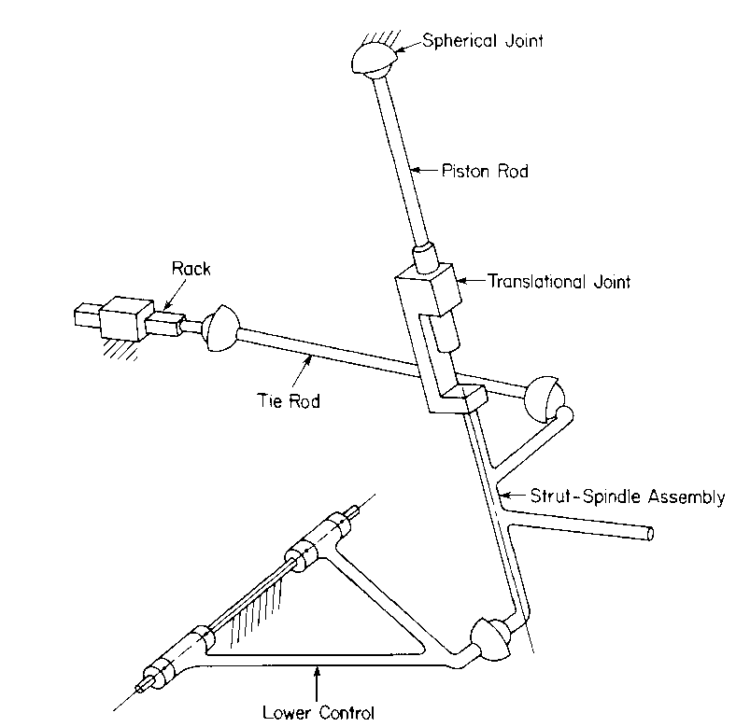
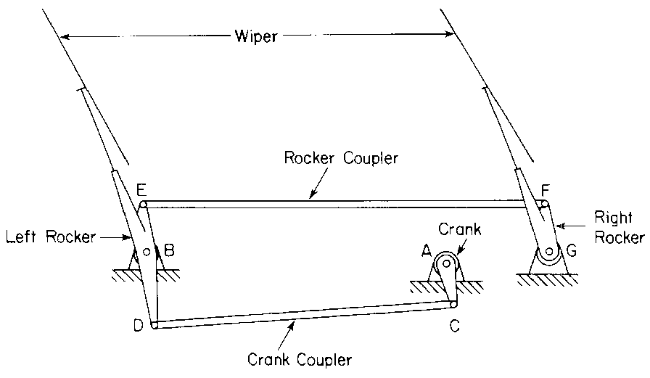
Dynamic Systems, Examples
Windshield wiper mechanism
McPherson Strut Front Suspension

Slide 22
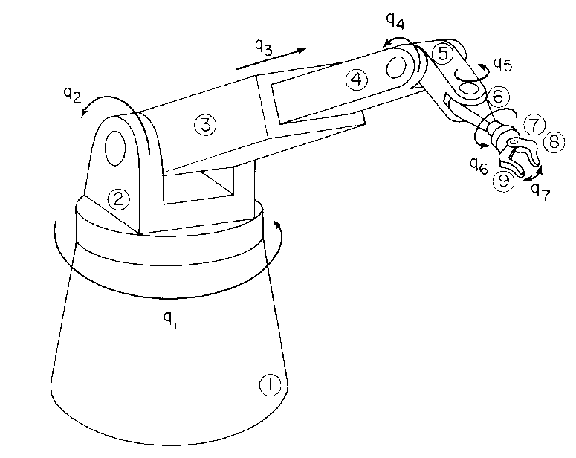
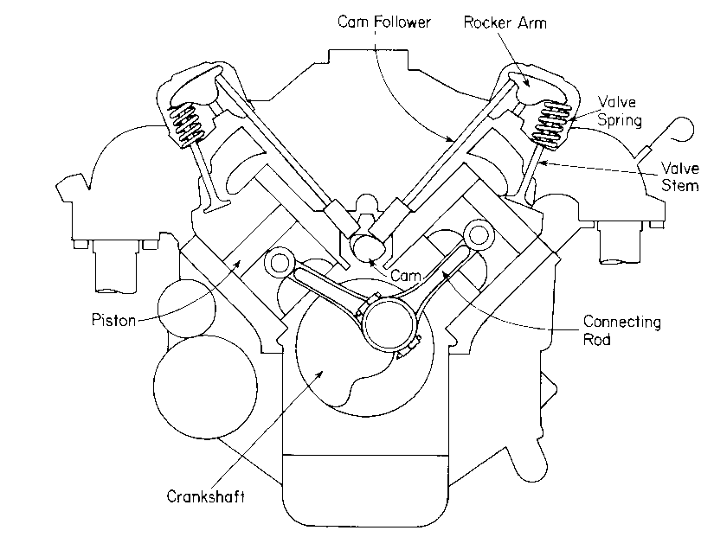
More examples …
Robotic Manipulator
Cross Section of Engine

Slide 23
Nomenclature
Mechanical System, definition:
  A collection of interconnected rigid bodies that can move relative to one another, consistent with joints that limit relative motions of pairs of bodies
Why type of analysis might one be interested in in conjunction with a mechanical system?
  Kinematics analysis
  Dynamics analysis
  Inverse Dynamics analysis
  Equilibrium analysis

Slide 24
Kinematics Analysis
Concerns the motion of the system independent of the forces that produce the motion
Typically, the time history of one body in the system is prescribed
We are interested in how the rest of the bodies in the system move
Requires the solution linear and nonlinear systems of equations
Windshield wiper mechanism

Slide 25
Dynamics Analysis
Concerns the motion of the system that is due to the action of applied forces/torques
Typically, a set of forces acting on the system is provided. Motions can also be specified on some bodies
We are interested in how each body in the mechanism moves
Requires the solution of a combined system of differential and algebraic equations (DAEs)
Cross Section of Engine

Slide 26
Inverse Dynamics Analysis
It is a hybrid between Kinematics and Dynamics
Basically, one wants to find the set of forces that lead to a certain desirable motion of the mechanism
Widely used in Controls…
Windshield wiper mechanism
Robotic Manipulator

Slide 27
What is the slant of this course?
When it comes to dynamics, there are several ways to approach the solution of the problem, that is, to find the time evolution of the mechanical system
  The ME240 way
    Very much solution is approached on a case-by-case fashion
    Typically works for small problems, not clear how to go beyond textbook cases
  Use a graphical approach
    Intuitive
    Doesn’t scale particularly well
    Somewhat cumbersome to bring computers into it
  Use a computational approach (emphasized in this class)
    Leverages the power of the computer
    Relies on a unitary approach to finding the time evolution of any mechanical system
      Sometimes the approach might seem an overkill, but it’s general, and remember, it’s the computer that does the work and not you

Slide 28
The Computational Slant…
Recall title of the class: “Advanced Computational Multibody Dynamics”
The topic is approached from a computational perspective, that is:
    A) Establish a simple way of describing mechanical systems
    B) Given a description of a system from A), produce a simple but general way to formulate the equations of motion (equations that govern the time evolution of the system)
    C) Identify numerical solution methods capable of approximating the solution of the equations of motion (Newton Raphson, Euler, Runge-Kutta, etc.)
    D) Post-process results to gain insights into the dynamics of the system (Usually it this requires a GUI for plotting results and generating movies with the dynamics of the system)

Slide 29
Overview of the Class
Introduction
  General considerations regarding the scope and goal of Kinematics and Dynamics
  Review of Linear Algebra: Focus on geometric vectors and matrix-vector operations
  Review of Calculus: partial derivatives, handling time derivatives, chain rule
Spatial Cartesian Kinematics
  Learn how to position and orient a rigid body in 3D space
  Introduces the concept of kinematic constraint as the mathematical building block used to represent joints in mechanical systems
  Poses the Kinematics Analysis problem, basically Chapter 9 of the Haug book
Spatial Cartesian Dynamics
  Learn how to formulate the equations that govern the time evolution of a mechanical system
  Basically Chapter 11 of the Haug book
Numerical Integration Methods
  Methods for the solution of ordinary differential equations (ODEs)
  Methods for the solution of differential algebraic equations (DAEs)
Methods for handling frictional contact problems in rigid body dynamics
  Penalty Methods
  Differential Variational Inequality Methods
High Performance Computing
  Why/How
  Intro to GPU Computing

Slide 30
MATLAB, ADAMS, and C
MATLAB will be used on a couple of occasions for HW
  It’ll be the vehicle used to formulate and solve the equations governing the time evolution of mechanical systems
ADAMS is a commercial software package used in industry
  Two short ADAMS presentations will be made in class: 02/04/2010
  A set of ADAMS tutorials are available on-line
    http://sbel.wisc.edu/Courses/ME751/2010/tutorialsADAMS.htm
  Currently the most widely used multibody dynamics simulation software
C will be used when discussing opportunities for High-Performance Computing (HPC) in determining the dynamics of mechanical systems

Slide 31
ADAMS
Automatic Dynamic Analysis of Mechanical Systems
It says Dynamics in name, but goes beyond that
  Kinematics, Statics, Quasi-Statics, etc.
Philosophy behind software package
  Offer a pre-processor (ADAMS/View) for people to be able to generate models
  Offer a solution engine (ADAMS/Solver) for people to be able to find the time evolution of their models
  Offer a post-processor (ADAMS/PPT) for people to be able to animate and plot results
It now has a variety of so-called vertical products, which all draw on the ADAMS/Solver, but address applications from a specific field:
  ADAMS/Car, ADAMS/Rail, ADAMS/Controls, ADAMS/Linear, ADAMS/Hydraulics, ADAMS/Flex, ADAMS/Engine, etc.
I used to work for six years in the ADAMS/Solver group

Slide 32
End: General Introduction
Begin: Review of Linear Algebra

Slide 33

Notation Conventions
A bold upper case letter denotes matrices
  Example: A, B, etc.
A bold lower case letter denotes a vector
  Example: v, s, etc.
A letter in italics format denotes a scalar quantity
  Example:

Slide 34
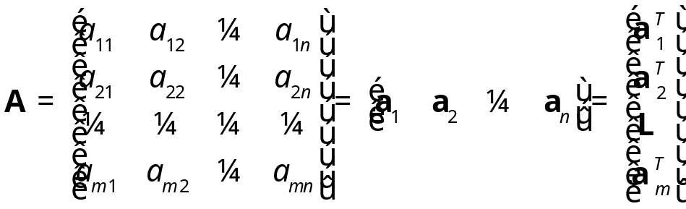
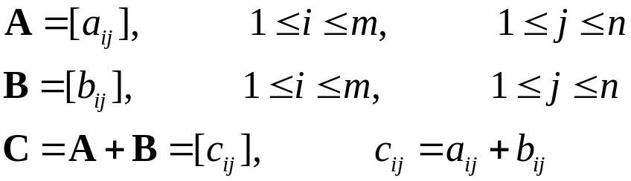

Matrix Review
What is a matrix?
Matrix addition:
  Addition is commutative

Slide 35
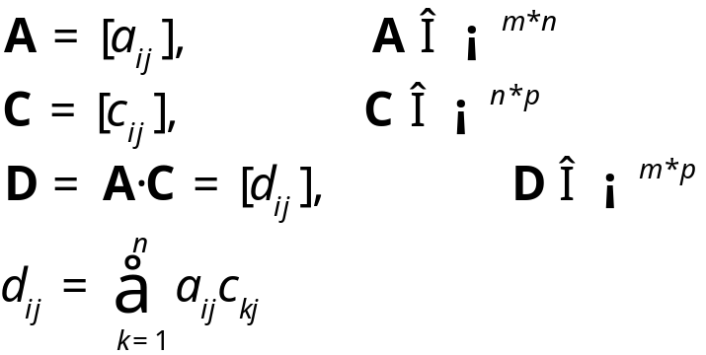
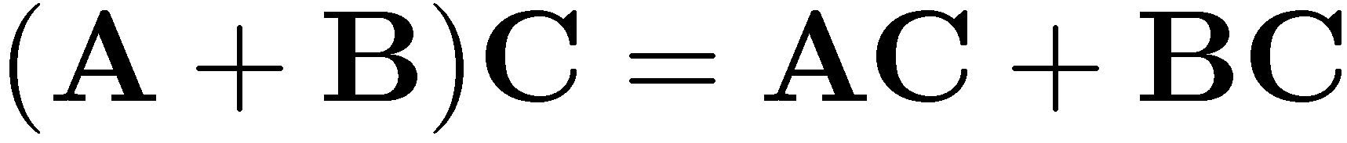
Matrix Multiplication
Remember the dimension constraints on matrices that can be multiplied:
  # of columns of first matrix is equal to # of rows of second matrix
This operation is not commutative
Distributivity of matrix multiplication with respect to matrix addition:

Slide 36
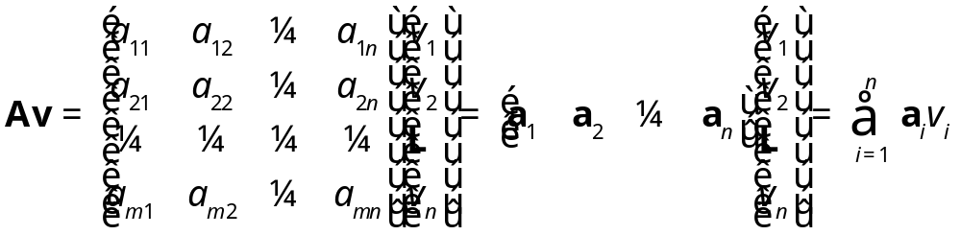
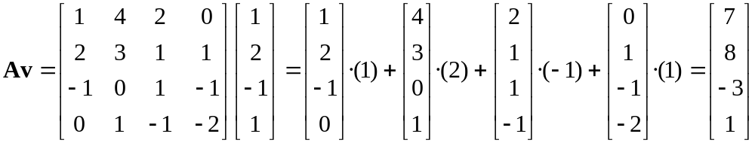
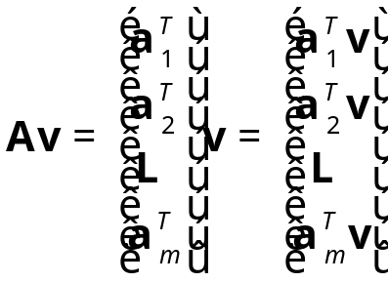
Matrix-Vector Multiplication
A column-wise perspective on matrix-vector multiplication
  Example:
A row-wise perspective on matrix-vector multiplication:

Slide 37

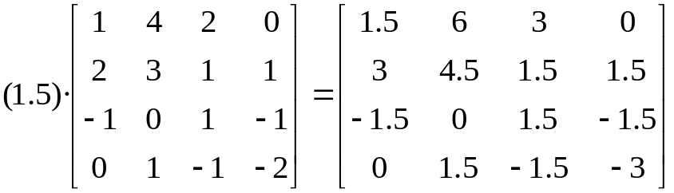
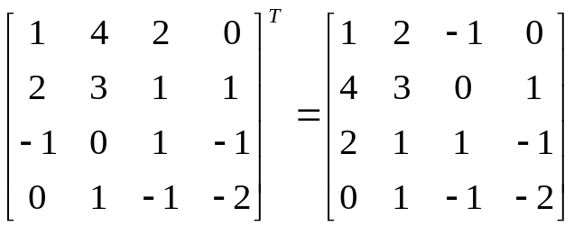
Matrix Review [Cntd.]
Scaling of a matrix by a real number: scale each entry of the matrix
  Example:
Transpose of a matrix A dimension m£n: a matrix B=A^{T} of dimension n£m whose (i,j) entry is the (j,i) entry of original matrix A

Slide 38

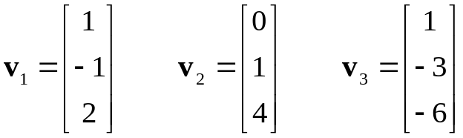
Linear Independence of Vectors
Definition: linear independence of a set of m vectors, v₁,…, v_{m} :
The vectors are linearly independent if the following condition holds
If a set of vectors are not linearly independent, they are called dependent
  Example:
  Note that v₁-2v₂-v₃=0

Slide 39
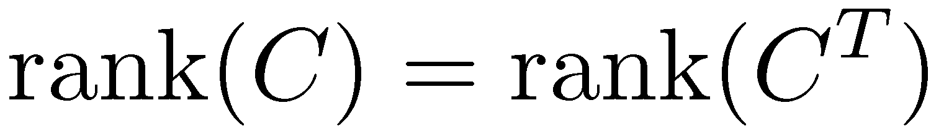
Matrix Rank
Row rank of a matrix
  Largest number of rows of the matrix that are linearly independent
  A matrix is said to have full row rank if the rank of the matrix is equal to the number of rows of that matrix
Column rank of a matrix
  Largest number of columns of the matrix that are linearly independent
NOTE: for each matrix, the row rank and column rank are the same
  This number is simply called the rank of the matrix
  It follows that

Slide 40
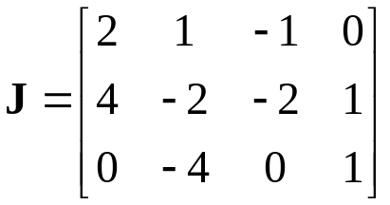
Matrix Rank, Example
What is the row rank of the matrix J?
What is the rank of J?

Slide 41
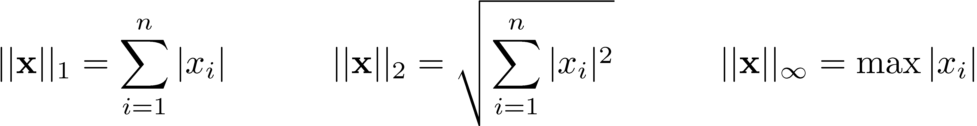
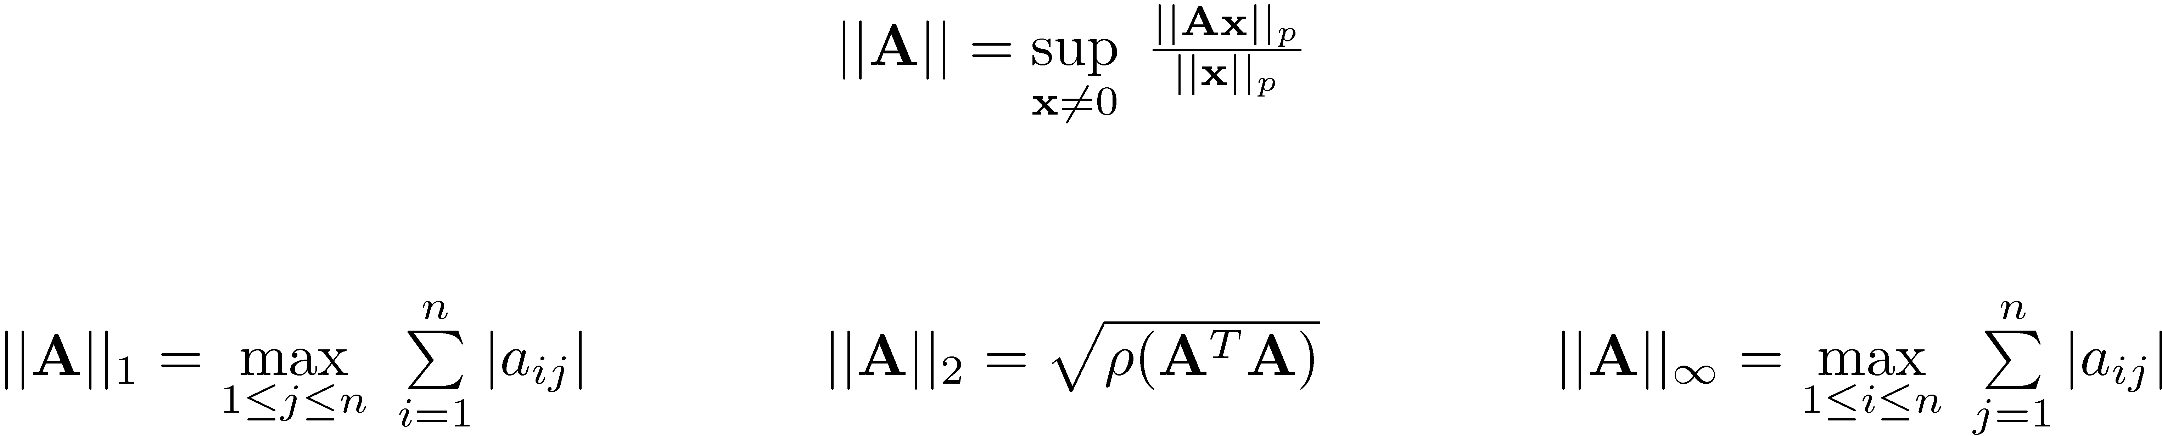
Matrix & Vector Norms
Norm of a vector
  Definitions: norm 1, norm 2 (or Euclidian), and Infinity norm
Norm of a matrix
  Definition: norm 1, norm 2 (or Euclidian), and Infinity

Slide 42
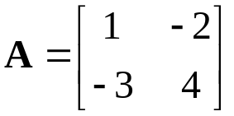
Matrix & Vector Norms, Exercise
Find norm 1, Euclidian, and Infinity for the following matrix:
Answer:

