Slide 1
ME751
Advanced Computational Multibody Dynamics
Introduction
January 21, 2010
Continuous effort - not strength or intelligence - is the key to unlocking our potential. W. Churchill
© Dan Negrut, 2010
ME751, UW-Madison
Dan Negrut
University of Wisconsin, Madison

Slide 2
Before we get started…
Last Time:
  Class Intro + Syllabus Outline
    Final Project discussion
    Established time/date of midterm exam
    Trip to Iowa and John Deere looks likely
  Started review on Linear Algebra
Today:
  Finish review of Linear Algebra
  Review of Calculus (two definitions and three theorems)
HW: posted on class website, due on Jan. 28.

Slide 3
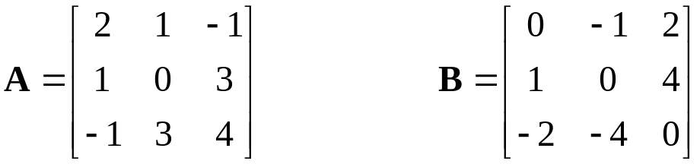
Matrix Review [Cntd.]
Symmetric matrix: a square matrix A for which A=A^{T}
Skew-symmetric matrix: a square matrix B for which B=-B^{T}
Examples:
Singular matrix: square matrix whose determinant is zero
Inverse of a square matrix A: a matrix of the same dimension, called A⁻¹, that satisfies the following:

Slide 4
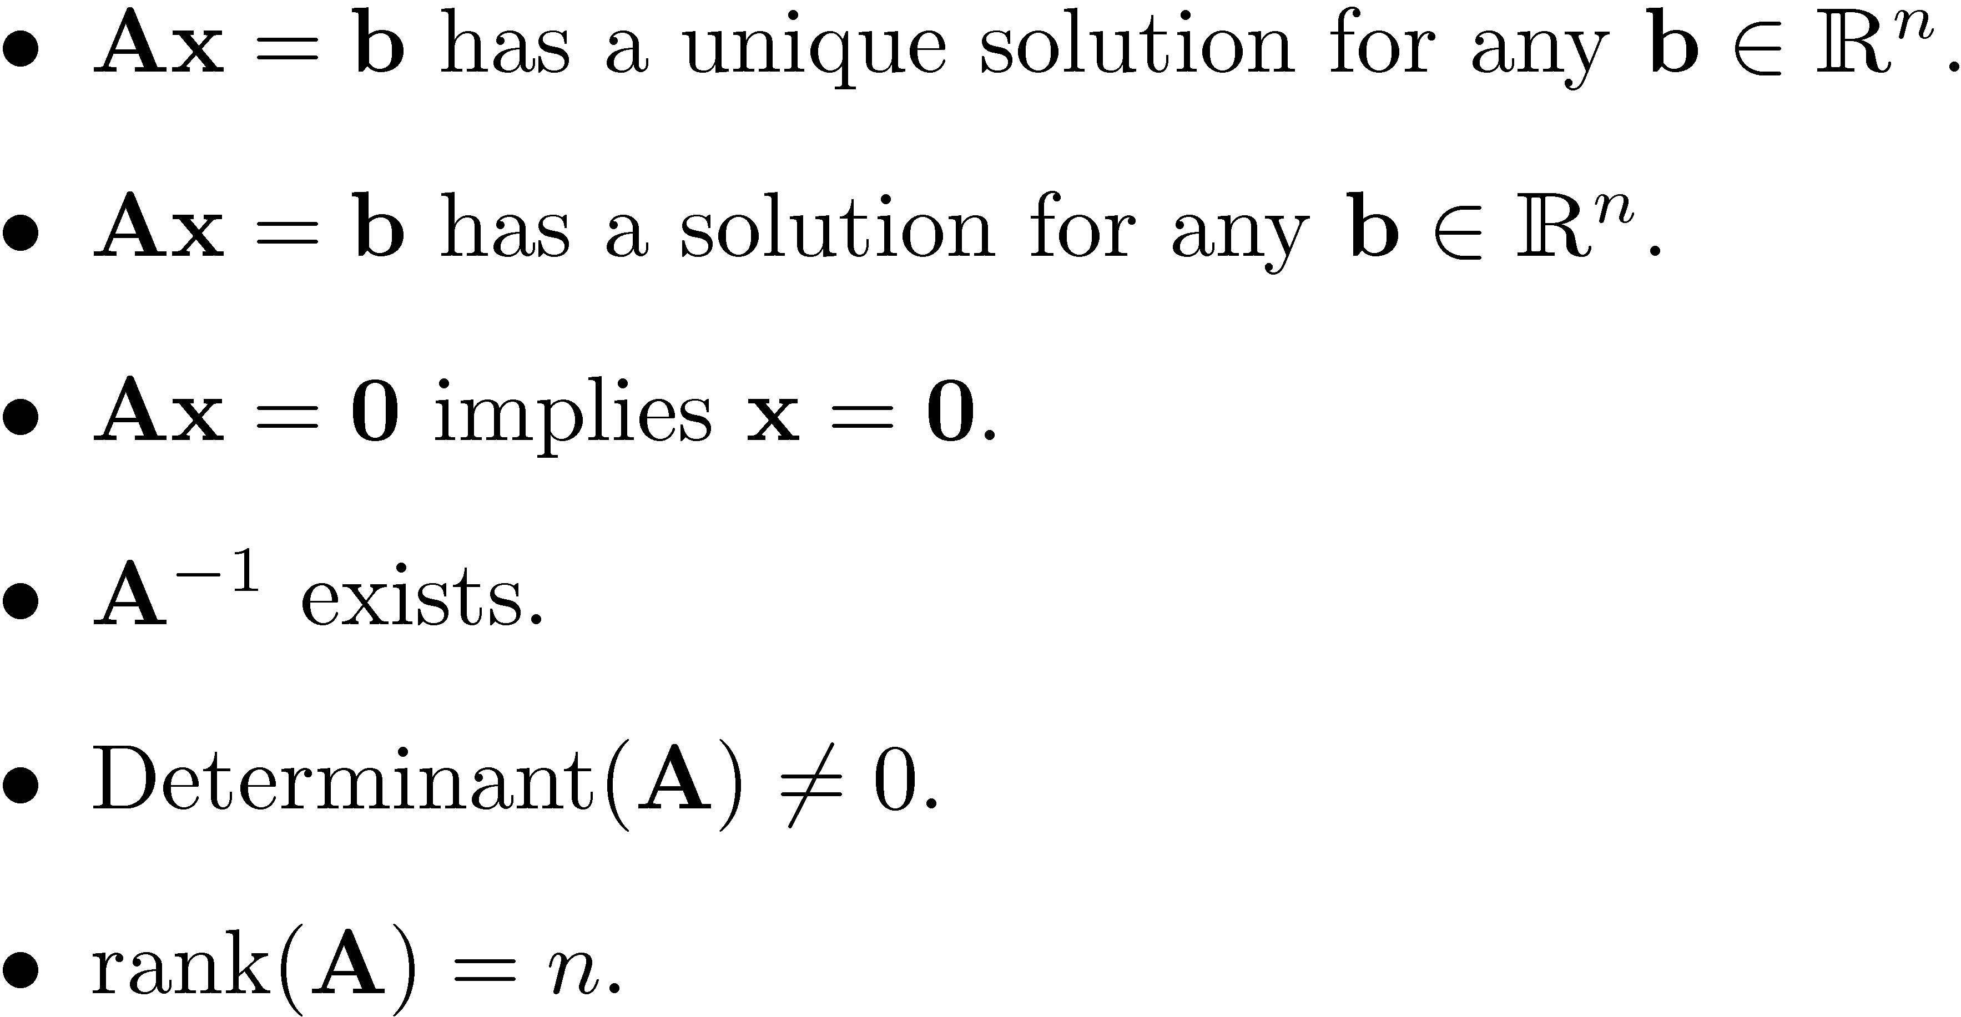
Singular vs. Nonsingular Matrices
Let A be a square matrix of dimension n. The following are equivalent:

Slide 5
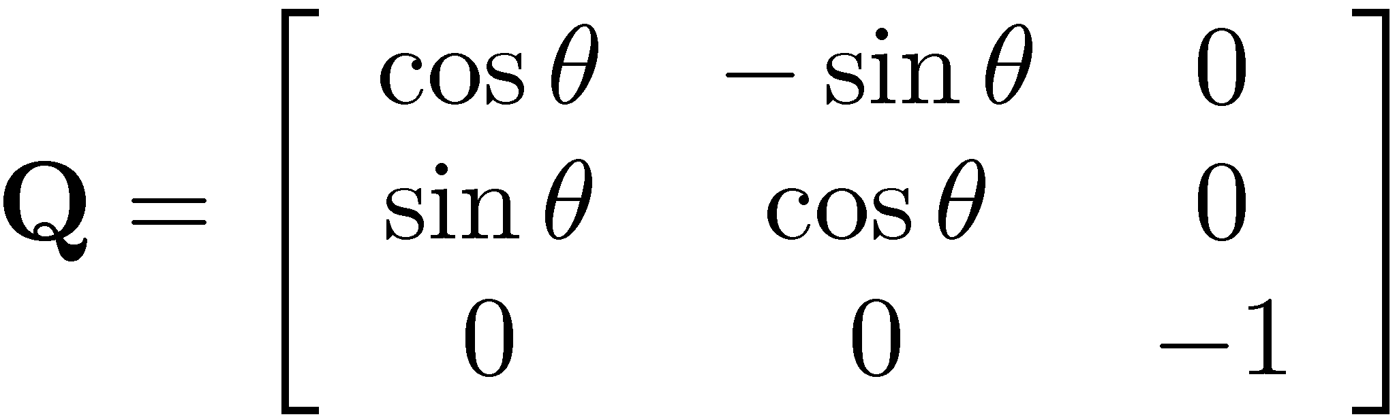
Orthogonal & Orthonormal Matrices
Definition (Q, orthogonal matrix): a square matrix Q is orthogonal if the product Q^{T}Q is a diagonal matrix
Matrix Q is called orthonormal if it’s orthogonal and also Q^{T}Q=I_{n}
    Note that people in general don’t make a distinction between an orthogonal and orthonormal matrix
Note that if Q is an orthonormal matrix, then Q⁻¹=Q^{T}
Example, orthonormal matrix:

Slide 6
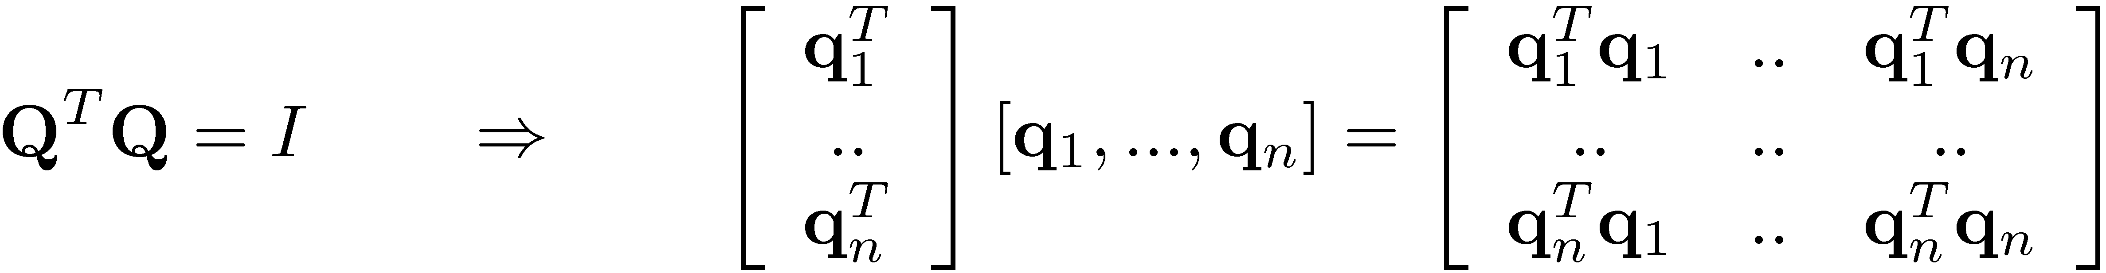

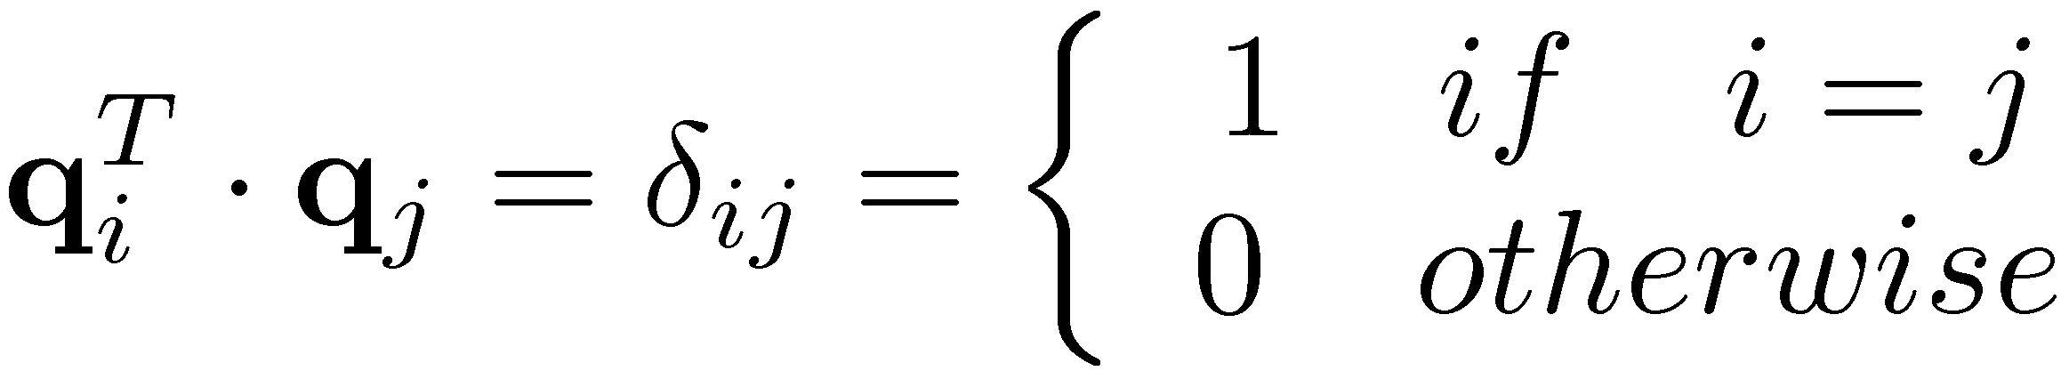
Remark:
On the Columns of an Orthonormal Matrix
Assume Q is an orthonormal matrix
In other words, the columns (and the rows) of an orthonormal matrix have unit norm and are mutually perpendicular to each other

Slide 7
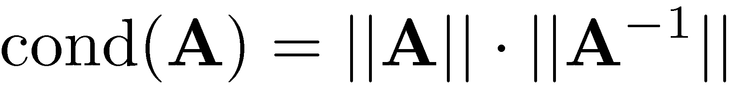
Condition Number of a Matrix
Let A be a square matrix. By definition, its condition number is
  Note that condition number depends on the norm used in its evaluation
The concept of ill-conditioned linear system Ax=b:
  A system for which small perturbations in b lead to large changes in solution x
  NOTE: A linear system is ill-condition if cond(A) is large
Three quick remarks:
  The closer a matrix is to being singular, the larger its condition number
  You can’t get cond(A) to be smaller than 1
  If Q is orthonormal, then cond(Q)=1

Slide 8
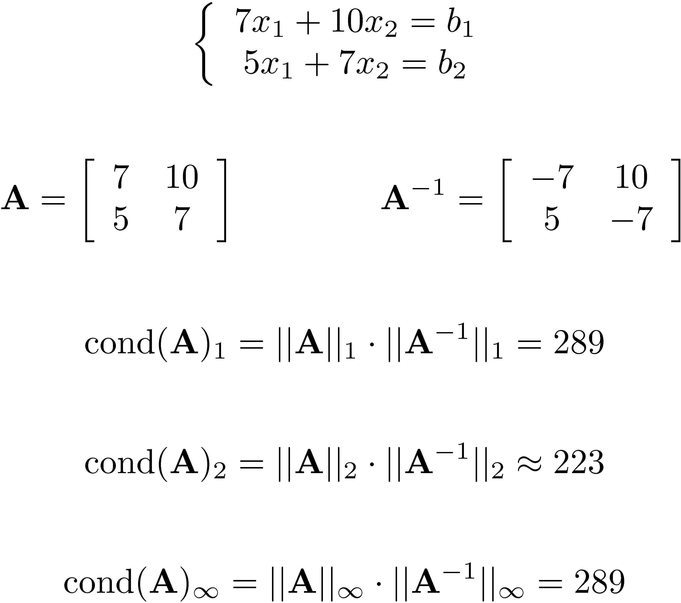
Condition Number of a Matrix
Example

Slide 9
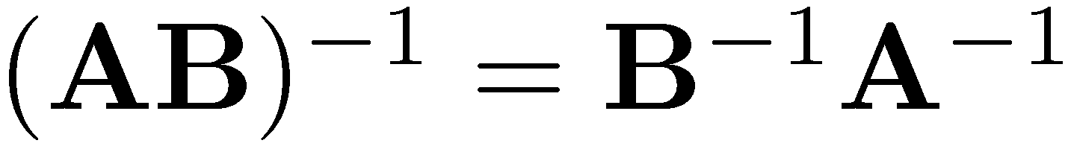
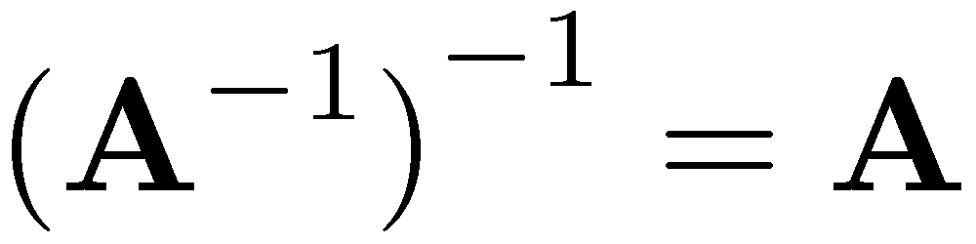


Other Useful Formulas
If A and B are invertible, their product is invertible and
Also,
For any two matrices A and B that can be multiplied
For any three matrices A, B, and C that can be multiplied

Slide 10
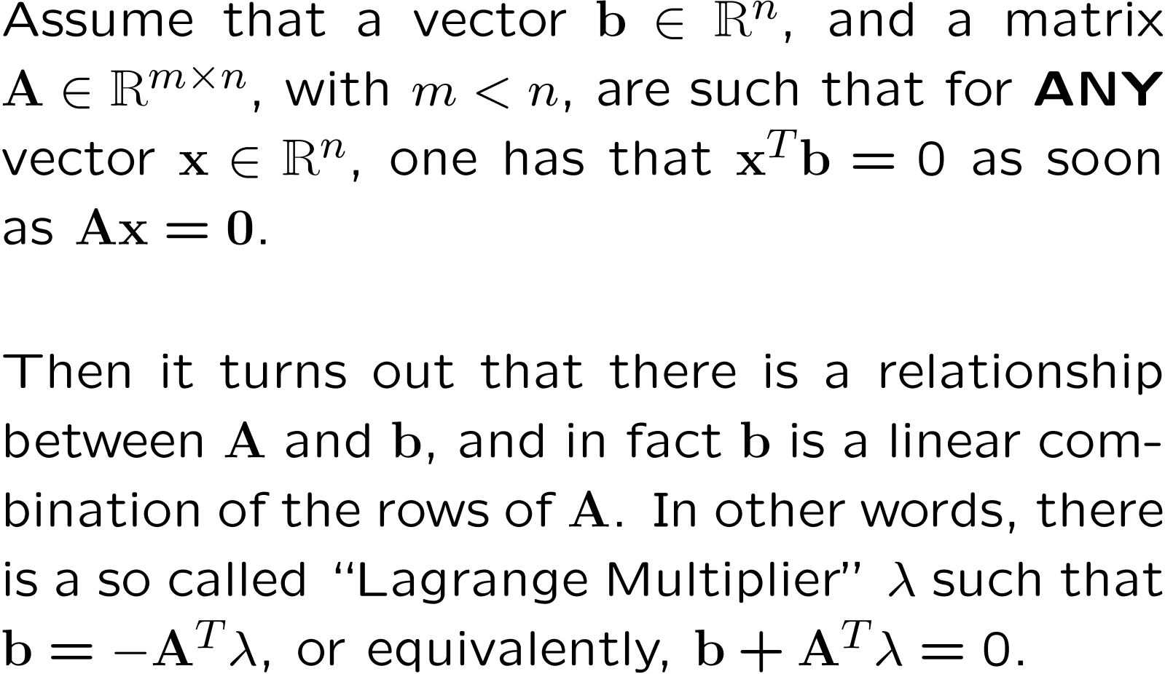
Lagrange Multiplier Theorem
Theorem:

Slide 11
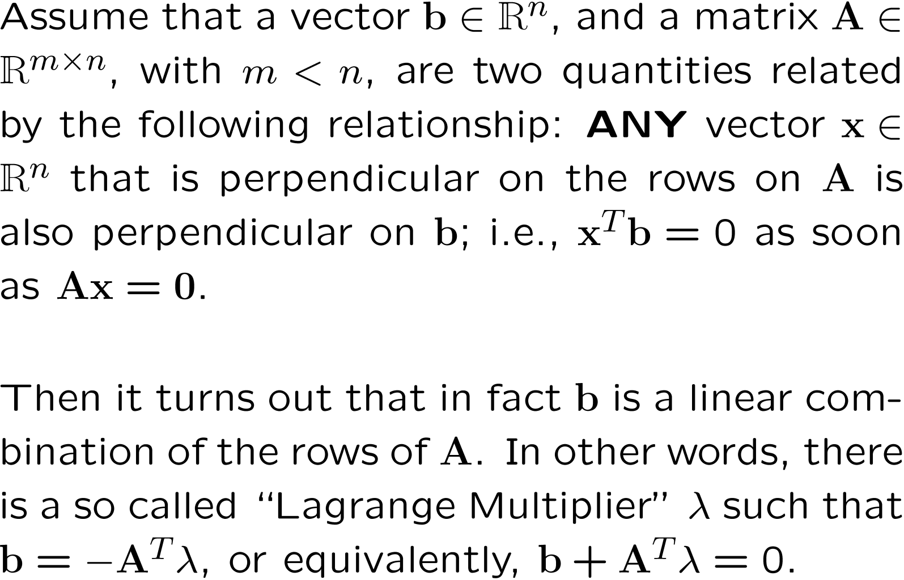
Lagrange Multiplier Theorem
Theorem:

Slide 12
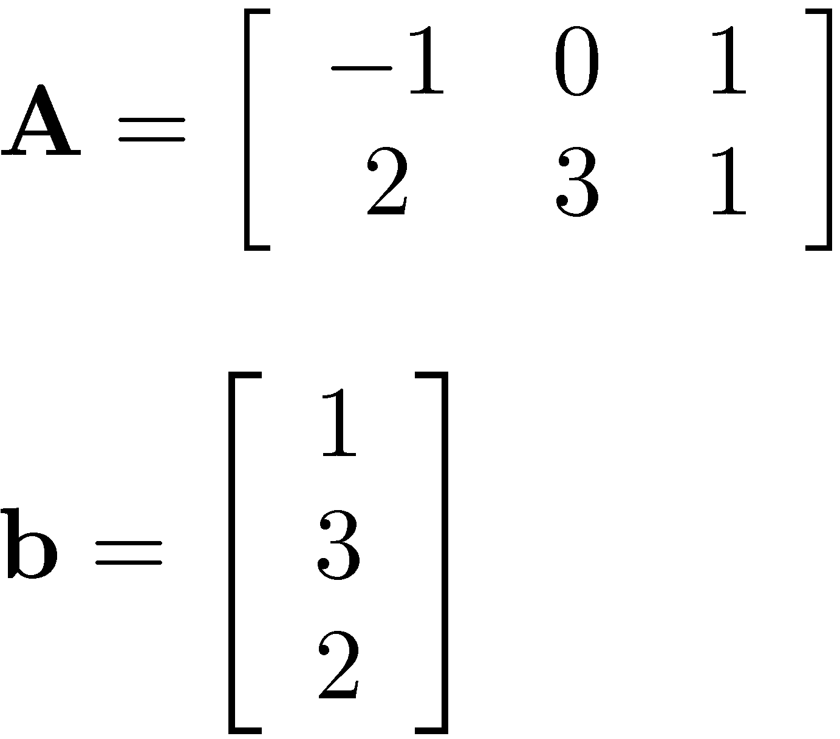
[AO (Ex. 6.3.3)]
Example: Lagrange Multipliers
First, show that any for any x=[x₁ x₂ x₃]^{T}, one has that x^{T}b=0 as soon as Ax=0
Next, show that there is indeed a vector λ such that b + A^{T}λ = 0

Slide 13
End: Review of Linear Algebra
Begin: Review of Calculus

Slide 14
Derivatives of Functions
GOAL: Understand how to
  Take time derivatives of vectors and matrices
  Take partial derivatives of a function with respect to its arguments
    We will use a matrix-vector notation for computing these partial derivs.
    Taking partial derivatives might be challenging in the beginning
    The use of partial derivatives is a recurring theme in the literature

Slide 15
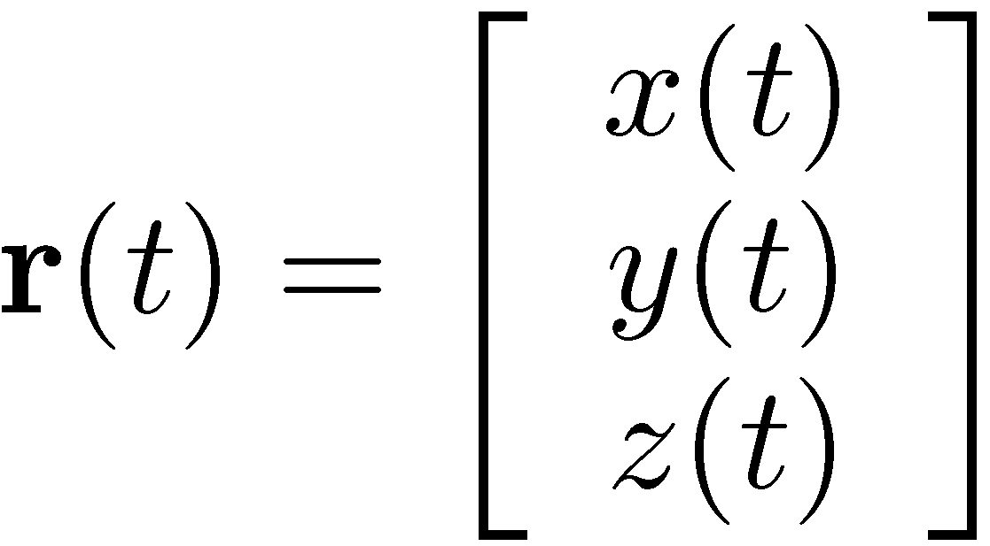
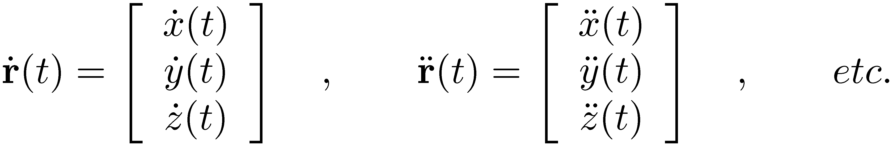
Taking time derivatives of a time dependent vector
FRAMEWORK:
  Vector r is represented as a function of time, and it has three components: x(t), y(t), z(t):
  Its components change, but the vector is represented in a fixed reference frame
THEN:

Slide 16
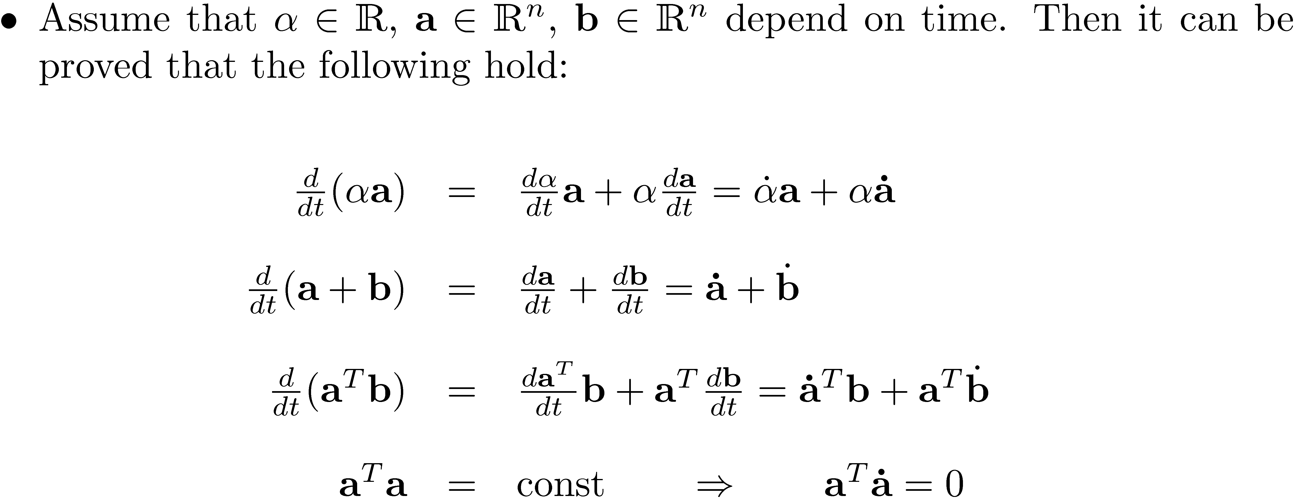
Time Derivatives, Vector Related Operations

Slide 17
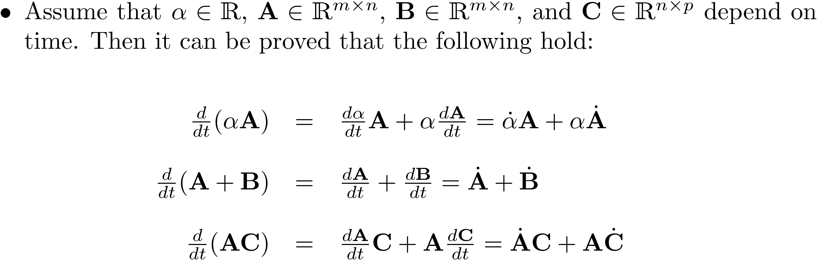
Taking time derivatives of
MATRICES
By definition, the time derivative of a matrix is obtained by taking the time derivative of each entry in the matrix
A simple extension of what we’ve seen for vector derivatives

Slide 18
Done with Time Derivatives
…
Moving on to Partial Derivatives

Slide 19
Derivatives of Functions:
Why Bother?
Partial derivatives are essential in this class
  In computing the Jacobian matrix associated with the constraints that define the joints present in a mechanism
  Essential in computing the Jacobian matrix of any nonlinear system that you will have to solve when using implicit integration to find the time evolution of a dynamic system
Beyond this class
  Whenever you do a sensitivity analysis (in optimization, for instance) you need partial derivatives of your functions

Slide 20
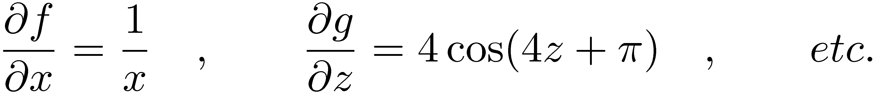
What’s the story behind the concept of partial derivative?
What’s the meaning of a partial derivative?
  It captures the “sensitivity” of a function quantity with respect to a variable the function depends upon
  Shows how much the function changes when the variable changes a bit
Simplest case of partial derivative: you have one function that depends on one variable:
Then,

Slide 21
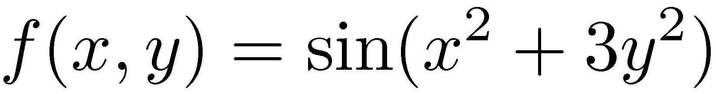
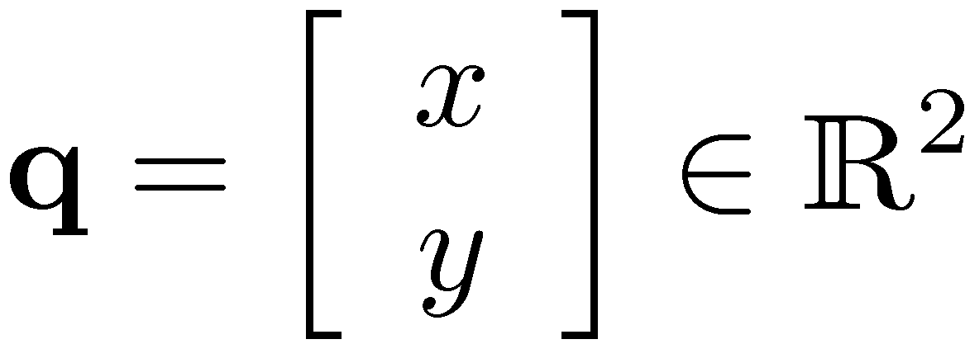
Partial Derivative, Two Variables
Suppose you have one function but it depends on two variables, say x and y:
To simplify the notation, an array q is introduced:
With this, the partial derivative of f(q) wrt q is defined as
Notation…

Slide 22
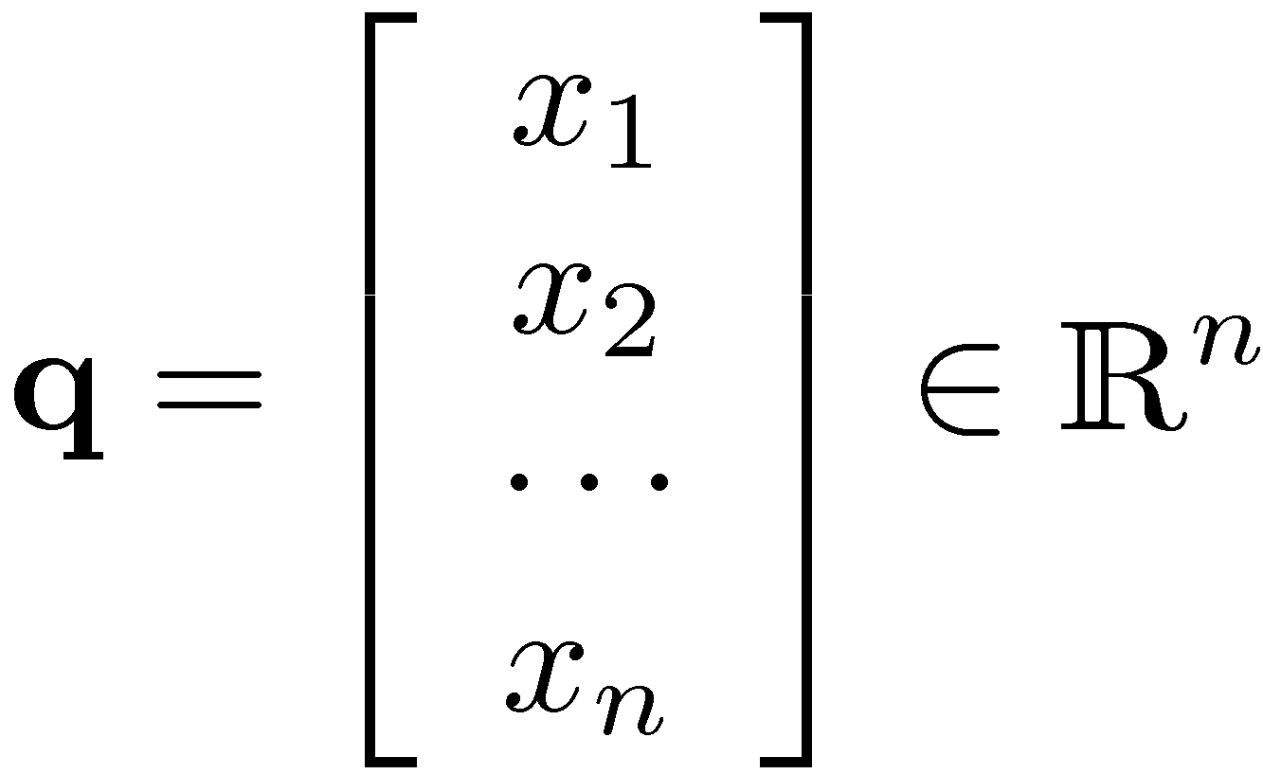
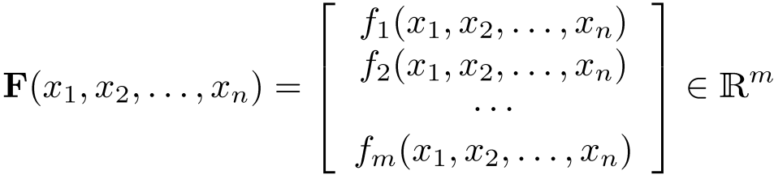
…and here is as good as it gets
(vector function)
You have a group of “m” functions that are gathered together in an array, and they depend on a collection of “n” variables:
The array that collects all “m” functions is called F:
The array that collects all “n” variables is called q:

Slide 23
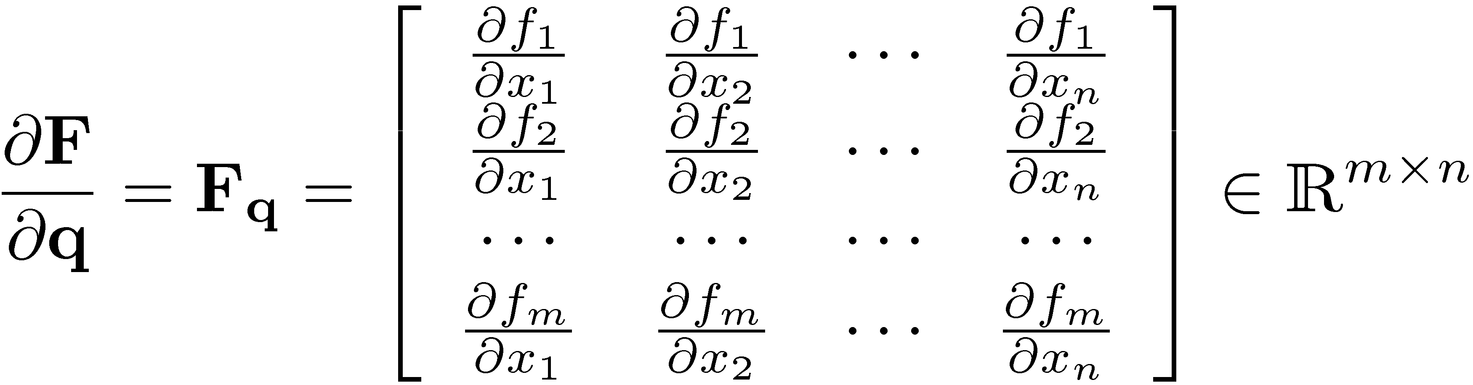

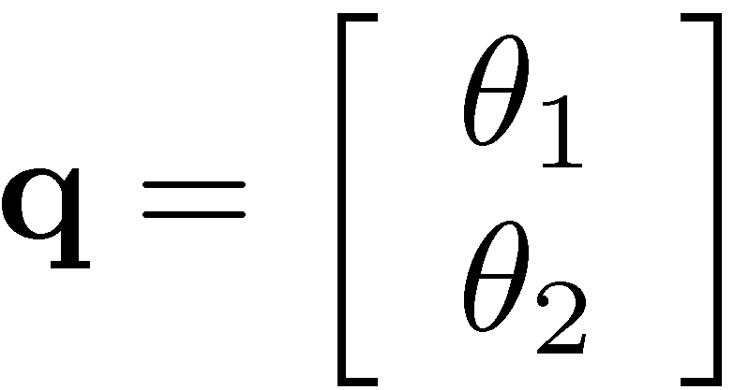
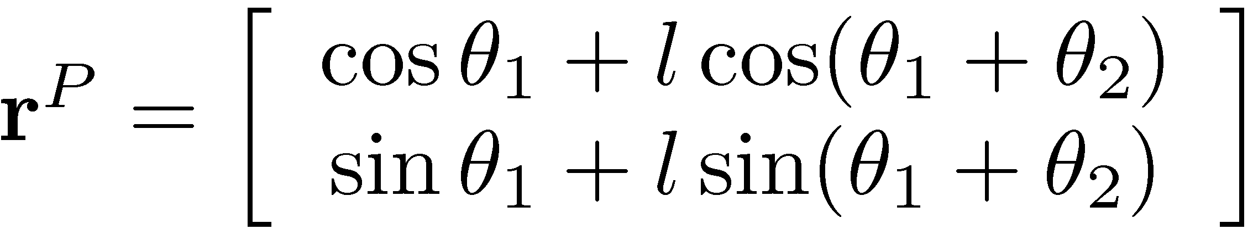

Most general partial derivative
(Vector Function, cntd)
Then, in the most general case, by definition
Example 2.5.2:
This is an m x n matrix!

Slide 24
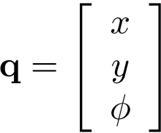
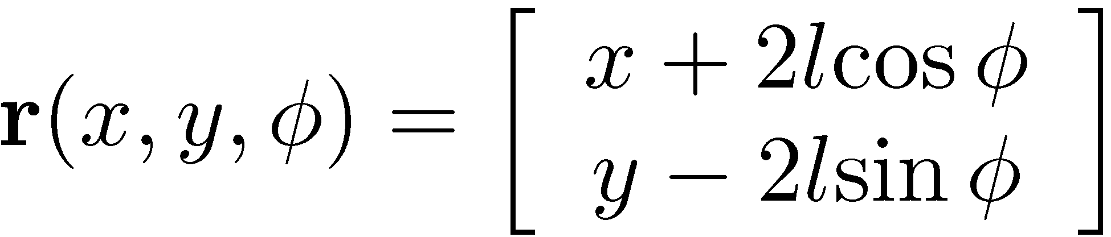
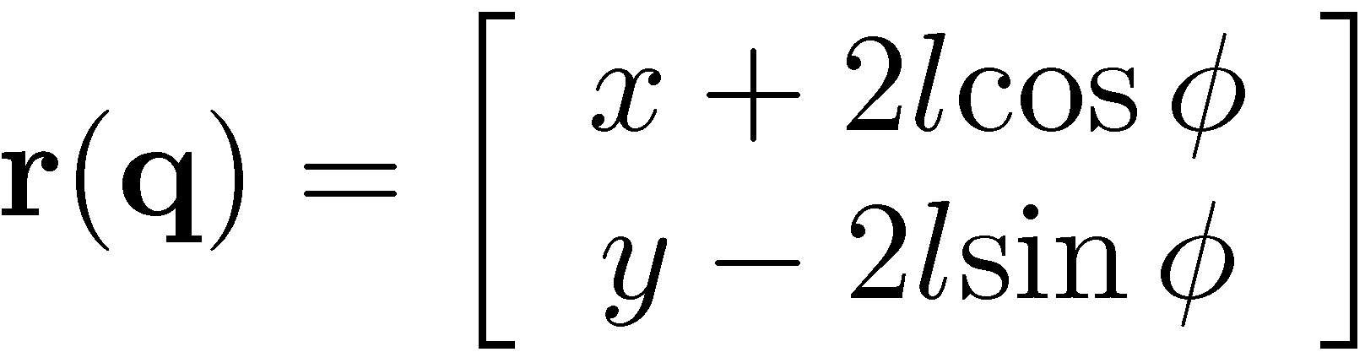

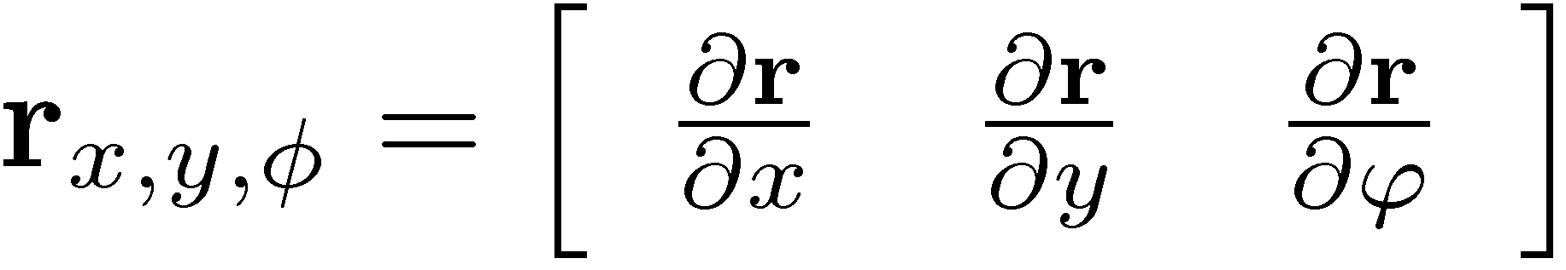
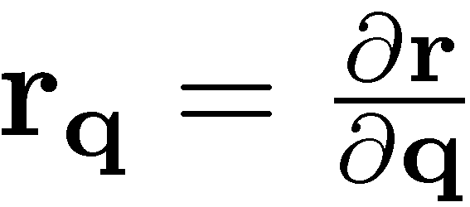
Example: Left and Right mean the same thing
Let x, y, and φ be three generalized coordinates
Define the function r of x, y, and φ as
Compute the partial derivatives
Let x, y, and φ be three generalized coordinates, and define the array q
Define the function r of q:
Compute the partial derivative

Slide 25
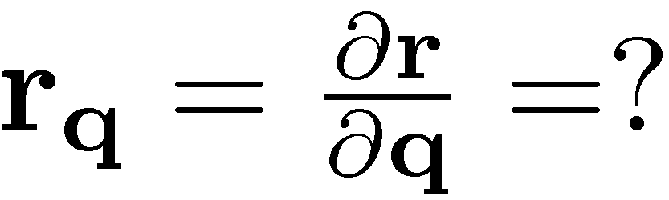

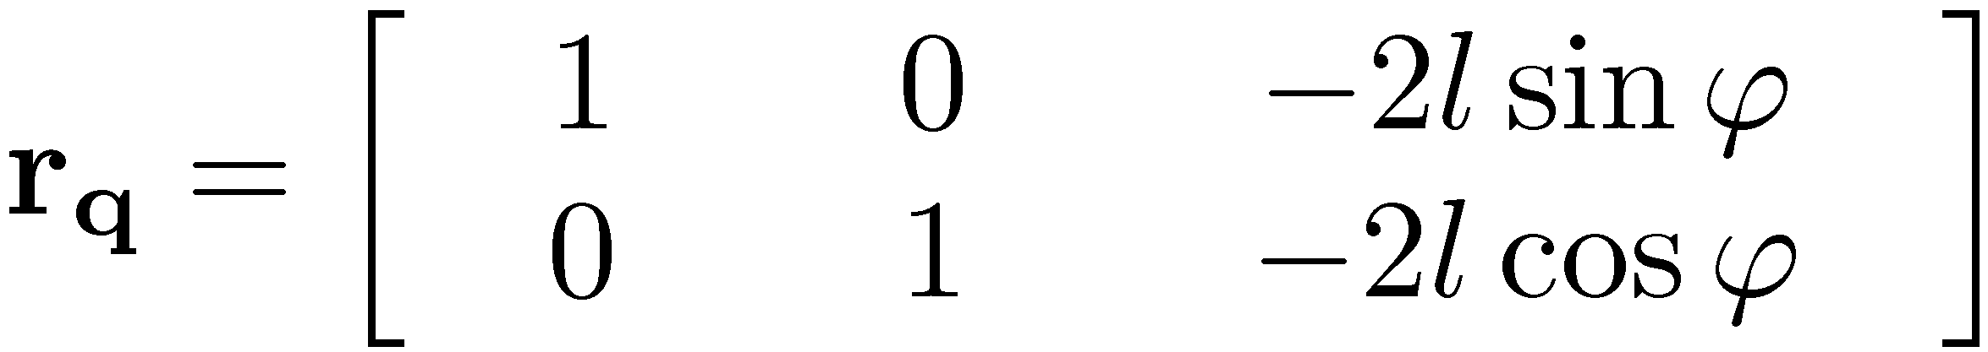
Exercise

Slide 26
Partial Derivatives: Good to Remember…
In the most general case, you start with “m” functions in “n” variables, and end with an (m x n) matrix of partial derivatives.
  You start with a column vector of functions and then end up with a matrix
Taking a partial derivative leads to a higher dimension quantity
    Scalar Function – leads to row vector
    Vector Function – leads to matrix
  I call this the “accordion rule”
In this class, taking partial derivatives can lead to one of the following:
    A row vector
    A full blown matrix
  If you see something else chances are you made a mistake…
So far, we only introduced a couple of definitions

Slide 27
Done with Partial Derivatives
…
Moving on to Chain Rule of Differentiation

Slide 28

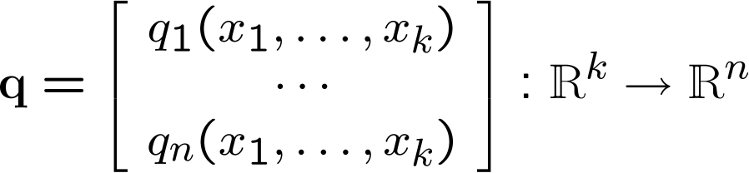
Scenario 1: Scalar Function
f is a function of “n” variables: q₁, …, q_{n}
However, each of these variables q_{i} in turn depends on a set of “k” other variables x₁, …, x_{k}.
The composition of f and q leads to a new function φ(x):

Slide 29
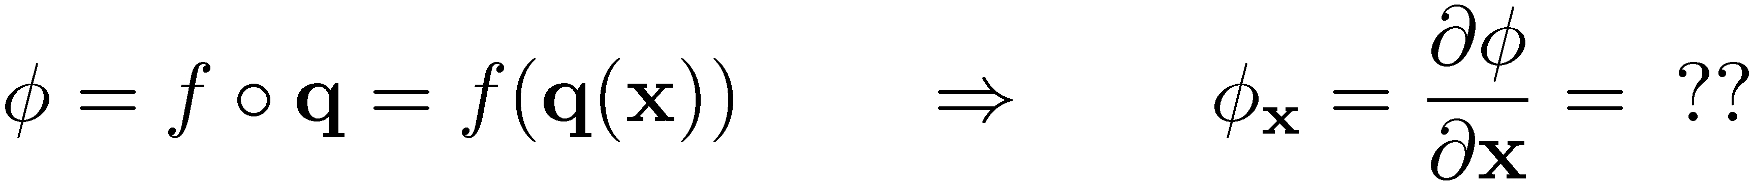
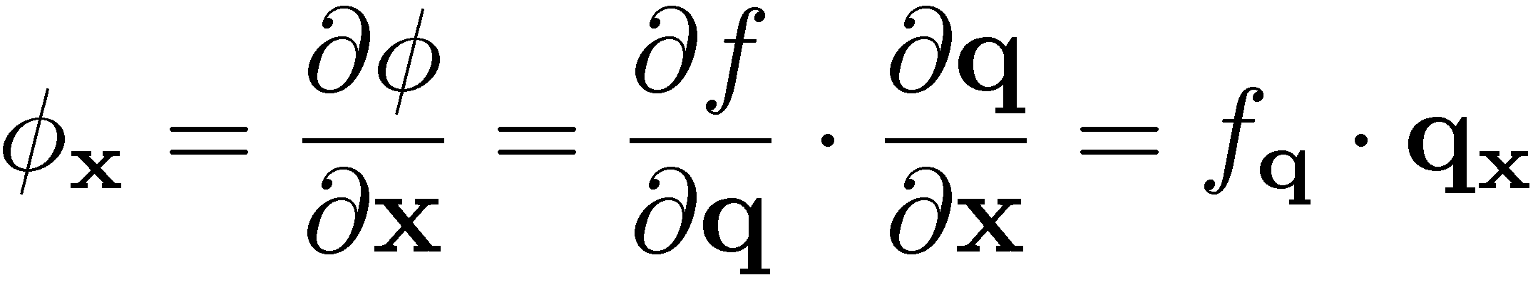
Chain Rule for a Scalar Function
The question: how do you compute φ_{x} ?
  Using our notation:
Theorem: Chain rule of differentiation for scalar function
(This theorem is proved in your elementary calculus class)

Slide 30
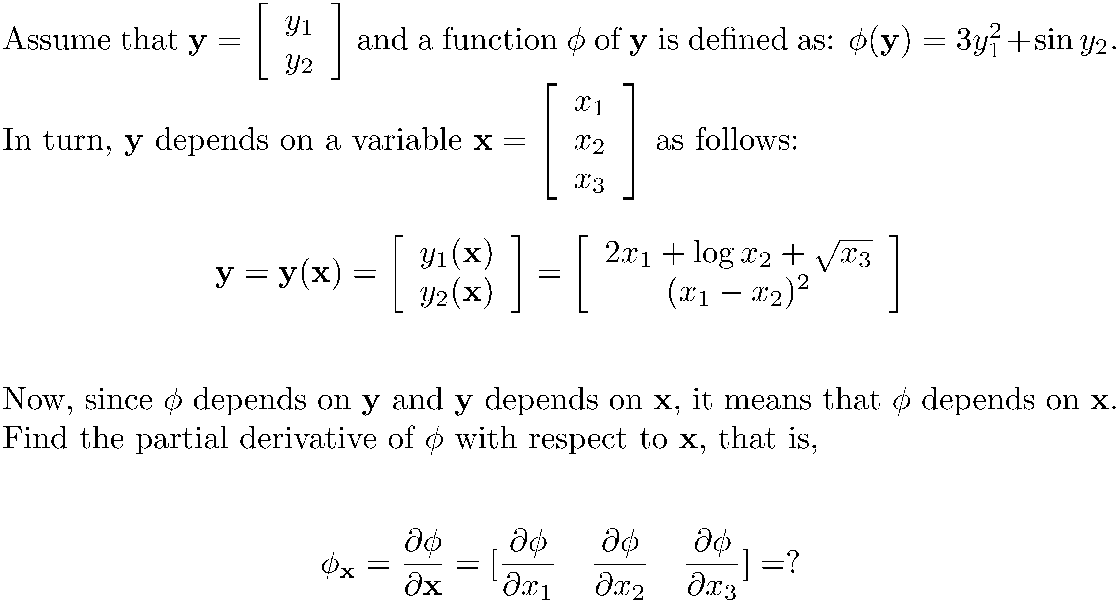
[AO]
Example

Slide 31

Scenario 2: Vector Function
F is a function of “n” variables: q₁, …, q_{n}
However, each of these variables q_{i} in turn depends on a set of “k” other variables x₁, …, x_{k}.
The composition of F and q leads to a new function Φ(x):

Slide 32

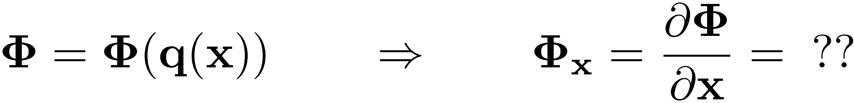
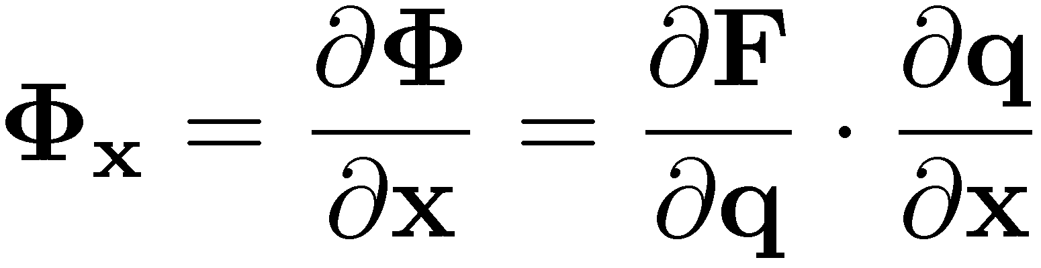
Chain Rule for a Vector Function
How do you compute the partial derivative of Φ?
Theorem: Chain rule of differentiation for vector functions
(This theorem is proved in your elementary calculus class)

Slide 33
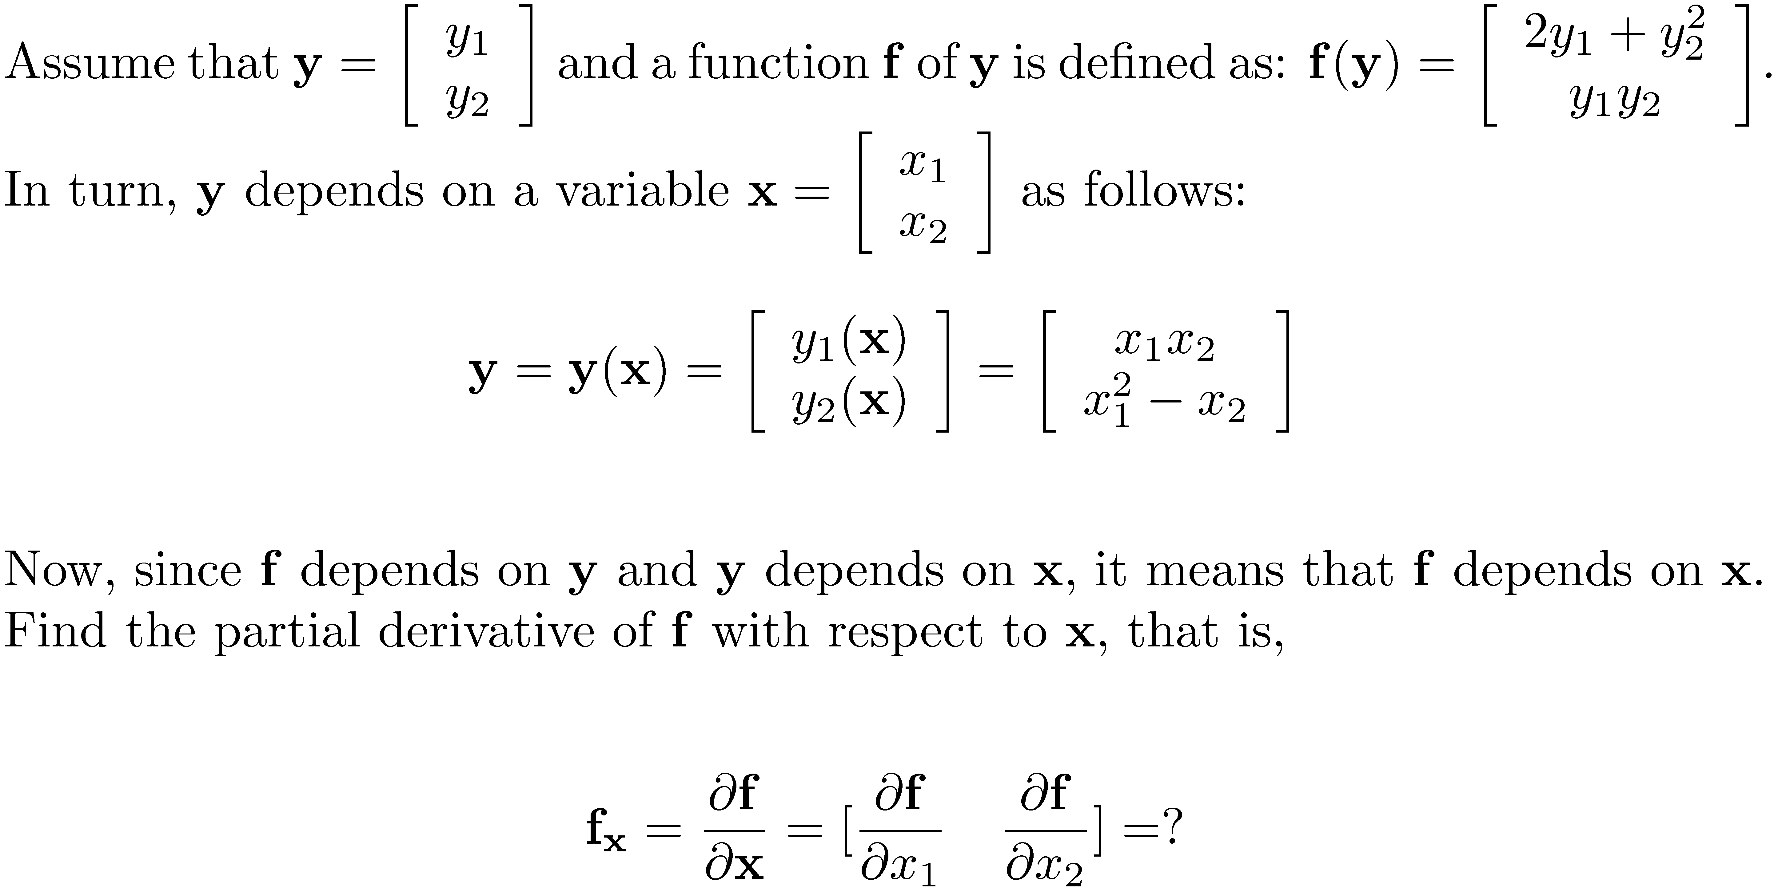
[AO]
Example

