Slide 1
ME751
Advanced Computational Multibody Dynamics
Review Calculus
Starting Chapter 9 of Haug book
January 26, 2010
© Dan Negrut, 2010
ME751, UW-Madison
"Motivation is what gets you started. Habit is what keeps you going.“ - James Ronald Ryun, Olympic athlete

Slide 2
Before we get started…
Last Time:
  Finished the Linear Algebra review
  Started review of Calculus
    Emphasis placed on partial derivatives and the chain rule
Today:
  Finish review of Calculus
  Discuss the concept of Geometric Vector (starting Chapter 9 of the book…)
  Introduce the concept of Reference Frame
  Establish the connection between Geometric Vector and Algebraic Vector
HW due on Jan. 28.
Trip to John Deere and NADS confirmed: May 4th
  Contemplating one more trip to Oshkosh Truck and/or P&H Mining

Slide 3

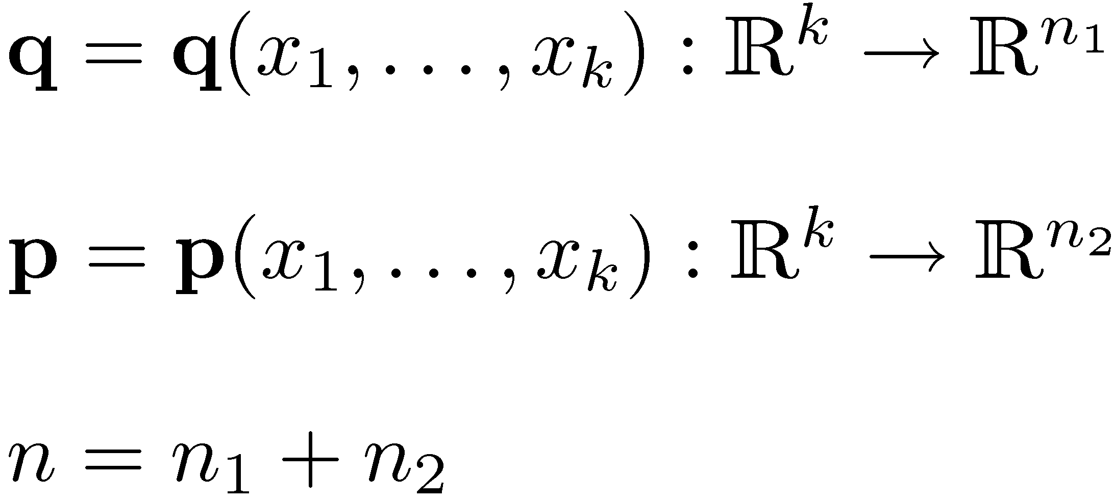
Scenario 3: Function of Two Vectors
F is a vector function of 2 vector variables q and p :
Both q and p in turn depend on a set of “k” other variables x=[x₁, …, x_{k}]^{T}:
A new function Φ(x) is defined as:

Slide 4
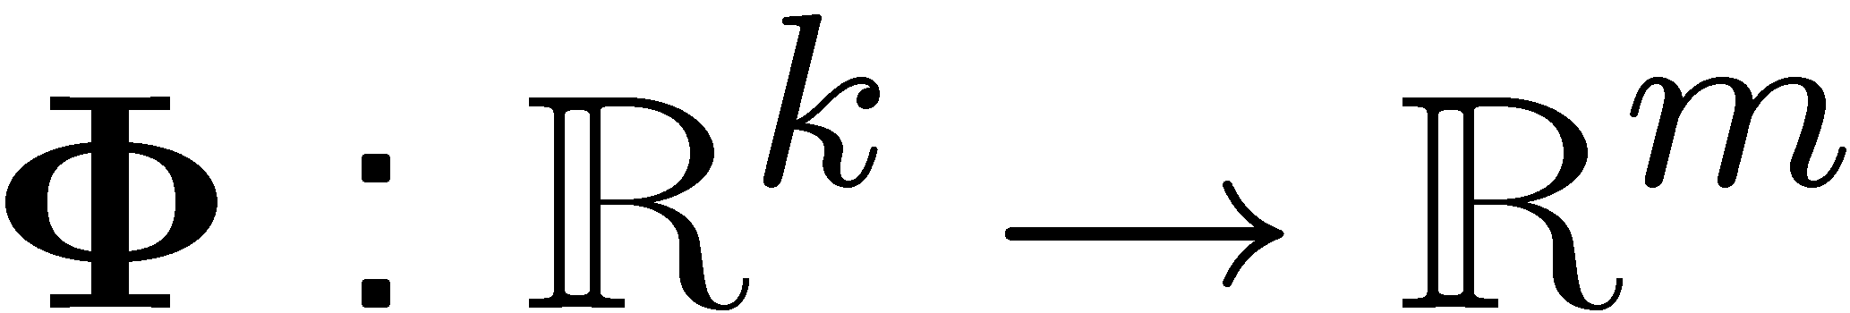
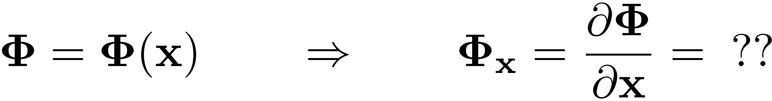
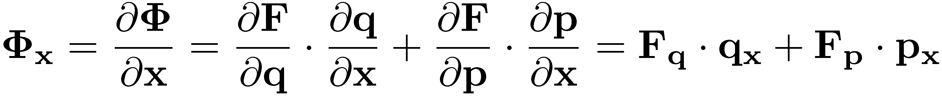
The Chain Rule
How do you compute the partial derivative of Φ with respect to x ?
Theorem: Chain rule for function of two vectors
(This theorem is proved in your elementary calculus class)

Slide 5
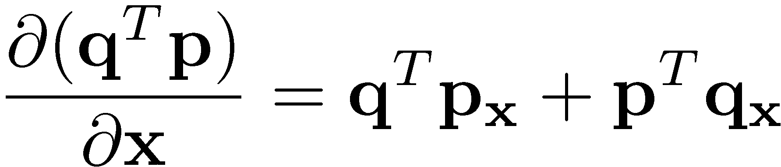
Example:

Slide 6
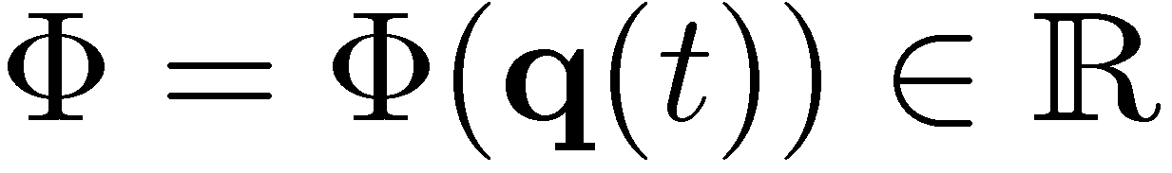
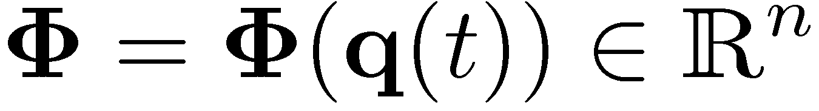
Scenario 4: Time Derivatives
On the previous slides we talked about functions f of y, while y in turn depended on yet another variable x
The relevant case is when the variable x is actually time, t
  This scenario is super common in 751:
    You have a function that depends on the generalized coordinates q, and in turn the generalized coordinates are functions of time (they change in time, since we are talking about kinematics/dynamics here…)
  Case 1: scalar function that depends on an array of m generalized coordinates that in turn depend on time
  Case 2: vector function (of dimension n) that depends on an array of m generalized coordinates that in turn depend on time

Slide 7
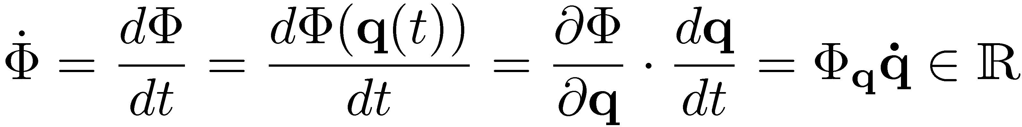
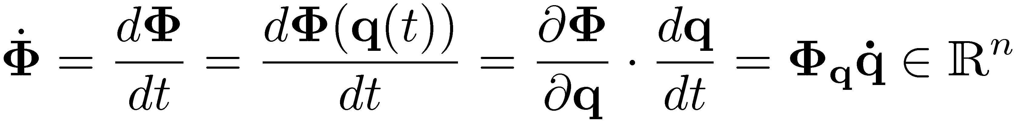
A Special Case: Time Derivatives (Cntd)
Of interest if finding the time derivative of Φ and Φ
Apply the chain rule, the scalar function Φ case first:
For the vector function case, applying the chain rule leads to the same formula, only the size of the result is different…

Slide 8
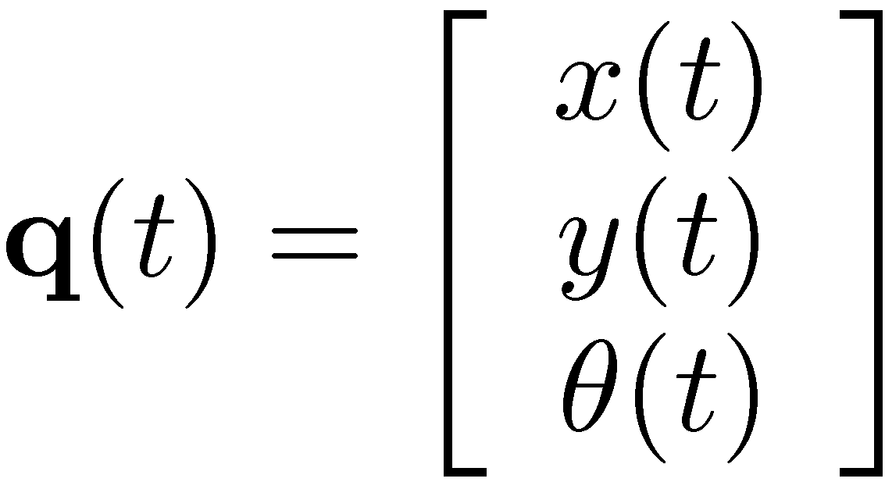
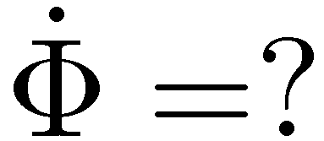
Example, Scalar Function Φ
Assume a set of generalized coordinates is defined through array q. Also, a scalar function Φ of q is provided:
Find time derivative of Φ

Slide 9
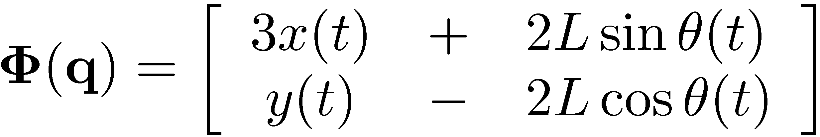
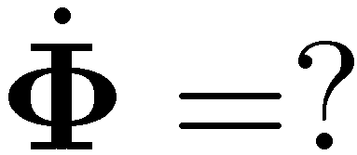
Example, Vector Function Φ
Assume a set of generalized coordinates is defined through array q. Also, a vector function Φ of q is provided:
Find time derivative of Φ

Slide 10
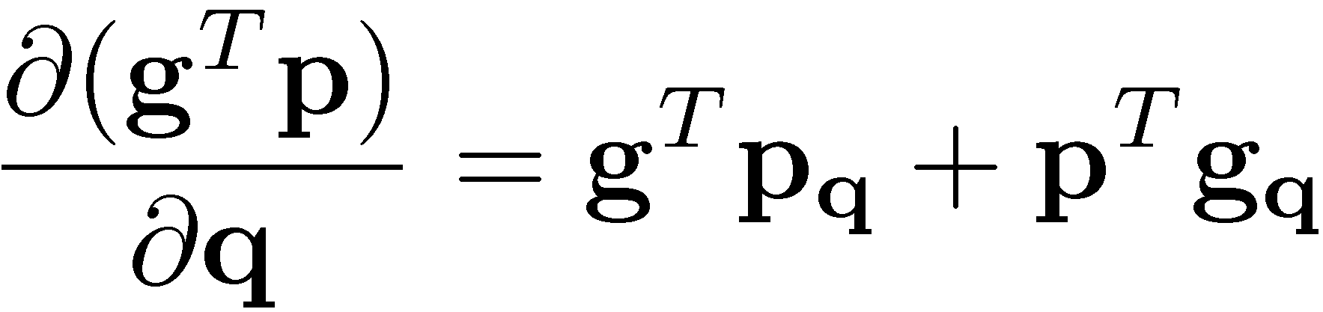
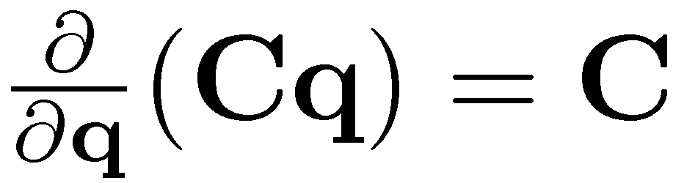
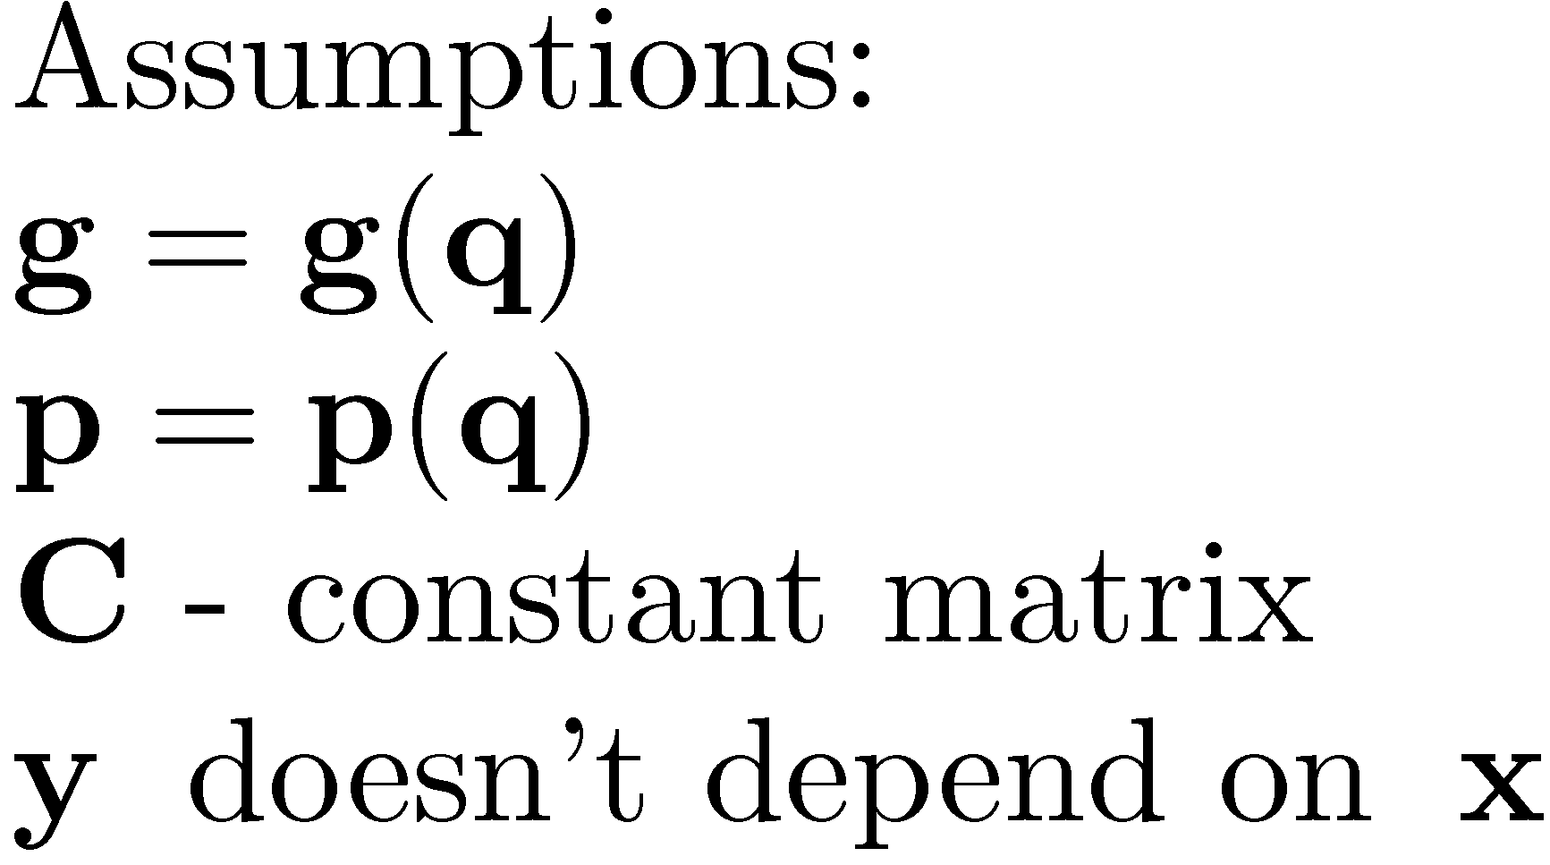
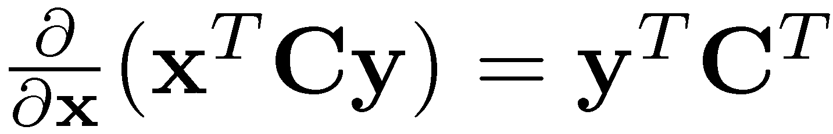
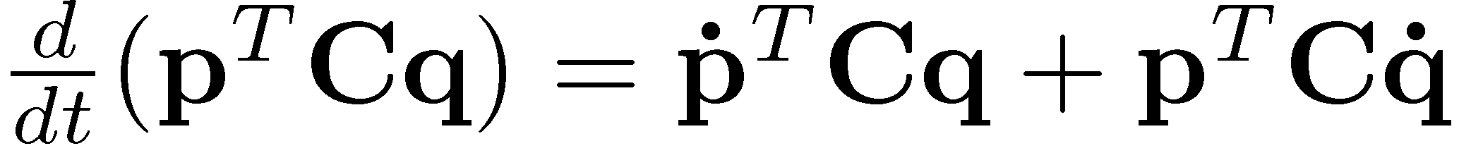
Useful Formulas
A couple of useful formulas, some of them you had to derive as part of the HW
The dimensions of the vectors and matrix above such that all the operations listed can be carried out.

Slide 11
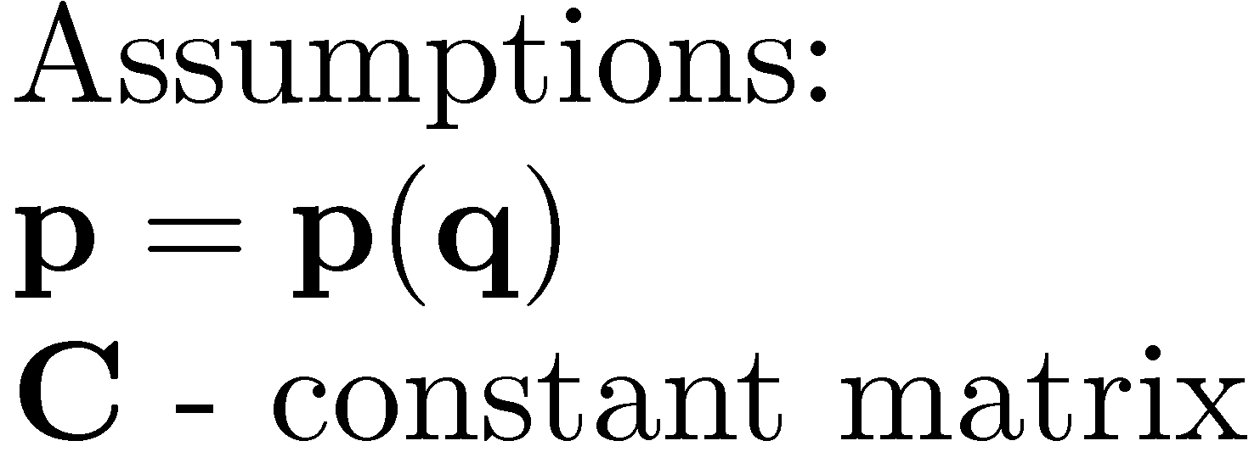
Example
Derive the last equality on previous slide
Can you expand that equation further?

Slide 12
End: Review of Calculus
Begin: 3D Kinematics of a Rigid Body

Slide 13
Geometric Entities: Their Relevance
Kinematics (and later Dynamics) of systems of rigid bodies:
  Requires the ability to describe as function of time the position, velocity, and acceleration of each rigid body in the system
  In the Euclidian 3D space, geometric vectors and second order tensors are extensively used to this end
    Geometric vectors - used to locate points on a body or the center of mass of a rigid body
    Second order tensors - used to describe the orientation of a body

Slide 14
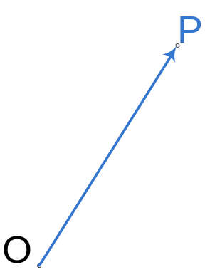
Geometric Vectors
What is a “Geometric Vector”?
  A quantity that has three attributes:
    A direction (given by the blue line)
    A sense (from O to P)
    A magnitude, ||OP||
  Note that all geometric vectors are defined in relation to an origin O
IMPORTANT:
  Geometric vectors are entities that are independent of any reference frame
ME751 deals spatial kinematics and dynamics
  We assume that all the vectors are defined in the 3D Euclidian space
  A basis for the Euclidian space is any collection of three independent vectors

Slide 15
Geometric Vectors: Operations
What geometric vectors operations are defined out there?
  Scaling by a scalar ®
  Addition of geometric vectors (the parallelogram rule)
  Multiplication of two geometric vectors
    The inner product rule (leads to a number)
    The outer product rule (leads to a vector)
  One can measure the angle θ between two geometric vectors
A review these definitions follows over the next couple of slides

Slide 16
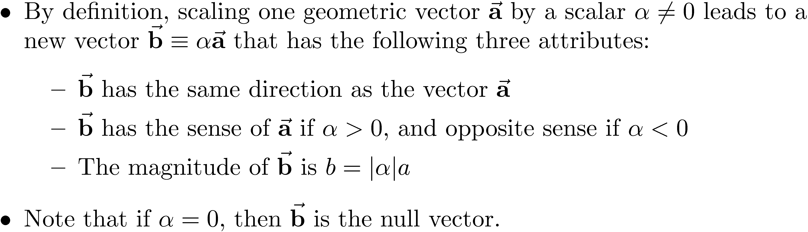
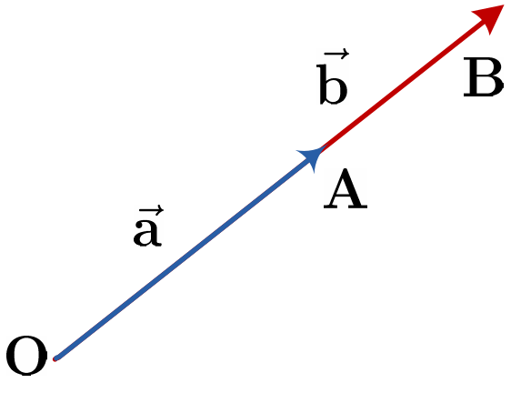
G. Vector Operation :
Scaling by ®

Slide 17
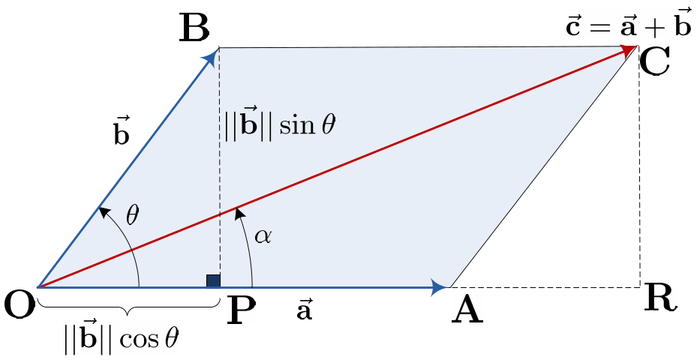
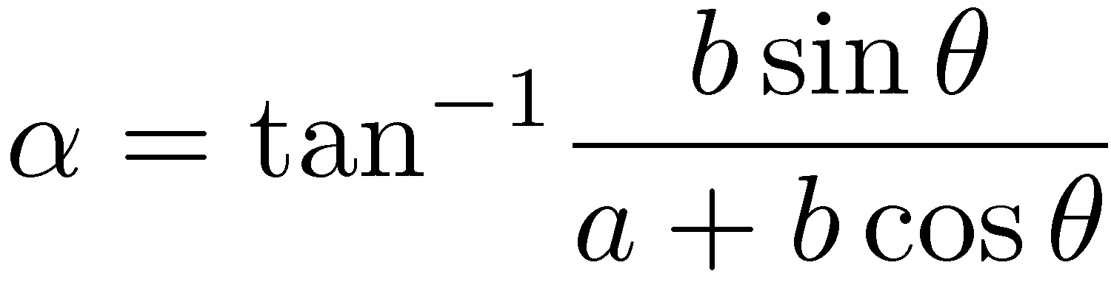
G. Vector Operation:
Addition of Two G. Vectors
Sum of two vectors (definition)
  Obtained by the parallelogram rule
Operation is commutative
Easy to see visualize, pretty messy to summarize in an analytical fashion:

Slide 18
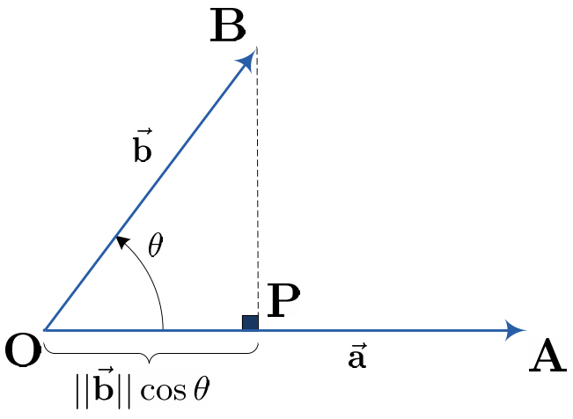
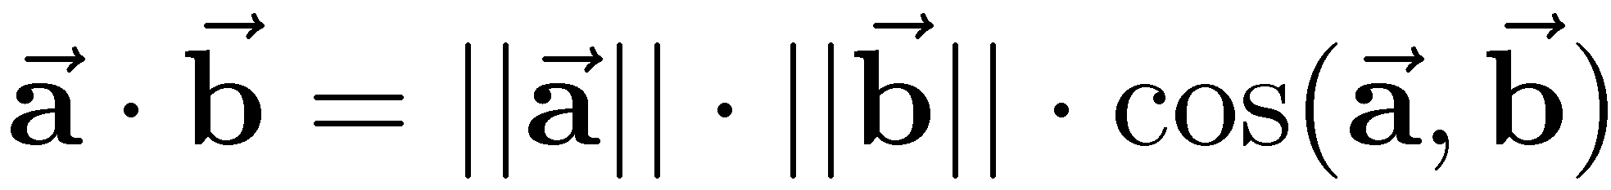
G. Vector Operation:
Inner Product of Two G. Vectors
The product between the magnitude of the first geometric vector and the projection of the second vector onto the first vector
Note that operation is commutative
Don’t call this the “dot product” of the two vectors
  This name is saved for algebraic vectors

Slide 19
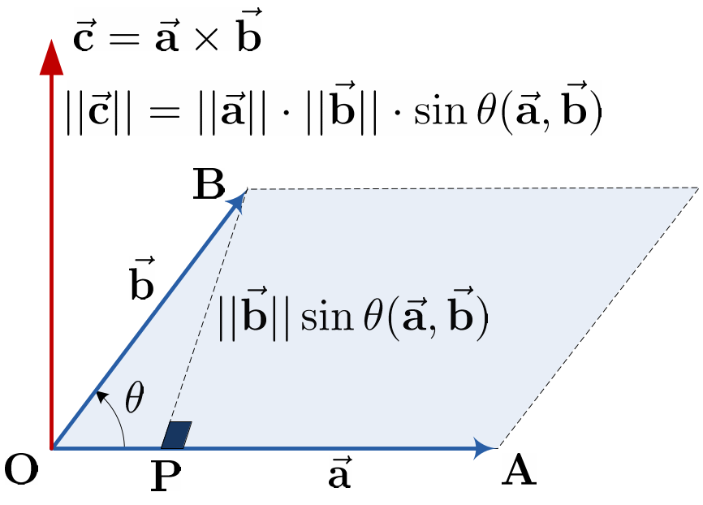
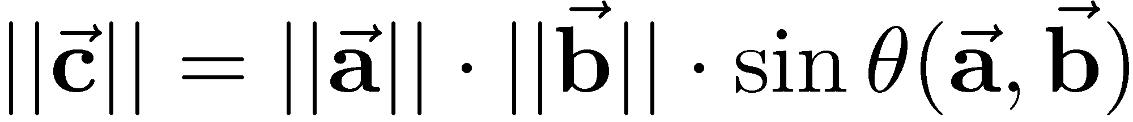
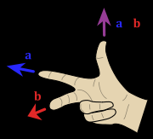
G. Vector Operation:
Outer Product of Two G. Vectors
Direction: perpendicular to the plane determined by the two geometric vectors
Sense: provided by the “right-hand rule”
Magnitude:
Operation is not commutative since, think right-hand rule

Slide 20
G. Vector Operation:
Angle Between Two G. Vectors
Regarding the angle between two vectors, note that
  Important: Angles are positive counterclockwise

Slide 21





Combining Basic G. Vector Operations
P1 – The sum of geometric vectors is associative
P2 – Multiplication with a scalar is distributive with respect to the sum:
P3 – The inner and outer products are distributive with respect to sum:
P4:
Look innocent, but rather hard to prove true

Slide 22
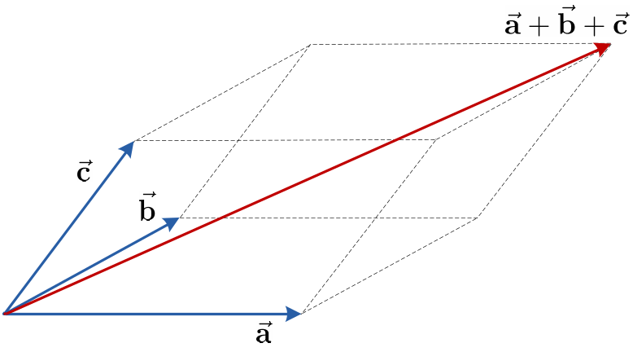
[AO]
Exercise, P1:
Prove that the sum of geometric vectors is associative:

Slide 23
[AO]
Exercise, P2:
Prove that multiplication by a scalar is distributive with respect to the sum:

Slide 24
Geometric Vectors: Making Things Simpler
Geometric vectors:
  Easy to visualize but cumbersome to work with
  The major drawback: hard to manipulate
    Was very hard to carry out simple operations (recall proving the distributive property just discussed)
    When it comes to computers, which are good at storing matrices and vectors, having to deal with a geometric entity is cumbersome
We are about to address these drawbacks by first introducing a reference frame that we’ll use to express all our vectors in
First, the following observation will prove useful:
  Three geometric vectors are independent if the third one does not belong to the plan defined by the first two ones

Slide 25

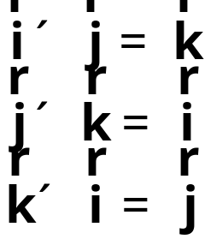
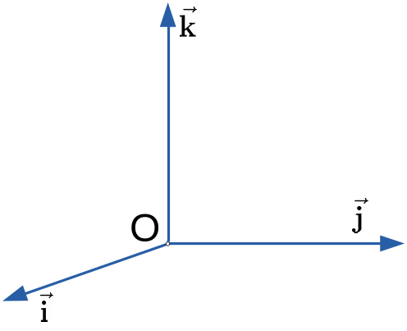
Using Reference Frames (RFs)
Recall that three vectors that are independent are enough to represent all the other vectors in the 3D Euclidian space
It’s convenient to choose these three vectors to be mutually orthonormal
  Length 1.0
  Angle between them: ¼/2
  Denoted by:
  Defined such that the following relations hold (right hand RF) :

Slide 26
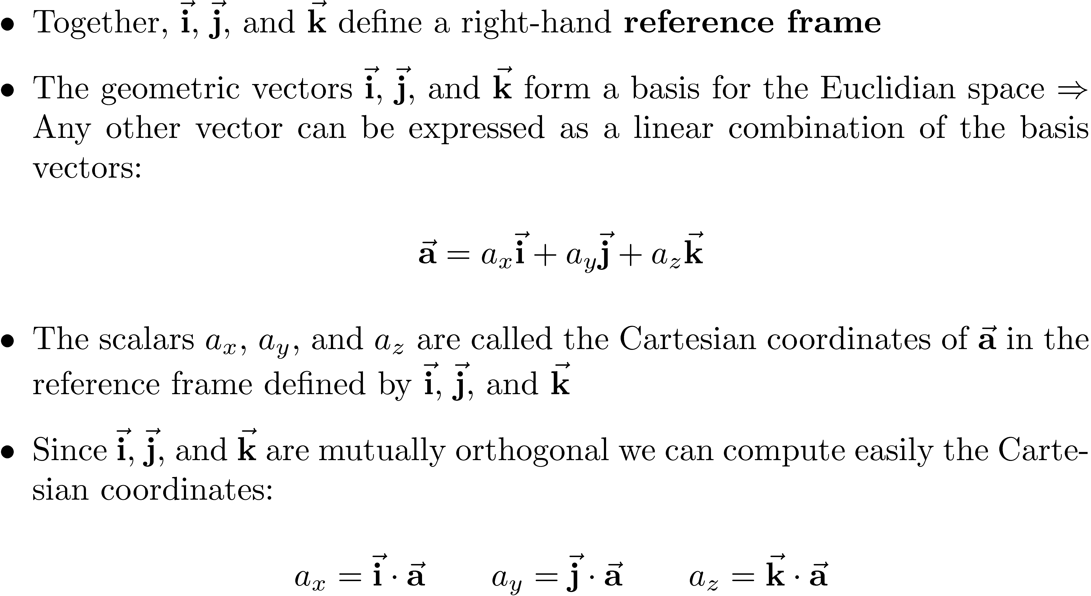
Representing a G. Vector in a RF;
Cartesian Coordinates

Slide 27
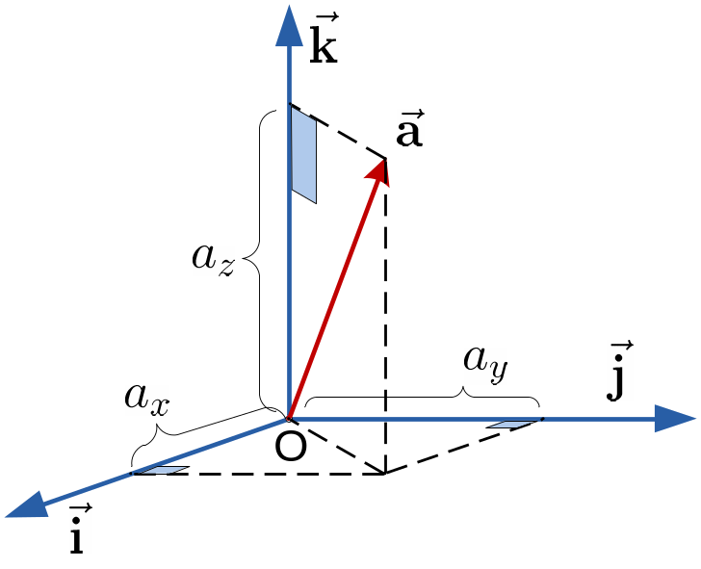
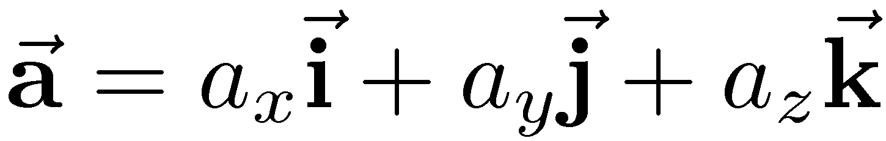
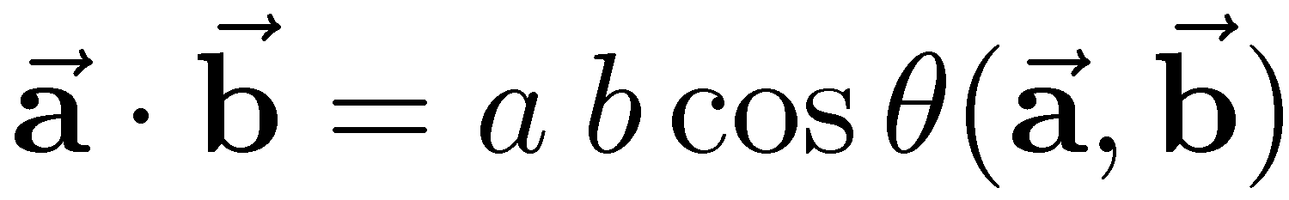
Representing a G. Vector in a RF
Inner product of two g. vectors, recall:
Since the angle between basis vectors is π/2:
  Therefore, the Cartesian coordinates are computed as

