Slide 1
ME751
Advanced Computational Multibody Dynamics
Section 9.2
January 28, 2010
© Dan Negrut, 2010
ME751, UW-Madison
“Age is an issue of mind over matter. If you don't mind, it doesn't matter.” Mark Twain

Slide 2
Before we get started…
Last Time:
  Finished Calculus review
  Introduced the concept of Geometric Vector
    Definition and five basic operations you can do with G. Vectors
    Combined simple operations: intuitive but tricky to prove
    Introduced reference frames to simplify handling of G. Vectors
Today:
  Introduce Algebraic Vectors (the algebraic counterpart of Geometric Vectors)
  Understand what it takes to change a RF
  Hopefully start talking about angular velocity of a rigid body
HW assigned today, available at class website
  Due on Feb. 4
I’ll be out on Th Feb. 4
  Justin and Makarand will present an overview of ADAMS

Slide 3
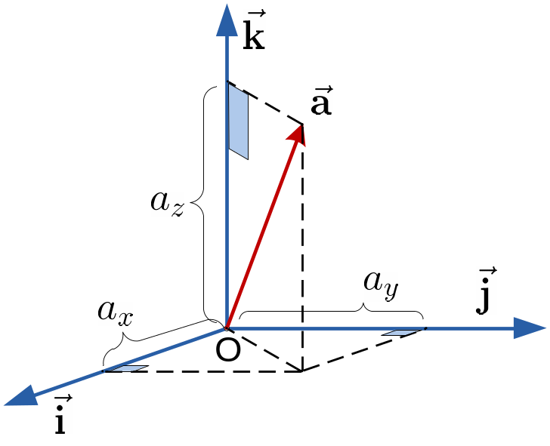
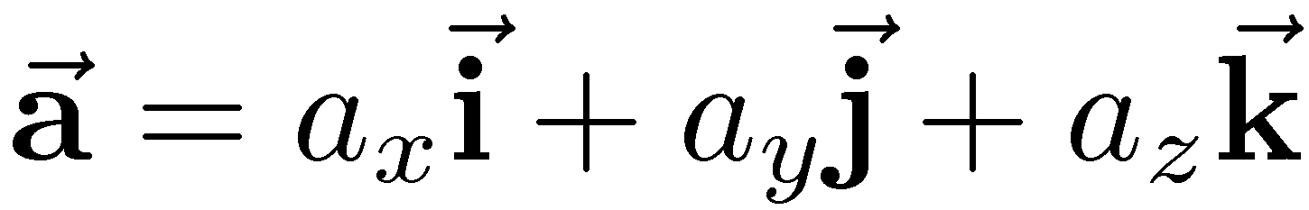
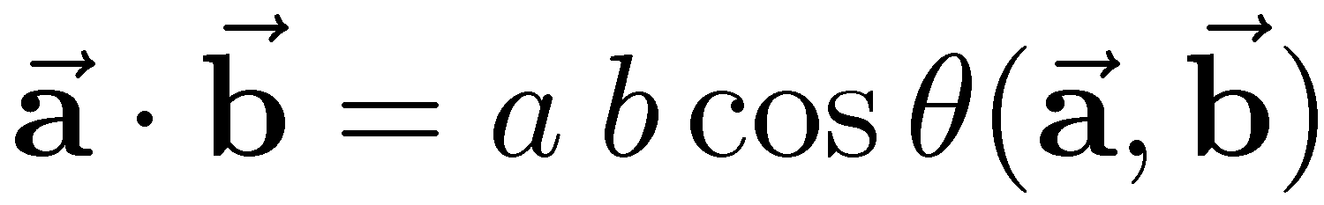
Representing a G. Vector in a RF
Inner product of two g. vectors, recall:
Since the angle between basis vectors is π/2:
  Therefore, the Cartesian coordinates are computed as

Slide 4
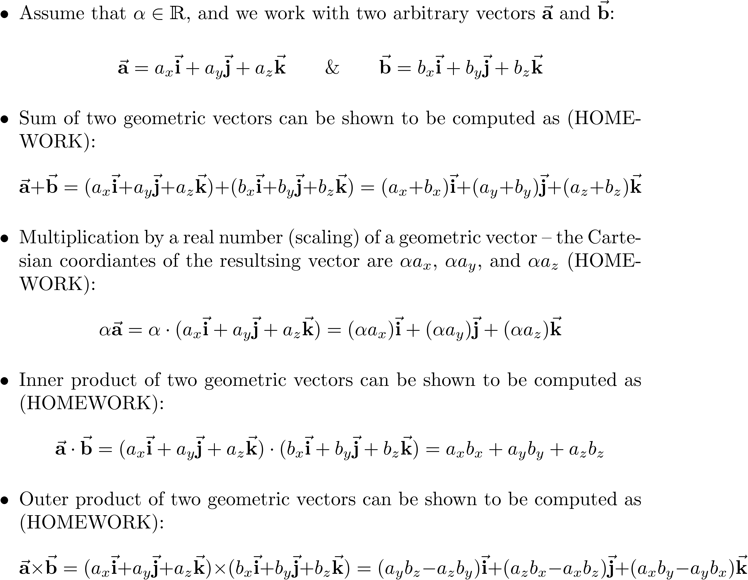
Geometric Vectors and RFs:
Revisiting the Basic Operations

Slide 5
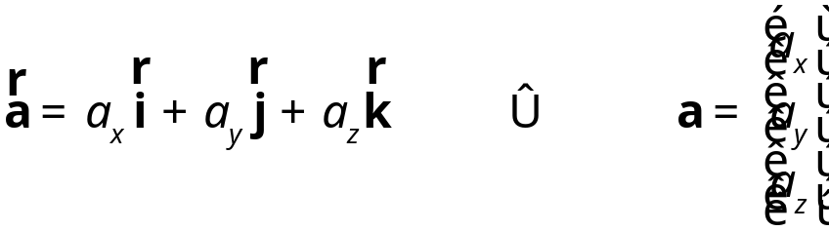
New Concept: Algebraic Vectors
Given a RF, each vector can be represented by a triplet
It doesn’t take too much imagination to associate to each geometric vector a tridimensional algebraic vector:
Note that I dropped the arrow on a to indicate that we are talking about an algebraic vector

Slide 6
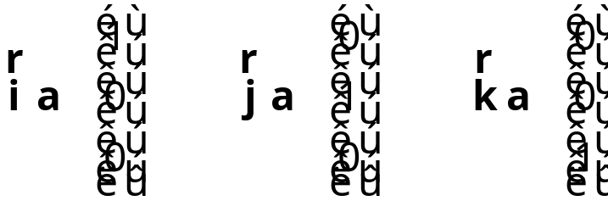
Putting Things in Perspective…
Step 1: I started with geometric vectors
Step 2: I introduced a reference frame
Step 3: Relative to that reference frame each geometric vector is uniquely represented as a triplet (the Cartesian coordinates)
Step 4: I generate an algebraic vector whose entries are provided by the triplet above
  This vector is the algebraic representation of the geometric vector
Note that the algebraic representations of the basis vectors are

Slide 7
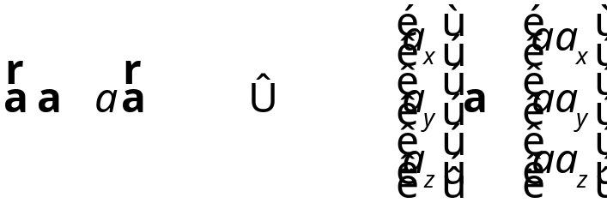
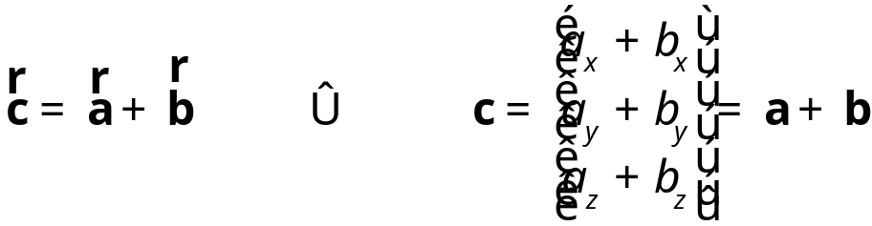
Revisiting the Basic Vector Operations
[An algebraic perspective]
Based on conclusions drawn in slide “Geometric Vectors and RFs: Revisiting the Basic Operations” it’s easy to see that:
  If you scale a geometric vector, the algebraic representation of the result is obtained by scaling of the original algebraic representation
  If you add two geometric vectors and are curious about the algebraic representation of the result, you simply have to add the two algebraic representations of the original vectors

Slide 8
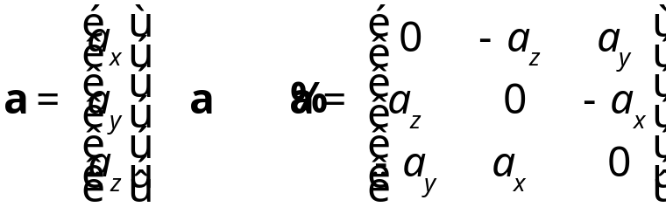
Revisiting the Basic Operations
[An algebraic perspective, Cntd.]
Based on conclusions drawn in slide “Geometric Vectors and RFs: Revisiting the Basic Operations” it’s easy to see that:
  If you take an inner product of two geometric vectors you get the same results if you compute the dot product of their algebraic counterparts
  Dealing with the outer product of two geometric vectors is slightly less intuitive
    Requires the concept of “cross product matrix” of a given algebraic vector a
      A 3 X 3 matrix defined as :
Note the slight inconsistency:
I promised I’d have all the matrices
in this class in bold upper case. This
is the only exception.

Slide 9
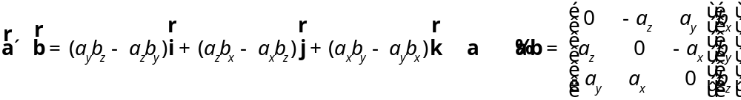

Revisiting the Basic Operations
[An algebraic perspective, Cntd.]
Based on conclusions drawn in slide “Geometric Vectors: Revisiting the Basic Operations” it’s easy to see that:
  If you take the outer product of two geometric vectors, then the algebraic vector representation of the result is obtained by left multiplying the second vector by the cross product matrix of the first vector:
  Note that the cross product matrix of a vector is a skew-symmetric matrix:

Slide 10


Reference Frames:
Nomenclature & Notation
G-RF: Global Reference Frame (the “world” reference frame)
  This RF is unique
  This RF is fixed; that is, its location & orientation don’t change in time
L-RF: Local Reference Frame
  It typically represents a RF that is *rigidly* attached to a moving rigid body
  Notation used
    An algebraic vector represented in an L-RF has either a prime , as in , or it has an overbar, like in
    The book *always* uses a prime, I will use both of these notations
A-RF: Arbitrary Reference Frame
  Notation used: See “Notation used” for L-RF

Slide 11

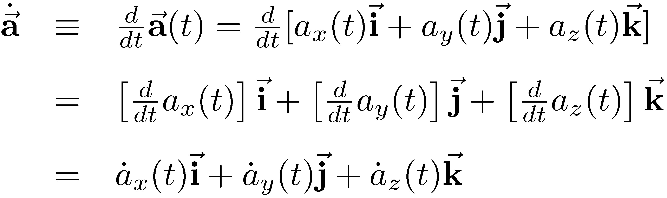

Differentiation of Vectors
(pp.315, Haug book)
Assumption: for the sake of this discussion on vector differentiation, the geometric vectors are assumed to be represented in a G-RF. Therefore:
Due to the assumption above, one has:
Therefore, the algebraic representation of the derivative of is

Slide 12
Differentiation of Vectors
(pp.315)
Similarly, by taking one more time derivative, it is easy to see that the second time derivative of a geometric vector has the following algebraic vector representation
Likewise, consider the only operation introduced so far involving two geometric vectors that leads to a real number: the inner product

Slide 13
Differentiation of Vectors
(pp.315)
The concluding remark is that as long as we are working in a G-RF, the time derivative of a geometric vector has an algebraic representation that comes in line with our expectations. Specifically:
  Simply take the time derivative of the components of the algebraic representation
This means that the time derivative of any basic operation that involves two geometric vectors to produce a third one (scaling, summation, outer product) boils down to taking the time derivative of the algebraic representation of the third geometric vector
Note that we just saw that this extends also to the inner product, so we covered all the basic operations of interest
It becomes apparent that I need to know how to take time derivative of operations that involve algebraic vectors

Slide 14
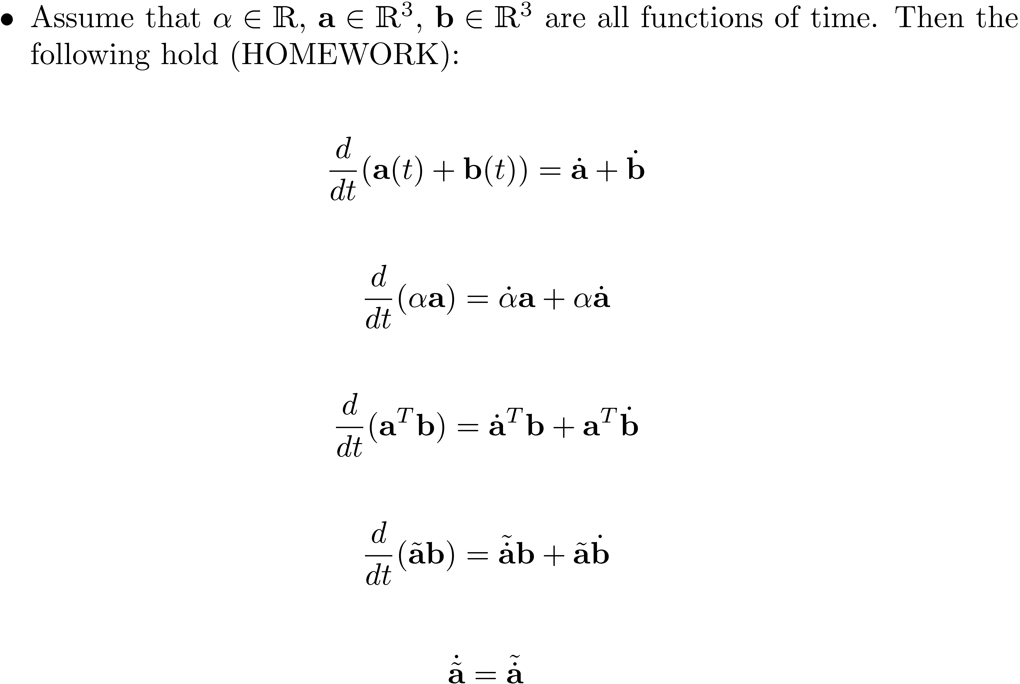
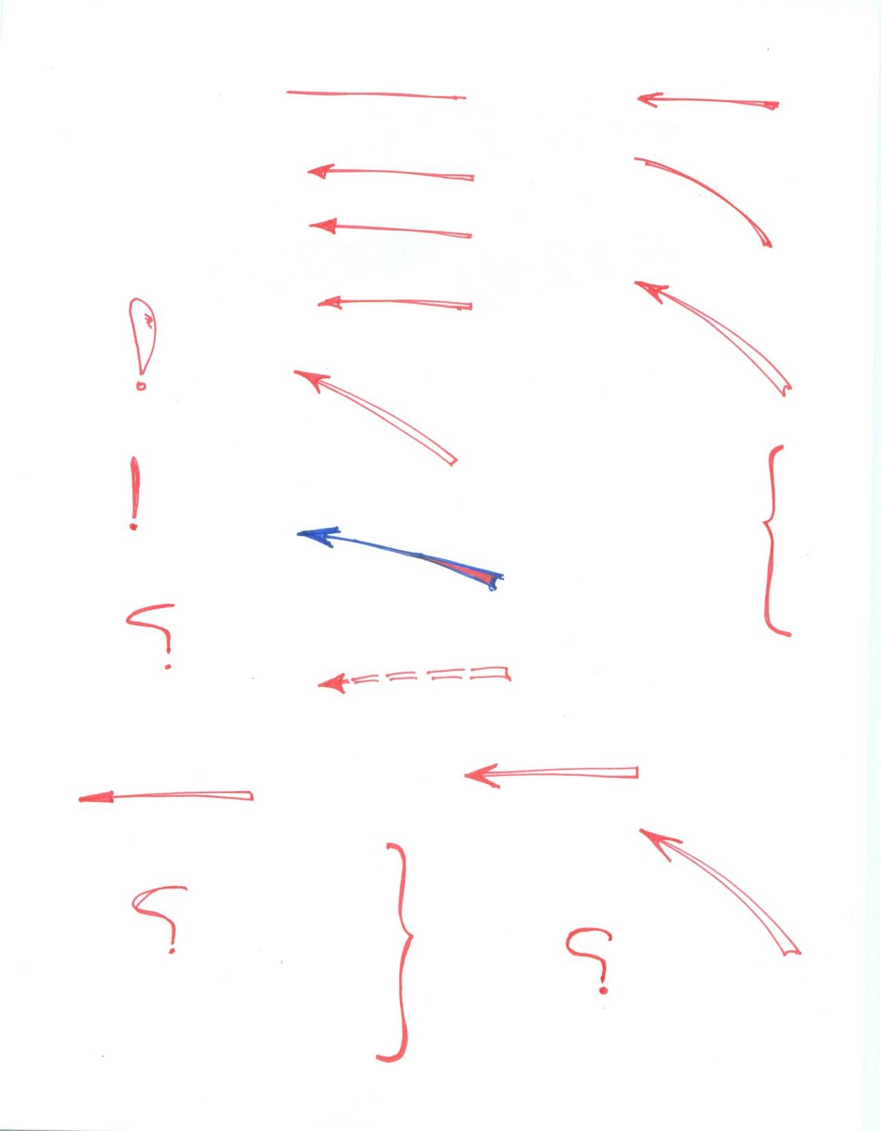
[Review]
Differentiation of Algebraic Vectors:
Rules
Take a minute to reflect on
this, specifically, on what
its geometric counterpart is

Slide 15
Algebraic Vectors and
Reference Frames
Recall that an algebraic vector was introduced as a representation of a geometric vector in a particular reference frame (RF)
Question: What if I now want to represent the same geometric vector in a different RF_{new} that is rotated relative to the original RF?
  This is one of the three tricky question of Computational Dynamics

Slide 16
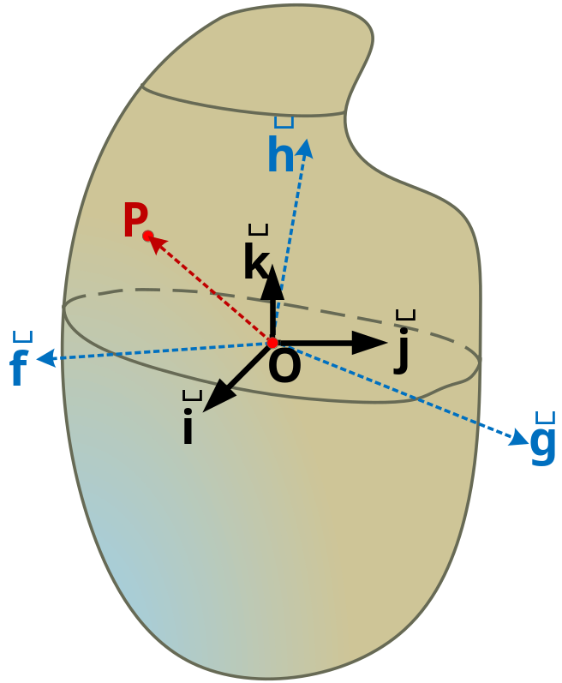
Problem Setup
A rigid body is provided and fixed at point O
G-RF is attached at O
P is some point of the body
Geometric vector in red assumes different algebraic representations in the blue and black RFs.
Question of Interest:
  What’s the relationship between these two representations?

Slide 17
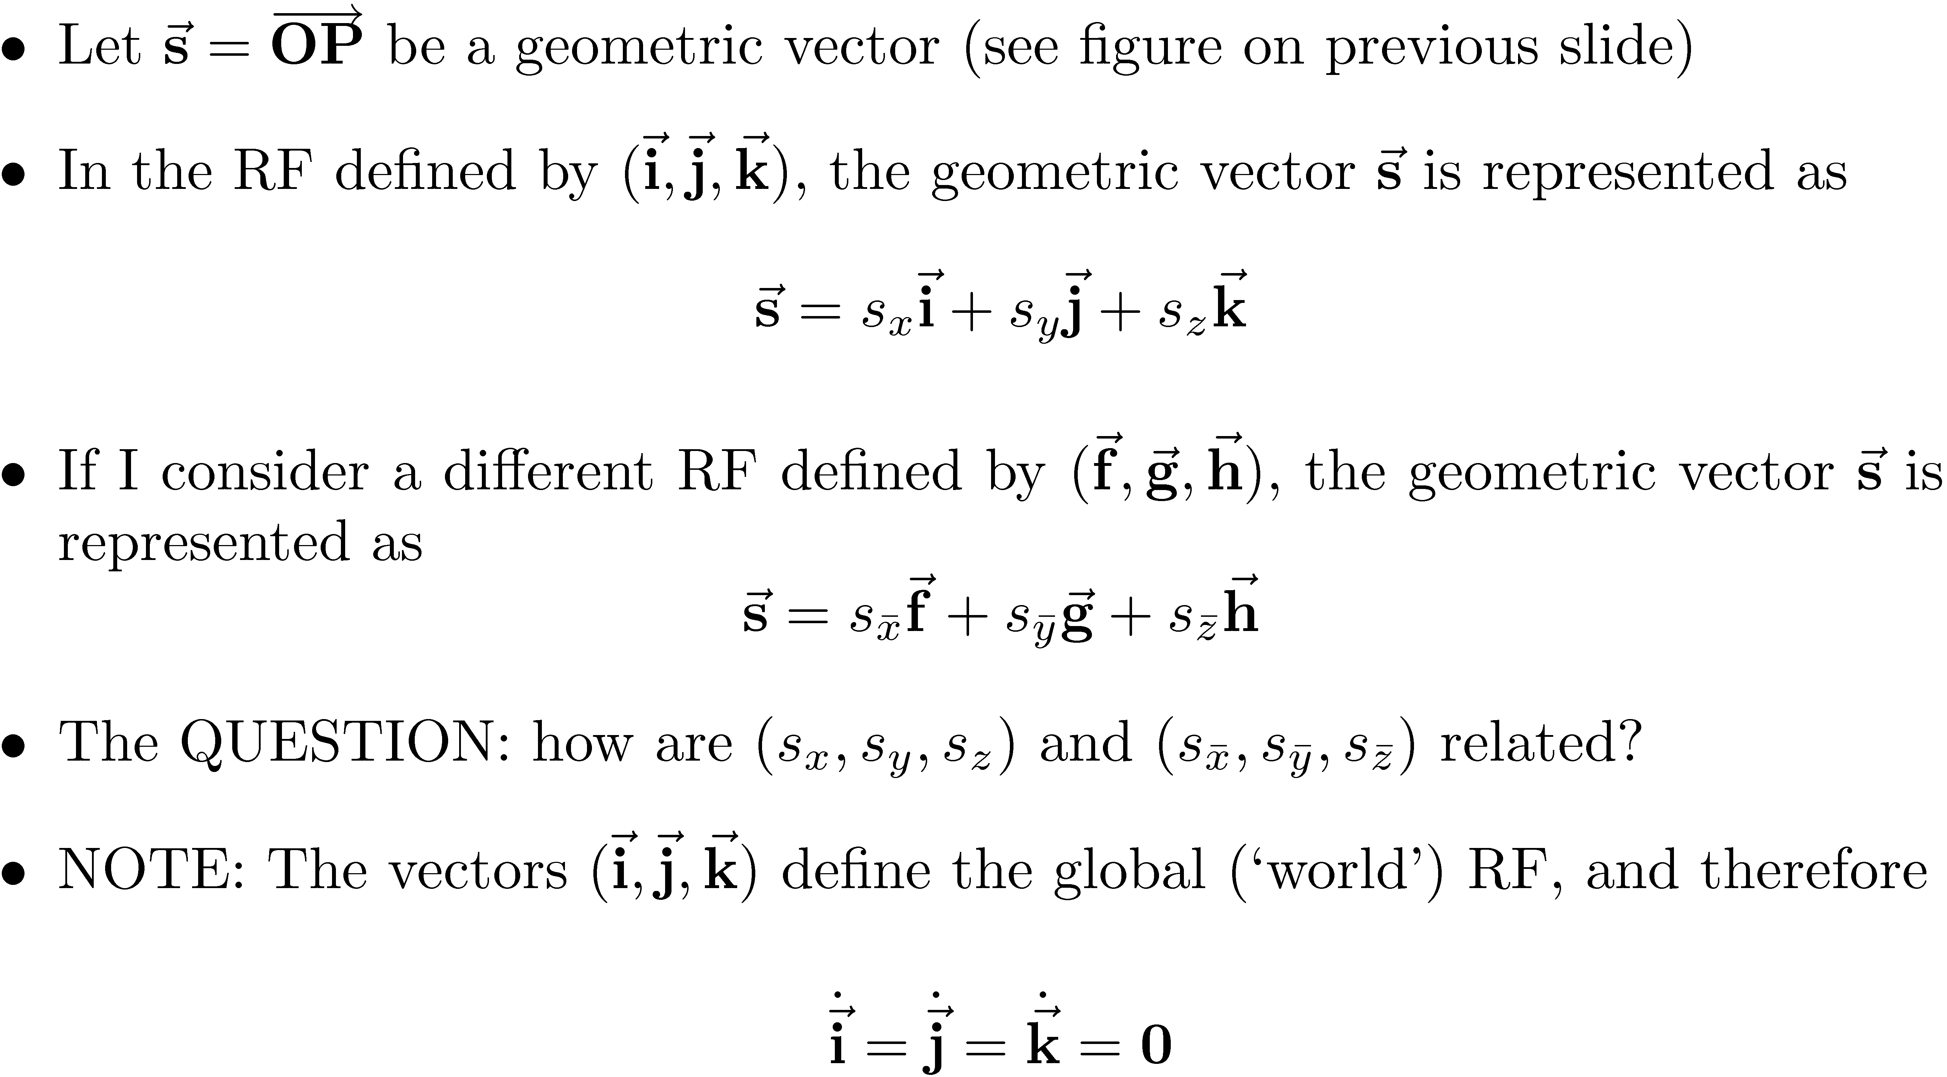
Algebraic Vectors and
Reference Frames

Slide 18
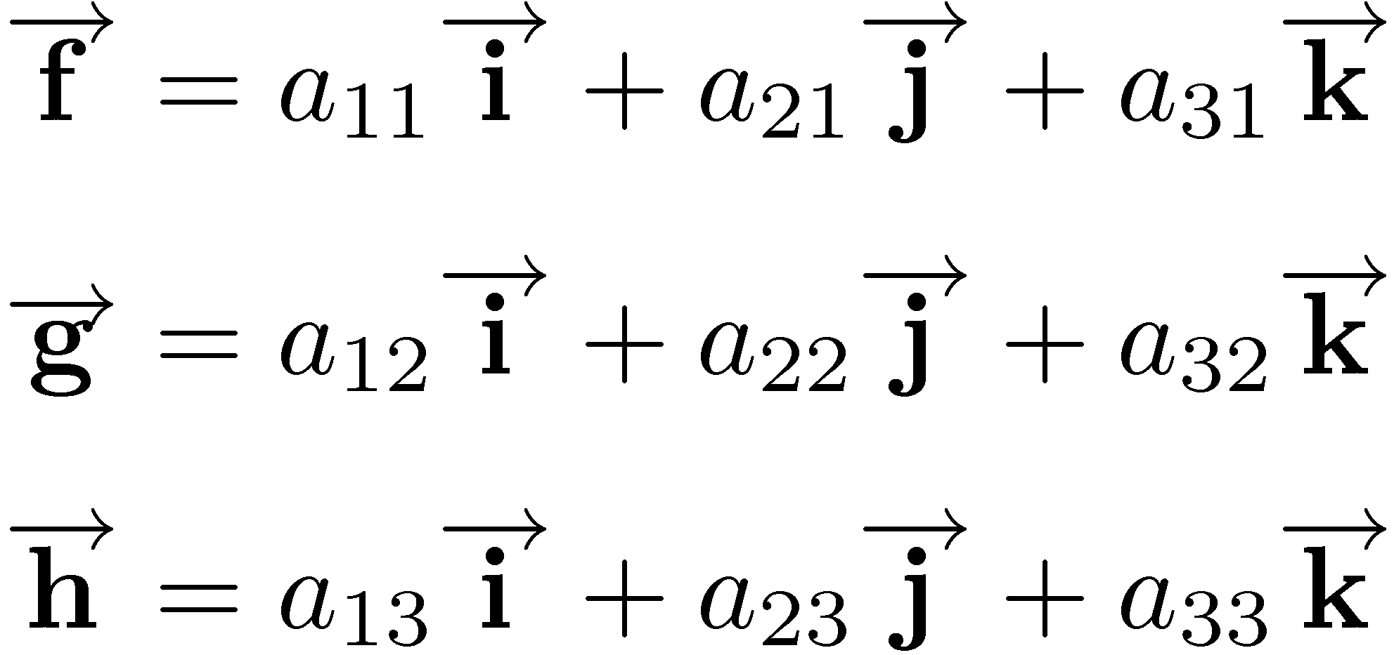
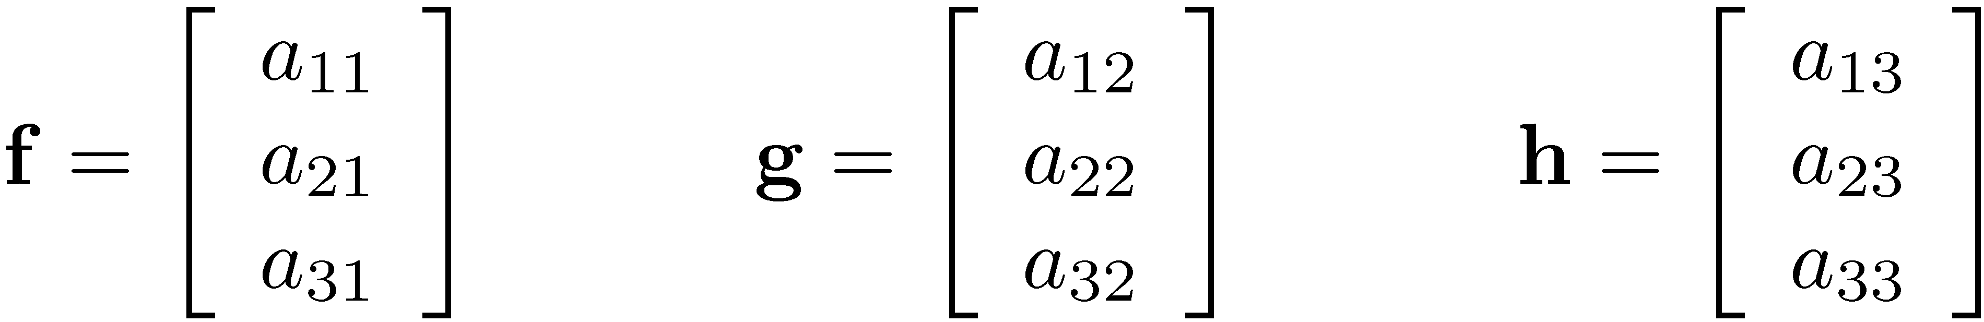
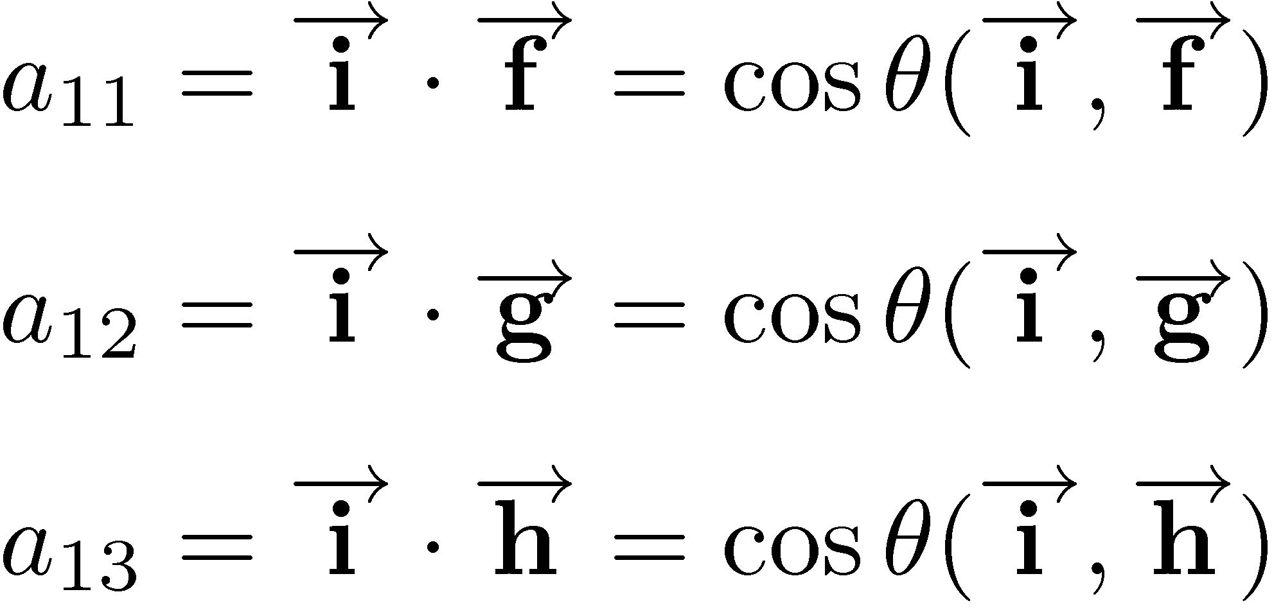
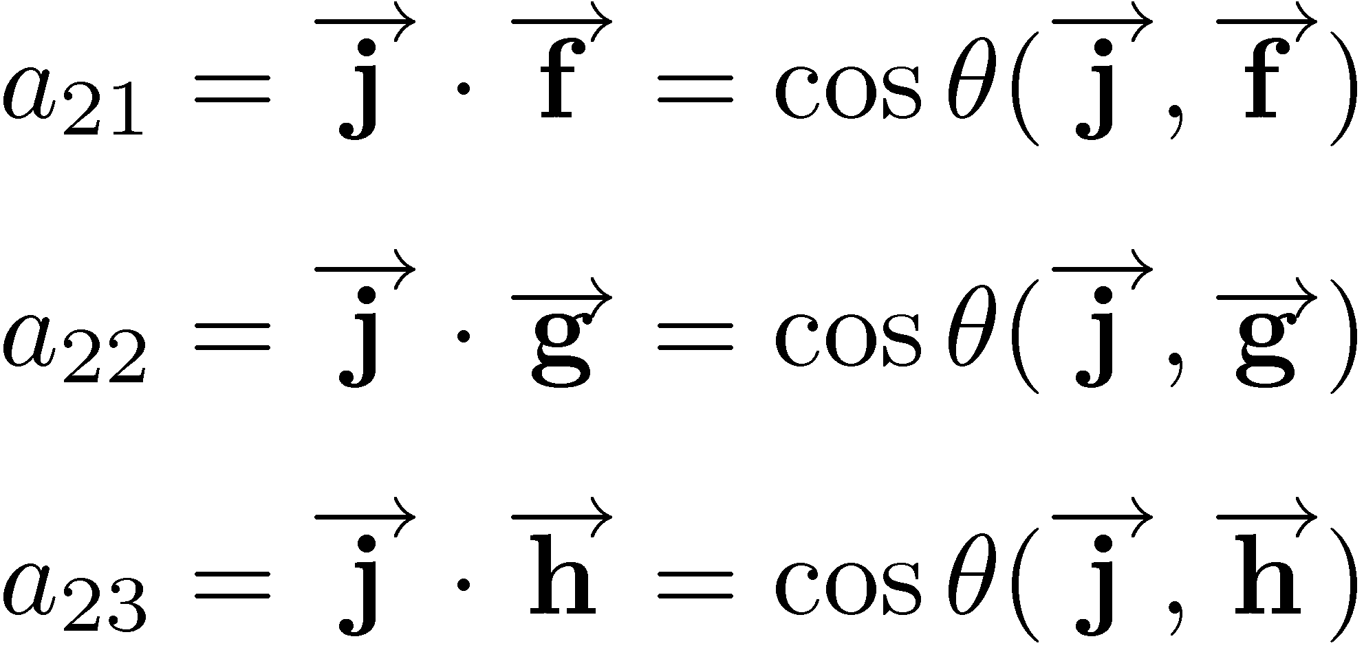
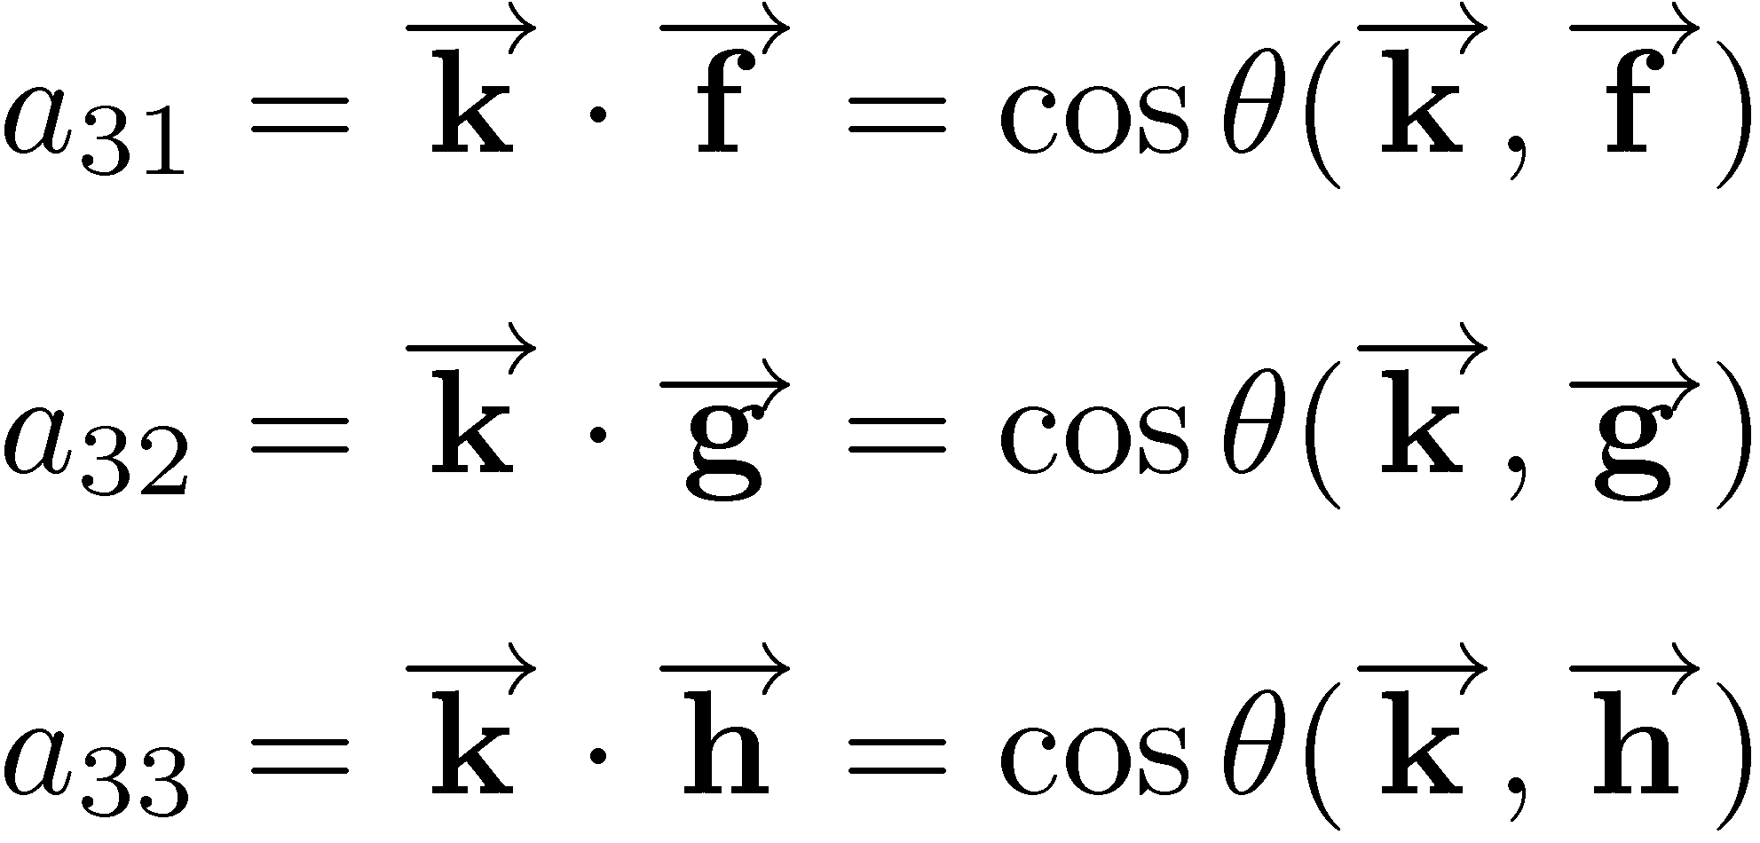
Relationship Between ARF Vectors and GRF Vectors

Slide 19
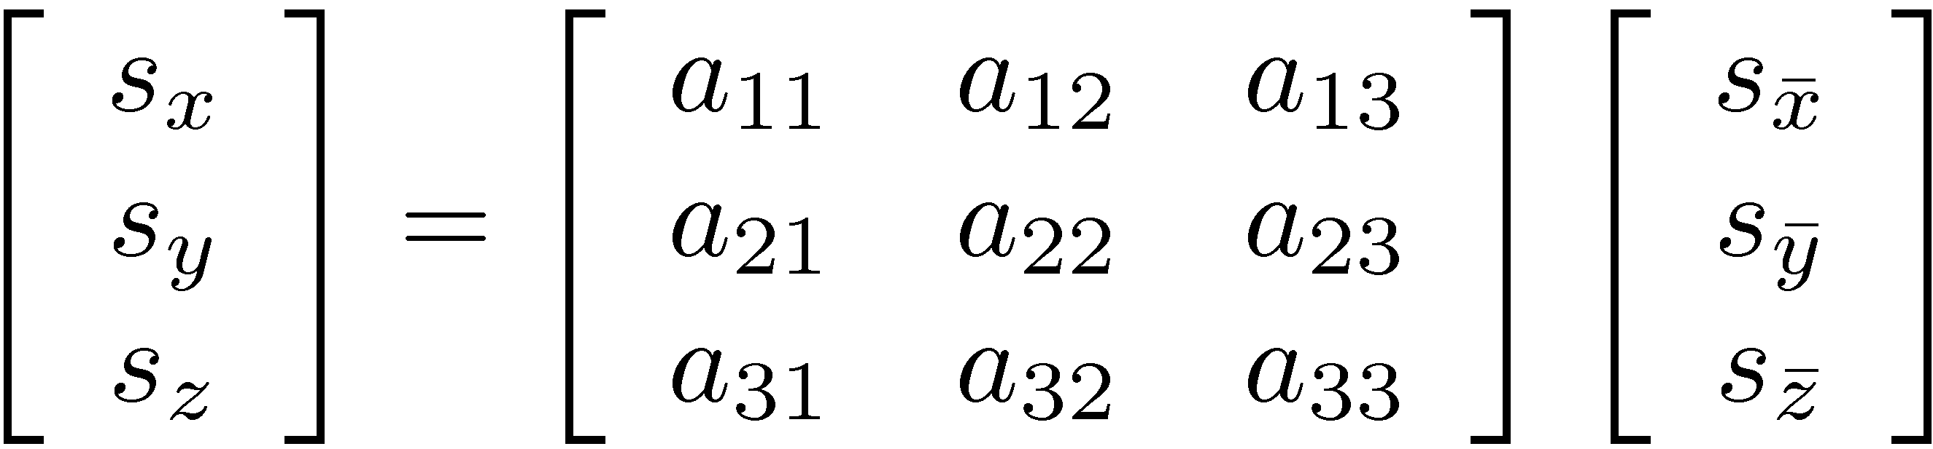

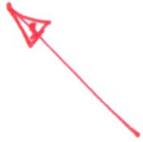
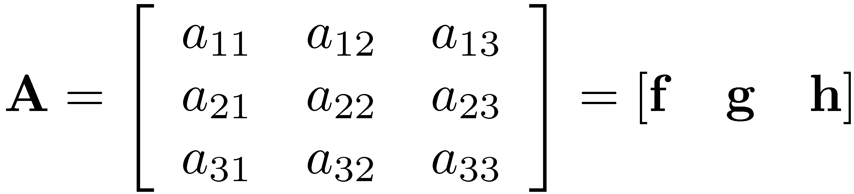
Relationship Between ARF and GRF Representations
This is important (see pp. 321)

Slide 20

Algebraic Vectors and
Reference Frames
Representing the same geometric vector in a different RF leads to the important concept of Rotation Matrix A:
  Getting the new coordinates, that is, representation of the same geometric vector in the new RF is as simple as multiplying the coordinates by the rotation matrix A:
NOTE 1: what is changed is the RF used for representing the vector, and not the underlying geometric vector
NOTE 2: rotation matrix A is sometimes called “orientation matrix”
Notes:
Slide 03

Slide 21
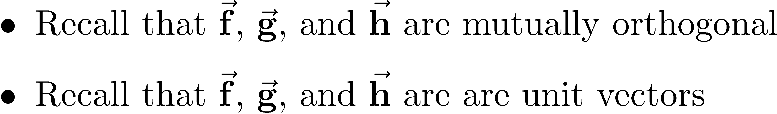
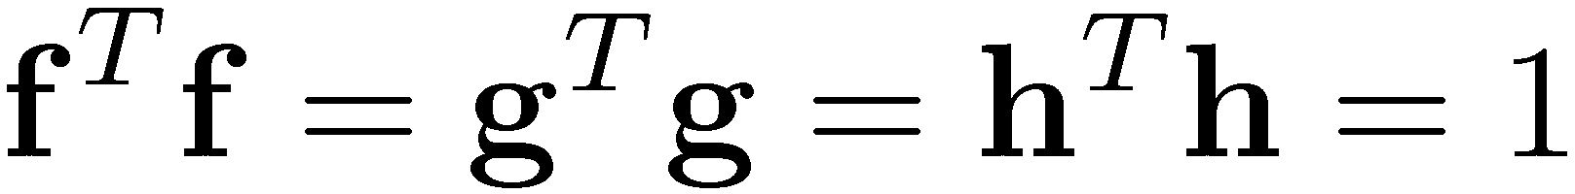
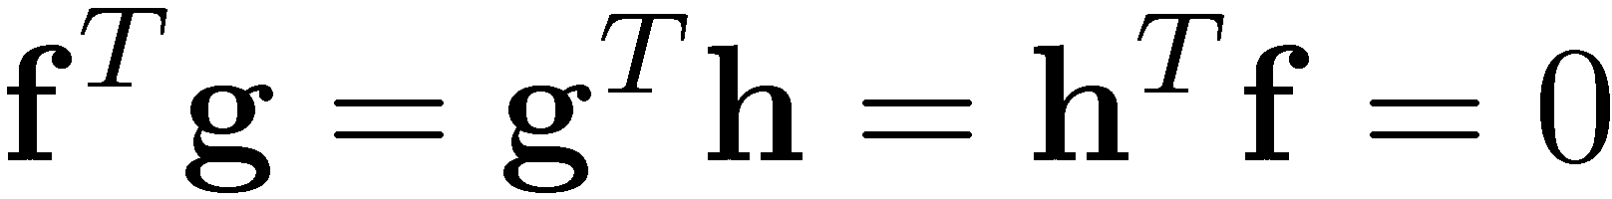
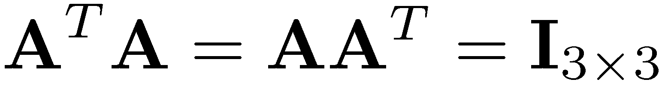
On the Orthonormality of A
Therefore, the following hold:
Consequently, the rotation matrix A is orthonormal:

Slide 22
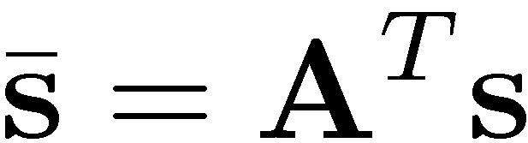
The Transformation Matrix A:
Further Comments
The nine entries of matrix A are called direction cosines
  The first column are the direction cosines of f, the second contains the direction cosines of g, etc.
Found the representation in G-RF given the one in an A-RF
  Found A-RF ! G-RF
Since A is orthonormal, it’s easy to find the transformation in the other direction: G-RF ! A-RF

Slide 23
Summarizing the Key Points
Linking two algebraic vector representations of the same geometric vector
Sometimes called a change of base or reference frame
Recall that A (its columns) are made up of the representation of f, g, and h in the new RF
  The algebraic vectors f, g, and h define the “old”, “local”, “initial” RF, that is, that reference frame in which where is expressed

Slide 24
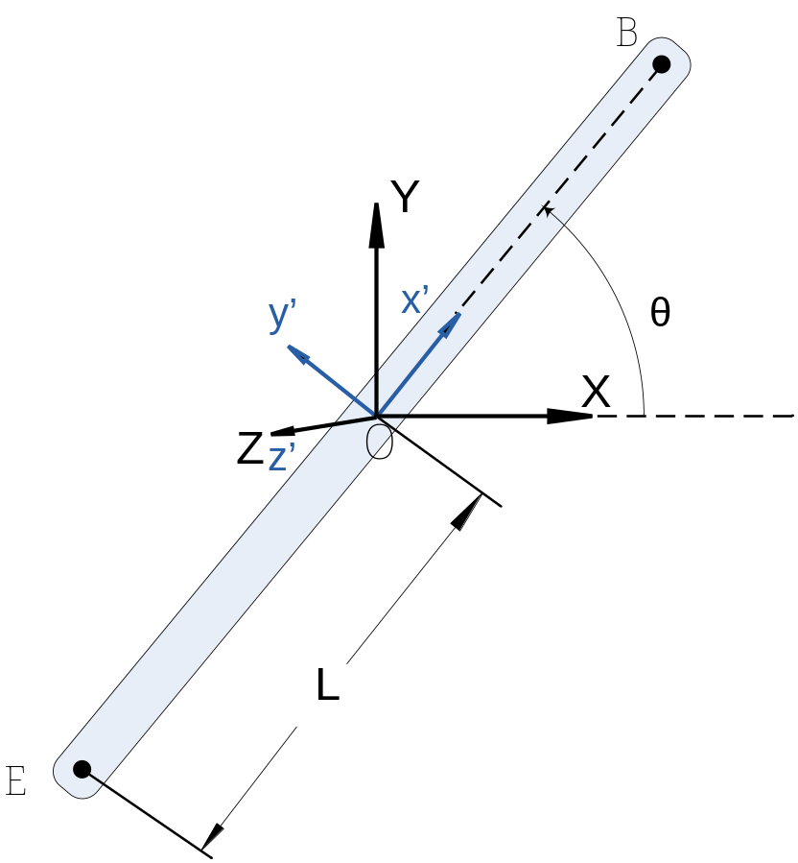

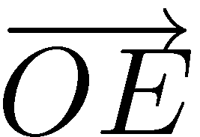
[AO]
Example: Assembling Matrix A
Express the geometric vector in the local reference frame OX’Y’.
Express the same geometric vector in the global reference frame OXY
Do the same for the geometric vector

Slide 25
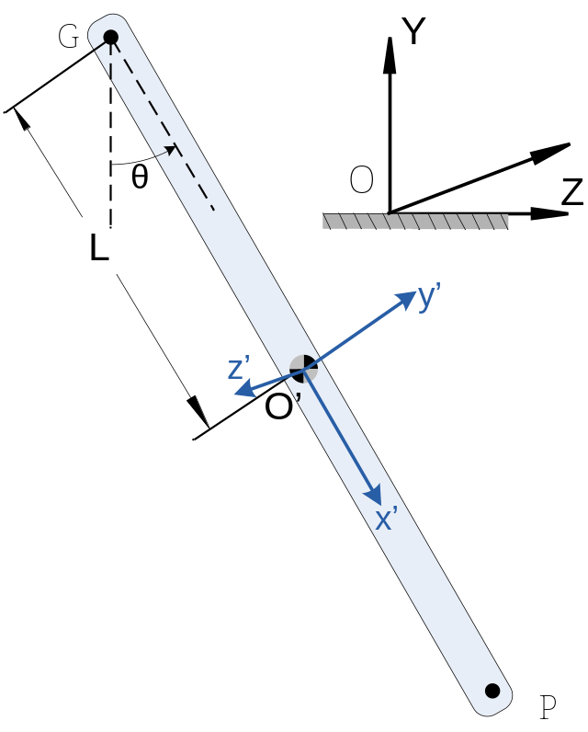
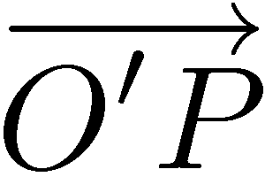
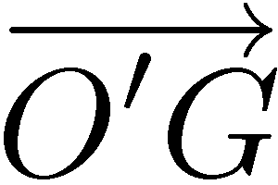
[HOMEWORK]
Assembling A
Express the geometric vector
in the local reference frame O’X’Y’Z’.
Express the same geometric vector in the global reference frame OXYZ
Do the same for the geometric vector
Note that the plane (O'X'Y') is parallel to the (OYZ) plane
Note that O and O’ should have been coincident; avoided to do that to prevent clutter of the figure (you should work under this assumption though)

Slide 26

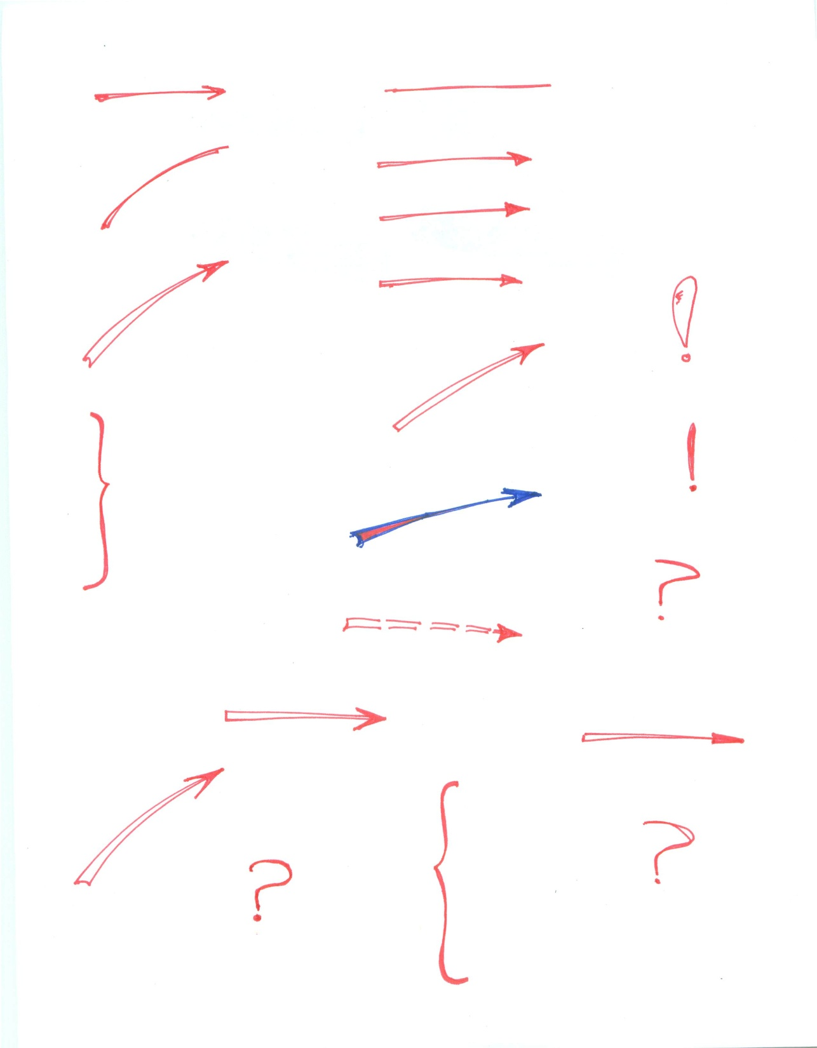

RF Change:
The Outer Product and Cross Product Matrix
Problem Setup:
  We saw how to switch between A-RF and G-RF when it comes to the algebraic representation of a geometric vector
    Boils down to multiplication by the rotation matrix A
  Recall that associated with each algebraic vector there is a cross product matrix
Question: How do you have to change the cross product matrix when you go from an A-RF to the G-RF ?
?

Slide 27


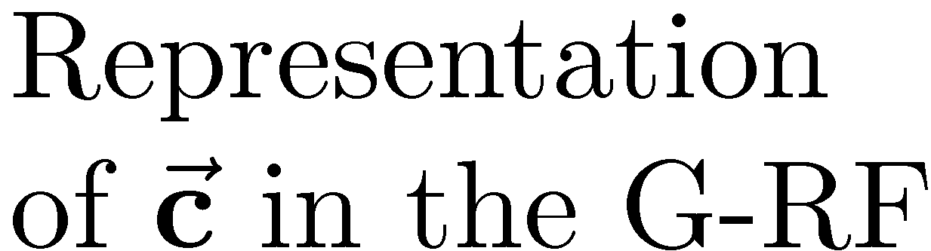
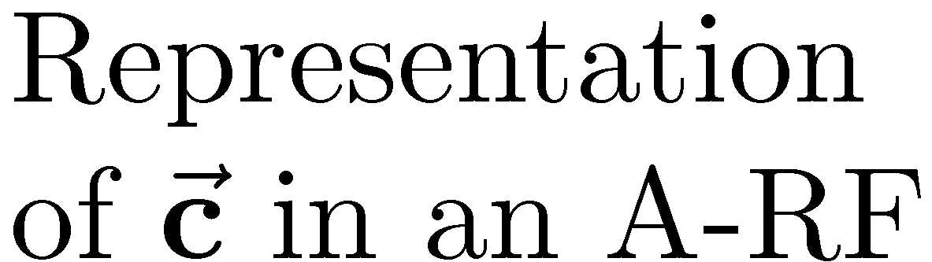





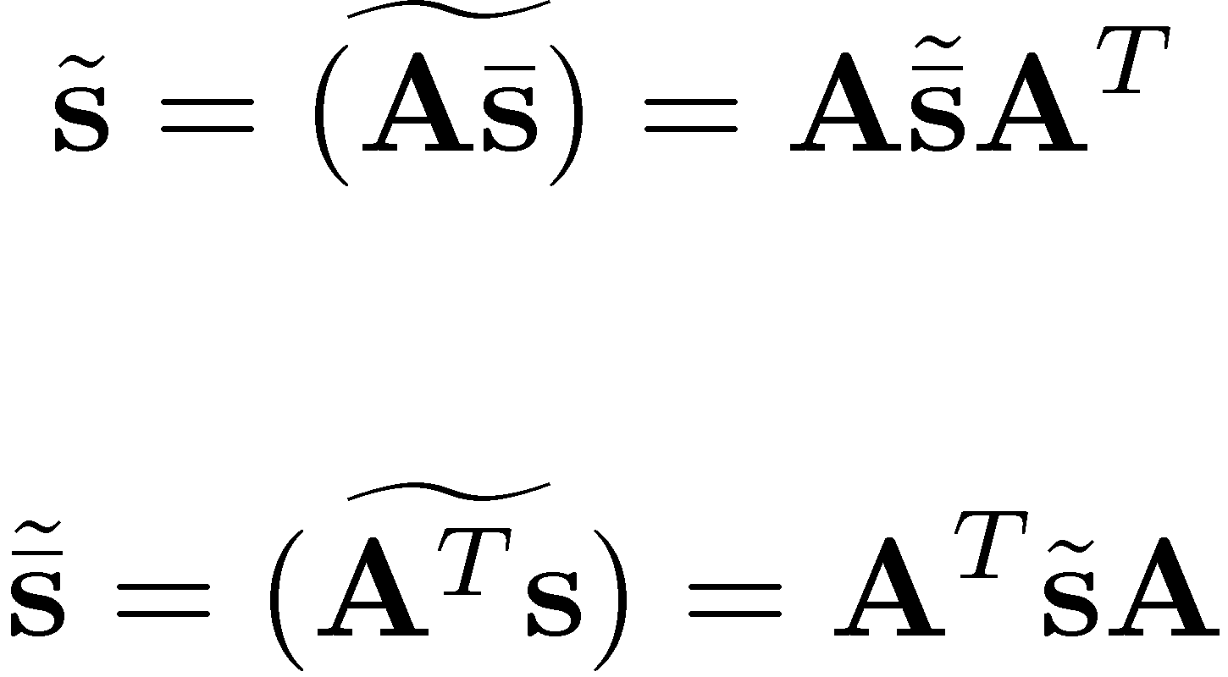
RF Change:
The Outer Product and Cross Product Matrix
The geometric vector representation: I have two geometric vectors, and care about their outer product,

Slide 28
Angular Velocity: Intro
The motivating question: How does the orientation matrix A change in time?
Matrix A changes whenever the representation of f, g, or h in the G-RF changes
Example: Assume blue RF is attached to the body (the L-RF) and the black is the G-RF, fixed to ground
  A ball joint (spherical joint) present between the body and ground at point O

Slide 29
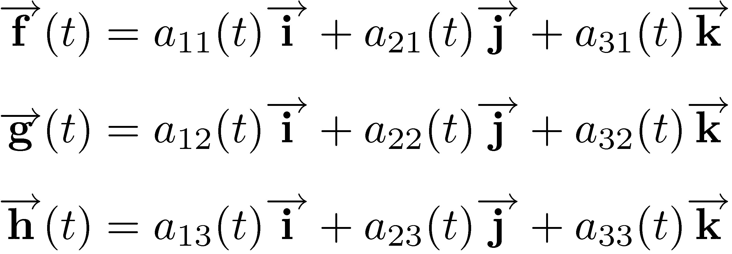
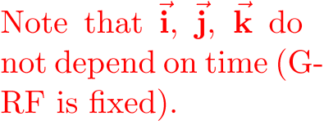
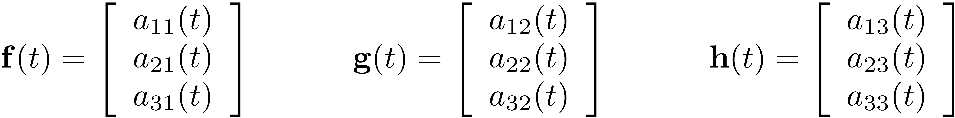
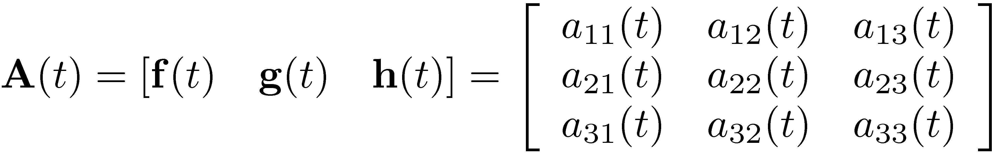
Angular Velocity: Intro
Note that if f, g, and h change, then a₁₁, a₂₁,…, a₃₃ change
  In other words, A=A(t)
Recall how the orientation matrix A was defined:

Slide 30
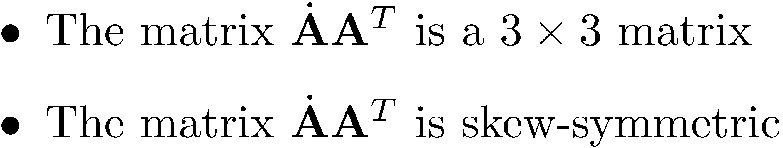
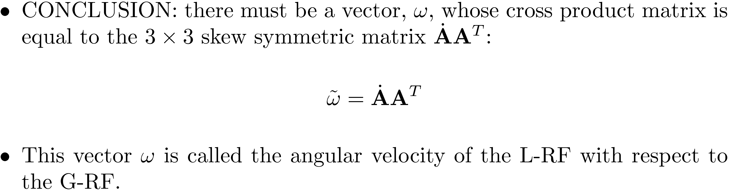
Angular Velocity: Getting There…
Recall that AA^{T}=I₃. Take time derivative to get:
Notice the following:

