Slide 1
ME751 Advanced Computational Multibody Dynamics
Section 9.2
February 2, 2010
© Dan Negrut, 2010 ME751, UW-Madison
“My own business always bores me to death; I prefer other people's.” Oscar Wilde

Slide 2
Before we get started…
Last Time:
Algebraic Vectors (the algebraic counterpart of Geometric Vectors)
Understand what it takes to do a change of RF
Started discussion about time derivative of the orientation matrix A
We barely introduced the concept of angular velocity
Today:
Finish introducing the concept of angular velocity of a rigid body
Talk about the number of generalized coordinates required to characterize the orientation of a rigid body
HW1 returned, solutions posted at Learn@UW
I’ll be out on Th Feb. 4
Justin and Makarand will present an overview of ADAMS
Today’s lecture is 20 minutes shorter

Slide 3
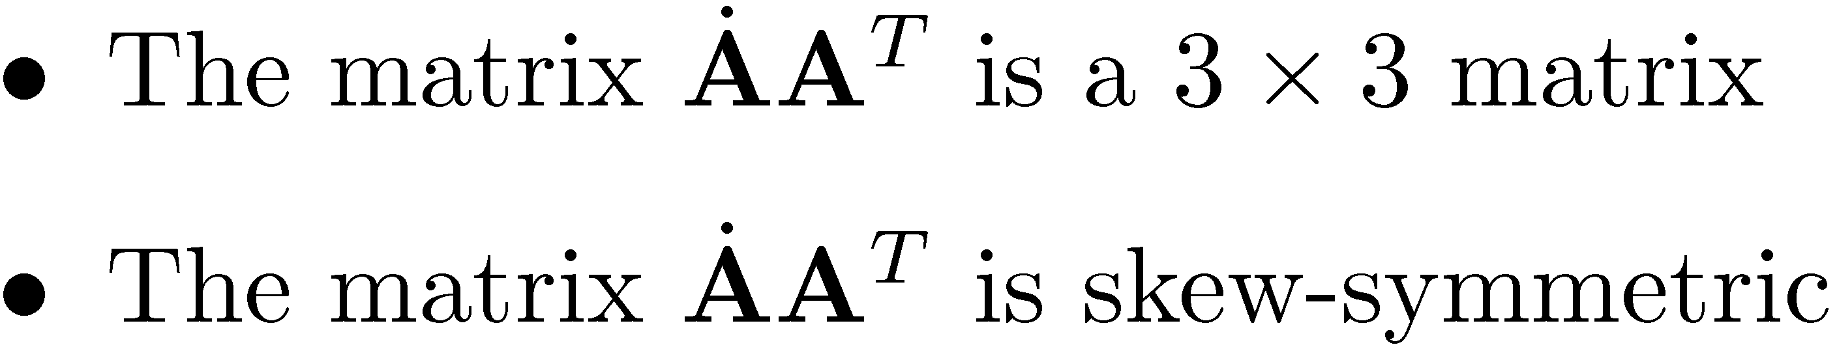
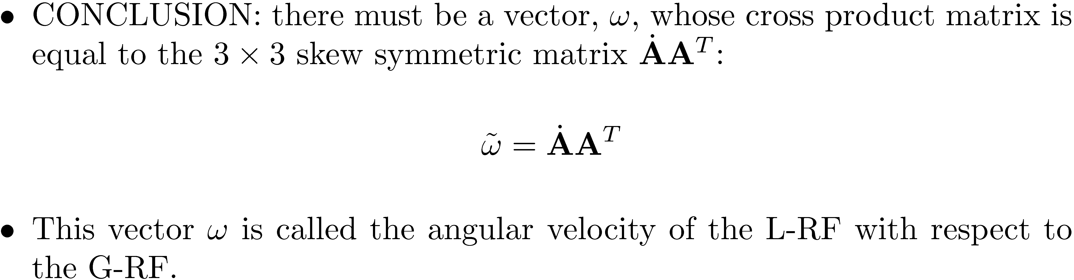
Angular Velocity: Getting There…
Recall that AA^{T}=I₃. Take time derivative to get:
Notice the following:

Slide 4
[Short Detour]: Two L-RF Attached to Same Body
Problem Setup:
You have one rigid body and two different L-RF rigidly attached to that body
Rigidly attached means that their relative orientation never change
Rigidly attached to the body = “welded” to the body ) they move as the body moves
Call the local references frames and orientation matrices L-RF₁, A₁, and L-RF₂, A₂
Question: what is the relationship between A₁ and A₂?

Slide 5
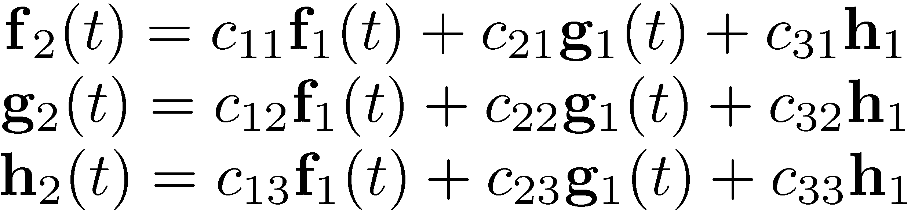
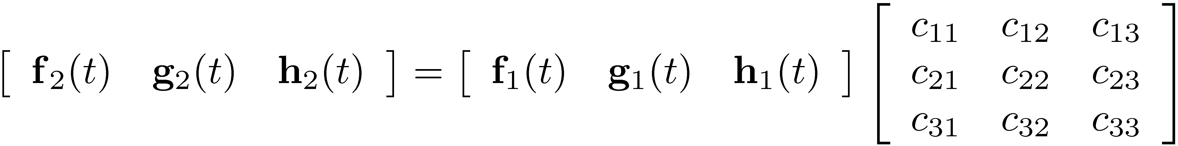
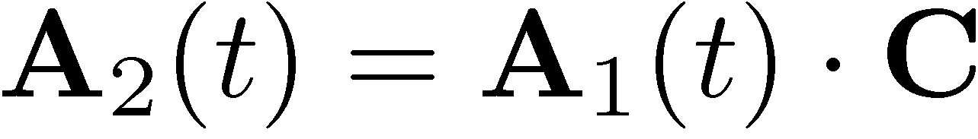
[Short Detour, Cntd.]: Two L-RF Attached to Same Body
The important observation: since both L-RF₁ and L-RF₂ are “welded” to the rigid body, their relative attitude (orientation) doesn’t change in time
Equivalent way of saying this:
The important point: C is a constant matrix (since L-RF₁ and L-RF₂ are “welded” to the rigid body)

Slide 6
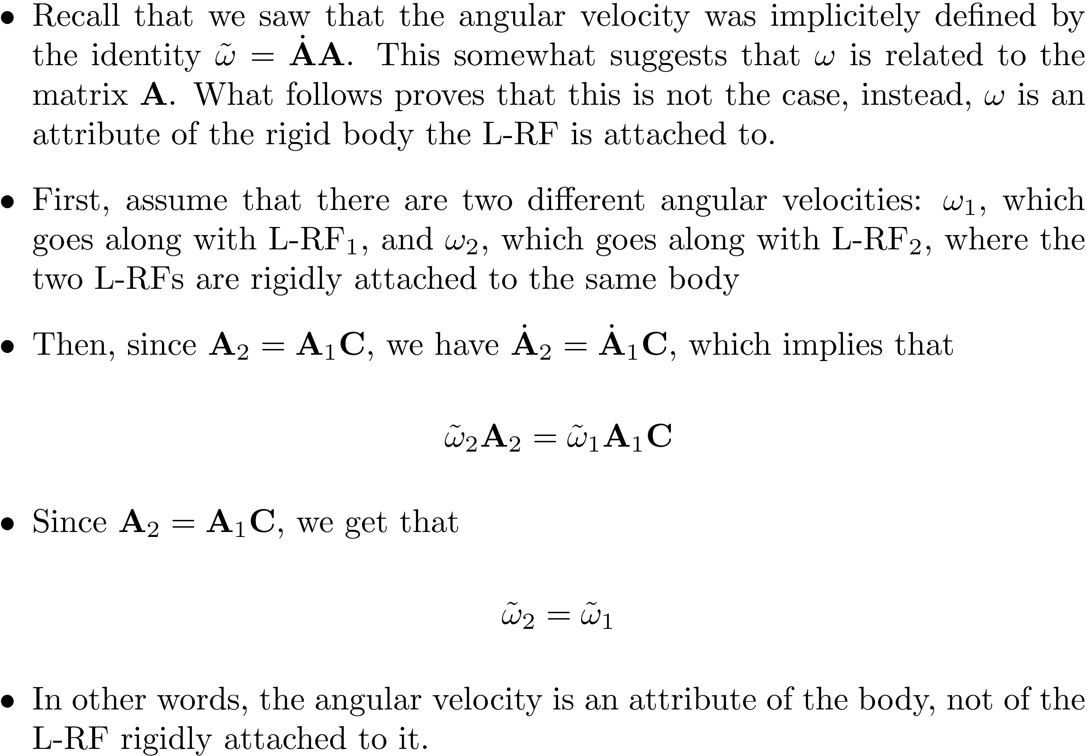
The Invariance Property of !

Slide 7
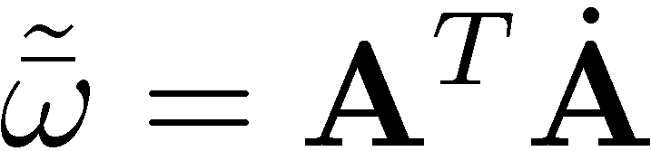
Angular Velocity: On Its Representation in the L-RF
Assume you have a L-RF attached a body
Assume that the angular velocity is !
Question: what is its representation in the L-RF ?
Therefore, we have that
Note that this also yields two ways of representing the time derivative of A:

Slide 8
The Second Time Derivative of A
Straight forward application of the definition of the first time derivative of A combined with the chain rule of differentiation
Using the angular velocity and its derivative expressed in the G-RF:
Using the angular velocity and its derivative expressed in the L-RF:

Slide 9
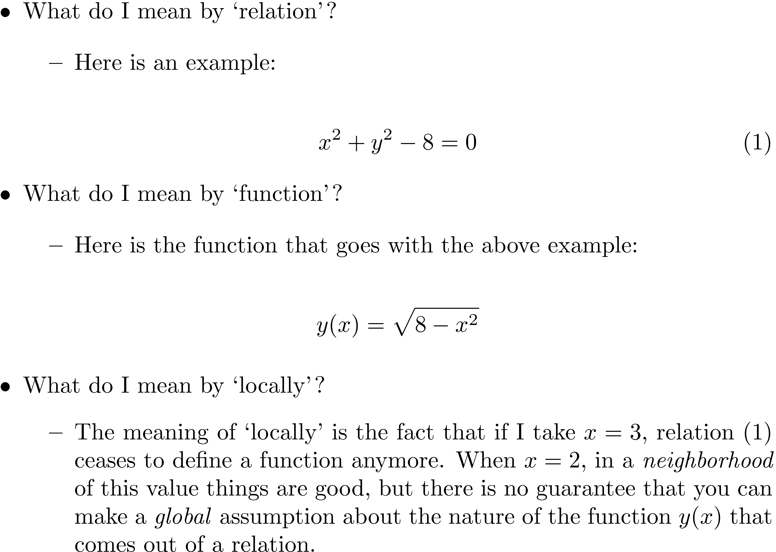
[New Topic, Short Detour:] The Implicit Function Theorem (IFT)
The Implicit Function Theorem provides the guarantee that a relation can locally be turned into a function

Slide 10
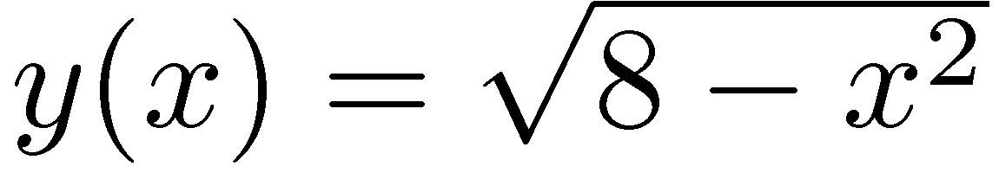
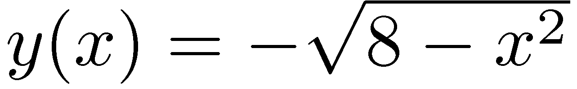
[Short Detour, Cntd.:] The Implicit Function Theorem
There is one more important thing to be considered in relation to the “locality” aspect
Note that both x=2,y=2 and x=2, y=-2 verify the relation (1).
However, x=2,y=2 forces the relation to lead to this function:
Yet x=2, y=-2 forces the relation to lead to this different function,
Conclusion: the values x₀, y₀ around which you seek the function that comes out of a relation play a role in defining the expression of that function

Slide 11
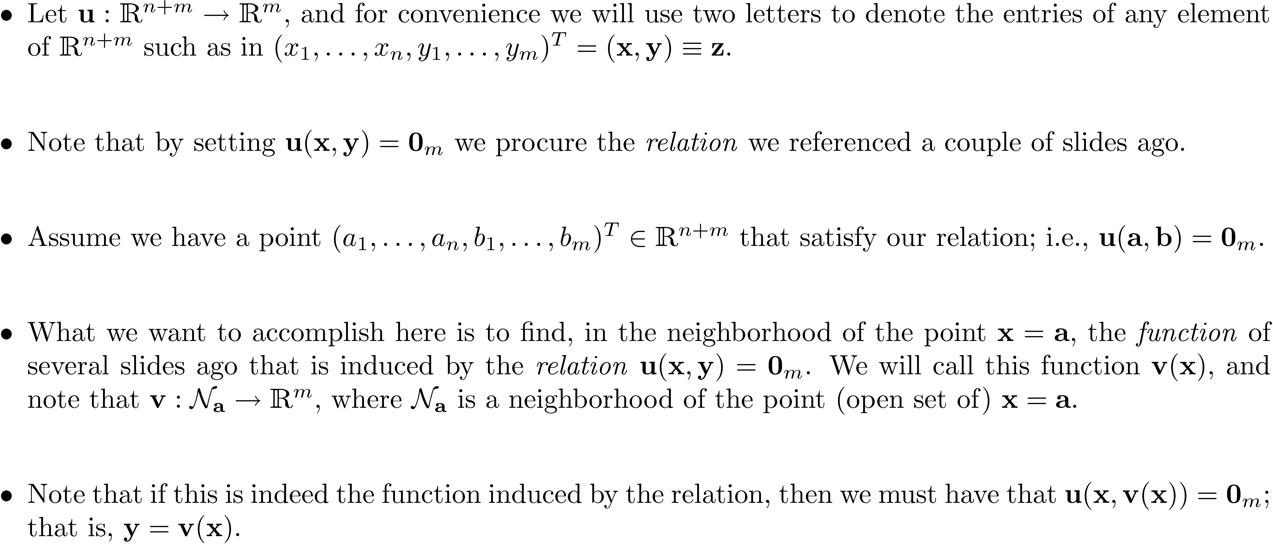
[Short Detour, Cntd.:] The Implicit Function Theorem: Setting the Stage, Formally

Slide 12
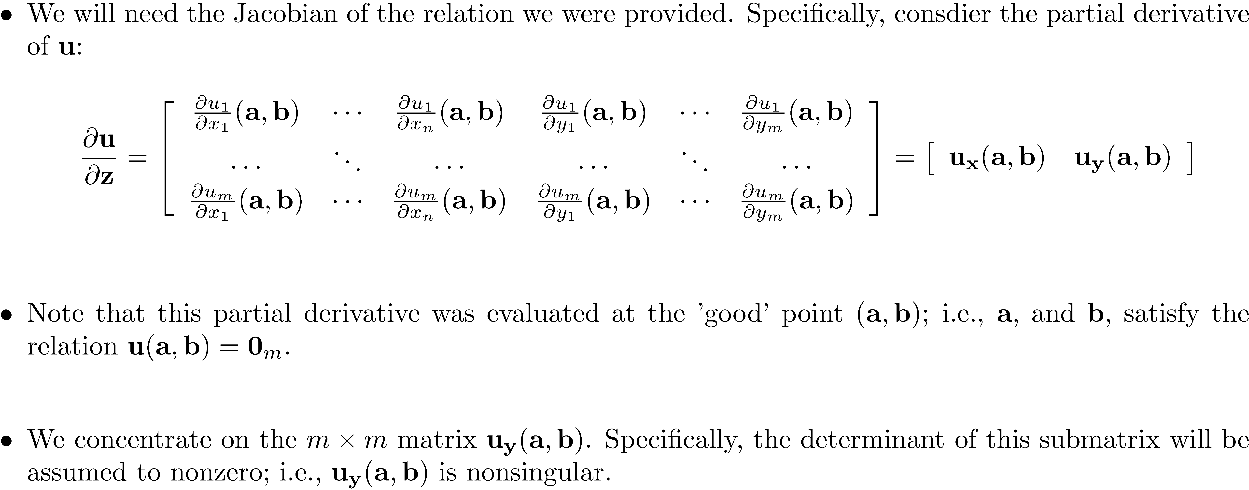
[Short Detour, Cntd.:] The Implicit Function Theorem: Bringing in the Jacobian

Slide 13
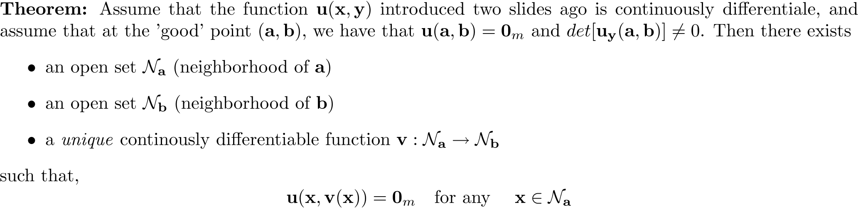
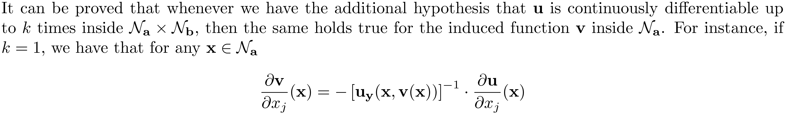
[Short Detour, Cntd.:] The Implicit Function Theorem: The Actual Formal Thing
Important observation regarding differentiability of v(x):

Slide 14
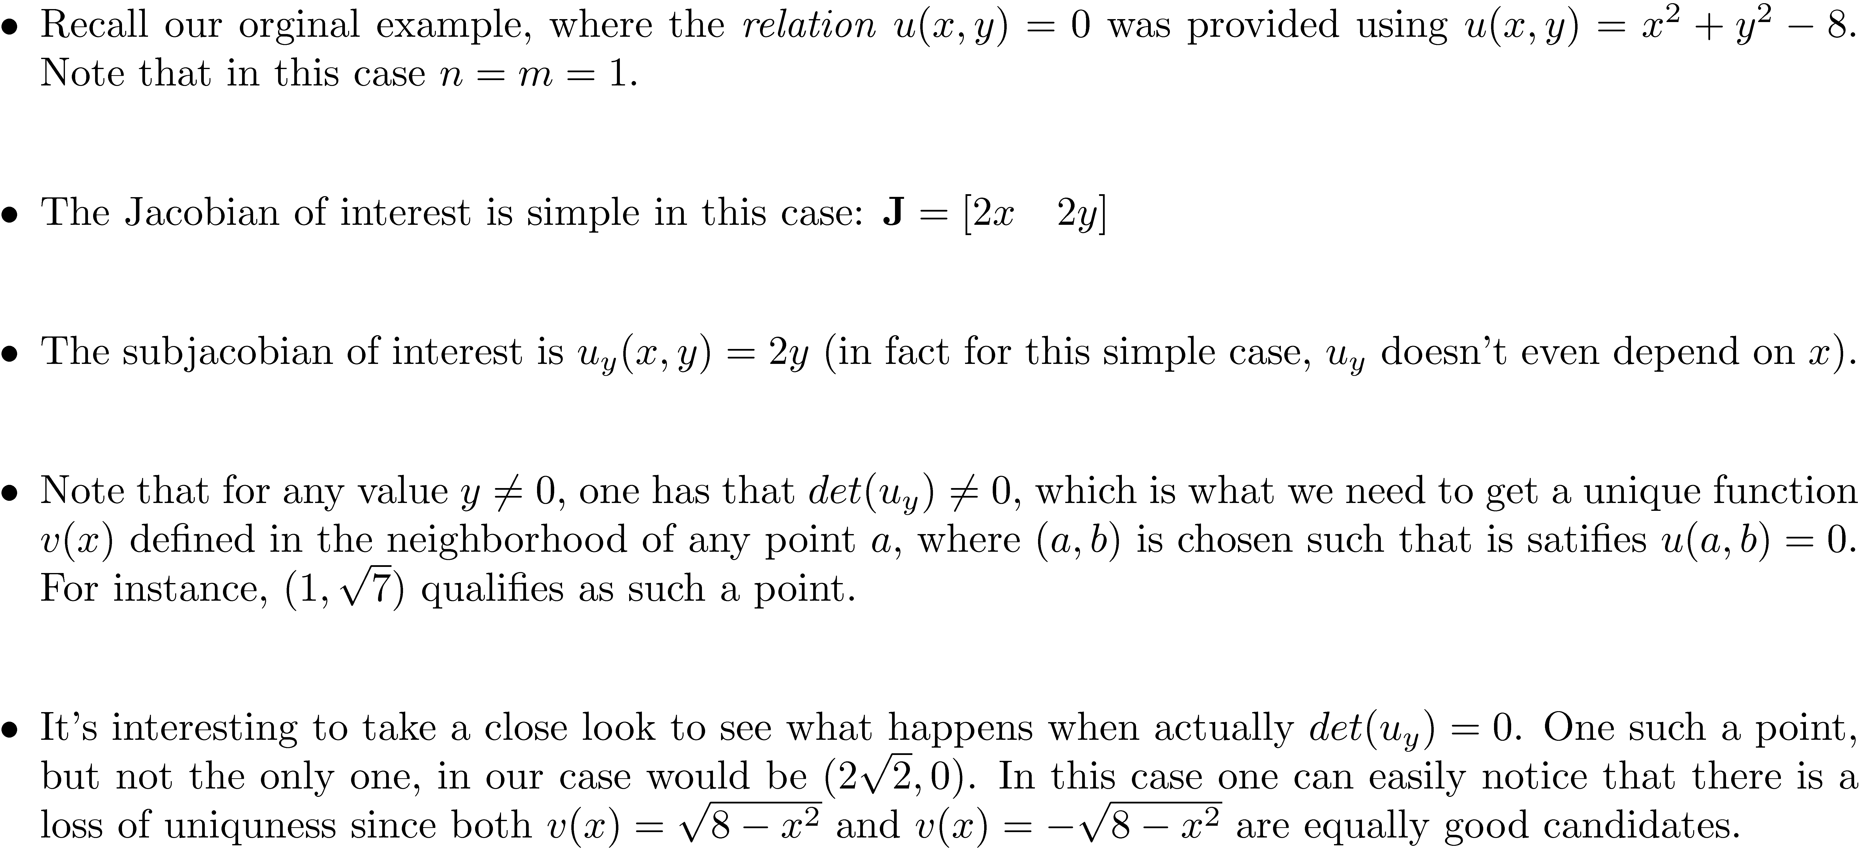
[Short Detour, Cntd.] The Implicit Function Theorem: Revisiting the Motivating Example

Slide 15
[End of Short Detour] The Implicit Function Theorem: Concluding Remarks
Implicit Function Theorem is one of the deep theorems of Applied Math
Make friends with Implicit Function Theorem

Slide 16
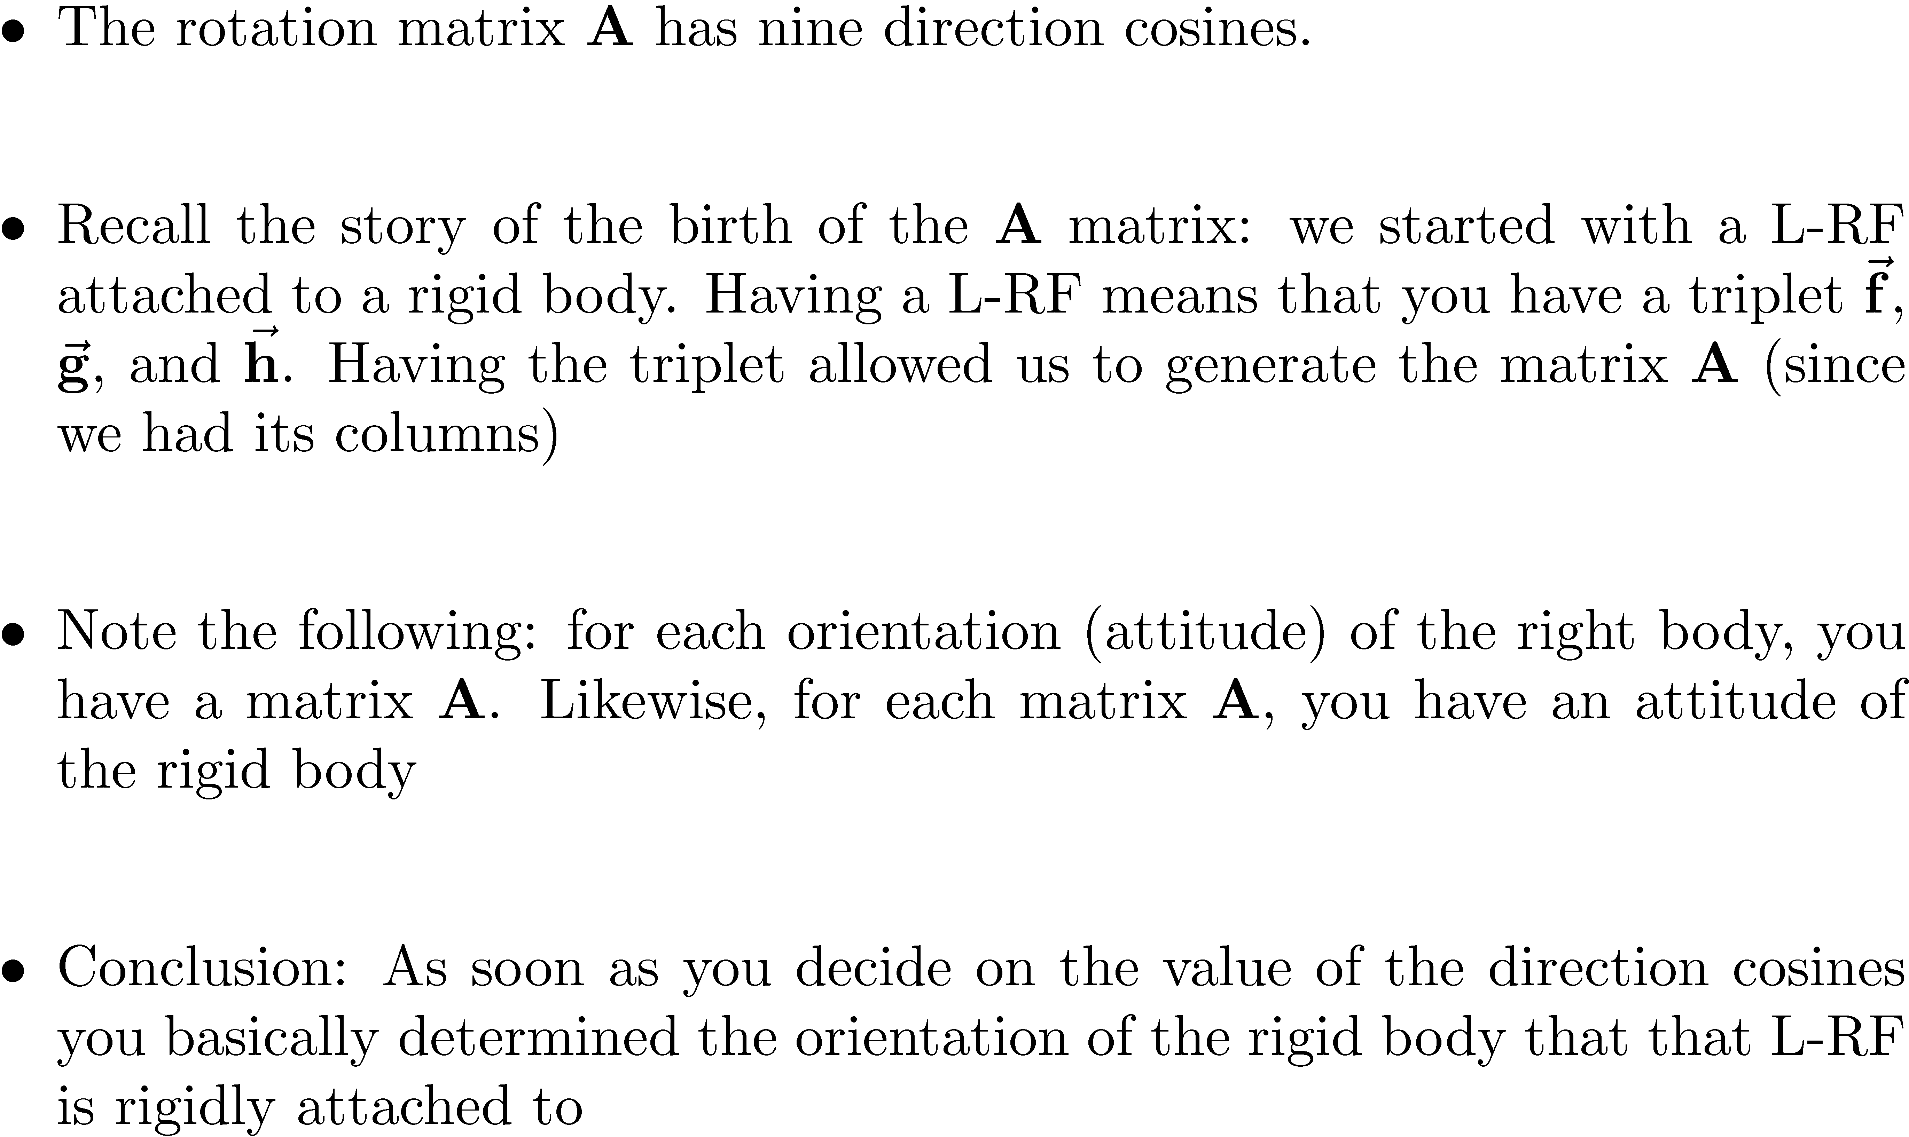
Degrees of Freedom Count, Orientation

Slide 17
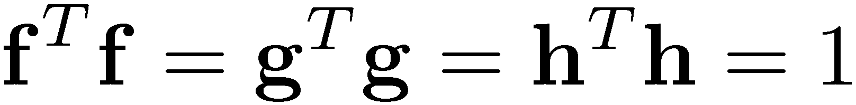
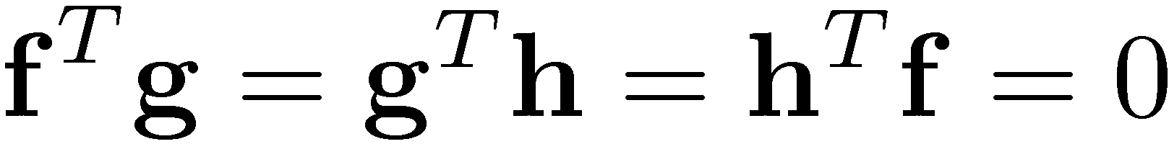
[Cntd.] Degrees of Freedom Count, Orientation
QUESTION: How many of the nine directions cosines can we specify?
In order words, how many free parameters do I have in conjunction with the rotation matrix A?
ANSWER: 3
I’m going to show that I can always choose three of the direction cosines and express the other six as a function of the three chosen ones
Why can I do “six function of three” trick?
I can do it because of these six conditions that the direction cosines satisfy:
How am I going to prove the “six function of three” trick?
I’m going to use the Implicit Function Theorem

Slide 18
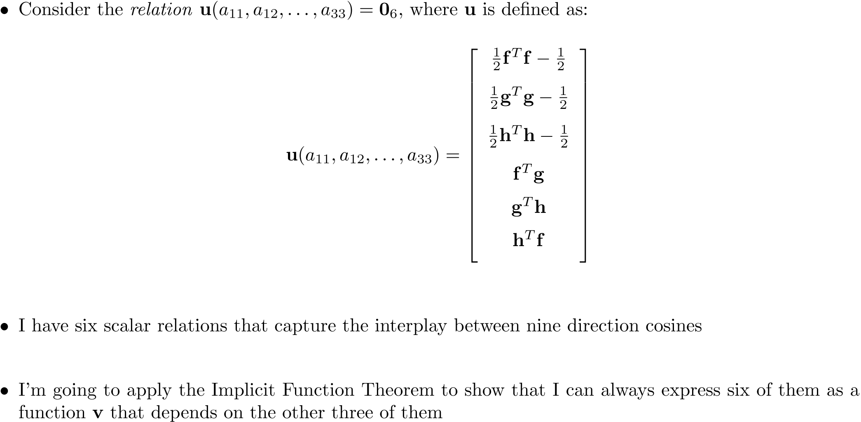
[Cntd.] [pp.324] Degrees of Freedom Count, Orientation

Slide 19
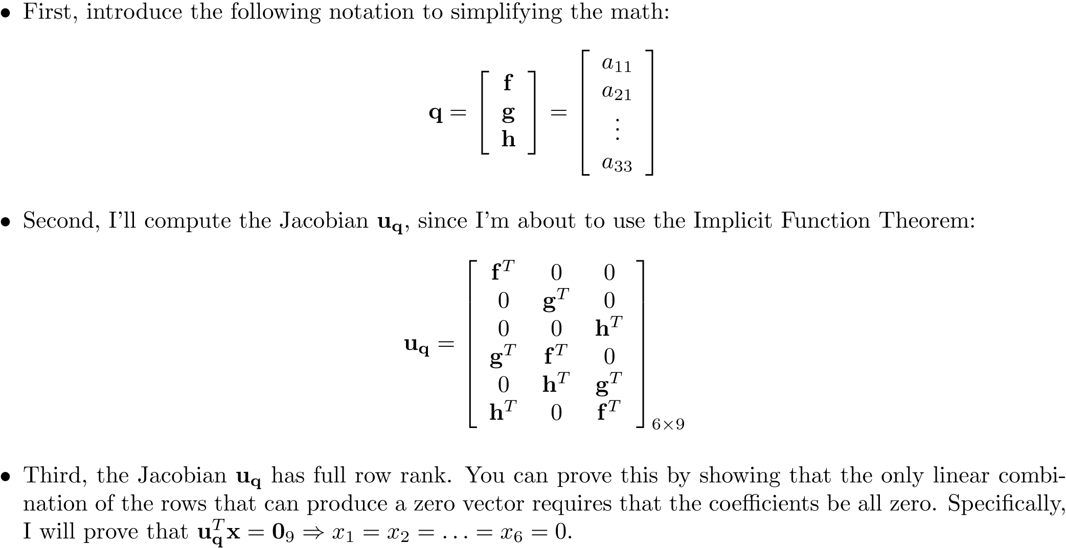
[Cntd.] [pp.324] Degrees of Freedom Count, Orientation

Slide 20
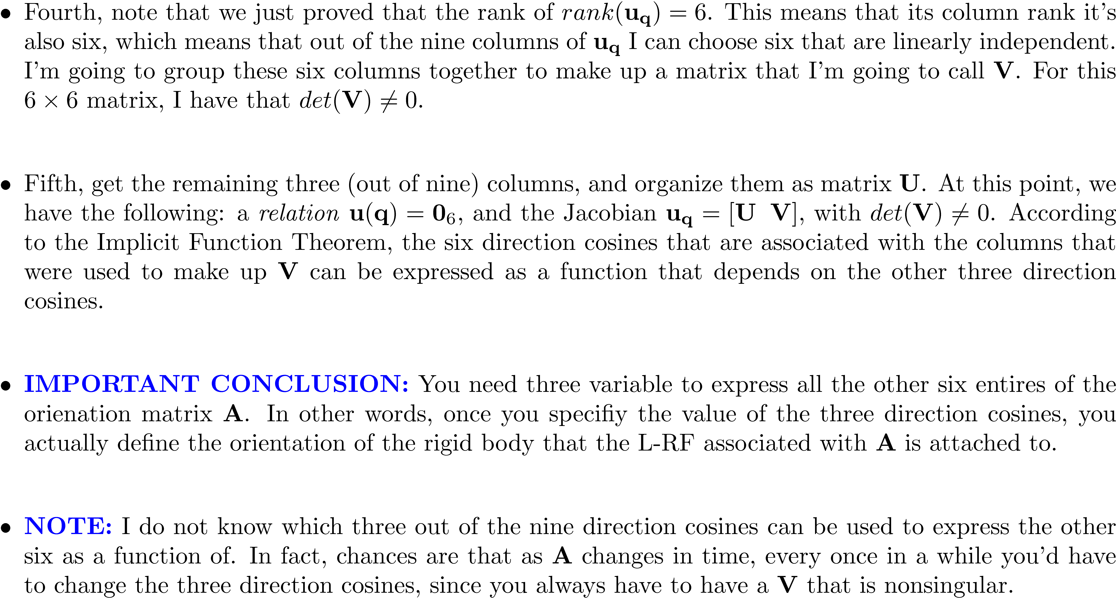
[Cntd.] [pp.324] Degrees of Freedom Count, Orientation

Slide 21
Remarks, Orientation Degrees of Freedom
QUESTION:
Why do we obsess about how many degrees of freedom do we have?
ANSWER:
We need to know how many generalized coordinates we’ll have to include in our set of unknowns when solving for the time evolution of a dynamic system
In this context, we arrived to the conclusion that three direction cosines are independent and need to be accounted for. The other six can be immediately computed once the value of the three independent direction cosines becomes available.
You can say that you solve for three, and recover the other six

Slide 22
Remarks, Orientation Degrees of Freedom [Cntd.]
QUESTION:
Do I really have to choose three direction cosines and include them in the set of generalized coordinates that I’ll use to understand the time evolution of the mechanical system?
ANSWER:
No, in fact I haven’t heard of anyone who does this
What is important is the number of generalized coordinates that are needed
Specifically:
I can choose three other quantities, call them µ, Á, °, that I decide to adopt as my three rotation generalized coordinates as long as there is a ONE-TO-ONE mapping between these three generalized coordinates and any set of three out of the nine direction cosines of the rotation matrix A

Slide 23
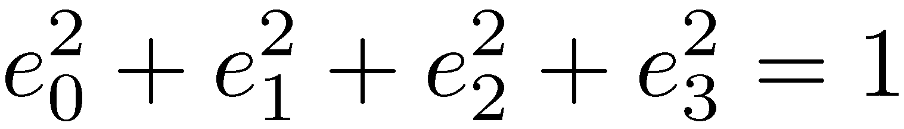
Remarks, Orientation Degrees of Freedom [Cntd.]
Here are a couple of possible scenarios:
I indeed choose three generalized coordinates: this is what Euler did, when he chose the Euler Angles to define the entries of A and thus capture the orientation of a L-RF with respect to the G-RF
I can choose a set of quaternion, or Euler parameters. There is four of them: e₀, e₁, e₂, and e₃, but they are related through a normalization condition:
Quaternions: born on Monday, October 16, 1843 in one of Sir William Rowan Hamilton’s moments of inspiration
If you want to be extreme, you do what people in Spain did: they chose all of the nine direction cosines as generalized coordinates but also added to the equations of motion the following set of six algebraic constraints:

Slide 24
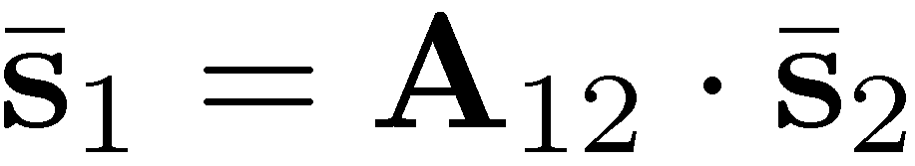
[Short Detour:] Hopping from RF to RF
The discussion framework:
Recall that when going from one A-RF₂ to a different A-RF₁, there is a transformation matrix that multiplies the representation of a geometric vector in A-RF₂ to get the representation of the geometric vector in A-RF₁ :
Question: What happens if you want to go from A-RF₃ to A-RF₂ and then eventually to the representation in A-RF₁ ?
Why are we curious?
Comes into play when dealing with Euler Angles

Slide 25

[End Detour:] Hopping from RF to RF
Going from A-RF₃ to A-RF₂ to A-RF₁ :
The basic idea is clear, you keep multiplying rotation matrices like that to hope from RF to RF until you arrive to your final destination
However, how would you actually go about computing A_{ij} if you have A_{i} and A_{j} (that is the two rotation matrices from RF_{i} to RF_{j} , respectively, into the G-RF)?
This means that you hop from A-RF_{j} to A-RF_{i}
Keep in mind the invariant here, that is, the geometric vector whose representation you are playing with:

