Slide 1
ME751 Advanced Computational Multibody Dynamics
Section 9.2
February 9, 2010
“In England, if you commit a crime, the police don't have a gun and you don't have a gun. If you commit a crime, the police will say Stop, or I'll say stop again.” Robin Williams
© Dan Negrut, 2010 ME751, UW-Madison

Slide 2
Before we get started…
Last Time (Th): Overview of ADAMS
Last Tuesday:
Implicit Function Theorem
Hopping from RF to RF
Today:
Describing the orientation of a body using Euler Angles
Describing the orientation of a body using Euler Parameters
HW3 due on Th

Slide 3
[AO] Exercise:
A body is rotated about the Ox axis by an angle µ (see below). What is the expression of the orientation matrix associated with a L-RF attached to the body?
If the expression of µ(t) as a function of time is prescribed, what is the angular velocity of the body in its rotation?

Slide 4
[Homework] Exercise:
A body is rotated about the Oz axis by an angle Ã . What is the expression of the orientation matrix associated with a L-RF attached to the body?
If the expression of Ã(t) as a function of time is prescribed, what is the angular velocity of the body in its rotation?

Slide 5
Euler Angles Putting Things in Perspective, What Comes Next
You need three generalized coordinates (GCs) to uniquely define the orientation of a body
We are about to choose the three GCs to be the set of Euler Angles
When using this set of GCs, we are interested in:
Producing the orientation matrix A
Finding the angular velocity of a body as a function of the time derivative of the GCs considered

Slide 6
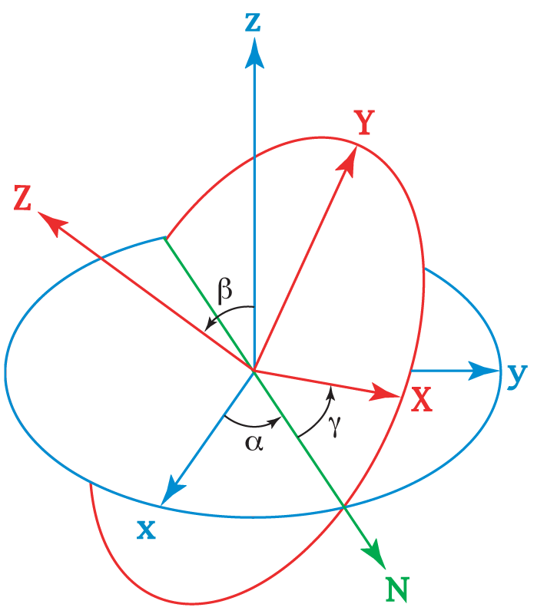



Euler Angles
Z
Euler Angles, definition:
A set of three angles used to describe the orientation of a reference frame in 3D space
Draws on the following observation:
You can align (superimpose) the global reference frame to any arbitrary reference frame through a sequence of THREE rotation operations
In picture: start from blue RF, end in the red RF after three rotations
y
z
Y
x
X
The sequence of three rotations that we’ll consider is
About axes Z then X then Z again (called the 3-1-3 sequence)
We’ll denote the three Euler Angles by Á, µ, and Ã, respectively
http://prt.fernuni-hagen.de/lehre/KURSE/PRT001/course_main_sh3d/node10.html

Slide 7
Euler Angles, Quick Remarks
Some notation conventions:
The G-RF is denoted by OXYZ
The L-RF that we must land on after three rotations Á, µ, Ã, denoted by O’x’y’z’
Details regarding the three rotations:
O’x’y’z’ is obtained by rotating O’’x’’y’’z’’ around the O’’z’’ axis by angle Ã
O’’x’’y’’z’’ is obtained by rotating O’’’x’’’y’’’z’’’ around the O’’’x’’’ axis by angle µ
O’’’x’’’y’’’z’’’ is obtained by rotating OXYZ around OZ axis by angle Á

Slide 8
Euler Angles, Quick Remarks [Cntd.]
There are other Euler Angles choices
1-2-3, 1-3-1, etc.
The approach we follow for our 3-1-3 choice to find A given the three angles of rotation applies exactly to any other choice of rotation sequence
ADAMS also uses the 3-1-3 sequence
It’s important to remember that the last two rotations (µ and Ã) are measured with respect to the rotated reference frame
Even the first one is, yet at the beginning, the z axis of the two RFs coincide

Slide 9
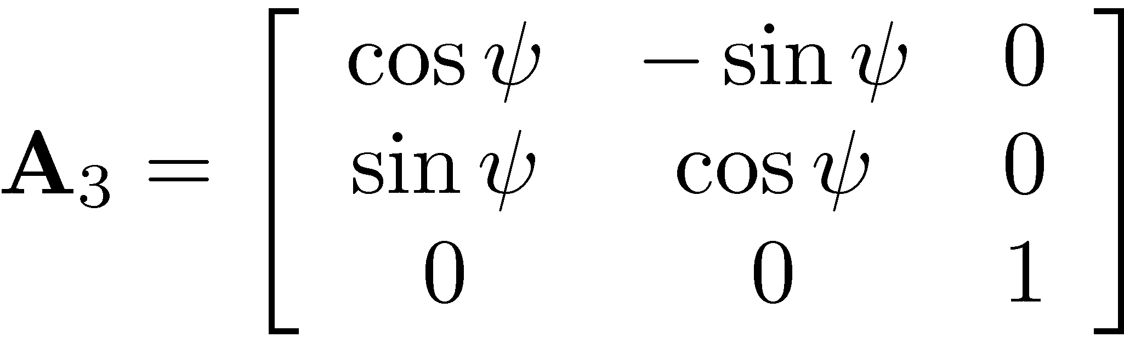
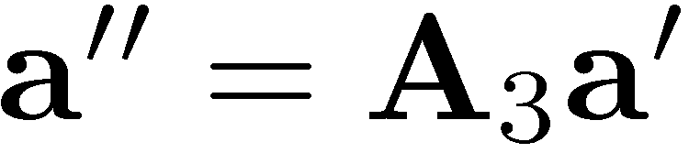
Expressing A using Euler Angles (Part 1 of 3)
Recall that I have a 3-1-3 rotation sequence.
The last sequence, is a rotation of angle ψ about z’’ to get O’x’y’z’.
Therefore, the rotation matrix that relates O’x’y’z’ to O’’x’’y’’z’’ is
In other words, if I have a vector represented as a’ in O’x’y’z’, it will be represented in O’’x’’y’’z’’ as

Slide 10
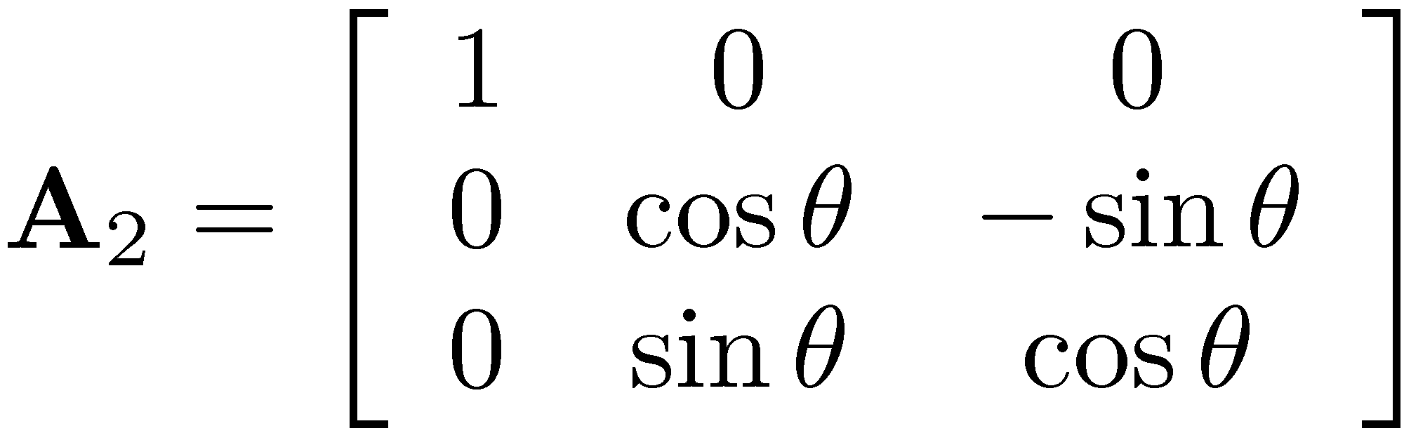
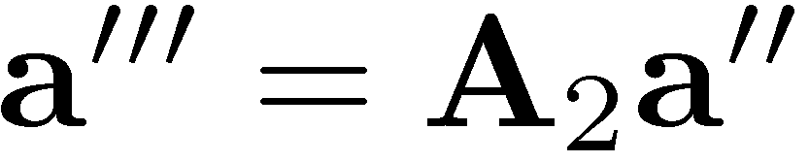
Expressing A using Euler Angles (Part 2 of 3)
Just dealt with the last “3” in the 3-1-3 rotation sequence (angle Ã)
Focus next on the “1” rotation in the 3-1-3 rotation sequence
This is the rotation of angle θ
The rotation of angle θ about the axis O’’’x’’’, takes O’’’x’’’y’’’z’’’ into O’’x’’y’’z’’
In other words, if I have a vector represented in O’’x’’y’’z’’ as a’’, the same vector will be represented in O’’’x’’’y’’’z’’’ as

Slide 11
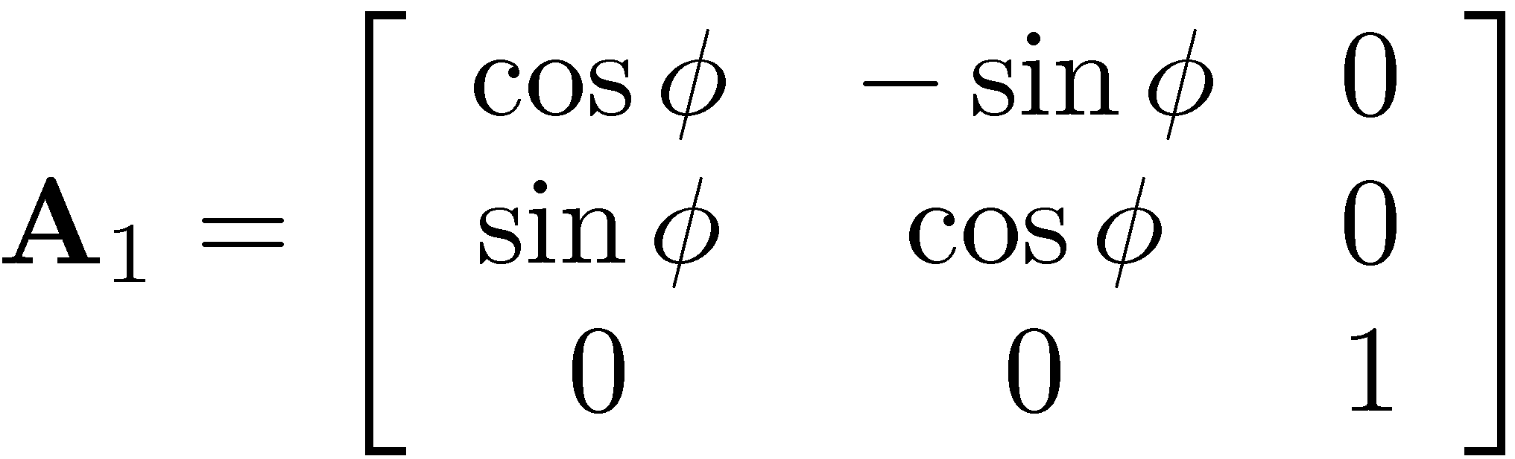
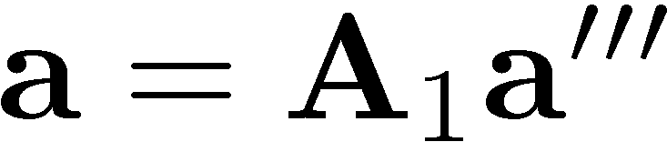
Expressing A using Euler Angles (Part 3 of 3)
Just dealt with the “1” in the 3-1-3 rotation sequence (angle µ)
Focus next on the first “3” rotation in the 3-1-3 rotation sequence
This is the rotation of angle Á
The rotation of angle Á about the axis OX, takes OXYZ into O’’’x’’’y’’’z’’’
In other words, if I have a vector represented in O’’’x’’’y’’’z’’’ as a’’’, the same vector will be represented in OXYZ as

Slide 12



Expressing A using Euler Angles ~ Putting it All Together ~
12
A Z-X-Z (or 3-1-3) rotation sequence takes OXYZ to O`x`y`z`
Recall that
Given a’, you get a’’ as
Given a’’ you get a’’’ as
Given a’’’ you get a as
Therefore,
Z
y
z
Y
x
X

Slide 13
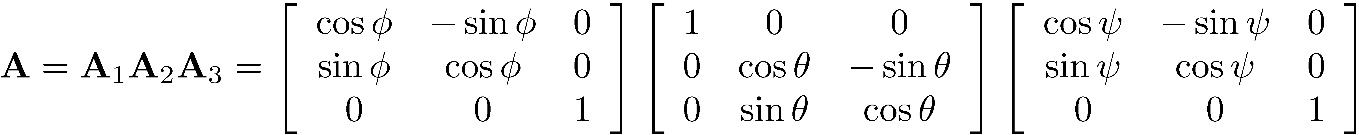
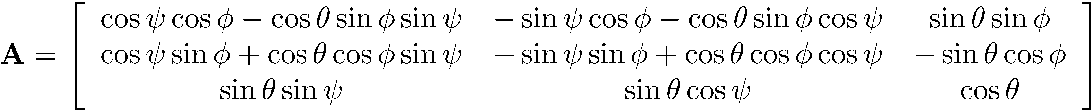
Expressing A using Euler Angles ~ Putting it All Together ~
Using the expression of the matrices A₁, A₂, A₃, one gets for the expression of the orientation matrix A
Carry out multiplications to get
[Homework]: Provide two proofs that A^{T} A=A A^{T}=I

Slide 14
Expressing A using Euler Angles ~ Two Questions ~
Some questions that ought to be asked
Should the order (sequence) Á ! µ ! Ã be observed?
You can always find one set of Á, µ, Ã angles to bring G-RF into L-RF
Is this set unique?
If not, do you run into any issue when you have more 3-1-3 rotations that relate the G-RF and the L-RF?

Slide 15
Expressing A using Euler Angles ~ Two Answers ~
Answers to previous two questions:
The order of the rotation should be observed since it’s important. If you change the order this will land you in a completely different rotational configuration
The only time when you run into a problem is when µ=k¼ (the “1” rotation in the 3-1-3 sequence is any integer multiple of ¼).
In this case it’s not clear how to split the rotations about the Z axes (the first “3” and the last “3” in the 3-1-3 sequence)
You cannot rely on this set of generalized coordinates since there is a loss of uniqueness associated with them

Slide 16
[AO] Exercise
The purpose of this exercise is to demonstrate that there fails to be a global one-to-one mapping between the nine direction cosines of A and the three generalized coordinates Á, µ, Ã used to describe the orientation of a L-RF:
Take φ=20, θ=0, and ψ=60. Compute A
Take φ=40, θ=0, and ψ=40. Compute A
In all cases you will end up with the same A
This is called the singularity associated with the Euler angles, and it is unavoidable
A solution is to start using a different L-RF_{new} when the initial L-RF is associated with a value of µ ¼ k¼, where k is any integer
This is possible since a L-RF is just an accessory for you to characterize the attitude (orientation) of a rigid body
NOTE: People have been attempting to use different generalized coordinates to determine in a more robust fashion the orientation of a body with respect to a global reference frame

Slide 17
Quick Remark
The fact that a set of three GCs cannot be found to express *globally* the orientation of a body with respect to the G-RF proved in 1964:
Stuelpnagel, J., “On the parametrization of the three-dimensional rotation group”, SIAM Review, 1964. 6: p. 422-430.
Paper available on the class website
Note that this does not mean that you cannot express A as a function of three GCs *locally*
This is in fact guaranteed by our Tu proof that drew on the Implicit Function Theorem

Slide 18
Expressing the Angular Velocity when Using Euler Angles

Slide 19
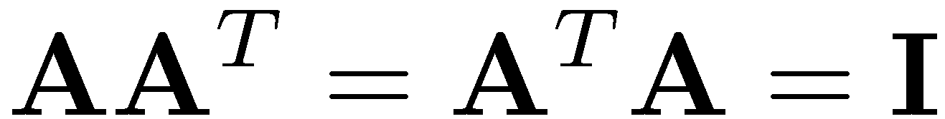
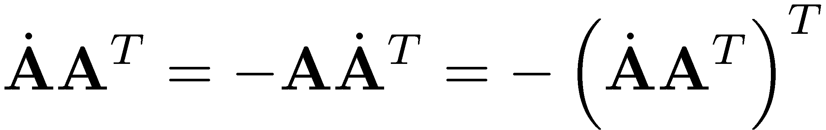
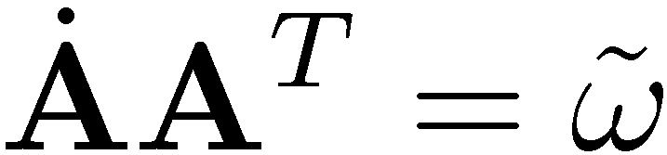
Quick Review
Note that since A is orthonormal,
Take a time derivative to eventually get
This means that the matrix product at the left is a skew-symmetric matrix
Therefore there is a generator vector ω that can be used to represent this skew-symmetric matrix:
By definition, the generator vector ω is called the angular velocity of the body on which the L-RF is attached
NOTE: ω is an attribute of the body, and not of the L-RF attached to it
Identity matrix

Slide 20
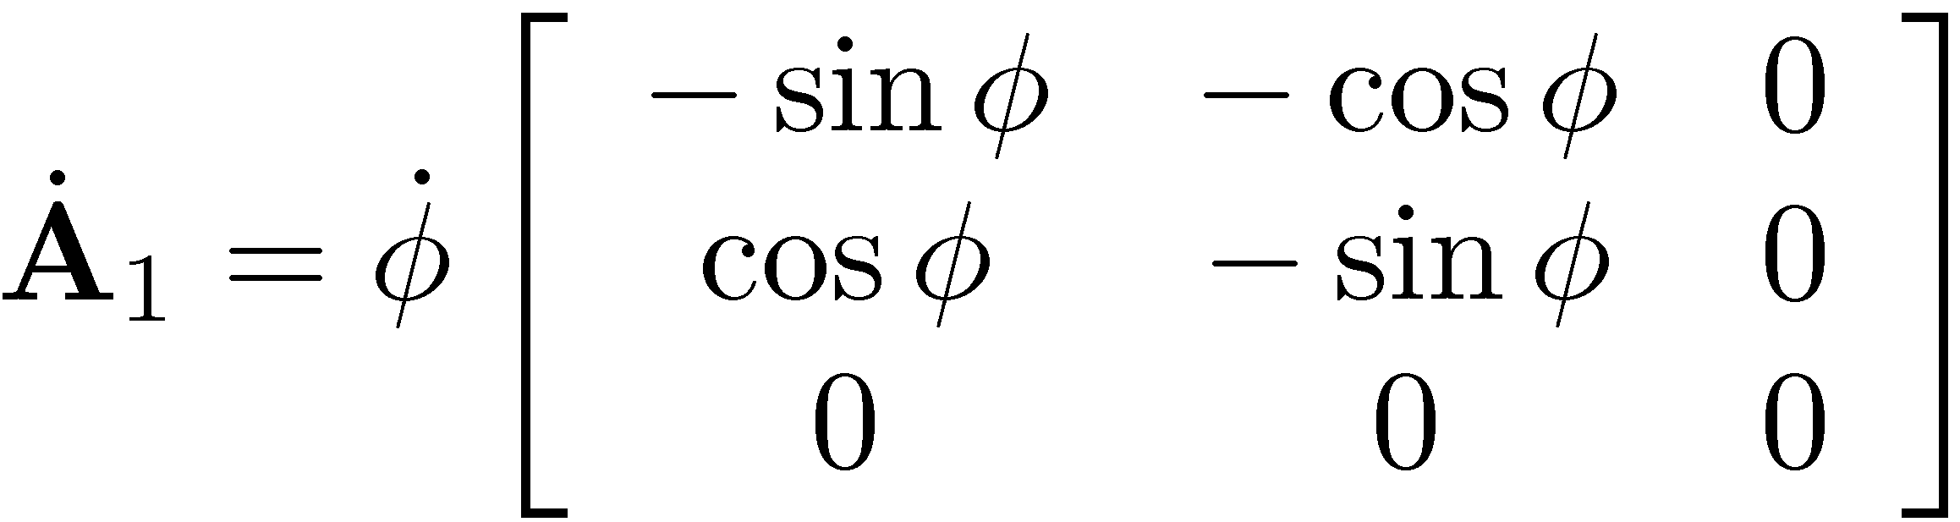

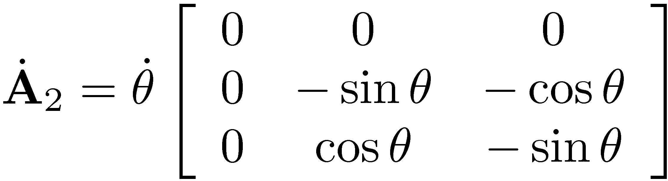

Angular Velocity for 3-1-3 Euler Sequence
When using the 3-1-3 Euler angles, based on the expression of A, one gets:
What you additionally know is that:

Slide 21
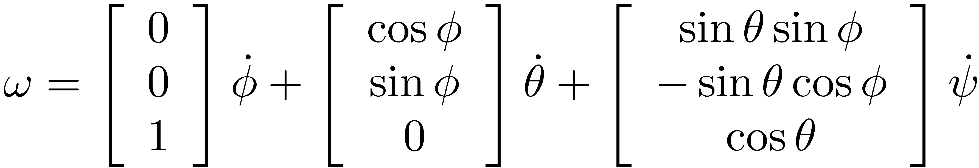
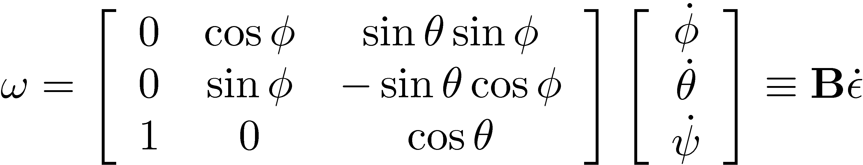
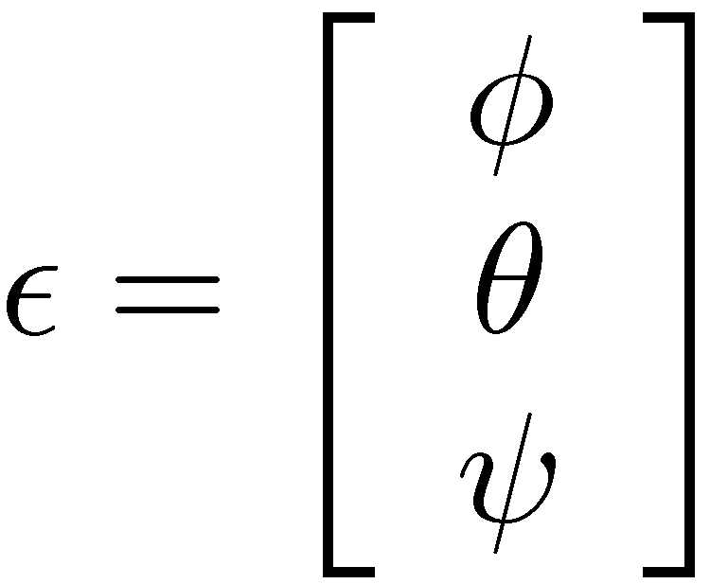
Angular Velocity for 3-1-3 Euler Sequence
If you carry out the horrific matrix multiplications you end up with the following expression for ω:
Equivalently, you can write this in matrix form like
…where the array of generalized coordinates ε is defined as

Slide 22

Angular Velocity for 3-1-3 Euler Sequence
There is a simpler way to get ! though, and it draws on the following identity that we proven on slide 27 on Jan. 28 :
The above identity is used in conjunction with :
Open up the parenthesis above to get that

Slide 23

Angular Velocity for 3-1-3 Euler Sequence
The previous slide says that you can compute the time derivatives of the Euler angles given ω by solving the linear system
Note that det(B)=sinθ, which yet again indicates that when the second rotation (the “1” in the 3-1-3 sequence) is µ =kπ, the matrix B is singular and you are in trouble (singular configuration)
To avoid this situation people introduced a set of four “Euler parameters” which have less issues albeit at a slight increase in abstraction
You have some redundancy in information (three parameters are necessary, yet you have four Euler parameters ) leads to one additional constraint equation)

Slide 24
End “Using Euler Angles as Generalized Coordinates for Rigid Body Rotation”
#
Begin “Using Euler Parameters as Generalized Coordinates for Rigid Body Rotation”

Slide 25
Euler Parameters: Analytical Foundation
Question – What is underlying this new approach that uses a set of four Euler parameters to characterize the orientation attitude of a rigid body?
Answer – The Euler Theorem:
If the origins of two right-hand Cartesian reference frames coincide, then the RFs may be brought into coincidence by a single rotation of a certain angle Â about a carefully chosen unit axis u
Euler Theorem proved in the following references:
Goldstein – Classical Mechanics, 2nd edition, (1980)
Wittenburg – Dynamics of Systems of Rigid Bodies (1977)
Angeles – Fundamentals of Robotic Mechanical Systems (2003)

Slide 26
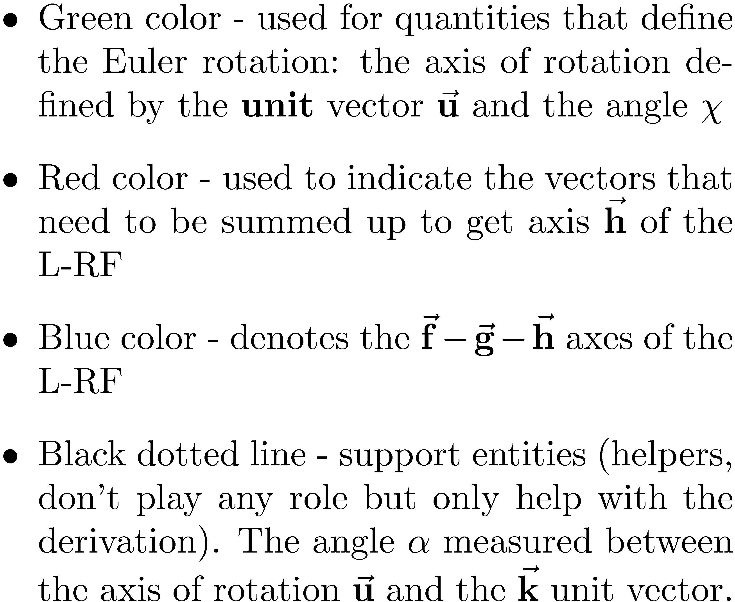
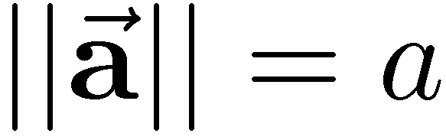
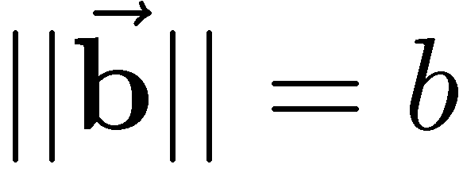
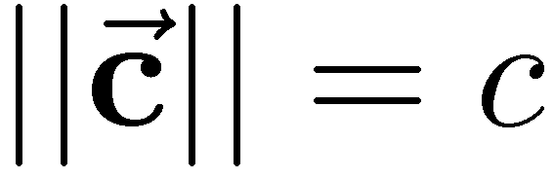
[pp.338] Euler Parameters
General remarks
Other notation used:

Slide 27
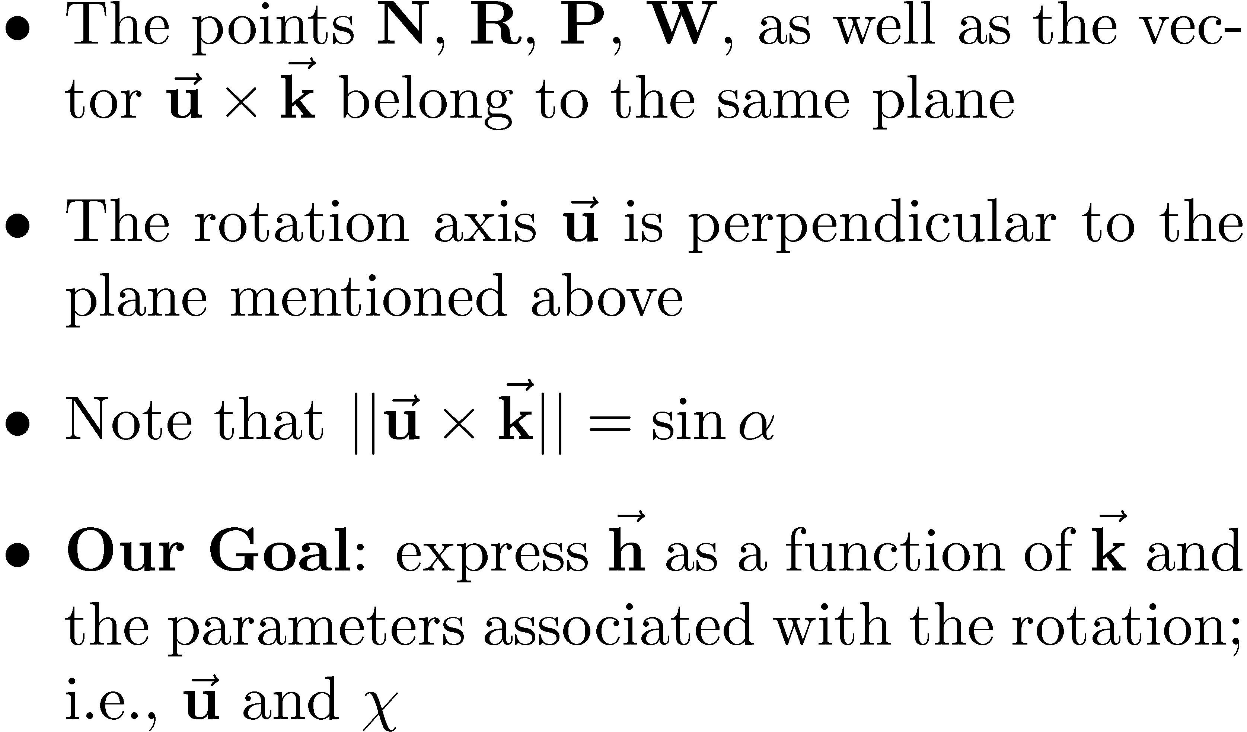
[pp.338] Euler Parameters
The starting point:

Slide 28
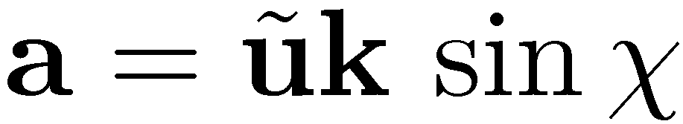
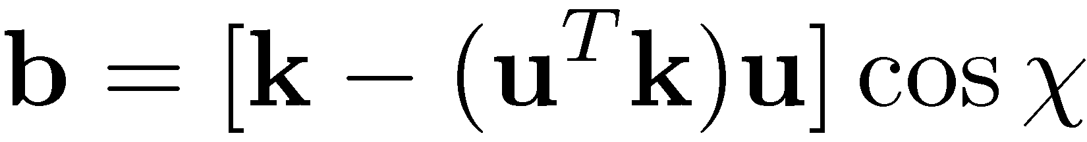
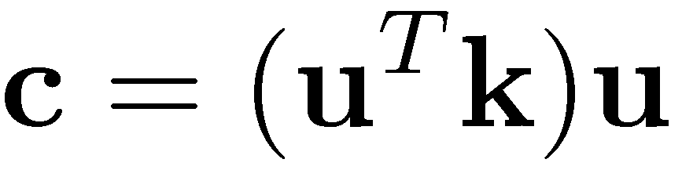
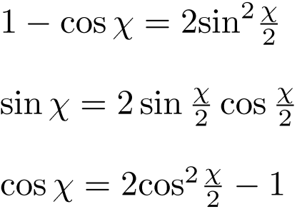
[HOMEWORK]
[HOMEWORK]

