Slide 1
ME751 Advanced Computational Multibody Dynamics
Section 9.3
February 11, 2010
“Success is a lousy teacher. It seduces smart people into thinking they can't lose.” Bill Gates
© Dan Negrut, 2010 ME751, UW-Madison

Slide 2
Before we get started…
Last Time:
Describing the orientation of a body using Euler Angles
Describing the orientation of a body using Euler Parameters
Today:
Finish Euler Parameters discussion
Rigid Body 3D Kinematics
Kinematic constraints
HW4
Posted this afternoon, due on Feb. 18
Quick Remark: start thinking about Final Project

Slide 3
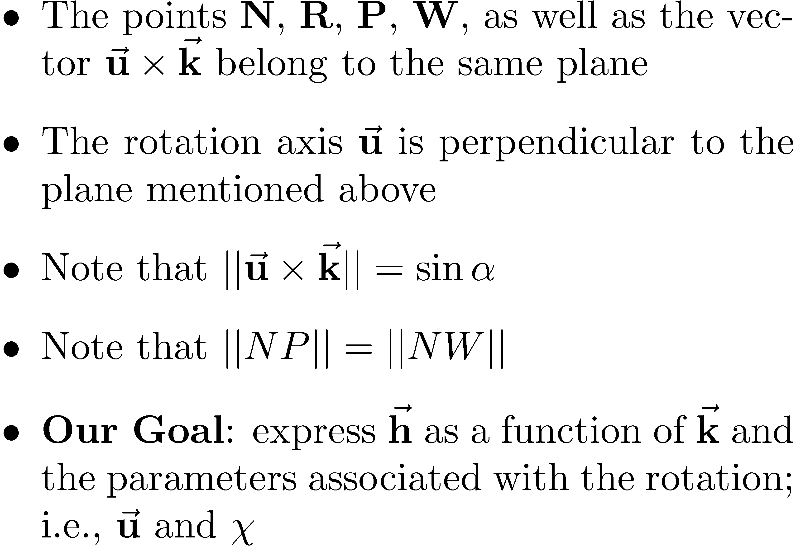
[pp.338] Euler Parameters
The starting point:

Slide 4
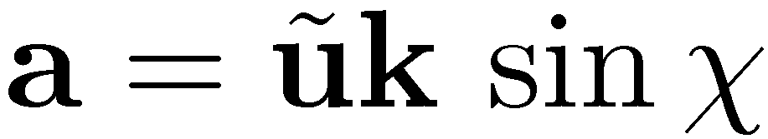
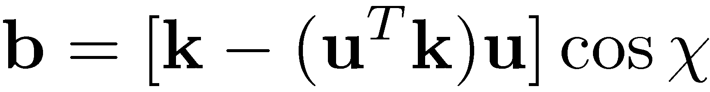
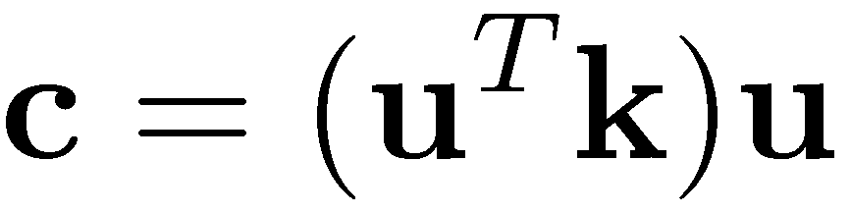
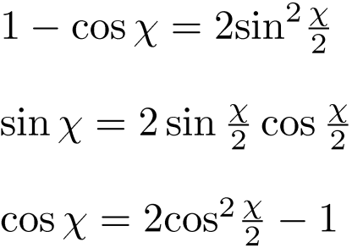

Slide 5
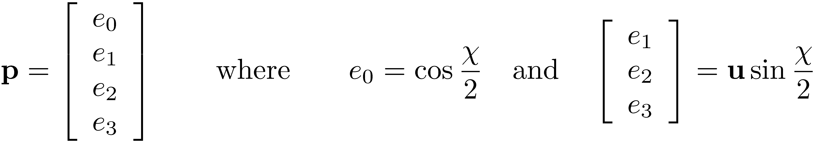
Euler Parameters: Definition
Note that following *exactly* the same steps for axes f and g we eventually get:
Recall that we want to express everything in terms of u =[u₁, u₂, u₃]^{T} and Â
The entries in the expressions of f, g, and h motivate the decision to introduce the following generalized coordinates (the “Euler Parameters”):

Slide 6
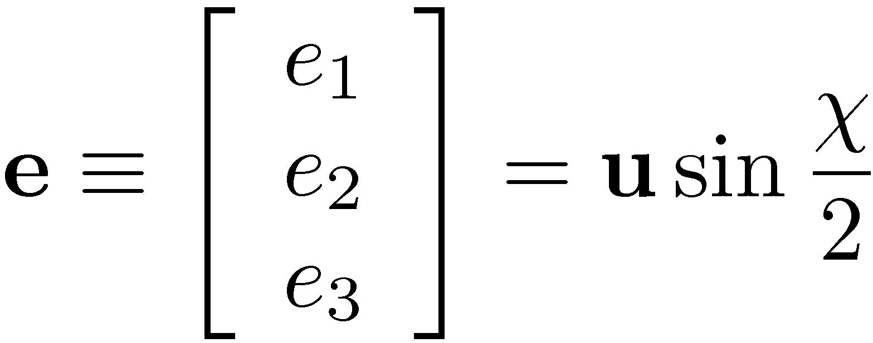
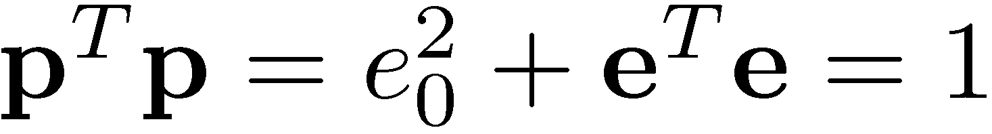
Euler Parameters: Quick Remarks
Recall that u is a unit vector. Therefore, the following holds
Identity above referred to as the “Euler Parameter normalization constraint”
The Euler Parameters e₁, e₂, and e₃ are typically grouped together and denoted by e:
Then, Eq.(1) becomes

Slide 7
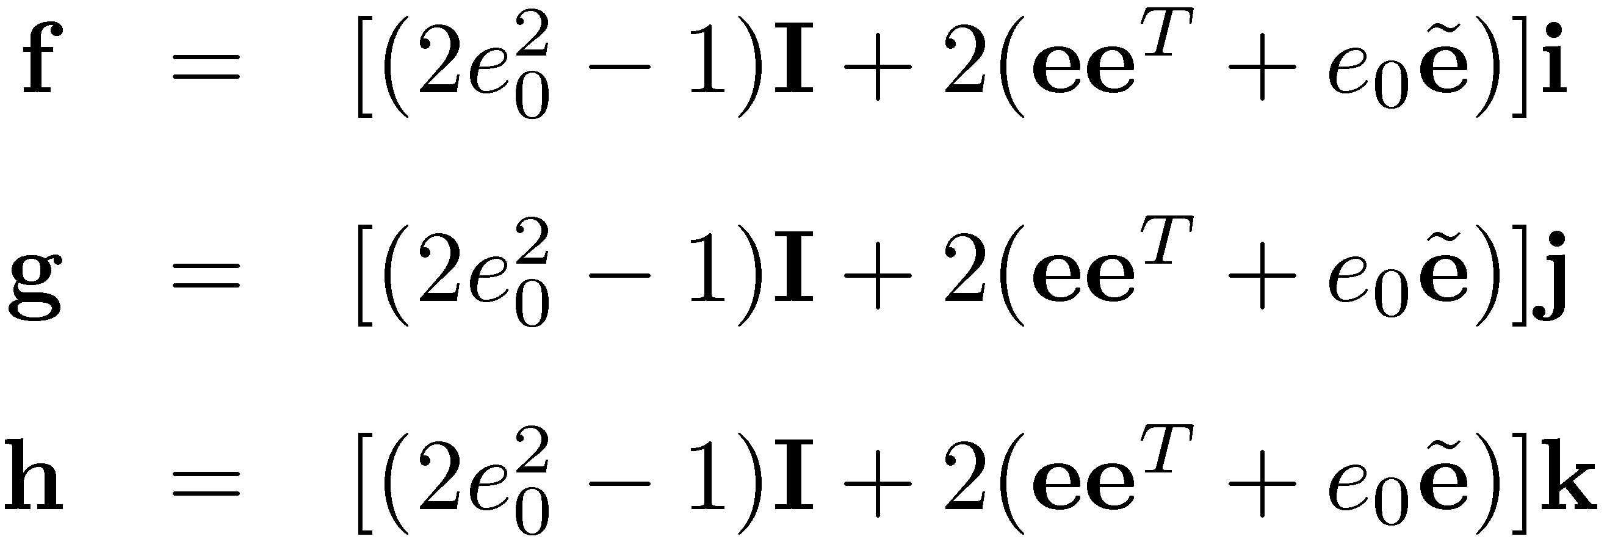
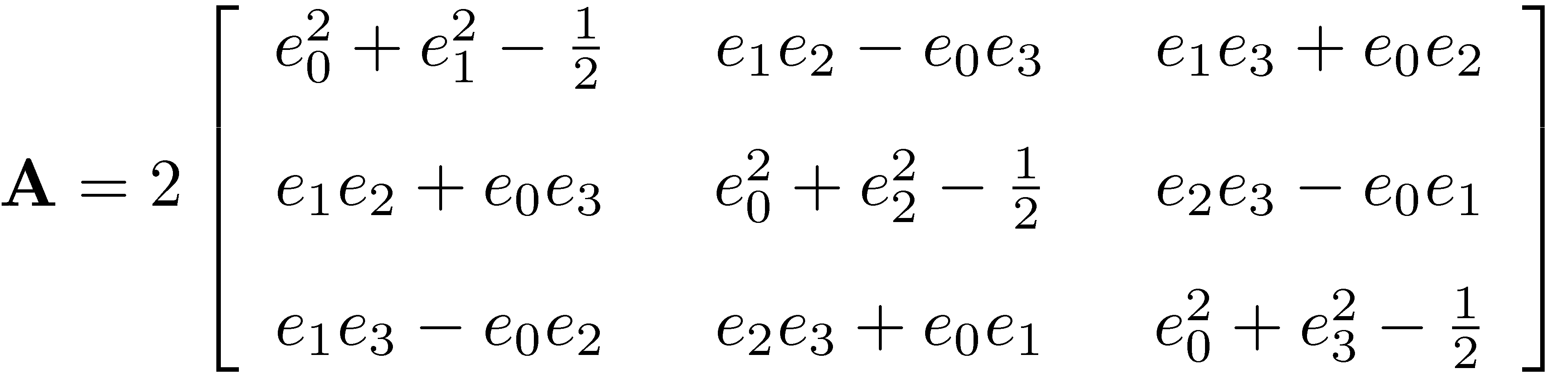
Using Euler Parameters to Express Orientation Matrix A
Recall that A=[f g h]
Based on the definition of e₀, e₁, e₂, and e₃, one has that
Equivalently, Eq.(1) can be explicitly expressed using e₀, e₁, e₂, e₃ as

Slide 8
Euler Parameters: Putting Things In Perspective
I can count on a rotational angle Â and an axis of rotation u to take the G-RF into an L-RF (Euler’s Theorem)
I used Â and u to define a set of four generalized coordinates
Called them Euler Parameters p
I managed to express the rotation matrix A in terms of my choice of generalized coordinates
I have to keep in mind that there is a constraint normalization condition that p must satisfy (its norm is one)
It remains to prove that there is a one-to-one mapping between A; i.e., the orientation of the body, and our choice p of GCs

Slide 9
Euler Parameters: The One-To-One Mapping to A
One-To-One Mapping: What are we interested in?
PART 1: We’d like to see that given a set of “healthy” Euler Parameters p, they lead to a unique orientation matrix A
Healthy p : it satisfies the constraint p^{T}¢ p = 1
Healthy A: the matrix is orthonormal (A^{T}¢ A=I₃)
PART 2: Conversely, we’d like to see that given a rotation matrix A, that is, an orientation of the rigid body, there is a unique set of “healthy” Euler Parameters p that are associated with that orientation of the body
Recall that the 3-1-3 Euler Angle representation didn’t cut it when µ=k ¼

Slide 10

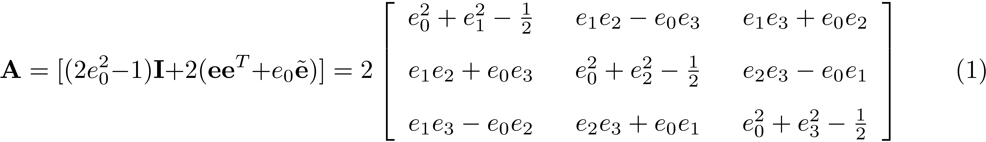
Part 1: The p and A One-To-One Mapping
Given a set of “healthy” Euler Parameters p, we should prove that they lead to a unique and healthy orientation matrix A
Healthy p : it satisfies the constraint p^{T}¢ p = 1
Healthy A: the matrix is orthonormal (A^{T}¢ A=I₃)
Recall that
Moreover, according to Eq. (1), it’s obvious that given p=[e₀, e₁,e₂,e₃]^{T} the matrix A is unique

Slide 11

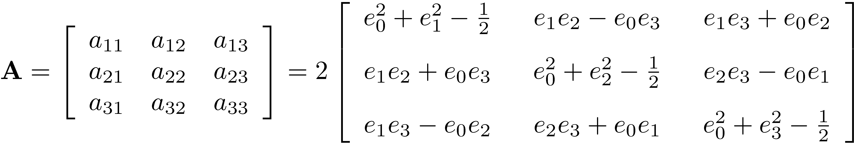
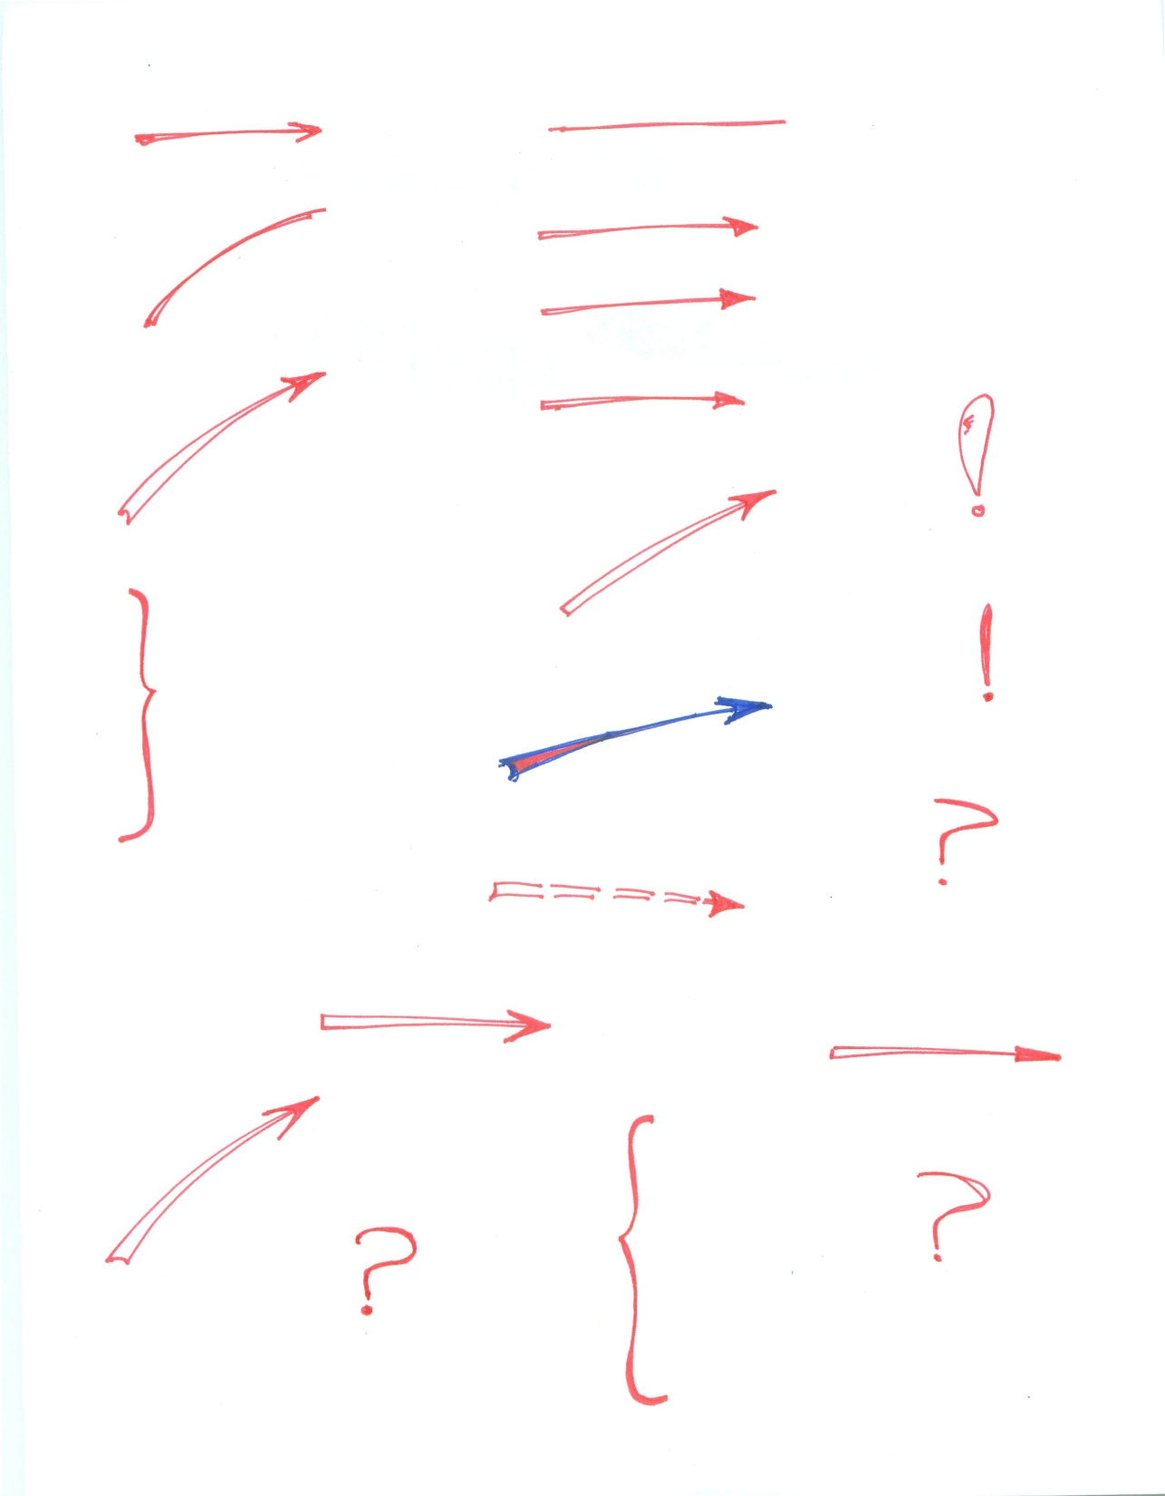
[pp.341] Part 2: The p and A One-To-One Mapping
Need to prove that given a rotation matrix A, that is, an orientation of the rigid body, there is a unique set of “healthy” Euler Parameters p that are associated with that orientation of the body
The basic idea of the analysis: given the entries a₁₁, …, a₃₃ of a healthy A, we should show that they lead to a unique p.
If it turns out that p is not unique, can we live with it?
These nine entries are given
Can you get e₀ , e₁ , e₂ , e₃ uniquely?

Slide 12
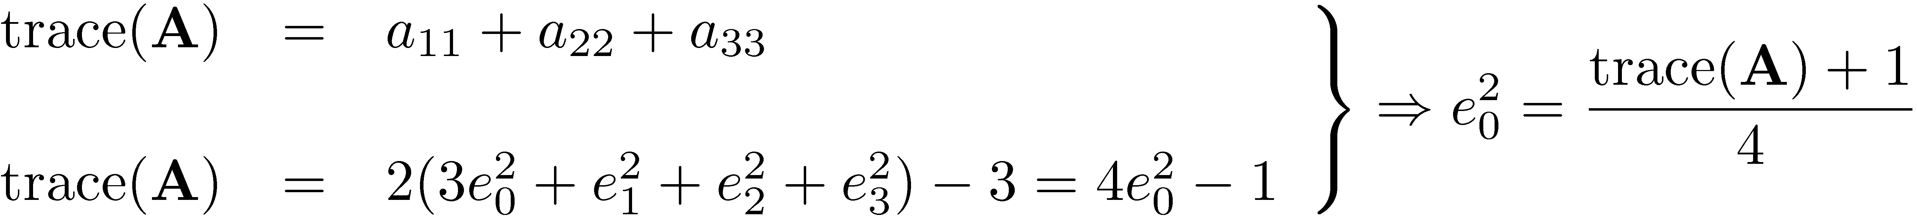
[pp.341] Part 2: Two Possible Cases
Note that
Based on the value of e₀ we have two cases associated with Part 2:
Case 1: e₀ ≠ 0
Note that in this case the sign of e₀ is arbitrary and not important (more later)
Nonetheless, in what follows we’ll have to stick with that sign decision
Case 2: e₀=0

Slide 13
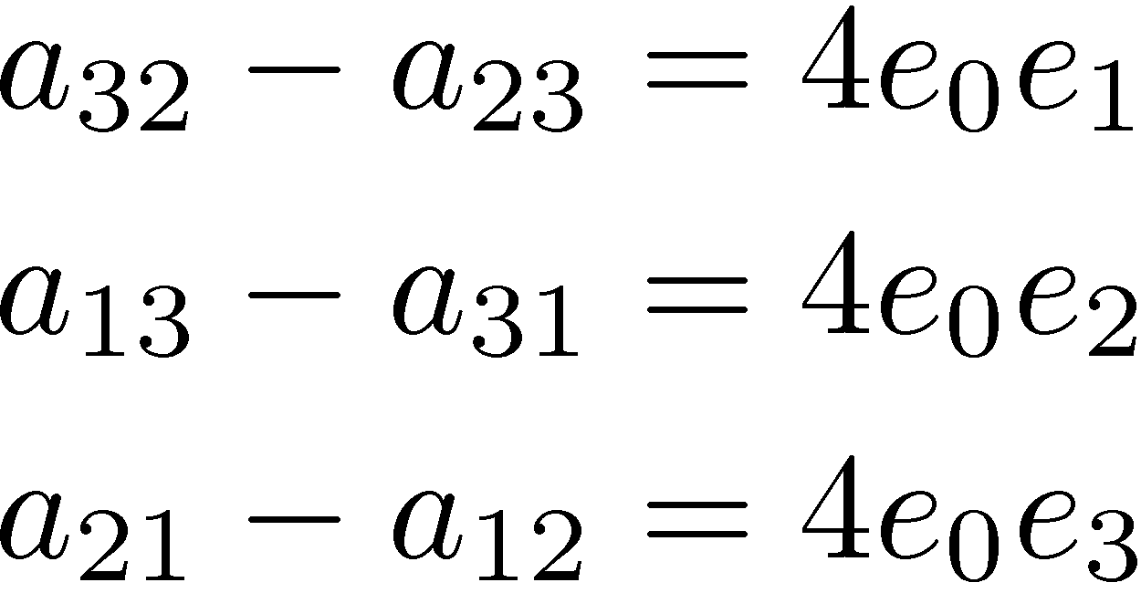
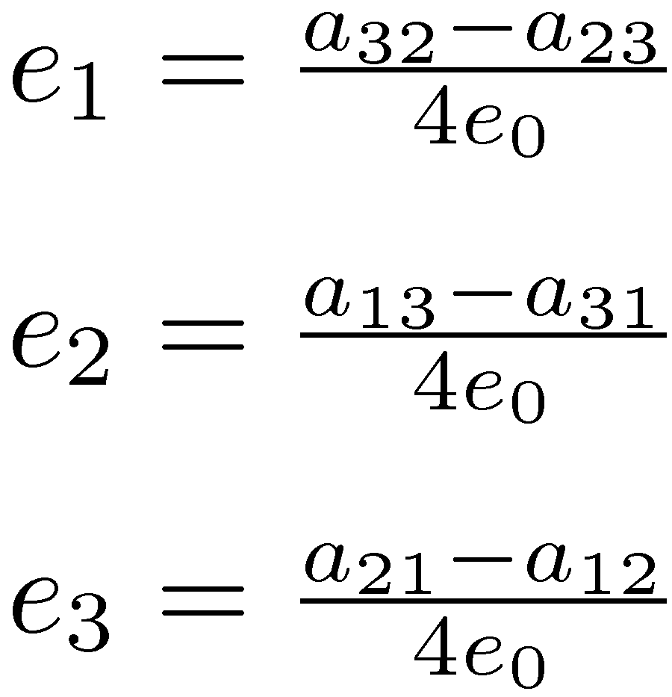
[pp.341] Part 2, Case 1: e₀ ≠ 0
Recall that
Then, with e₀≠ 0 available to you (see previous slide), you get
From where,

Slide 14
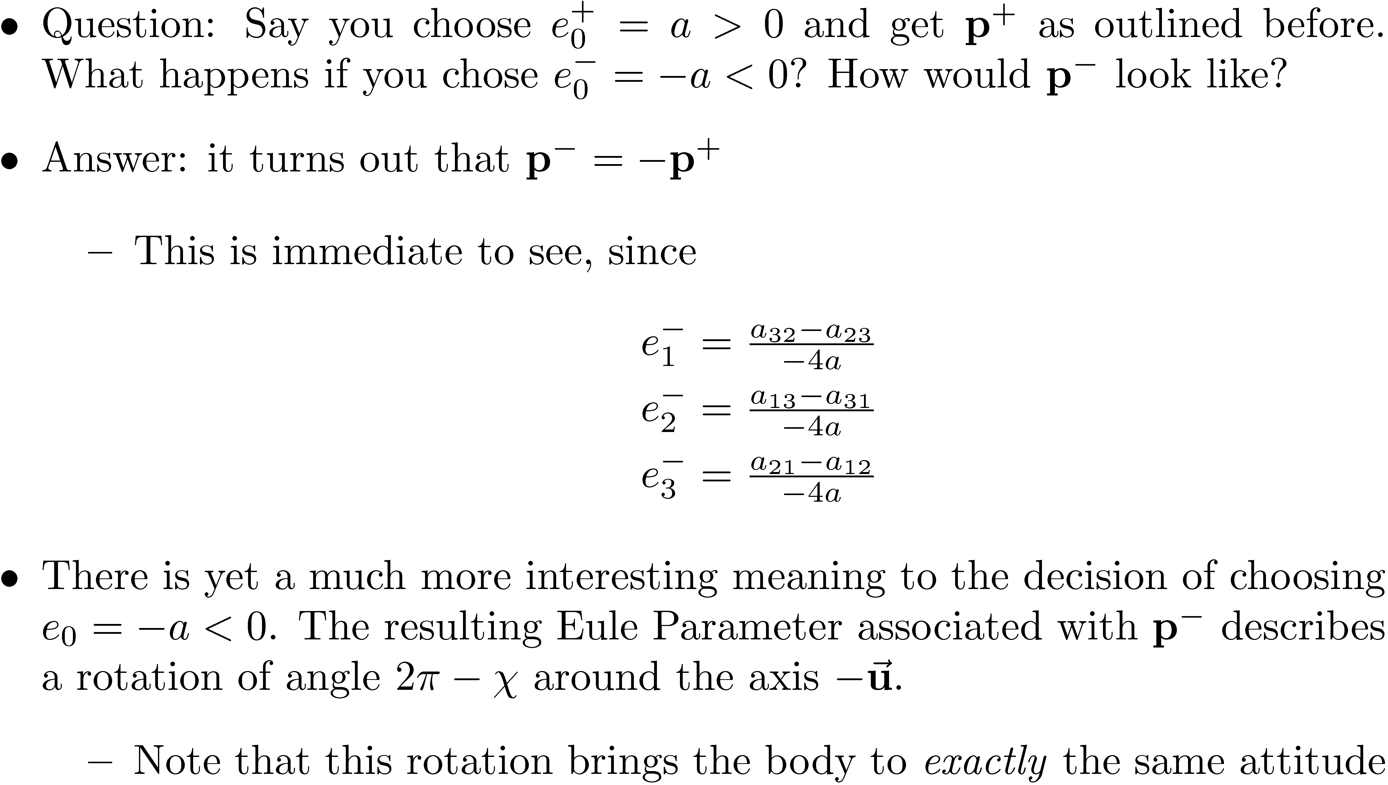
“p” or “–p”?

Slide 15
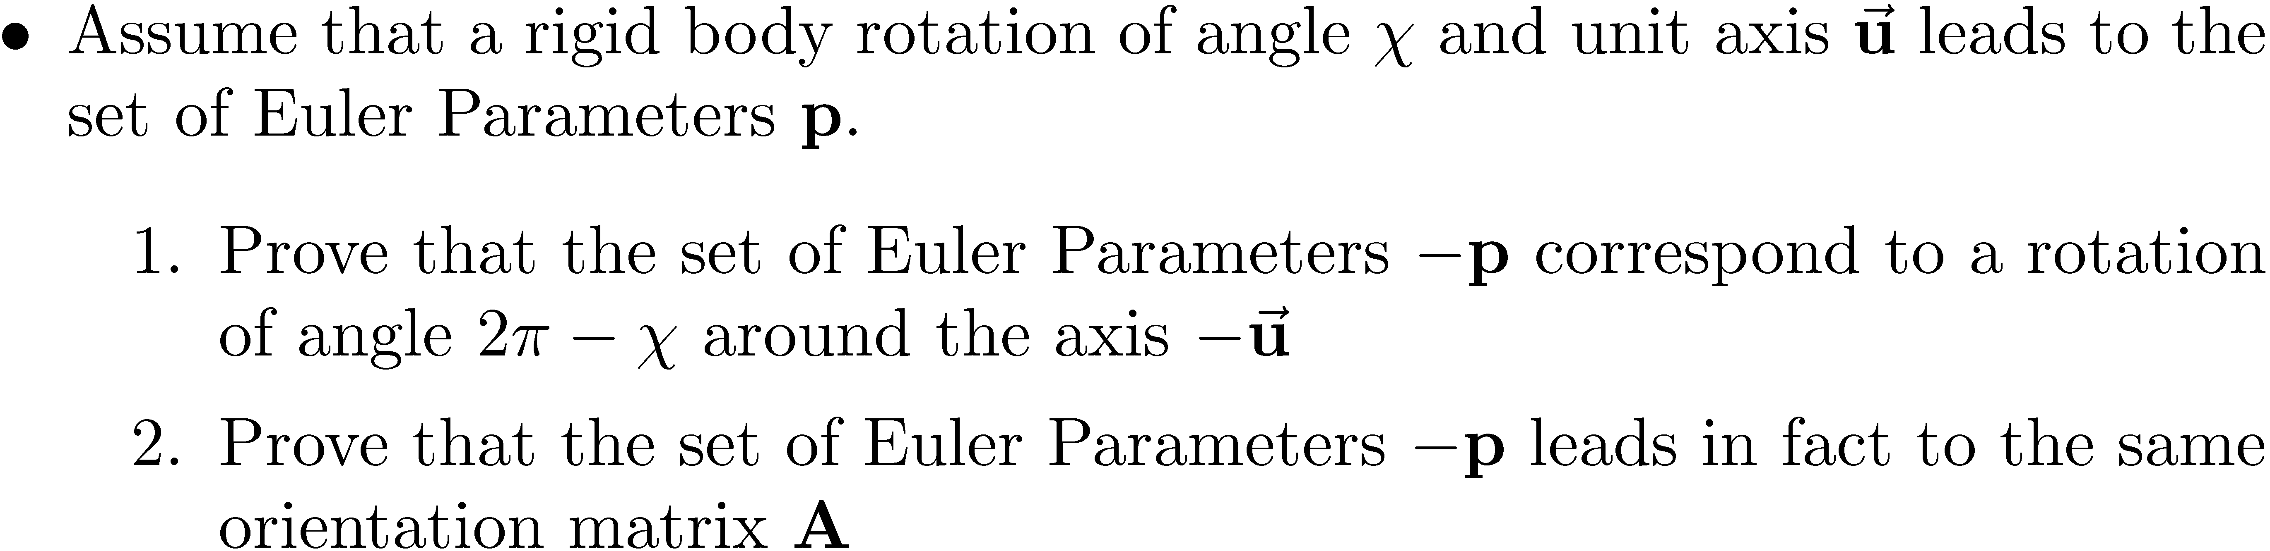
[AO] Exercise

Slide 16
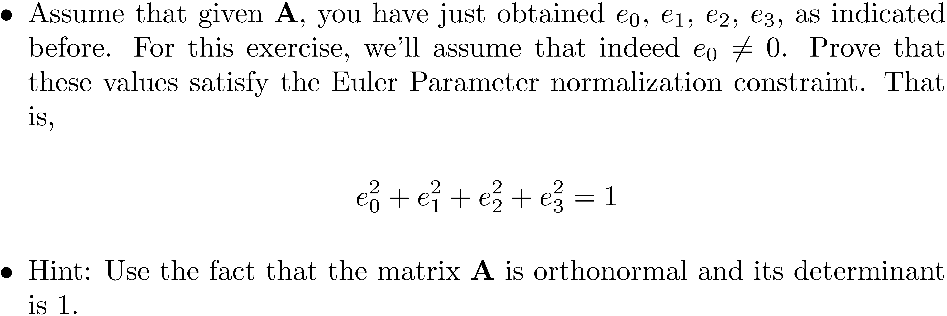
[HW] Exercise

Slide 17
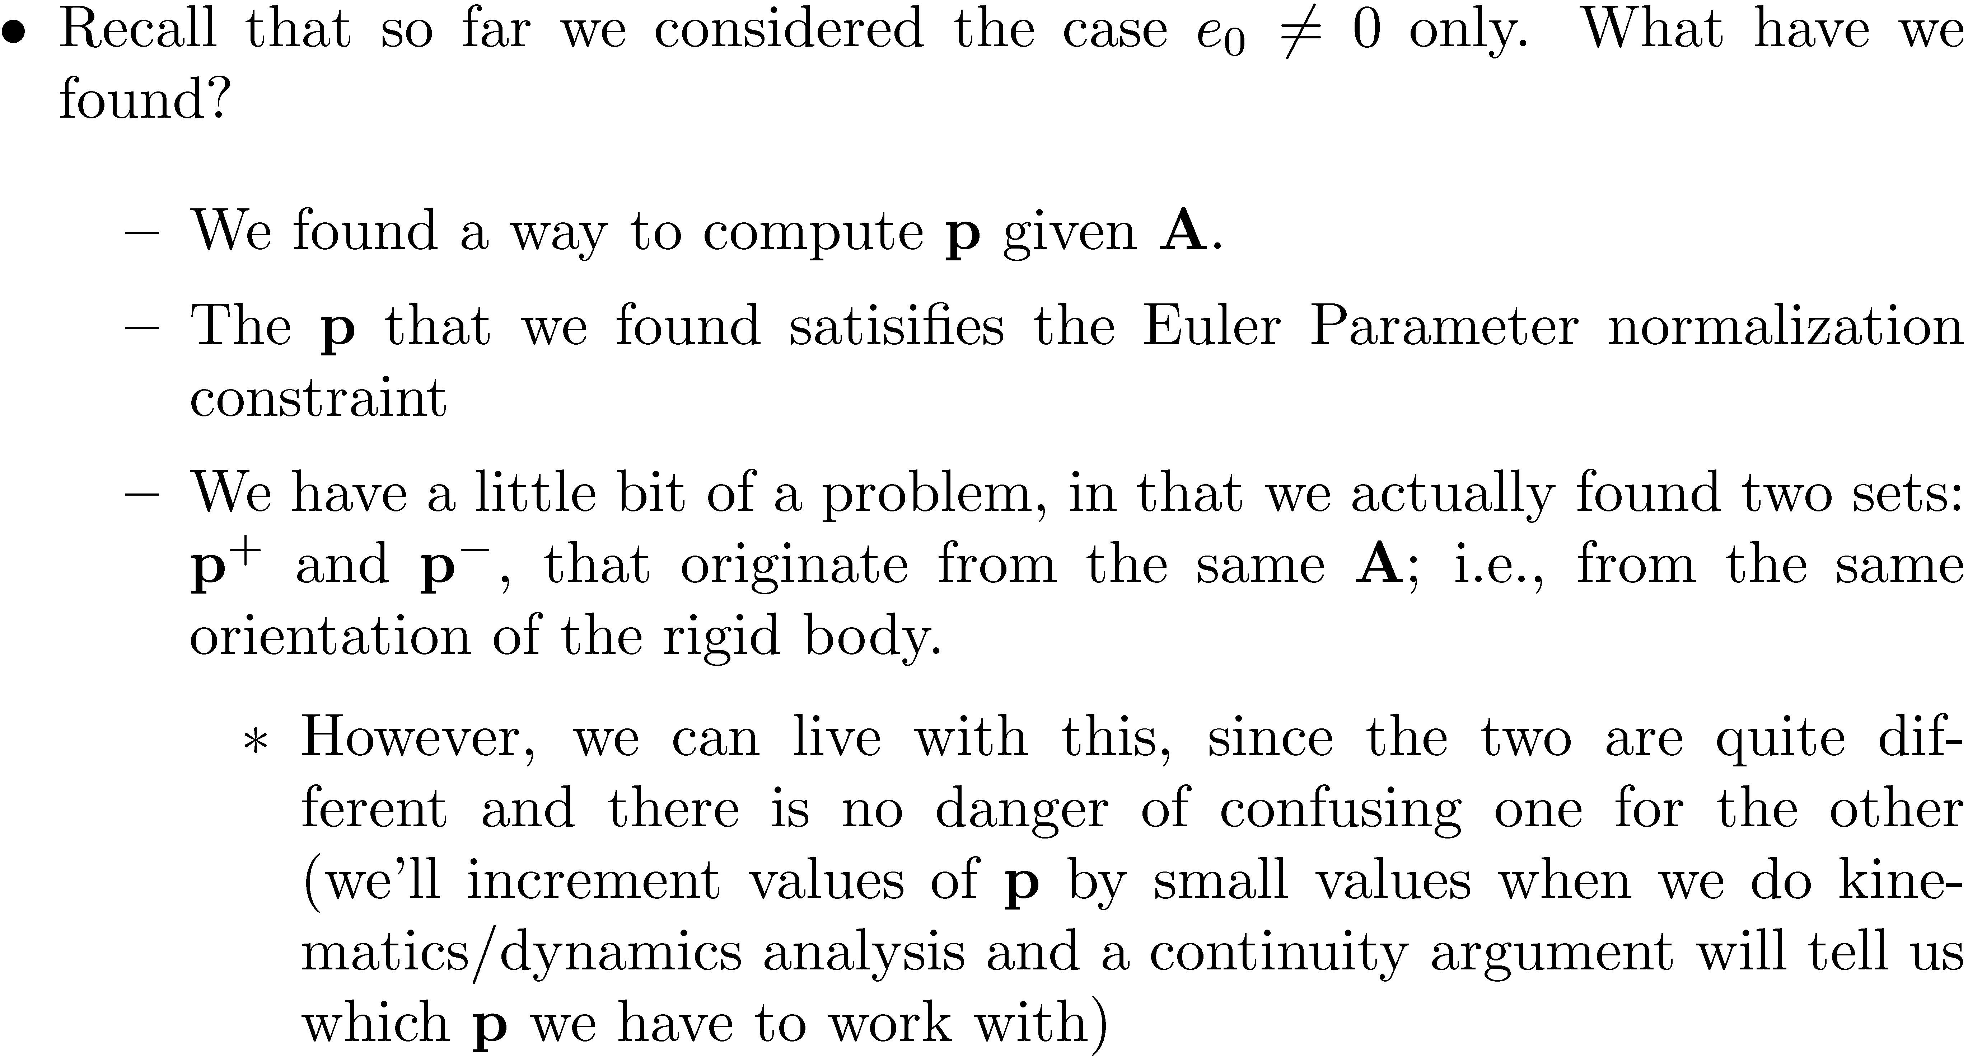
Putting Things in Perspective…

Slide 18
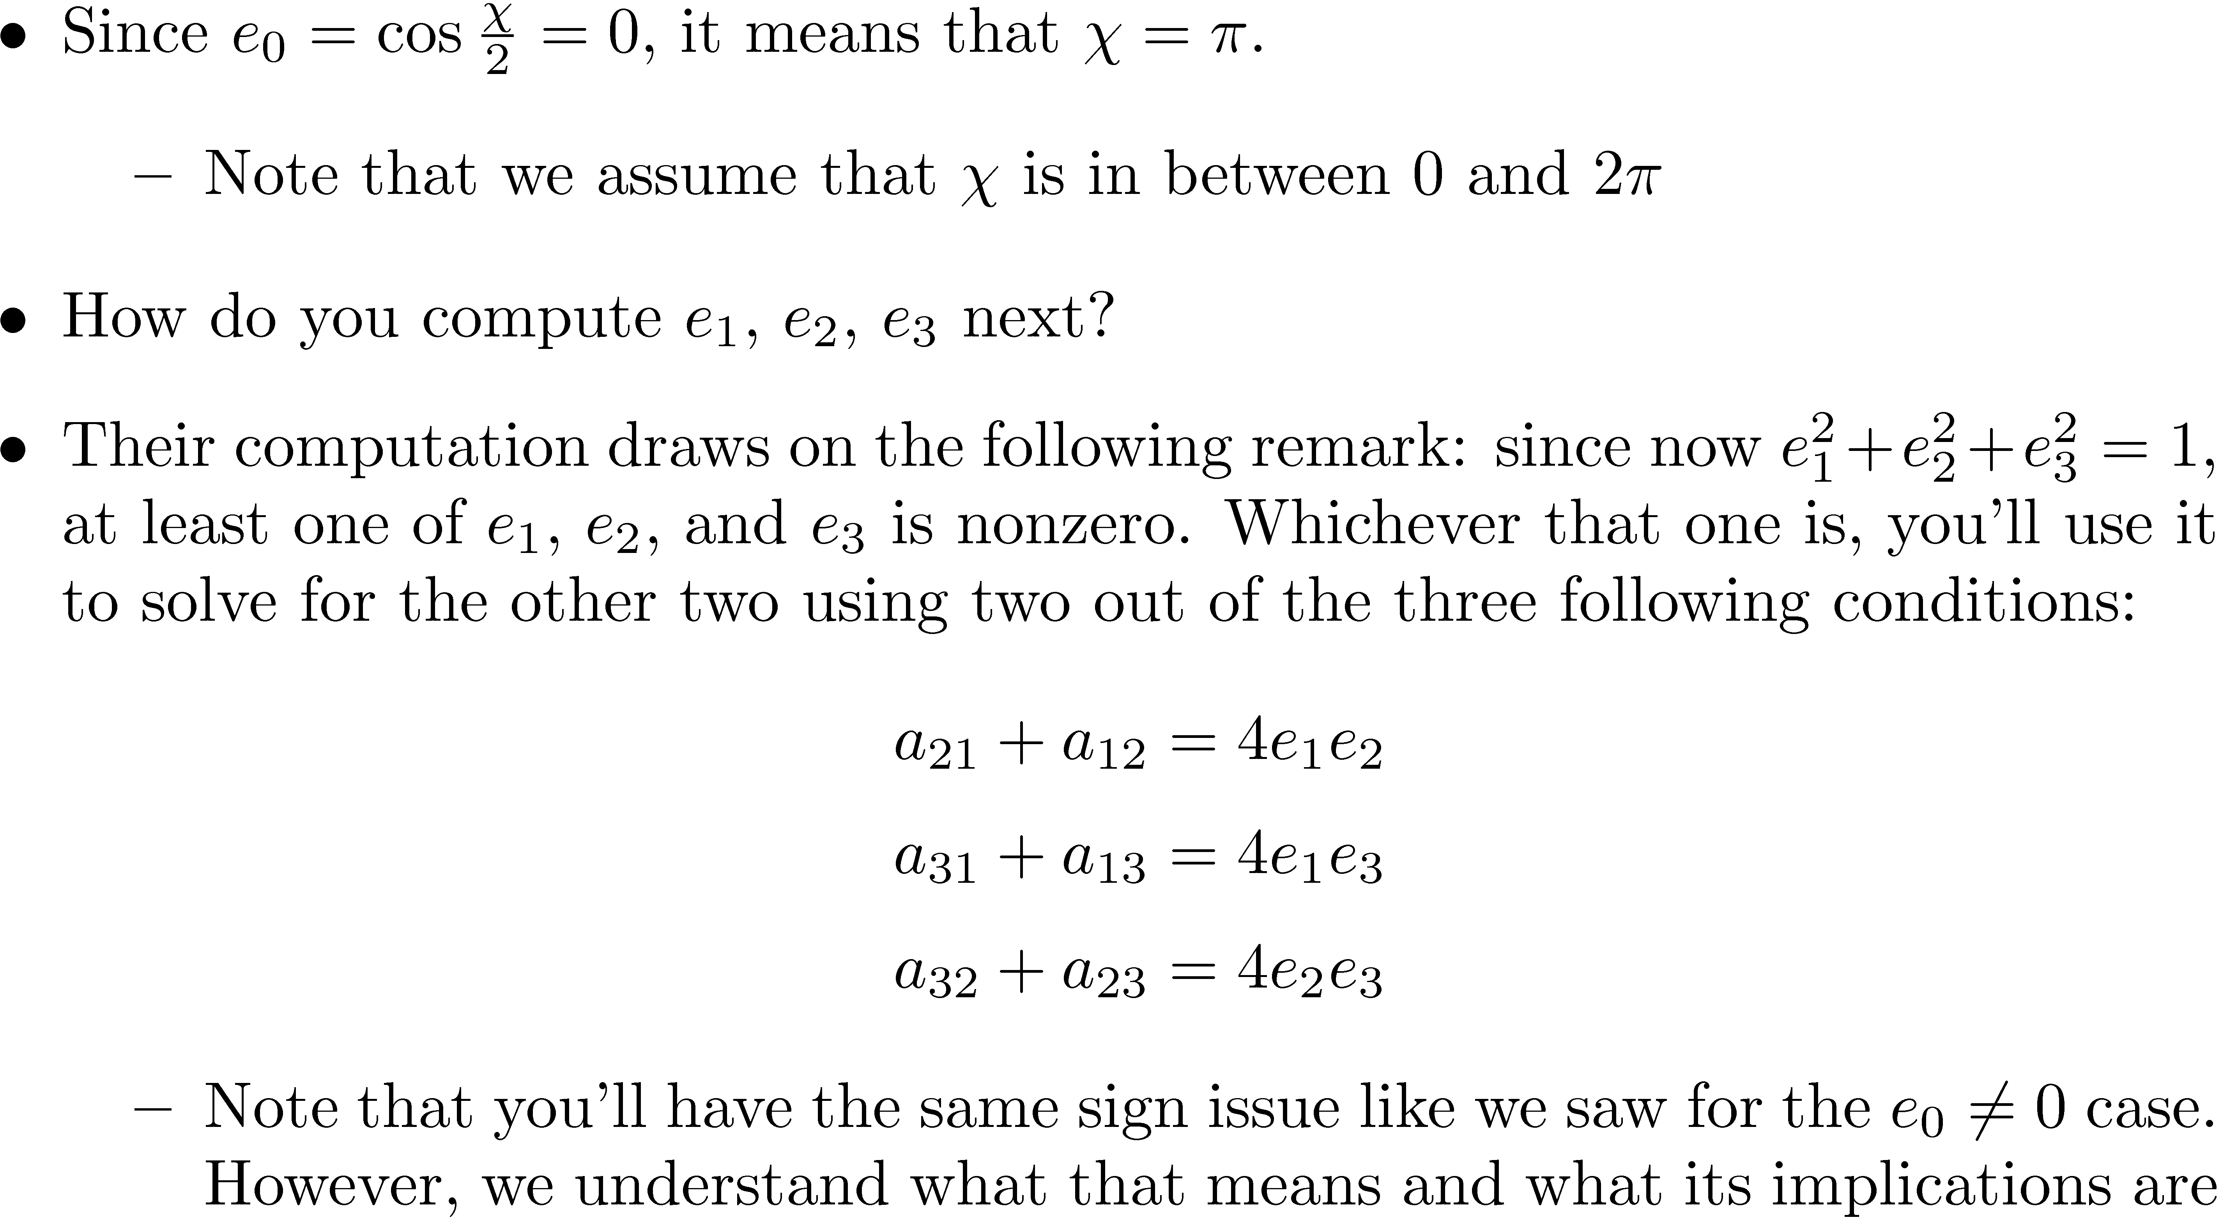
[pp.341] Part 2, Case 2: e₀ = 0

Slide 19
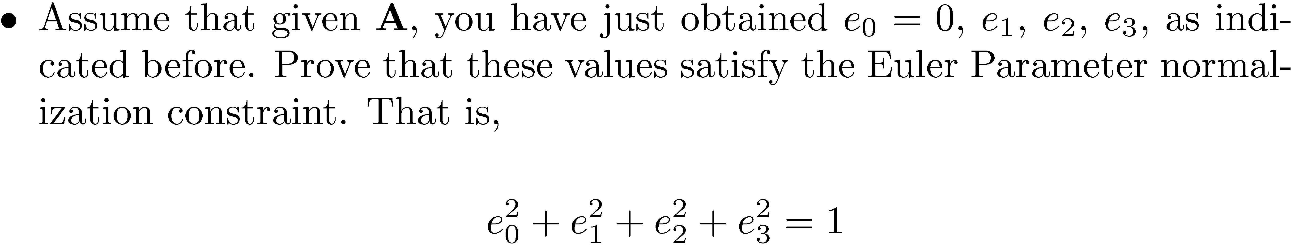
[HW] Exercise

Slide 20
Euler Parameters: The One-To-One Mapping to A – Concluding Remarks
One-To-One Mapping, Euler Parameter to Body Orientation, final word:
Things worked out well…
…(with the caveat that you have for each A two p sets, yet they are far apart and there is no danger to get confused)

Slide 21
[New Topic] Euler Parameter Identities
We’ll discuss a couple of identities (formulas) that involve the Euler parameters. Why?
They are needed for the discussion regarding the angular velocity
They are needed later on when discussing about the concept of virtual displacement
There is very little intuition behind these identities (at least to me)
Take them as they are: some helpers who are going to show up here and there in proving various results that involve the matrix A or its time derivatives

Slide 22
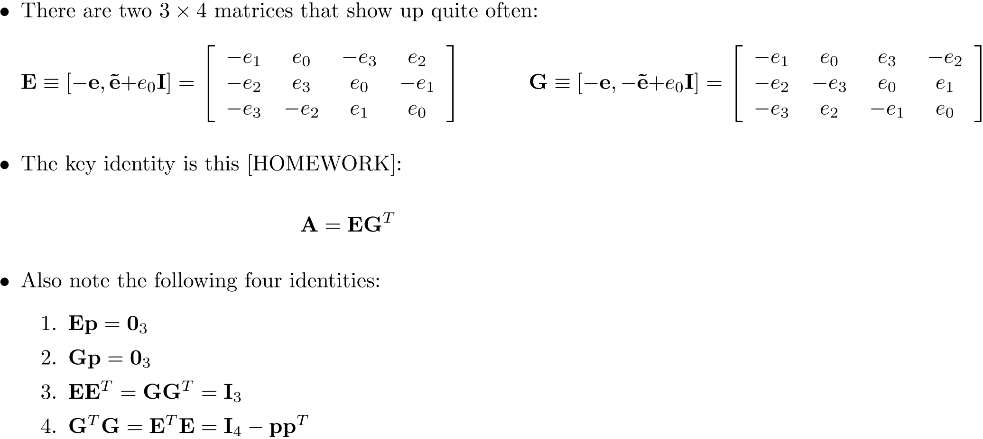
Position Level Identities [Level 0 Identities][p.343]

Slide 23
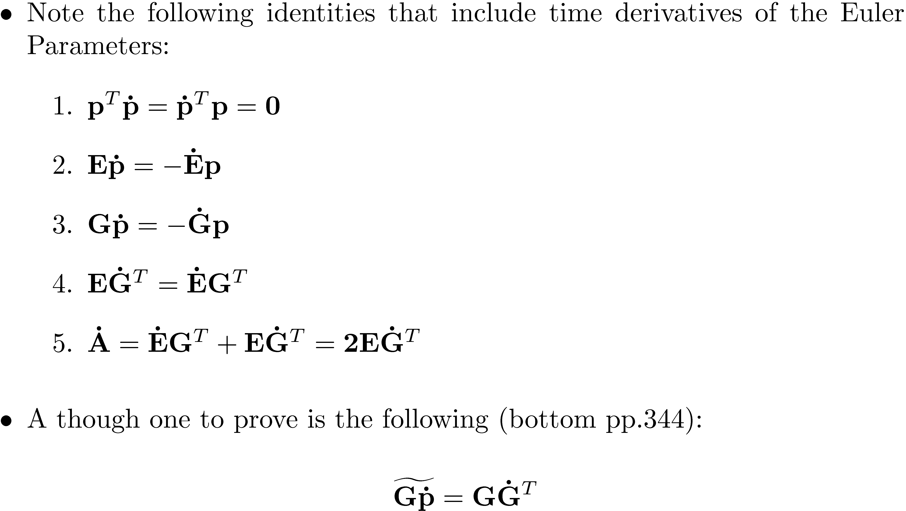
Velocity Level Identities [Level 1 Identities][p.344]

