Slide 1
ME751 Advanced Computational Multibody Dynamics
Section 9.3
February 16, 2010
“Courage is fear holding on a minute longer.”
General George S. Patton
© Dan Negrut, 2010 ME751, UW-Madison

Slide 2
Before we get started…
Last Time:
Concerned with describing the orientation of a body using Euler Parameters
Today:
Finish Euler Parameters discussion (angular velocity)
3D Kinematics of a Rigid Body
Kinematics Analysis
Kinematic constraints
HW4
Due on Th – make sure you don’t make it harder than it needs to be
Formatting issues cropped up in web ppt material
Situation will be corrected shortly (you can fix now, install MathType on your machine)
Asking for Feedback – Tu, Feb. 23: Provide anonymously on a printed page two concerns and/or things that I can do to improve ME751

Slide 3
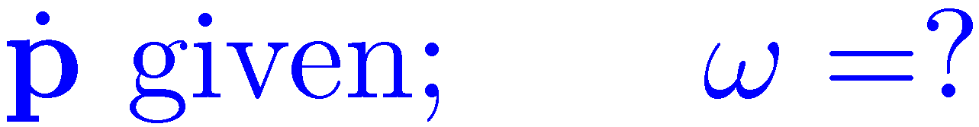
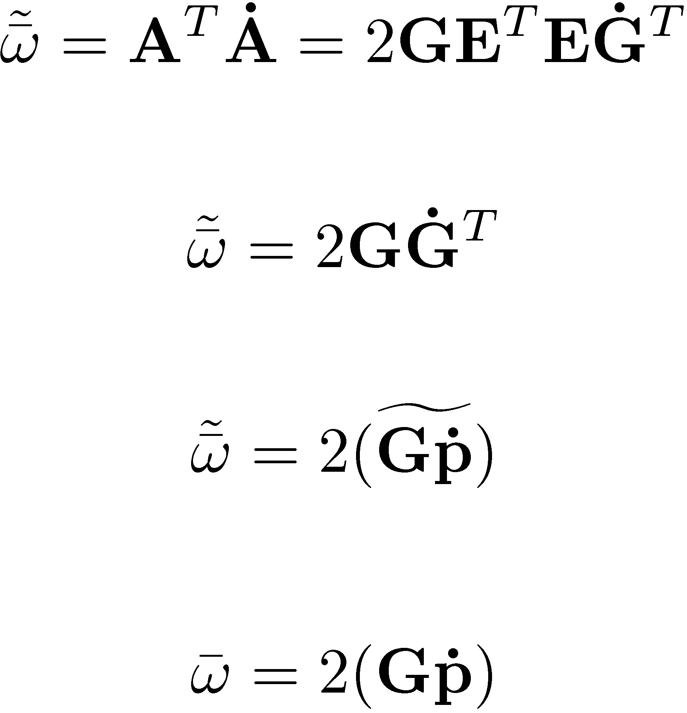
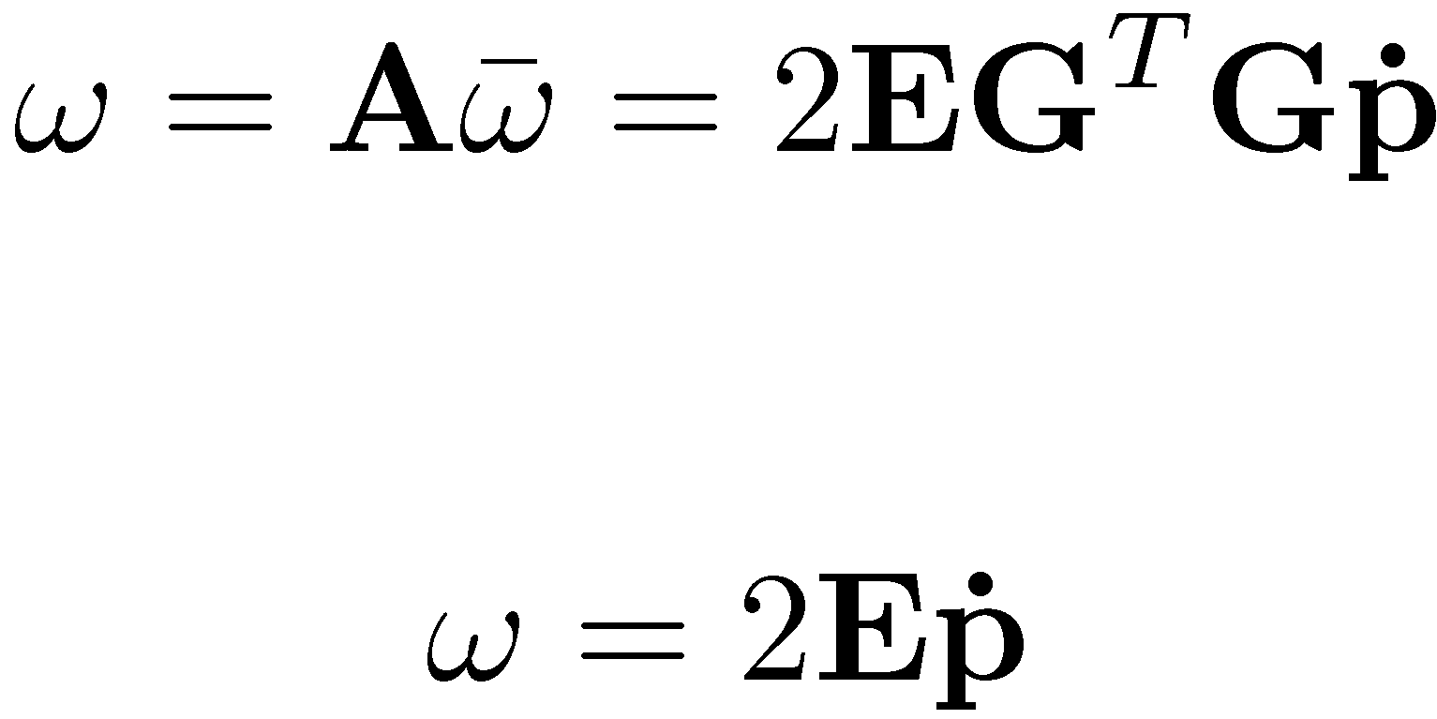
pp.344, Haug’s book

Slide 4

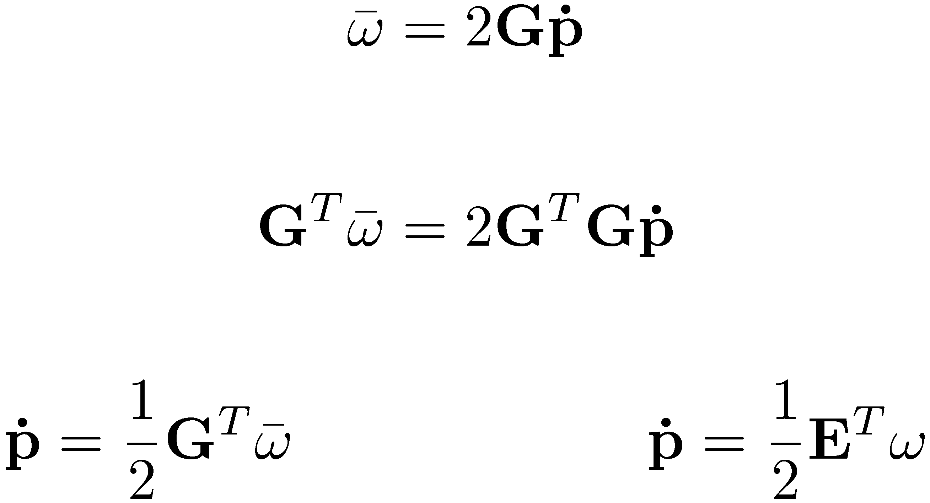
pp.345, Haug’s book

Slide 5
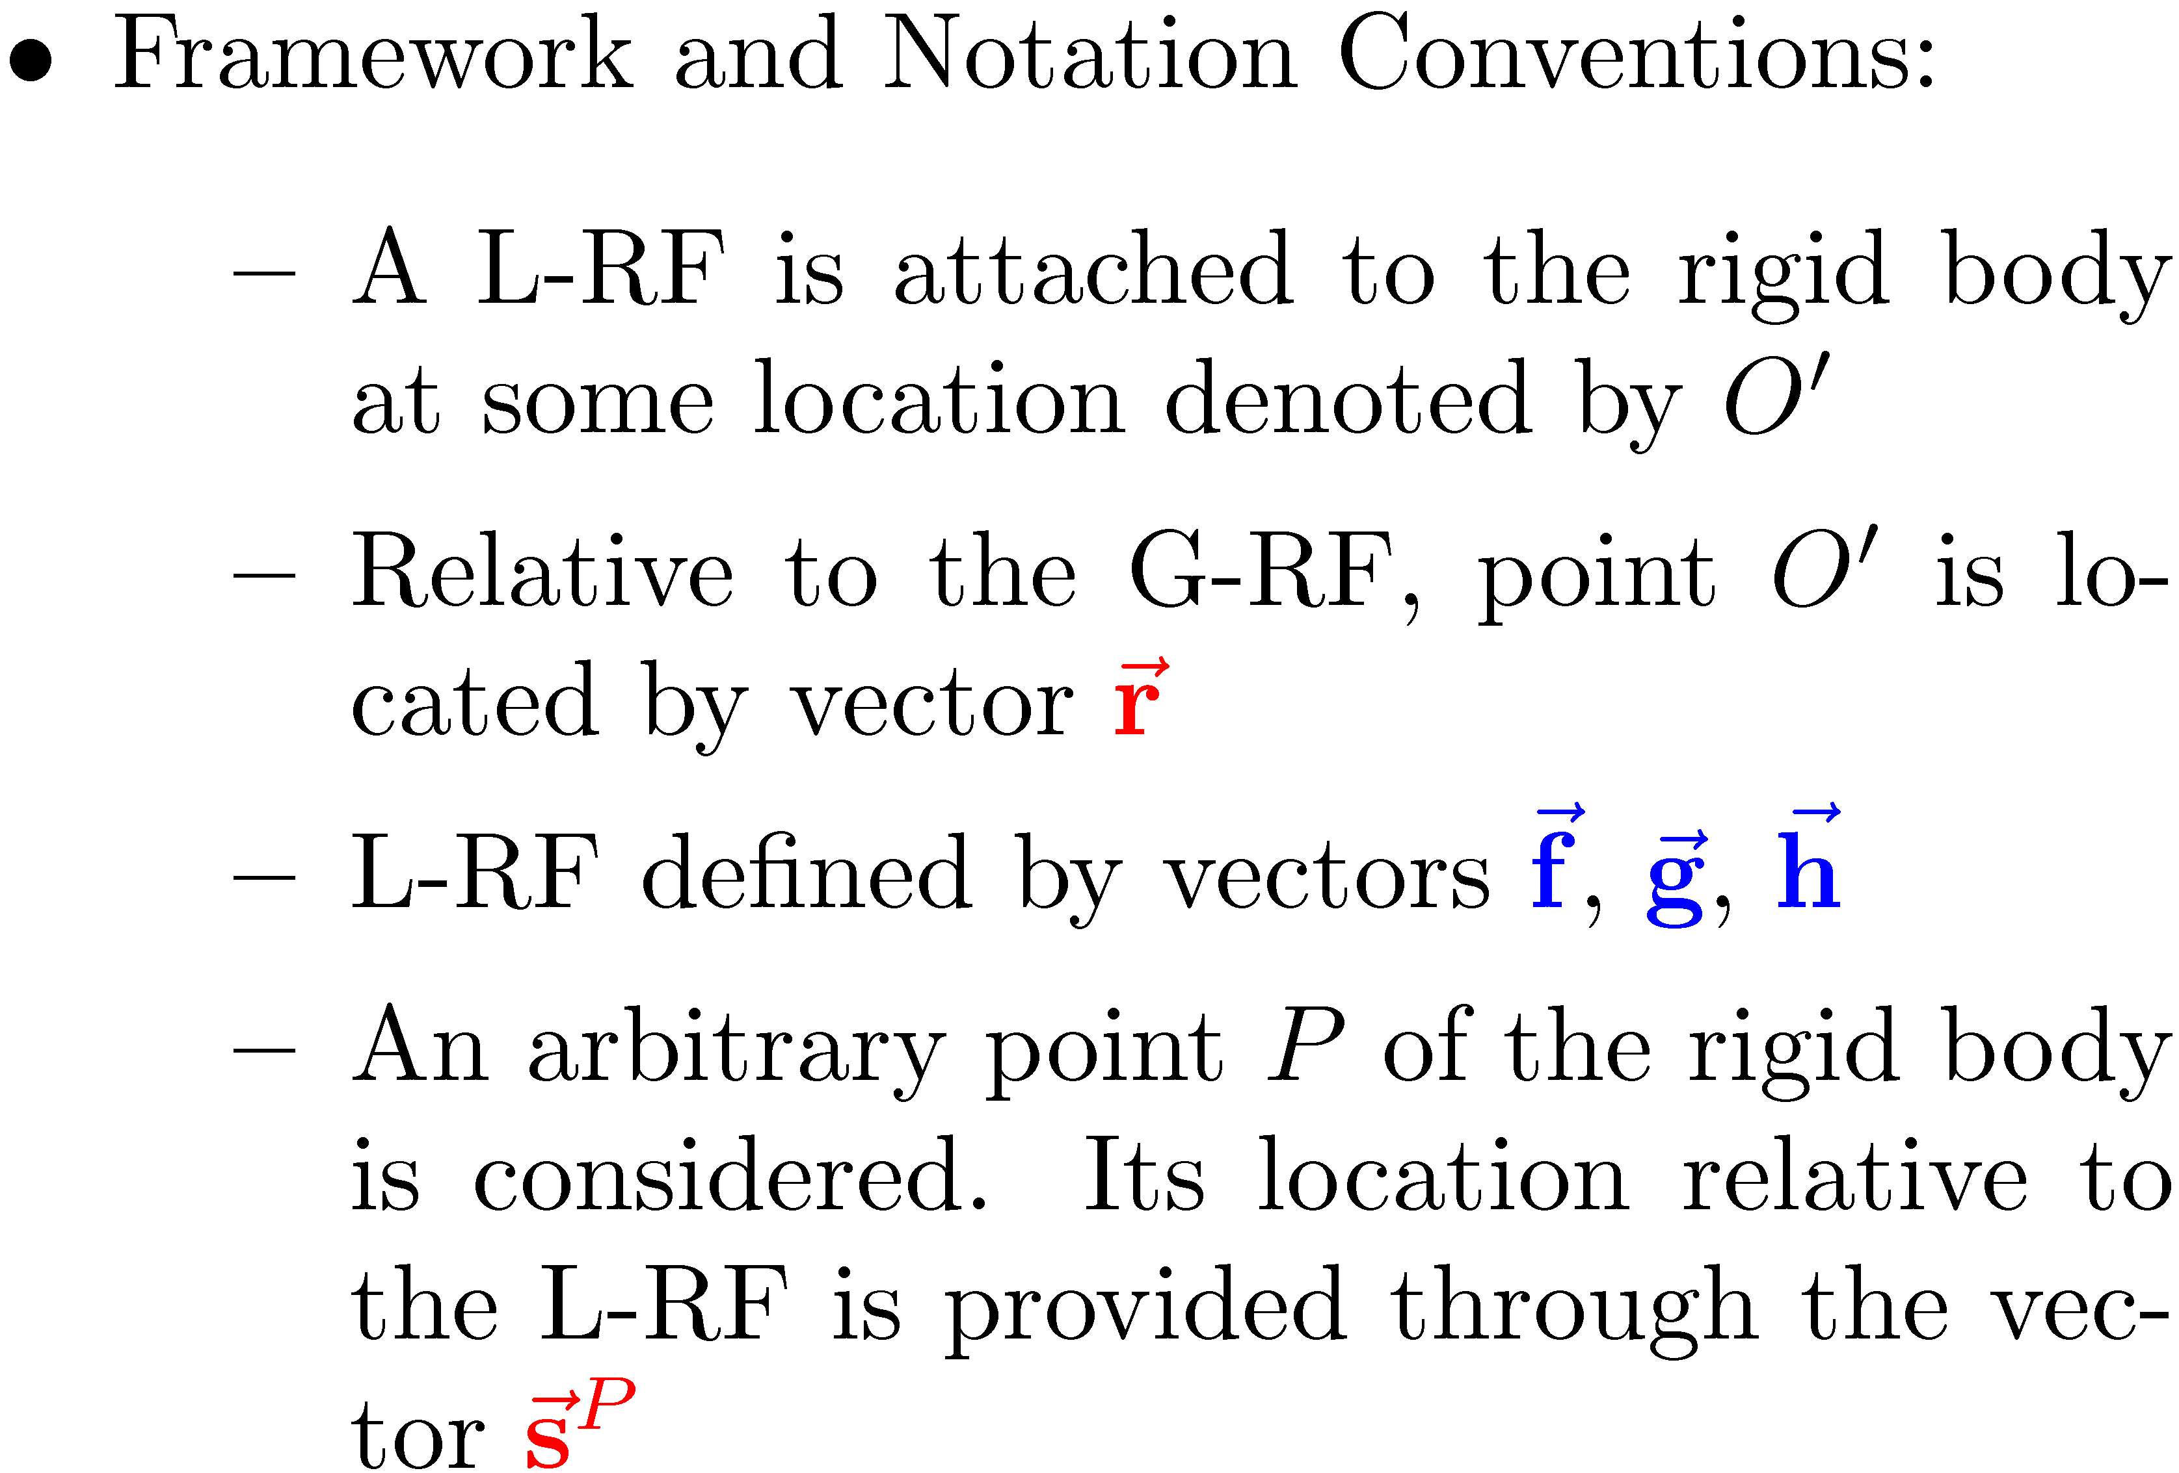
[New Topic: Combining Translation and Rotation] Full 3D Kinematics of Rigid Bodies
So far, we focused on the rotation of a rigid body
Scenario used: the body was connected to ground through a spherical joint that allowed it to experience an arbitrary rotation
Yet bodies are in general experiencing both translation and rotation

Slide 6
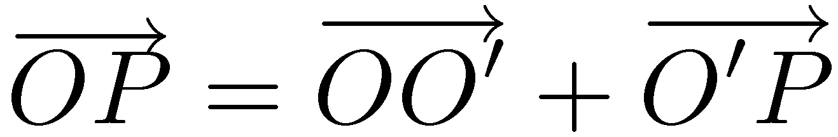
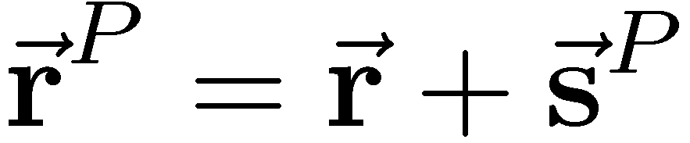
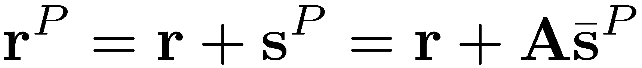
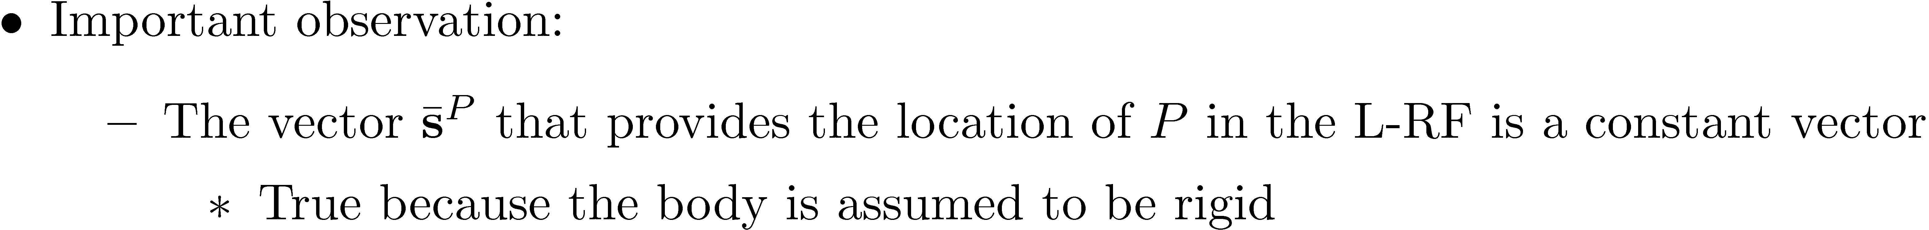
3D Rigid Body Kinematics: Determining Position of Arbitrary Point P [Very Important to Understand]
In the Geometric Vector world:
Algebraic Vector world:

Slide 7
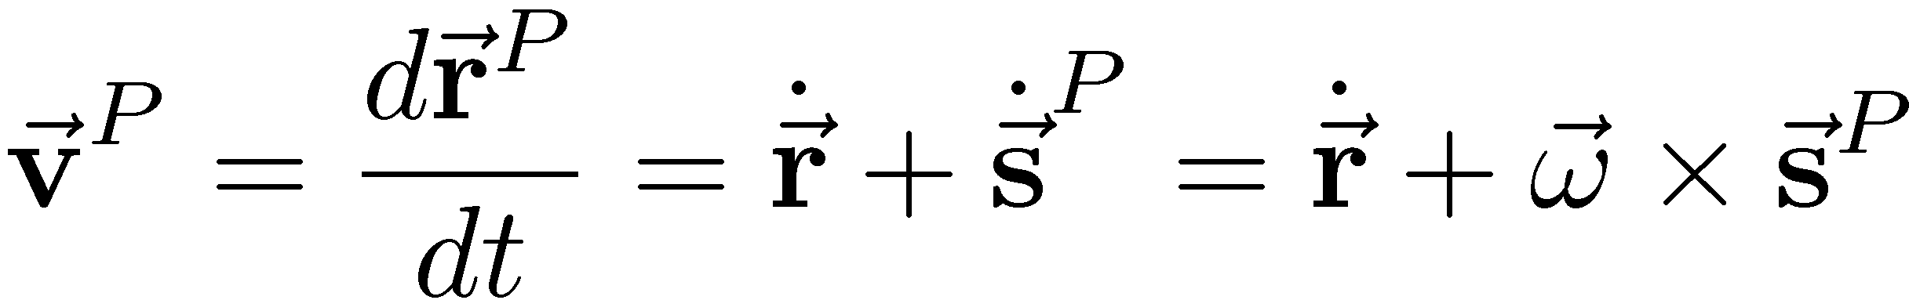
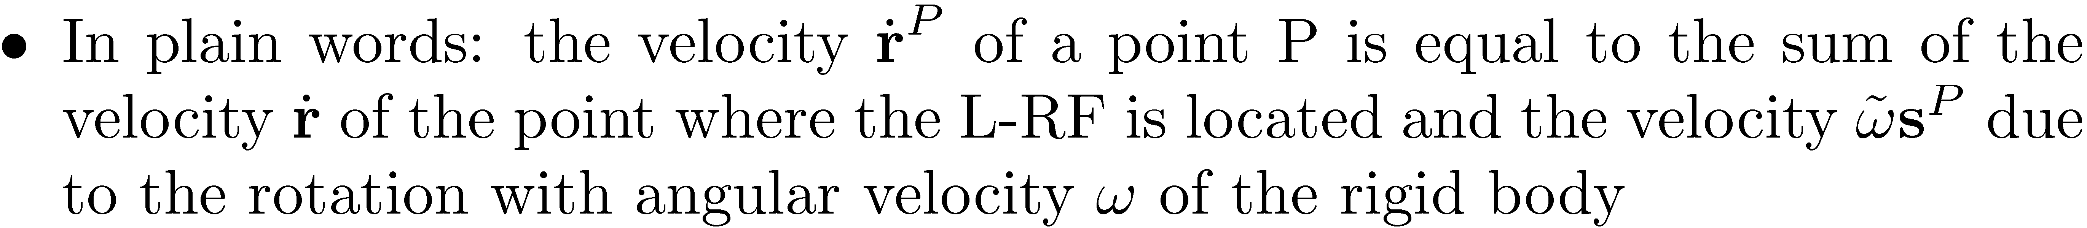
3D Rigid Body Kinematics: Determining Velocity of Arbitrary Point P
In the Geometric Vector world, by definition:
Using the Algebraic Vector representation:

Slide 8
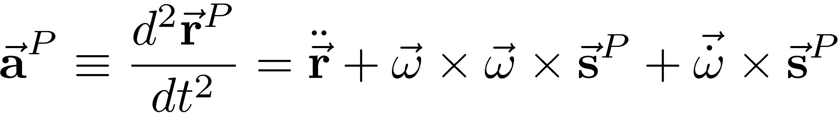
3D Rigid Body Kinematics: Determining Acceleration of Arbitrary Point P
In the Geometric Vector world, by definition:
Using the Algebraic Vector representation:

Slide 9
3D Translation and Rotation OK. Now What?
Given an arbitrary point P on a rigid body, we know how to
Capture its position with respect to both a G-RF and a L-RF
Compute its velocity
Compute its acceleration
This will become important when we discuss how to express in mathematical terms the fact that the motion of a body is constrained by the presence of joints that limit its relative motion to ground or to other bodies in a mechanical system
We start with a geometric perspective on the relative motion between two bodies and then formulate a set of equations in terms of algebraic vectors that enforce the kinematics; that is, capture the effect of the joint connecting the two bodies

Slide 10
End: Kinematics of a Rigid Body in 3D Begin: Kinematics Analysis of Mech. System

Slide 11
Kinematics Analysis: Definition
Kinematics Analysis – the process of computing the position, velocity, and acceleration of a system of interconnected bodies that make up a mechanical system independent of the forces that produce its motion

Slide 12
Motivating Example: Motion of Simple Pendulum
A revolute (hinge) joint present at point P
A motion µ(t)=4t² is applied to the pendulum
Find the time evolution of this pendulum

Slide 13
Kinematic Analysis Stages
Position Analysis Stage
Challenging
Velocity Analysis Stage
Simple
Acceleration Analysis Stage
OK
To take care of all these stages, ONE step is critical:
Write down the constraint equations associated with the joints present in your mechanism
Once you have the constraints, the rest is boilerplate

Slide 14
Why is Kinematics Important?
It can be an end in itself…
Kinematic Analysis - Interested how components of a certain mechanism move when motion[s] are applied
Kinematic Synthesis – Interested in finding how to design a mechanism to perform a certain operation in a certain way
NOTE: ME751 only covers Kinematic Analysis
It is important to understand Kinematics since the building blocks of the infrastructure here will be recycled when assembling the infrastructure for the Kinetic problem (“Dynamics Analysis”, discussed in Chapter 11)
In general, the Dynamic Analysis sees more mileage compared to the Kinematic Analysis of mechanism

Slide 15
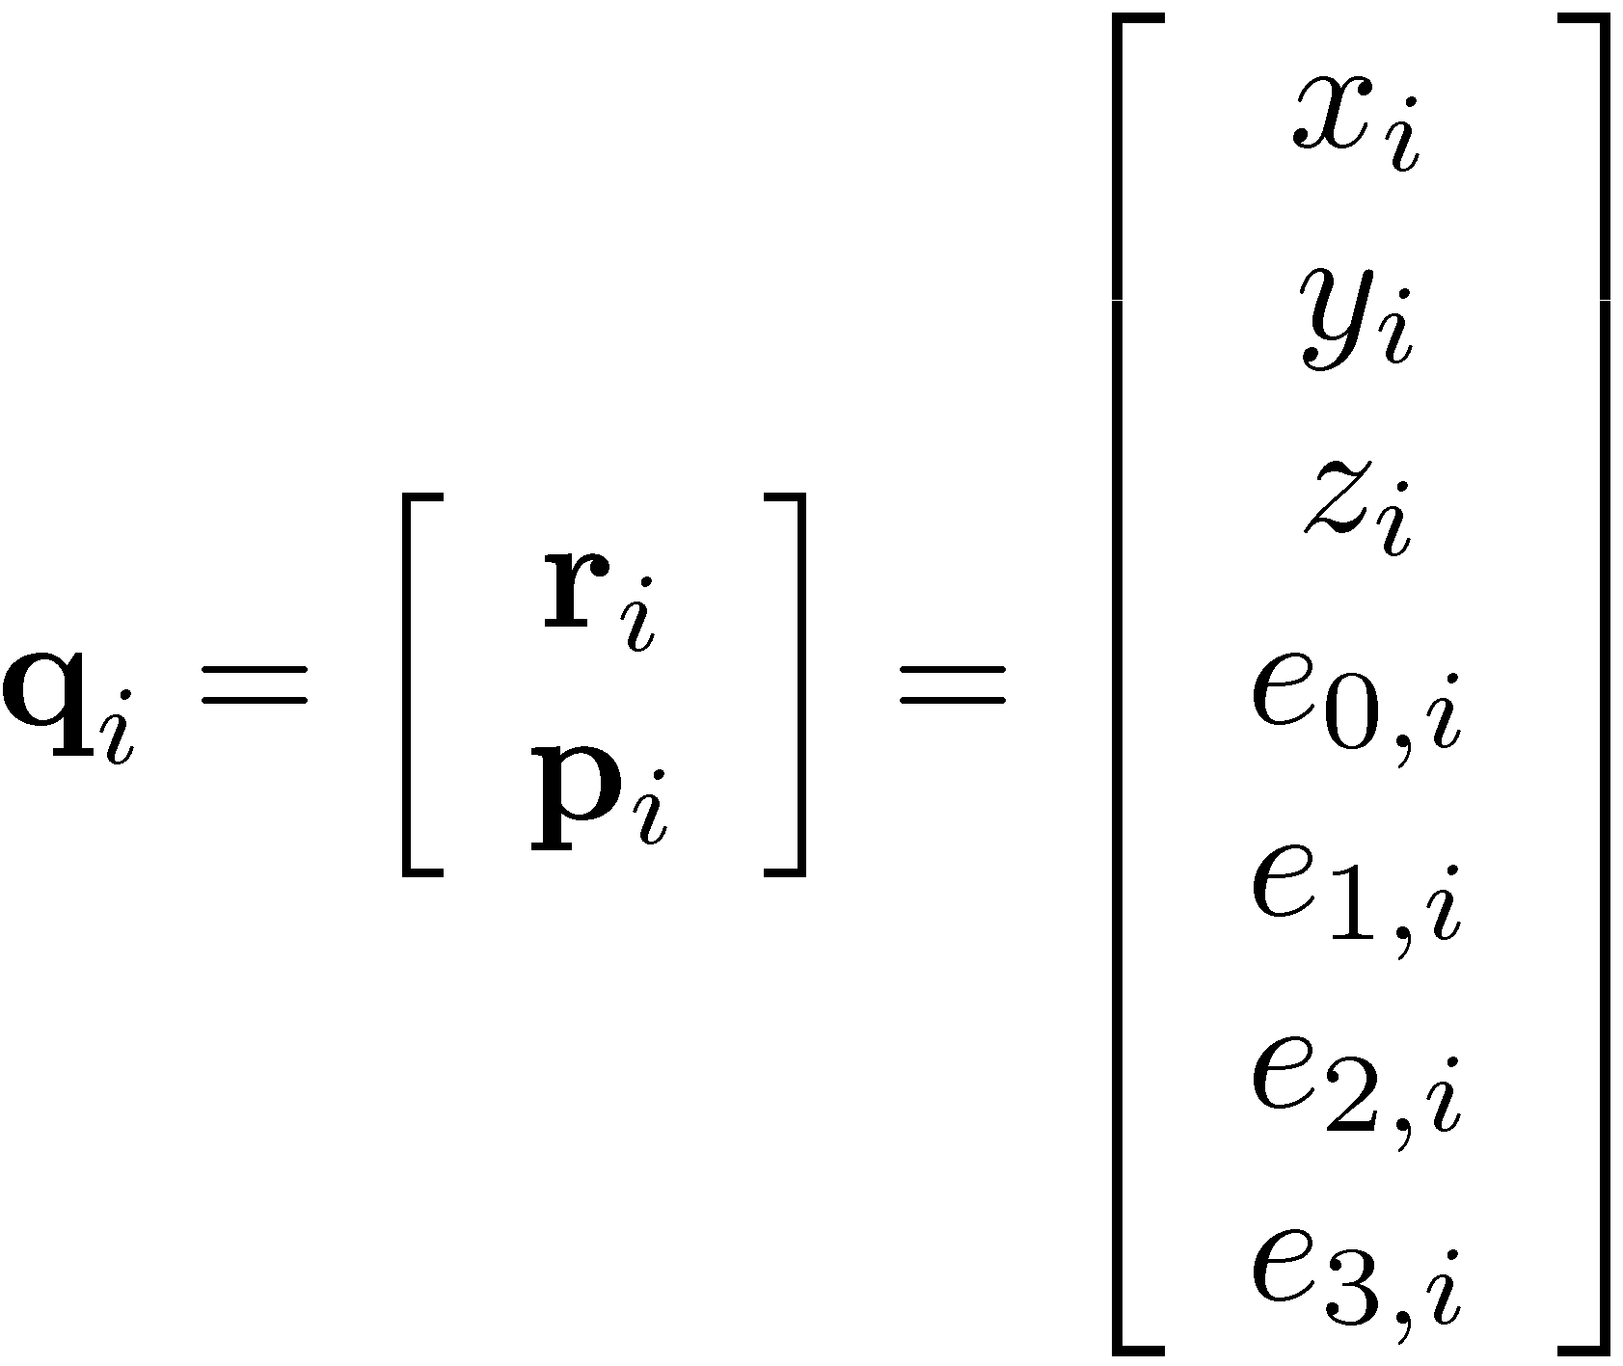

Nomenclature & Conventions [1st out of 2]
We are dealing with rigid bodies only
Recall this: L-RF – is a body fixed Reference Frame used to describe the position and orientation of a rigid body in the 3D space
Body Cartesian generalized coordinates (GCs)
Used to define the position and orientation of the L-RF mentioned above
We’ll use Euler Parameters (less headaches than Euler Angles…)
For body “i” the GCs that we’ll work with are
Tell us where the body is located
Tell us how the body is oriented

Slide 16
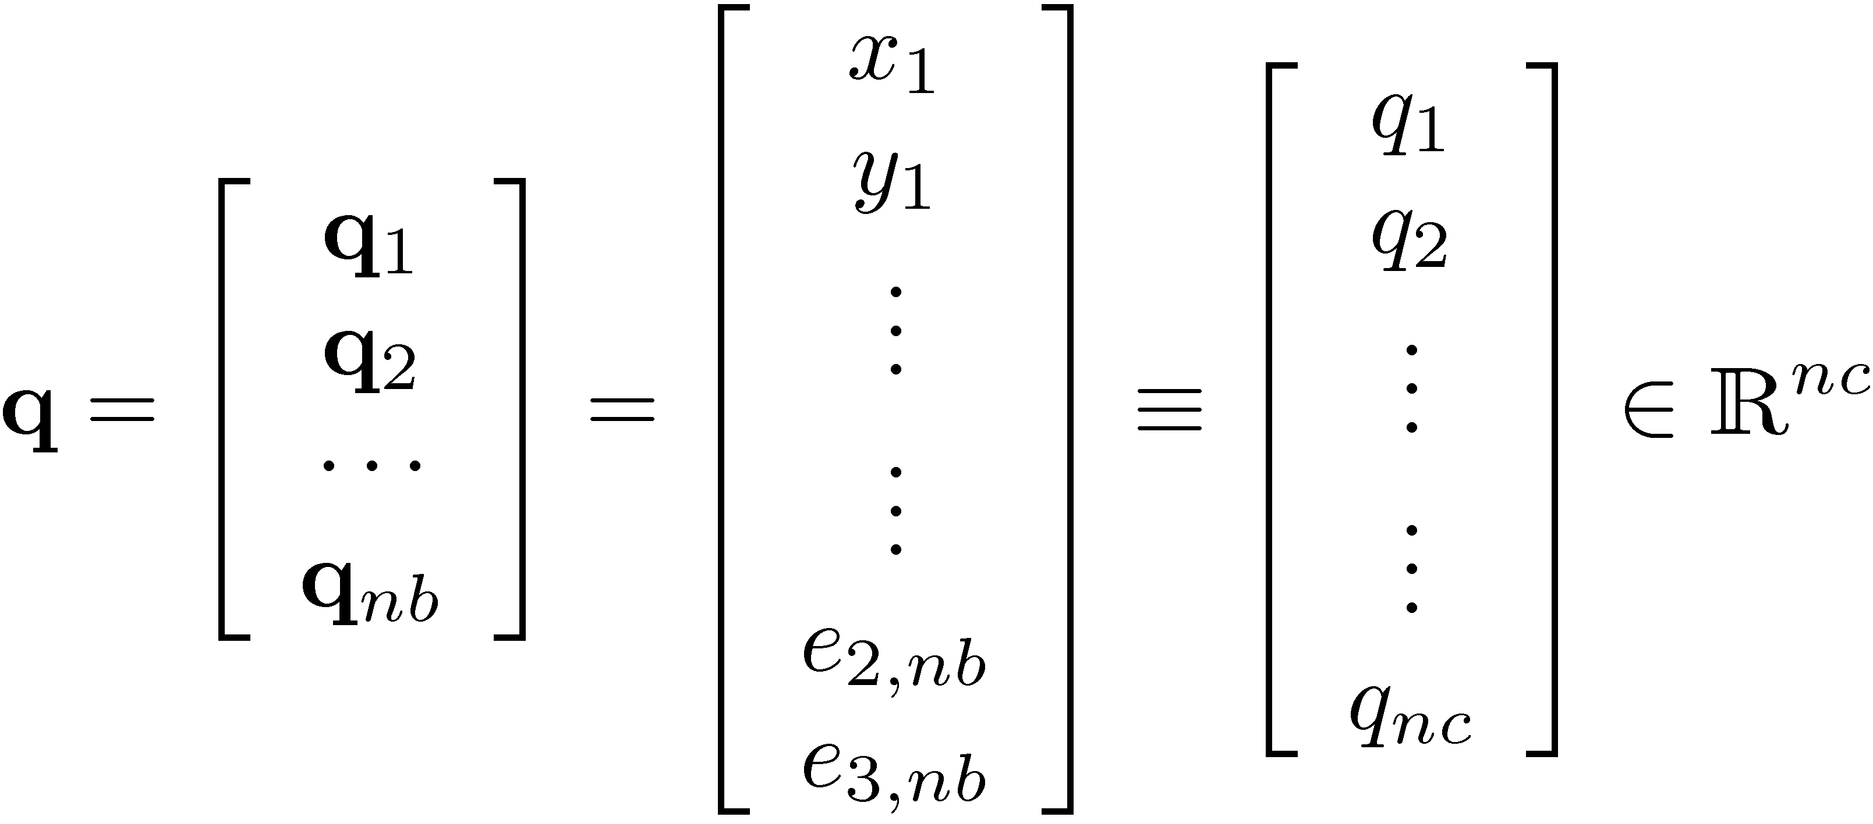
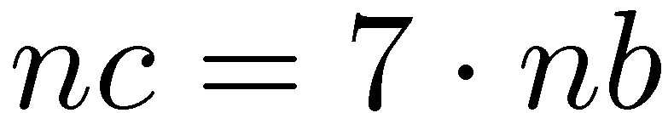
Nomenclature & Conventions [2/2]
The system GSs – the array of all bodies GCs
NOTE: for a mechanism with nb bodies, the number nc of Cartesian generalized coordinates is
“nc” stands for “number of coordinates”
Recall we have a number of nb “Euler Parameter normalization constraints”:

Slide 17
Putting Things in Perspective
Before getting lost in the details of the Kinematics Analysis:
Recall that we presented a collection of terms that will help understand the “language” of Kinematics
We are about to give a 30,000 feet perspective of things to come to justify the need for the material presented over the next two lectures
Among the concepts introduced today, here are the more important ones:
Constraint equations (as a means to specifying the geometry associated with the motion of a mechanism)
Jacobian matrix (or simply, the Jacobian)

Slide 18


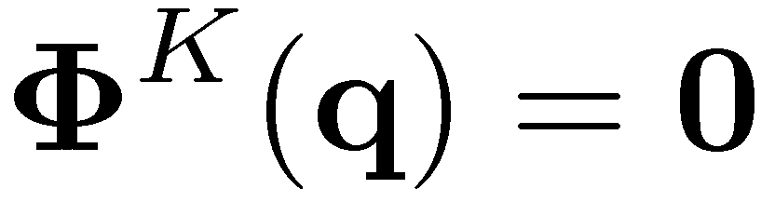
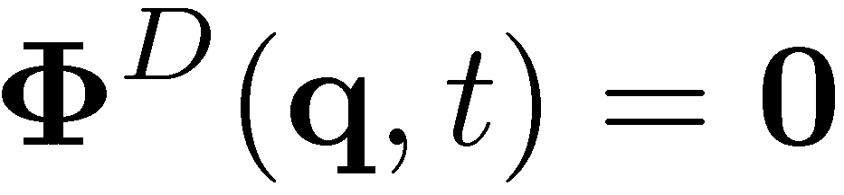
Joints (Physical System) vs. Constraint Equations (Virtual System)
Physical Mechanical System:
A mechanical system (mechanism) uses joints to connect bodies
Moreover, some of its components are driven in a predefined fashion
Virtual System:
A set of constraint equations needs to be specified to capture the effect of the joints present in the physical model
Some of these equations will be time dependent to capture motions
Constraint Equations, taxonomy
Holonomic vs. Nonholonomic constraint
Holonomic: only depends on generalized coordinates, not on their time derivative
Scleronomic (“Kinematic”) vs. Rheonomic (“Driving”) constraints

Slide 19
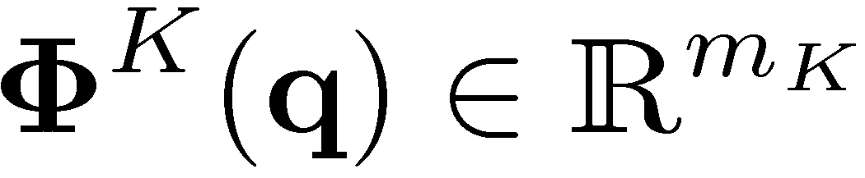
Kinematic Constraints,
What are they, and what role do they play?
A collection of equations that, if satisfied, coerce the bodies in the model to move like the bodies of the mechanism
They enforce the geometry of the motion
Most important thing in relation to constraints:
For each joint in the model, the equations of constraint that you use must imply the relative motion allowed by the joint
This is where we’ll spend a lecture
Keep in mind: the way you model should resemble the physical system (the geometry of the motion)
Notation: We’ll use m_{K} to denote the number of kinematic (or scleronomic) constraints present in the model:

Slide 20
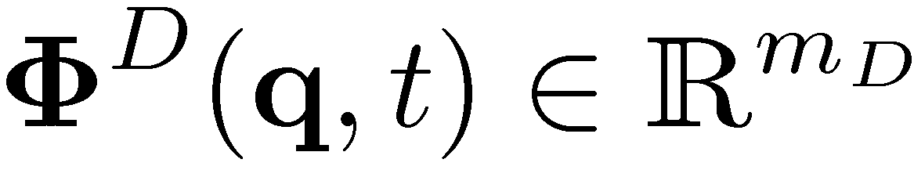
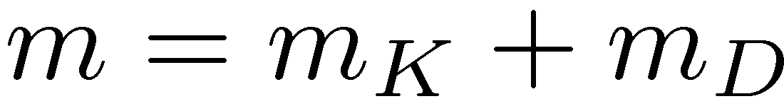
Driving Constraints,
What are they, and what role do they play?
An equation, such as µ(t)=¼ t + ¼/2, that specifies how a generalized coordinate or a relation that depends on model GCs changes in time
They define (prescribe) the motion
Notation:
We’ll use m_{D} to denote the number of driving (or rheonomic) constraints present in the model
We’ll use m to denote the total number of constraints (kinematic and driving) present in the model:

Slide 21
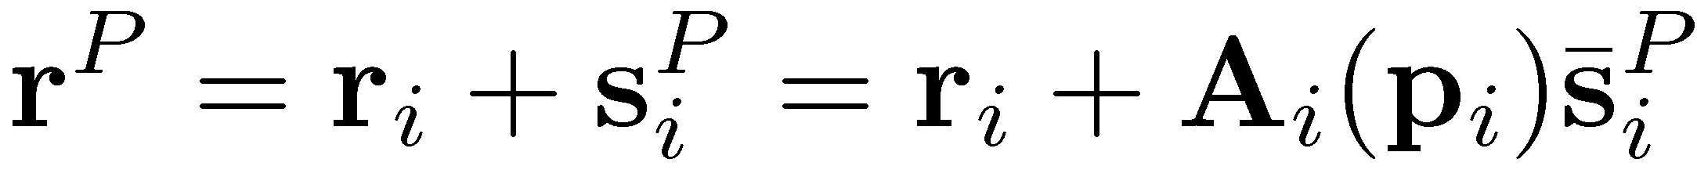
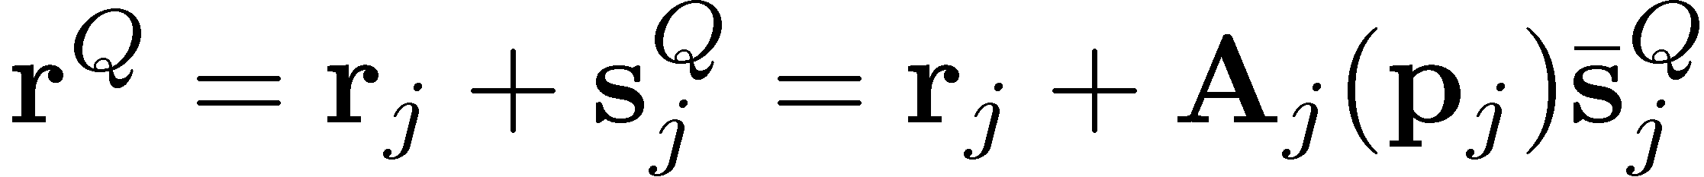
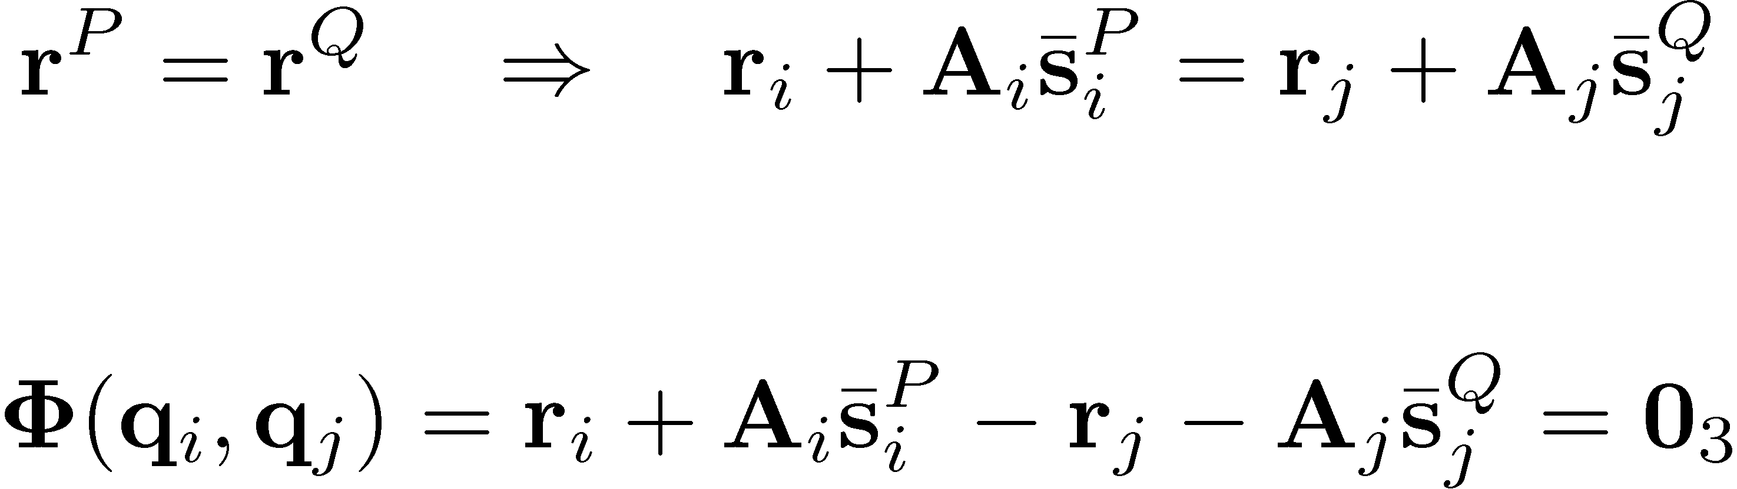

Example: Handling a Spherical Joint
Define a set of Kinematic Constraints that reflect the existence of a spherical joint between points P on body i and Q on body j
Note that the spherical joint condition is enforced by requiring that the points P and Q coincide at all times

Slide 22
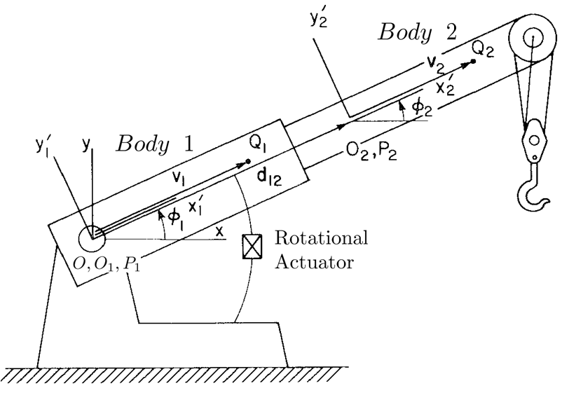
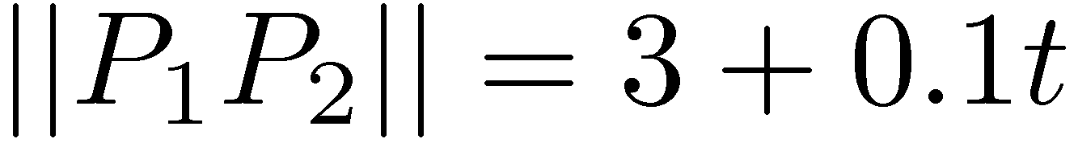

Example: Specifying Motions
Wrecker boom with two motions prescribed (ME451 example)
Prescribed motions:

Slide 23
Degrees of Freedom
Number of degrees of freedom (NDOF, ndof) is equal to total number of generalized coordinates minus the number of constraints that these coordinates must satisfy
Sometimes also called “Gruebler Count”
Quick Remarks:
NDOF is an attribute of the model, and it is independent of the set of generalized coordinates used to represent the motion of the mechanism
When using Euler Parameters for body orientation, m_{K} should also include the set of nb normalization constraints
In general, for carrying out Kinematic Analysis, NDOF=0
For Dynamics Analysis, NDOF 0

Slide 24

Motion: Causes
How can one set a mechanical system in motion?
Approach leading to Kinematic Analysis
Prescribe motions for various components of the mechanical system until NDOF=0
For a well posed problem, you’ll be able to uniquely determine q(t) as the solution of an algebraic problem
Approach leading to Dynamics Analysis
Apply a set of forces upon the mechanism and specify a number of motions, but when doing the latter make sure you end up with NDOF 0
For a well posed problem, q(t) found as the solution of a differential problem
(Forget this for now…)

Slide 25
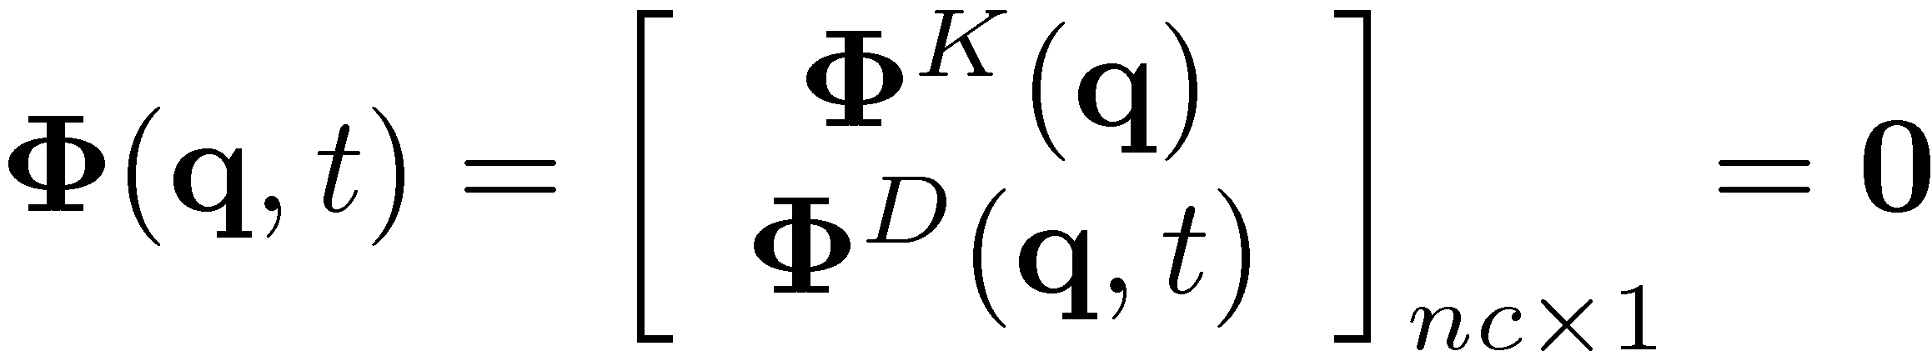



Position Analysis
How do you get the position configuration of the mechanism?
Kinematic Analysis key observation: The number of constraints (kinematic and driving) is equal to the number of generalized coordinates: m=nc
This is a prerequisite for Kinematic Analysis
The solution of the nonlinear system is found by using the so called “Newton-Raphson” algorithm
We’ll elaborate on this later, for now just assume that you have a way to solve the above nonlinear system to find the solution q(t)
IMPORTANT: This is a nonlinear systems with nc equations and nc unknowns that you must solve to find q

Slide 26
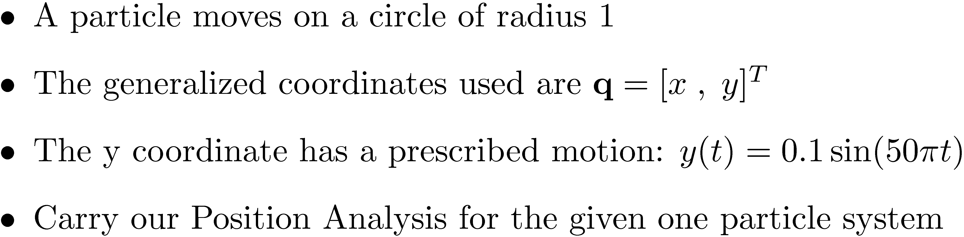
Exercise: Kinematic Analysis

Slide 27
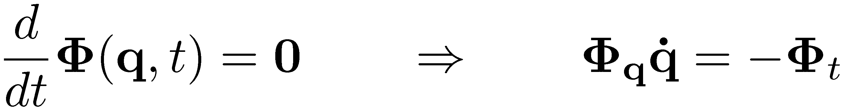


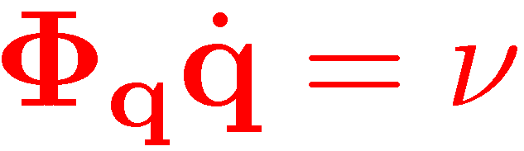
Velocity Analysis
Take one time derivative of constraints Φ(q,t) to obtain the velocity equation:
The Jacobian has as many rows (m) as it has columns (nc) since for Kinematics Analysis, NDOF=nc-m =0
Therefore, you have a linear system that you need to solve to recover

Slide 28



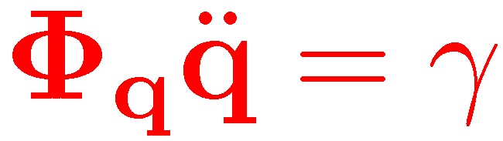
Acceleration Analysis
Take yet one more time derivative to obtain the acceleration equation:
NOTE: Getting right-hand side of acceleration equation is tedious
One observation that simplifies the computation: note that the right side of the above equation is made up of everything in the expression of that does *not* depend on second time derivatives (accelerations)
Just like we pointed out for the velocity analysis, you also have to solve a linear system of retrieve the acceleration

Slide 29
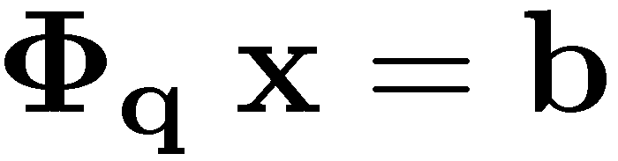
Kinematics Analysis: Comments on the Three Stages
The three stages of Kinematics Analysis: position analysis, velocity analysis, and acceleration analysis they each follow *very* similar recipes for finding for each body of the mechanism its position, velocity, and acceleration, respectively
ALL STAGES RELY ON THE CONCEPT OF JACOBIAN MATRIX:
Φ_{q} – the partial derivative of the constraints wrt the generalized coordinates
ALL STAGES REQUIRE THE SOLUTION OF A SYSTEM OF EQUATIONS
WHAT IS DIFFERENT BETWEEN THE THREE STAGES IS THE EXPRESSION OF THE RIGHT-SIDE OF THE LINEAR EQUATION, “b”

Slide 30
Formulating Kinematic Constraints
What are we after?
Derive kinematic constraints that specify that the location and/or attitude of a body wrt the global (or absolute) RF is constrained in a certain way
Sometimes called absolute constraints
Derive kinematic constraints that couple the relative motion of two bodies
Sometimes called relative constraints

Slide 31
The Drill…
Step 1: Identify a joint or joint primitive (revolute, translational, relative distance, etc.; i.e., the physical thing) acting between two components of a mechanism
Step 2: Formulate the algebraic equations Φ(q)=0, that capture the effect of the joint
This is called “modeling”
Step 3: Compute the Jacobian (or the sensitivity matrix) Φ_{q}
Step 4: Compute ν, the right side of the velocity equation
Step 5: Compute γ, the right side of the acceleration equation (tedious…)

