Slide 1
ME751 Advanced Computational Multibody Dynamics
Section 9.6
February 25, 2010
“In China if you are one in a million – there are 1,300 other people just like you."
Bill Gates
© Dan Negrut, 2010 ME751, UW-Madison

Slide 2

Before we get started…
Last Time:
Finished Geometric Constraints
Started discussion about their partial derivatives
Today:
Discussion of assignment
Finish partial derivatives
Discuss computation of
Quick remarks on Position Analysis + Newton Raphson
Start the dynamics problem
HW6 – due on March 4, posted online today
Heads up: next week’s HW7 will ask you to define your ME751 Final Project
Student Feedback: posted online on class website
Only two students provided feedback

Slide 3
Today’s Assigned HW
First in a series of assignments that each contains a MATLAB component
For first one you’ll have to implement computational support for two basic GCon’s
You will be coding over the next four or five HWs a series of MATLAB functions that in the end should form a cohesive 3D Simulation Engine for Kinematics and Dynamics Analysis
On Th, March 4, Hammad will give a 15 minute presentation of the steps you need to take in order to visualize the motion of your model
Using Ogre, an open source 3D Graphics Engine (http://www.ogre3d.org/)
The task of putting together 3D Simulation Engine can become your Final Project

Slide 4
[1/3] 3D Simulation Engine: Comments
At least three A grades will be assigned in conjunction with 3D Simulation Engine:
Category Speed: The student with the fastest code on a benchmark problem gets an automatic A grade in ME751
Category Functionality: The student with the implementation with the richest functionality will get an automatic A grade
Functionality: defined as the number of GCon’s supported, analysis modes implemented (Kinematics, Dynamics, Equilibrium, Inverse Dynamics, etc.), integration method supported, etc.
Category Pre-Processing: The student with the best way to define a multi-body model (preferably GUI-based model definition) will get an automatic A grade
Might or might not be offered
Category Post-Processing: The student with the best way to visualize simulation results will get an automatic A grade

Slide 5
[2/3] 3D Simulation Engine: Comments
The code of each of you will be made available online at the course website (under the “Students’ Code” link)
Privacy concerns: we’ll use code names to protect your identity
Please send me your code name (Examples: jamesbond, batman, robinhood, etc.)
If you don’t provide a code name I’ll assign one and email to you (you don’t want this to happen)
Use the following email message “ME751 code name: jamesbond”. Don’t include anything in the body of the email since I’m not going to read it
The TA will not debug your code. He’ll only try to validate it using a set of different input data
If you did mess up the code for week 2 (you’ll know if this is the case once you get your HW score back), when working on week 3 assignment it might be wise to look on the class website at other people’s code and recycle it
NOTE: For this approach to work, I will not accept late HW

Slide 6
[3/3] 3D Simulation Engine: Comments
When you email your code; that is, when you submit your homework, zip all your MATLAB files and email to me
Include *all* your MATLAB files; i.e., Week 3 will include your week 2 and week 1 files, etc.
Use the following email subject: “ME751: 3D Simulation Engine” and don’t include anything *except* a zip file. Any questions you might have, email them separately
The way the TA will check your code will be by running a MATLAB file called “simEngine3D.mat”
In other words, make sure you run your code by executing this MATLAB file, which in turn calls other MATLAB files that you implement
Why? Because we don’t want to learn how to run the program of each and every one of you. This will enforce a unique entry point to all 3D Simulation Engine developed in ME751
This is a multi-week project – please make sure you USE COMMENTS heavily in your code. Otherwise, in week 4 you’ll struggle to understand what you did in week 1

Slide 7
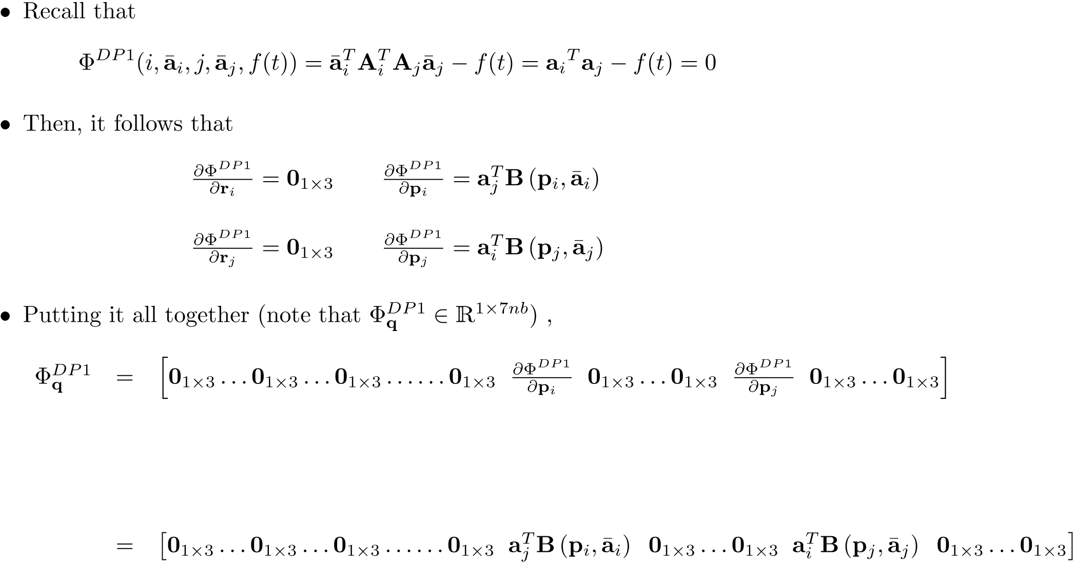
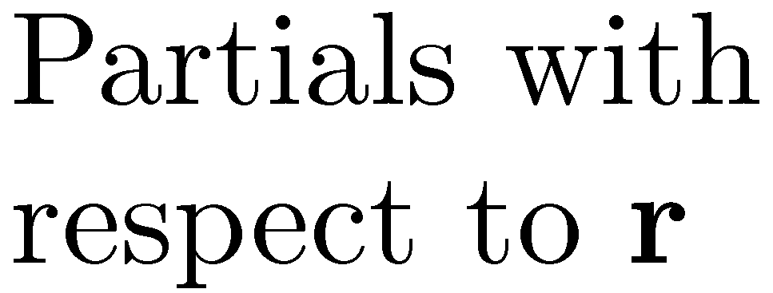
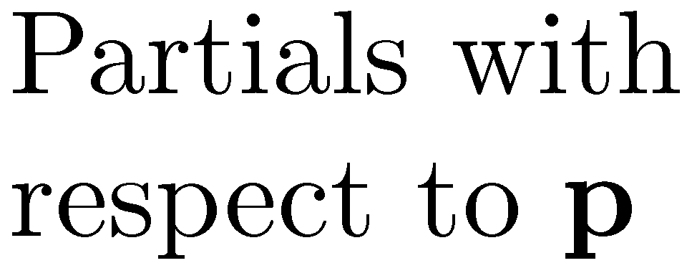
Body
1, r
Body
i, r
Body
j, r
Body
i-1, p
Body
i, p
Body
i+1, p
Body
j-1, p
Body
j, p
Body
j+1, p
Body
nb, p

Slide 8

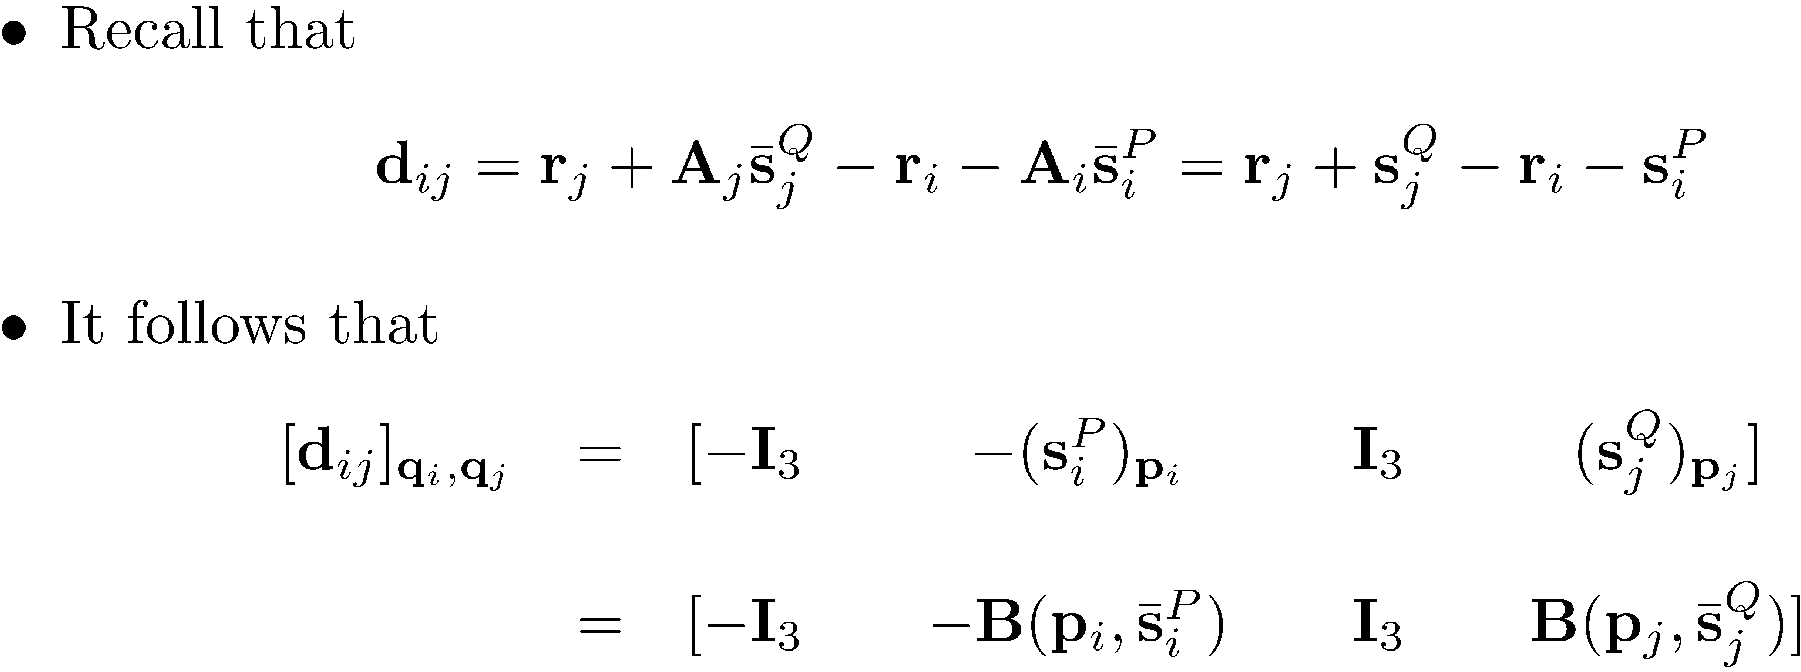
[Short Detour]:

Slide 9
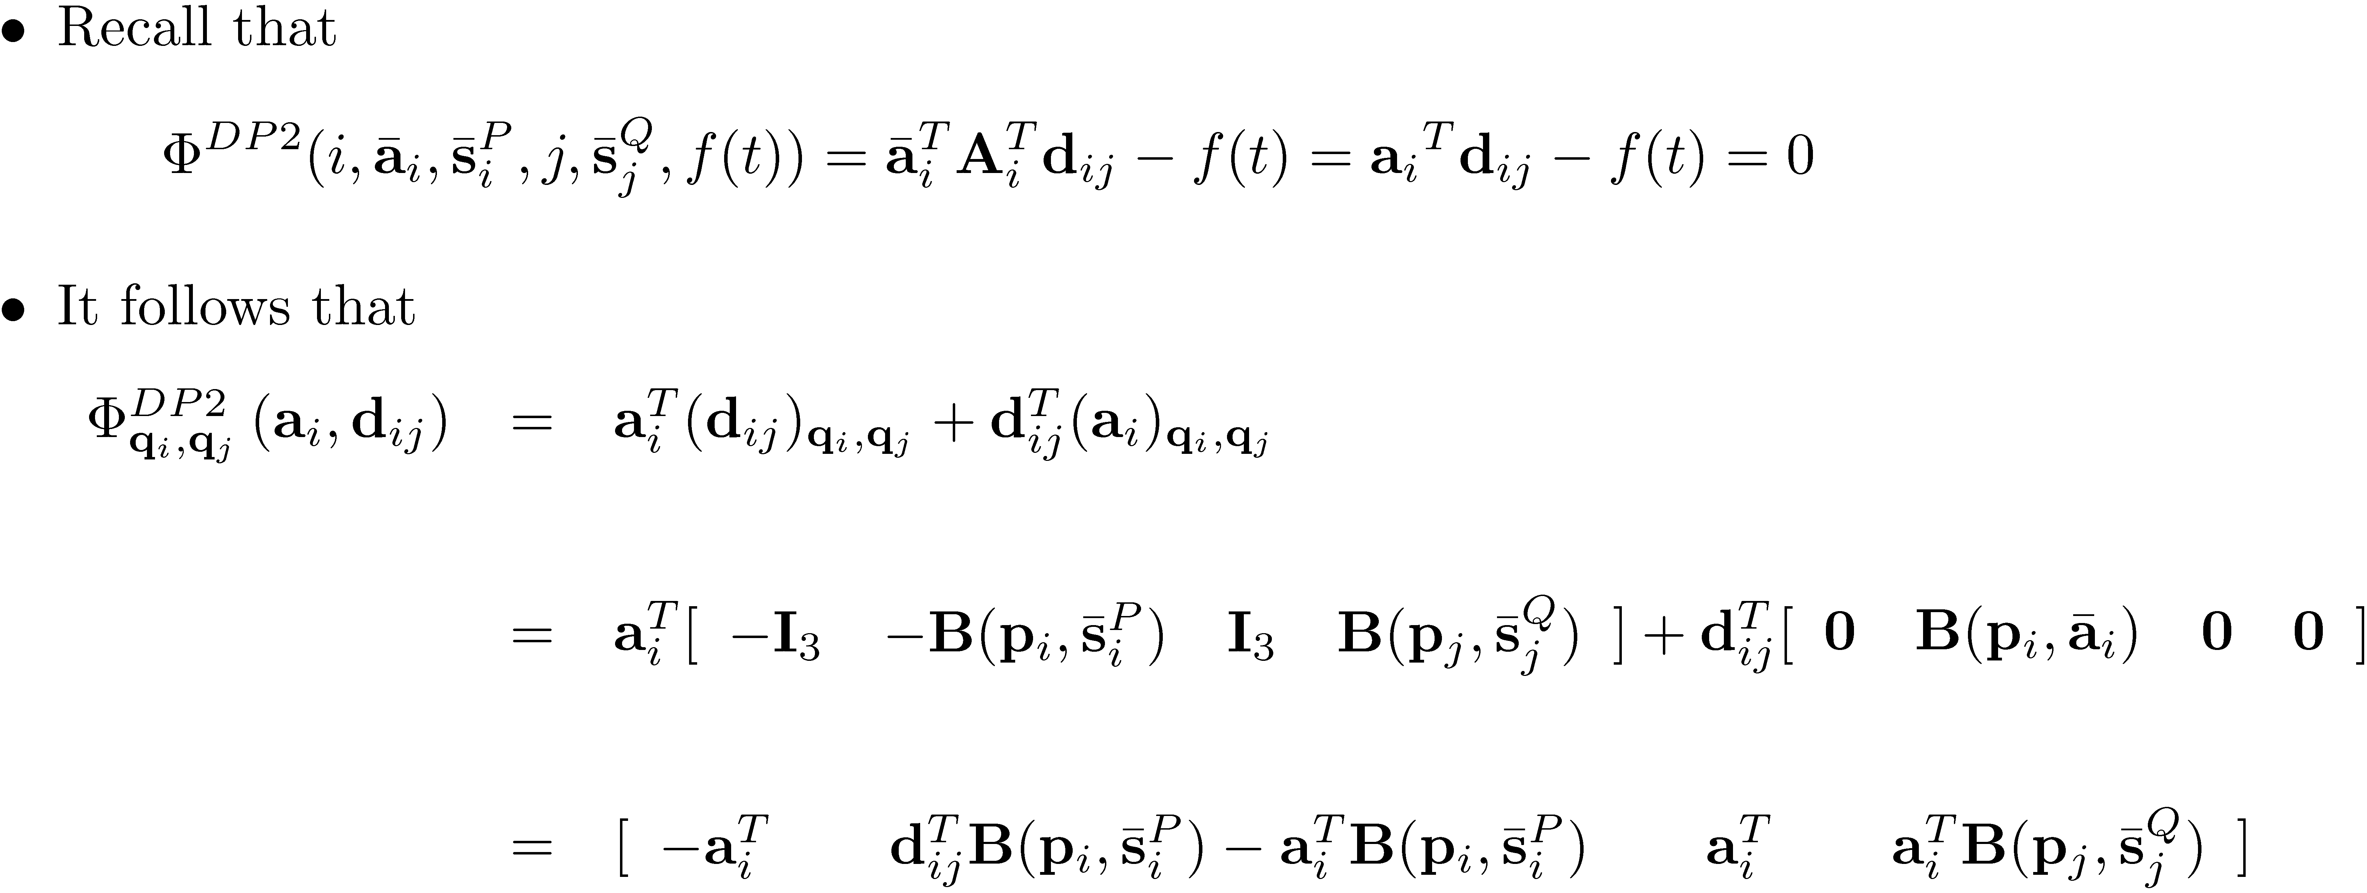

Slide 10

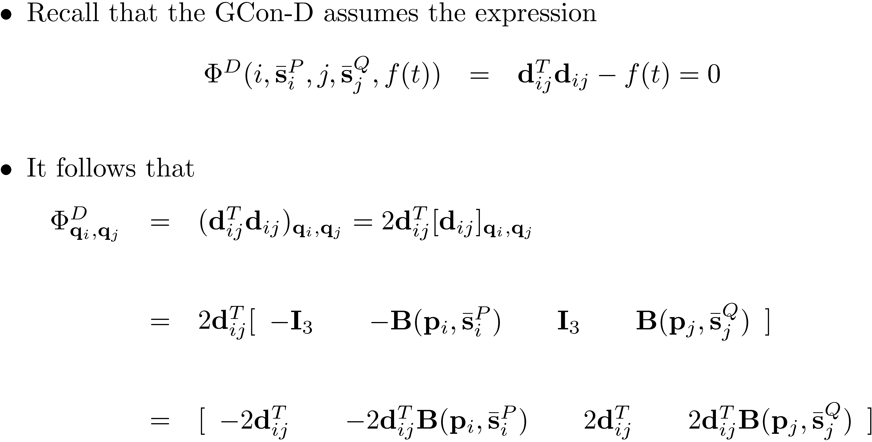

Slide 11
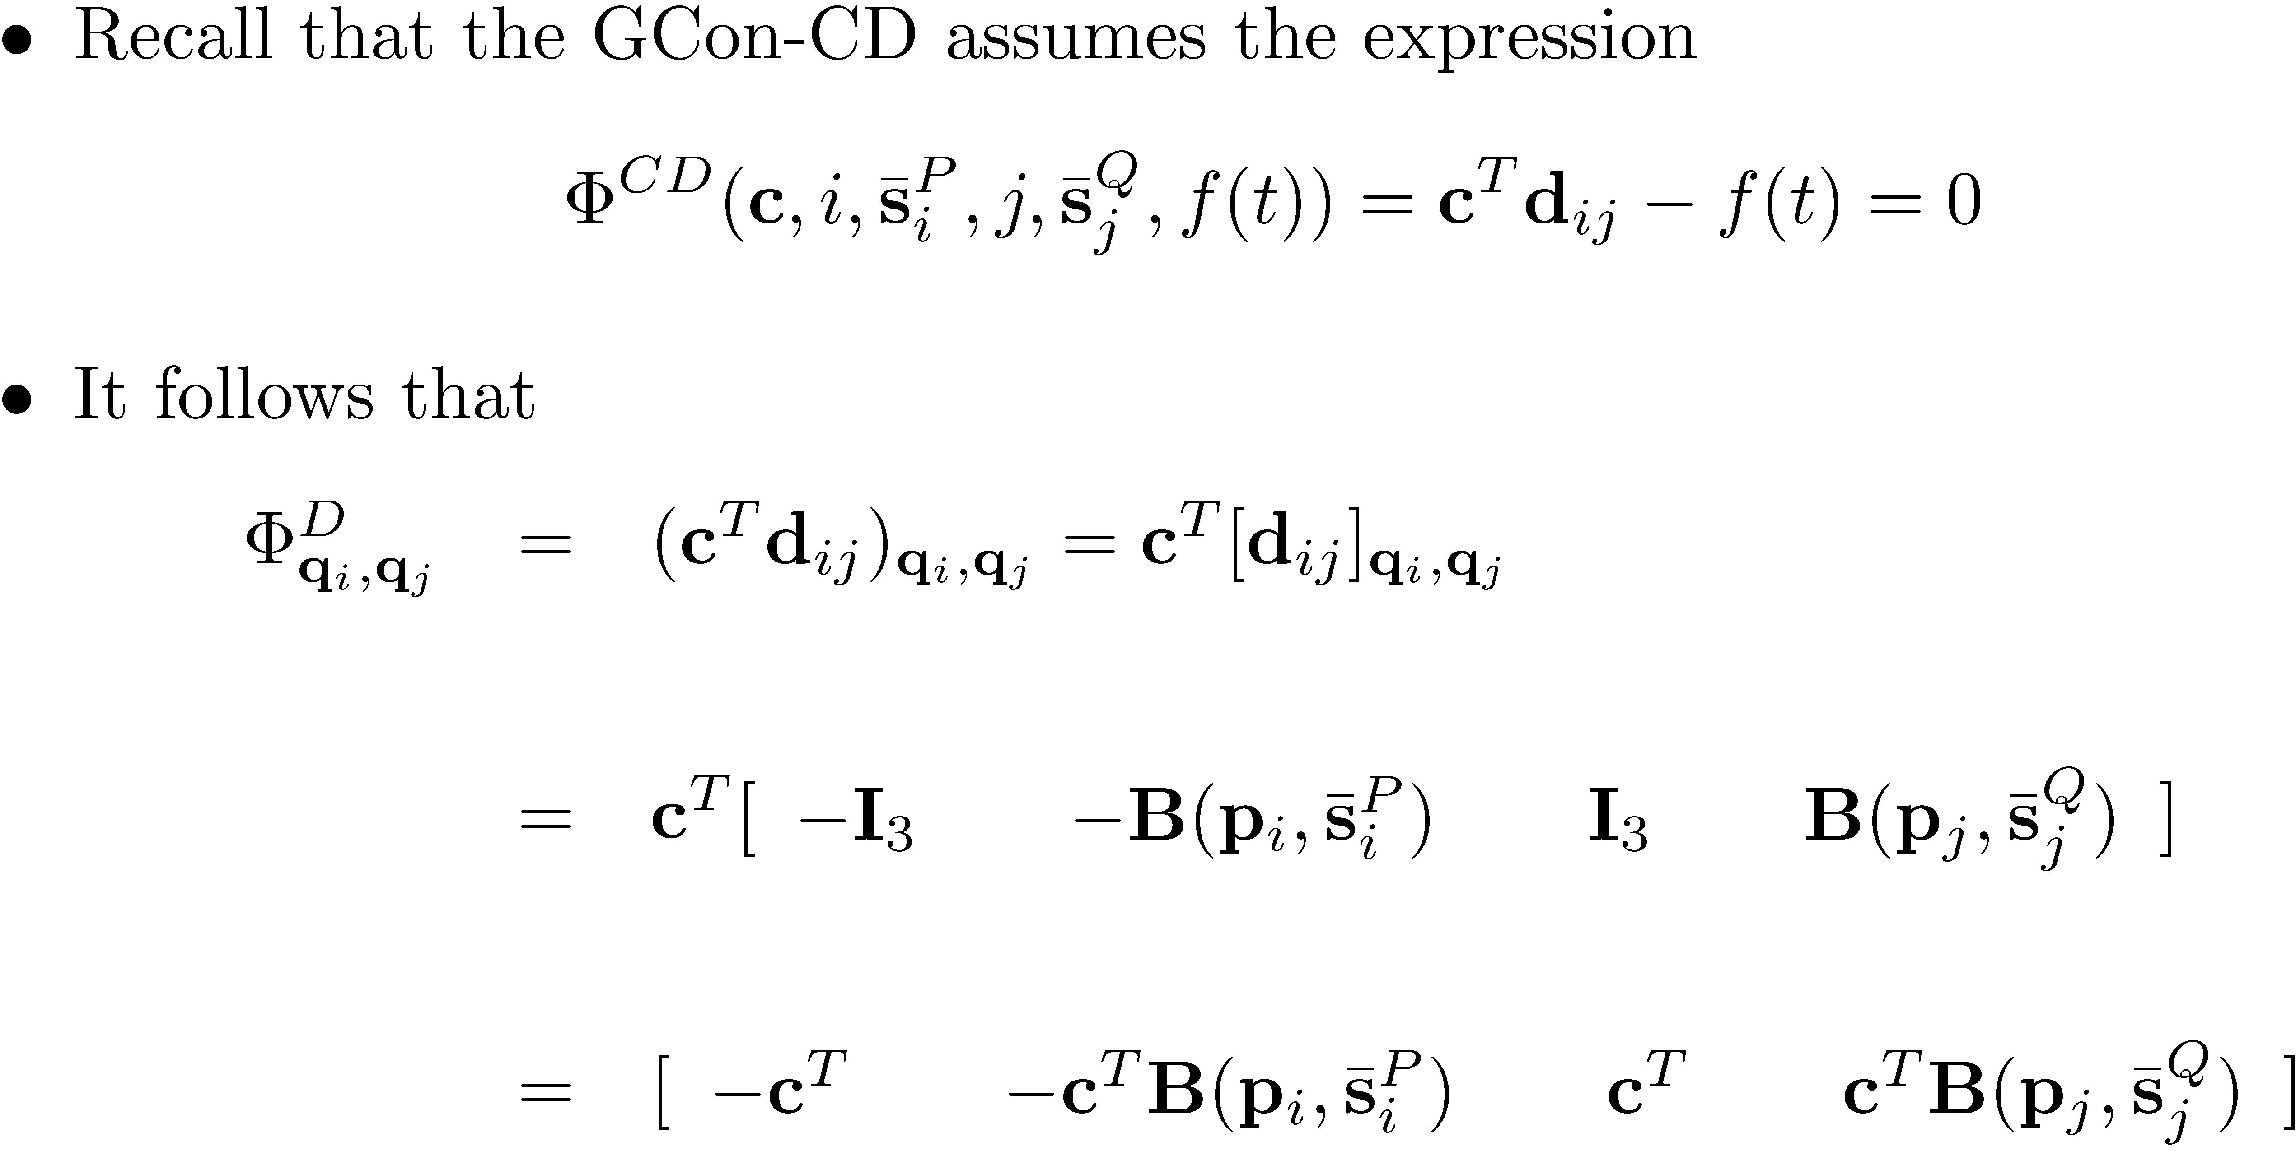

Slide 12
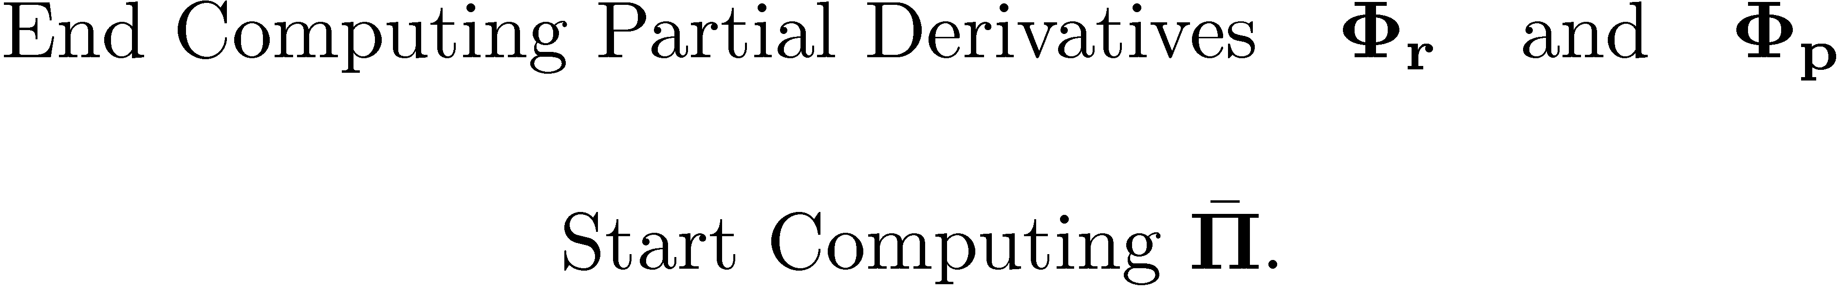

Slide 13

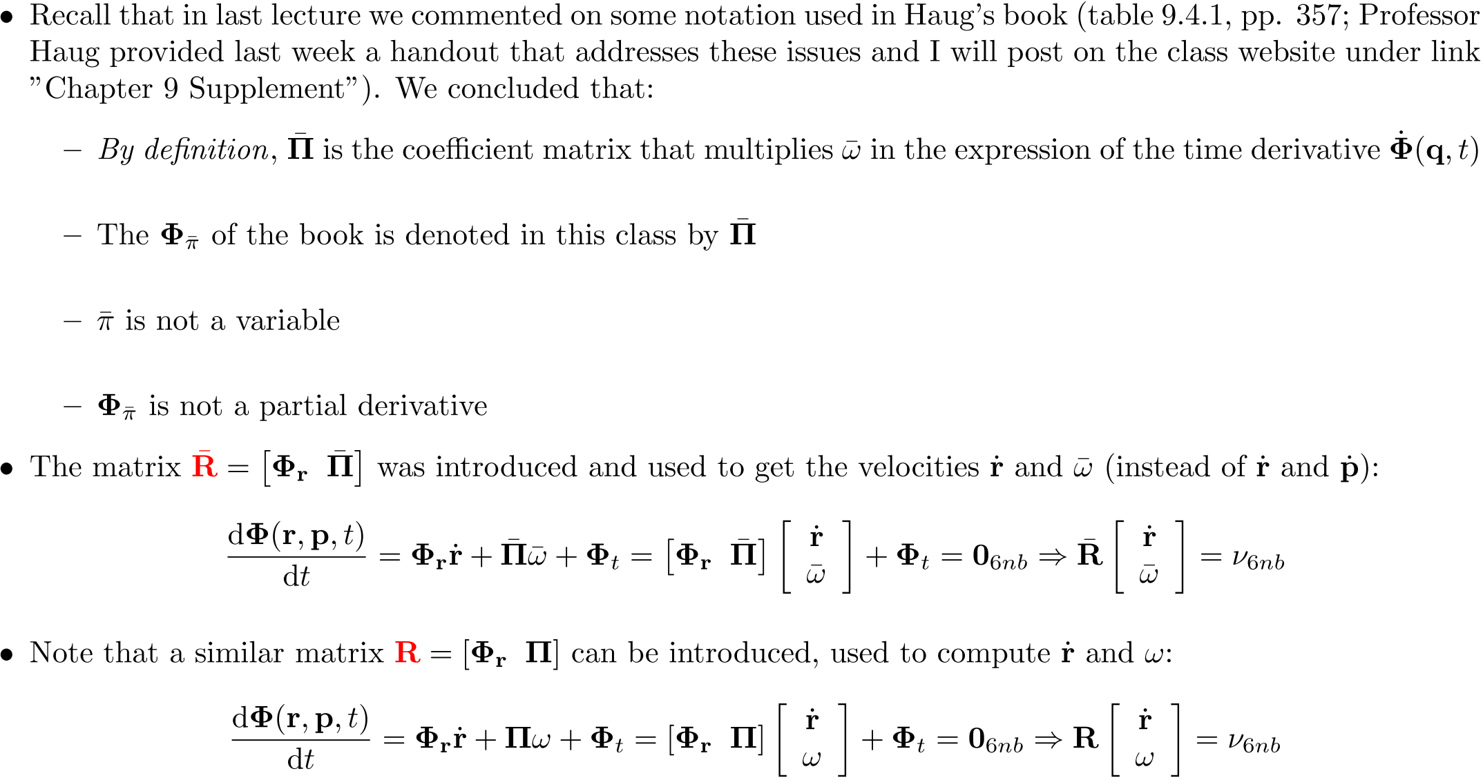

Slide 14
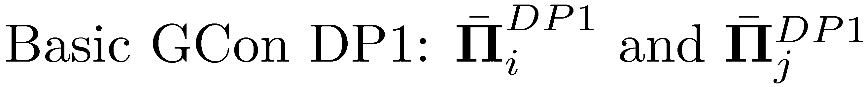
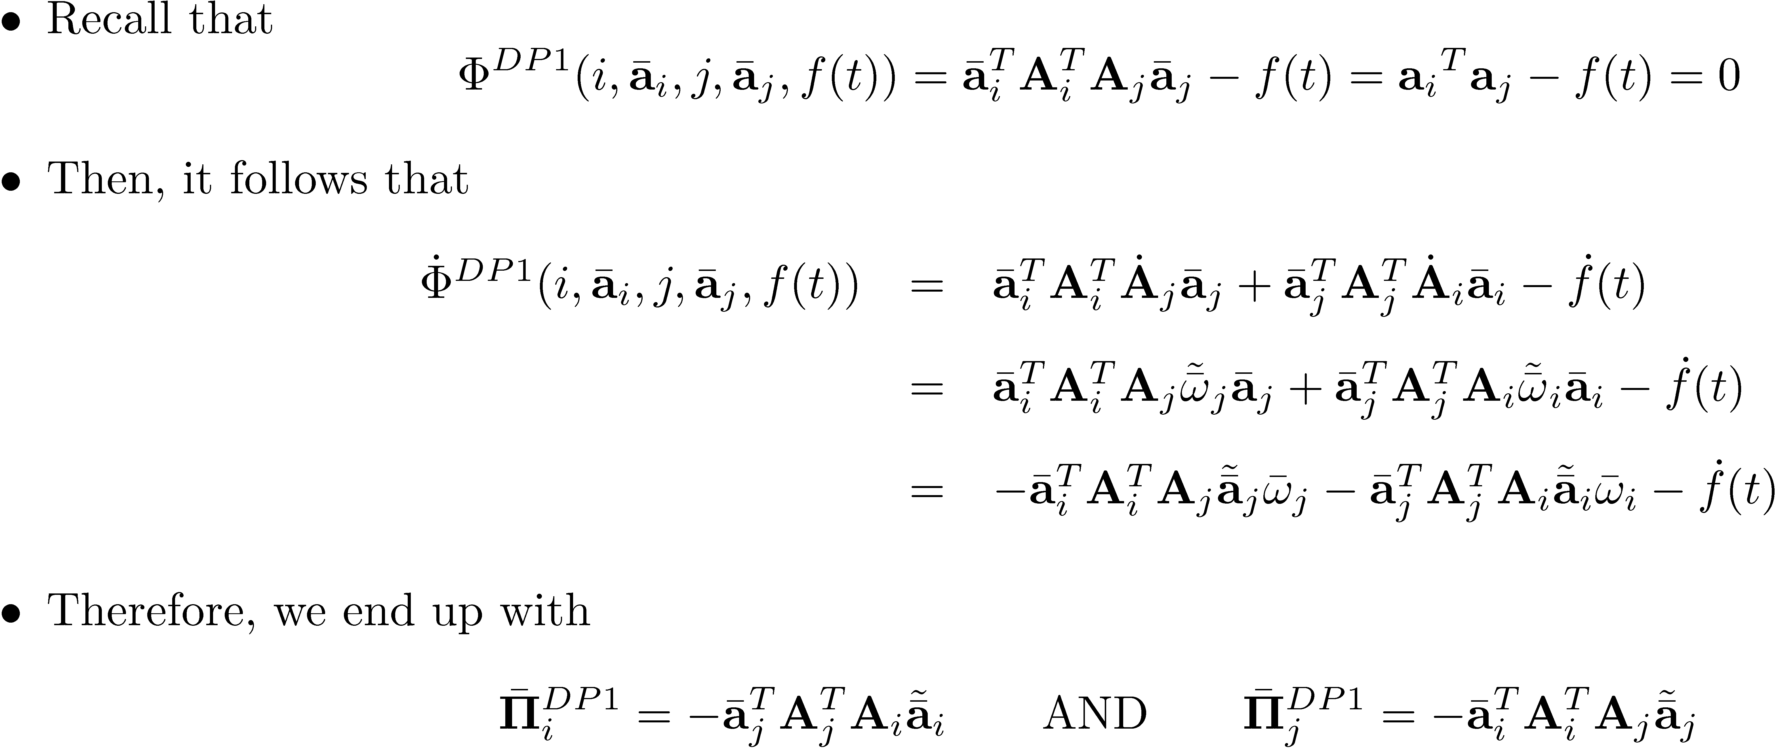

Slide 15

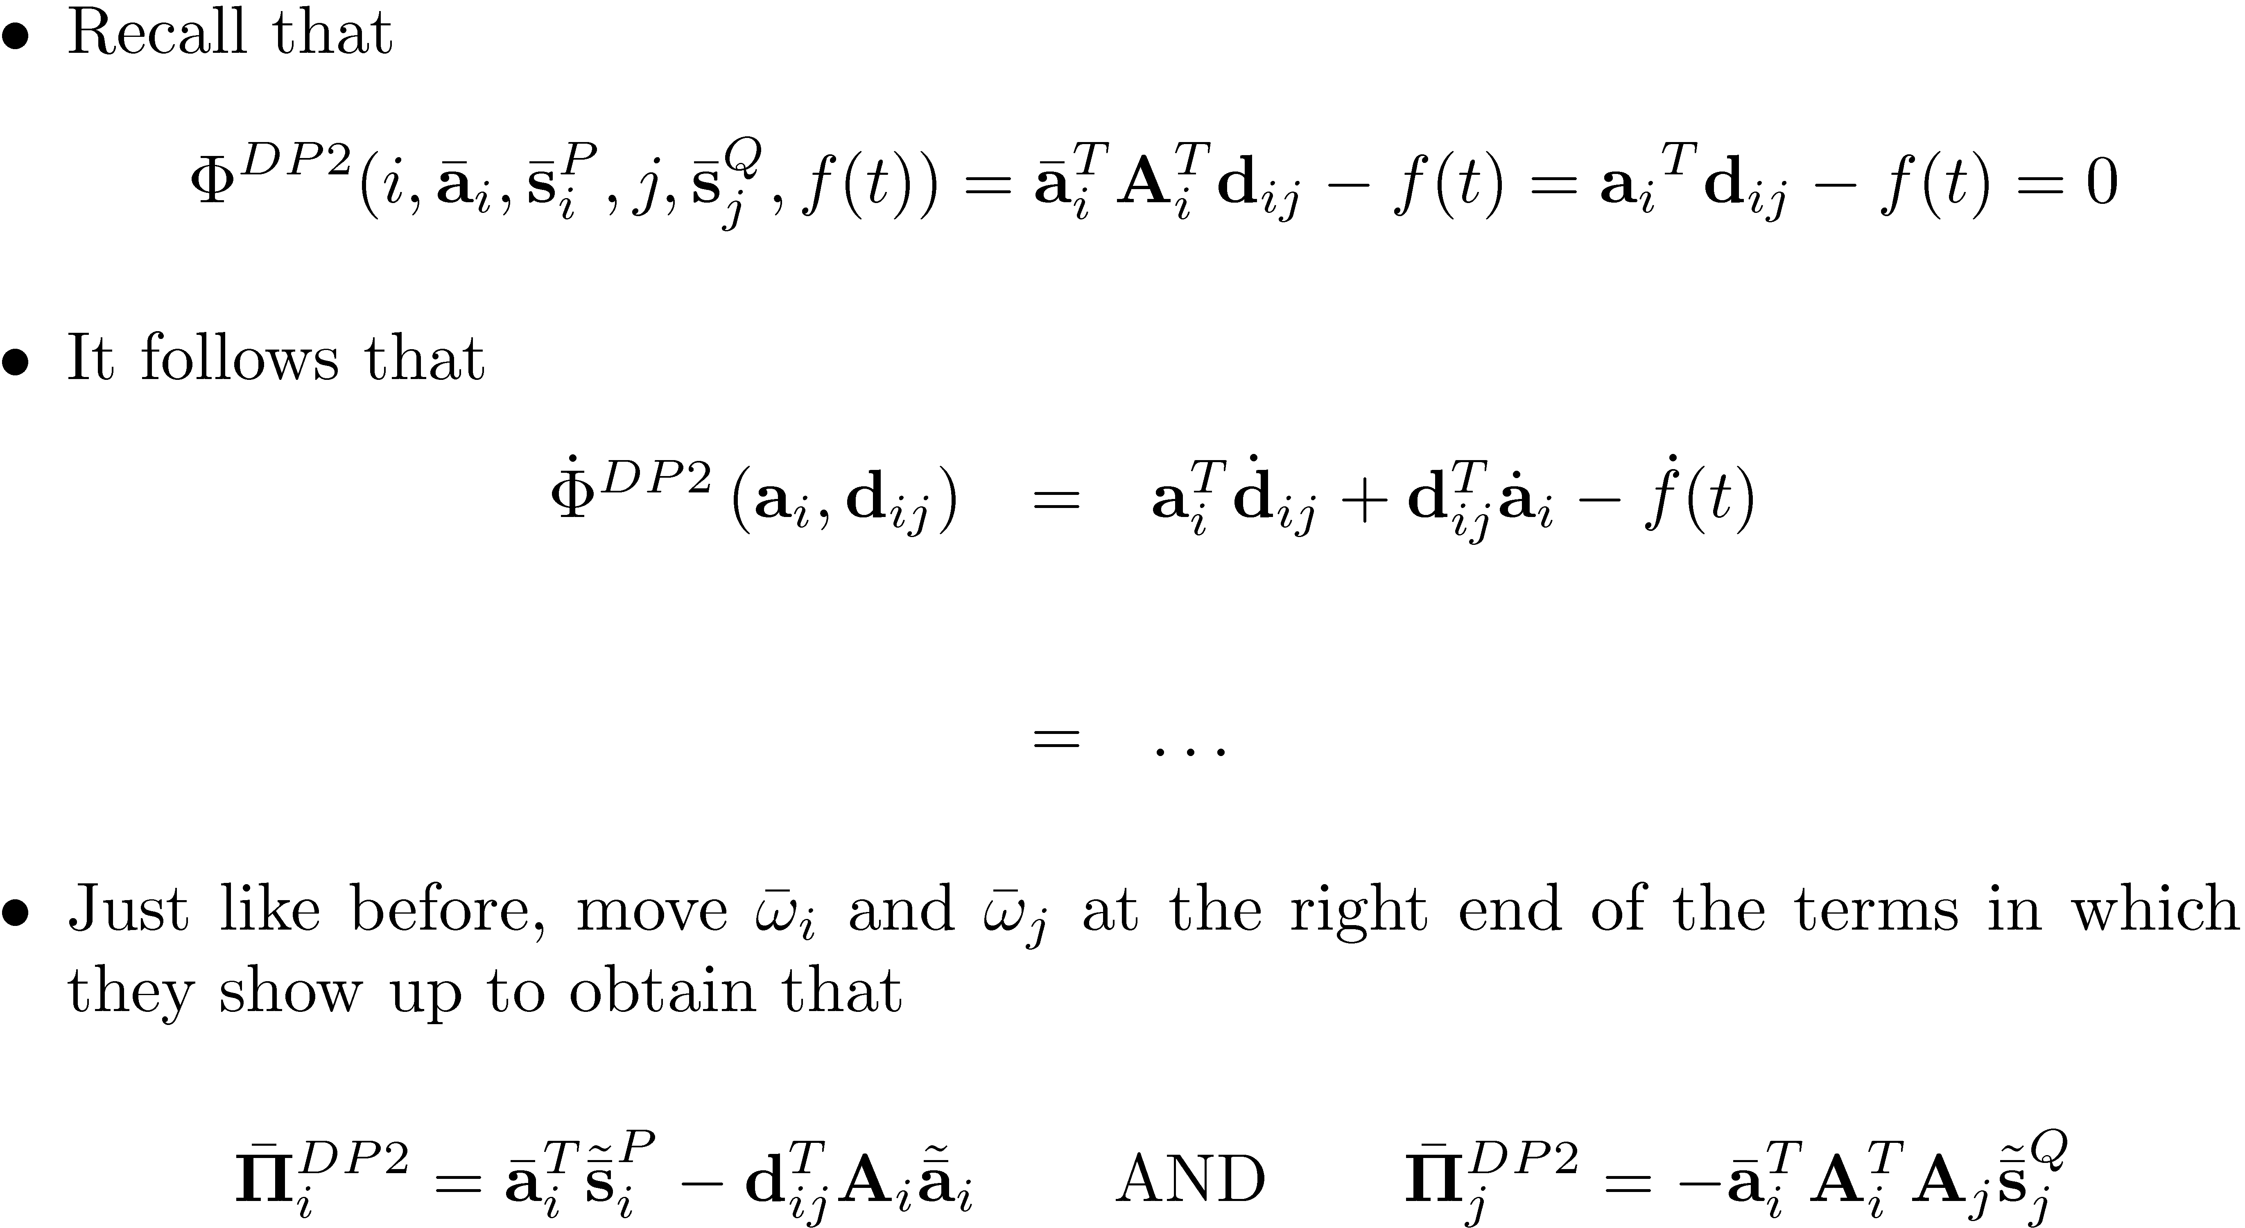

Slide 16
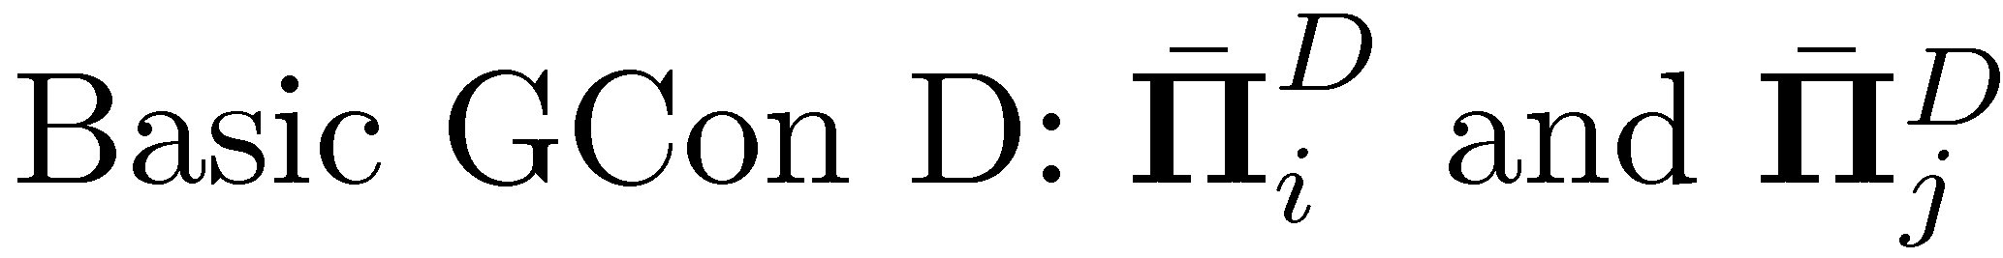
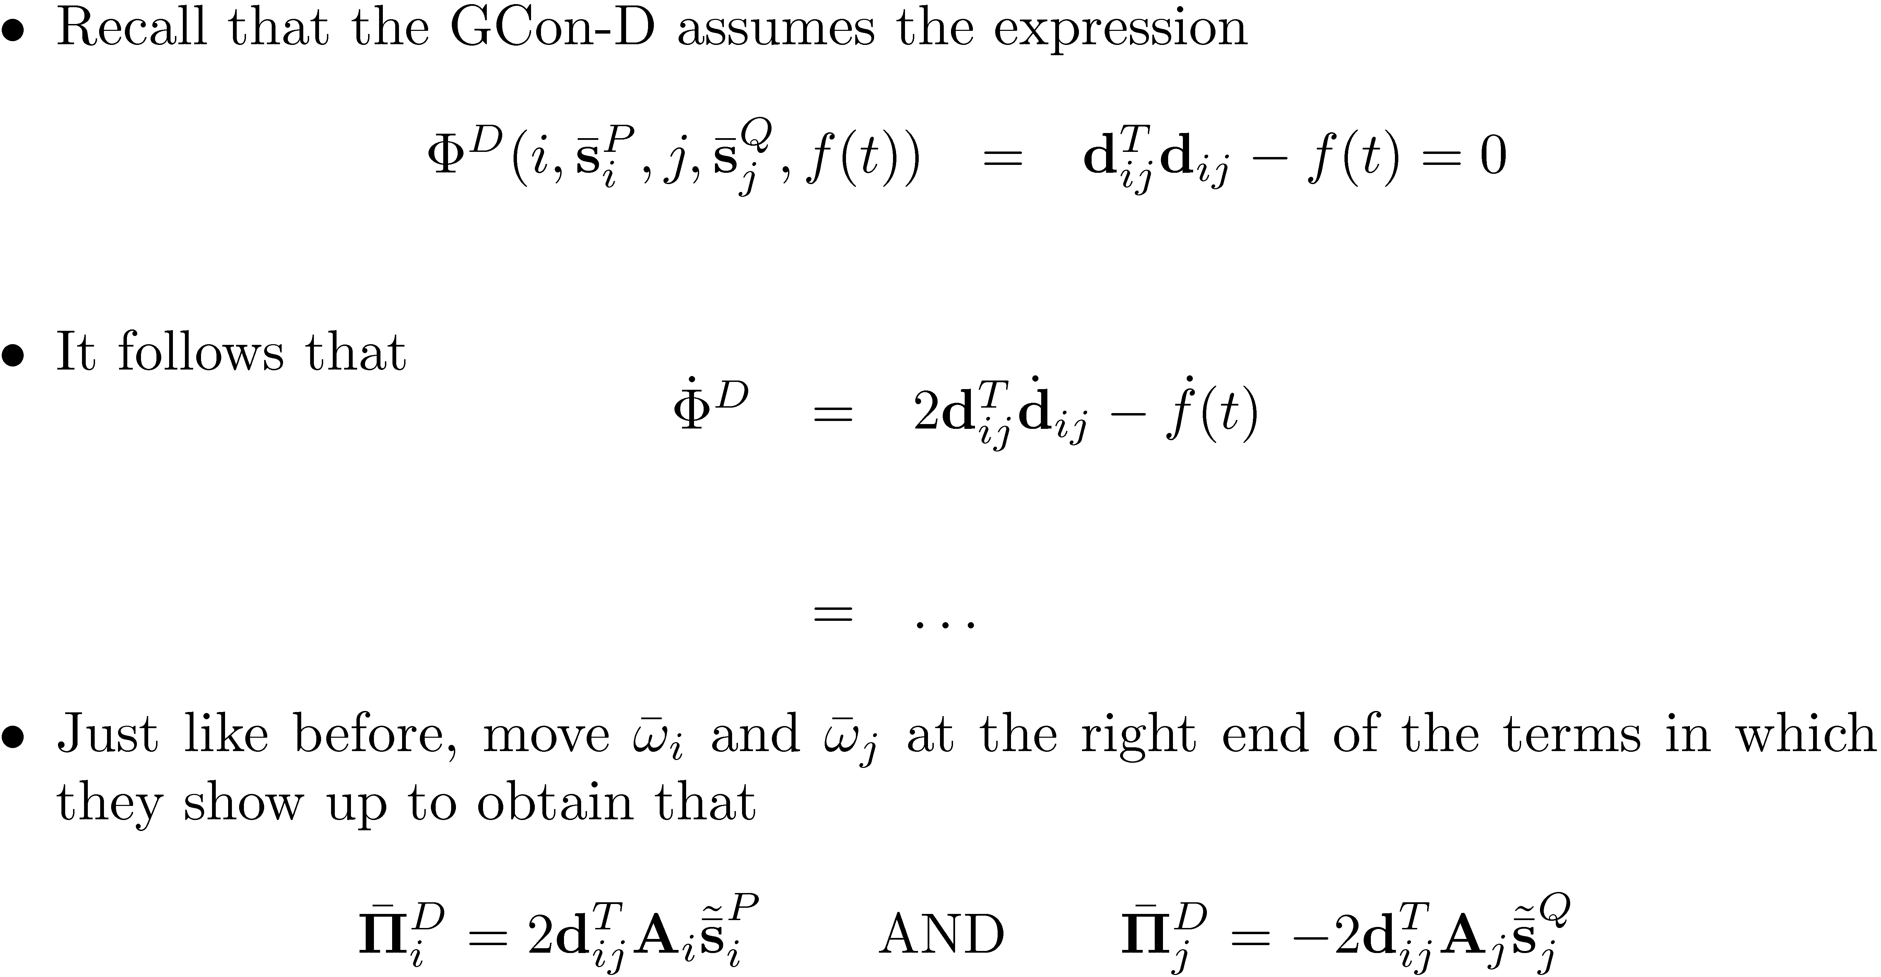

Slide 17

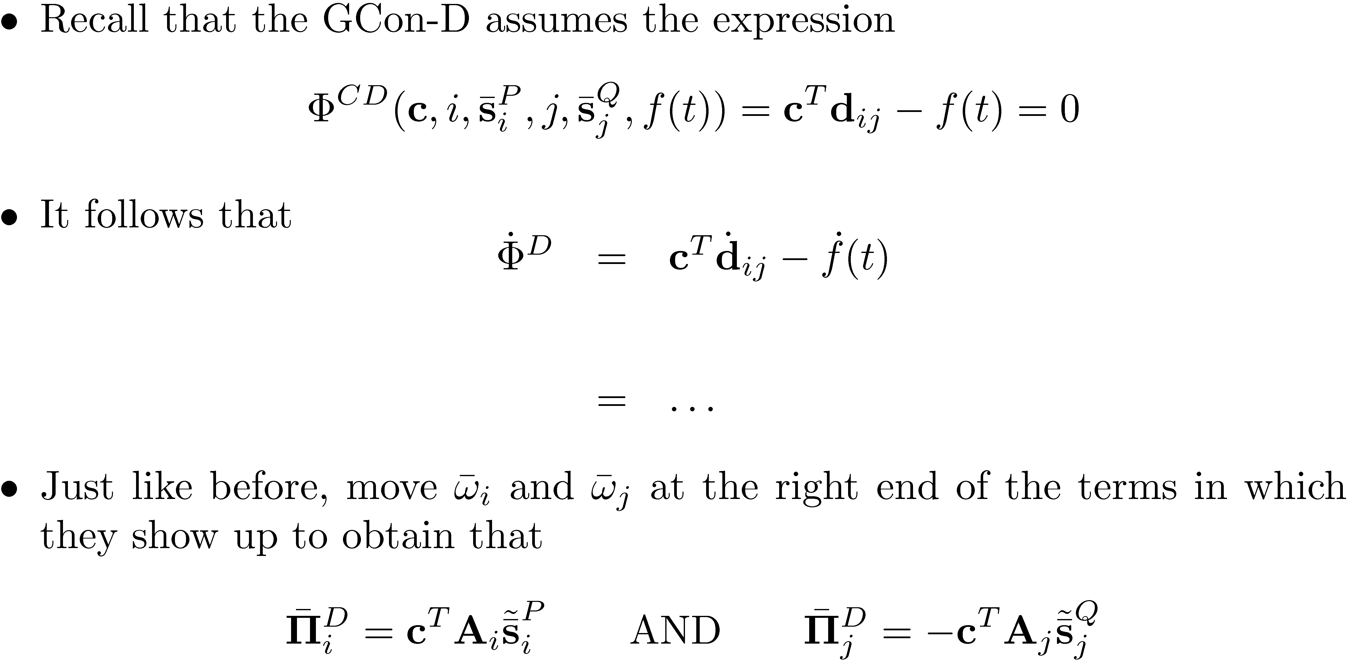

Slide 18
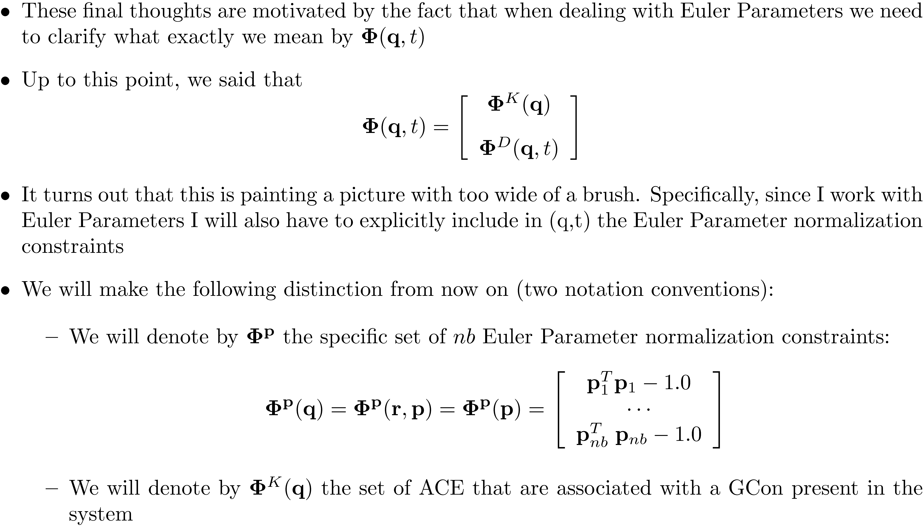

Slide 19
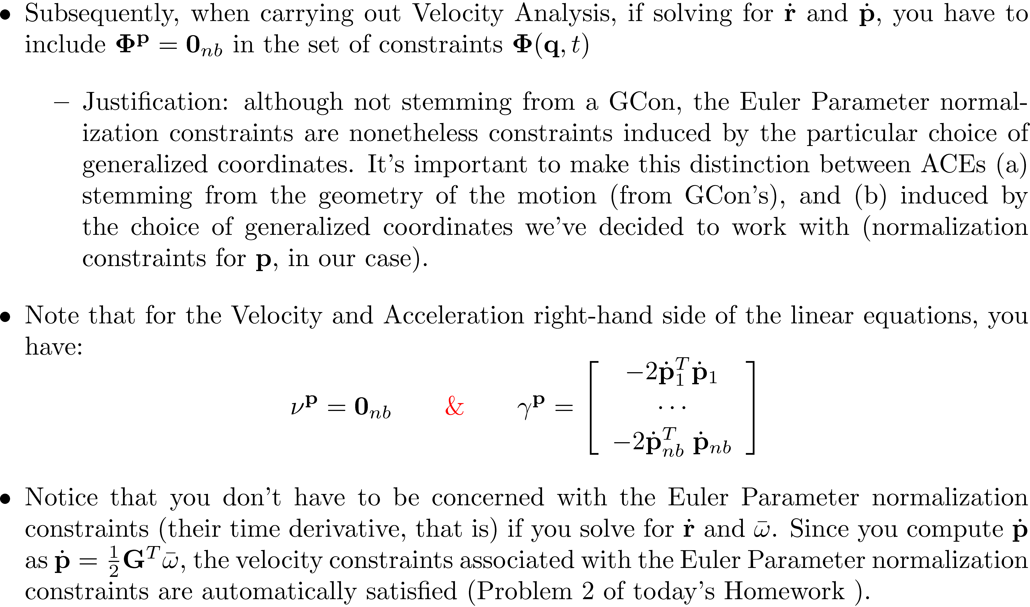

Slide 20
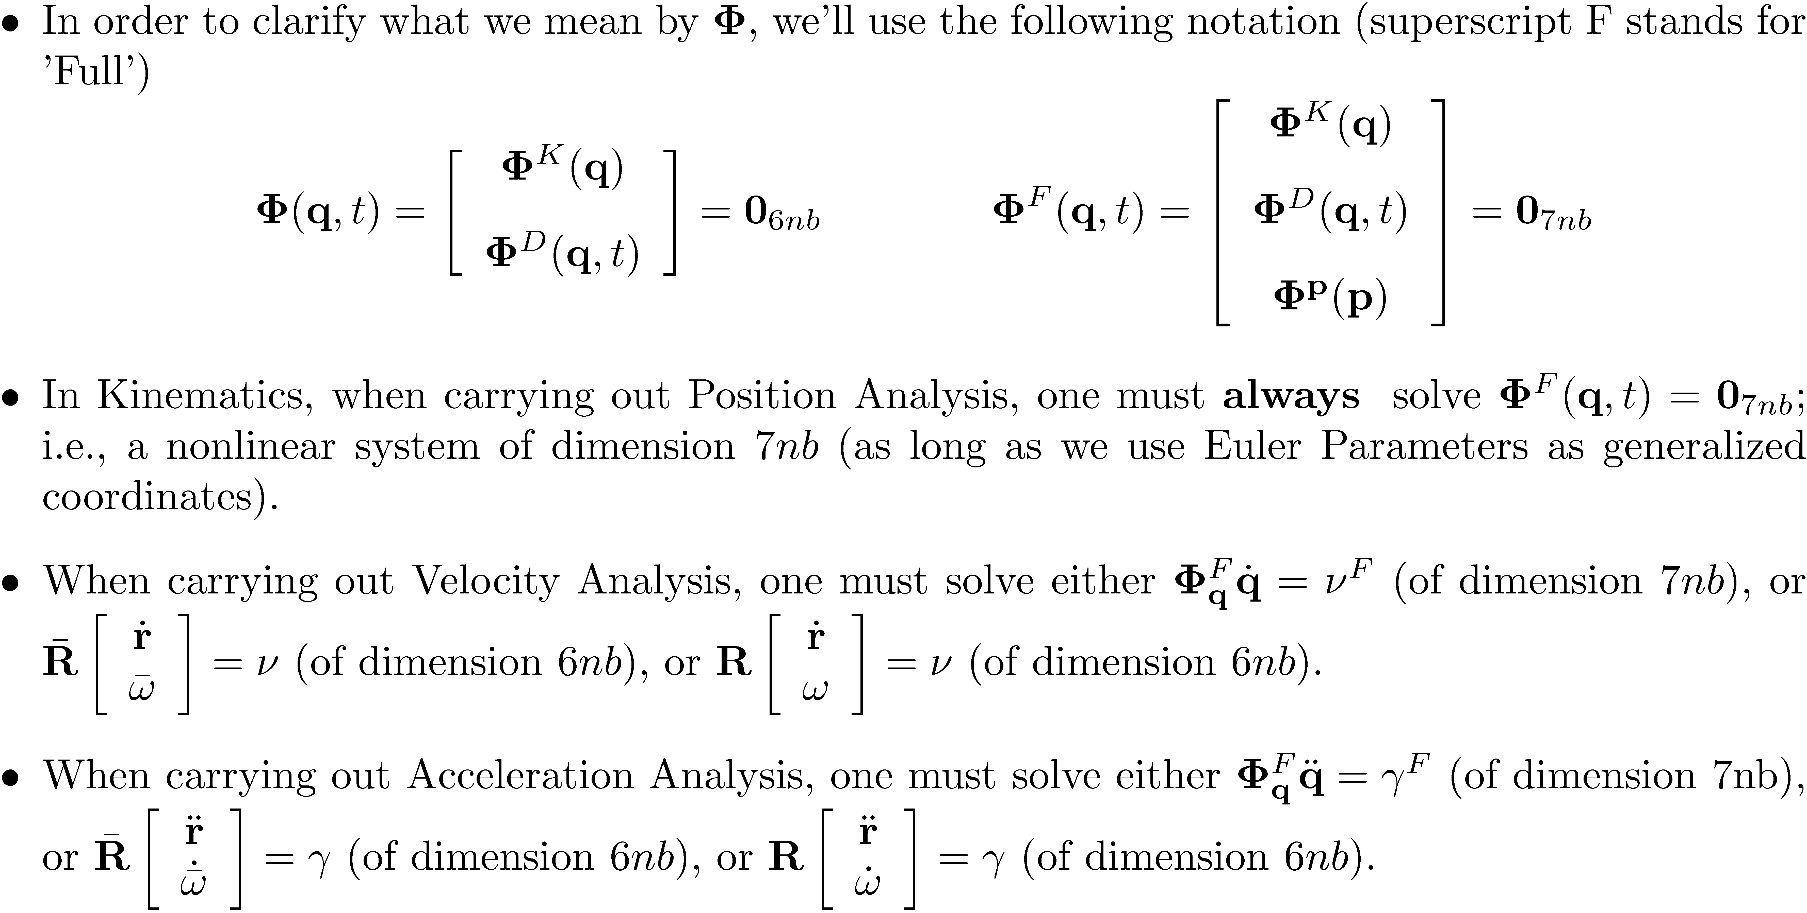

Slide 21
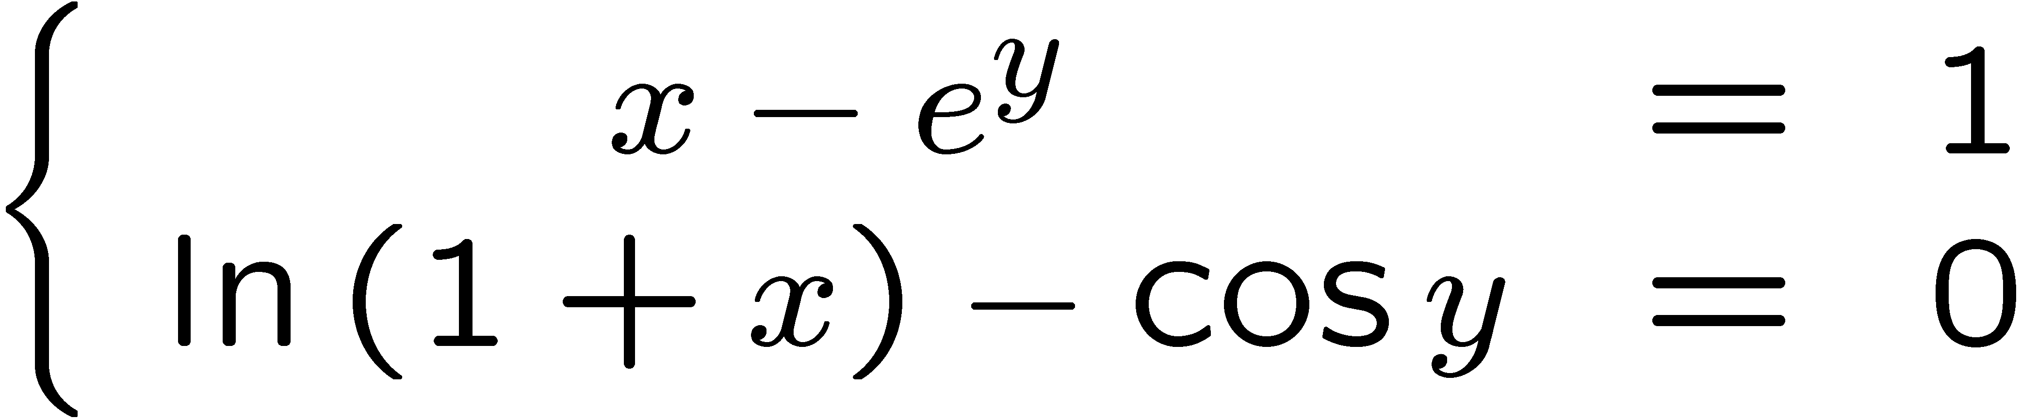
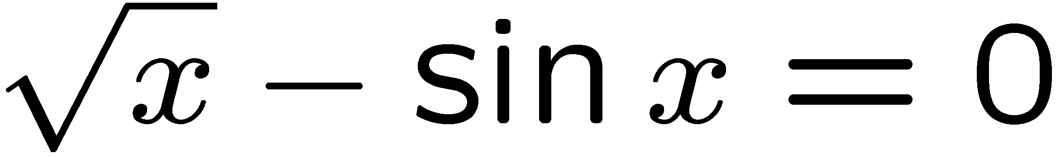
Solving a Nonlinear System
The most important numerical algorithm to understand in Kinematics
Relied upon heavily by ADAMS, used almost in all analysis modes
Kinematics
Dynamics
Equilibrium
How does one go about finding the solution?

Slide 22
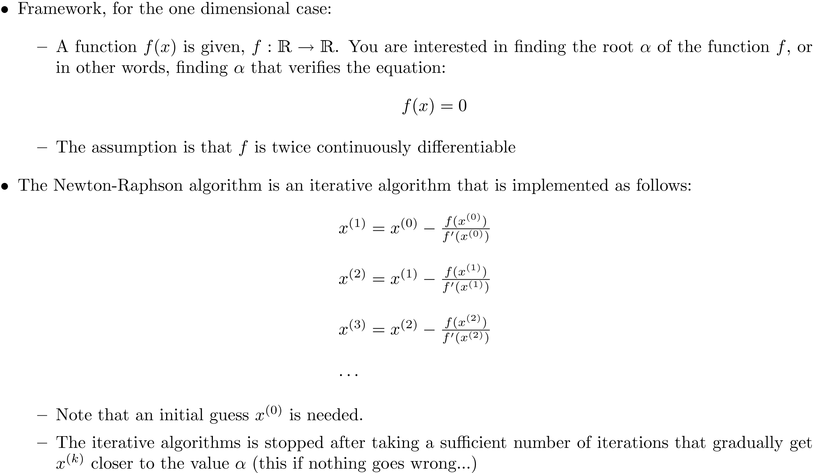
Newton-Raphson Method

Slide 23
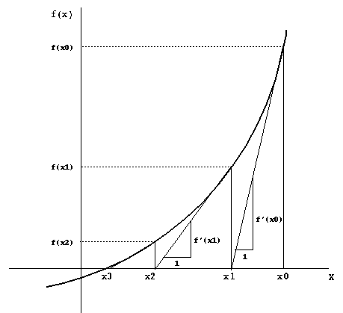
Newton-Raphson Method Geometric Interpretation

Slide 24
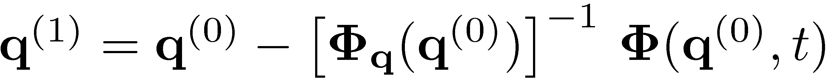
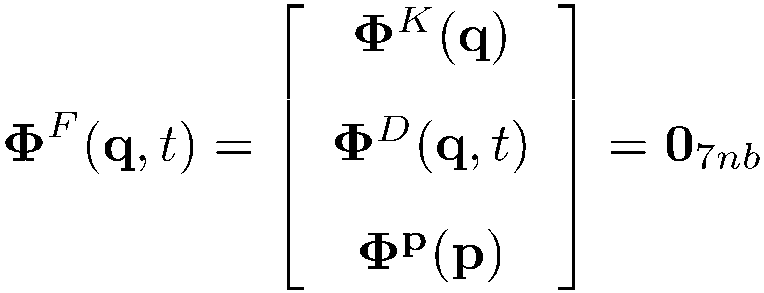
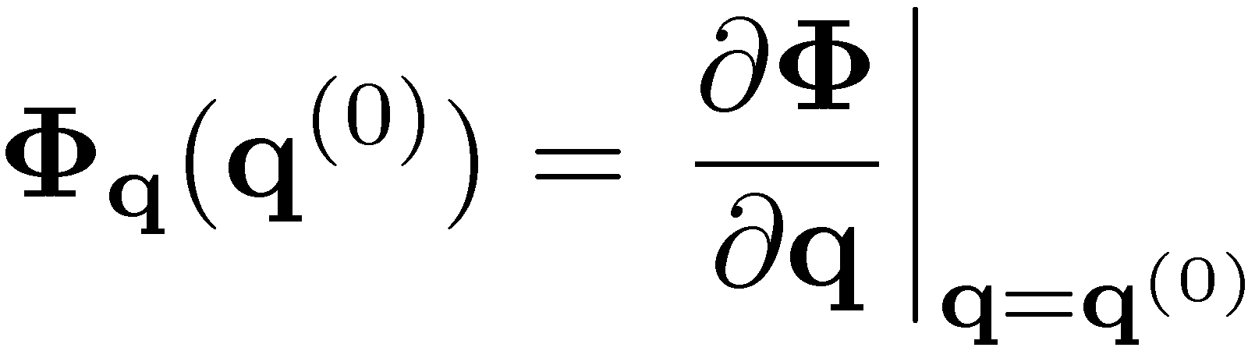
Newton-Raphson The Multidimensional Case
Solve for
the nonlinear system
The algorithm becomes
The Jacobian is defined as

Slide 25
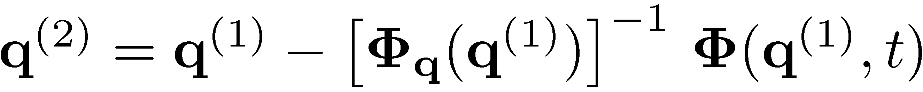
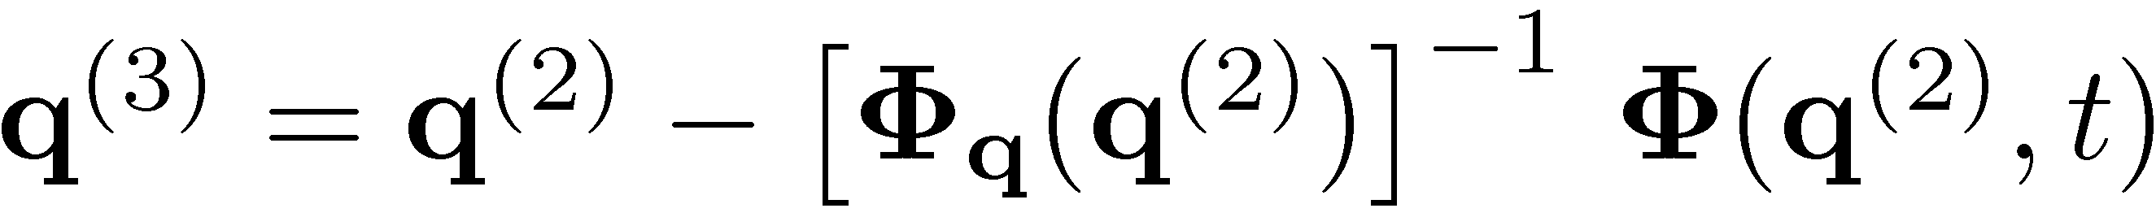

Putting things in perspective…
Newton algorithm for nonlinear systems requires:
A starting point q⁽⁰⁾ from where the solution starts being searched for
An iterative process in which the approximation of the solution is gradually improved:

Slide 26
Newton’s Method: Closing Remarks
Can ever things go wrong with Newton’s method?
Yes, there are at least three instances:
Most commonly, the starting point is not close to the solution that you try to find and the iterative algorithm diverges (goes to infinity)
Since a nonlinear system can have multiple solutions, the Newton algorithm finds a solution that is not the one sought (happens if you don’t choose the starting point right)
The speed of convergence of the algorithm is not good (happens if the Jacobian is close to being singular (zero determinant) at the root, not that common)

Slide 27
Newton’s Method: Closing Remarks
What can you do address these issues?
You cannot do anything about 3 above, but can fix 1 and 2 provided you choose your starting point carefully
Newton’s method converges very fast (quadratically) if started close enough to the solution
To help Newton’s method in Position Analysis, you can take the starting point of the algorithm at time t_{k} to be the value of q from t_{k-1} (that is, the very previous configuration of the mechanism)
See the pptx file available on the class website for MATLAB code that implements the Newton-Raphson method implemented in conjunction with the Position Analysis stage

Slide 28
End Kinematics
Start Dynamics

Slide 29
Purpose of Chapter 11
At the end of this chapter you should understand what “dynamics” means and how you should go about carrying out a dynamics analysis
We’ll learn a couple of things:
How to formulate the equations that govern the time evolution of a system of bodies in 3D motion
These equations are differential equations and they are called equations of motion
As many bodies as you wish, connected by any joints we’ve learned about…
How to compute the reaction forces in any joint connecting any bodies in the mechanism
Understand how to properly handle the applied, that is, external, forces to correctly use them in formulating the equations of motion

Slide 30
The Idea, in a Nutshell…
Kinematics
You have as many constraints (kinematic and driving) as generalized coordinates
No spare degrees of freedom left
Position, velocity, acceleration found as the solution of algebraic problems (both nonlinear and linear)
We do not care whatsoever about forces applied to the system, we are told what the motions are and that’s enough for the purpose of kinematics
Dynamics
You only have a few constraints imposed on the system
You have extra degrees of freedom
The system evolves in time as a result of external forces applied on it
We very much care about forces applied and inertia properties of the components of the mechanism (mass, mass moment of inertia)

Slide 31
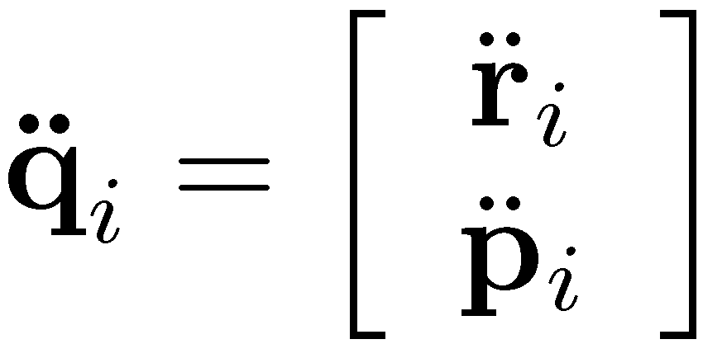

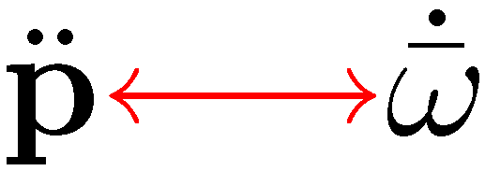
A Relevant Question…
Dynamics key question: how can I get the acceleration of each body of the mechanism?
Why is acceleration so relevant? If you know the acceleration you can integrate it twice to get velocity and position information for each body
In other words, you want to get this quantity:
Alternatively, you can get first
Then use the fact that there is a relationship (haven’t covered it yet)

Slide 32
… and Its Answer
The answer to the key question: To get the acceleration of each body, you first need to formulate the equations of motion (EOM)
Simplest possible form, ME240, motion of a particle: F=ma
Actually, the proper way to state this is ma=F, which is the “equation of motion” and is the most important piece of the dynamics puzzle
Back then, the acceleration would have been simply a=F/m
In ME751, first we’ll show that the EOM are obtained as
This will be then revisited to formulate the equations of motion for a system of bodies interacting through contact, friction, and bilateral constraints, at the same time being subjected to the action of external forces

