Slide 1
ME751 Advanced Computational Multibody Dynamics
March 3, 2010
“If you don't know where you are going, you might wind up someplace else”
Yogi Berra
© Dan Negrut, 2010 ME751, UW-Madison

Slide 2

Before we get started…
Last Time:
Finish partial derivatives
Discuss computation of
Quick remarks on Position Analysis + Newton Raphson
Start the dynamics problem
Today:
Discuss about Virtual Displacements and Variation of a Function
HW6 – due on March 4. It’s demanding.
I’ll be travelling Tu returning on Wd, might run a bit late for office hours

Slide 3
Motivation
Why do we have to talk about “virtual displacements” (VDs)?
Because they play a crucial role in evaluating the virtual work.
Why do we care about virtual work?
Because it is the crucial ingredient required to formulate the equations of motion (EOM)
How are the EOM formulated actually?
By applying D'Alembert’s Principle and then falling back on the Principle of Virtual Work
NOTE: The Principle of Virtual Work is a powerful tool used to get equations of motion in rigid and deformable body dynamics
It states that at equilibrium, the virtual work of forces acting on a system is zero

Slide 4
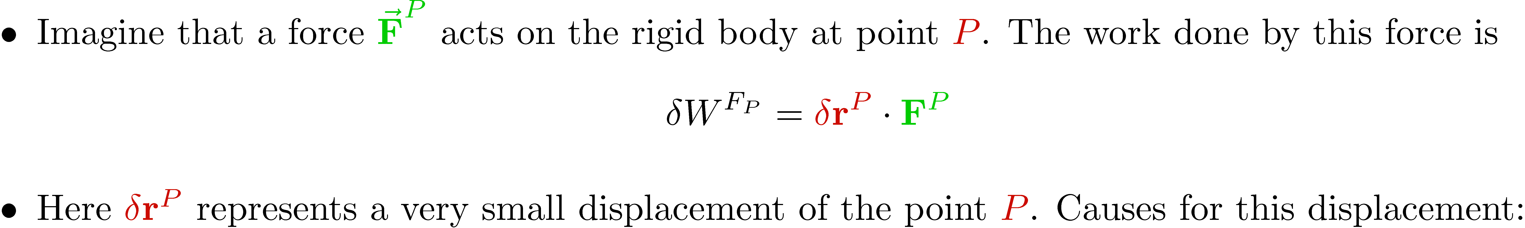
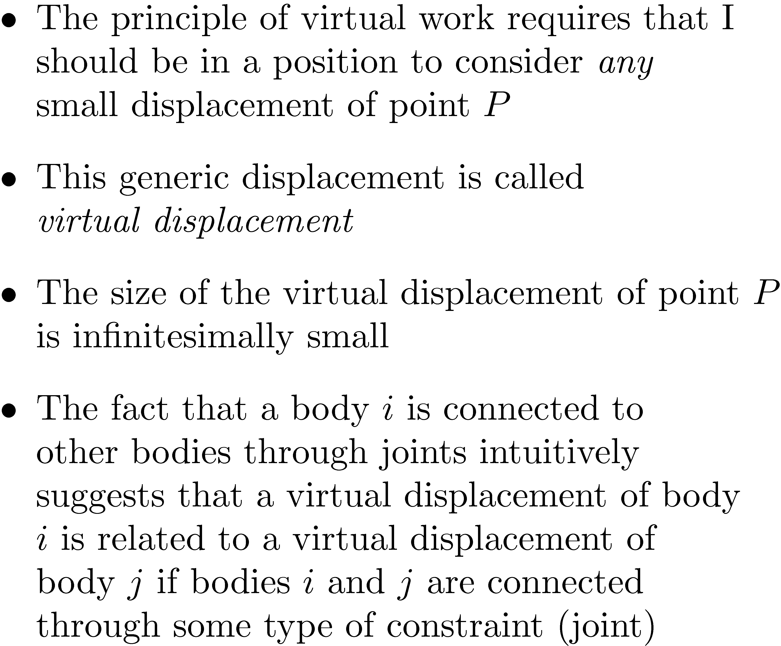
Motivation [Cntd.]

Slide 5
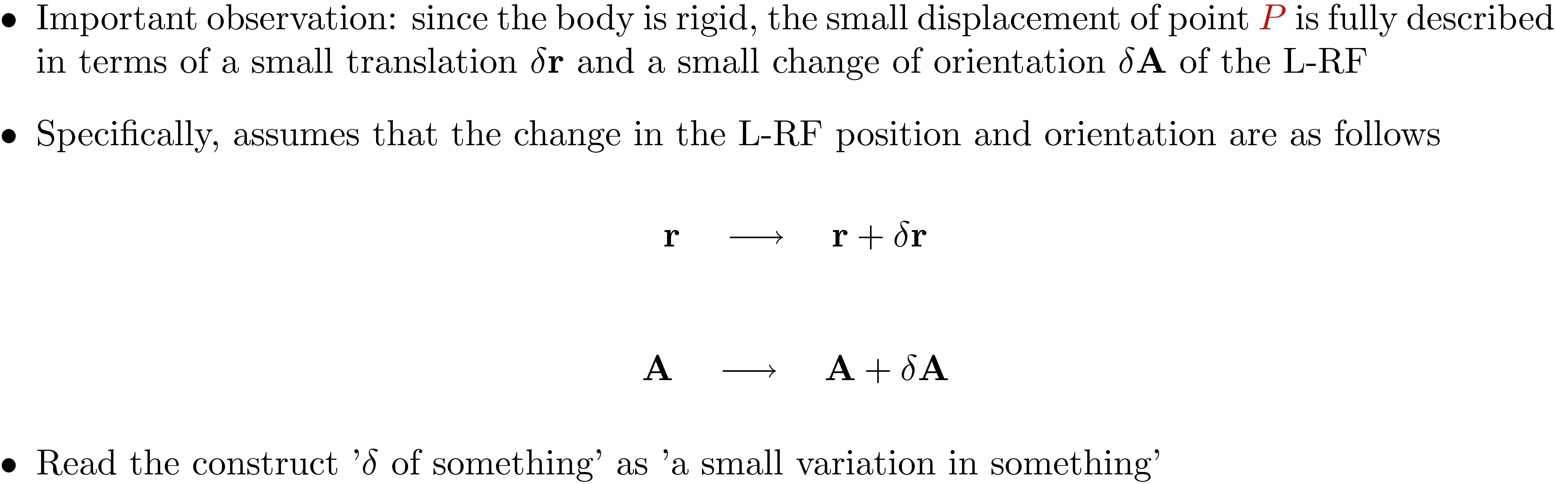
Virtual Translation + Virtual Rotation

Slide 6
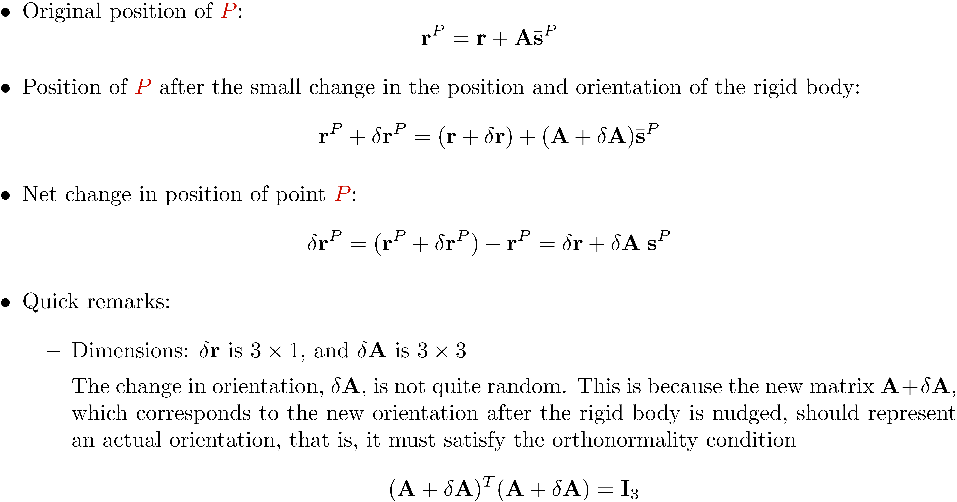
Virtual Displacement of Point P
Location, after
Virtual Displacement
Location,
Original

Slide 7
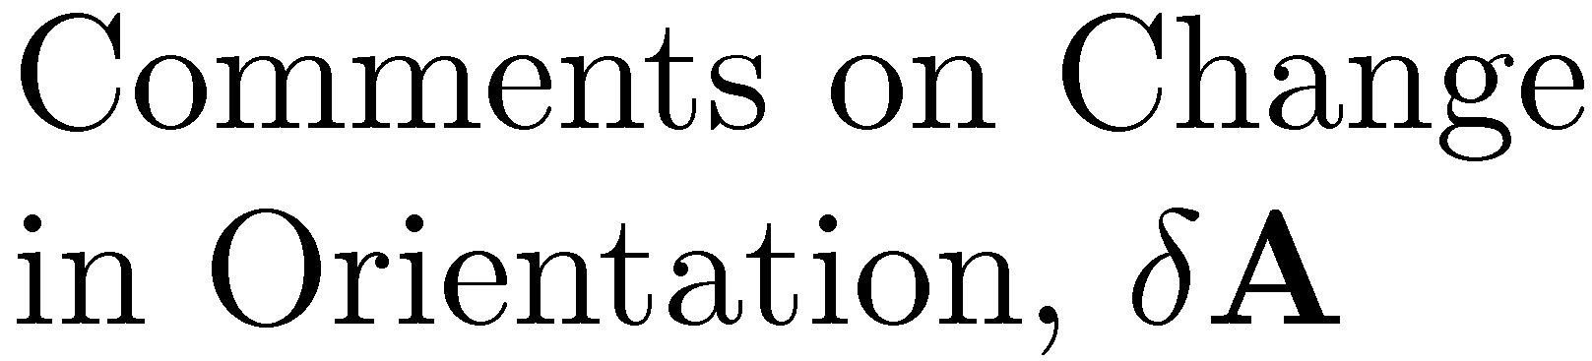
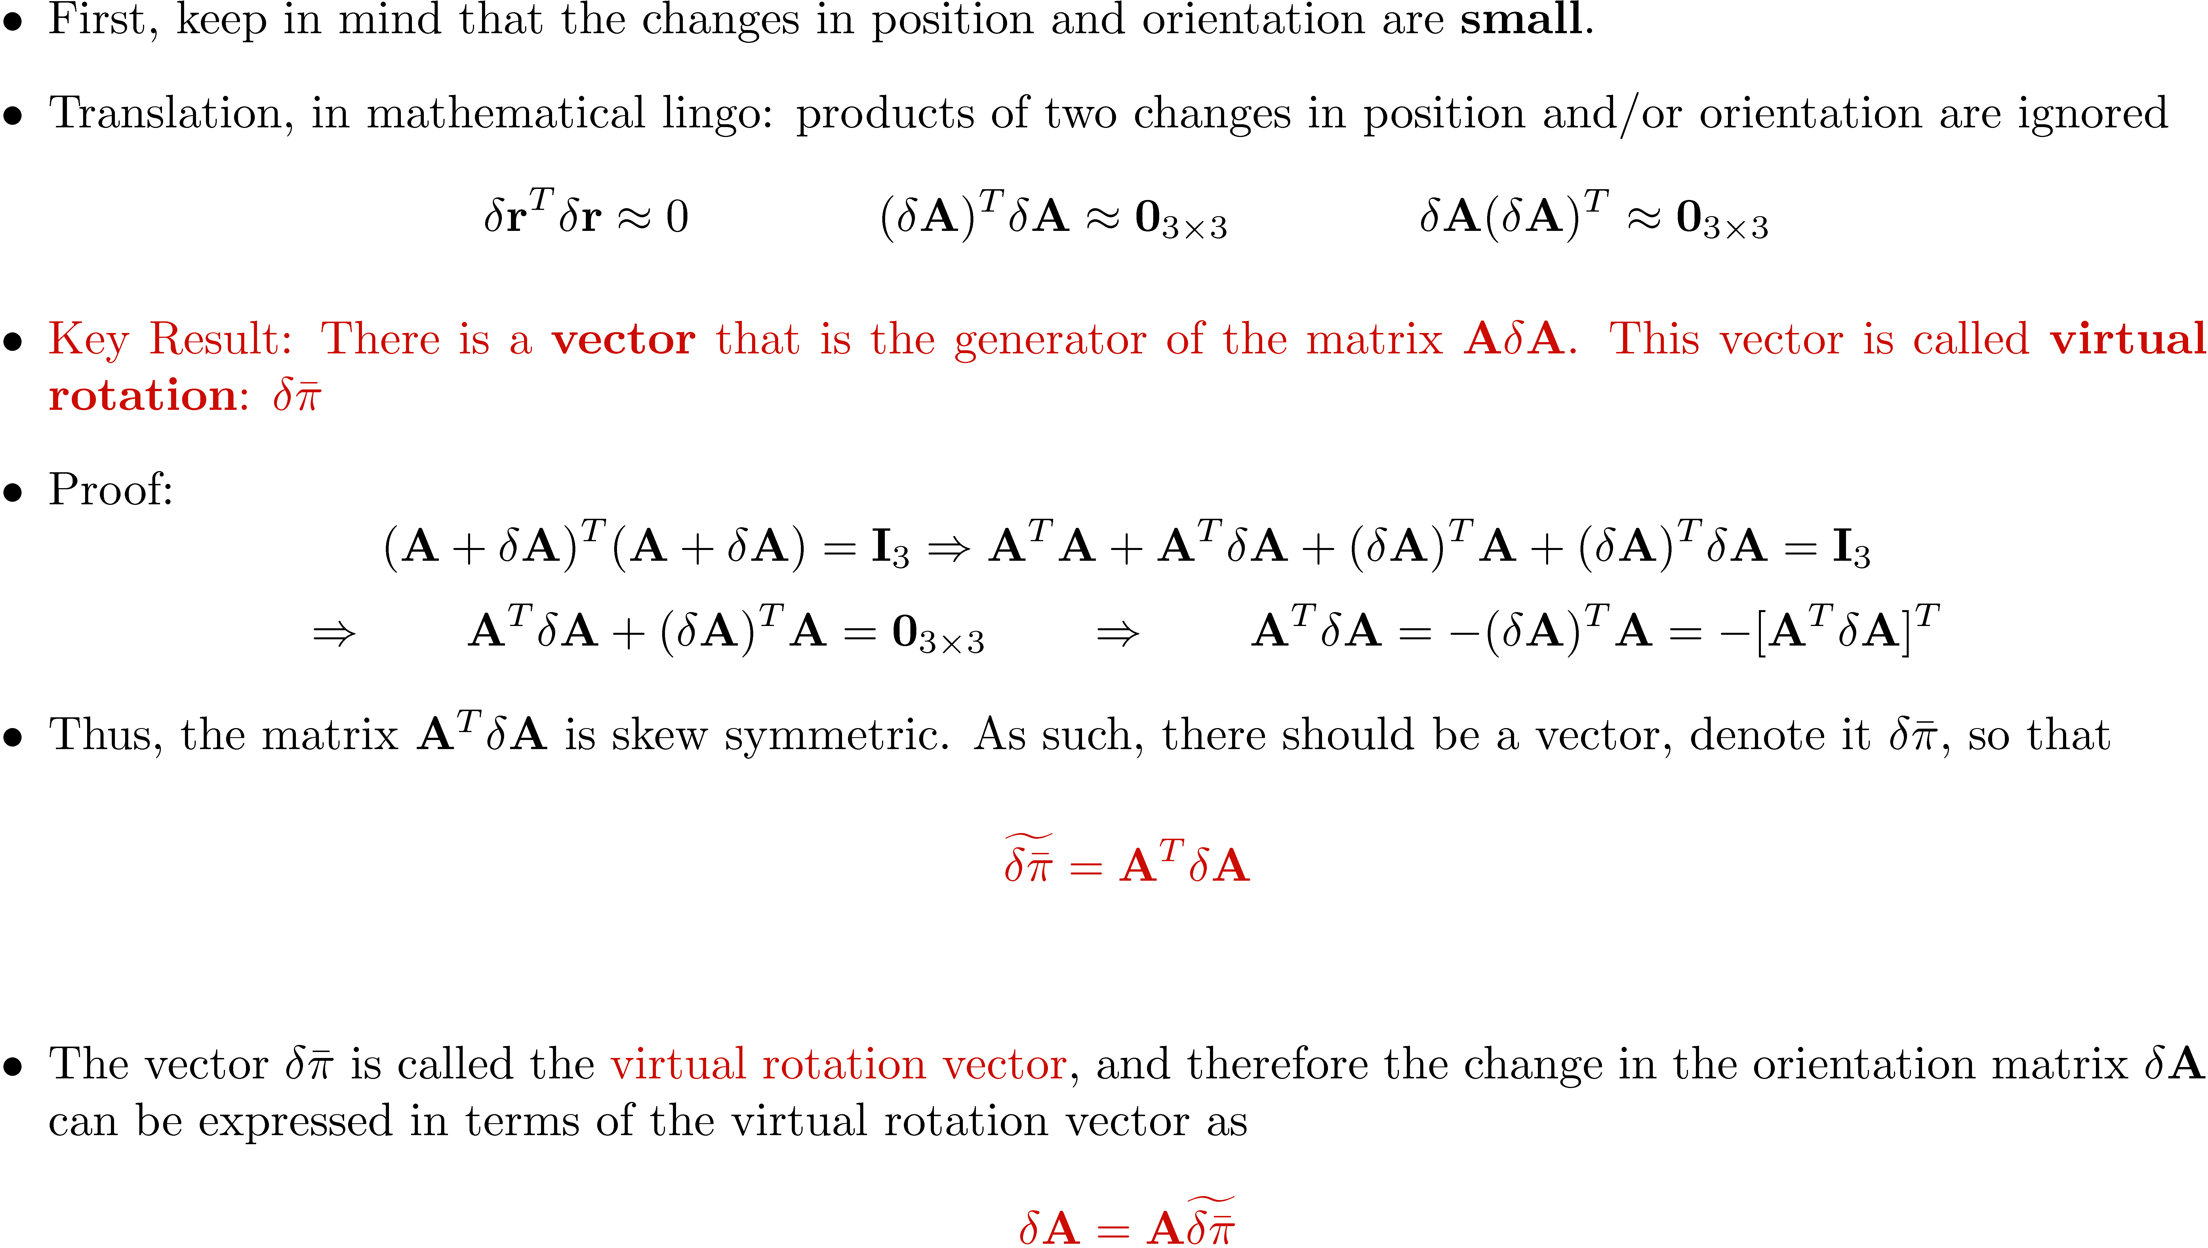
0

Slide 8
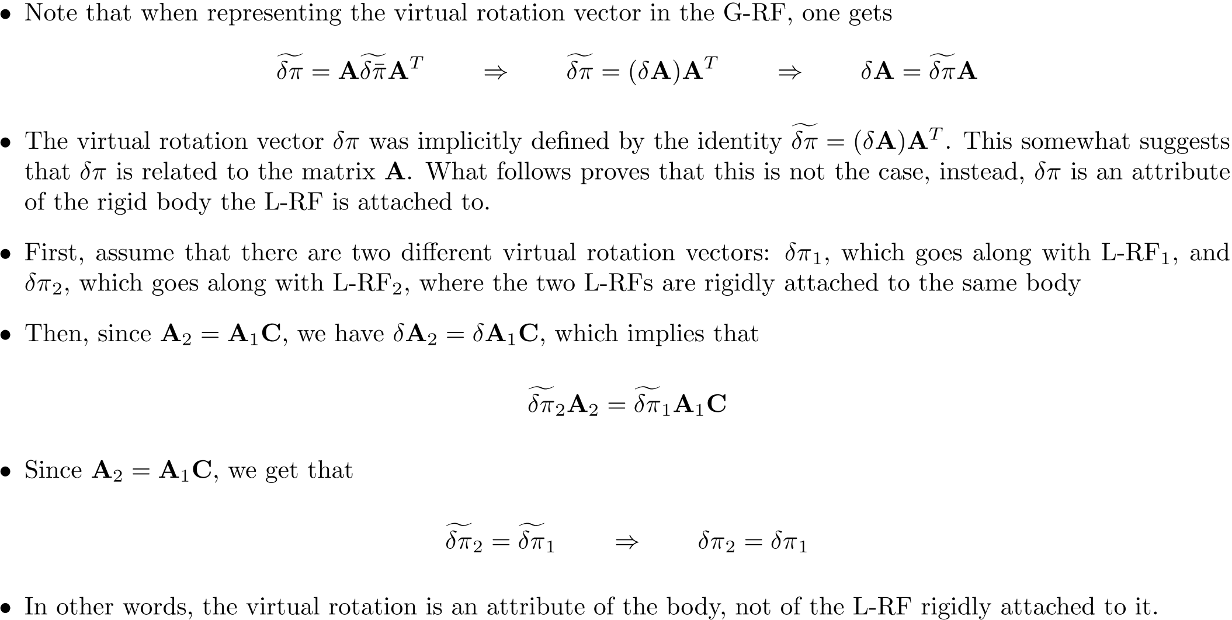
The Invariance Property of ±¼

Slide 9
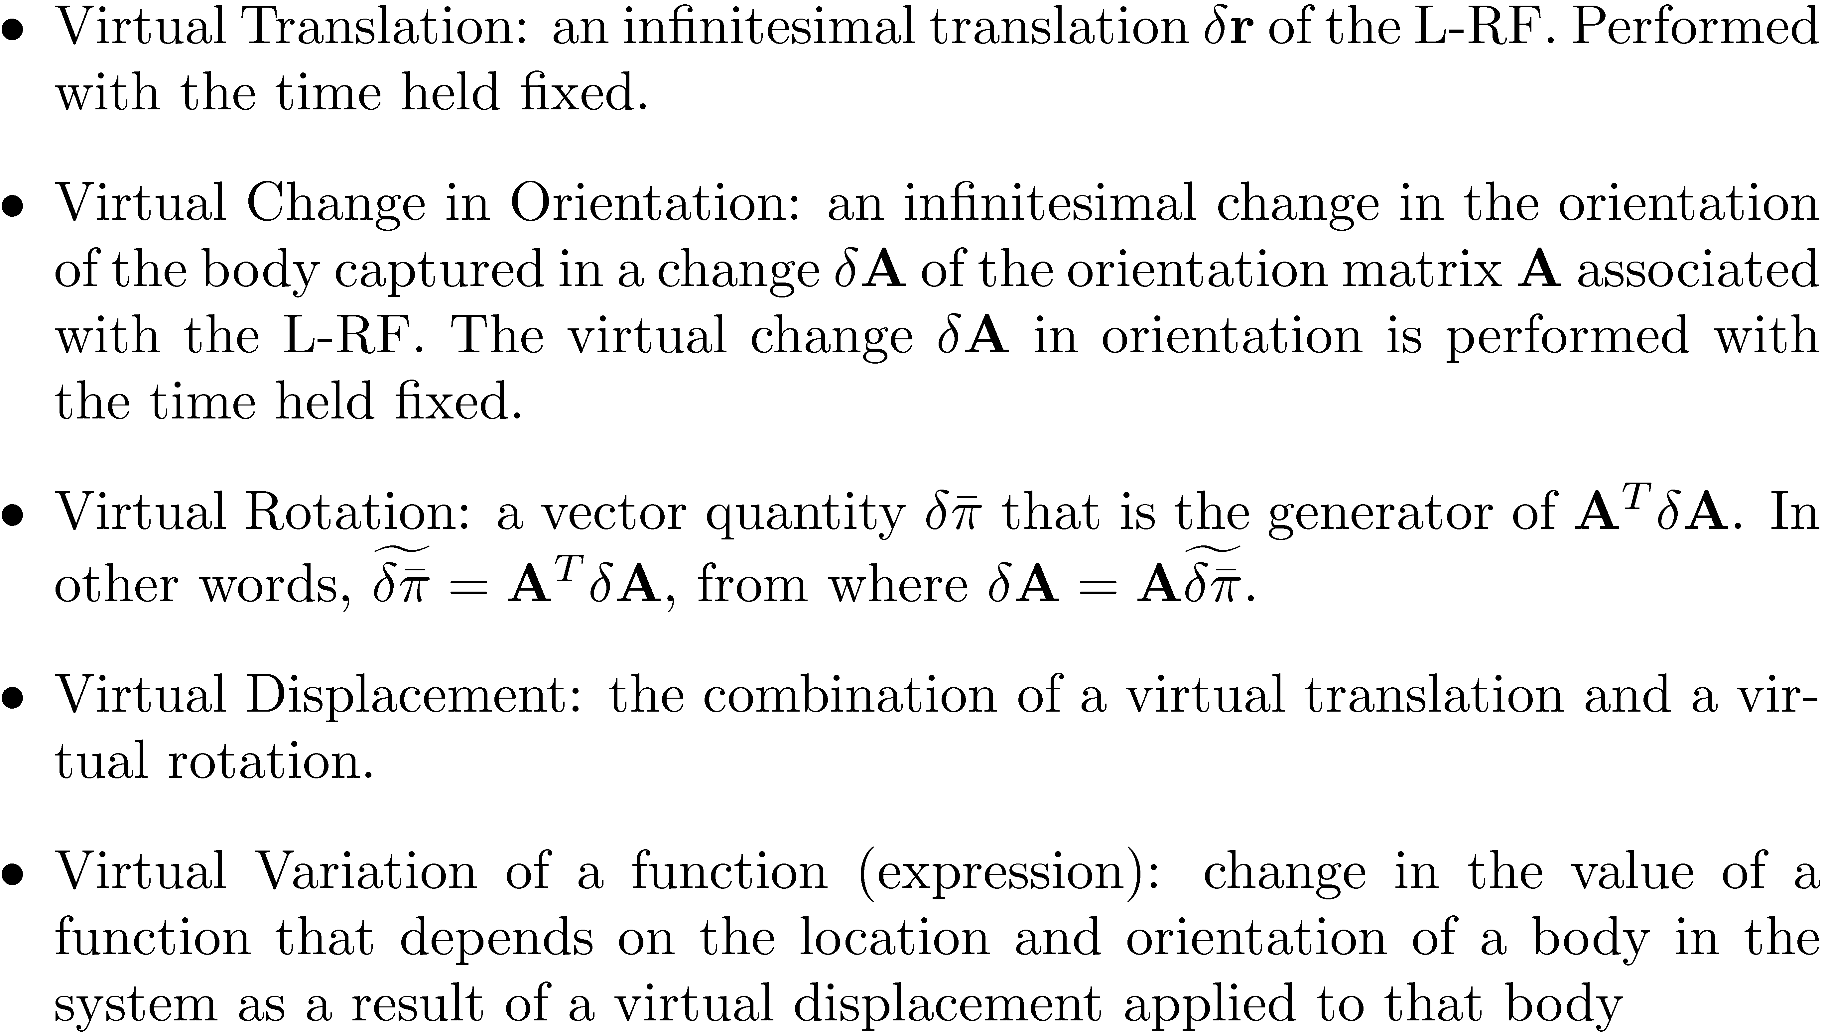
Putting Things in Perspective

Slide 10
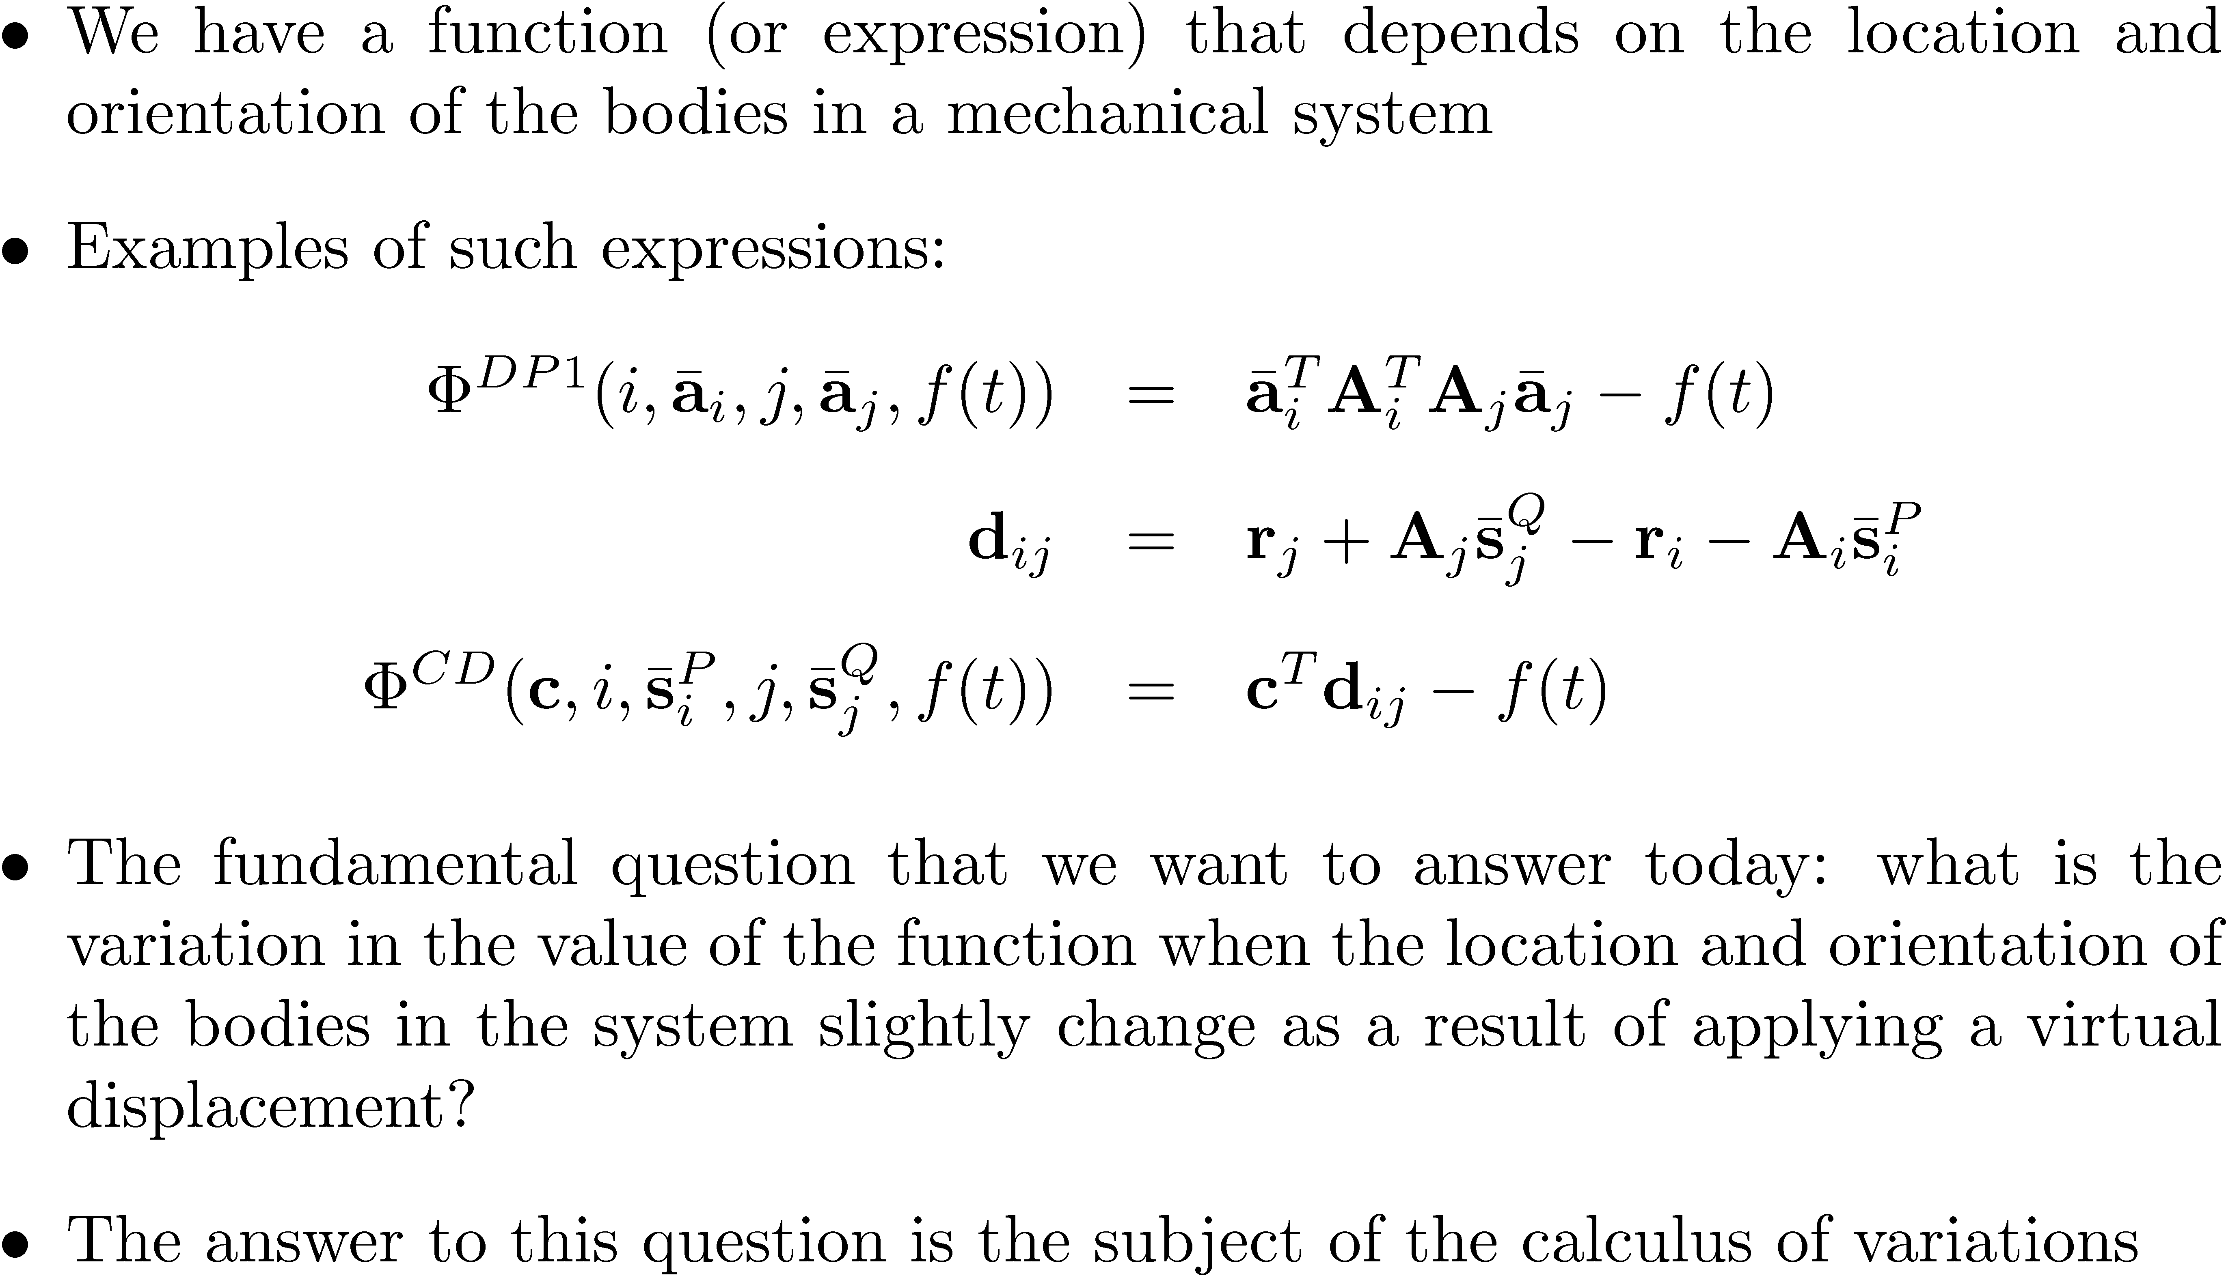
Variational Calculus

Slide 11
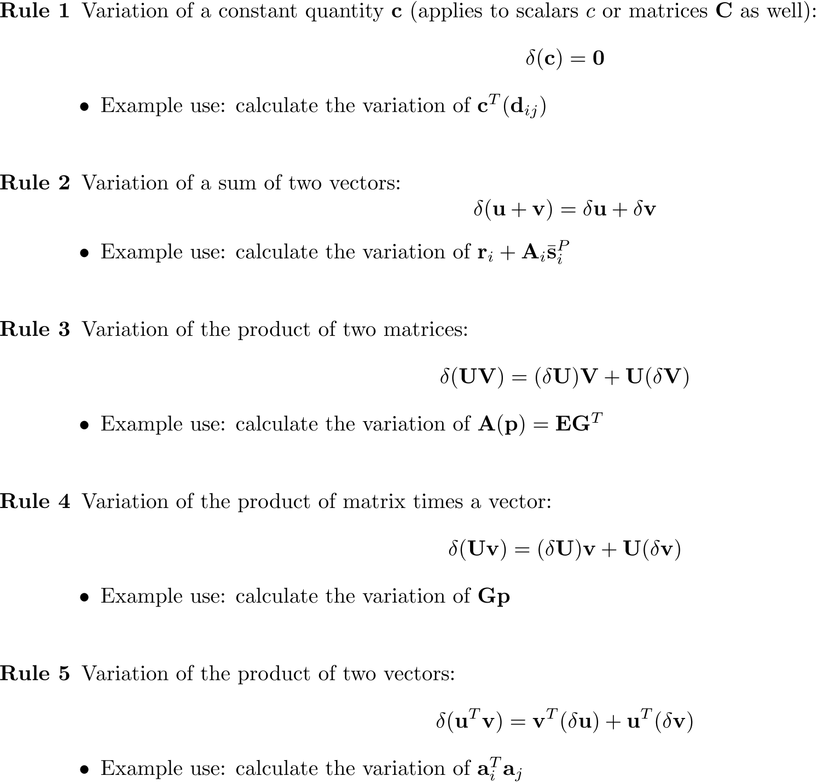
Variational Identities

Slide 12
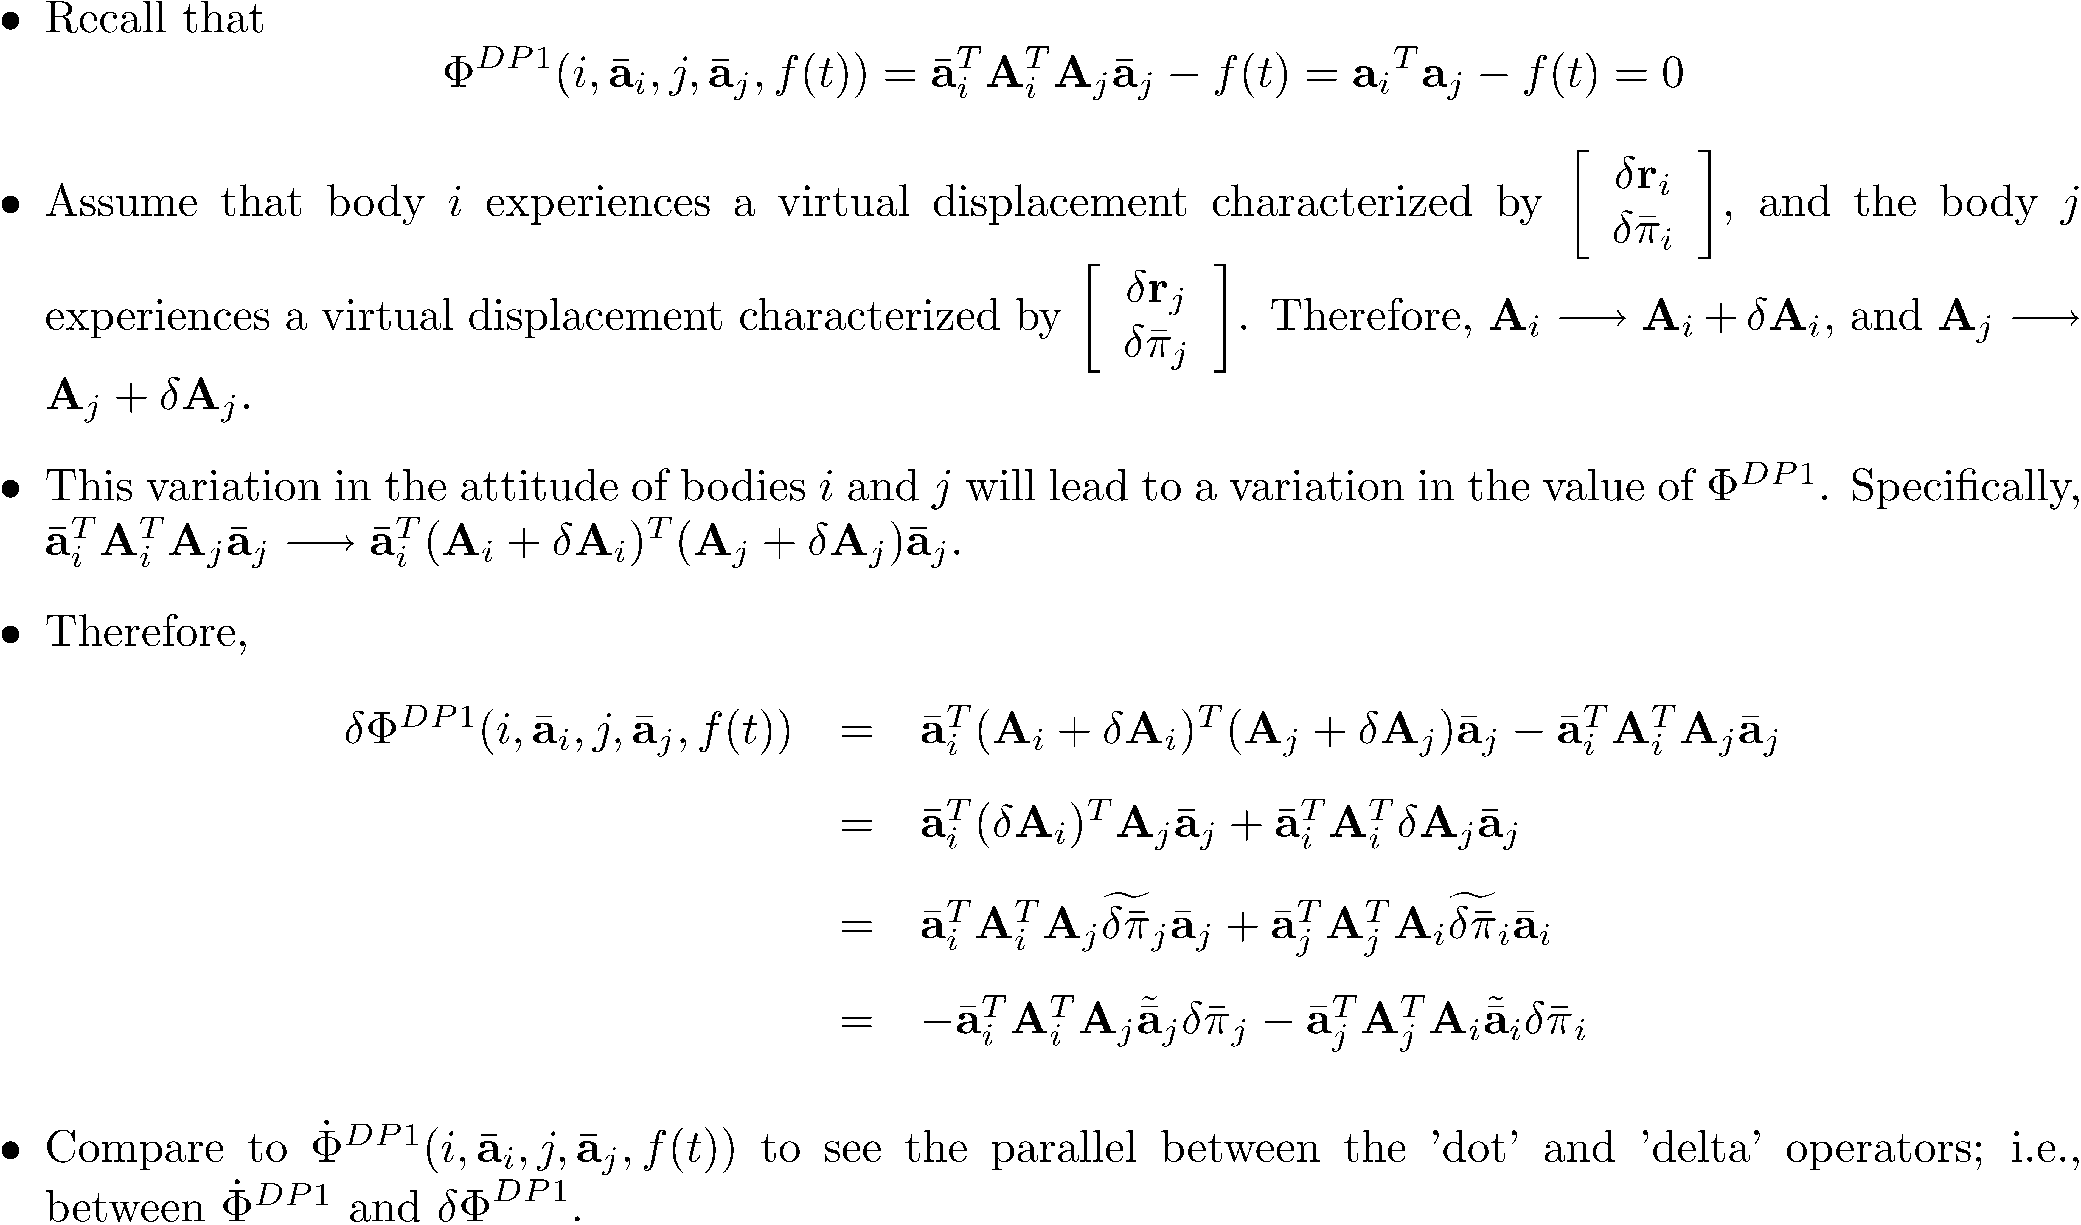

Slide 13
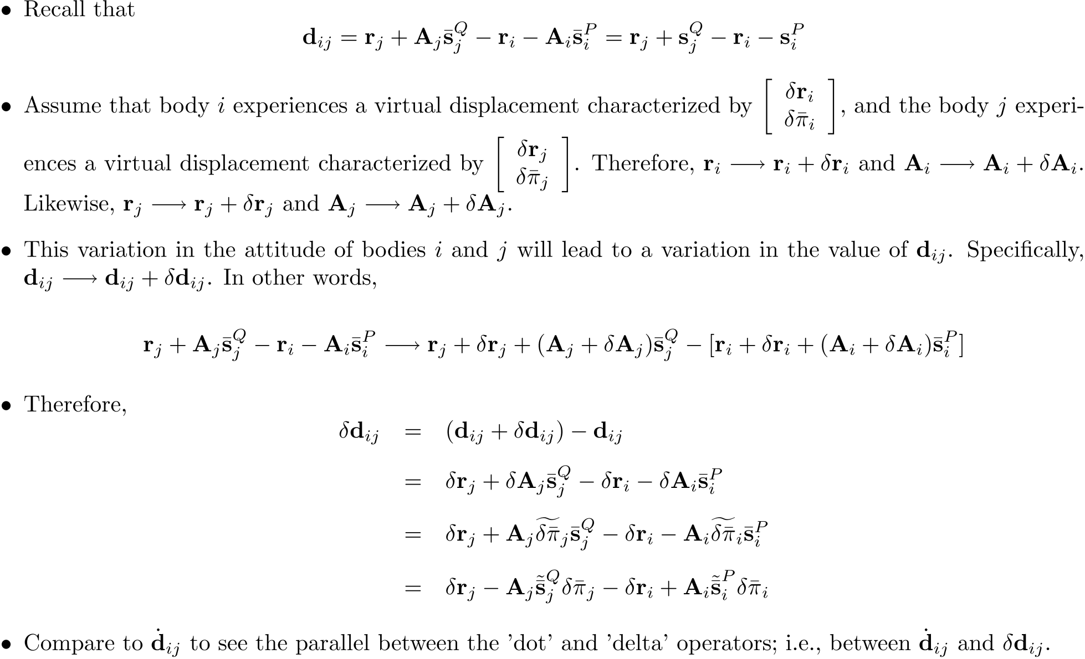
[Short Detour]:

Slide 14
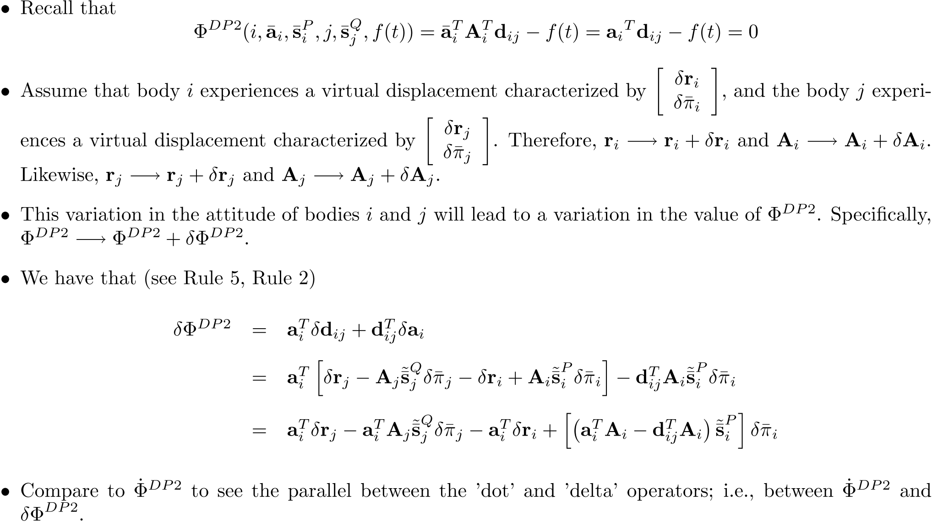

Slide 15
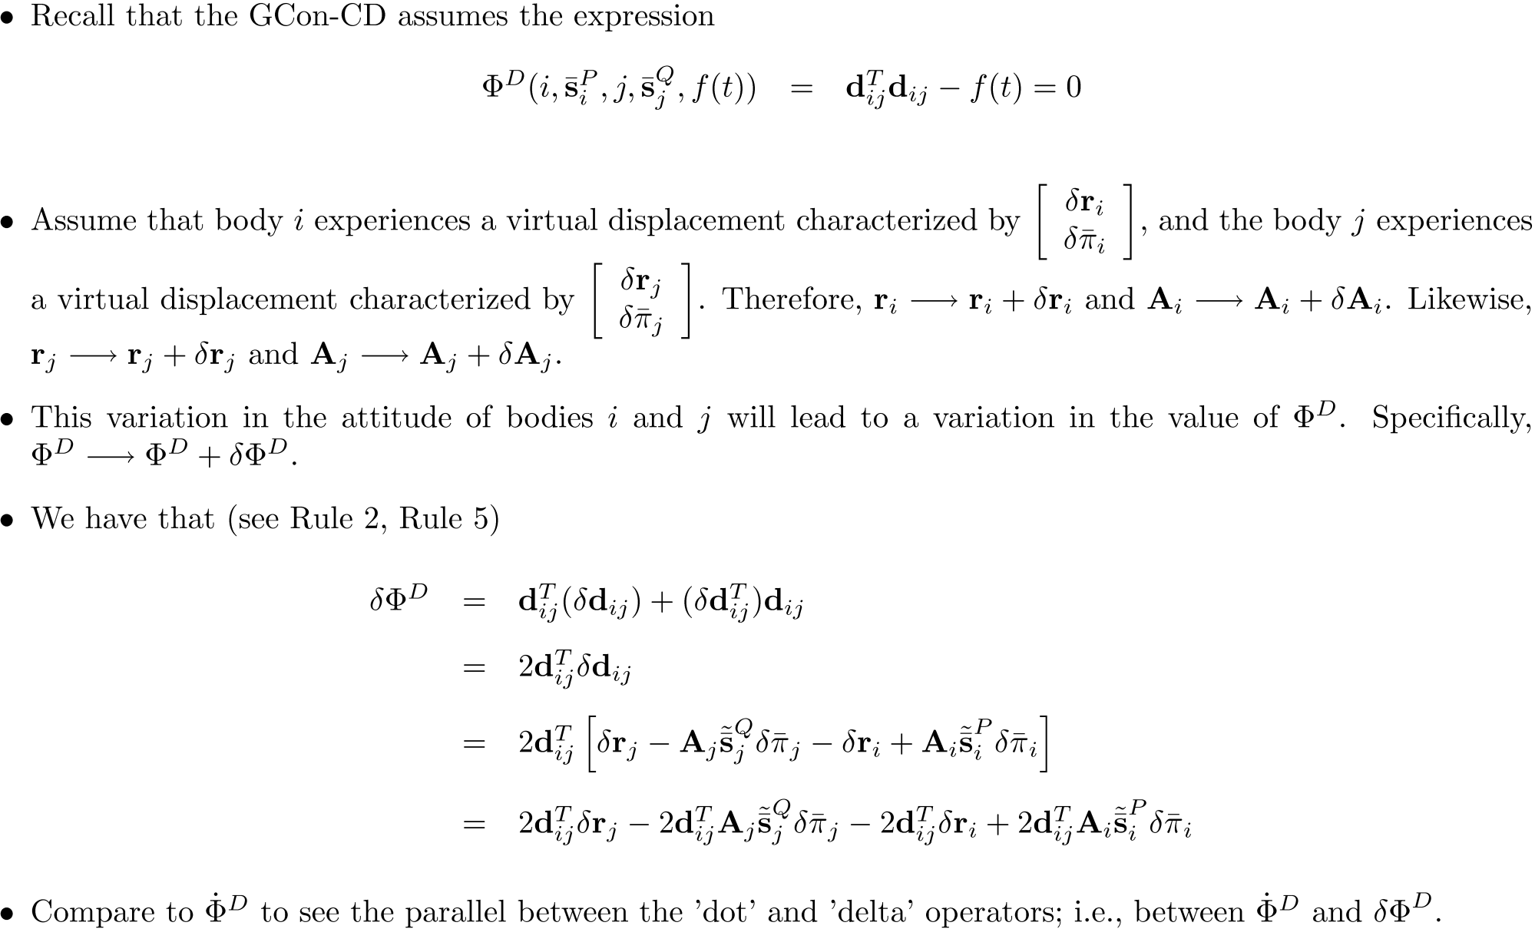

Slide 16
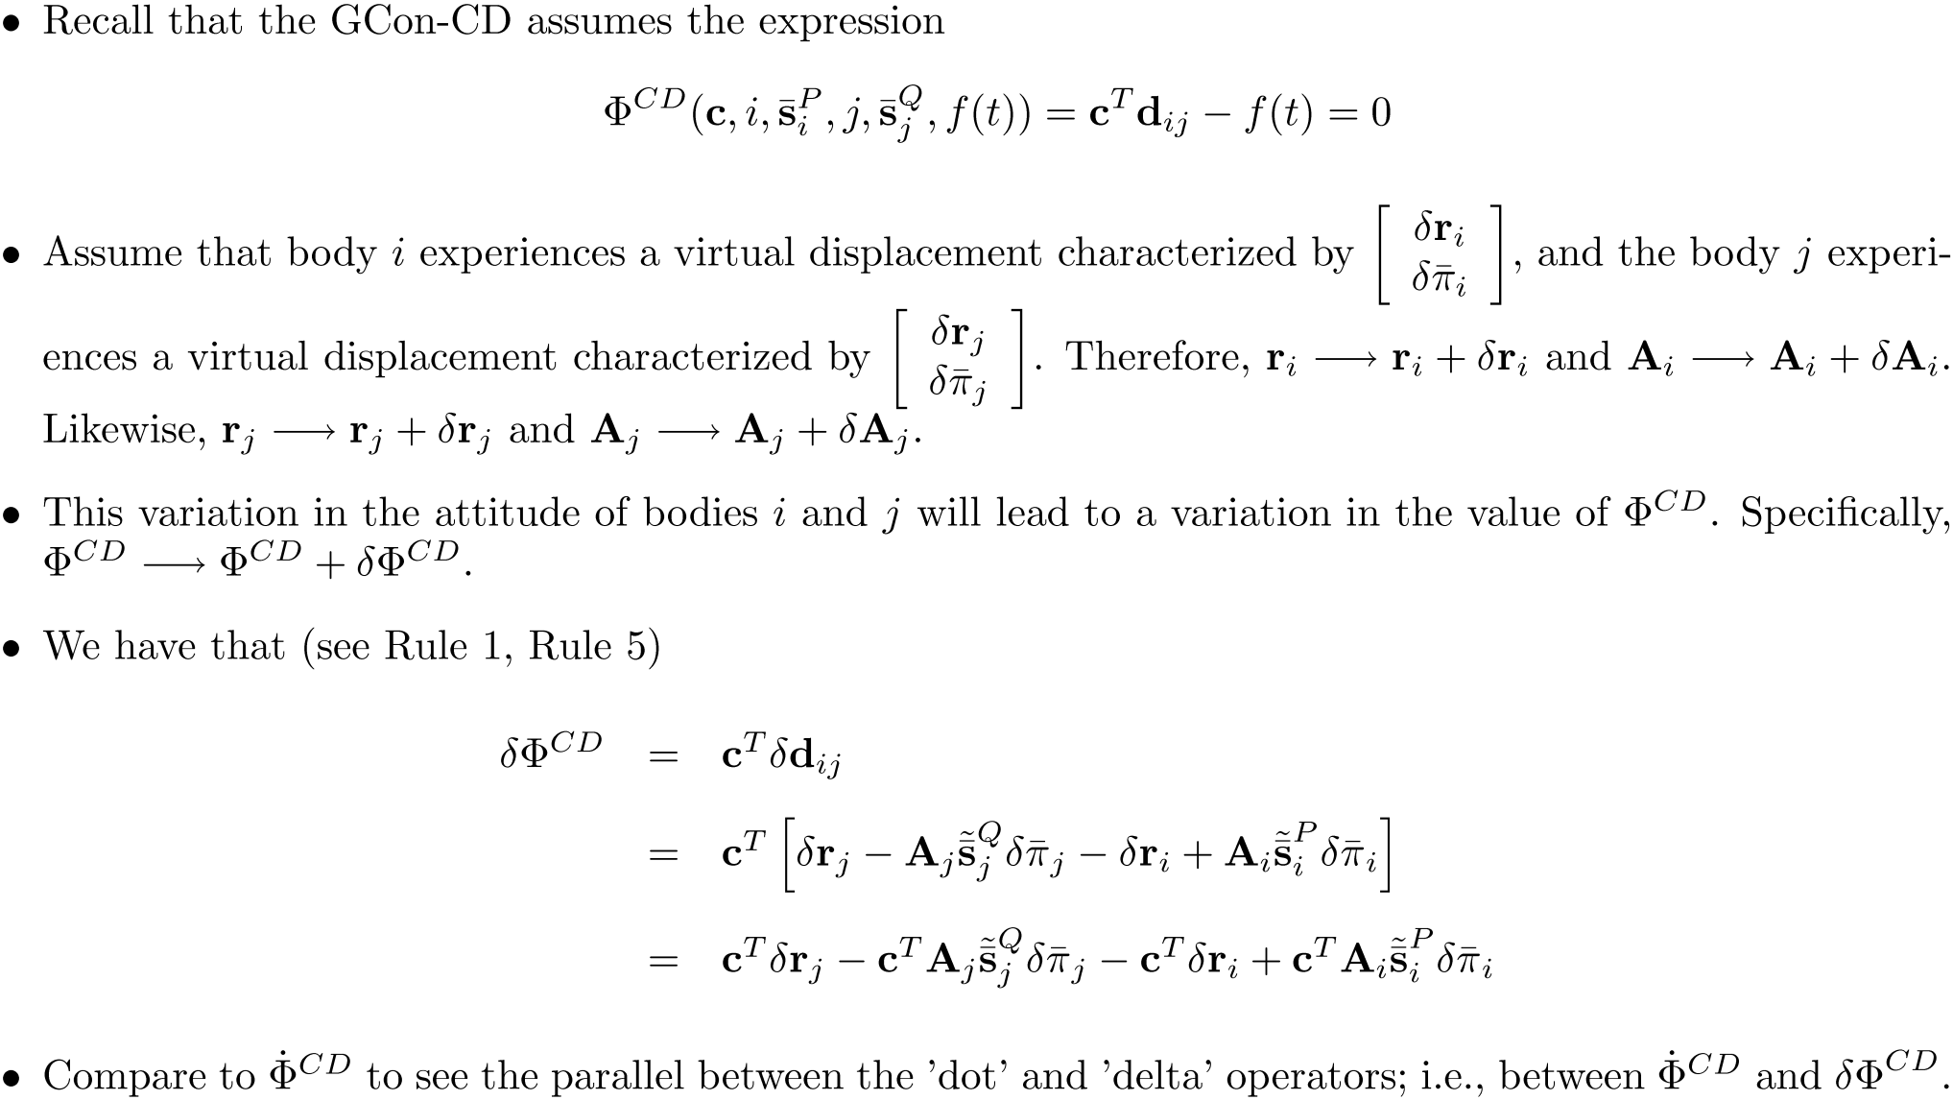

Slide 17
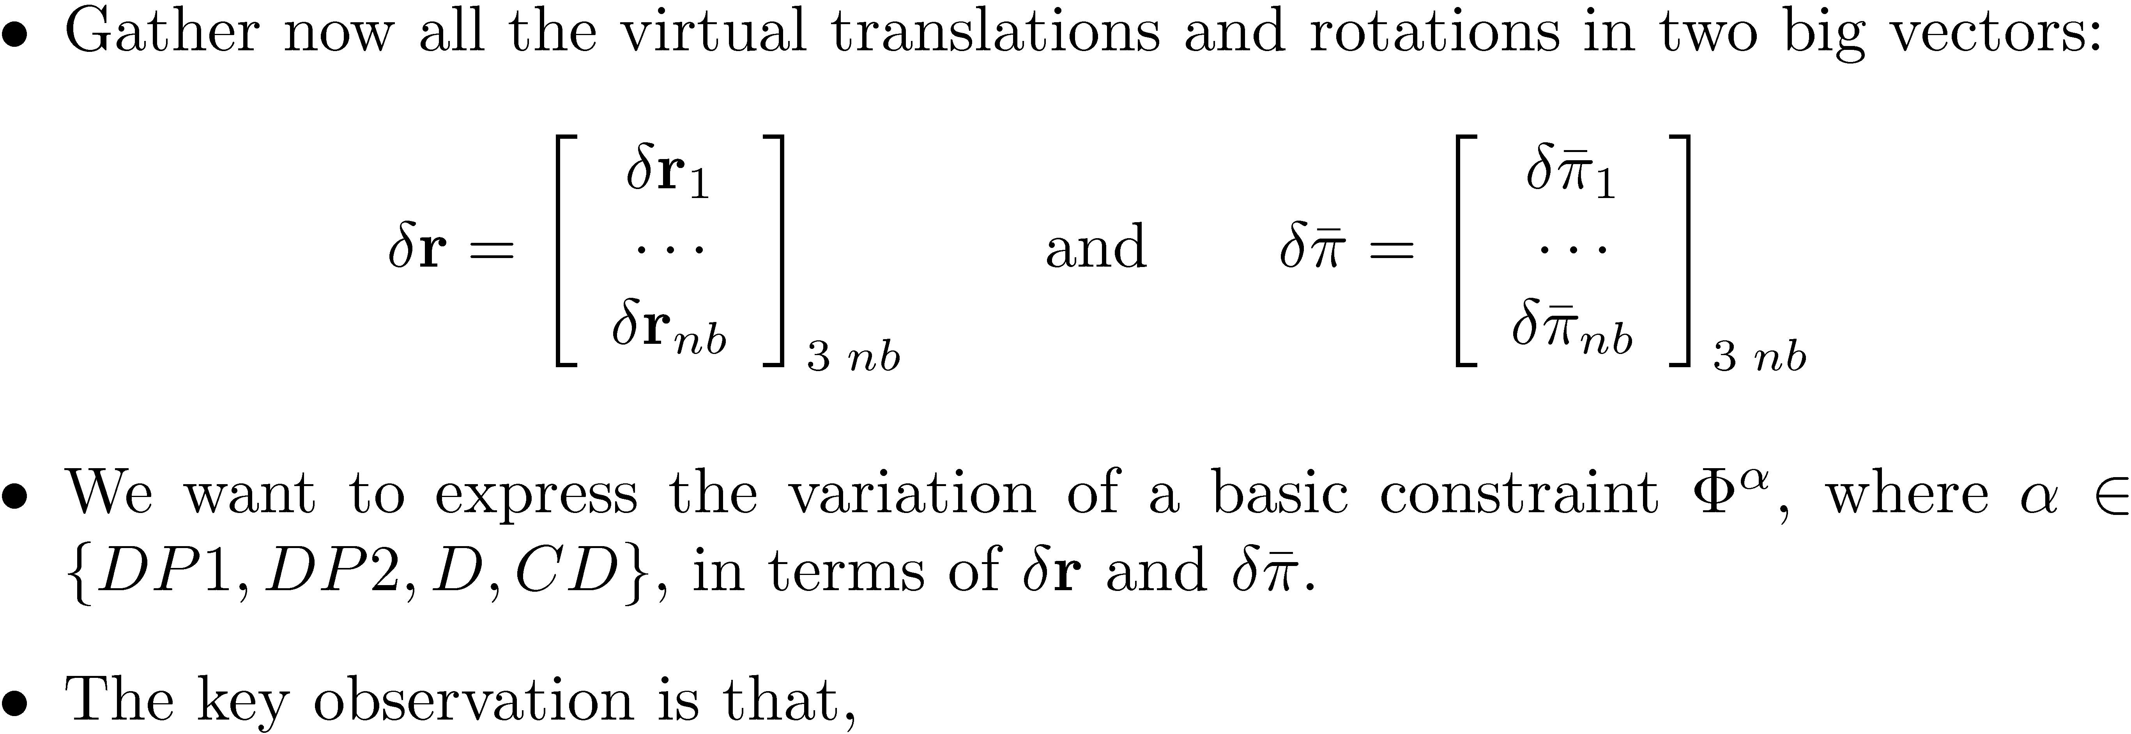
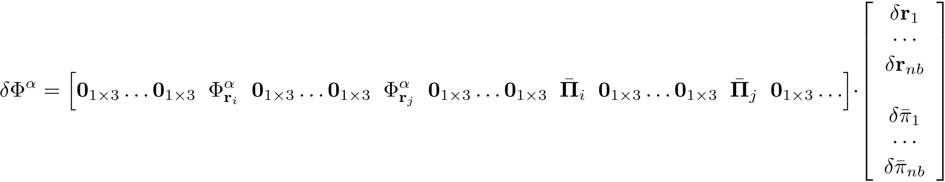
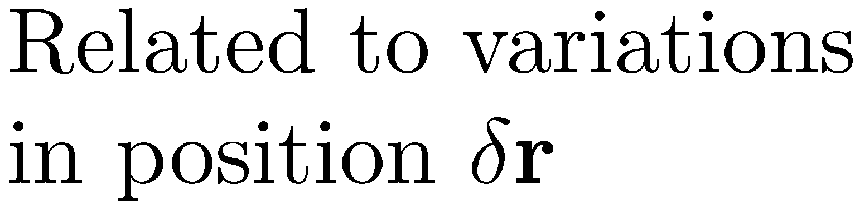
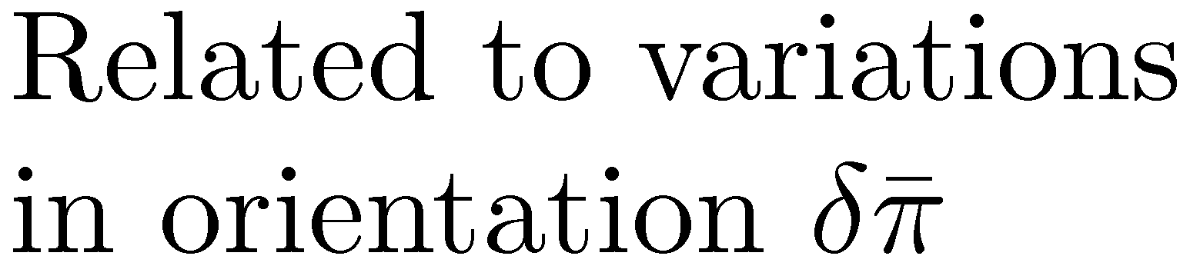
Body 1,
Transl.
Body i,
Transl.
Body j, Transl.
Body i, Rotation
Body j, Rotation

Slide 18
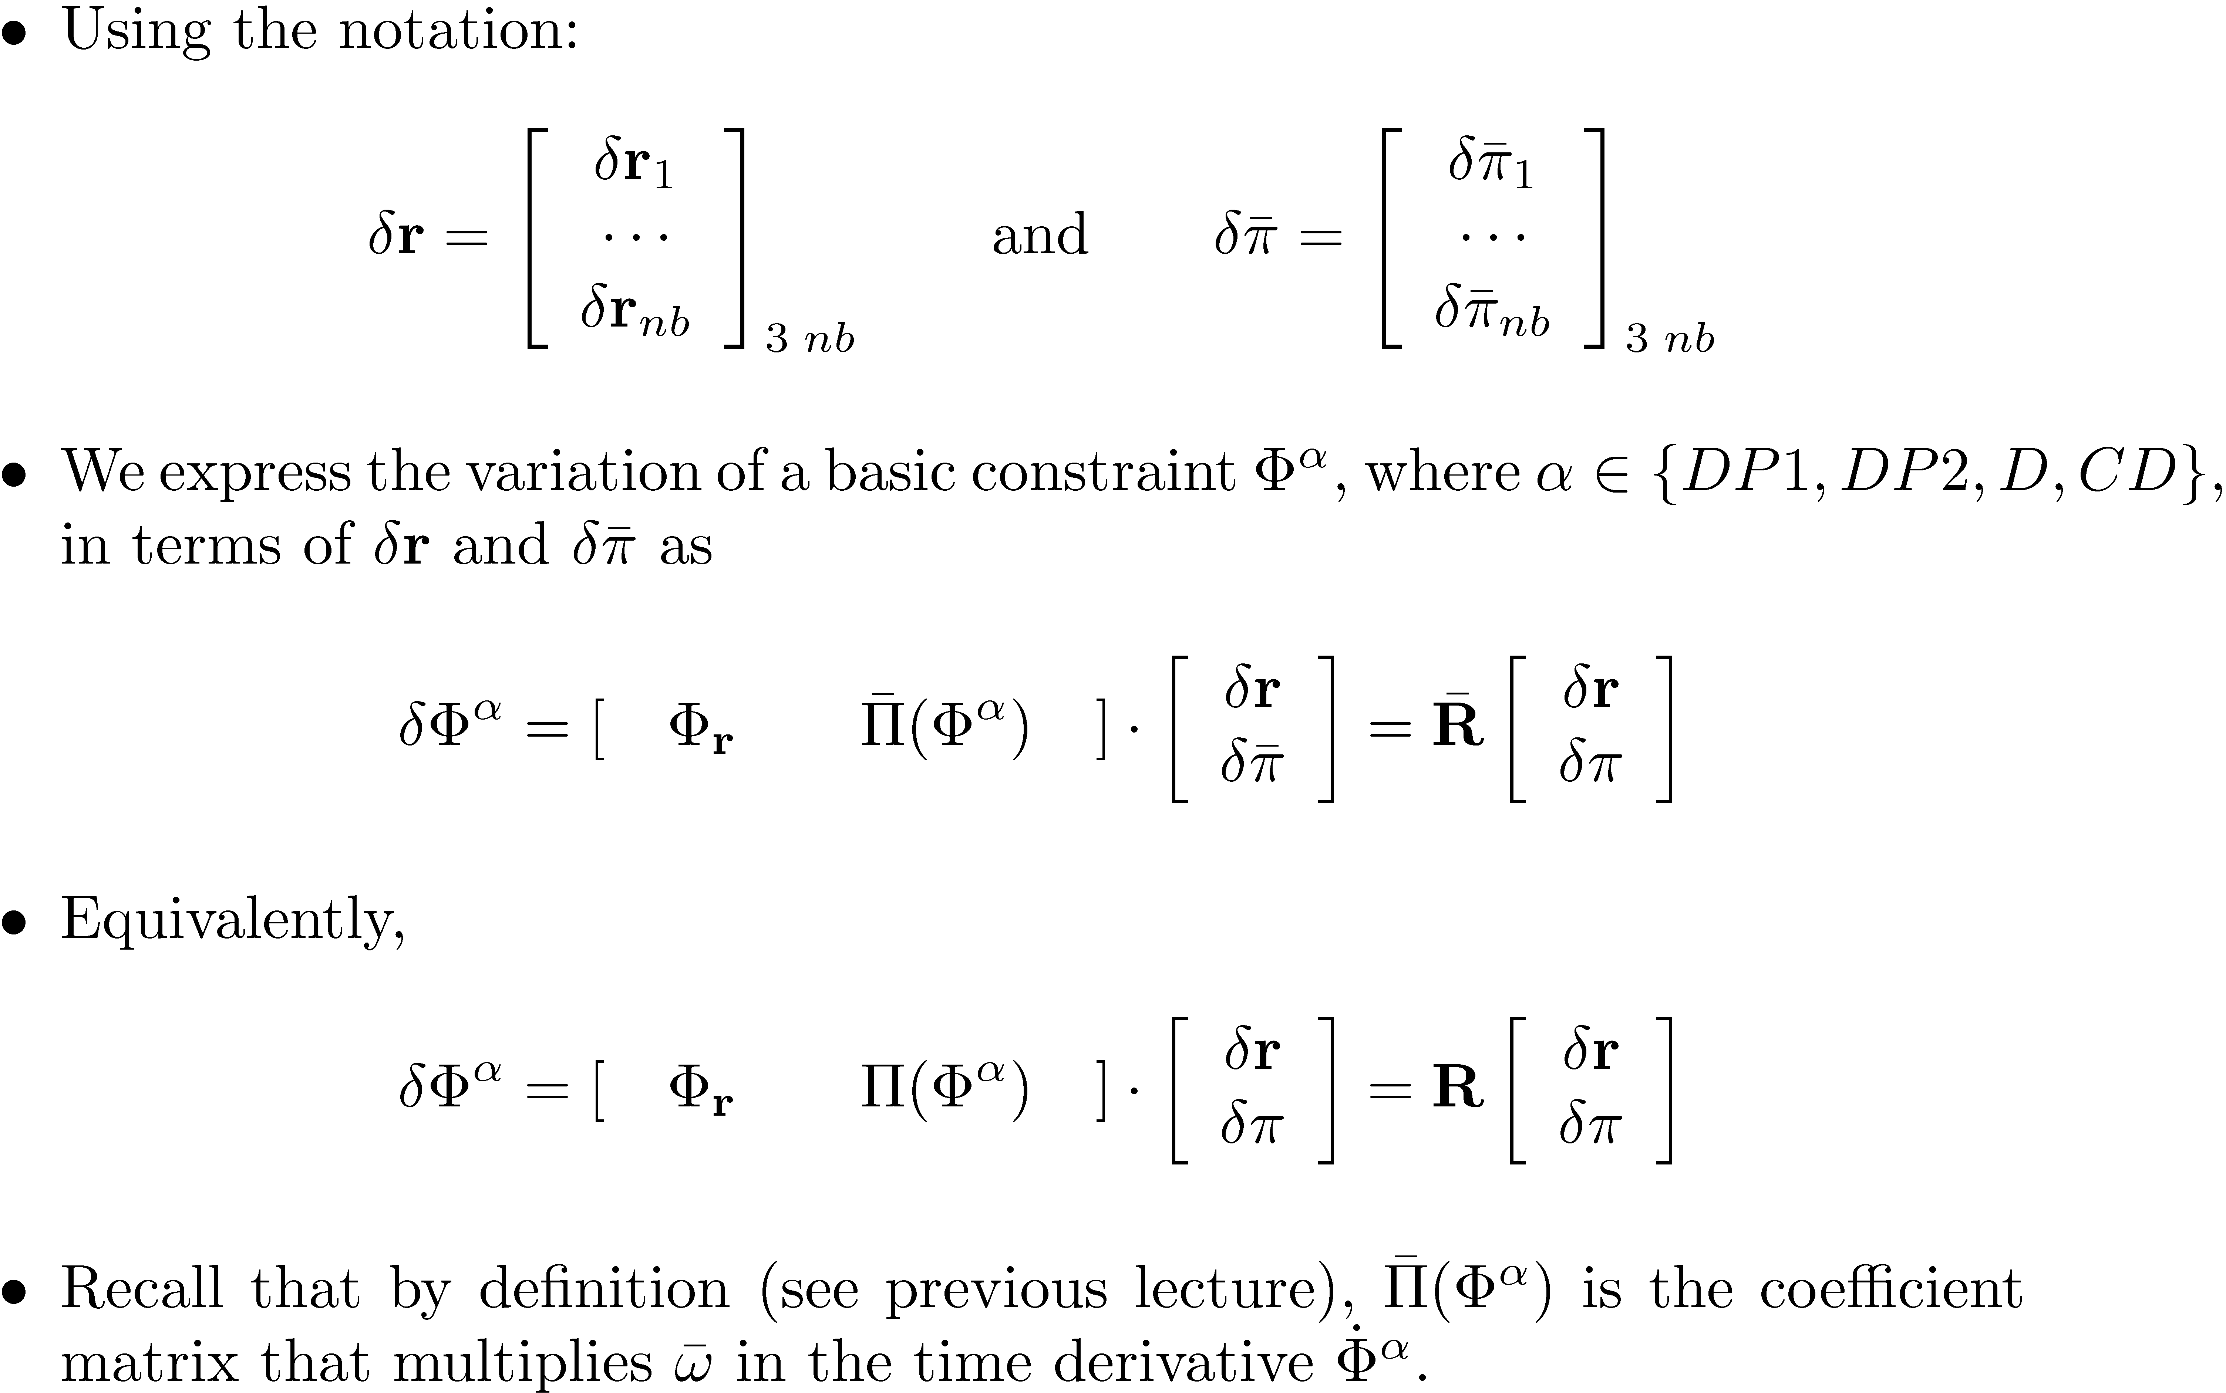

Slide 19
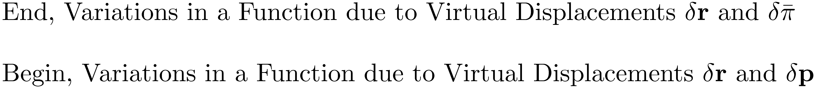

Slide 20

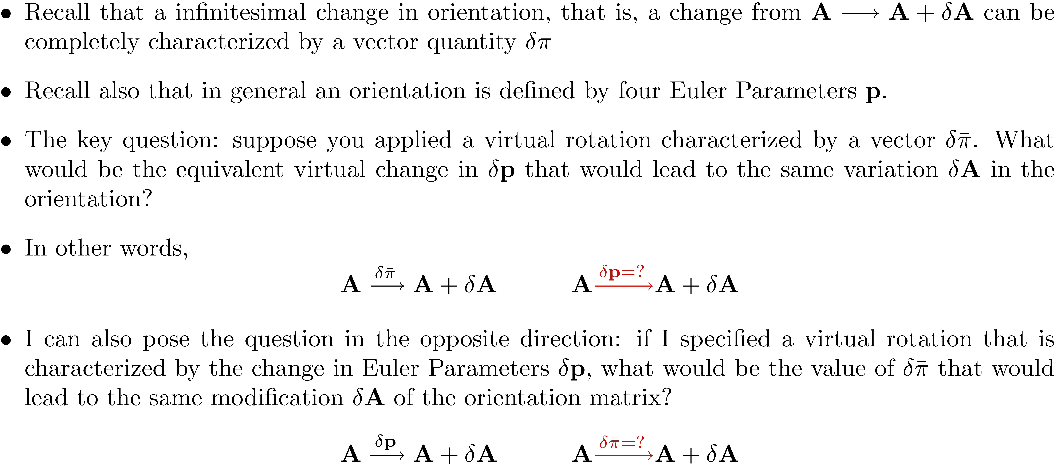
[Posing the Problem]:
The same ± A
The same ± A

Slide 21
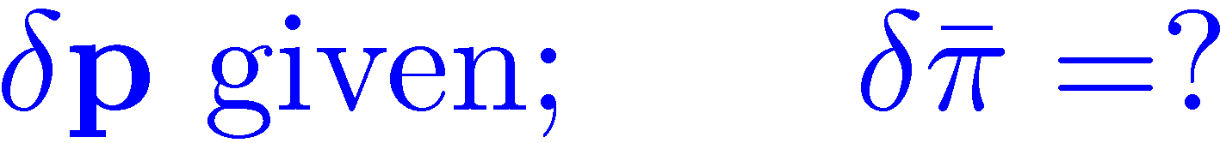
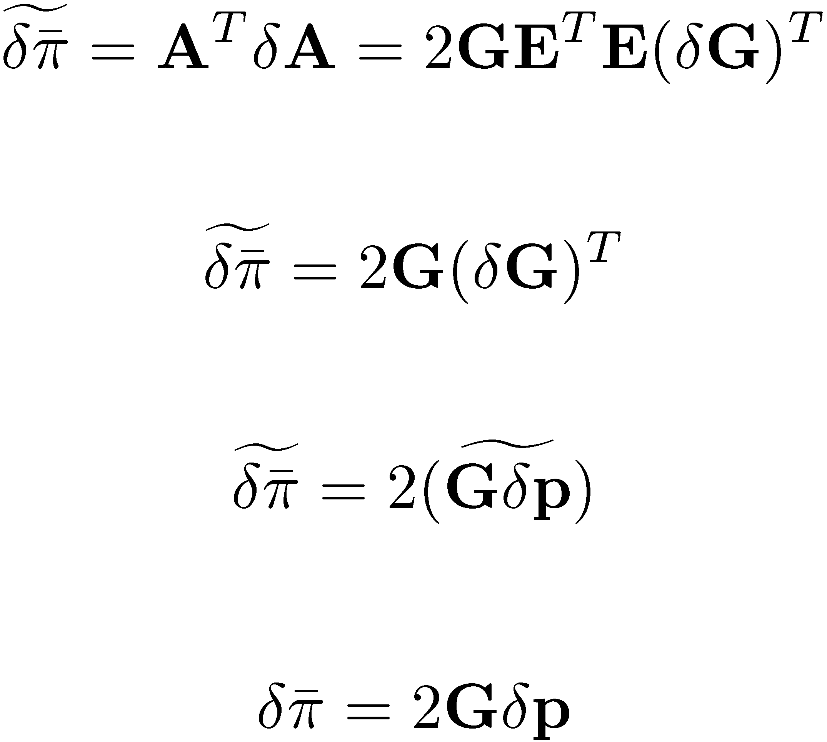
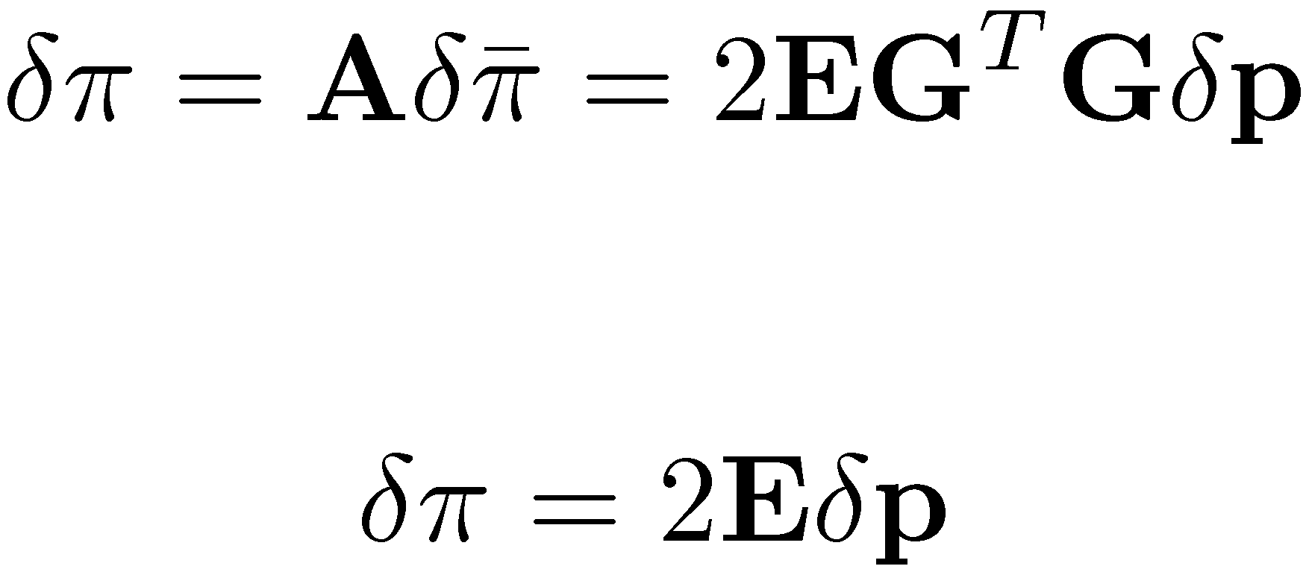
Draws on pp.344, Haug’s book
(Eq. 9.3.32)

Slide 22
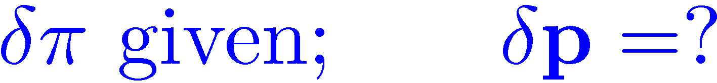
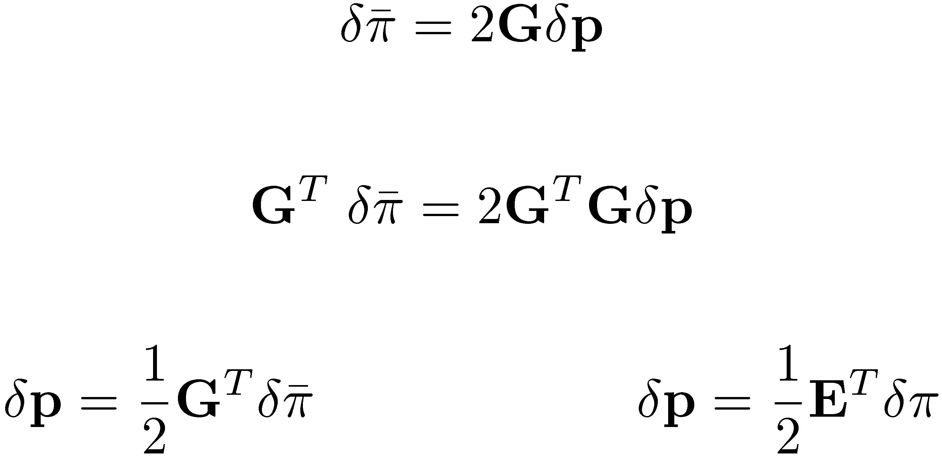
pp.345, Haug’s book

