Slide 1
ME751 Advanced Computational Multibody Dynamics
March 4, 2010
“Without music to decorate it, time is just a bunch of boring production deadlines or dates by which bills must be paid.”
Frank Zappa
© Dan Negrut, 2010 ME751, UW-Madison

Slide 2
Before we get started…
Last Time:
Discussed Virtual Displacement and Variation of a Function
Covered the ±r , ±¼ case
Today:
Discuss about how to visualize the time evolution of a mechanical system
Virtual Displacement: cover the ±r, ±p case
Start discussion on how to obtain the EOM (the Dynamics problem)
HW7 – due on March 11: posted online later today
This HW will require you to decide on a Final Project
Forum up and running: http://sbel.wisc.edu/Forum/index.php?board=4.0
Use the forum to post questions about your HW, class notes, etc
I plan to monitor the discussion threads and contribute as much as I can
Started a discussion topic on course notes mistakes
Everyone who finds/posts a valid mistake first gets $1 from me

Slide 3
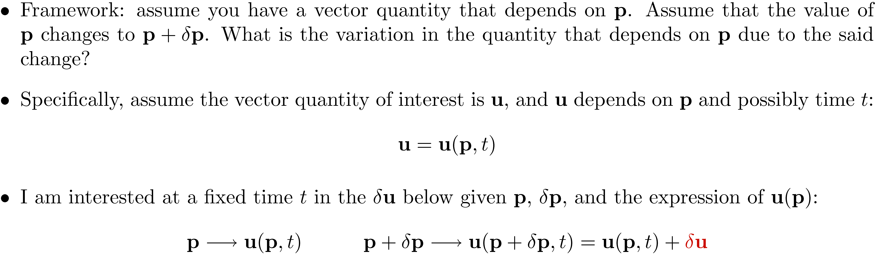


Slide 4
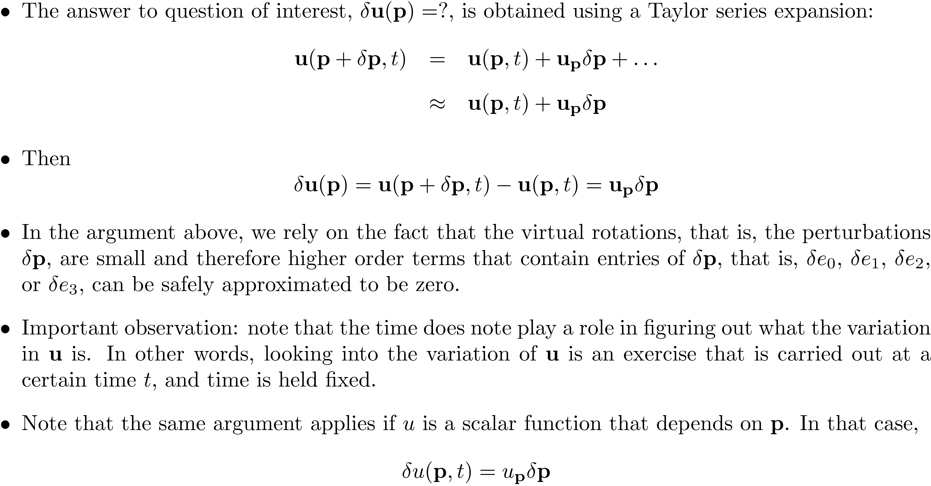
[Cntd.]:

Slide 5
Exercise

Slide 6
Exercise

Slide 7
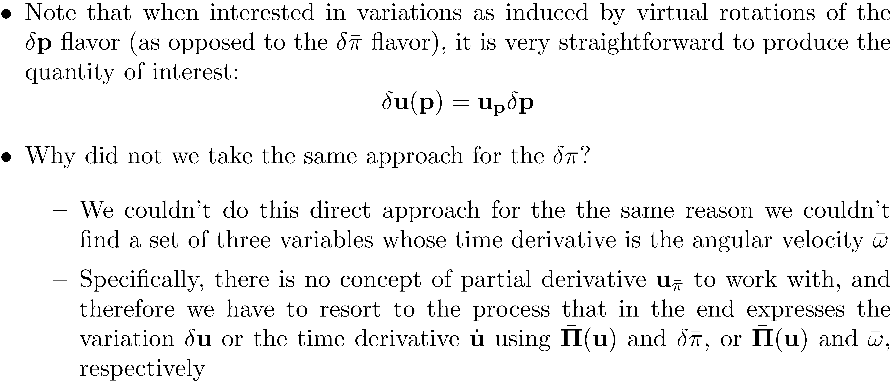
Quick Question

Slide 8

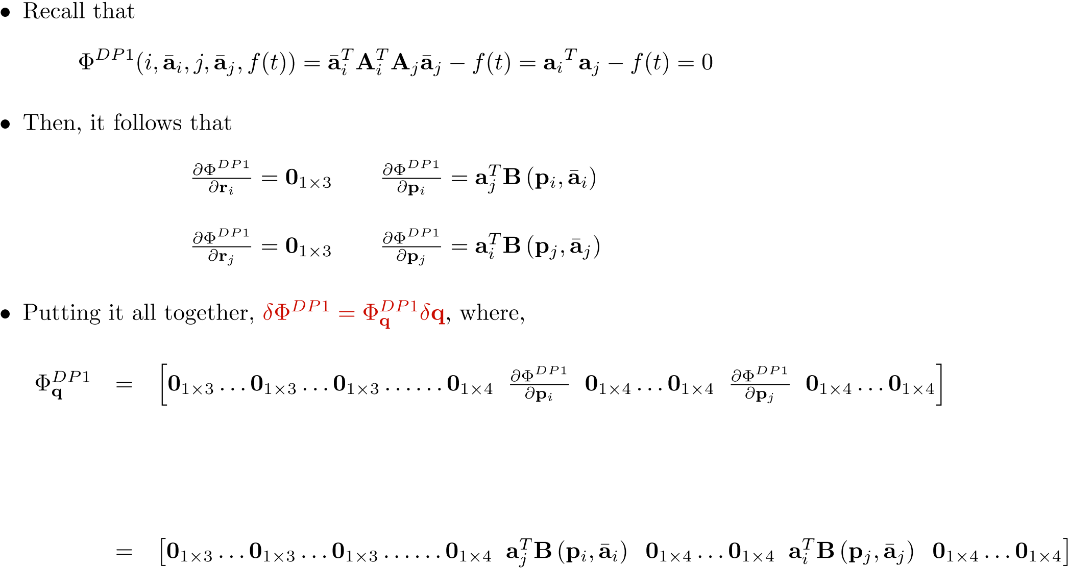
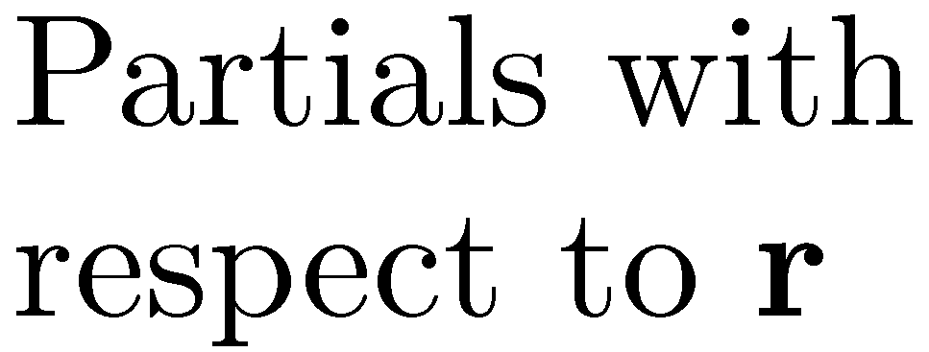
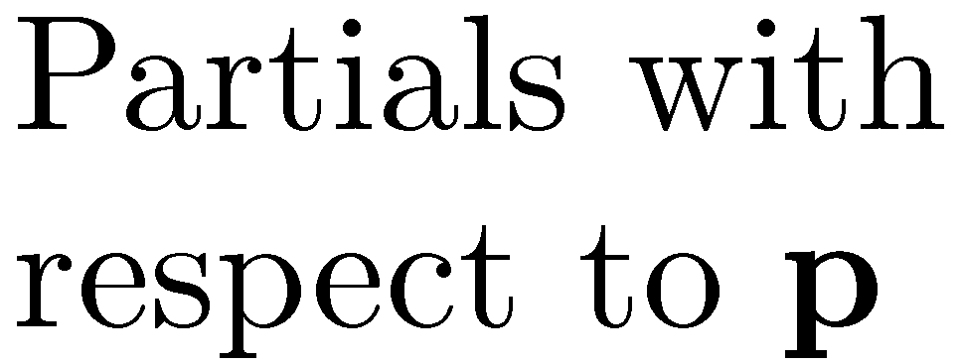
Body
1, r
Body
i, r
Body
j, r
Body
i-1, p
Body
i, p
Body
i+1, p
Body
j-1, p
Body
j, p
Body
j+1, p
Body
nb, p

Slide 9
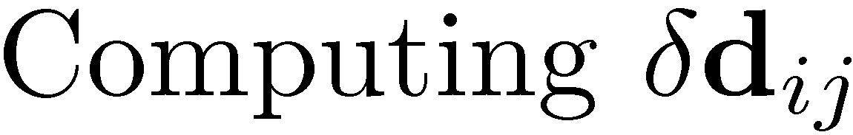
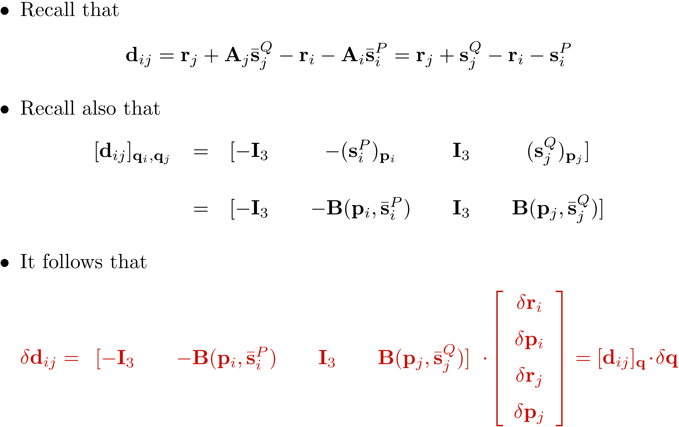
[Short Detour]:

Slide 10
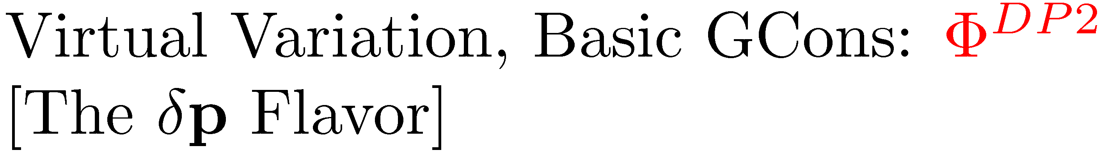
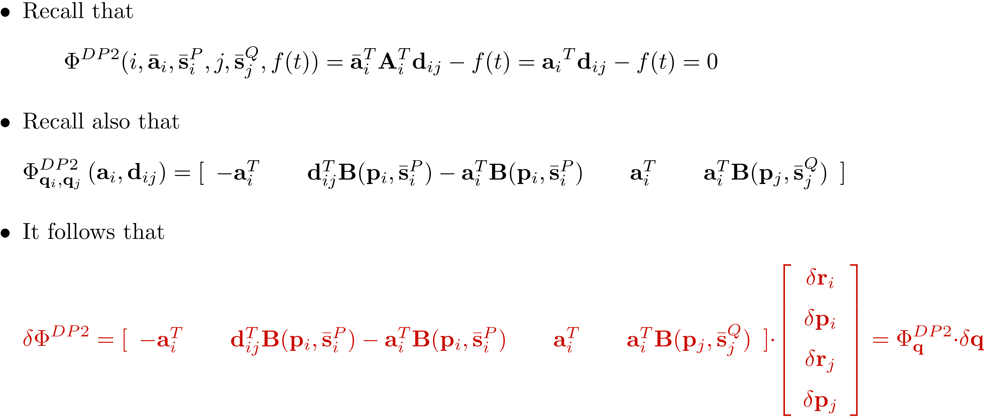

Slide 11
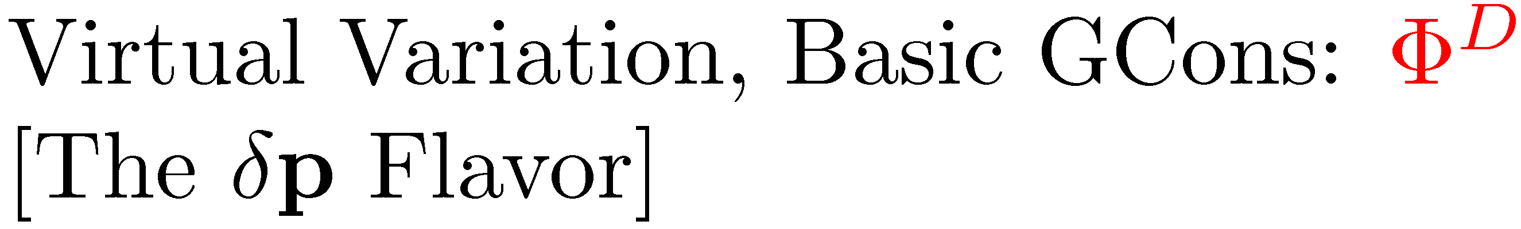
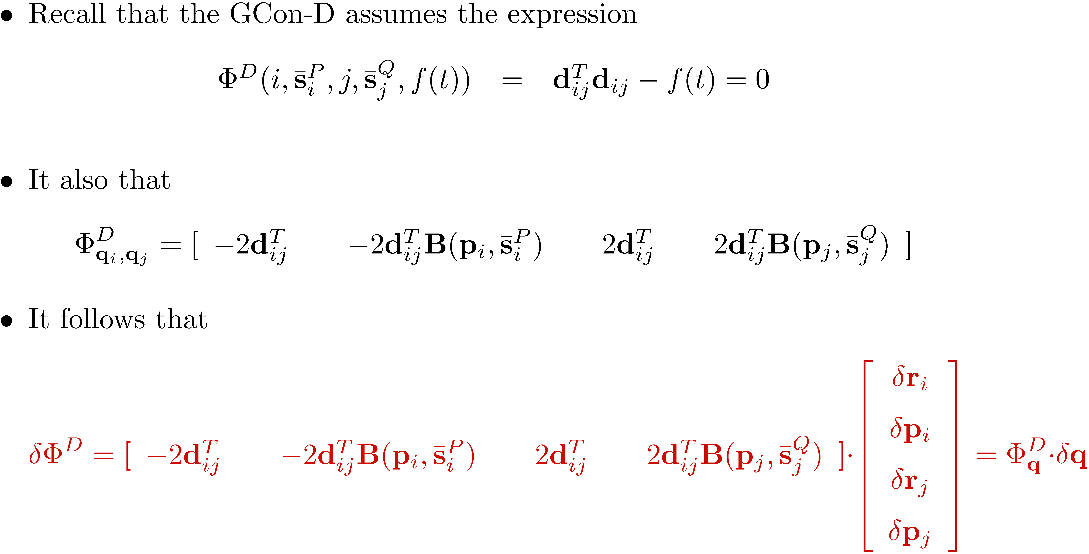

Slide 12

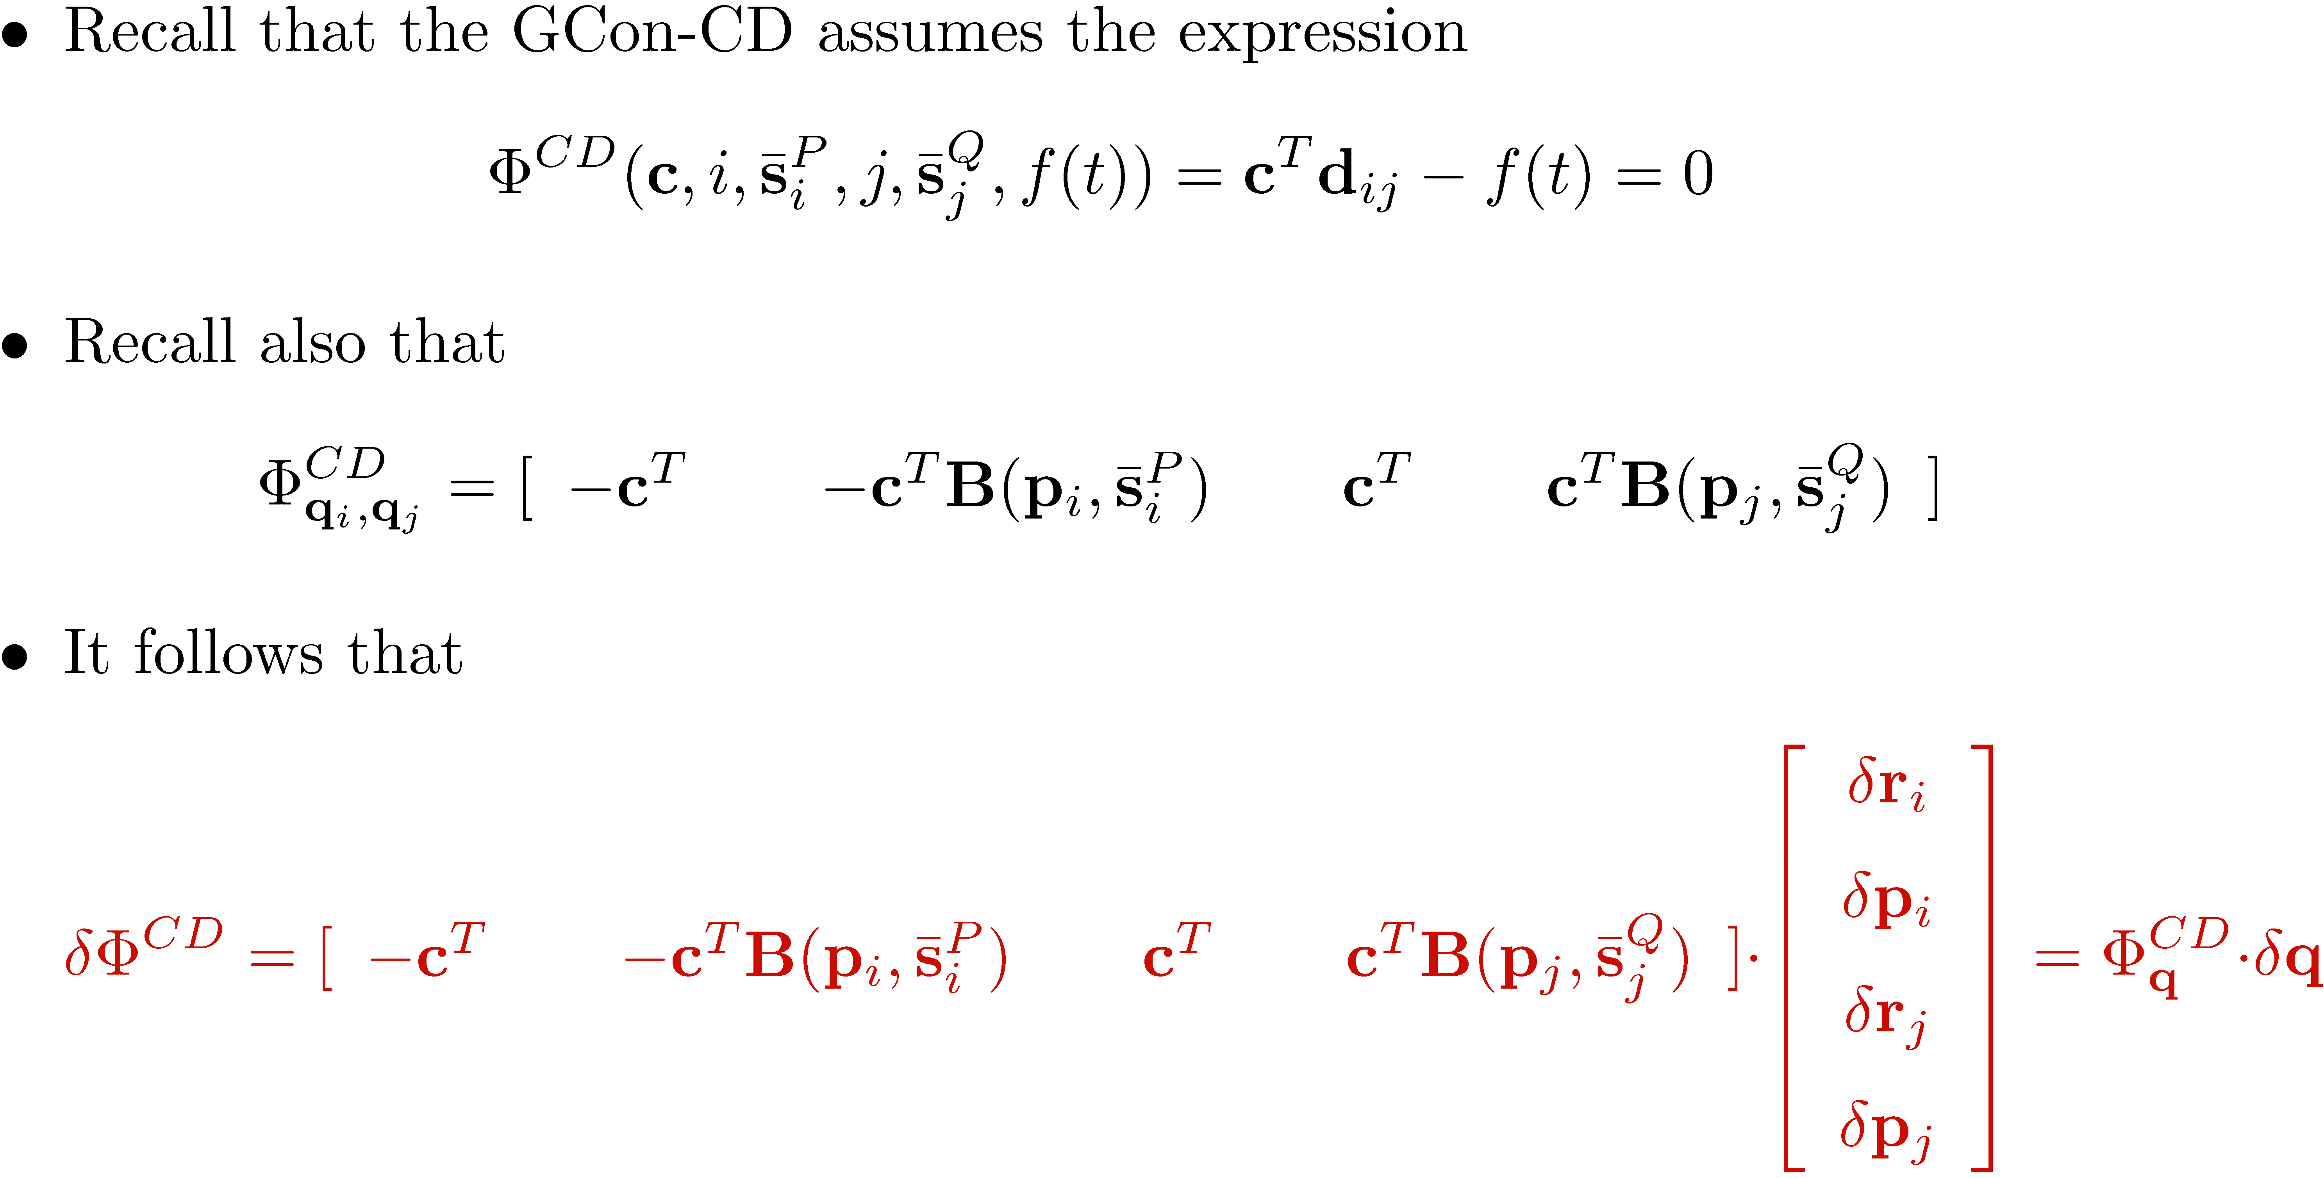

Slide 13
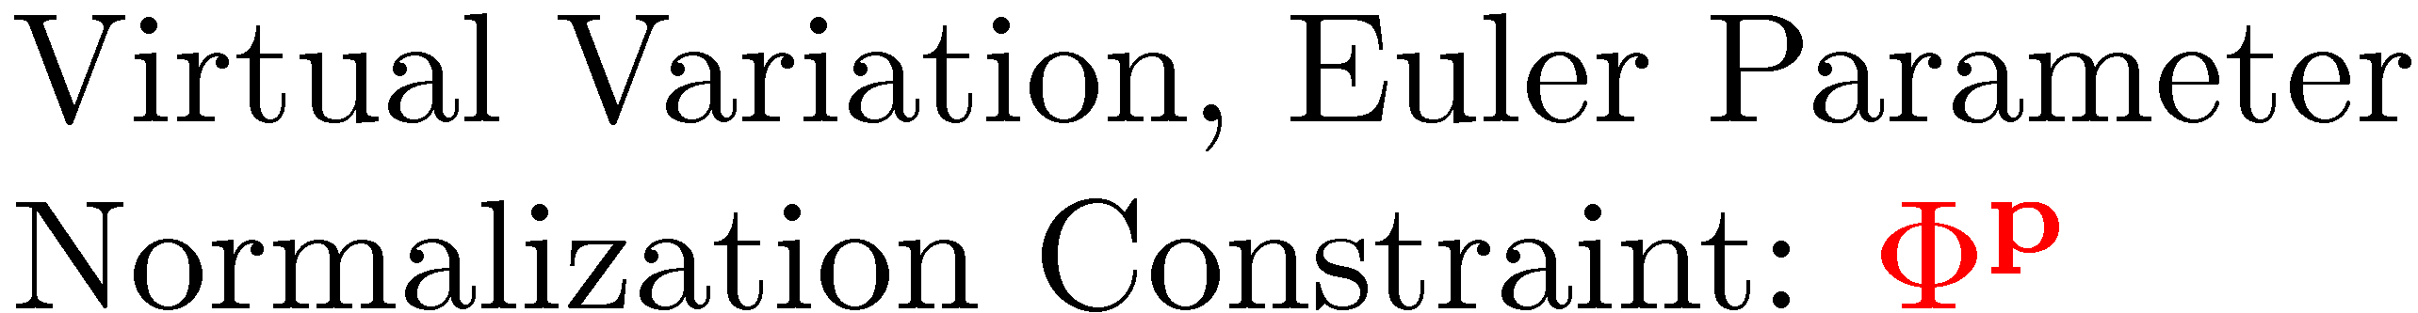
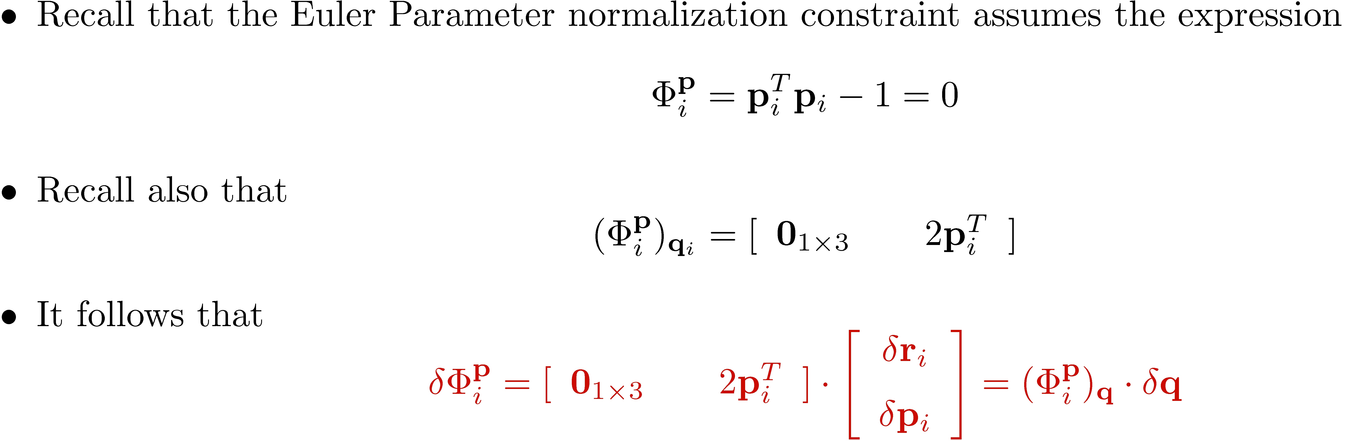

Slide 14
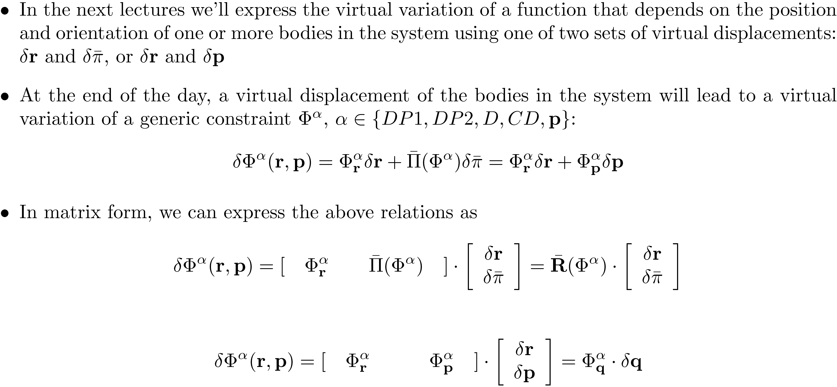
Comments [1/2]

Slide 15
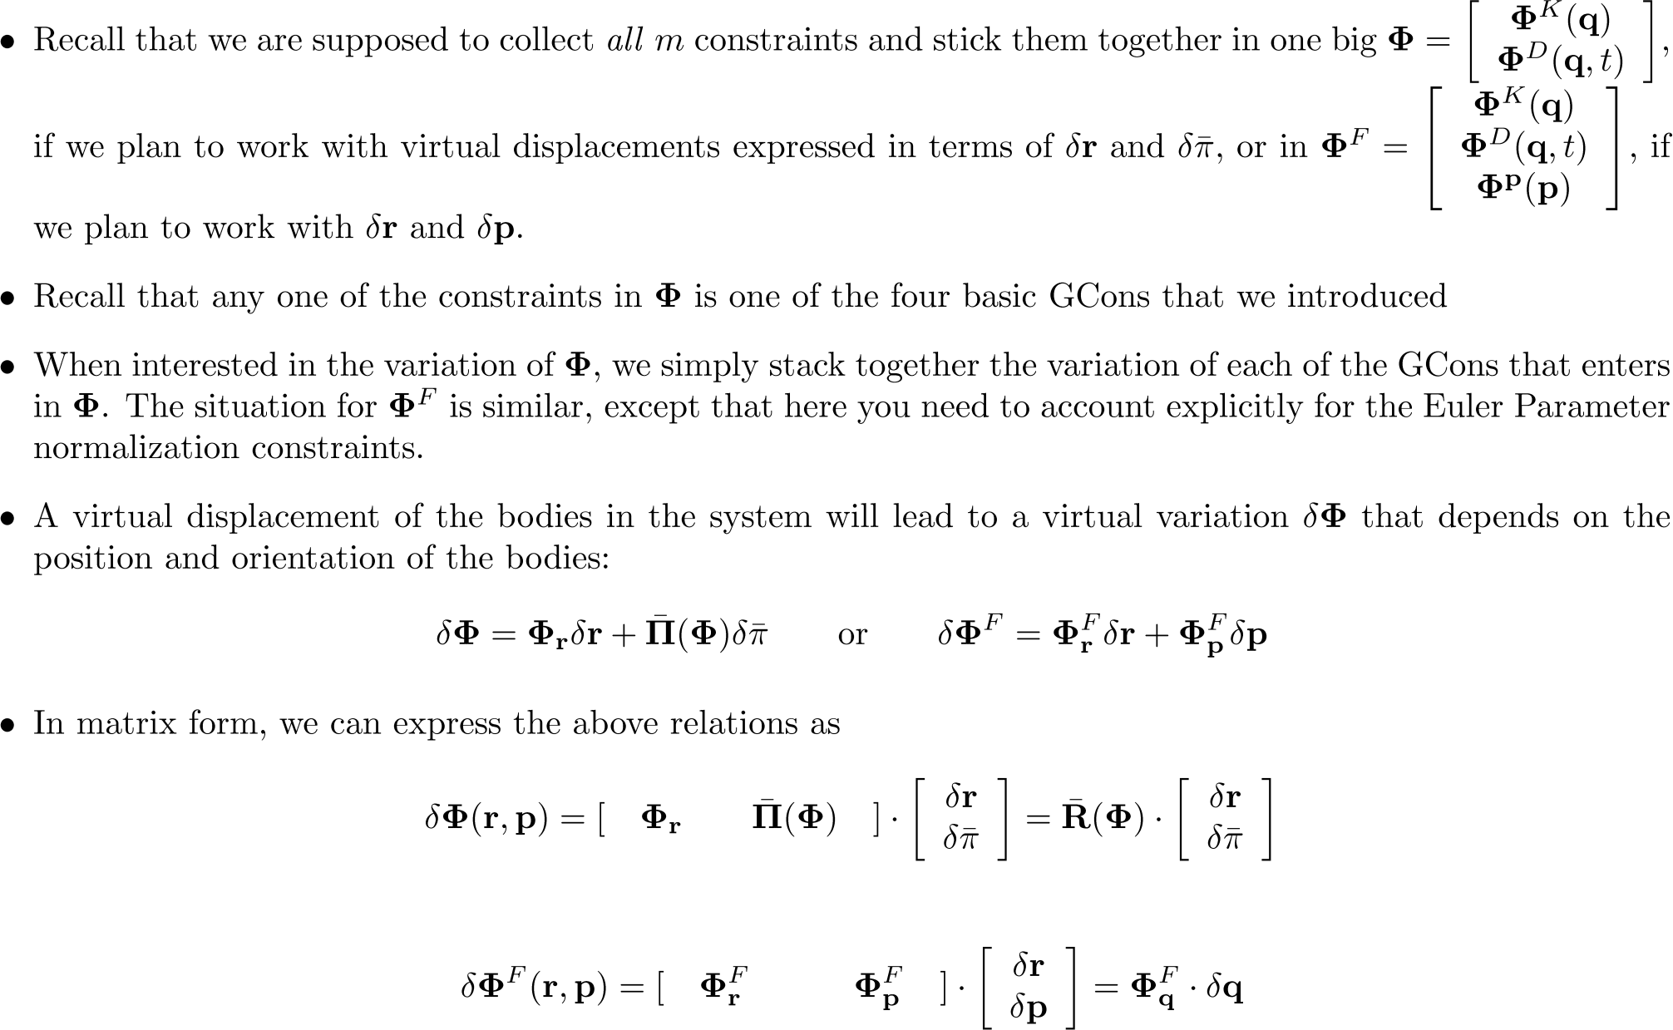
Comments [2/2]

Slide 16
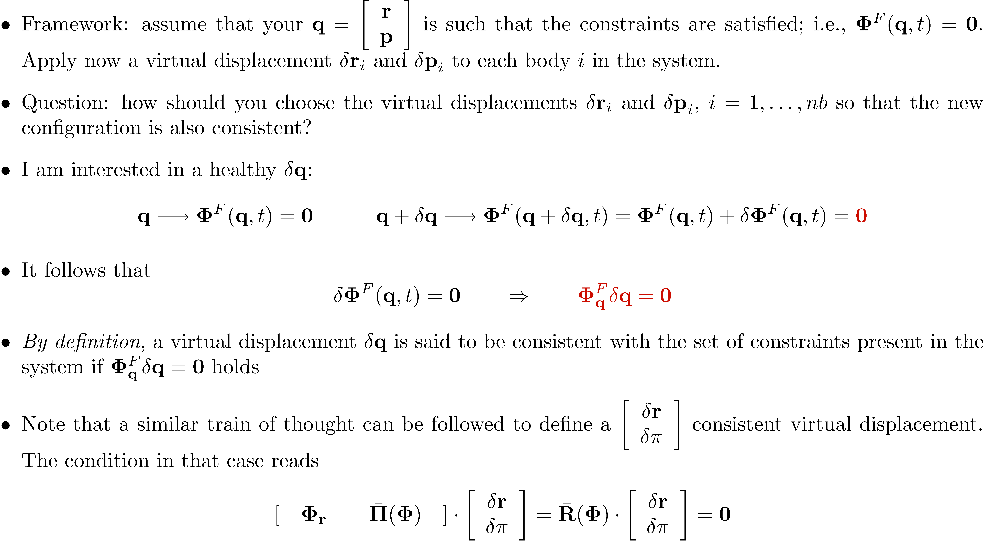
The Concept of Consistent Virtual Displacements

Slide 17
Deriving the EOM

