Slide 1
ME751 Advanced Computational Multibody Dynamics
Newton-Euler Form of the EOM
March 9, 2010
“The man who smiles when things go wrong has thought of someone to blame it on.”
Robert Bloch, author, “Psycho”
© Dan Negrut, 2010 ME751, UW-Madison

Slide 2
Before we get started…
Last Time:
Finished discussion on Virtual Displacement and Variation of a Function
Started the discussion on how to obtain the EOM
Today:
Learn how to obtain EOM for a 3D system: the r-! formulation
Next Time:
Learn how to visualize the motion of your multibody system (Hammad)
Obtain the EOM: the r-p formulation
HW7 – due on Th, March 11
This HW requires you to decide on a Final Project
SimEngine3D MATLAB and C++ code
Available at http://sbel.wisc.edu/Courses/ME751/2010/SimulationEngine/index.htm
Forum up and running: http://sbel.wisc.edu/Forum/index.php?board=4.0
I’ll get M&M for mistakes you find in the notes, no more $.

Slide 3
Deriving the EOM

Slide 4
Road Map
Introduce the forces present in a mechanical system
Distributed
Concentrated
Express the virtual work produced by each of these forces
Apply principle of virtual work and obtain the EOM
Eliminate the reaction forces from the expression of the virtual work
Obtain the constrained EOM (Newton-Euler form)
Express the reaction (constraint) forces from the Lagrange multipliers

Slide 5
Types of Forces & Torques
Distributed over the volume of a body
Inertia forces
Distributed forces
Internal interaction forces
Concentrated at a point
Reaction (or constraint) forces and torques
Action (or applied, or external) forces and torques

Slide 6

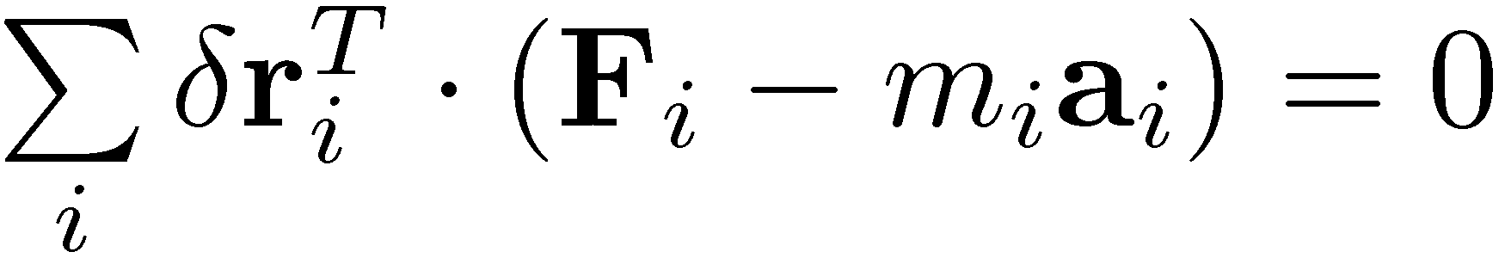
On Principles
Principle of Virtual Work
Applies to a collection of particles
States that at equilibrium, the virtual work of the forces acting on the collection of particle is zero
D’Alembert’s Principle
For a collection of particles moving around you can still fall back on the Principle of Virtual Work when you also include in the set of forces acting on each particle its inertia force
Note: we are talking here about a collection of particles
Consequently, we’ll have to regard each rigid body as a collection of particles that are rigidly connected to each other and that together make up the body

Slide 7
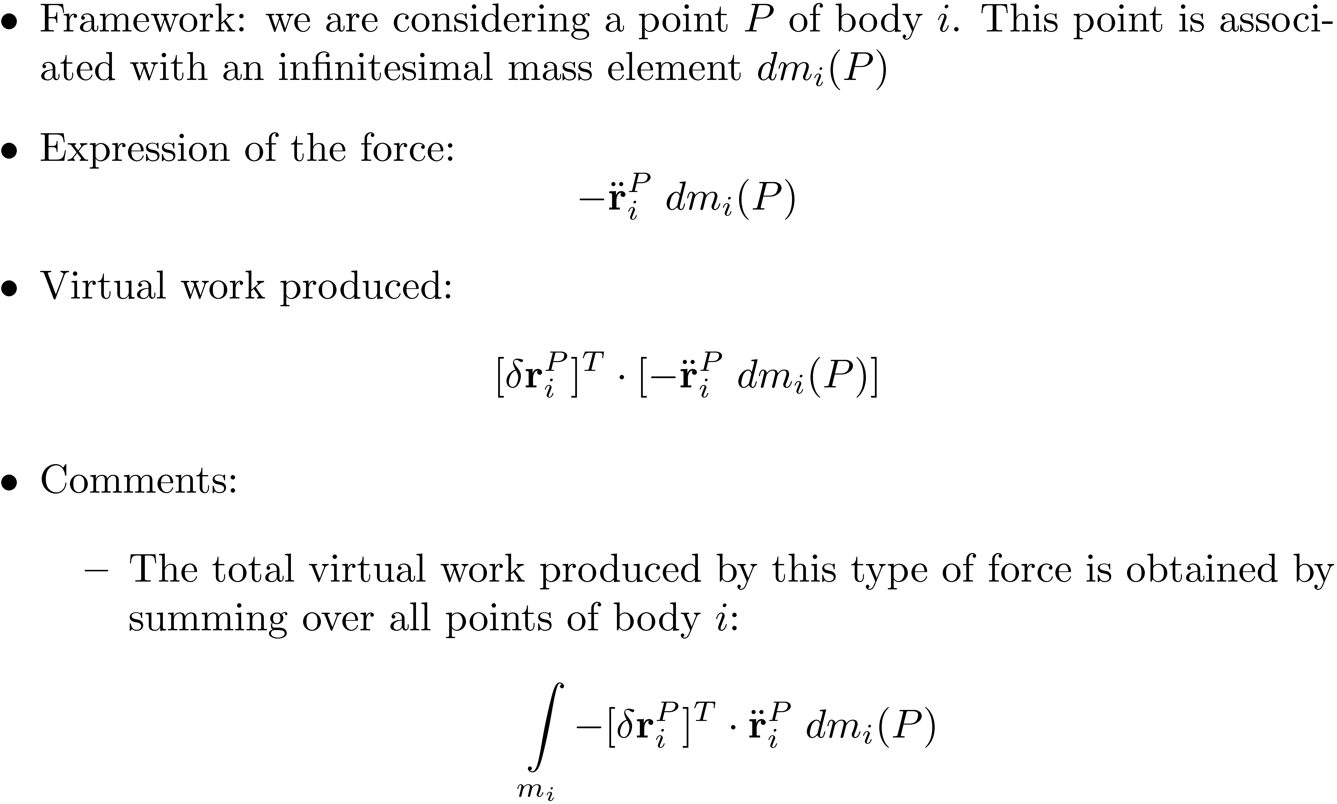
Dealing with Inertia Forces

Slide 8
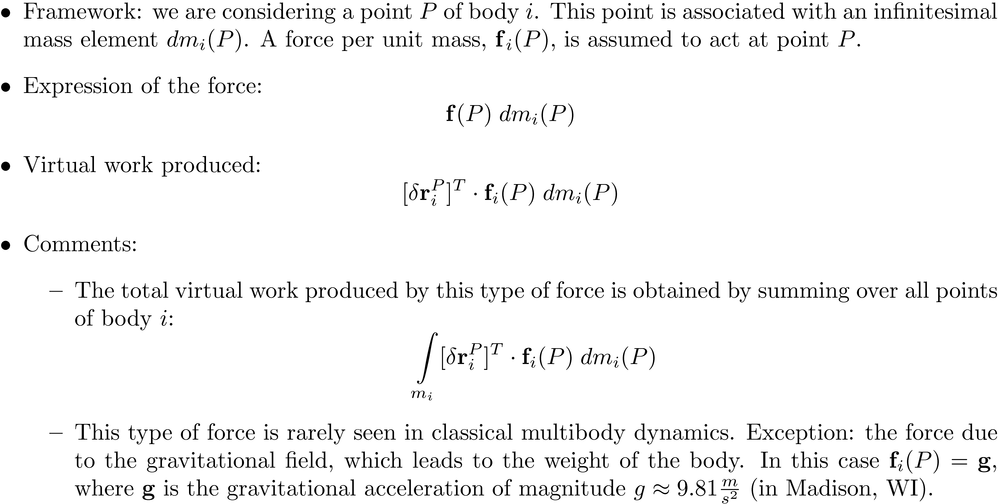
Dealing with Mass-Distributed Forces

Slide 9
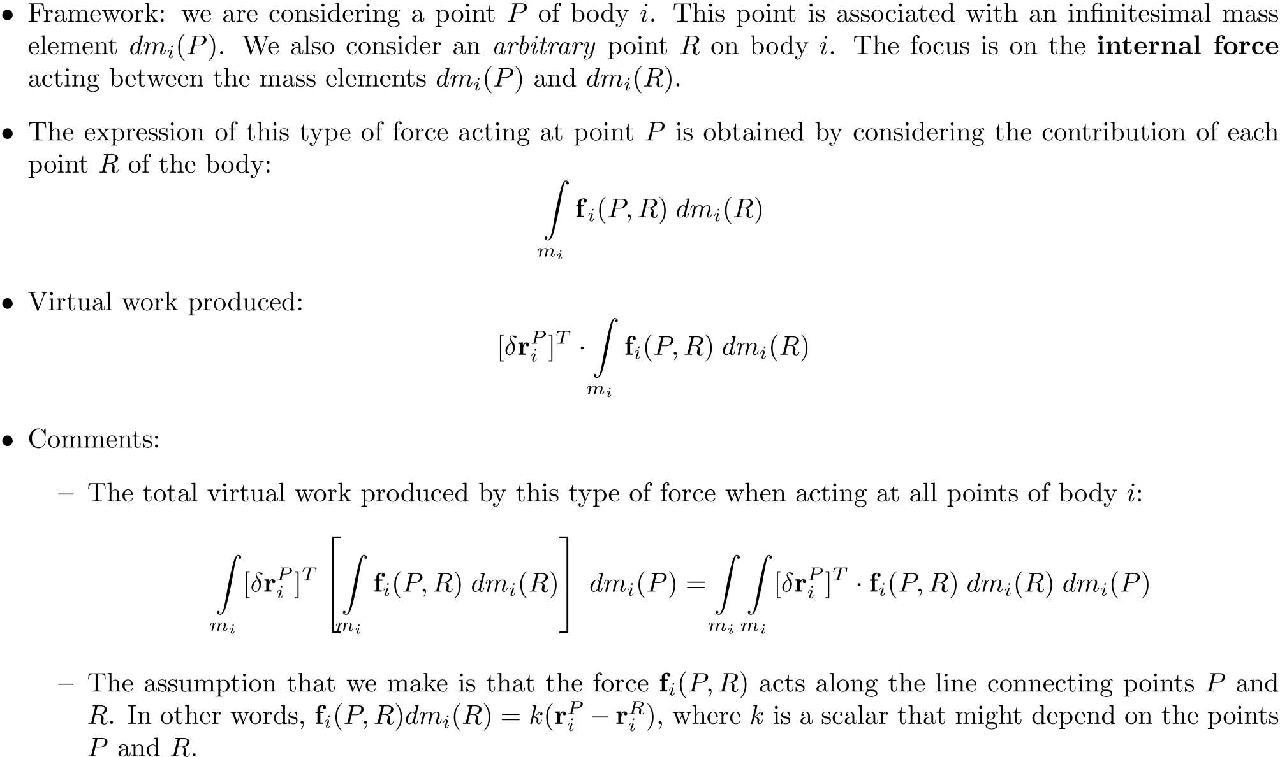
Dealing with Internal Interaction Forces

Slide 10
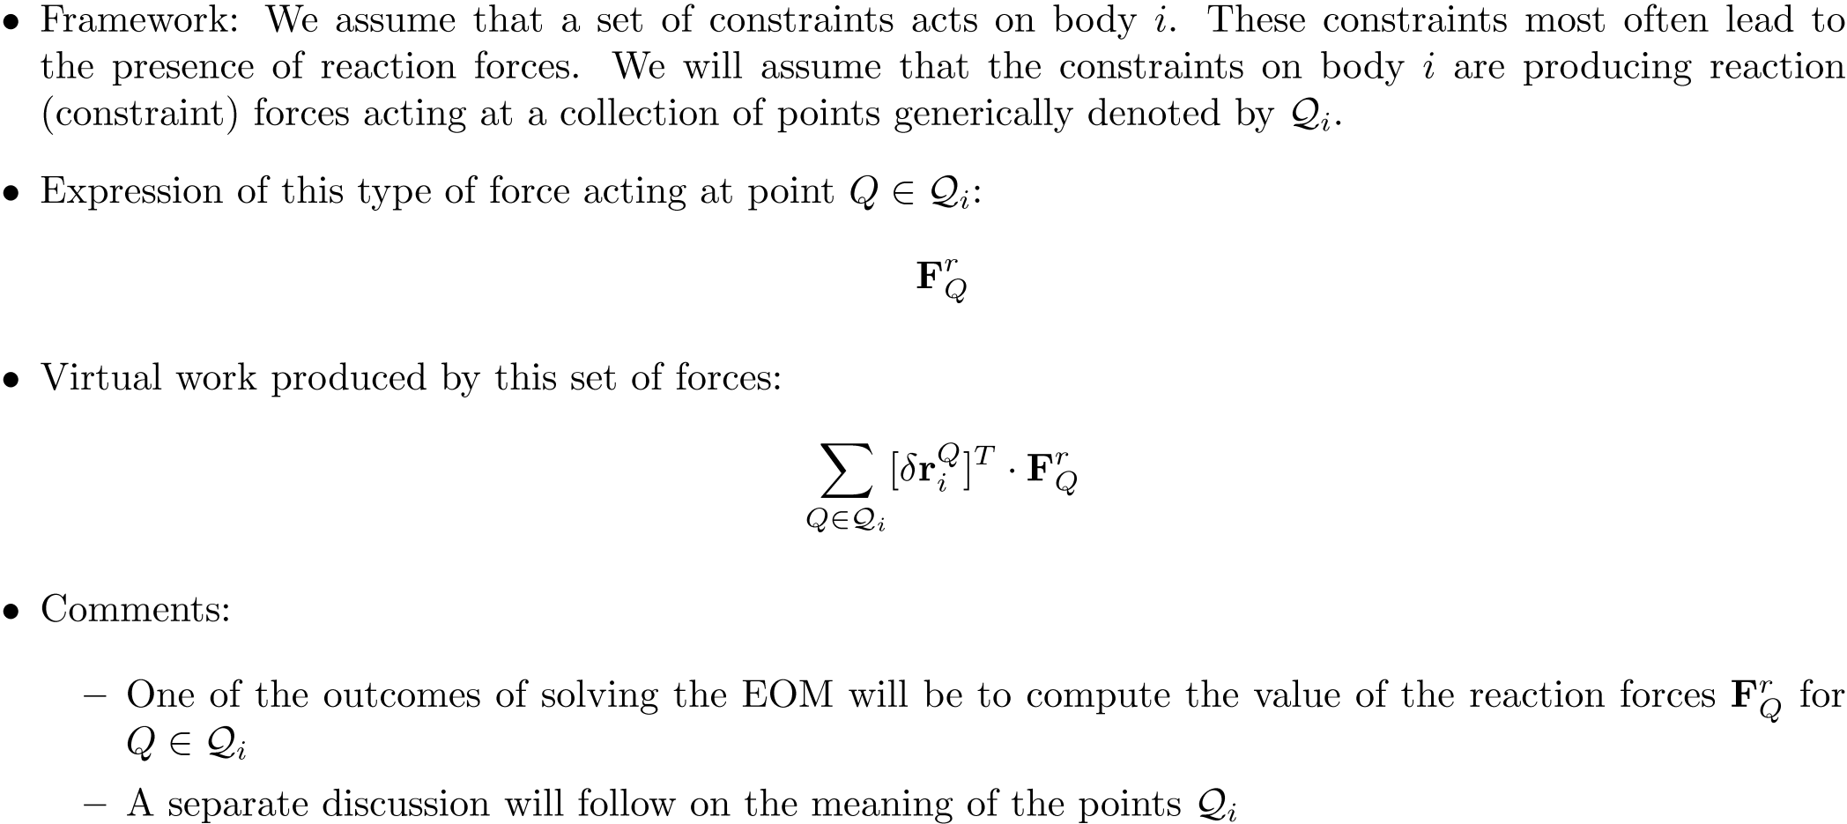
Dealing with Constraint Reaction Forces

Slide 11
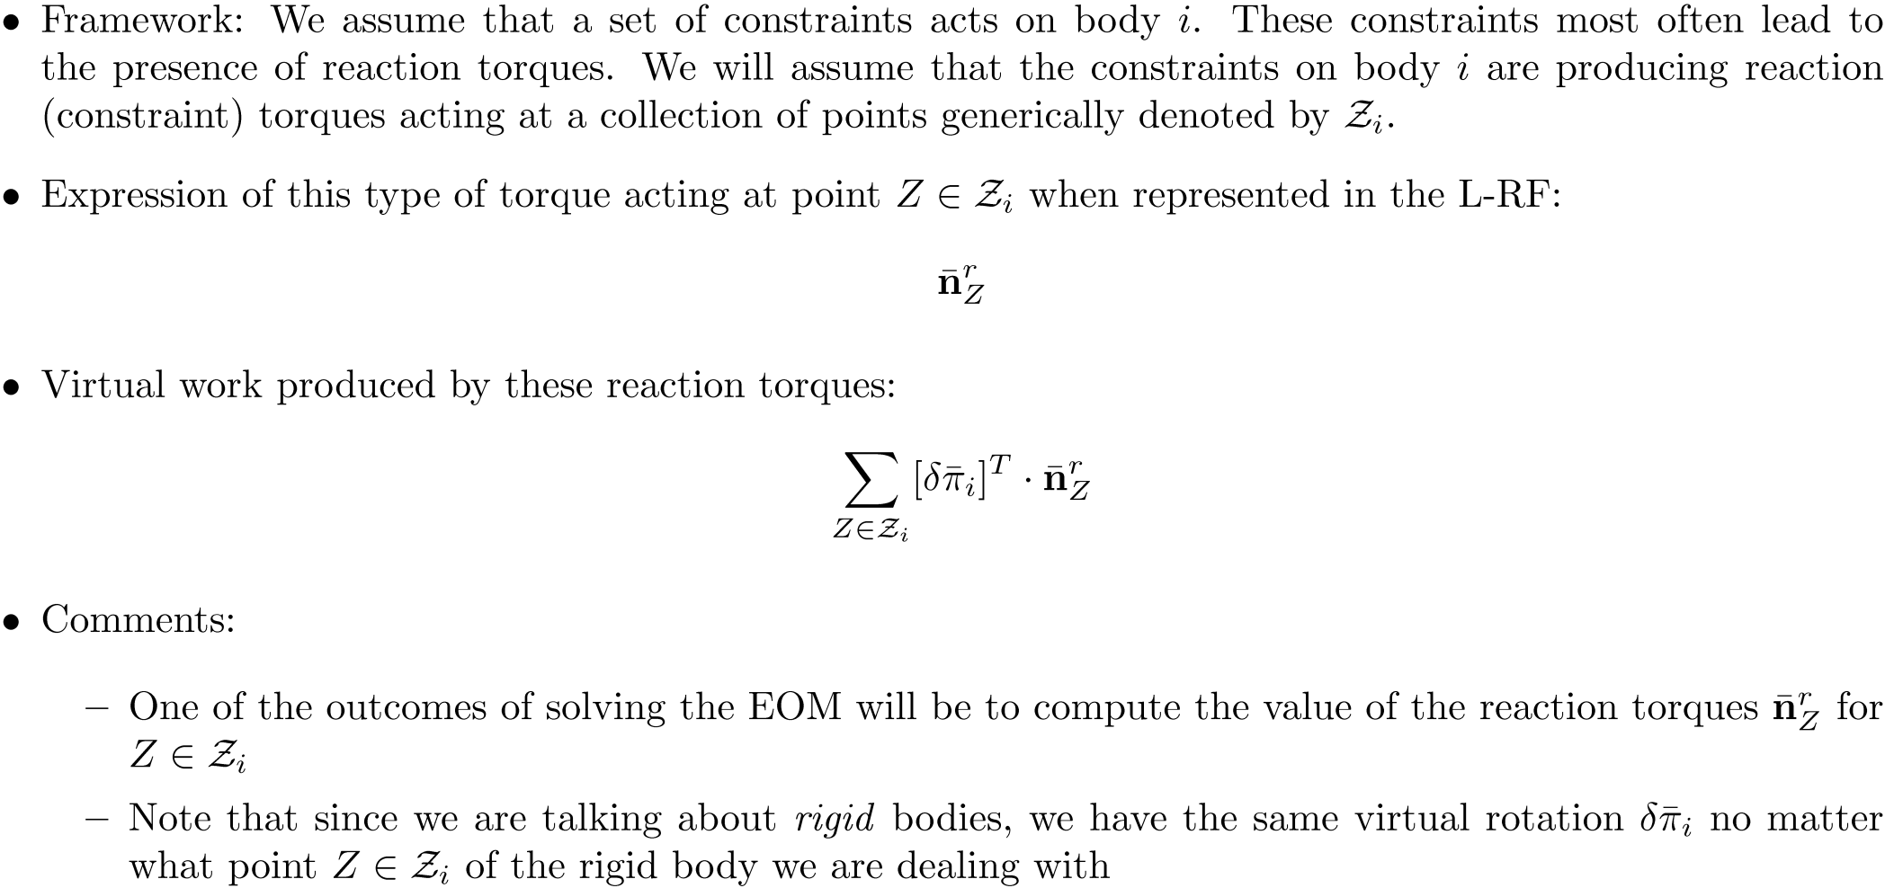
Dealing with Constraint Reaction Torques

Slide 12
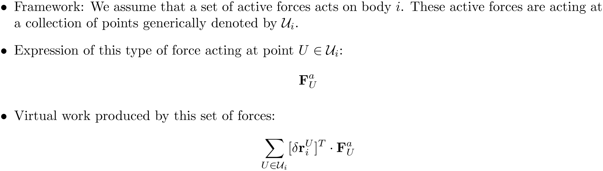
Dealing with Active Forces

Slide 13
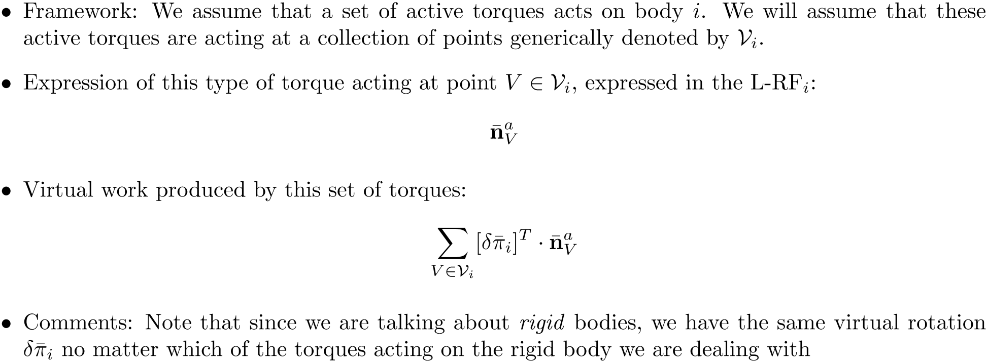
Dealing with Active Torques

Slide 14

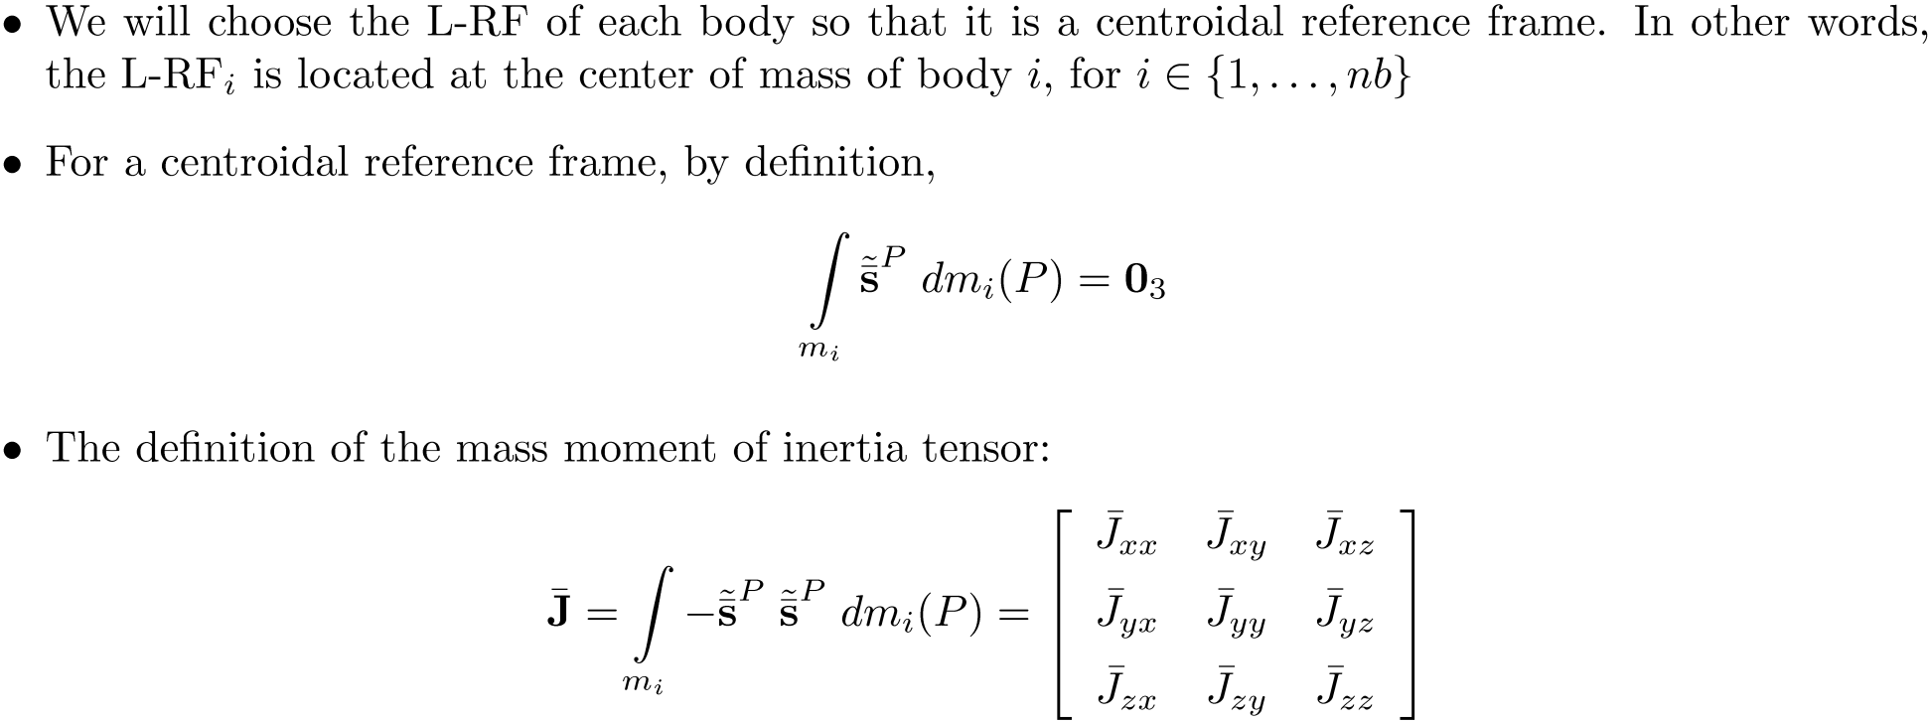

Slide 15
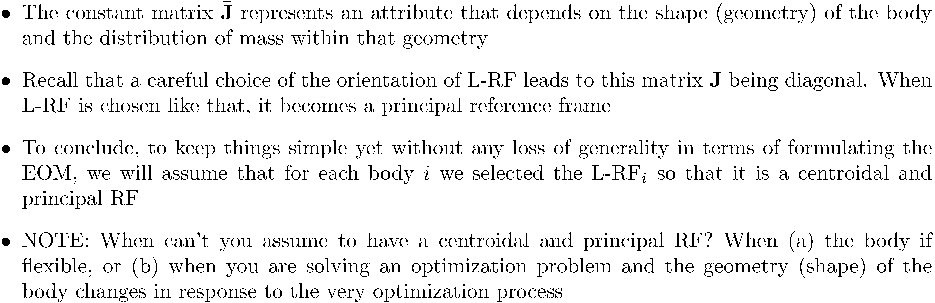

Slide 16
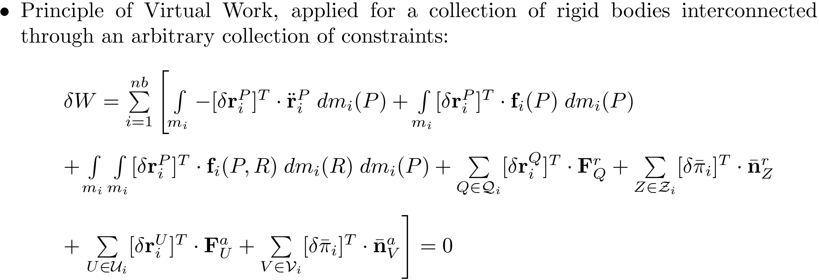
The Expression of the Virtual Work

Slide 17
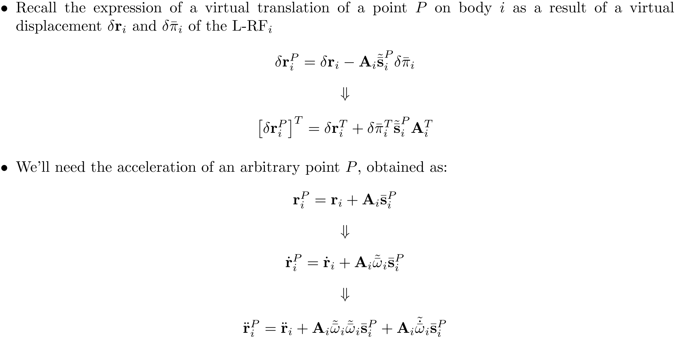
[Short Detour]: Virtual Translation of a Point & Acceleration of a Point

Slide 18
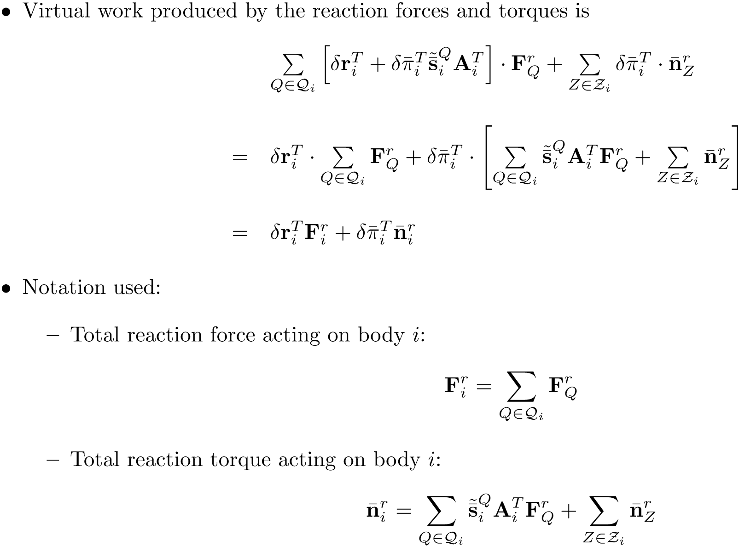
Virtual Work: Contribution of the reaction forces/torques

Slide 19

Virtual Work: Contribution of the active forces/torques

Slide 20
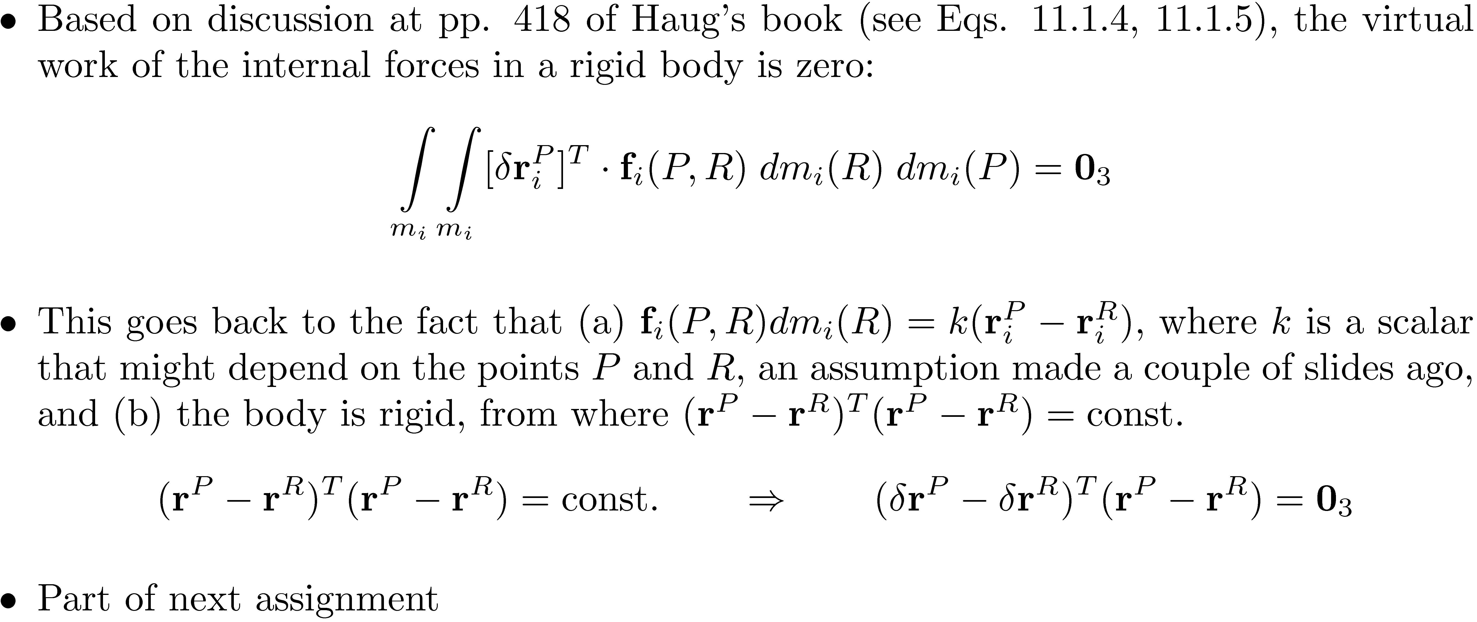
Virtual Work: Contribution of internal forces

Slide 21
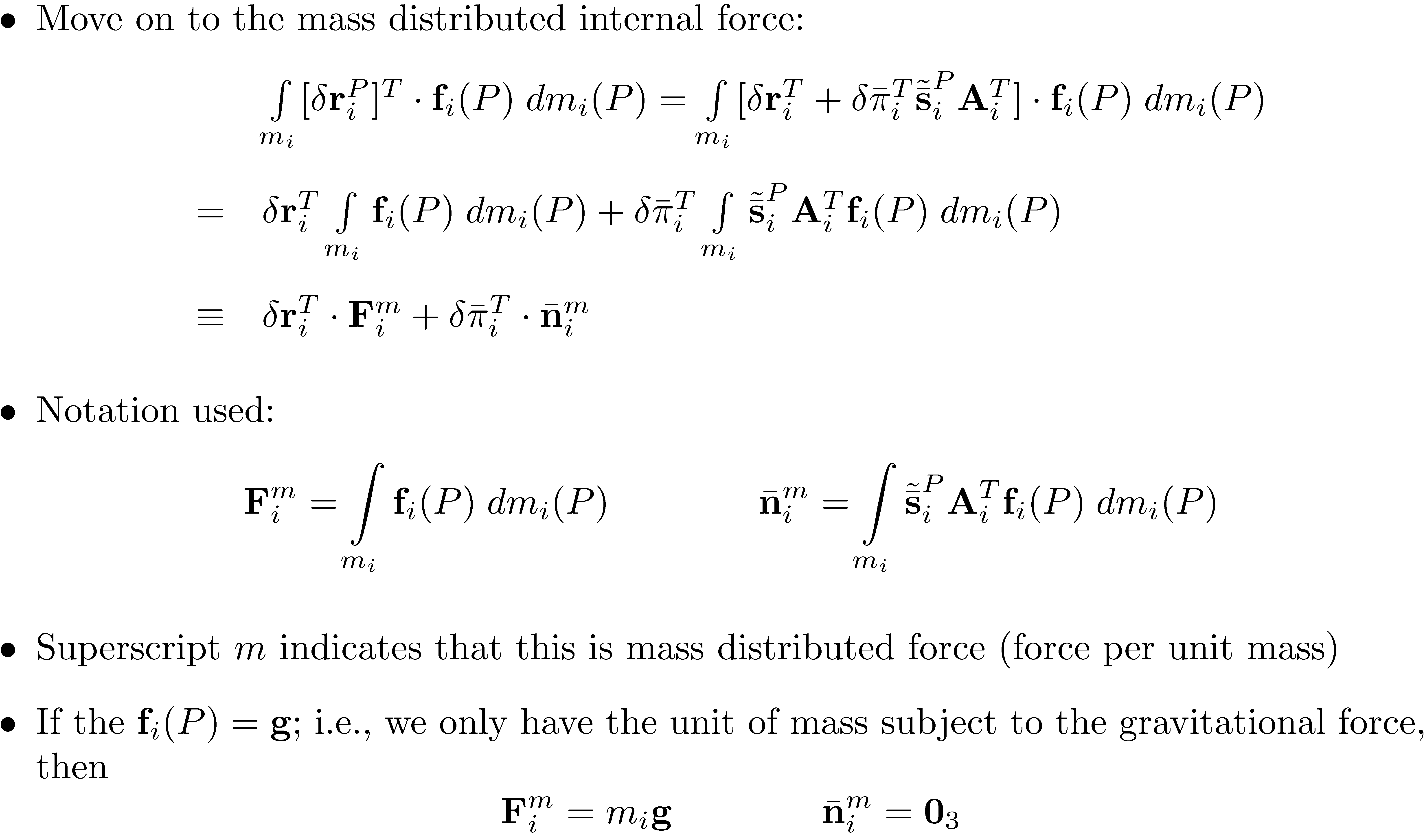
Virtual Work: Contribution of mass-distributed forces

Slide 22
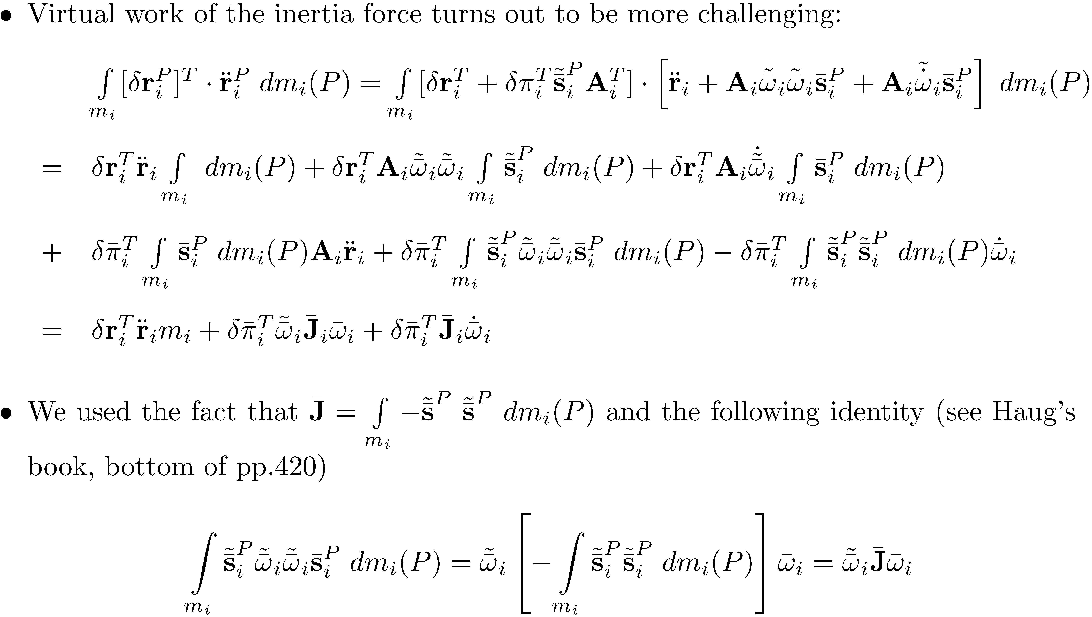
Virtual Work: Contribution of inertia forces

Slide 23
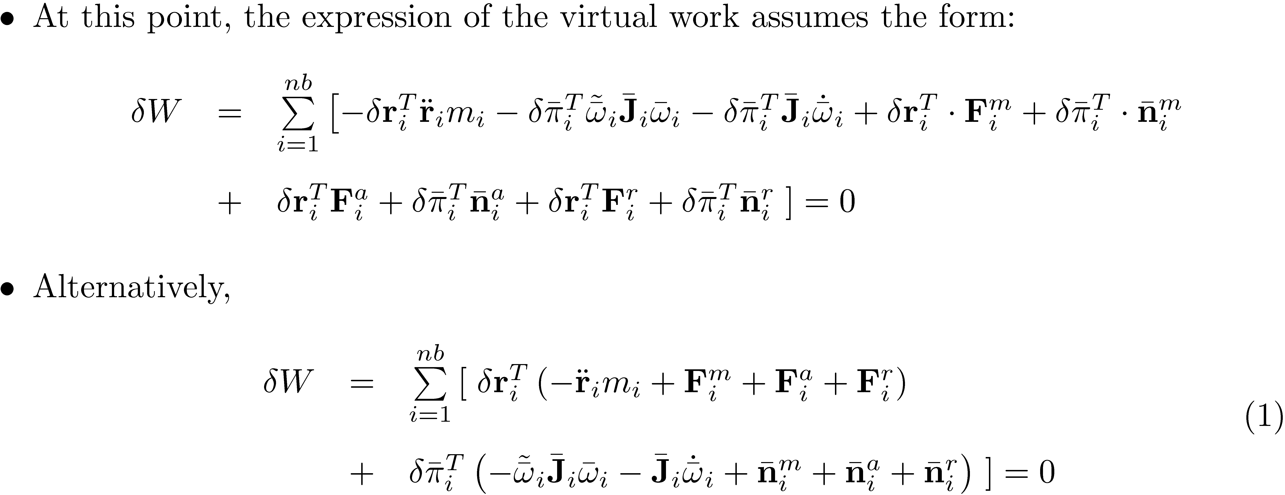
Virtual Work: Putting Things in Perspective

Slide 24
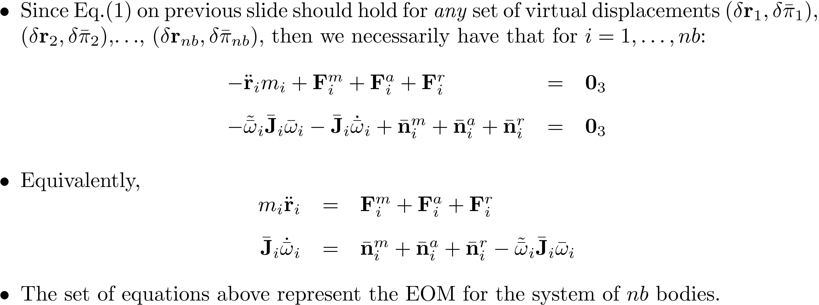
Virtual Work: Putting Things in Perspective

Slide 25
Exercise [2D Sanity Check]

