Slide 1
ME751 Advanced Computational Multibody Dynamics
Simulation Visualization “How To”
Newton-Euler Form of the EOM
March 11, 2010
"I am so clever that sometimes I don't understand a single word of what I am saying.”
Oscar Wilde
© Dan Negrut, 2010 ME751, UW-Madison

Slide 2
Before we get started…
Last Time:
Learn how to obtain EOM for a 3D system: the r-! formulation
Today:
Learn how to visualize the motion of your multibody system (Hammad)
Obtain the EOM: Handling the Reaction Forces.
Visualization discussion topic started on Forum
http://sbel.wisc.edu/Forum/index.php?topic=62.0
New assignment posted online
HW 8 due on March 18
Final Project:
I’ll provide feedback within one week
Topics and your one pager will appear on the class webpage

Slide 3
Simulation Visualization
Hammad Mazhar

Slide 4
Goals
A nice way to view a simulation
Provide a means to look at data from different angles
Post process visuals

Slide 5
Workflow
Generate Data [Simulation Engine]
Create Geometry [Solidworks, Maya, Blender…]
Convert Geometry [Ogre mesh converter, Ogre XMLConverter]
Create Input File
View Simulation
Render Simulation [Virtual Dub, Divx]

Slide 6
Step 1: Data Collection
Store simulation data to file
“data” means the collection of values (numbers) assumed by the generalized coordinates at each time step
“data” to be generated as an outcome of Kinematics or Dynamics analysis
Need to meet minimum requirements
Positions of all objects
Euler Parameters of all objects
(Prevents Gimbal lock)
One file per frame: pos000.dat, pos001.dat, etc
One object per line

Slide 7
Example: pos23.dat
1, 20, -0.25, 0, 0, 0, 0, 0, [#, x, y, z, e0, e1, e2, e3]
2, 0, 2.5, 0, 0, 0, 0, 0,
3, 40, 2.5, 0, 0, 0, 0, 0,
4, 20, 2.5, -40, 0, 0, 0, 0,
5, 20, 2.5, 40, 0, 0, 0, 0,
6, -33.775, 25, 0, 0.965926, 0, 0, -0.258819,
7, -32.525, 27.1651, 39, 0.965926, 0, 0, -0.258819,
8, -32.525, 27.1651, -39, 0.965926, 0, 0, -0.258819,
9, 33.775, 50, 0, 0.965926, 0, 0, 0.258819,
10, 32.525, 52.1651, 20, 0.965926, 0, 0, 0.258819,
11, 32.525, 52.1651, -20, 0.965926, 0, 0, 0.258819,
12, 5.08655, 1.47155, -6.50457, -0.543056, -0.465413, -0.105751, -0.690878,
13, 10.0644, 0.358719, 28.176, -0.463821, 0.413781, 0.366809, -0.692184,
14, 10.3082, 0.398135, -21.7696, -0.687234, -0.217201, -0.692418, -0.0328985,
15, -0.708364, 6.53418, -18.624, -0.310487, -0.0341572, 0.00743839, -0.949934,
16, -2.05941, 8.52682, -13.7048, -0.743404, 0.308513, -0.370145, -0.463861,
17, 27.2258, 0.316766, -23.067, 0.505163, 0.00571037, 0.858919, -0.0839137,
18, -1.00176, 7.0769, 3.75132, 0.76269, -0.0641002, 0.475516, 0.433679,
19, 17.1133, 0.706114, -13.3631, -0.556282, 0.61313, 0.260976, -0.496504,
20, -5.51988, 9.85426, -13.7024, -0.165998, -0.255, -0.951555, 0.0445564,

Slide 8
Step 2: Generate Models
Using Cad/3D Modeling software create geometry
Autocad, Solidworks, Maya, 3DS Max … etc
Any Geometry can be used
Not constrained to simulation geometry
Purely for visual effect

Slide 9
Step 3: Convert Models
Export model from modeling software
Import into Blender
Set Materials
Export as .mesh
Ogre-Specific geometry file

Slide 10
Step 4:Create simulation input file
Define:
Data Location
Number of frames
Start/Stop Times
Number of objects
Materials
Number of each type of object

Slide 11
Example:conf.txt
pos .dat
1500 1
1011 12
1 Cube.mesh 40 .5 80 Material1
1 Cube.mesh .5 5 80 Material1
1 Cube.mesh .5 5 80 Material1
1 Cube.mesh 40 5 .5 Material1
1 Cube.mesh 40 5 .5 Material1
1 Cube.mesh 78 .5 78 Material1
1 Cube.mesh 78 5 .5 Material1
1 Cube.mesh 78 5 .5 Material1
1 Cube.mesh 39 .5 39 Material1
1 Cube.mesh 39 5 .5 Material1
1 Cube.mesh 39 5 .5 Material1
1000 Cube.mesh .5 .5 .5 Material1

Slide 12
Other parameters
Materials are in ./resources/materials.material file:
material Material1
{
technique
{
pass
{
ambient 0.000000 0.000000 0.000000 1.000000
diffuse 1.00000 1.00000 1.00000 1.000000
specular 0.500000 0.500000 0.500000 1.000000 12.500000
emissive 0.000000 0.000000 0.000000 1.000000
}
}
}
File “resources.cfg” contains paths to model and data zips
# Resources required
[General]
Zip=resources/SdkTrays.zip
Zip=resources/models.zip
FileSystem=./resources
[Data]
Zip=resources/data.zip

Slide 13
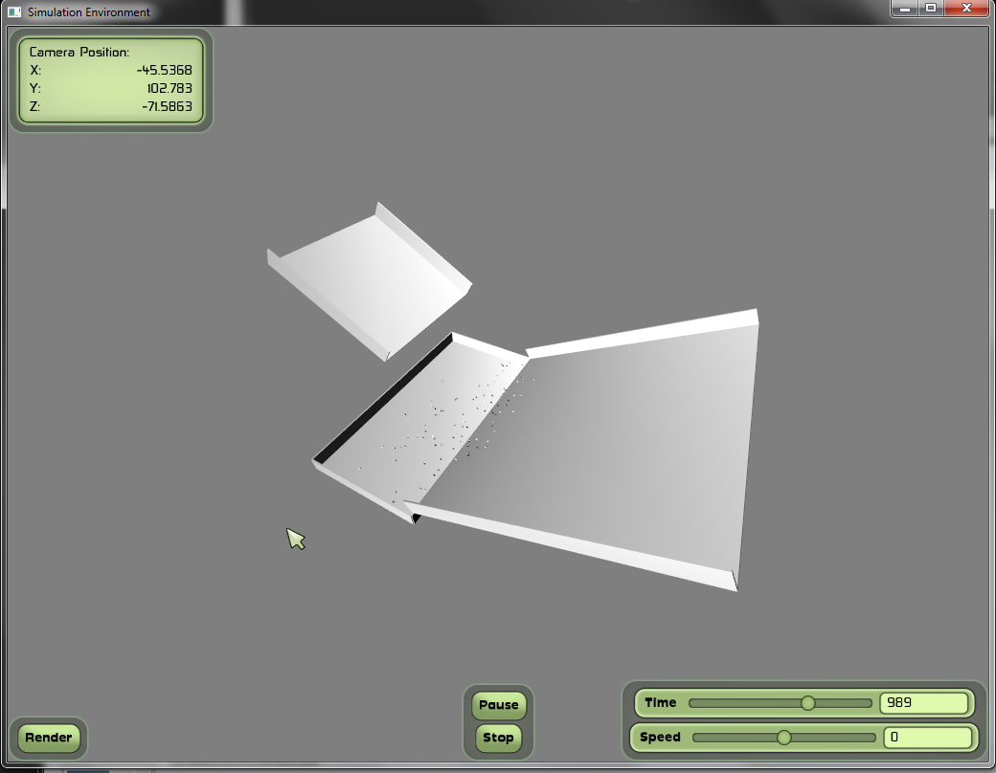
Viewing Simulation:

Slide 14
Rendering
Click Render to store each frame to an image file
Saved in the ./render directory
Use Virtual Dub to join images together
Open up first image and the rest will be loaded
Select compression from video->compression
Save video

Slide 15
Links
Blender
http://www.blender.org/
Ogre Exporter for blender
http://www.ogre3d.org/wiki/index.php/Blender_Exporter
Python
http://www.python.org/download/
Ogre3d
http://www.ogre3d.org/
VirtualDub
http://virtualdub.sourceforge.net/

Slide 16
Visualization: The Work Flow

Slide 17
~Fin~
Yes the code has bugs
No the code is not idiot proof
Use xvid to compress video in virtual dub
Faster, better quality and smaller size
http://www.xvid.org/Downloads.15.0.html

Slide 18
We now return to our regularly scheduled program…

Slide 19
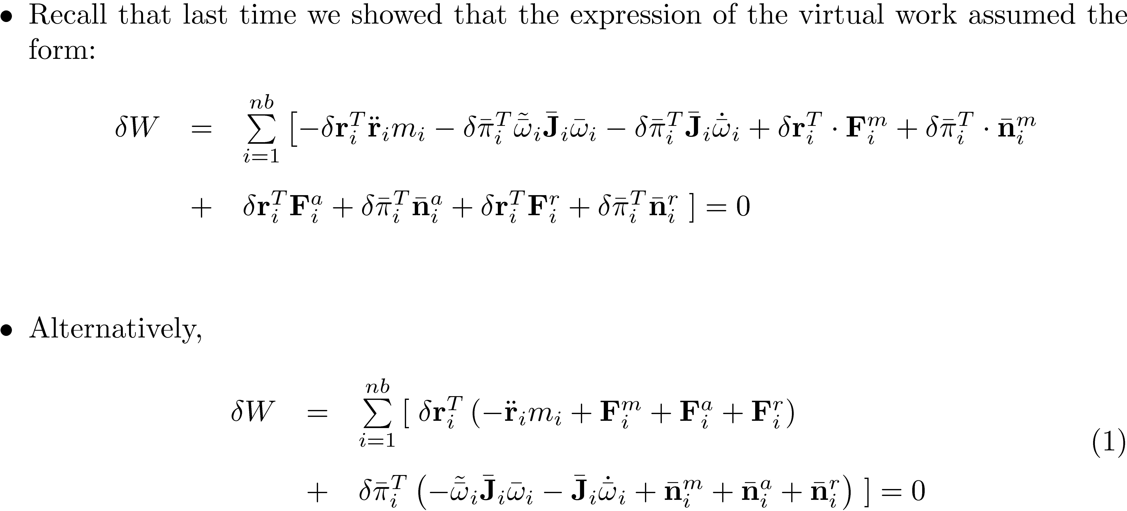
Virtual Work: Putting Things in Perspective

Slide 20
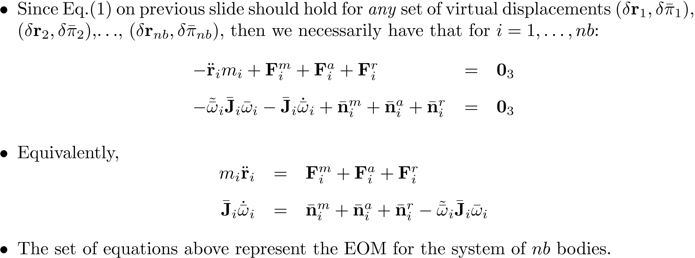
Virtual Work: Putting Things in Perspective

Slide 21
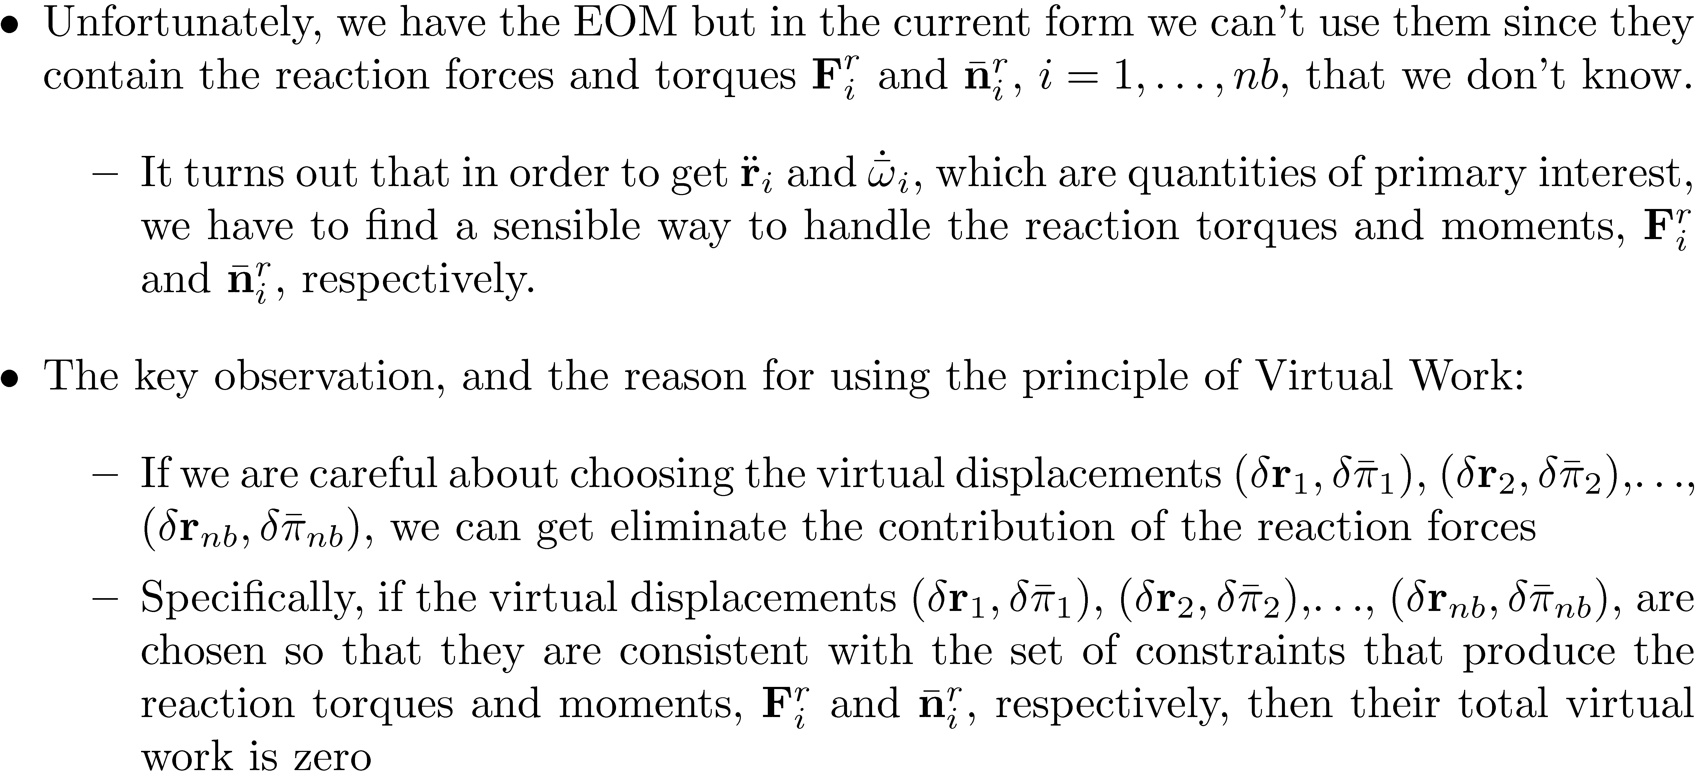
Handling the Reaction Forces

Slide 22
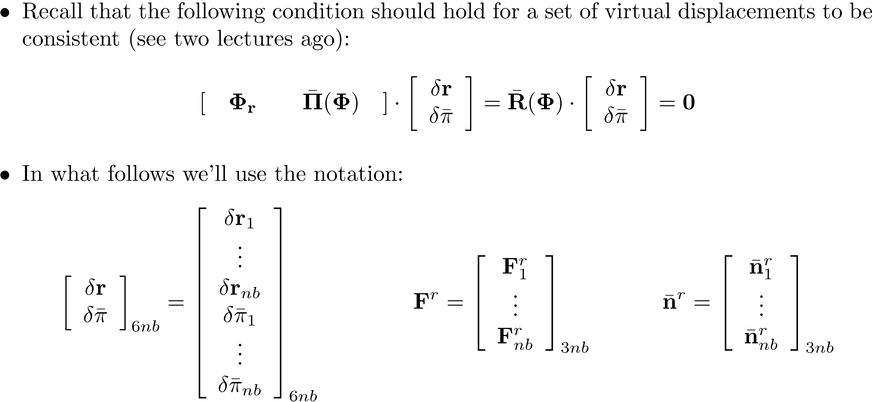
Handling the Reaction Forces

Slide 23
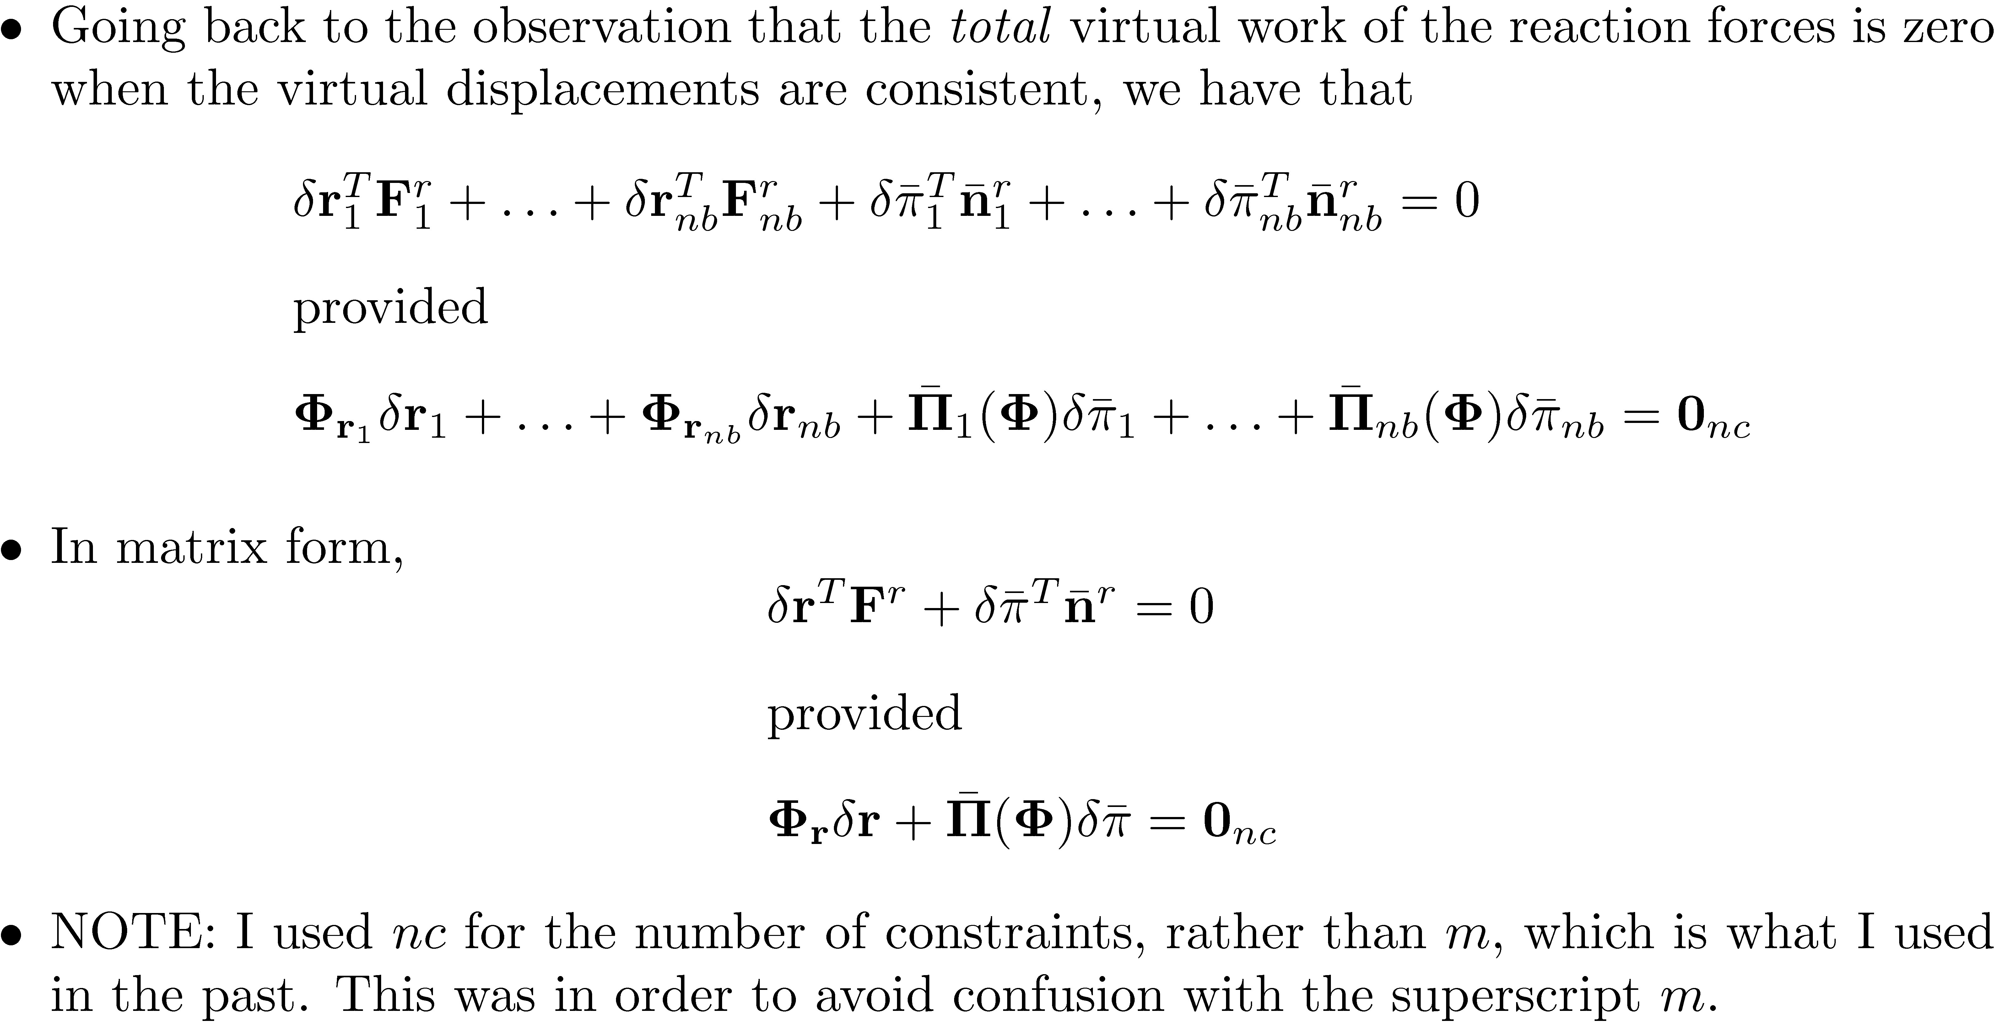
Handling the Reaction Forces [Cntd.]

Slide 24
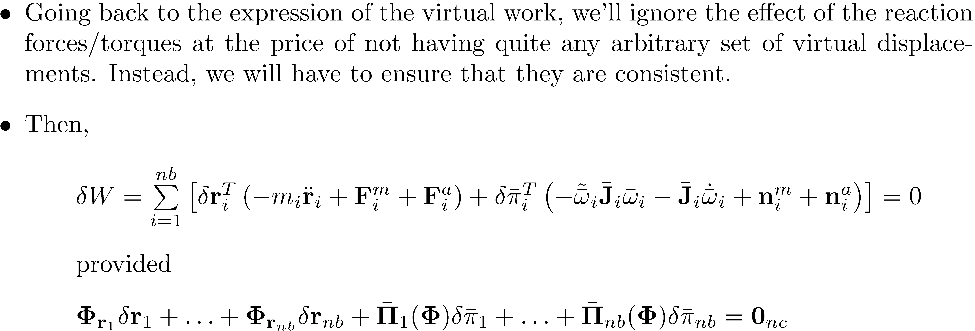
Handling the Reaction Forces [Cntd.]

Slide 25
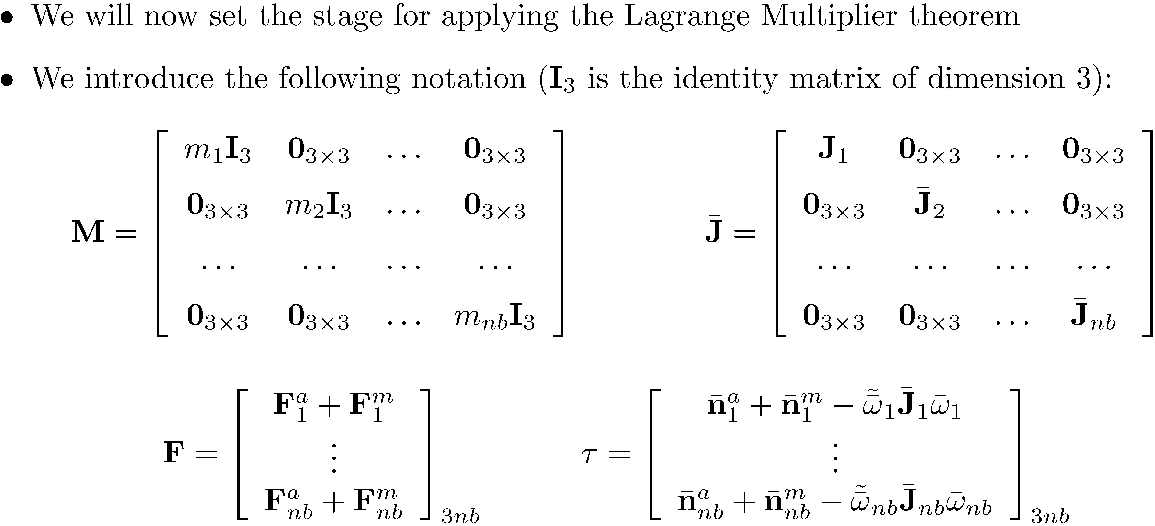
Handling the Reaction Forces [Cntd.]

Slide 26
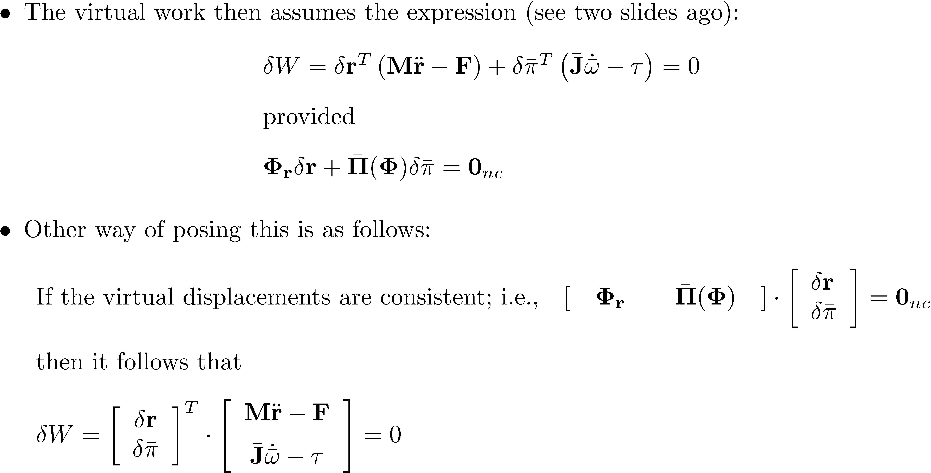
Handling the Reaction Forces [Cntd.]

Slide 27
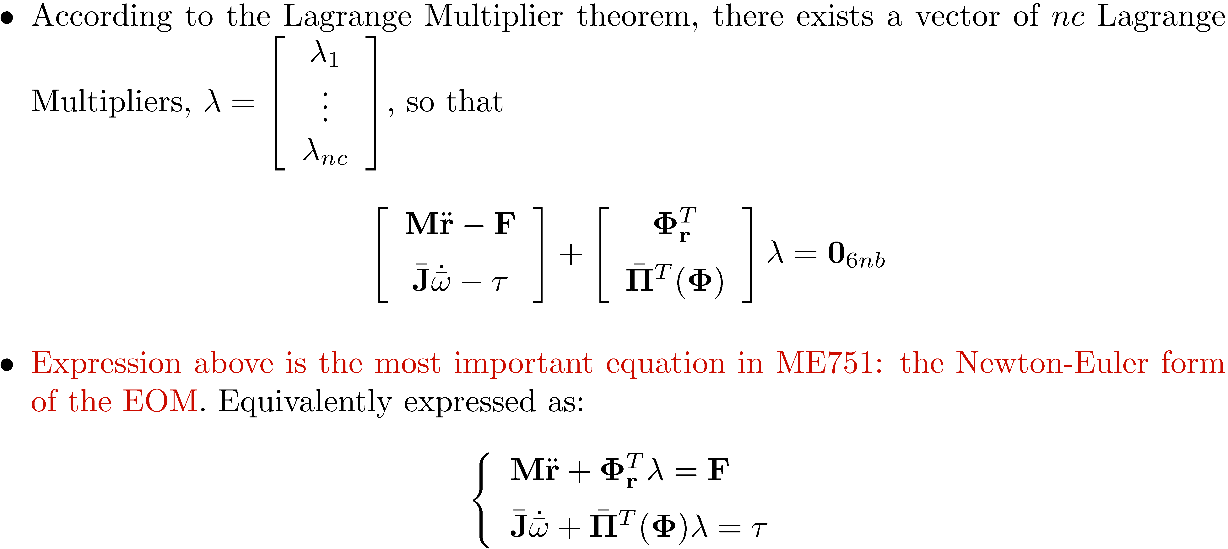
Handling the Reaction Forces: Applying Lagrange Multiplier Theorem

Slide 28
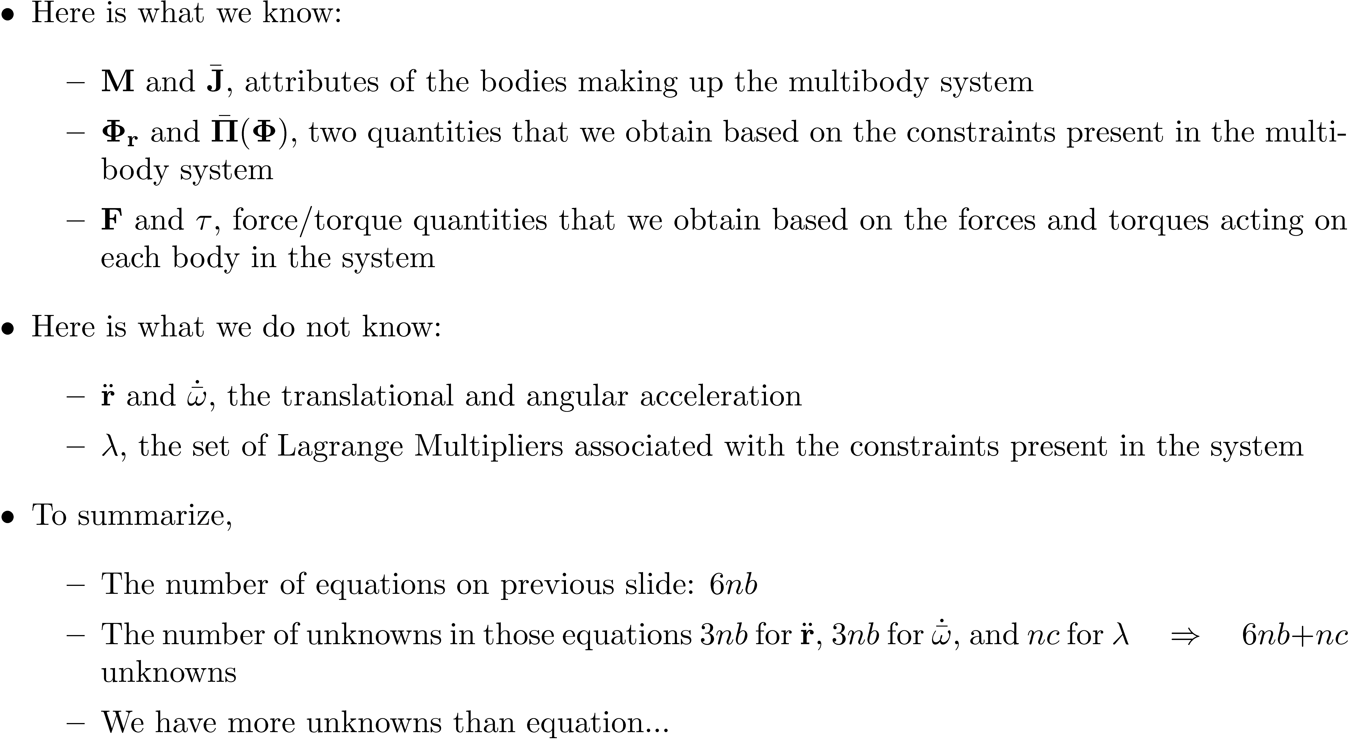
Comments on the Newton-Euler Form of the EOM

Slide 29
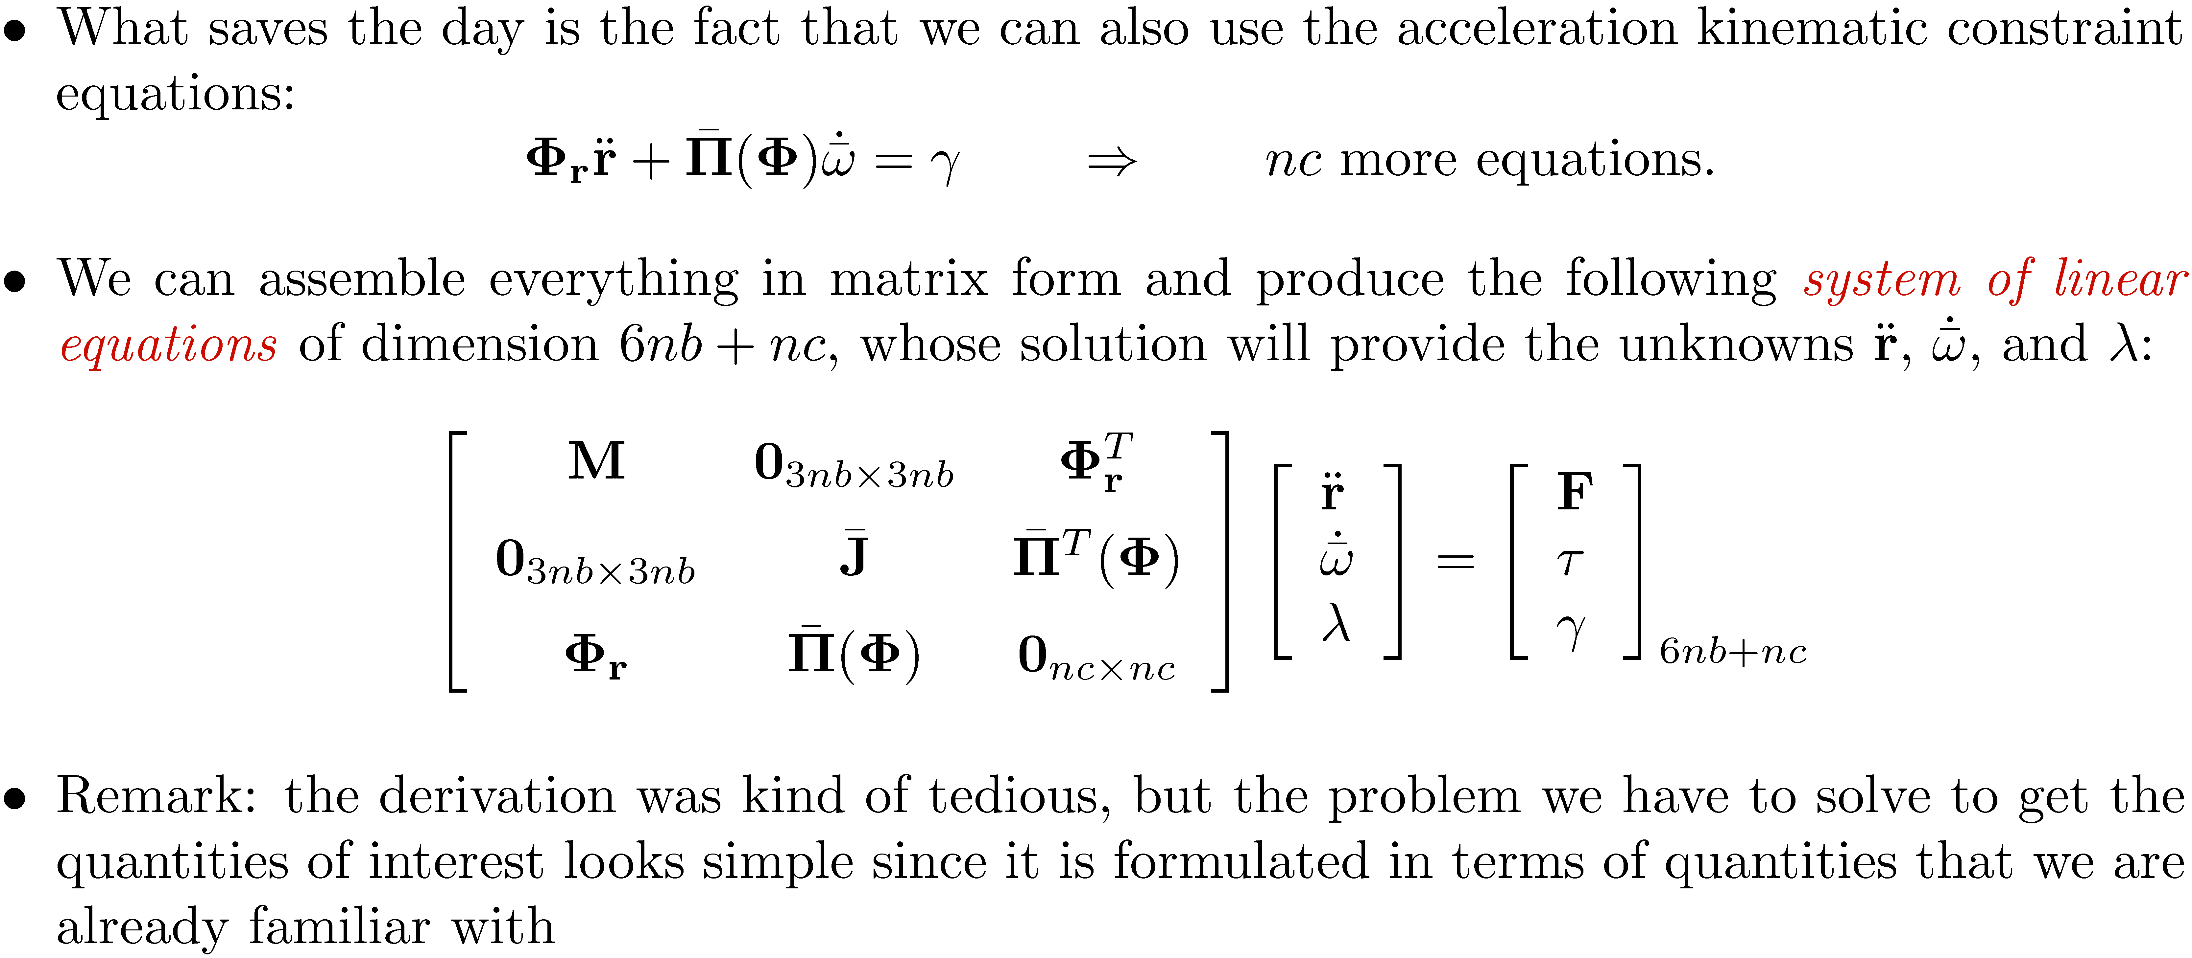
Augmenting the EOM. The Complete Picture.

Slide 30
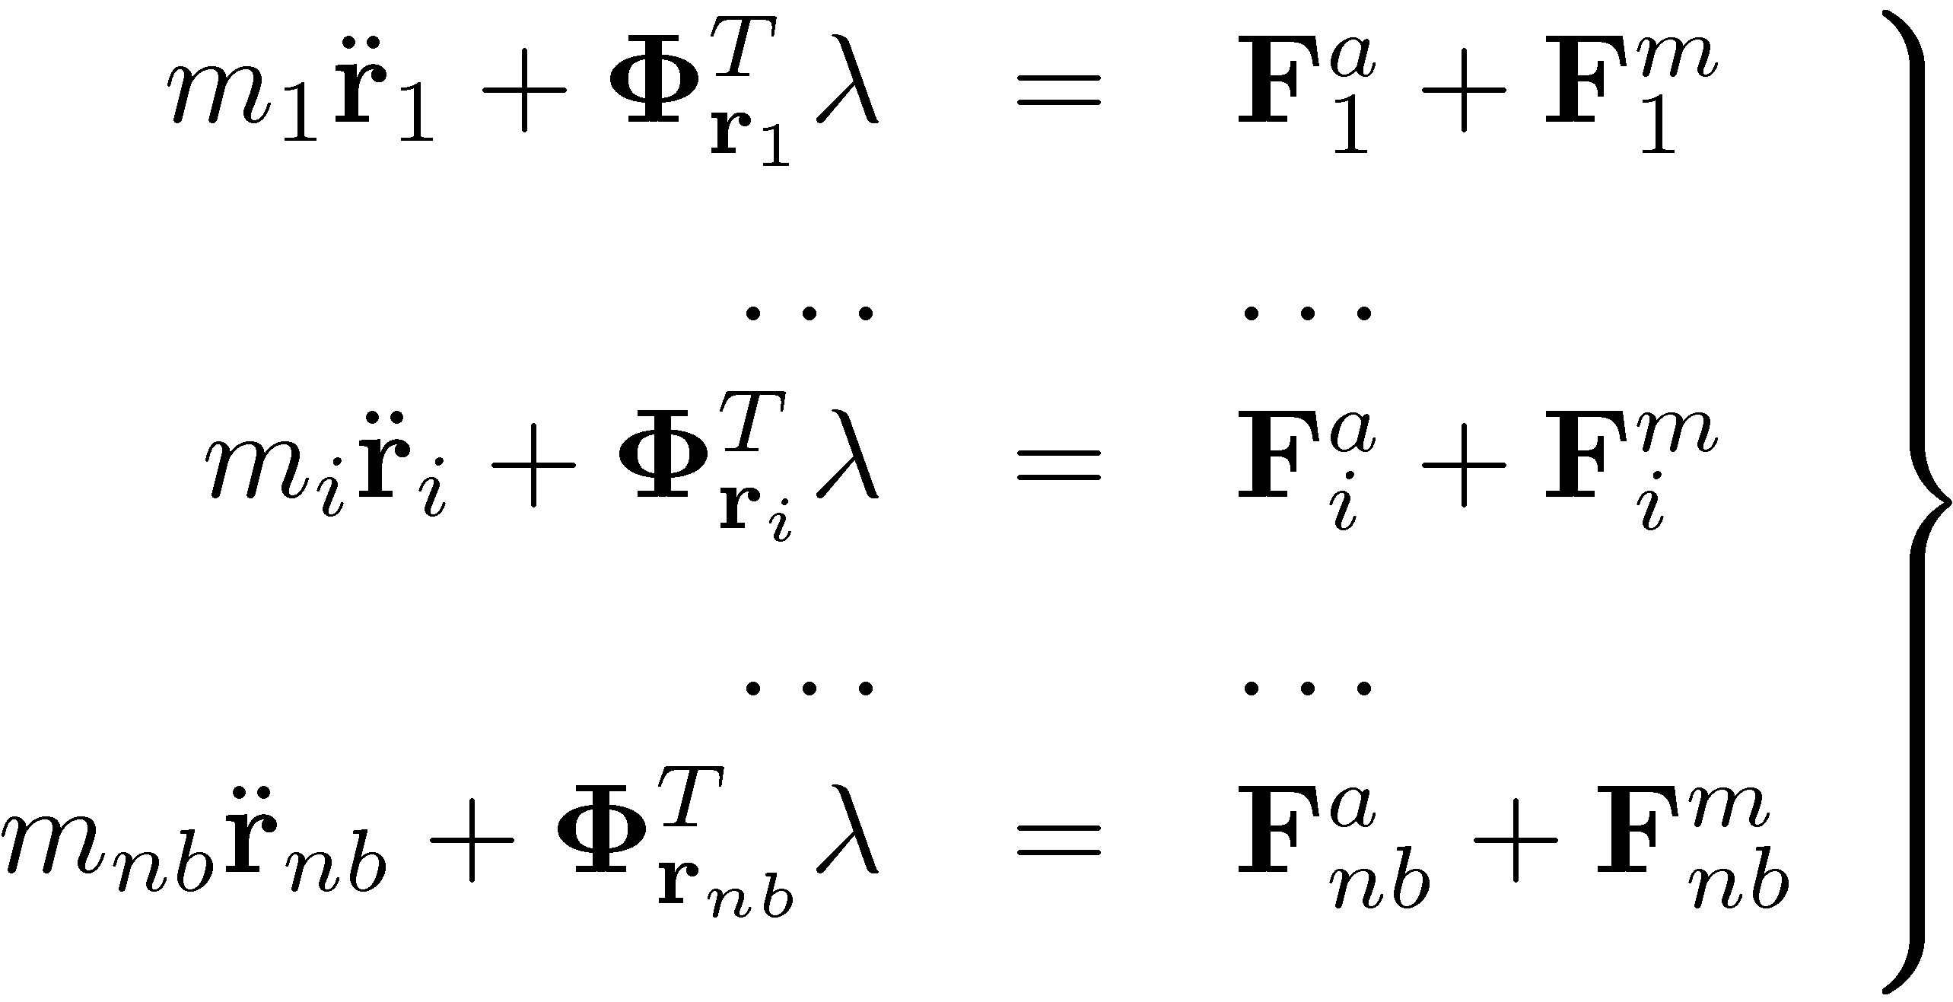

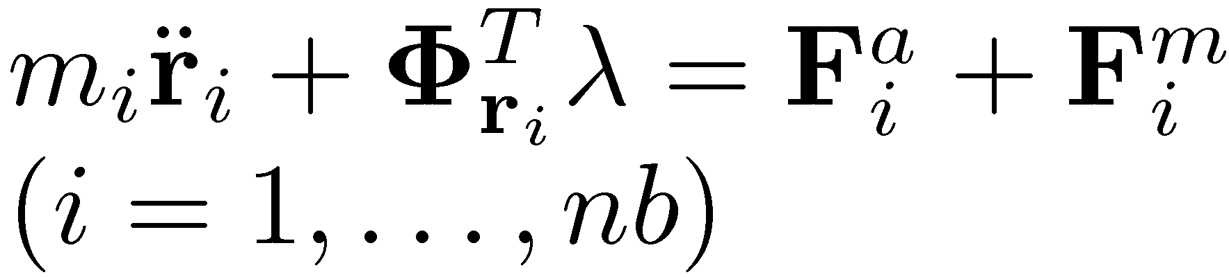
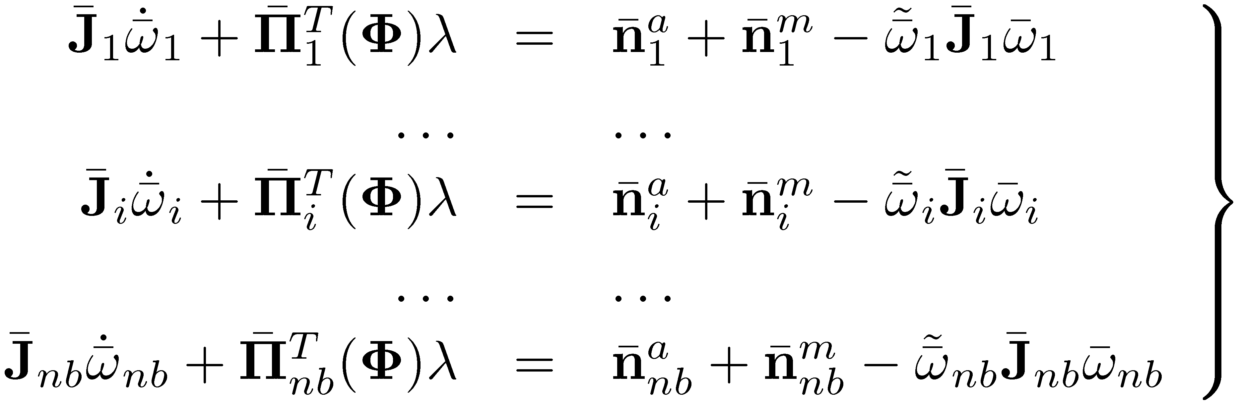
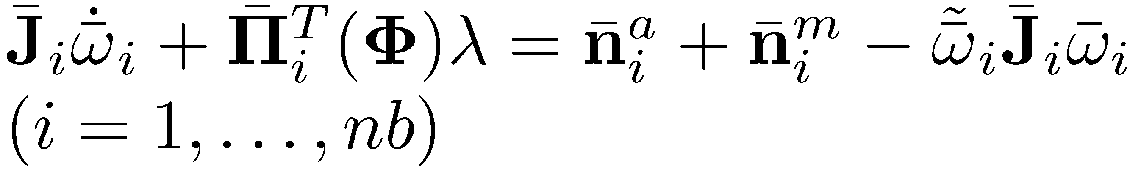
Recovering The Reaction Forces/Torques

Slide 31
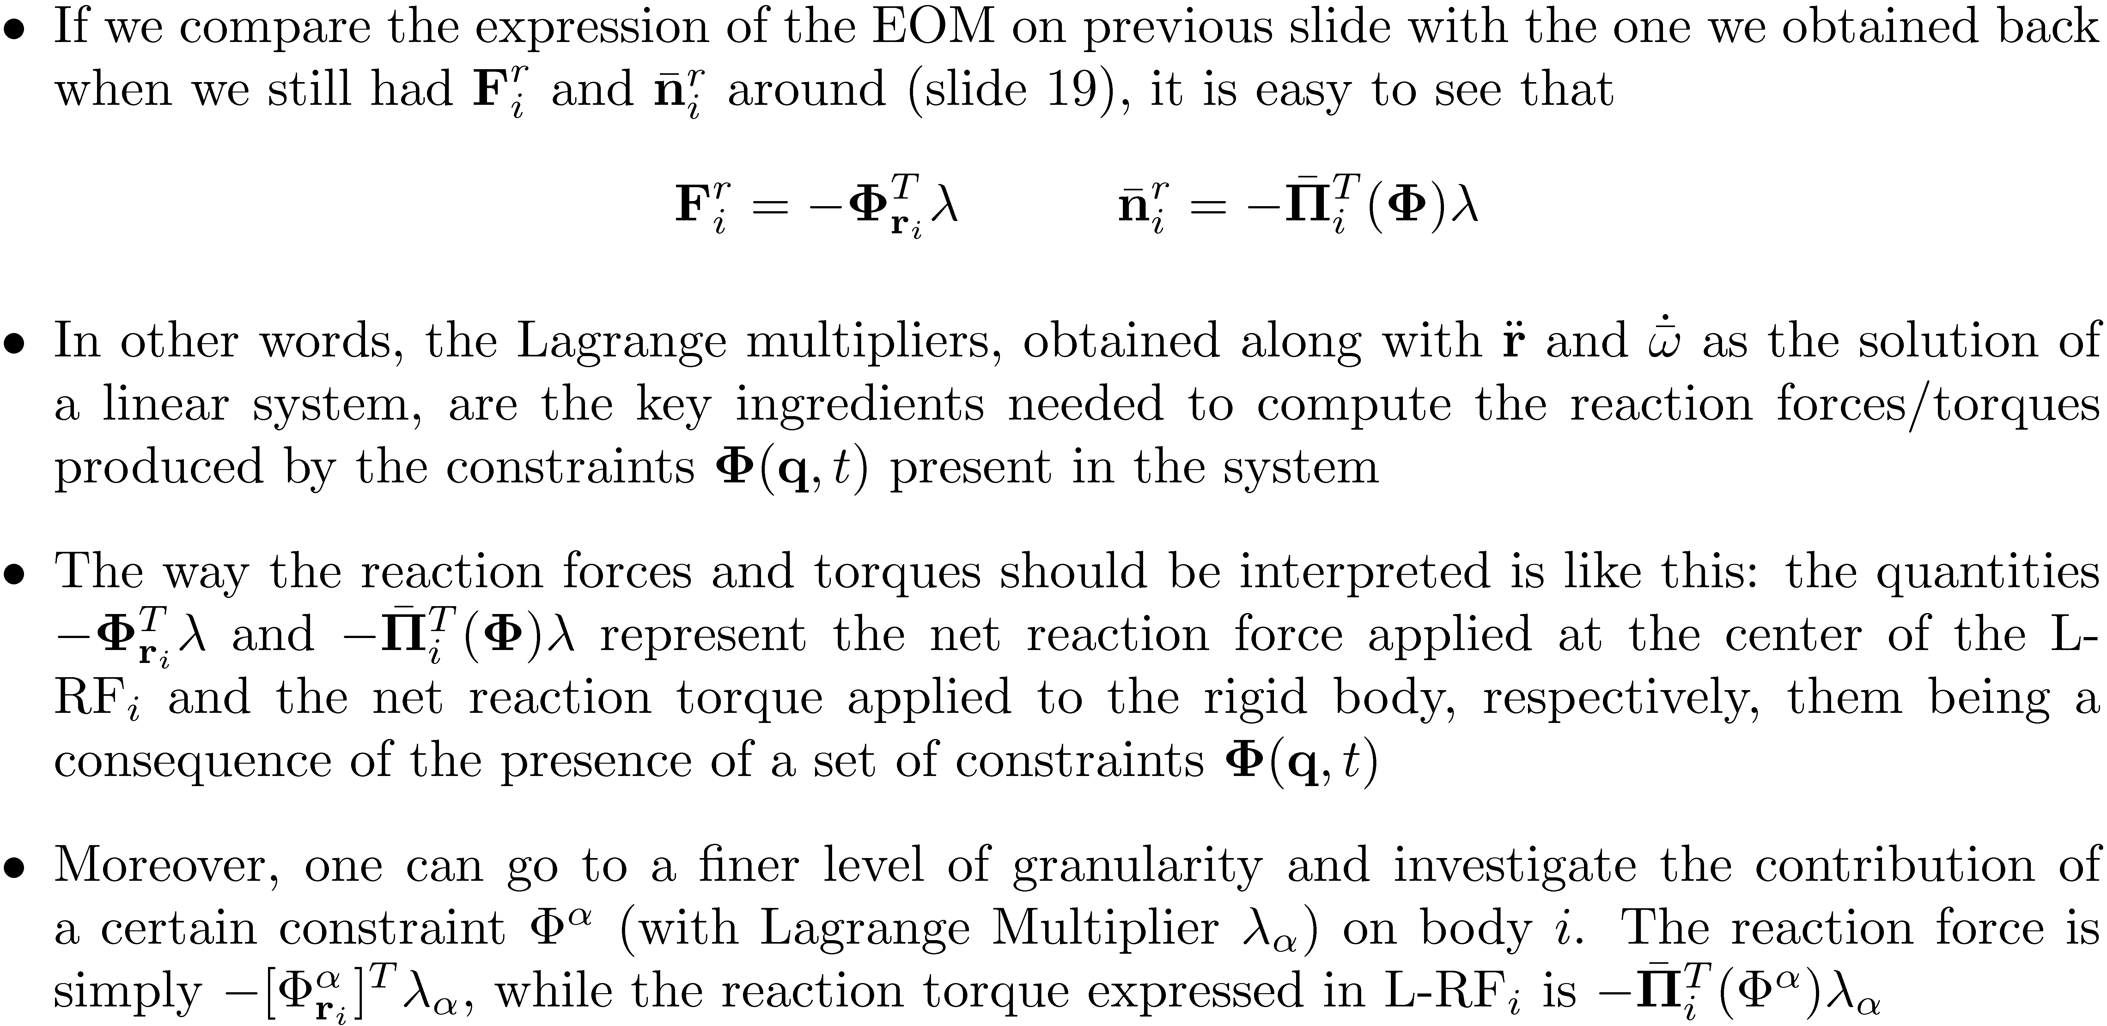
Recovering The Reaction Forces/Torques [Cntd.]

Slide 32
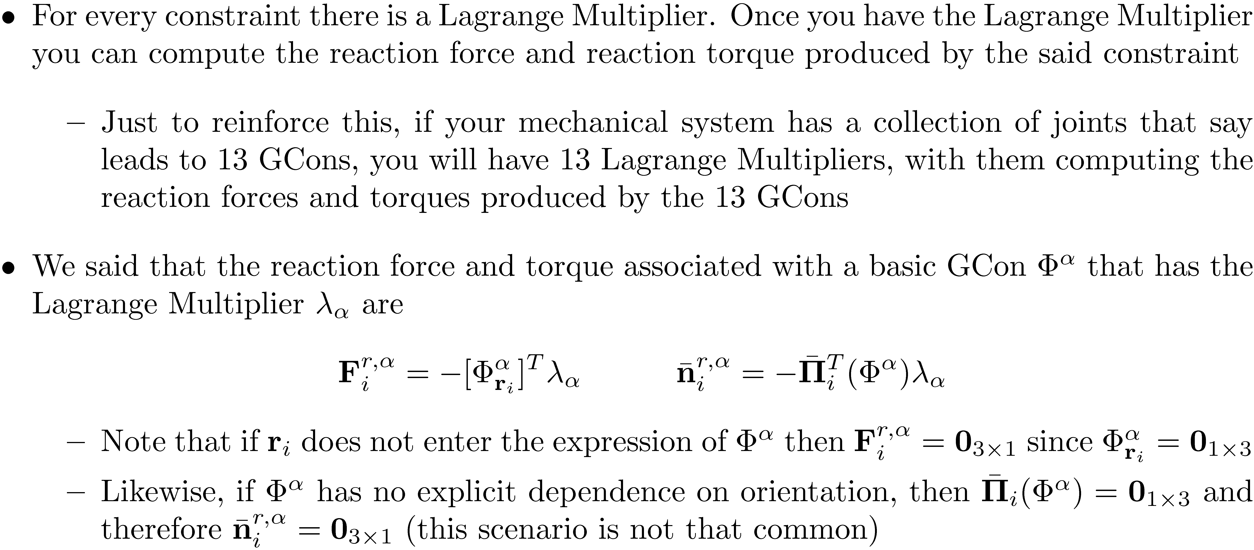
Comments on the Reaction Forces/Torques

