Slide 1
ME751 Advanced Computational Multibody Dynamics
Solving Initial Value Problems
Basic Concepts
March 23, 2010
“I have bad reflexes. I was once run over by a car being pushed by two guys.“ Woody Allen
© Dan Negrut, 2010 ME751, UW-Madison

Slide 2
Before we get started…
Last Time:
Super briefly talked about the EOM when using Euler Angles
Discussed two classes of forces likely to be encountered in Engineering Apps
Inverse Dynamics Analysis
Equilibrium Analysis
Today:
Discuss about the solution of differential equations
Final Project:
Attach the one pager proposal to your Th HW
I’ll need a head count in the next two weeks regarding people who plan to make the trip to John Deere and NADS

Slide 3
Dynamics Analysis
Dynamics Analysis, Framework:
The state of a mechanical system (position, velocity) changes in time under the influence of internal and external forces and/or prescribed motions
The goal is to determine how the state of the system changes in time
Almost always you will only be able to determine the state of the mechanical system at a collection of grid points in time
That is, not everywhere, yet you can have as many grid points you wish (and afford)
Time evolution is obtained as the solution of the EOM (Newton-Euler equations derived before)

Slide 4
Dynamics vs. Kinematics
Kinematics Analysis
Prescribed motions exclusively determine how the system changes in time
The concept of force/torque does not factor in anywhere
For a Kinematics Analysis to be possible, the NDOF should be zero
Its solution provided at each time step by a sequence of 3 algebraic problems:
Nonlinear system of equations provides the position at each time step
Linear system of equations provides the velocity configuration at each time step
Linear system of equations provides the acceleration configuration at each time step
Dynamics Analysis
External forces/torques dictate how the system evolves in time
It is more general than Kinematics:
A Kinematics problem can be solved using the methods of Dynamics, but not the other way around
Its solution obtained at each time step by numerical integration (solving a differential equation)

Slide 5
Dealing With Dynamic Systems
What have we done in ME751 so far?
We posed a dynamics problem
Discussed the elements of a mechanical system
Understood what their presence entails
Formulated a set of second order differential equations that governs the time evolution of the system
What’s left: solving the differential equation to obtain the dynamics of the mechanical system
Four lectures: discuss solution techniques that produce an approximation of the solution of the differential problem

Slide 6
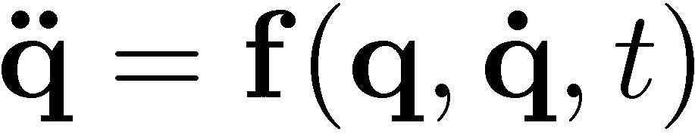
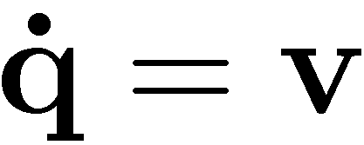
30,000 Feet Perspective
When carrying out Dynamics Analysis, what you can compute is the acceleration of each part in the model
Acceleration represents the second time derivative of your coordinates
Somewhat oversimplifying the problem, in ME751 you get the second time derivate
This represents a second order differential equation since it has two time derivatives taken on q
Problem is reduced to a set of first order differential equations by introducing a helper variable v (the velocity):
With this, the original second order differential problem becomes:

Slide 7
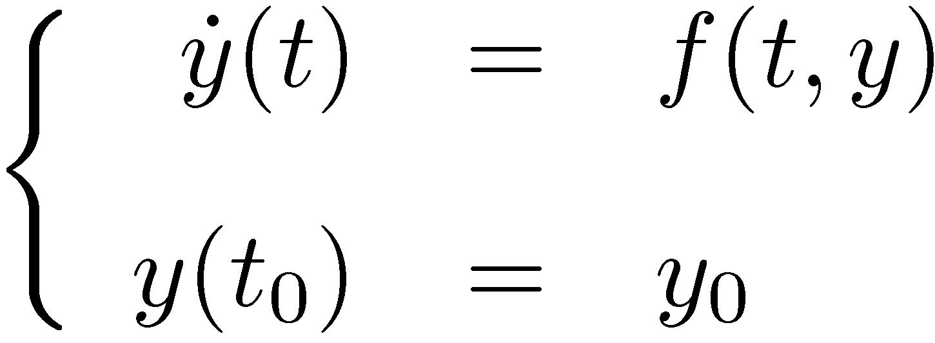
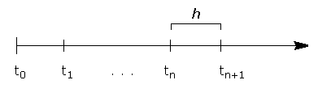

Numerical Integration ~The Problem ~
Initial Value Problem:
(IVP)
IVP: Stating the Problem
You are looking for a function y(t) that depends on time (changes in time), whose time derivative is equal to a function f(t,y) that is given to you (see equation above)
In other words, you are given the derivative of a function, can you tell what the function is?
In ME751, the best you can hope for is to find an approximation of the unknown function y(t) at a sequence of discrete points (as many of them as you wish)
The numerical algorithm produces an approximation of the value of the unknown function y(t) at the each grid point. That is, the numerical algorithm produces an approximation for y(t₁), y(t₂), y(t₃), etc.; i.e., y₁, y₂, y₃, etc.

Slide 8
Road Map (Tu & Th)
Difference between ODE and IVP
Basic Concepts in Numerical Integration
Basic Methods for Numerical Integration
Runge-Kutta
AB & AM Methods
BDF Methods
Text used:
Computer Methods for Ordinary Differential Equations and Differential-Algebraic Equations, by U. Ascher and L. Petzold, SIAM, 1998
On reserve at Wendt Library

Slide 9
ODE vs. IVP
Difference between ODE and IVP - Often a source of confusion
Ordinary Differential Equation (ODE)
Typically, has an infinite number of solutions
Initial Value Problem (IVP)
Is an ODE plus an initial condition (IC):
The IC: The unknown function assumes at time T=0 a certain prescribed value
The solution for the IVP’s that we’ll deal with is UNIQUE
We’ll assume that f(t,y) is well behaved (Lipschitz continuous)

Slide 10
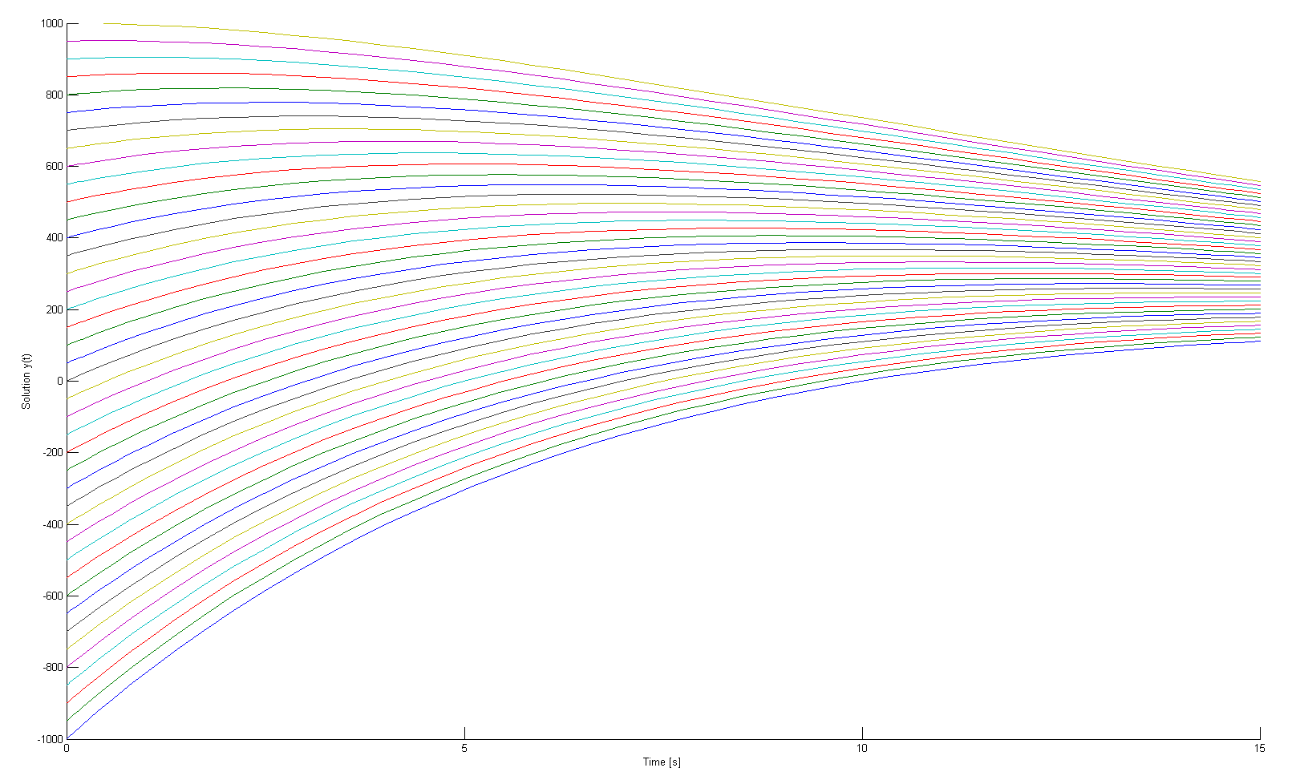
ODE: Infinite Number of Solutions

Slide 11
ODE vs. IVP [Cntd.]
Remember:
1. IVP = ODE + IC
2. IVP has a UNIQUE solution (unlike on ODE)
Why is observation above important?
In general, when we start working on a numerical solution to a problem we better know that the problem we are trying to solve is well posed (has a solution and it is unique)
Turns out that in the Dynamics Analysis we are dealing with a well posed problem (an IVP)
Focus then on finding a way to approximate its solution by using the computer
The computer will produce numbers that at each node of the time grid will approximate the value of the generalized coordinates and their velocity

Slide 12
Initial Value Problems: Basic Concepts
Truncation Error
Accuracy
Convergence
0-stability
Order of a method
Local Error
Stability
Absolute stability
A-stable Integration Methods
L-Stable Integration Methods (Methods with Stiff Decay)

Slide 13
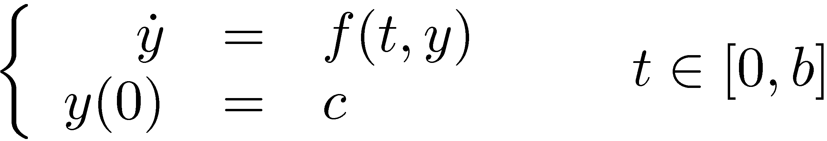
Framework
Interested in finding a function y(t) over an interval [0,b]
This function must satisfy the following IVP:
We assume that f is bounded and smooth, so that y exists, is unique, and smooth
Given to you:
The constants c and b
The function f(t,y).

Slide 14
Framework [Cntd.]
The expression of the given function f(t,y) is typically far from being simple
Case 1: f(t,y) is simple, in very rare cases you can find y(t) analytically; i.e., find the exact solution of the IVP (the pen and paper case)
Case 2: f(t,y) is complex but nonetheless you have direct access to it.
Producing an exact solution is not possible, resort to numerical integration, solution approximated using the computer
Case 3: f(t,y) is so complex that you don’t even have an expression for it. Instead you have another application (program) evaluate f(t,y) based on the value of t and y that you provide
Producing an exact solution is not possible, resort to numerical integration, solution approximated using several computer programs
This is what happens typically in multi-discipline engineering analysis

Slide 15
Framework [Cntd.]
Implications (in relation to the complexity of f(t,y)):
Most likely you can’t find the function y(t) analytically (using pen and paper)
You’ll have to use a numerical approximation method to come up with approximations of the unknown function y(t)
What you’ll produce is an approximation of the value of y(t) at 0, t₁, t₂, etc.
You are working on a grid of of N time points, starting at 0 and ending at b
For simplicity, we assume that the grid points are equally spaced by a value h
This value is called the “integration step-size”, usually denoted by h or ¢t

Slide 16
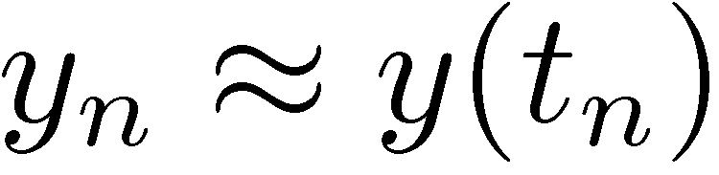
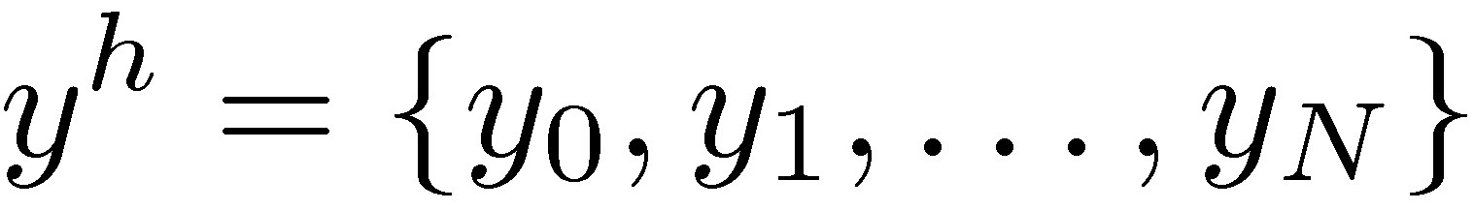
Framework [Cntd.]
Remember this: we’ll approximate the value of y(t_{n}) by a value y_{n} that we’ll learn how to obtain
The unknown function y
evaluated at t_{n}
An approximation of the value of
the unknown function at time t_{n}
Notation: I’ll use y^{h} to denote the set of values y₀, y₁, …, y_{N} that I come up with in my effort to approximate the unknown function y(t) at the grid points t₀, t₁, …, t_{N}:
Quick Remark: a professional grade method for finding the approximate solution does not use an equally spaced grid of points 0, t₁, t₂, t₃…
We’ll stick with this assumption of equally spaced points though

Slide 17
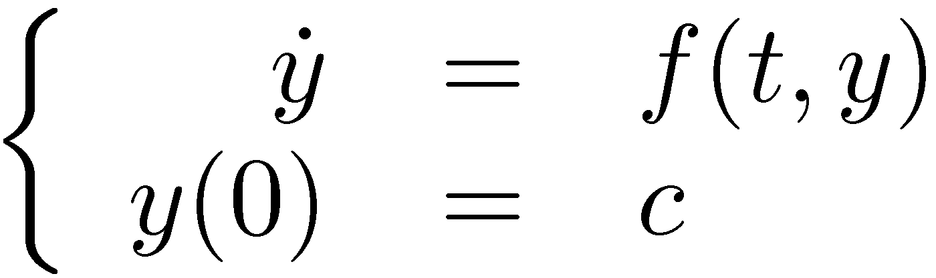
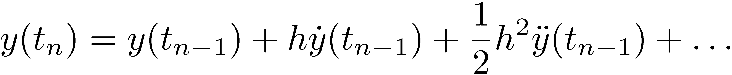
Basic Concepts: Truncation Error [Preliminaries]
We have our standard IVP:
Before talking about Truncation Error, let’s introduce the simplest numerical integration scheme: Forward Euler
Invoke a Taylor series expansion of function y(t) around t_{n-1}:
Drop terms with powers of h of order 2 and higher
Note that I won’t use y(t_{n}) anymore, but I will now use y_{n}
Make sure you understand this distinction between the exact value and approximate value…

Slide 18
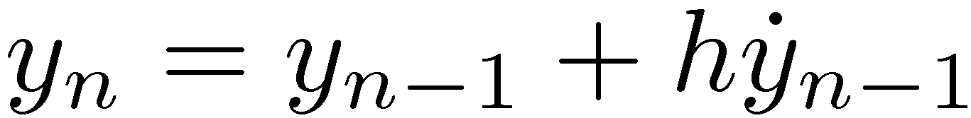
[Basic Concepts] Truncation Error [Preliminaries]
I had this:
But compute my solution like this
Truncation error
Or equivalently,
It’s fair to expect that there is a slight difference between the exact value and numerical approximation:

Slide 19
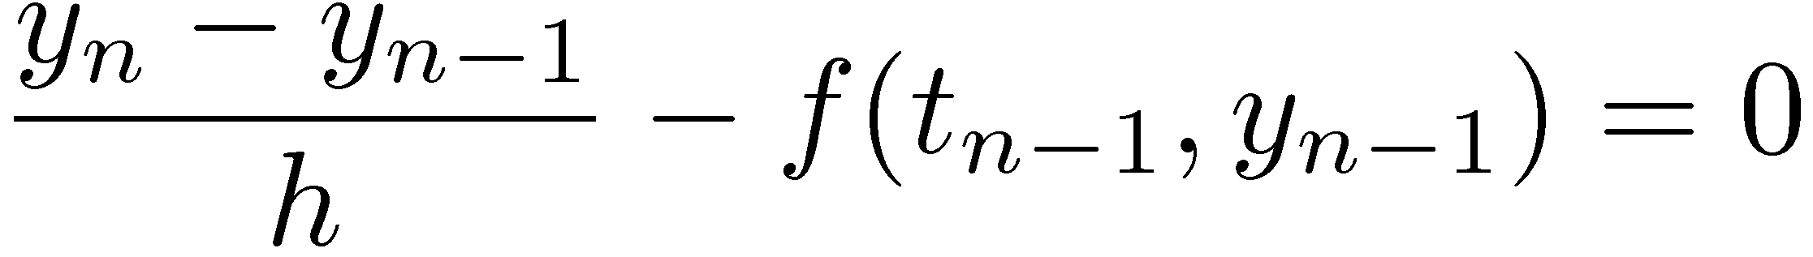
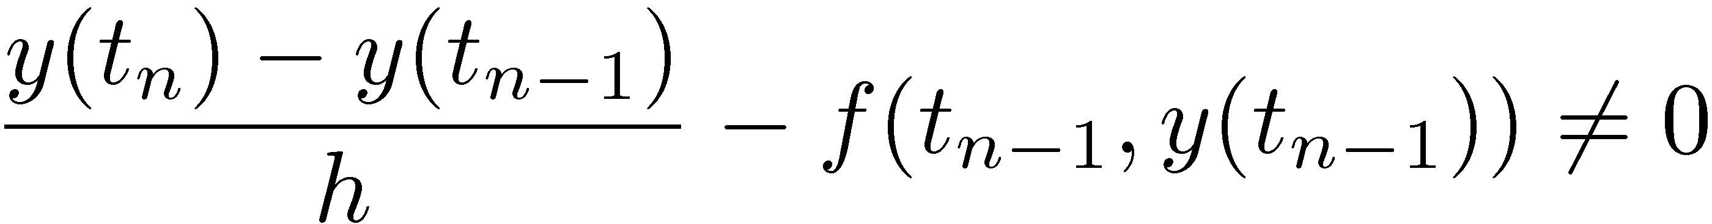
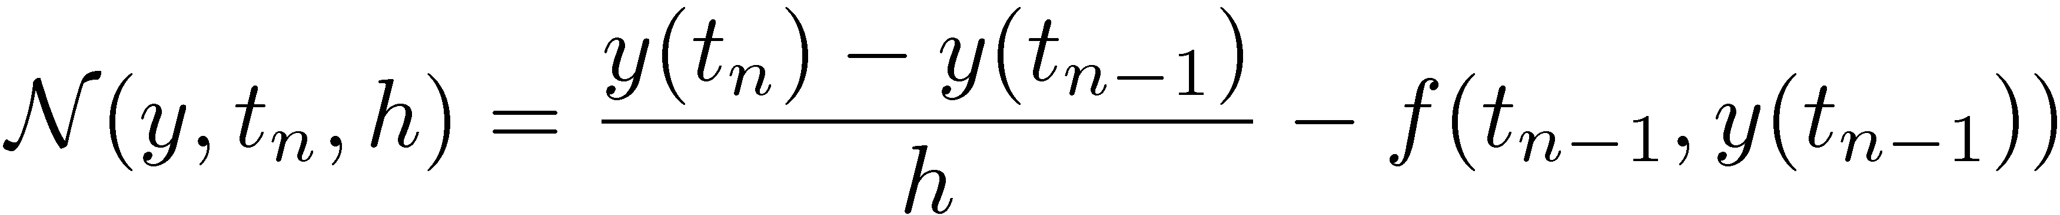
[Basic Concepts] Truncation Error
[Definition]
Consider how the solution is obtained:
Note that in general, if you stick the actual solution in the equation above it is not going to be satisfied:
By definition, the quantity above is called the truncation error and is denoted by
Note that this depends on the function (y), the point where you care to evaluate the truncation error (t_{n}), and the step size used (h)

Slide 20
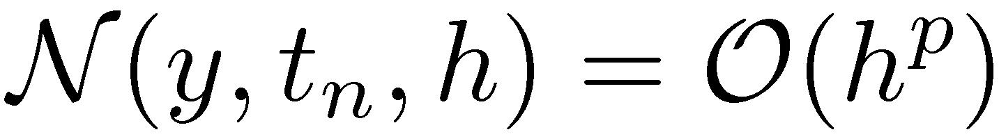
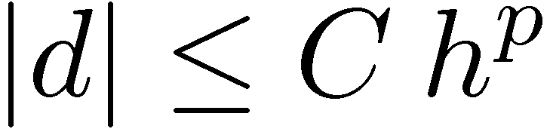
[Basic Concepts] Accuracy Order
Important remark:
Note that the truncation error depends on the integration scheme used to compute y^{h}:
Definition: an integration scheme is said to be accurate (or consistent) of order p for a positive p if
By the way, a quantity “d” is order h^p if there is a constant C so that when h is small enough, one has that

Slide 21
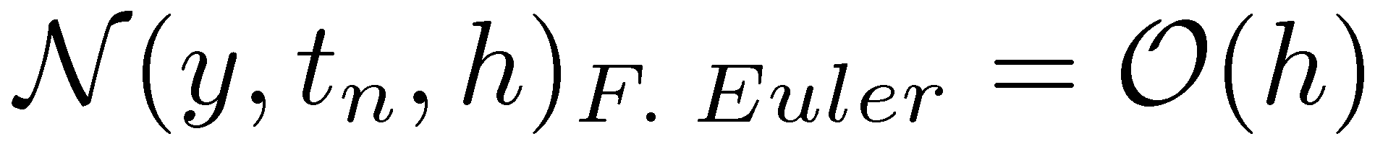
[Basic Concepts] Accuracy Order
Exercise:
Prove that Forward Euler is order 1 accurate, that is,

Slide 22
[Basic Concepts] Convergence
Important question:
Does the numerical solution y^{h} actually converge to the unique solution of the IVP?
“Converge” means as h gets smaller and smaller, do you see the numerical solution at each t_{n} approaching the exact solution?
More formal way to frame the convergence concept
Define
Note that N¢h=b (as h goes to zero, N keeps growing…)
The numerical integration is said to be convergent of order p if

Slide 23
Zero-stability (0-stability)
There is a relationship between Accuracy and Convergence
To capture this relationship we need to introduce the concept of zero-stability
Definition: the numerical discretization scheme is 0-stable if there are positive constants h₀ and K such that for any solutions x^{h} and z^{h}, obtained for h<h₀, one has that

Slide 24
Exercise
Prove that Forward Euler is a 0-stable discretization scheme

Slide 25
Order “p” Convergence
Theorem:
Some more specifics:
If the method is accurate of order p and 0-stable, then it is convergent of order p:

Slide 26
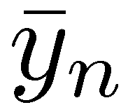
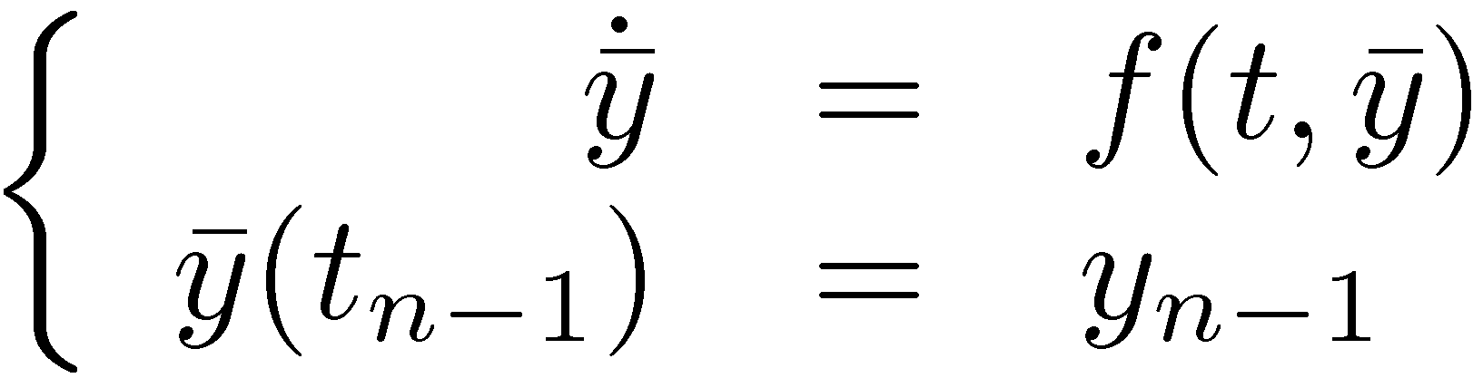
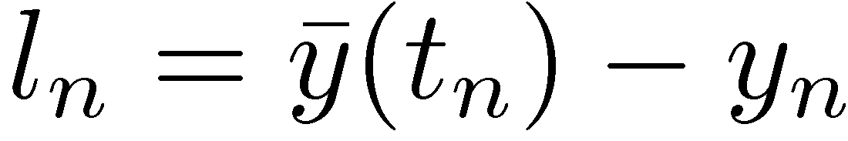
[Basic Concept] Local Error
Imagine it as being the error that is noticed in *one* integration step
Specifically, you start at time step t_{n-1}, from the point y_{n-1}
The numerical solution finds for t_{n} the approximate value y_{n} (no surprise here)
The analytical solution that passes through the initial value y_{n-1} produces at t_{n} the value :
The local error is the difference
Note the relationship that exists between the local error and local truncation error:

Slide 27
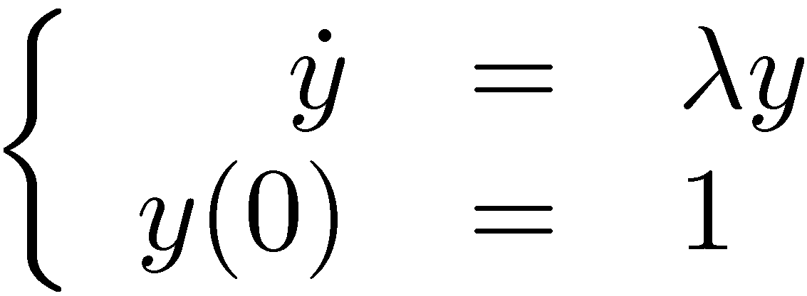
[Basic Concept] Absolute Stability
Convergence is good, but it tells me what happens if I work with smaller and smaller step-sizes h
In reality, I want to operate with values of h that are large
Recall that if h is small you have to take a very large number of integration steps to cover the interval [0,b]
The relevant question: How large can I consider h yet know for a fact that I don’t get garbage approximations of the solution?
The answer to this question is posed to each numerical discretization scheme
Moreover, it is posed in conjunction with a test problem:

Slide 28
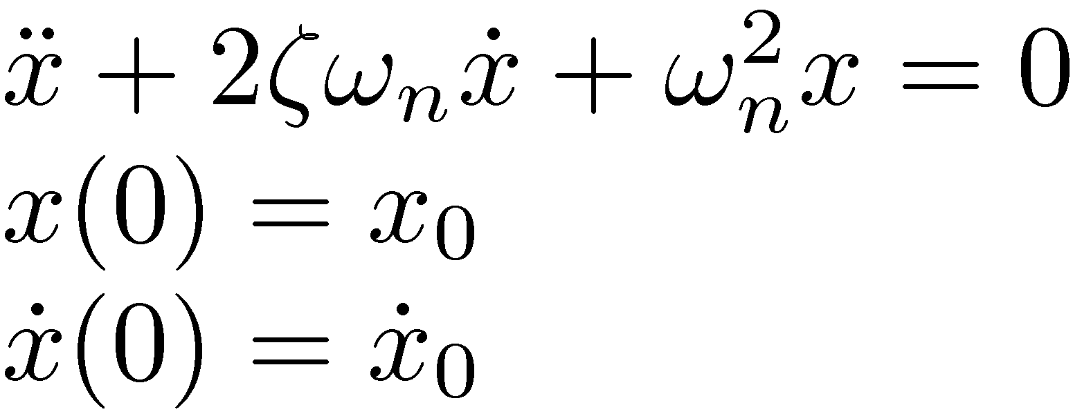
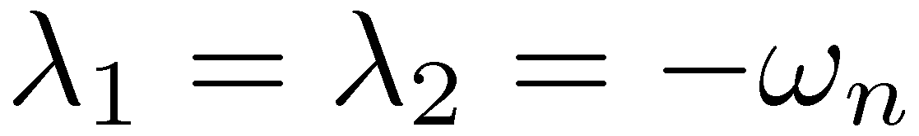
[Basic Concept, Short Detour] Absolute Stability
Example: mass-spring-damper oscillation
Case 1: underdamped system
Case 2: overdamped system
Case 3: critically damped system

Slide 29
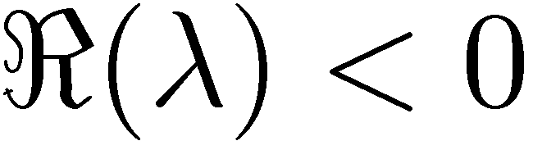
[Basic Concept] Absolute Stability
Example, the concluding remark:
In mechanical engineering, ¸ assumes values for which typically
It better be that our numerical discretization scheme leads to numerical solutions that can handle the test IVP for negative values of ¸ (or its real part, when dealing with complex values…)
It turns out that this is not trivial
Take Forward Euler for a spin to see how problems crop up…

Slide 30
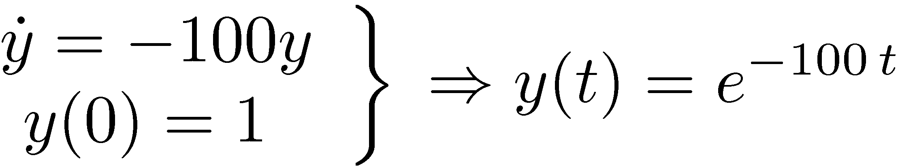



Example: (¸=-100)
- Integrate 5 steps using forward Euler formula: Δt=0.002, Δt=0.01, Δt=0.03 - Compare the errors between numerical and analytical solutions
Δt=0.002: Error
Δt=0.01: Error
Δt=0.03: Error
0
0.01873075307798
0.03032004603564
0.03681163609403
0.03972896411722
0.04019944117144
0
0.36787944117144
0.13533528323661
0.04978706836786
0.01831563888873
0.00673794699909
0
2.04978706836786
-3.99752124782333
8.00012340980409
-15.99999385578765
32.00000030590232

Slide 31
Example: (¸=-100)
Forward Euler
Analytical Solution
(Δt=0.03)

Slide 32
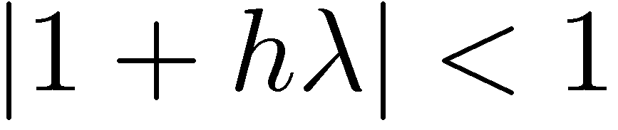
Basic Concept: Absolute Stability
One quick way to see that things went south
First note that
You’d expect that the numerical solution will mirror this behavior:
Use Forward Euler to express y_{n} as a function of y_{n-1} and require that the condition y_{n}<y_{n-1} to obtain that

Slide 33
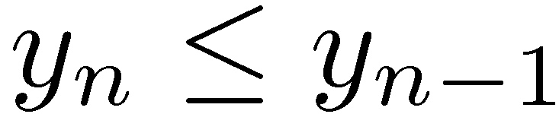
Basic Concept: Absolute Stability
Recall what happened
We started with the test problem
We required that for the test problem, the numerical approximation should behave like the solution. That is, we required that
We used the discretization scheme (Forward Euler, in our case) to express how y_{n} is related to y_{n-1}
This led to a condition that the step size should satisfy, specifically, for Forward Euler, we obtained that
What we just did was to determine the region of absolute stability of Forward Euler
The KEY point: to get the absolute stability region for other integration methods, you have to use that integration method to express how y_{n} is related to y_{n-1}

Slide 34
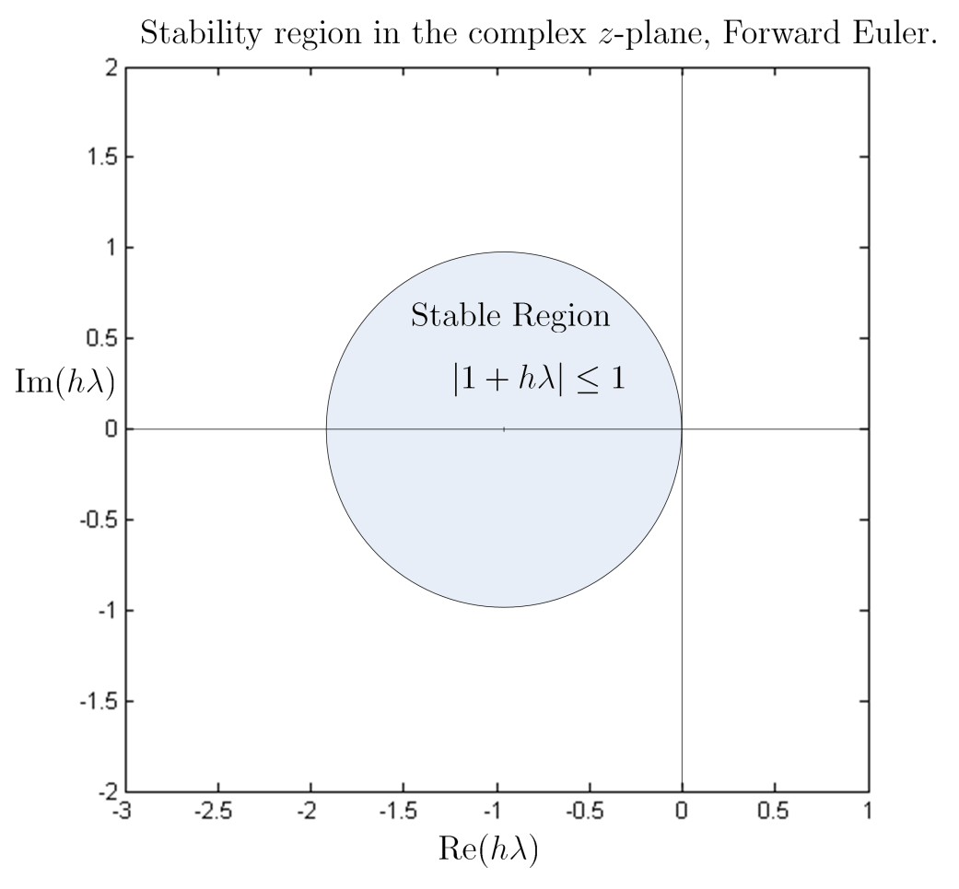
Basic Concept: Absolute Stability
The step size h should be such that h¸ lands into the shaded circle
Note that a very negative value for ¸ will require a very small value of h so that the product h¸ is inside the circle

Slide 35
Accuracy vs. Stability
Note that Forward Euler is accurate to order 1
That is, locally,
This is an asymptotic and *local* result, which holds better as h gets smaller
For the test IVP, the local error compounds due to the particular form of the problem that we work with (the test IVP)
This compounding and the fact that h does not assume small values (you try to work w/ large h) leads to the phenomenon of loss of stability
To conclude, there is no contradiction here (the numerical scheme being order 1 accurate yet losing stability for large values of h)

Slide 36
Accuracy vs. Stability: The Concept of Stiffness
Recall that the size/shape of the stability region (SR) is specific to each discretization scheme
For some discretization schemes the SR is ridiculously small
Forward Euler is one of them
A small SR to start with, combined with a problem for which ¸ is very negative leads to unreasonably small values of h
Such a problem is called a “stiff” IVP
In this case it is *not* the accuracy concerns that restrict the value of the step-size h, but rather the stability issue prevails
Note that it can be the case that if you change the integration method, the stiff problem is just fine (if the stability region is generous)

Slide 37
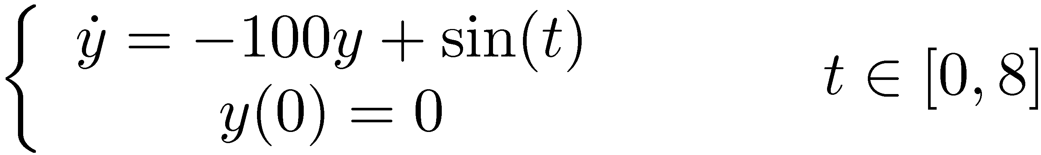
Example:
Use Forward Euler to find an approximation of the solution of the following IVP:

Slide 38
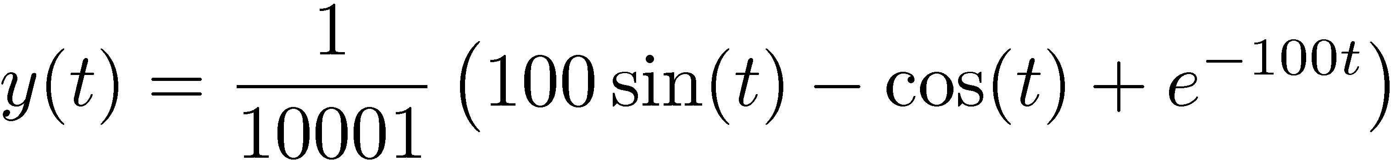
Example [Cntd.]
Easy to figure out that the exact solution is
For all purposes, the solution can be rewritten as

Slide 39
Example [Cntd.]
Note that for the given IVP, ¸=-100, which suggests we’ll have to work with small step-sizes…
Note in the plot that the contribution of the exponential is not even seen in the MATLAB plot
You’d expect that since the exponential component of the solution goes away so quickly one could use Forward Euler and have no difficulties, which is not true… (see next slide)
% Solves the IVP y_dot = -100*y + sin(t) and y(0)=0
% yExact is the analytical solution
% yFE is the solution obtained with Forward Euler
% yBE is the solution obtained with Backward Euler
%
% Input: the integration step-size
h = input('Input step size h:');
tend = 8;
tm=0:h:tend;
yExact = 1/10001*(100*sin(tm)-cos(tm)+exp(-100*tm));
yFE = zeros(size(tm'));
yBE = zeros(size(tm'));
for i=2:1:length(yFE)
yFE(i) = yFE(i-1)*(1-100*h) + h*sin(tm(i-1));
end
dummyINV = 1/(1+100*h);
for i=2:1:length(yBE)
yBE(i) = yBE(i-1)*dummyINV + h*dummyINV*sin(tm(i));
end

Slide 40
Example, Approached with Forward Euler: h=0.01 s

Slide 41
Example, Approached with Forward Euler : h=0.02 s

Slide 42
Example, Approached with Forward Euler: h=0.0205 s
As soon as you go beyond the limit value h=0.02 (that goes hand in hand for Forward Euler with \lambda=-100), you run into trouble
Note that this happens even though the contribution of the exponential goes away very fast…

Slide 43
Example, Approached with Forward Euler
Conclusion
For this type of problem with very negative ¸, Forward Euler is bad
The step size is significantly limited on stability grounds
Qualitative definition:
An IVP where Forward Euler behaves bad is called STIFF IVP

