Slide 1
ME751 Advanced Computational Multibody Dynamics
RK-Methods
AB & AM Methods
BDF Methods
March 25, 2010
“A Constitution should be short and obscure.”
Napoleon Bonaparte
© Dan Negrut, 2010 ME751, UW-Madison

Slide 2
Before we get started…
Last Time:
Numerical solution of IVP
Basic Concepts: truncation error, accuracy, zero-stability, convergence, local error, stability
Today:
Finish discussion of Basic Concepts
Concentrate on Implicit Integration: why it’s hard, and what it buys you
Basic Methods
Skip altogether Runge-Kutta, Adams-Bashforth, and Adams-Moulton Methods
Cover BDF methods
New HW uploaded on the class website
It’s ugly
Trip to John Deere & NADS: need head count by April 8 – email me
Transportation and hotel will be covered
Leave on May 3 at 6 pm or so, return on May 4 at 10 pm
Might also visit software company in Iowa City, they have a simulation tool just like ADAMS

Slide 3
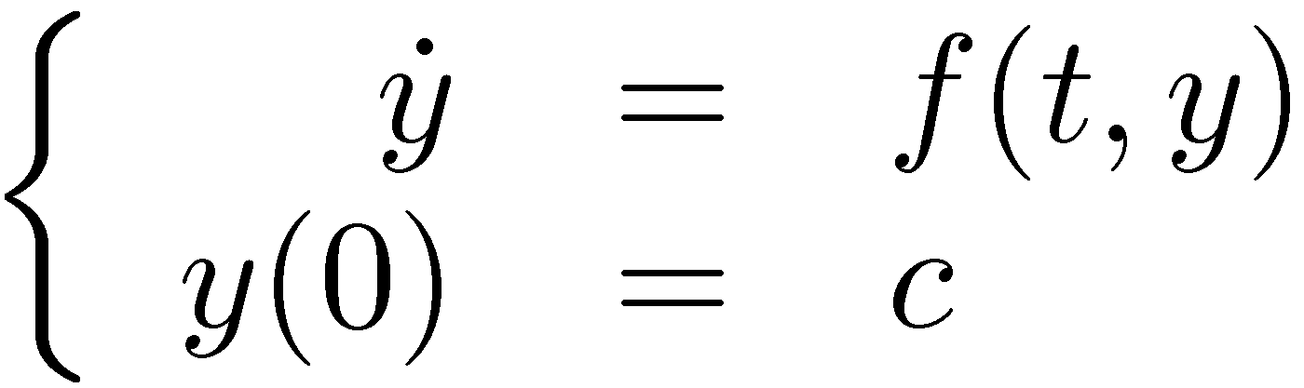
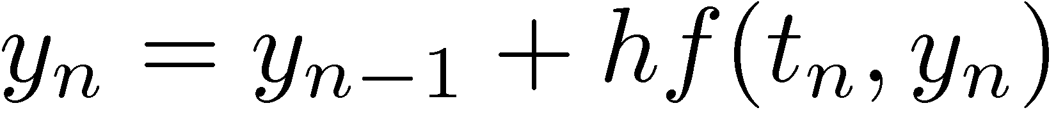
Implicit Methods
Implicit methods were derived to answer the limitation on the step size noticed for Forward Euler, which is an explicit method
Simplest implicit method: Backward Euler
Given the IVP
Backward Euler finds at each time step t_{n} the solution by solving the following equation for y_{n}:

Slide 4
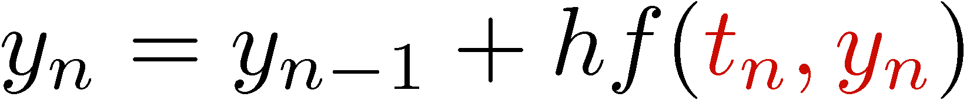
Explicit vs. Implicit Methods
A method is called explicit if the approximation of the solution at the next time step is computed straight out of values computed at previous time steps
In other words, in the right side of the formula that gives y_{n}, you only have dependency on y_{n-1}, y_{n-2}, etc. – it’s like a recursive formula
Example: Forward Euler
A method is called implicit if the solution at the new time step is found by solving an equation:
In other words, in the right side of the formula that gives y_{n}, you have dependency on y_{n}, y_{n-1}, y_{n-2}, etc.
Example: Backward Euler

Slide 5
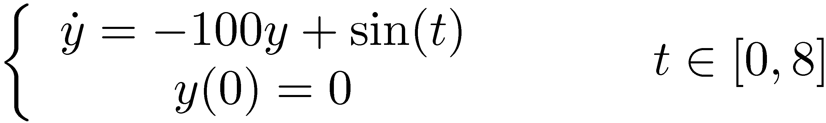
Example, Approached with Backward Euler: h=0.01

Slide 6
Example, Approached with Backward Euler: h=0.02

Slide 7
Example, Approached with Backward Euler: h=0.03
Note that things are good at large values of the integration step size

Slide 8
Exercise, Backward Euler
Prove that
Backward Euler is accurate of order 1
It satisfies the 0-order stability condition
It’s convergent with convergence order 1
Generate
The stability region of the method and compare to Forward Euler
A convergence plot for the IVP

Slide 9
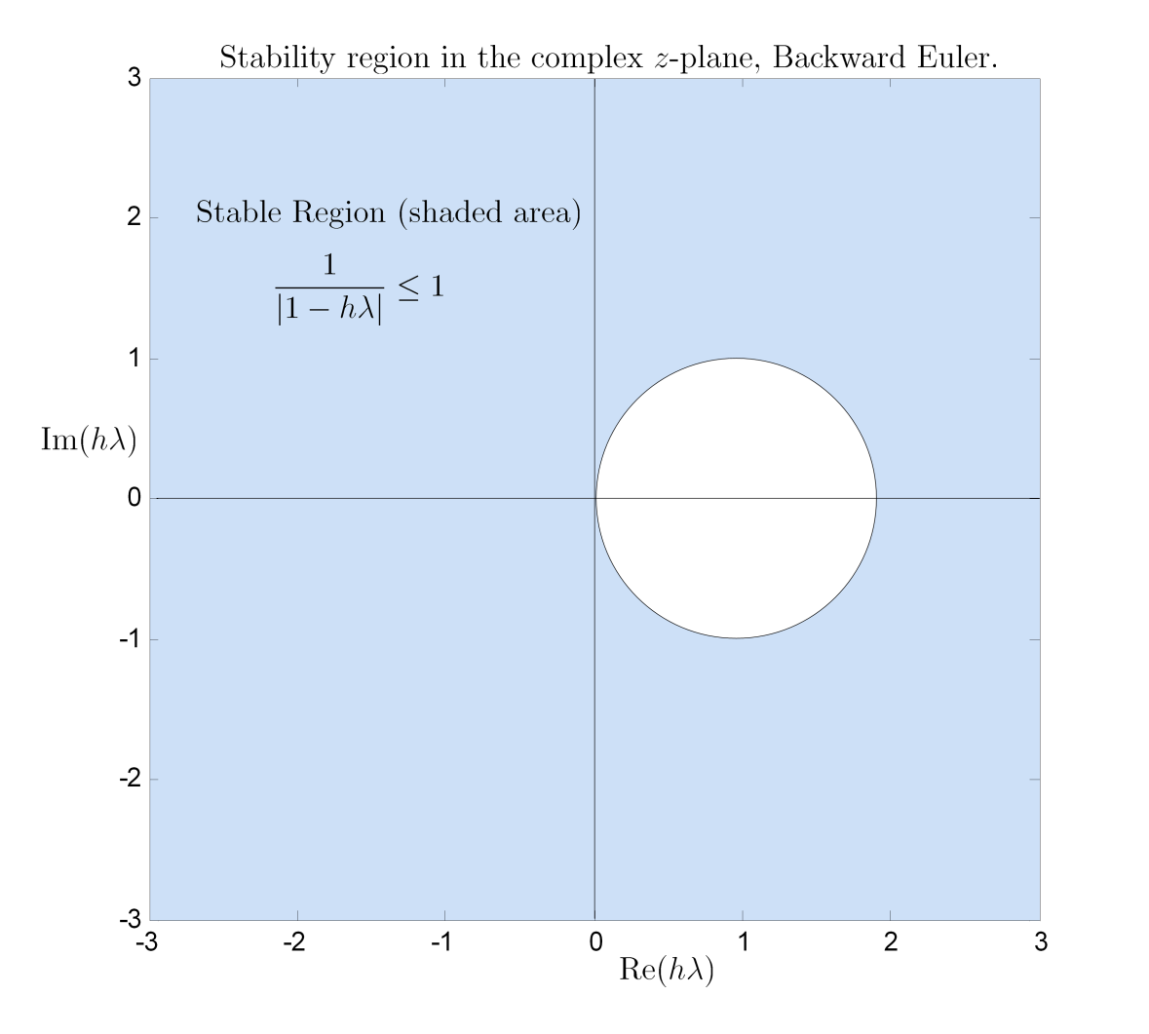
Stability Region, Backward Euler

Slide 10
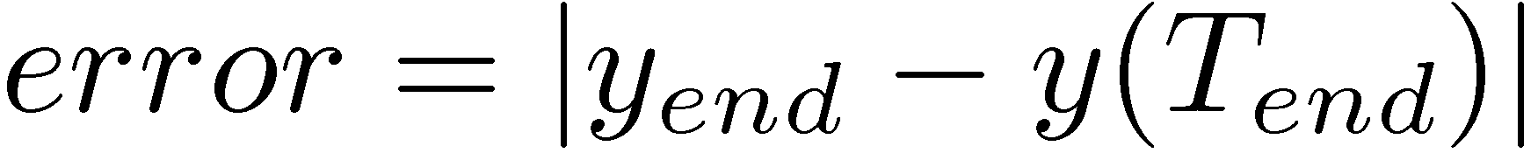
Generating Convergence Plot
Procedure to generate Convergence Plot:
First, get the exact solution, or some highly accurate numerical solution that can serve as the reference solution
Run a sequence of 6 to 8 simulations with decreasing values of step size h
Each simulation halves the step-size of the previous simulation
For each simulation of the sequence, compare the value of the approximate solution at Tend to the value of the reference solution at Tend
You don’t necessarily have to use Tend, some other representative time is ok
Generate an array of pairs (h, error), and plot log2(h) vs. log2(error)
You should see a line of constant slope. The slope represents the convergence order

Slide 11
Convergence Plots

Slide 12
Code to Generate Convergence Plot
nPoints = 8; % number of points used to generate the convergence plot
hLargest = 2^(-6); % largest step-size h considered in the convergence analysis
tEnd = 8; % Tend
hSize = zeros(8,1);
hSize(1) = hLargest;
for i=1:nPoints-1
hSize(i+1)=hSize(i)/2;
end
% First column of "results" : the step size used for integration
% Second column of "results": the error in the Forward Euler at Tend
% Third column of "results" : the error in the Backward Euler at Tend
results = zeros(nPoints, 3);
% Run a batch of analyses, the step size is gradually smaller
for i=1:nPoints
yE = zeros(size(0:hSize(i):tEnd))';
yFE = zeros(size(yE));
yBE = zeros(size(yE));
[yE, yFE, yBE] = fEulerVSbEuler(hSize(i), tEnd);
results(i,1) = hSize(i);
results(i,2) = abs(yE(end)-yFE(end));
results(i,3) = abs(yE(end)-yBE(end));
end

Slide 13
Implicit Methods, The Ugly Part
Why not always use implicit integration methods?
Implicit method come with some baggage: you need to solve an equation (or system of equations) at *each* integration time step t_{n}
Specifically, look at Backward Euler. At each t_{n}, you need to solve for y_{n}. This is a nonlinear equation, since f(t,y) in general is a nonlinear function
Solving nonlinear systems is something that I’d avoid if possible…

Slide 14
Implicit Integration, Solving the Nonlinear System
Note that if you are dealing with a system of ODEs, that is, if y is a vector quantity, you have to solve not a nonlinear equation, but a nonlinear system of equations:
We’ll assume in what follows (as almost always the case) that the system above is a nonlinear one
Issues that we discuss in this context:
The “functional iteration” approach to finding y_{n}
Newton Iteration
Approximating the Jacobian associated with the nonlinear system

Slide 15

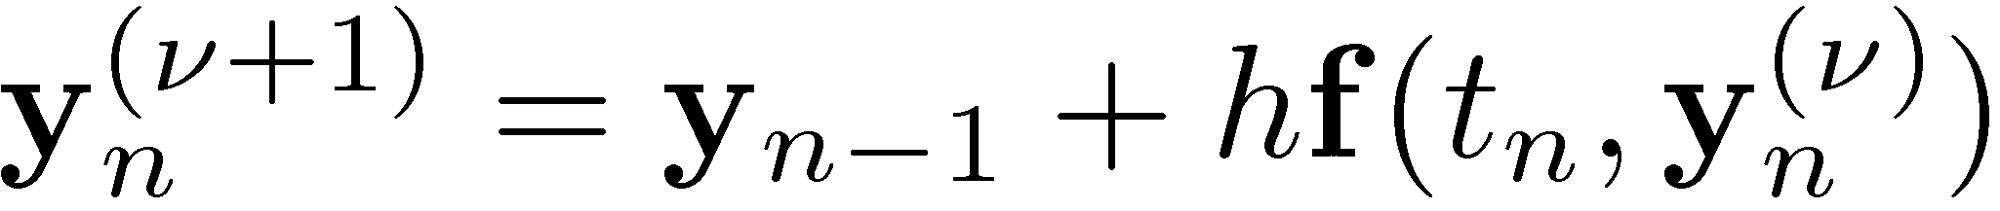
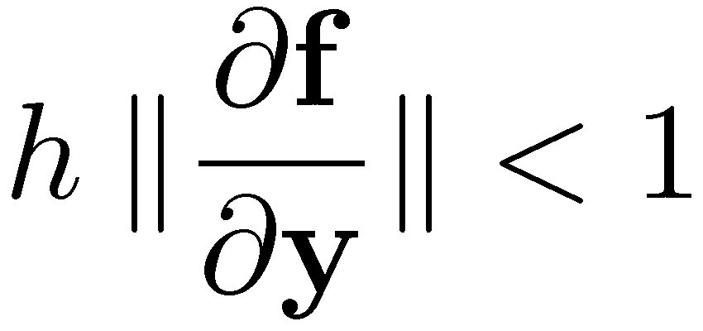
Nonlinear System Solution: The Functional Iteration
The basic idea is to solve the system through a functional iteration
The superscript (º+1) indicates the iteration count
An initial guess is needed to “seed” the iterative process
If this defines a contractive map in a Banach space, the functional iteration leads to a fixed point, which is the solution of interest
However, for this to be a contractive mapping in some norm, the following needs to hold in a neighborhood of the solution y_{n}:
For stiff systems, the matrix norm above is very large. This requires small h. And this defeats the purpose of using an implicit formula…

Slide 16
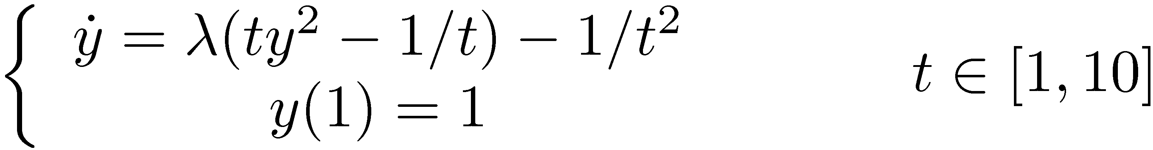
Exercise
Analyze the restrictions on the step-size imposed by the requirement that the functional iteration convergence for the following IVP:
Here ¸<0 is some parameter that determines the stiffness of the IVP
Note that for ¸=-1, the solution is y(t)=1/t

Slide 17
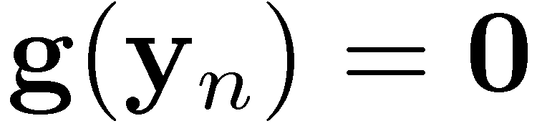
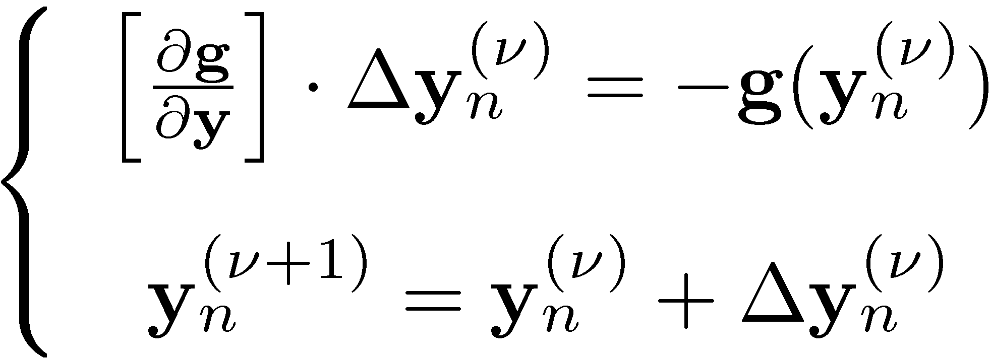


Nonlinear System Solution: The Newton Iteration
This is simply applying Newton’s method to solve the system
Boils down to carrying out the iterative process:
This is where most of the computational effort is spent
The superscript (º+1) indicates the iteration count
An initial guess is needed to “seed” the iterative process (take it y_{n-1})
Iterative process stopped when correction is smaller than prescribed value
NTOL depends on the local error bound that the user aims to achieve
Stop when

Slide 18
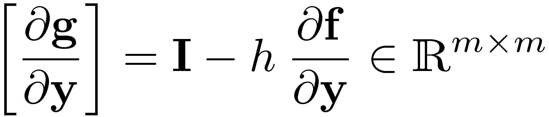
Nonlinear System Solution: The Newton Iteration
Iteration matrix:
Typically, the approach does not place harsh limits on the value of the step size
Note that the iteration matrix is guaranteed to be nonsingular for small enough values of the step-size h
The iteration matrix is not updated at each iteration. Updated only when convergence in Newton iteration gets poor
Note that each update also requires LU factorization of iteration matrix
Adding insult to injury…

Slide 19
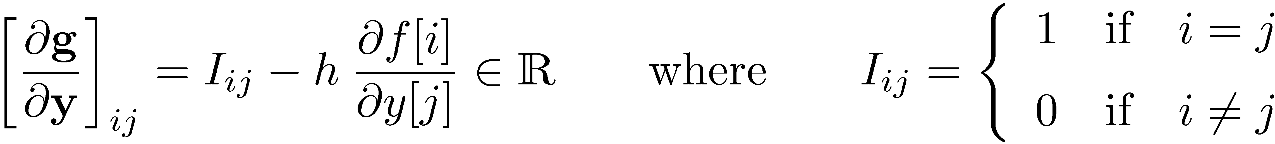
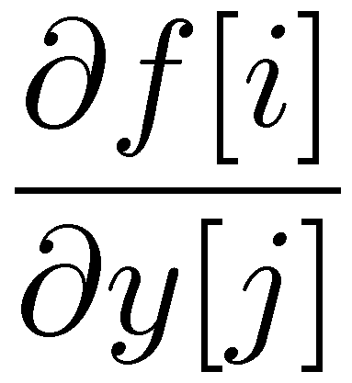
Nonlinear System Solution: The Newton Iteration
Iteration matrix, entry (i,j):
The expensive part is computing the partial derivative
Ideally, you can compute this exactly
Otherwise, compute using finite differences:
Very amenable to parallel computing
Be aware of notational inconsistency;
employed to keep things simple

Slide 20
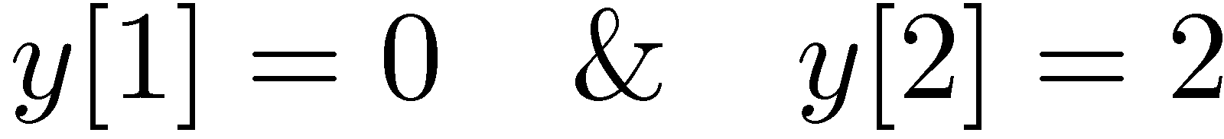
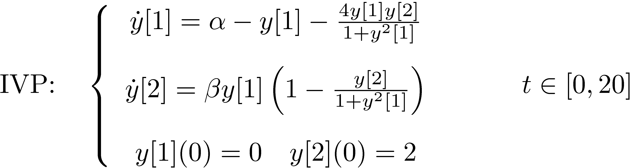
Exercise [AO, Handout]
For IVP below, find iteration matrix when solved with B. Euler
Find it analytically
Find it using finite differences
In both cases use for evaluating the matrix

Slide 21
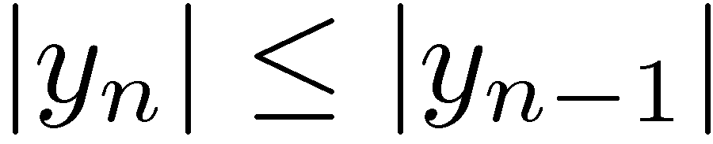
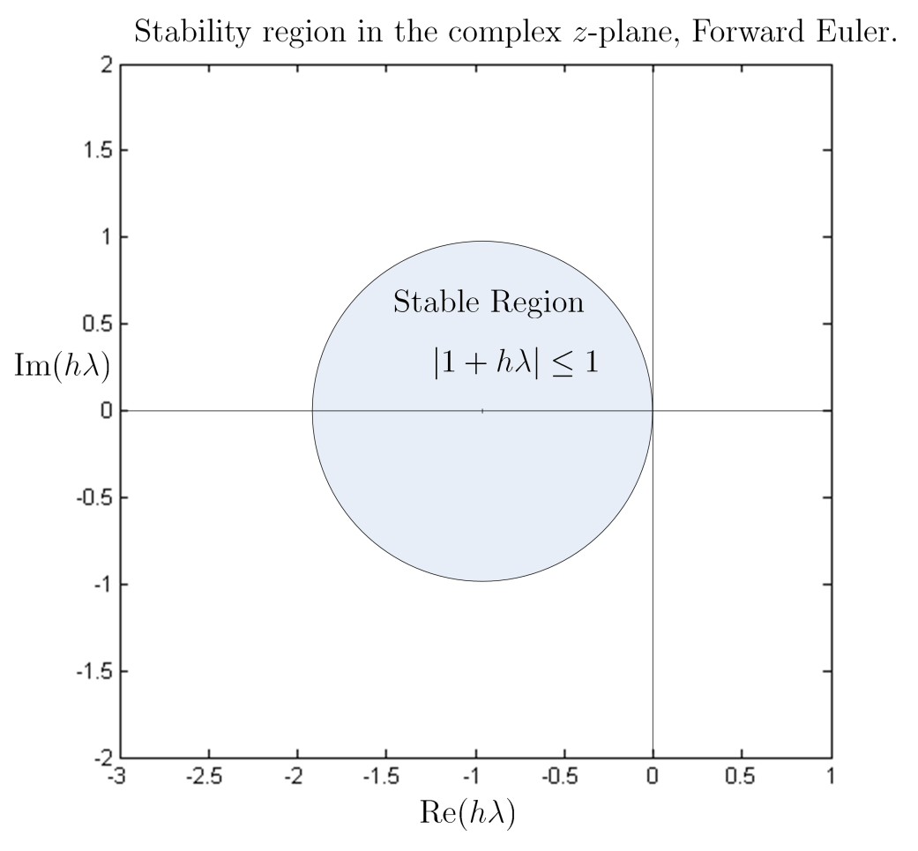
[Stability, First Flavor] A-Stable Integration Methods
Definition, A-Stability
First, recall the region of absolute stability: defined in conjunction with the test IVP, represents the region where h¸ should land so that
By definition, a numerical integration scheme is said to be A-stable if its region of absolute stability covers the entire left half-plane
Forward Euler is not A-stable
Backward Euler is A-stable

Slide 22
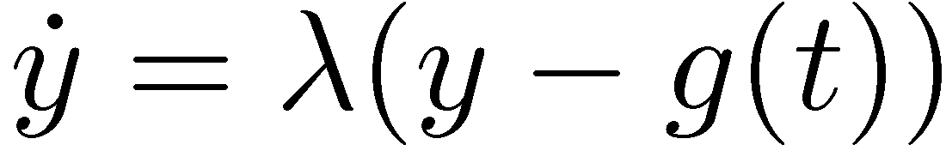
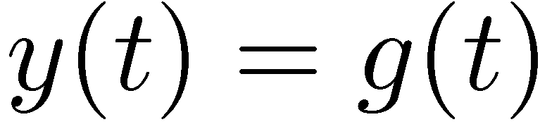
[Stability, Second Flavor] L-Stable Integration Methods
(Methods with Stiff Decay)
The concept of A-stability is not enough. It only requires that
What happens if the problem is super stiff? That is, in the test IVP, ¸ << 0 (very negative, on the real axis)…
Consider a new IVP, very similar to the test IVP we worked with:
The assumption is that g(t) is some bounded smooth function
Note that for the solution we have (after some very short transients)

Slide 23
[Stability, Second Flavor] L-Stable Integration Methods
(Methods with Stiff Decay)
The natural question to ask is this: will my solution y_{n} get quickly to g(t_{n}) irrespective of the value of y_{n-1}?
So I want
If a numerical integration scheme satisfies this requirement it is said to have “stiff decay”
What’s the nice thing about methods with stiff decay?
They have the ability to skip fine-level (i.e., rapidly varying) solution details and still maintain a decent description of the solution on a coarse level in the very stiff case

Slide 24
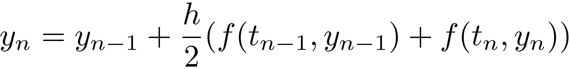
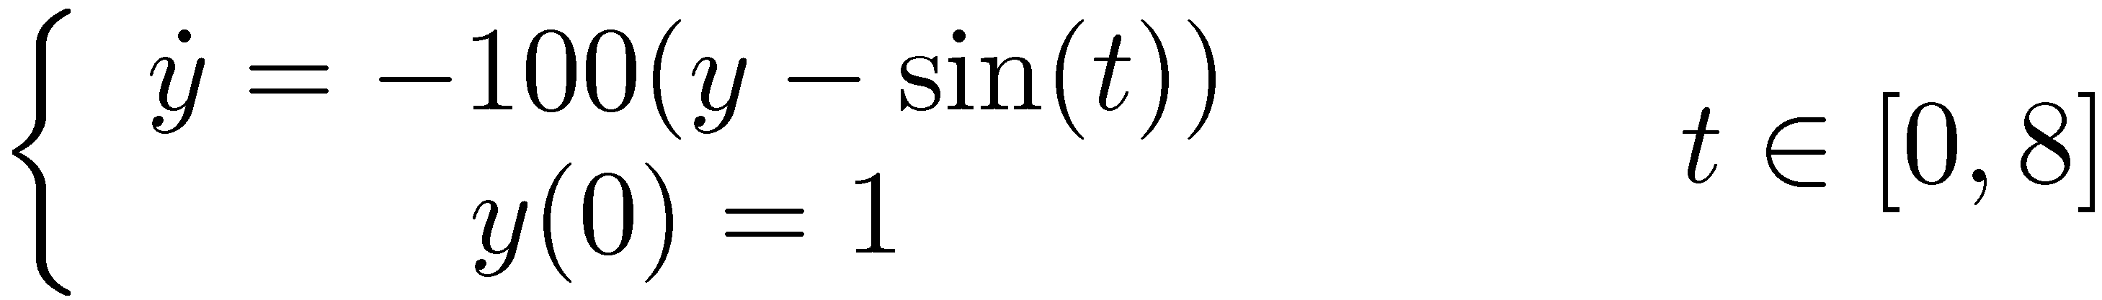
Exercise
Prove that Forward Euler doesn’t have stiff decay
Prove that Backward Euler has stiff decay
Does the trapezoidal formula (provided below) have stiff decay?
Plot the numerical solution of the following IVP, first obtained with Backward Euler and then with the trapezoidal formula. Comment on the relevance of the stiff decay attribute:

Slide 25
Further Exercises
Out of Ascher & Petzold book:
Problem 3.1
Problem 3.2
Problem 3.3
Problem 3.9

Slide 26
Numerical Integration Methods Taxonomy
Numerical Integration Schemes
For First Order IVPs
Runge-Kutta Type
Multistep Type
For Second Order IVPs
Newmark
Generalized-alpha
Nonstiff
Stiff
Nonstiff
Stiff

