Slide 1
ME751 Advanced Computational Multibody Dynamics
Implicit Integration Methods
BDF Methods
Handling Second Order EOMs
April 06, 2010
“Do what you can, with what you have, where you are.”
Theodore Roosevelt
© Dan Negrut, 2010 ME751, UW-Madison

Slide 2
Before we get started…
Last Time:
Discussed Implicit Integration Methods, general considerations
Today:
BDF Methods (one of several families of implicit numerical integration methods)
Dealing with 2nd order IVPs
HW due on Th – challenging
Exam coming up on April 29, 7:15 PM
Closed books (no book to open anyway)
Can bring one normal sheet of paper with formulas (both sides)
I’ll provide the cheat sheet that you received a while ago
Trip to John Deere & NADS:
Need head count by April 8, use forum discussion topic to indicate if you are in or not
Transportation and hotel will be covered
Leave late afternoon on May 3, return on May 4 at 10 pm or so

Slide 3

BDF Methods
BDF stands for Backward Differentiation Formula
Proposed by Bill Gear in 1970
Super nice person
Back in ’70s he was a professor in Comp. Science at UIUC
Former director of NEC Research Institute
Professor Emeritus, Princeton
BDF methods are the most widely used implicit multistep methods
BDF methods, together with HHT methods, are the two most used to integration formulas in ADAMS (the software package)
Bill Gear

Slide 4
BDF Methods Relation to AB or AM Methods
Recall that in getting AB-M and AM-M methods, the important decision was to integrate the value of function f
Integrating at t_{n} over f_{n-1},…,f_{n-k} led to AB-M
Integrating at t_{n} over f_{n},…,f_{n-k} led to AM-M
The interpolation polynomial was integrated and the outcome was the family of Adams integration formulas

Slide 5
BDF Methods Relation to AB or AM Methods
Compared to AM and/or AB Methods, BDF formulas are obtained by making completely opposite choices
Rather than interpolating f, we will interpolate y
Rather than using the interpolation polynomial to perform a time integration, the interpolation polynomial will be used in computing a time derivative
Specifically, the points y_{n},…,y_{n-k} are used to generate a polynomial that approximates y(t)
If one takes the time derivative of this interpolation polynomial at time t_{n} the value obtained should be an approximation of the time derivative of y(t). By setting this time derivative to f(t_{n},y_{n}) one gets a BDF method.

Slide 6
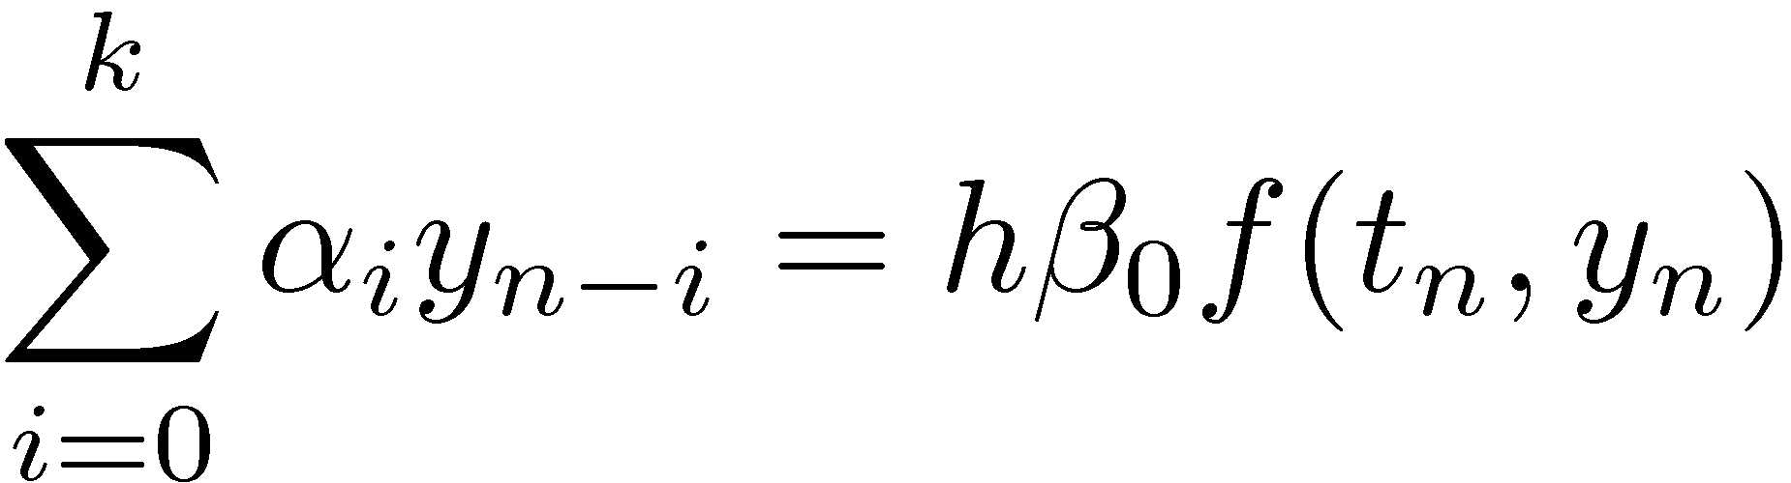
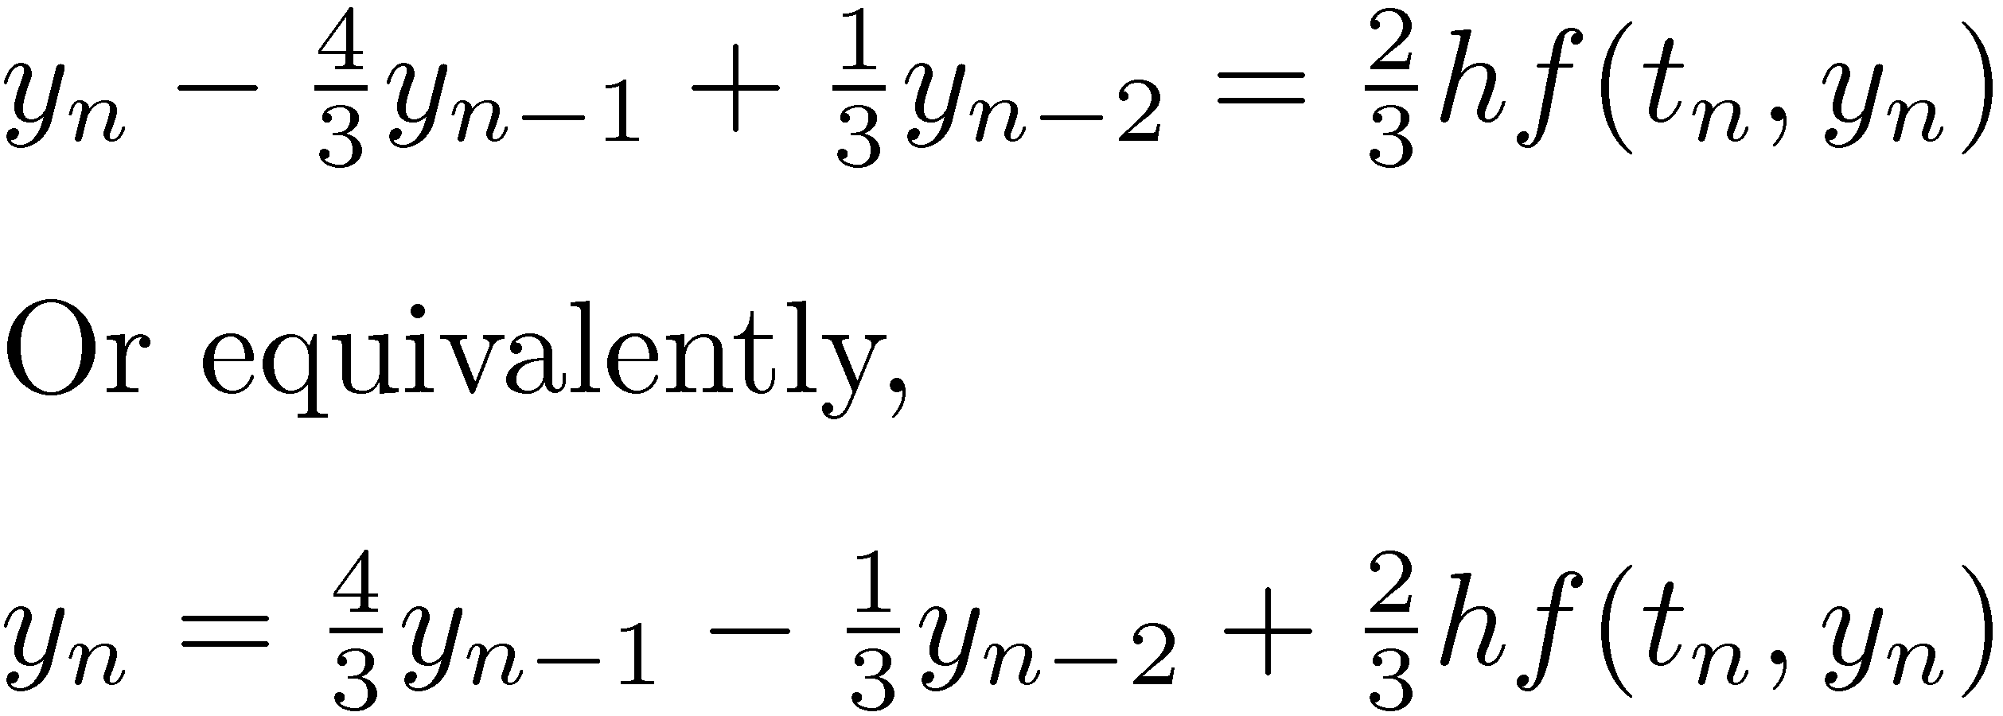
BDF Methods
The BDF methods are implicit methods
With ®₀=1, they assume the form
NOTE: for k>6, the absolute stability region of the resulting BDF methods is so small that they are useless
Example: BDF of order two
Since BDF is a multistep method you’ll need to ‘prime’ the method; i.e., providing the solution for a number of steps before the method is self sufficient

Slide 7
Exercise [AO, Handout]
Find the BDF that uses y_{n}, y_{n-1}, y_{n-2} in approximating the solution of t_{n}.
Hint: Take the following steps
Build polynomial p(t) that passes through y_{n}, y_{n-1}, y_{n-2}
Take time derivative of p(t) at t_{n} and set it to f(t_{n},y_{n})

Slide 8
BDF Methods:
Table below provides convergence order p, the number of steps k of the M method, the coefficients ¯₀, and the values of the coefficients ®₀, ®₁,…
p | k | ¯₀ | ®₀ | ®₁ | ®₂ | ®₃ | ®₄ | ®₅ | ®₆
1 | 1 | 1 | 1 | -1
2 | 2 | 2/3 | 1 | -4/3 | 1/3
3 | 3 | 6/11 | 1 | -18/11 | 9/11 | -2/11
4 | 4 | 12/25 | 1 | -48/25 | 36/25 | -16/25 | 3/25
5 | 5 | 60/137 | 1 | -300/137 | 300/137 | -200/137 | 75/137 | -12/137
6 | 6 | 60/147 | 1 | -360/147 | 450/147 | -400/147 | 225/147 | -72/147 | 10/147
Example: based on the table above, the second order BDF formula (k=2) is

Slide 9
Exercise
Plot the absolute stability regions for the BDF formulas up to order 6
Comment on the size of the region of absolute stability

Slide 10
Exercise
Prove that the BDF method with k=4 is convergent with order 4
Approach:
Compute the roots of the characteristic equations to prove zero-stability
Verify that the order conditions are satisfied up to order 4
Use theorem that says that
Zero-stability + Accuracy to order p ) Convergence of order p

Slide 11
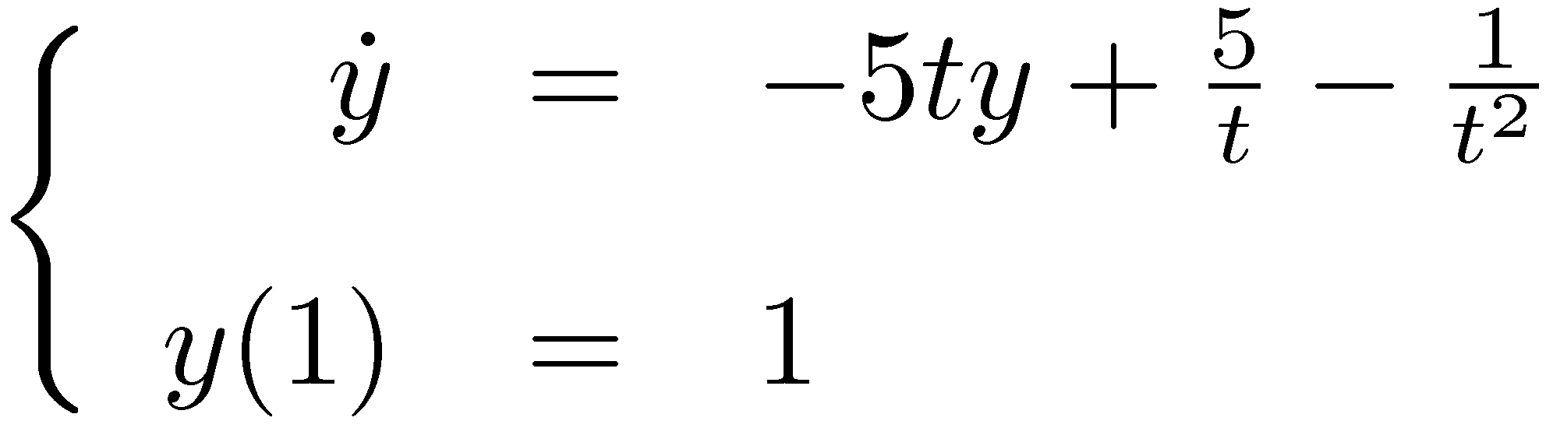
Exercise
Generate the convergence plot for the BDF method of order 6 for the following IVP:
Use the analytical solution, that is, y(t)=1/t, t 2 [1,4] to generate the starting points (history) required by the integration formula
Note that in practice you can’t count on this break for the starting points, so you will have to use RK methods or gradually increase the order of the M method used to build the required history

Slide 12
BDF Method: Implementation Details (Newton Iteration)
Recall that the BDF method is an implicit method
Requires at each time step the solution of a nonlinear system of equations
Approaches discussed so far for implicit multistep methods when it comes to solving the nonlinear discretization system:
Functional Iteration
PECE schemes (which can still be regarded as a flavor of Functional Iteration)
Note that these two approaches only work for nonstiff IVPs, unless one is open to the idea of having very small step-sizes (which defeats the purpose of implicit integration…)

Slide 13
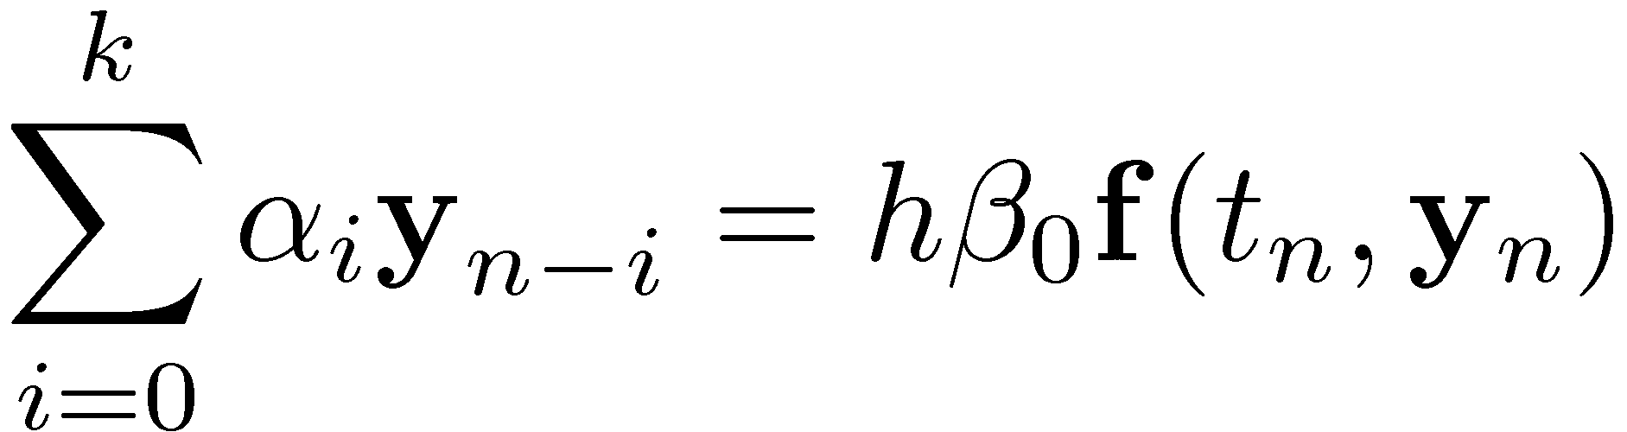
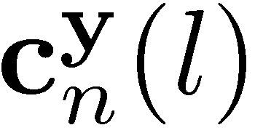
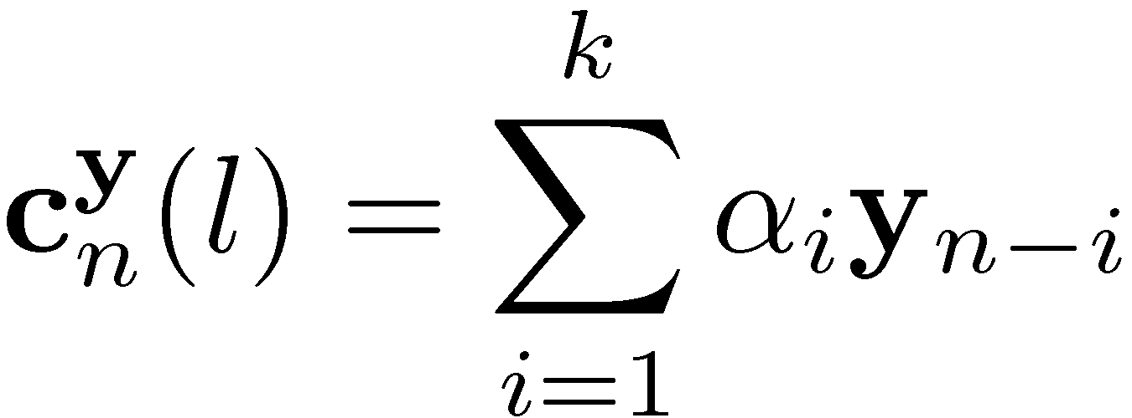
BDF Method: Implementation Details (Newton Iteration)
The approach adopted for stiff problems is to solve the discretization nonlinear system by using Newton-Raphson or some variant
Recall the nonlinear algebraic problem that we have to solve at each time step t_{n}:
It boils down to solving the following system of nonlinear equations:
Note that is a constant quantity that only depends on previous values of the unknown function y (l stands for the order of the BDF):

Slide 14
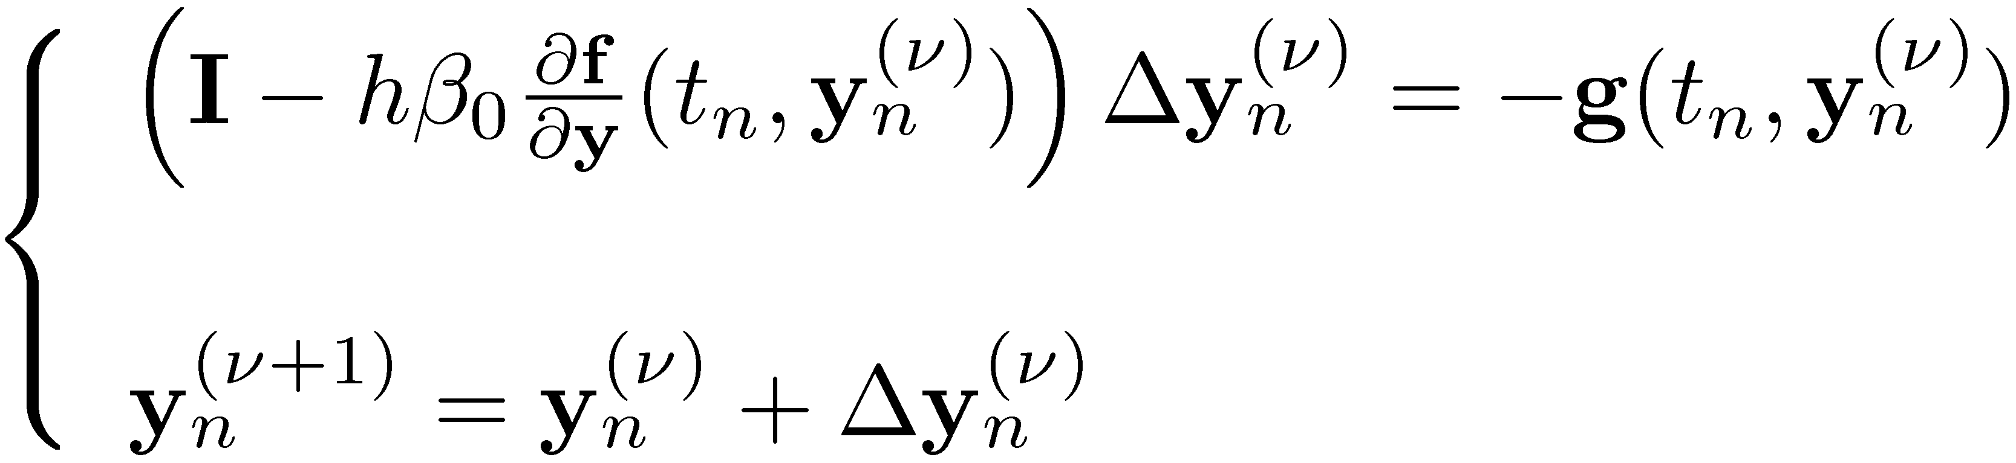
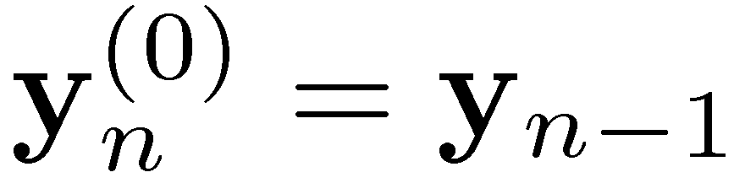
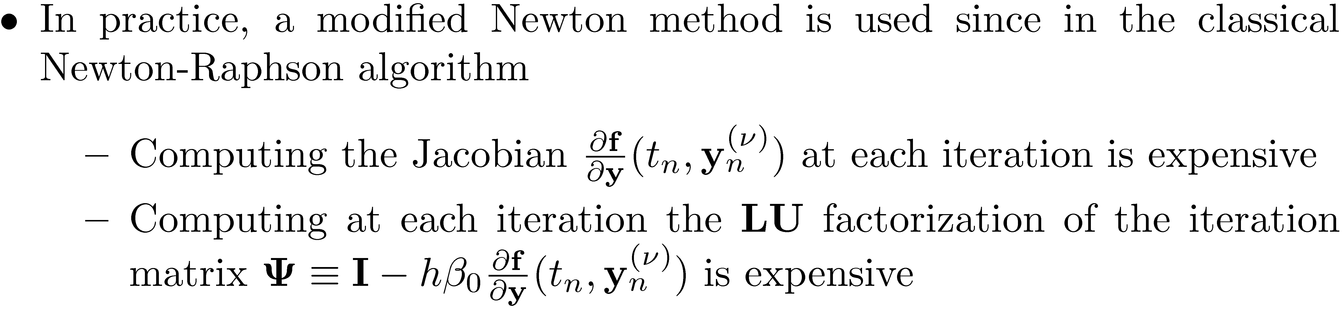
BDF Method: Implementation Details (Newton Iteration)
The Newton-Raphson iteration assumes the expression:
The starting point is usually chosen like

Slide 15
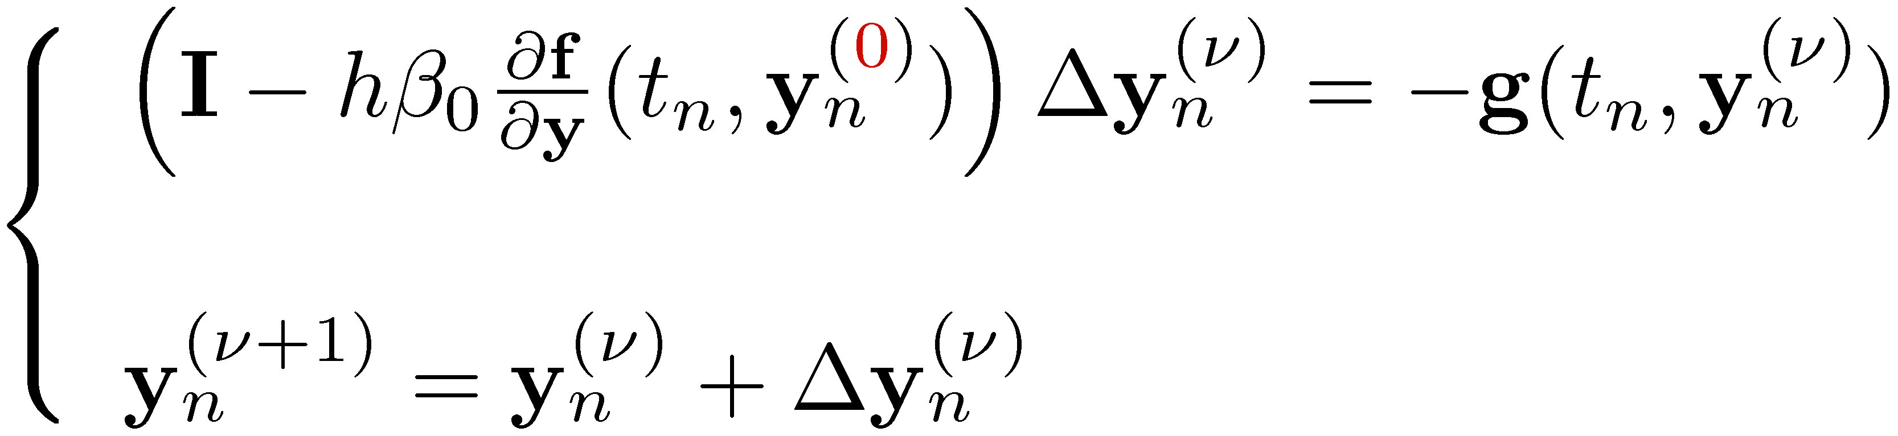
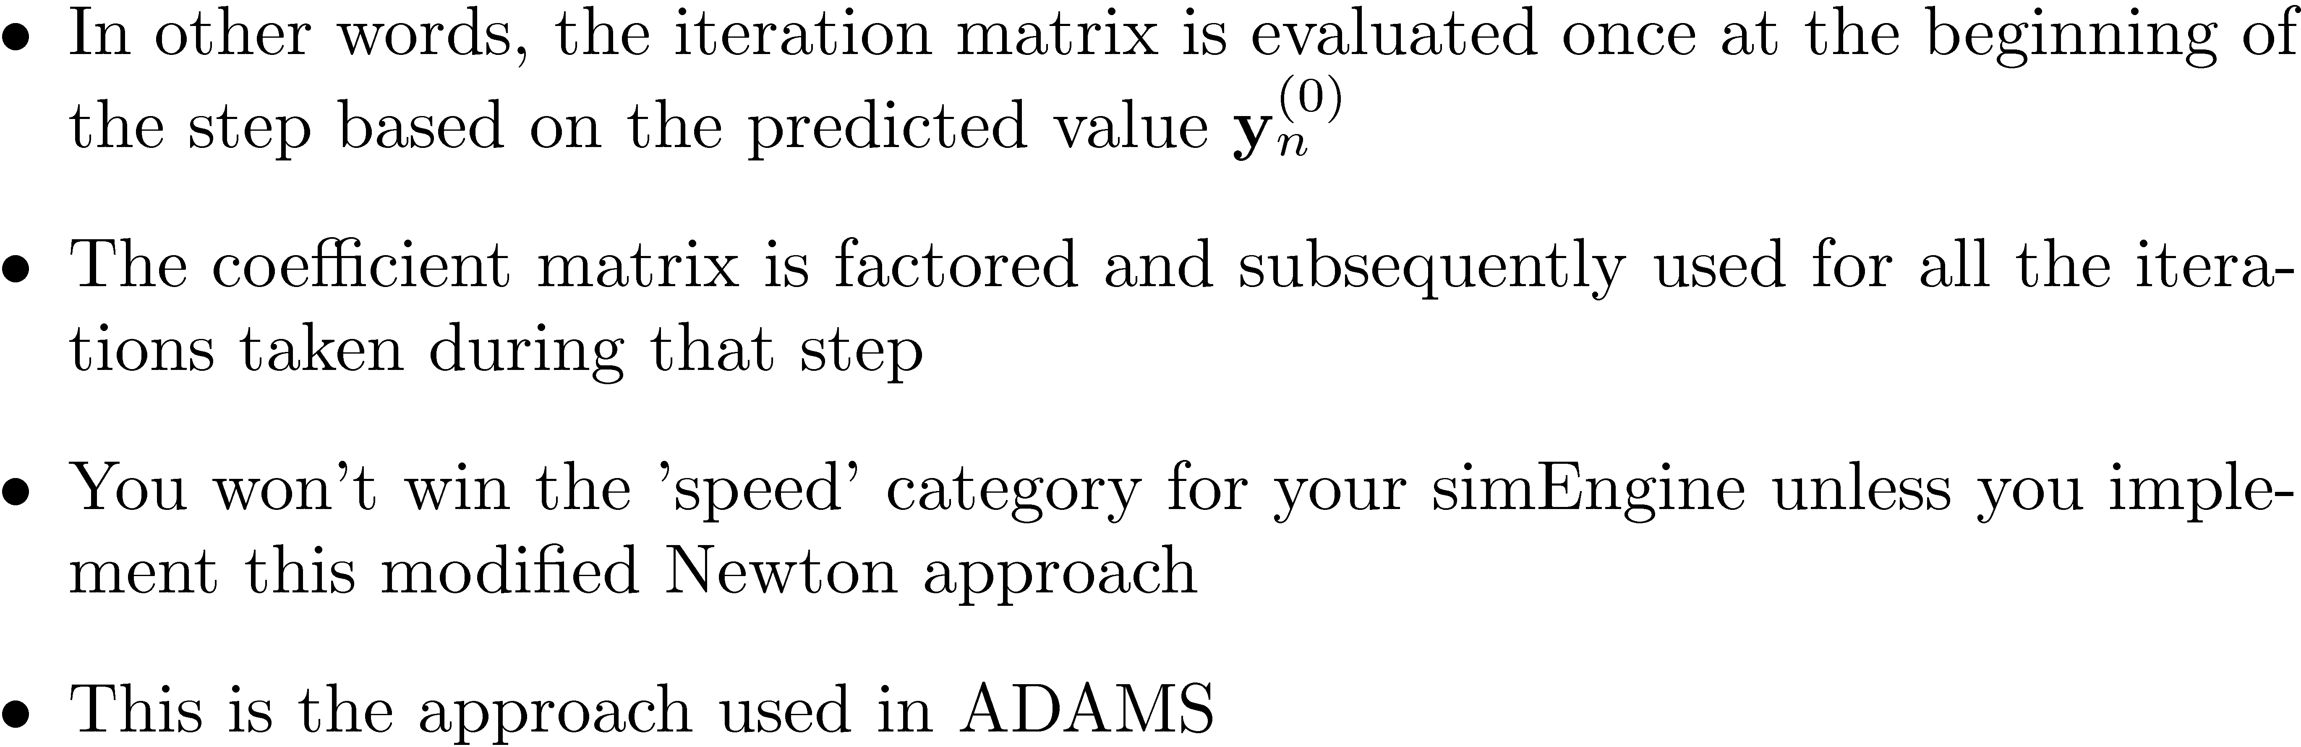
BDF Method: Implementation Details The Modified Newton step
The modified-Newton assumes the form (note the (0) superscript):

Slide 16
Loose Ends
We have not discusses about the following aspects of M methods
Local error estimation
Step size selection
Order selection
The three strategy for changing the step size
Fixed-coefficient strategy
Variable-coefficient strategy
Fixed leading-coefficient strategy
These aspects discussed in Ascher-Petzold book

Slide 17
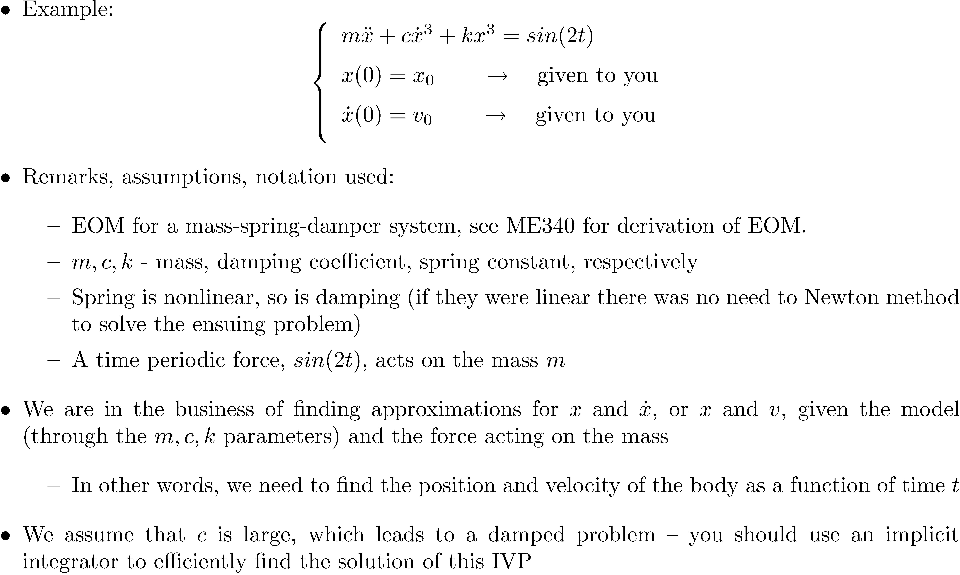
[New Topic] Handling 2nd Order IVP

Slide 18
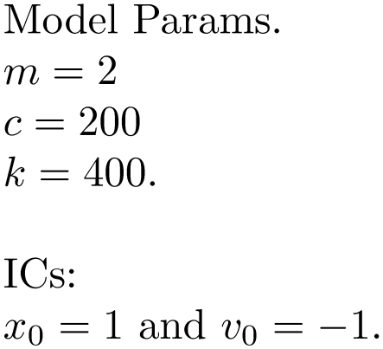
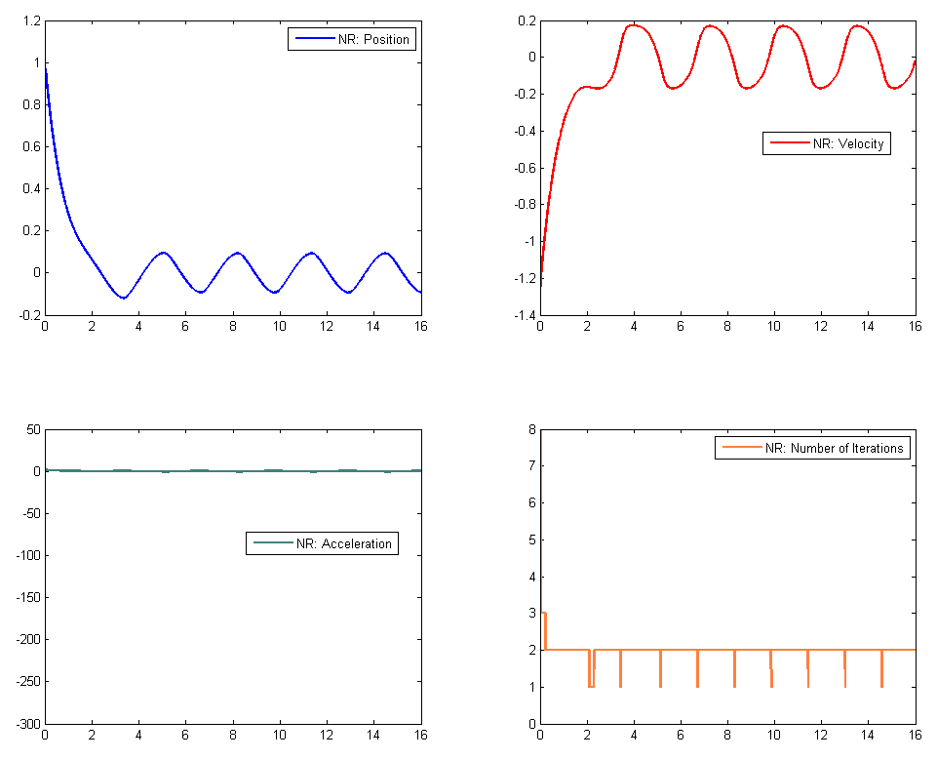
Outcome, Dynamics Analysis [Nonlinear Mass-Spring-Damper]

Slide 19
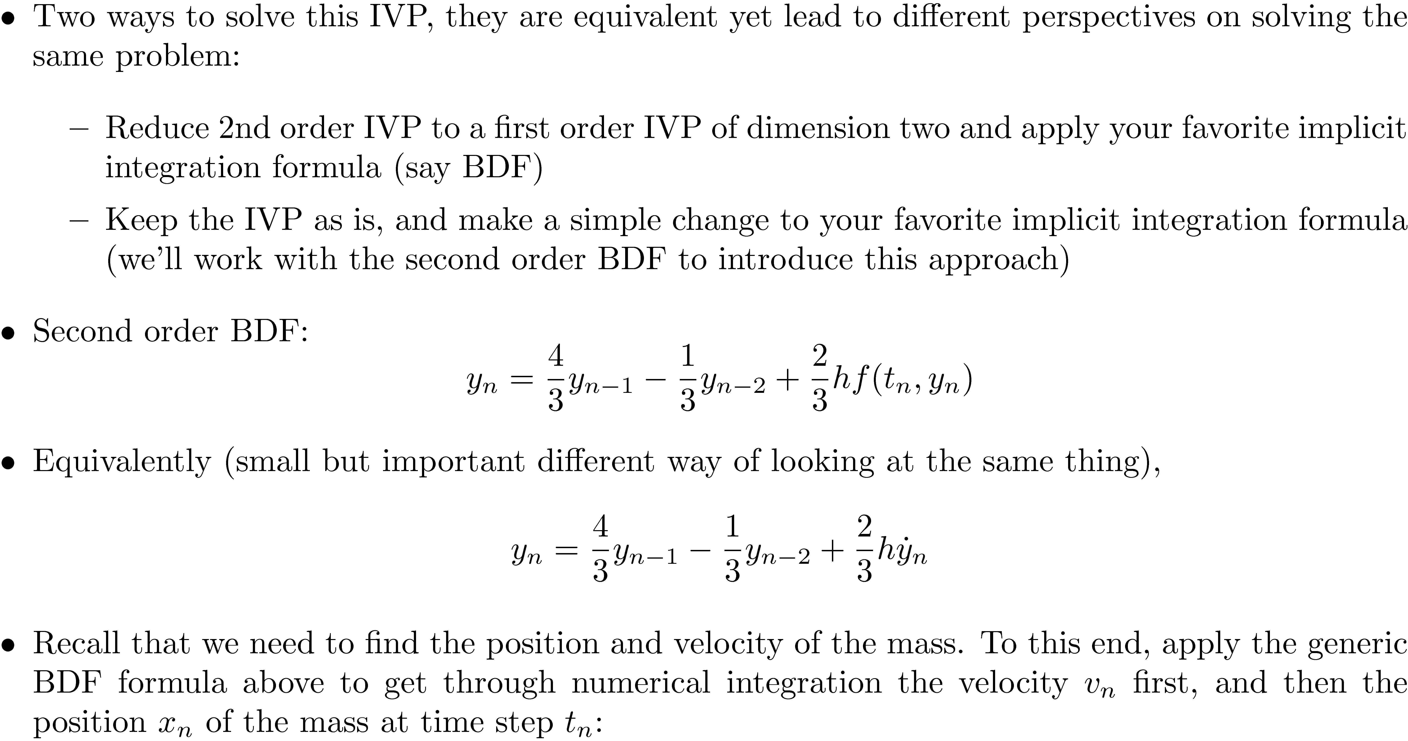

Slide 20
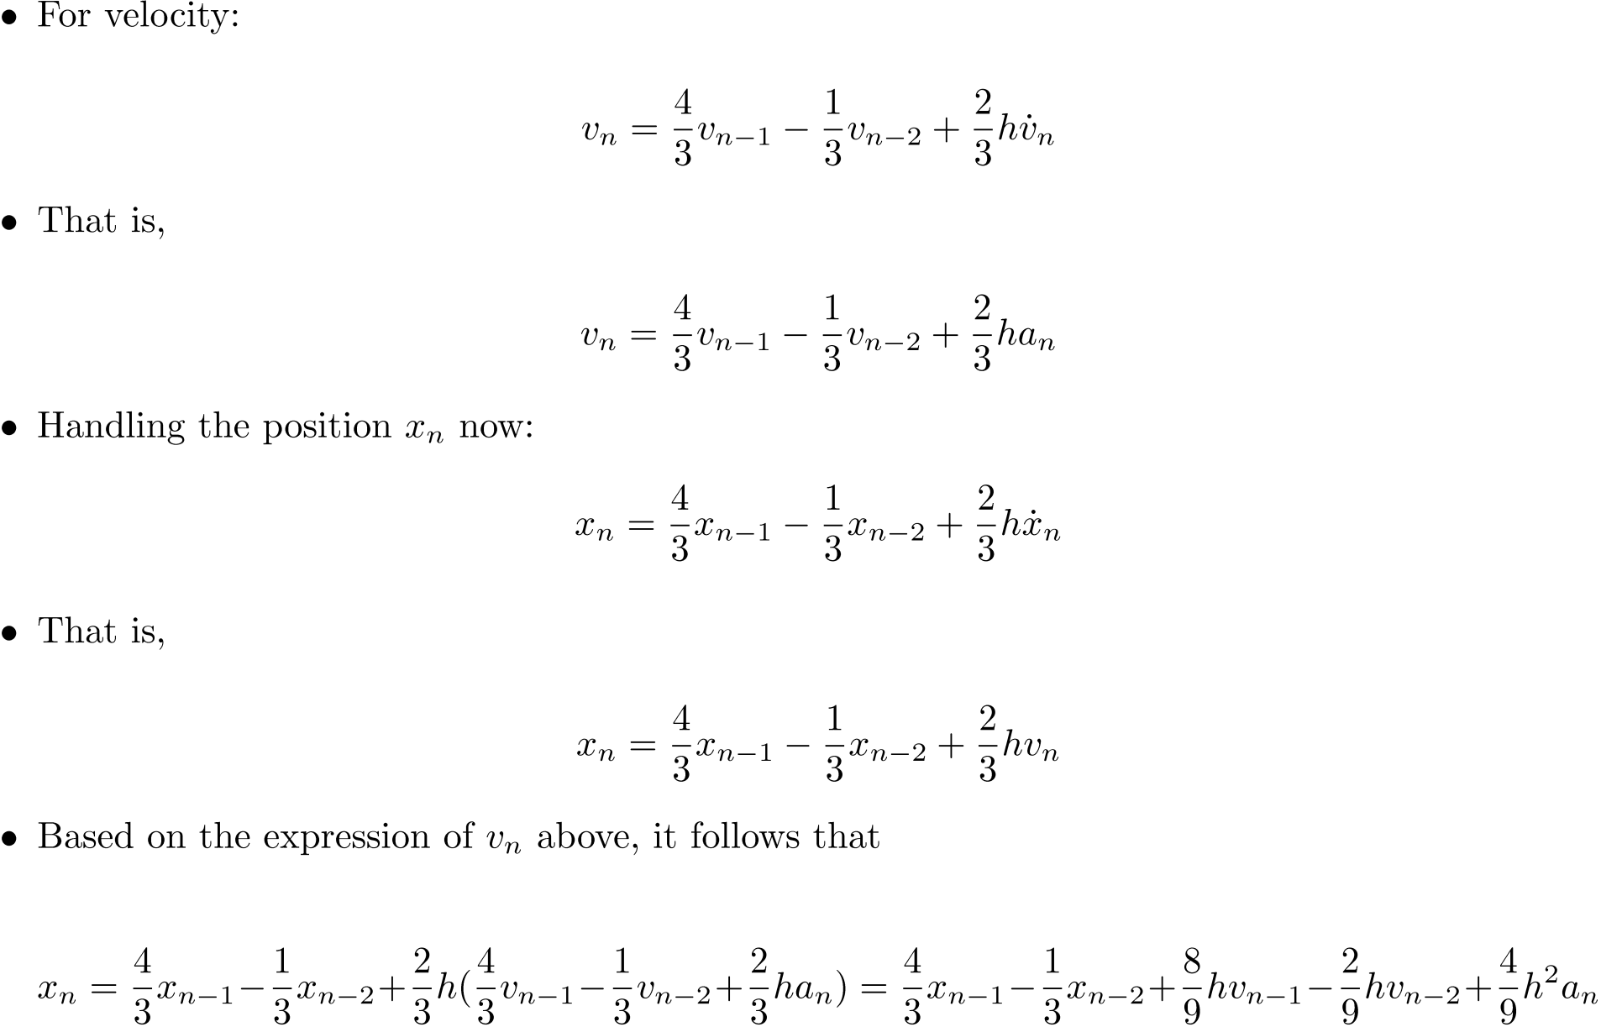
Expressing the Position and Velocity as Functions of Acceleration

Slide 21
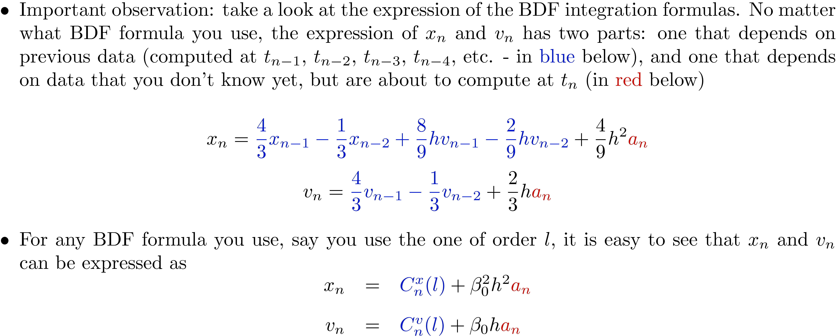
Separating the Terms: Known vs. Unknown

Slide 22
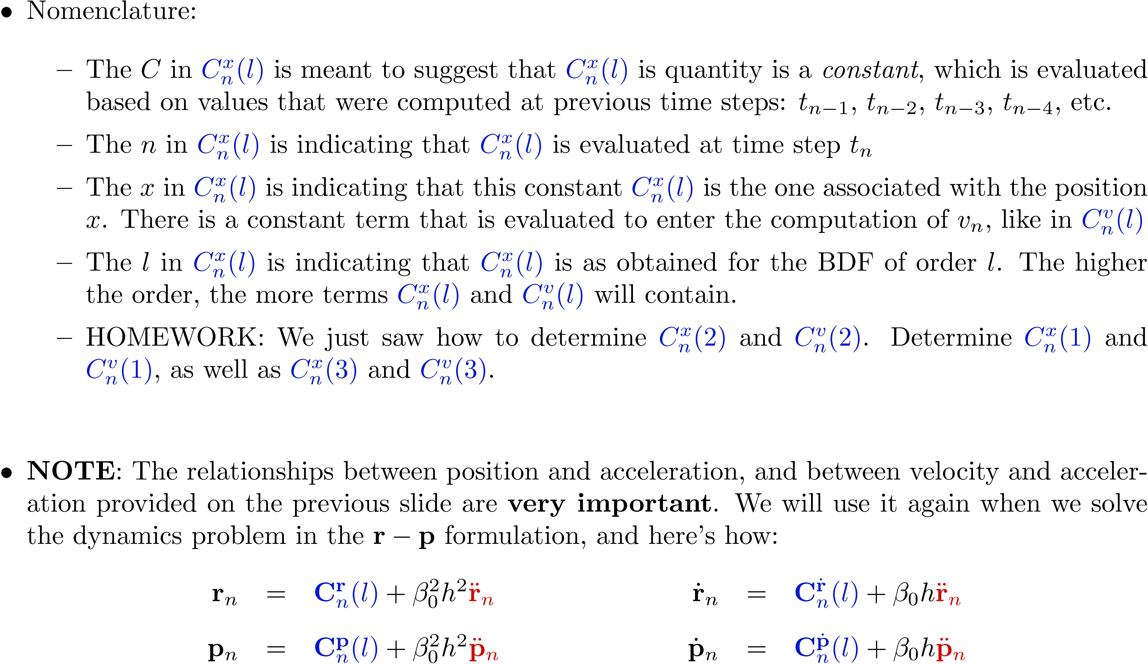
Separating the Terms: The Known Terms

Slide 23
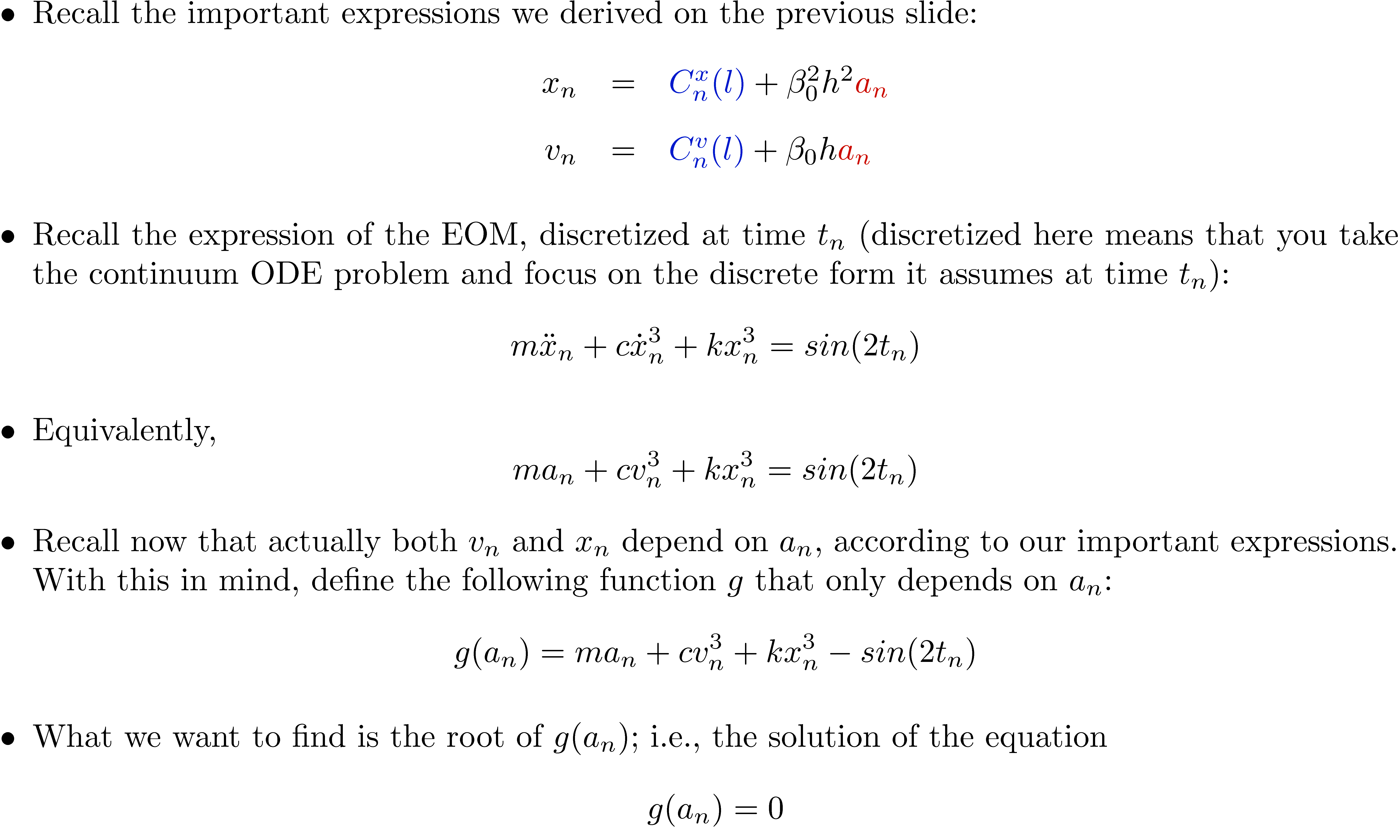
The Nonlinear System

Slide 24
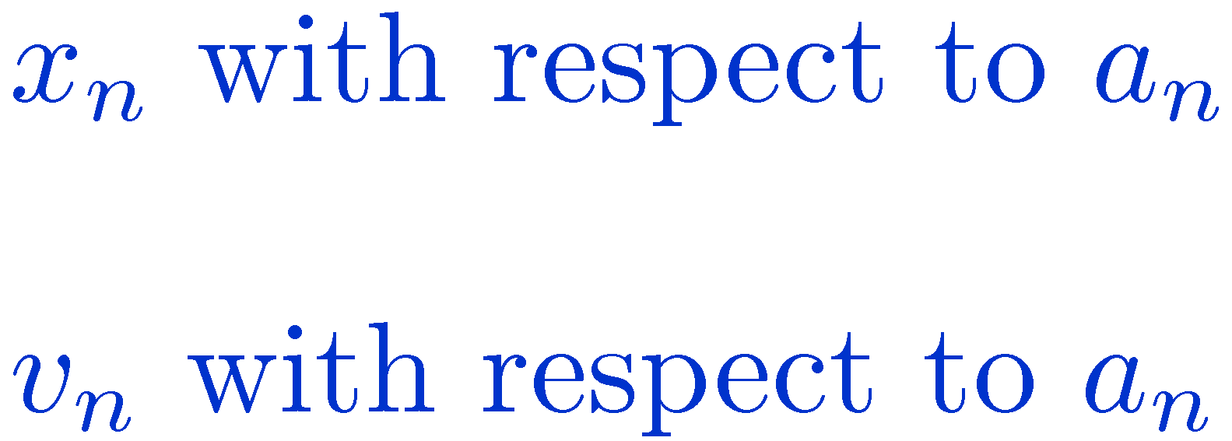
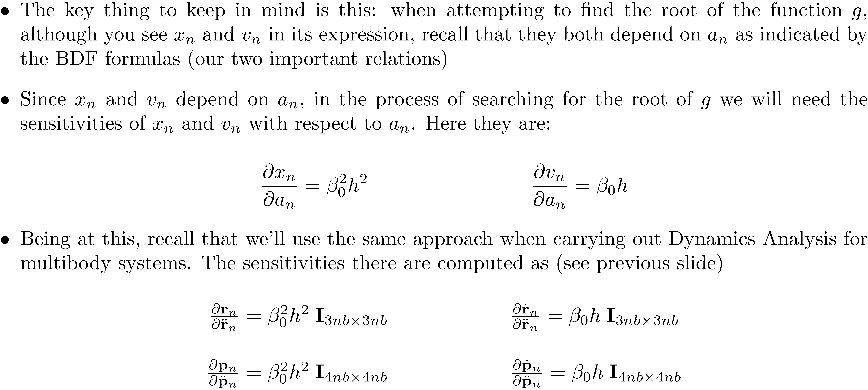
Computing Sensitivities

Slide 25
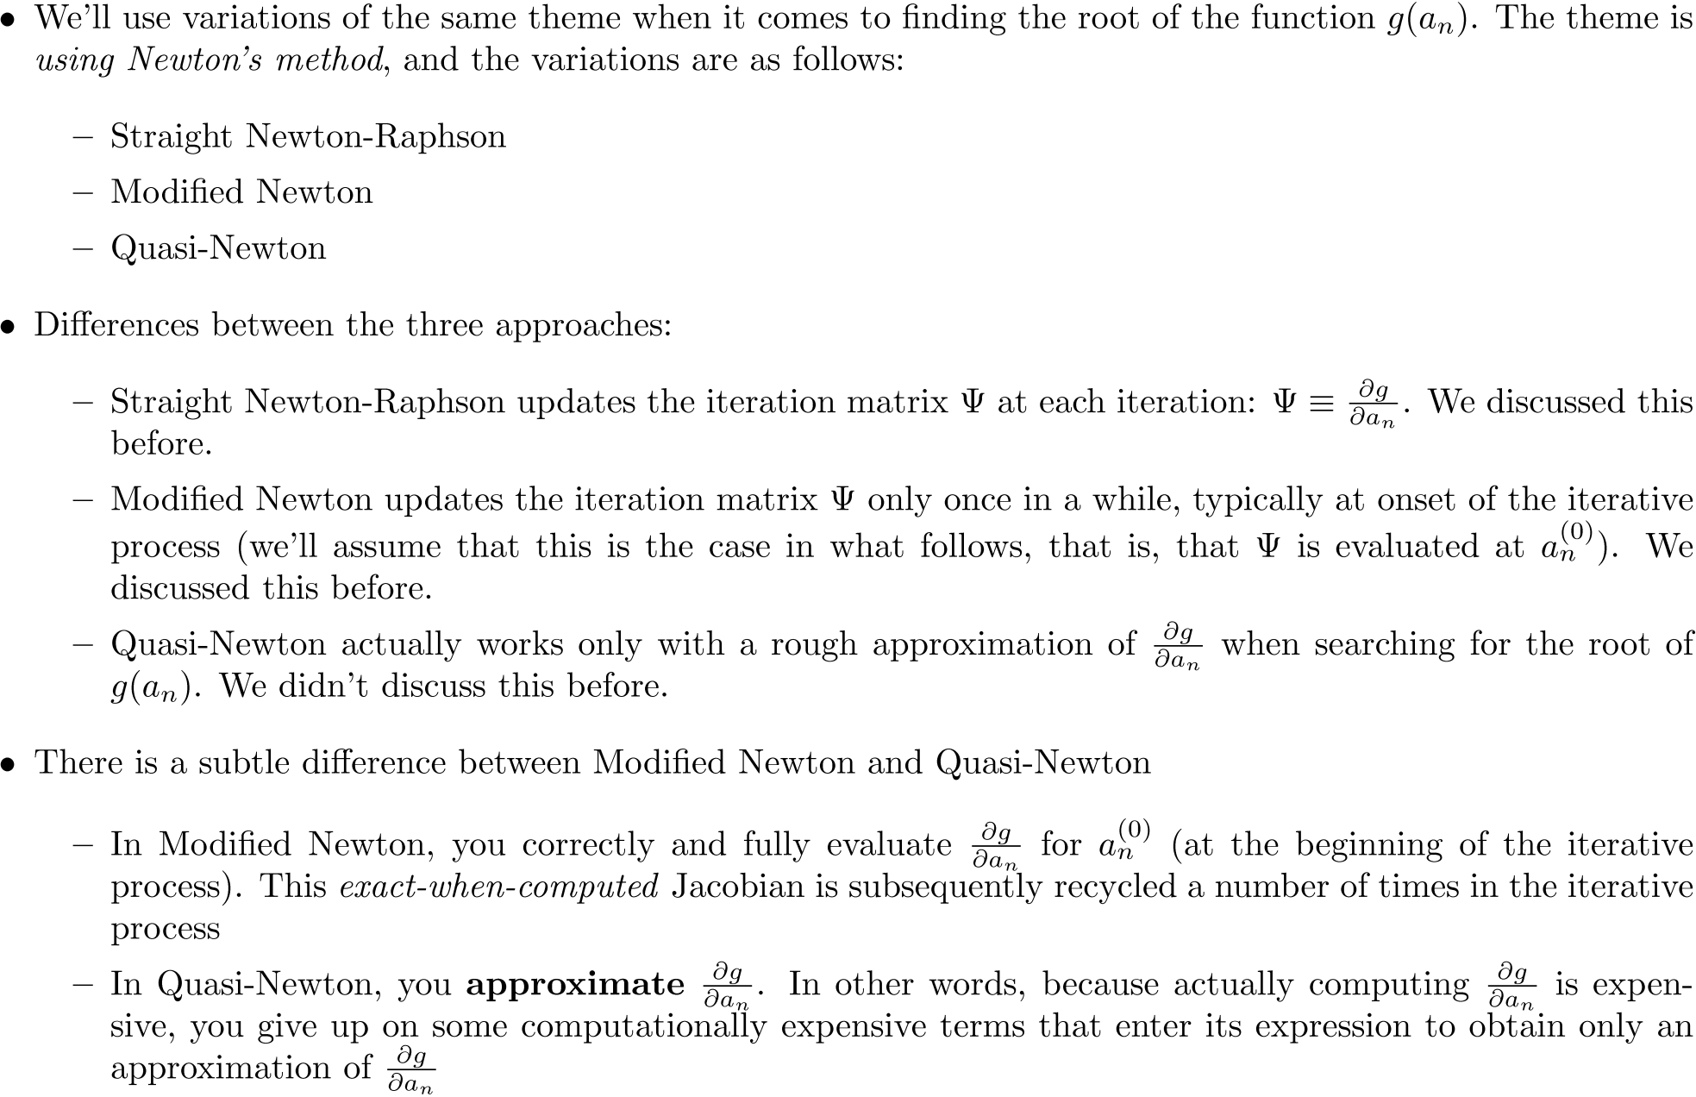
Newton-Type Methods: Three Flavors

Slide 26
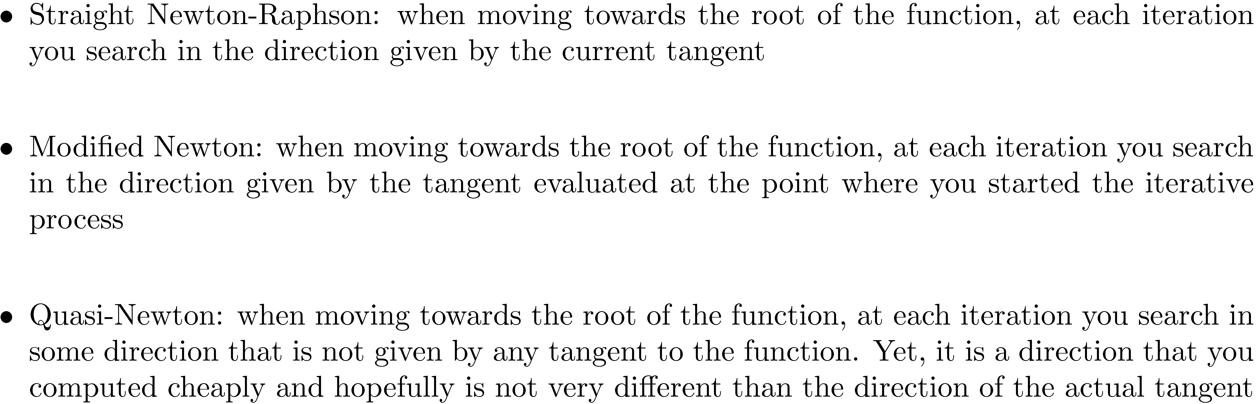
Newton-Type Methods: [Geometric Interpretation]

