Slide 1
ME751 Advanced Computational Multibody Dynamics
Loose Ends, BDF Solution of the Dynamics Analysis Problem
Discussion of Friction and Contact Forces
April 13, 2010
" With my sunglasses on, I'm Jack Nicholson. Without them, I'm fat and 60.” Jack Nicholson
© Dan Negrut, 2010 ME751, UW-Madison
TexPoint fonts used in EMF.
Read the TexPoint manual before you delete this box.: AAAAA

Slide 2
Before we get started…
Last Time:
Use BDF Methods to Solve the Dynamics Analysis problem
Discussed NR, MN, QN
Today:
Take care of some loose ends: Initial Conditions, Flow Chart for Dynamics Problem
Discuss two important classes of forces: Contact and Friction
HW
Due on Th - challenging
Last HW where you’ll have to generate code for SimEngine3D
Exam coming up on April 29, 7:15 PM
Closed books. You can bring one normal sheet of paper with formulas (both sides)
I’ll provide the cheat sheet that you received a while ago
Trip to John Deere & NADS:
I’ll send out an email with the list of people who expressed an interest in taking the trip

Slide 3
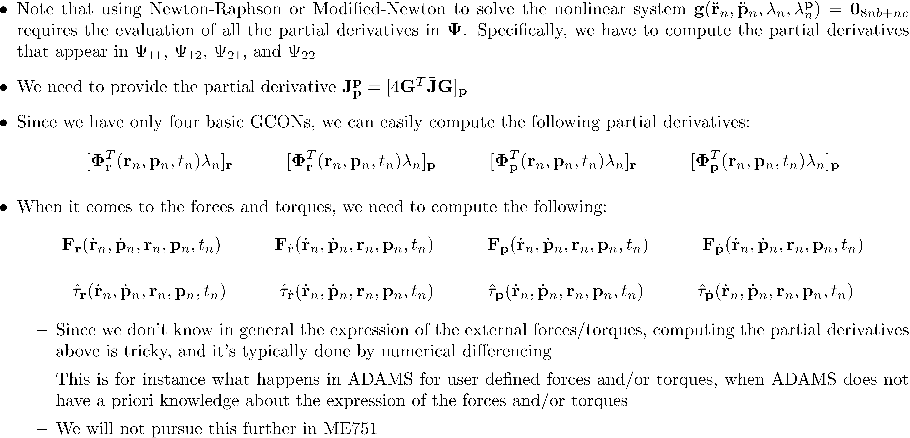
The Newton-Raphson and Modified-Newton Iteration Matrix [Step 3, Details of the Details]

Slide 4
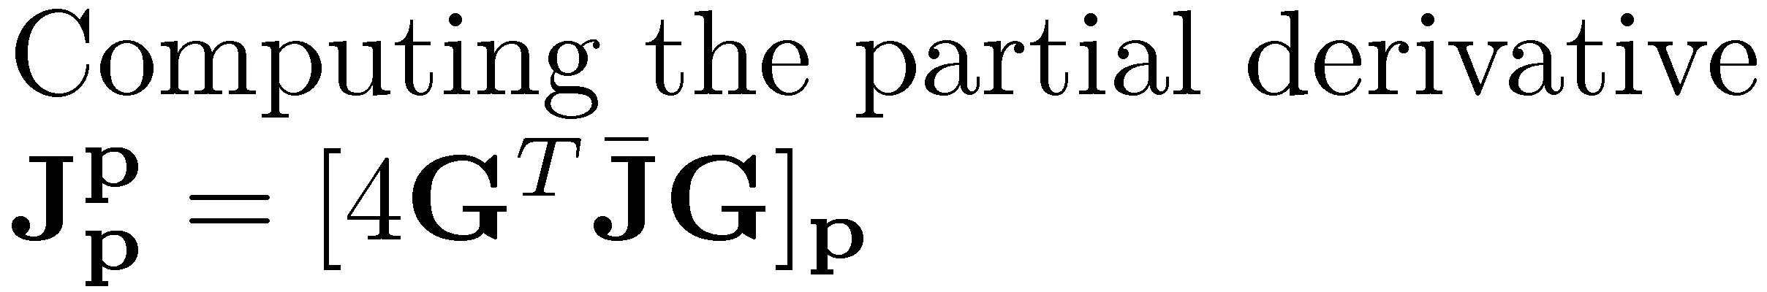
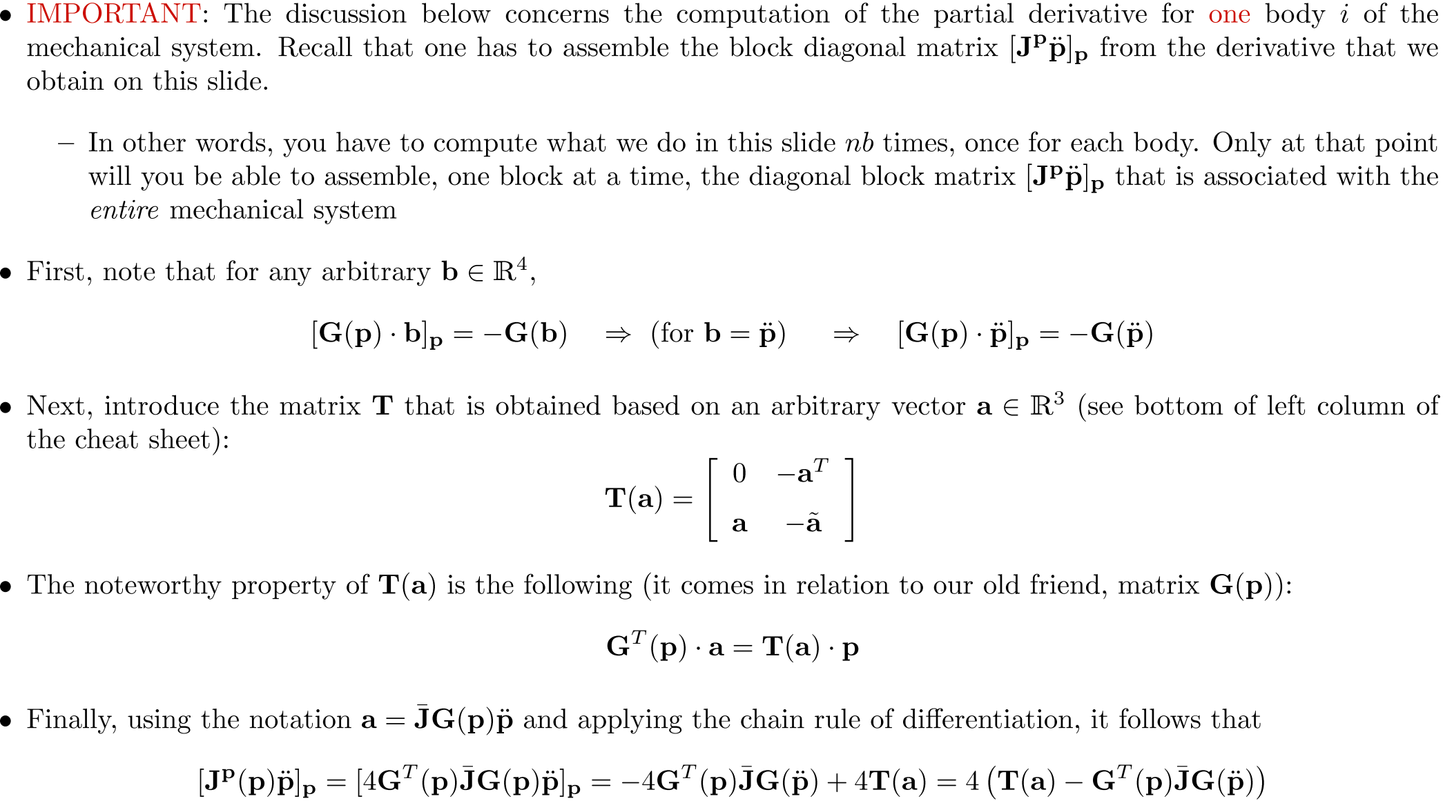

Slide 5
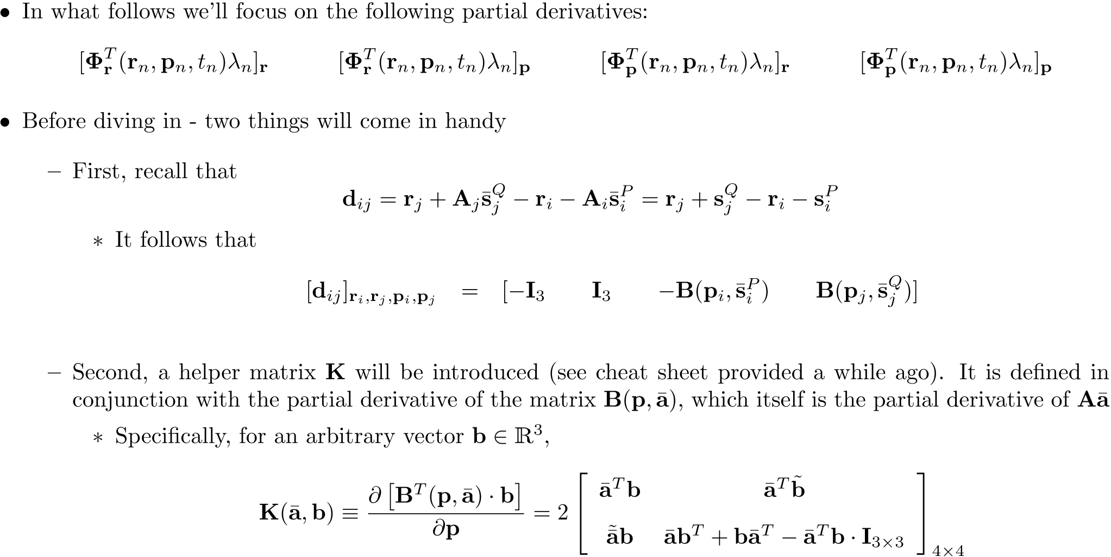
Computing the Partial Derivatives of the Reaction Forces

Slide 6
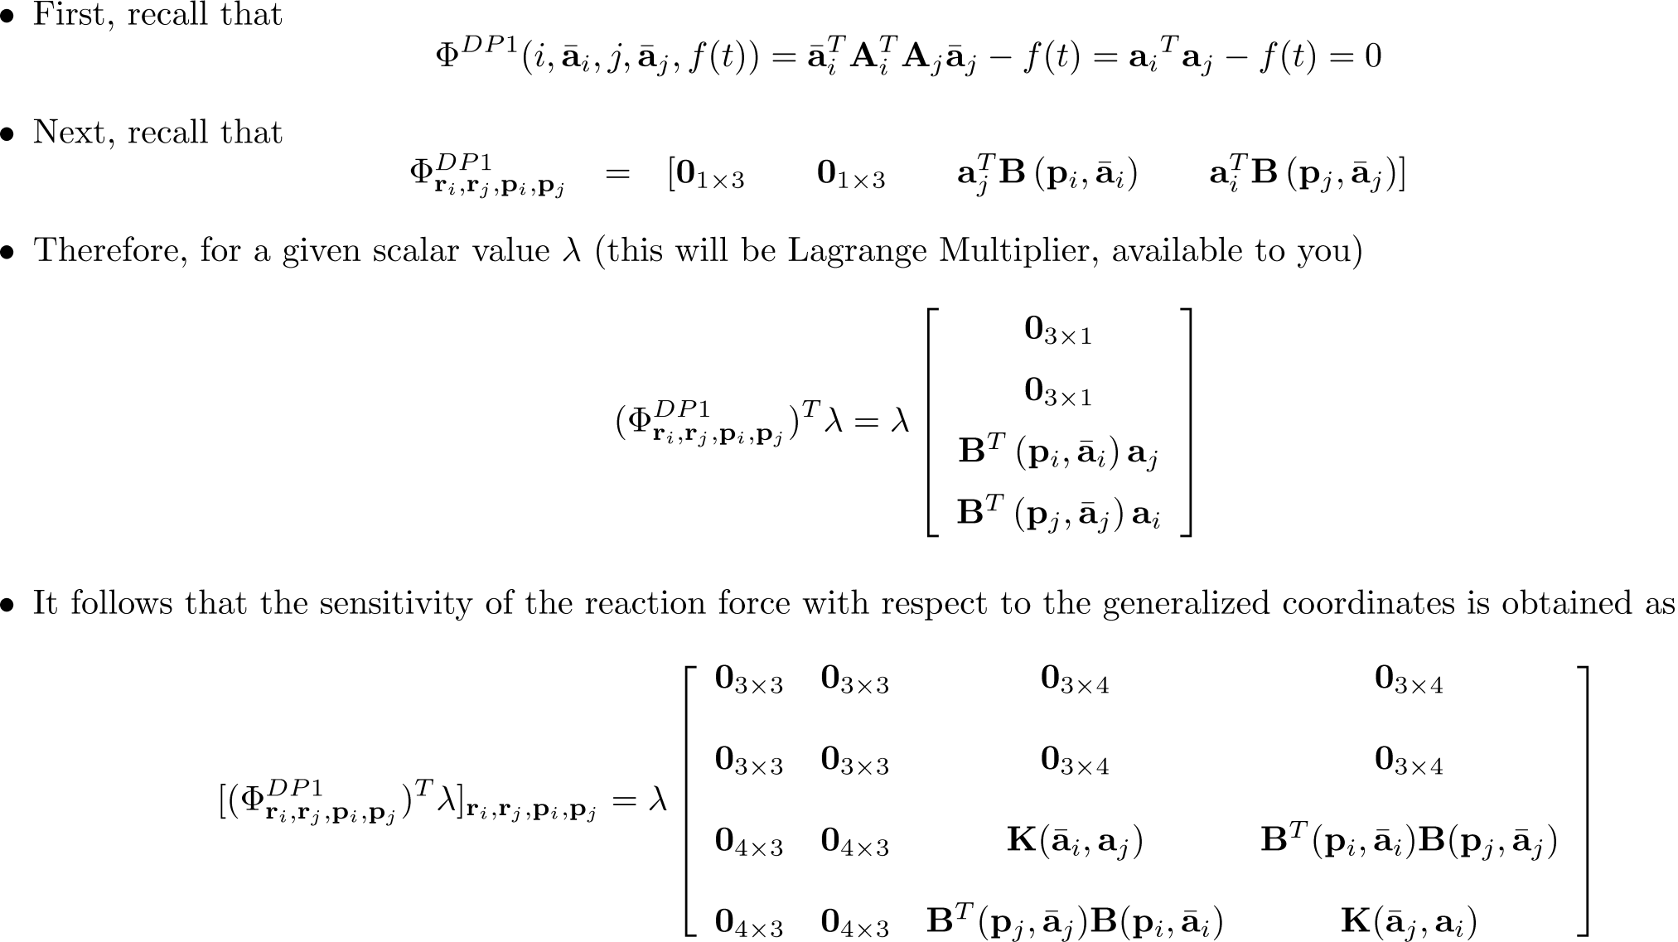
The GCon-DP1 Case

Slide 7
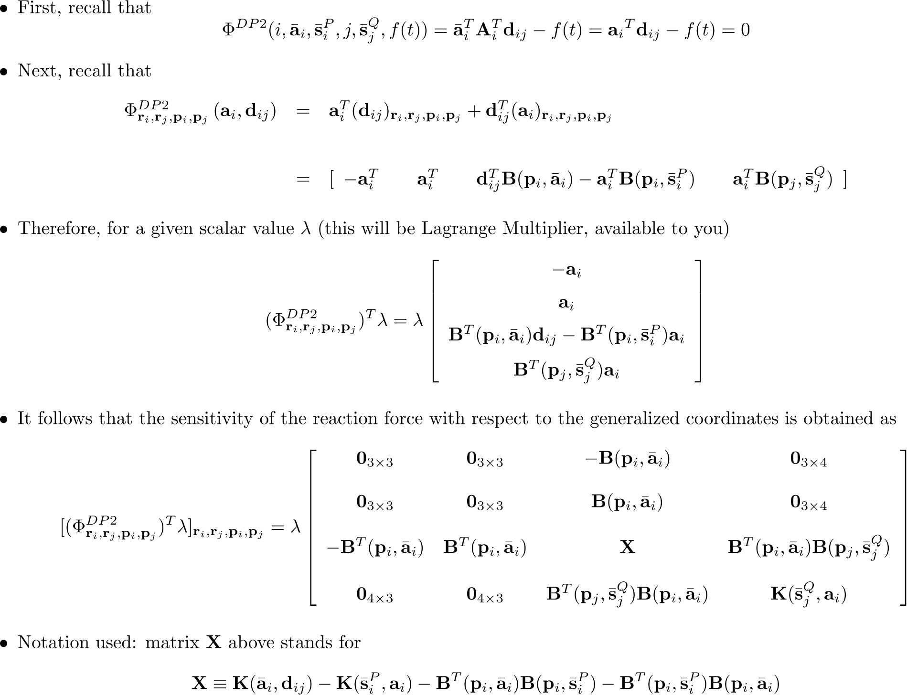
The GCon-DP2 Case

Slide 8
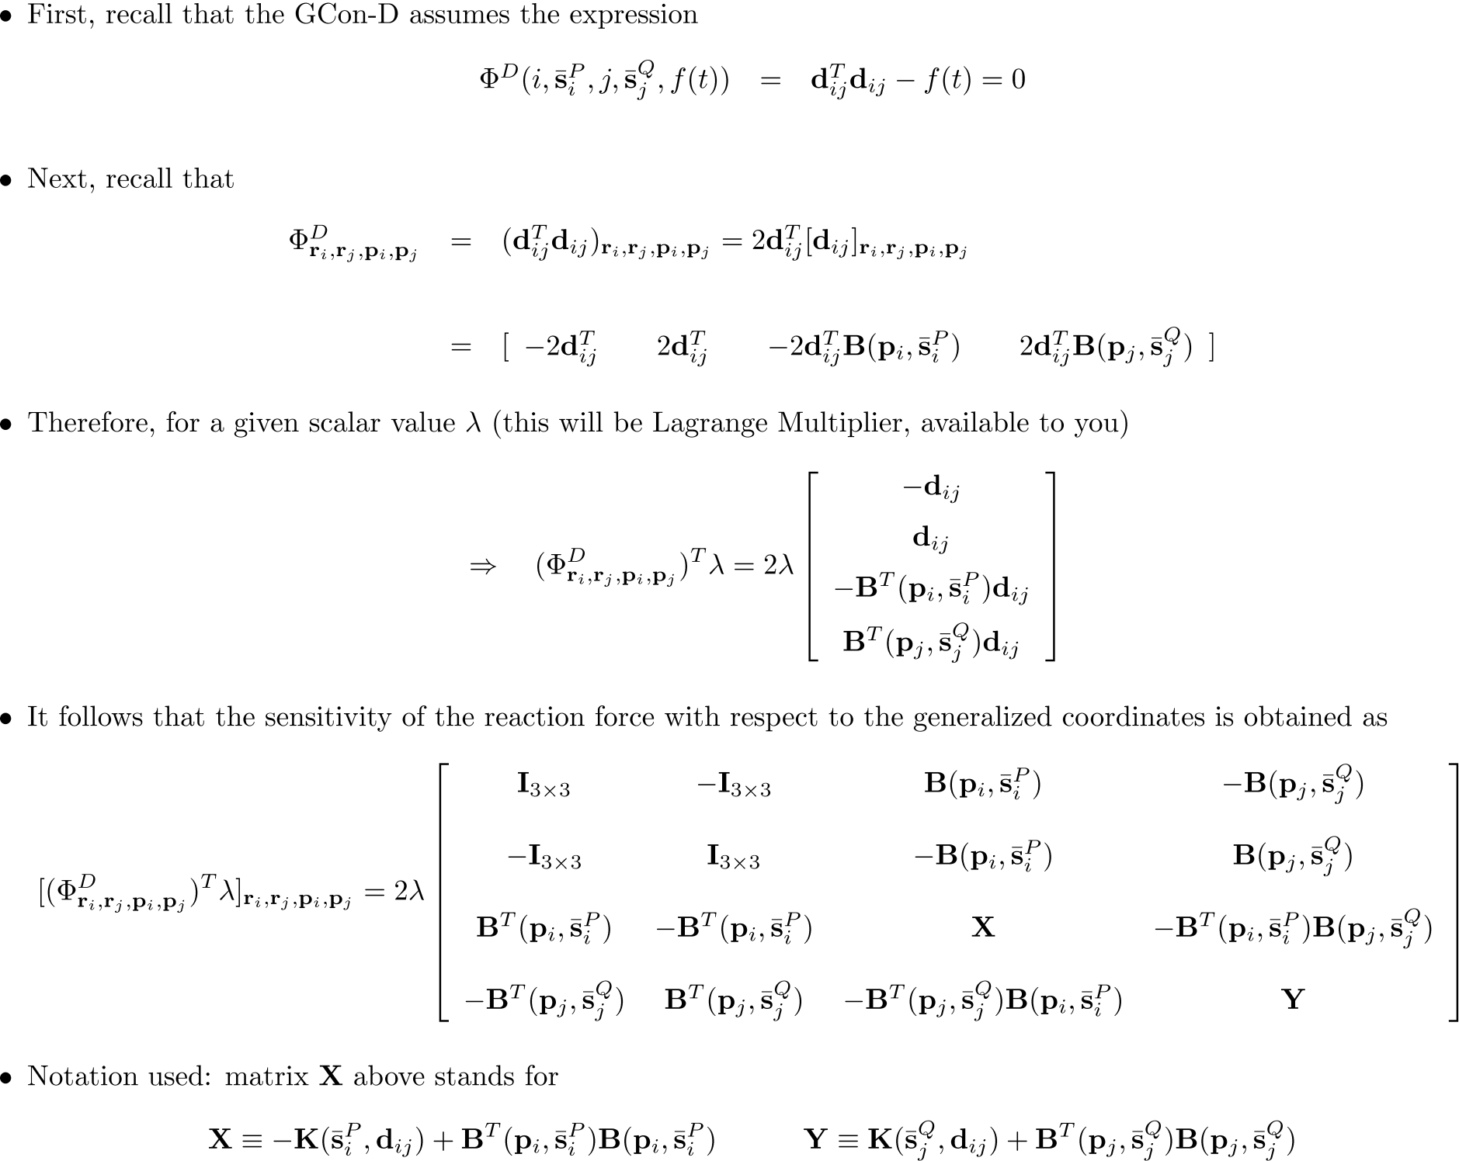
The GCon-D Case

Slide 9
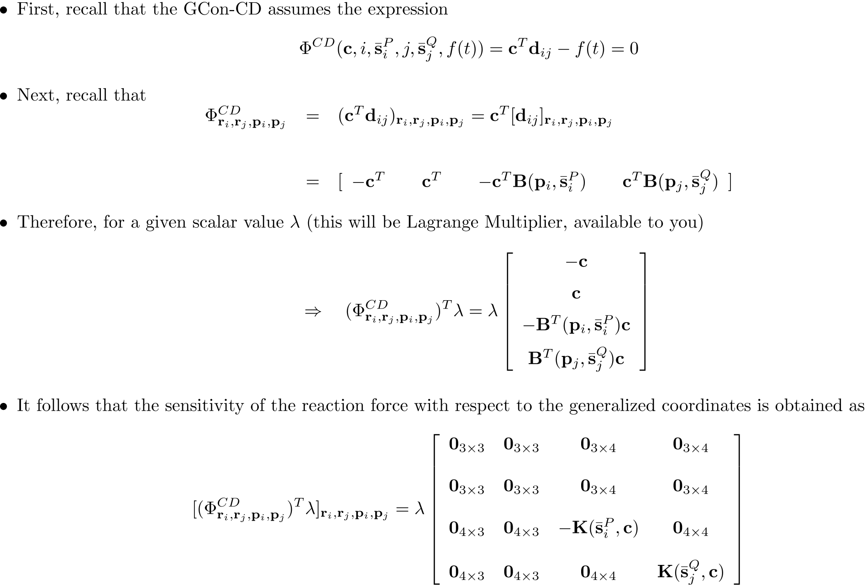
The GCon-CD Case

Slide 10
The Multibody Dynamics Problem: Putting Things in Perspective…
We derived the Newton-Euler equations of motion for a mechanical system
We had a set of kinematic and Euler parameterization constraints
Ended up with a set of DAEs that we solved on a time grid
At each node of the time grid, we discretized the DAE in conjunction with BDF to get a nonlinear system
We discussed NR, MN, and QN in relation to solving this system of nonlinear equations
Next: discuss about prescribing initial conditions
Very important: you must start in a healthy (consistent) configuration for your solution to make sense

Slide 11
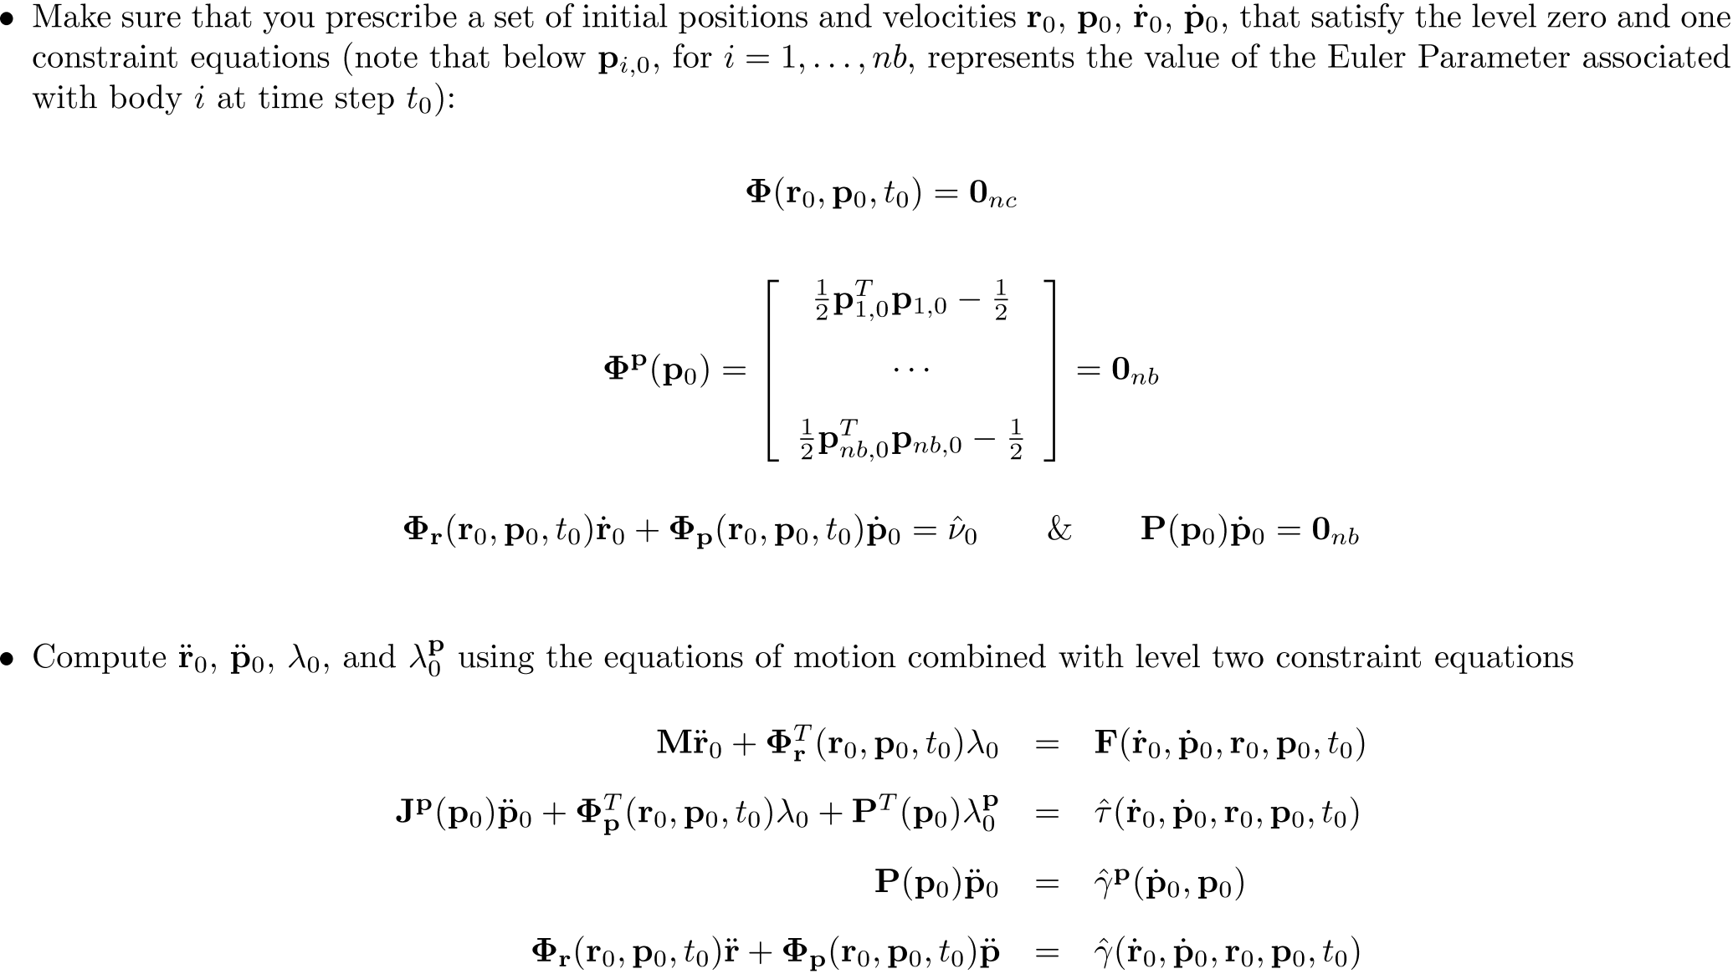
The Dynamics Analysis Problem: Prescribing Initial Conditions

Slide 12
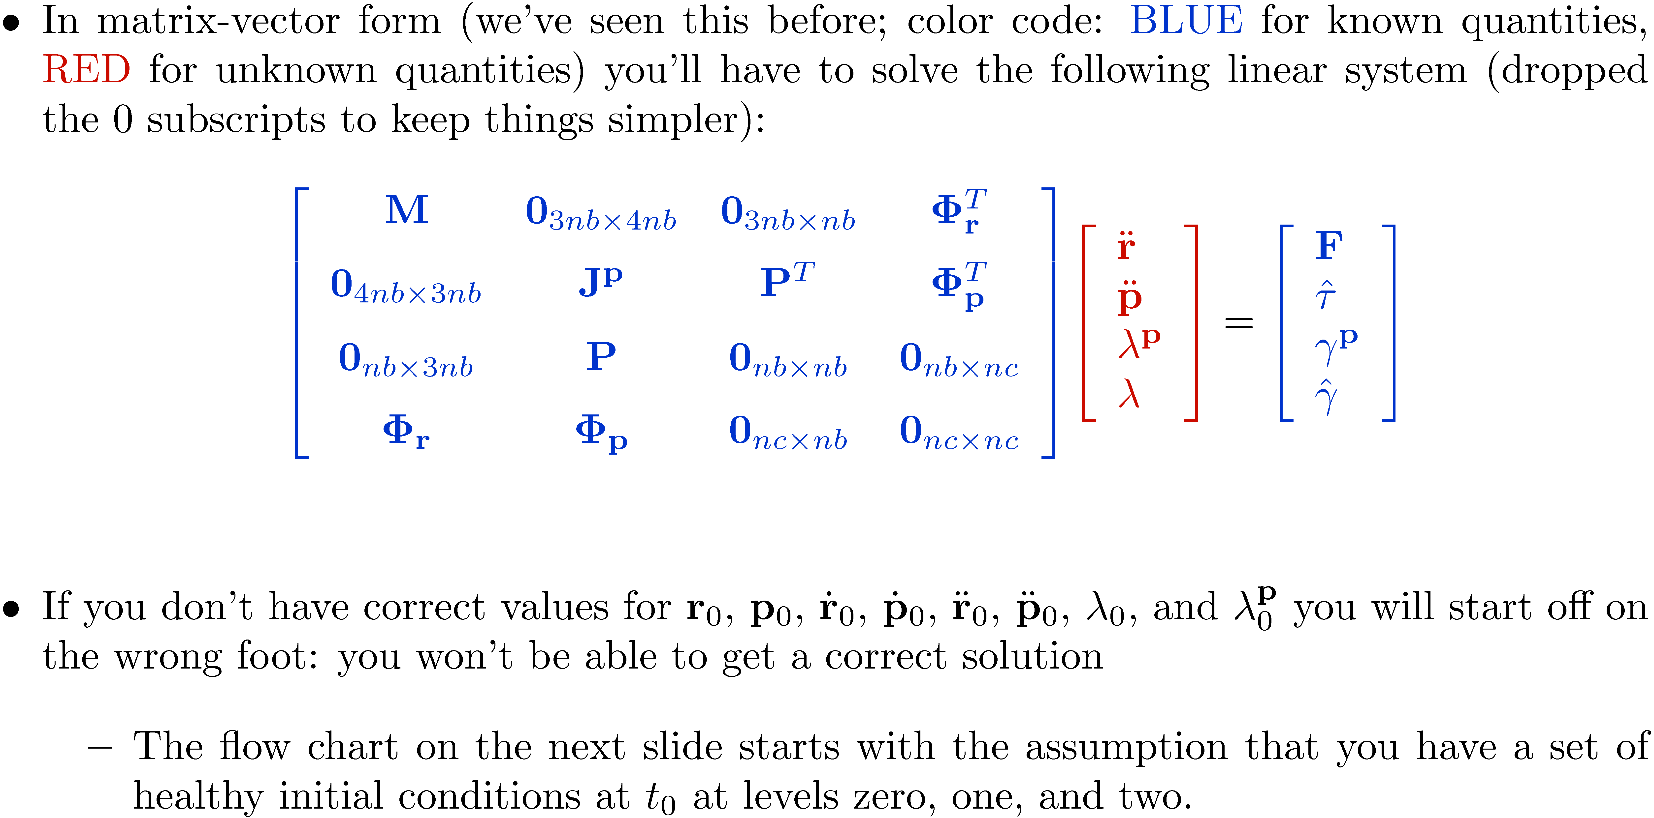
Initial Conditions [Cntd.]

Slide 13
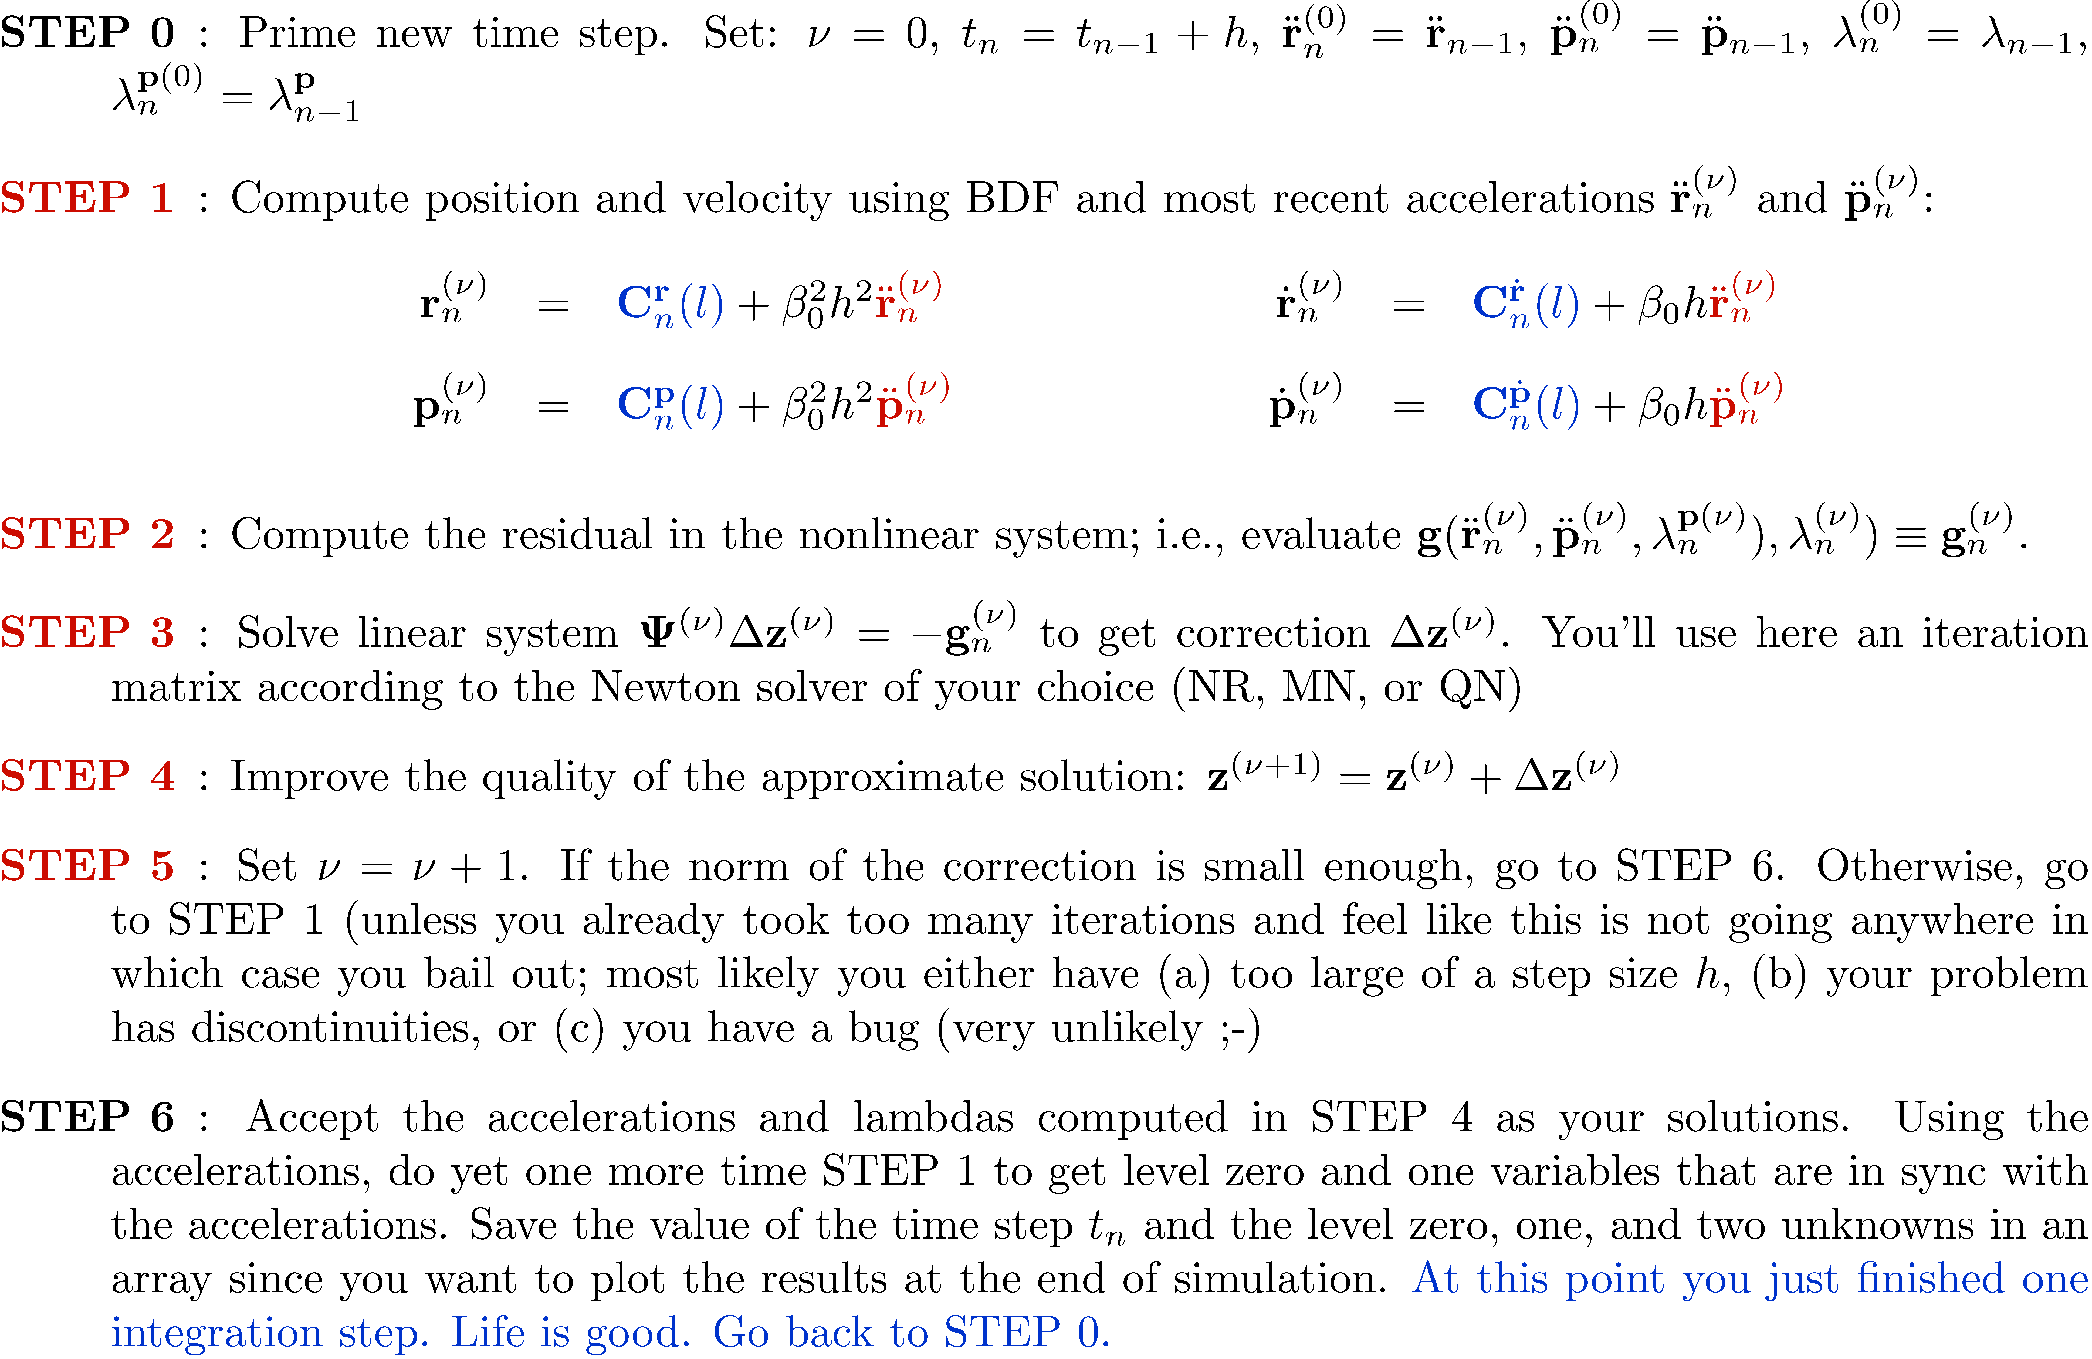
Solving the Dynamics Problem: The Flow Chart

Slide 14
End: The Dynamics Analysis Problem Begin: Handling Friction and Contact in Multibody Dynamics

Slide 15
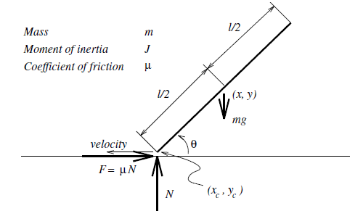
Handling Frictional Contact
One of Painlevé’s paradoxes (similar to chalk scratching on board)
Topic is an active area of research, very challenging problem
Topic is extremely relevant applications in CAE and Video Gaming
Quick remarks:
We liked the rigid body model, it significantly simplified the dynamics problem
Painlevé (late 1800’s) came up with simple examples that looked like paradoxes: there would be no solution for the time evolution of simple rigid body dynamics problems with contact and Coulomb friction
Embracing an elastic body model will not make your life simpler. Addresses the paradoxes but at a very heavy analytical and computational price
D. Steward and M. Anitescu: came up with approaches that resolve Painlevé’s paradox

Slide 16
Dealing with Friction and Contact in ME751
30,000 feet perspective

Slide 17
General Comments, DEM
Especially in Discrete Element Method (DEM) approaches, there is a tendency to regard everything in the universe as spheres or collections of spheres
The DEM proceeds by using deformable body mechanics to understand what happens when two spheres are pressed against each other
Standard reference:
K. L. Johnson, Contact Mechanics, University Press, Cambridge, 1987.
This understanding is subsequently grafted to the general dynamics problem of rigid bodies flying in space and colliding with each other
When they collide, a fictitious spring-damper element is placed between the two bodies
Sometimes spring & damping coefficient based on continuum theory mentioned above
Sometimes values are guessed (calibration) based on experimental data

