Slide 1
ME751 Advanced Computational Multibody Dynamics
Discussion of Friction and Contact Forces
Wrap Up, DEM
Start DVI Methods
April 15, 2010
“If I wasn't Bob Dylan, I'd probably think that Bob Dylan has a lot of answers myself.” Bob Dylan
© Dan Negrut, 2010 ME751, UW-Madison
TexPoint fonts used in EMF.
Read the TexPoint manual before you delete this box.: AAAAA

Slide 2
Before we get started…
Last Time:
Took care of some loose ends: Initial Conditions, Flow Chart for Dynamics Problem
Started handling Contact and Friction ! discussed DEM
Today:
Wrap up DEM
Start DVI (last topic discussed in ME751)
HW
New assignment posted later today
See yesterday’s email for logistics in terms of last two assignments
Final Project
Presentation only
Email software and PPT presentation at least 12 hours prior to your presentation time slot
Four students picked their time slots
Trip to John Deere & NADS:
John Deere looks questionable

Slide 3
Dealing with Friction and Contact in ME751
30,000 feet perspective

Slide 4
General Comments, DEM
Especially in Discrete Element Method (DEM) approaches, there is a tendency to regard everything in the universe as spheres or collections of spheres
The DEM proceeds by using deformable body mechanics to understand what happens when two spheres are pressed against each other
Standard reference:
K. L. Johnson, Contact Mechanics, University Press, Cambridge, 1987.
This understanding is subsequently grafted to the general dynamics problem of rigid bodies flying in space and colliding with each other
When they collide, a fictitious spring-damper element is placed between the two bodies
Sometimes spring & damping coefficient based on continuum theory mentioned above
Sometimes values are guessed (calibration) based on experimental data

Slide 5
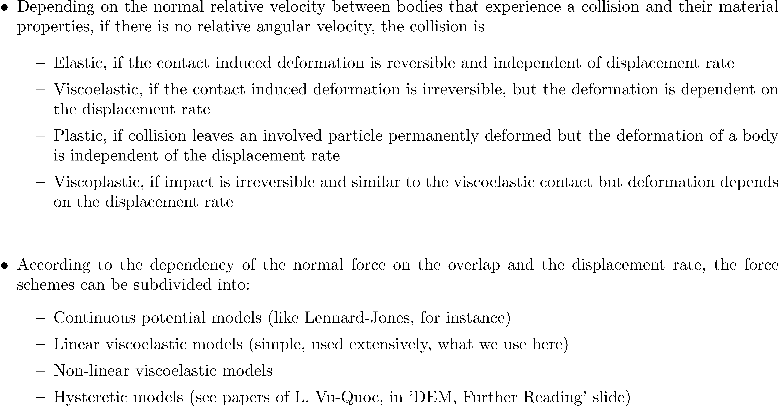
The Discrete Element Method (DEM)

Slide 6
Gravity-driven Dense Granular Flows
D. Ertas, G. S. Grest, T. C. Halsey, D. Levine and L. E. Silbert

Slide 7
Paper Overview
D. Ertas, G. Grest, T. Halsey, D. Levine and L. Silbert, Gravity-driven dense granular flows, EPL (Europhysics Letters), 56 (2001), pp. 214-220.
Analyzes dense granular flows on an incline with a rough bottom
Inter-particle interactions between spheres modeled using linear damped spring or Hertzian force laws.
2D and 3D analysis
Main obstacle in simulation: reaching and maintaining steady state
Periodic and no slip boundary conditions (BCs) are imposed
Can’t deal with too many particles, from where the use of periodic BCs
Side-wall effects are avoided

Slide 8
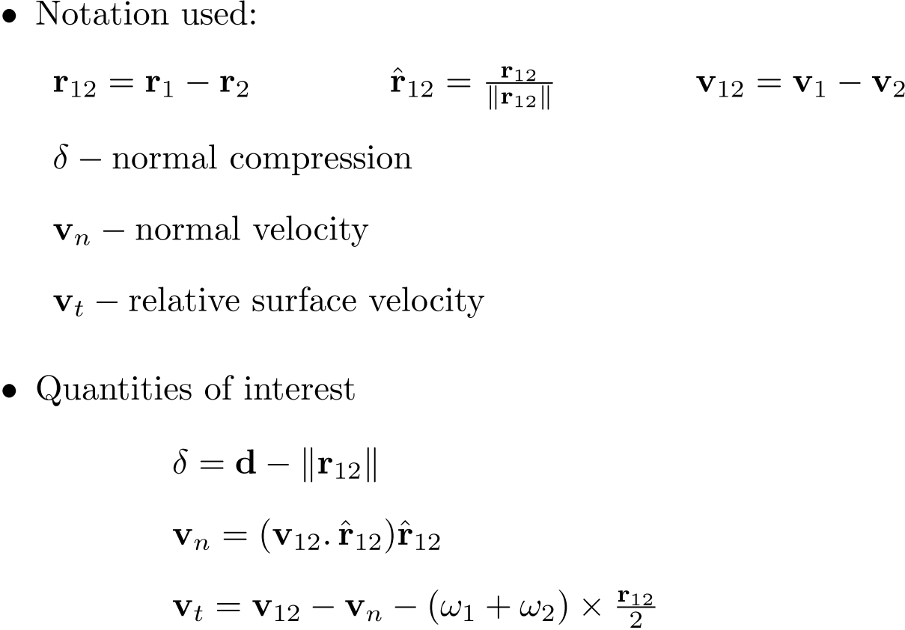
The Frictional Contact Model

Slide 9
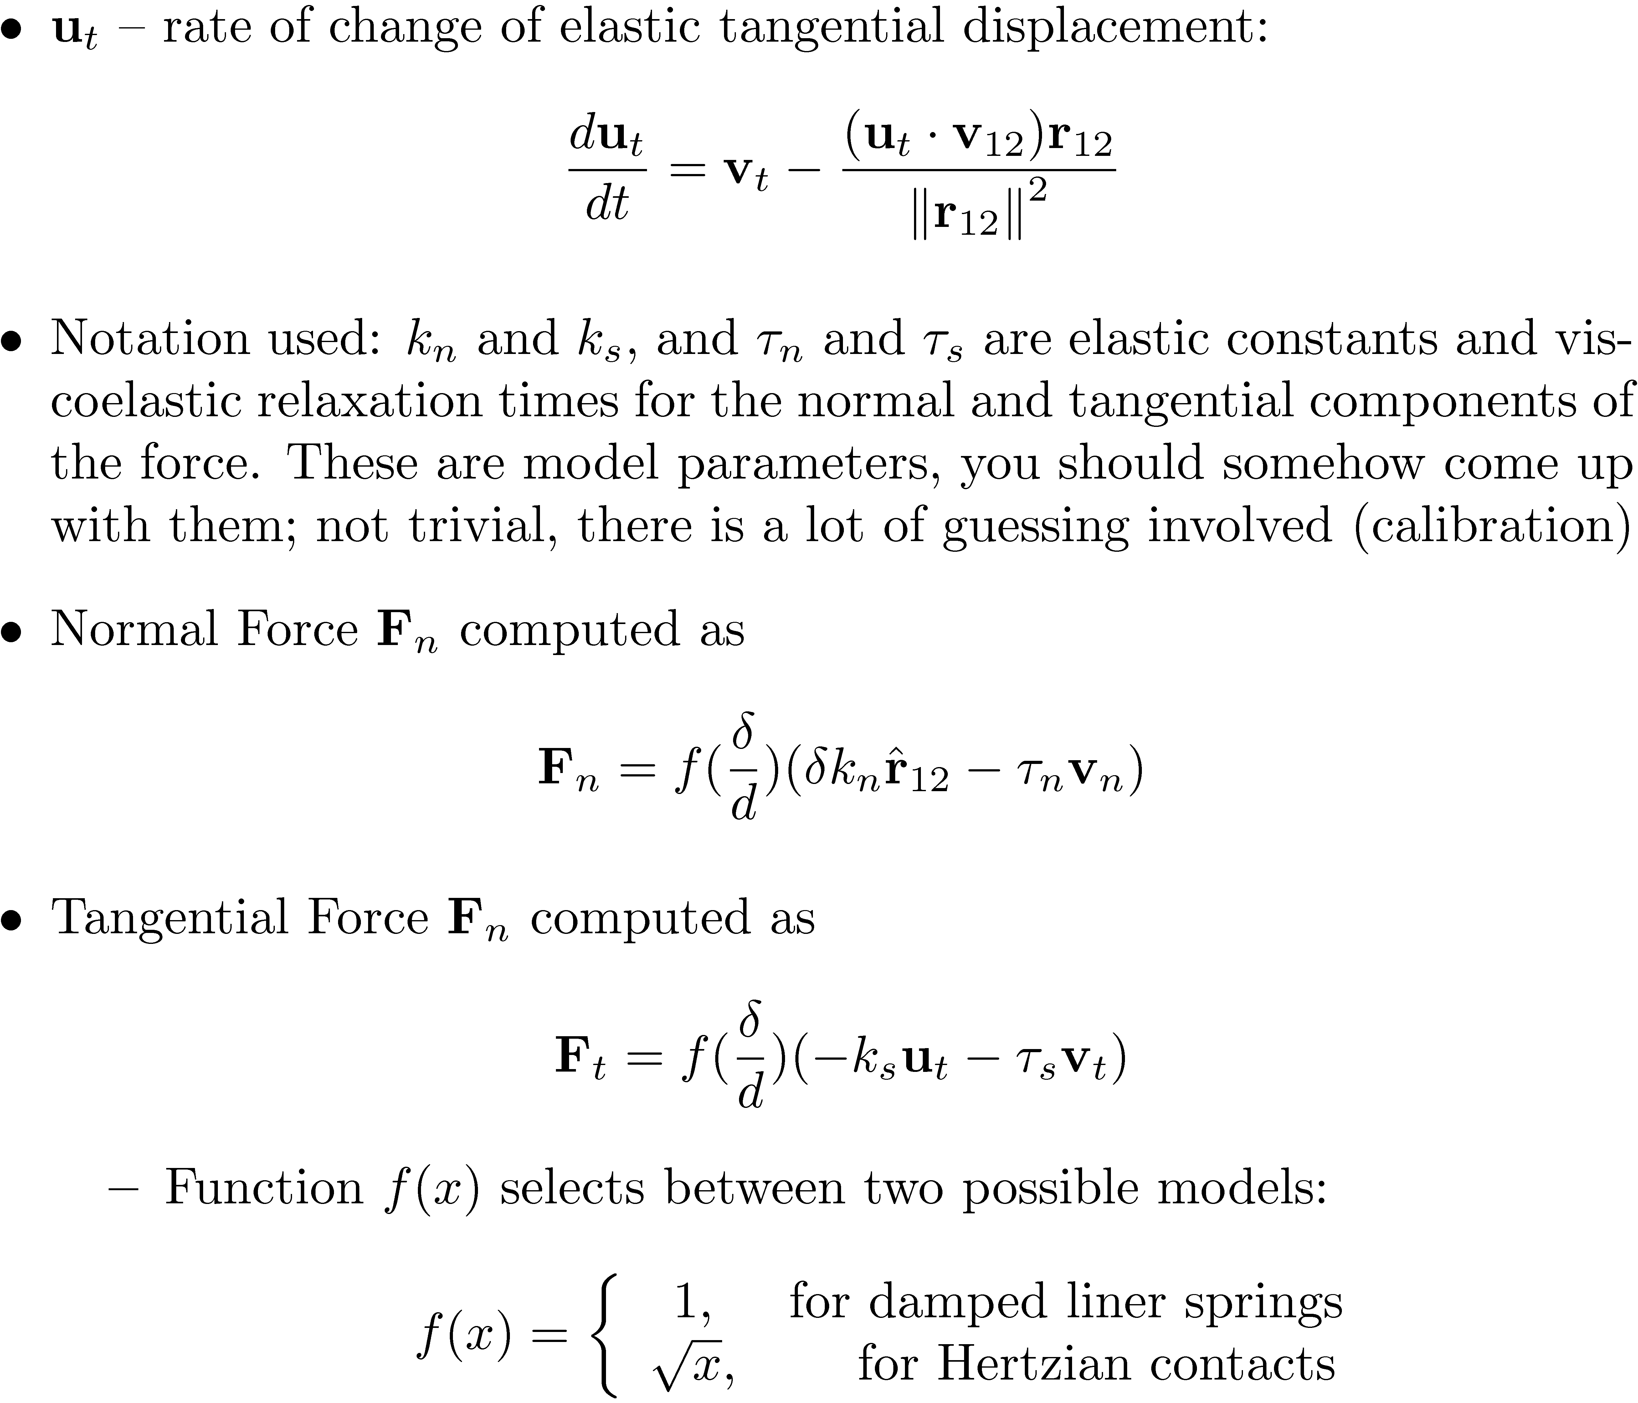
Gravity-driven Dense Granular Flows

Slide 10
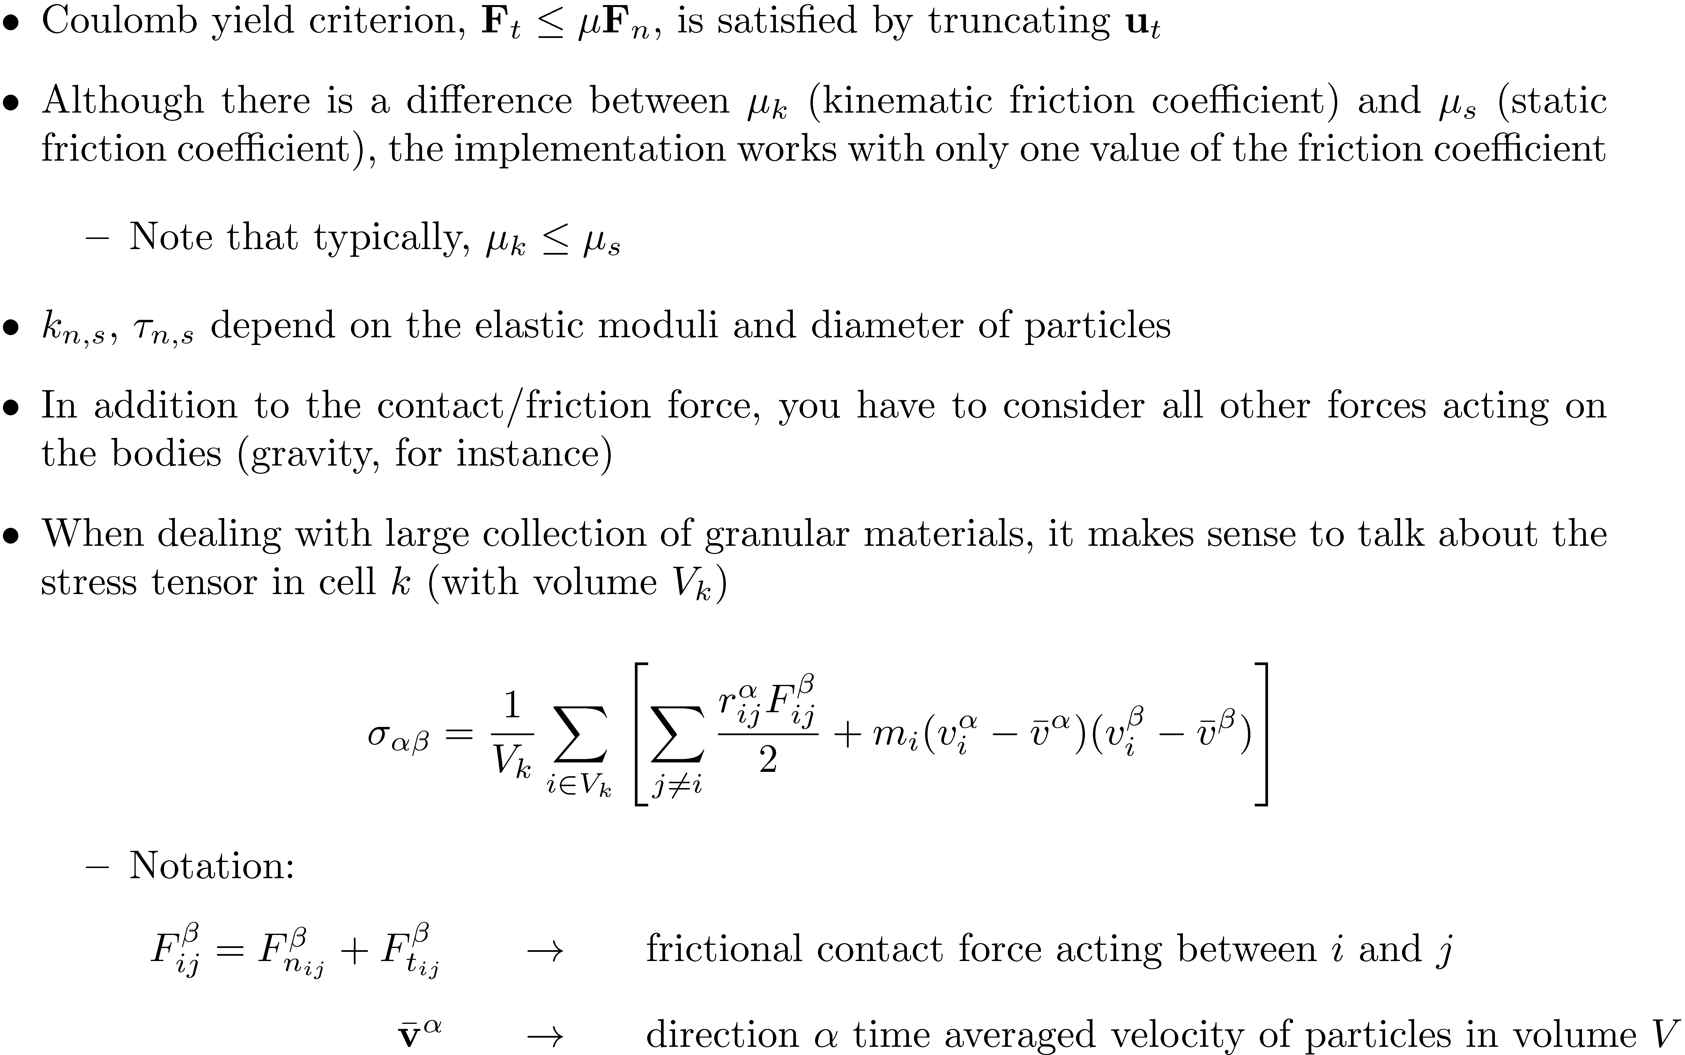
Gravity-driven Dense Granular Flows

Slide 11
Radial and axial segregation of granular matter in a rotating cylinder
D. C. Rapaport

Slide 12
Overview
D. C. Rapaport, Radial and axial segregation of granular matter in a rotating cylinder: A simulation study, Physical Review E, 75 (2007), pp. 031301.
Uses same DEM concept, yet the way the forces (normal and tangential) are calculated is different
Goes to say that there is no one way of computing them, tweaking usually involved in the process
The cylinder contains mixture of granular particles of two different species

Slide 13
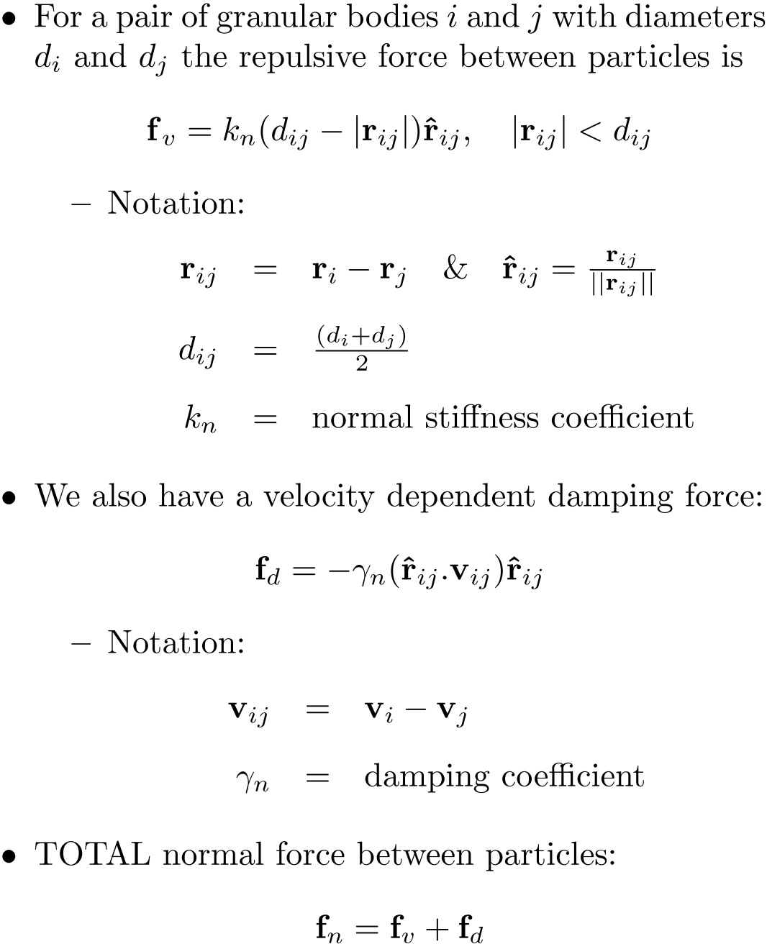
Normal Force Model

Slide 14
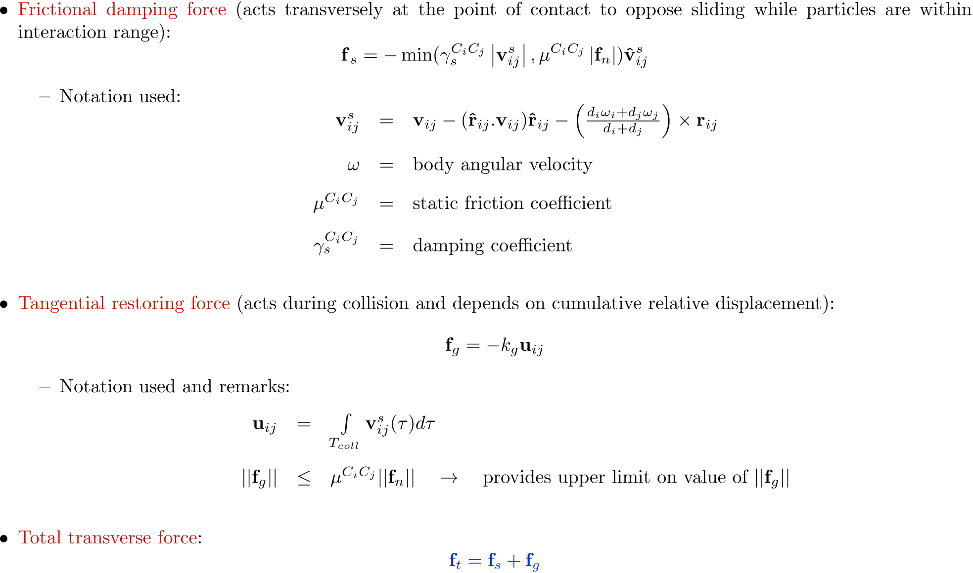
Tangential Force Model

Slide 15
General Remarks, DEM The Good Part
The approach is very straight forward to implement
The approach can be integrated easily in the computational framework discussed in ME751
If interested, Martin has a DEM code both in MATLAB and C that you can use to augment your SimEngine3D
Solution method is embarrassingly parallel
First, on a per-contact basis, compute the frictional contact force
Second, on a per-body basis, sum up the forces, apply Newton-Euler equations of motion, and do straight numerical integration using an explicit method, say Verlet.

Slide 16
General Remarks, DEM The Bad Part
The approach requires very small integration step-sizes h to maintain stability and accuracy
This is a fallout of the rigid body assumption that we are working with
You want to prevent body interpenetration, stiff springs take care of this
Stiff springs lead to high transients, numerical integration stability considerations limit step sizes based on the value of the stiffness
For Hertzian models, stiffness (SI units) is of the order k=10¹² ) step sizes of the order h=1/k^{1/2} ¼ h=10⁻⁶
Takes forever to finish simulation
Because of stiff springs, you see a lot of artificial bounciness in the bodies
The system never settles, you continuously have some “noise” in the problem

Slide 17
DEM, Further Reading
[1] D. Ertas, G. Grest, T. Halsey, D. Levine and L. Silbert, Gravity-driven dense granular flows, EPL (Europhysics Letters), 56 (2001), pp. 214-220.
[2] H. Kruggel-Emden, E. Simsek, S. Rickelt, S. Wirtz and V. Scherer, Review and extension of normal force models for the Discrete Element Method, Powder Technology, 171 (2007), pp. 157-173.
[3] H. Kruggel-Emden, S. Wirtz and V. Scherer, A study on tangential force laws applicable to the discrete element method (DEM) for materials with viscoelastic or plastic behavior, Chemical Engineering Science (2007).
[4] D. C. Rapaport, Radial and axial segregation of granular matter in a rotating cylinder: A simulation study, Physical Review E, 75 (2007), pp. 031301.
[5] L. Silbert, D. Ertas, G. Grest, T. Halsey, D. Levine and S. Plimpton, Granular flow down an inclined plane: Bagnold scaling and rheology, Physical Review E, 64 (2001), pp. 51302.
[6] L. Vu-Quoc, L. Lesburg and X. Zhang, An accurate tangential force–displacement model for granular-flow simulations: Contacting spheres with plastic deformation, force-driven formulation, Journal of Computational Physics, 196 (2004), pp. 298-326.
[7] L. Vu-Quoc, X. Zhang and L. Lesburg, A normal force-displacement model for contacting spheres accounting for plastic deformation: force-driven formulation, Journal of Applied Mechanics, 67 (2000), pp. 363.

Slide 18
Differential Variational Inequality Methods

Slide 19
General Comments, DVI
Differential Variational Inequality (DVI): a set of differential equations that hold in conjunction with a collection of constraints, both equality and inequality
Recall the constrained equations of motion we dealt with: we had the Newton-Euler equations of motion
Their solution also satisfied a set of kinematic constraints coming from joints
These constraints are called bilateral constraints
When dealing with contacts, the non-penetration condition will be captured as a unilateral constraint
At the point of contact, relative to body 1, body 2 can move outwards, but not inwards
While there is a lot of common sense intuition behind DEM, approaches that draw on the DVI are very non-intuitive (at least for me)
Developed mostly by mathematicians (scary)

Slide 20
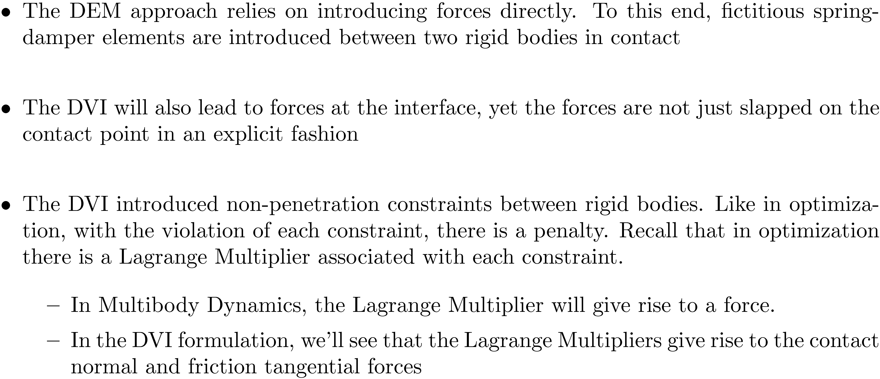
DVI-Based Methods General Comments

Slide 21
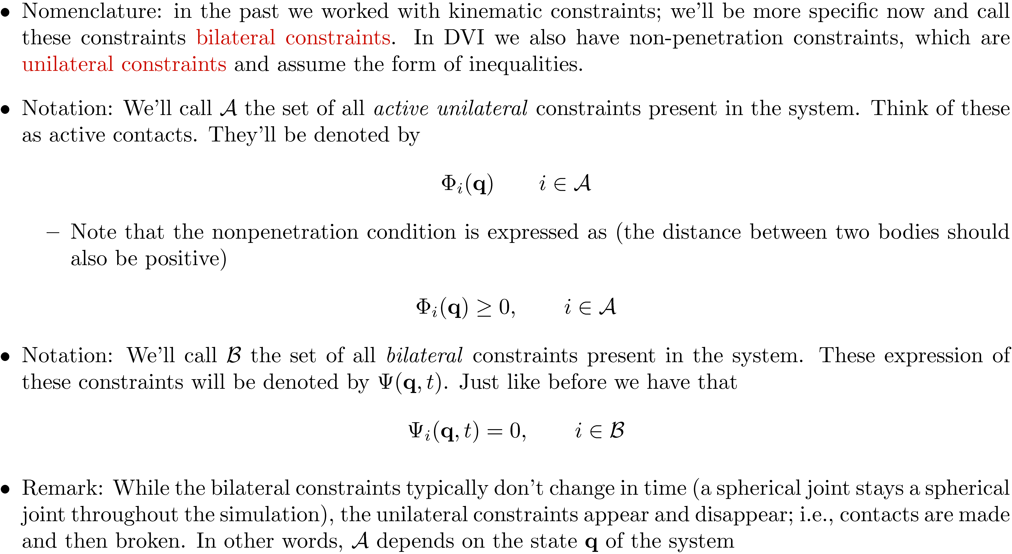
Bilateral vs. Unilateral Constraints

Slide 22
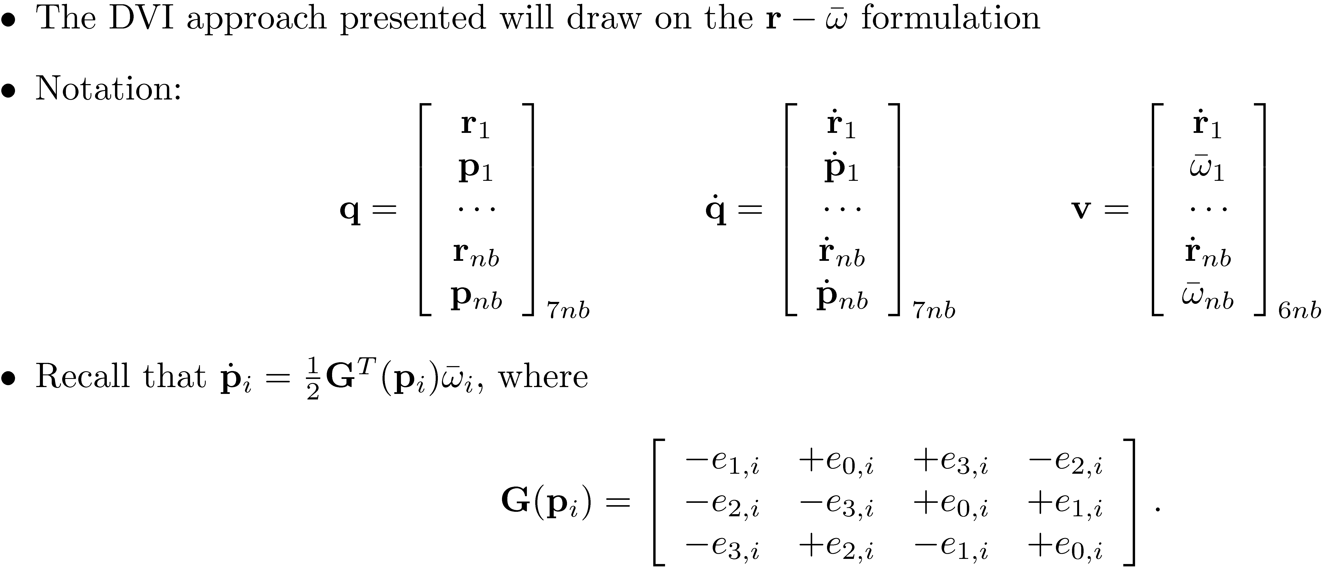
DVI-Based Methods: Notation Used

Slide 23
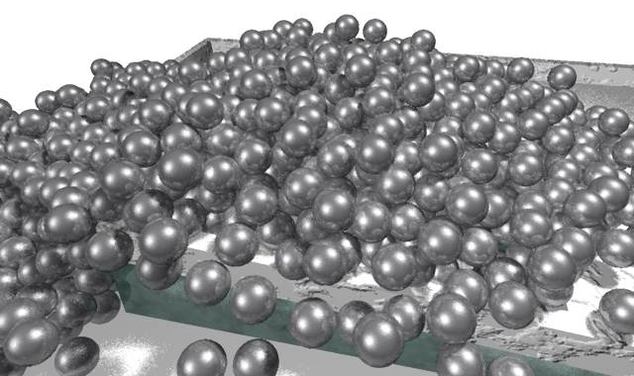
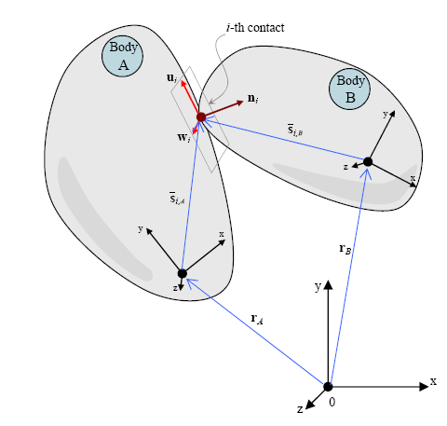
Body A – Body B Contact Scenario

Slide 24
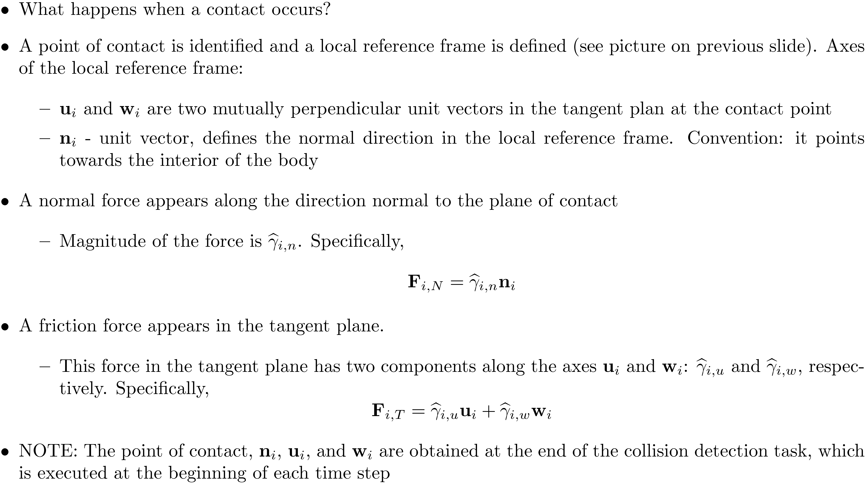
Defining the Normal and Tangential Forces

Slide 25
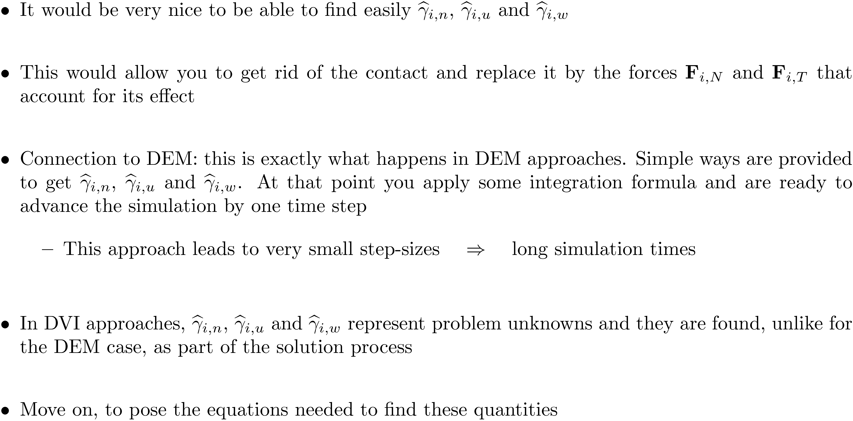
DVI-Based Methods Unknowns and Quick DEM Comparison

Slide 26
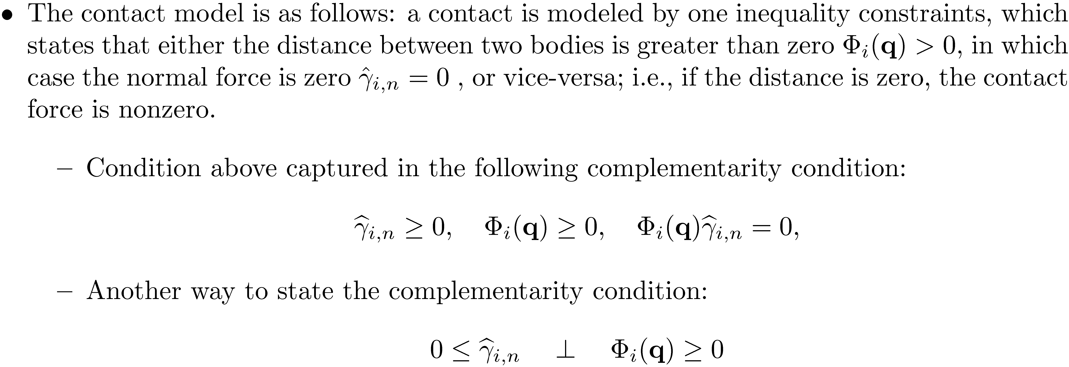
DVI-Based Methods The Contact Model

Slide 27
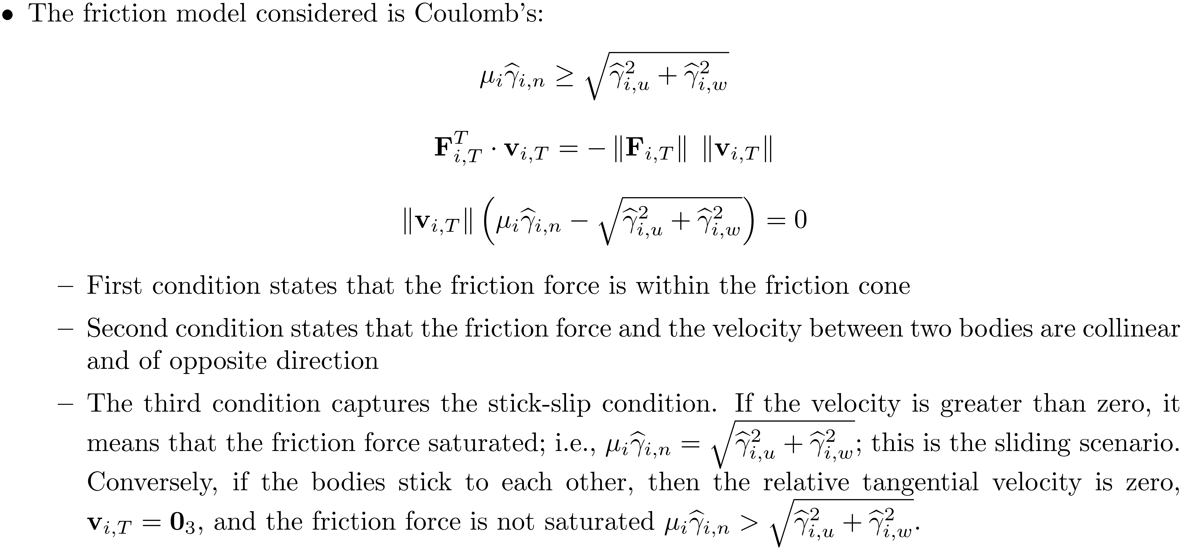
DVI-Based Methods: The Friction Model

Slide 28
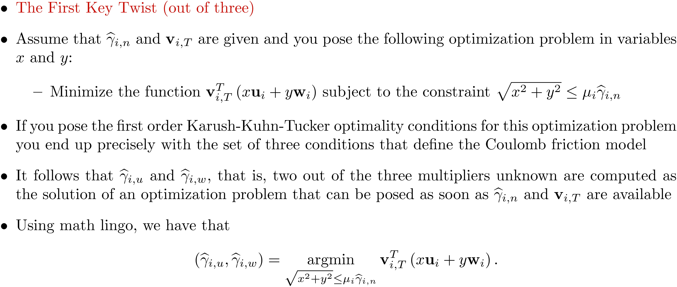
Coulomb’s Model Posed as the Solution of an Optimization Problem

Slide 29
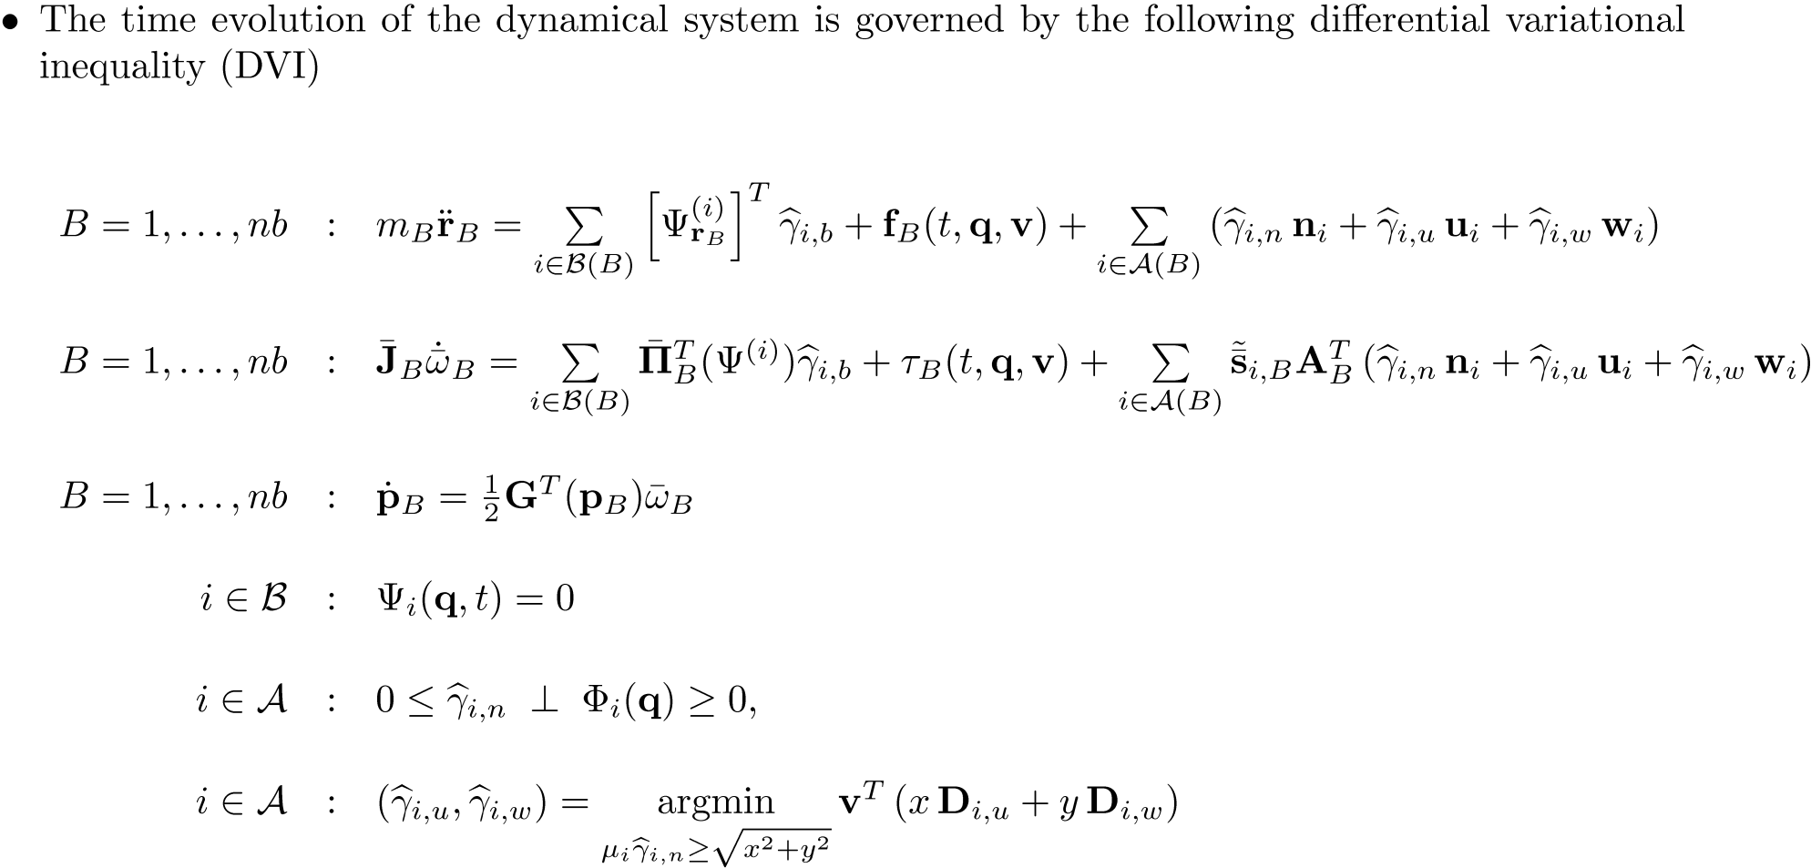
The DVI Problem: The EOM, in Fine Granularity Form

