Slide 1
ME751 Advanced Computational Multibody Dynamics
Frictional Contact: Differential Variational Inequality Approaches
Final Thoughts, ME751
April 20, 2010
© Dan Negrut, 2010 ME751, UW-Madison
“All you need is ignorance and confidence and the success is sure.” Mark Twain
TexPoint fonts used in EMF.
Read the TexPoint manual before you delete this box.: AAAAAA

Slide 2
Before we get started…
Last Time:
Wrapped up DEM
Started DVI (last topic discussed in ME751)
Today:
Finish the DVI approach
Final thoughts, ME751
HW
Posted on class website, due on April 29, at the time of midterm exam
What comes next
Talks from industry: NVIDIA (Apr 22), ADAMS (Apr 27), NVIDIA (May 6)
Midterm exam (Apr 29, 7:15-9:15 pm) – Room TBA
Trip to John Deere and Iowa (May 3-4)

Slide 3
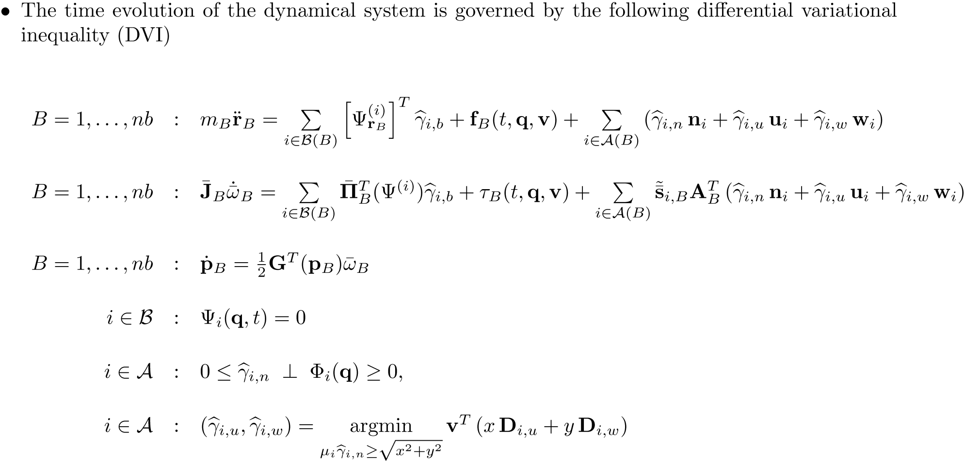
The DVI Problem: The EOM, in Fine Granularity Form

Slide 4
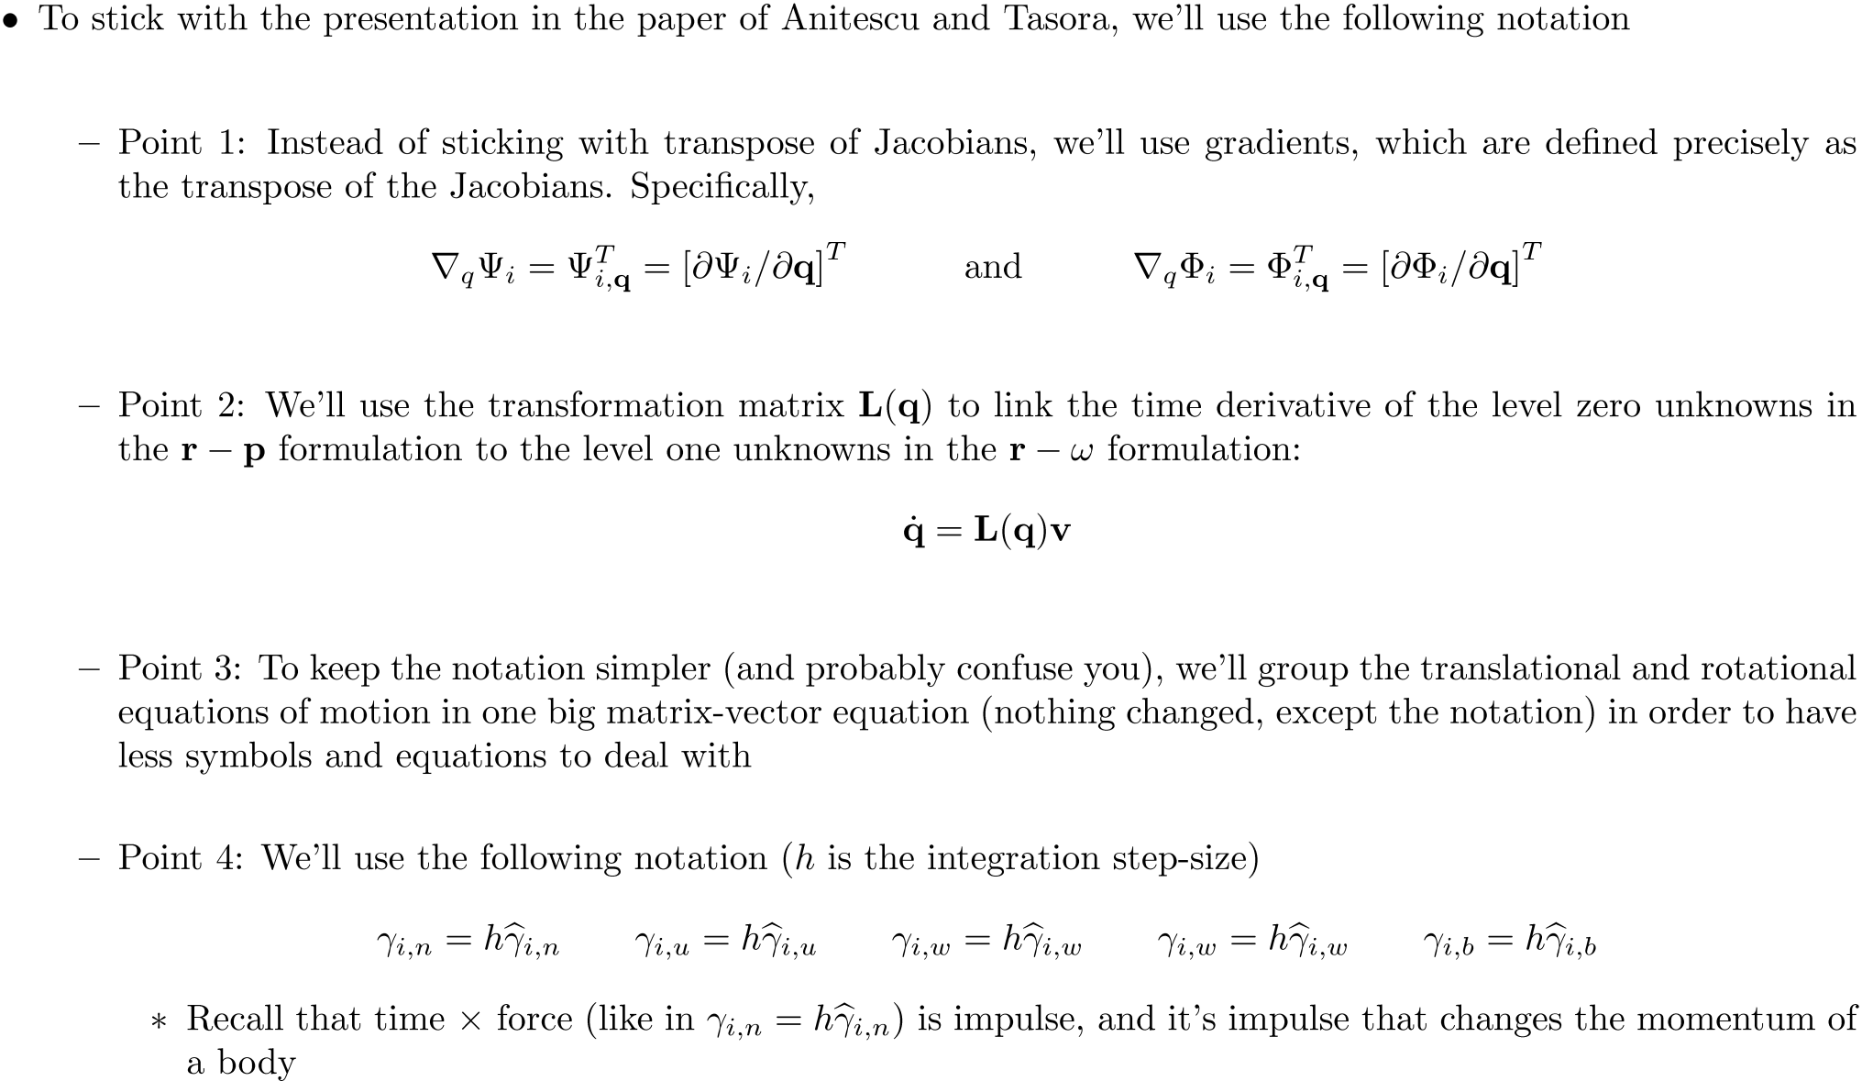
Notation Conventions [1/2]

Slide 5
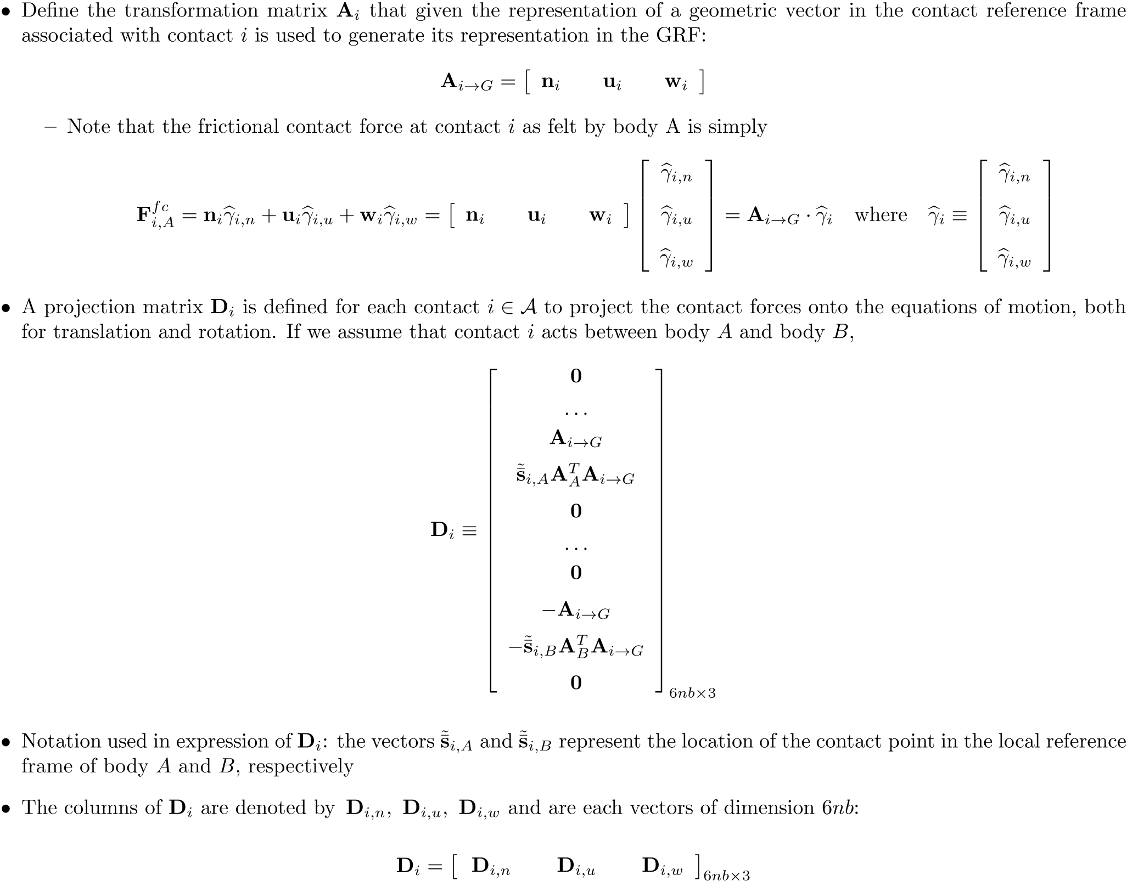

Slide 6
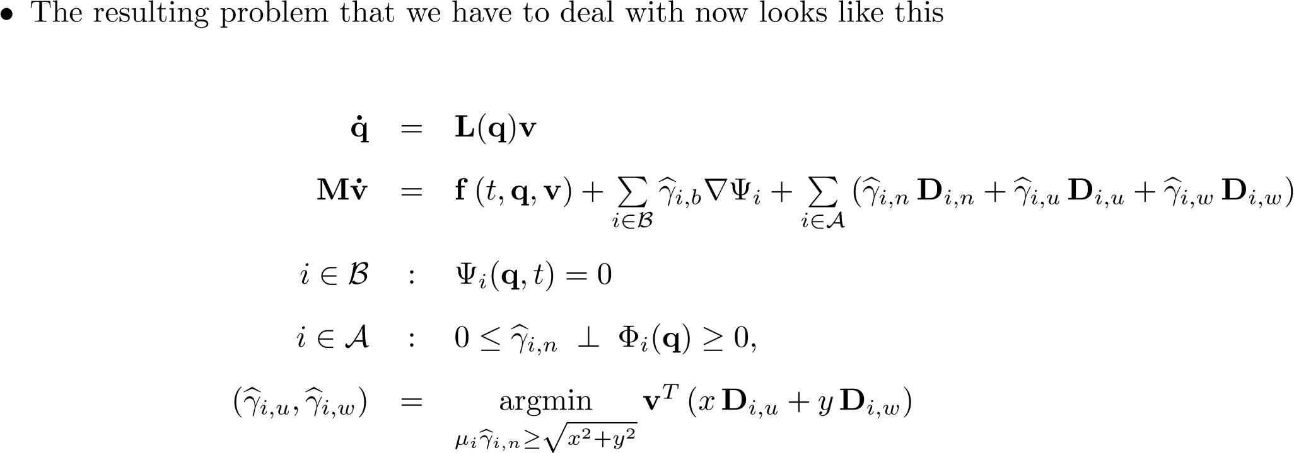
The Problem Setup

Slide 7
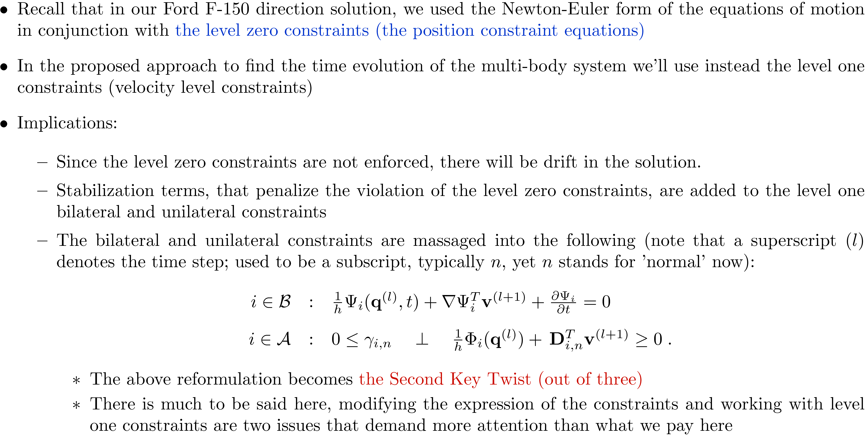
The Discretization Process

Slide 8
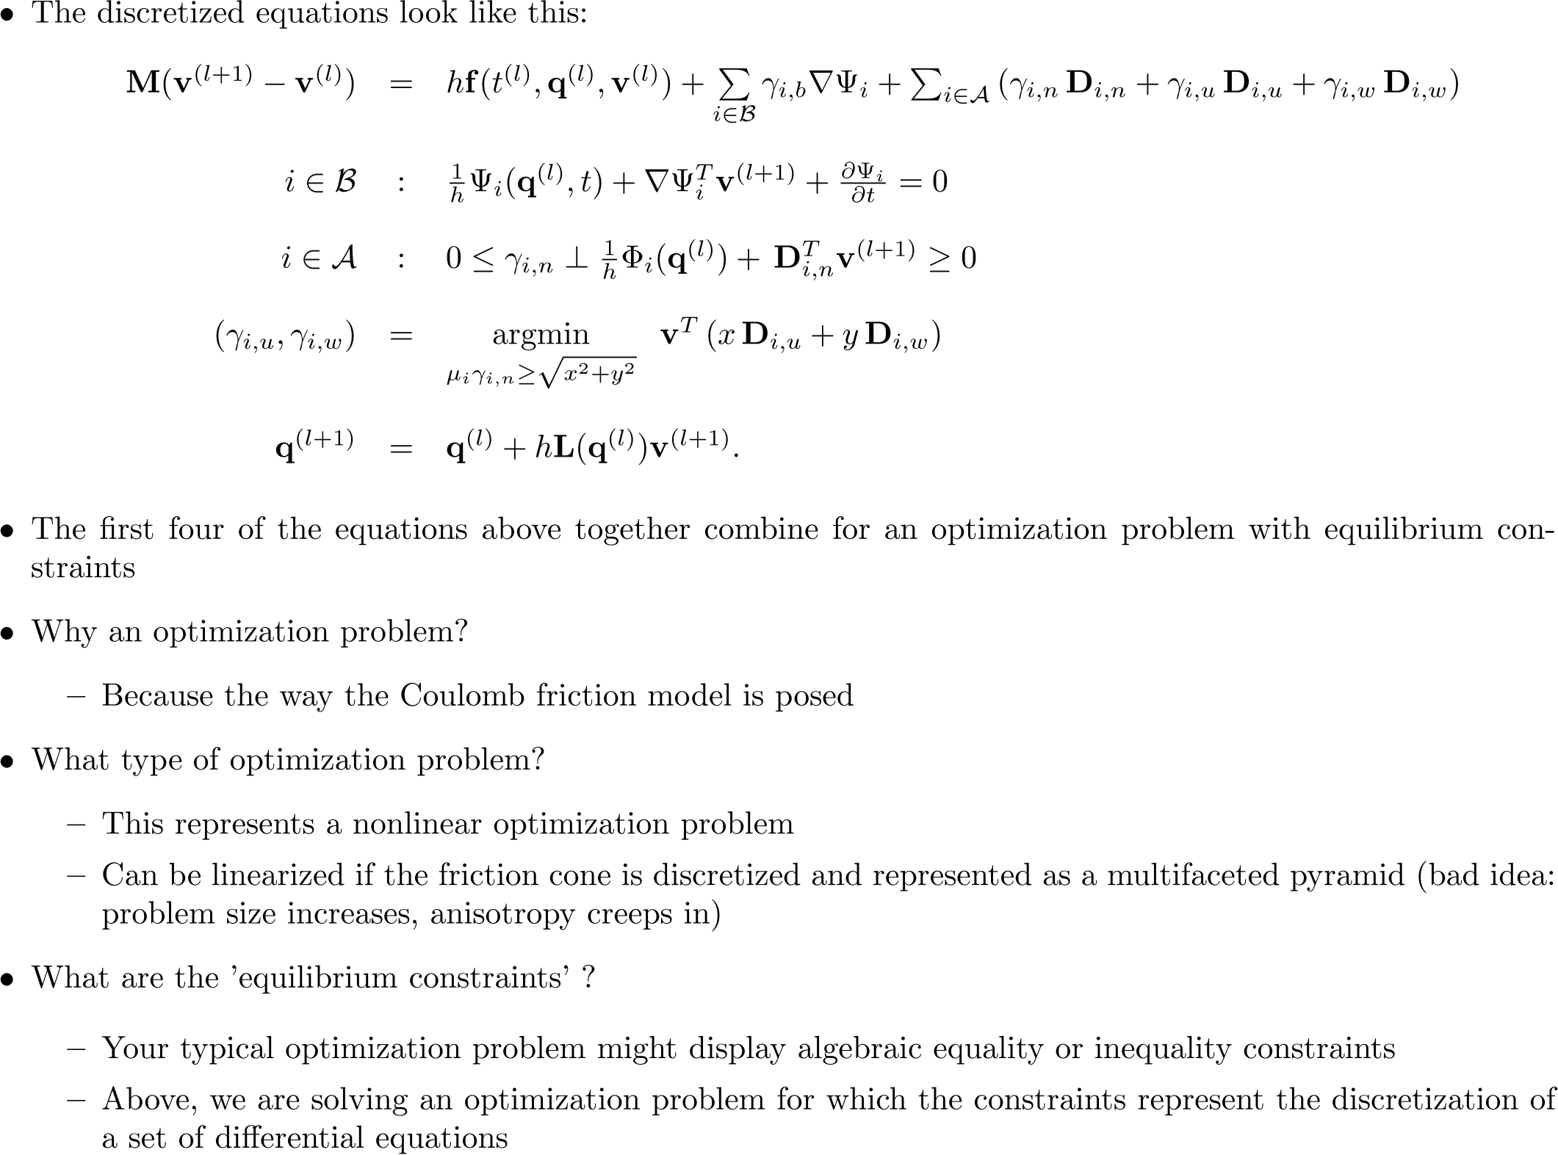
The Discretization Process

Slide 9
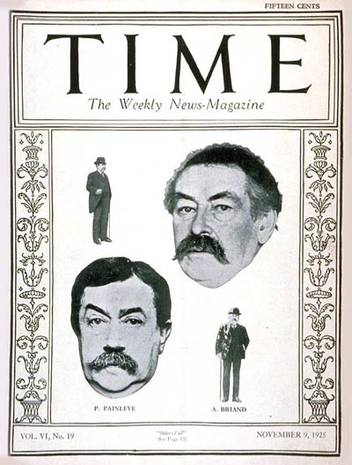
Left: November 1925 issue of TIME magazine with Painleve on the cover
Right: Discretization of the friction cone with a multifaceted pyramid (bad idea)

Slide 10
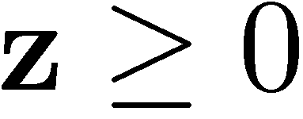


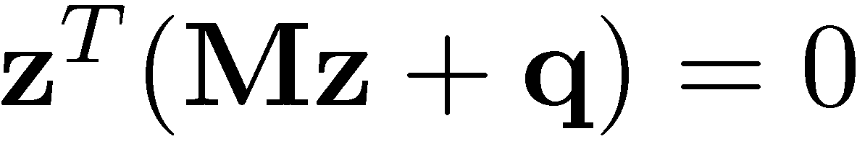
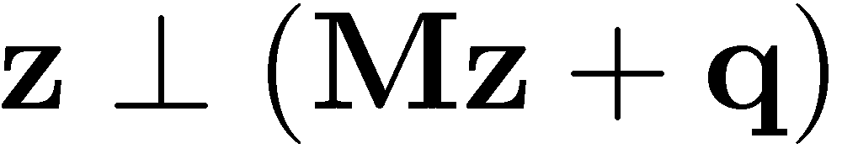
[Short Detour, four slide review of LCP] Linear Complementarity Problem (LCP)
Given: matrix M of dimension n x n, and vector q of dimension n
Find: vector[s] z of dimension n such that
The last condition above sometimes stated as
Seminal contributions: Lemke, Cottle, Mangasarian, J.S. Pang

Slide 11
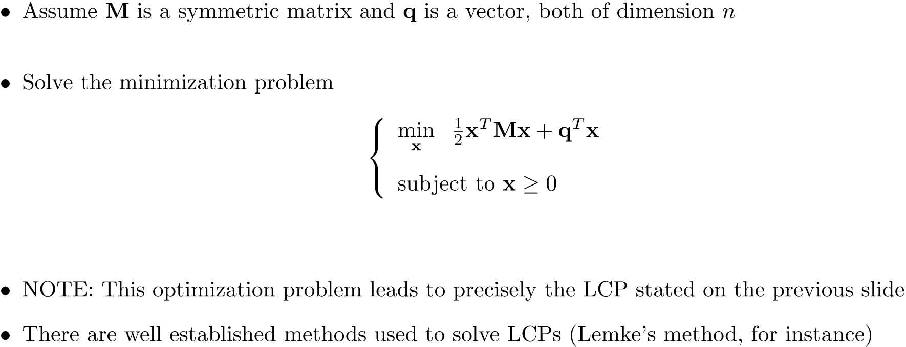
Example, Problem Leading to LCP

Slide 12
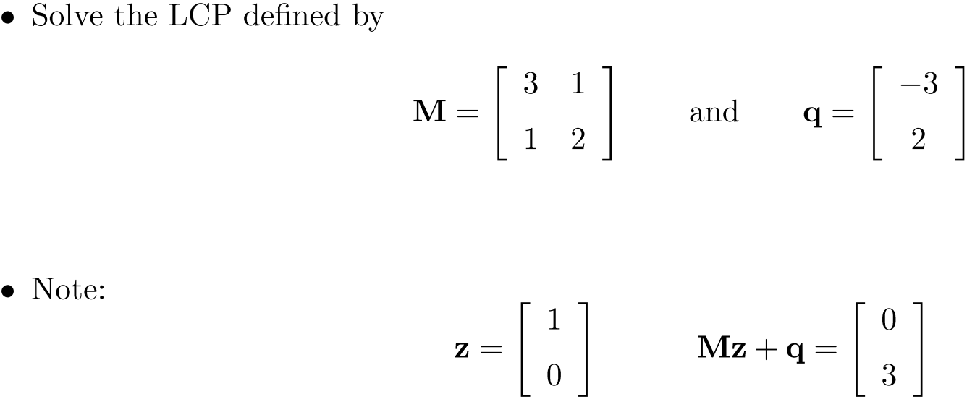
[LCP] Example 1

Slide 13
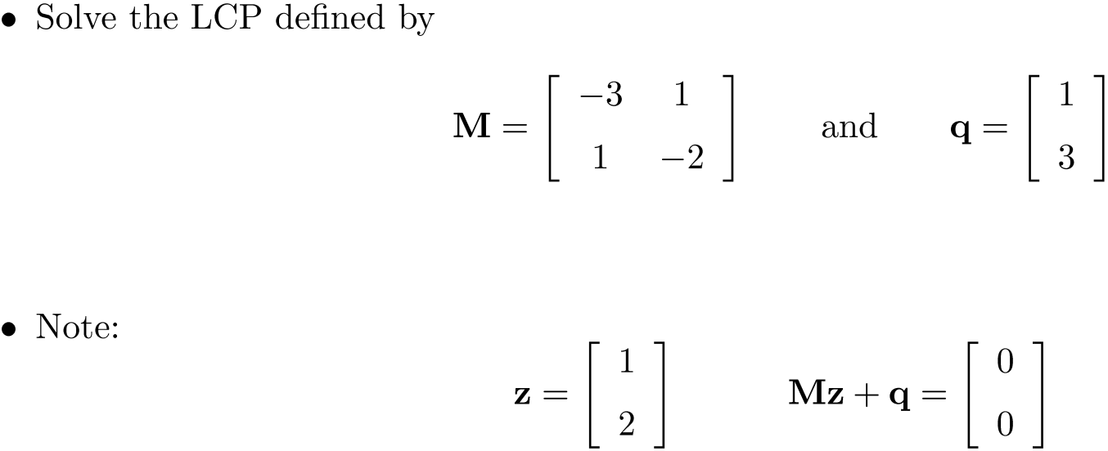
[LCP] Example 2

Slide 14
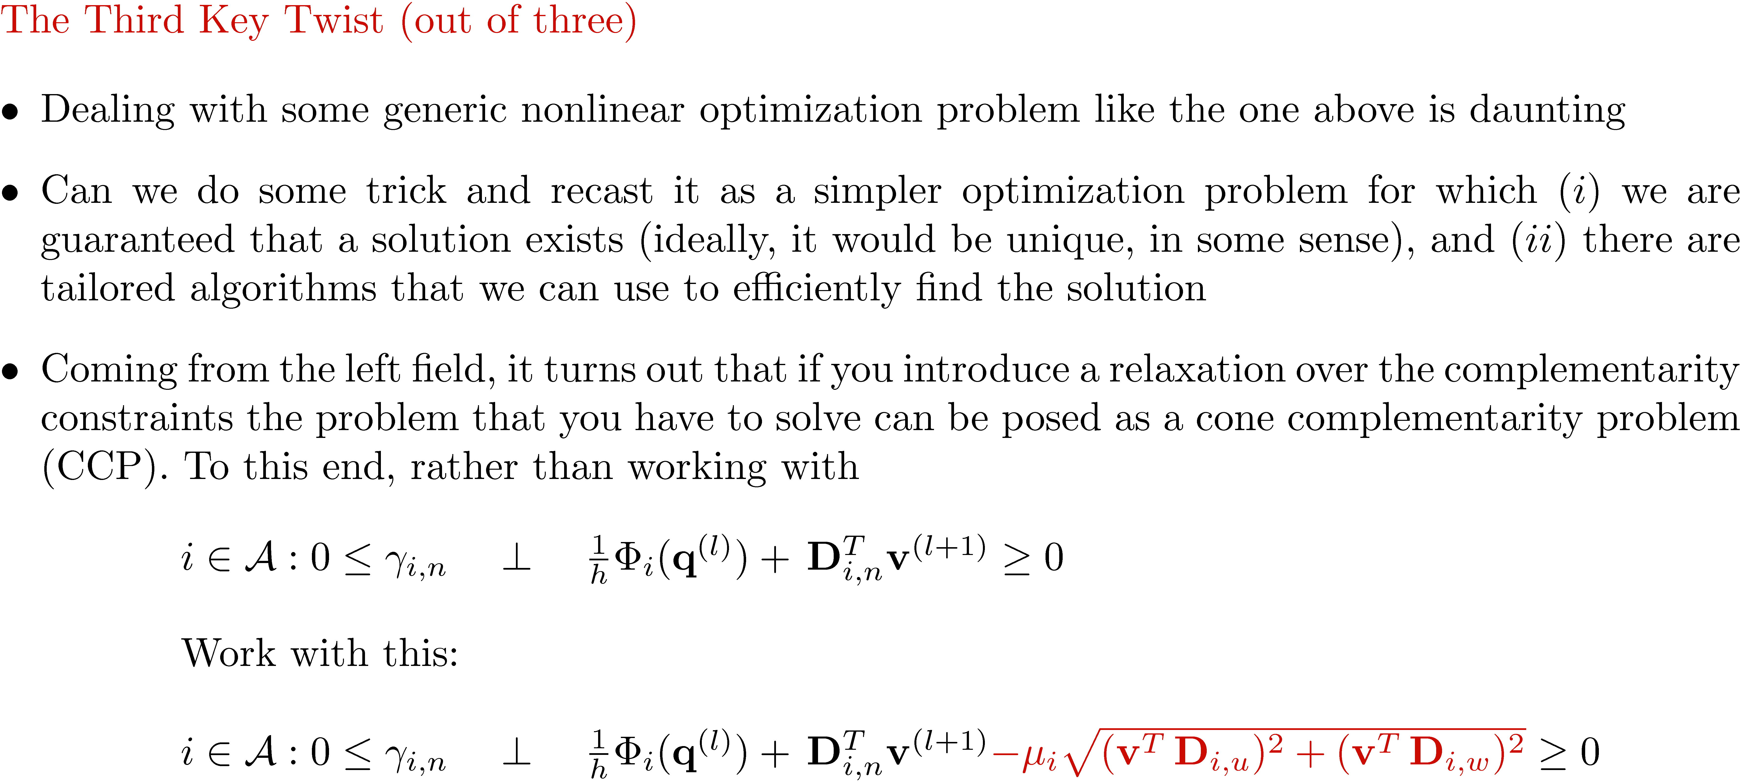
The NCP ! CCP Metamorphosis

Slide 15
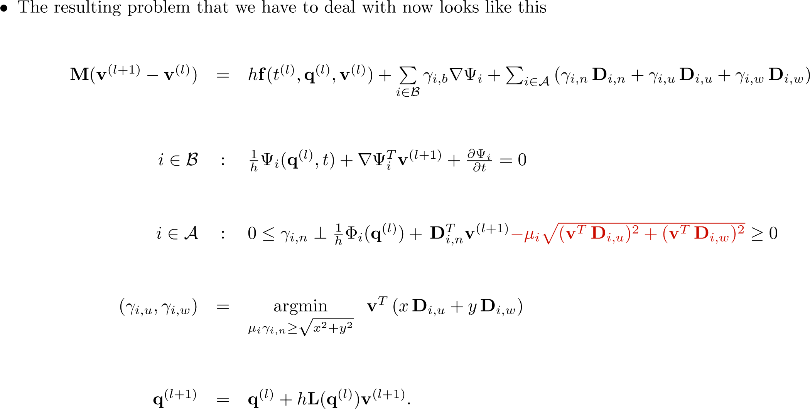
The Cone Complementarity Problem

Slide 16
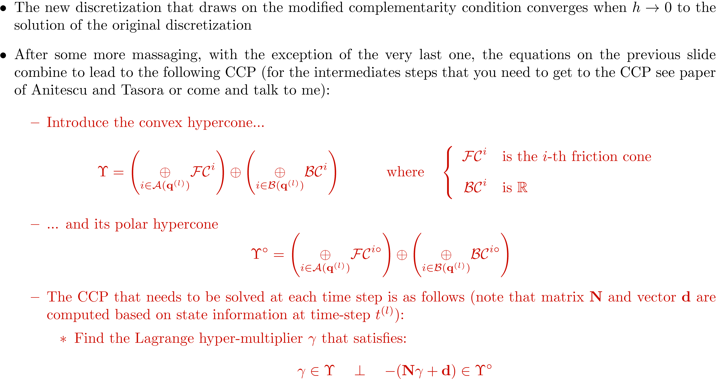
Cone Complementarity Problem (CCP)
Notes:
16

Slide 17
Sliding scenario
Sticking scenario

Slide 18
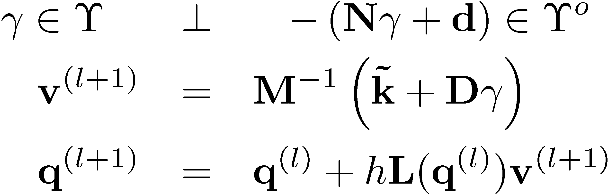

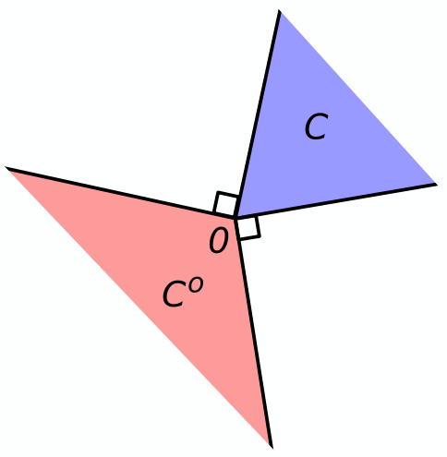

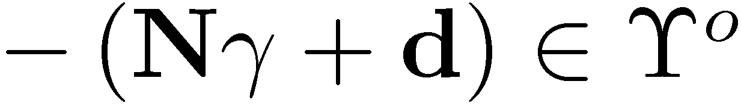
Problem Solved At Each Time Step
It boils down to solving this:

Slide 19
Implementation of Method
The method outlined implemented using two loops
Outer loop – runs the time stepping
Inner loop – CCP Algorithm (solves CCP problem at each time step)

Slide 20
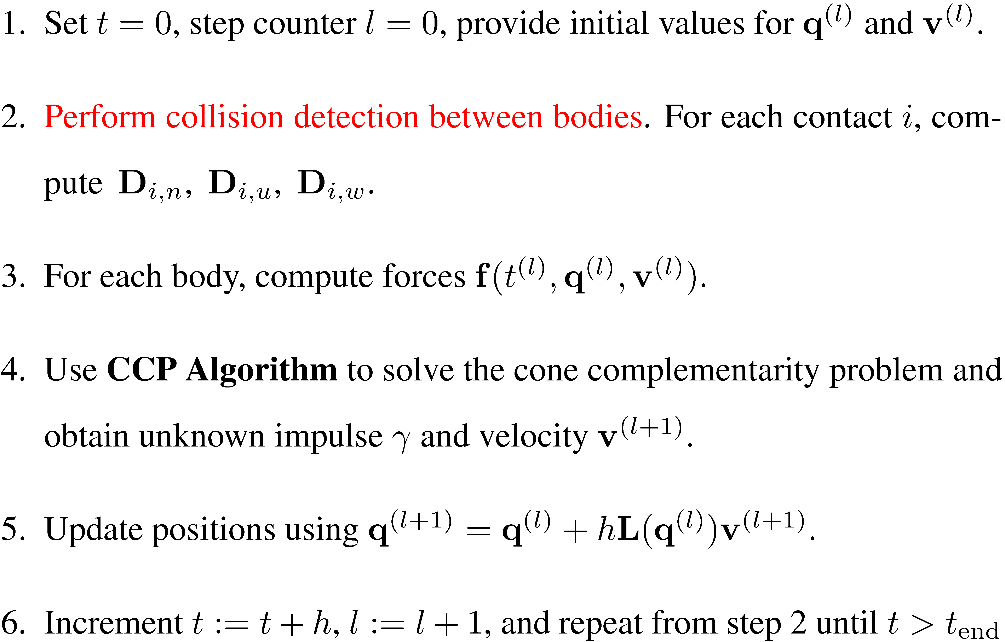

Outer Loop (Time-Stepping)
Preprocessing
“Inner Loop”
Post processing

Slide 21
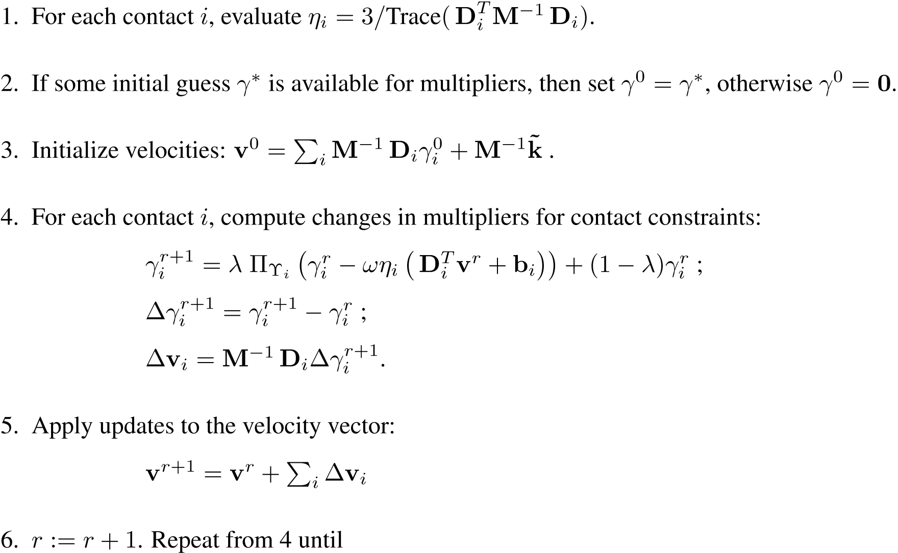
Inner Loop (CCP Algorithm)

Slide 22
Parallelism, Opportunities
Perform parallel collision detection
Copy contact, body, and constraint data structures to GPU
(Body parallel) Force kernel
(Contact parallel) Contact preprocessing kernel
(Contact parallel) CCP contact kernel
(Constraint parallel) CCP constraint kernel
(Reduction-slot parallel) Reduction kernel
(Body parallel) Body velocity update kernel
(Body parallel) Time integration kernel
Iteration loop

Slide 23
General Comments, DEM and DVI
There is hand waving when it comes to handling friction and contact
More so with DEM than DVI
Handling frictional contact is equally art and science
To get something to run robustly requires tweaking
Requires time to understand the landscape in this area
Doing justice to this topic would probably require six more lectures
It’s an active area of research that can answer some challenging engineering and science open questions

Slide 24
Reference, DVI Literature
D. E. Stewart and J. C. Trinkle, An implicit time-stepping scheme for rigid-body dynamics with inelastic collisions and Coulomb friction, International Journal for Numerical Methods in Engineering, 39 (1996), pp. 2673-2691.
D. E. Stewart, Rigid-body dynamics with friction and impact, SIAM Review, 42 (2000), pp. 3-39
M. Anitescu and G. D. Hart, A constraint-stabilized time-stepping approach for rigid multibody dynamics with joints, contact and friction, International Journal for Numerical Methods in Engineering, 60 (2004), pp. 2335-2371.
M. Anitescu and A. Tasora, An iterative approach for cone complementarity problems for nonsmooth dynamics, Computational Optimization and Applications, 10.1007/s 10589-008-9223-4 (2008).
A. Tasora, D. Negrut and M. Anitescu, GPU-based Parallel Computing for the Simulation of Complex Multibody Systems with Unilateral and Bilateral Constraints: An Overview (Submitted), Computational Methods in Applied Sciences, E. Onate, ed., Springer, New York, 2010.

Slide 25
ME751 Putting Things in Perspective

Slide 26
ME751 – What did we learn? [1/2]
Learned about vectors and locating points attached to moving rigid bodies
Learned how to describe the orientation of a body in 3D space
Learned how to express geometric constraints associated with the relative motion of two bodies (four building blocks – DP1, DP2, D, CD)
Learned about the Kinematics Analysis, carried out for zero DOF systems in which one or more motions are prescribed
Position Analysis (requires solution of nonlinear system)
Velocity Analysis (requires solution of linear system)
Acceleration Analysis (requires solution of linear system)

Slide 27
ME751 – What did we learn? [2/2]
Learned how to formulate the equations of motion for a system of interconnected and mutually interacting rigid bodies
Learned how to solve the equations that govern the time evolution of mechanical system
These equations are differential-algebraic equations (DAEs)
The workhorse was the BDF family of implicit integration formulas
We used the F-150 direct approach but more sophisticated approaches exist
We discussed briefly about accounting for the friction and contact phenomena in mechanical systems
DEM approaches – simple, integration step-sizes are very short
DVI approaches – pretty complex, integration step-sizes are long though

Slide 28
ME751: Things overlooked
We didn’t do justice to the frictional contact problem
Would be good to talk about this for more 7-8 lectures
We didn’t cover at all multi-body systems with deformable bodies
Floating frame of reference formulation
Absolute nodal coordinate formulation (ANCF)
Structural finite element approaches
Linear & nonlinear isoparametric finite element method
Handling of friction and contact for deformable bodies
Real-time simulation for gaming and virtual reality applications
Connection to SPH (Smoothed Particle Hydrodynamics)
High Performance Computing (HPC) for Computational Multibody Dynamics applications

