Slide 1
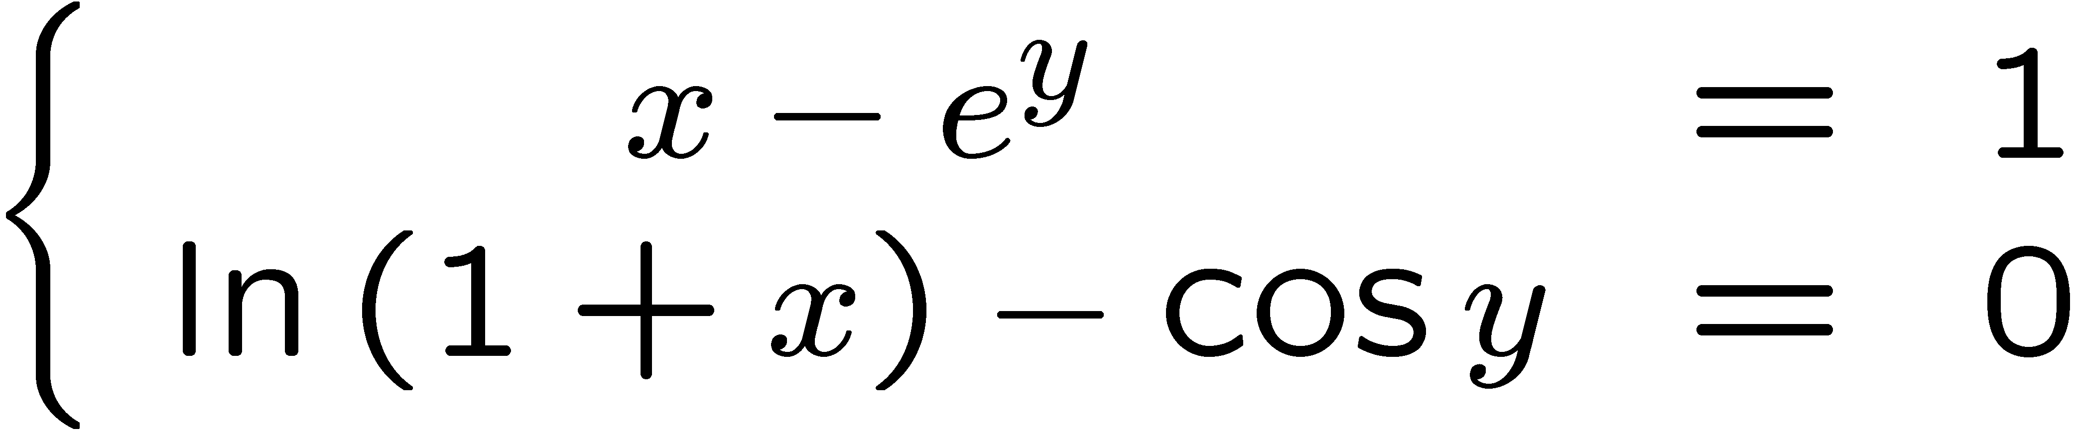
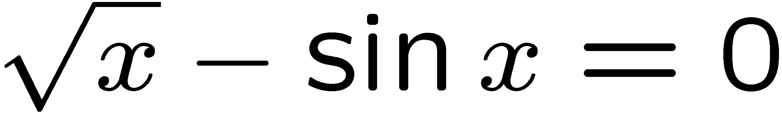
Solving a Nonlinear System
The most important numerical algorithm to understand in Kinematics
Relied upon heavily by ADAMS, used almost in all analysis modes
Kinematics
Dynamics
Equilibrium
How does one go about finding the solution?

Slide 2
Newton-Raphson Method
Start by looking at the one-dimension case:
Find solution x* of the equation (root of the function):
Assumption:
The function is twice differentiable

Slide 3
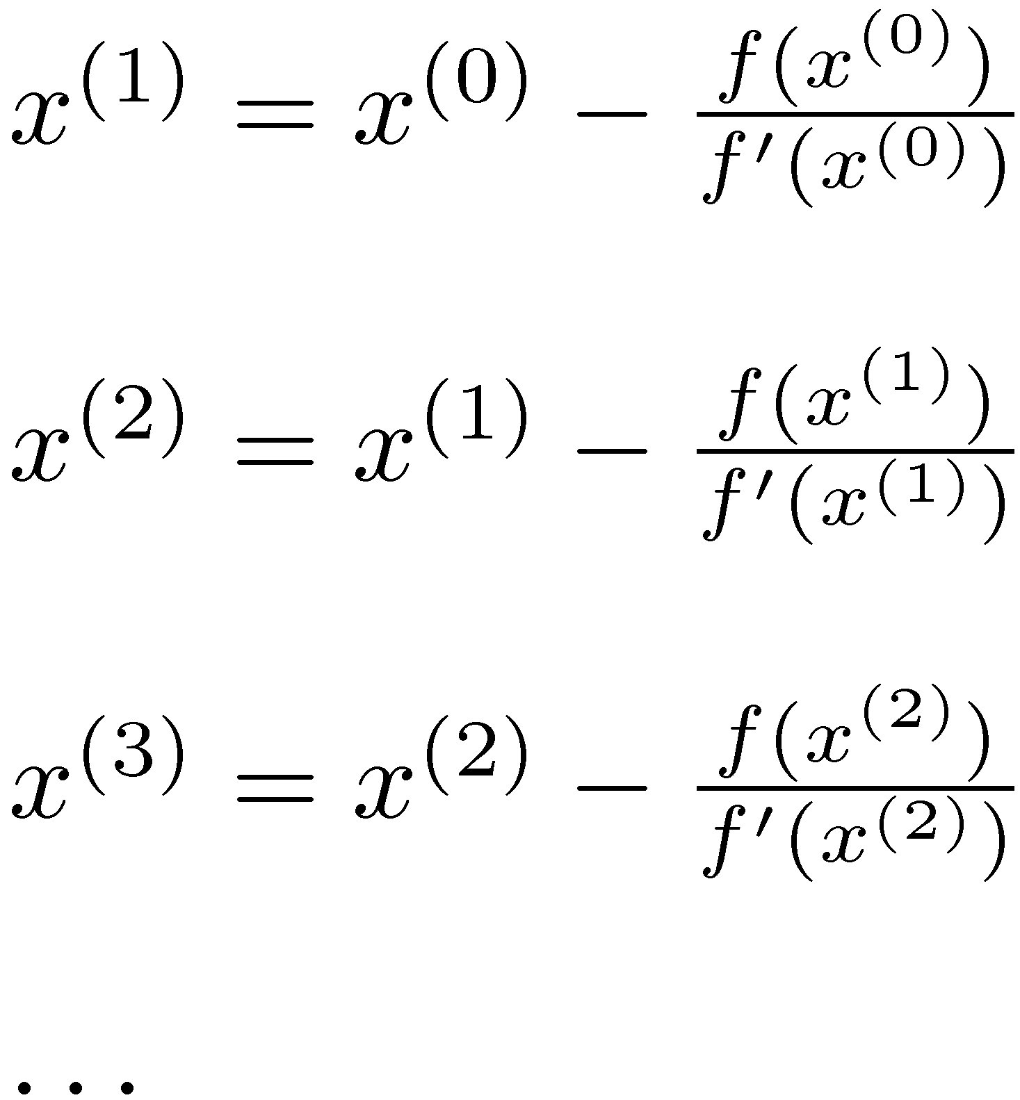
Newton-Raphson Method
Algorithm
Start with initial guess x⁽⁰⁾ and then compute x⁽¹⁾, x⁽²⁾, x⁽³⁾, etc.
This is called an iterative algorithm:
First you get x⁽¹⁾, then you improve the predicted solution to x⁽²⁾, then improve more yet to x⁽³⁾, etc.
Iteratively, you keep getting closer and closer to the actual solution

Slide 4
Newton-Raphson Example
STEP
x
f
′
(
x
)
f
(
x
)
0
2
3
.
5838
3
.
0678
1
2
−
3
.
0678
/
3
.
5838
=
1
.
1439
2
.
7109
0
.
3775
2
1
.
1439
−
0
.
3775
/
2
.
7109
=
1
.
004
2
.
5451
0
.
0107
The exact answer is x* = 1.0

Slide 5
Understanding Newton’s Method
What you want to do is find the root of a function, that is, you are looking for that x that makes the function zero
The stumbling block is the nonlinear nature of the function
Newton’s idea was to linearize the nonlinear function
Then look for the root of this new linear function that hopefully approximates well the original nonlinear function
If the only thing that you have is a hammer, then make all your problems a nail

Slide 6
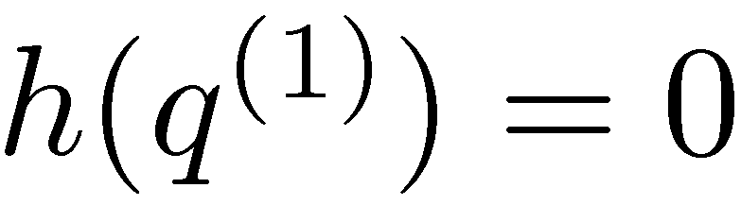
Understanding Newton’s Method (Cntd.)
You are at point q⁽⁰⁾ and linearize using Taylor’s expansion
After linearization, you end up with linear approximation h(q) of f(q):
Find now q⁽¹⁾ that is the root of h, that is:

Slide 7
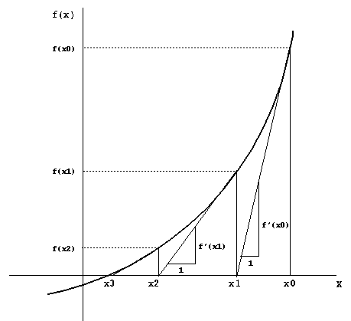
Newton-Raphson Method Geometric Interpretation

Slide 8
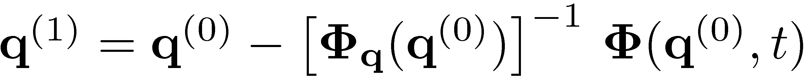
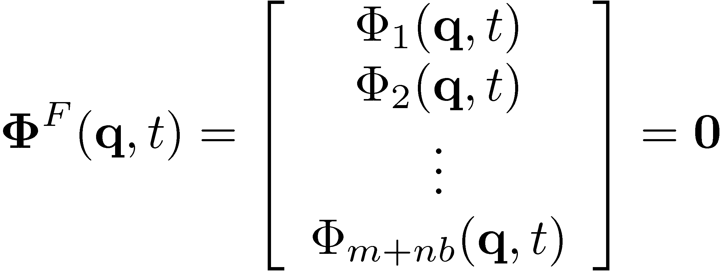
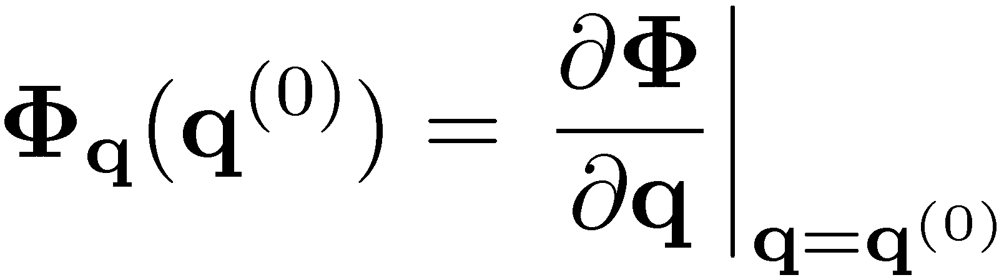
Newton-Raphson The Multidimensional Case
Solve for
the nonlinear system
The algorithm becomes
The Jacobian is defined as

Slide 9
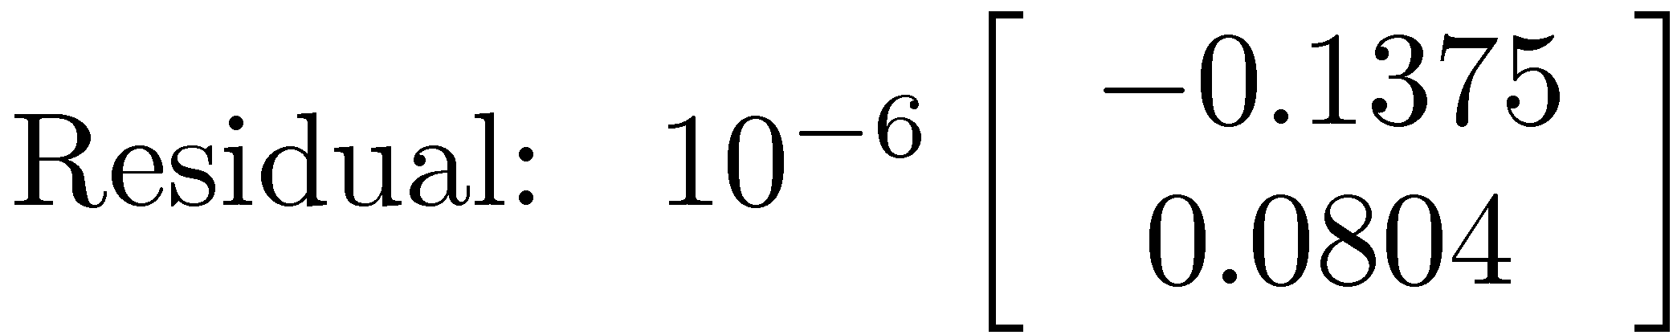
Example: Solve nonlinear system:
% Use Newton method to solve the nonlinear system
% x-exp(y)=0
% log(1+x)-cos(y)=0
% provide initial guess
x = 1;
y = 0;
% start improving the guess
disp('Iteration 1');
residual = [ x-exp(y) ; log(1+x)-cos(y) ];
jacobian = [1 -exp(y) ; 1/(1+x) sin(y)];
correction = jacobian\residual;
x = x - correction(1)
y = y - correction(2)
disp('Iteration 2');
residual = [ x-exp(y) ; log(1+x)-cos(y) ];
jacobian = [1 -exp(y) ; 1/(1+x) sin(y)];
correction = jacobian\residual;
x = x - correction(1)
y = y - correction(2)
Initial guess:
x = 1
y = 0
Iteration 1
x = 1.6137
y = 0.6137
Iteration 2
x = 1.5123
y = 0.4324
Iteration 3
x = 1.5042
y = 0.4085
Iteration 4
x = 1.5040
y = 0.4081
Iteration 5
x = 1.5040
y = 0.4081

Slide 10
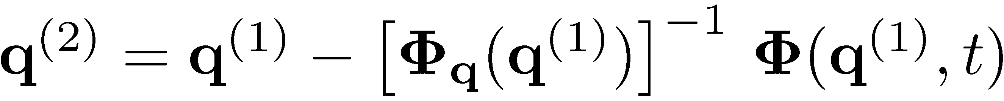
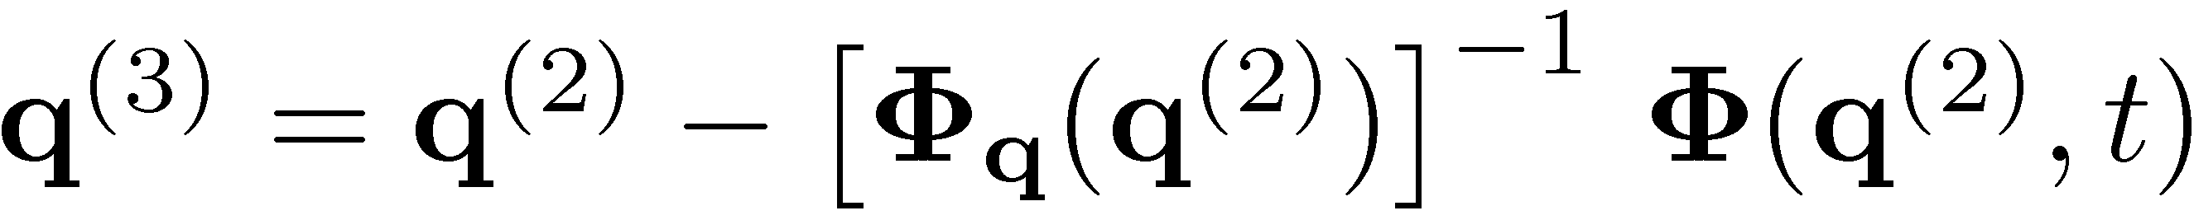

Putting things in perspective…
Newton algorithm for nonlinear systems requires:
A starting point q⁽⁰⁾ from where the solution starts being searched for
An iterative process in which the approximation of the solution is gradually improved:

Slide 11
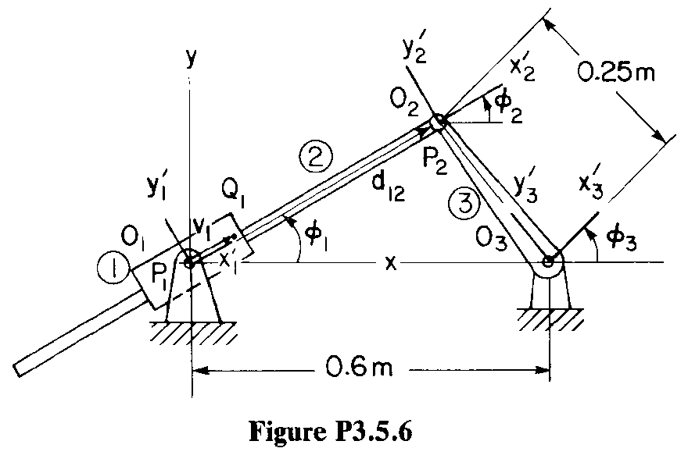
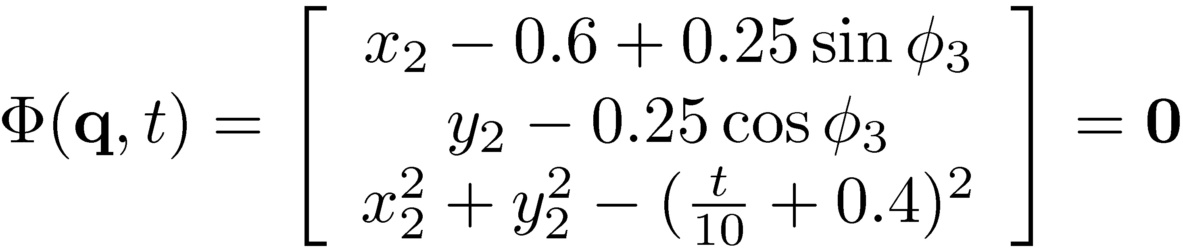
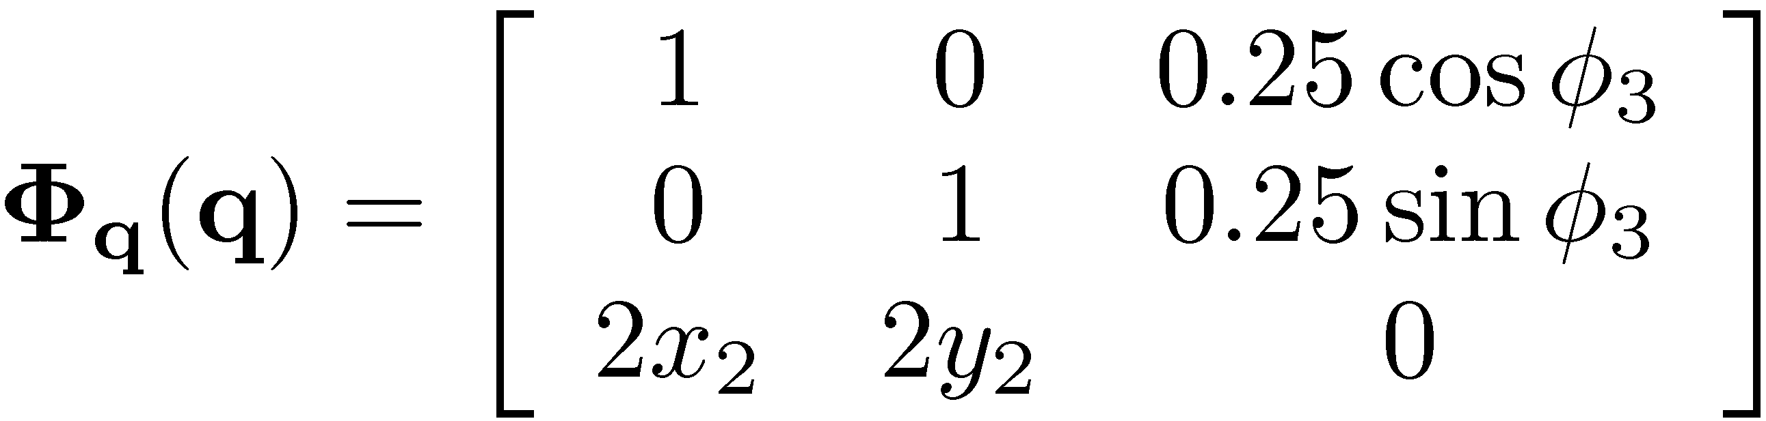
Example: Position Analysis of Mechanism
Problem 3.5.6, modeled with reduced set of generalized coordinates (see posted solution)
Iterations carried out like:

Slide 12
Dumb approach, which nonetheless works…
% Problem 3.5.6
% Solves the nonlinear system associated with Position Analysis
% Numerical solution found using Newton's method.
% get a starting point, that is, an initial guess
q = [0.2 ; 0.2 ; pi/4]
time = 0;
% start improving the guess
%%%%%%%%%%%%%%%%%%%%%%%%%%%%%%%
disp('Iteration 1');
dummy1 = q(1) - 0.6 + 0.25*sin(q(3));
dummy2 = q(2) - 0.25*cos(q(3));
dummy3 = q(1)*q(1) + q(2)*q(2) - (time/10+0.4)*(time/10+0.4);
residual = [ dummy1 ; dummy2 ; dummy3 ];
jacobian = [1 0 0.25*cos(q(3)) ;
0 1 0.25*sin(q(3));
2*q(1) 2*q(2) 0];
correction = jacobian\residual;
q = q - correction
%%%%%%%%%%%%%%%%%%%%%%%%%%%%%%%
disp('Iteration 2');
dummy1 = q(1) - 0.6 + 0.25*sin(q(3));
dummy2 = q(2) - 0.25*cos(q(3));
dummy3 = q(1)*q(1) + q(2)*q(2) - (time/10+0.4)*(time/10+0.4);
residual = [ dummy1 ; dummy2 ; dummy3 ];
jacobian = [1 0 0.25*cos(q(3)) ;
0 1 0.25*sin(q(3));
2*q(1) 2*q(2) 0];
correction = jacobian\residual;
q = q – correction
%%%%%%%%%%%%%%%%%%%%%%%%%%%%%%%
disp('Iteration 3');
dummy1 = q(1) - 0.6 + 0.25*sin(q(3));
dummy2 = q(2) - 0.25*cos(q(3));
dummy3 = q(1)*q(1) + q(2)*q(2) - (time/10+0.4)*(time/10+0.4);
residual = [ dummy1 ; dummy2 ; dummy3 ];
jacobian = [1 0 0.25*cos(q(3)) ;
0 1 0.25*sin(q(3));
2*q(1) 2*q(2) 0];
correction = jacobian\residual;
q = q - correction
%%%%%%%%%%%%%%%%%%%%%%%%%%%%%%%
disp('Iteration 4');
dummy1 = q(1) - 0.6 + 0.25*sin(q(3));
dummy2 = q(2) - 0.25*cos(q(3));
dummy3 = q(1)*q(1) + q(2)*q(2) - (time/10+0.4)*(time/10+0.4);
residual = [ dummy1 ; dummy2 ; dummy3 ];
jacobian = [1 0 0.25*cos(q(3)) ;
0 1 0.25*sin(q(3));
2*q(1) 2*q(2) 0];
correction = jacobian\residual;
q = q - correction
%%%%%%%%%%%%%%%%%%%%%%%%%%%%%%%
disp('Iteration 5');
dummy1 = q(1) - 0.6 + 0.25*sin(q(3));
dummy2 = q(2) - 0.25*cos(q(3));
dummy3 = q(1)*q(1) + q(2)*q(2) - (time/10+0.4)*(time/10+0.4);
residual = [ dummy1 ; dummy2 ; dummy3 ];
jacobian = [1 0 0.25*cos(q(3)) ;
0 1 0.25*sin(q(3));
2*q(1) 2*q(2) 0];
correction = jacobian\residual;
q = q - correction

Slide 13
Example: Position Analysis of Mechanism
Output of the code shows how the position configuration at time t=0 is gradually improved
Initial guess: q = 0.2000 0.2000 0.7854
Iteration 1: q = 0.4232 0.1768 0.7854
Iteration 2: q = 0.3812 0.1348 1.0228
Iteration 3: q = 0.3813 0.1216 1.0635
Iteration 4: q = 0.3813 0.1210 1.0654
Iteration 5: q = 0.3813 0.1210 1.0654
After 4 iterations it doesn’t make sense to keep iterating, the solution is already very good

Slide 14
Better way to implement Position Analysis…
% Problem 3.5.6
% Solves the nonlinear system associated with Position Analysis
% Numerical solution found using Newton's method.
% get a starting point, that is, an initial guess
q = [0.2 ; 0.2 ; pi/4]
time = 0;
% start improving the guess
for i = 1:6
crnt_iteration = strcat('Iteration ', int2str(i));
disp(crnt_iteration);
dummy1 = q(1) - 0.6 + 0.25*sin(q(3));
dummy2 = q(2) - 0.25*cos(q(3));
dummy3 = q(1)*q(1) + q(2)*q(2) - (time/10+0.4)*(time/10+0.4);
residual = [ dummy1 ; dummy2 ; dummy3 ];
jacobian = [1 0 0.25*cos(q(3)) ;
0 1 0.25*sin(q(3));
2*q(1) 2*q(2) 0];
correction = jacobian\residual;
q = q - correction
end
This way is better since you introduced an iteration loop and go through six iterations before you stop. Compared to previous solution it saves a lot of coding effort and makes it more clear and compact

Slide 15
Even better way to implement Position Analysis…
% Problem 3.5.6
% Solves the nonlinear system associated with Position Analysis
% Numerical solution found using Newton's method.
% get a starting point, that is, an initial guess
q = [0.2 ; 0.2 ; pi/4]
time = 0;
% start improving the guess
normCorrection = 1.0;
tolerance = 1.E-8;
iterationCounter = 0;
while normCorrection>tolerance,
iterationCounter = iterationCounter + 1;
crnt_iteration = strcat('Iteration ', int2str(iterationCounter));
disp(crnt_iteration);
dummy1 = q(1) - 0.6 + 0.25*sin(q(3));
dummy2 = q(2) - 0.25*cos(q(3));
dummy3 = q(1)*q(1) + q(2)*q(2) - (time/10+0.4)*(time/10+0.4);
residual = [ dummy1 ; dummy2 ; dummy3 ];
jacobian = [1 0 0.25*cos(q(3)) ;
0 1 0.25*sin(q(3));
2*q(1) 2*q(2) 0];
correction = jacobian\residual;
q = q - correction;
normCorrection = norm(correction);
end
disp('Here is the value of q:'), q
This way is even better since you keep iterating until the norm of the correction becomes very small…

Slide 16


function phi = getPhi(q, t)
% computes the violation in constraints
% Input : current position q, and current time t
% Output: returns constraint violations
dummy1 = q(1) - 0.6 + 0.25*sin(q(3));
dummy2 = q(2) - 0.25*cos(q(3));
dummy3 = q(1)*q(1) + q(2)*q(2) - (t/10+0.4)*(t/10+0.4);
phi = [ dummy1 ; dummy2 ; dummy3 ];
% Problem 3.5.6
% Solves nonlinear system associated with Position Analysis
% Numerical solution found using Newton's method.
% get a starting point, that is, an initial guess
q = [0.2 ; 0.2 ; pi/4]
time = 0;
% start improving the guess
normCorrection = 1.0;
tolerance = 1.E-8;
iterationCounter = 1;
while normCorrection>tolerance,
residual = getPhi(q, time);
jacobian = getJacobian(q);
correction = jacobian\residual;
q = q - correction;
normCorrection = norm(correction);
iterationCounter = iterationCounter + 1;
end
disp('Here is the value of q:'), q
function jacobian = getJacobian(q)
% computes the Jacobian of the constraints
% Input : current position q
% Output: Jacobian matrix J
jacobian = [ 1 0 0.25*cos(q(3)) ;
0 1 0.25*sin(q(3));
2*q(1) 2*q(2) 0 ];

Slide 17
Newton’s Method: Closing Remarks
Can ever things go wrong with Newton’s method?
Yes, there are at least three instances:
Most commonly, the starting point is not close to the solution that you try to find and the iterative algorithm diverges (goes to infinity)
Since a nonlinear system can have multiple solutions, the Newton algorithm finds a solution that is not the one sought (happens if you don’t choose the starting point right)
The speed of convergence of the algorithm is not good (happens if the Jacobian is close to being singular (zero determinant) at the root, not that common)

Slide 18
Newton’s Method: Closing Remarks
What can you do address these issues?
You cannot do anything about 3 above, but can fix 1 and 2 provided you choose your starting point carefully
Newton’s method converges very fast (quadratically) if started close enough to the solution
To help Newton’s method in Position Analysis, you can take the starting point of the algorithm at time t_{k} to be the value of q from t_{k-1} (that is, the very previous configuration of the mechanism)

Slide 19

Position Analysis: Final Form
% Driver for Position Analysis
% Works for kinematic analysis of any mechanism
% User needs to implement three subroutines:
% provideInitialGuess
% getPhi
% getJacobian
% general settings
normCorrection = 1.0;
tolerance = 1.E-8;
timeStep = 0.05;
timeEnd = 4;
timePoints = 0:timeStep:timeEnd;
results = zeros(3,length(timePoints));
crntOutputPoint = 0;
% start the solution loop
q = provideInitialGuess();
for time = 0:timeStep:timeEnd
crntOutputPoint = crntOutputPoint + 1;
while normCorrection>tolerance,
residual = getPhi(q, time);
jacobian = getJacobian(q);
correction = jacobian\residual;
q = q - correction;
normCorrection = norm(correction);
end
results(:, crntOutputPoint) = q;
normCorrection = 1;
end
function q_zero = provideInitialGuess()
% purpose of function is to provide an initial
% guess to start the Newton algorithm at
% time=0
q_zero = [0.2 ; 0.2 ; pi/4];
function phi = getPhi(q, t)
% computes the violation in constraints
% Input : current position q, and current time t
% Output: returns constraint violations
dummy1 = q(1) - 0.6 + 0.25*sin(q(3));
dummy2 = q(2) - 0.25*cos(q(3));
dummy3 = q(1)*q(1) + q(2)*q(2) - (t/10+0.4)*(t/10+0.4);
phi = [ dummy1 ; dummy2 ; dummy3 ];
function jacobian = getJacobian(q)
% computes the Jacobian of the constraints
% Input : current position q
% Output: Jacobian matrix J
jacobian = [ 1 0 0.25*cos(q(3)) ;
0 1 0.25*sin(q(3));
2*q(1) 2*q(2) 0 ];

