Slide 1
Runge-Kutta Methods

Slide 2
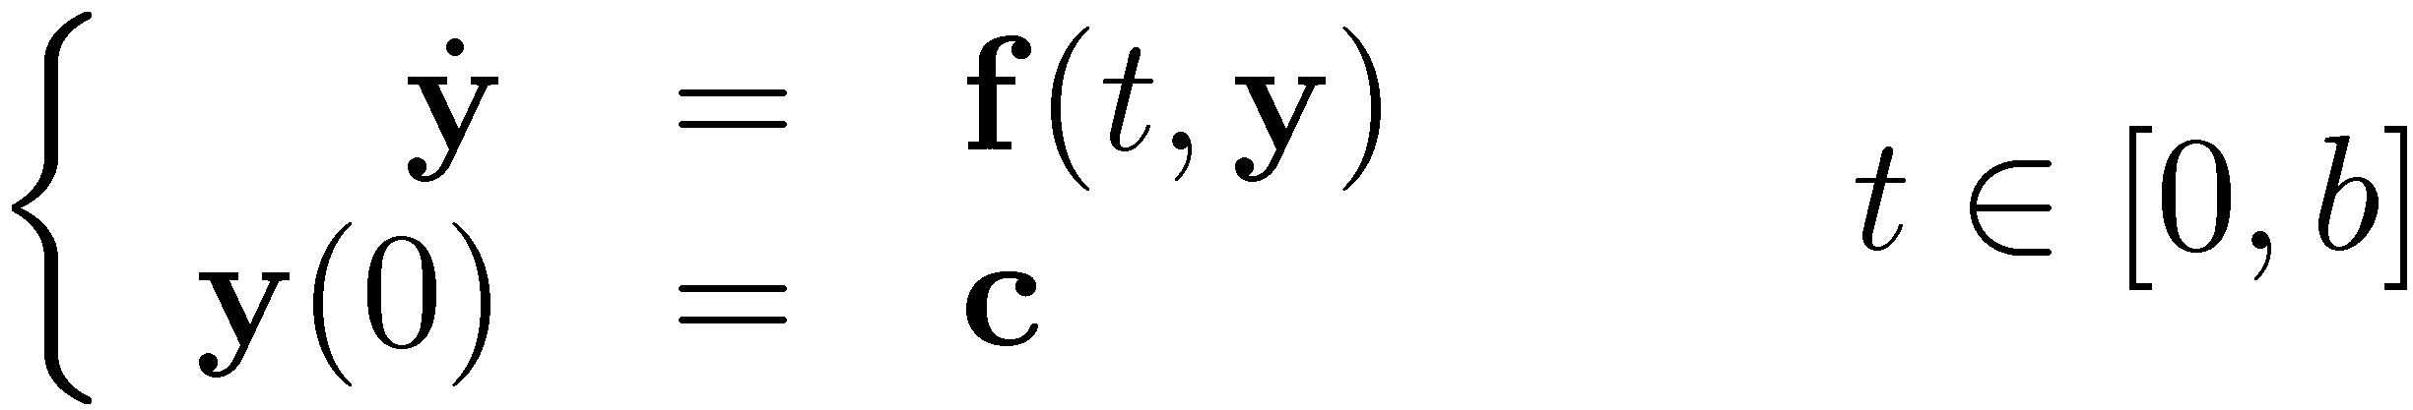
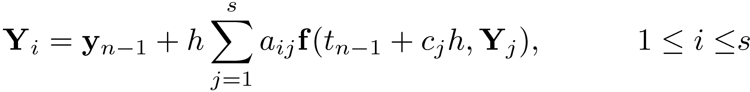
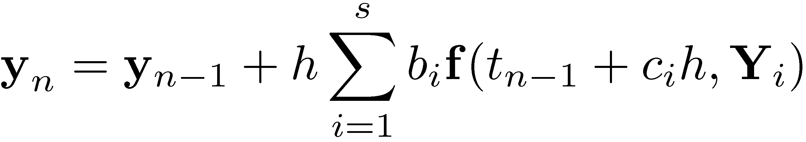
Runge-Kutta Methods
Consider the typical IVP that you want to solve:
The Runge-Kutta integration process is the sum of two tasks:
Task 1: compute the s stage values (the time consuming part):
Task 2: compute the solution at t_{n} (this is trivial…):
Note that these two tasks are carried out at each integration time step t₁, t₂, etc.

Slide 3
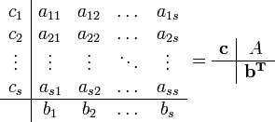


Runge-Kutta (RK) Methods
Three sets of parameters together define a RK method: a_{ij}, b_{i}, and c_{i}.
The coefficients defining a RK method are given to you and typically grouped together in what’s called Butcher’s Tableau
A, b, and c are defined to represent the corresponding blocks of Butcher’s Tableau (see above)
All properties of a RK scheme (stability, accuracy order, convergence order, etc.) are completely defined by the entries in A, b, and c
Nomenclature: number of stages s is defined by the number of rows in A
Professor John Butcher,
New Zealand, awesome guy

Slide 4
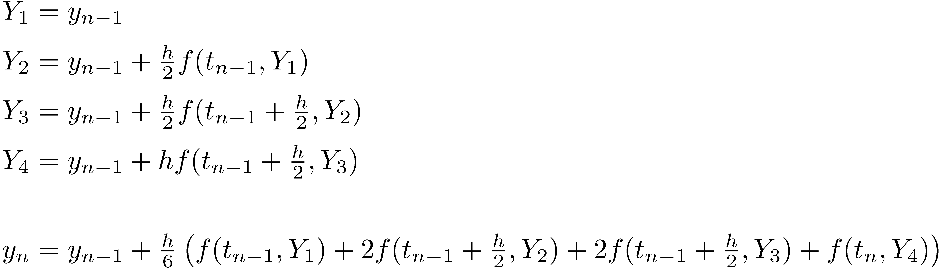
Example: Classical Fourth Order RK Method
The Butcher Tableau representation looks like this:
0 | 0 | 0 | 0 | 0
1/2 | 1/2 | 0 | 0 | 0
1/2 | 0 | 1/2 | 0 | 0
1 | 0 | 0 | 1 | 0
 | 1/6 | 1/3 | 1/3 | 1/6

Slide 5
Choosing A, b, and c for an Explicit RK
Purpose of this and next slide: point out how challenging it is to generate a good RK method
Recall that it boils down to choosing the coefficients in A, b, and c
It has been proved that given a number of stages “s” that you accept to have in an explicit RK method, a limit on the order of the method “p” ensues:
s | 1 | 2 | 3 | 4 | 5 | 6 | 7 | 8 | 9 | 10
p | 1 | 2 | 3 | 4 | 4 | 5 | 6 | 6 | 7 | 7

Slide 6
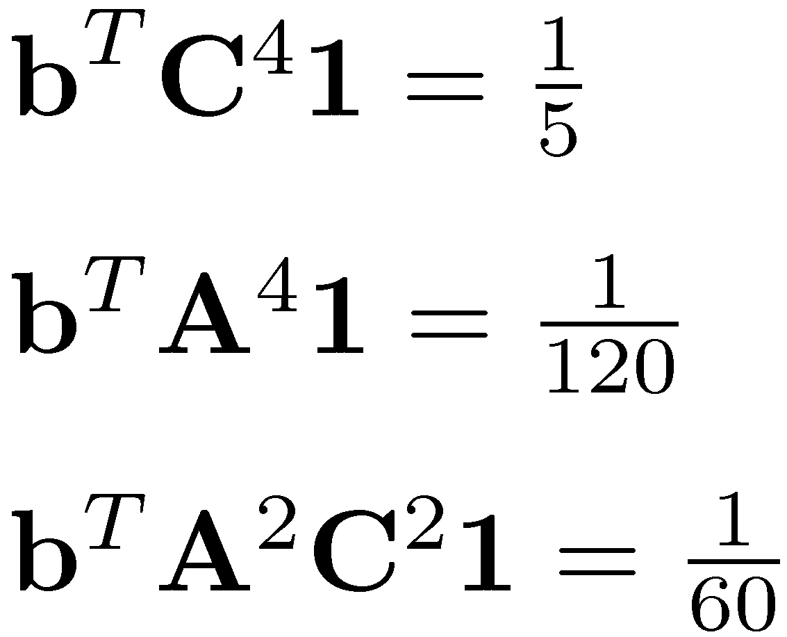
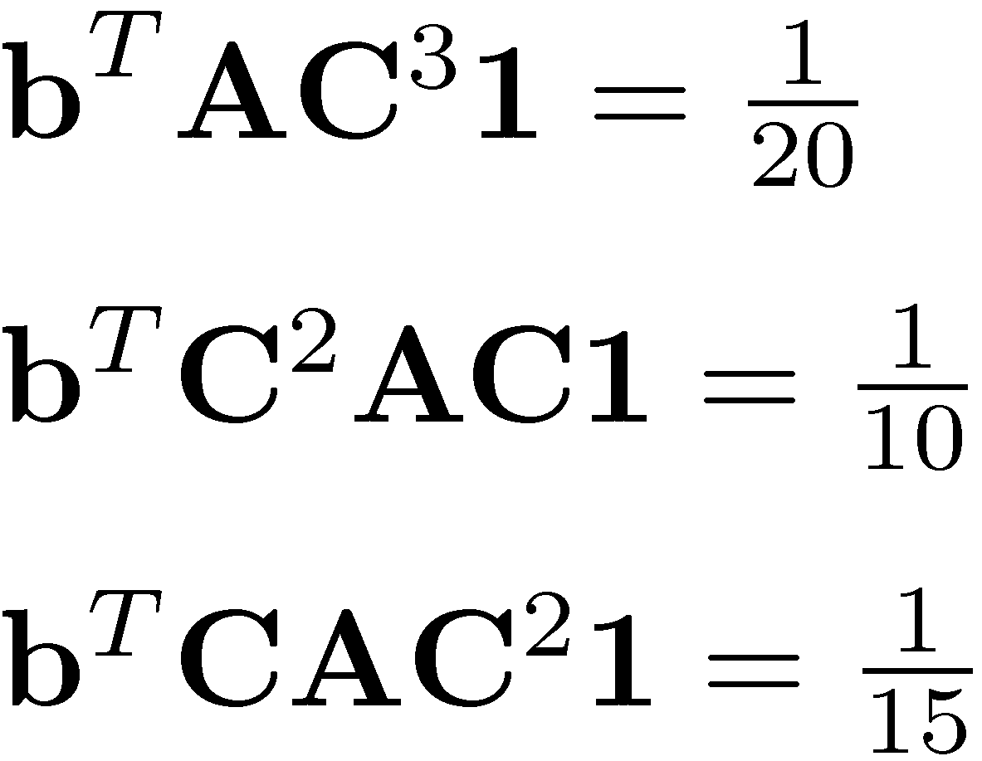
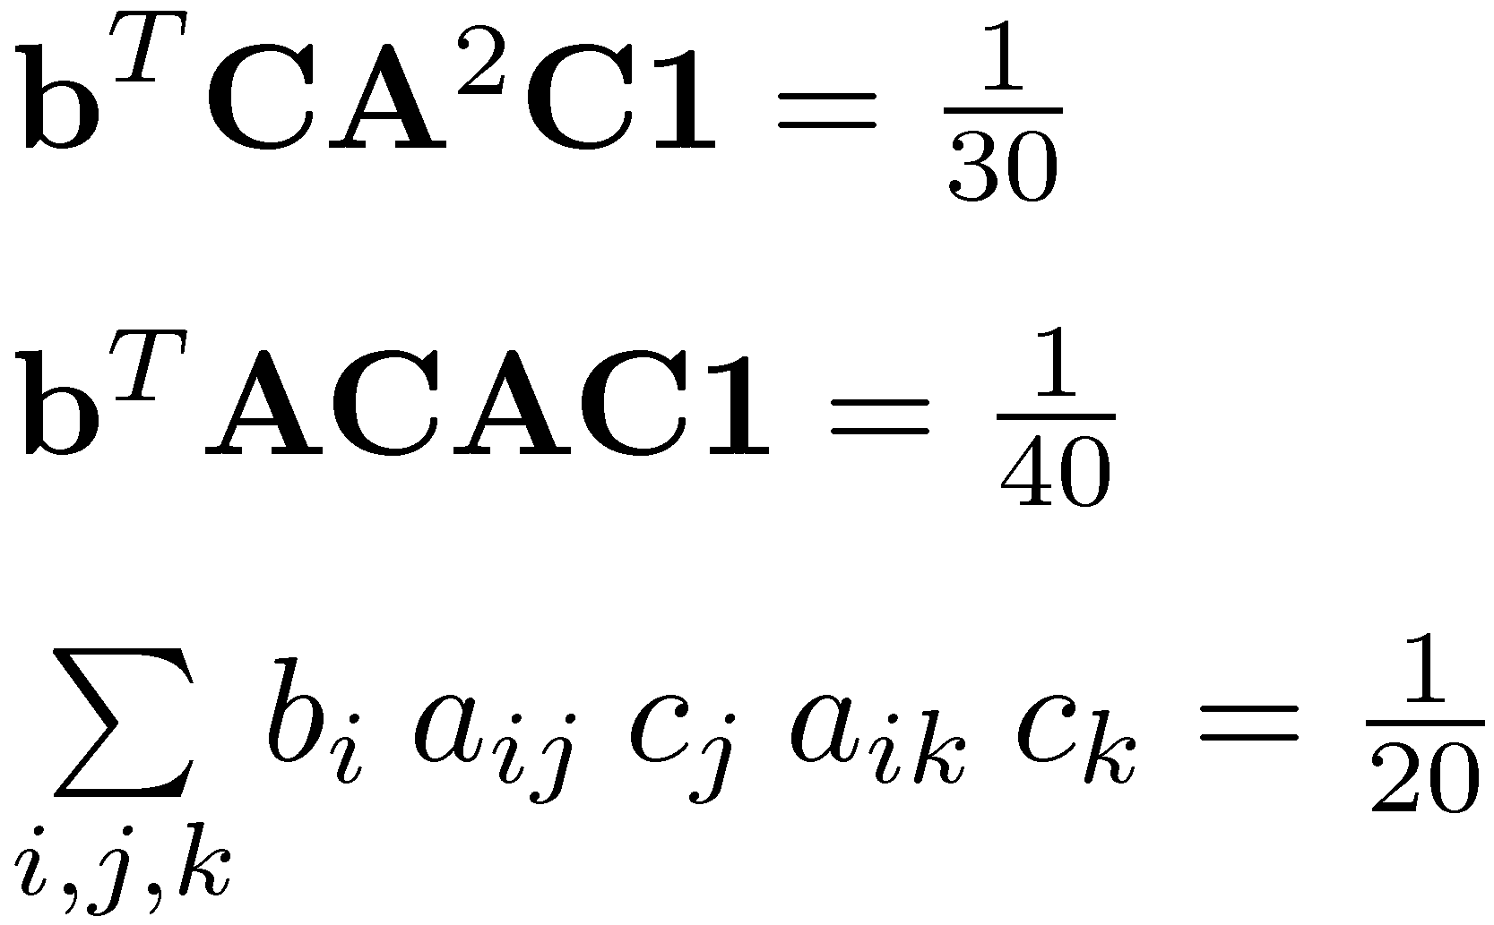
Choosing A, b, and c for RK
Example:
*Necessary* conditions for an explicit method to have order 5
Notation used: C=diag(c₁,…,c_{s}) and 1=(1,1,…,1)^{T}
The number of *necessary* and *sufficient* conditions to guarantee a certain order for an RK method is as follows:
Order p | 1 | 2 | 3 | 4 | 5 | 6 | 7 | 8 | 9 | 10
no. of conditions | 1 | 2 | 4 | 8 | 17 | 37 | 85 | 200 | 486 | 1205
Conclusion: Building a high-order RK is tricky…

Slide 7
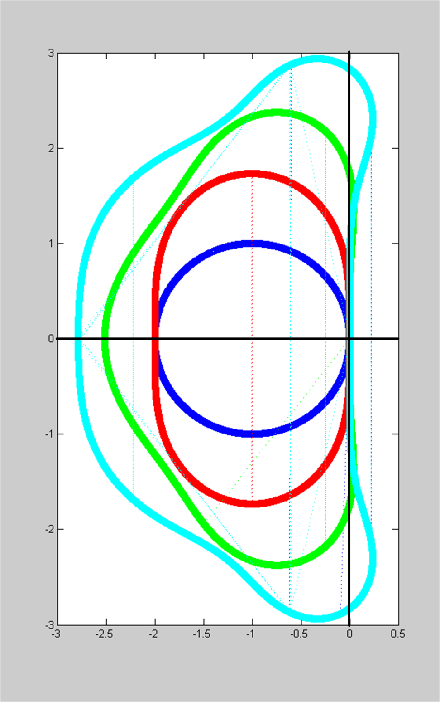
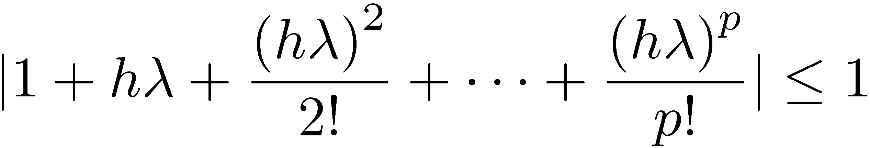
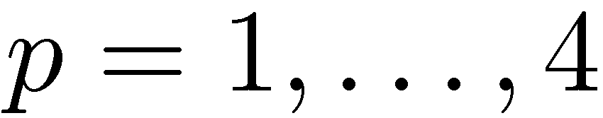
Absolute Stability Regions
Plots report absolute stability regions for explicit RK methods with s stages and of order p=s, for s=1,2,3,4
Blue: s=1
Red: s=2
Green: s=3
Cyan: s=4
Methods are stable inside the curves
Absolute stability region given by

Slide 8
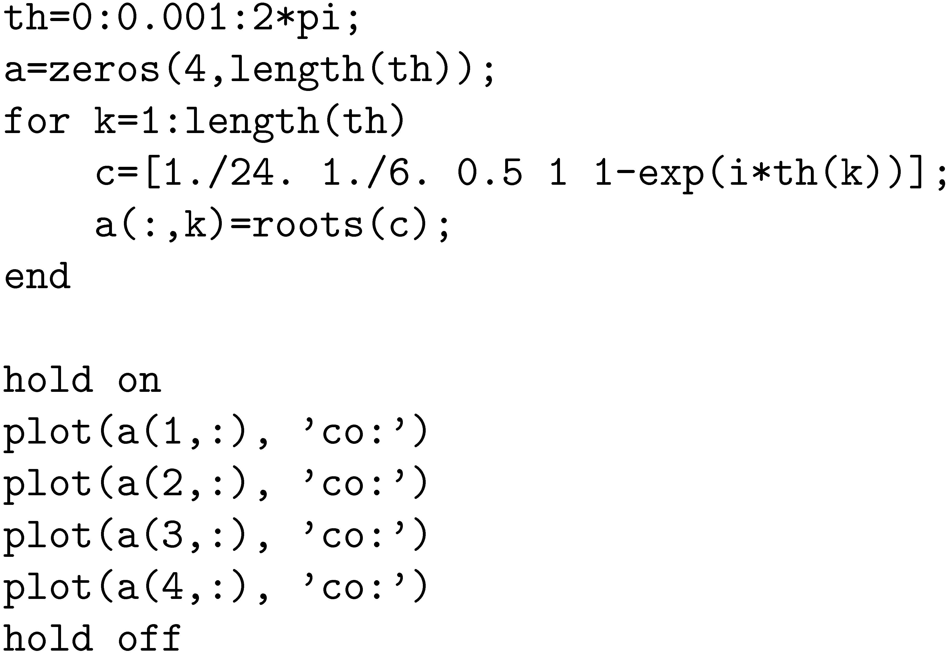
Absolute Stability Regions [Cntd.]
MATLAB script to generate the fourth order abs-stability region (cyan):

Slide 9
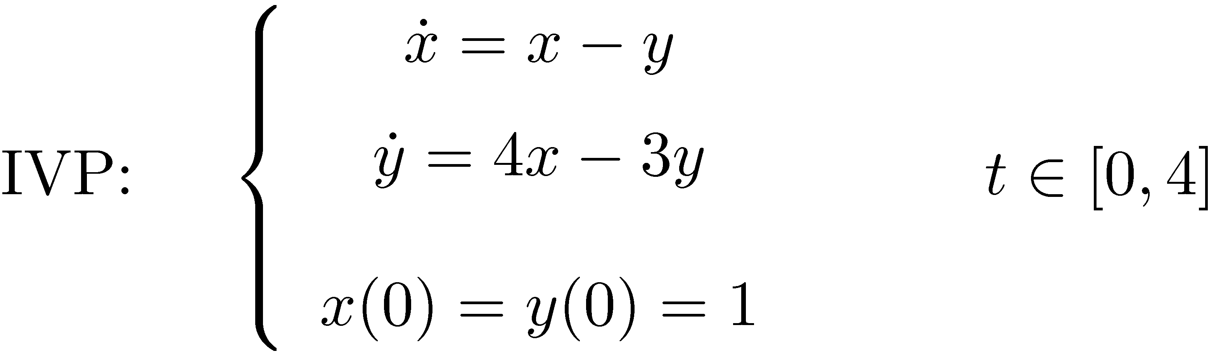
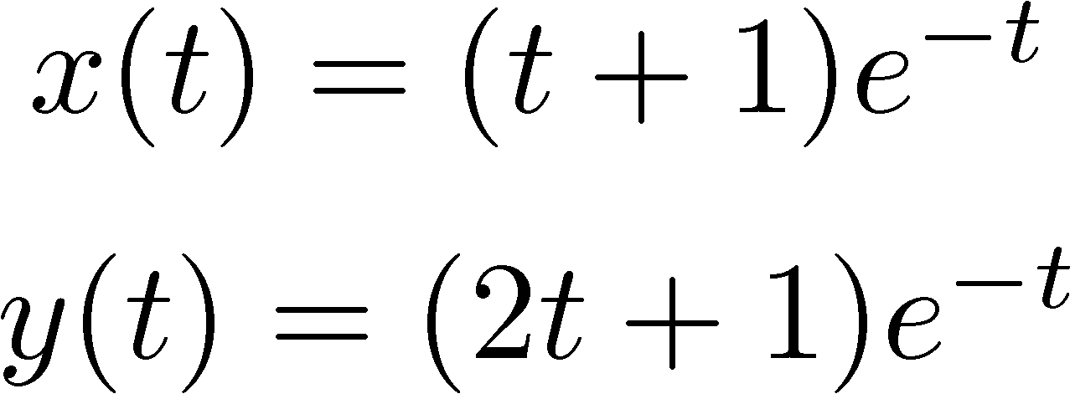
Exercise
Generate the Convergence Plot of the fourth order RK provided a couple of slides ago for the following IVP:
Note that the exact solution of this IVP is:

Slide 10
RK Method, A Different Possibility to Advance the Numerical Solution
Recall that in stage “i” of the s stage approach, we generated a value Y_{i} . We call this approach “y-flavored”:
First, for each of the s stages,
Next, a combination of these stage values leads to the solution at t_{n}:
A different approach can be followed, this is “f-flavored”
It approximates derivatives at each stage rather than values y
See next slide…

Slide 11
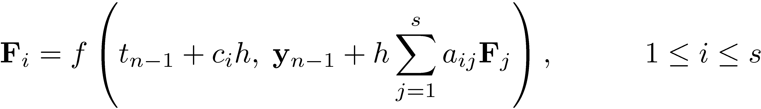
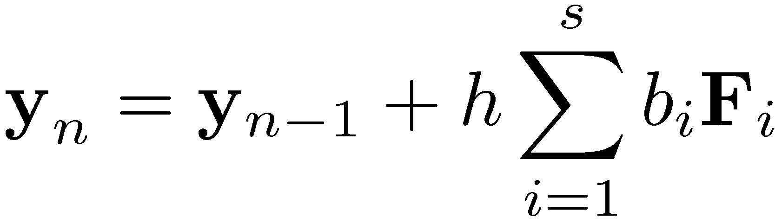
RK Method, A Different Possibility to Advance the Numerical Solution
At each of the s stages of the RK method, you need to figure out F_{i}:
Once the stage values are available, the solution is computed as
Personally, I find the f-flavor better than the y-flavor implementation

Slide 12
RK Method, A Different Possibility to Advance the Numerical Solution
Exercise: show that the f-flavor is easily obtained from the y-flavor by using an appropriate notation.

Slide 13
Exercises
Note that Forward Euler, Backward Euler, and Trapezoidal Formula can all be considered as belonging to the RK family
Provide the Butcher Tableau representation for Forward Euler
Provide the Butcher Tableau representation for Backward Euler
Provide the Butcher Tableau representation for the Trapezoidal Formula

Slide 14
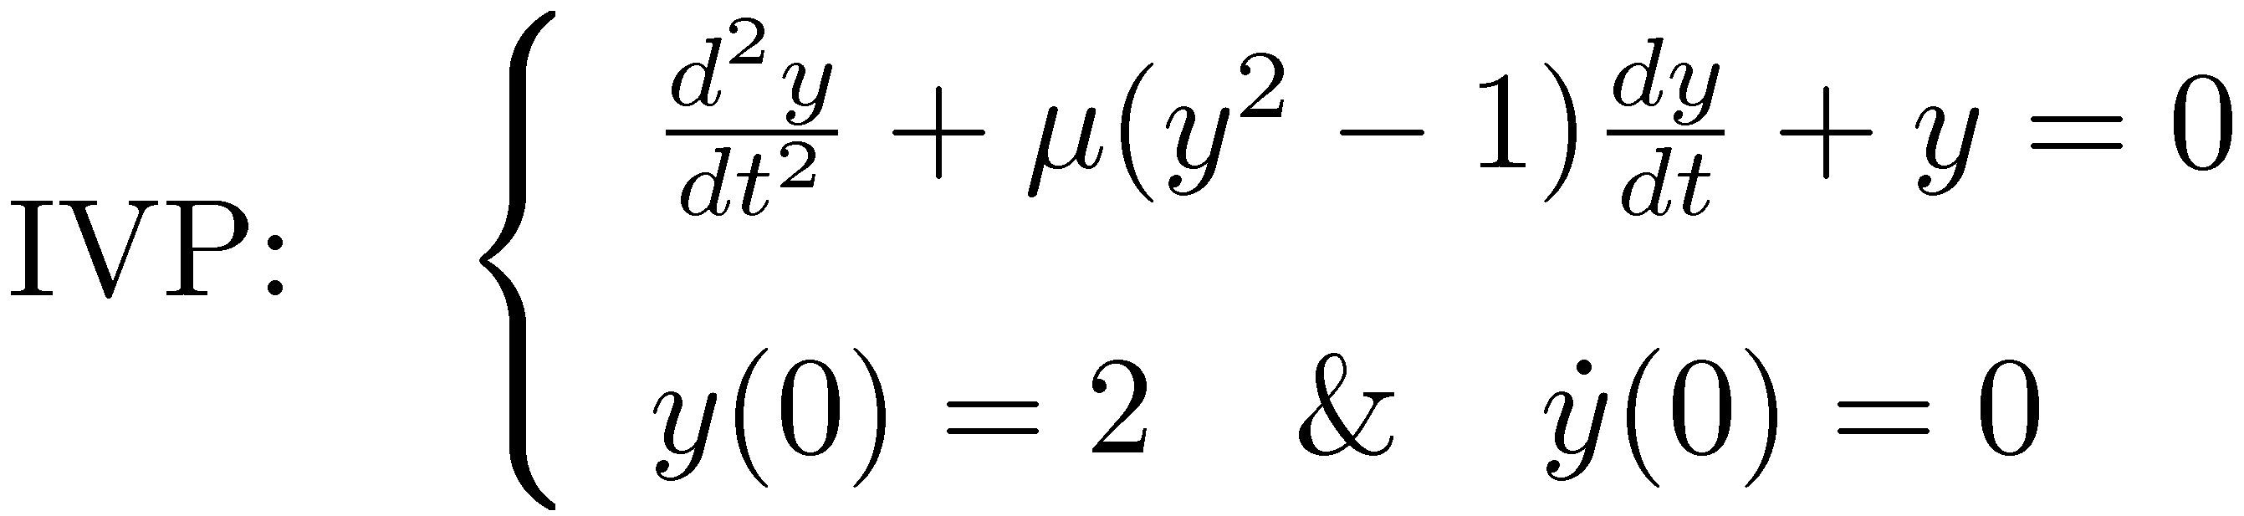
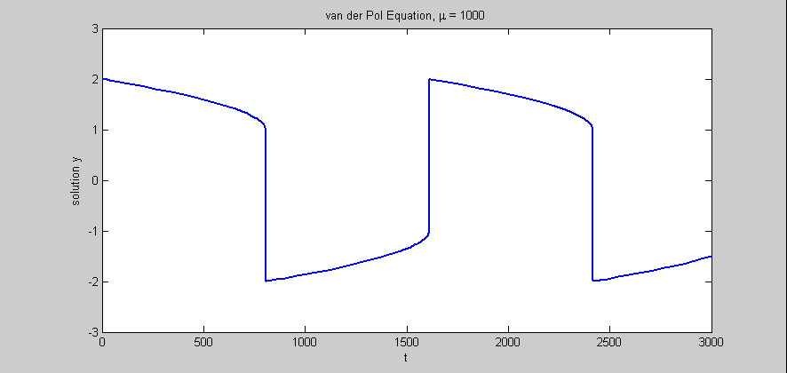
Integration Error Control
The problem: imagine a dynamic system that varies rapidly every once in a while, but the remaining time is very tame
Example: solution of the van der Pole IVP
tspan = [0, 3000];
y0 = [2; 0];
Mu = 1000;
ode = @(t,y) vanderpoldemo(t,y,Mu);
[t,y] = ode15s(ode, tspan, y0);
plot(t,y(:,1))
title('van der Pol Equation, \mu = 1000')
axis([0 3000 -3 3])
xlabel('t')
ylabel('solution y')

Slide 15
Integration Error Control
If you don’t adjust the integration step-size h you are forced to work during the entire simulation with a very conservative value of h
Basically, you have to work with that value of h that can negotiate the high transients
This would be for almost the entire simulation a waste of resources
Basic Idea:
When you have high transients, reduce h to make sure you are ok
When the dynamics is tame, increase the value of h and sail quickly through these intervals
On what should you base the selection of the step size h?
On the value of local error
It would be good to be able to use the actual error, but that’s impossible to do

Slide 16

Integration Error Control: The Details
In the end, we need a mechanism that tries to guarantee that the local error at each time step stays below a user-prescribed threshold value
Computing the threshold value
Draws on two values specified by the user: absolute tolerance ATOL and relative tolerance RTOL (think of these as allowances)
If dealing with an m-dimensional problem, threshold value »_{i} for component “i” of solution y is computed as
The key observation: the entire error control effort concentrates on keeping an *approximation* of the local error at t_{n} smaller than »

Slide 17
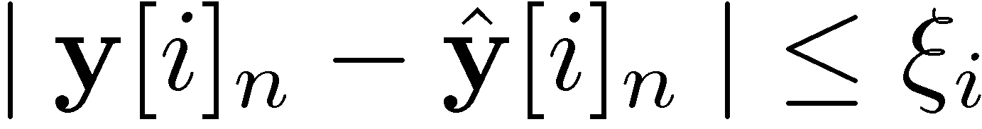
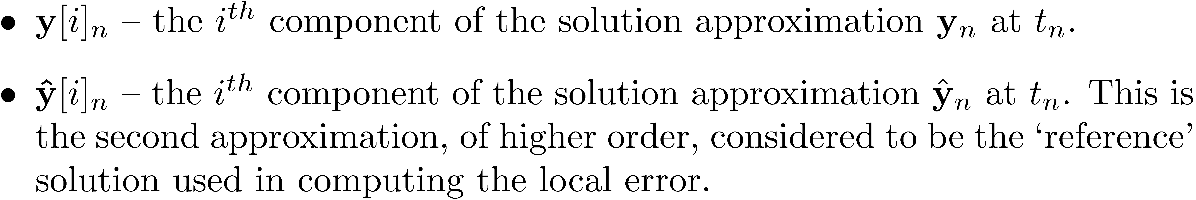
Integration Error Control: The Details
What’s left at this point is to somehow provide an approximation of the local error l[i]_{n} at time step t_{n}
To get l[i]_{n}, you produce a *second* approximation of the solution at t_{n}, and you pretend that that second solution is the actual solution(kind of funny). Then you can get an approximation of the local error:
Here we had:

Slide 18
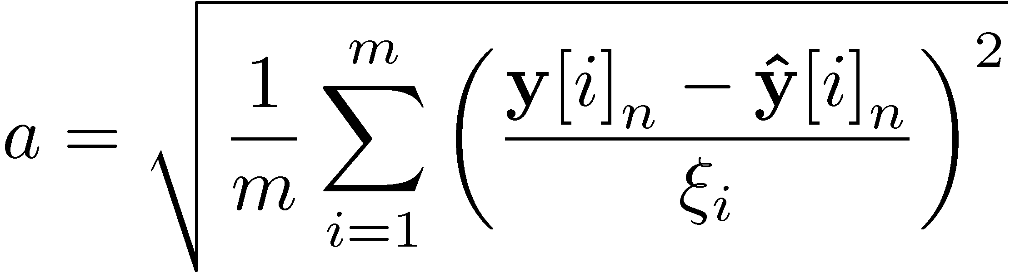
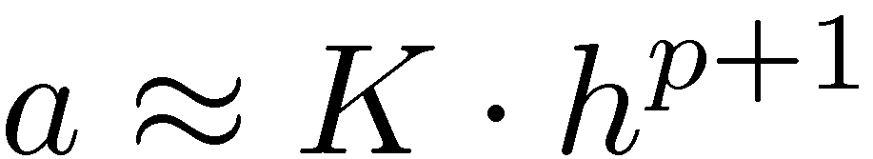
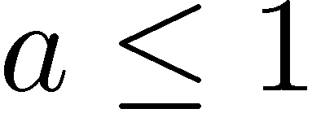

Integration Error Control: The Details
A measure of the acceptability “a” of the solution given the user prescribed tolerance is obtained as
Note that asymptotically, since the method we use is assumed to be order p, we have for v that (K is an unknown constant):
Note that any reading indicates an acceptable situation
Otherwise, if , it’s an indication that the quality of the solution does not meet the user prescribed tolerance
If this is the case, the step size should be decrased, y_{n} is rejected and it’s to be computed again…

Slide 19
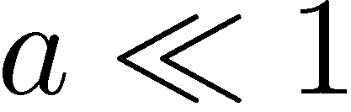
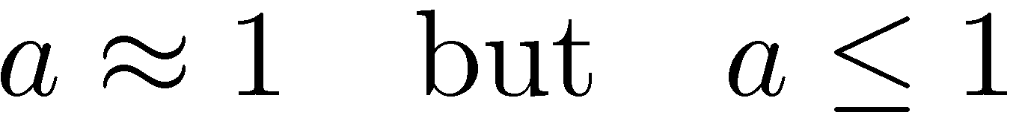
Integration Error Control: The Details
Summary of possible scenarios
Step-size is too small, you are being way more accurate than the user needs
Step-size is exactly where you want it to be, acceptability is on the margin
Step-size is too large, you are to aggressive and this leads to local errors that are exceeding the user specified tolerance

Slide 20
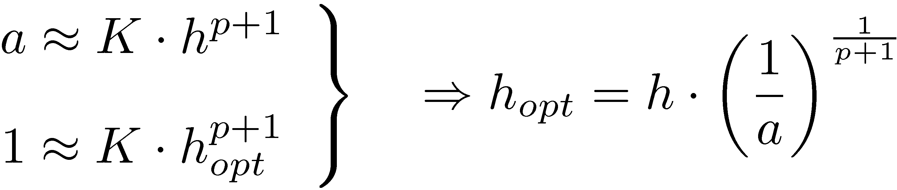
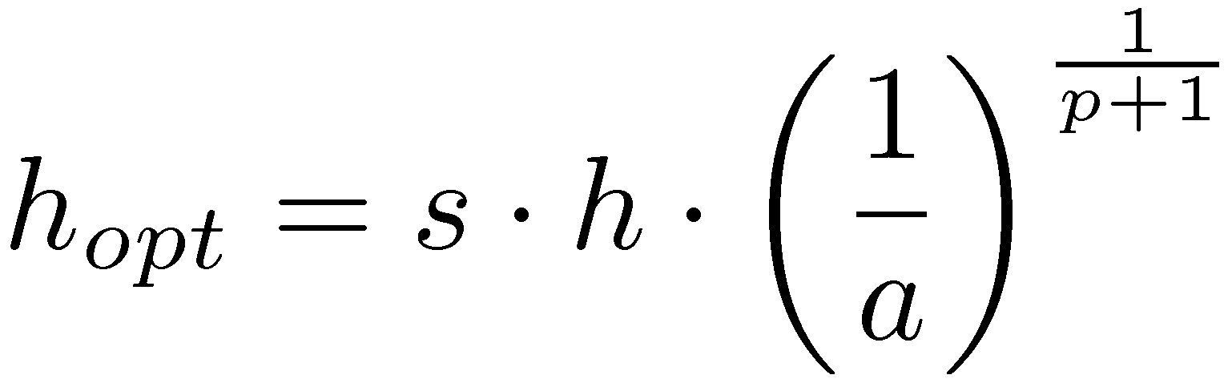
Integration Error Control: The Details
Finally, how do you choose the optimal step-size h_{opt}?
You want to be in the sweet spot, acceptability is 1.0
The step-size is chosen to meet this requirement:
Because there was some hand waving involved and these arguments are in general true only asymptotically, one usually uses a safety factor s=0.9 to play it conservatively. Then the new step size is chosen as

Slide 21






Integration Error Control: The “Embedded Method”
How do you usually get the second approximate solution?
The idea is to use the same stage values you produce to generate the first solution
In other words, use the same A and c, but change only b
When using Butcher’s Tableau, this is captured by adding a new row for the new values of :
Embedded Method:
Produces second num solution
(used in local error control)
Original Method:
Produces num solution
Typical notation used
for Butcher’s Tableau

Slide 22
Example 1: RK Embedded Methods
The Fehlberg 4(5) pair
Empty cells have a zero in them
0
1/4 | 1/4
3/8 | 3/32 | 9/32
12/13 | 1932/2197 | -7200/2197 | 7296/2197
1 | 439/216 | -8 | 3680/513 | -845/4104
1/2 | -8/27 | 2 | -3544/2565 | 1859/4104 | -11/40
 | 25/216 | 0 | 1408/2565 | 2197/4104 | -1/5 | 0
 | 16/135 | 0 | 6656/12825 | 28561/56430 | -9/50 | 2/55

Slide 23
Example 2: RK Embedded Methods
The Dormand-Prince 4(5) pair
Empty cells have a zero in them
This is what’s used in MATLAB as the default for the ODE45 solver
0
1/5 | 1/5
3/10 | 3/40 | 9/40
4/5 | 44/45 | -56/15 | 32/9
8/9 | 19372/6561 | -25360/2187 | 64448/6561 | -212/729
1 | 9017/3168 | -355/33 | 46732/5247 | 49/176 | -5103/18656
1 | 35/384 | 0 | 500/1113 | 125/192 | -2187/6784 | 11/84
 | 5179/57600 | 0 | 7571/16695 | 393/640 | -92097/339200 | 187/2100 | 1/40
 | 35/384 | 0 | 500/1113 | 125/192 | -2187/6784 | 11/84 | 0

Slide 24
Explicit vs. Implicit RK
One can immediately figure out whether a RK method is explicit or implicit by simply inspecting Butcher’s Tableau
If the A matrix has nonzero entries on the diagonal or in the upper triangular side, the method is implicit
Implicit RK methods belong to several subfamilies
Gauss methods
They are maximum order methods: for s stages, you get order 2s (as good as it gets)
Radau methods
Attain order 2s-1 for s stages
Lobatto methods
Attain order 2s-2 for stages

Slide 25




Examples, Implicit RK Methods
Members of the Gauss subfamily
Members of the Radau subfamily
Members of the Lobatto subfamily
1/2 | 1/2
 | 1
 | 1/4
 |  | 1/4
 | 1/2 | 1/2
Implicit Midpoint
s=1, p=2
No name, s=2, p=4
1 | 1
 | 1
1/3 | 5/12 | -1/12
1 | 3/4 | 1/4
 | 3/4 | 1/4
Backward Euler s=1, p=1
No name, s=2, p=3
0 | 0 | 0
1 | 1/2 | 1/2
 | 1/2 | 1/2
0 | 0 | 0 | 0
1/2 | 5/24 | 1/3 | 0
1 | 1/6 | 2/3 | 1/6
 | 1/6 | 2/3 | 1/6
Trapezoidal Method s=2, p=2
No name, s=3, p=4

Slide 26
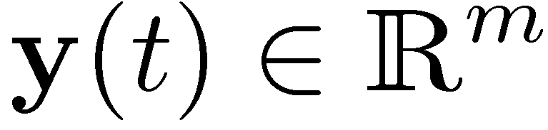
Implicit RK Methods: Implementation Issues
Implicit RK methods are notoriously hard to implement
Suppose you have an IVP where the dimension of the unknown function is m:
Then, the dimension of the nonlinear system that you have to solve at each time step is of an s-stage implicit RK method is s*m
This is a serious drawback
A lot of research goes into parallelizing this process: rather than solving one nonlinear system of dimension s*m, the idea is to solve s systems of dimension m
This is still not that impressive, to be compared to the effort in multistep methods (to be covered shortly…)

Slide 27
Exercise
Consider the van der Pol IVP, which is to be solved using the order 3 Radau formula
Write down the nonlinear system of equations that one has to solve when advancing the simulation by one time step h
Use the F-flavor representation of the RK method

Slide 28






Diagonal Implicit RK Methods (DIRK Methods)
One immediate way to decouple the large nonlinear system and have s systems of dimension m is to use diagonal implicit RK methods
Called DIRK methods
If *all* the diagonal entries in the A matrix are the same, then the method is called SDIRK (singly diagonal implicit RK) method
Note that for SDIRK, each of the s decoupled nonlinear systems have the same iteration matrix (Jacobian is the same)
Example, SDIRK methods
Backward Euler
Also the following two look good…
 |  | 0
 | 1/2 | 1/2
 |  | 0
s=2, p=3
s=2, p=2

Slide 29

RK and Stiff Decay
Stiff Decay is also called in the literature L-stability
There is a theorem that provides sufficient conditions for stiff decay of a RK method
Specifically, the following are sufficient conditions for stiff decay
A matrix is nonsingular, and
The last row of the A matrix is identical to b^{T}
Example, SDIRK with stiff decay:
 |  | 0
s=2, p=2

Slide 30
RK Methods – Final Thoughts
Explicit RK relatively straight forward to implement
Implicit RK are challenging to implement due to the large nonlinear system that ensues discretization
This family of methods is well understood
Reliable
On the expensive side in terms of computational effort (for each time step, you have to do multiple function evaluations)
Things of interest that we didn’t cover
Estimation of global error
Stiffness detection
Sensitivity to data perturbations (sensitivity analysis)
Symplectic methods for Hamiltonian systems

Slide 31
Exercises
Problem 4.8 – tricky at times
Problem 4.12 – deals with step-size control for a sun-earth problem
Example 4.6: use MATLAB to generate an approximate solution of the IVP therein. The solution is y(t)=sin(t). If the approximate MATLAB solution doesn’t look good, try to tinker with MATLAB or implement your own numerical scheme to solve the problem

Slide 32
New Topic: Linear Multistep Methods

Slide 33
Multistep vs. RK Methods
Fewer function evaluations per time step
Simpler, more streamlined method design
Recall the table with number of conditions that the RK method coefficients had to satisfy to be guaranteed a certain order for the RK method
Error estimation and order control are much simpler
In fact, order control (the ability to change the order of the method on the fly) is something that is not typically done for RK
Order control is very common for Multistep Methods
On the negative side
There is high overhead when changing the integration step-size
Loses some of the flexibility of one RK methods (there you had many parameters to adjust, not that much the case for Multistep methods)
More simpleton in nature than their sophisticated RK cousins

Slide 34
Review of Framework
Interested in finding a function y(t) over an interval [0,b]
This m-dimensional function y(t) must satisfy the following IVP:
We assume that f is bounded and smooth, so that y exists, is unique, and smooth
Given to you:
The constants c and b
The function f(t,y).

Slide 35
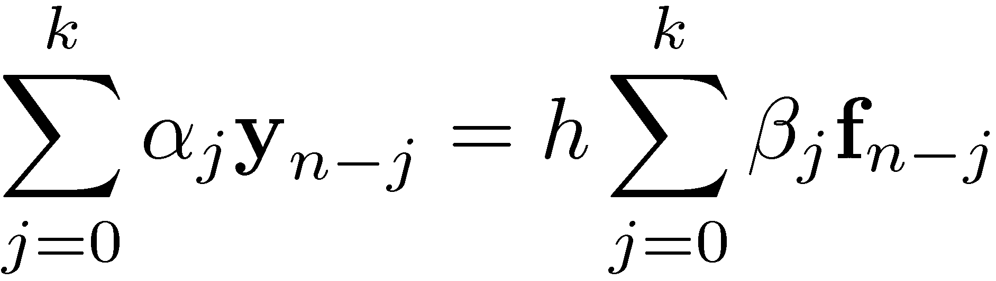
Multistep Methods - Nomenclature
Notation used:
y_{l} represents an approximation at time t_{l} of the actual solution y(t_{l})
f_{l} represents the value of the function f evaluated at t_{l} and y_{l}
We work with *multistep* methods. We’ll use k to represent the number of steps in a particular Multistep method
The general form of a Multistep method (M-method) is as follows
®_{j} and ¯_{j} are coefficients specific to each M method

Slide 36
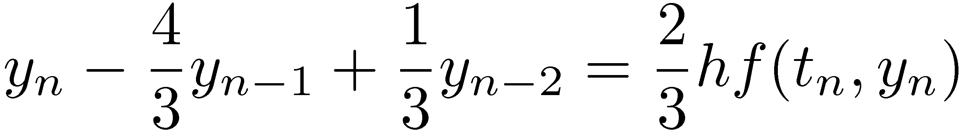
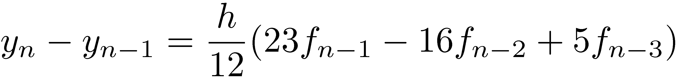
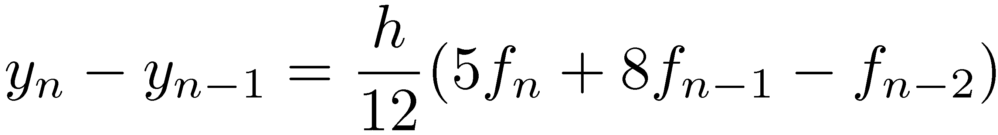
Examples - Multistep Methods
General Form:
BDF method
Adams-Bashforth method
Adams-Moulton method

Slide 37
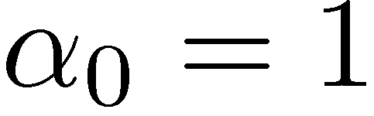
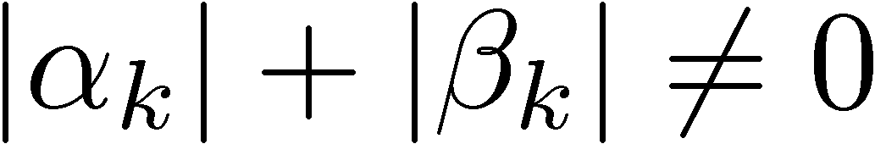
M Methods: Further Remarks
To eliminate arbitrary scaling, it is assumed that
To truly talk about a k-step method, it is also assumed that
Note that if ¯_{j}=0 the method is explicit. Otherwise, it is implicit
Finally, note that the step size over the last k integration step is assumed constant
This is going to give some headaches later on when you actually want to change the step size on the fly to control error

Slide 38
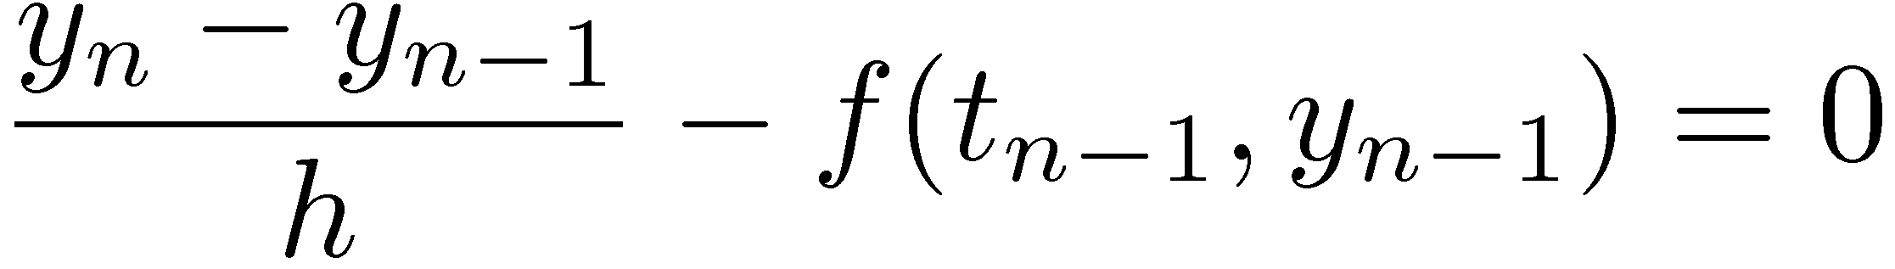
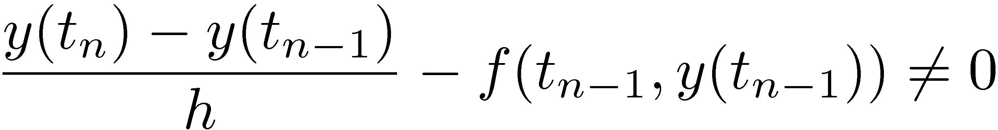
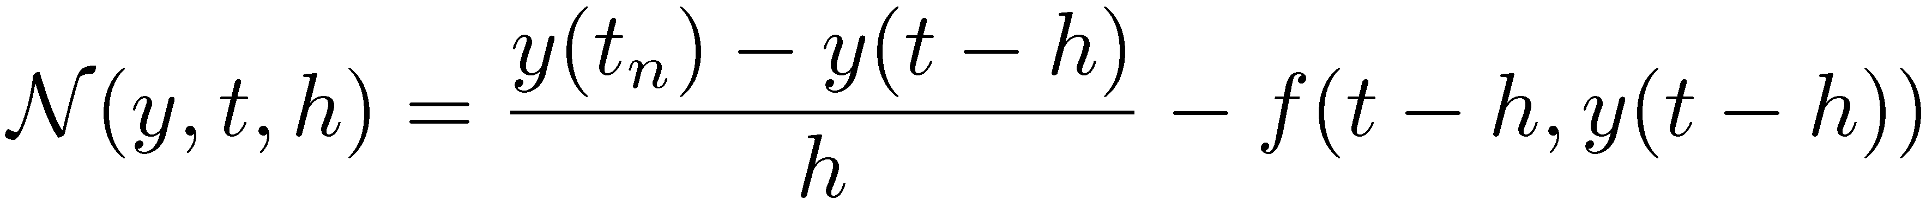
Quick One Slide Review: Local Truncation Error, Forward Euler
Consider how the solution is obtained:
Note that in general, if you stick the actual solution in the equation above it is not going to be satisfied:
By definition, the quantity above is called the truncation error and is denoted by
Note that this depends on the function (y), the point where you care to evaluate the truncation error (t_{n}), and the step size used (h)

Slide 39
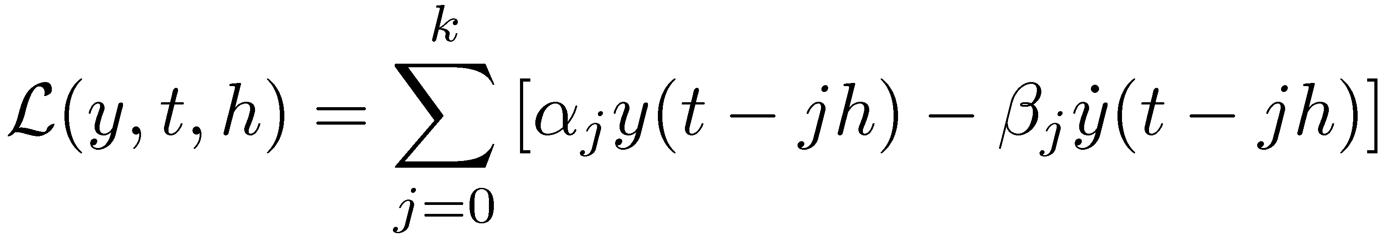
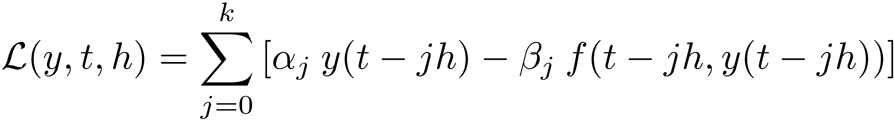
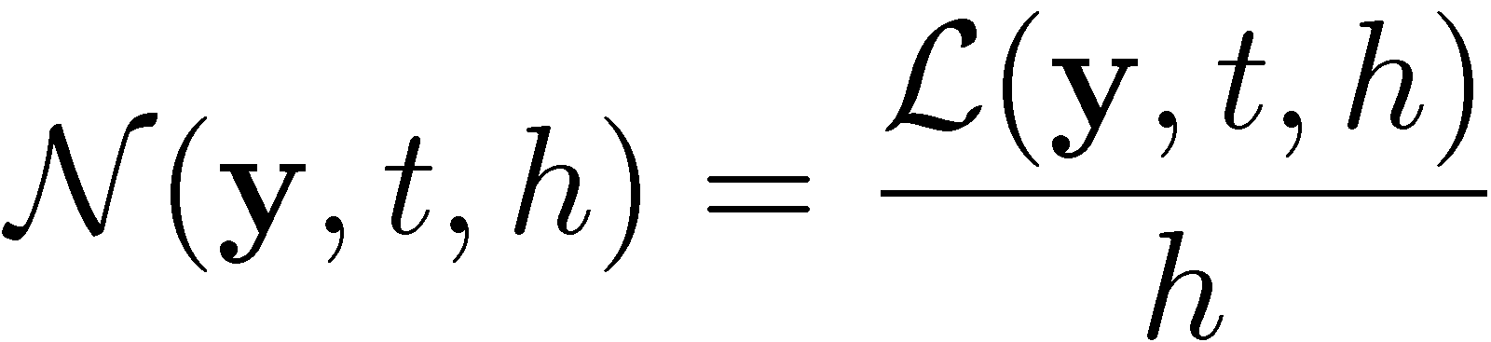
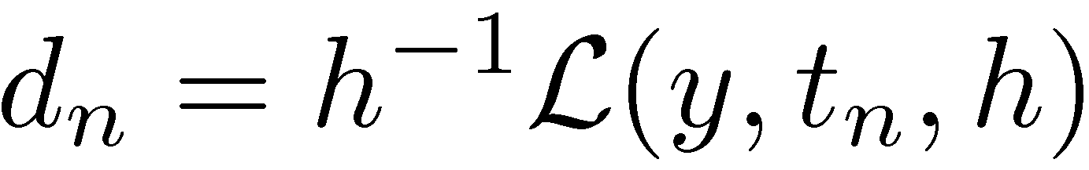
The Local Truncation Error: Multistep Methods
Consider the linear operator (assume y is scalar function, for simplicity of notation)
Equivalently, since y is the exact solution of the IVP,
Then it follows that
Or, in other words, the local truncation error is

Slide 40
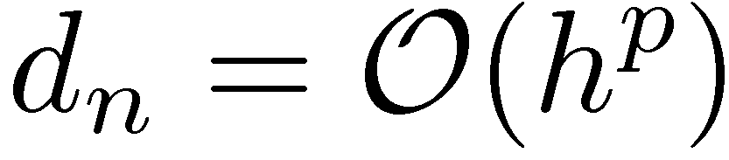
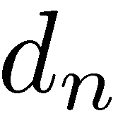
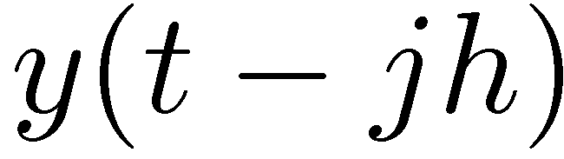
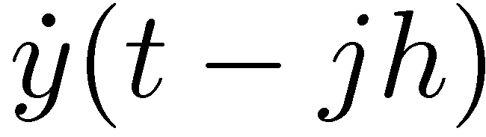
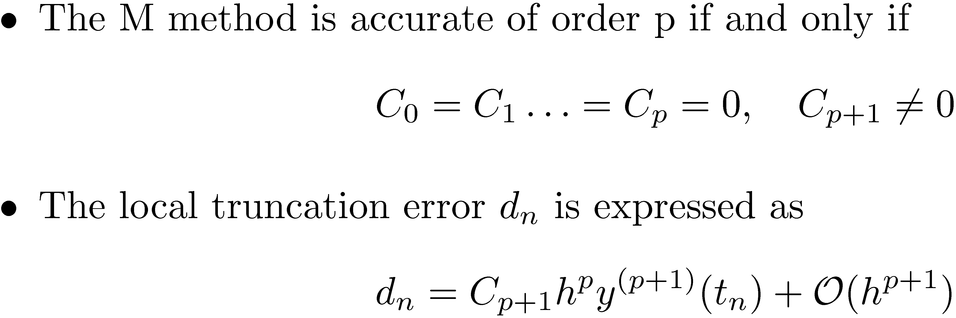
M Methods: Order Conditions
Recall that by definition a method is accurate of order p if
To assess the order of , carry out a Taylor expansion of and
This to be done for j=0,…,k, then collect terms to obtain the following representation of the linear operator
Then, we get the following

Slide 41
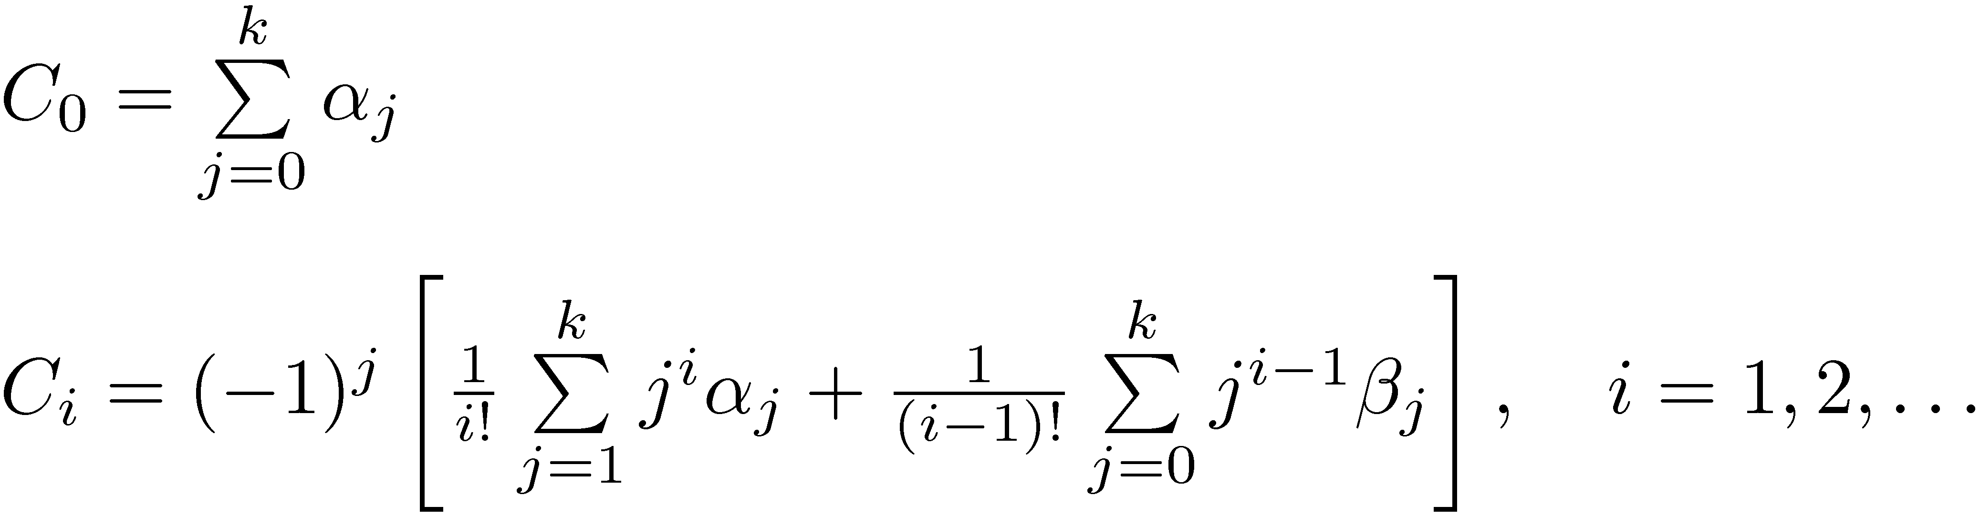
M Methods: Order Conditions
From the Taylor series expansions, one can obtain in a straightforward fashion that
Nomenclature:
When the order is p, then C_{p+1} is called the error constant of the method
Obviously, one would like a method that has C_{p+1} as small as possible

Slide 42
Exercises
Proof that the expression of C_{i} on the previous slide is correct
Pose the Forward Euler method as a M method and verify its order conditions (should be order 1)
Pose the Backward Euler method as a M method and verify its order conditions (should be order 1)
Pose the Trapezoidal method as a M method and verify its order conditions (should be order 2)

Slide 43
Quick Review: Order “p” Convergence
Theorem:
Some more specifics:
If the method is accurate of order p and 0-stable, then it is convergent of order p:

Slide 44
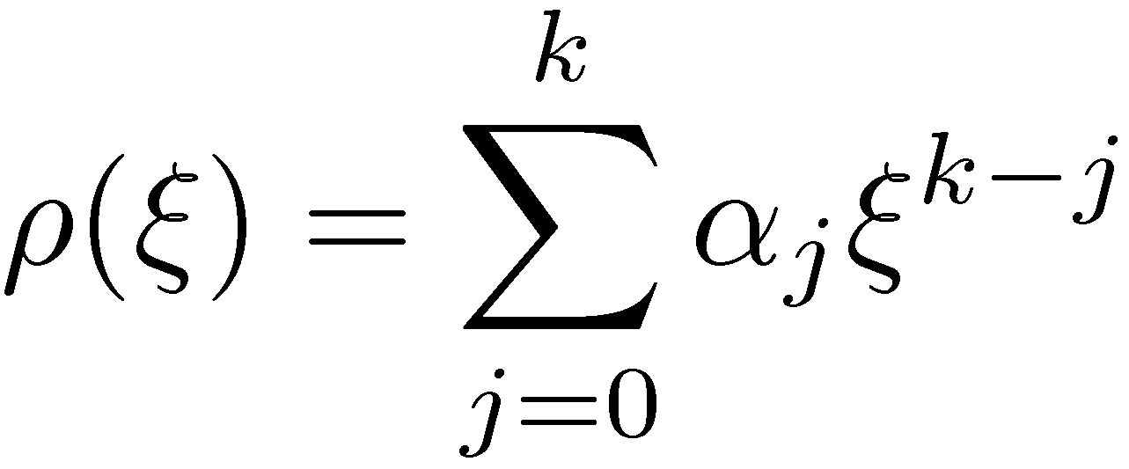
M Methods: Convergence Results
We saw what it takes for a M method to have a certain accuracy order
What’s left is to prove 0-stability
The concept of characteristic polynomial comes in handy:
Note that for the k stage M method, the characteristic polynomial only depends on ®_{j}

Slide 45
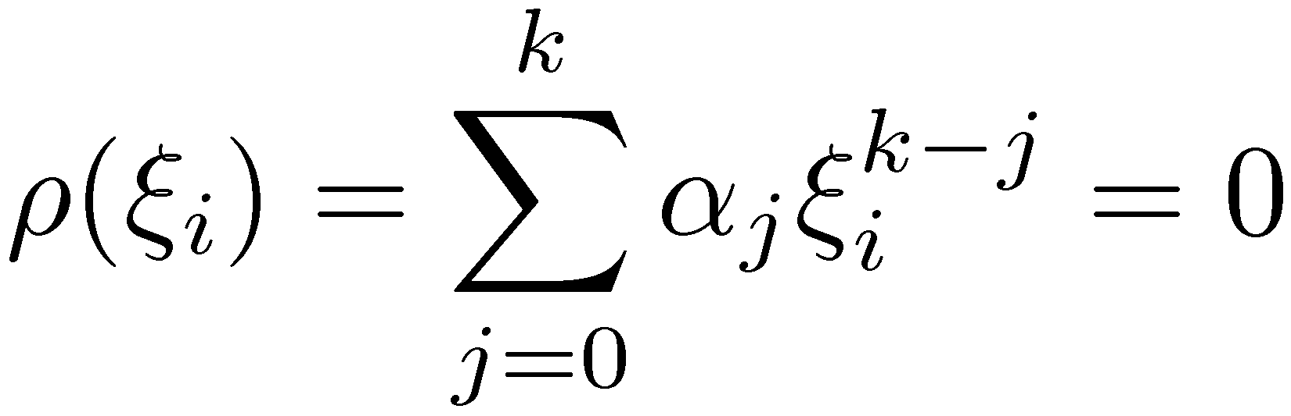
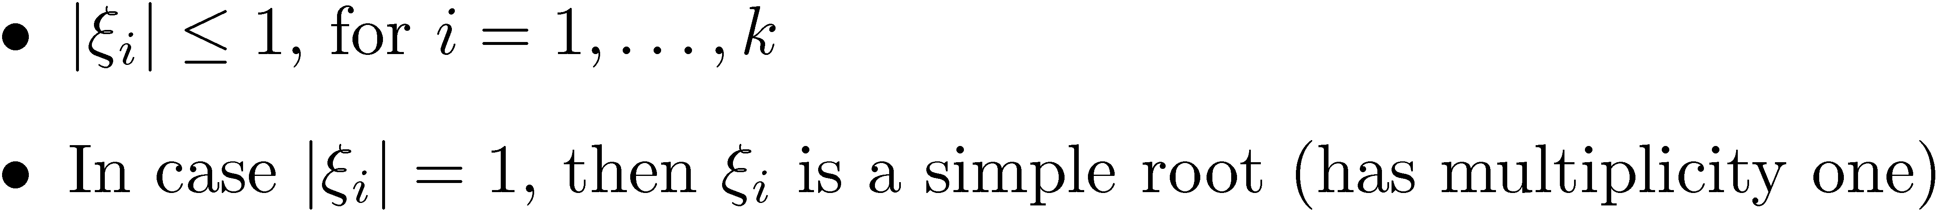
M Methods: The Root Condition
We provide without proof the following condition for a M-method to be 0-stable (the “root condition”)
Let »_{i} be the k roots of the characteristic polynomial. That is,
Then, the M-method is 0-stable if and only if

Slide 46
M Methods: Convergence Criterion
An M-method is convergent to order p if the following conditions hold:
The root condition holds
The method is accurate to order p
The initial values required by the k-step method are accurate to order p
Exercise:
Identify the convergence order of the Forward Euler, Backward Euler, and Trapezoidal Methods

Slide 47


M Methods: Exercise, Root Condition
Consider the following M-method:
What is the accuracy order of the method?
Does the method satisfy the root condition?
Use the M-method above to find the solution of the simple IVP
For the M-method, take

Slide 48


The Root Condition: Further Comments
Exercise: Generate the convergence plot for Milne’s method…
… in conjunction with the following IVP:
Compute the starting points using the exact solution of the above IVP

Slide 49
Short Side Trip: Difference Equations
Difference equations, the framework
Someone gives you k initial values x₀,…,x_{k-1}
You find the next value x_{k} by solving a “difference equation”:
It’s obvious that the value of x_{n} is uniquely defined once you have the first k values
How can we compute this unique value x_{n} yet not explicitly reference the first k values?
Trick used: assume the following expression for x_{n}:
This choice of the expression of x_{n} leads to the following equation that must be satisfied by » (typically called Characteristic Equation)

Slide 50
Short Side Trip: Difference Equations [Cntd.]
Characteristic Equation (CE):
Has degree k
Has k roots (might be distinct or multiple roots amongst them): »₁, »₂,…,»_{k}
Exercise: show that the value of x_{n} can be expressed as (assume no multiple roots)
Expression of x_{n} gets slightly more complicated for multiple roots:
Double root (say »₁=»₂):
Triple root (say »₁ =»₂ =»₃):
NOTE: This Difference Equations theory relevant when looking into absolute stability

Slide 51



Absolute Stability [quick review]
The process used to find out the region of absolute stability
We started with the test problem
We required that for the test problem, the numerical approximation should behave like the exact solution. That is, we required that
Used the discretization scheme to express how y_{n} is related to y_{n-1} and impose the condition above
This leads to a condition that the step size should satisfy in relation to the parameter ¸
Example: for Forward Euler, we obtained that for absolute stability that

Slide 52
Region of Absolute Stability
Apply the methodology on previous slide for the test problem when used in conjunction with a multistep scheme
This leads to
Recall that we had the expression for x_{n} Re
For us to hope that y_{n}! 0, we need |»_{i}| · 1 for 8 i ¸ k

Slide 53
Region of Absolute Stability [Cntd.]
Drop the subscript i for convenience. The conclusion is that any root of the Characteristic Equation; i.e. any » that satisfies…
… must also satisfy |»| · 1
Note that if the above condition holds, then we will get to the desired condition that y_{n} is monotonically decreasing in absolute value:

Slide 54
Region of Absolute Stability [Cntd.]
So in the end, it boils down to this simple sufficient condition: if h¸ is such that the roots of the CE all have the norm less than or equal to 1, then h¸ belongs to the stability region
Recall that the CE assumes the form
How would you find the boundaries of the stability region?
This is precisely that situation where |»|=1, or in other words, where »=e^{iµ}
So the boundary is given by those values of h¸ for which »=e^{iµ}
Yet note that from the CE, one has that for µ2[0,2¼),

Slide 55
Exercise
Plot the region of absolute stability for Milne’s method

Slide 56
Absolute Stability: Closing Comments
It is relatively straight forward to show that no explicit M method can be A-stable
Lindquist’s Barrier (1962, not simple to prove)
You cannot construct an A-stable M method that has order higher than 2
Note that there is no such barrier for RK methods
The second order A-stable implicit M method with smallest error constant (C₃=1/12) is the trapezoidal integration method
The problem with the trapezoidal formula is that it does not have stiff decay (it is A-stable but not L-stable)

Slide 57
How Did People Get M-Methods?
One early approach (about 1880): integrate the ordinary differential equation, and approximate the function f using a polynomial
Based on previous values f(t_{n-1},y_{n-1}),…, f(t_{n-k},y_{n-k}), one can fit a k-1 degree polynomial in the variable t to approximate the unknown function f(t,y)
Once the polynomial is available, simply plug it back in the integral above and evaluate it to get y_{n} (an approximation of y(t_{n}))
NOTE: this approach leads to a family of explicit integration formulas called Adams-Bashforth Multistep methods (AB-M methods)

Slide 58
Exercise
Derive the AB-M method for k=1, k=2, and k=3
Plot the absolute stability region for the AB-M methods above

Slide 59

AB-M Method, Closing
Table below provides convergence order p, the number of steps k of the M method, the coefficients ¯_{n-j}, and the value of the leading coefficient of the error term C_{p+1}
p | k | j! | 1 | 2 | 3 | 4 | 5 | 6 | C_{p+1}
1 | 1 | ¯_{n-j} | 1 |  |  |  |  |  | 1/2
2 | 2 | 2¯_{n-j} | 3 | -1 |  |  |  |  | 5/12
3 | 3 | 12¯_{n-j} | 23 | -16 | 5 |  |  |  | 3/8
4 | 4 | 24¯_{n-j} | 55 | -59 | 37 | -9 |  |  | 251/720
5 | 5 | 720¯_{n-j} | 1901 | -2774 | 2616 | -1274 | 251 |  | 95/288
6 | 6 | 1440¯_{n-j} | 4277 | -7923 | 9982 | -7298 | 2877 | -475 | 19087/60480
Example: based on the above table, the third order AB-M formula is

Slide 60
Starting a M Method
Implementation question: How do you actually start a M method?
In general, you need information for the first k steps to start a M method
If you work with a scheme of order p, you don’t want to have in your first k values y₀, …, y_{k-1} error that is larger than O(h^{p})
Most common approach is to use for the first k-1 steps a RK method of order p.
A second approach starts using a method of order 1 with smaller step, than increases to order 2 when you have enough history, then increase to order 3, etc.
NOTE: for the previous exercise, you have the exact solution so you can use it to generate the first k steps

Slide 61
Exercise
Generate the Convergence Plot of the AB-M method for k=3 and k=4 for the following IVP:
Indicate whether your results come in line with the expected convergence behavior
Note that the exact solution of this IVP is:

Slide 62
Exercise
Prove that the AB-M method with k=3 is convergent with order 3

Slide 63
Exercise
Plot the absolute stability regions for the AB-M formulas up to order 6
Comment on the size of the absolute convergence regions

Slide 64
The AM-M Method
The AB-M method is known for small absolute stability methods
Idea that partially addressed the issue:
Rather than only using the previous values f(t_{n-1},y_{n-1}),…, f(t_{n-k},y_{n-k}), one should include the extra point f(t_{n},y_{n}) to fit a k degree polynomial in the variable t to approximate the unknown function f(t,y)
The side-effect of this approach:
The resulting scheme is implicit: you use f(t_{n},y_{n}) in the process of finding y_{n}
The resulting scheme will assume the following form:
This family of formulas is called Adams-Moulton Multistep (AM-M) methods

Slide 65
Exercise
Derive the AM-M method for k=2 and then k=3
Plot the absolute stability region for the AM-M methods above

Slide 66

AM-M Method, Closing
Table below provides convergence order p, the number of steps k of the M method, the coefficients ¯_{n-j}, and the value of the leading coefficient of the error term C_{p+1}
p | k | j! | 0 | 1 | 2 | 3 | 4 | 5 | C_{p+1}
1 | 1 | ¯_{n-j} | 1 |  |  |  |  |  | -1/2
2 | 1 | 2¯_{n-j} | 1 | 1 |  |  |  |  | -1/12
3 | 2 | 12¯_{n-j} | 5 | 8 | -1 |  |  |  | -1/24
4 | 3 | 24¯_{n-j} | 9 | 19 | -5 | 1 |  |  | -19/720
5 | 4 | 720¯_{n-j} | 251 | 646 | -264 | 106 | -19 |  | -3/160
6 | 5 | 1440¯_{n-j} | 475 | 1427 | -798 | 482 | -173 | 27 | -863/60480
Example: based on the above table, the third order AM-M formula (k=2) is

Slide 67
Exercise
Prove that the AM-M method with k=3 is convergent with order 4

Slide 68
Exercise
Generate the Convergence Plot of the AB-M method for k=2 and k=3 for the following IVP:
Indicate whether your results come in line with the expected convergence behavior
Note that the exact solution of this IVP is:
NOTE: use the analytical solution to generate the first k steps of the integration formula

Slide 69
Exercise
Plot the absolute stability regions for the AM-M formulas up to order 6
Comment on the size of the absolute convergence regions

Slide 70
Implicit AM-M: Solving the Nonlinear System
Since the AM-M method is implicit it will require at each time step the solution of a system of equations
If f is nonlinear in y this system of equations will be nonlinear
This is almost always the case
Approaches used to solve this nonlinear system:
Functional iteration
Predictor Corrector schemes
Modified Newton iteration
Focus on first two, defer discussion of last for a couple of slides

Slide 71

M Methods: Functional Iteration
Idea similar to the one introduced for the RK method
Iterative process carried out as follows:
Notation: K represents a constant pre-computed based on past information
It does not change during the iterative process
As a starting point, for º=0, typically one takes this value to by y_{n-1}
This will be revisited shortly, when discussing predictor-corrector schemes
Stopping criteria identical to and discussed in relation to modified Newton iteration

Slide 72

M Methods: Functional Iteration
This represents a fixed point iteration
Fixed point iteration converges to the fixed point provided it is a contraction, which is the case if the following condition holds
NOTE: this condition basically limits the Functional Iteration approach to nonstiff problems

Slide 73
M Methods: The Predictor-Corrector Approach
The predictor corrector formula is very similar to the Functional Iteration approach
There are two differences:
The starting point is chosen in a more intelligent way
The number of iterations is predefined
This is unlike the Functional Iteration approach, where convergence is monitored and it is not clear how many iterations º will be necessary for convergence

Slide 74

The Predictor-Corrector Approach: Choosing the Starting Point
The key question is how should one choose
An explicit method is used to this end
This step is called prediction (“P”), and the explicit M method used to obtain is called “predictor”
Most of the time, the predictor is an AB-M method:
The predicted value for y is immediately used to evaluate (“E”) the value of the function f:

Slide 75


The Predictor-Corrector Approach: Carrying out Corrections
The second distinctive attribute of a Predictor-Corrector integration formula is that a predefined number º of corrections of are carried out
In other words, º_{end} is predetermined, and the final value for y_{n} is
The corrector (“C”) formula is usually chosen to be the AM-M method
Starting with º=0, the correction step assumes then the expression
Typically, the C step is followed by an E step to obtain a new expression for f that goes hand in hand with the newly corrected; i.e., improved, value of y:

Slide 76
The Predictor-Corrector Approach: Carrying out Corrections
The predictor-corrector integration method process just described is called PECE
It predicts (P), evaluates (E), corrects (C), and finally evaluates again (E)
Note that strictly speaking, the last (E) could be regarded as superfluous since it’s not used for computation of y_{n} anymore
Last E is essential though since it’s used in the computation of y_{n+1} and it improves the stability properties of the integration method
Note that approach described (PECE), corresponds to choosing º_{end}=1
For larger values of º_{end} the “EC” part in PECE is executed º_{end} times
The nomenclature used for these methods is P(EC)^{º} E
Example: P(EC)³E refers to the following predictor-corrector integration formula:

Slide 77
Example: PECE Method
The following example combines a two step AB-M method, with the second-order one step AM-M method (the trapezoidal formula)
Given y_{n-1}, f_{n-1}, f_{n-2}:
It can be shown that the local truncation error for this method is

