Slide 1
ML Method on Microbiome Dataset
Tianyi Xu

Slide 2
Intro
Give a gut microbiome dataset, which is a set of OTUs, we would like to predict the diagnostic group of the sample.
At the time of the work, I did not have access to the gut microbiome data yet.
Thus, I will use one of the dataset I have, which is a soil microbiome dataset to simulate the situation. Instead of predicting diagnostic group (AD or not), we are predicting the fumigation status.

Slide 3
Experiment Setup
We use the soil dataset to simulate the process of predicting diagnostic group.
Each soil sample is simulating a human subject.
Fumigation status is simulating the diagnostic group.
 | Gut Microbiome Dataset | Soil Microbiome Dataset
Samples | Human Subjects | Area of Grass
Features | Microbiome Taxa | Microbiome Taxa
Label | AD/Not AD | Not fumigated/Recently fumigated/Fumigated more than a month ago
Research Question | Predict whether each human subject is of class of AD or not. | Predict whether each sample is fumigated, or not fumigated.

Slide 4
Experiment Setup
Phylum
Logistic Regression
Family
Raw Data
Random Forest
Genus
XGBoost
Species

Slide 5
Workflow
The raw data consists of information including the sequence information, the taxonomic information of each level and the count of them in each samples.
We aggregate on each taxonomic level and then try to predict the fumigation status in each level using 3 different traditional machine learning models.

Slide 6
Model Choice
Some methods described in the past for predicting diagnostic groups in microbiome dataset includes Logistic Regression, Random Forest, and XGBoost (https://www.frontiersin.org/articles/10.3389/fmicb.2021.634511/full).
We experiment them in this dataset for all the 4 levels.

Slide 7
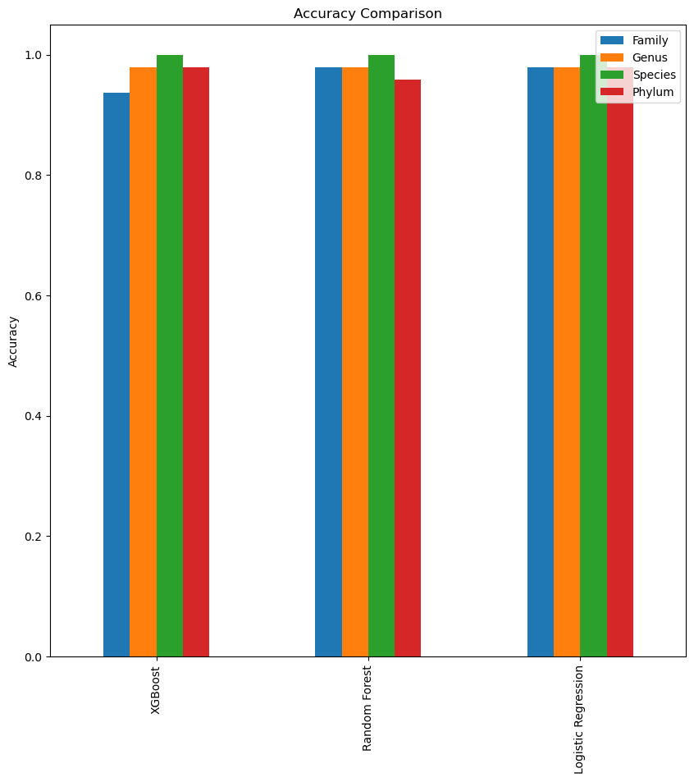
Result

Slide 8
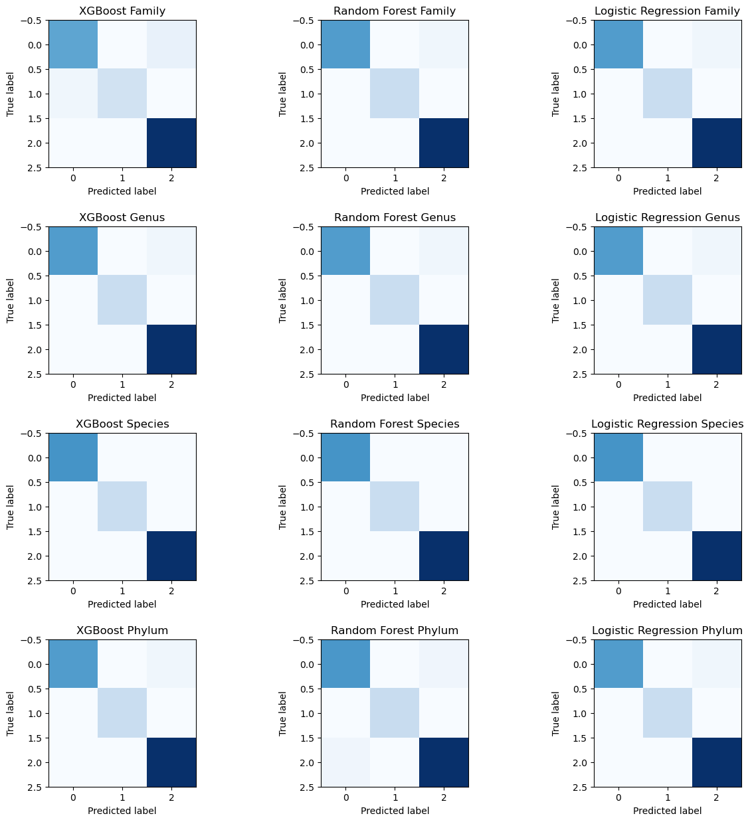
Result - Confusion Matrix

Slide 9
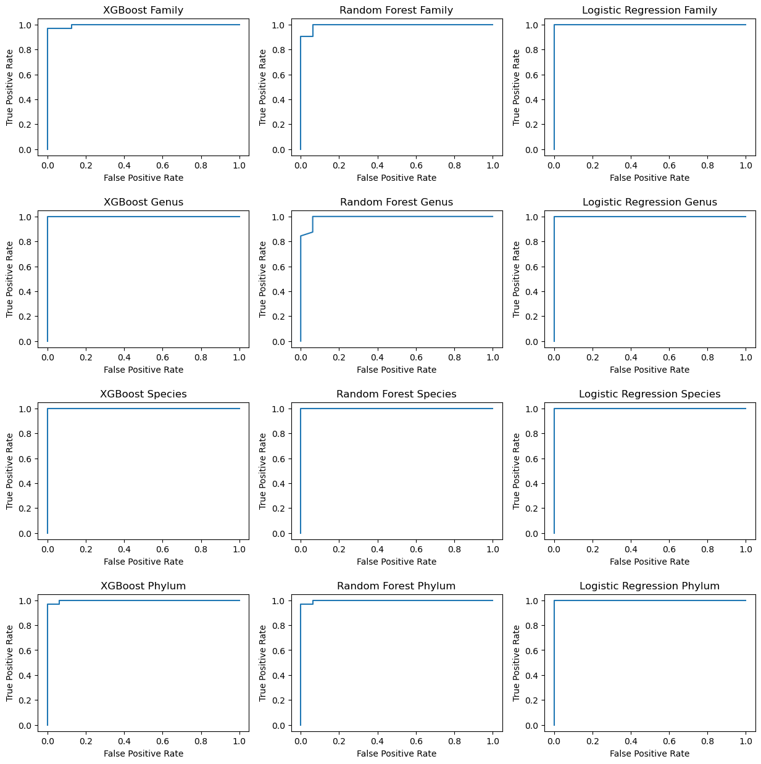

Slide 10
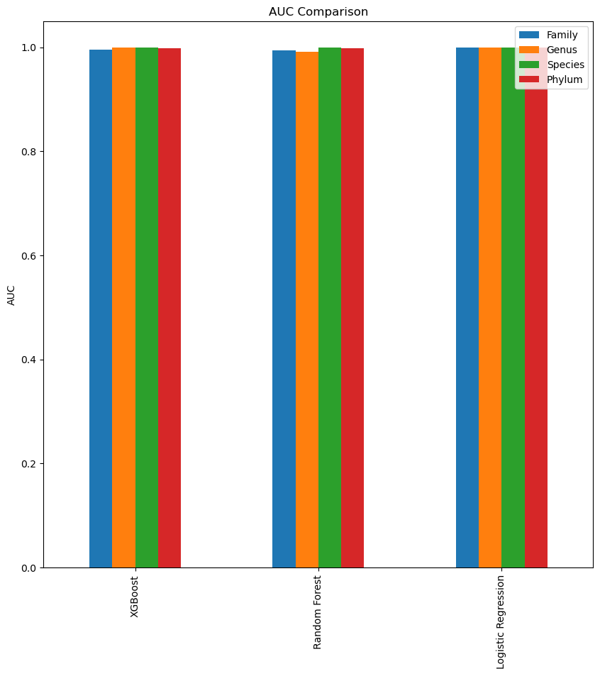

Slide 11
Feature Investigation
One great advantage of using traditional ML algorithm is the interpretability of such models. We look to see which features (OTUs) does the model relies most on or think is the most important. Then, for each level, we also see which features does all models agree on. We filter to the top 20 most important taxa identified by the model.

Slide 12
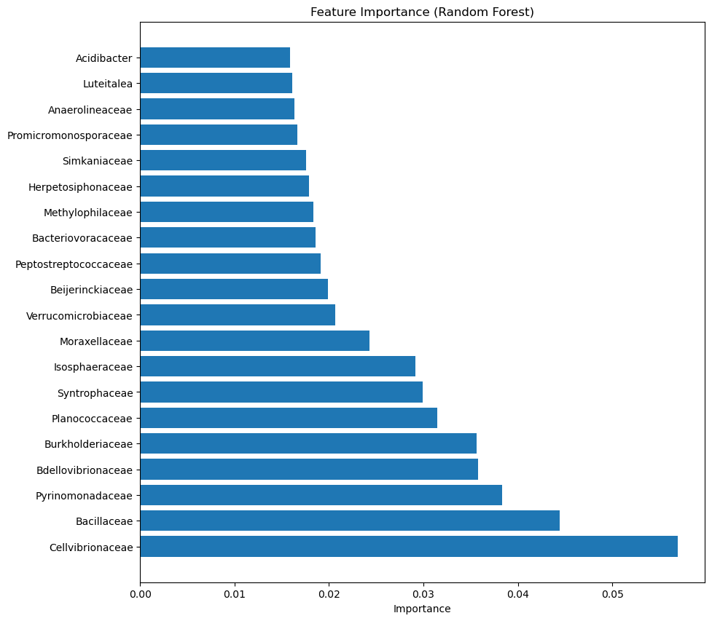
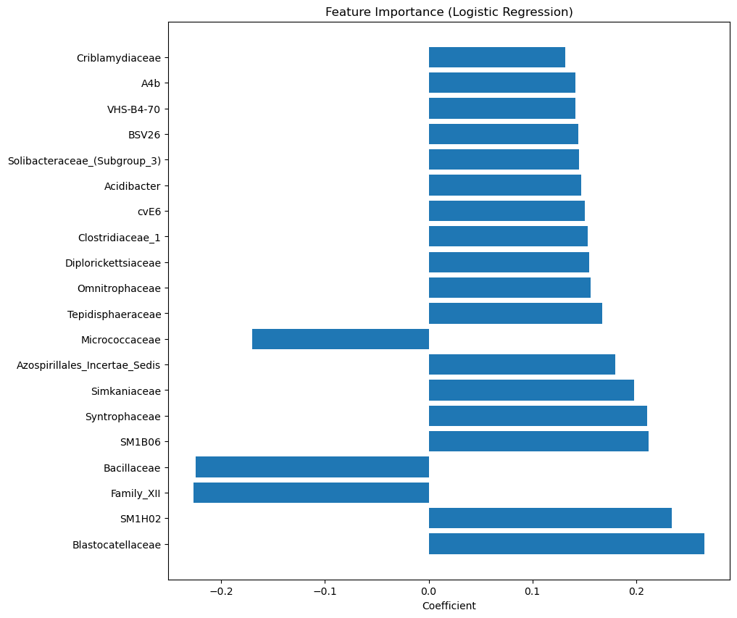
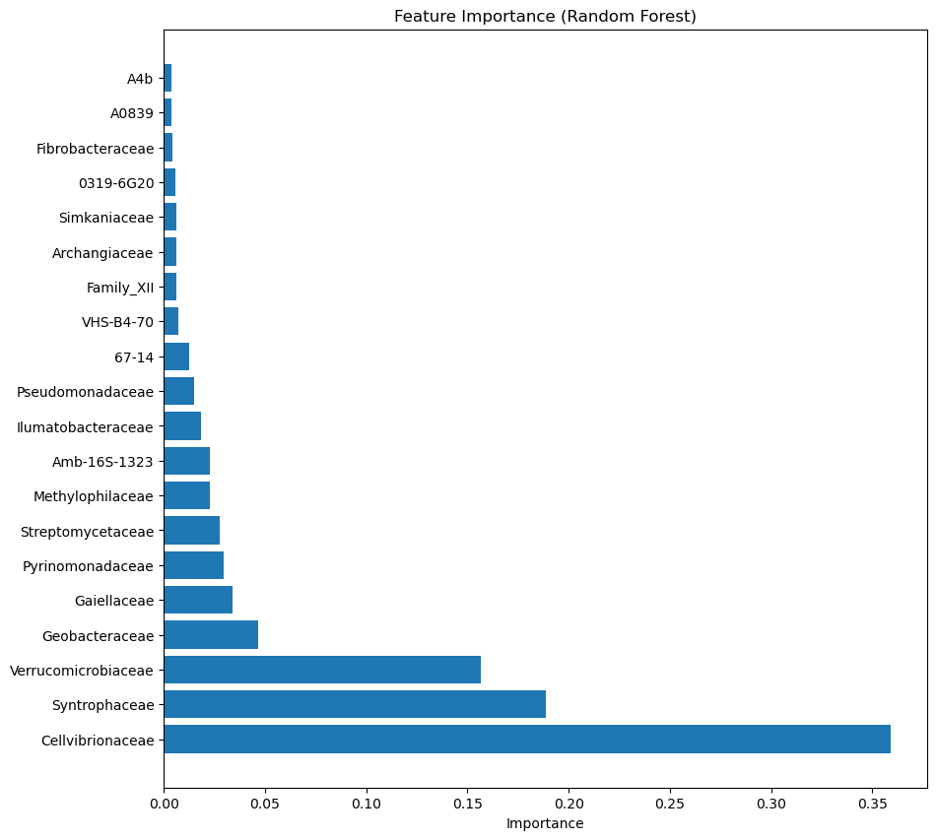
Family

Slide 13
Common Families
Common Families identified as important by all 3 methods:
Syntrophacae, Simkaniaceae

Slide 14
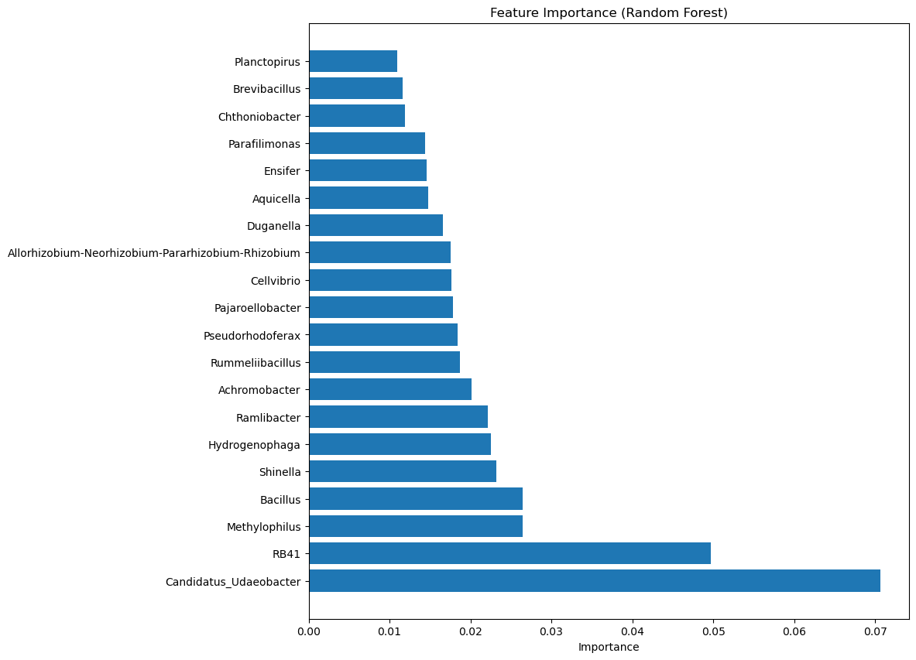
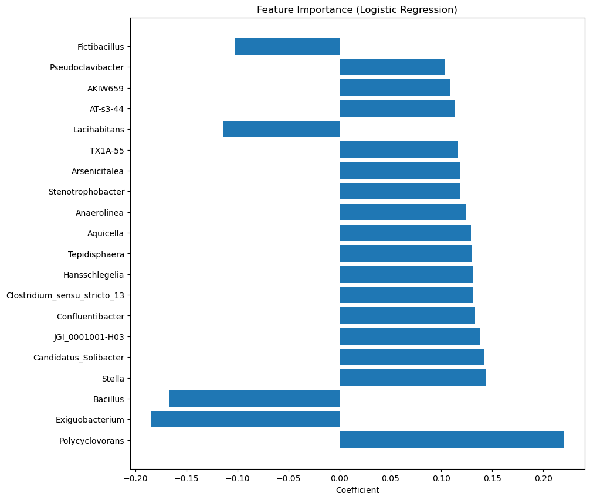
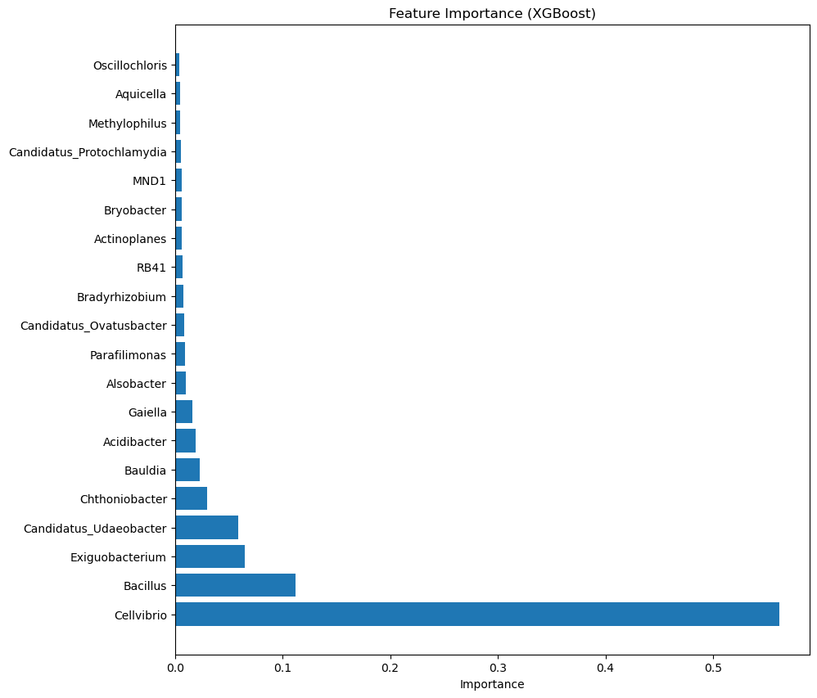
Genus

Slide 15
Common Genuses
Common genuses identified as important by all 3 methods:
Bacillus, Aquicella

Slide 16
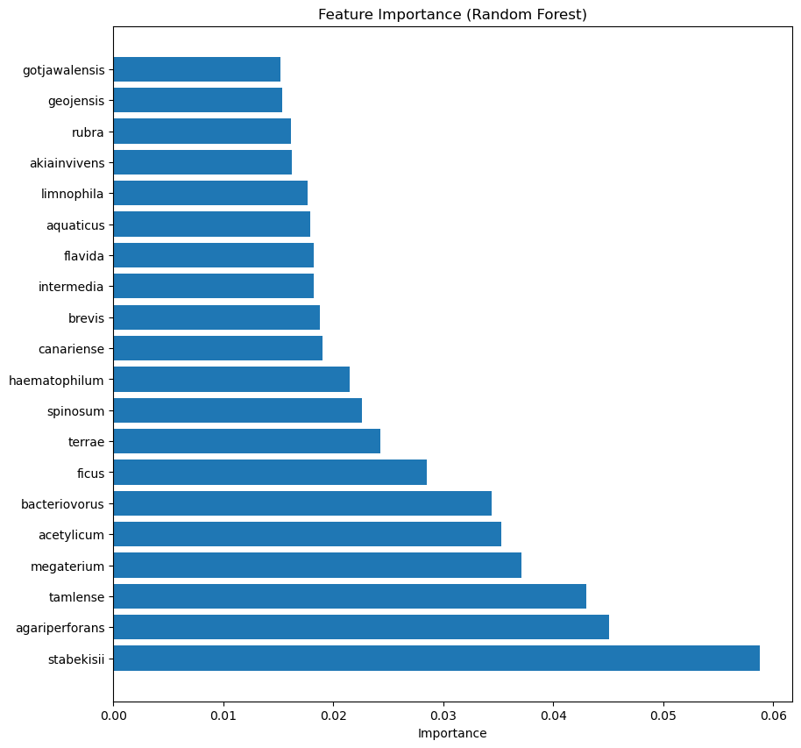
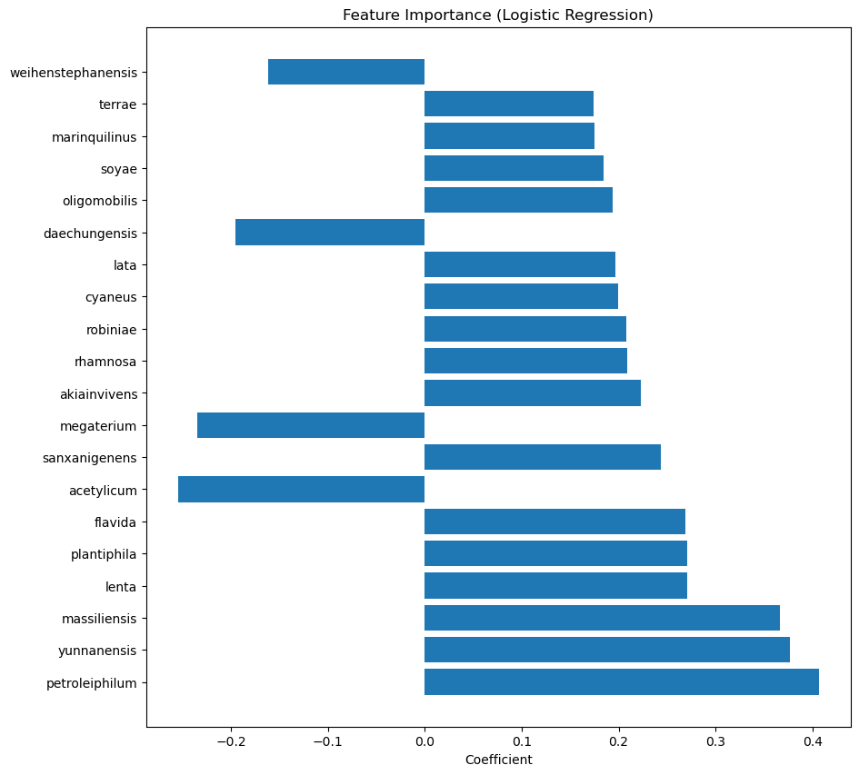
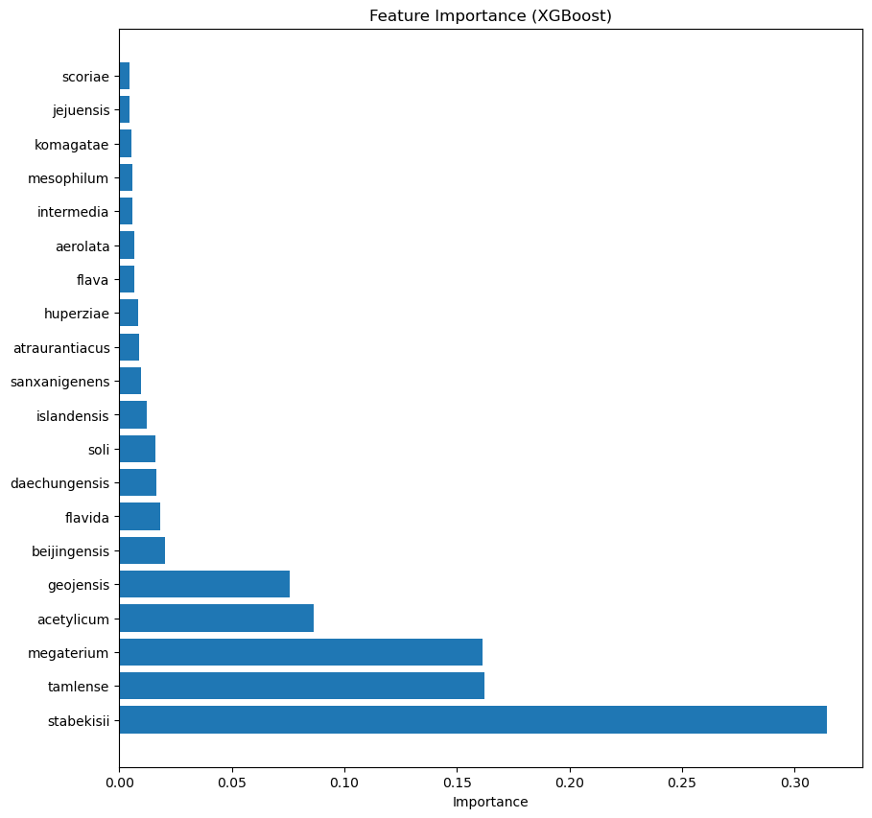
Species

Slide 17
Common Species
Common species identified as important by all 3 methods:
Flavida, Acetylicum, Megaterium

Slide 18
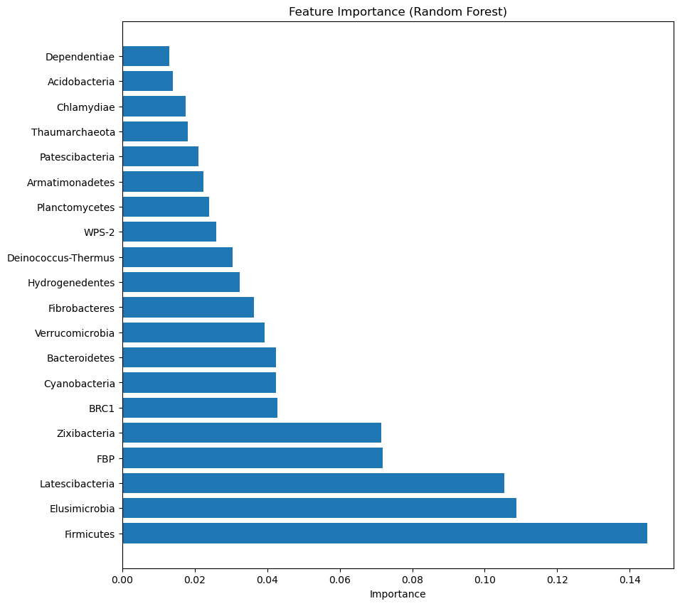
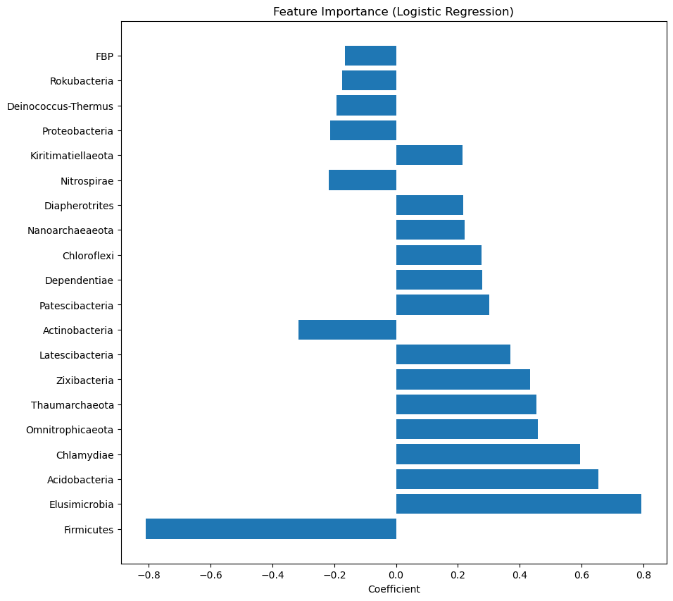
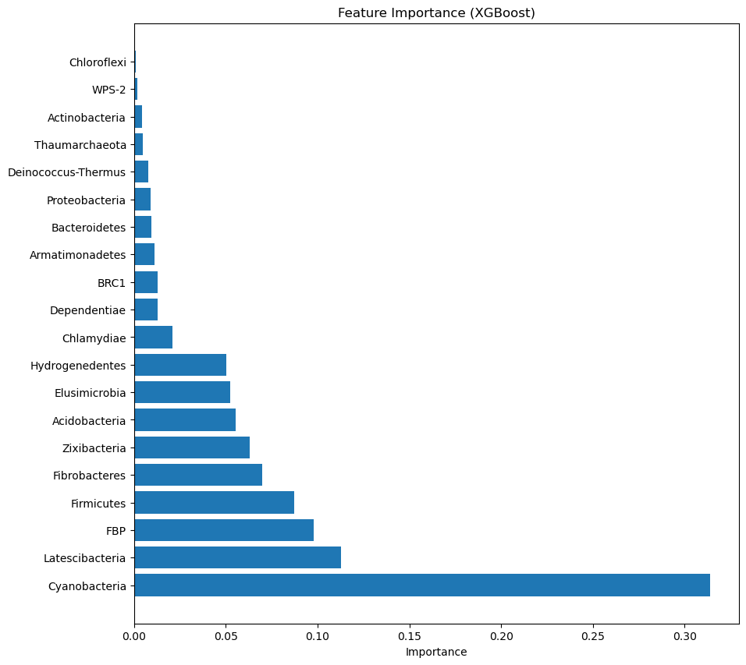
Phylum

Slide 19
Common Phylum
Common phylum identified as important by all 3 methods:
Firmicutes, Elusimicrobia, Acidobacteria, Chlamydiae, Thaumarchaeota, Zixibacteria, Latescibacteria, Dependentiae, Deinococcus-Thermus, FBP

