Slide 1


Slide 2



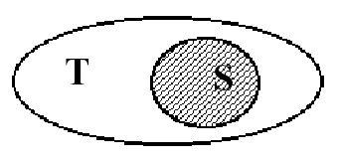

Slide 3



Slide 4
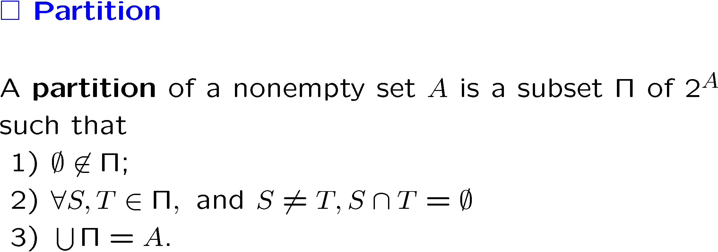
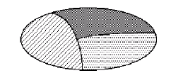

Slide 5
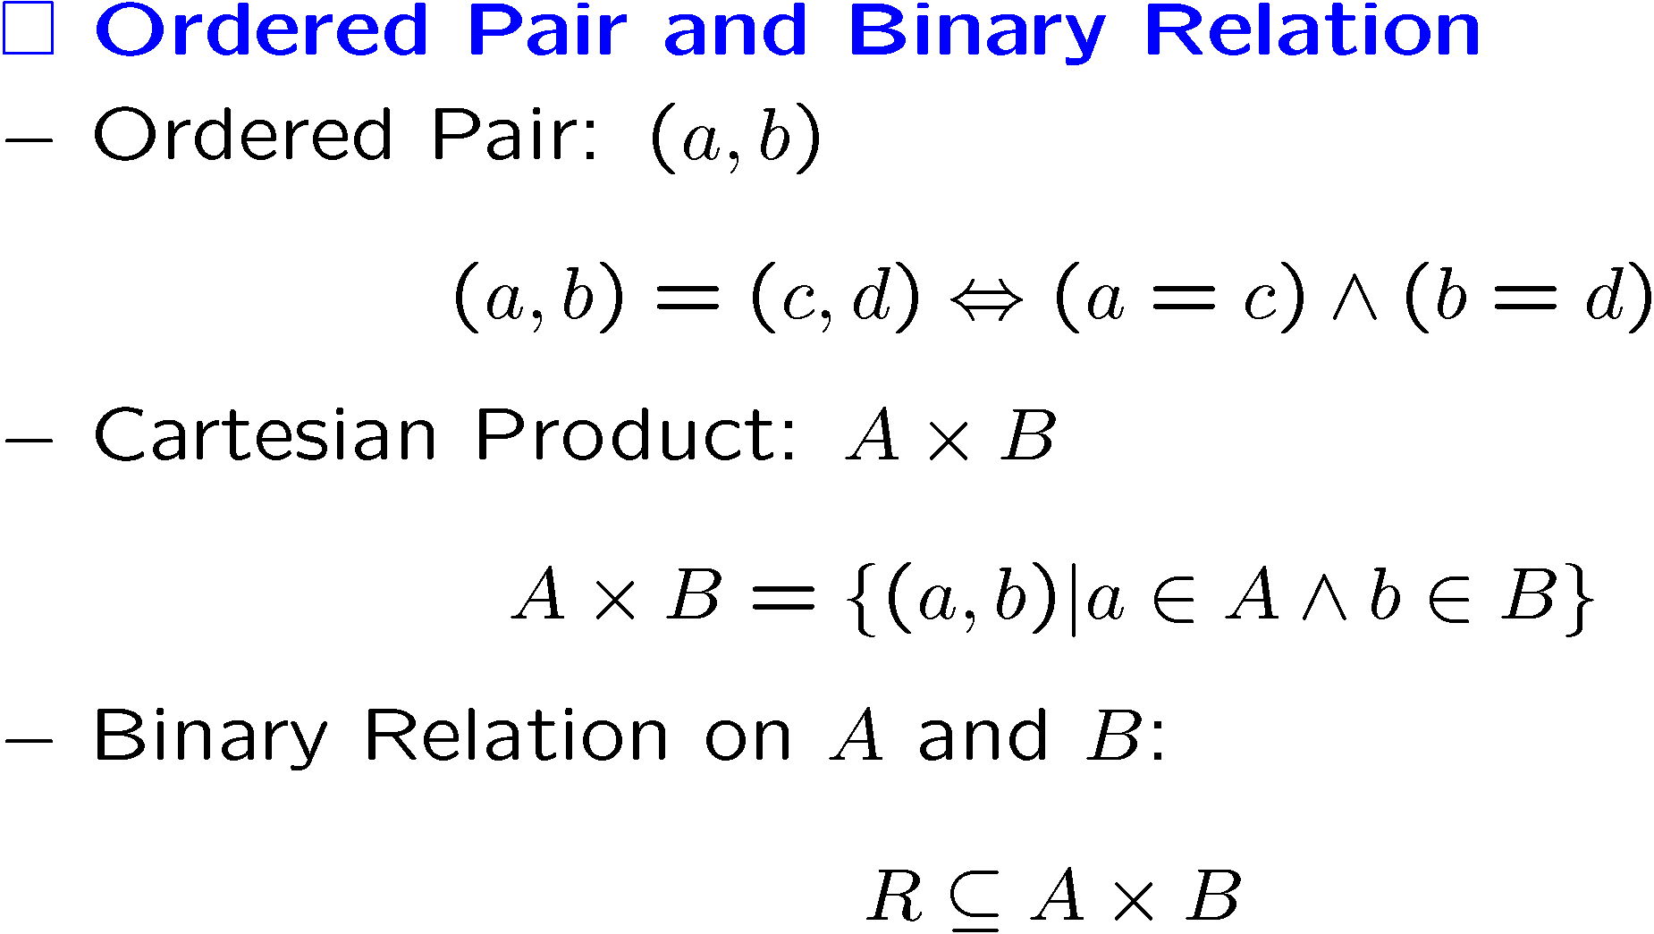

Slide 6
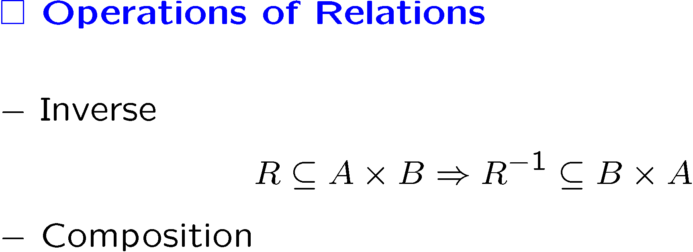

Slide 7





Slide 8




Slide 9



Slide 10
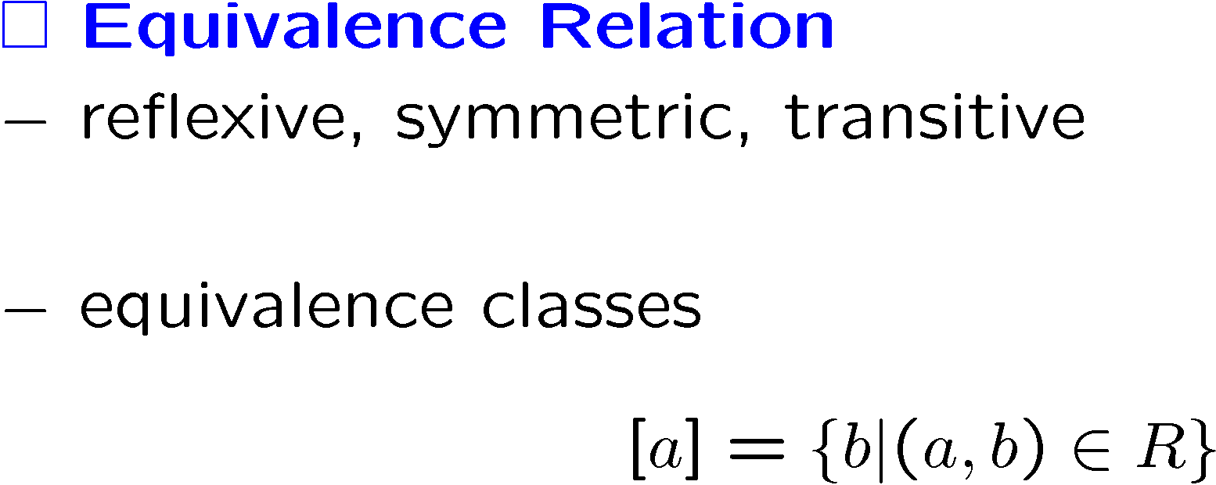


Slide 11
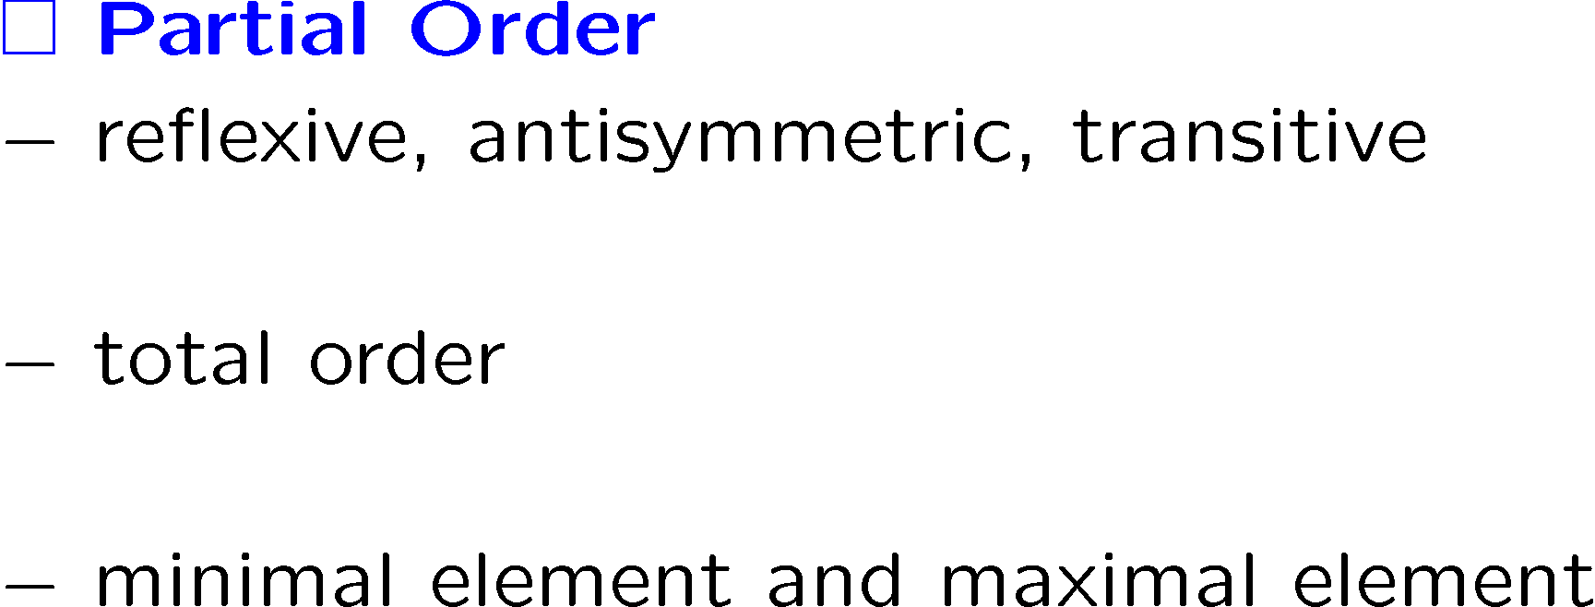

Slide 12



Slide 13


Slide 14


Slide 15


Slide 16


Slide 17




Slide 18



Slide 19




Slide 20



Slide 21


Slide 22




Slide 23




Slide 24




Slide 25


Slide 26




Slide 27



Slide 28
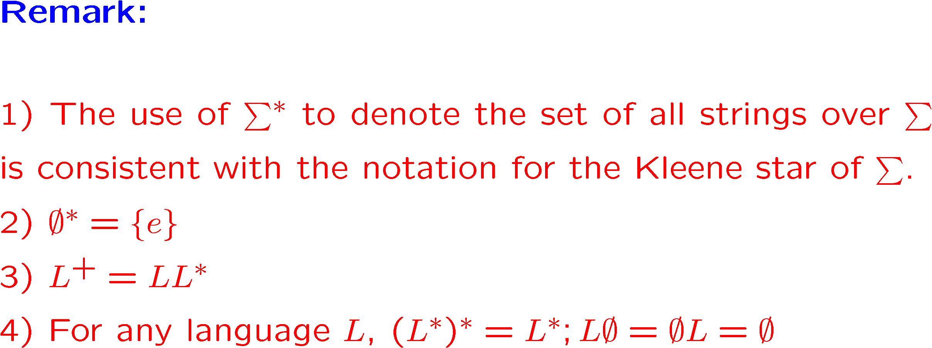

Slide 29





Slide 30


1.9 The Goal of this Course

