Slide 1
第8章
理解需求
Software Engineering: A Practitioner’s Approach, 8/e
by Roger S. Pressman and Bruce R. Maxim
《软件工程： 实践者的研究方法 》（第8版）
Roger S. Pressman ， Bruce R. Maxim 著
《软件工程原理》
沈备军 著
感谢沈备军老师提供部分PPT
These slides are designed to accompany Software Engineering: A Practitioner’s Approach, 8/e (McGraw-Hill, 2014). Slides copyright 2014 by Roger Pressman.

Slide 2
引子——噩梦
这是最恐怖的噩梦：一个客户走进你的办公室，坐下，正视着你，然后说，我知道你认为你理解我说是什么，但你并不理解的是，我所说的并不是我想要的。
这种情况总是在项目后期出现，而当时的情况通常是：已经做出交付期限的承诺，声誉悬于一线并且已经投入大量资金。

Slide 3
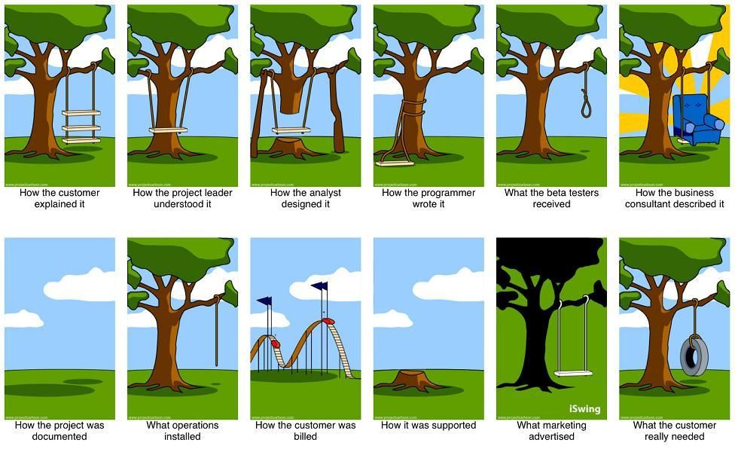
引子——需求的漂移

Slide 4
引子——需求过程的问题
用户提不出需求
需求经常变化，项目没有时限
开发人员不得不大量超时工作，因为误解或二义性的需求直到开发后期才发现
系统测试白费了，因为测试者并未明白产品要做什么
功能都实现了，但由于产品的低性能、使用不方便或其它因素用户不满意
维护费用相当高，因为客户的许多增强要求未在需求获取阶段提出

Slide 5
需求工程的定义
指致力于不断理解需求的大量任务和技术。
从软件工程角度看，需求工程是一个软件工程动作，开始于沟通并持续到建模活动。

Slide 6
需求定义
需求
  系统必须符合的条件或能力
软件需求
  用户对目标软件系统在功能、行为、性能、设计约束等方面的期望。
  内容包括：FURPS +
关注What!
Notes:
RMUC Instructor Notes
Module 0 - About This Course
Definitions:
RUP: A requirement describes a condition or capability to which a system must conform; either derived directly from user needs, or stated in a contract, standard, specification, or other formally imposed document.
UML: A desired feature, property or behavior of the system.
Requirements specify what the system must do rather than how the system does it.
There are many kinds of requirements.
Requirements management is successful only if it allows for uncertainty of the requirements early in the project. However, requirements management also ensures that requirements become better defined over time.
通过对应问题及其环境的理解与分析，为问题涉及的信息、功能及系统行为建立模型，将用户需求精确化、完全化，最终形成需求规格说明，这一系列的活动即构成软件开发生命周期的需求。
It’s a good idea to have some examples of requirements to make this definition less abstract. Include functional requirements such as would be included in a use-case model. Also include performance, legal, availability, and so on. For an ATM machine, a functional requirement might be “withdraw cash.” An example of a performance requirement might be to validate the customer ID within 5 seconds.

Slide 7
什么是软件需求?
输入
系统
输出
功能
环境
性能
Notes:
RMUC Instructor Notes
Module 0 - About This Course
A requirement is a capability or condition to which the system must conform.
Software requirements provide an almost “black-box” definition of the system. They define only those externally observable “What’s” of the system, not the “How’s.”
Of course, there has to be enough of the “How” specified to build the right system, but these should be identified as design constraints.
Point out that there has to be enough of the “How” specified to build the right system, but these should be identified as design constraints. This provides a nice segue into the next slide.

Slide 8
FURPS
Functional（功能性） | 特性集合、功能、安全性；
Usability（可用性） | 人为因素、美学、帮助、文档
Reliability（可靠性） | 故障频率、可恢复性、可预测性、MTBF
Performance（性能） | 响应时间、吞吐量、有效性、资源利用率
Supportability（可支持性） | 可测试性、可扩充性、适应性、可维护性、国际化、可配置性。
Notes:
RMUC Instructor Notes
Module 0 - About This Course
FURPS provides a checklist of items to make sure you are building a quality system.
The FURPS acronym represents a portion of the types of requirements for which you should be searching. It reminds you of the types of nonfunctional requirements you should look for.
Let’s look at the URPS categories in more depth. How can you specify URPS requirements?
This slide is a lead-in to the next set of slides, about each of the URPS categories and how to specify them.
Emphasize that URPS requirements may be in either a particular use case report or in the supplementary specifications.
Requirements must be verifiable. If you cannot verify that you have met the condition or capability, then it is not a requirement.
In this case, it is better to specify as a constraint or goal and then create a requirement that can be tested. For example, how can you verify “the system must be available 99.9% of the time over a 12 month period?”
Do you run a test harness for a year? I hope not. Instead, specify it as a goal and then create a testable requirement that the customer agrees to. For example, “The system must be available, under load, 100 percent of the time over a one week period. During this time there must be no degradation of the following system resources: memory, available file handles and disk space.”

Slide 9
FURPS +
设计约束（design constraints）：规定或约束了系统的设计的需求；（如必须要用某个算法/某种架构）
实现需求（implementation requirements） ：规定或约束了系统的编码或构建，如所需标准、编程语言、数据库完整性策略、资源限制和操作环境；
接口需求（interface requirements）：规定了系统必须与之交互操作的外部软件或硬件，以及对这种交互操作所使用的格式、时间或其他因素的约束；
物理需求（physical requirements.）：规定了系统必须具备的物理特征，可用来代表硬件要求，如物理网络配置需求。

Slide 10
软件需求的三个层次
系统需求
业务需求／产品需求
项目干系人需求
Stakeholder Needs
原始需求
项目前景文档
Vision
概要需求
软件需求规约
Software Requirement Spec
详细需求
Notes:
RMUC Instructor Notes
Module 0 - About This Course
非功能需求：标准、规范、性能、质量等
需求的具体内容：
·业务需求——反映了组织机构或客户对系统、产品高层次的目标要求，通常在项目vision文档中予以说明。
项目干系人需求——必须从产品的项目干系人处收集。他们清楚要使用该产品完成什么任务和一些非功能性的特性需求。例如：程序的易用性、健壮性和可靠性，而这些特性将会使用户很好地接受具有该特点的软件产品。描述了用户使用产品必须要完成的任务。
·功能需求——定义了开发人员必须实现的软件功能，使用户利用系统能够完成他们的任务，从而满足了业务需求。
·非功能性的需求——描述了系统展现给用户的行为和执行的操作等，它包括产品必须遵从的标准、规范和约束，操作界面的具体细节和构造上的限制。
优秀的软件产品建立在优秀的需求基础之上，而优秀的需求源于客户与开发人员之间有效的交流和合作。只有双方参与者都明白自己需要什么、成功的合作需要什么时，才能建立起一种良好的合作关系。
由于项目的压力与日俱增，所有项目干系人有着一个共同目标，那就是大家都想开发出一个既能实现商业价值又能满足用户要求，还能使开发者感到满足的优秀软件产品。

Slide 11
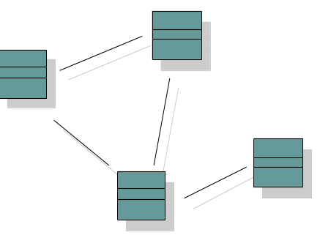
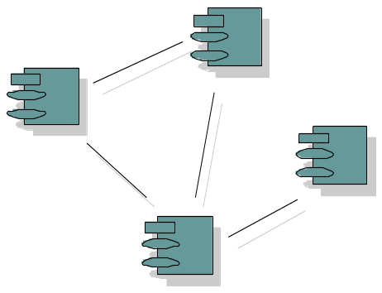
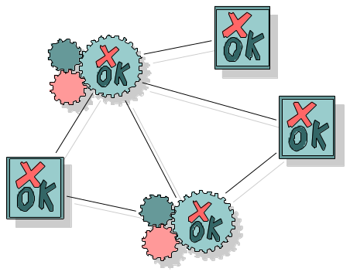
需求驱动开发
项目
计划
需求
Realized by
Implemented by
Verified by
设计模型
实现模型
测试模型
Notes:
RMUC Instructor Notes
Module 0 - About This Course
Use cases defined for a system are the basis for the entire development process. They provide the unifying thread through the system and define the behavior performed by a system. Use cases play a role in each of the core process disciplines:
The use-case model is a result of the requirements workflow. In this early process you need the use cases to model what the system should do from the user's point of view.
In analysis and design use-cases are realized in a design model. You create use-case realizations, which describe how the use-case is performed in terms of interacting objects in the design model. This model describes, in terms of design objects, the different parts of the implemented system, and how the parts should interact to perform the use cases.
During implementation the design model is the implementation specification. Because use cases are the basis for the design model, they are implemented in terms of design classes.
During test the use cases constitute basis for identifying test cases and test procedures. The system is verified by performing each use case.
Use cases have other roles as well:
Basis for planning an iterative development
Foundation for what is described in user manuals
Definition of ordering units. For example, a customer can get a system configured with a particular mix of use cases
Now that we have finished and reviewed the requirements specifications, where do we go from here? Let’s take a brief look at how they are used in the rest of the development of the system to be built.
Use-Case Driven: The Use cases serve as a unifying thread throughout system development
The same use-case model is used in requirements, analysis and design, implementation and test.

Slide 12
谁看需求?
客户
开发小组
Client
Users
Project
Manager
Tester
Technical
Writer
Requirements
Specifier
Designer
Notes:
RMUC Instructor Notes
Module 0 - About This Course
Use cases are read by a variety of stakeholders. They provide a means of describing the problem in a way that everybody understands. The model should be comprehensible to people inside the development organization (analysts, designers, implementers, testers) and to people outside (customers, users).
Because use cases are specified from the user’s perspective, the use-case model is ideal for communicating the proposed system’s functionality and behavior to the customer or user. How do you know that you are developing the right system? Ask the users and the customer if the use-case model is what they want to do with the system.
The use-case model is also key to developing the right system. The use-case model provides a unifying thread for system development. Use cases are the behavior the system must provide.
What do your designers design to?
They design a system that allows users to do the tasks specified in the use-case model.
What do your testers test?
They test to make sure that the system is able to perform all the use cases.
What does the user documentation look like?
It documents how to do all the tasks in the use cases.
Could you use help in these areas with your current requirements management process?

Slide 13
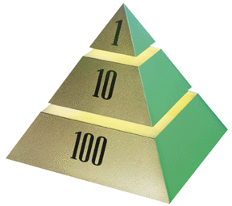
需求出错的高成本
The 1-10-100 规则
Stage
.5 - 1
需求
2.5
设计
5
编码
“All together, the results show as much as a 200:1 cost ratio between finding errors in the requirements and maintenance stages of the software lifecycle.”
10
单元测试
25
接受测试
100
维护
Notes:
RMUC Instructor Notes
Module 0 - About This Course
The most expensive errors to correct are those introduced at Requirements Time and not found until after release to the customer.
Note: These same errors are also the least expensive to correct if found during Requirements Time. The longer they exist, the more expensive they become.
Use this slide to explain the 1-10-100 rule.
Start by saying that before you get to the actual costs, let’s illustrate the costs with some real examples.
Ask if there is anybody in the class who writes requirements specifications. Ask him/her what they need to correct an error in a requirement BEFORE the Requirements Specification is released for the first time. The answer is probably to get approval and to change the text.
Then ask if somebody in the class is a tester. Ask him/her what they need to do to correct an error they find during acceptance test. The answer is probably very lengthy. Point out the difference in cost between fixing a requirement initially and during testing.
Now explain the 1-10-100 rule by pointing to the pyramid. The figures are the order-of-magnitude relative costs of fixing a requirement error during requirements capture, coding, and testing. You can mention the Boehm and Grady studies that found similar relative costs. Stay away from getting caught up in the fractions and other details.
Help students understand that requirement errors are obviously the most expensive cost if they are not discovered until later in the lifecycle.

Slide 14
需求工程-I
起始—提出一系列问题…
  对问题的基本理解
  谁需要解决方案
  所期望解决方案的性质
  与项目利益相关者和开发人员之间达成初步交流合作的效果
导出—征求各利益相关者的需求
精化—开发一个需求模型，来说明软件的功能、特征和信息的各个方面
协商—协商形成一个能令开发人员和客户都满意的可交付系统
These slides are designed to accompany Software Engineering: A Practitioner’s Approach, 8/e (McGraw-Hill, 2014). Slides copyright 2014 by Roger Pressman.

Slide 15
需求工程-II
规格说明—是下面的一个（或者多个）：
  一份写好的文档
  一套模型
  一个形式化的数学模型
  一组使用场景（使用案例）
  一个原型
确认—一组检查机制来发现
  内容或解释上的错误
  需要进一步解释的地方
  丢失的信息
  不一致性(建造大型产品或系统时遇到的主要问题)
  冲突的需求或是不可实现的（不能达到的）需求
需求管理
These slides are designed to accompany Software Engineering: A Practitioner’s Approach, 8/e (McGraw-Hill, 2014). Slides copyright 2014 by Roger Pressman.

Slide 16
一、建立根基
确认利益相关者/项目干系人（Stakeholder）
  “你认为我还应该和谁交谈？”
识别多重观点
协同合作
首次提问
  谁是这项工作的最初请求者？
  谁将使用该解决方案？
  成功的解决方案将带来什么样的经济收益？
  对于这个解决方案你还需要其它资源吗？
These slides are designed to accompany Software Engineering: A Practitioner’s Approach, 8/e (McGraw-Hill, 2014). Slides copyright 2014 by Roger Pressman.

Slide 17
识别项目干系人
项目干系人（Stakeholder）。又称为涉众、利益相关人，是积级参与项目，或其利益因项目的实施或完成而受到积极或消极影响的个人和组织，他们还会对项目的目标和结果施加影响。
  你的项目中有哪些项目干系人?
  （内部和外部客户、最终用户、顾问、产品工程师、软件工程师……）
Notes:
RMUC Instructor Notes
Module 0 - About This Course
Part of analyzing the problem is understanding who has the problem. You need to understand the real stakeholders in your project, in addition to the customer who is paying the bill.
Make sure you consider all those affected by the outcome of the system, including stock shareholders, system maintainers, and developers. It is important to consider which stakeholders will be sources of requirements. While we must identify all our stakeholders, it is important to focus your efforts where you will receive the best return. Some of your stakeholders will not provide you with many or any requirements (for example, shareholders). While these interests certainly need to be considered and represented, you should focus your efforts accordingly.
项目干系人示例：
客户（或客户代表）、用户（或用户代表） 、投资者 、股东
开发经理 、买方 、设计员 、测试员 、文档编写员等
通常，要确定项目干系人，只需与决策者、潜在用户和其他相关各方进行访谈。以下问题将有所帮助：
谁是系统的用户？
谁是系统的购买者？
还有谁将受到系统输出的影响？
交付并部署系统后，谁将评估并维护系统？
是否存在其他必须满足其需求的内部或外部系统用户？
谁将维护新系统？
还有其他人吗？
好的，再没有其他人了吗？
Emphasize the importance of knowing who has the problem. Who is materially affected by solving the problem?
The students develop a list of stakeholders for the class project in the exercise at the end of the module. At this point, just have them mention some example of stakeholders for their own projects. If they have trouble coming up with some of their stakeholders, focus on an example of your own, such as an ATM or the e-Bay™ online auction system.
All users of the system are stakeholders because they are materially affected by the system. But there are some stakeholders (for example, stockholders) who are probably not actors because they will never use the system. Make sure your students mention some stakeholders who are not also actors, such as managers or clerks not interacting with the system, and stockholders.

Slide 18
识别多重观点
不同利益相关者关心的点不一样，例如：
市场销售部门 有助于新系统销售的功能
业务经理 预算内实现的功能
最终用户 易使用性
软件工程师 架构、技术特性

Slide 19
协同合作
若有5个利益相关者，对一套需求会有……
标识公共区域和矛盾区域
优先点法解决冲突

Slide 20
首次提问（1）
谁是这项工作的最初申请者？
是将使用该解决方案？
成功的解决方案将带来怎么样的经济效益？
对于这个解决方案你还需要其他资源吗？

Slide 21
首次提问（2）
如何描述由某成功的解决方案产生的“良好”输出的特性？
该解决方案强调解决了什么问题？
能向我们展示（或描述）解决方案使用的商业环境吗?
存在将影响解决方案的特殊的性能问题或约束吗？

Slide 22
首次问题（3）——元问题
你是回答这些问题的合适人选吗?
我的提问和你想解决的问题相关吗？
还有其他人员可以提供更多的信息吗？
还有我应该问的其他问题吗？

Slide 23

分析问题及根源
什么是问题?
  理解和记录客户的观点
  达成共识
什么是真正的问题?
  寻找问题根源，探究症结
避免Yes…But现象，避免IT黑洞
从业务角度
{Problem}
理解的
期望的
Notes:
RMUC Instructor Notes
Module 0 - About This Course
要想对有待解决的问题达成一致，最简单的方法就是将该问题写下来，征求每个人的意见。
询问小组成员：问题是什么？
人们往往急于确定解决方案，而不是首先花时间理解问题。请记下问题，看看是否每个人都同意对问题的界定。
然后请再次询问小组成员：问题真的是这样的吗？
探究症结所在或“隐藏在问题之后的问题”。真正的问题往往隐藏在那些看似问题的问题之后。
请不要满足于对问题的第一次说明，而应反复地问“为什么？”以便揭示“真正”的问题。
有时小组过分关注于某个预想的解决方案，以致于很难让他们澄清根本问题。此时下面的做法将有所帮助：先探究该解决方案的优点，然后尝试找出有了这些优点则可避免的问题。接着您可分析这些问题是否是组织中存在的“真正”问题。寻找隐藏在问题之后的问题的常用技巧包括集体讨论、鱼刺图与 Pareto 图。
信息系统的本质是记帐系统，是一个协同平台。
Gaining agreement on the definition of the problem is a critical step in problem analysis.

Slide 24
举例：一个选课系统
问题 | 某校存有大量过时的以及大量的人工选课流程
影响到的人 | 学生、教授与教务管理人员
具体影响 | 一个缓慢且耗费巨大的流程，与一堆不满意的学生和教授。
一个成功的解决方案将 | 提升学校形象，吸引更多的学生，理顺管理注册功能。

Slide 25
举例：一个ETC系统
问题 | 过高速公路速度慢，需要大量人工
影响到的人
具体影响
一个成功的解决方案将

Slide 26
举例：一个网上售药系统
问题 | 过高速公路速度慢，需要大量人工
影响到的人
具体影响
一个成功的解决方案将

Slide 27
举例：医联电子病历系统
问题
影响到的人
具体影响
一个成功的解决方案将

Slide 28
网上售生鲜系统
问题
影响到的人
具体影响
一个成功的解决方案将

Slide 29
二、获取需求（诱导需求）
会议由软件工程师和其他的共利益者共同举办和参与
制定筹备和参与会议的规则
拟定一个会议议程
由一个“主持人”（可以是客户、开发人员或其他人）控制会议
采用“方案论证手段”（可以是工作表、活动挂图、不干胶贴纸或电子公告牌、聊天室或虚拟论坛）
目标是
  标识问题
  提出解决方案的要素
  协商不同方法
  确定一套解决需求问题的初级方案
These slides are designed to accompany Software Engineering: A Practitioner’s Approach, 8/e (McGraw-Hill, 2014). Slides copyright 2014 by Roger Pressman.

Slide 30
需求的收集技术
访谈
调查问卷
需求研讨会
Use-Case 研讨会
Storyboards
角色扮演
复审现有需求
观察正在工作的用户
Notes:
RMUC Instructor Notes
Module 0 - About This Course
这些技巧可以单独使用，也可以结合使用。所有技巧都可以与Use-Case方法结合起来。例如，您可以为系统中预想的每个Use-Case制作一个或几个示意板。还可以通过角色扮演来帮助您理解主角如何使用系统并帮助您确定Use-Case。
Discuss very briefly each of these techniques in the following slides. These techniques are useful for gathering information about stakeholder needs. The techniques can also be used very effectively for gathering information about feature requirements or detailed software requirements.
Many of these techniques can be used together. For example, a requirements workshop brings stakeholders together. At the requirements workshop, the participants may brainstorm for new ideas, or they may sketch out the use cases for the system to be built.
What follows is a crash course in elicitation techniques. We have selected the techniques on our list because of their usefulness in our experience. We briefly discuss each topic in turn.
Beyond the techniques we discuss there are many other techniques such as:
Production software
Task analysis
Most techniques discussed in this module are generally useful for eliciting information. We discuss them from the perspective of eliciting needs and features, but the same techniques can be used for all types of requirements (needs, features, software requirements), and at many levels of detail.

Slide 31
启始工作产品
必要性和可行性的声明
对系统或产品规模大小的声明
参与需求获取的客户，用户和其他利益相关者的列表
系统技术环境的描述
需求列表（最好以功能为主来组织）和适用于每个人的约束范围
一组在不同操作条件下提供对系统或产品使用洞察的场景
任何原型开发以便更好的定义需求
These slides are designed to accompany Software Engineering: A Practitioner’s Approach, 8/e (McGraw-Hill, 2014). Slides copyright 2014 by Roger Pressman.

Slide 32
质量功能部署
功能部署决定系统需求功能的价值（正如对客户的价值）
信息部署定义了数据对象和事件
任务部署是指检查系统的行为
价值分析确定需求的相对优先级
These slides are designed to accompany Software Engineering: A Practitioner’s Approach, 8/e (McGraw-Hill, 2014). Slides copyright 2014 by Roger Pressman.

Slide 33
非功能需求
非功能需求 (NFR) – 质量属性，性能属性，安全属性或一个系统中的常规限制。
定义出两个阶段方法以帮助软件团队和利益相关者识别非功能需求：
  在第一阶段为系统建立一套软件工程指南，这包括最佳实践指南，还表述了架构风格和设计模式的应用。
  第二阶段，团队为每个非功能需求排出优先级，生成一套同类的非功能需求；使用一套决策规则，用来决定要建立实施哪些指南，要放弃哪些指南。
These slides are designed to accompany Software Engineering: A Practitioner’s Approach, 8/e (McGraw-Hill, 2014). Slides copyright 2014 by Roger Pressman.

Slide 34
前景文档（Vision）-- 产品范围文档
简介 Introduction
定位 Positioning
  2.1 商机 2.2 问题说明 2.3 产品定位
项目干系人和用户描述 Stakeholder and User Descriptions
产品概述 Product Overview
产品特性 Product Features
约束 Constraints
质量范围 Quality Ranges
优先级 Precedence and Priority
其它产品需求 Other Product Requirements
文档需求 Documentation Requirements
Notes:
RMUC Instructor Notes
Module 0 - About This Course
One of the main activities in the “Define the System” task is to develop the Vision for the system. The Vision contains the high-level definition of the system.
This outline shows the major sections of the Vision document. As you can see, the Vision provides a wealth of information about the product to be built. In the “Define the System” task, you make sure you understand and record the decisions made with your customer about all of the kinds of information in the Vision template.
A sample Vision document can be found in the Student Handouts.
The tasks you have already done contribute to the Vision for the product. Analyzing the Problem and Understanding Stakeholder Needs are for the purpose of eliciting the high-level understanding of the problem and the proposed solution.
This information is gathered together in constructing your Vision for the product to be built. This slide summarizes the major activities you have done and how they contribute to the Vision.
Animation:
Go over the outline briefly to focus on the kinds of information the Vision Document records for a project.
At this point it is useful to open RUP and show them an example Vision document template. Point out how the template guides you through filling out the document.
Have the students turn to the stapled vision document. Briefly run them through the contents of the Vision. Here we are “showing them the dog house before we ask them to build it.”
Tie the template in to the topic of this module by pointing out that the Vision is the high-level definition of the system to be built.

Slide 35
三、精化（建模）
核心是开发一个精确的需求模型，用以说明软件的功能、特征和信息的各个方面。
细化是由一系列的用户场景建模和求精任务驱动的。
用户场景描述了最终用户和其他参与者与如何与系统进行交互，解析每个用户场景以便提取分析类，确定类的属性、服务以及类之间的协作关系。

Slide 36
用例
用户场景的集合描述了系统的线程使用
每个场景都是从“参与者”的角度来描述——即人或设备与软件的交互
每个场景都需要回答下列问题：
  谁是主要参与者、次要参与者？
  参与者的目标是什么？
  故事开始前有什么前提条件？
  参与者完成的主要工作或功能是什么？
  按照故事所描述的还可能需要考虑什么异常？
  参与者的交互中有什么可能的变化？
  参与者将获得、产生或改变哪些系统信息？
  参与者必须通知系统有关外部环境的改变吗？
  参与者希望从系统获取什么信息？
  参与者希望得知会有意料之外的变更吗？
These slides are designed to accompany Software Engineering: A Practitioner’s Approach, 8/e (McGraw-Hill, 2014). Slides copyright 2014 by Roger Pressman.

Slide 37
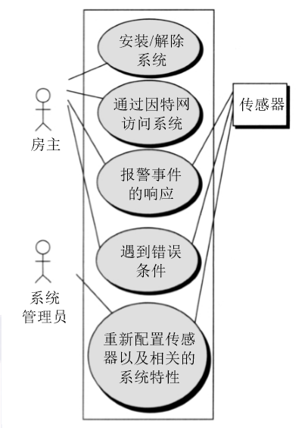
用例图
These slides are designed to accompany Software Engineering: A Practitioner’s Approach, 8/e (McGraw-Hill, 2014). Slides copyright 2014 by Roger Pressman.

Slide 38
构建分析模型
分析模型的元素
  基于场景的元素
    功能—从用户的角度描述软件功能
    用例—描述用户和系统之间的相互关系
  基于类的元素
    通过场景来表现
  行为元素
    状态图
  流化元素
    数据流图
These slides are designed to accompany Software Engineering: A Practitioner’s Approach, 8/e (McGraw-Hill, 2014). Slides copyright 2014 by Roger Pressman.

Slide 39
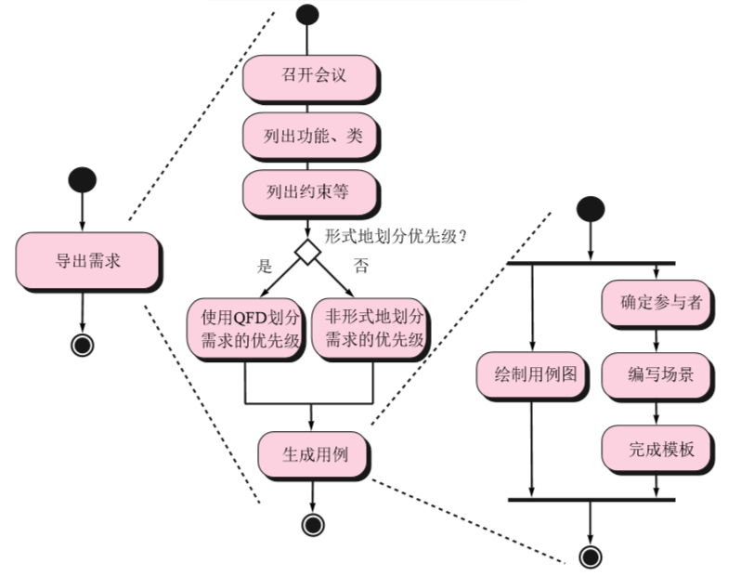
需求诱导
These slides are designed to accompany Software Engineering: A Practitioner’s Approach, 8/e (McGraw-Hill, 2014). Slides copyright 2014 by Roger Pressman.

Slide 40
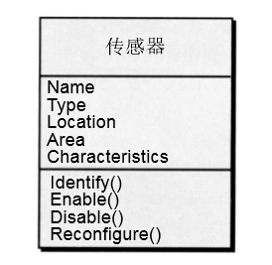
类图
传感器Sensor的类图
These slides are designed to accompany Software Engineering: A Practitioner’s Approach, 8/e (McGraw-Hill, 2014). Slides copyright 2014 by Roger Pressman.

Slide 41
状态图
读指令
状态名
System status = “ready”
Display msg = “enter cmd”
Display status = steady
状态变量
Entry/subsystems ready
Do: poll user input panel
Do: read user input
Do: interpret user input
状态活动
These slides are designed to accompany Software Engineering: A Practitioner’s Approach, 8/e (McGraw-Hill, 2014). Slides copyright 2014 by Roger Pressman.

Slide 42
分析模式
  模式名称：一种刻画了模式本质的描述。
  目的：描述模式完成内容或所代表的含义。
  动机：一个场景说明了如何用模式解决问题。
  问题与上下文: 一种外部问题的描述会影响到模式的使用方式以及模式在应用过程中外部问题的解决方式。
  解决方案：一种如何应用模式来解决问题的描述，重点在于结构和行为问题。
  后果：解释了模式应用时会发生的状况以及在其应用过程中会出现的交换物。
  设计：讨论分析模式如何通过已知的设计模式的来使用。
  已知用途：在实际系统中使用的例子。
  相关模式：一个或多个分析模式与命名模式相关联是因为(1)这是常用的命名模式;(2)它在结构上类似于命名模式;(3)这是命名模式的一种变形。
These slides are designed to accompany Software Engineering: A Practitioner’s Approach, 8/e (McGraw-Hill, 2014). Slides copyright 2014 by Roger Pressman.

Slide 43
四、协商需求
识别关键的利益相关者
  这些都是将参与协商的人
确认利益相关者“赢”的条件
  赢得条件并不总是很显而易见
协商
  朝着双赢的需求工作
These slides are designed to accompany Software Engineering: A Practitioner’s Approach, 8/e (McGraw-Hill, 2014). Slides copyright 2014 by Roger Pressman.

Slide 44
五、规格说明
是下面的一个（或者多个）：
  一份写好的文档
  一套模型
  一个形式化的数学模型
  一组使用场景（使用案例）
  一个原型

Slide 45
SRS模板 （采用传统技术）
1. 简介
2. 整体说明
3. 具体需求
  3.1 功能
  3.2 可用性
  3.3 可靠性
  3.4 性能
  3.5 可支持性
  3.6 设计约束
  3.7 联机用户文档和帮助系统需求
  3.8 购买的构件
  3.9 接口
  3.10 许可需求
  3.11 法律、版权及其他声明
  3.12 适用的标准
4. 支持信息
索引、附录等
Notes:
RMUC Instructor Notes
Module 0 - About This Course
This is a template for an SRS package. It includes introductory and overview information, and all software requirements. Some of the software requirements will be in use cases in the section called Use-Case Reports. Some of the requirements will be in declarative form in the section called Supplementary Specifications.
Section 2, the Overall Description, consists of the Use-Case-Model Survey, and any other assumptions and dependencies. The Use-Case-Model Survey gives the overview of the use-case model: the actors and use cases (it was described in Module 5).
Section 3, the Specific Requirements, consists of the Use-Case Reports and the Supplementary Specifications. Each Use-Case Report fully details a particular use case. The Supplementary Specifications describe all the software requirements that are not part of a particular use case.
Note that the SRS template lays out the content and logical ordering of the SRS package. There will probably be a document that gives the overview of the SRS package, but many of its sections may contain pointers to the location of an item in the SRS. For example, a use-case report section may contain pointers to the URLs where its use-case diagrams and textual representations can be found.
For more details on this approach, see the “Modern SRS” outline and discussion in Managing Software Requirements, by Leffingwell and Widrig.
When reviewing the outline, emphasize the content (what is a part of the SRS package) and logical ordering.
Emphasize that the SRS is a package. Use the following slide to discuss in more detail where the items in the SRS package are actually stored.
See student notes for other points to emphasize.
At this point it is useful to open RUP and show them an example Software Requirements Specification Template. Show them the two variations – with use cases and without use cases.

Slide 46
SRS模板 （采用Use-Case技术）
1. 引言
  1.1 Purpose
  1.2 Scope
  1.3 Definitions, Acronyms, and Abbreviations
  1.4 References
  1.5 Overview
2. 综述
  2.1 Use-Case Model Survey
  2.2 Assumptions and Dependencies
3. 具体需求
  3.1 Use-Case 报告
  3.1.1 <Use Case 1>
  3.1.2 ...
  3.2 补充说明
  3.2.1 可用性需求
  3.2.2 …
4. 支持信息
索引、附录、用户界面原型等
Notes:
RMUC Instructor Notes
Module 0 - About This Course
This is a template for an SRS package. It includes introductory and overview information, and all software requirements. Some of the software requirements will be in use cases in the section called Use-Case Reports. Some of the requirements will be in declarative form in the section called Supplementary Specifications.
Section 2, the Overall Description, consists of the Use-Case-Model Survey, and any other assumptions and dependencies. The Use-Case-Model Survey gives the overview of the use-case model: the actors and use cases (it was described in Module 5).
Section 3, the Specific Requirements, consists of the Use-Case Reports and the Supplementary Specifications. Each Use-Case Report fully details a particular use case. The Supplementary Specifications describe all the software requirements that are not part of a particular use case.
Note that the SRS template lays out the content and logical ordering of the SRS package. There will probably be a document that gives the overview of the SRS package, but many of its sections may contain pointers to the location of an item in the SRS. For example, a use-case report section may contain pointers to the URLs where its use-case diagrams and textual representations can be found.
For more details on this approach, see the “Modern SRS” outline and discussion in Managing Software Requirements, by Leffingwell and Widrig.
When reviewing the outline, emphasize the content (what is a part of the SRS package) and logical ordering.
Emphasize that the SRS is a package. Use the following slide to discuss in more detail where the items in the SRS package are actually stored.
See student notes for other points to emphasize.
At this point it is useful to open RUP and show them an example Software Requirements Specification Template. Show them the two variations – with use cases and without use cases.

Slide 47
六、确认需求 - I
每项需求都和系统或产品的整体目标一致吗？
所有的需求都已经在相应的抽象层上说明了吗？换句话说，是否有一些需求是在技术细节过多的层次上提出的，并不适合当前的阶段。
需求是真正必需的，还是另外加上去的，有可能不是系统目标所必需的特性吗？
每项需求都有界定且无歧义吗？
每项需求都有归属吗？换句话说，是否每项需求都标记了来源（通常是一个明确的个人）？
有需求和其他需求相冲突吗？
These slides are designed to accompany Software Engineering: A Practitioner’s Approach, 8/e (McGraw-Hill, 2014). Slides copyright 2014 by Roger Pressman.

Slide 48
六、确认需求 - II
在系统或产品所处的技术环境下每个需求都能够实现吗？
一旦实现后，每个需求是可测试的吗？
需求模型恰当地反映了将要构建系统的信息、功能和行为吗？
需求模型是否已经使用合适的方式“分割”，能够逐步地揭示详细的系统信息？
已经使用需求模式简化需求模型吗？已经恰当地确认了所有的模式吗？所有的模式都和客户的需求一致吗？
These slides are designed to accompany Software Engineering: A Practitioner’s Approach, 8/e (McGraw-Hill, 2014). Slides copyright 2014 by Roger Pressman.

Slide 49

需求验证
原型确认
  抛弃型原型确认
  演进型原型确认
需求评审
  评审需求文档（Vision和SRS等），及时发现缺陷，寻找改进的契机，同时从评审反馈中获得知识，补充了正规的交流和培训机制，帮助团队建立对产品的共同理解
Notes:
RMUC Instructor Notes
Module 0 - About This Course

Slide 50

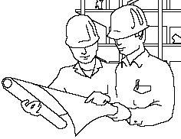

评审方法
审查
小组评审
走查
结对编程
同级桌查
轮查
临时评审
正式化程度
Notes:
RMUC Instructor Notes
Module 0 - About This Course

Slide 51
需求评审的输入和输出
输入
  待评审的需求文档
  Check list
输出
  评审结论
    通过
    有条件通过
    不通过
  缺陷清单
软件需求基线

Slide 52
七、需求管理
定义需求基线
需求跟踪
需求变更控制（建立新的需求基线）

Slide 53
1）建立需求基线
Feature 1: The system must...
Feature 2: The system must...
Feature 3: The system must...
Feature 4: The system must...
Feature n: The system must...
How do we know what the needs are?
How do we determine priority?
Where do we set the baseline?
Time
Project
Start Date
Target
Release
Date
Notes:
How do we reach agreement on what features should be included in our project? Where would we set our baseline commitment for delivery? By “baseline” we mean the set of features that constitutes the agreed upon basis for development and that can only be changed through a formal procedure.
The key is to under-promise and over-deliver – but not too much! We want to maintain our credibility.
What needs of our stakeholders do the features represent?
How should features be prioritized?
What factors might influence the order in which we rank the features?
Refer to our discussion of this slide in Module 1.

Slide 54
2）需求跟踪
项目干系人需求
业务规则
Vision
特性
软件需求
功能需求
非功能需求
约束条件
Stakeholder
需求
设计模型
测试模型
用户文档
Notes:
RMUC Instructor Notes
Module 0 - About This Course
P150
The first step is to establish your requirements structure and the relationship of different types of requirements to each other.
Based on this structure, you need to set up traceability links between all associated requirements or other project elements.
Trace top-level requirements into detailed requirements.
Trace requirements into design.
Trace requirements into test procedures.
Trace requirements into user documentation plans.

Slide 55
需求跟踪矩阵
功能特征 | 用例 | 设计模块 | 代码 | 测试用例
文档+功能编号+名称+说明 | 需求文档+用例编号+名称+说明 | 设计文档+模块编号+名称+说明 | 目录名+文件名+类名+函数名 | 测试文档+测试用例编号+名称+说明

Slide 56
3）需求变更控制
需求/范围变化的原因
  初期的认识不足导致错误或不完整的需求/范围
  需求/范围本身存在不一致
  业务变化导致的刚性需求/范围变更
  外部经济、市场环境的变化
  客户和项目组对已确认的需求/范围理解不一致
  技术制约或多目标权衡带来的需求/范围变更

Slide 57
需求和范围经常变化, 怎么办
尽可能多地收集需求
  各种需求收集技术
  领域专家
  预测可能的需求变更
采用迭代的过程，允许在软件开发过程中，对需求进行变更
  每个迭代初期都有需求收集与分析
  当存在大量的需求变更时，敏捷过程更适合

Slide 58
需求和范围经常变化, 怎么办（续）
减少需求变更时所引起返工的工作量
  软件架构稳定
  模块独立性好（耦合度低，内聚性高）
  文档齐全
  代码可读性好
需求按属性进行优先级排序，优先级高的先开发，当资源不足时，删除优先级最低的需求
需求变更按变更控制流程实施

Slide 59
需求监控
在渐增式开发中，显得尤为有益
  分布式调试–发现错误并找到出错原因
  运行验证–确认软件与规格说明是否相配
  运行确认–评估逐步扩展的软件是否满足用户目标
  商业活动监控–评估系统是否满足商业目标
  演化与协同设计 –为作为系统演化者的利益相关者提供信息
These slides are designed to accompany Software Engineering: A Practitioner’s Approach, 8/e (McGraw-Hill, 2014). Slides copyright 2014 by Roger Pressman.

Slide 60
作业
8.3 8.9 8.10 8.15

