Slide 1
Control System Instrumentation
P&ID (Piping and Instrumentation Diagram)
Sensors , transmitters and transducers
Final control elements
Chapter 8

Slide 2
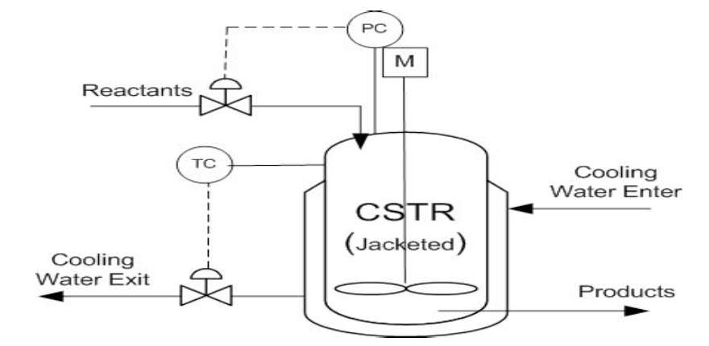
P&ID

Slide 3
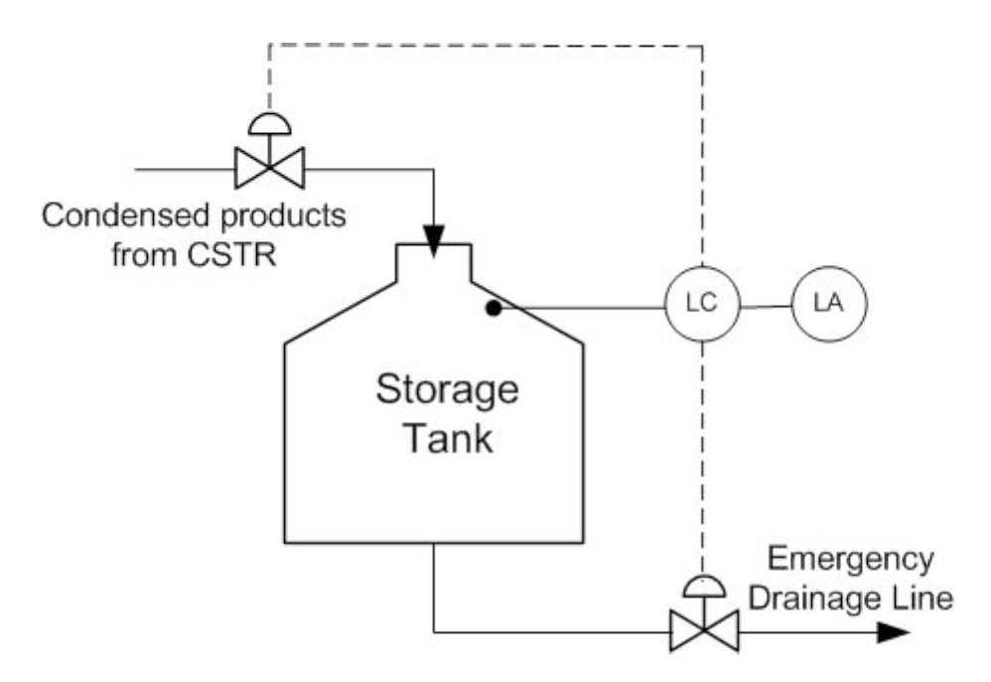
P&ID

Slide 4

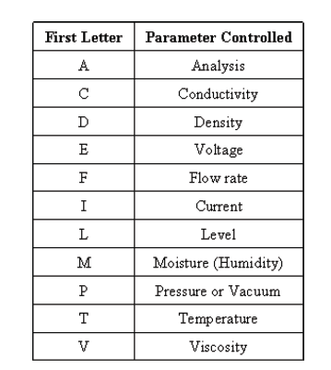
Second Identification Letter
A | Alarm
C | Control
I | Indicate
T | Transmit
V | Valve
It is not uncommon to see just _C as an integrated alarm, controller , indicator and transmitter.

Slide 5
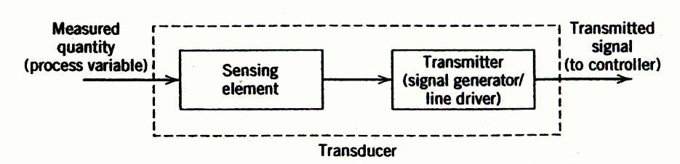
8.1Transducers and Transmitters
A typical process transducer.
The figure illustrates the general configuration of a measurement transducer; it typically consists of a sensing element combined with a driving element (transmitter).

Slide 6
Sensor
  Produces a physical response related to the process variable
  Thermocouple: temperature → millivolt signal
Transmitter
  Converts sensor signal to a signal appropriate for the controller
  Temperature transmitter: millivolt signal → voltage signal
Standard ranges
  Analog: 4-20 milliamp, 1-5 volts
  Pneumatic: 3-15 psig

Slide 7
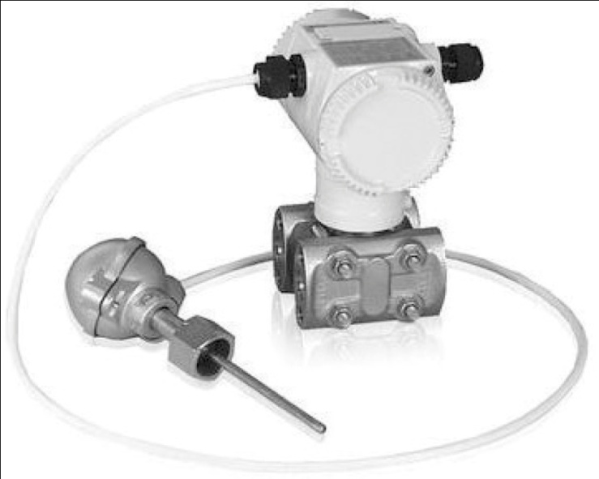
Common Measurement Options
Temperature
  Thermocouple, resistance temperature detector (RTD)
Flow
  Orifice meter, venturi meter
Pressure
  Strain gauge, piezoelectric transducers
Level
  Pressure taps, float activated chain gauge
Composition
  Gas chromatography, mass spectrometry
Some sensors measure multiple variables
A multivariable pressure transmitter

Slide 8
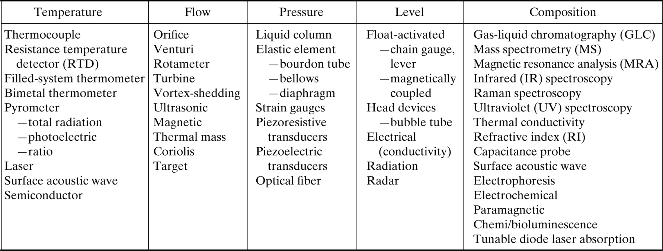
On-Line Measurement options for Process Control
Chapter 8
Table 8.1

Slide 9
Transmitters
A transmitter usually converts the sensor output to a signal level appropriate for input to a controller, such as 4 to 20 mA.
Transmitters are generally designed to be direct acting.
In addition, most commercial transmitters have an adjustable input range (or span).
For example, a temperature transmitter might be adjusted so that the input range of a platinum resistance element (the sensor) is 50 to 150 °C.

Slide 10
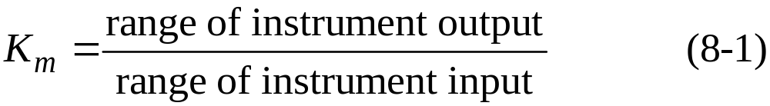
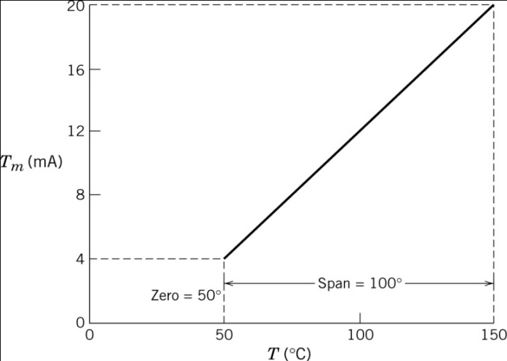
Static and Dynamic Characteristics
Input | Output
50 °C | 4 mA
150 °C | 20 mA
Static
  50 ºC → 4 mA, 150 ºC → 20 mA
This instrument (transducer) has a lower limit or zero of 50 °C and a range or span of 100 °C.
  Gain:
  The gain of the measurement
  element Km is 0.16 mA/°C.

Slide 11
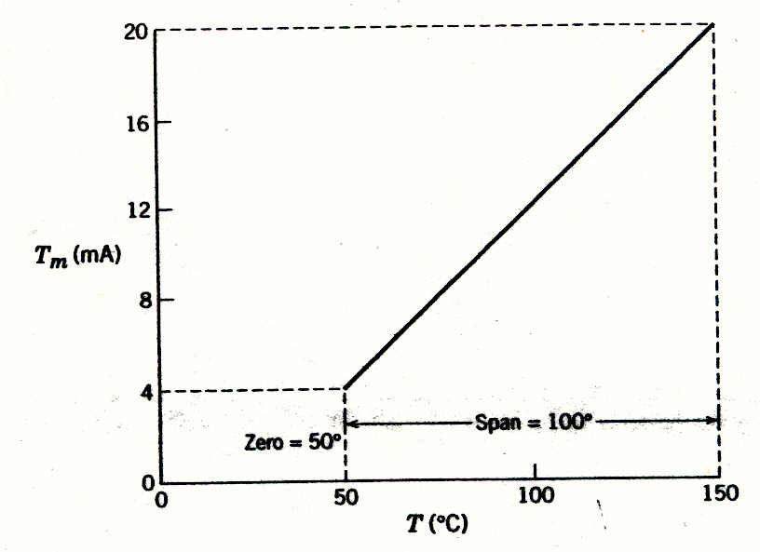
Figure 8.5 A linear instrument calibration showing its zero and span.

Slide 12
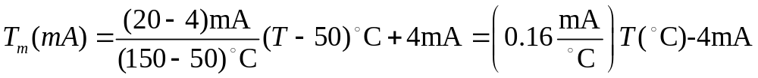
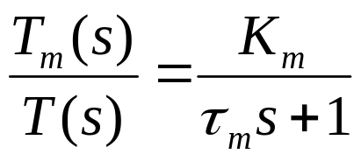
  Conversion:
For the temperature transmitter discussed above, the relation between transducer output and input is
Sensor dynamics – assume linear first order
  Good sensor: tm << tp (process time constant)

Slide 13
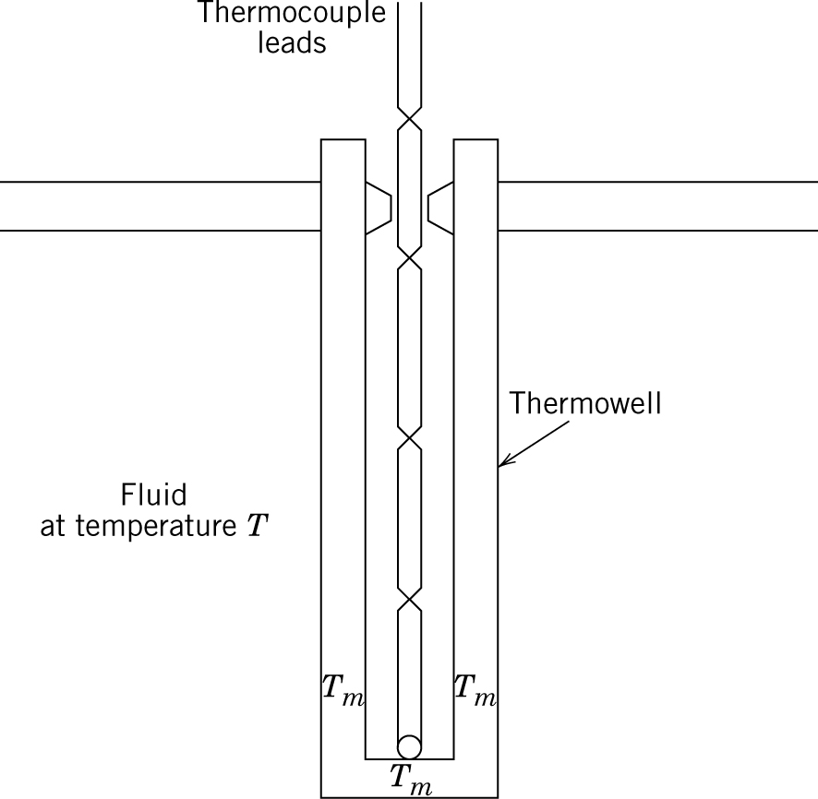
Chapter 8
Figure 8.16 A thermowell /thermocouple

Slide 14
8.2 Final Control Elements
Every process control loop contains a final control element (actuator), the device that enables a process variable to be manipulated.
For most chemical and petroleum processes, the final control elements (usually control valves) adjust the flow rates of materials, and indirectly, the rates of energy transfer to and from the process.

Slide 15
Control Valves
There are many different ways to manipulate the flows of material and energy into and out of a process; for example, the speed of a pump drive, screw conveyer, or blower can be adjusted.
However, a simple and widely used method of accomplishing this result with fluids is to use a control valve, also called an automatic control valve.
The control valve components include the valve body, trim, seat, and actuator.

Slide 16
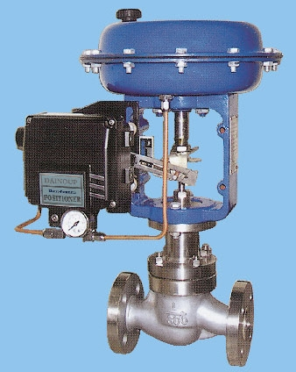
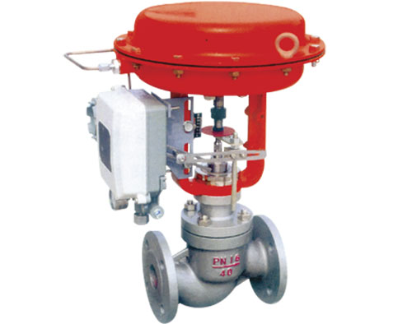
Pneumatic control valve

Slide 17
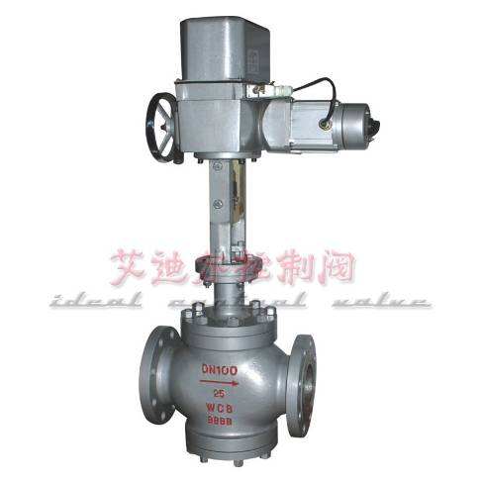
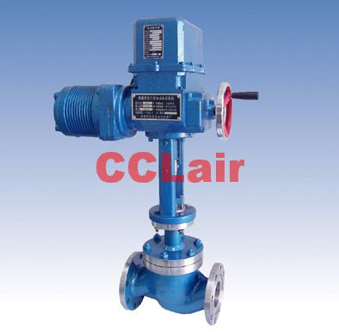
Electronic control valve

Slide 18
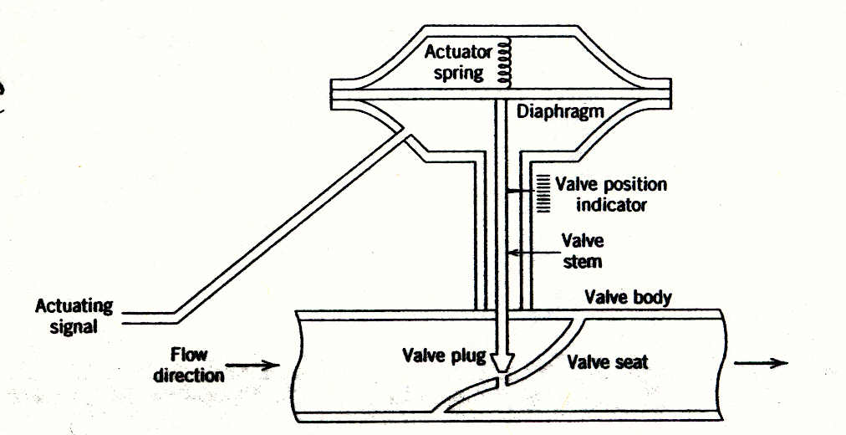
Figure 8.7 A pneumatic control valve (air-to-open).

Slide 19
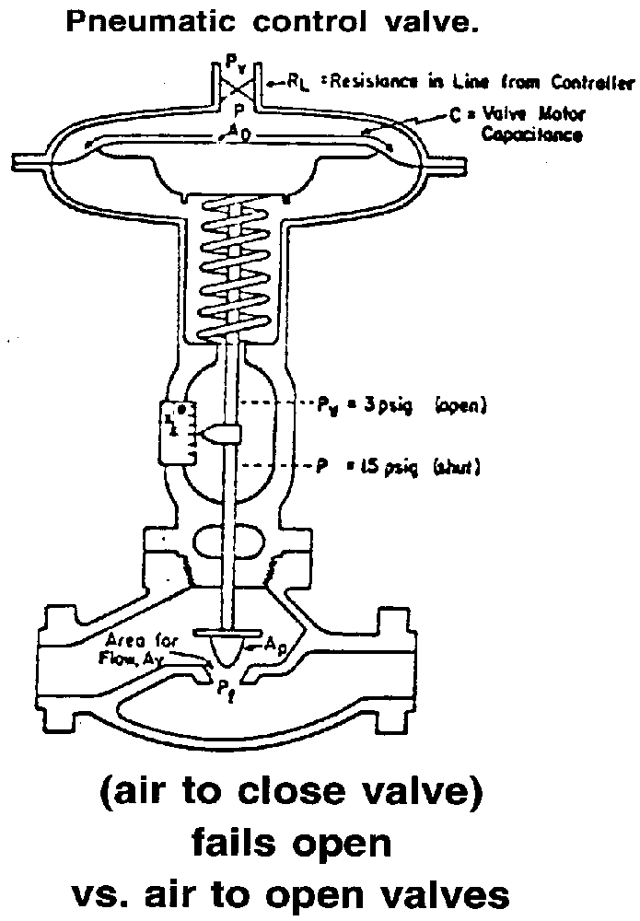

Slide 20
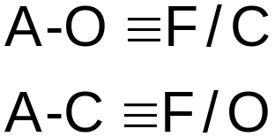
Air-to-Open vs. Air-to-Close Control Valves
Normally, the choice of A-O or A-C valve is based on safety considerations.
We choose the way the valve should operate (full flow or no flow) in case of a transmitter failure.
Hence, A-C and A-O valves often are referred to as fail-open and fail-closed, respectively.
Failure philosophy: Keep process pressure low,
protect environment (equipment and engineers)

Slide 21
Pneumatic control valves are to be specified for the
applications listed below. State whether an A-O or A-C
valve should be specified for the following manipulated
variables:
(a) Steam pressure in a reactor heating coil.
(b) Flow rate of reactants into a polymerization reactor.
(c) Flow of effluent from a wastewater treatment
holding tank into a river.
(d) Flow of cooling water to a distillation condenser.
Chapter 8

Slide 22
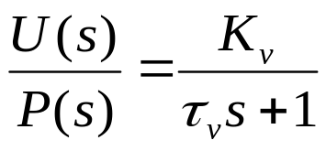
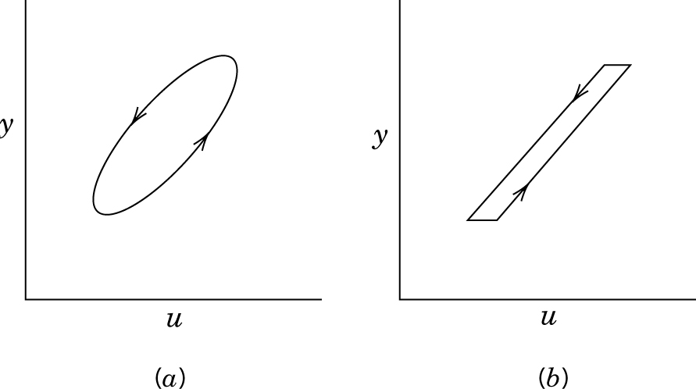
Control Valve Behavior
Valve dynamics – assume linear first order
  Good valve: t_{v} << t_{p} (process time constant)
Nonideal behavior
  Hysteresis – different flows obtained when valve opening and closing at same valve position
  Deadband – no change in flow over a range of valve positions
  Can be mostly overcome with valve positioners

Slide 23


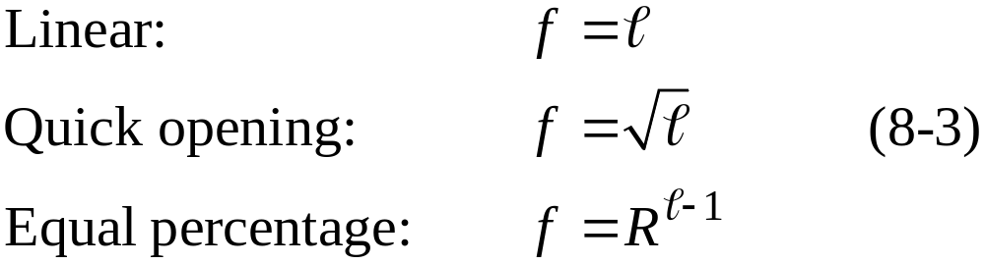
Flow characteristic
The flow characteristic is related to the lift , that is, the extent of valve opening, by one of the following relations:
where R is a valve design parameter that is usually in the range of 20 to 50.

Slide 24
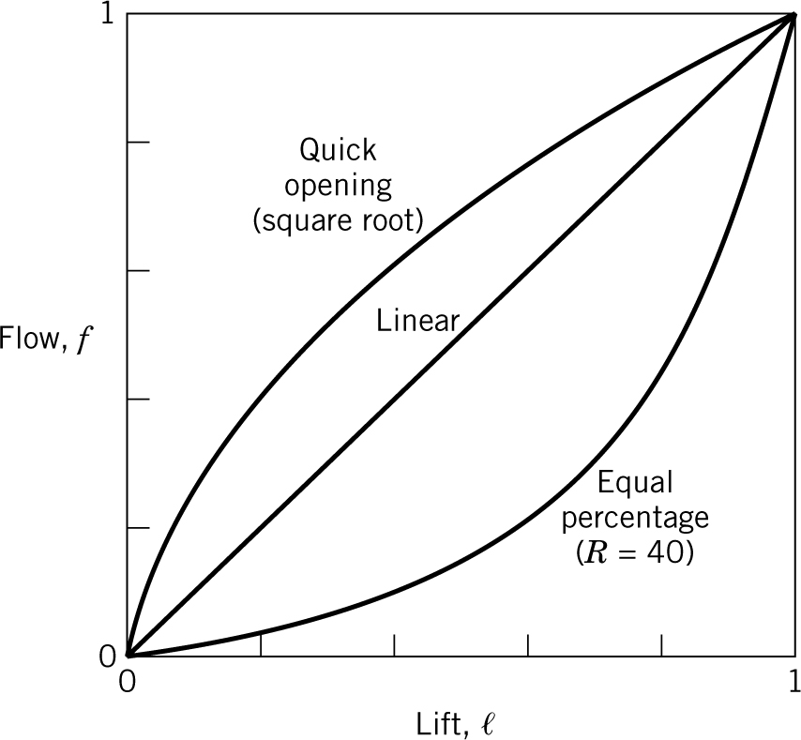
Figure 8.10

Slide 25
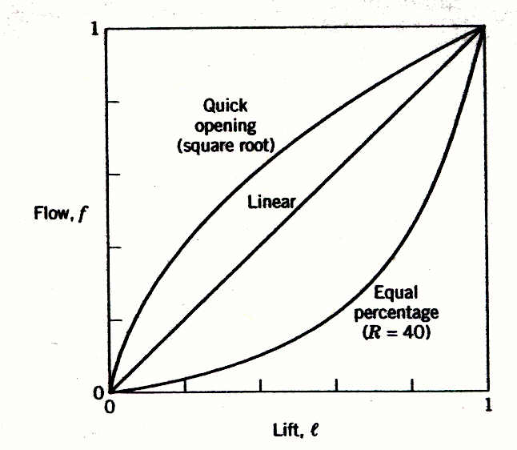
Quick Opening- used for safety by-pass applications where quick opening is desired
Equal Percentage- used for about 90% of control valve applications since it results in the most linear installed characteristics
Linear- used when a relatively constant pressure drop is maintained across the valve

