Slide 1
Chapter 4
Structures and Properties of Polyatomic Molecules

Slide 2
Both the MO method and the VB method predict that diatomic molecules have two centers. In most cases, the two methods give same results.
(However, the two methods can give different results in some cases. For example, the VB method cannot explain the paramagnetism of O₂, while the MO method can.)

Slide 3
For polyatomic molecules, the MO method and the VB method give completely different images. The VB method still predicts a double-centered pattern, while the MO method predicts a multi-centered pattern. That is, molecular orbital (the wave function of a single electron in a molecule) in principle is associated with all the atoms in the molecule. This is the so-called canonical molecular orbital or delocalized molecular orbital.

Slide 4
VB double centers
Diatomic molecule
MO double centers
(Simple molecular
orbital theory)
VB double centers
Polyatomic molecule
(Delocalized / canonical
molecular orbital
MO multiple centers
“Average” result
Localization (consistent with VB method)
Delocalization (i.e., delocalization in the usual sense)

Slide 5
In principle, all the problems that can be solved by the VB method can be solved by the MO method. However, problems that can be solved by the MO method may not be solved by the VB method. The MO method is not popularly used, especially for polyatomic molecules, since it is not consistent with the classical concept of bond. Therefore, many improvements and developments have been made to VB. One of the earliest developments is the hybrid orbital theory (which is still in the framework of valence bond theory).

Slide 6

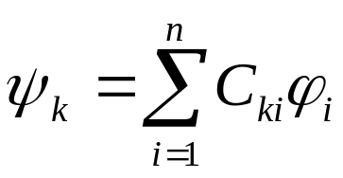
4.1 Hybrid orbital theory
4.1.1 Properties of hybrid orbitals
(1) Hybrid orbital is a linear combination of atomic orbitals participating in hybridization
k=1,2,…,n
4-1
Obviously, for hybridization with n atomic orbitals,
n hybrid orbitals will be generated.
It should be noted that this expression is exactly same with MO-LCAO, but the meaning is different. Here, refers to different states (different atomic orbitals) of an atom. Hybrid atomic orbitals are still atomic orbitals.

Slide 7
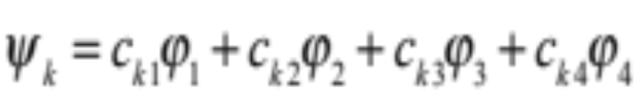
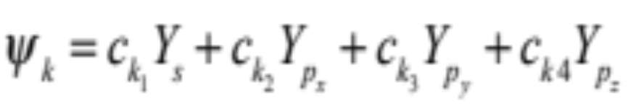
For example: s-p type hybridization
Use Y_{i} instead of sp# hybridization
When this formula is expanded, there are 4 hybrid atomic orbitals (k=1,2,3,4). The construction of the wavefunction of the hybrid orbital is to determine the 16 coefficients c_{ki}. The angle between the hybrid orbitals and the atomic orbital components in the hybrid orbital can be determined by c_{ki}.

Slide 8
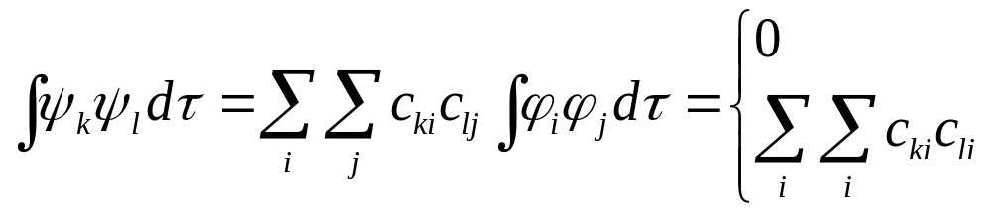
The meaning of hybridization:
The atomic orbitals deform and recombine together under the perturbation of the environment, which is favorable to the formation of chemical bonds.
(2) Orthonormality of Ψ_{k}
(when i≠j, φ_{i,j} are orthogonal)
(when i=j, φ_{i} is normalized)

Slide 9
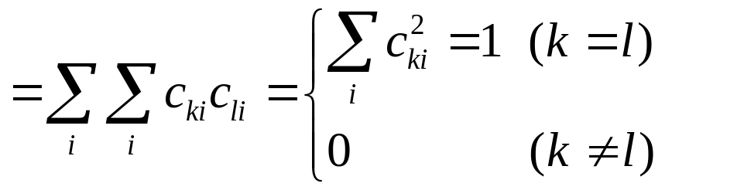
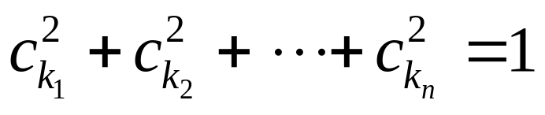
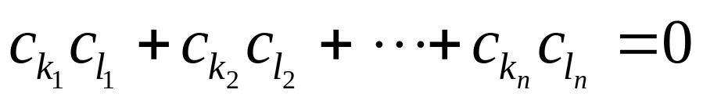
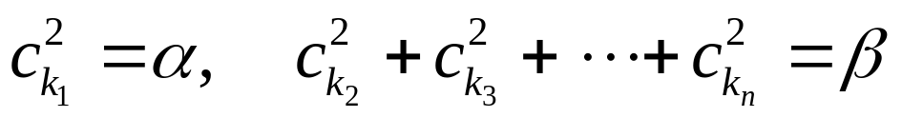
Normalization
4-2
Orthogonality
Expand (4-2):
Row Normalization
Row Orthogonality
Similarly, there are also column normalization and column orthogonality properties.
Let
（α, β are the components of the s and p atomic orbitals in the s-p hybridization, respectively)

Slide 10
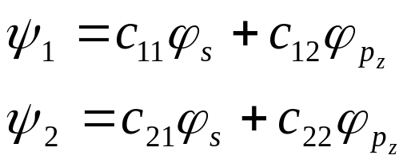
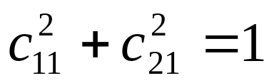
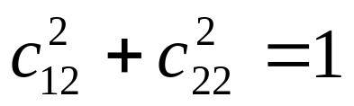
(3) Contribution of basis orbital
The sum of the components of a certain atomic orbital in each orbital should be 1. (This is actually called column normalization.)
For example: sp hybridization
Namley

Slide 11
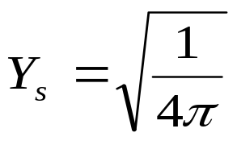
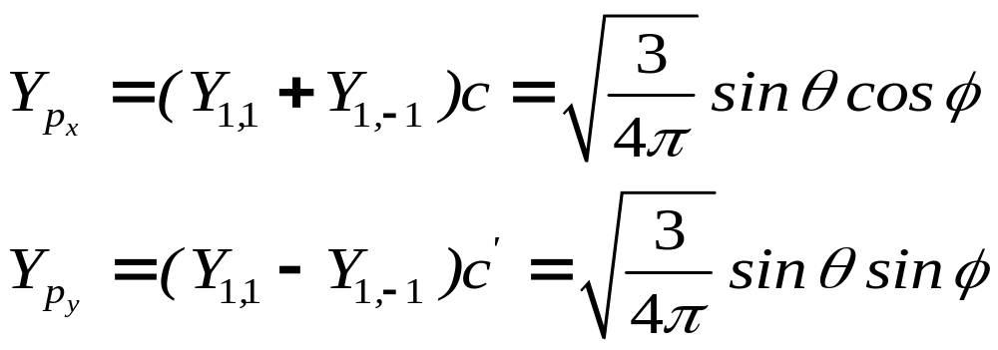
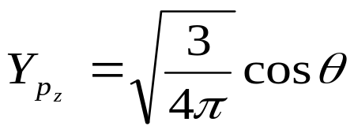
(4) Bonding power f
Pauling defined the bonding power (f) of an atomic orbital: the maximum value of the angular function of an atomic orbital.
Angular function of sp orbital

Slide 12
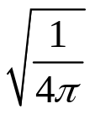
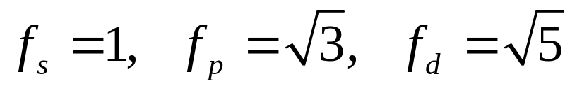
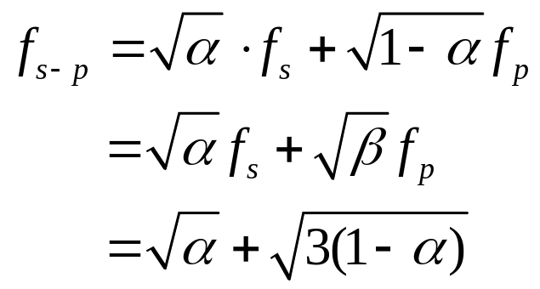
By using as the unit, we can obtain:
It can be speculated from the above definition that the bonding
power of a hybrid orbital is related to the corresponding
combination coefficients.
4-3

Slide 13
S component α | 0 | 1/4 | 1/3 | 1/2 | 1
Hybridization type sp^{n} | p | sp³ | sp² | sp | s
Bonding power f | 1.732 | 2.00 | 1.991 | 1.933 | 1.00
Angle θ between hybrid orbitals |  | 109°28 ′ | 120° | 180°
Obviously, the bonding power increases after hybridization,
which is the reason for the reorganization of atomic
orbitals under the bonding environment.

Slide 14
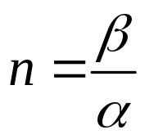
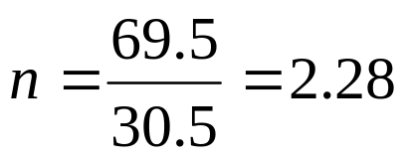
Hybridization Index (FYI)
For sp^{n} hybridization
Obviously, the hybridization index can be a fraction.
C₆₀
The average ∠CCC bond angle is 116°, and the sum of the three CCC bond angles is 348°. The calculation shows that in each sp^{n} orbital of C, the p orbital component is 69.5% and the s orbital component is 30.5%. So,
So in C₆₀ the C atom has sp^{2.28} hybridization.

Slide 15
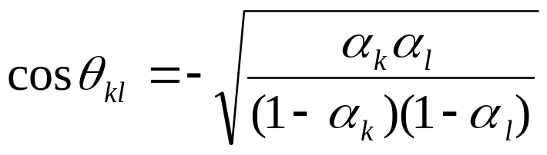
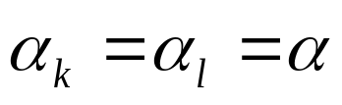
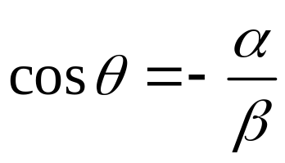
(5) Angle between hybrid orbitals (sp^{n} hybridization)
From the orthonormality of φ_{k} and φ_{l}, it can be deduced that the angle between hybrid orbitals φ_{k} and φ_{l} is
Equivalent hybridization：
4-4
Equivalent hybridization means that in each hybrid orbital, the s orbital component or the p orbital component is equivalent.

Slide 16
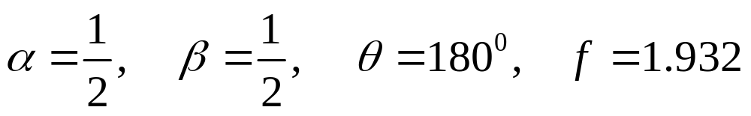
4.1.2 Application of Equivalent Hybrid Orbital Theory
(1) sp hybridization
Selection of coordinate axis
(The form of the hybrid orbital wave function is related to the selection of coordinate axes)
ψ₂
ψ₁
The extreme values ​​of the two hybrid orbitals are in the ±z direction
z

Slide 17
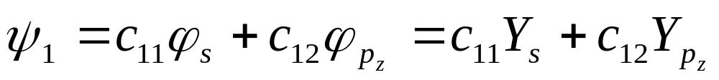
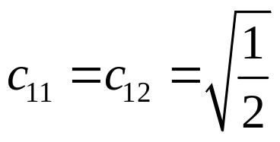
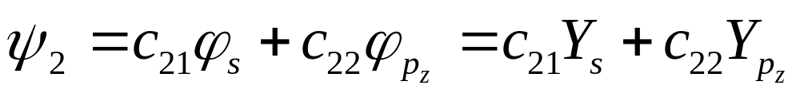
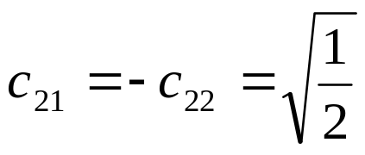
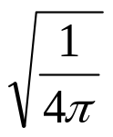
Among
Among
The four combination coefficients can be calculated from the row normalization, the column normalization, the row orthogonality, and the column orthogonality conditions. Angular function is used and is taken as the unit.

Slide 18
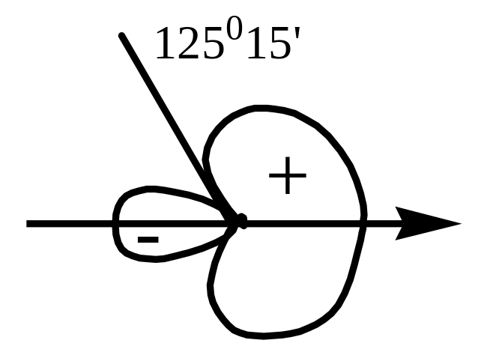
The angular distribution diagram of the sp-type orbital
θ | 0 | 30⁰ | 60⁰ | 90⁰
cosθ | 1 | 0.87 | 0.50 | 0.0
Y₁ | 1.93 | 1.77 | 1.32 | 0.71
θ | 120⁰ | 125⁰15‘ | 150⁰ | 180⁰
cosθ | -0.50 | -0.577 | -0.87 | -1.00
Y₁ | 0.09 | 0.0 | -0.36 | -0.52
Fig 5-1 Angular distribution diagram of a sp hybrid orbital
The Y₂ is exactly the same with this method, but the maximum value calculated for Y₂ is in the opposite direction.

Slide 19
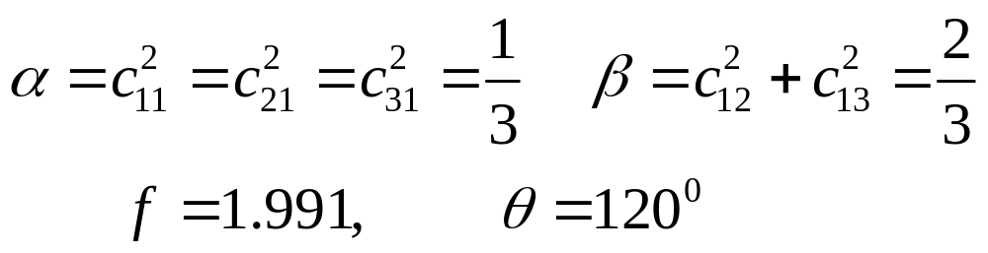
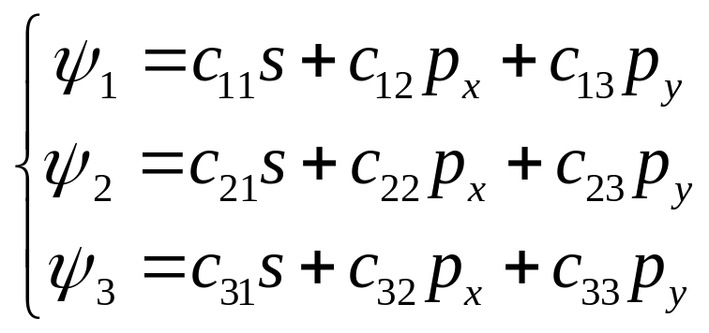
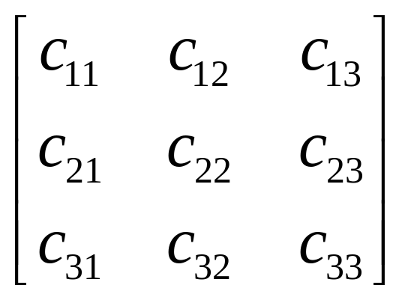
(2) sp² hybridization

Slide 20
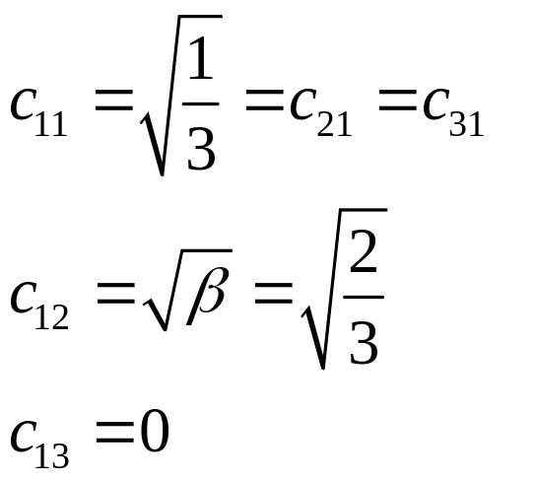
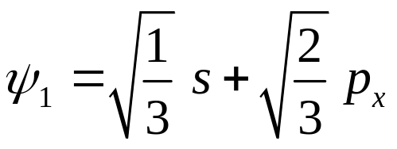
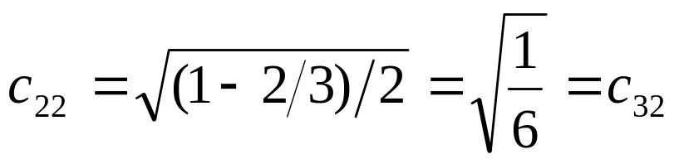
Selection of coordinate axis
ψ₂
y
30°
x
ψ₁
30°
ψ₃
The Projection of p_{y} on Ψ₁ is 0, that is:
The remaining part of p_{x} is equally divided in Ψ₂ and Ψ₃, and they have the same direction (same sign).

Slide 21
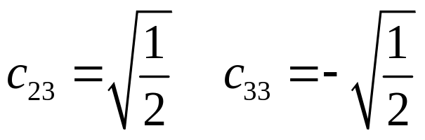
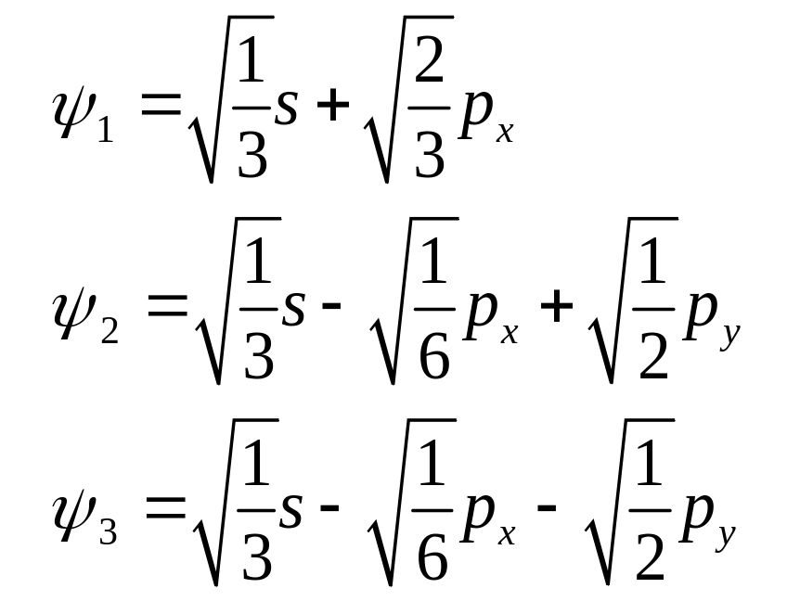
p_{y} is equally divided in Ψ₂ and Ψ₃, and they have opposite signs:
It can be verified that Ψ_{i} satisfies the
orthonormalization condition

Slide 22
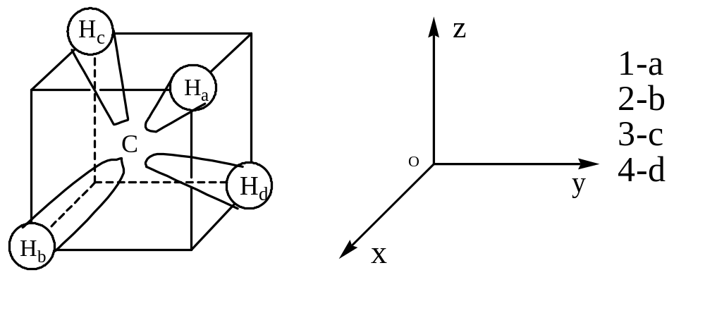
(3) sp3 hybridization
Take CH₄ as an example
Fig. 5-2 Schematic diagram of the orientations of the four sp³ hybrid orbitals

Slide 23
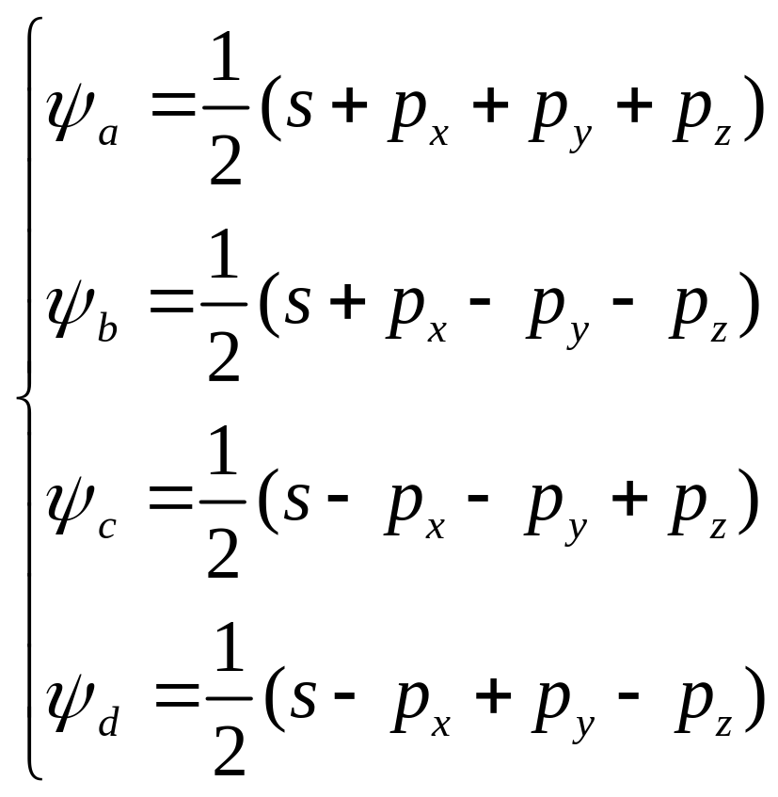
Construction of the Wavefunction of a Hybrid Orbital

Slide 24
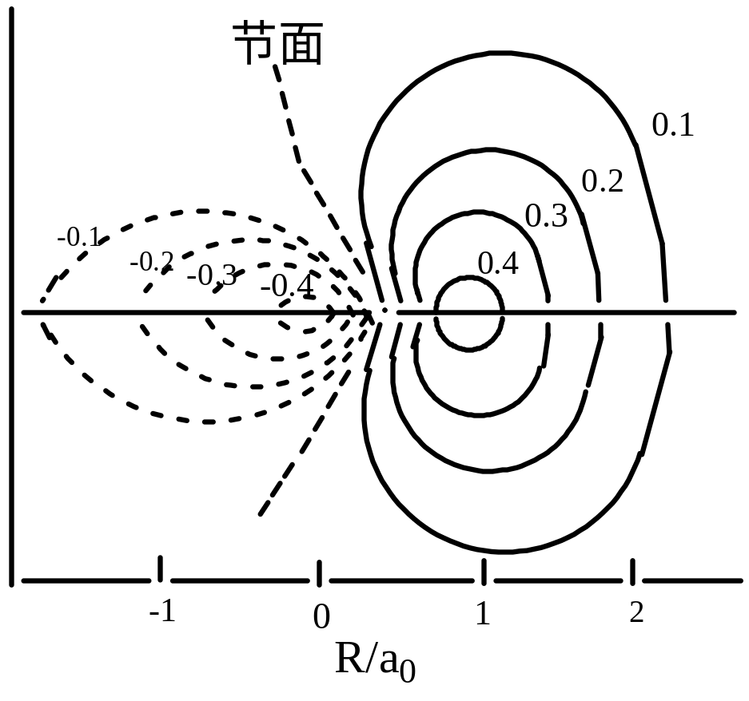
Nodal surface
Fig. 5-3 Contour map of sp³ hybrid orbitals of carbon atoms

Slide 25
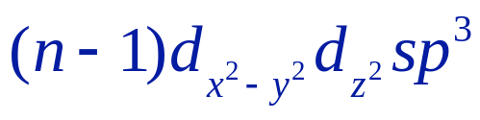
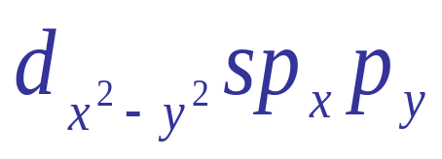
(4) hybridization with d orbitals
The corresponding hybridization form of the regular
octahedral configuration is:
d²sp³
or sp³d²
The hybridization form of the square planar configuration is:

Slide 26
(4) hybridization with d orbitals (FYI)
For transition metals, the energy levels of (n-1)d orbitals are close to that of ns and np orbitals, leading to the formation of d-s-p hybrid orbitals. For example, d²sp³ hybridization: in some molecules or complex ions with a coordination number of 6, the central atom or ion adopts d²sp³ hybridization, such as [Co(NH₃)₆]³⁺; dsp² hybridization: in complex ions with a coordination number of 4 such as [Ni(CN)₄]²⁺, the center Ni²⁺ adopts dsp² hybridization with a square planar configuration. The basis function of hybridization is: d_{x2-y2},s,p_{x},p_{y}
For p-zone elements, their ns, np, and nd orbitals are close in energy, which leads to the formation of s-p-d hybrid orbitals; sp³d² hybridization: for example SF₆ molecules, which are regular octahedral molecules, and the basis functions participating in the hybridization are:
d_{x2-y2}, d_{z2}, s, p_{x}, p_{y}, p_{z}

Slide 27
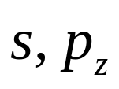
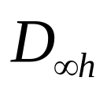
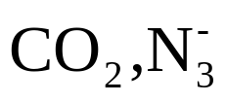
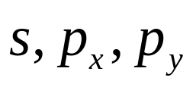
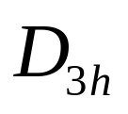

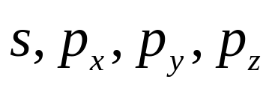


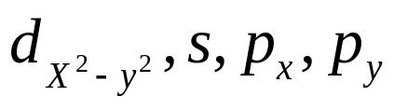
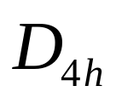








Table 4-1 Some common hybrid orbitals
Hybrid orbital | Atomic orbitals participating in hybridization | Configuration | Symmetry | Example
sp |  | Straight
sp² |  | Plane triangle
sp³ |  | Tetrahedral
dsp² |  | Plane square
sp³d |  | Triangular biconical
sp³d² |  | Square cone
sp³d² |  | Octahedron shape

Slide 28

Discussion
FYI
a
For a specific configuration, its hybridization type is not unique.
For examples: sp³ and sd³ both have a tetrahedral configuration,
MnO₄⁻ has sd³ hybridization.
b
For a specific configuration, the choice of same type atomic orbitals is not arbitrary.
For examples: sp³d²(d²sp³) can only be a regular octahedron;
If sp³d_{xz}d_{yz} is selected, it is an inverse triangular prism configuration.

Slide 29

Discussion
FYI
c
The complexes with a coordination number of eight are mostly in the inverse tetragonal configuration when the chemical bonds are covalent bonds, and there is no corresponding cubic configuration. The cubic configuration appears only when the chemical bonds are ionic bonds. The reason is that there is no suitable hybridization type.
For example, TaF₈⁴⁻ and UF₈⁴⁻ have the inverse tetragonal column configuration; while CsCl is in the cubic configuration, the former is hybridization, and the bonds in the latter are formed due to electrostatic interactions.

Slide 30
4.1.3 Inequivalent hybridization
The problem
Both NH₄⁺ and CH₄ have regular tetrahedral structures. N and C take equivalent sp³ hybridization. In H₂O and NH₃, the experimental values ​​of bond angles are 104.5°and 107.3°. Although they are molecules having same number of electrons with NH₄⁺ and CH₄, the bond angle is smaller than 109°28', which is still larger than the angle of bond with pure p orbitals. Therefore, H₂O and NH₃ should be described by the inequivalent sp3 hybridization concept.

Slide 31

Inequivalent hybridization means that in each hybrid orbital, the s or p orbital component doesn’t equal.
The s component in the bond orbital is α, and the s component in the lone pair electron orbital is α’.
By
Calculate the s orbital component in the bond orbital.

Slide 32
Example
H₂O θ =104.5°
since
The s component in the bond orbital is α =0.20
the p component β =1-0.20=0.80
The s component in the orbital occupied by the lone pair of electrons is α’ = (1-0.20×2)/2 = 0.30
the p component β '=0.70
Obviously, orbitals occupied by lone pair electrons have greater s component, and the electron cloud occupies a larger space, which has a compressive effect on the bond electrons, making the bond angle smaller than 109°28'.

Slide 33
Ex.
NH₃ θ =107.3°
α =0.23 β =0.77
α’ =0.31 β’ =0.69
The s component in the orbital occupied by lone pair electrons is greater than that in the bond orbital.

Slide 34
4.2 Repulsion of Valence electron pairs
Since the valence electron pairs around the atom repel each other, under the condition of a certain bond length, the longer the distance between each other, the more stable the molecule is.
Valence electron pairs include bond electron pairs and lone electron pairs.
Order of magnitude of repulsion between valence electron pairs:
Lone pairs of electrons >> Lone pair of electrons-bond electron pair > Bond electron pairs
Since the repulsion between the lone pairs of electrons is very large, the angle between the lone pairs of electrons must be greater than 90 degrees.
The order of the magnitude of the repulsive force between the bond electron pairs: triple bonds> double bonds> single bonds

Slide 35
Example: Ammonia molecule. The central nitrogen atom takes the sp3 hybridization to form N-H bonds with three hydrogen atoms. There is also a lone pair of electrons. A total of four pairs of valence electrons exist, arranged in a tetrahedron, and the lone pair of electrons is one of the vertices. Due to the large repulsion of the lone pair of electrons, the angle between the N-H bonds is less than 109 degrees.
N
H
H
H
Example: Xenon tetrafluoride molecule. The central xenon atom takes the sp3d2 hybridization to form Xe-F bonds with four fluorine atoms. There are also two lone pairs of electrons, a total of six pairs of valence electrons exist, arranged in an octahedron. Due to the large repulsion between the lone pairs of electrons, the angle must be more than 90 degrees, so two lone pairs of electrons are in a straight line, four fluorine atoms are on a plane, and the molecule is a square.
F
F
Xe
F
F

Slide 36
Example: Iodine dichloride anion. The central iodine atom adopts sp3d hybridization to form an I-Cl bond with two chlorine atoms. There are also three lone pairs of electrons, a total of five pairs of valence electrons exist, which are arranged in a triangular bipyramid. Due to the large repulsion between the lone pairs of electrons, their angles must be more than 90 degrees, therefore, the three lone pairs of electrons can only be arranged in an equilateral triangle on one plane, two chlorine atoms are in a straight line, and the molecule is a straight line.
Cl
I
Cl
This repulsion principle of valence electrons is inaccurate for certain compounds, such as CaF₂, and cannot be used in transition metal compounds, unless the metal atom has a fully-filled or half-filled or completely empty d orbital.

Slide 37
4.3 Delocalized π bond and conjugation effect
4.3.1 The conditions and types of forming delocalized large π bonds
① condition
☻ The atoms forming the delocalized π bond should be coplanar or quasi-coplanar, and each atom can provide a mutually parallel p orbital perpendicular to the plane. This condition guarantees the maximum overlap.
☻ The number of π electrons provided by conjugated atoms is less than twice the number of total p orbitals forming π bonds. This condition guarantees the net bonding electrons.

Slide 38

② type
Number of π electrons
The number of atomic p orbitals forming a
delocalized π bond (the number of atoms)
☻Normal large Π bond Π_{n}^{m} (m=n)
☻Rich-electron large Π bond Π_{n}^{m} (m>n)
☻Poor-electron large Π bond Π_{n}^{m} (m< n)

Slide 39
4.3.2 The influence of conjugation effect on molecular properties
Due to the formation of delocalized π bonds, the movement
range of π electron increases, so that the molecule has special physical
and chemical properties, such as lower energy, enhanced stability,
averaged bond lengths, changes of the acidity/basicity and various
types of chemical properties.

Slide 40




① Chemical reactivity
For example
stable intermediate
π₄⁶ exists in it, which makes its
properties change abnormally
the formation of makes the C-Cl bond shorter, reactivity of Cl decreased.

Slide 41
② Conductivity
The formation of large Π bonds makes it is easy for π electrons to move on the molecular skeleton, which is the reason why conjugated molecules can conduct electricity. As the conjugate chain grows, conduction band, empty band, and band gap are formed, similar to semiconductors. When the band gap is very small (Εg < 3 eV) , it becomes a conductor.

Slide 42
③ color
A change in the size of a conjugate system causes a variation in the energy level interval. When the absorption is in the visible region, the color must change.

Slide 43

④ Acid-base
When O, Cl, N, S taking a lone pair of electrons to participate in the delocalization, such as the delocalization of the lone pair of electron for N in an amide, the is formed , which makes the N less basic.

Slide 44
4.4 Non-localized (canonical) molecular orbital theory of saturated molecules
(FYI)
When using molecular orbital theory to deal with polyatomic molecules, according to the universality principle of MO, the whole molecule is regarded as a entirety, and each electron is moving on the overall molecular skeleton. For example, each electron in CH₄ moves in a field composed of five nuclei and other electrons, not between two bonded atoms.

Slide 45

4.4.1 Construction of the regular molecular orbital wave function of CH₄
Select the coordinate system shown in Figure 5-4：

Slide 46
Basic ideas for dealing with problems:
Firstly, the 1s orbitals of the four H (respectively marked as a, b, c, d) were combined into a symmetry group orbital, and then make a linear combination with the 2s, 2px, 2py, 2pz atomic orbitals of C (actually 8 Atomic orbital combination will definitely produce 8 molecular orbitals).

Slide 47


It is consistent with C's 2s symmetry. a1 represents one dimension.
The same reason: get the expression of Table 5-1,
The energy level diagram is shown in Figure 5-5

Slide 48

Table 4-1 Bonding and anti-bonding delocalized molecular orbitals of CH₄ (i.e., CMO)
Delocalized molecular orbital Anti-bond delocalized molecular orbital
（CMO) （CMO)

Slide 49




C
CH₄
4H
2P
1S
（-14.6eV，UPS：-14.35eV）
2S
（-25.24eV，UPS：-22.91eV）
Figure 4-5 Molecular orbital energy level diagram of the valence layer of CH₄
8 valence electrons are filled in 4 bonding molecular orbitals.
The ionization energy of a1 orbital measured by photoelectron spectroscopy is 22.9 eV, the ionization energy of the remaining three orbits t1 is 14.4 eV.

Slide 50
4.4.2 The comparison between regular MO and local bond model for CH₄
Each of the 8 electrons on the regular MO spreads over all atoms, and these 8 electrons are distributed in the whole molecule. As a result, each C and H obtained one of the two electrons, which is equivalent to C-H bond. The electron configuration is (a₁² t₁⁶), which does not mean that the 4 C-H bonds are unequal. It should be emphasized that there is no one-to-one correspondence between molecular orbitals and chemical bonds in polyatomic molecular systems.

Slide 51
It can be compared in this way. The VB method considers that the entire electron cloud in the molecule is made up of pieces (C-H), while the MO method considers the entire electron cloud is superimposed layer by layer (ψ_{a1}, ψ_{x}, ψ_{y}⋅⋅⋅) . For some saturated molecules (such as CH₄), the two are equivalent.

Slide 52





Figure 5-6 The determination of the symbol of the combination coefficient when delocalized molecular orbitals are linearly combined into localized molecular orbitals of ψ _{c}′

Slide 53
Regular MO is more useful in explaining molecular properties.
For all physical properties related to the movement of electrons in a molecule, such as bond energy, dipole moment, charge density, etc., the explanations of the two theories are consistent. However, the properties involving the behavior of individual electrons, such as electronic spectra, ionization energy, etc., it can only be explained by the MO method, while the VB method cannot do anything. In order to make the canonical MO correspond to the classical image of chemical bond, the localized molecular orbital theory was developed. The so-called localized molecular orbital is the twice linear combination of the regular molecular orbital wave function. Refer to the expression in the textbook P₁₅₂₋₁₅₃ for the specific combination result.

Slide 54
Table 4-3 Applicable scope of delocalized orbital and localized orbital
Delocalized orbital CMO Localized orbital LMO
Electronic spectrum, electronic energy
spectrum (photoionization) Bond length, bond energy
Electron affinity Force constant
Redox potential Charge density, dipole moment
Walsh description of molecular geometry VSEPR description of molecular geometry
magnetic Brønsted acid

Slide 55
4.5 HMO method and the structure of conjugated molecules
Properties of conjugated molecules:
★ Average bond length in butadiene molecule and
1,4-addition reaction
★ Each of C-C bond in the benzene molecule is equal and cannot be distinguished as single or double bond. The configuration is a regular hexagon, and the substitution reaction is easier than the addition reaction.

Slide 56
These properties of conjugated molecules indicate that there is a delocalized π bond in the molecule (each C atom adopts sp² hybridization, and the remaining p orbitals are parallel to each other, overlapping to form a whole system. The p electrons move among multiple atoms, forming delocalized big Π bond.
In 1931, Hückel applied the LCAO-MO method and used simplified process to explain a large number of organic conjugated molecules, constructing the Hückel molecular orbital theory (HMO).

Slide 57
4.5.1 Basic content of HMO
σ-π separation;
Single electron approximation;
LCAO—MO approximation
Hückel approximation;
Obtain the energy level E_{k} corresponding to the molecular orbital Ψ_{k} and draw the Ψ_{k} diagram;
Population analysis;

Slide 58


①
After σ-π separation, only π electrons are handled here.
σ-π separation
4-5
Selecting the linear combination of 2p_{z} as the variational function.
②
4-6
(φ_{i} is the 2p_{z} orbital perpendicular to the molecular plane not participating in the hybridization)
Single electron approximation
LCAO—MO approximation

Slide 59



Substitute into the variational equation to get the secular equation：
After expansion, we can get
4-7

Slide 60


Huckel hypothesis：
③
(i=j)
(i=j±1 adjacent)
(i and j is not adjacent)
(i=j normalization)
(i≠j)
Note: Here, φ_{i} and φ_{j} are different atomic states. Originally, S is a small positive value when i and j are adjacent, and it is 0 when they are not adjacent. But now, S is regarded as 0 no matter what the situation is.

Slide 61



④
Population analysis：
Charge density ρ_{i}, bond order P_{ij}, free valence F_{i} and molecular diagram
4-8
4-9
4-10
j

Slide 62


4.5.2 HMO Treatment for linear conjugated polyene
Taking butadiene as an example：
1
2
3
4
Variational
function：
4-11

Slide 63



Expand the secular equation and simplify
it according to the Huckel assumption
C
C
C
C
1
2
3
4
4-12
division β，and make ，that is
4-13

Slide 64

C
C
C
C
1
2
3
4
● Solution of energy：
To make (4-13) have a non-zero solution,
the determinant of coefficient should be zero
4-14
Note: For other arbitrary conjugate systems, different numbering methods can give different form of the determinant, but the value remains unchanged. There are many ways to solve equation (4-14), such as symmetry method, group theory method, algebraic remainder expansion method, etc. The algebraic remainder method is a universal method.

Slide 65

x₁=-1.62 x₂=-0.62
x₃=0.62 x₄=1.62
Solution
E₁ = α + 1.62β ; E₂ = α + 0.62β
E₃ = α − 0.62β ; E₄ = α − 1.62β
so

Slide 66
E₄
E₃
E₂ =α+0.62β(-9.08eV)
E₁=α+1.62β(-12.2eV)
Proof of photoelectron spectroscopy

Slide 67

● Solve the combination coefficient：
Substitute x₁=-1.62 into the secular equation (4-13), and combine the normalized conditions
Solution result：c₁=c₄=0.372 c₂=c₃=0.602
Therefore, the molecular orbital wave function with the lowest energy is
In the same way, substituting x_{i} into equation (4-13),
the results in Table 4-4 can be solved.

Slide 68




Table 4-4 1,3 The wave function and energy level of π-type molecular orbital of butadiene
Energy level | Wave function

Slide 69

Discussion
1
The relationship between the number of nodes and energy
E₄= −1.62β
E₃= −0.62β
α=0
E₂=0.62β
E₁=1.62β
2
3
1
4
Figure 4-7 Molecular orbital and energy level diagram of the delocalized bond of butadiene

Slide 70



2
Energy effect
Total electron energy of delocalized big π bond：
Bond energy of big π bond：
或
Delocalization energy：
or
The value of |β | is usually measured by the heat of hydrogenation，
generally 20-40 kJ·mol⁻¹.

Slide 71



3
Population analysis
Charge density（π charge）
The net charge density is:
q_{i} =1-ρ_{i} equivalent to and in organic chemistry
ψ₂ = 0.602φ₁ + 0.372φ₂ - 0.372φ₃ - 0.602φ₄
ψ₁ = 0.372φ₁ + 0.602φ₂ + 0.602φ₃ + 0.372φ₄

Slide 72



Bond order of π bond
ψ₂ = 0.602φ₁ + 0.372φ₂ - 0.372φ₃ - 0.602φ₄
ψ₁ = 0.372φ₁ + 0.602φ₂ + 0.602φ₃ + 0.372φ₄
2
3
1
4

Slide 73





Free valence F_{i}
j
The maximum bonding degree of tertiary methyl methane was considered as 4.732 in the past.
There are π bond order between each C-C
The maximum bonding degree of the middle C is
0.896
0.448
C
C
C
C
1
2
3
4
Remaining bonding power

Slide 74

4
Molecular diagram
0.836 0.388
Free valence
0.896 0.448
Bond order of π bond
C
C
C
C
1.000
1.000
Charge density（π charge）

Slide 75

5
Reactivity of butadiene
F₁=F₄=0.836 The carbon at both ends have greater free valence and are also more active than the middle carbon. Therefore, the reaction will exhibit as the 1,4-addition, which also proves the existence of the π bond.
Compared with the HOMO of ethylene (-10.5 eV), it is obvious that the butadiene has higher HOMO (-9.08 eV) energy and higher reactivity.
Butadiene has a delocalization energy of 0.48 β, so butadiene has better thermostability than ethylene (involving the overall behavior of all electrons in the molecule).
behavior of individual electron leads?
Points to note when discussing stability:
behavior of the whole electrons leads?
乙烯
Ethylene

Slide 76



6
Simple calculation formula for linear conjugated polyene (FYI)
j=1,2,3···n_{c}
E_{最高}−E_{最低}=
E_{max} - E_{min}
Therefore, as the chain grows, the number of energy levels increases within the width of 4β, and the interval of energy levels decreases. Finally the energy levels transform into the energy bands. This is also one of the reasons for the electric conductivity of organic compounds.
In addition, as the chain grows, the ΔE (E_{HOMO}−E_{LUMO}) also decreases, which is the so-called redshift phenomenon discussed in Chapter 1.

Slide 77


4.5.3 HMO treatment for monocyclic conjugated polyene
Taking benzene as an example, the secular equation is:
So x₁=-2 x₂=x₃=-1 x₄=x₅=1 x₆=2

Slide 78
Substituting x_{i} into the secular equation and combining the normalized conditions, the π-type molecular orbital can be obtained, Ψ_{i} .
E₁=α+2β
E₂ =E₃ =α+β
E₄ =E₅ =α-β
E₆ =α-2β

Slide 79
E₆ =α-2β
E₄ =E₅ =α-β
E₂ =E₃ =α+β
E₁=α+2β

Slide 80

● Discussion：
1
The relationship between the number of nodes and energy
Figure 4-8. π-MO diagram of benzene
The more the number of nodes, the higher the energy. This conclusion is universal.

Slide 81


2
Energy effect
or
Better thermostability and more stable than butadiene (often used as an inert solvent).
3
Population analysis
The same method can be used to obtain characteristic quantities, such as charge density and free valence.

Slide 82

4
Simple calculation formula (FYI)
(i is imaginary number)
Two wave functions (complex functions) with the same energy level are linearly combined into a real function.

Slide 83



● Frost diagram and 4m+2 Hukel rule（Huckel aromaticity）
Draw a round with 2β as the radius, and draw a regular polygon inscribed in the round with the vertex facing the lowest point. The position of each vertex is the energy level corresponding to the π molecular orbital of the monocyclic conjugated polyene.
Figure 5-9. The energy level diagram of π orbital of cycloolefin
From Figure 5-9, one can see when the number of π electrons following the 4m+2 principle, the electrons are all filled in the bonding molecular orbitals, and they are all paired at the state of antiparallel spin, which indicated that the system is relatively stable. This is the essence of Huckel rule.

Slide 84


Slide 85

4.5.4 Conjugation system with heteroatom participation and application of molecular diagram
1
HOMO treatment for heteroatom conjugated system
FYI
Still using linear variational method to deal with π electrons.
Approximate correction

Slide 86
2
Application of molecular diagram
(i) Electrophilic groups tend to react where the charge density is the greatest.
(ii) Nucleophilic groups tend to react where the charge density is the smallest.
(iii) Neutral radicals react at the maximum of the free valence.
(iv) If the charge density is equal, all kinds of groups will react preferentially
where the free valence is the largest.

Slide 87






-NH₂ is ortho-para directing group
-NO₂ is meta directing group
-OH is ortho-para directing group

Slide 88


Linear alkene：
Asymmetric olefin addition(Marconikov rule)

