Slide 1

Introduction and Application of Spectroscopy
Dr. Junji Zhang (张隽佶)
Institute of Fine Chemicals
Key Lab for Advanced Materials
Lab 13, Room 325, Xuhui Campus
zhangjunji@ecust.edu.cn
Mobile: 13764263481
1

Slide 2
Spectroscopy:
Spectroscopy is an analysis of spectra lines that are related to the interaction between the magnetic wave (or energy) and certain molecules, which helps determine the molecular structures or photo-physical/chemical properties.
UV-Vis Spectroscopy
IR Spectroscopy
NMR Spectroscopy
MS Spectroscopy
Molecular Structure Analysis

Slide 3
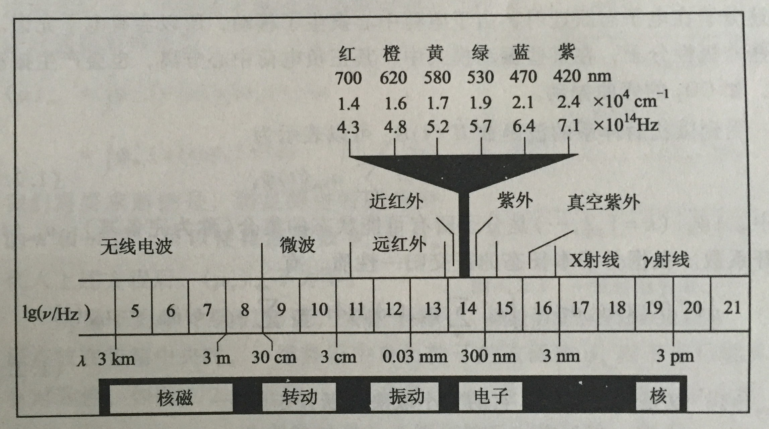
Spectrum Wavelength:
NMR
IR
UV-Vis
Electron

Slide 4
For What:
UV-Vis Spectroscopy: Conjugation or not?
IR Spectroscopy: Functional groups?
NMR Spectroscopy: C or H environments, precise structures
MS Spectroscopy: the Mass of the structure

Slide 5
What should we learn?
Mechanism (What & Why)
Analysis (How)
Instruments & Techniques

Slide 6
课程评分标准：考试 70% + 平时 30%
考试：闭卷+开卷结合，70%
平时：考勤10%+作业10%+小测验10%
考勤：五次以上，无故旷课达课程总学时 1/3 以上者，取消考试资格；
作业：计分，无故不按时完成作业累计数达应交数的 1/3 以上者，取消考试资格；
小测验：计分，期中阶段进行

