Slide 1
Nuclear Magnetic Resonance Spectroscopy
(NMR)
1

Slide 2
What is NMR?
Nuclear Magnetic Resonance is a phenomenon that a nuclei transits between different magnetic energy levels after absorbing certain frequency of irradiation when it locates in the magnetic field.
Molecular structures can be determined via the position, intensity and fine structures of the peak signals on the NMR spectrum.

Slide 3
1. Mechanism of NMR
NMR Phenomenon
Relaxation
Chemical Shift
Spin-Spin Coupling

Slide 4
1) NMR Phenomenon
Nucleus Spin
Table１ Nucleus Spin Quantum Number (I)
Mass | Proton | Neutron | I | Example
Even | Even | Even | ０ | ¹²C, ¹⁶O
Even | Odd | Odd | n/2(n=2,4,…) | ²H,¹⁴N
Odd | Even Odd | Odd Even | n/2(n=1,3,5…) | ¹H,¹³C,¹⁹F,³¹P,¹⁵N
I≠0, NMR Active; I=0, NMR Inactive

Slide 5
Each nucleus has it constant spin quantum numbers，e.g.¹H I=1/2；
I=0，no spin，NMR inactive；I≠0,NMR active。
Ｉ＝1/2：¹H，¹³C，¹⁹F，³¹P
uniformly distribution of charges on the surface of the nucleus，mostly targeted in NMR analysis.
For other nucleus I≠0
uneven distribution of charges on the surface of the nucleus,
complex NMR.

Slide 6
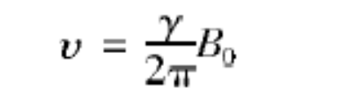
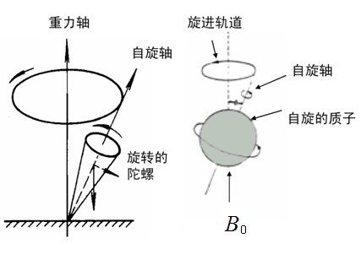
Nucleus Precession
The nucleus rotates around the direction of the external magnetic field subjecting to the action of the magnetic force, and meanwhile keeps spinning. This kind of motion is defined as Nucleus Precession.
The frequency of the precession is

Slide 7
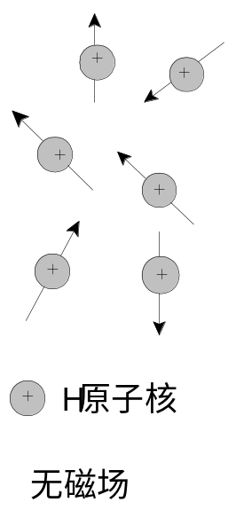
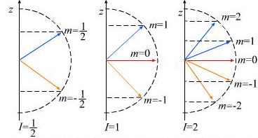
Nucleus Orientation and Energy Level Splitting
The orientation of the nucleus in the space direction is quantized under external magnetic field, which is depend on the magnetic quantum number （m can be one of the 2I+1 discrete values of I,I-1,I-2…-I, ）.
For I=1/2 nucleus (¹H,¹³C)，only 2 orientations.

Slide 8

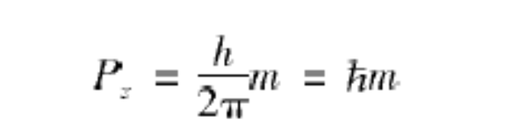
Spin Angular Momentum (P)
P is a vector，whose component on z-axis P_{z} is：
m is magnetic quantum number，which is total 2I+1 discrete values of I,I-1,I-2…-I.

Slide 9


Nucleus Magnetic Moment (μ)
g_{N} – Landes Factor
e – charges of nucleus
m_{p} – mass of the nucleus
µ_{N} – nuclear magneton
μ is also a vector，whose component on the z-axis μ_{z} is：

Slide 10
Nucleus Spin Magnetic Ratio (γ)
γ＝μ／P is a nucleus depend constant，which is related to the nucleus mass, charge and Landes factor.
Larger γ，stronger NMR signal.
¹H γ ＝26.752×10⁷ T⁻¹·S⁻¹
¹³C γ ＝6.728×10⁷ T⁻¹·S⁻¹
（T⎯Tesla）；

Slide 11
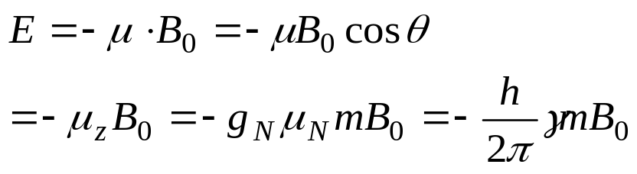
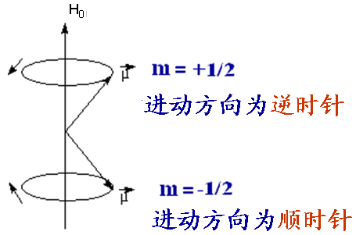
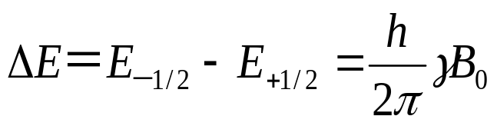
  Energy of Magnetic Nucleus under B₀
I=1/2, m=+1/2
E_{＋1/2} = -g_{N}μ_{N}mB₀ = -1/2g_{N}μ_{N}B₀ = -hγB₀/4π
I=1/2, m=+1/2
E_{-1/2} = g_{N}μ_{N}mB₀ = 1/2g_{N}μ_{N}B₀ = hγB₀/4π
ΔE∝B₀
When B₀ = 0，the two energy levels are degenerated.

Slide 12
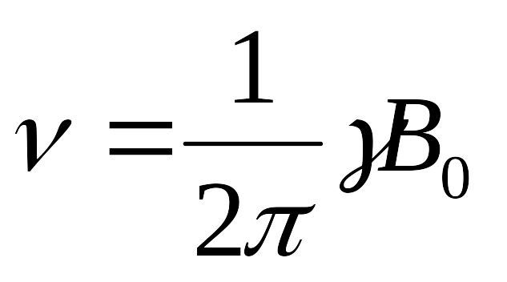
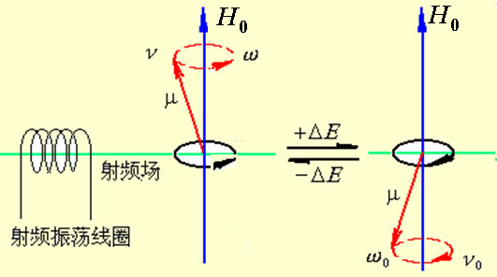
NMR:
Magnetic Nucleus (I≠0)
External Magnetic Field (B₀)
Frequency of Electro-magnetic irradiation

Slide 13
(1) Same Nucleus，same γ，ν ∝ B₀
¹H： B₀ = 1.409 T ， ν = 60 MHz
B₀ = 2.305 T ，ν =100 MHz
(2) Different Nucleus, different γ，same B₀，ν ∝ γ
B₀ = 2.35T, ¹H 100MHz, ¹³C 25 MHz
(3) Two methods：
A. Frequency sweeping methods
B. Field sweeping methods
(4) Commonly used NMR:
¹H NMR
¹³C NMR
¹⁹F NMR
³¹P NMR

Slide 14
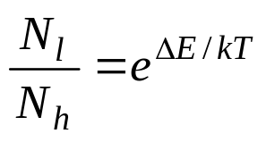
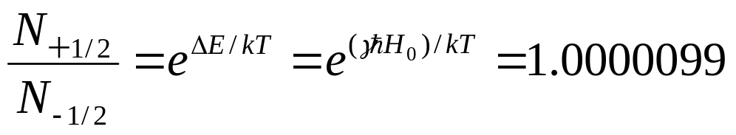
2）Relaxation
The process of returning from the excited state to the Boltzman equilibrium
－ Boltzmann equilibrium: particle numbers on the base level is more than excited level

Slide 15
Spin-lattice relaxation
Energy Transfer between Spin Nucleus and Surrounding Molecules (Solid: lattice; Liquid: solvent)
Shorter relaxation time (T₁), higher relaxation efficiency: favors for NMR
Shorter T₁ for liquid (~s); Longer T₁ for solid (~hr).
That’s why liquid sample for NMR analysis.

Slide 16
Spin-spin relaxation
Energy transfer between spin nuclei.
No contribution to Boltzmann equilibrium
Relaxation time (T₂): Longer T₂ for liquid (~s); Shorter T₂ for solid (~10⁻⁴-10⁻⁵s)
Width of NMR signal is reciprocal to T_{2.}
That’s why liquid sample for NMR analysis.

Slide 17
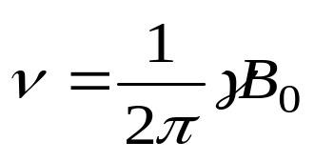
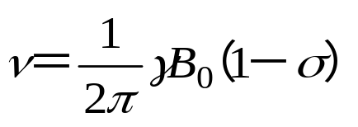
3) Chemical Shift
Exposed Nucleus
B₀
Nucleus with Electron Clouds
σ - Shielding Constant
The density of electron cloud depends on the nucleus environment. Resonance changes due to the variation of nucleus chemical environment is defined as chemical shift.
B₀

Slide 18
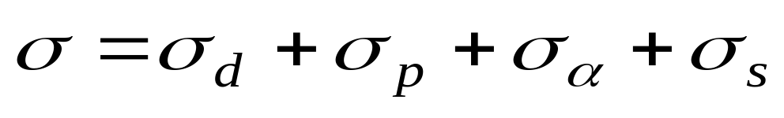
σ_{d} anti-magnetic shielding Shielding from magnetic field produced by s electrons with spherical symmetry, mainly for H.
σ_{p} para-magnetic shielding Shielding from magnetic field produced by other electrons with non-spherical symmetry, mainly for other nucleus.
σ_{a} Shielding from anisotropy from adjacent groups.
σ_{s} Shielding from solvent and other medium.

Slide 19
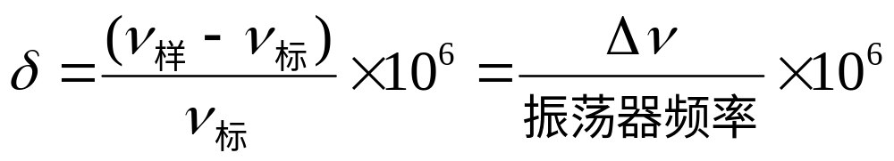
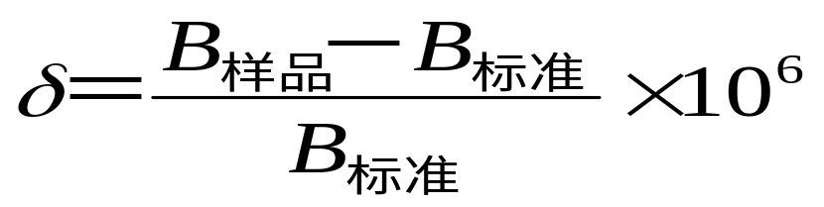
Chemical Shift Constant (δ)
Frequency Sweeping：
Field Sweeping：

Slide 20
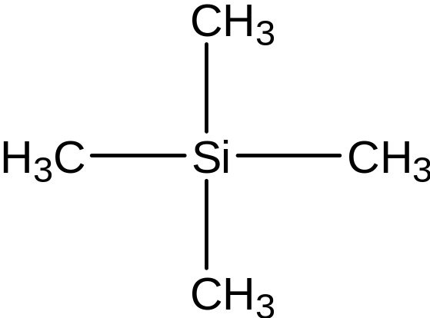
Reference Materials：
Tetra-methyl Silane(TMS)：
Chemically inert
Same chemical environment for all methyls, only 1 peak as δ=0
Lower electronegativity of Si(1.9) than C(2.5) ，much more lower chemical shift constant than common organic compounds
Low boiling point（27℃）

Slide 21
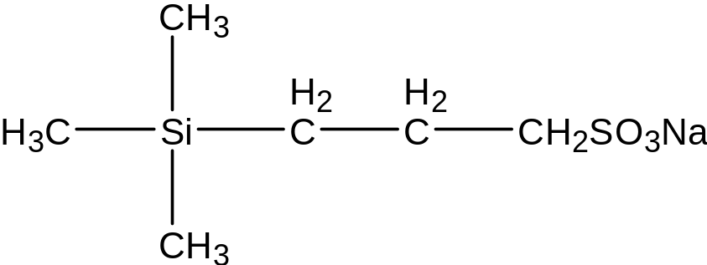
Sodium 2,2-dimethyl-2-pentasilyl-5-sulfonate (DSS)：
For water soluble samples.
Solvent for NMR
Deuterium solvent
CDCl_{3,} CD₃COCD_{3,} CD₃OD, D₂O and etc.

Slide 22
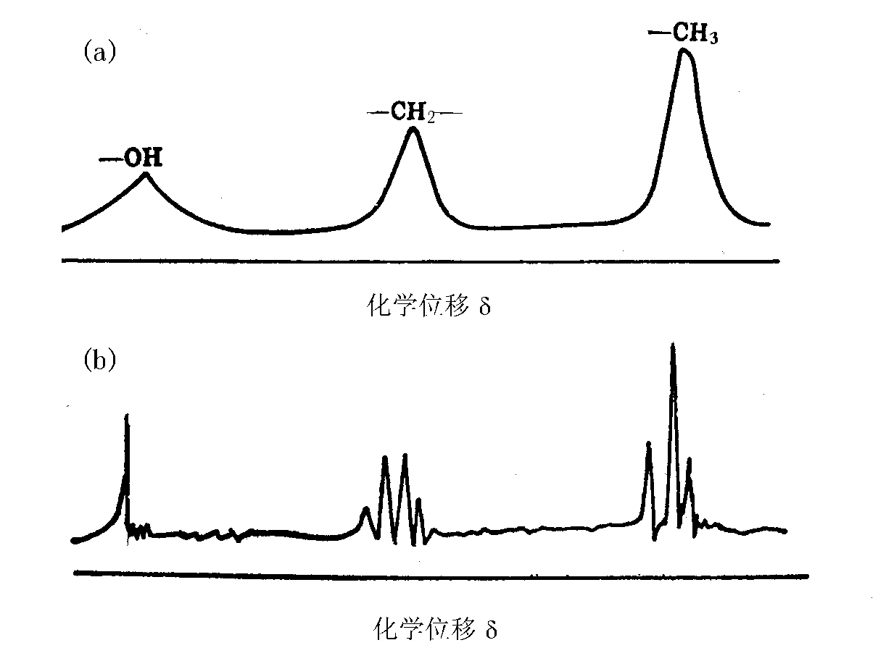
4) Spin-Spin Coupling
NMR of ethanol
Low resolution
High resolution

Slide 23
Interactions between magnetic nuclei is defined as spin-spin coupling
Multiple peaks caused by spin-spin coupling is defined as spin splitting

Slide 24
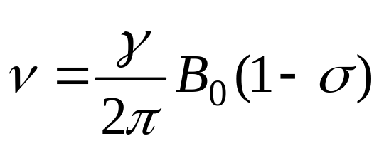
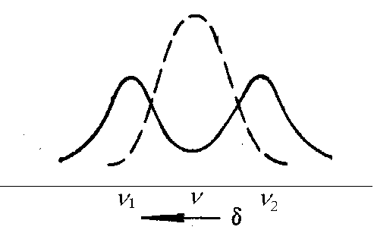
Mechanism of spin-spin coupling
No adjacent nucleus：
If X is adjacent to A (I=1/2)
X orientation:+/-1/2
The magnetic field on A is now:
[ B₀（1－σ）＋ΔB]
[ B₀（1－σ）－ΔB]

Slide 25
Two adjacent magnetic nuclei X₁ and X₂
X₁
X₂
+2ΔB 0 0 －2ΔB
Magnetic field for A：
[ B₀（1－σ）＋2ΔB] 1
B₀（1－σ） 2
[ B₀（1－σ）－2ΔB] 1
Triplet peak with intensity ratio 1：2：1

Slide 26
Coupling constant (J)
  Interference degree between coupled magnetic nuclei，Hz as the unit.
  Depend on the chemical bonds between each nucleus and stereo-chemistry
  Defined as ¹J_{C－H}、 ³J_{H－H}

Slide 27
二、核磁共振谱仪简介
用于有机物结构分析的必须是高分辨率仪器
核磁共振仪的分类：
  按外磁场强度不同而所需的照射频率分为： 60MHz、100 MHz、200 MHz、300 MHz、400 MHz 、500 MHz、600 MHz、800 MHz等型号，核磁共振仪的型号通常用H的共振频率来表示;
  按磁场的来源：分为永久磁铁、电磁铁和超导磁体；
  根据射频的照射方式：分为连续波核磁共振谱仪（CW－NMR）和脉冲傅里叶变换核磁共振谱仪（PFT－NMR）。

Slide 28
连续波核磁共振谱仪
磁体：提供强的稳定均匀的磁场
射频振荡器：产生一个与外磁场强度相匹配的射频频率，提供能量使磁核从低能级到高能级。
射频接受器 ：用于接受携带样品核磁共振信号的射频输出,并将接收到的信号传送到放大器放大。
探头:有样品管座、发射线圈、接受线圈、变温元件等。
扫描单元：安装在磁极上的扫描线圈，提供一个附加可变磁场，用于扫描测定。

Slide 29
脉冲傅里叶变换核磁共振谱仪PFT-NMR
在外磁场保持不变的条件下，使用一个强而短的射频脉冲照射样品。这个射频脉冲包括所有不同环境的同类磁核的共振频率。各种核同时激发，发生共振，然后通过弛豫逐步恢复Boltzmann平衡。在这个过程中,射频接受器接受信号，得到随时间衰减的信号，称自由感应衰减信号（FID)，通过计算机进行傅里叶变换转化为通常的NMR谱图。

Slide 30
FT-NMR谱仪特点：
扫描速度快，测定一张谱图只需要几秒-几十秒的时间。
不仅改善¹H等天然丰度高的核种的谱图质量，而且使天然丰度小、绝对灵敏度低的同位素核的核磁共振测定得以实现。

