Slide 1
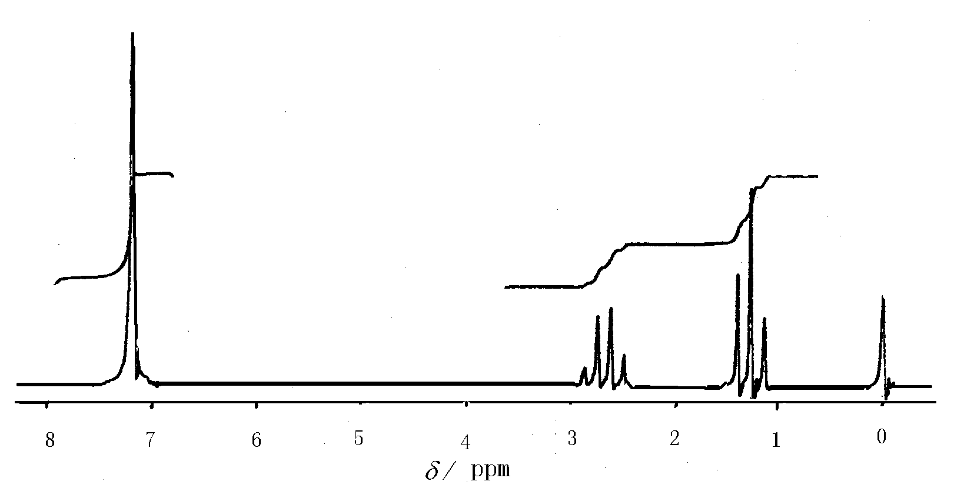
2 NMR Spectrum
Low field
High field
Peak position: Chemical Shift (δ)
Peak shape: peak splitting from spin-coupling
Peak area: Integral curve height ∝ the number of protons

Slide 2
2.1 Chemical shift of ¹H
1．Factors that affects chemical shift
2. Chemical shifts of different ¹H

Slide 3
Carboxylic acid
aromatics
XCHn CCHn
14 13 12 11 10 9 8 7 6 5 4 3 2 1 0
aldehyde
alkene
alkyne

Slide 4
1．Factors that affect the chemical shift
(1) Induction effect
Chemical shift is generated from the anti-magnetic shield effect of the electron cloud.
Electronegativity of adjacent atoms
CH₃X CH₃F CH₃OCH₃ CH₃Cl CH₃Br
δ 4.26 3.24 3.05 2.68
4.0 3.5 3.1 2.8
CH₃X CH₃CH₃ CH₃H CH₃Li
δ 0.88 0.2 －1.95
2.5 2.1 0.98

Slide 5
Numbers of adjacent electronegative atoms
  CH₃Cl CH₂Cl₂ CHCl₃
  δ 3.05 5.30 7.27
Numbers of chemical bonds from electronegative atoms
CH₃OH CH₃CH₂OH CH₃CH₂CH₂OH
δ_{CH3} 3.39 1.18 0.93

Slide 6
(2) Hybridized state of adjacent C
C
H
S content ↑
sp³
sp²
sp
p
hybridize
s
+
ethane 0.88；ethene 5.23；ethyne 2.88

Slide 7
(3) Anisotropy
For non-spherical symmetric electron clouds, e,g,
π electron，will induce an additional magnetic field that performs anisotropy:
If the induced magnetic field is in the opposite direction with the external magnetic field, the external magnetic field with be weakened, which is defined as anti-magnetic shielding effect (+). High Field
If the induced magnetic field is in the same direction with the external magnetic field, the external magnetic field with be enhanced, which is defined as para-magnetic shielding effect (-). Low Field

Slide 8
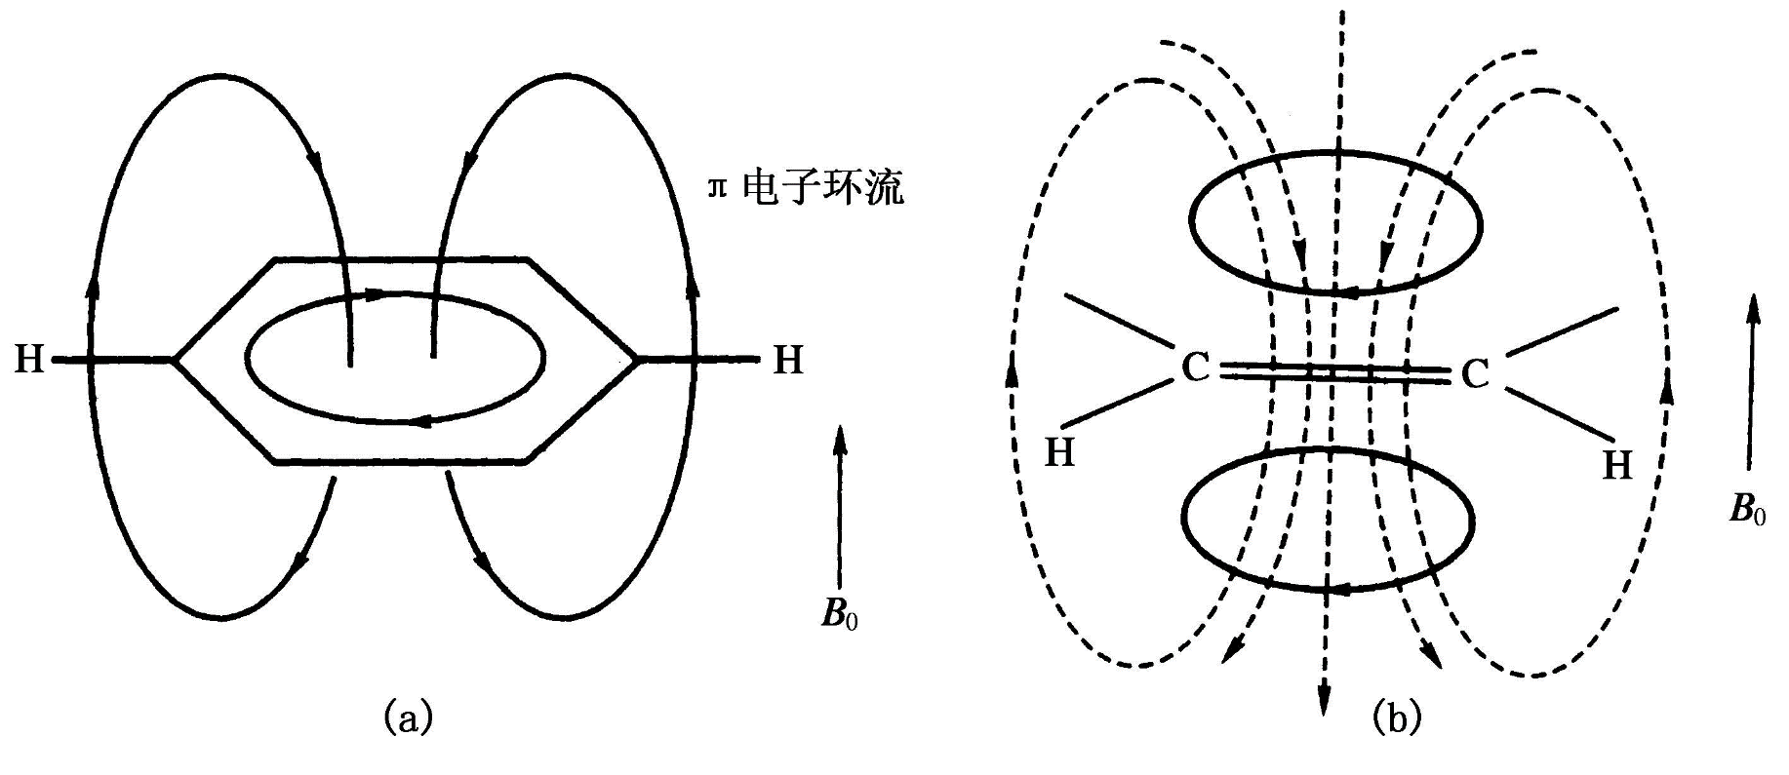
Anisotropy of Aromatics
＋
－
－
＋
δ＝7.27

Slide 9
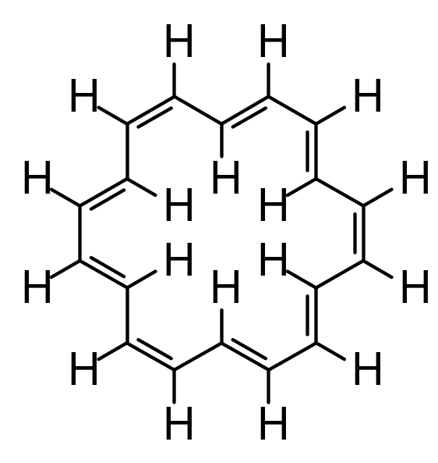
[18]Annulene
12 exo-cyclic H, para-magnetic shielding effect δ_{环外氢} ≈ 8.9
6 endo-cyclic H, anti-magnetic shielding effect δ_{环内氢} ≈ -1.8

Slide 10
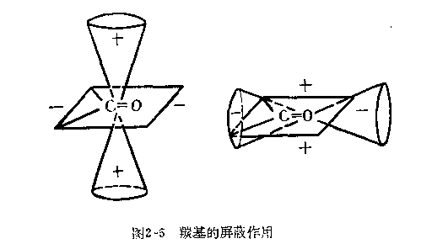

Anisotropy of Carbonyls
H of aldehyde is in the para-magnetic shielding area together with the induction effect, thus δ = 9-10

Slide 11
Anisotropy of C-C double bonds
＋
－
－
＋
δ＝5.23

Slide 12
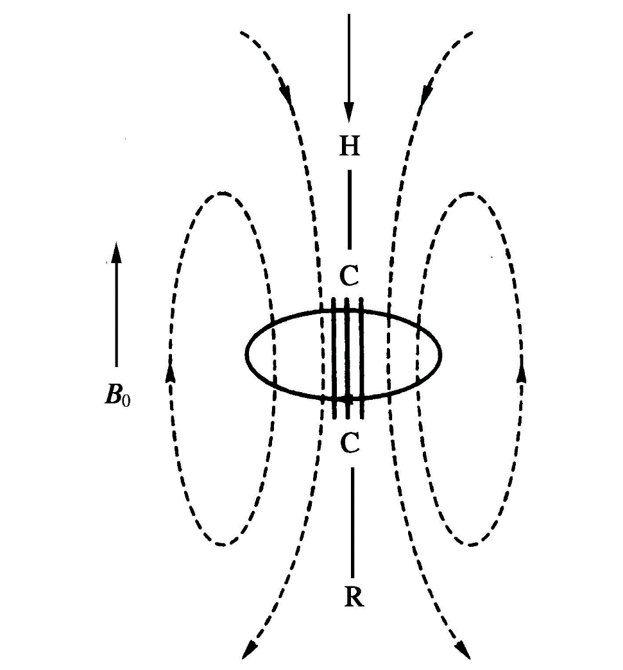
Anisotropy of C-C triple bond
＋
anti-magnetic shielding + sp hybridization lead to δ = 2-3 for H on the alkynes.
－
－
＋

Slide 13
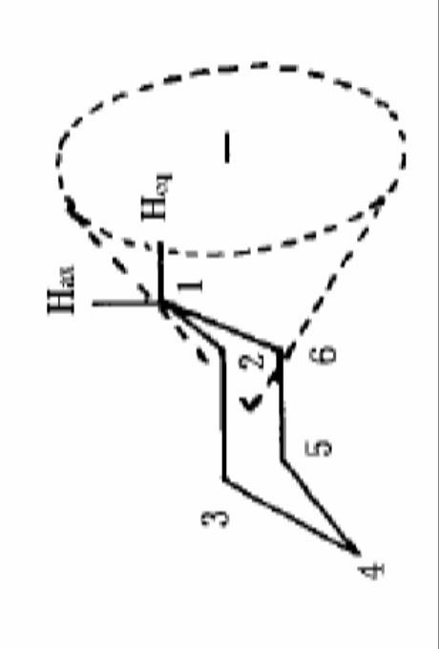
Anisotropy of C-C single bond
Upright H（Hax）is in the anti-magnetic shielding area，high δ
Equatorial H（Heq）is in the para-magnetic shielding area，low δ
Notes:
直立氢（Hax）处于屏蔽区，在较高场共振，平伏氢（Heq）处于去屏蔽区，在较低场共振。
若考虑 C₁上的平伏氢（Heq）和直立氢（Hax），C₁—C₆键与 C₁—C₂键均分别对它们产生屏蔽和去屏蔽作用，两种作用相互抵销。而 C₂—C₃键和 C₅—C₆键的作用使直立氢（Hax）处于屏蔽区，在较高场共振，而平伏氢（ Heq）处于去屏蔽区，在较低场共振。两者的化学位移差很小，约 0.5。

Slide 14
(4) Van der Waal Effect
The electron clouds will repel each other when two protons are very close. Magnetic shielding effect would be weakened due to the reduction of electron cloud density, causing δ to shift to the low field.
Notes:
H_{b}和H_{c}比较，H_{a}(1)和H_{a}(2)比较

Slide 15
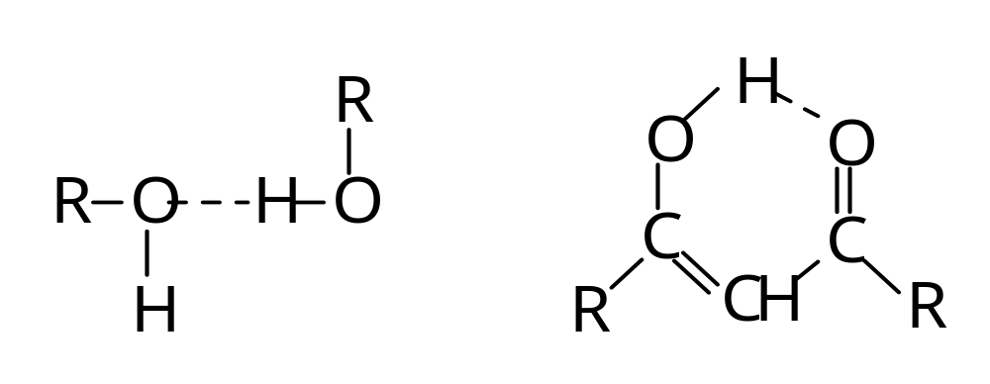
(5) Hydrogen Bonding
δ moves to the low field
δ is not constant，δ is between 0.5～5 for alcohol OH，4～7 for phenol OH.
Notes:
β-二酮的烯醇式

Slide 16
Hydrogen bonding is an exothermic process; High temperature, low hydrogen bonding, δ shifts to the high field；
In non-polar solvent, lower concentration, lower hydrogen bonding, δ shifts to the high field；
Change temperature/concentration to determine the position for OH and NH；
Intramolecular hydrogen bonding, δ always in the low field.

Slide 17
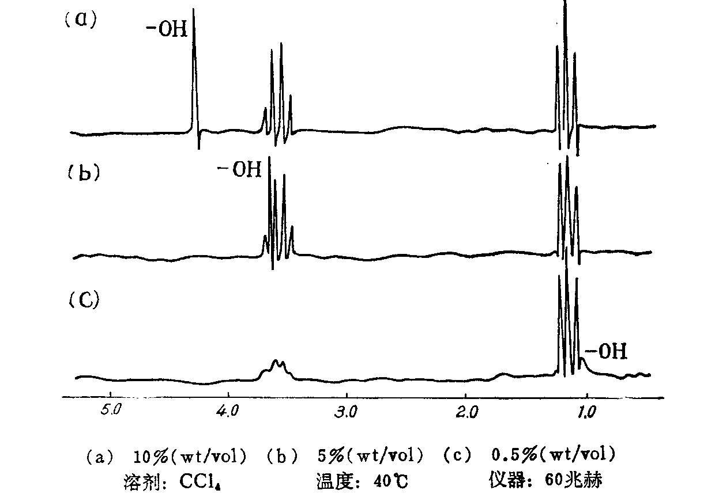
Ethanol

Slide 18
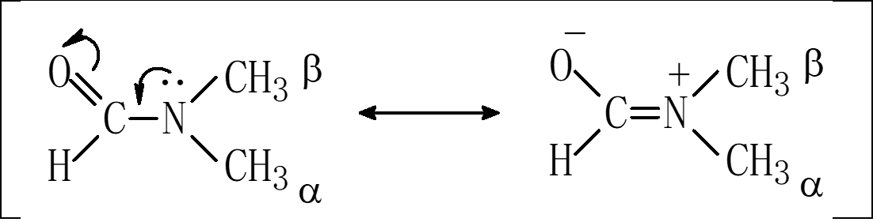
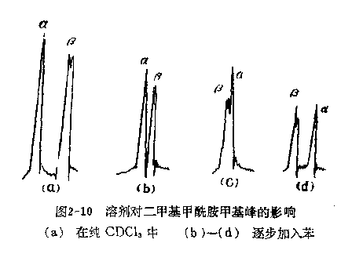
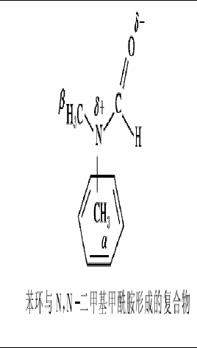
(6) Solvent Effect
Notes:
由于p-π共轭，C-N单键具有双键性而不能自由旋转，2个甲基处于不同的化学环境。

Slide 20
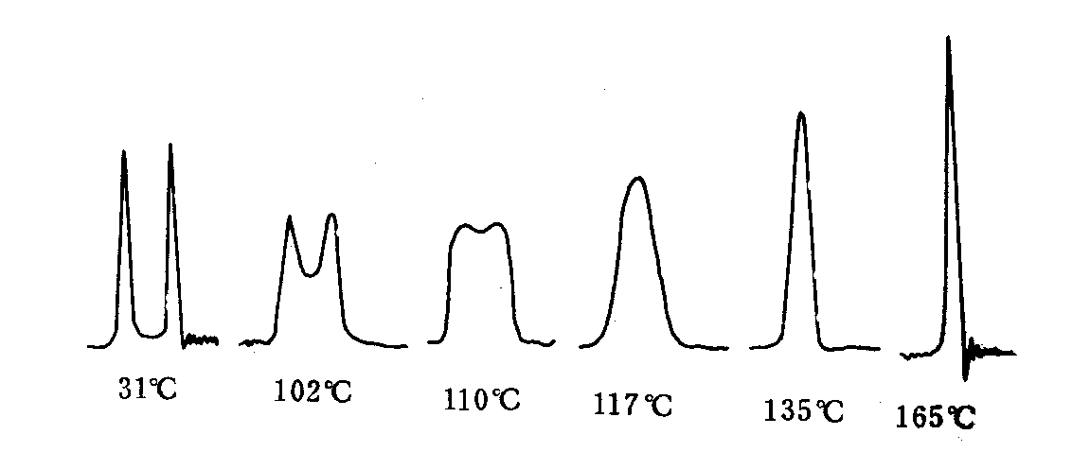
(7) Exchange reaction
N,N-dimethyl formamide

Slide 21
Intermolecular exchange
RCOOH_{(a)}＋HOH_{(b)} ↔ RCOOH_{(b)}＋HOH_{(a)}
Only one average H signal can be detected on the NMR spectrum, the position of which is depend on the molar ratio of carboxylic acid and water.
δ_{obs}＝N_{a}⋅δ_{a}＋N_{b}⋅δ_{b}
Notes:
活泼氢是指与氧、氮及硫原子直接相连的氢。

Slide 22
2.2 ¹H Chemical Shift for different compounds
Carboxylic acid
aromatics
XCHn CCHn
14 13 12 11 10 9 8 7 6 5 4 3 2 1 0
aldehyde
alkene
alkyne

Slide 23
Alkanes
Methyl, Methylene, Methylidyne
Shoolery equation：
δ = 0.23 + ∑σ

Slide 24
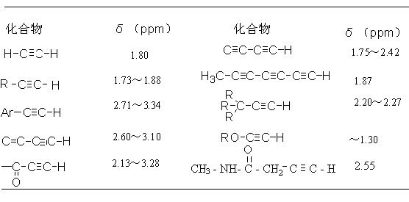
Alkene/Alkyne
Alkynes
δ = 1.6 - 3.4

Slide 25
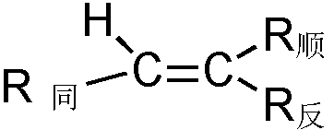
Alkene
Tobey-Simon equation：
δ = 5.25 + Z_{same} + Z_{trans} + Z_{cis}

Slide 26
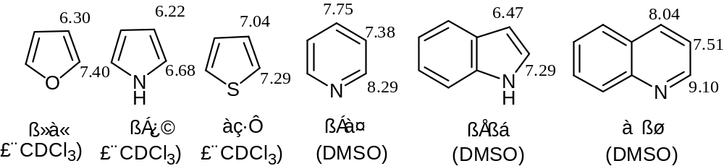
Aromatics
δ = 7.27 -∑Z_{i}
Notes:
一般供电子基团使邻对位质子共振移向高场，吸电子基团使邻对位质子共振移向低场。

Slide 27
Active Hydrogen
-OH, -NH, -COOH, -SH
Form hydrogen bonding/exchange reaction. Influenced by temperature, concentration and solvent.
Discriminated by D₂O exchange

Slide 28
δ of Activate Hydrogens
Compound | δ | Compound | δ
Alcohol | 0.5-5.5 | Aromatic thiol | 3-4
Phenol (intramolecular hydrogen bond) | 10.5-16 | Sulfonic acid | 11-12
Phenol | 4-8 | Amine | 0.4-3.5
Ene-ol(intramolecular hydrogen bond） | 15-19 | Aromatic amine | 2.9-4.8
Carboxylic acid | 10-13 | Primary amide | 5-6.5
Oxime | 7.4-10.2 | Secondary amide | 6-8.2
Thiol | 0.9-2.5 | Aromatic amide | 7.8-9.4

Slide 29
3. General rules for coupling and first-order spectrum
3.1 Nucleus equivalence
Chemical equivalence (different peaks)
Magnetic equivalence (different splittings)

Slide 30
Chemical equivalence
Two atoms or groups are chemically equivalent if two atoms or radicals are exchanged by rapid rotation or symmetry.

Slide 31
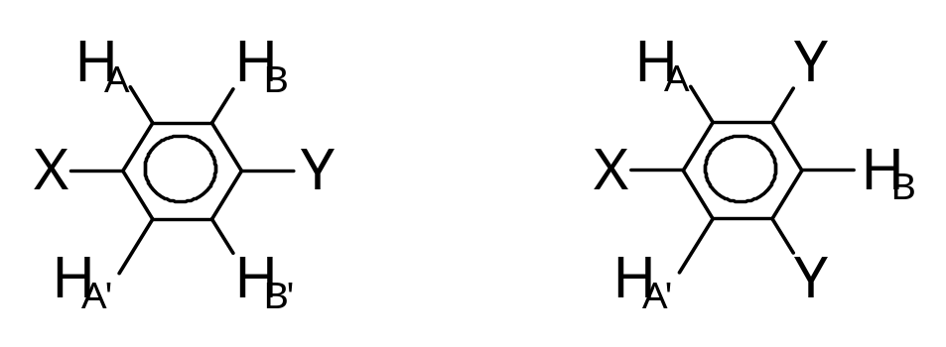
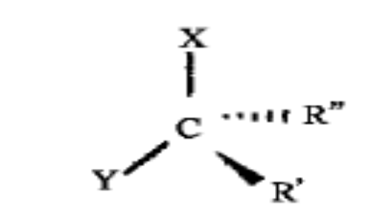
Symmetry exchange
Symmetry axis exchange
Symmetry plane exchange

Slide 32
General rules:
  Methyl H or same groups on saturated C are chemically equivalent；
  H of the fixed CH₂ on the ring are chemically inequivalent；
  H of CH₂ attached to the chiral C are chemically inequivalent；
  H/same groups on the same atom whose single bond cannot rotate freely are chemically inequivalent.

Slide 33
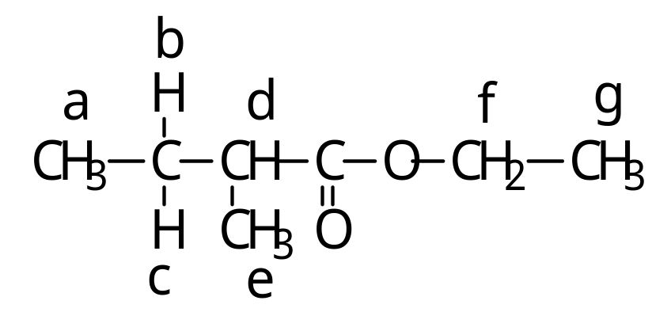
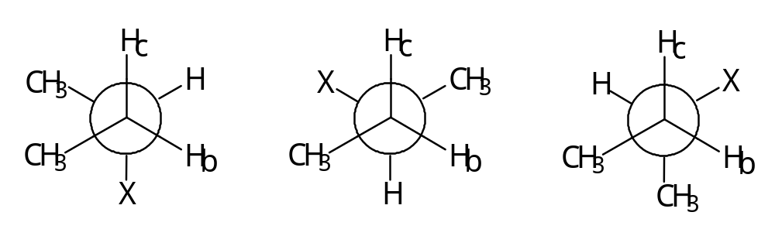
CH₂ attached to the chiral C

Slide 34
One NMR signal for chemically equivalent atoms.
Different NMR signal numbers are corresponding to different chemically inequivalent atoms, respectively.
e.g. 1：CH₃-O-CH₃ 1 signal
e.g. 2：CH₃-CH₂-Br 2 signals
e.g. 3：(CH₃)₂CHCH(CH₃)₂ 2 signals
e.g. 4：CH₃-CH₂COO-CH₃ 3 signals

Slide 35
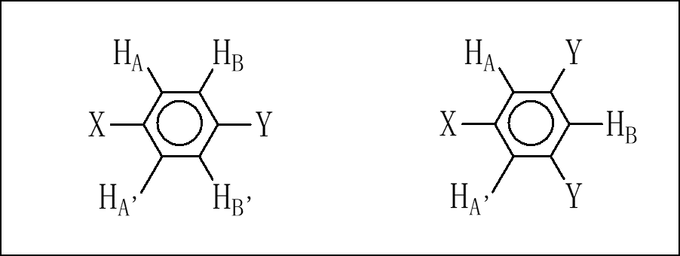
Magnetic equivalence
Same chemical shift; same coupling splitting and constant.
1,1-difluoroethene
1-chloroethane

Slide 36
3.2 General rules for coupling
Coupling with n magnetic equivalent nuclei, splitting to 2nI＋1 peaks，for ¹H,¹³C (I＝1/2)，then n＋1 peaks，“n＋1 rule”。
Coupling with n magnetic equivalent nuclei and another m magnetic equivalent nuclei，splitting to (n+1)(m+1) peaks.
Notes:
自旋核的核磁矩可以通过成键电子影响邻近磁核是引起自旋－自旋偶合的根本原因。磁性核在磁场中有不同的取向，产生不同的局部磁场，从而加强或减弱外磁场的作用，使其周围的磁核感受到两种或数种不同强度的磁场的作用，故在两个或数个不同的位置上产生共振吸收峰。这种由于自旋-自旋偶合引起谱峰裂分的现象称为自旋-自旋裂分（Spin-Spin Splitting）。

Slide 37
Intensity of the multiple coupling peaks can be presented as the coefficient of (a+b)^{n} expansion, n is the number of magnetic equivalent nucleus；
The center of the splitting peaks is the chemical shift δ. The splitting between the peaks is defined as splitting constant J (Hz) ；
There is coupling between magnetic equivalent nuclei, yet no splitting.

Slide 38
3.3 First-order spectrum
Spectrum complied to the above rules is defined as first-order spectrum.
Δν /J >6, Δν is the difference of coupling constant of two coupling nuclei.
Δν /J <6, not first-order spectrum which is not complied to the rules.
Notes:
在测量耦合常数时应注意J 是以频率（ Hz）为单位，而核磁共振谱图的横坐标是化学位移值，直接从谱图上量得的裂分峰间距（Δδ）必须乘以仪器的频率才能转化为Hz。

Slide 39
3.4 Factors that affect the coupling constant
Same carbon coupling（²J_{H-C-H}或 ²J ）
Adjacent carbon coupling（³J_{H-C-C-H}或 ³J ）
Distant coupling

Slide 40
(1) Same carbon coupling（ ²J ）
²J is a minus number, e.g.：
  Hexane（sp³） ²J ＝－12.6 Hz
  End-ene (＝CH₂)（sp²） ²J = -0.5～-3 Hz
Notes:
sp³杂化体系由于单键能自由旋转，同碳质子大多是磁等价的，无裂分现象。

Slide 41
(2) Adjacent carbon coupling（³J）
sp³杂化体系
  Free rotating single bond，³J ≈ 7 Hz。
  Fixed conformation， ³J＝J₀cos²θ ＋C （0°<θ<90°）
  ³J＝J₁₈₀cos²θ ＋C （90°<θ<180°）
  J₀: θ ＝0°，J₁₈₀: θ ＝180°

Slide 42
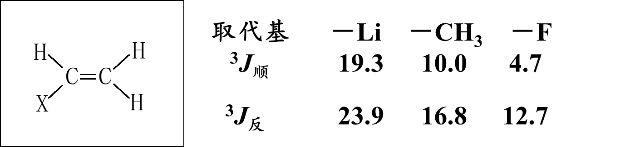
Alkene ³J: trans θ ＝0°；cis θ ＝180°; ³J_{trans} > ³J_{cis}
More electronegativity, lower J.

Slide 43
(3) Distant coupling
Coupling between nuclei over 3 chemical bonds
In π conjugated systems, e.g. alkenes, alkynes, aromatics etc., long distant coupling is commonly observed.
Notes:
质子之间的偶合若通过4根或4根以上键时，通称为“远程偶合”。一般通过π-键或张力环传递。

Slide 44
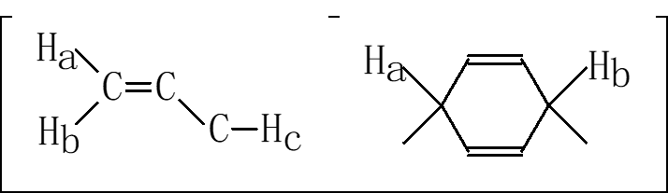
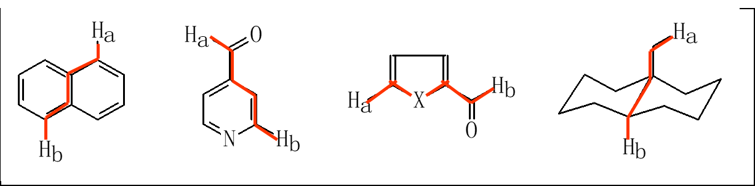
Aromatics
J_{ortho}：6～10Hz；J_{meta}：1～3Hz；J_{para}：0～1Hz

Slide 45
Coupling between H and other elements
Coupling between ¹⁹F、³¹P and ¹H are more common and important (¹⁹F、³¹P, I = ½)，and are complied to n +1 rule.

Slide 46
¹⁹F -¹H coupling
Coupling between ¹⁹F and ¹H can be observed from 2-5 chemical bonds
In saturated chain alkanes: ²J_{F-H} = 45-80 Hz，³J_{F-H} = 0-30 Hz，⁴J_{F-H} = 0-4 Hz；
In alkenes: ²J_{F-H} = 70-90 Hz， ³J_{F-H}（trans）= 10-50 Hz， ³J_{F-H}（cis）= –3-20 Hz；
In aromatics: ³J_{F-H}（ortho）= 6-9 Hz， ⁴J_{F-H}（meta）= 4-8 Hz， ⁵J_{F-H} （para）= 0-3 Hz。

Slide 47
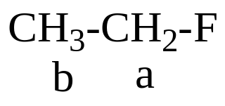
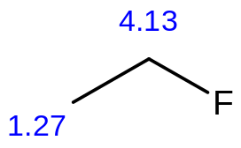
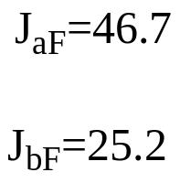



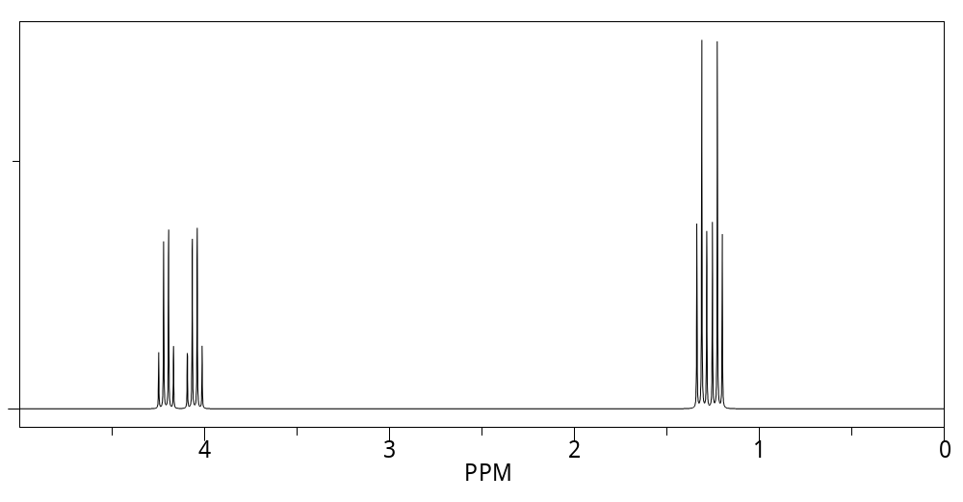

Slide 48
³¹P -¹H coupling
¹J_{P-H} = 180-200 Hz；
Weaker than the H-F coupling

