Slide 1
Ions in MS
Molecular Ion
Fragment Ion
Isotope Ion
Multi-charge Ion
Negative Ion
Rearranged Ion
Metastable Ion

Slide 2
Molecule Ion（M ^{+ ·}）
  Ion formed after molecule loses one valence electron; Odd electron Ion
  m/z equals molecular weight
  note: not all molecules show molecule ions M ^{+ ·}

Slide 3
Fragment Ion
  Ions produced after fragmentation
  Providing rich structural information
  Fragmentation mechanisms

Slide 4
Isotope Ion
  Formed by stable natural isotopes
  Molecular and Fragment ions are defined as those with the maximum abundance isotope elements; others are defined as Isotope ions
  Usually, isotopes with the maximum abundance are of least molecular weight; thus, isotope ion peaks always show at higher weight side in the spectrum
  The type of the element can be derived by measuring the relative intensity ratio between molecular ion and isotope ions

Slide 5
Multi-charge Ion
  Molecule loses more than 2 valence electrons，Z≥2；
  Only stable structures
  e.g. benzene m/z39 (z=2)
Notes:
电喷雾离子源（ESI）容易形成多电荷离子。

Slide 6
Negative Ion
  Formed after capturing an electron
  The abundance of negative ion is 10⁻⁴ of positive ion in EI
  Mostly used in CI

Slide 7
Metastable Ion
  Ions formed via fragmentation between motion from ion source to analyser
  Important method to study fragmentation mechanism

Slide 8
Rearranged Ion
  Ions formed via rearrangement during fragmentation
  Rearrangement Mechanisms
  Important for structural analysis in MS

Slide 9
Determination of Molecular Ion & Molecular Weight
Criteria for Molecular Ion Peaks
  Singly Charged Ion
  Nitrogen Rules
  Reasonable Neutral Loss
Notes:
T

Slide 10
Singly Charged Ion
Unsaturation Degree: f ＝ 1＋n₄＋1/2（n₃－n₁）
The calculated result is an integer
Notes:
－n₁ n₃ n₄分别为分子中一价、三价和四价原子的数目。

Slide 11
Nitrogen Rule
Molecules contain odd number of N, the molecular weight should be an odd number.
Molecules contain even number of N, the molecular weight should be an even number.
Notes:
常见元素的最丰同位素其质量和化合价间有一个巧合，除氮外，或者均为偶数，或均为奇数。

Slide 12
Reasonable Neutral Loss
The mass difference between the molecular ion and the nearest fragment ion should not be in the reasonable region: (4~14), (21~25)
Notes:
没有一个合理元素组成的基团符合上述质量数，并能从分子离子中丢失。

Slide 13
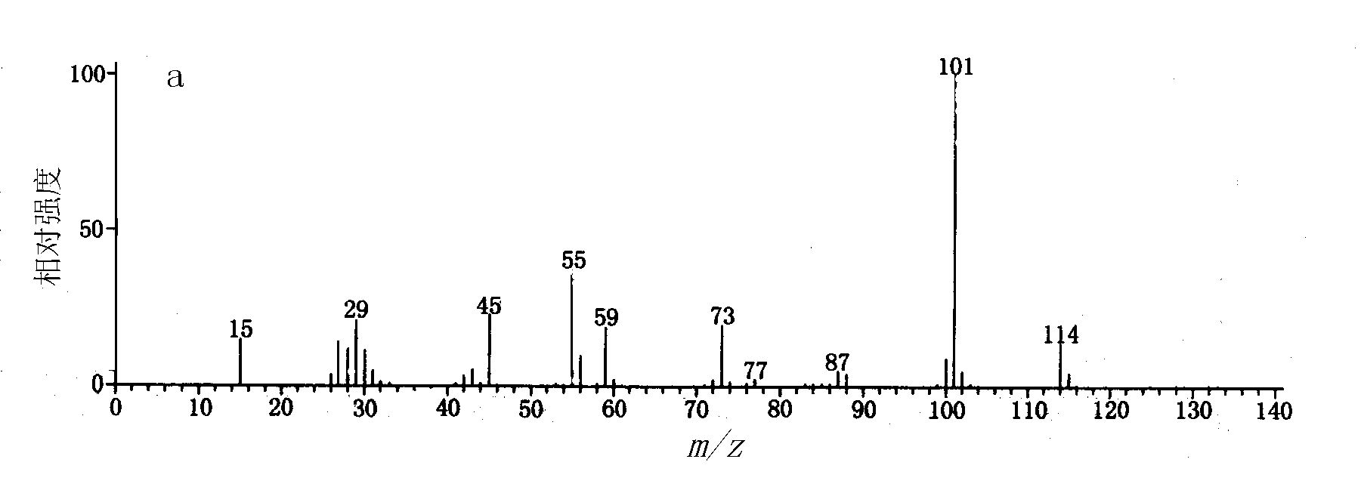
e.g. unknown compound without N
m/z 114 is not molecular ion peak
Notes:
114与最靠近的101的差值为13，不合理，故非分子离子峰。

Slide 14
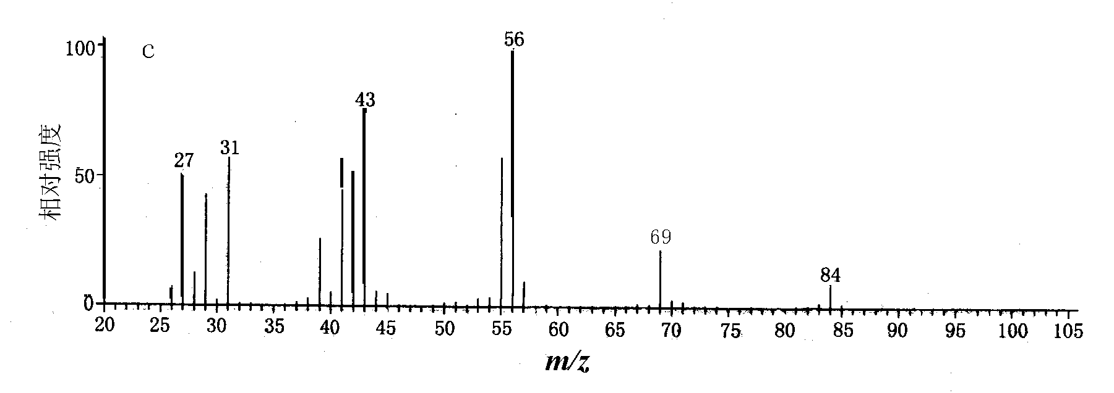
How about this?

Slide 15
Determination of molecular formula
Abundance ratio between molecular ion and isotope ions
Precise molecular weight by high-resolution MS

Slide 16
Isotope abundance ratio
Isotope abundance of elements commonly contained in organic compounds
Abundance / %
Abundance / %
Abundance / %
Element
Element
Element
¹H
100
²H
0.015
¹²C
100
¹³C
1.1
¹⁴N
100
¹⁵N
0.36
¹⁶O
100
¹⁷O
0.04
¹⁸O
0.2
²⁸Si
100
²⁹Si
5.1
³⁰Si
3.4
³²S
100
³³S
0.8
³⁴S
4.4
³⁵Cl
100
³⁷Cl
32.5
⁷⁹Br
100
⁸¹Br
98
¹⁹F
100
³¹P
100
¹²⁷I
100

Slide 17
  A type: F、P、I；
  A＋1 type: C、N、H；
  A＋2 type: Cl、Br、S、Si;

Slide 18
Cl、Br
For Cl, ³⁵Cl : ³⁷Cl ≈ 3 : 1
For Br, ⁷⁹Br : ⁸¹Br ≈ 1:1
1 Cl：
CH₃³⁵Cl CH₃³⁷Cl
(m/z50) (m/z52)
3 : 1
50(3)
52(1)

Slide 19
2 Cl
1#Cl 35（3） 37（1） 35（3） 37（1）
2#Cl 35（3） 35（3） 37（1） 37（1）
MW 84 86 86 88
CH₂Cl₂ (3×3) (1×3) + (3×1) (1×1)
84(9)
86(6)
88(1)

Slide 20
Cl, Br
For molecule containing several Cl or Br, the abundance ratio can be calculated as the expansion of (a+b)^{n}
a，b – abundance of isotope A and A+2
n – number of Cl or Br
For Cl，a=3，b=1
For Br, a=1，b=1
e.g. for a molecule containing two Cl：
(a+b)^{n}= (3+1)²=3²+2x3+1, so as to be 9：6：1

Slide 21
Cl | ratio | Br | ratio
1 | 3:1 | 1 | 1:1
2 | 9:6:1 | 2 | 1:2:1
3 | 27:27:9:1 | 3 | 1:3:3:1
Molecule containing both Cl and Br: (a+b)^{n}(c+d)^{m}
a、b – isotope abundance of Cl (a=3, b=1)
c、d – isotope abundance of Br (c=1, d=1)
n – number of Cl; m – number of Br

Slide 22
S, Si
³⁴S(4.4%)， ³⁰Si(3.4%)。
M+2 peak
M+2:M abundance ratio << 1：3

Slide 23
S, Si
For molecules containing multiple S, Si, the abundance ratio can be calculated via expansion of (a+b)^{n}
1 S，[M]：[M+2]=100：4.4
2 S，[M]：[M+2]：[M+4] =（100+4.4）² = 100：8.8：0.19， [M+4]: [M]=0.19%，which can be omitted

Slide 24
C
¹³C : ¹²C = 1.1%
C atom number up-limit =（[M+1]×100% /[M])÷1.1%
(round numbers）

Slide 25
1. m/z Intensity（ %）
132( M^{+·} ) 100
133 9.9
134 0.7
Notes:
P19 需同时考虑价键理论及氮规则

Slide 26
M+2/M=0.7:100, A+2 elements such as Cl、Br、S、Si are excluded.
C atom number up-limit：M+1/M÷1.1%=9
The possible formula:
a.C₉H₂₄, b.C₉H₁₀N, c.C₉H₈O

Slide 27
2. m/z Intensity（ %）
140（M+·） 100
141 10
142 4.8
143 0.4

Slide 28
M+2/M=1.2/25=4.8/100, possibly 1 S 。
C atom number up-limit：(M+1/M -0.8%)÷1.1%≈8,
Possible formula：C₈H₁₂S, C₇H₂₄S, C₇H₈OS , C₇H₁₀NS

Slide 29
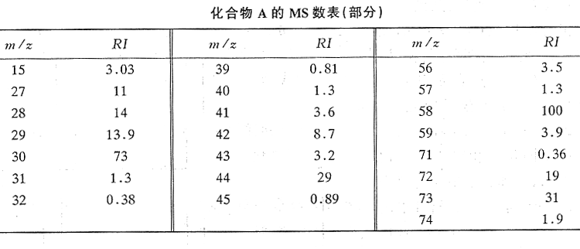
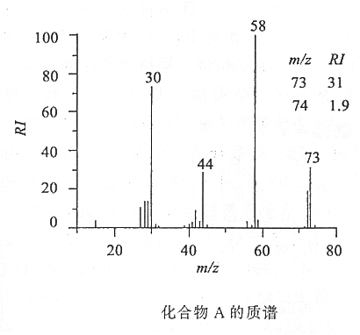
3：Please infer the molecular formula of compound A according to its MS data

Slide 30
1) If m/z 73 is M^{+.}，the adjacent fragment ion is 58，Δ=15 is reasonable. Therefore, 73 is the molecular ion peak, 74 is the M+1 peak. Since M^{+.} is an odd number, N is included in the formula.
2) C atom number up-limit ≌ 5
3) The possible formula might be C₄H₁₁N

Slide 31
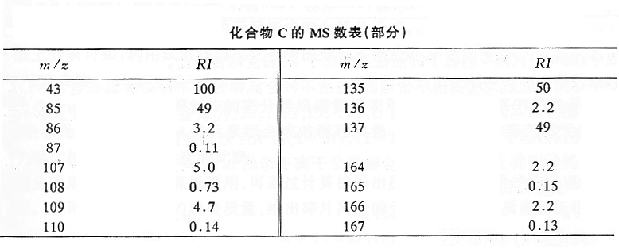
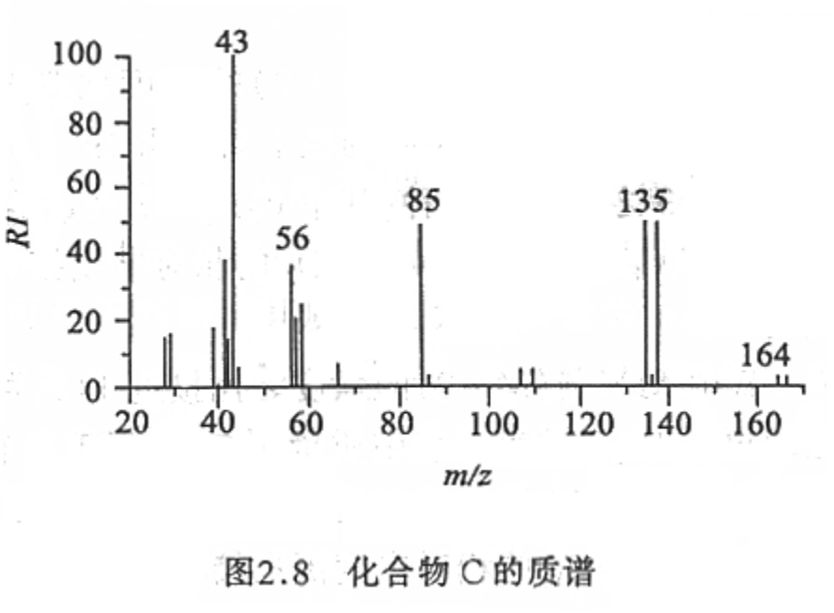
4. Please infer the molecular formula of compound C according to its MS data

Slide 32
1) m/z 164 & 166，135 & 137 are 1：1, 1 Br
2) C atom number up-limit：(M+1/M )÷1.1%≈6
3) Possible formula is C₆H₁₃Br

Slide 33
High-resolution MS: Precise molecular weight
¹²C 12.00000000， ¹H 1.00782506，
¹⁴N 14.00307407， ¹⁶O 15.9949147
Different molecules may have same molecular weight in their integral part, but show differences in decimals.
N₂＝28.00614814 , CO＝27.99491475 , C₂H₄＝28.03130024
For high-resolution MS, molecular weight always show in four places in decimal (0.0001). And the molecular weight should be accurate to 0.001.

Slide 34
Advantages of HR-MS
No interference from impurities
High accuracy
Determine the molecular weight and composition at the same time

