Slide 1
MS Spectra of Organic Compounds

Slide 2
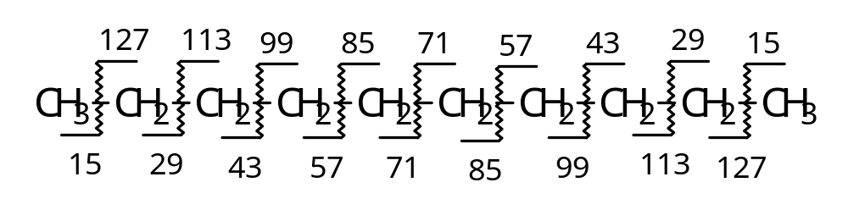
1. Carbon Hydrates (C_{m}H_{n}) a. Alkane
C-C σ- fragmentation, C_{n}H_{2n+1}^{┑+} cations
Most abundance (Base peak): C₃H₇＋（m/z 43）and C₄H₉＋（m/z 57）
Branched C-C favors cleavage and lose the most weighted alkyl, forming stable secondary/tertiary carbon cations
Weak molecular Ion peak

Slide 3
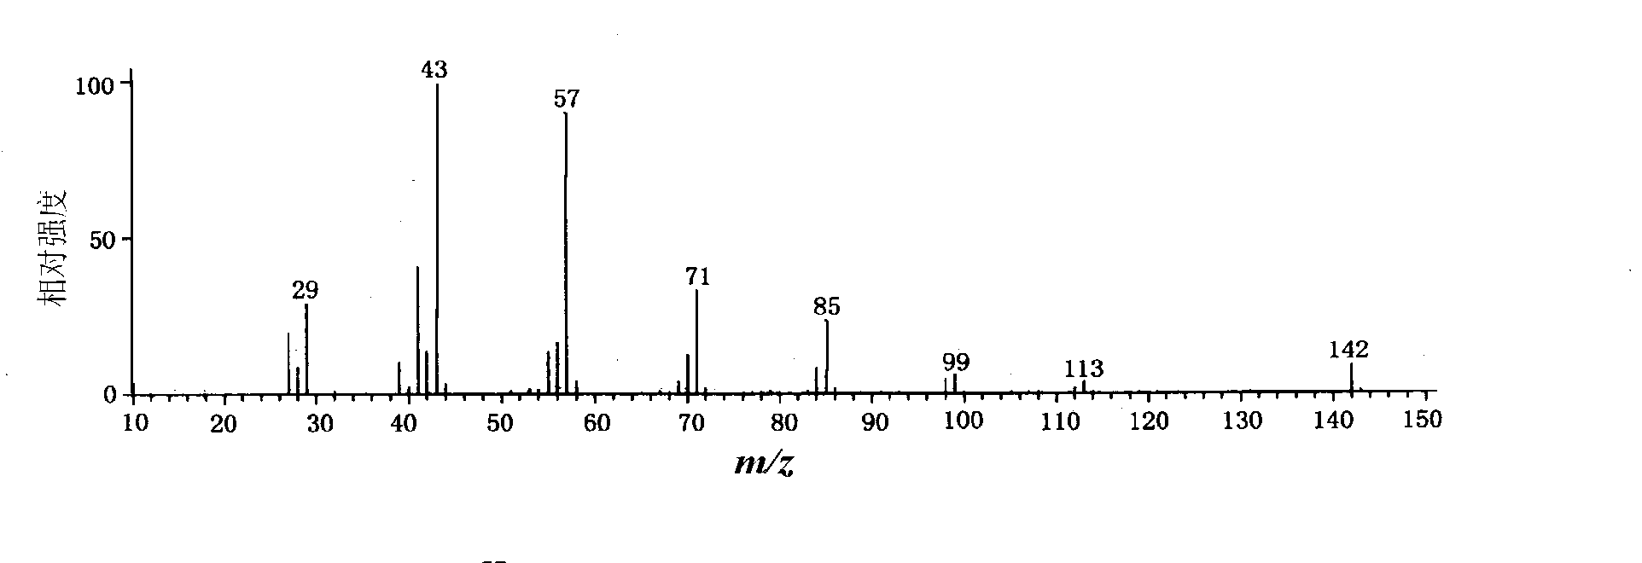
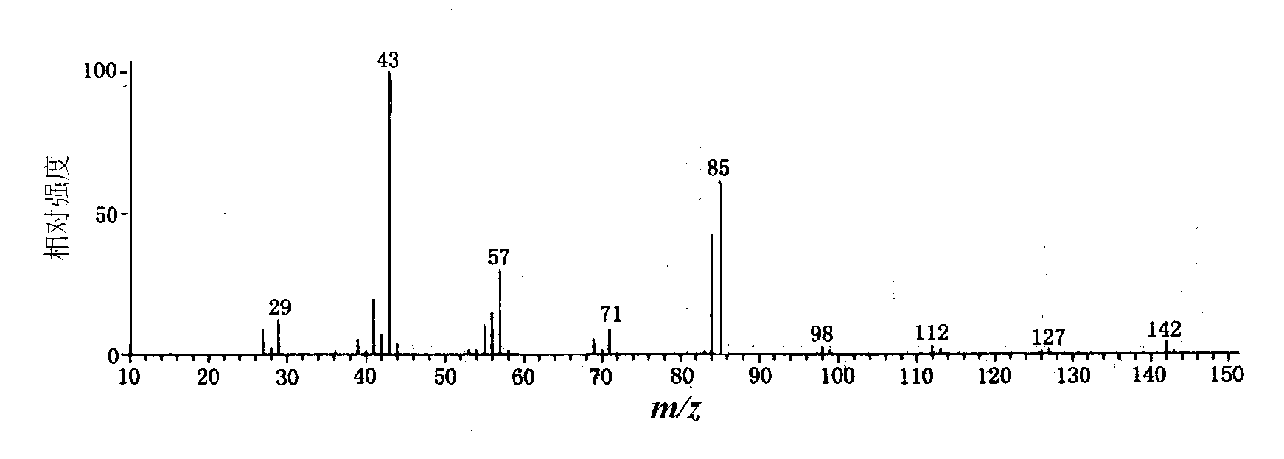
（a）
（b）
n-decane(a) vs 5-methylnonane(b)

Slide 4
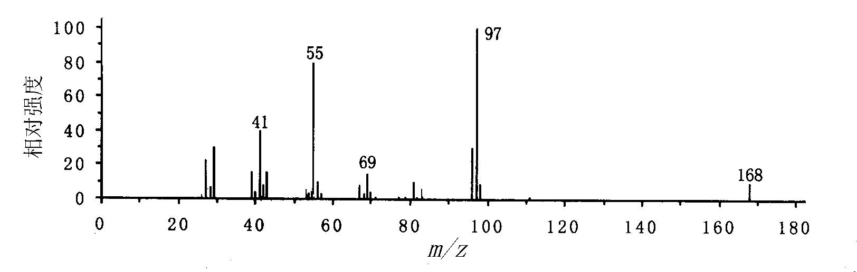
b. cycloalkane
Strong molecular ion peaks
Side chain cleavage is favored
C_{n}H_{2n－1}^{┑+}cations in the low-weight side
1-methyl-3-pentylcyclohexane
Notes:
97---- 1－甲基－3－戊基环己烷丢失戊基侧链生成碎片离子C₇H₁₃⁺

Slide 5
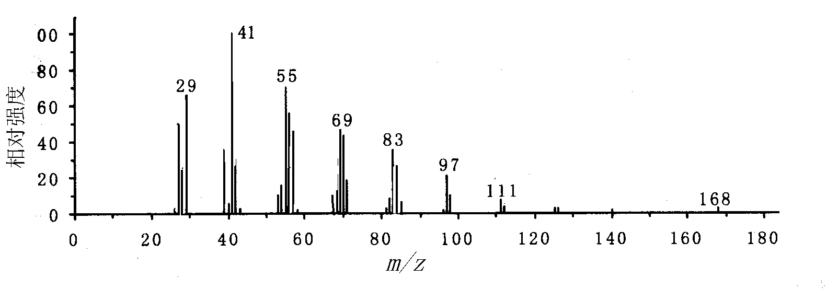
c. Alkene
    1-dodecene
Stronger molecular ion peak than alkane
C_{n}H_{2n－1}^{┑+} with difference of 14
Allyl cleavage (α-cleavage)

Slide 6
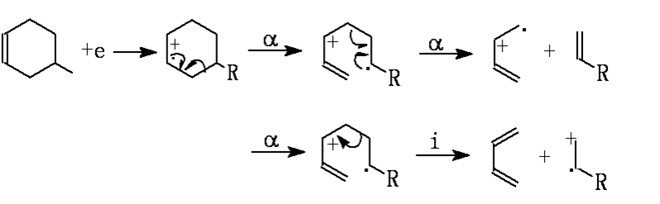
d. cycloalkene
Retro-Diels-Alder

Slide 7
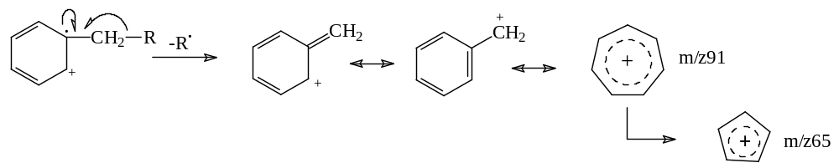
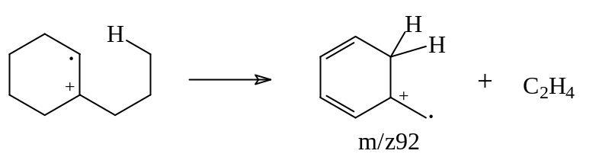
e. Benzene
Strong M^{+•}，low fragments
m/z 39, 50－52，63－65，75-77 fragment ion peaks for benzene，but weak intensity
Benzyl cleavage for alkyl substituted benzenes (m/z 91)
McLafferty rearrangement for alkylbenzenes with γ-H

Slide 8
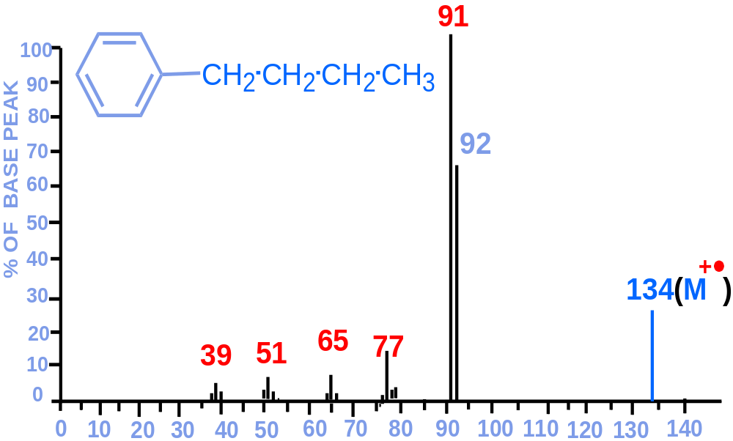

Slide 9
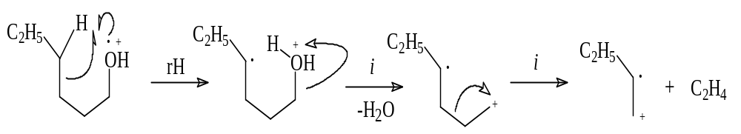
2. Alcohols (-OH)
a. Aliphatic alcohols
Very low molecular ion peaks
Long primary and secondary alcohols would perform hydrogen rearrangement and lose one H₂O.
The base peak sequentially cleaves and loses one C₂H₄ to produce C_{n}H_{2n－1}⁺ fragment cations.

Slide 10
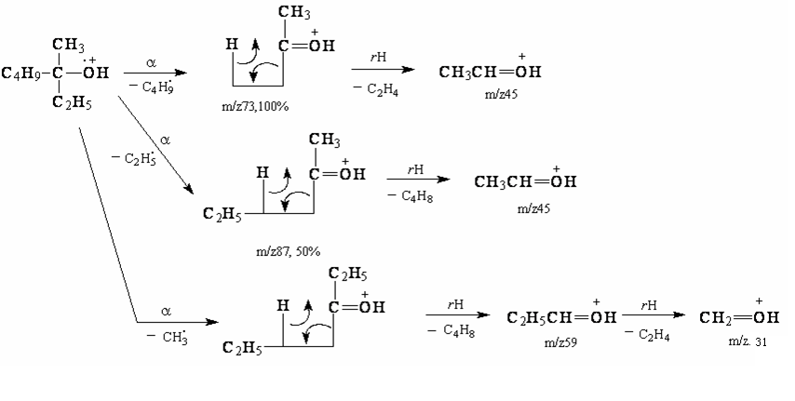
Featured oxonium ion via α-cleavage. m/z 31 for primary alcohols
m/z 31+14n for secondary and tertiary alcohols via H rearrangement and elimination of C_{n}H_{2n} from oxonium ion RR’C=O⁺H 。

Slide 11
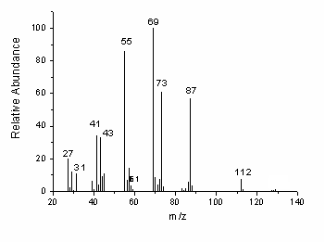
4-octanol

Slide 12
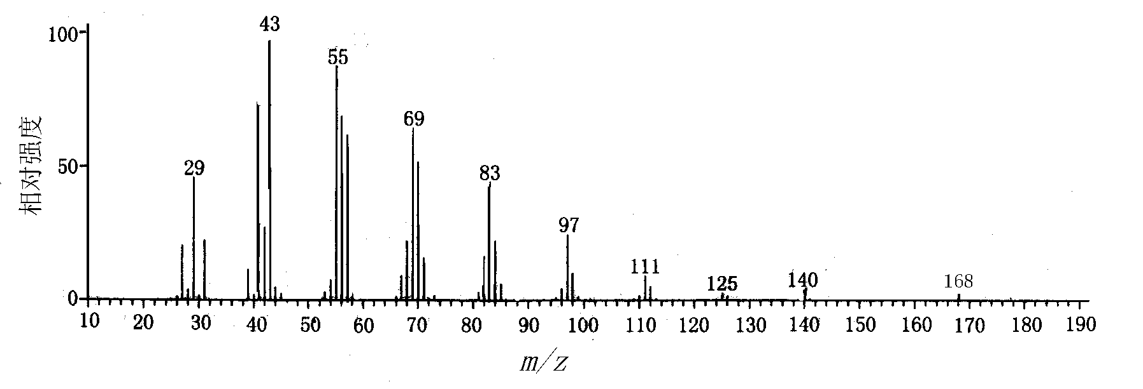
(a)
(b)
1-dodecanol(a) vs 1-dodecene(b)
Notes:
C_{n}H_{2n-1}^{┑+},

Slide 13
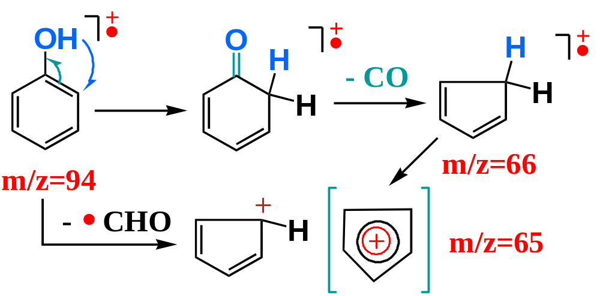
b. Phenol
Strong molecular ion peak
- CO and - CHO, ［M-28]^{+•} and [M-29]⁺

Slide 14
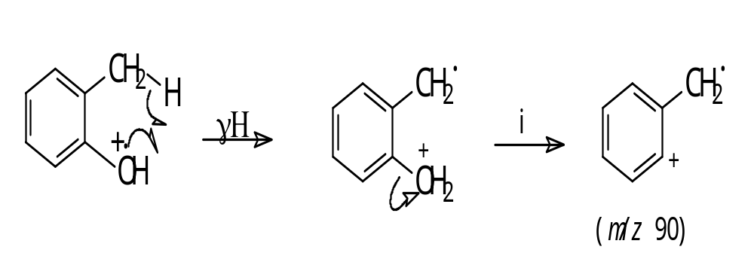
Ortho-substituted phenol, lose neutral molecule via ortho-effect
Strong [M-1]⁺ peak for methylphenol and benzyl alcohol

Slide 15
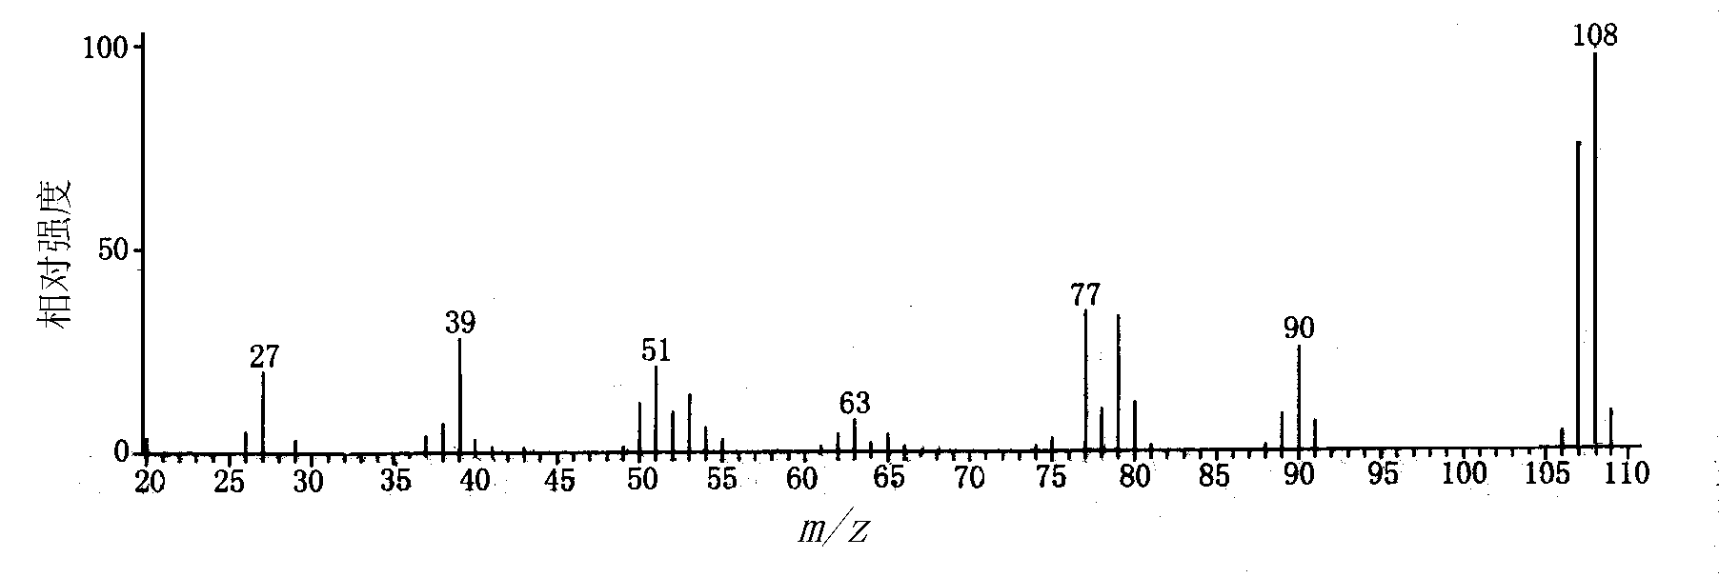
o-methylphenol

Slide 16
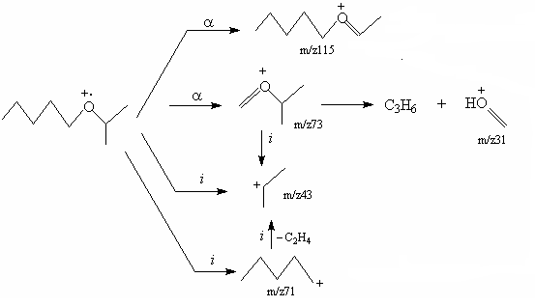
3. Ether
Low molecular ion peak, higher than alcohol
R-O⁺=CR′R〞 fragment ion（m/z 45,59,73,87…) via α-cleavage; the larger alkyl, easier to lose.
Alkyl cation via i-cleavage

Slide 17
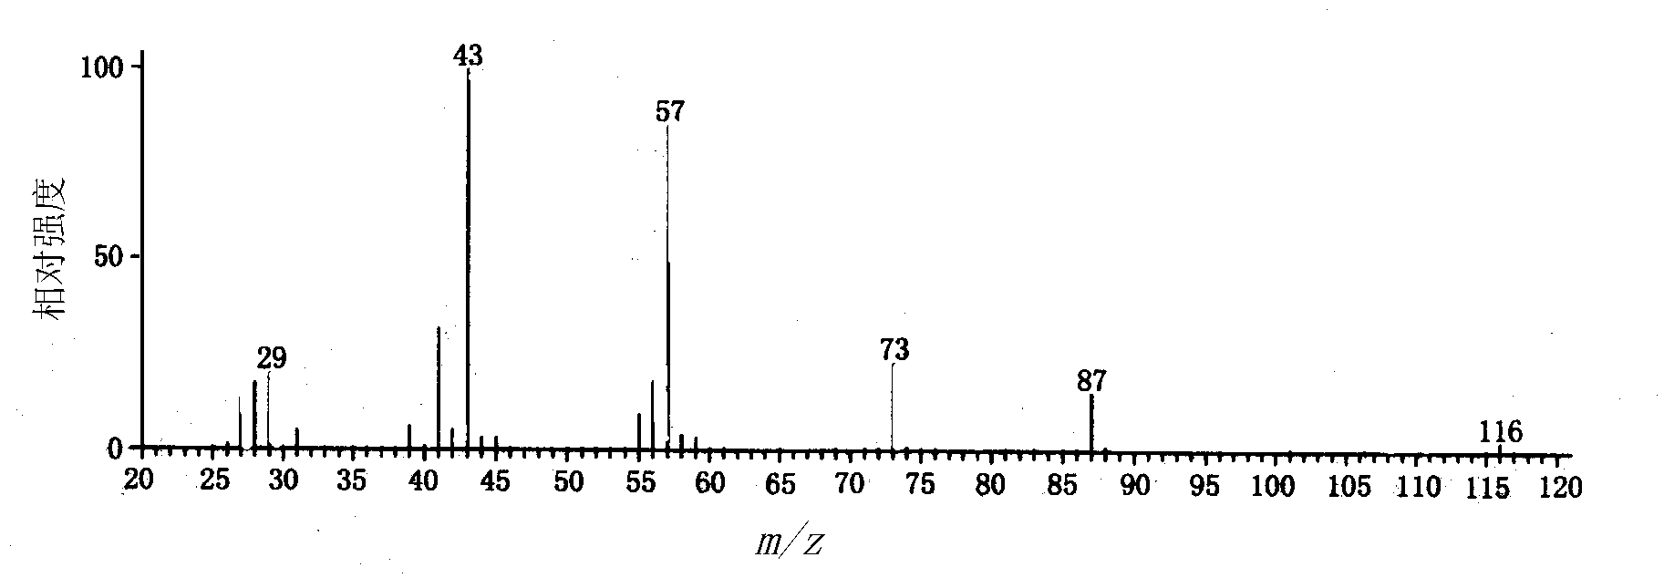
propylbutyl ether

Slide 18
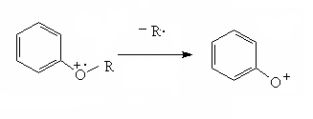
For aromatic ether:
Strong molecular ion peak.
Most fragmentation:
m/z 93
For R is long chain, McLafferty rearrangement would occur; For no other substitution of benzene, m/z 94 as feature fragment ion

Slide 19
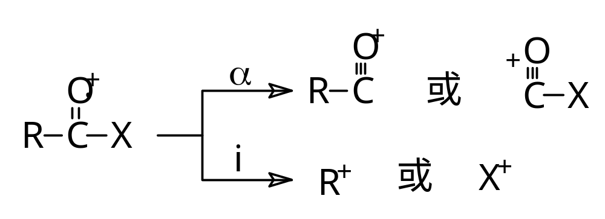
4. Carbonyl derivatives
1) α-cleavage and i-cleavage
2) R is long chain and with γ-H: McLafferty Rearrangement

Slide 20
a. Aliphatic ketone
    Obvious molecular ion peak
    Carbonyl cation via α-cleavage: C_{n}H_{2n-1}O^{¬+}
    Alkyl cation via i-cleavage: C_{n}H_{2n＋1}^{¬+}
    Methyl ketone (no α-substitution）shows a m/z 58 via McLafferty rearrangement

Slide 21
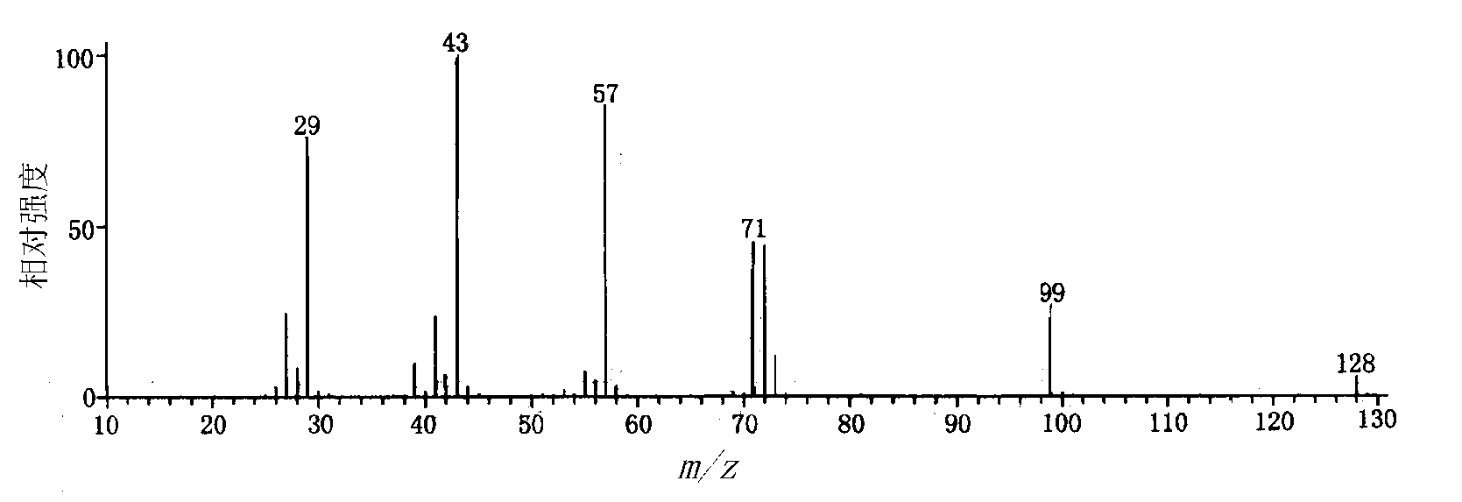
5-methyl-3-heptanone

Slide 22
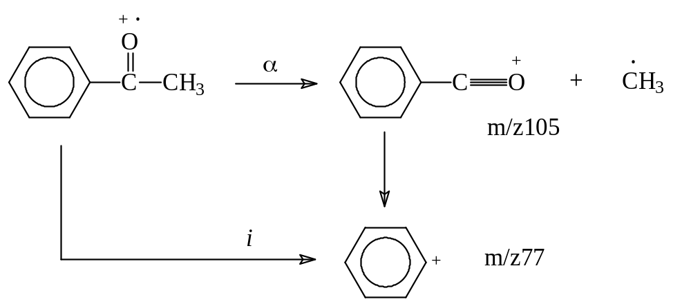
b. Aromatic ketone
Strong molecular ion peak
High abundance of aromatic carbonyl cation（Ar-C≡O⁺) m/z 105.
Sequential elimination of CO produces phenyl cation m/z 77

Slide 23
Obvious molecular ion peak for aliphatic aldehyde; strong for aromatic aldehyde
Carbonyl cation［M-1]⁺ and HC≡O⁺(m/z 29) via α-cleavage. Carbonyl cation［M-1]⁺ is feature ion peak for aldehyde, especially aromatic aldehyde.
c. Aldehyde
[M-29]⁺ via i-cleavage is for high molecular weight aldehyde.
m/z 44 via McLafferty rearrangement if no α-substitution of aldehyde.

Slide 24
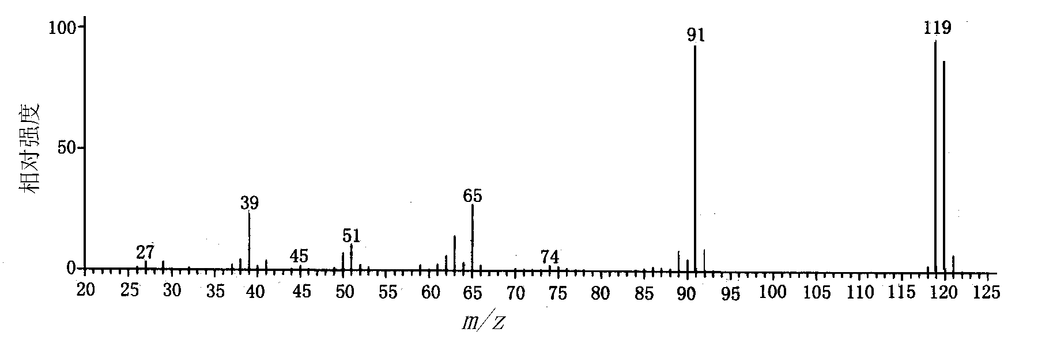
p-methylbenzaldehyde

Slide 25
d. Ester and Carboxylic acid
Obvious molecular ion peak for aliphatic ester and carboxylic acid; strong for aromatic ones.
[M-OH]⁺ and OH-C≡O⁺ (m/z 45) via α-cleavage for low molecular weight acids, for higher ones only m/z 45.
[M-OR]⁺ and [COOR]⁺ via α-cleavage for esters.

Slide 26
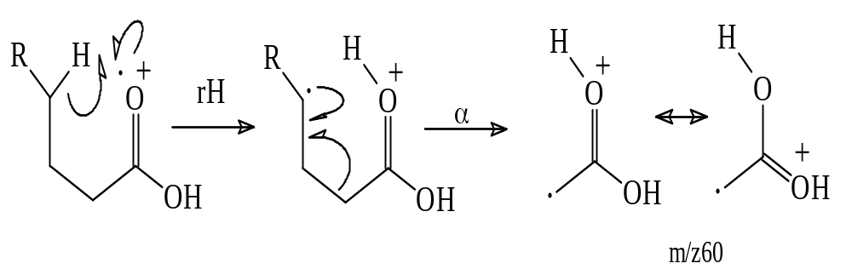
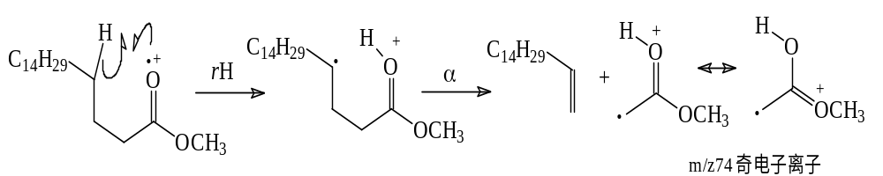
McLafferty rearrangement: m/z60 for carboxylic acid, m/z60+14n for esters.
m/z 59+14n for long chain aliphatic acid.
m/z 61 for long chain acetate (Page 40)

Slide 27
e. Aromatic Ester and Carboxylic acid
Phenyl carbonyl cation（Ar-C≡O⁺) via α-cleavage is feature fragment ion for aromatic ester and acid
ortho-effect would occur when benzene is substituted with CH₃ and OH in the ortho-position. Sequentially elimination of H₂O and alcohol would occur and relative fragment ions would be produced.

Slide 28
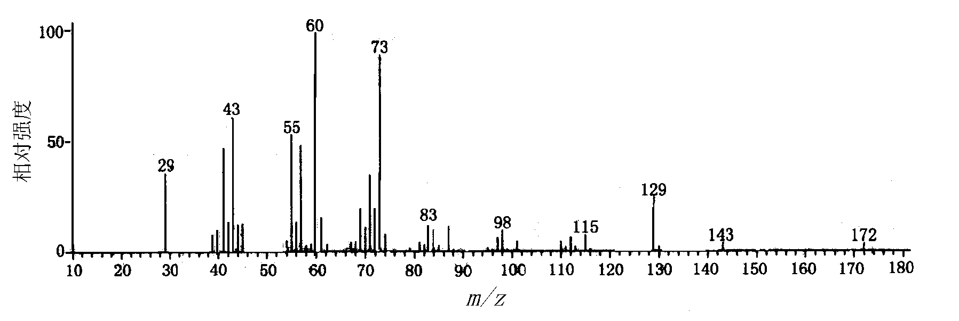
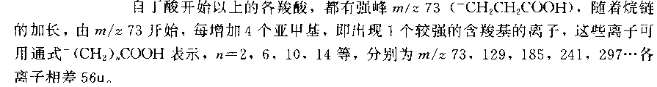
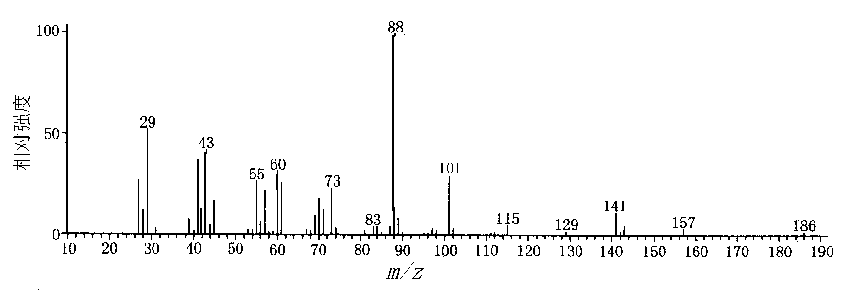
Decanoic acid (a) and Ethyl nonaoate(b)

Slide 29
f. Amide
R-C≡O⁺ and O≡C-NR₂ via α-cleavage，m/z 44 for primary amides.
McLafferty rearrangement for long chain aliphatic amides: m/z59+14n
C_{n}H_{2n}ON^{¬+} for C-C cleavage of long chains.
Strong phenyl carbonyl cation（Ar-C≡O⁺) via α-cleavage and molecular ion peak for aromatic amides.

Slide 30
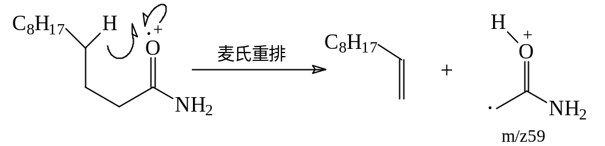
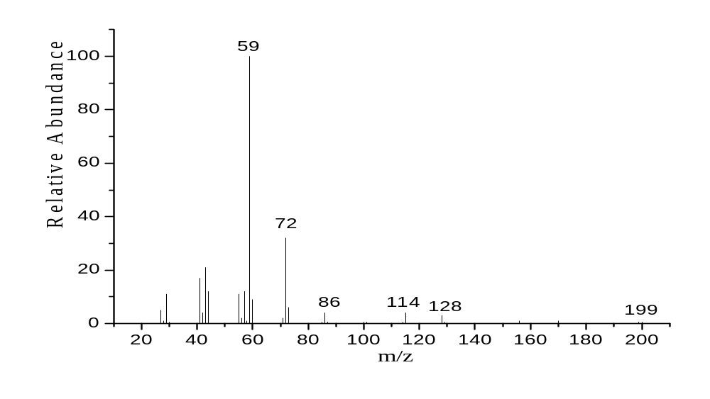
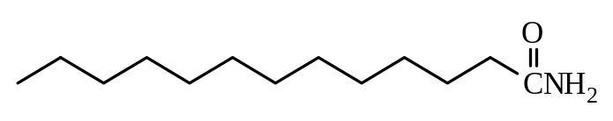
Lauramide

Slide 31
5. Amine
Weak molecular ion peak for aliphatic amines; Strong for aromatic amines.
Feature fragment ion peak m/z 30+14n via α-cleavage; high weigh alkyl prefers to be cleaved.
Sequential rearrangement after α-cleavage and eliminate one ethene to form secondary fragment ions.
For anilines, [M-1]⁺ (lose H.) and [M-27]^{+.} (-HCN) are characteristic peaks, similar with phenols.
For nitriles and nitro compounds, see Page 42.

Slide 32
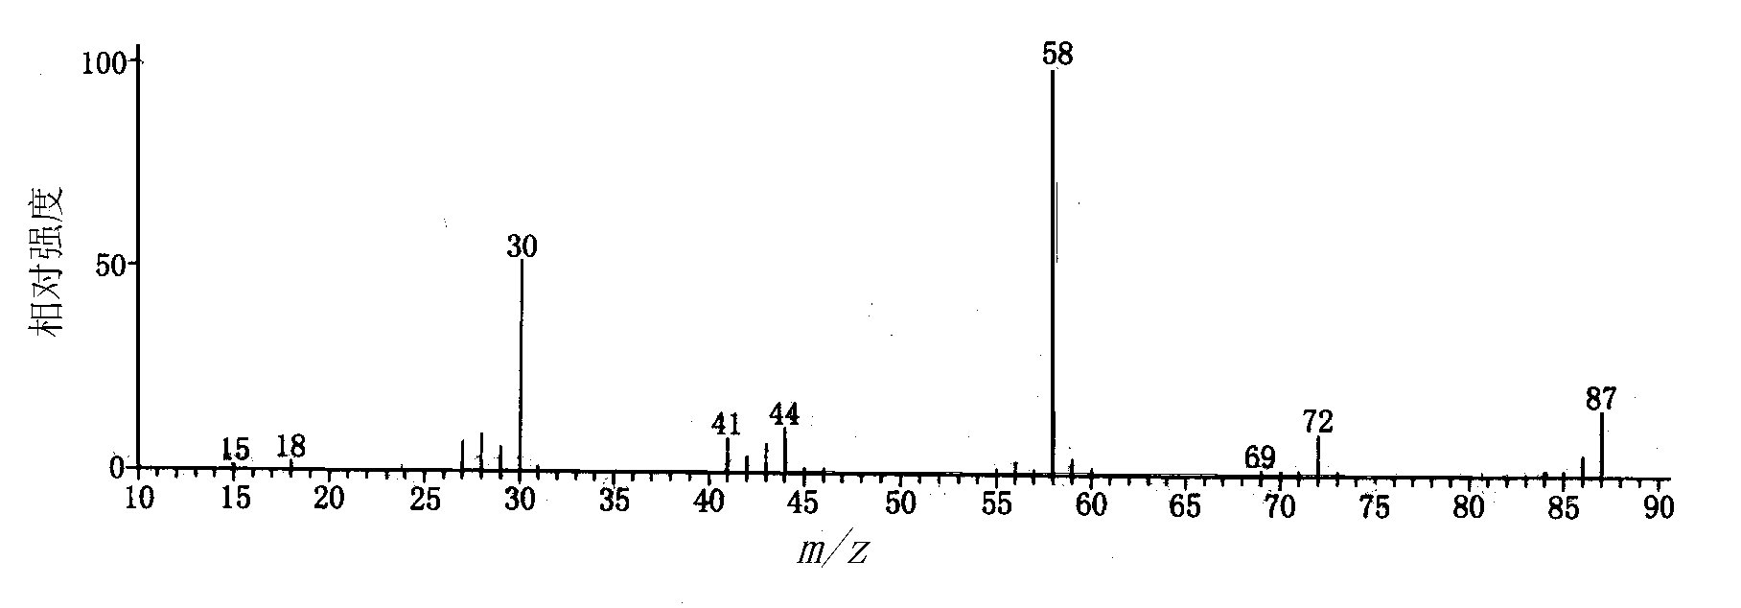
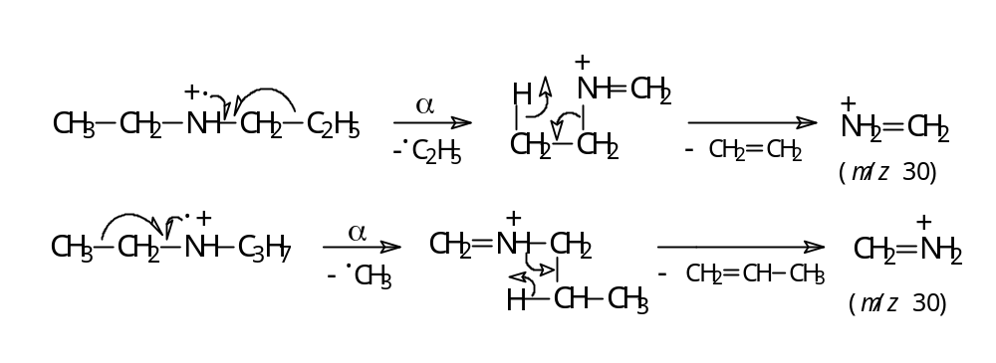
ethylpropylamine

Slide 33
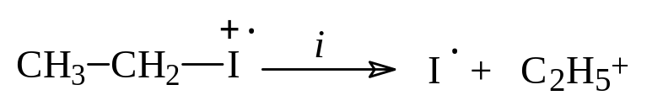
6. Halides
Feature fragment ion peak [M-X]⁺ via i-cleavage for Cl,Br and I derivatives，but not for F.
[M-H]⁺
1,3-elimination for long chain halides, loses one HX
Feature Isotope peaks for molecular ion peak.

Slide 34
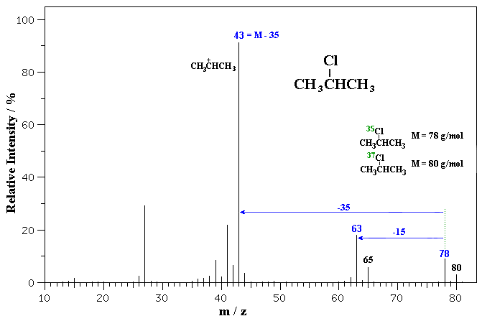

Slide 35
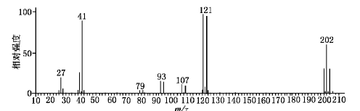
1,3-dibromopropane

Slide 36
7. Sulfides
Isotope peak [M+2]⁺；
Obvious molecular ion peak；
m/z 33＋14n

Slide 37
Fragment ion CH₂=SH⁺ (m/z 47) for primary thiols via α-cleavage. For secondary and tertiary thiols，higher molecular weight alkyls prefers to cleavage.
a. Thiol
Fragment ion [M-H₂S]⁺ via 1,4-elimination for primary thiols and sequentially lose C₂H₄。For secondary and tertiary thiols, alkyl cations are tends to formed after losing HS.

Slide 38
α-cleavage would occur at the alkyls besides S with the larger alkyl leaves first. R-S⁺=CH₂ is produced and may rearrange and eliminate C_{n}H_{2n}.
alkyl cation is produced after i-cleavage.
RS⁺ cation is produced after σ –cleavage of C-S bond.
b. Thioether

Slide 39
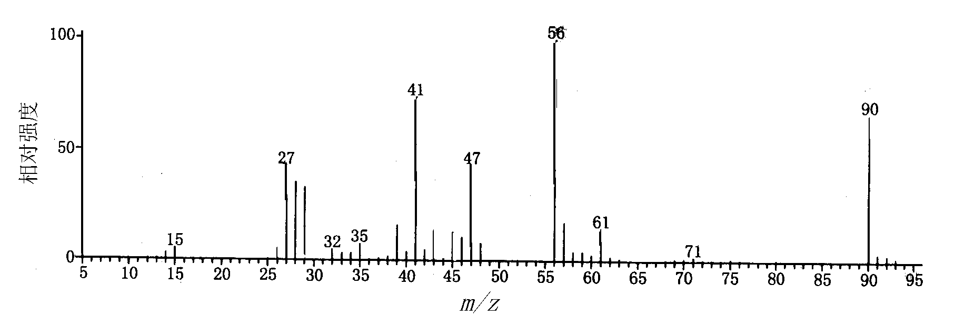
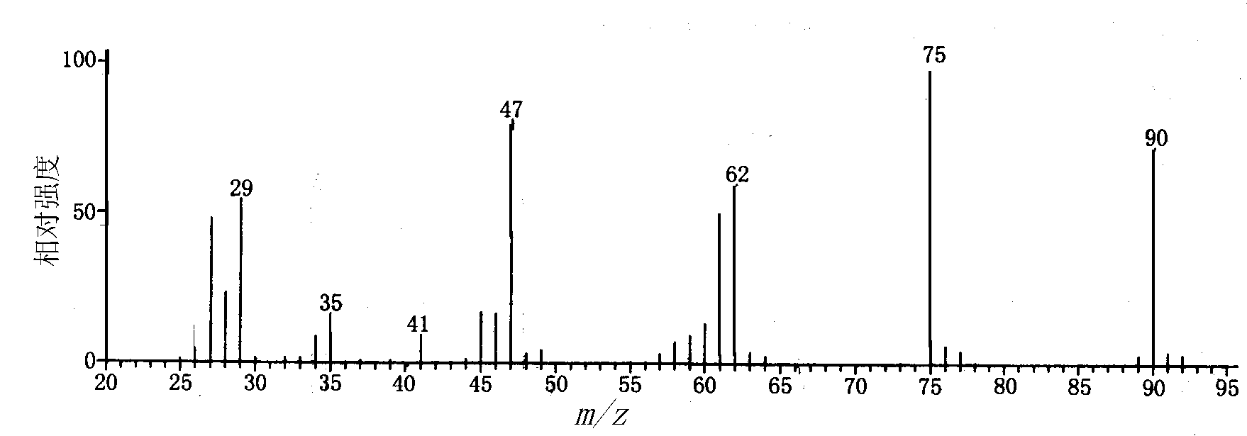
M-H₂S
(a)
CH₂=SH+
(b)
CH₂=SH+
Mercapto-butane(a) vs Diethyl sulfide(b)
Notes:
硫醚的CH2=SH+是通过类似麦氏重排的过程失去1分子烯烃得到的。

