Slide 1
概率统计模型

Slide 2
几个概率分布
几个数学模型

Slide 3
均匀分布
（一维连续型）
（二维连续型）
（多维连续型）

Slide 4
使用场合：
1）该问题具有某种均匀性；
2）该问题无任何先验信息。

Slide 5
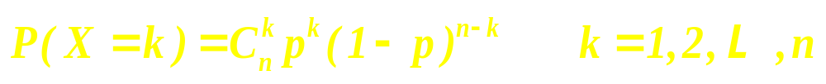

二项分布
设试验 E 只有两个结果：Ａ和 ，记:
独立地重复 n 次。
记作：

Slide 6
使用场合：
只有两个结果：Ａ和 ，
独立地重复 n 次。

Slide 7
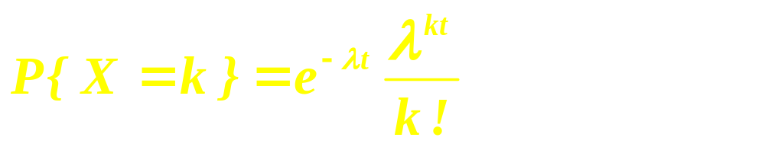
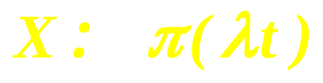
Poission 分布

Slide 8
使用场合：
具有：
平稳性
独立增量性
普通性

Slide 9
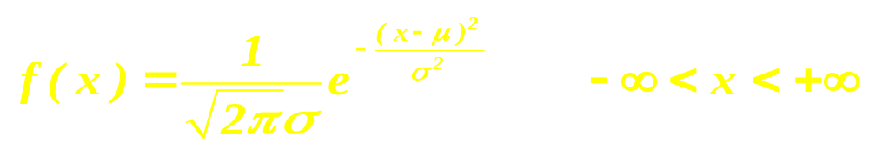
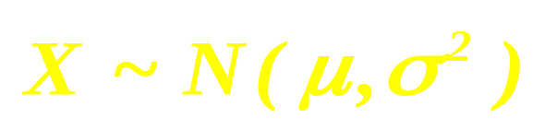
正态分布（normal）

Slide 10
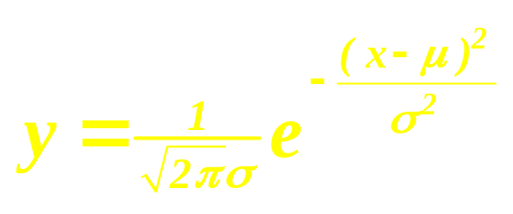
y

Slide 11



三倍标准差原则：
可以认为，Y 的取值几乎全部集中在
区间内。

Slide 12
使用场合：
满足中心极限定理条件。

Slide 13
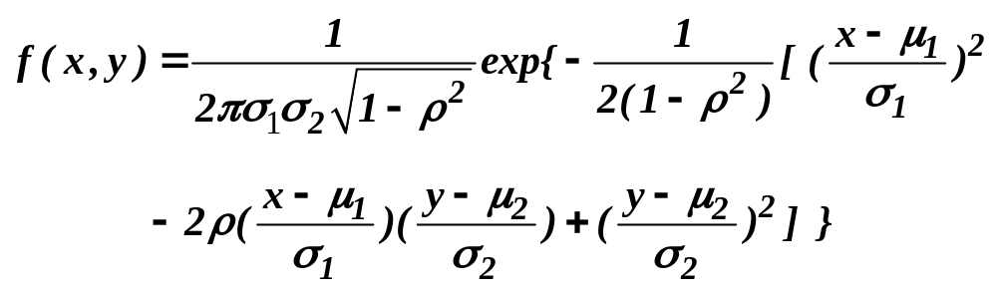

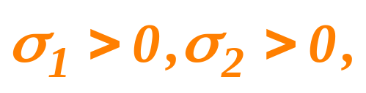

二维正态分布
其中
均为常数,且

Slide 14
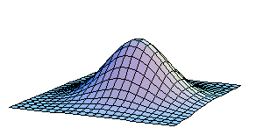

Slide 15
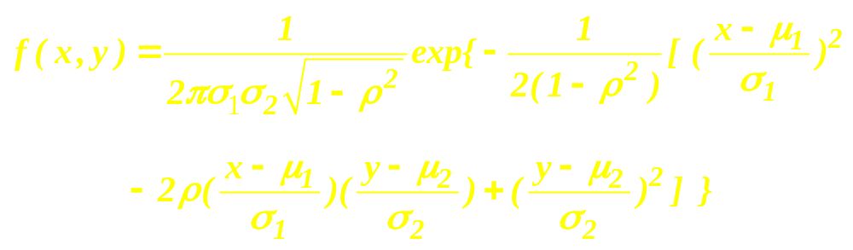
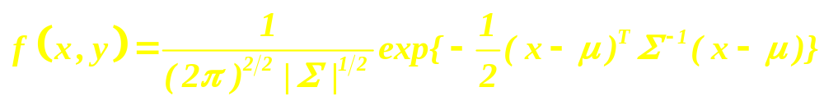

Slide 16
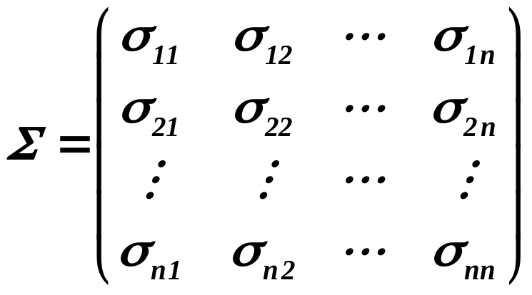
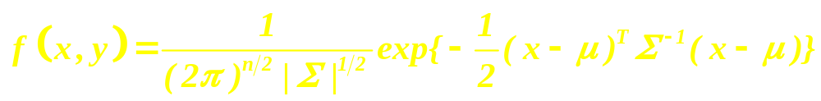

Slide 17
Airline Overbooking（2002 MCM)
You're all packed and ready to go on a trip to visit your best friend in New York City. After you check in at the ticket counter, the airline clerk announces that your fright has been overbooked passengers need to check in immediately to determine if they still have a seat.
Historically, airlines know that only a certain percentage of passengers who have made reservations on a particular flight will actually take that flight. Consequently, most airlines overbook —— that is, they take more reservations than the capacity of the aircraft. Occasionally, more passengers will want to take a flight than the capacity of the plane, leading to one or more passengers being bumped and thus unable to take the flight for which they had reservations.

Slide 18
Airlines deal with bumped passengers in various ways. Some are given nothing, some are booked on later flights on other airlines, and some are given some kind of cash or airline ticket incentive.
Consider the overbooking issue in light of the current situation:
fewer flights by airlines from point A to point B;
heightened security at and around airports,
passengers' fear, and
loss of billions of dollars in revenue by airlines to date.

Slide 19
Build a mathematical model that examines the effects that different overbooking schemes have on the revenue received by an airline company, in order to find an optimal overbooking strategy --that is, the number of people by which an airline should overbook a particular flight so that the company's revenue is maximized. Ensure that your model reflects the issues above and consider alternatives for handling "bumped" passengers. Additionally, write a short memorandum to the airline's CEO summarizing your findings and analysis.

Slide 20
Technical Considerations
If the airline arranges substitute transportation such that the passenger will reach his/her destination within one hour of the original flight's arrival time, there is no obligatory compensation.
If the airline arranges substitute transportation such that the passenger will reach his/her destination between one and two hours after the original flight's arrival time, the airline must pay the passenger an amount equal to the one-way fare for flight to the final destination.

Slide 21
If the substitute transportation is scheduled to arrive any later than two hours after the original flight's arrival time, or if the airline does not make any substitute travel arrangements, the airline must pay an amount equal to twice the cost of the fare to the final destination.
Frontier offers only one class of service to all passengers. Thus, we base our overbooking models on single-class aircraft.

Slide 22
Airline booking considerations are frequently based on the break-even load-factor, a percentage of airplane seat capacity that must be filled to acquire neither loss or profit on a particular flight. The break-even load-factor for Flight 502 in 2001 was 57.8%.
We need concern ourselves only with the sale of restricted tickets. Frontier's are nonrefundable, save for the ability to transfer to another Frontier flight for $60 [Frontier 2001]. Restricted tickets represent all but a very small percentage of all tickets, and many ticket brokers, such as Priceline.com, sell only restricted tickets.

Slide 23

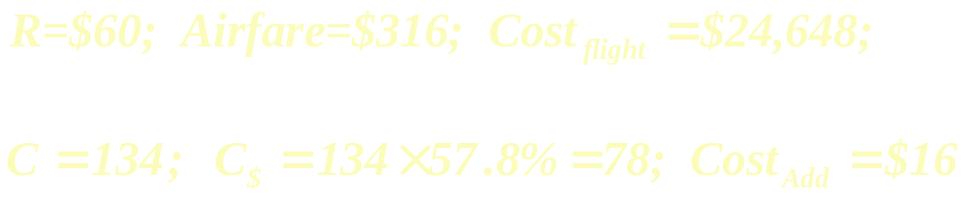

Slide 24
Modeling:
No Overbooking
Bump Threshold Model
Linear Compensation Plan

Slide 25
Nonlinear Compensation Plan
Time-Dependent Compensation Plane

Slide 26
Results:
No Overbooking
Lost opportunity cost $300*16 = $4,800 !

Slide 27
Bump Threshold Model
Linear Compensation Plan
Bump cost | Optimal to book | Expected profit
200 | ∞ | ∞
316 | 162 | $17,817
500 | 153 | $17,121
900 | 150 | $16,601

Slide 28
Nonlinear Compensation Plan
Bump function | Optimal to book | Expected profit
 | 160 | $18,700
 | 158 | $18,240
 | 156 | $17,722
 | 154 | $17,363

Slide 29
Time-Dependent Compensation Plane
Profitability is maximized around B=160

Slide 30
零件的参数设计(CUMCM 1997年A题)
一件产品由若干零件组装而成，标志产品性能的某个参数取决于这些零件的参数，零件参数包括标定值和容差两部分．进行成批生产时，标定值表示一批零件该参数的平均值，容差则给出了参数偏离其标定值的容许范围．若将零件参数视为随机变量，则标定值代表期望值，在生产部门无特殊要求时，容差通常规定为均方差的3倍。
进行零件参数设计，就是要确定其标定值和容差．这时要考虑两方面因素；
一、当各零件组装成产品时，如果产品参数偏离预先设定的目标值，就会造成质量损失，偏离越大，损失越大；
二、零件容差的大小决定了其制造成本，容差设计得越小，成本越高。

Slide 31
试通过如下的具体问题给出一般的零件参数设计方法：
粒子分离器某参数( y )由7个零件的参数( x₁，x₂，…，x₇ )决定，经验公式为:
y 的目标值( y₀ )为1.50．当 y 偏离y₀±0.1时，产品为次品，质量损失为1000元；当y偏离y₀±0.3时，产品为废品，损失为9000元．

Slide 32
 | 标定值容许范围 | C等 | B等 | A等
x₁ | [0.075,0.125] | / | 25 | /
x₂ | [0.225，0.375] | 20 | 50 | ／
x₃ | [0.075．0.125] | 20 | 50 | 200
x₄ | [0.075．0.125] | 50 | 100 | 500
x₅ | [1.125，1.875] | 50 | / | ／
x₆ | [12，20] | 10 | 25 | 100
x₇ | [0.5625，0.935] | / | 25 | 100
A等为±l％，B等为±5％，C等为±l0％，

Slide 33
现进行成批生产，每批产量1000个，在原设计中，7个零件参数的标定值为：
x₁=0.1, x₂=0.3,x₃=0.1 x₄=0.1, x₅=1.5 x₆=16, x₇=0.75;
容差均取最便宜的等级。
请你综合考虑 y 偏离 y₀ 造成的损失和零件成本，重新设计零件参数(包括标定值和容差)，并与原设计比较，总费用降低了多少。

Slide 34
损失函数 1
损失函数 2

Slide 35
基本模型

Slide 36
在
中，求 使：

Slide 37
自动化车床管理[CUMCMl999年A题)
一道工序用自动化车床连续加工某种零件，由于刀具损坏等原因该工序会出现故障，其中刀具损坏故障占95％，其他故障仅占5％．工序出现故障是完全随机的，假定在生产任一零件时出现故障的机会均相同．工作人员通过检查零件来确定工序是否出现故障．
现积累有100次刀具故障记录，故障出现时该刀具完成的零件数如附表．现计划在刀具加工一定件数后定期更换新刀具． 已知生产工序的费用参数如下：

Slide 38
故障时产出的零件损失费用 f=200 元/件
进行检查的费用 t=10 元／次；
发现故障进行调节使恢复正常的平均费用d=3000 元/次 (包括刀具费)；
未发现故障时更换一把新刀具的费用 k=1000 元/次．

Slide 39
假定工序故障时产出的零件均为不合格品，正常时产出的零件均为合格品。试对该工序设计效益最好的检查间隔(生产多少零件检查一次)和刀具更换策略。
如果该工序正常时产出的零件不全是合格品，有2％为不合格品；而工序故障时产出的零件有40％为合格品，60%为不合格品．工序正常而误认有故障停机产生的损失费用为1500元／次．对该工序设计效益最好的检查间隔和刀具更换策略。
在2. 的情况．可否改进检查方式获得更高的效益。

Slide 40
附：100次刀具故障记录(完成的零件数)
459 | 362 | 624 | 542 | 509 | 584 | 433 | 748
815 | 505 | 612 | 452 | 434 | 1982 | 640 | 742
565 | 706 | 593 | 680 | 926 | 653 | 164 | 487
734 | 608 | 428 | 1153 | 593 | 844 | 527 | 552
513 | 781 | 474 | 388 | 824 | 538 | 862 | 659
775 | 859 | 755 | 649 | 697 | 515 | 628 | 954
771 | 609 | 402 | 960 | 885 | 610 | 292 | 837
473 | 677 | 358 | 638 | 699 | 634 | 555 | 570
84 | 416 | 606 | 1062 | 484 | 120 | 447 | 654
564 | 339 | 280 | 246 | 687 | 539 | 790 | 581
621 | 724 | 531 | 512 | 577 | 496 | 468 | 499
544 | 645 | 764 | 558 | 378 | 765 | 666 | 763
217 | 715 | 310 | 851

Slide 41
检查间隔：n 更换周期：u
完成零件数： X （随机变量,概率密度为p(x)）
零件损失费用： f
检查的费用： t
调节平均费用：d
更换新刀具费用 ：k

Slide 42


1）考虑刀具故障
……
0
n
2n
（s-1）n
X
s n
√
√
√
……
√
×
平均为( n+1 ) / 2件
……
0
n
2n
u
√
√
√
……
√

Slide 43
刀具故障费用函数：
周期内的刀具故障平均费用：

Slide 44
周期内刀具故障前完成零件数：
周期内刀具故障前完成零件的平均数：
每一个零件的平均费用：

Slide 45
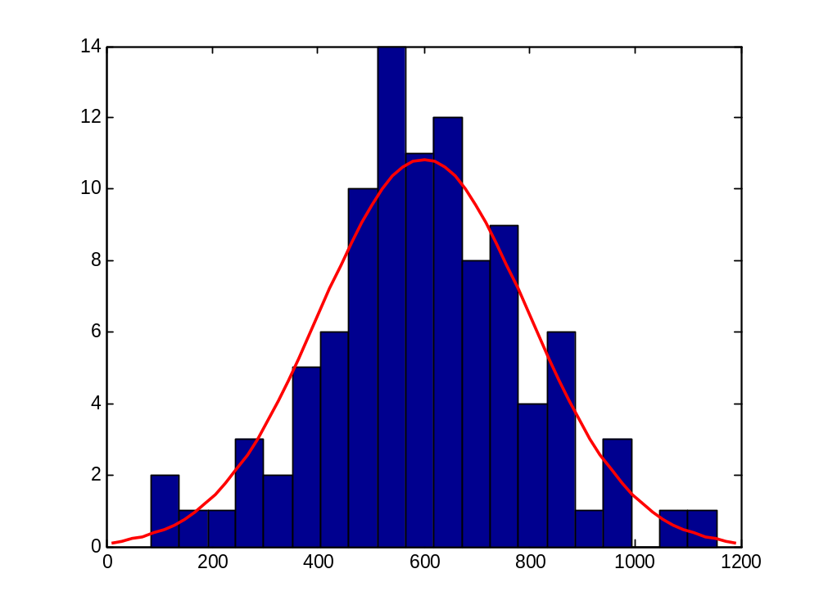
刀具寿命分布

Slide 46
2）考虑非刀具故障
平均故障率为：

Slide 47
周期内的非刀具故障平均费用：
周期内非刀具故障前平均完成零件数：

Slide 48
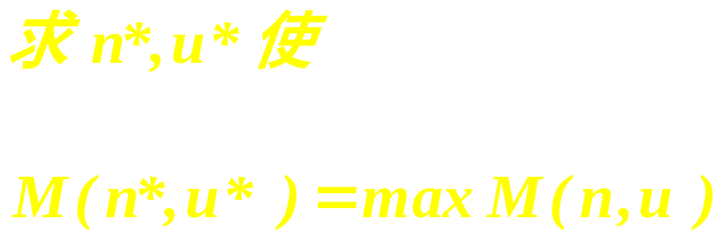
3) 综合考虑两种故障：
周期内平均费用：
周期内平均完成零件数：

Slide 49
Thank you for listening

