Slide 1
第9章
宏观经济的基本指标及其衡量
Notes:
It would be helpful to have your students bring their calculators to class for this chapter so they can practice calculating real and nominal GDP and so forth.
This is the first purely macro chapter in the textbook. It covers the definition of GDP, the spending components of GDP, real vs. nominal GDP, the GDP deflator, and why GDP is a useful but not perfect measure of a nation’s well-being.

Slide 2
本章我们将探索这些问题的答案：
什么是国内生产总值（GDP）？
GDP与一国的总收入与总支出有什么联系？
GDP由哪几部分组成？
GDP怎么进行通货膨胀的校正？
GDP是衡量经济福利的好指标吗？
CPI与GDP平减指数的比较？
失业及其类型

Slide 3
收入与支出
国内生产总值 (GDP) 衡量经济中所有人的总收入
GDP也衡量用于经济中物品与劳务生产的总支出
对一个整体经济而言，
收入等于支出
因为某个买者的1元支出正是某个卖者的1元收入
Notes:
Notes:
1. The text in the first bullet point is NOT the formal textbook definition of GDP. The formal definition is given and discussed in detail immediately after the Circular-Flow Diagram.
2. “g&s” = goods and services
A good way to judge how well someone is doing economically is to look at his or her income. We can judge how well a country is doing economically by looking at the total income that everyone in the economy is earning. GDP is our measure of the economy’s total income, often called “national income.”
GDP also measures total expenditure on the goods and services produced in the economy, and the value of the economy’s output (production) of goods and services. Thus, GDP is also referred to as “output.”
The equality of income and expenditure is an accounting identity (not, for example, an equilibrium condition): it must be true that income equals expenditure.

Slide 4
循环流量图
宏观经济的一个简单描述
用支出，收益，要素支付和收入来说明GDP
预备知识：
  生产要素：诸如劳动，土地，资本，企业家才能
  要素支付：支付给生产要素的报酬（例如，工资，租金）
Notes:
If your students already know the terms “factors of production” and “factor payments,” you may wish to delete the “preliminaries” from this slide.

Slide 5
循环流量图
家庭:
拥有生产要素，出售或出租它们给企业以换取收入
购买并消费物品与劳务
企业
家庭
企业:
购买或租赁生产要素，用它们来生产物品与劳务
出售物品与劳务
Notes:
This and the following slide build the Circular-Flow Diagram piece by piece.

Slide 6
循环流量图
收入 (=GDP)
支出(=GDP)
物品与劳
务市场
物品和劳务的销售
物品和劳务的购买
企业
家庭
生产投入
劳动、土地和资本
生产要素
市场
工资、租金和利润 (=GDP)
收入 (=GDP)
Notes:
In this diagram, the green arrows represent flows of income/payments. The red arrows represent flows of goods & services (including services of the factors of production in the lower half of the diagram).
To keep the graph simple, we have omitted the government, financial system, and foreign sector, as discussed on the next slide.
Changing the animation on this slide:
If you wish, you can easily change the order in which the markets and arrows appear. From the “Slide Show” drop-down menu, choose “Custom Animation…” Then, a box will appear (maybe along the right-hand-side of your PowerPoint window) that allows you to modify the order in which things appear (as well as other aspects of the animation). For further information, open PowerPoint help and search on “change the sequence of animations.”

Slide 7
这张图省略了什么
政府
  征税，购买物品与劳务
金融体系
  在储蓄者资金的供给和借款者贷款的需求之间达成均衡
外国部门
  物品与劳务贸易，金融资产，外国居民的货币
Notes:
In future chapters, we will study the role of each of these in greater detail.
We could draw a more complicated circular flow diagram that includes the government, financial system, and foreign sector. Including them, however, would not change the basic conclusion that GDP simultaneously measures the country’s total income, expenditure, revenue, and factor payments.

Slide 8
（注入）
企 业
出口
投资
政府购买
支付生产要素报酬
购买最终产品
国 外
金融机构
政 府
储蓄
税收
进口
（漏出）
家 庭
四部门经济的国民收入流程模型

Slide 9
国内生产总值GDP
国民生产总值GNP
GDP: 一国(或一个地区）在一定时期内生产的全部最终产品和劳务的市场价值。
GNP:一国永久居民在一定时期生产的全部最终产品和劳务的市场价值。

Slide 10
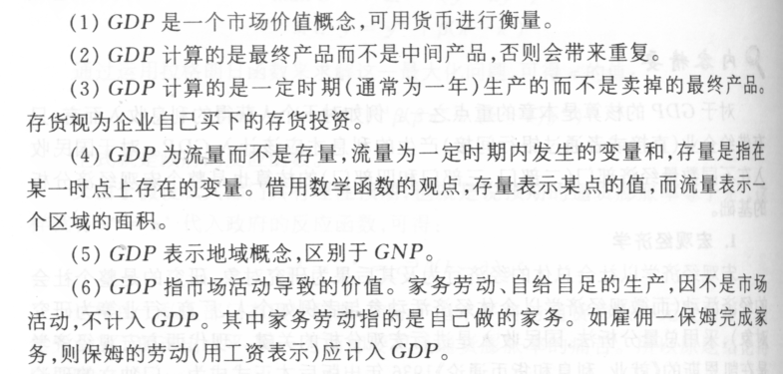
理解

Slide 11
国内生产总值（GDP）：
在某一既定时期一个国家内生产的所有最终物品与劳务的市场价值
物品用它们的市场价值来评价，那:
所有物品都用相同的单位来衡量 (比如,在美国用美元)
那些没有市场价值的物品被排除在外，比如你为自己而做的家务
Notes:
This slide and the five that follow focus on the meaning of each part of this critically important definition.
Note that transactions occurring in the so-called “underground economy” are also omitted from the official measure of GDP. In the textbook, near the end of this chapter, an “In the News” box contains an excellent article on the underground economy.

Slide 12
国内生产总值 (GDP) ：
在某一既定时期一个国家内生产的所有最终物品和劳务的市场价值
最终物品：为终端使用者所准备
中间物品：生产其他物品的一种组成成份或要素
GDP只包括最终产品—生产过程中使用的中间物品的价值已经包含在最终物品的价值中

Slide 13
国内生产总值 (GDP)：
在某一既定时期一个国家内生产的所有最终物品和劳务的市场价值
GDP包括有形的物品
(比如DVD, 山地自行车, 啤酒)
也包括无形的劳务
(比如干洗, 音乐会, 理发服务)

Slide 14
国内生产总值 (GDP)：
在某一既定时期一个国家内生产的所有最终物品和劳务的市场价值
GDP 只包括现期生产的物品，不包括过去生产的物品

Slide 15
国内生产总值 (GDP)：
在某一既定时期一个国家内生产的所有最终物品和劳务的市场价值
GDP 衡量的生产价值局限于一个国家的地理范围之内，不管是由本国的国民还是住在本国的外国人生产。

Slide 16
国内生产总值 (GDP)：
在某一既定时期一个国家内生产的所有最终物品和劳务的市场价值
通常是一年或一个季度（3个月）

Slide 17
国内生产总值和国民生产总值的区别
计算原则:GDP——国土原则;
GNP——国民原则。
例：一个在中国开公司的美国人取得的利润属于美国GNP的一部分，但不是美国GDP的一部分。

Slide 18
GDP与GNP的联系
GNP=GDP+NFP
NFP:国外净要素收入, 本国居民在外国取得的收入减去外国居民在本国取得的收入.
例：一国的GNP小于GDP，说明该国公民从外国取得的收入（大于/小于 ）外国公民从该国取得的收入。

Slide 19
GDP的组成部分
GDP的测算方法一：支出法
四个组成部分：
  消费 （C）
  投资 （I）
  政府购买 （G）
  净出口（NX）
这四个组成部分的总和等于GDP（用Y表示）：
Y = C + I + G + NX
Notes:
Each of the four components is defined and discussed in detail on the following slides.

Slide 20
消费 (C)
家庭除购买新住房之外用于物品和劳务的总支出
（1）对耐用消费品（彩电、冰箱、空调等）的支出；
（2）对非耐用消费品（食物、衣服、染料等）的支出；
（3）服务支出（医疗、教育、娱乐等）。
关于居住成本的注释：
  对租房者而言，消费包括租金
  对房主而言，消费包括住房的隐含租金价值，但不包括住房的购买价格或按揭贷款
Notes:
Mostly, the term “consumption” refers to what students probably already think of as total consumer spending. The note about the treatment of owner-occupied housing is an exception, and some of the test bank questions are designed to see if students remember this exception.
(For more on this issue, see the notes accompanying the following slide.)

Slide 21
投资 （I）
投资是对用于未来生产更多物品和劳务的物品的购买
包括下列支出：
  资本设备 (比如机器, 工具)
  建筑物(工厂，办公楼，住房)
  存货 (已经生产出来但尚未售出的物品)
注意: “投资 ”并不是指购买股票或债券这类金融资产
Notes:
More on the treatment of owner-occupied housing:
In the national income and product accounts, a house is considered a piece of capital that is used to produce a flow of services – housing services.
When a consumer (as a tenant) rents a house or apartment, the consumer is buying housing services. These services are considered consumption, so the price paid for these services – rent – is counted in the “consumption” component of GDP .
When someone buys a new house to live in, she is both a producer and a consumer. As a producer, she has made an investment (the purchase of the house) that will produce a service. She is also the consumer of this service, which is valued at the market rental rate for that type of house. So, the accounting conventions treat this situation as if the person is her own landlord and rents the house to/from herself.
When students begin to understand this, they may wonder why certain other goods (like cars) that produce a flow of consumer services are not also treated this way. There really is no good answer. It’s just a convention of the national income and product accounts.

Slide 22
思考：
经济学上的投资是指（ ）:
A、企业增加一笔存货
B、建造一座住宅
C、企业购买一台计算机
D、以上都是

Slide 23
政府购买 （G）
是地方、州、和联邦政府用于物品与劳务的支出。
政府购买不包括转移支付，比如社会保障补助或失业保险补助
因为它们不是物品与劳务的购买
Notes:
You might tell your students that transfer payments, like Social Security checks, are excluded from G to avoid double-counting: retired persons spend part or all of their Social Security benefits on food, rent, prescriptions, and so forth, all of which count in consumption. If we also counted the Social Security check as part of G, then the same money would be counted twice, which would make GDP look bigger than it really is.

Slide 24
净出口 （NX）
NX = 出口 – 进口
出口代表外国对国内生产物品与劳务的支出
进口是消费，投资和政府购买中对外国生产的物品和劳务的支出
把所有组成部分加总起来得到：
Y = C + I + G + NX
Notes:
The “net” in “net exports” refers to the fact that we are subtracting imports from exports. This subtraction is important, because imports are also counted in the other components of GDP; failing to subtract them would cause GDP to measure not just the value of goods produced domestically, but also goods produced abroad and imported.
For example, if a consumer spends $100 on a DVD player imported from Japan, that $100 counts in “consumption,” even though the player was not produced domestically. We subtract off that $100 import so that GDP ends up including the value of only domestically-produced goods and services.

Slide 25
美国的GDP及其组成部分：2007
总量（10亿）
占总量的百分比
人均量
Y
$13,841
100.0
$45,825
C
9,734
70.3
32,228
I
2,125
15.4
7,037
G
2,690
19.4
8,905
NX
–708
–5.1
–2,344
Notes:
This data is slightly different than that shown in Table 1 in this chapter of the textbook. The data on this slide was obtained after the BEA had slightly revised its initial GDP figures.
Source for data on GDP & components: http://www.bea.gov
http://www.bea.gov/national/index.htm
Source for population data (used to calculate the per capita figures):
http://research.stlouisfed.org/fred2/categories/104, series “POP”, value for July 1, 2007, Source: U.S. Department of Commerce: Census Bureau, www.census.gov

Slide 26
GDP和支出的组成部分：1997
总计
（10亿美元）
人均
（美元）
国内生产总值
消费
非耐用品
耐用品
劳务
投资
非居民固定投资
居民固定投资
存货投资
政府购买
联邦政府
州和地方政府
净出口
出口
进口
8083.4 30173
5488.6 20487
1592.7 5945
659.4 2461
3226.5 12081
1237.6 4620
845.4 3156
327.5 1222
64.6 241
1453.9 5427
524.8 1959
929.1 3468
-96.7 -361
958.8 3579
1055.5 3940
资料来源：U.S.Department of Commerce.

Slide 27
主动学习 1
GDP及其组成部分
在下面的各种情形下，计算GDP及它受影响的组成部分的变化量
  A. Debbie在波士顿最好的饭店花了$200请他丈夫吃晚饭
  B. Sarah为了出版业务的需要，花$1800买了一台新笔记本。这台笔记本是在中国制造的
  C. Jane为了她编辑业务的需要花了$1200购买一台新电脑，这台电脑是由本地的制造商在去年生产的
  D. 通用汽车公司生产了价值5亿美元的汽车，但消费者只购买了价值4.7亿美元的汽车
Notes:
Suggestion: Show these questions, and give your students 1-3 minutes to formulate their answers. When you are ready to discuss the answers, go to the next slide….

Slide 28
主动学习 1
参考答案
A. Debbie在波士顿最好的饭店花了$200请他丈夫吃晚饭
消费和 GDP都增加了200美元
B. Sarah为了出版业务的需要，花$1800买了一台新笔记本。这台笔记本是在中国制造的
投资增加1800美元，净出口减少1800美元, GDP 不变
Notes:
Suggestion (continued from previous slide): Show part A (but not the answer) and ask for someone to volunteer his or her response. Then show the answer to part A. Repeat for parts B, C, and D. (The answers to parts C and D appear on the following slide.)
After showing the answer to part A, ask your students whether the answer would be different if Debbie were a government employee. The correct answer is NO. Government employees engage in consumption, just like everyone else.

Slide 29
主动学习 1
参考答案
C. Jane为了她编辑业务的需要花了$1200购买一台新电脑，这台电脑是由本地的制造商在去年生产的
当前的GDP与投资都不变，因为电脑是在去年生产出来的
D. 通用汽车公司生产了价值5亿美元的汽车，但消费者只购买了价值4.7亿美元的汽车
消费增加4.7亿美元，存货投资增加0.3亿，GDP 增加5亿美元
Notes:
Regarding part C:
Jane’s purchase causes investment (for her own business) to increase by $1200. However, the computer is sold out of inventory, so inventory investment falls by $1200. The two transactions cancel each other, leaving aggregate investment and GDP unchanged.
Regarding part D:
This problem illustrates why expenditure always equals output, even when firms don’t sell everything they produce due to lackluster demand. The point here is that unsold output is counted in inventory investment, even when that “investment” was unintentional.

Slide 30
计算GDP的方法二—生产法/增值法
生产法：一个国家在一定时期内所生产的所有产出和服务的价值总和减去生产过程中所使用的中间产品的价值总和，用这种方法统计出来的价值总和反映的是一个国家在这一时期所有新创造的价值。

Slide 31
例：一件衣服要经过种棉、纺纱、织布、制衣和销售五个环节，假设棉花价值15元（当年新增价值），纺成纱售价20元，再将纱织成布售价30元，制成成衣卖给售衣商价格45元，最后售衣商卖给消费者一件衣服为50元。试用增值法计算GDP？
解：15＋5＋10＋15＋5＝50元

Slide 32
计算GDP的方法三—收入法
收入法:通过把参加生产过程的所有生产要素的所有者的收入相加来计算国民生产总值。
GDP=工资+利息+利润+租金+间接税和企业转移支付＋折旧

Slide 33
思考题：
1、下列哪一项计入GDP（ ）？
A、 购买一辆用过的旧自行车；
B、 购买普通股票；
C、 汽车制造厂买进10吨钢板；
D、 银行向某企业收取一笔货款利息。

Slide 34
讨论1：
假定甲为乙提供服务应得报酬400美元，乙为甲提供服务应得报酬300美元，甲乙商定相互的支付互相抵消300美元，结果甲只收乙100美元。试问计入GNP的是否就是这100美元？

Slide 35
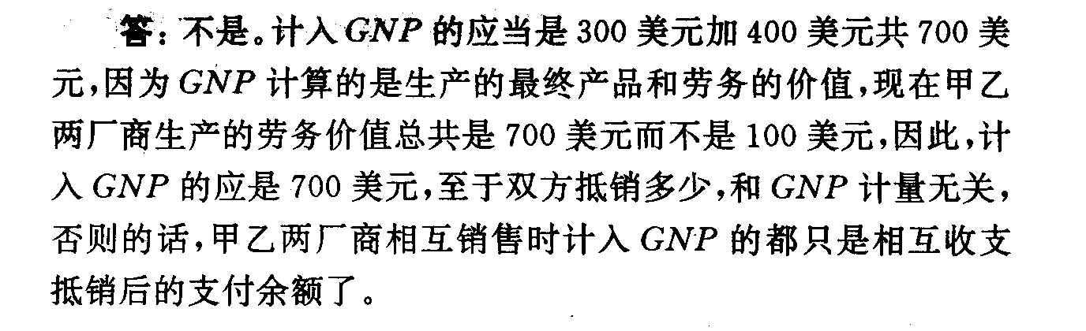

Slide 36
GNP（或GDP）的缺陷：
1.没有反映非市场性经济活动的价值;
2.没有反映地下经济活动创造的价值;
3.由于价格水平的差异, 人均GDP指标并不能完全反映不同国家或地区居民生活水平的实际差异;例两国GDP相同，一国产粮食而一国生产歌曲，显然，两国的物质生活水平不一样。
4.人均GDP并不反映一个国家国民收入的分配状况。
5.GDP并不反映一个国家的自然资源拥有情况和环境质量。

Slide 37
GDP（GNP）是一个国家经济活动和收入水平的重要指标，但不是完全反映一国经济福利及生活质量的唯一指标和完全准确的指标。

Slide 38
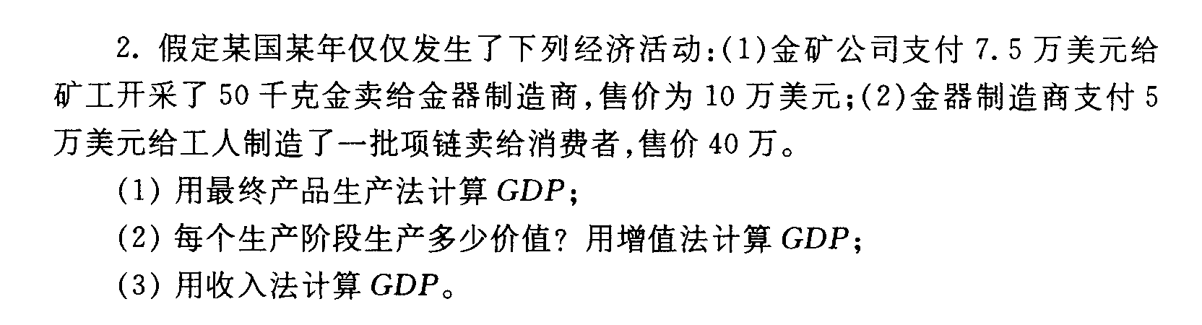
例：

Slide 39
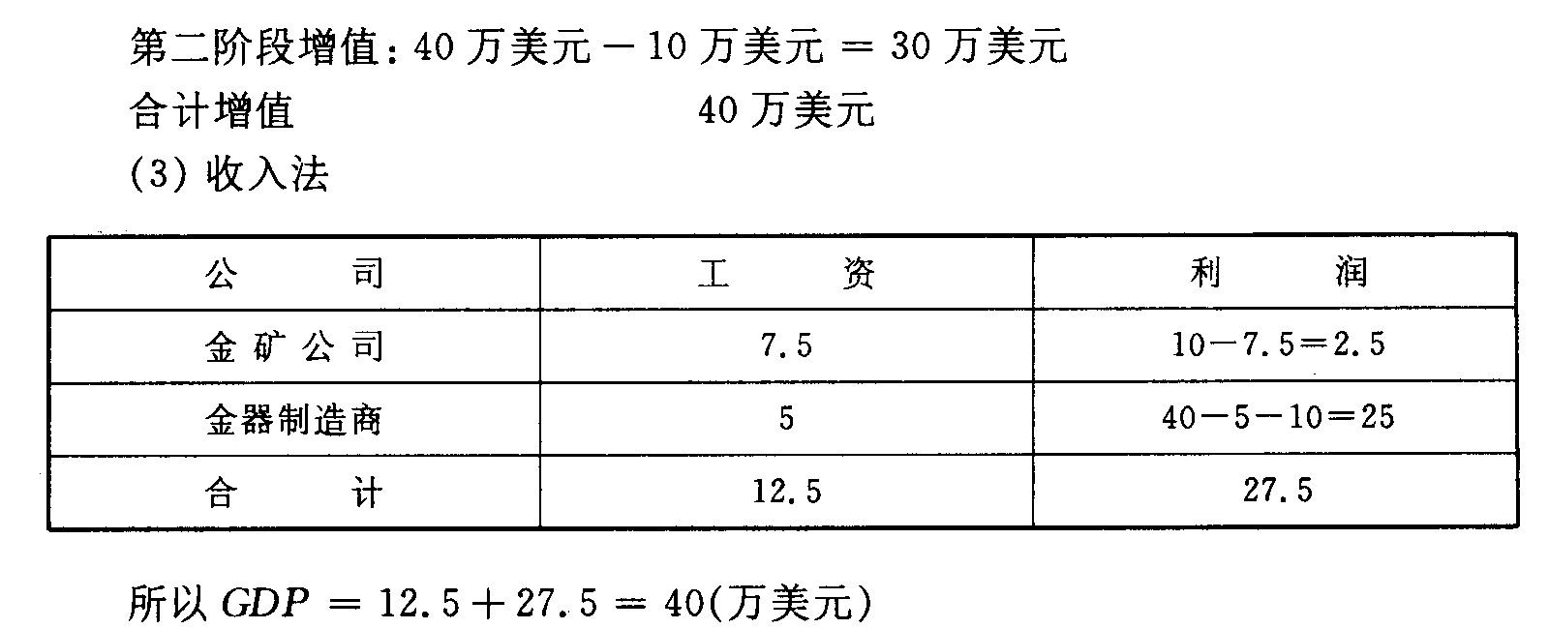
解：（1）最终产品为项链售价40万美元，故GDP为40万美元。
（2）增值法 第一阶段增值：10－0＝10万美元

Slide 40
讨论3：某冰箱厂今年倒闭了，这将给国内生产总值带来什么影响？分别用生产法、收入法和支出法的计算来理解这种影响。

Slide 41
答：这个国家的GDP会减少。从生产法的角度看，假设这家电冰箱企业原本可以生产1万台电冰箱，每台价值1000元，则GDP将减少1000万元；从支出法的角度看，当该企业倒闭了，消费者只能少消费1万台电冰箱，从而消费支出会减少1000万元，这进一步会导致GDP减少1000万元；从收入法的角度看，这家企业现在不生产价值1000万元的电冰箱，这意味着原本参与生产电冰箱的所有生产要素的所有者现在也得不到价值1000万元的要素报酬，这显然会使GDP减少1000万元。

Slide 42
国民收入的几个主要概念
1.国民生产净值 NNP=GNP－折旧
2.国民收入 NI
NI=NNP－企业间接税和企业转移支付＋政府补助金
3.个人收入PI
PI= NI －公司未分配利润－公司所得税和社会保险税＋政府向个人的转移支付
4.个人可支配收入DPI
DPI=PI－个人所得税

Slide 43
NI、PI和DPI
GNP | 折旧
 | NNP | 间接税
 |  | NI | PI=NI-企业利润-社会保险金+转移支付+净利息收入+红利 | 个人所得税
 |  |  |  | DPI

Slide 44
价格水平及其衡量
一、真实GDP与名义GDP
通货膨胀会扭曲像GDP这样的经济变量，因此我们有两种类型的GDP：
一种是经过通货膨胀校正，另一种则没有
名义GDP 按现期价格评价的物品与劳务的生产，它没有经过通货膨胀校正
真实 GDP 按基年价格评价的物品与劳务的生产，它经过通货膨胀校正

Slide 45
例：
 | 皮萨 |  | 拿铁咖啡
年份 | P | Q | P | Q
2005 | $10 | 400 | $2.00 | 1000
2006 | $11 | 500 | $2.50 | 1100
2007 | $12 | 600 | $3.00 | 1200
计算每年的名义GDP：
2005: $10 x 400 + $2 x 1000 = $6,000
2006: $11 x 500 + $2.50 x 1100 = $8,250
2007: $12 x 600 + $3 x 1200 = $10,800
增加：
37.5%
30.9%
Notes:
This example is similar to that in the text, but using different goods and different numerical values.
Suggestion: Ask your students to compute nominal GDP in each year before revealing the answers. Ask them to compute the rate of increase before revealing the answers.
In this example, nominal GDP grows for two reasons: prices are rising, and the economy is producing a larger quantity of goods.
Thinking of nominal GDP as total income, the increases in income will overstate the increases in society’s well-being because part of these increases are due to inflation.
We need a way to take out the effects of inflation, to see how much people’s incomes are growing in purchasing power terms. That is the job of real GDP.

Slide 46
例：
 | 皮萨 |  | 拿铁咖啡
年份 | P | Q | P | Q
2005 | $10 | 400 | $2.00 | 1000
2006 | $11 | 500 | $2.50 | 1100
2007 | $12 | 600 | $3.00 | 1200
$10
$2.00
计算每年的真实GDP,
以2005 年作为基年:
增加：
2005: $10 x 400 + $2 x 1000 = $6,000
2006: $10 x 500 + $2 x 1100 = $7,200
2007: $10 x 600 + $2 x 1200 = $8,400
20.0%
16.7%
Notes:
This example shows that real GDP in every year is constructed using the prices of the base year and that the base year doesn’t change.
The growth rate of real GDP from one year to the next is the answer to this question:
“How much would GDP (and hence everyone’s income) have grown if there had been zero inflation?”
Thus, real GDP is corrected for inflation.

Slide 47
例:
年份 | 名义 GDP |  | 真实 GDP
2005 | $6000 |  | $6000
2006 | $8250 |  | $7200
2007 | $10,800 |  | $8400
每年,
名义GDP是用当期价格来衡量
真实GDP是用不变的基年价格来衡量（本例中以2005年作为基年）
Notes:
The table in the top half of this slide merely summarizes the answers from the previous two slides. This table will be used shortly to compute the growth rates in nominal and real GDP and to compute the GDP deflator and inflation rates.

Slide 48
例：
年份 | 名义 GDP |  | 真实 GDP
2005 | $6000 |  | $6000
2006 | $8250 |  | $7200
2007 | $10,800 |  | $8400
37.5%
20.0%
30.9%
16.7%
名义GDP的变化反映了价格与产量的变化
真实GDP的变化是价格不变时（就是零通货膨胀条件），GDP数量的变化
因此，真实 GDP经过通货膨胀校正
Notes:
Again, the growth rate of real GDP from one year to the next is the answer to this question:
“How much would GDP (and hence everyone’s income) have grown if there had been zero inflation?”
This is why real GDP is corrected for inflation.

Slide 49
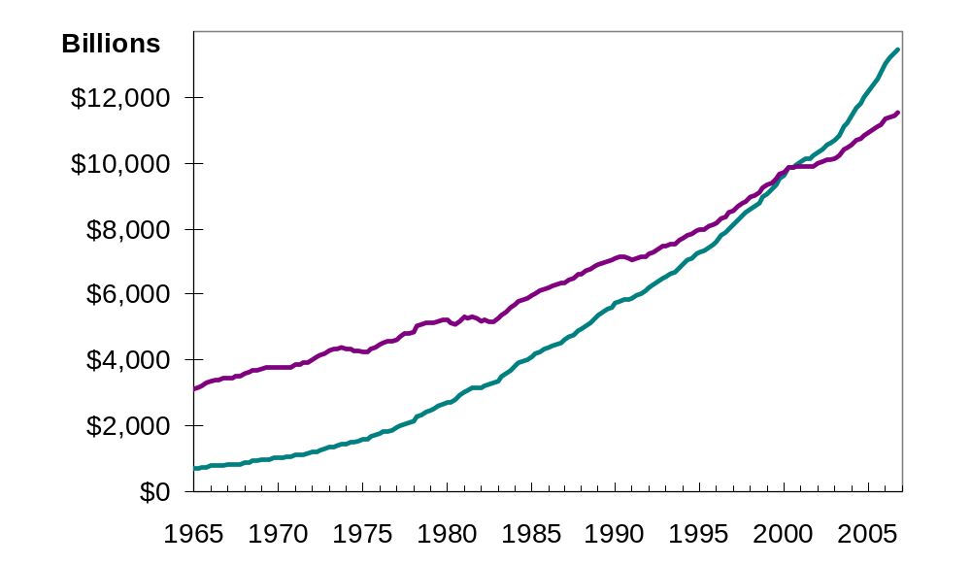
美国的名义GDP与真实GDP：
1965-2007
真实GDP(基年是2000年)
名义GDP
Notes:
The source I used: http://research.stlouisfed.org/fred2/
The original source: U.S. Department of Commerce: Bureau of Economic Analysis
Note: This graph is different than the one in this chapter of the textbook. The one in the textbook excludes nominal GDP, but includes shaded vertical bars over the dates of each recession.
Since you have just finished covering real vs. nominal GDP, it might be worthwhile pointing out the following to your students:
The graph shows that nominal GDP rises faster than real GDP. This should make sense, because growth in nominal GDP is driven by growth in output AND by inflation. Growth in real GDP is driven only by growth in output.
The two lines cross in the year 2000 (the base year for the real GDP data in this graph). This should make sense because real GDP equals nominal GDP in the base year. (Better yet, ask your students whether there’s anything significant about the point where the two lines cross.)
Before the base year, real GDP > nominal GDP. For example, in 1970, nominal GDP is about $1 trillion, while real GDP is about $3.8 trillion (in 2000 dollars). This should make sense because prices were so much higher in 2000 than in 1970, so using those high 2000 prices to value 1970 output would lead to a bigger result than valuing 1970 output using 1970 prices.
Similarly, after 2000, nominal GDP is higher than real GDP because prices are higher in later years than they were in 2000.

Slide 50
GDP平减指数
GDP平减指数是对总体价格水平的衡量
定义:
GDP平减指数= 100 x
名义 GDP
真实 GDP
衡量经济通货膨胀率的一种方法是计算从一年到下一年GDP平减指数增加的百分比
Notes:
The GDP Deflator gets its name because it is used to “deflate” (i.e., take the inflation out of) nominal GDP to get real GDP.

Slide 51
例：
年份 | 名义 GDP | 真实 GDP | GDP 平减指数
2005 | $6000 | $6000
2006 | $8250 | $7200
2007 | $10,800 | $8400
100.0
14.6%
114.6
12.2%
128.6
计算每年的GDP 平减指数：
2005: 100 x (6000/6000) = 100.0
2006: 100 x (8250/7200) = 114.6
2007: 100 x (10,800/8400) = 128.6

Slide 52
主动学习 2
GDP的计算
 | 2007 (基年) |  | 2008 |  | 2009
 | P | Q | P | Q | P | Q
物品 A | $30 | 900 | $31 | 1,000 | $36 | 1050
物品 B | $100 | 192 | $102 | 200 | $100 | 205
使用上述数据解决以下问题：
  A. 计算 2007年的名义GDP
  B. 计算2008年真实GDP
  C. 计算2009年的GDP平减指数
Notes:
The data in the table are for a hypothetical economy that produces two final goods, A and B. For all parts of this problem, use 2007 as the base year.
If you’re running short on time, you can skip part A – it’s the least challenging. If you only have time for one of the three, you might skip A and B, as C by itself covers all of the material: it requires students to compute nominal and real GDP before they can compute the GDP deflator.

Slide 53
主动学习 2
参考答案
 | 2007 (基年) |  | 2008 |  | 2009
 | P | Q | P | Q | P | Q
物品 A | $30 | 900 | $31 | 1,000 | $36 | 1050
物品 B | $100 | 192 | $102 | 200 | $100 | 205
A. 计算2007年的名义GDP
$30 x 900 + $100 x 192 = $46,200
B. 计算2008年的真实GDP
$30 x 1000 + $100 x 200 = $50,000

Slide 54
主动学习 2
参考答案
 | 2007 (基年) |  | 2008 |  | 2009
 | P | Q | P | Q | P | Q
Good A | $30 | 900 | $31 | 1,000 | $36 | 1050
Good B | $100 | 192 | $102 | 200 | $100 | 205
C. 计算2009年GDP平减指数
名义GDP = $36 x 1050 + $100 x 205 = $58,300
真实GDP = $30 x 1050 + $100 x 205 = $52,000
GDP平减指数 = 100 x (名义 GDP)/(真实 GDP)
= 100 x ($58,300)/($52,000) = 112.1

Slide 55
二、消费物价指数 (CPI)
0
衡量普通消费者的生活成本
在许多合同与社会保障中作为生活费用调整的依据

Slide 56
如何计算消费物价指数
0
固定 “篮子”
劳工统计局通过调查消费者找出普通消费者 “购物篮”中的物品
找出价格
劳工统计局收集购物篮中所有物品价格的数据
计算这一篮子东西的费用
用价格数据计算出这一篮子物品的费用

Slide 57
如何计算消费物价指数
0
选择基年并计算指数
任一年的CPI等于
100 x
当年一篮子物品与劳务的费用
基年一篮子物品与劳务的费用
计算通货膨胀率
从上一年以来物价指数变动的百分比
通货膨胀率
今年CPI – 去年CPI
=
x 100%
去年CPI

Slide 58
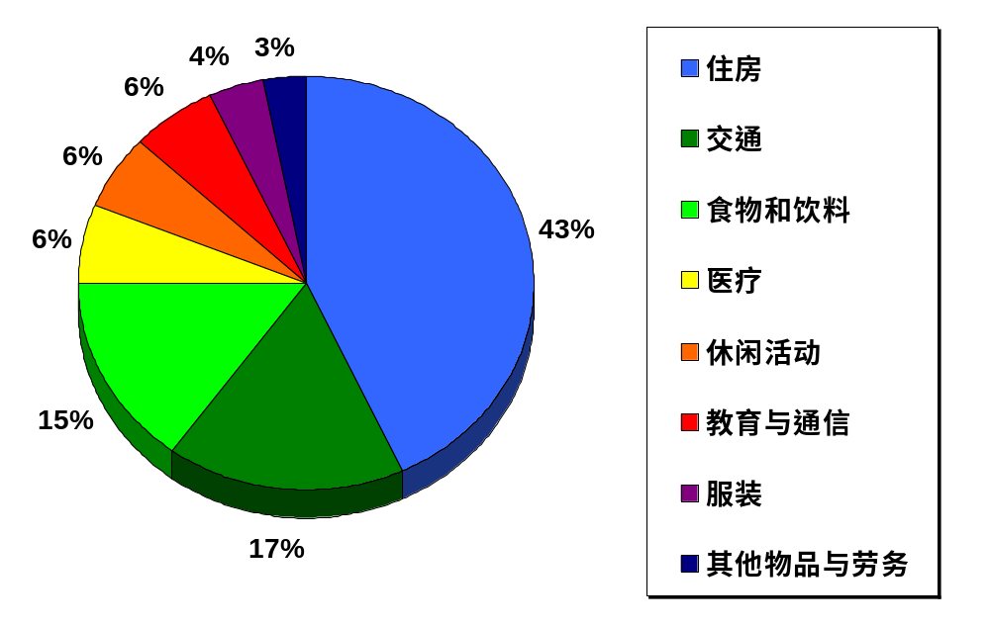
CPI的篮子中有些什么?
0
Notes:
This slide replicates Figure 1 from the textbook.
Source: Bureau of Labor Statistics, http://www.bls.gov/cpi/
This graph shows just a few highly aggregated categories. A more detailed breakdown is available at the BLS website: look for “Relative Importance of Components in the Consumer Price Index” there.

Slide 59
例：
0
篮子： {4 个皮萨, 10杯拿铁咖啡}
年份
皮萨价格
拿铁咖啡价格
篮子费用
2007
$10
$2.00
$10 x 4 + $2 x 10 = $60
2008
$11
$2.50
$11 x 4 + $2.5 x 10 = $69
2009
$12
$3.00
$12 x 4 + $3 x 10 = $78
计算每年的CPI
2007: 100 x ($60/$60) = 100
2008: 100 x ($69/$60) = 115
2009: 100 x ($78/$60) = 130
以2007年为基年
通货膨胀率:
115 – 100
15%
=
x 100%
100
130 – 115
13%
=
x 100%
115
Notes:
Suggestion: Show students the data in the first three columns of the table. Before showing them the cost of basket calculations, tell them to take 3 minutes to compute the cost of the basket in each of the three years, and use those results to compute the value of the CPI in each of the three years. Then, show the rest of the slide.
Or, you can just cruise through this example, but tell them to pay close attention because in a few moments they will have to compute a similar example.

Slide 60
主动学习 1
计算 CPI
0
 | 牛肉价格 | 鸡肉价格
2004 | $4 | $4
2005 | $5 | $5
2006 | $9 | $6
CPI篮子：
{10 磅牛肉,
20 磅鸡肉}
在2004年CPI篮子的费用是120 美元，以2004年为基年
A. 计算2005年的CPI
B. 2005年到2006年以CPI计算的通货膨胀率是多少
Notes:
Part A is not difficult but requires an intermediate step: students must compute the cost of the basket in 2005 to find the CPI in 2005.
Part B has two intermediate steps: computing the cost of the basket in 2006, then computing the CPI in 2006.

Slide 61
主动学习 1
参考答案
0
0
 | 牛肉价格 | 鸡肉价格
2004 | $4 | $4
2005 | $5 | $5
2006 | $9 | $6
CPI 篮子:
{10 磅牛肉,
20 磅鸡肉}
2004年CPI 的篮子费用是120 美元，以2004年为基年。
A. 计算2005年的 CPI :
2005年CPI篮子的费用
= ($5 x 10) + ($5 x 20) = $150
2005的CPI = 100 x ($150/$120) = 125

Slide 62
主动学习 1
参考答案
0
0
 | 牛肉价格 | 鸡肉价格
2004 | $4 | $4
2005 | $5 | $5
2006 | $9 | $6
CPI 篮子:
{10 磅牛肉,
20 磅鸡肉}
2004年CPI篮子的费用是120 美元，以2004年为基年
B.2005年到2006年以CPI计算的通货膨胀率是多少
2006年CPI篮子的费用
= ($9 x 10) + ($6 x 20) = $210
2006年的CPI = 100 x ($210/$120) = 175
CPI通货膨胀率 = (175 – 125)/125 = 40%

Slide 63
主动学习 2
替代偏向
0
CPI 篮子：
{10 磅牛肉,
20 磅鸡肉}
2004-5:
家庭购买CPI篮子
2006：家庭买 {5 磅牛肉, 25 磅鸡肉}
 | 牛肉 | 鸡肉 | CPI篮子的费用
2004 | $4 | $4 | $120
2005 | $5 | $5 | $150
2006 | $9 | $6 | $210
A. 计算2006年家庭购买篮子的费用
B. 以2005年6月家庭篮子费用来计算增长率，并与CPI通货膨胀率比较
Notes:
Students understand substitution bias better if they work a concrete example like the one on this slide.
Before displaying the questions (A + B), you might want to ask your class why households bought different quantities of beef and chicken in 2006 than they did in 2005.
Or if that seems too easy, just mention before displaying questions A and B that households are responding to the change in relative prices: beef has become a lot more expensive relative to chicken, so households buy less beef and more chicken.

Slide 64
主动学习 2
参考答案
CPI 篮子：
{10 磅牛肉,
20 磅鸡肉}
家庭在2006年购买篮子：
{5 磅牛肉, 25 磅鸡肉}
 | 牛肉 | 鸡肉 | CPI篮子的费用
2004 | $4 | $4 | $120
2005 | $5 | $5 | $150
2006 | $9 | $6 | $210
A. 计算2006年家庭购买篮子的费用
($9 x 5) + ($6 x 25) = $195
Notes:
This is just a straight-forward calculation.

Slide 65
主动学习 2
参考答案
CPI 篮子：
{10 磅牛肉,
20 磅鸡肉}
家庭在2006年购买篮子：
{5 磅牛肉, 25 磅鸡肉}
 | 牛肉 | 鸡肉 | CPI篮子的费用
2004 | $4 | $4 | $120
2005 | $5 | $5 | $150
2006 | $9 | $6 | $210
B. 以2005年6月家庭篮子费用来计算增长率，并与CPI通货膨胀率比较
增长率：($195 – $150)/$150 = 30%
由问题1得出的CPI通货膨胀率 = 40%
Notes:
Ask students which inflation rate (30% or 40%) they think more accurately measures the true increase in the cost of living for this example.
Most students will correctly say “30%.” Ask them to explain their reasoning. You are guiding them to figure out substitution bias and why it’s a problem.

Slide 66
CPI存在的问题:替代偏向
0
当价格年复一年地变动时，一些物品的价格上升得比另一些快一些
消费者用那些变得不太昂贵的物品来替代
CPI没有考虑这种替代，因为它使用了一篮子固定不变的物品
因此CPI高估了生活费用的增加
Notes:
If you spent a few minutes of class time on the preceding exercise, you can go through this slide fairly quickly.

Slide 67
CPI存在的问题:新产品的引进
0
新产品的引进增加了产品的种类，允许消费者选择那些更满足他们需求的产品
从而每一美元变得更值钱
由于CPI使用的是一篮子固定的物品，它没有考虑到这种影响
因此CPI高估了生活费用的增加

Slide 68
CPI存在的问题:无法衡量的质量变动
0
篮子中物品质量的提高增加了每一美元的价值
劳工统计局试图统计质量的变动，但还是漏掉了一些，因为质量是难以衡量的
因此CPI高估了生活费用的增加

Slide 69
CPI存在的问题
0
上述的这些问题都使CPI高估了生活费用的增加
劳工统计局已经进行了一些技术调整，但 CPI仍然可能每年高估了0.5%的通货膨胀
这很重要，因为社会保障补助以及许多合同都会根据CPI进行通货膨胀调整
Notes:
In the 1990s, it was estimated that the CPI’s bias cost taxpayers $1 trillion every 12 years in unnecessary COLAs in Social Security and government pension payments!!!

Slide 70
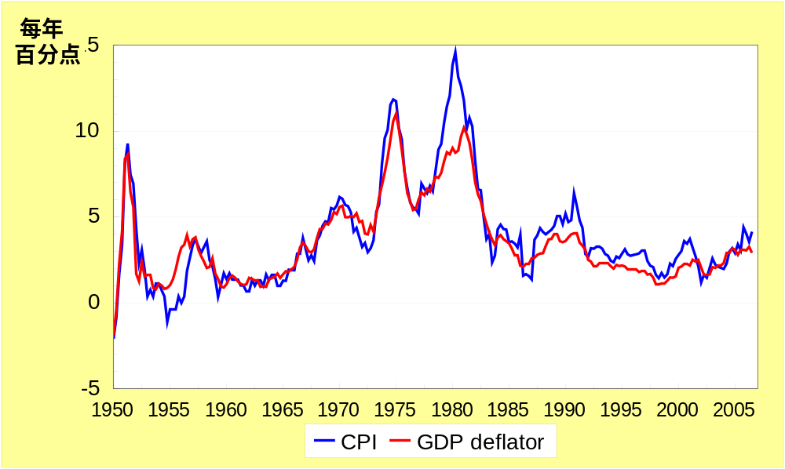
通货膨胀的两个衡量指标：1950-2007
0
MEASURING THE COST OF LIVING
Notes:
This figure shows the inflation rate – the percentage change in the level of prices – as measured by the GDP deflator and the Consumer Price Index using quarterly data from the U.S. economy.
Notice that the two measures of inflation generally move together. There are a few years when they diverge a bit. The reasons for this are on the next slide.
Sources:
GDP deflator – Bureau of Economic Analysis, U.S. Dept of Commerce
CPI – Bureau of Labor Statistics, U.S. Dept of Labor
I obtained both from the Federal Reserve Bank of St. Louis “Fred” database:
http://research.stlouisfed.org/fred2/

Slide 71
CPI与GDP平减指数的对比
0
进口消费物品：
  包含在CPI内
  不包含在GDP平减指数内
资本商品:
  不包含在CPI内
  包含在GDP平减指数内 (如果是在国内生产)
篮子：
  CPI用固定的篮子
  GDP平减指数用一篮子现期生产的物品和劳务
  如果不同物品与劳务价格的变动量不同，我们对各种价格加权的方法对于整个通货膨胀率就是至关重要的
MEASURING THE COST OF LIVING

Slide 72
主动学习 3
CPI与GDP平减指数
在下列情况下，说出对CPI和GDP平减指数的影响
  A. 星巴克提高了卡布奇诺咖啡的价格
  B. 福特汽车制造商提高了它在美国生产的大排量轿车的价格
  C. 亚曼尼提高了它在美国销售的意大利牛仔的价格
Notes:
To make this exercise more challenging, move the preceding slide so that it appears immediately after the answers to this exercise.
If you are outside the U.S., please make the following changes:
In (b), change the example to “A local manufacturer raises the price on industrial tractors it produces.”
In (c), change “U.S.” to your country’s name, unless your country is Italy. In that case, change the example to something involving an imported consumer good.

Slide 73
主动学习 3
参考答案
A. 星巴克提高了卡布奇诺咖啡的价格
CPI和GDP平减指数都上升了
B. 福特汽车制造商提高了它在美国生产的大排量轿车的价格
CPI和GDP平减指数都上升了
C. 亚曼尼提高了它在美国销售的意大利牛仔的价格
CPI上升，GDP平减指数不变
Notes:
Explanations:
A. Frappuccinos are produced in the U.S., so their prices are part of the GDP deflator. They are purchased by consumers, so their prices are part of the CPI. Hence, an increase in the price of Frappuccinos causes both the CPI and GDP deflator to increase.
B. Since the tractors are produced here in the U.S., the price increase causes the GDP deflator to rise. However, industrial tractors are a capital good, not a consumer good, so the CPI is unaffected.
C. Italian jeans appear in the U.S. consumer’s shopping basket, and hence the increase in their price causes the CPI to rise. However, the GDP deflator is unchanged because it only includes prices of domestically produced goods and excludes the prices of imports.

Slide 74
失业及其衡量
思考：
为什么我们要研究失业？
失业会带来什么问题？

Slide 75
失业是损失：
经济成本—奥肯定理：
GDP每增加2%，失业率大概下降1个百分点。
社会成本：贫富分化，社会矛盾扩大。
美国学者统计：失业每增加1％，犯罪增加4％，自杀率增加4.1%,精神病增加4.3%；工人失业后，1／8夫妻分居，20％失眠，28％头疼，21％胃病。

Slide 76
其他指数
※痛苦指数MI（1975年由美国民主党人提出）
痛苦指数＝失业率＋通胀率
失业

Slide 77
劳动力数据
0
劳工统计局（ BLS ）把受调查家庭中的成年人分为三个类别：
  就业者： 包括作为得到报酬的员工而工作的人，在自己的企业里工作且得到报酬的人，以及在家族企业里工作但拿不到报酬的人
  失业者： 包括能够工作且在之前4周内努力找工作但没有找到工作的人
  非劳动力： 不属于前两个类别的人
劳动力 定义为就业者和失业者之和
Notes:
Good idea:
Tell students to take good notes on this slide and the following one, because in a moment they will have to use these definitions to solve a problem. You can tell them the problem is very similar to what they might see on their next exam – that always gets their attention!

Slide 78
劳动力数据
0
失业率：
失业者占劳动力的百分比
失业率
= 100 x
失业者人数
劳动力
劳动力参工率：
劳动力占成年人口的百分比
劳动力参工率
= 100 x
劳动力
成年人口
失业
Notes:
Many of the following slides abbreviate “unemployment rate” as “u-rate” to reduce slide clutter and to reduce the note-taking burden on students.

Slide 79
主动学习 1
计算劳动力数据
用以下数据计算劳动力，失业率， 成年人口和劳动力参工率
美国成年人口的分类：2008.6
就业者 | 1.459 亿
失业者 | 8.5 百万
非劳动力 | 79.20 百万
Notes:
This exercise gives students immediate reinforcement and application of the concepts on the preceding slides. It prepares them for some of the kinds of questions they might see on your exam. And it gives them a sense of the actual magnitude of these statistics in the U.S. in a recent month.
Suggestion: Before lecturing on this chapter, update the numbers in this table (and in the answers that follow) using the latest available data, which you can find here:
Data source: Bureau of Labor Statistics, U.S. Department of Labor
http://www.bls.gov, look for latest “Employment Situation Survey”

Slide 80
主动学习 1
参考答案
劳动力 = 就业者 + 失业者 = 1.459 + 0.085
= 1.544 亿
失业率 = 100 x (失业者人数)/(劳动力)
= 100 x 8.5/154.4
= 5.5%
Notes:
Your students may get slightly different answers due to rounding differences.

Slide 81
主动学习 1
参考答案
成年人口 = 劳动力 + 非劳动力
= 154.4 + 79.2
= 233.6 百万
劳动力参工率 = 100 x (劳动力)/(成年人口)
= 100 x 154.4/233.6
= 66.1%
Notes:
Your students may get slightly different answers due to rounding differences.

Slide 82
失业的类型
充分就业
定义：充分就业不是指完全就业，而是指失业率保持在自然失业率时候的就业。或者说一切生产要素都有机会以自己愿意的报酬参加生产的状态。
失业类型
摩擦失业——在生产过程中由于难以避免的摩擦如劳动力流动性不足、工种转换困难等造成的短期、局部性失业 。

Slide 83
结构性失业是劳动力供给结构与劳动力需求结构不一致造成的失业。特点是既有失业又有职位空缺，失业者或者没有合适的技能，或者居住地点不当，因此无法填补现有得职位空缺。
自然失业率为摩擦性失业率及结构性失业率加总之和。

Slide 84
自愿失业——工人不愿意接受现行工资水平而造成的失业。
非自愿失业——愿意接受现行工资但仍找不到工作的失业。
自然失业率——凯恩斯认为如果非自愿失业已经消除，失业仅限于摩擦性失业和自愿失业的话，就实现了充分就业。

Slide 85

小 结
1.国内生产总值及最终产品的含义。
2.国民生产总值与国内生产总值的区别。
3.GNP/GDP的三种核算方法。
4.国民收入核算中五个总量的含义及其相互关系。

Slide 86
小 结
5、名义国内生产总值与实际国内生产总值的区别及其折算方法——GDP平减指数。
6、CPI、CPI衡量中的三大问题、CPI和GDP平减指数的区别；
7、失业及其衡量。

