Slide 1
MS Spectra Analysis
General procedure for MS spectra analysis
Examples for MS spectra analysis

Slide 2
General procedure for MS Spectra analysis
Determine the elemental composition of the molecular and fragment ions
Molecular ion discrimination
Mass overview of the molecule and determine the molecular type
Molecular structure speculation
Confirm the molecular structure

Slide 3
1. Determination of molecule composition
HR-MS
Isotope abundance calculation

Slide 4
2. Molecular ion discrimination
N-Rule
  m/z is even: no or even number of N
  m/z is odd: odd number of N
Reasonable Neutral Loss

Slide 5
3. MS spectra overview
For structural information
m/z: molecular/fragment ion
Abundance: ion stability
Ion amounts and distribution: molecule type and functional groups

Slide 6
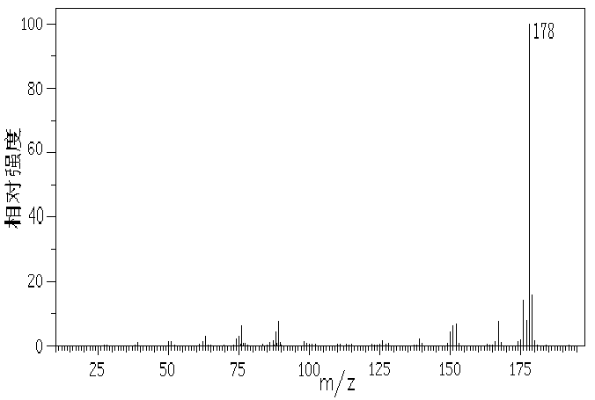
Compound A
Base peak: highest m/z, probably molecular ion
Fragment ions: low abundance
Hmmm…fused aromatic rings?

Slide 7
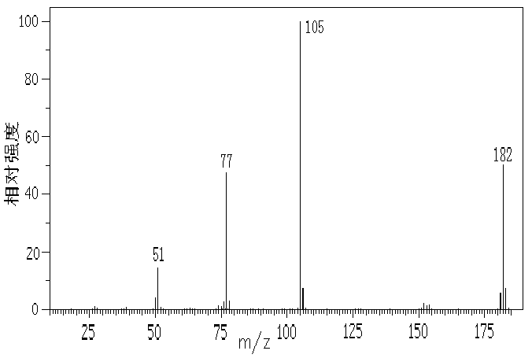
Compound B
m/z 182 with high abundance，molecular ion?
Few fragment ions
m/z 182 and m/z 105, 182-105 = 77; m/z 77
Hmmm…two single bond linked phenyl rings?
Notes:
质核比最大的离子(m/z 182) 丰度较强，低质量端碎片离子少，强度弱，这与未知物A相似，但在m/z 182和基峰105之间有一个很大的间隔，表明该分子有两个稳定的结构单元，二者之间有较弱的键相连。

Slide 8
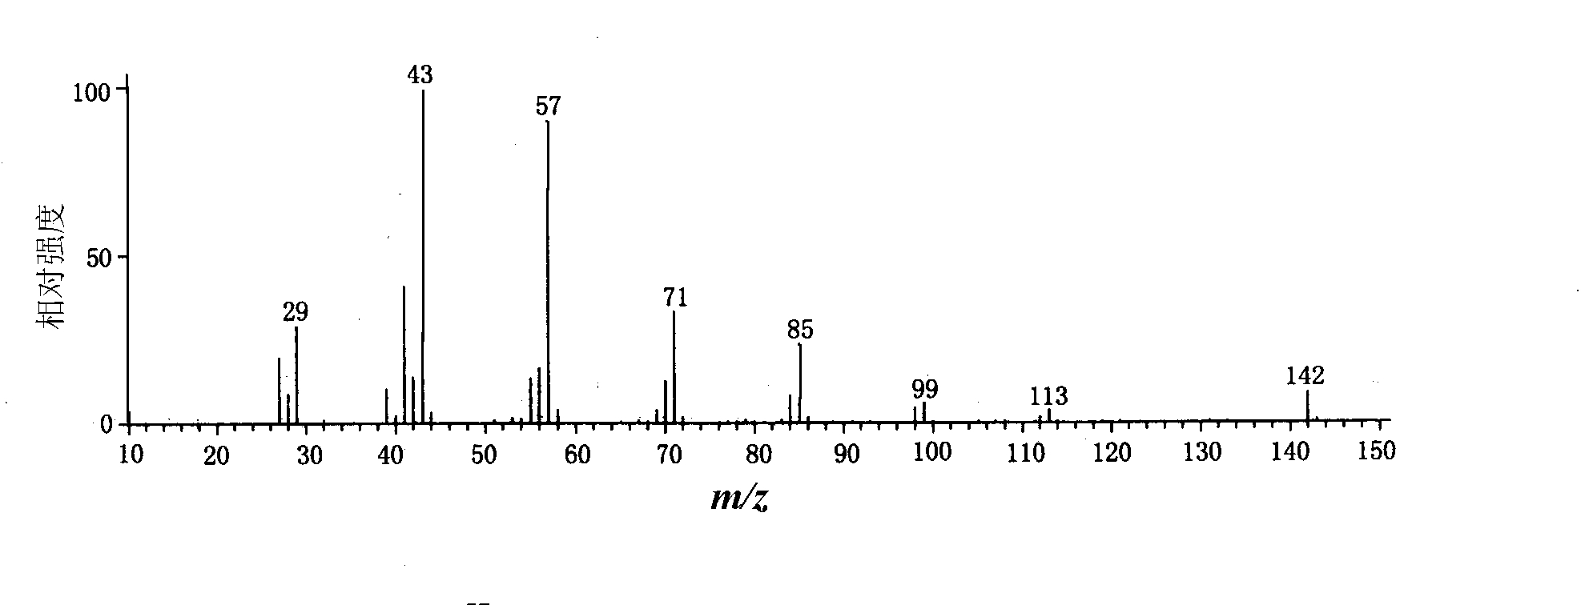
Compound C
Low abundance for high m/z ions
m/z 43 & 57, strongest
Fragment ions with Δm/z 14
Hmmm…aliphatic alkane?
Notes:
高质量端离子丰度很低，低质量端的离子又多又强，且有相同质量间隔（14）的一系列离子峰，说明可能是具有长的烷基链得脂肪族化合物。

Slide 9
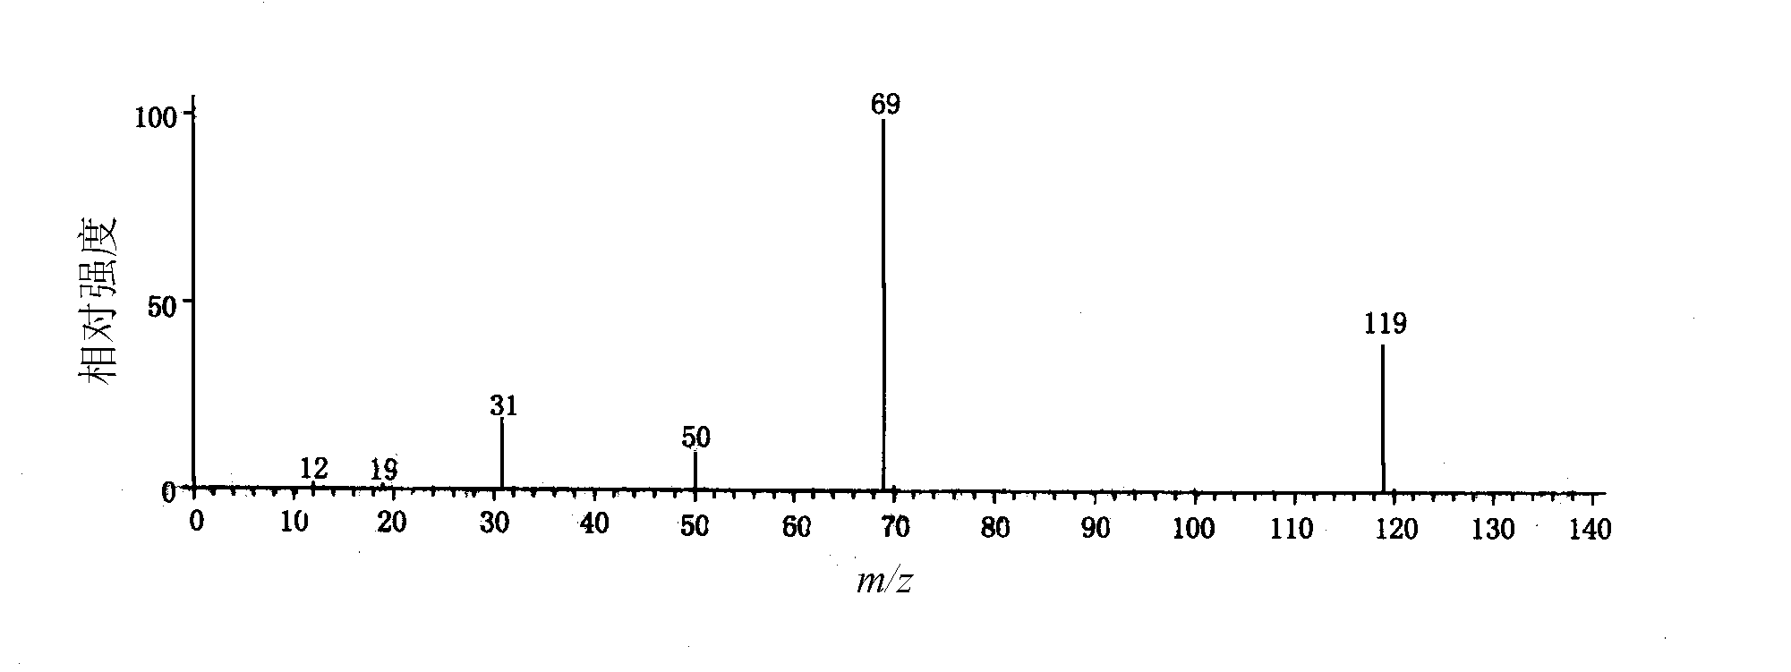
Compound D
Lonely, lonely fragment ions…molecules that with few H.
Notes:
该图十分特殊，离子峰都很孤单，重同位素峰（A+1）丰度非常小，推测该化合物含有A类元素-单同位素原子（F、P、I），质核比小的一侧没有伴随峰，说明分子中不含或只含很少个氢原子。

Slide 10
a. Low molecular weight ions
4. Molecular structure speculation
group | composition | m/z
Alkyl | C_{n}H_{2n+1}^{┑+} | 15、29、43、57、71、85…
Aldehyde/ketone | C_{n}H_{2n－1}O^{┑+} | 29、43、57、71、85…
Amine | C_{n}H_{2n+2} N^{┑+} | 30、44、58、72、86…
Amide | C_{n}H_{2n}NO^{┑+} | 44、58、72、86…
Ether/alcohol | C_{n}H_{2n+1}O^{┑+} | 31、45、59、73、87…
Carboxylic acid/ether | C_{n}H_{2n－1}O₂^{┑+} | 45、59、73、87…
Thiol/sulfide | C_{n}H_{2n+1} S^{┑+} | 33、47、61、75、89…
Alkene/cylcoalkane | C_{n}H_{2n－1}^{┑+} | 27、41、55、69、83…
Aromatics | C_{n}H_{m} ^{┑+}_{（m≤n）} | 38、39、50~52、63~65、75~78

Slide 11
Notes：
  Different fragment ions would have same m/z. e.g. m/z 29+14n for both alkanes and ketones
  Same fragment ion would have different abundances in different compounds. e.g. high abundance of C_{n}H_{2n+1}^{┑+} in alkanes but much lower in alkylbenzenes and long chain carboxylic acids.
  Not all fragment ions would appear in spectra

Slide 12
b. High molecular weight ions — small neutral losses
Directly fragmented from molecular ions, very meaningful for spectra analysis
Analysis of large m/z ions is always from neutral losses. e.g.[M－1]⁺、[M－15]⁺、[M－18]⁺、[M－20]⁺ presents H·、CH_{3·}、H₂O and HF。

Slide 13
ion | Fragment loss | Possible structures
M-1 | H• | Aldehyde, fluoride, some ether/amine
M-15 | CH₃• | methyl
M-18 | H₂O | alcohol，saccharides, dicarboxylic acid
M-26 | C≡N,CH ≡CH | Aliphatic cyanine、aromatics
M-28 | C₂H₄， | Retro-DA，McLafferty
 | CO | phenol，aromatic aldehyde，cycloketone
M-29 | CHO，C₂H₅ | Aldehyde, ethyl
M-34 | H₂S | Thiol
M-35 | Cl | chloride
M-36 | HCl
M-43 | CH₃CO，C₃H₇ | Methylketone, propyl
M-45 | COOH | Carboxylic acid
M-60 | CH₃COOH | ester

Slide 14
6. Feature ions
Very characteristic fragment ions for certain type of compounds. e.g. m/z 91 for benzyl；m/z 31 for primary alcohol.
Singly-charged ions from McLafferty rearrangement or elimination are always feature ions.
Those tables in the books…e.g. P51

Slide 15
Feature Ions
ions | Possible structures | m/z
CHO、C₂H₅ | Aldehyde, ethenyl | 29
CH₂NH₂ | Primary amine | 30
CH₃CO、C₃H₇ | Methylketone, propyl | 43
C₂H₅、C₃H₇ etc. | alkyl | 29、43、57、71
Aromatics | Aromatics | 39、50~52、63~65、75~78
CH₂COOH +H (McLafferty) | Carboxylic acid | 60
C₆H₅CH₂ | benzyl | 91
C₆H₅CO | Benzoyl | 105

Slide 16
5. Confirm the molecular structure
Always confirm the molecular structure with the standard MS spectra!
Well…if you have it…

Slide 17
2. Examples for MS spectra analysis

Slide 18
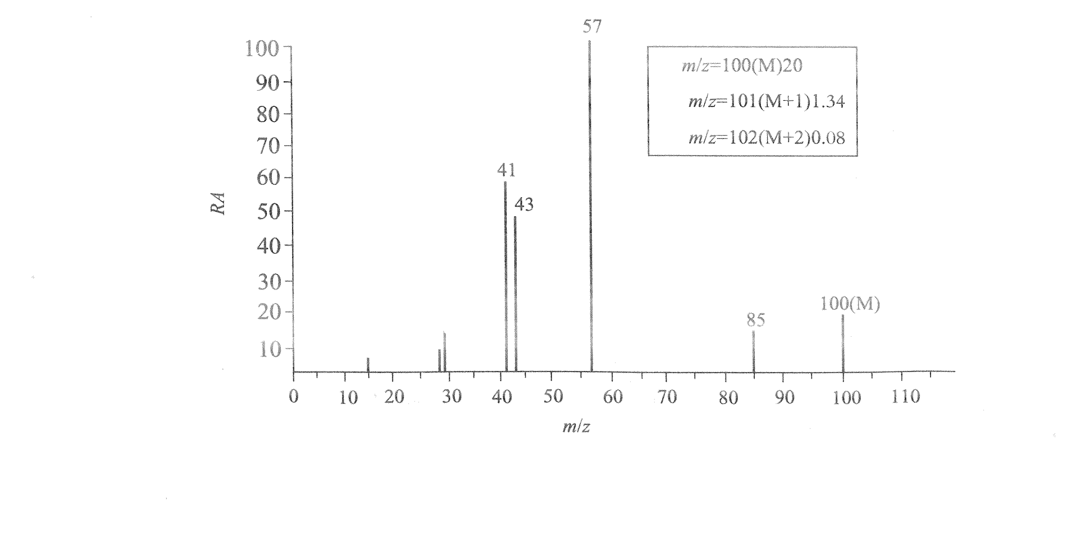
e.g.1 Molecular Structure?

Slide 19
Analysis:
M=100，［M+1]/[M]/1.1% → C₆H₁₂O.carbony?
m/z 85，methyl
m/z57 C₄H₉+ ?;
m/z43 CH₃C ≡ O⁺ ?

Slide 20
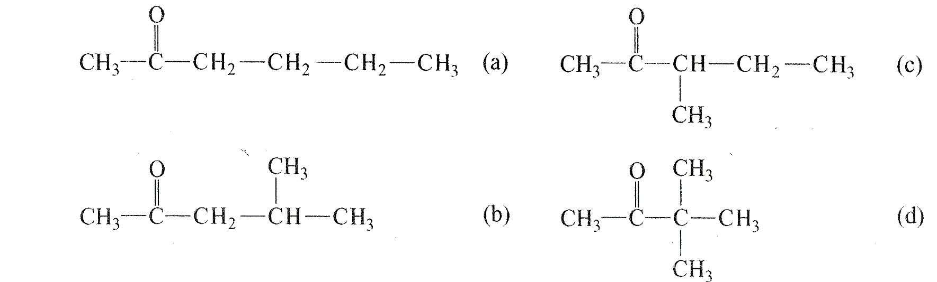
Probable Structure：

Slide 21
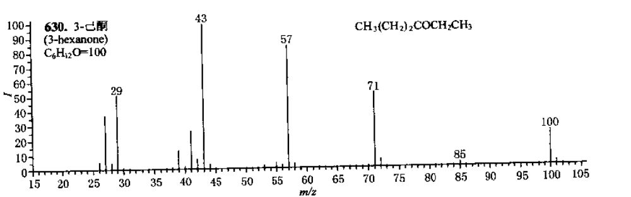

Slide 22
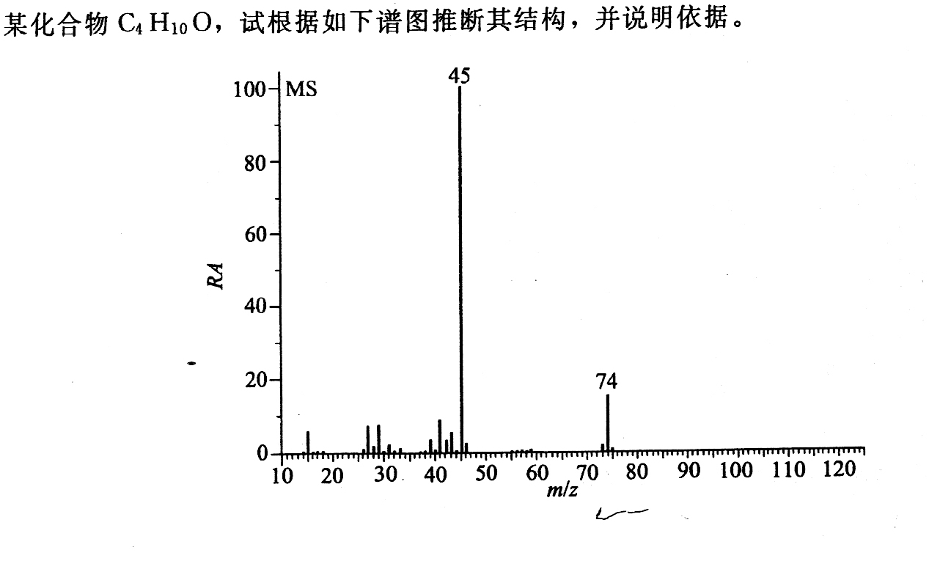
e.g.2

Slide 23
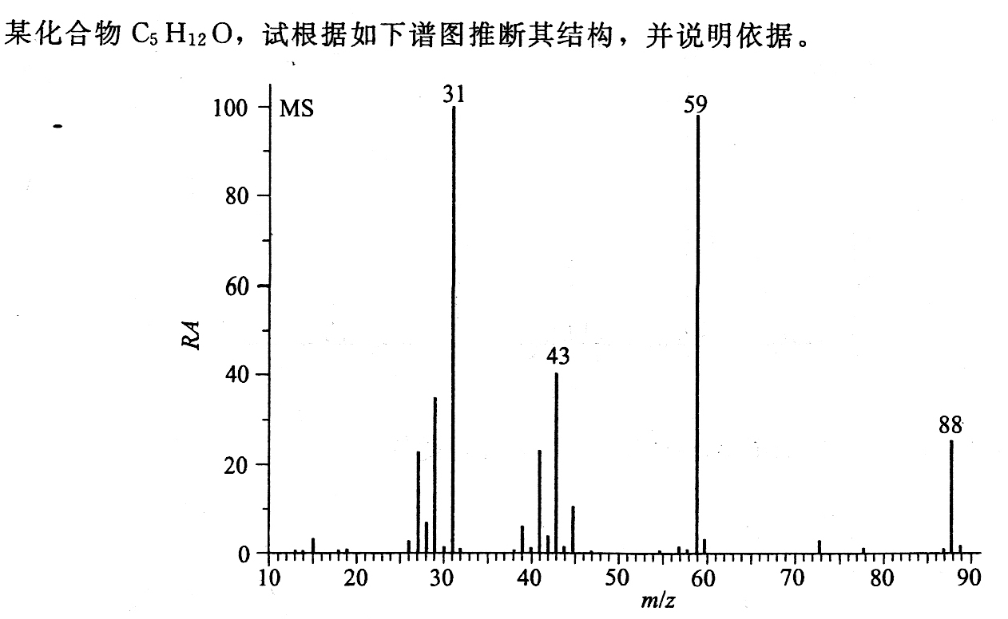
e.g.3

Slide 24
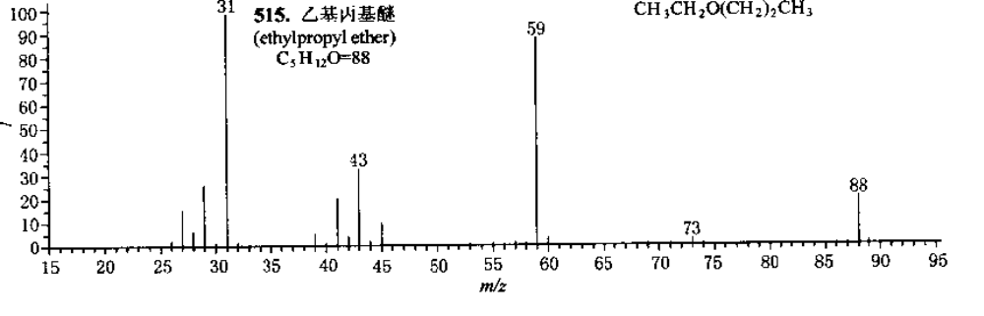

Slide 25
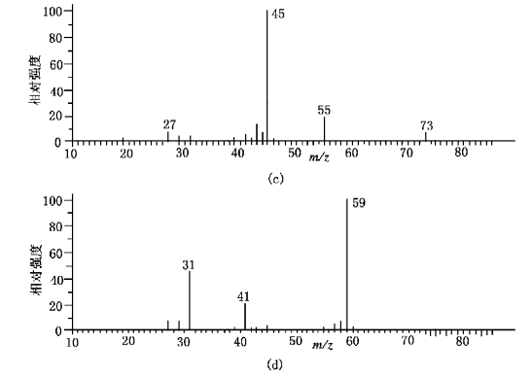
e.g.5
C₅H₁₂O for both MS spectra, molecular structures?

Slide 26
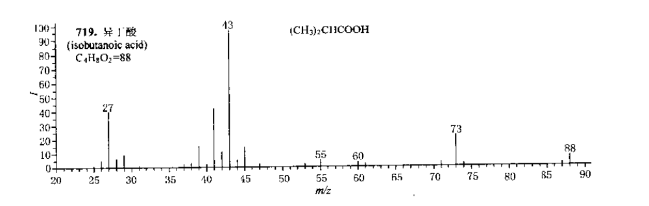

Slide 27
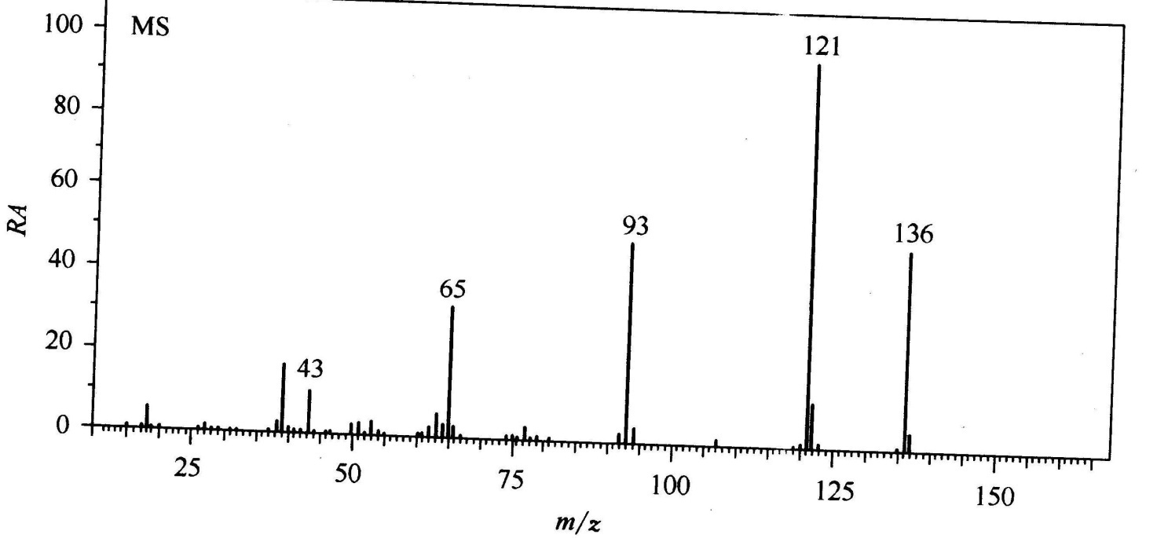
e.g.6
MS spectra of an unknown compound with the molecular formula of C₈H₈O₂. Structure?

Slide 28
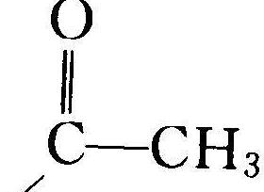
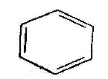
Molecular ion m/z 136
Unsaturation 5
1 Benzene
m/z121,m/z136, Δ m/z 15,（－CH₃)
m/z93, m/z136, Δ m/z 43,（－COCH₃)
Therefore, we have fragments like:

Slide 29
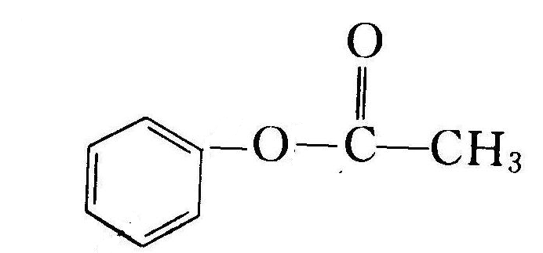
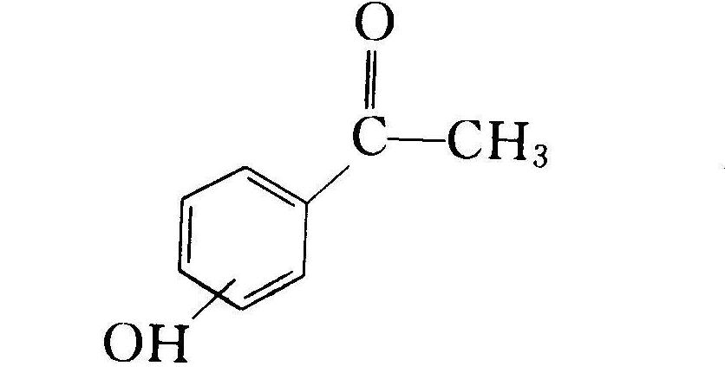
(1) (2)

Slide 30
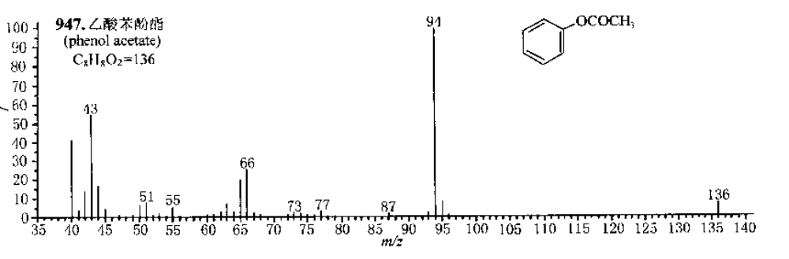

Slide 31
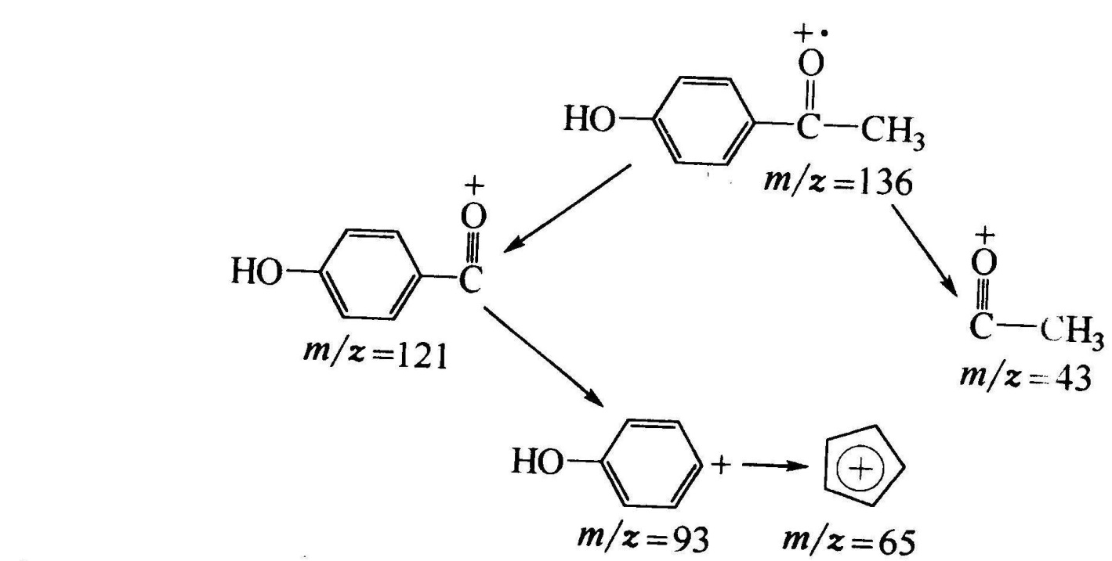
Possible fragmentation：

Slide 32
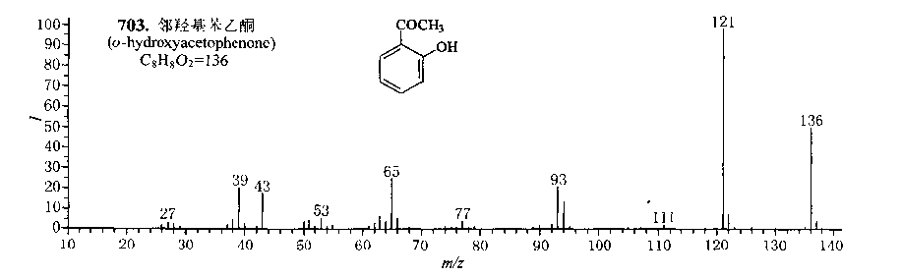
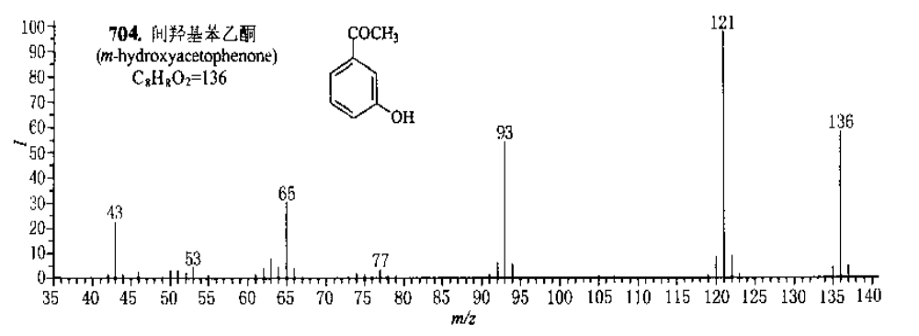
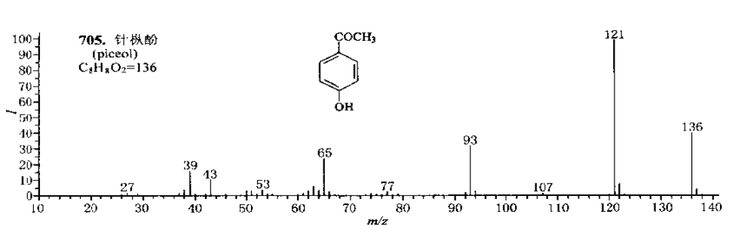

Slide 33
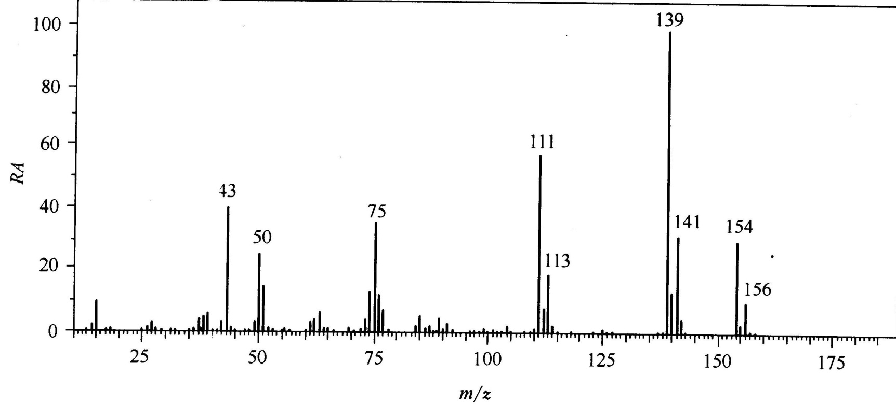
e.g.9
Unknown compound with m/z154 as molecular ion，structure?

Slide 34
m/z156:m/z154=3:1,1 Cl
m/z139，m/z154， Δ m/z 15 （－CH3)
m/z111，m/z154， Δ m/z 43（－COCH₃ or -C₃H₇)
m/z77,51，1 Benzene
m/z43,－COCH₃ or -C₃H₇
So, we have:
, Cl, －COCH₃, -C₃H₇

Slide 35
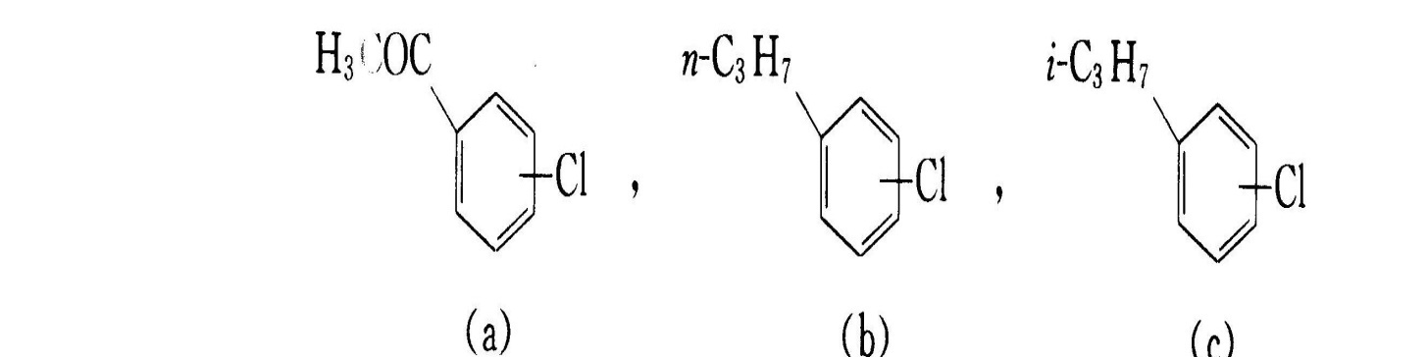

Slide 36


Slide 37
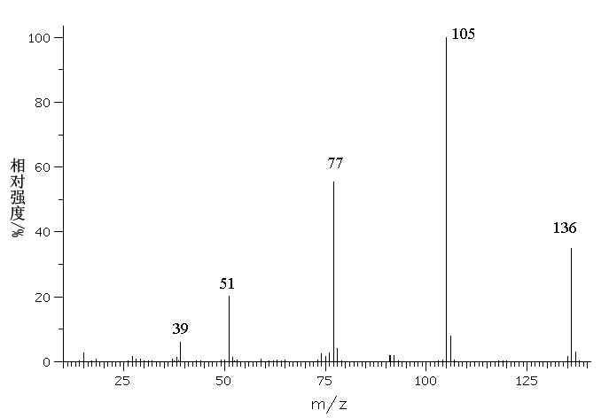
例：已知某化合物质谱如下，试推测其结构(m/z = 137与m/z = 136的离子强度比为9:100）。

Slide 38
1) 解析分子离子峰区域
分子离子峰较强
根据M+1/M = 9.0%，可知分子约含8个碳；
取C6~C10进行计算：
a. C₉H₁₂O (f = 4) b. C₈H₈O₂ (f = 5) c. C₇H₄O₃ (f = 6)
2) 解析碎片离子区域
m/z = 39, 51, 77，说明有苯环存在;
m/z = 105，说明有C₆H₅C≡O⁺存在，为分子离子失去.OCH₃或.CH₂OH形成；

Slide 39
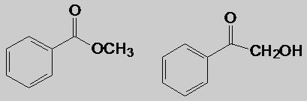
3) 列出可能结构单元
C₆H₅CO(Ω= 5), CH₃O 或CH₂OH 排除a,c
剩余结构：0
4) 确定可能结构
若为后者，质谱中应有明显的m/z = 31峰；
故应为a结构；
5) 验证结构
写出裂解过程（略）

