Slide 1


Mechanism of Fragmentation
Heterolytic and Homolytic Cleavage
  Homolytic cleavage Two bonding electrons are belong to two fragments, respectively, during the bond cleavage. Only one electron transfers during the cleavage. Presented as“ ”. Homolytic cleavage often takes place in σ bond.
CH₃──CH₃^{┐+ ·} ─→ CH₃ · + CH₃ ⁺

Slide 2

  Heterolytic cleavage A pair of electrons transfer to one fragment during the cleavage. Presented as “ ”.
  CH₃－CH₂──Br^{+ ·} ─→ CH₃－CH₂⁺ + Br·

Slide 3
Odd number electron(OE^{+•}) & Even number electron(EE⁺)
fragmentation
───→ ABC＋ ＋ D ·
fragment ion neutral piece
（EE⁺） (radicals)
ABCD＋·
Molecular Ion rearrangement
（OE＋ ·） ───→ AD＋ · ＋ BC
fragment ion neutral piece
（OE＋·） （molecule）
With one unpaired electron
Without unpaired electron
──→ AB＋ ＋ C
fragment ion neutral piece
fragmentation （EE⁺） (molecule)
ABC＋ ───→
fragment ion
（EE＋） ─×→ AB＋ · ＋ C ·
fragment ion neutral piece
（OE＋·） （radicals）
EE＋ fragment ions are more stable
Notes:
带有一个不成对电子的离子----------OE^{+•}，较不稳定，易发生碎裂。
没有不成对电子的离子-------- EE⁺，较稳定，二级碎裂时，只能生成偶电子离子。

Slide 4
1. Principles of Fragmention
Electrons with the lowest ionization potential are the most intend to lose in the molecule, the resulted positive charge and radical are consequentially located on the position of the lost electrons.
Ionization potentials：
  n ~ 9.8eV
  π ~ 10.6eV
  σ ~ 11.5eV

Slide 5
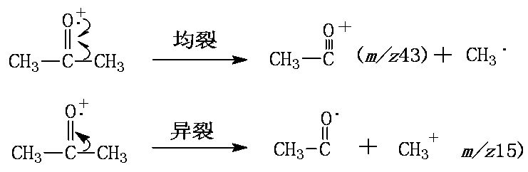
The cause of fragmentation:
  Impact energy is larger than chemical bond energy
  Homolytic cleavage via single electron pairing intention
  Heterolytic cleavage via induction of positive charges
Methyl radical is more stable than methyl cation, thus homolytic cleavage is favored with m/z43 as the base peak

Slide 6
Fragment ions are in a large amount and very complex
That’s why we need to know the principle of fragmentation
The relative abundance of fragment ions is decided by their relative stability

Slide 7
2. Fragmentation of Cations
Normal Fragmentation
  σ-homolytic cleavage
  α-cleavage
  i-cleavage
Rearrangment
  Rearrangement with H
  Rearrangement with functional groups
Complex fragment
Notes:
前面讲了质谱碎裂的一般规律及影响因素。

Slide 8
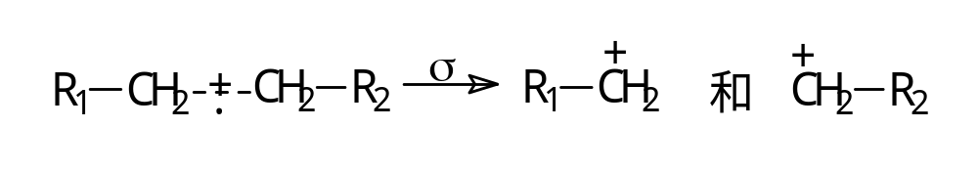
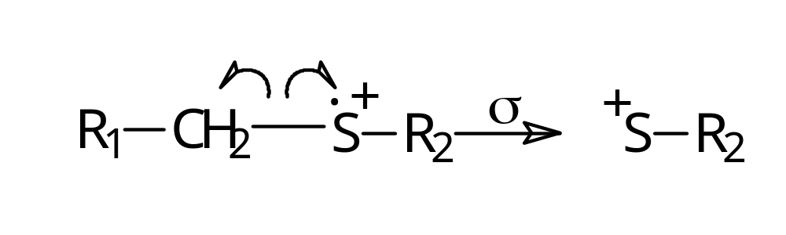
a. Normal Fragmentation
σ- homolytic cleavage
  Resulted in two fragment cations

Slide 9
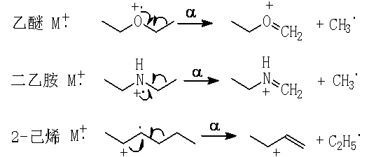
α- cleavage：
Homolytic cleavage at α-position via radicals
Compounds with α-cleavage：Carbonyl, alcohol, ether, amine, alkene, aromatics

Slide 10
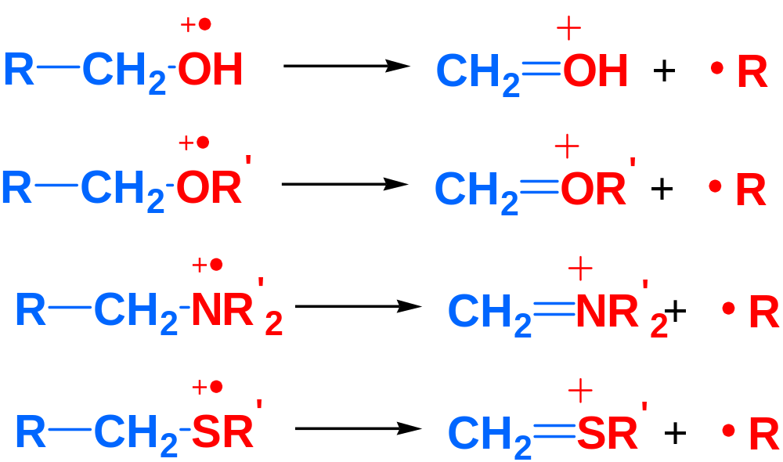
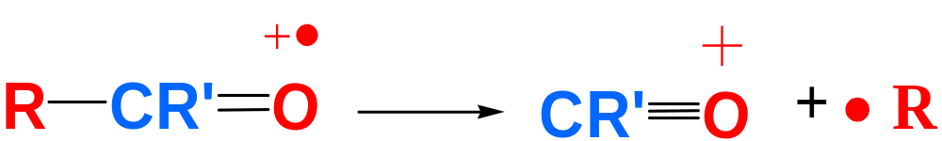
α―断裂
Notes:
Z是杂原子

Slide 11
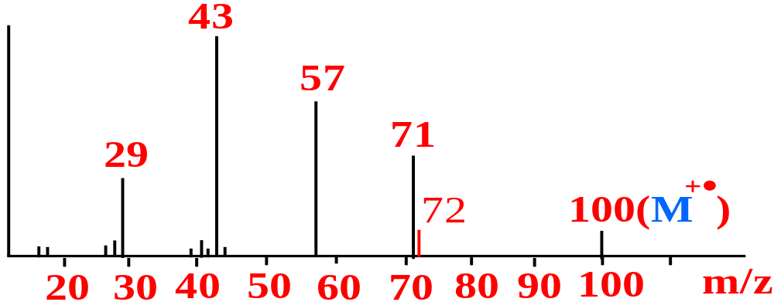
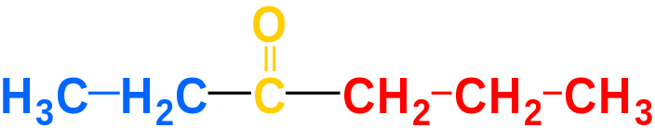
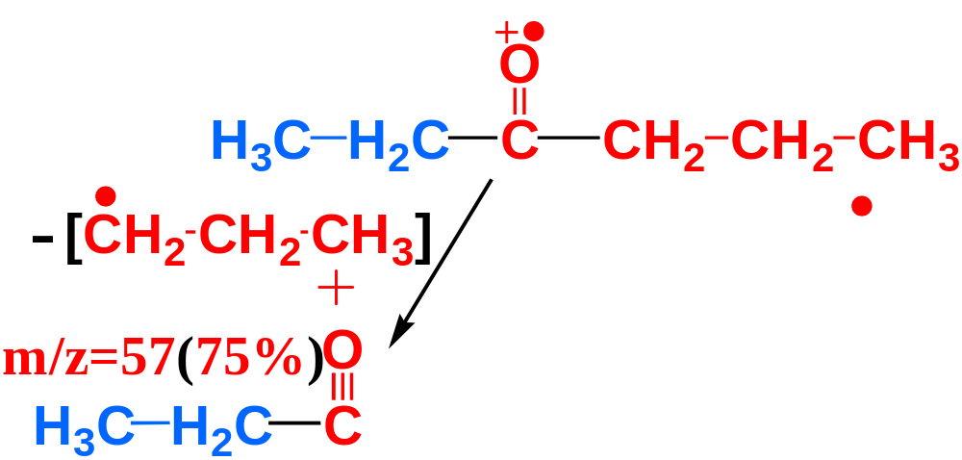
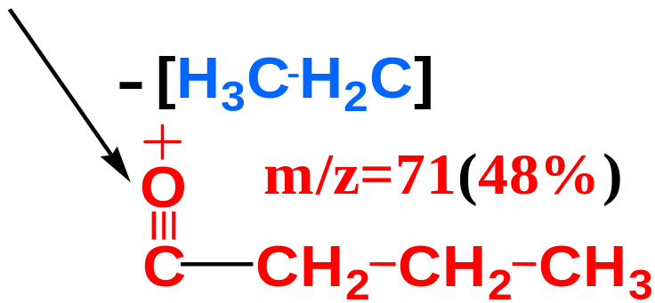

Slide 12
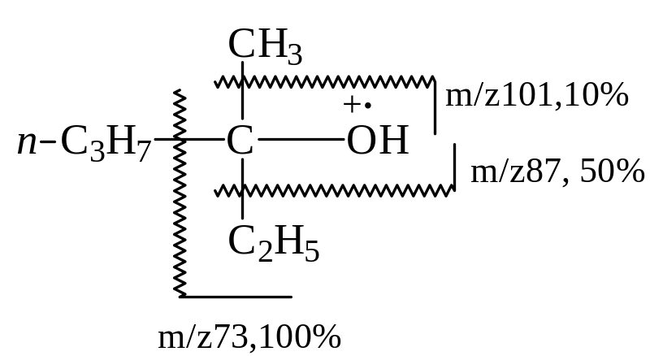
Maximum Alkyl Loss

Slide 13
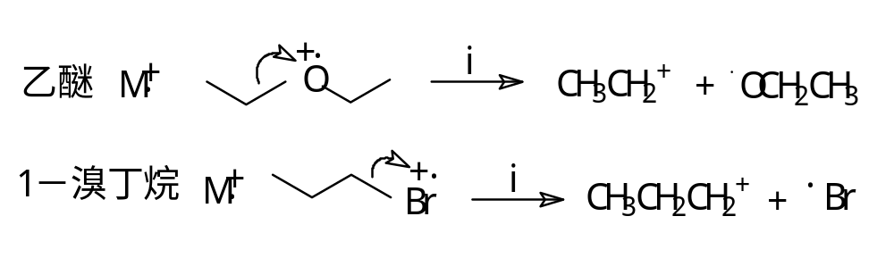
i-cleavage
  Heterolytic cleavage induced by cations and accompanied by the transfer of the positive charge.

Slide 14
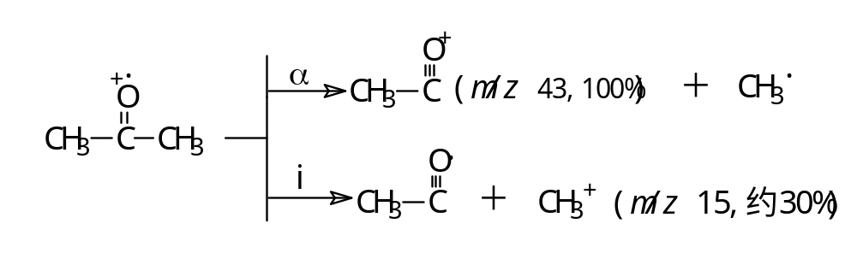
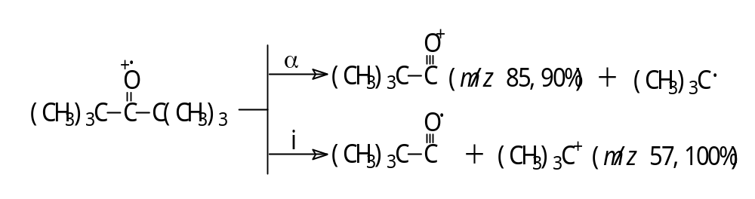
α-cleavage and i-cleavage are competitive reactions
Notes:
α-断裂与i-断裂是两种相互竞争的反应。 N 一般进行α-断裂；卤素则易进行 i-断裂

Slide 15
b. Rearrangement
  Rearrangement with H
  McLafferty Rearrangement (麦氏重排)
Unsaturated group
γ - H

Slide 16
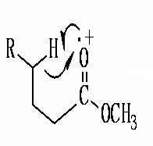
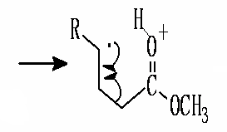
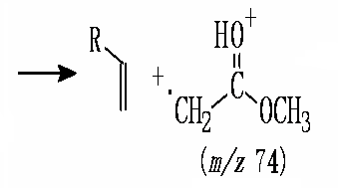
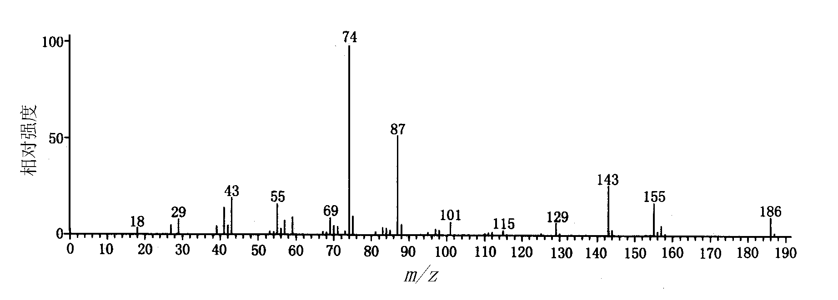
Methyl Decanoate

Slide 17
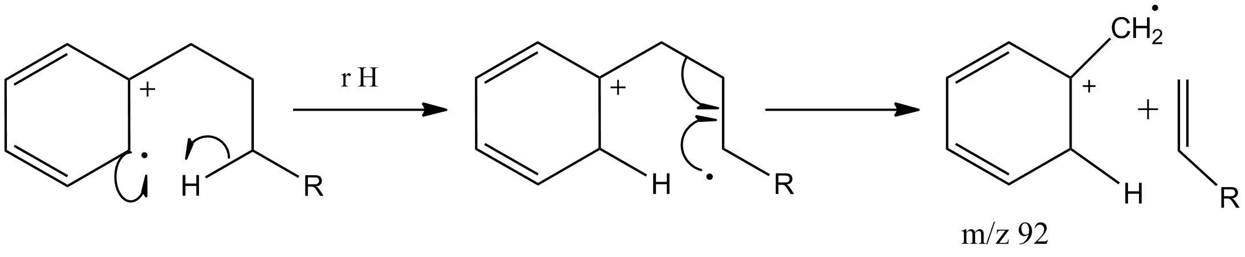
    Alkene, Alkyne, Alkylphenyl, Aldehyde, Ketone, Carboxylic acid, Ester, Amide, Oxime, Hydrozone with γ-H

Slide 18
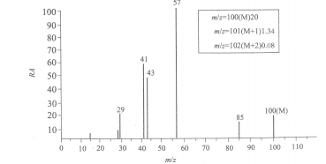
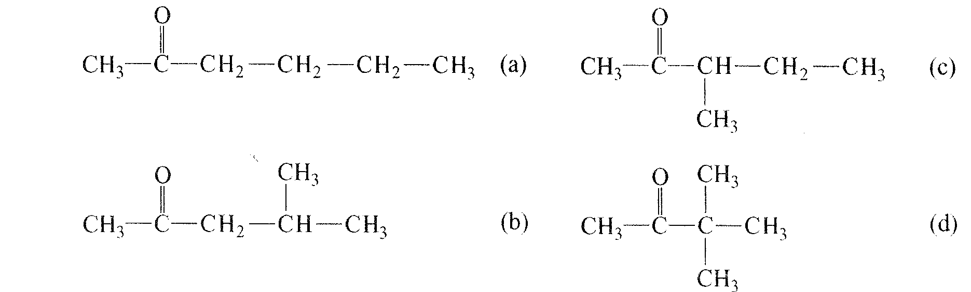
√

Slide 19
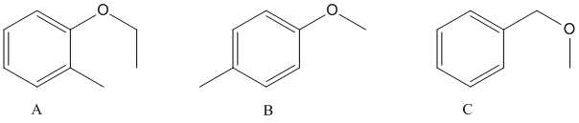
Now it’s your turn：
The fragment ion of m/z92 could be attributed to which compound?

Slide 20
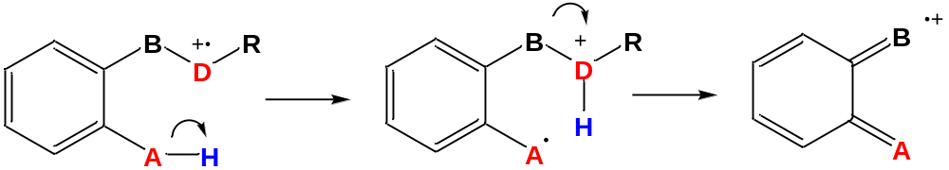
  Rearrangement with H
  Ortho-effect (邻位效应)
D: Hetero-atom (N, O, S…)
A: Hetero-atom (N, O, S…) or C
H is eliminated after re-arrangement

Slide 21

H rearrangement in saturated molecules
--- Elimination reaction
X=halide，-HX
X=-OH，-H₂O
X=-SH，-H₂S

Slide 22
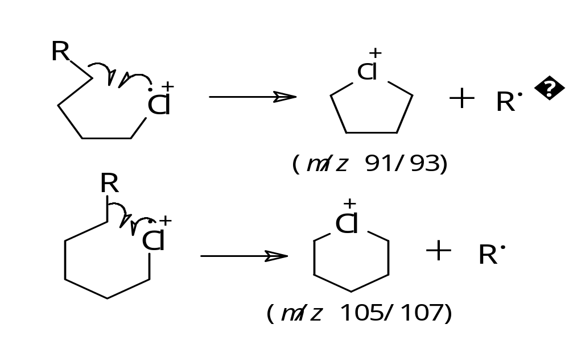
Rearrangement with functional groups

Slide 23
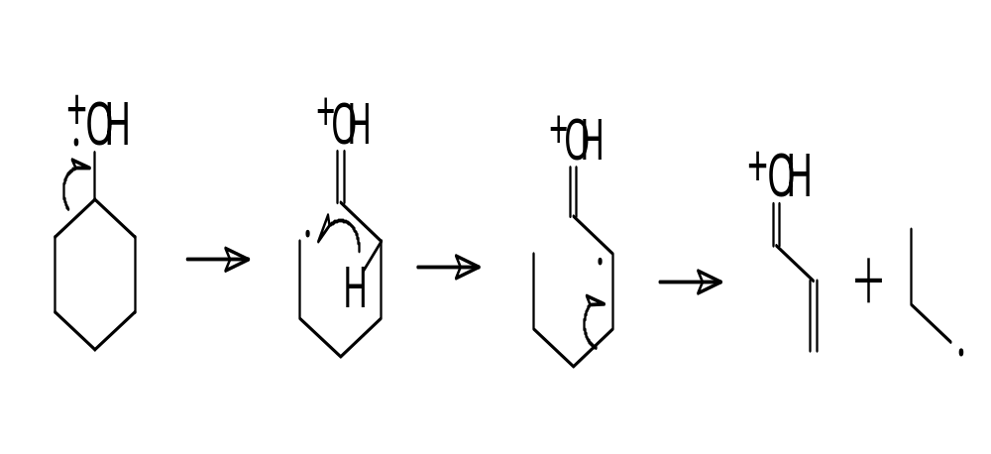
Complex Fragmentation

Slide 24
3. Factors affecting Ion Fragmentation
Chemical bond strength
weaker bond, easier to cleavage
Stability of the fragment ion
more stable, more abundance
Stereo-chemistry factors
affecting rearrangements

Slide 25
a. Chemical bond strength
Chemical bond energy（kJ·mol⁻¹）
single bond double bond triple bond
C－C 345 607 835
C－N 304 615 889
C－O 359 748
C－S 272 535
C－H 409
C－F 485
C－Cl 338
C－Br 284
C－I 213
O－H 462

Slide 26
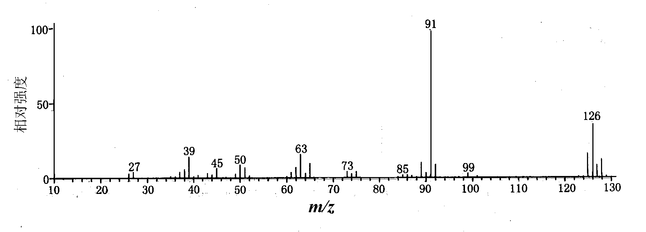
(a)
para-chlorotoluene
Molecular ion peak：m/z 125 [M-H]⁺
Base peak: m/z 91 [M-Cl]⁺
C－Cl：338 kJ·mol⁻¹ < C－H：409 kJ·mol⁻¹，
C－Cl is more intent to be cleaved，therefore [M-Cl]⁺（m/z 91）is the base peak

Slide 27
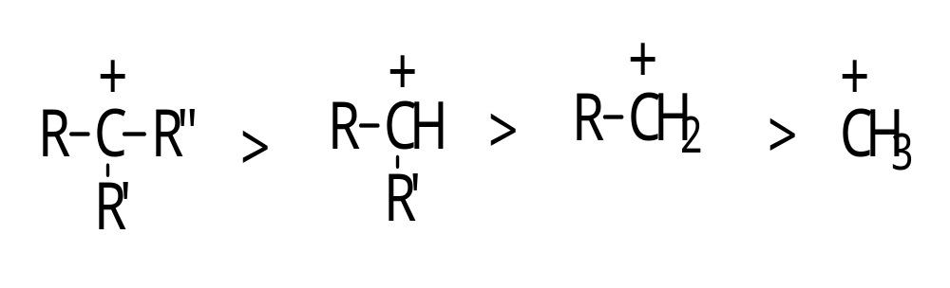
2. Fragment ion stability
Stability for alkyl cations:

Slide 28
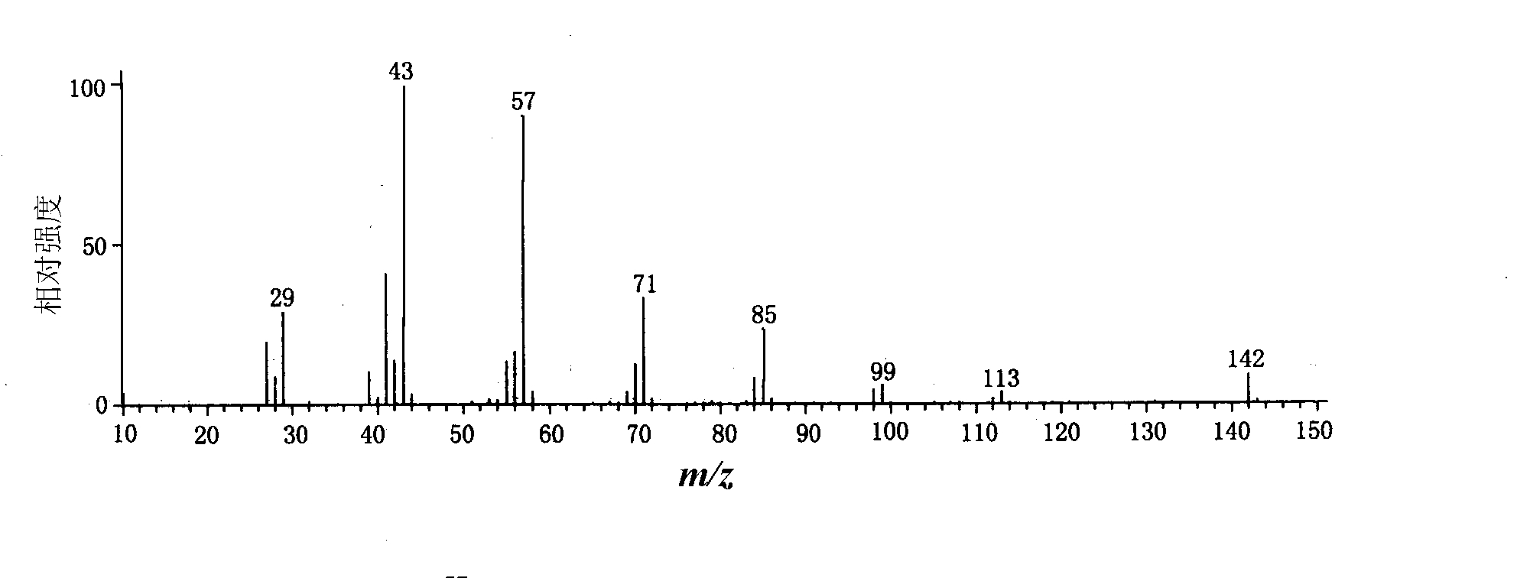
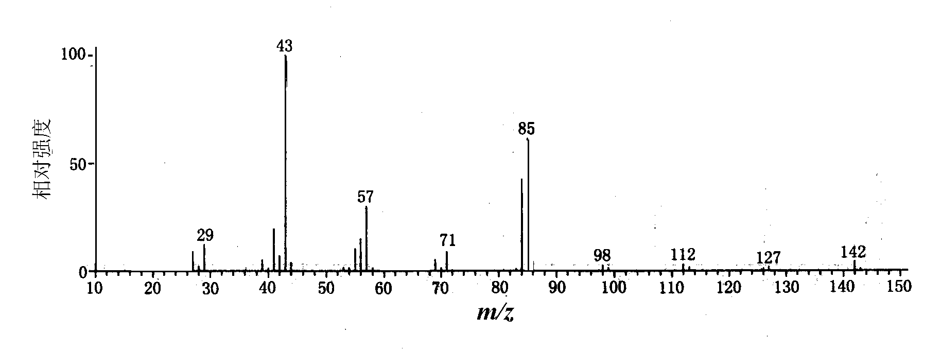
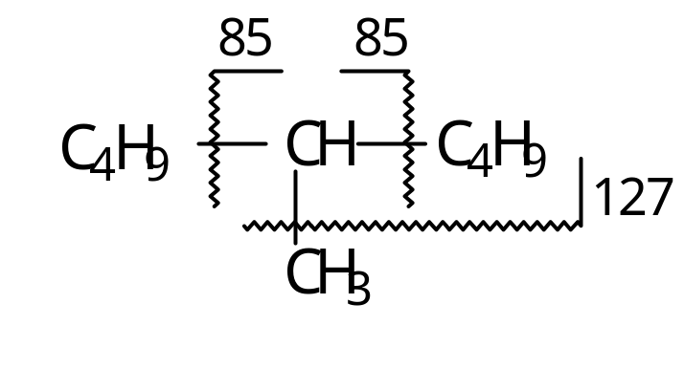
n-decane
5-methylnonane

Slide 29
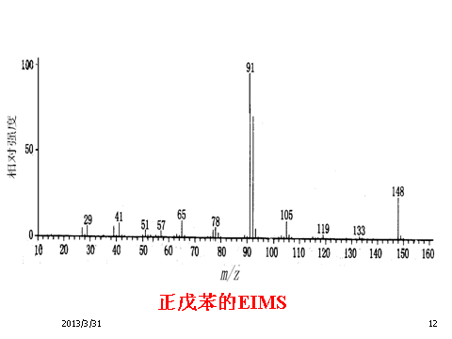
Ally and benzyl cations are preferred to be formed during fragmentation.

Slide 30
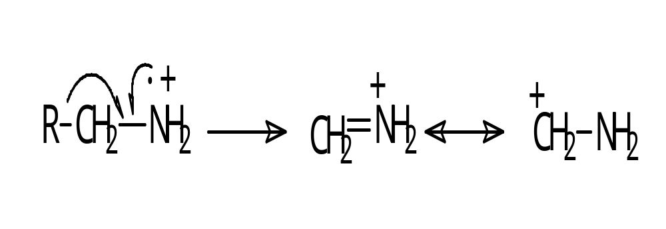
Cation stabilized by adjacent hetero-atoms
Carbon cation is stabilized by lone pair electrons on the adjacent hetero-atoms.

Slide 31
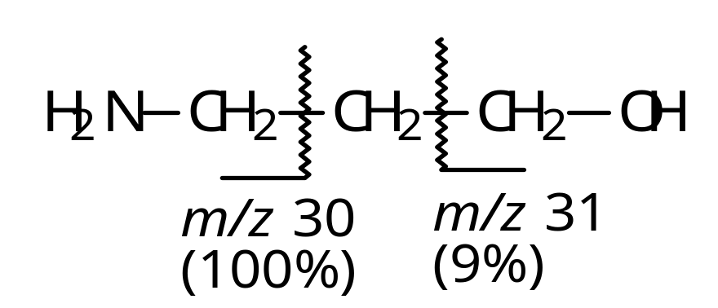
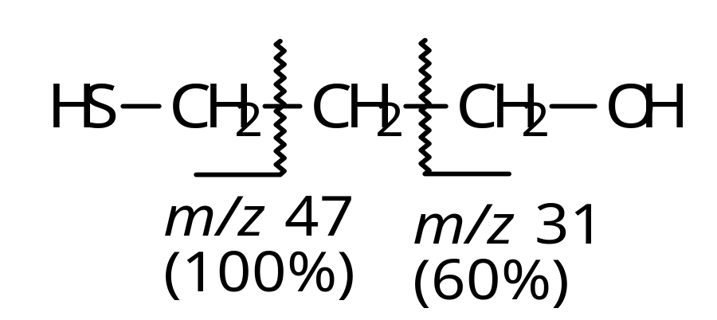
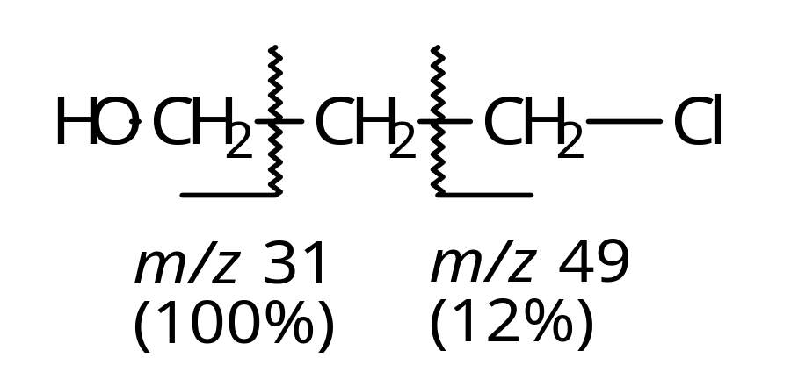
N > S > O> X

Slide 32
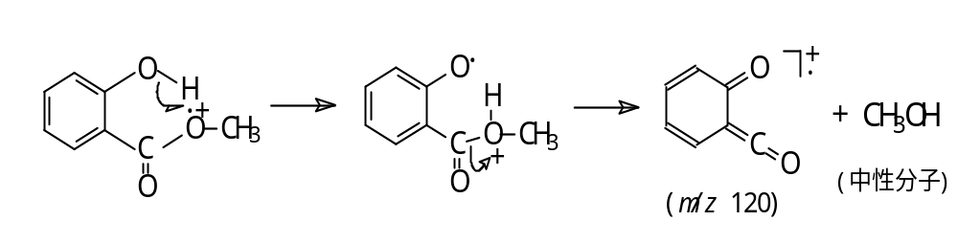
c. Stereo-chemistry factor
During rearrangement, a transition state is necessary, which is related to the position of the group. That is stereo-chemistry factor. e.g. the ortho-effect for ortho-benzene derivatives.

Slide 33
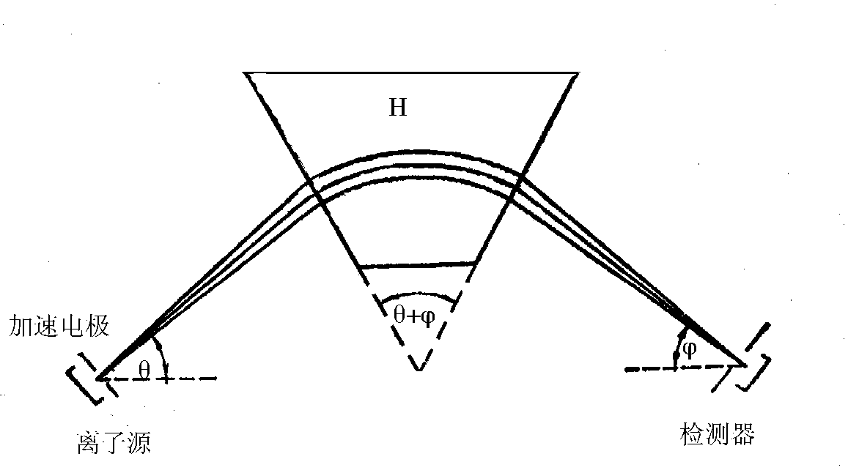
4. Metastable ions in fragment ion analysis
Metastable ion represent ions formed from the ion source to analyzer.

Slide 34
e.g. in the first field-free area（from ion source to analyzer）：
m₁⁺ （parent ion）─→ m₂⁺（sub-ion） + ( m₁ - m₂ )
zV = m₁v₁²/2
Hzv₁ = m₂v₁²/R
(m₂²/m₁)/z = H²R²/2V
m*/z = H²R²/2V

Slide 35
m* = m₂²/m₁
m* (apparent mass of metastable ion)
The appearance of metastable ion peak means there is“mother-child relationship”between m₁⁺ and m₂⁺，which shows a fragmentation relation of m₁⁺ ─→ m₂⁺ .
Notes:
其含义是：在单聚焦磁偏转质谱计第一无场区中产生的亚稳离子以m₂的质量和 v₁速度经过磁场，故在常规质谱图中既不出现在m₁，也不出现在m₂的位置，而是出现在m*位置。

Slide 36
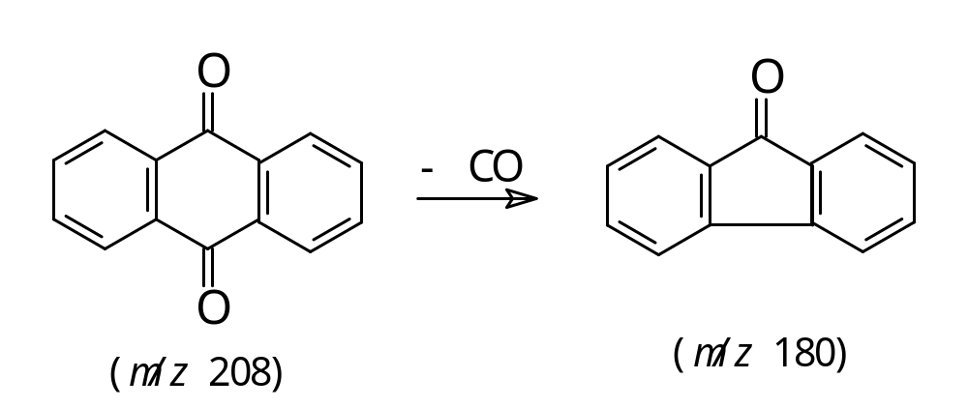
m* = m₂²/ m₁ = 180²/208 = 155.76

Slide 37
Features and functions of metastable ion
Low abundance, broad peak, non-intergral
Prove the fragmentation of m₁⁺ ─→ m₂⁺
Assist the determination and anaylsis of molecular weight and structure; discriminate the isomers.

