Slide 1
Dynamic Behavior and Stability of Closed-Loop Control Systems
Block representation
Closed-loop transfer function
Stability of closed-loop control systems

Slide 2
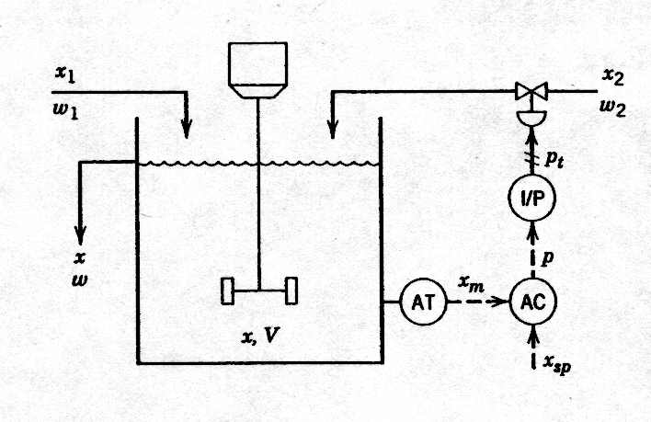
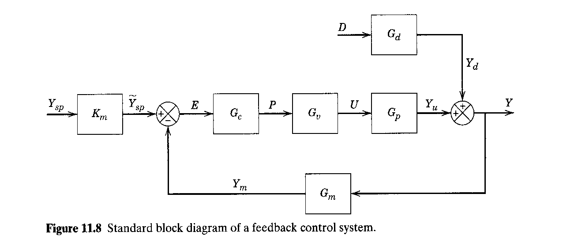
Block Diagram Representation

Slide 3
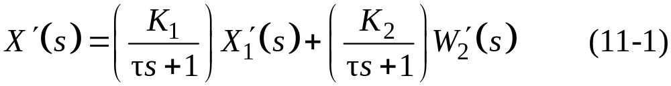
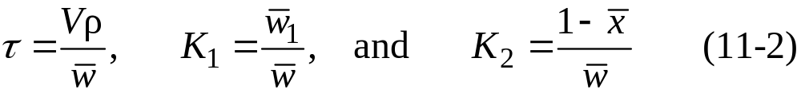
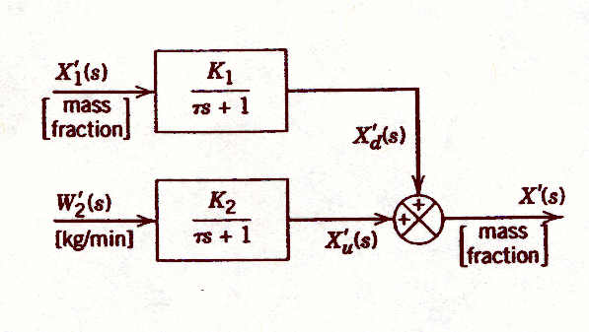
Process
In section 4.3 the approximate dynamic model of a stirred-tank blending system was developed:
where

Slide 4
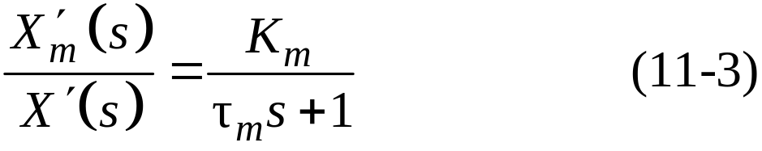
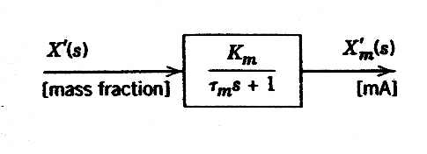
Composition Sensor-Transmitter (Analyzer)
We assume that the dynamic behavior of the composition sensor-transmitter can be approximated by a first-order transfer function:

Slide 5
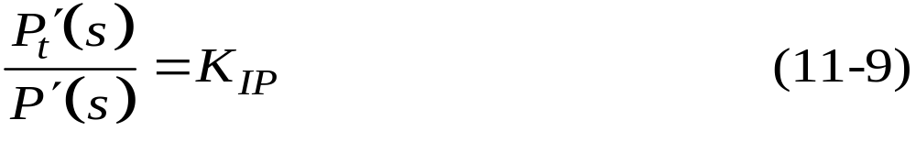
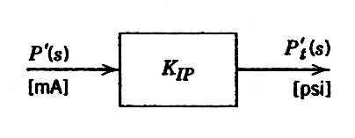
Current-to-Pressure (I/P) Transducer
Because transducers are usually designed to have linear characteristics and negligible (fast) dynamics, we assume that the transducer transfer function merely consists of a steady-state gain K_{IP}:
Figure 11.5 Block diagram for the I/P transducer.

Slide 6
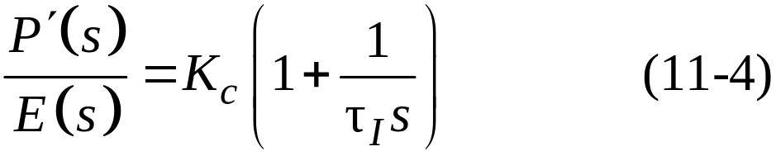



Controller
Suppose that an electronic proportional plus integral controller is used. The controller transfer function is
where and E(s) are the Laplace transforms of the controller output and the error signal e(t). Note that and e are electrical signals that have units of mA, while K_{c} is dimensionless.

Slide 7
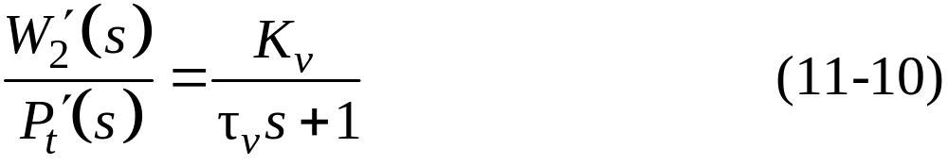
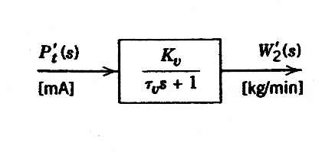
Control Valve
As discussed in Section 9.2, control valves are usually designed so that the flow rate through the valve is a nearly linear function of the signal to the valve actuator. Therefore, a first-order transfer function usually provides an adequate model for operation of an installed valve in the vicinity of a nominal steady state. Thus, we assume that the control valve can be modeled as
Figure 11.6 Block diagram for the control valve.

Slide 8
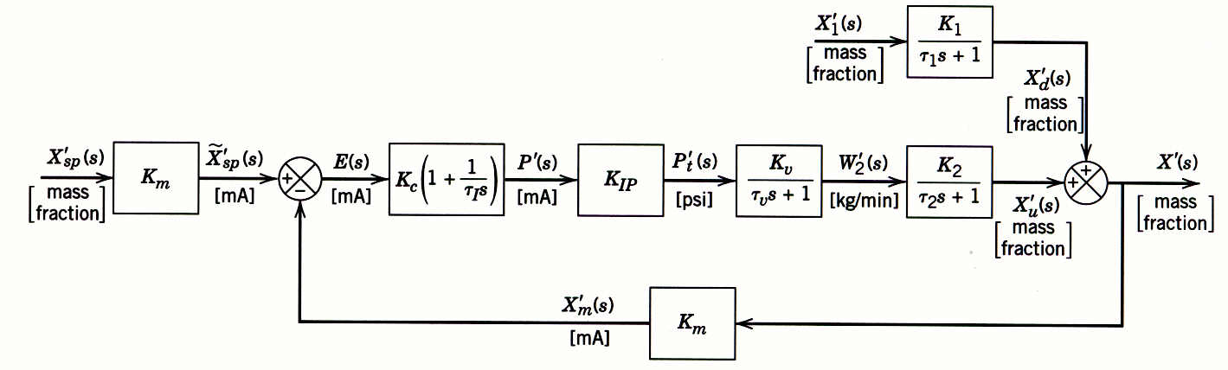
Block Diagram Representation
Figure 11.1 Composition control system for a stirred-tank blending process.

Slide 9
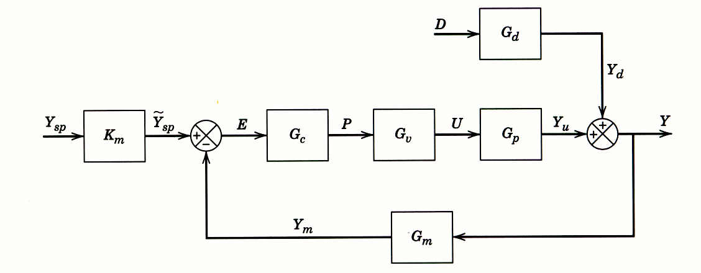
Figure 11.7 Block diagram for the entire blending process composition control system.
Figure 11.8 Standard block diagram of a feedback control system.

Slide 10

Closed-Loop Transfer Functions
The block diagrams considered so far have been specifically developed for the stirred-tank blending system. The more general block diagram in Fig. 11.8 contains the standard notation:
Y = | controlled variable
U = | manipulated variable
D = | disturbance variable (also referred to as load variable)
P = | controller output
E = | error signal
Y_{m} = | measured value of Y
Y_{sp} = | set point
 | internal set point (used by the controller)

Slide 11
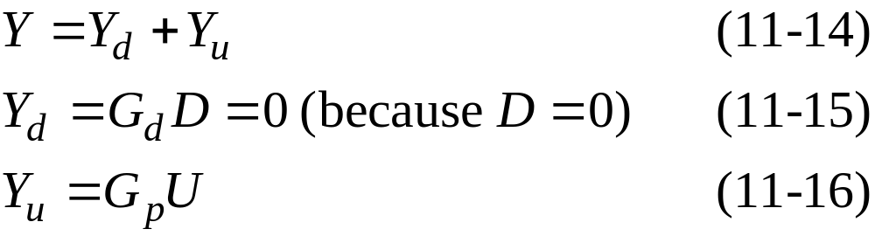
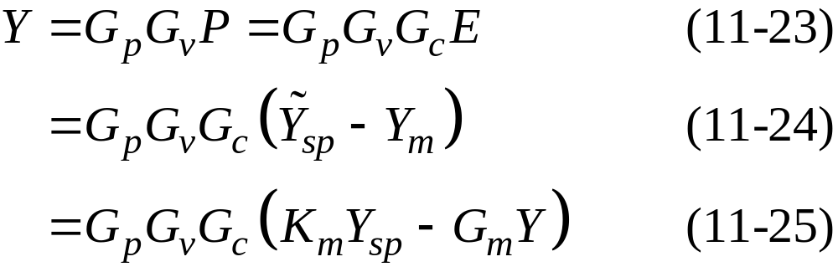
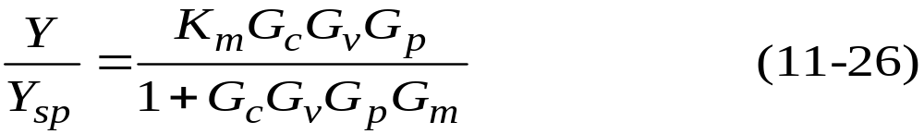
Set-Point Changes

Slide 12
Disturbance Changes
Substituting (11-18) through (11-22) gives

Slide 13
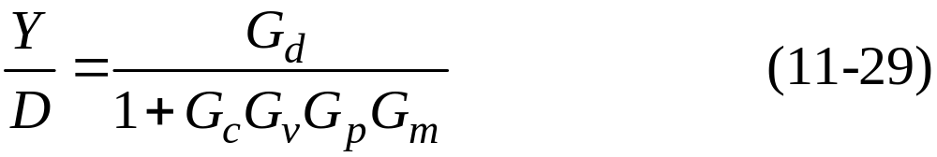

Because Y_{sp} = 0 we can arrange (11-28) to give the closed-loop transfer function for disturbance changes:
A comparison of Eqs. 11-26 and 11-29 indicates that both closed-loop transfer functions have the same denominator, 1 + G_{c}G_{v}G_{p}G_{m}. The denominator is often written as 1 + G_{OL} where G_{OL} is the open-loop transfer function,
At different points in the above derivations, we assumed that D = 0 or Y_{sp} = 0, that is, that one of the two inputs was constant.
But suppose that D ≠ 0 and Y_{sp} ≠ 0, as would be the case if a disturbance occurs during a set-point change. To analyze this situation, we rearrange Eq. 11-28 and substitute the definition of G_{OL} to obtain

Slide 14
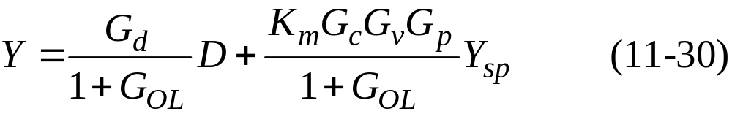
Thus, the response to simultaneous disturbance variable and set-point changes is merely the sum of the individual responses, as can be seen by comparing Eqs. 11-26, 11-29, and 11-30.
This result is a consequence of the Superposition Principle for linear systems.

Slide 15
Closed-Loop Responses of Simple Control Systems
In this section we consider the dynamic behavior of several elementary control problems for disturbance variable and set-point changes.
The transient responses can be determined in a straightforward manner if the closed-loop transfer functions are available.

Slide 16
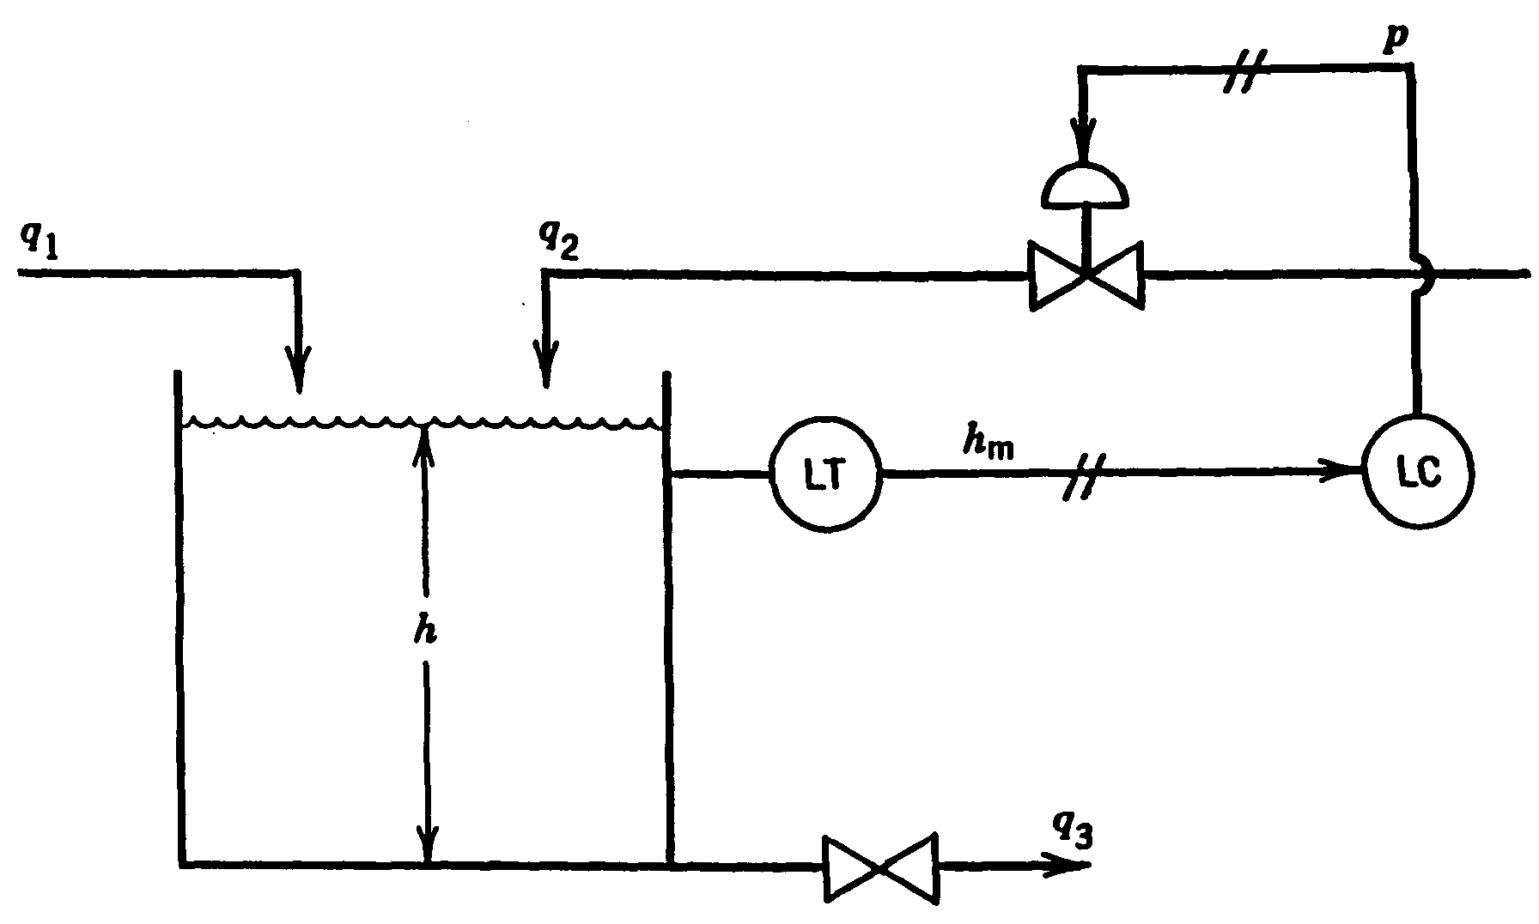
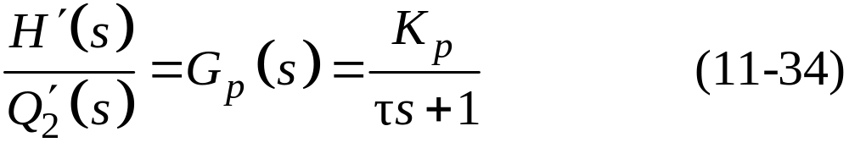
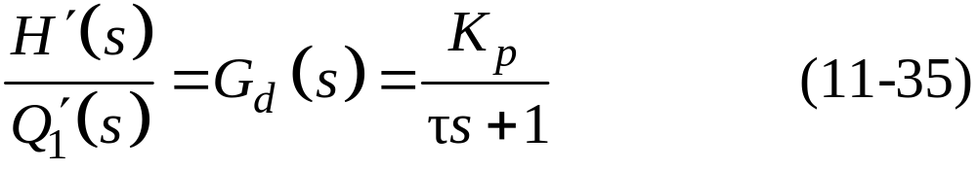

Figure 11.15 Liquid-level control system.
where K_{p} = R and = RA. Note that G_{p}(s) and G_{d}(s) are identical because q₁ and q₂ are both inlet flow rates and thus have the same effect on h.

Slide 17
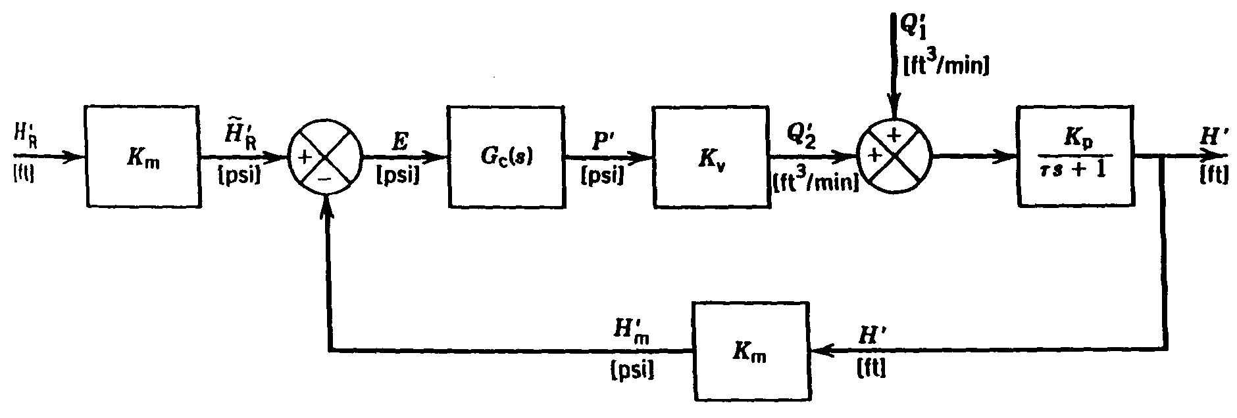
Figure 11.15 Liquid-level control system.

Slide 18
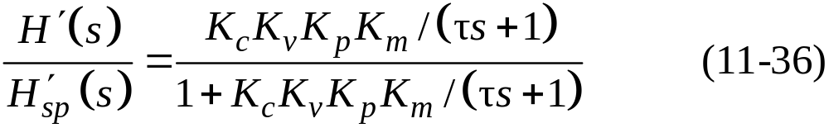
Proportional Control and Set-Point Changes
If a proportional controller is used, then G_{c}(s) = K_{c}.

Slide 19
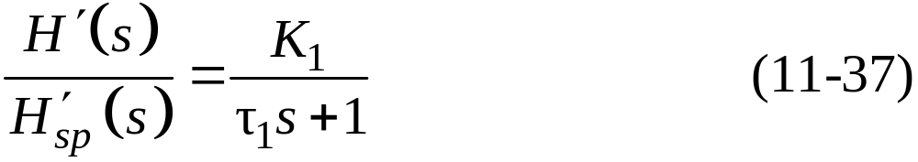
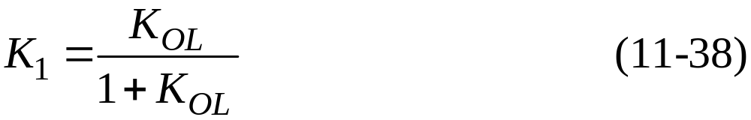
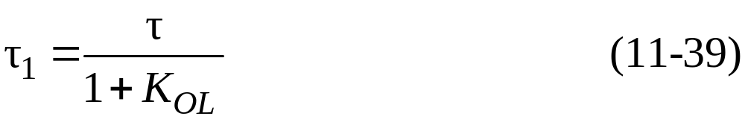
This relation can be rearranged in the standard form for a first-order transfer function,
where:
and the open-loop gain K_{OL} is given by

Slide 20
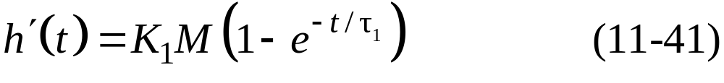

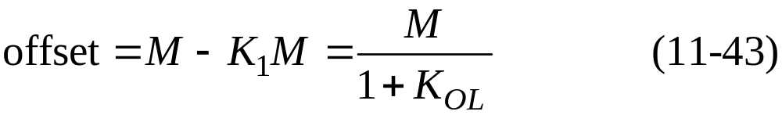
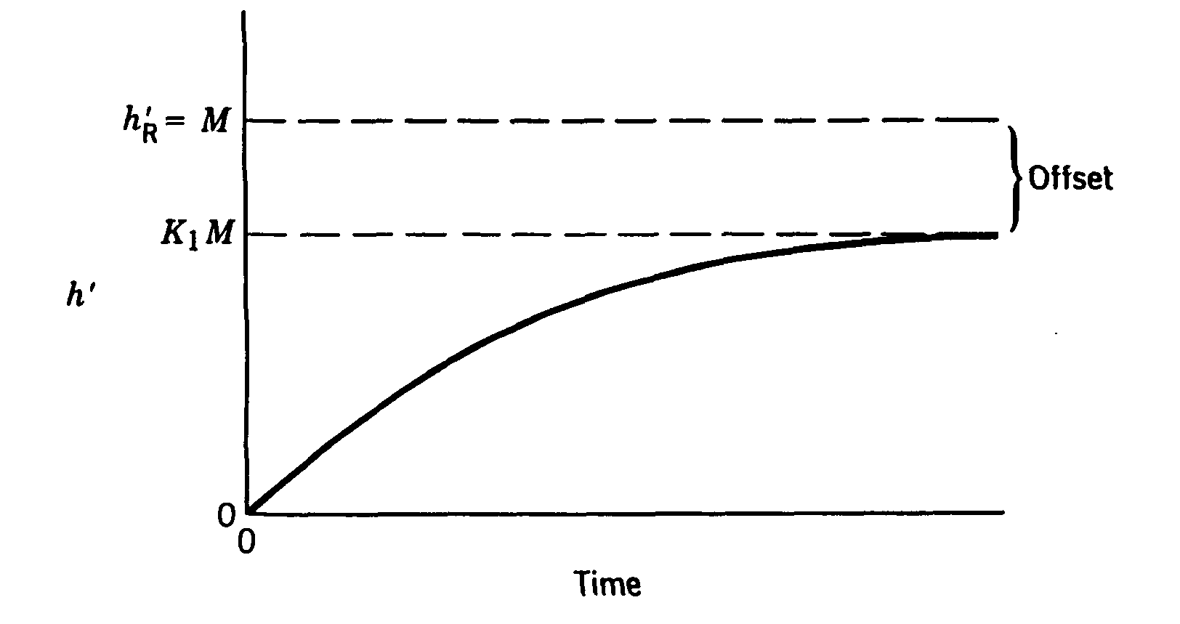
The closed-loop response to a unit step change of magnitude M in set point is given by
The new steady-state value :
The offset is defined as

Slide 21
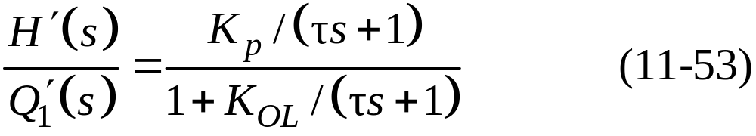
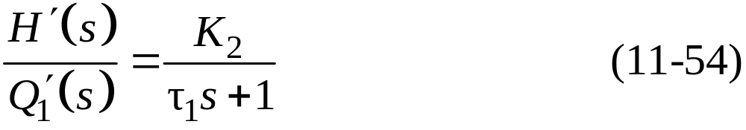

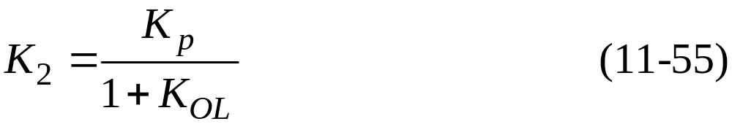
Proportional Control and Disturbance Changes
From Fig. 11.16 and Eq. 11-29 the closed-loop transfer function for disturbance changes with proportional control is
Rearranging gives
where is defined in (11-39) and K₂ is given by

Slide 22
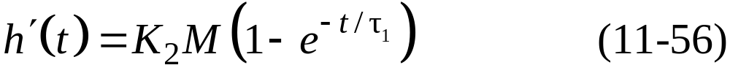


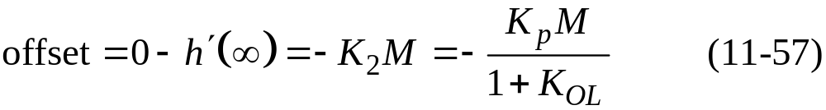
A comparison of (11-54) and (11-37) indicates that both closed-loop transfer functions are first-order and have the same time constant.
However, the steady-state gains, K₁ and K₂, are different.
From Eq. 11-54 it follows that the closed-loop response to a step change in disturbance of magnitude M is given by
The offset can be determined from Eq. 11-56. Now since we are considering disturbance changes and for a step change of magnitude M.
Thus,

Slide 23
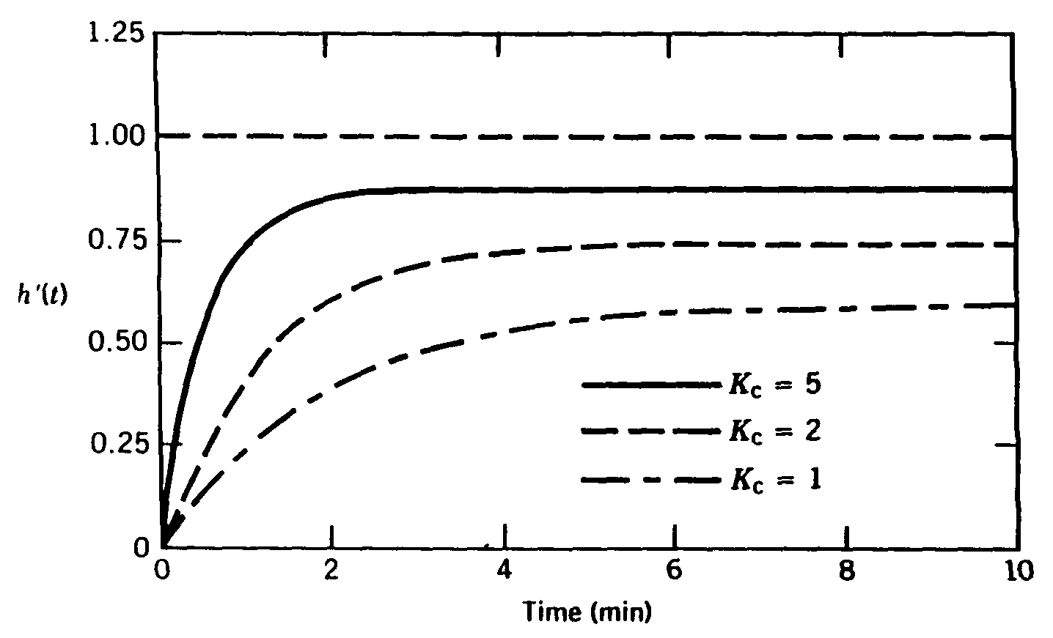
Figure 11.18 Set-point responses for Example 11.2.

Slide 24
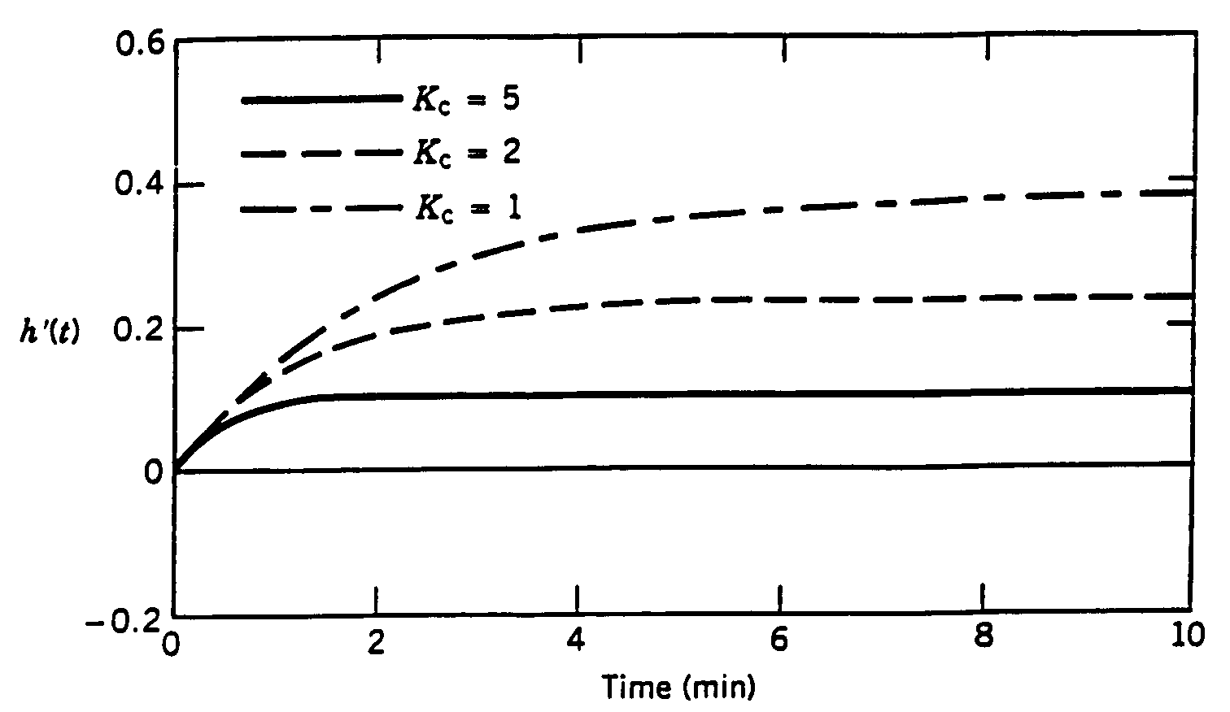
Figure 11.19 Load responses for Example 11.3.

Slide 25

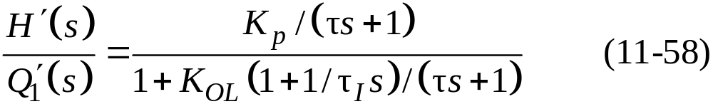
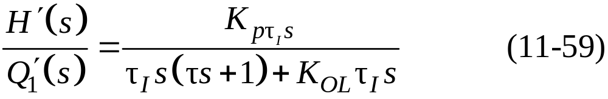
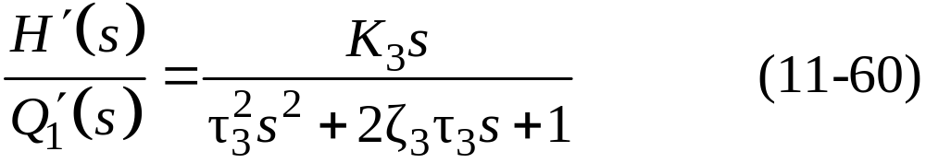
PI Control and Disturbance Changes
For PI control, . The closed-loop transfer function for disturbance changes can then be derived from Fig. 11.16:
Clearing terms in the denominator gives
Further rearrangement allows the denominator to be placed in the standard form for a second-order transfer function:

Slide 26
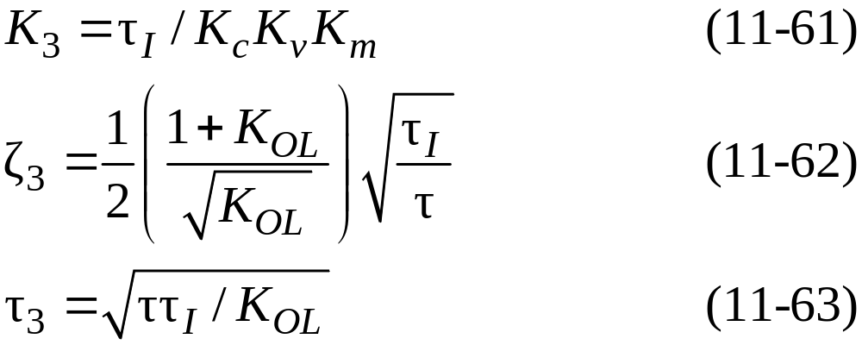

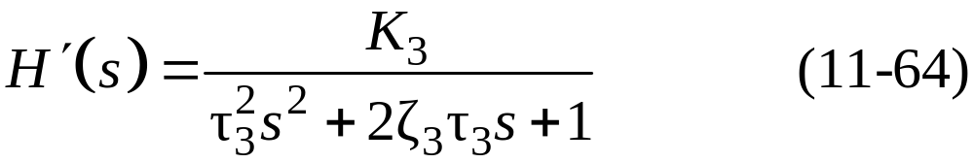

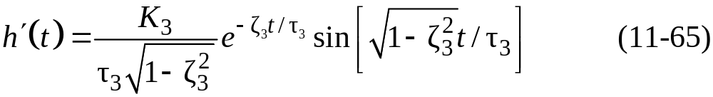
where
For a unit step change in disturbance, , and (11-59) becomes
For , the response is a damped oscillation that can be described by

Slide 27
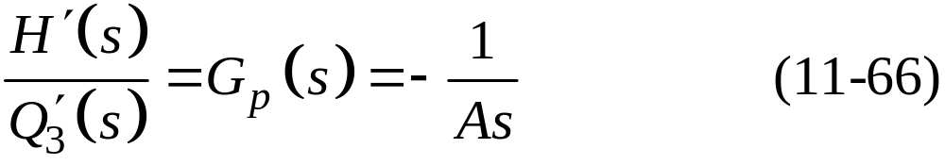
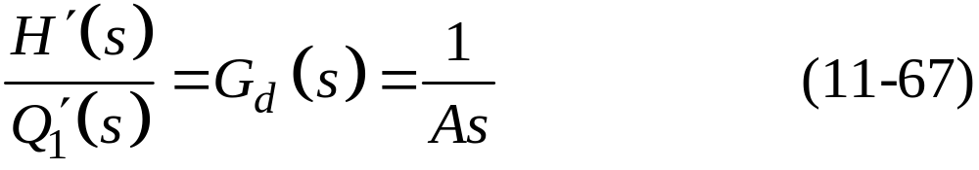
PI Control of an Integrating Process
Consider the liquid-level control system shown in Fig. 11.22. This system differs from the previous example in two ways:
the exit line contains a pump and
the manipulated variable is the exit flow rate rather than an inlet flow rate.
In Section 5.3 we saw that a tank with a pump in the exit stream can act as an integrator with respect to flow rate changes because

Slide 28
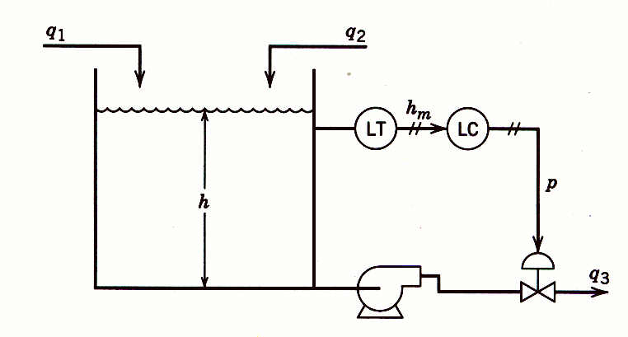
Figure 11.22 Liquid-level control system with pump in exit line.

Slide 29
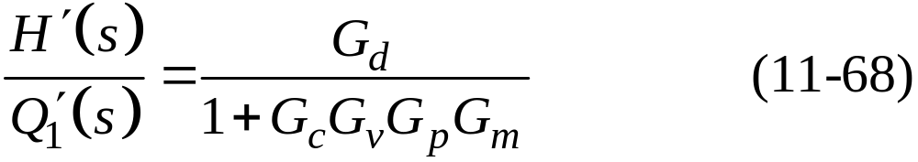
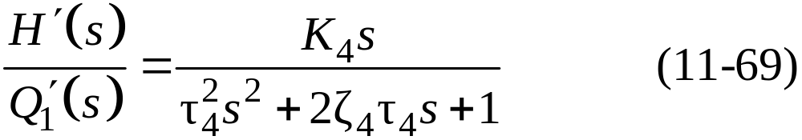
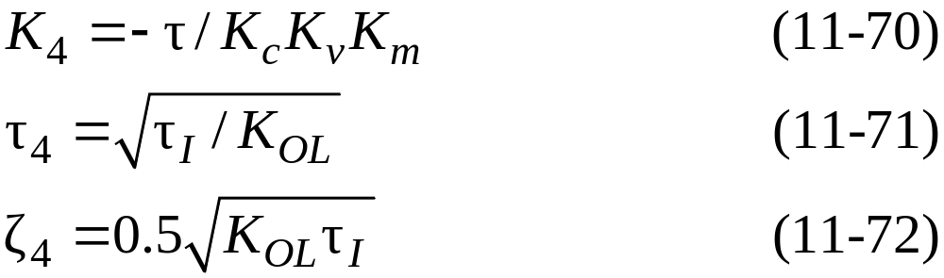
If the level transmitter and control valve in Eq. 11.22 have negligible dynamics, the G_{m}(s) = K_{m} and G_{v}(s) = K_{v}. For PI control, . Substituting these expressions into the closed-loop transfer function for disturbance changes
and rearranging gives
where
And K_{OL} = K_{c}K_{v}K_{p}K_{m} with K_{p} = - 1/A.

Slide 30
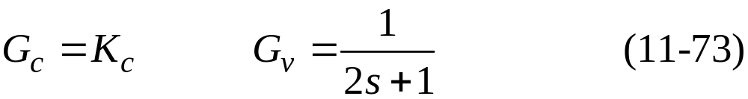

Stability of Closed-Loop Control Systems
Example 11.4
Consider the feedback control system shown in Fig. 11.8 with the following transfer functions:
Show that the closed-loop system produces unstable responses if controller gain K_{c} is too large.

Slide 31

Figure 11.23. Effect of controller gains on closed-loop response to a unit step change in set point (example 11.1).

Slide 32
Stability
Most industrial processes are stable without feedback control. Thus, they are said to be open-loop stable or self-regulating.
An open-loop stable process will return to the original steady state after a transient disturbance (one that is not sustained) occurs.
By contrast there are a few processes, such as exothermic chemical reactors, that can be open-loop unstable.
Definition of Stability. An unconstrained linear system is said to be stable if the output response is bounded for all bounded inputs. Otherwise it is said to be unstable.

Slide 33


Characteristic Equation
As a starting point for the stability analysis, consider the block diagram in Fig. 11.8. Using block diagram algebra that was developed earlier in this chapter, we obtain
where G_{OL} is the open-loop transfer function, G_{OL} = G_{c}G_{v}G_{p}G_{m}. For the moment consider set-point changes only, in which case Eq. 11-80 reduces to the closed-loop transfer function,

Slide 34
Comparing Eqs. 11-81 and 11-82 indicates that the poles are also the roots of the following equation, which is referred to as the characteristic equation of the closed-loop system:
General Stability Criterion. The feedback control system in Fig. 11.8 is stable if and only if all roots of the characteristic equation are negative or have negative real parts. Otherwise, the system is unstable.
Example 11.8
Consider a process, G_{p} = 0.2/（-s + 1), and thus is open-loop unstable. If G_{v} = G_{m} = 1, determine whether a proportional controller can stabilize the closed-loop system.

Slide 35

Figure 11.25 Stability regions in the complex plane for roots of the charact-eristic equation.

Slide 36

Figure 11.26 Contributions of characteristic equation roots to closed-loop response.

Slide 37
Solution
The characteristic equation for this system is
Which has the single root, s = -1 + 0.2K_{c}. Thus, the stability requirement is that K_{c} < 5. This example illustrates the important fact that feedback control can be used to stabilize a process that is not stable without control.
Routh Stability Criterion
The Routh stability criterion is based on a characteristic equation that has the form

Slide 38


Routh array:
Row
1 | a_{n} | a_{n-2} | a_{n-4}
2 | a_{n-1} | a_{n-3} | a_{n-5}
3 | b₁ | b₂ | b₃
4 | c₁ | c₂
n + 1 | z₁
where:

Slide 39

and:
Routh Stability Criterion:
A necessary and sufficient condition for all roots of the characteristic equation in Eq. 11-93 to have negative real parts is that all of the elements in the left column of the Routh array are positive.

Slide 40
Example 11.9
Determine the stability of a system that has the characteristic equation
Solution
Because the s term is missing, its coefficient is zero. Thus, the system is unstable. Recall that a necessary condition for stability is that all of the coefficients in the characteristic equation must be positive.

Slide 41
Example 11.10
Find the values of controller gain K_{c} that make the feedback control system of Eq. 11.4 stable.
Solution
From Eq. 11-76, the characteristic equation is
All coefficients are positive provided that 1 + K_{c} > 0 or K_{c} < -1. The Routh array is
10 | 8
17 | 1 + K_{c}
b₁ | b₂
c₁

Slide 42
To have a stable system, each element in the left column of the Routh array must be positive. Element b₁ will be positive if K_{c} < 12.6. Similarly, c₁ will be positive if K_{c} > -1.
Direct Substitution Method
The imaginary axis divides the complex plane into stable and unstable regions for the roots of characteristic equation, as indicated in Fig. 11.26.
On the imaginary axis, the real part of s is zero, and thus we can write s=jω. Substituting s=jω into the characteristic equation allows us to find a stability limit such as the maximum value of K_{c}.
As the gain K_{c} is increased, the roots of the characteristic equation cross the imaginary axis when K_{c} = K_{cm}.

Slide 43



Example 11.12
Use the direct substitution method to determine K_{cm} for the system with the characteristic equation given by Eq. 11-99.
Solution
Substitute and K_{c} = K_{cm} into Eq. 11-99:
or (11-105)

Slide 44

Equation 11-105 is satisfied if both the real and imaginary parts are identically zero:
Therefore,
and from (11-106a),

Slide 45


Root Locus Diagrams
Example 11.13
Consider a feedback control system that has the open-loop transfer function,
Plot the root locus diagram for
Solution
The characteristic equation is 1 + G_{OL} = 0 or

Slide 46
The root locus diagram in Fig. 11.27 shows how the three roots of this characteristic equation vary with K_{c}.
When K_{c} = 0, the roots are merely the poles of the open-loop transfer function, -1, -2, and -3.

Slide 47

Figure 11.27 Root locus diagram for third-order system. X denotes an open-loop pole. Dots denote locations of the closed-loop poles for different values of K_{c}. Arrows indicate change of pole locations as K_{c} increases.

Slide 48

Figure 11.29. Flowchart for performing a stability analysis.

