Slide 1
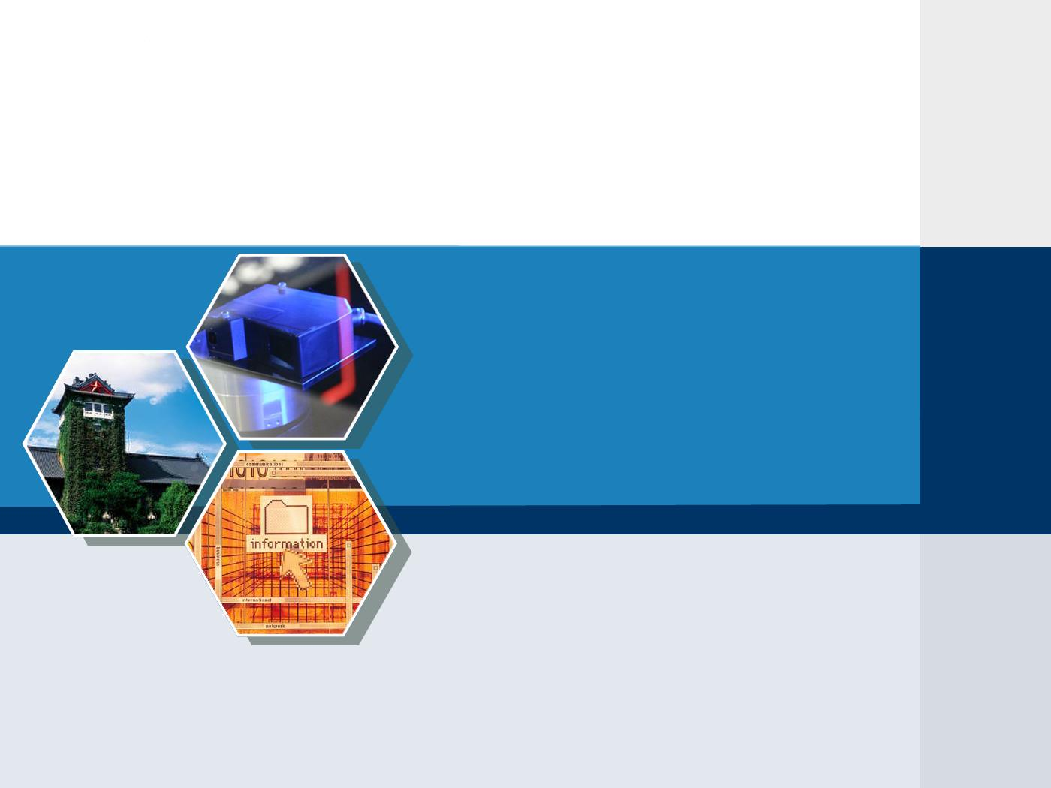
Supporting VCR-like Operations in Derivative Tree-Based P2P Streaming Systems
Tianyin Xu, Jianzhong Chen,
Wenzhong Li, Sanglu Lu
Nanjing University
Yang Guo
Corporate Research, Thompson
Mounir Hamdi
Hong Kong University of Science and Technology

Slide 2
Outline
Background
P2P media streaming, interactive streaming, VCR-like operations;
Motivation
Solutions
Derivative tree; System overview; VCR-like operation support.
Performance Evaluation
Conclusions

Slide 3
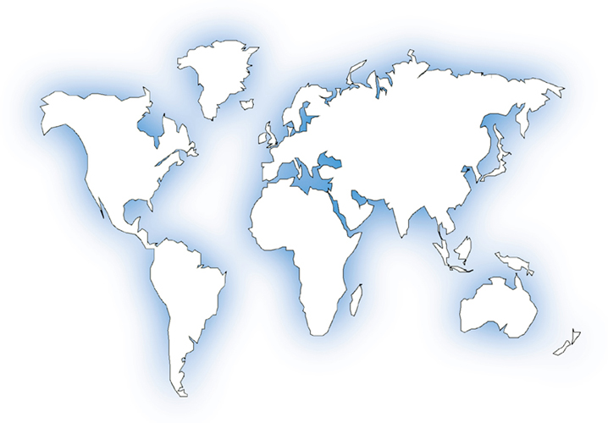
Background
P2P media streaming
Everyone can be a content producer/provider.
Cache-and-relay mechanism: peers actively cache media contents and further relay them to other peers that are expecting them.
* P2P live streaming is very successful!
CoolStreaming (INFOCOM’05),
PPLive, Joost

Slide 4
Background
P2P interactive streaming is challenging!
1. Allow different users to watch different portions of the video
Affects the efficiency of coordinating content delivery
2. Support user VCR-like operations
VCR-like (Video Cassette Recorder) operations
random seek, pause, fast forward/backward (FF/FB)
For VCR-like operations, “jump” process is the most important.
Most VCR-like operations can be implemented by “jump”.
random seek & pause: 1 jump; FF/FB: series of jump;

Slide 5
Motivation
Frequent VCR-like operations lead to peer churn.
Peers dynamically (often frequently) leave their current positions and “jump” to new playback positions.
May severely deteriorate users’ perceived video quality
- e.g., playback freezing, long response latency, even blackout

Slide 6
Motivation
Example of VCR Impact
Tree-based Overlay

Slide 7
Motivation
Example of VCR Impact
Mesh-based Overlay

Slide 8
Question: How to reduce VCR impact?
Traditional data delivery tree
Derivative tree
Intuition behind our idea
A well structured overlay
Departure of leaf node does not impact the system performance.
Departure of non-leaf node can recover quickly.

Slide 9



Derivative Tree
Basic concepts
Split line
Overlapping ratio
Derivative
Construction rule:
For each node in the tree, if it is root or a left child, it may have a number of right children and no more than one left child;
If it is a right child, it cannot have children any more.
Properties: (Theorem 1)
The number of nodes in the tree
Data range of a derivative tree is:

Slide 10
Derivative Tree
Derivative tree has the following features:
Supports asynchronous user requests by using an overlapping buffer design.
Be well structured and controllable.
Can trade off the network latency and message overhead by adjusting the overlapping ratio and the height of the tree.
Provides low cost VCR-like operations and quick streaming service reconstruction.
Basic Operations
Join
Departure

Slide 11
Node Join
Case 1: join as a right child
Theorem 3: Operation overhead: O(1)

Slide 12
Node Join
Case 2: join in a left subtree
Theorem 3: Operation overhead: O(2) (with central index in the root)

Slide 13
Node Departure
Case 1: leaf node leaving
Theorem 4: Operation overhead: 0

Slide 14
Node Departure
Case 2: non-leaf node leaving (with right children)
Theorem 4: Operation overhead: O(1)

Slide 15
Node Departure
Case 3: non-leaf node leaving (without right children)
Theorem 4: Operation overhead: O(H)

Slide 16
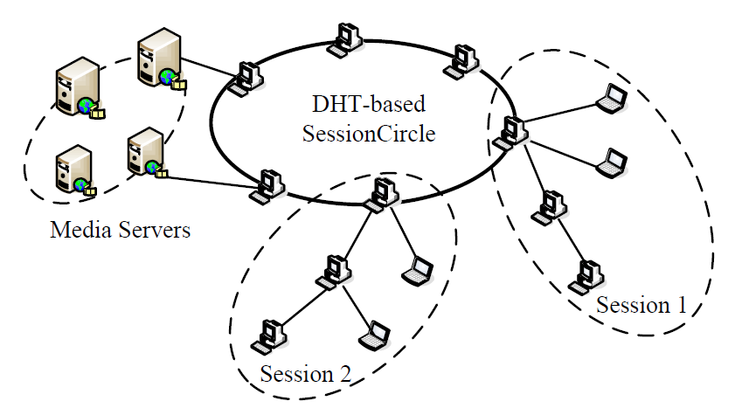
System Overview
Three components
- Media servers
· Simply provide media streaming
service (do not provide any VCR
function)
- Sessions
· Formed as derivative trees
- SessionCircle
· Connects the root nodes of all
sessions to form a DHT ring.
· Session discovery service (SDS)
is implemented for fast session
location.
Theorem 5: It takes at most hops to locate the desired sessions using SDS, where is the number of sessions.

Slide 17
VCR-like Operation Support
The jump process caused by VCR-like operations: (Theorem 6)
Case 1. Jump in the local session
=> Performs a departure and a join in the local session
overhead = 1 departure + 1 join
= T(leave) + T(join) =
Case 2. Jump to another session
=> Performs a departure, followed by a SDS search operation, and then a
join operation to the new session.
overhead = 1 departure + 1 SDS search + 1 join
= T(leave) + T(SDS search) + T(join)
=
Case 3. Jump nowhere
=> Departs the current session, and after a search failure, initiate a new session.
overhead = 1 departure + 1 SDS search
= T(leave) + T(SDS search) =

Slide 18
Simulation Settings
The simulation is built on top of a topology of 5000 peer nodes based on the transit-stub model generated by GT-ITM.
The default size of the playback buffer is 30Mbytes, i.e., each peer can cache 120 second recent stream.
The default overlapping ratio α of DT-based scheme is ½.
The arrival of peers follows the Poisson Process with λ = 5.
We compare some simulation results with RINDY(ICC’07) and DSL(TPDS’07).
The three systems use similar buffer management (sliding buffer window) without setting dedicated disk storage.

Slide 19
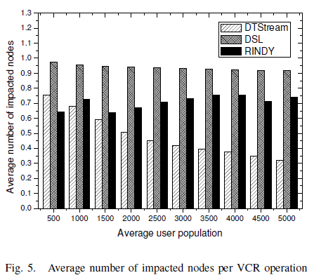
Performance Evaluation
1

Slide 20
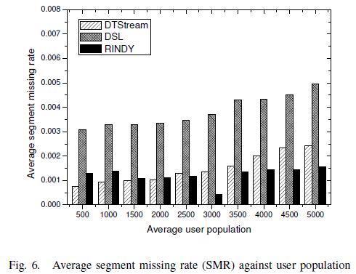
Performance Evaluation
2

Slide 21
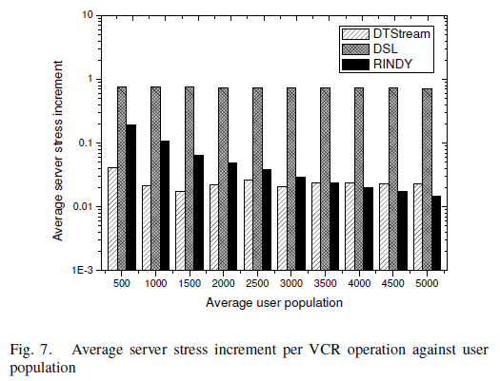
Performance Evaluation
3

Slide 22
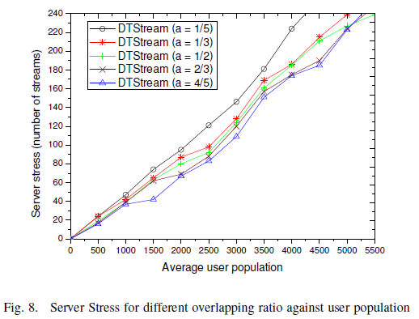
Performance Evaluation
4

Slide 23
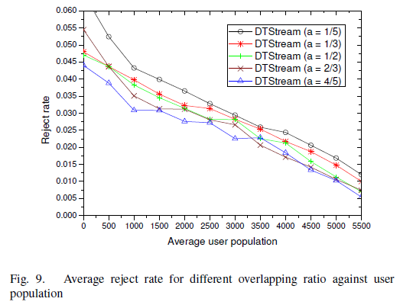
Performance Evaluation
3

Slide 24
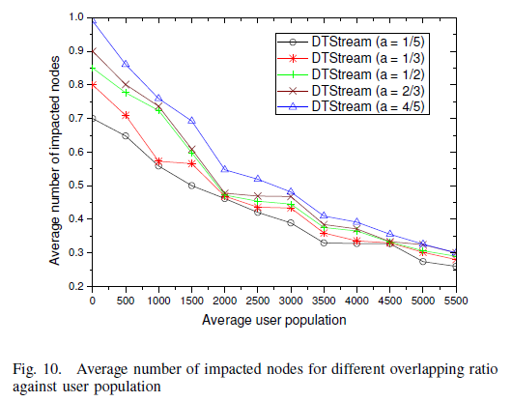
Performance Evaluation
4

Slide 25
Conclusions
We introduce Derivative Tree, a novel distributed overlay structure with inherent ability to organize dynamic and asynchronous peers while bring high resilience to peer churn. Thus, it effectively reduces the impact of dynamic node join and departure with low network overhead.
We propose VCR-like operation implementation in the P2P streaming system. The overhead of VCR-like operations is proved to be in O(log N)
The efficiency of the proposed scheme is confirmed using extensive simulations. The result show that our scheme outperforms the existing representative systems in terms of VCR impact.

Slide 26
The End

