Slide 1





Scaling Microblogging Services with Divergent Traffic Demands
Presented by Tianyin Xu
Tianyin Xu, Yang Chen, Lei Jiao,
Ben Zhao, Pan Hui, Xiaoming Fu
University of Goettingen, UC San Diego
UC Santa Barbara, Deutsche Telekom

Slide 2
Microblogging services are growing at exponential rates!
145,000,000
75,000,000
User Population
5,000,000
1,000
750,000
Year

Slide 3



















Not only Twitter!

Slide 4
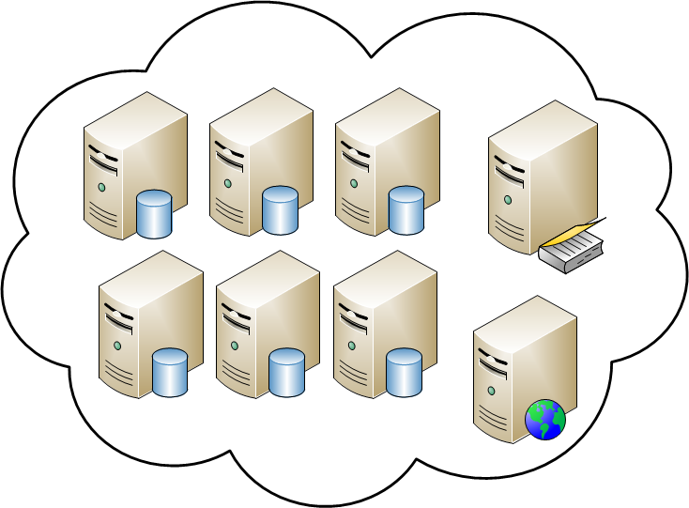

Current Architecture
All is traffic waste!
polling
nothing new!!!

Slide 5
Current Architecture
Still traffic waste!
polling
something new!!!

Slide 6

What about millions of users polling?

Slide 7



How is the availability and performance of these microblogging services?
(Measurement Study on Twitter)
Measurement period: Jun. 4 – Jul. 18, 2010
- Including a flash crowd event:
→ FIFA World Cup 2010

Slide 8
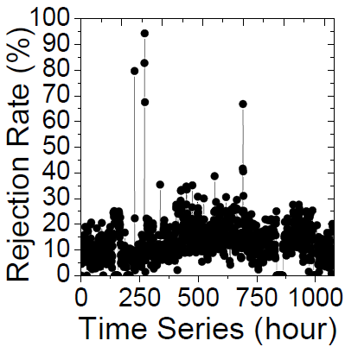
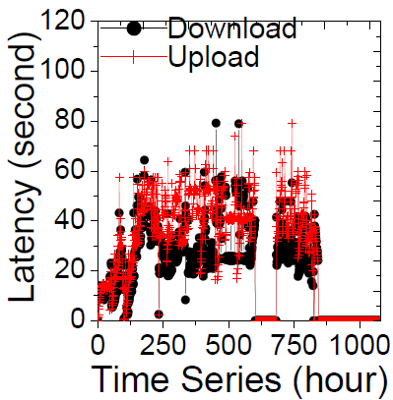
Measurement Study on Twitter
World Cup
World Cup
6/4 6/11 7/11 7/18
6/4 6/11 7/11 7/18
Twitter’s performance and availability is not satisfying (even at normal time).
The flash crowd event has an obvious impact on both performance and availability.

Slide 9

Twitter’s Short-Term Solutions
1. Per-user request and connection limits
- Rate limit
Only allows clients to make a limited number of calls in a given period
Twitter: 150 requests per hour, 2,000 requests for whitelist
- Upper limit on the number of followees
Orkut: 1000, Flickr: 3000, Facebook: 5000,
Twitter: 2000 before 2009, now using a more sophisticated strategy
The Problems are still there!!!
identi.ca jaiku emote.in Chinese Sina microblogging
2. Network usage monitoring
3. Doubling the capacity of internal network

Slide 10


How about push?
I have 5 followers!
Social Network Usage

Slide 11





















How about these guys?
16,000,000
11,000,000
5,000,000
- Either celebrities or news media outlets.

Slide 12


What will happen when ladygaga has something to say?
I have 16,000,000 followers!
News Media Usage

Slide 13
How different the two kinds of usage models contribute to the traffic?
Analysis of large-scale Twitter user trace
- 3,117,750 users’ profiles, social links, tweets
Consider two built-in Twitter interaction models
- POST and REQUEST
Differentiate social network usage and news media usage by threshold 1000
- Only users with followers <1000 show assortativity*
*H. Kwak et al., What is Twitter, a Social Network or a News Media? WWW 2010.

Slide 14
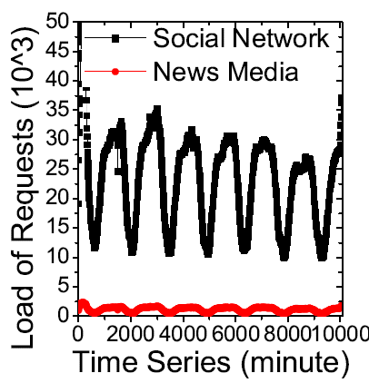
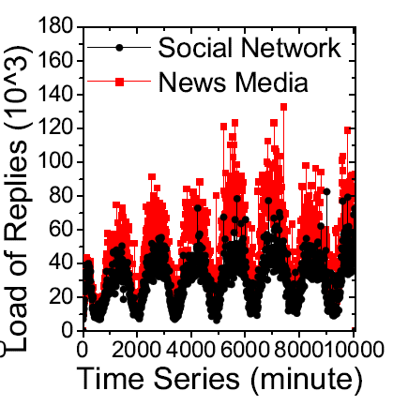
The results of the divergent traffic
Incoming traffic load (10^3)
Outgoing Traffic Load (10^3)
Social network usage holds the majority of incoming server load (~95%).
News media usage occupies a great proportion of outgoing server load (~63%).

Slide 15
The difference between the two components.
Social Network Component | News Media Component
a few followers | large numbers of followers
most symmetric links | most asymmetric links
not active in updating statuses | very active in reporting news
great incoming traffic | great outgoing traffic

Slide 16
What makes microblogging systems like Twitter hard to scale?
They are being used as both the social network and the news media infrastructure at the same time!
There is NO single dissemination mechanism can really address both two at the same time!!

Slide 17



Decouple the two components
- Complementary delivery mechanisms
direct unicast push
gossip dissemination

Slide 18

System Architecture (Cuckoo)
Cloud servers (a small server base)
Ensure high data availability
Maintain asynchronous consistency
Host all the user contents
Cuckoo peers (peers at network edge)
Data delivery
Abandon naïve polling
Decentralized user lookup

Slide 19
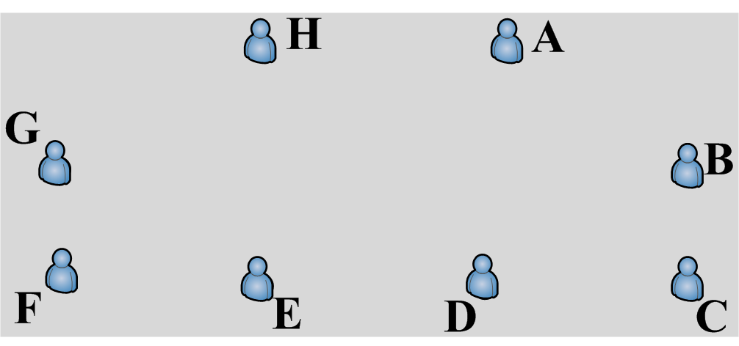
Unicast Delivery for SocialNet
……
follower
follower
follower
Serial unicast delivery
1. simple 2. reliable

Slide 20
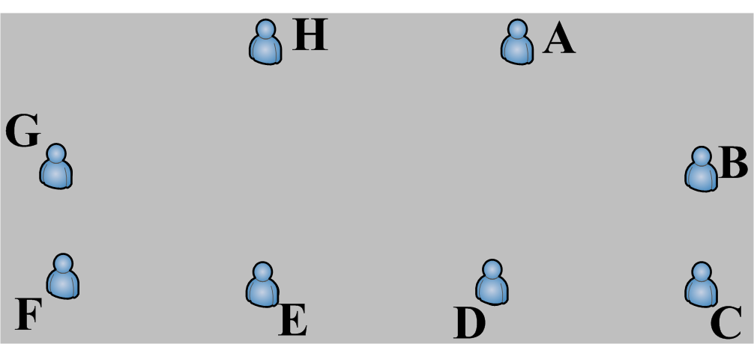
Gossip Dessimination for MediaNet
……
follower
partner
follower
follower
partner
partner
partner
partner
partner
Gossip dissemination Pros: 1. scalable 2. resilient to network dynamics 3. load balance Cons: 1. each node has to maintain partners

Slide 21
Message Loss
Due to asynchronous access
-- regain lost tweets in offline period
→ efficient inconsistency checking based on the timeline
2. Due to uncertainty of gossip and unreliable channels
-- exploit unique statusId to check
UserId
Sequence Number
→ gap between the sequence number means message loss

Slide 22




Support for Client Heterogeneity
Differentiate user clients into three categories:
Cuckoo-Comp
Stable nodes
Construct DHT and provide DHT-based user lookup
Participate in message dissemination
Over 40% of all tweets were from mobile
devices, up from only 25% a year ago.
Cuckoo-Lite
Lightweight clients (i.e., laptops)
Do not join DHT
Only participate in message dissemination
Cuckoo-Mobile
Mobile nodes
Neither join DHT nor message dissemination

Slide 23
Dataset
Twitter dataset containing 30,000 user information
MySpace dataset to model session durations
Classify the three categories of Cuckoo users according to their daily online time
→ ~50% of Cuckoo peers are Cuckoo-Mobile clients.

Slide 24
Implementation and Deployment
A prototype of Cuckoo using Java comprises both the Cuckoo peer and the server cloud.
- Cuckoo client: 5000 lines of code - Server cloud: 1500 lines of code
30,000 Cuckoo clients on 12 machines
4 machines to build the server cloud

Slide 25
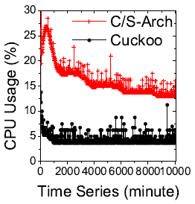
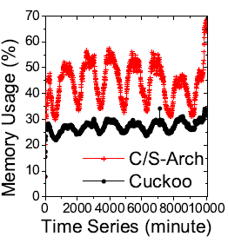
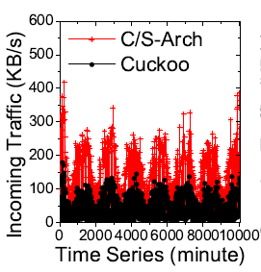
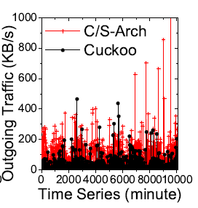
Server Cloud Performance
- Resource Usage
CPU
Memory
Incoming/Outgoing traffic
Results
1. ~50% CPU usage reduction
2. ~50%/~16% memory usage reduction at peak/leisure time
3. ~50% bandwidth savings for incoming/outgoing traffic

Slide 26
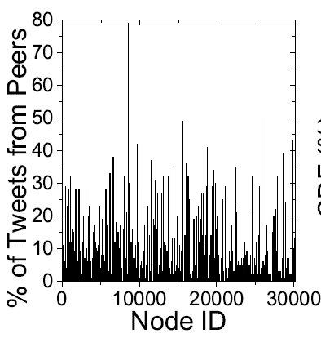
Cuckoo Peer Performance
- Message Sharing
Results
- 30% of users get more than 5% of tweets from other peers
- 20% of users get more than 10% of tweets from others -> The performance is mainly impacted by user online durations
-> The MySpace duration dataset leads to a pessimistic deviation
jaiku emote.in Chinese Sina microblogging
Expecting better performance in Cuckoo

Slide 27
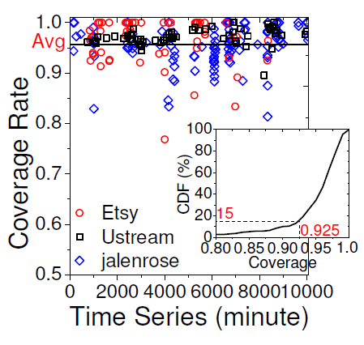
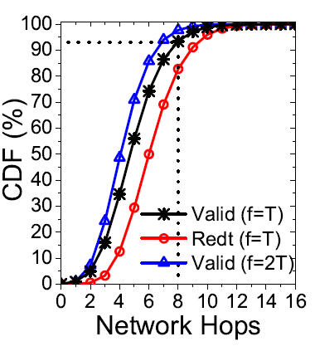
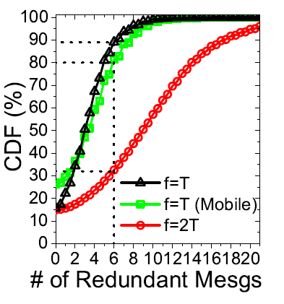
Cuckoo Peer Performance
- Micronews Dissemination
Results
95+% coverage rate of content dissemination
2. 90% of valid micronews received are within 8 hops
3. 89% of users receive less than 6 redundant tweets per dissemination round

Slide 28
Related Work
Microblogging and Pub-Sub Systems
[Rama_NSDI2006], [Sandler_IPTPS2005],
Measurement Study on Microblogging
[Ghosh_WOSN2010], [Krish_WOSN2007], [Kwak_WWW2009], [Cha_ICWSM2010],
Decentralized Microblogging
[Sandler_IPTPS2009], [Buchegger_SNS2009], [Shakimov_WOSN2009]

Slide 29
Conclusion
A novel system architecture tailored for microblogging to address scalability issues
Relieve main server burden
Achieve scalable content delivery
Decoupling the dual functionality components
A detailed measurement of Twitter
A prototype implementation and trace-driven emulation over 30,000 Twitter users
Notable bandwidth savings
Notable CPU and memory reduction
Good performance of content delivery/dissemination

Slide 30


Acknowledgement
Opera Group
U.C. San Diego, USA
Middleware Conference

Slide 31
Thank you very much!! http://mycuckoo.org

