Slide 1
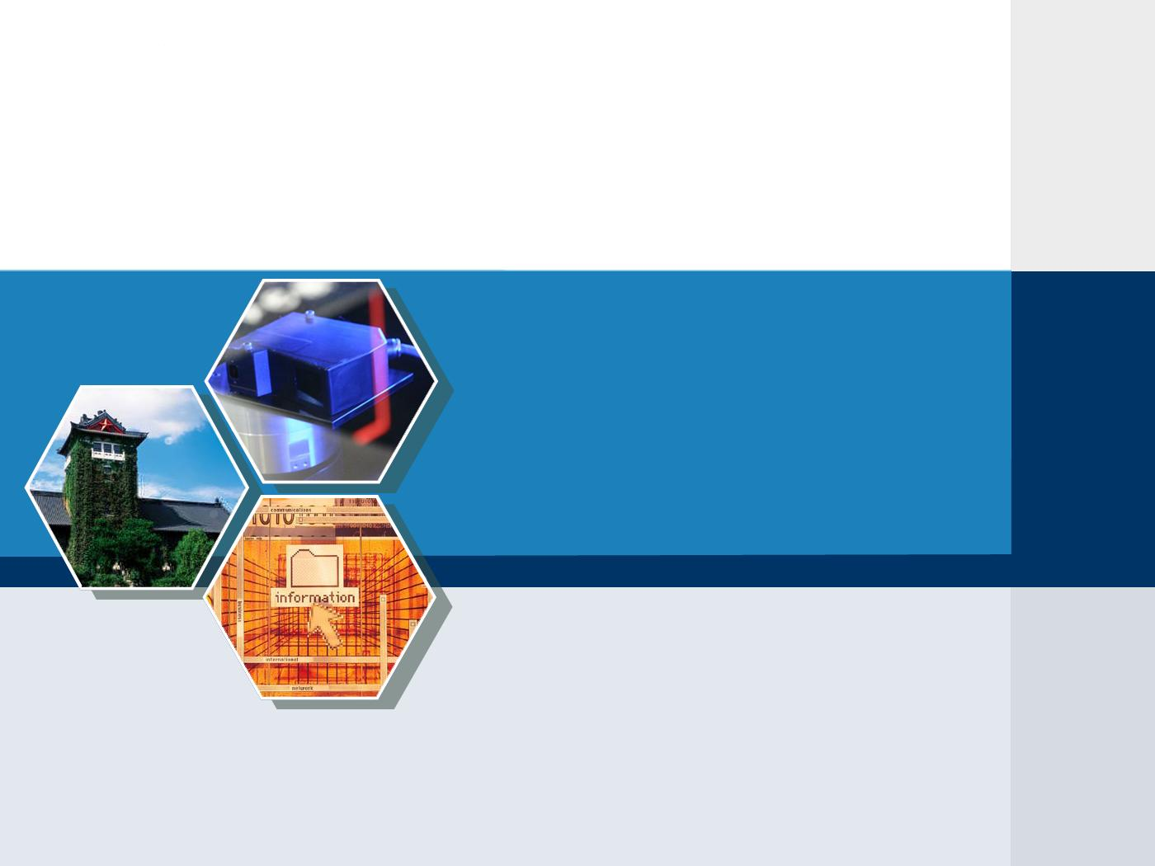

Twittering by Cuckoo – Decentralized and
Socio-Aware Online Microblogging Services
Tianyin Xu Yang Chen
Nanjing University, University of Goettingen University of Goettingen
Xiaoming Fu Pan Hui
University of Goettingen Deutsche Telekom Laboratories

Slide 2
Outline
Background
Current Problems and Limitations
Key Design Issues of Cuckoo
Future Work

Slide 3









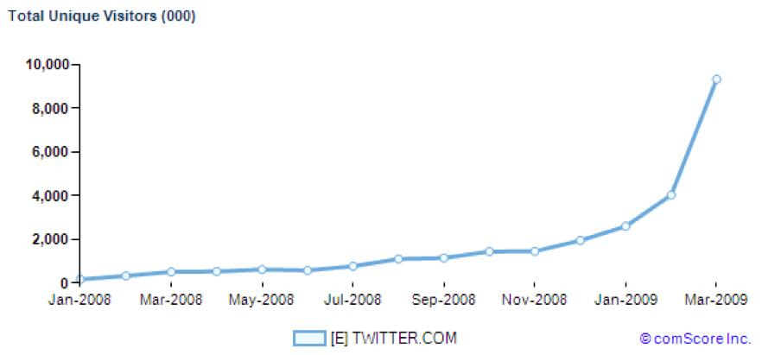
Online microblogging services have become tremendously popular in recent years!!
Twitter Yammer Plurk Google Buzz Squeelr
identi.ca jaiku emote.in Chinese Sina microblogging
Take Twitter as an example:
Less than 4 years (launched in October 2006)
More than 41 million users as of July 2009;
- userbase is still growing exponentially
3. Over 50 million microblogs posted per day

Slide 4

MICROBLOGGING’S SOLE FUNCTIONS
Publish a microblog
  Publish a short message (usually < 140 characters)
Follow
  1. Being a follower means the user receive all the messages from those he follows;
  2. A user can follow any other user, and the user being followed need not follow back;
  No reciprocation, different from Facebook/LinkedIn/…!
A
B
C
B follows A and C follows B
A´s microblogs are visible to B and B´s microblogs are to C

Slide 5
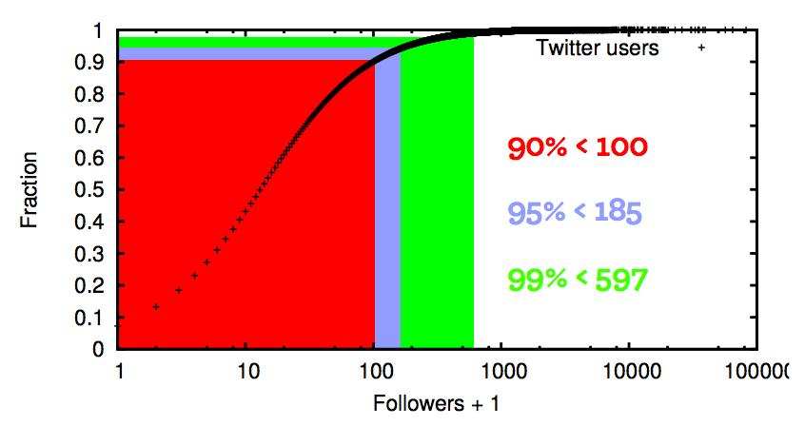
CDF OF TWITTER FOLLOWERS*
*D. R. Sandler et al., Bird of a FETHR: Open, decentralized micropublishing, IPTPS-2009.

Slide 6
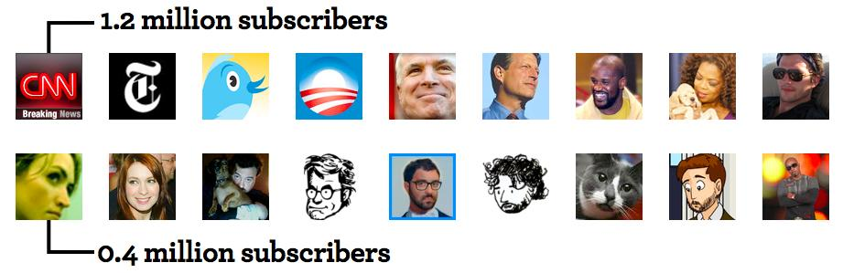
There are a few highly-subscribed(followed) celebrities.
Twitter serves more as an information spreading medium than an online social network service*.
*H. Kwak et al., What is Twitter, a Social Network or a News Media? WWW-2010.

Slide 7
USER CLASSIFICATION ACCORDING TO THEIR SOCIAL RELATIONS*
Broadcasters / Celebrities / Influentials
Have huge amount of followers
News media & celebrities
Acquaintances
Tend to exhibit reciprocity in their relationships
Miscreants / Evangelists
Try to contact everyone and hope that someone can follow back
Spammers or stalkers
*B. Krishnamurthy et al., A Few Chirps About Twitter, WOSN-2008.

Slide 8
Outline
Background
Current Problems and Limitations
Key Design Issues of Cuckoo
Future Work

Slide 9
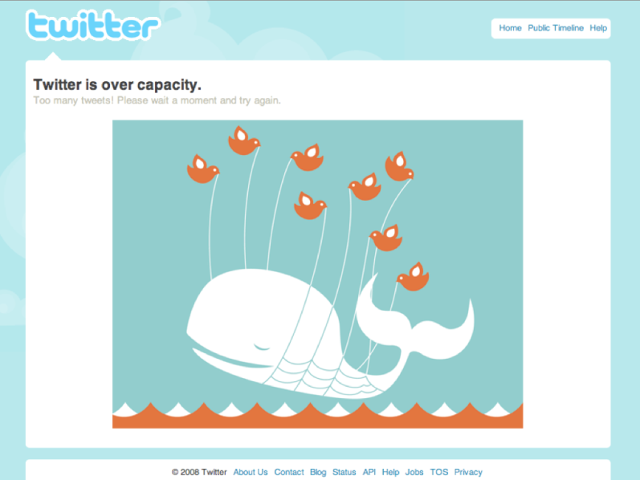
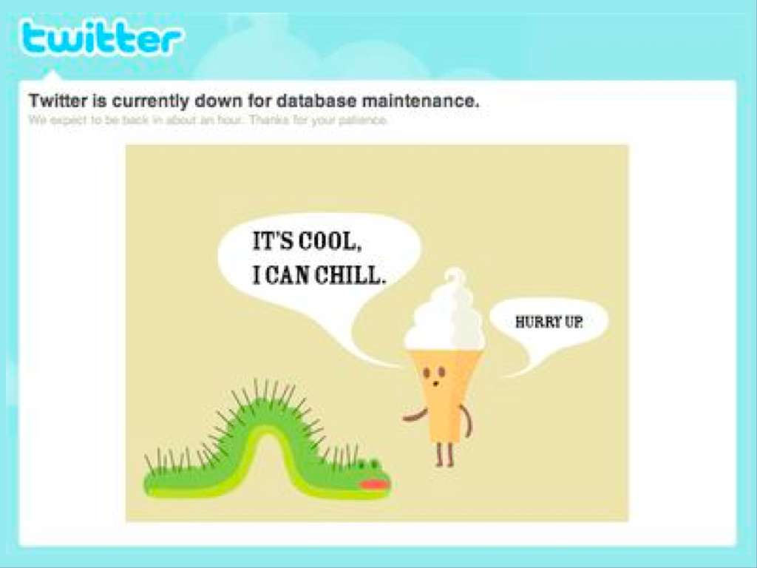
Current microblogging systems are based on centralized architectures!
Performance Bottleneck
“Over capacity error”
- 3% of page requests in June 2008*
“Database maintenance error”
*E. Williams, Measurable improvements, July 2008, http://scobleizer.com/2008/05/12/post/quake-in-china/.

Slide 10
Current microblogging systems are based on centralized architectures! (cont.)
Current Solution
Rate limiting
- Only allows clients to make a limited number of calls in a given hour.
- Twitter: 150 requests per hour, 2,000 requests for whitelist
TinyURL
- Replaces URLs of a certain length with TinyURL contractions
Upper limit on the number of people a user could follow
- Orkut: 1000, Flickr: 3000, Facebook: 5000,
- Twitter: 2000 before 2009, now using a more sophisticated strategy*
*The Effects of Restrictions on Number of Connections in OSNs: A Case-Study on Twitter, WOSN-2010.

Slide 11
Current microblogging systems are based on centralized architectures! (cont.)
Security
- Vulnerable to malicious attacks and service blocking
1. Twitter did be a victim of DDoS attack*
2. Twitter is currently blocked in several regions due to political reasons
- Hard to recovery from central server failure
1. Facebook database outrage cut off about 150,000 users§
* Twitter, Facebook attack targeted one user, http://news.cnet.com/8301-27080_3-10305200-245.html?tag=mncol
§Facebook database outrage cut off about 15,000, http://news.cnet.com/8301-13577_3-10373349-36.html/

Slide 12
We need a peer-assisted scheme for microblogging!

Slide 13
Outline
Background
Current Problems and Limitations
Design Rationale of Cuckoo
Future Work

Slide 14
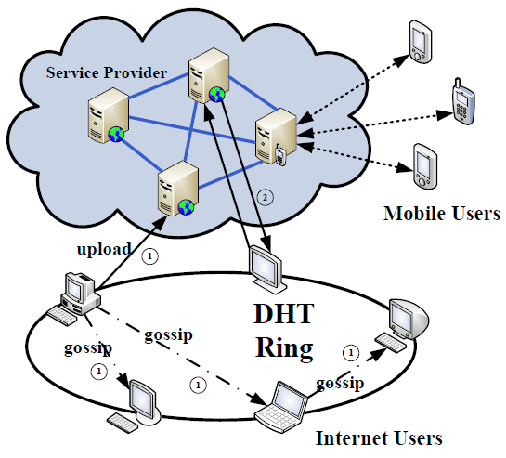
SYSTEM ARCHITECTURE:
PEER-ASSISTED INSTEAD OF FULLY DISTRIBUTED
Fully compatible with current Twitter arch.
Push is more efficient than Pull
- But… Twitter server (API)
only support the “pull”
- So gossip push among peers,
pull between peers and server
Use DHT (Pastry) as underlying infrastructure
- support lookup service
- improve availability
Do not exclude service providers from the picture

Slide 15



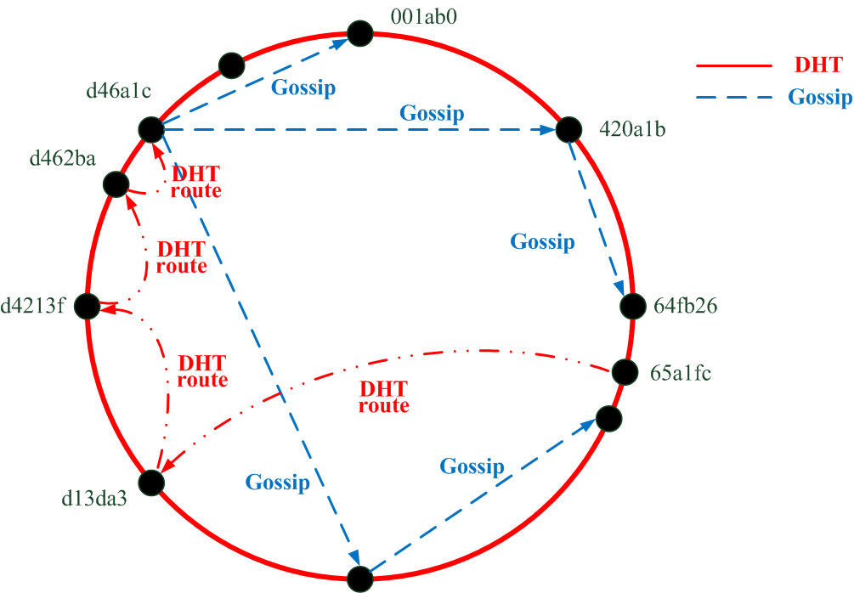








HYBRID OVERLAY NETWORKS:
STRUCTURED (DHT) + UNSTRUCTURED (GOSSIP)
Göttingen DHT
DHT-based overlay: lookup service + improve availability
Gossip-based overlay: micro-news dissemination

Slide 16
TAKE ADVANTAGE OF SOCIAL RELATIONS
Using the 4 social relationships:
Friend
- Friend is a reciprocate social link between two users
- Friends are acquaint with each other and willing to help each other
Neighbor
- Users sharing common interests
- For example, two user sharing a same followee are neighbors
- Neighbors assists the bootstrap & micro-content propagation
Followee / Following
- Most common one-way connections

Slide 17
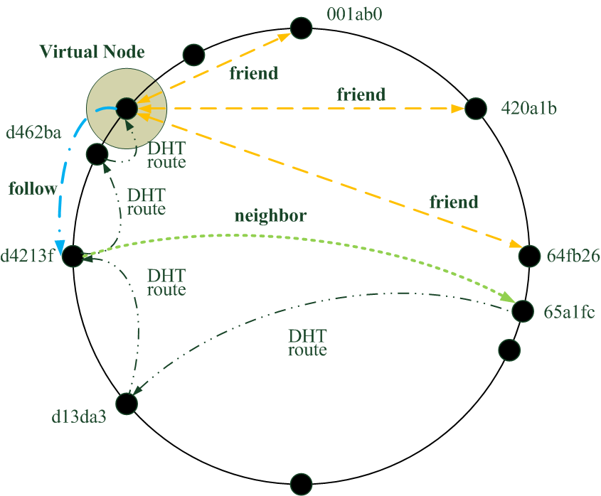
4 KINDS OF SOCIAL RELATIONS
Friend
- Virtual node: help each other to balance load and improve availability
- W. Pauli and C. F. Gauss are friend.
Partner/Neighbor
- Assisted gossip dissemination
- Assists bootstrap
- D. Hilbert and M. Born are Partner for W. Pauli.
Followee / Follower
- Direct pushing/sending
- W. Pauli pushes new updates to his follower D. Hilbert
Göttingen DHT

Slide 18
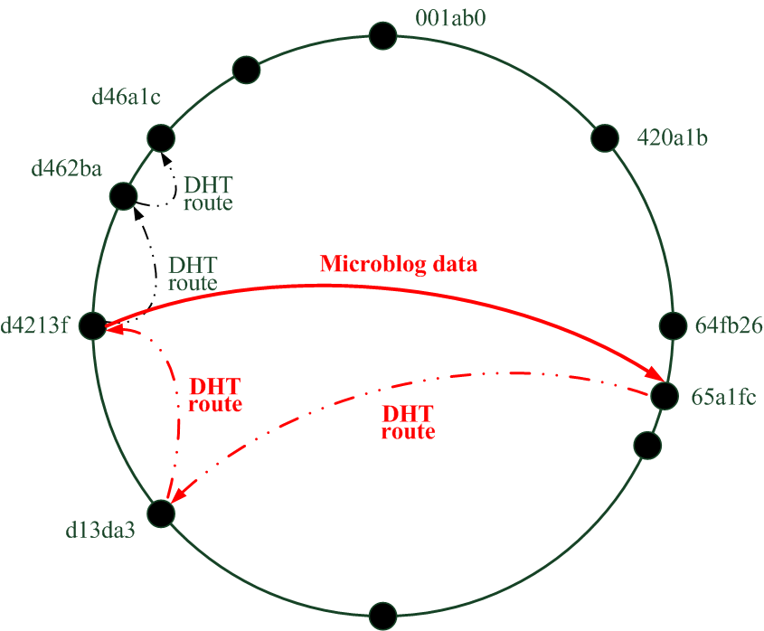
SOCIO-AWARE UPDATING
-- USING DHT-BASED OVERLAY
Example:
M. Born wakes up, updates the latest status of W. Pauli.
Both of M. Born and D. Hilbert follows W. Pauli
(they’re neighbors)
=> M. Born gets the statuses of W. Pauli
directly from D. Hilbert.
Pros
Shorten the DHT routing path;
Distribute the traffic of the popular host into its followers.
Göttingen DHT
Different kinds of Message Types
1. ReqFollow/RplFollow: address indexing
2. ReqStatus/RplStatus: content indexing

Slide 19
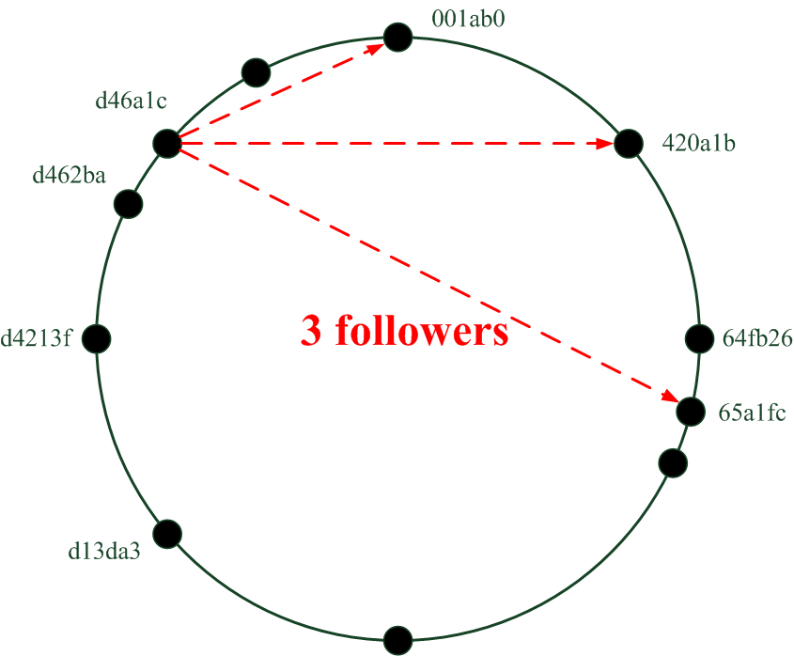
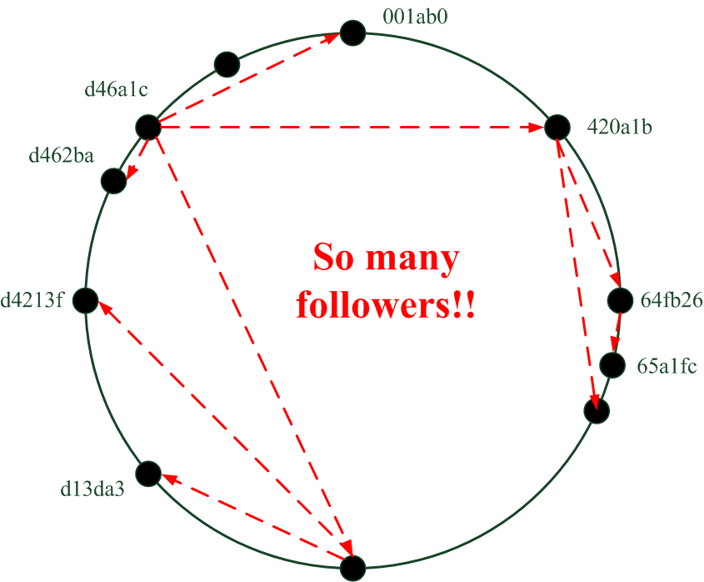
MICRO-CONTENT PROPAGATION
-- USING GOSSIP-BASED DISTRIBUTION
Normal Users
Directly pushing messages;
90% users have less than 100 followers.
Broadcasters
(W. Pauli in this example)
Gossip-based push between neighbors (B. Riemann and J. von Neumann are relay nodes).
Göttingen DHT

Slide 20
ROLE OF SERVICE PROVIDERS
Achieving better quality of service
Support synchronization for peers with asynchronized access
Guarantee high availability (always online)
Nothing to lose, nothing to change
Fully compatible with current architecture
Will not lose any functionalities nor user communities
Keep all the precious resources (profile & microblogs) as before
Excellent platform for third party developers to enrich additional functions
Simple functions on the server side and more colorful functions between peers
Our Objective
Help the service provides, but not to bury them!

Slide 21
INCENTIVES FOR
SERVICE PROVIDERS AND END USERS
For Service Providers
Low Bandwidth Cost
High scalability
High security
Will not lose any functionality nor user community
For End Users
High reliability
- store locally, easy to recovery
Better Quality of Experience
- low response latency, high searching efficiency, less service unavailability
Enrichment of Additional Functions
- Third-party developers can implement new functions (not supported by service
providers) based on the underlying overlay network

Slide 22
Outline
Background
Current Problems and Limitations
Design Rationale of Cuckoo
Future Work

Slide 23
FUTURE WORK
1. Support “topic trend” functions
Currently, a quite common use for microblogging is looking at particular topics
- e.g., UK general election
2. Supporting user mobility
3. Group Communication
Can we build a group communication (multicast)?
- Should based on gossip protocol;
- Like FeedTree on Scribe on Pastry;
4. Add some functions on the server side

Slide 24


Thanks!
Welcome to our website!
http://mycuckoo.org

