Slide 1
APEX: A Personalization Framework to Improve Quality of Experience for DVD-like Functions in P2P VoD Applications
Tianyin Xu, Baoliu Ye, Qinhui Wang,
Wenzhong Li, Sanglu Lu
Nanjing University, China
Xiaoming Fu University of Gottingen, Germany
June 16, 2010

Slide 2
Outline
Background
Motivation
APEX Design
Topic-oriented Access Pattern Mining
Personalized Navigation/Prefetching
Membership Management
Performance Evaluation
Conclusions

Slide 3
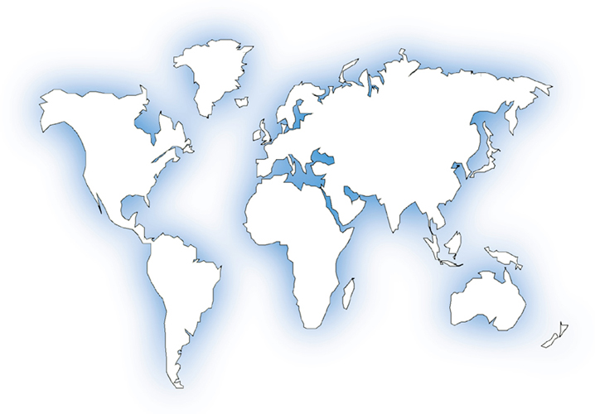
Facts of P2P streaming
From killer application to popular service
PPLive
110M users, 2M concurrent online peers , 600+ channels
10% of backbone traffic at major Chinese ISP is PPLive, more than BitTorrent
PPstream
70M users, 340+ channels, 2M concurrent peers
UUSee
1M concurrent online peers during Olympic Games

Slide 4
Essence of P2P Streaming
P2P computing based service mode
Everyone can be a content producer/provider
Variation of ALM communication
Self-organized overlay networks
Cache-and-Relay mechanism
Peers actively cache media contents and further relay to other peers expecting them

Slide 5
Streaming Service Model
No VoD (Live Streaming)
Users cannot interact with the server and passively receive the broadcasted video
Near VoD (NVoD)
Video files (or segments) are periodically broadcasted in dedicated channels
Users can select a specific channel to receive the stream
True VoD (VCR-like Operations)
Users have full control (i.e., with full VCR capability) for the stream
More than VoD (DVD-like Functions)
In addition to giving users full control for the stream, the services can help users to find the contents they may like

Slide 6
Outline
Background
Motivation
APEX Design
Topic-oriented Access Pattern Mining
Personalized Navigation/Prefetching
Membership Management
Performance Evaluation
Conclusions

Slide 7
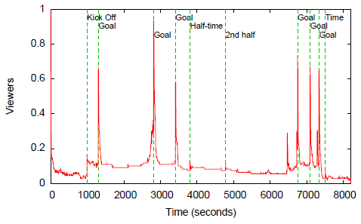
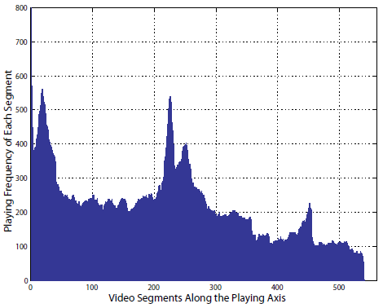
Problem Observation
Weakness of locate-and-download mechanism
May deteriorate users’ quality of experience
Playback freezing
Long response latency
……
User rarely view the movie from the beginning to the end
some popular segments (called highlights) attract more user requests than non-popular segments
Brampton et al., NOSSDAV’07
Zheng et al., P2PMMS’05

Slide 8

Weakness of Early prefetching scheme
Based on one user behavior model
Reflecting the whole group preference
The underlying assumption is that all users share the same preference
Question:
Is it possible to achieve personalization in P2P VoD applications?

Slide 9
Motivation
Users’ preferences are quite different
Support personalizing navigation by preference recommendation
Recommend users the contents they may prefer
Improve QoE by personalized prefetching
Prefetch the preferred contents
Optimize content sharing according to users’ preferences
Find out who shares the same preference with the active user

Slide 10
Related Work
Solution 1: Let the server do personalization for each user
Pro
Server has large volumes of user viewing logs
Con
Poor scalability
Solution 2: Let the clients exchange user logs and do personalization
Pro
Scalable
Cons
Lack of large volumes of user logs
High computing cost & training time

Slide 11
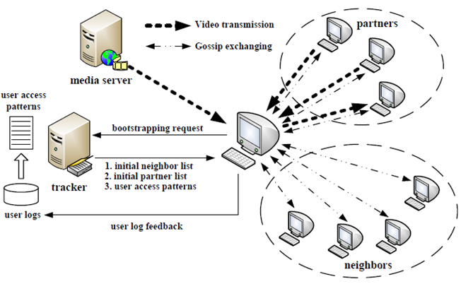
System Architecture
Topic-Oriented User Access Patterns
Collaborative Filtering
Our solution:
Server side: offline pattern mining => topic-oriented user access patterns
Peer side: online collaborative filtering => personalized navigation, prefetching and membership management

Slide 12
Outline
Background
Motivation
APEX Design
Topic-oriented Access Pattern Mining
Personalized Navigation/Prefetching
Membership Management
Performance Evaluation
Conclusions

Slide 13
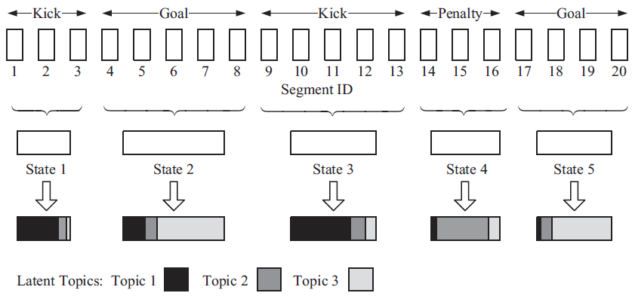
Topic Model
A video is a finite mixture over an underlying set of topics
Each state is a mixture over the topic set

Slide 14
Some Notations
State-Topic Matrix: [Φ_{ij}]_{|S|*|T|}
the level of association between each state in S and each topic in T
User Session Set: U_{k}
Weighted State Sequence: u_{k}
u_{k} = (w₁, …, w_{|s|})
w_{i} is the weight of state s_{i} in session U_{k}
Probability Distribution over T: ϴ_{k}
ϴ_{k} = (ϴ_{k1}, …, ϴ_{k|T|})
ϴ_{k} reflects the topic preference of the user generating U_{k}
Session-Topic Matrix: [Φ_{ij}]_{|U|*|T|}
Topic-oriented User Access Patterns: P
P = {p₁, …, p_{|T|}}

Slide 15
Offline Pattern Mining
Split video into a state set
The same as PREP ^{[1]}
the tracker maintains a weight matrix US
US = [w_{ki}]_{|U|*|S|}
Calculate the topic distribution
Computes state-topic matrix [Φ_{ij}]_{|S|*|T|} and session-topic matrix [Φ_{ij}]_{|U|*|T|} with LDA model according to weight matrix US
Construct the topic-oriented user access pattern
Choose user sessions that are strongly associated with each topic t_{j} based on session-topic matrix
For topic t_{j}, p_{j} = ∑ϴ_{kj} *u_{k} subject to ϴ_{kj} > μ
[1] T. Xu, W. Wang, B. Ye, W. Li, S. Lu, and Y. Gao, “Prediction-based Prefetching to Support VCR-like Operations in Gossip-based P2P VoD Systems”, ICPADS-2009.

Slide 16
Collaborative Filtering
Get the user access pattern, the state set and the topic-state matrix from the tracker
Periodically measure the similarity between active user session u_{c} and every mined pattern in P
Cosine coefficient
Discover Strongly Associated Topic Set (SAT-Set)
Find which states the active user prefers
Discover Top-N Associated State Set (TAS-Set)
Find which states the active user prefers
Calculate Recommendation Score R_{i} for each unviewed state s_{i} as follows
Select N states with top-N highest recommendation scores

Slide 17
Personalized Navigation/Prefetching
Navigation
Show the navigation screenshots of the states in TAS-Set to the user
The screenshots are small and stored like cookies
Prefetching
Try to download the state with highest recommendation score in TAS-Set
Prefetch anchors to improve utilization ratio
Reasonable for the strong association among segments within each state

Slide 18
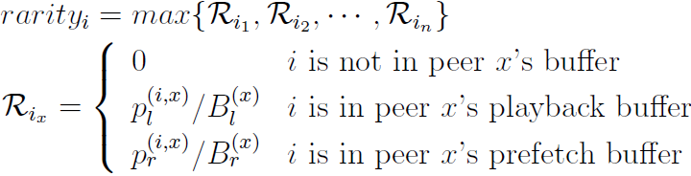
Data Scheduling for Prefetching
2-stage scheduling strategy
Stage 1: fetch urgent segments into playback buffer
Guarantee the continuity of normal playback
Urgent line mechanism ^{[1]}
Stage 2: prefetch based on prediction
Prefetch predicted segments from partner by utilizing residual bandwidth
use greedy rarest-first strategy to get the rarest segments as early as possible
[1] Z. Li, J. Cao, and G. Chen, “ContinuStreaming: Achieving High Plackback Continuity of Gossip-based Peer-to-Peer Streaming”, IPDPS-2008.

Slide 19
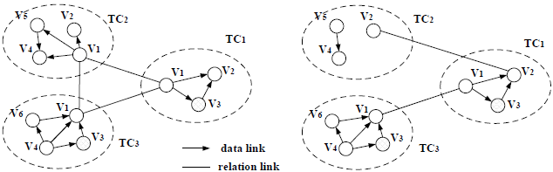

Personalized Membership Management
Organize peers into different Topic Clusters (TC)
Each TC is made up of peers interested in the same topic
Each peer computes the SAT-Set in each scheduling period and distributes it via gossip messages
Each peer updates both the partner list and neighbor pool upon receiving the gossip message
Give peers with similar preferences higher priority
_{k}
Z_{k}: number of states associated with topic t_{k} n_{k}: the number of States a peer holding C_{k}: the number of peers in TC_{k}

Slide 20
QoE Improvement
The jump process caused by DVD-like functions
Case 1. The jump segment is already prefetched on the local peer => Just playback
Lat₁ = 0
Case 2. The jump segment is cached on the partners’ buffer => download and playback
Lat₂ = T_{down}
Case 3. The jump segment is cached on the neighbor’ buffer => connect, download and playback
Lat₃ = T_{conn} + T_{down}
Case 4. Neither cached on the local peer nor cached by the partners => relocate, connect and download
Lat₃ = T_{loc} + T_{conn} + T_{down}
Expected delay
E[Lat] = p₁×E[Lat₁]+p₂×E[Lat₂]+p₃×E[Lat₃] +p₄×E[Lat₄]
p₁ + p₂ + p₃ + p₄ = 1
p₁: be improved by prefetching algorithm
p₂ & p₃: be optimized by membership management strategy

Slide 21
Outline
Background
Motivation
APEX Design
Topic-oriented Access Pattern Mining
Personalized Navigation/Prefetching
Membership Management
Performance Evaluation
Conclusions

Slide 22
Performance Evaluation
Simulation settings
User viewing logs
8000s Video with 4338 history logs of user sessions
Session average duration: 232.86s with 5.22 DVD-like operations
Topology size: 3000 peers
Playback bit rate: 256 Kpbs
Download Bandwidth: [256Kbps, 768Kbps]
Playback buffer size: 30Mbytes
25M for playback, 5M for prefetching
Request arrival rate: Poisson Process with λ = 5.4
Membership
5 partners and 10 neighbors
Schedule period: 5s

Slide 23
Performance Evaluation (Cont’d)
Performance evaluation factors
Hit Ratio of CF-based model
Accumulated Hit Ratio of Collaborative Filtering
Searching Efficiency
Response Latency
Prefetching Overhead

Slide 24
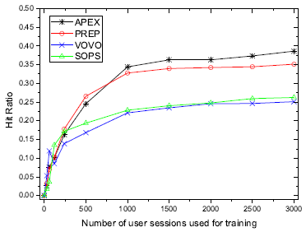
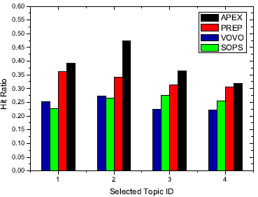
Experimental Results
Hit ratio of CF-based model

Slide 25
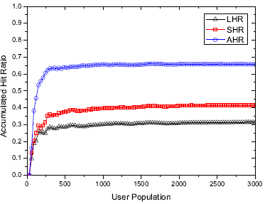
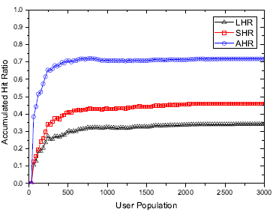
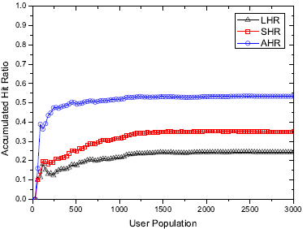
Experimental Results (cont’d)
Accumulated hit ratio with collaborative filtering
Full-server prefetching
Semi-server prefetching
No-server prefetching

Slide 26
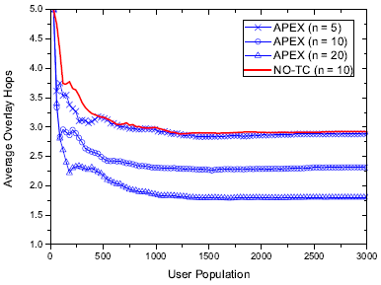
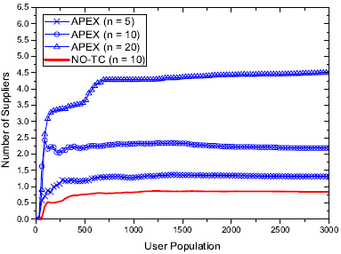
Experimental Results (cont’d)
Searching efficiency

Slide 27
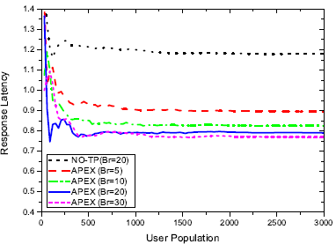
Experimental Results (cont’d)
Response latency

Slide 28
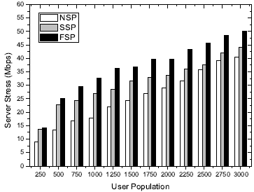
Experimental Results (cont’d)
Prefetching overhead

Slide 29
Outline
Background
Motivation
APEX Design
Topic-oriented Access Pattern Mining
Personalized Navigation/Prefetching
Membership Management
Performance Evaluation
Conclusions

Slide 30
Conclusions
Personalization support for P2P VoD systems
Mining pattern from real user viewing logs
Access sequential pattern/Topic-oriented user access pattern
Selective prefetching
Prediction/collaborative filtering based prefetching
Optimize membership for media delivery
Pattern Mining
Selective Prefetching

Slide 31
APEX: A Personalization Framework to Improve Quality of Experience for DVD-like Functions in P2P VoD Applications
Thanks
Baoliu Ye
yebl@nju.edu.cn
State Key Lab. for Novel Software and Technology Nanjing University
June 16, 2010

