Slide 1

Reliability of Cloud-Scale Systems and The Little Wisdom I Acquired in Grad School
Tianyin Xu
UIUC
CS 591, Nov. 29, 2018

Slide 2
$ Whoami
I got my PhD from UCSD in 2017.
Thesis: Hardening cloud systems against misconfigurations
I applied grad school two times.
“For systems research, persistence is more important than genius.”
I worked at Facebook for a year before joining UIUC.
“Most academic research papers are useless.”
FAQ: “Are you still coming back / leaving?”
Advice: do something you truly believe.
Convince yourself first.
There will be tough time (e.g., paper rejections).
2

Slide 3
I work on software/system reliability
Why does it matter?
How did I find my thesis?
How to do reliability research?
What am I working on?
3

Slide 4
I work on software/system reliability
Why does it matter?
How did I my advisor help me find my thesis?
How to do reliability research?
What am I working on?
3

Slide 5




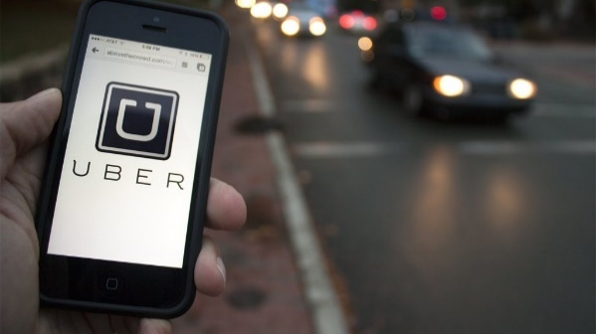

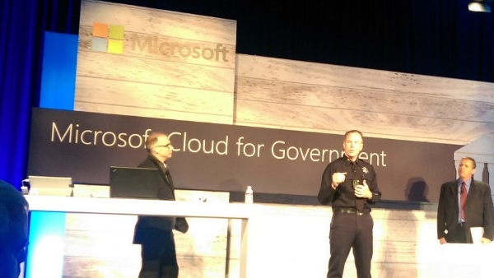
Why does system reliability matter?
4
Notes:
Today, our life has been relying more and more on cloud services, right, ranging from social networking, online shopping, entertainment, all the way to transportation, residence, and even government.

Slide 6
Why does system reliability matter?
Service
Unavailable
Service
Unavailable
Service
Unavailable
Service
Unavailable
Service
Unavailable
Service
Unavailable
SYSTEM FAILURE
3
Notes:
But, what if the underlying datacenter systems fail?

Slide 7



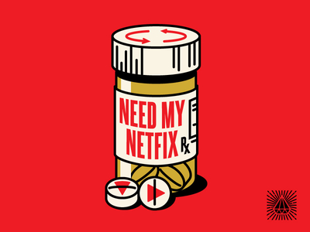

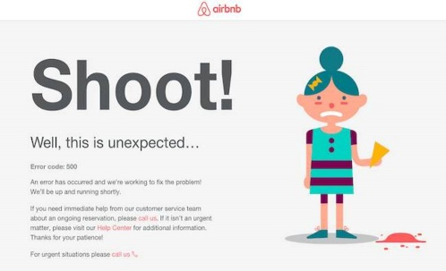


Catastrophic failures are not uncommon. not uncommon.
(turned down 70+ popular online services)
~50% of cloud services have 3+ severe outages on headline news every year;
None reaches 99.999% uptime (“the utopia”).
5
*Gunawi et al, Why does the cloud stop computing? Lessons from hundreds of service outages, SOCC’16.

Slide 8
Reliability research is about building practical technologies to understand, prevent, tolerate, mitigate, and recover from real-world system failures.
6

Slide 9
How did I find my thesis topic?
% Disruption incidents
7
L. A. Barroso, J. Clidaras and U. Hölzle, The Datacenter as a Computer: An Introduction to the Design of Warehouse Scale Machines (2nd Edition), Morgan & Claypool Publishers, 2013.

Slide 10
How did I find my thesis topic?
under-studied
benefit from years of research efforts
% Disruption incidents
My thesis
7
L. A. Barroso, J. Clidaras and U. Hölzle, The Datacenter as a Computer: An Introduction to the Design of Warehouse Scale Machines (2nd Edition), Morgan & Claypool Publishers, 2013.

Slide 11
How to do reliability research?
How did the target systems fail?
Why existing methods fail to help?
How to prevent the failures?
prevent the same failures from happening again
prevent this type of failures
How to make the systems better?
design/implementation principles
What tools would you wish to have?
tools detecting the bugs?
tools making the systems stronger?
tools making diagnosis easier?
8

Slide 12

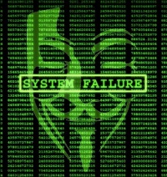


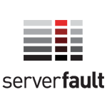



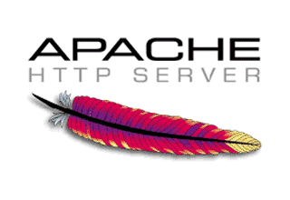
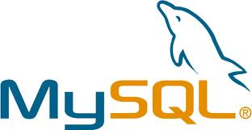
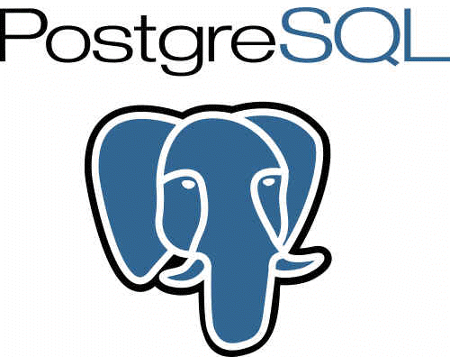

Understanding before building
Practices & Problems
Systems design/implementation
Prevention
Difficulties in configuration
Mistakes (misconfigurations)
Validating configurations
Fixing configuration errors
→ Complexity
→ Error-proneness
→ Checking code for configurations
→ Reaction to error manifestation
Defense
Issue DB
9
Customer
Notes:
To investigate these questions, I study configuration practices of sysadmins, configuration problems in the field, and software systems commonly deployed in cloud and datacenters, mainly in aspects of error prevention and defense.
I usually start with real-world practices and problems, and nail down the critical design and implementation aspects, from two main perspectives:
error prevention and defense.
are desired but are deficient in existing systems.
For error prevention, I studied difficulties and mistakes of real-world sysadmins, as the root causes of misconfigurations, which drives me to systematically examine the complexity and error-proneness of existing configuration design.
For defense, I looked at how sysadmins validate configuration values and fix configuration errors, which motivated me to study the systems checking code and their reactions to configuration errors.
To be able to understand real-world practices, I study and characterize configuration cases collected from the customer issue databases, mainly from our industrial collaborators, online forums such as ServerFault, and mailing lists of systems software.
To understand software systems, I study the source code, revision history, and bug database of both commercial and open-source systems.
The answer has to be centered around how configuration errors come into being and how they lead to system failures.

Slide 13
PCheck: auto-generating checking code for configuration parameters [OSDI ’16]
PCheck
systems program
checker
…
checker
checker
10

Slide 14
PCheck: auto-generating checking code for configuration parameters [OSDI ’16]
PCheck
systems program
/* sys_init */
pthread_create(thd, 0,
, 0);
invoke
checker
…
invoke
periodic
checker
invoke
checker
10

Slide 15
How to build reliable cloud systems in the face of misconfigurations …
What have I been working on?
… and prevent misconfigurations in
the first place by better design?
11

Slide 16
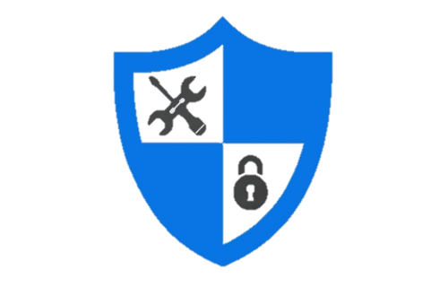

What have I been working on?
Improving usability and manageability
software
systems
(Re)think configuration as an interface
HCI
[CHI’17]
Reduce configuration complexity
SOFTWARE
ENGINEERING
DESIGN
IMPLEMENTATION
TESTING
[FSE’15]
Hardening systems-level defense
SYSTEMS
Detect configuration errors early
[OSDI’16, best paper]
React to misconfigurations gracefully
[SOSP’13]
12

Slide 17



What have I been working on?
Cloud system reliability
Mobile system reliability
Mitigating datacenter failures
[OSDI’18, IMC’18]
Defending against disruptive app behavior
[MobiSys’16, EuroSys’16]
Maelstrom
Defdroid
Guarding against cellular traffic overuse [NSDI’16]
Global traffic management for reliability and performance
[working with FB]
TGuard
Taiji
Storage and filesystem reliability
Testing cloud systems with softwarized networks
[from CS 598]
Matador
L
Characterizing and monitoring failures in distributed filesystems
[from CS 598]
LustreFail
Web-based delta sync for cloud storage systems
[FAST’18, IMC’14]
Websync
13

Slide 18
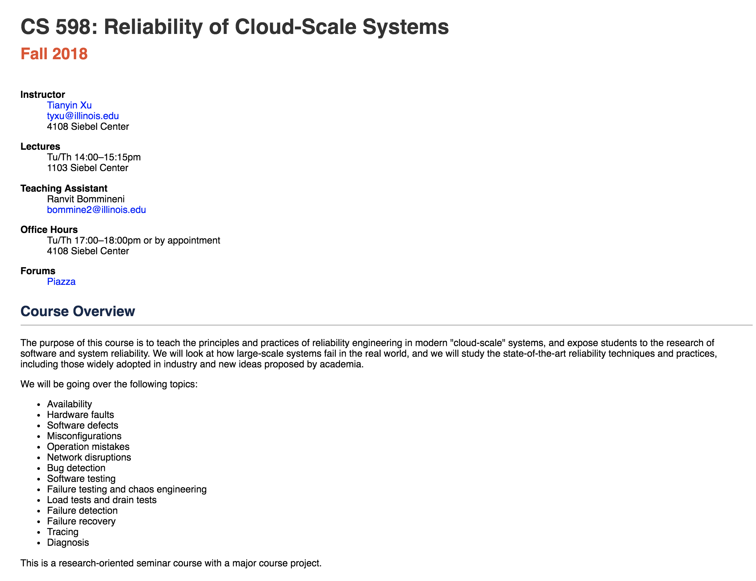
The course will be offered again in Spring 2020.
14

Slide 19
Think hard.
Work smart.
Have fun!
15

